Slide 1
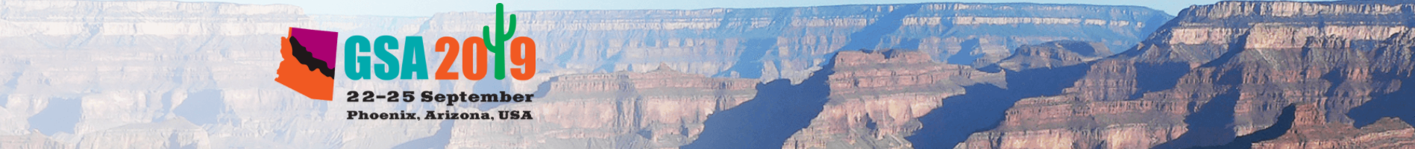

Long-term behaviour of CO₂-rich fluid in the little grand wash fault, Utah, USA
Dr. Yutong Shu^{1,2}, Dr. Mark Wilkinson², Prof. Stuart Haszeldine², Prof. Xiangyun Hu¹，Dr. Yihe Li¹, Prof. Yangyi Sun¹
¹China University of Geosciences,
²University of Edinburgh
Notes:
受CO2影响断层附近页岩的CO2-水-围岩的长期反应

Slide 2
Agenda
Low carbon technology: Carbon Capture and storage
Natural analogue (Crystal Gayser) for geological carbon storage
Study of paleo-fluid
CO₂-rich fluid induced alteration and the implication for carbon storage

Slide 3
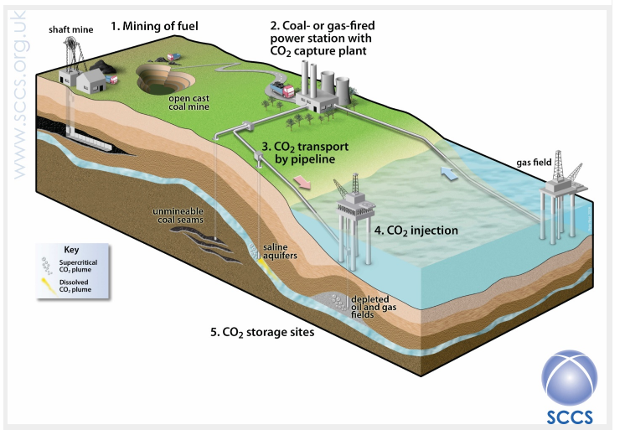
CCS: Carbon Capture and Storage
“CCS is the only clean technology
capable of decarbonising major
industrial sectors such as steel,
cement, pulp and paper, refining
and petrochemicals.”
——BRAD PAGE
Chief Executive Officer
Global CCS Institute

Slide 4
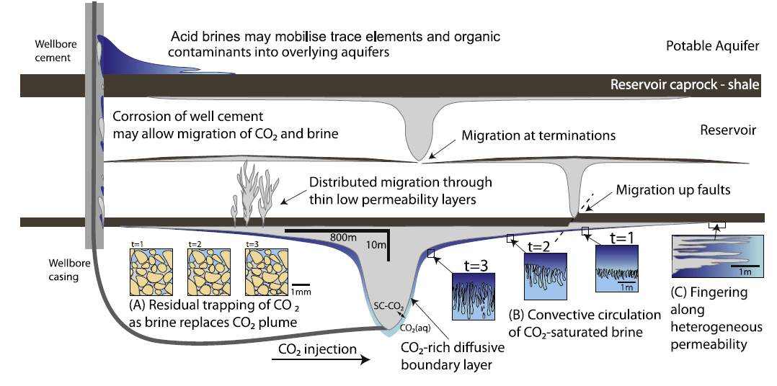
Key question: Leakage risks
Diagrammatic illustration of geological carbon storage
Notes:
Three potential leakage ways: a. from wellbores (when the wells are degraded or abandoned inappropriately); b. from caprocks where the buoyancy force of the column exceeds the capillary pressure; c. from the pre-existing fractures and faults that are not properly infilled, or from CO2 injection induced or new fractures and faults.
Studying methods:
lab experiments; numerical modelling; natural analogues: provide information that can be potentially integrated into reservoir-scale; geological timescale modelling.

Slide 5
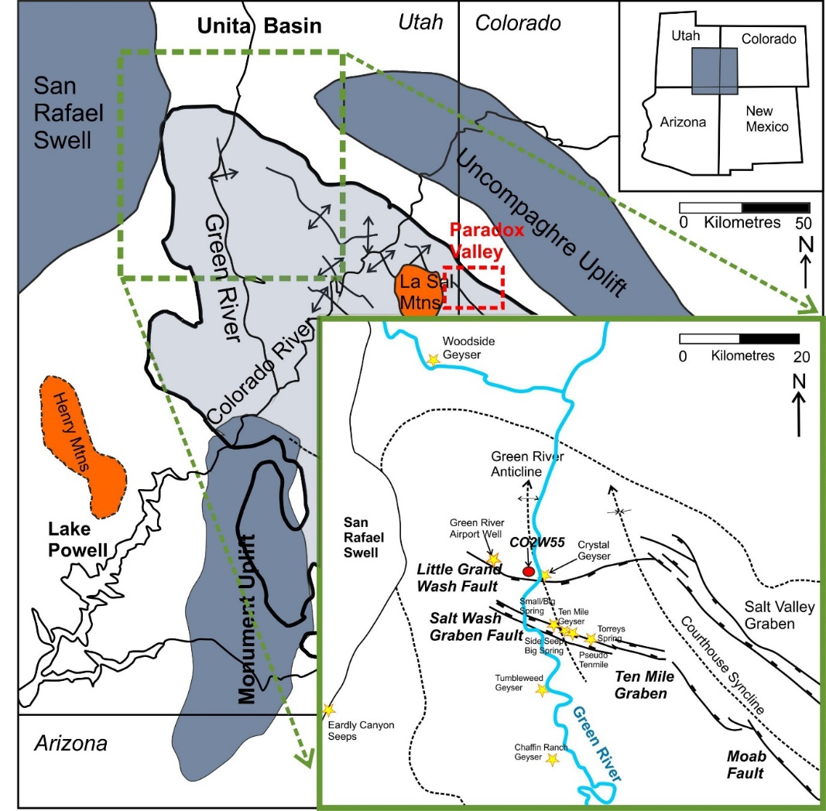
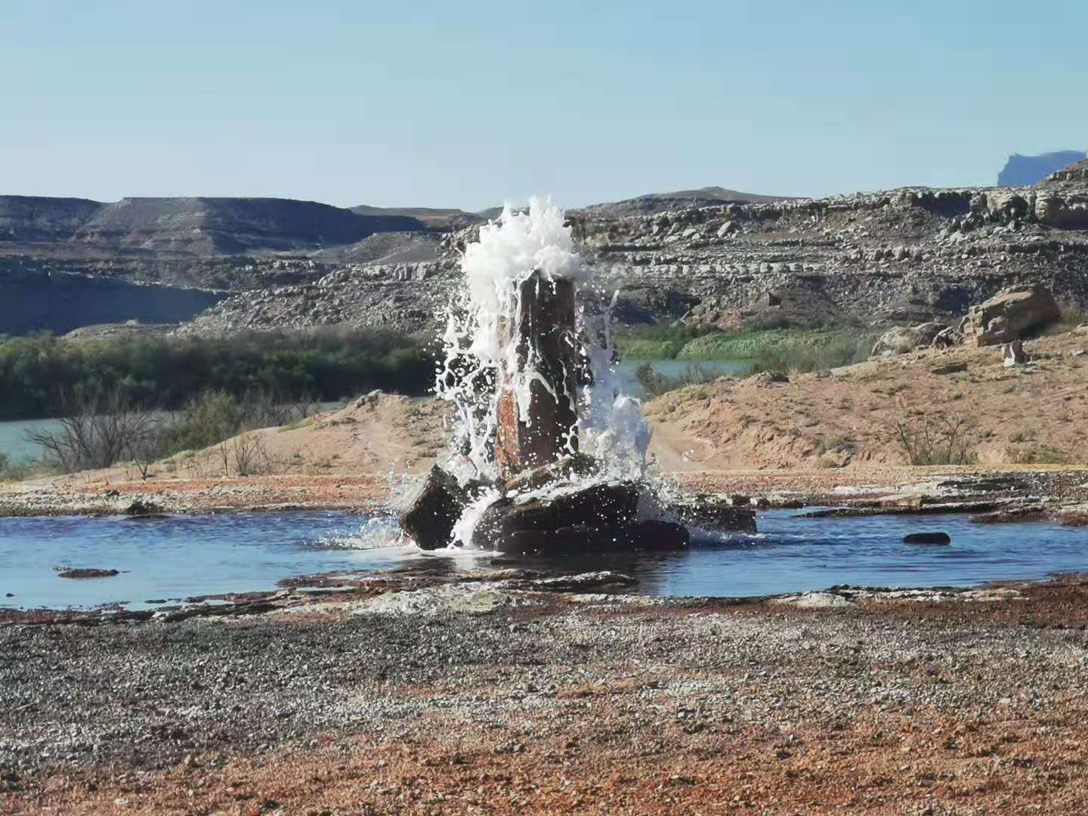
Natural analogue: Crystal Geyser Dating: The leakage of CO₂ has been demonstrated to be last for at least 400kyrs (Burnside et al., 2013).
Notes:
Crystal Geyser is well known examples of natural CO2 leakage systems. Crystal Geyser locates in the northern end of Paradox Basin, at Utah State , it’s on the cross section of the Green River and the Little Grand Wash fault, The Green River region contains a number of hydrocarbon fields and CO₂ fields. CO2 derived from the crust migrating upwards through the Little Grand Wash fault/Salt Wash Graben fault, and deposited multiple travertines alongside the footwall of the fault. The leakage has been last for over 400k years, which could be used as natural analogue to investigate on how CO₂-rich fluid could alter the ambient rocks in the geological timescale.

Slide 6
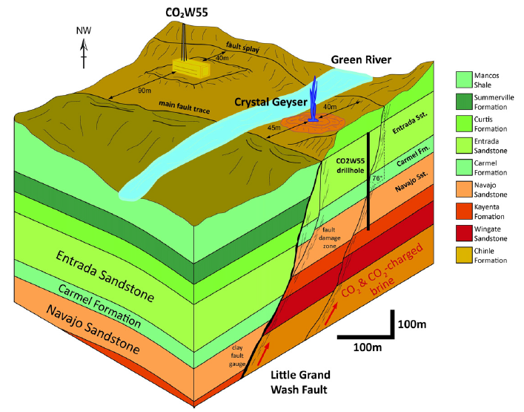
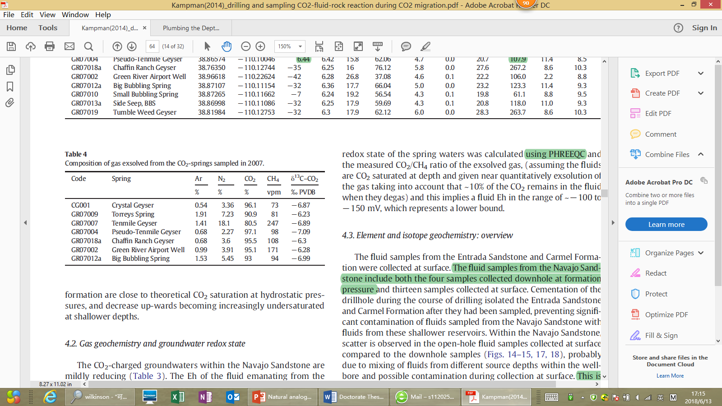
Crystal Geyser
CO₂ degassing of the Calcium-rich ground water
Kampman et al., 2014
Notes:
The schematic sketch of the Little Grand Wash fault. Here is the picture of the crystal geyser. It’s an active cool CO₂ spring, It began erupting when the Glen Ruby # well was drilled in 1935. the eruption is about 10m high. The spring water is a mixture of CO₂ rich brine water form the depth, and the recharged meteoric water from the surface. The chart shows the composition of the gas exsolved from the water. The erupted water is majorly composed of CO2, with minor nitrogen and argon.

Slide 7
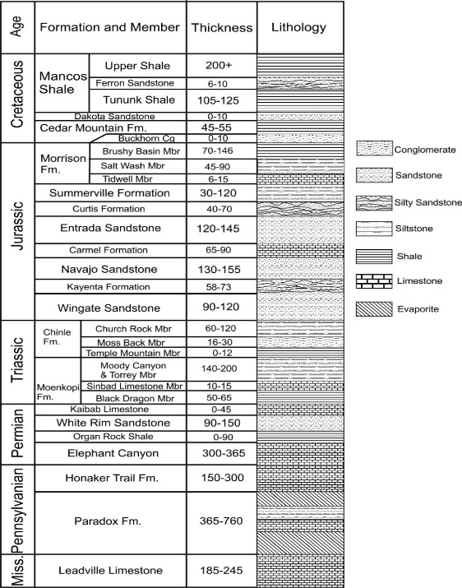
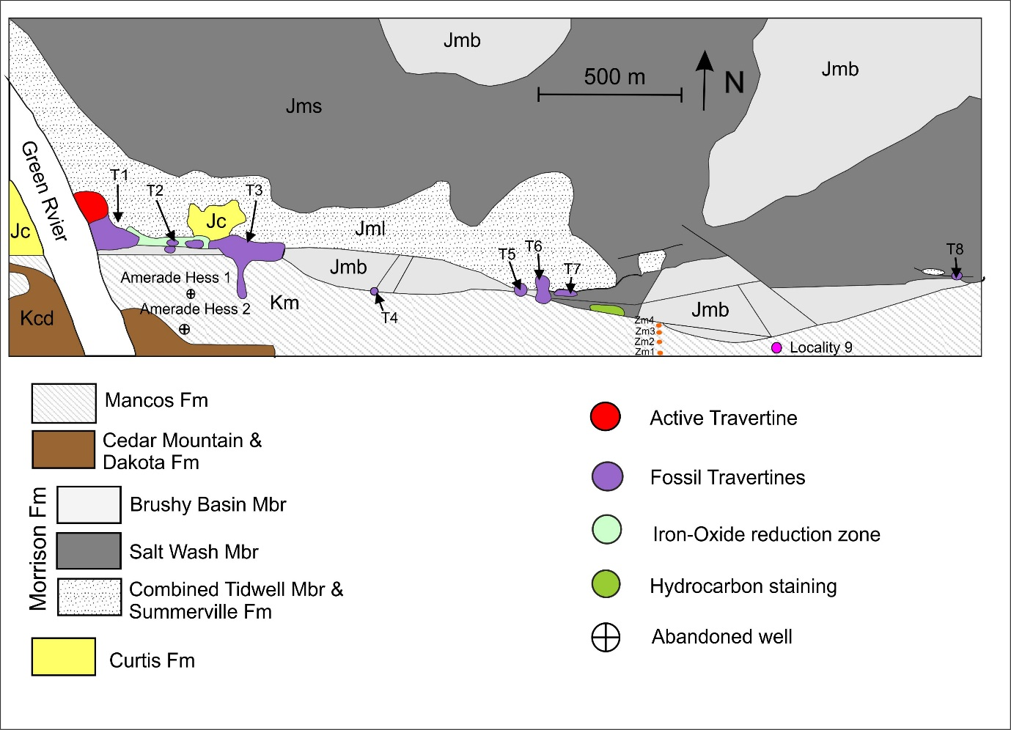
Sampling
Notes:
Here is a map of the travertines in relationship with the Little Grand Wash fault. Most of the travertines are on the footwall side of the fault. The existence of springs and travertines, deposition of veins and diagenetic alteration are the proof of the faults acting as conduits for fluid migration . Travertines are formed from the CO2 degassing of the Calcium-rich ground water (see the equation).
The sketch of the cross section of the fault, with fault core is about 1-3m wide. Various directions of the fractures and cracks are displayed in the damaged zone of the host rock, which promote to the permeability of the fault zone.
The outcrop of the footwall is mostly composed of Jurassic sandstones, and the hanging wall is mostly covered by Mancos shale. We sampled sandstones on footwall and Mancos from the host rock of T3, T4 and T6 to see how the host rock has been changed by the fluid.

Slide 8
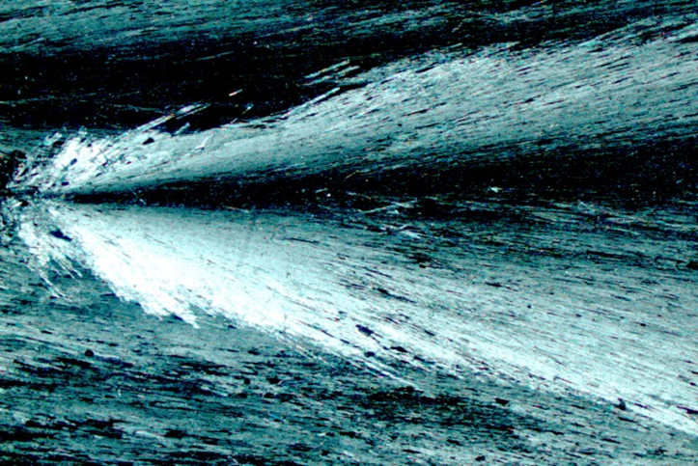
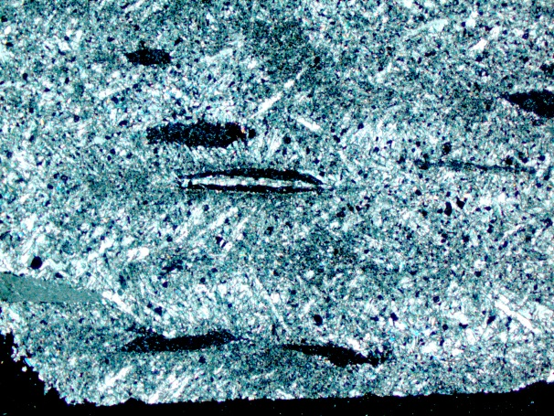
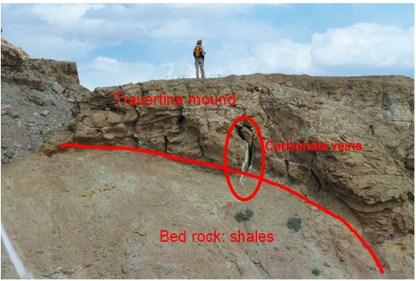
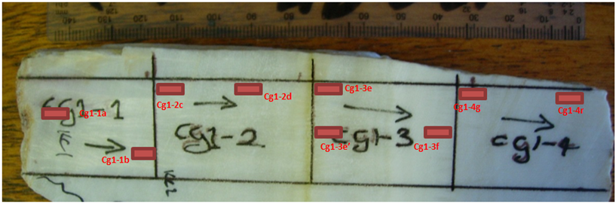
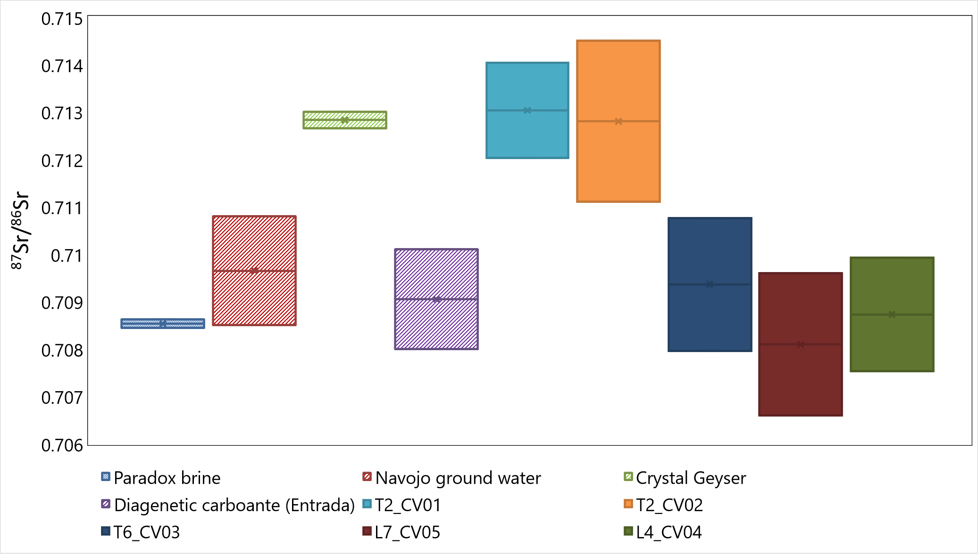
Fluid study: has the fluid changed through the time?
Equant-shaped crystal
nucleation
Retarded grow: fault sealing
Fast grow: fan-shaped, elongated crystal
Age: ~57,000 - 60,000 yrs, by U-Th dating
T2 aragonite vein (rhombohedral structure)
$2HCO_{3}^{−}\left(aq\right)+{Ca}^{2+}\left(aq\right)→CaCO_{3}\left(s\right)+{CO}_{2}\left(g\right)+H_{2}O\left(l\right)$
Notes:
In the first place, we investigated on whether the erupted spring is the same as the paleo-fluid that deposited the carbonate veins. We sampled one thick banded vein from the footwall of the Little Grand Wash fault. We used a series of geochemistry methods on white banded veins to examine the composition of the paleo-fluid.
⁸⁷Sr/⁸⁶Sr ratio is used to identify whether the deposited carbonates are CO2-fluid related. The Sr isotope of the T2 vein and others (Paradox brine, CO2-charged Crystal Geyser…). There is no significant fractionation between the parent fluid and the precipitation for 87Sr/86Sr, so that 87Sr/86Sr value was utilized to distinguish the veins formed by diagenetic or from CO2-charged fluids.

Slide 9
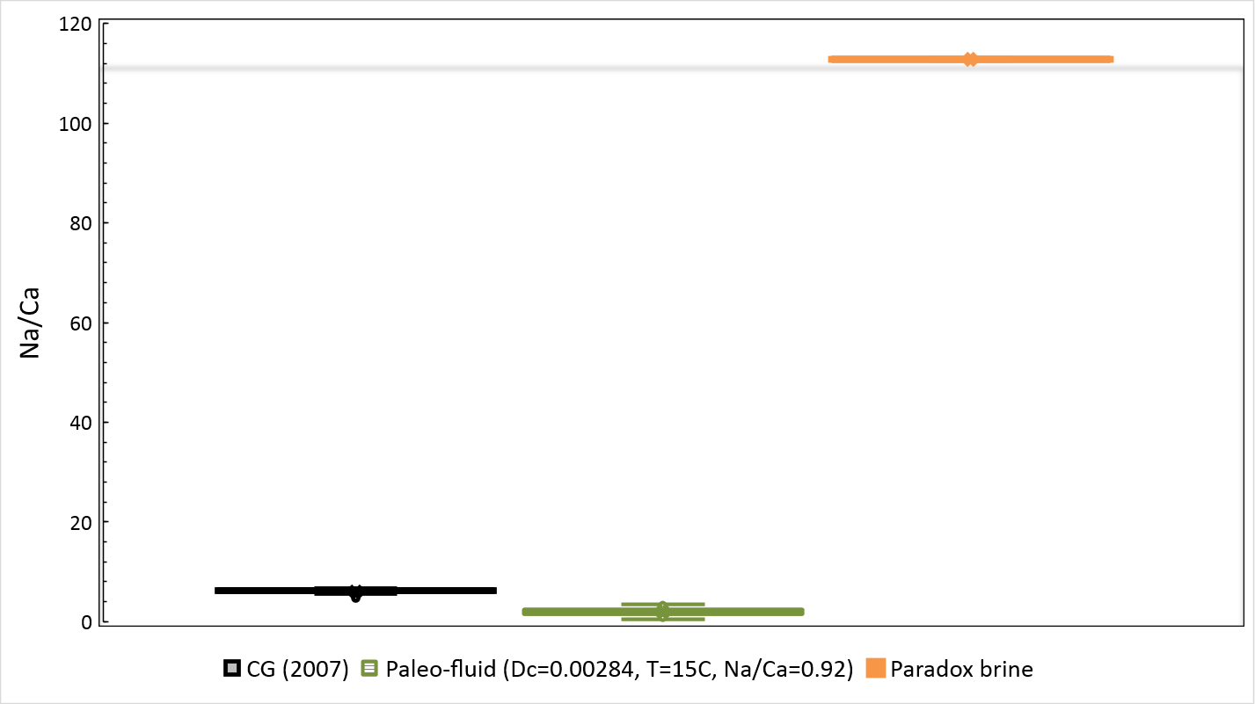
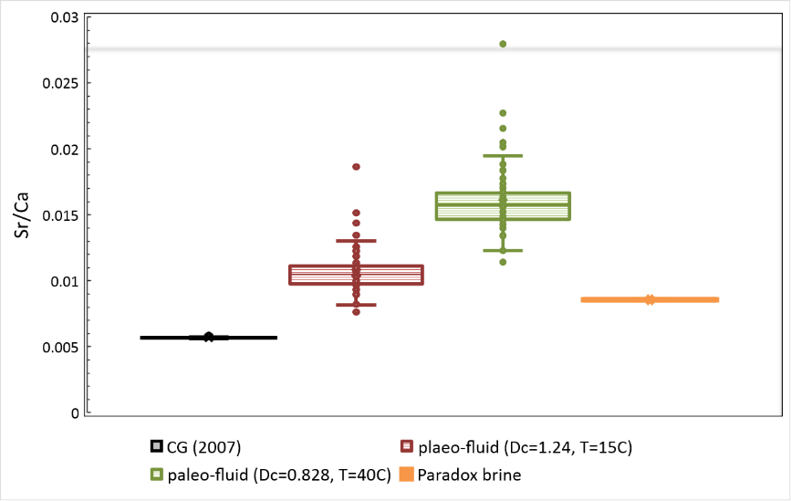
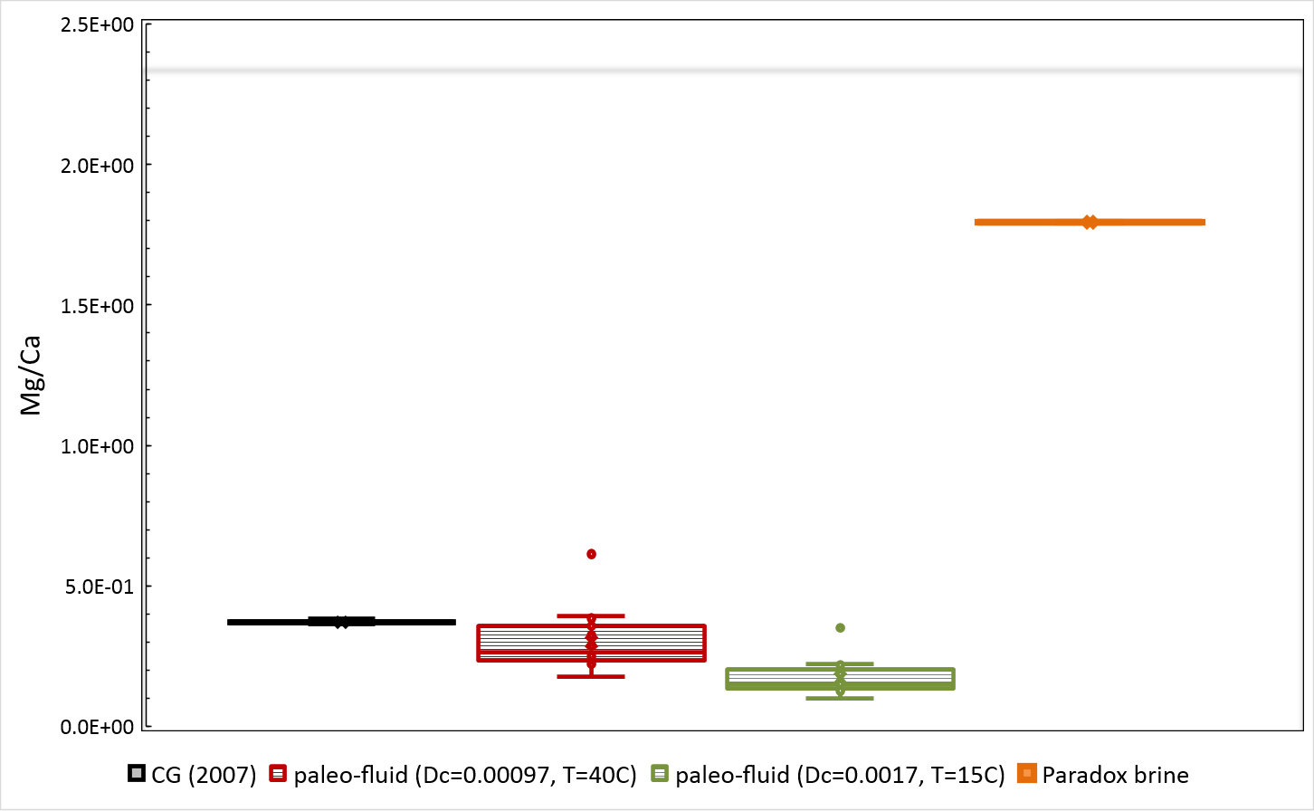
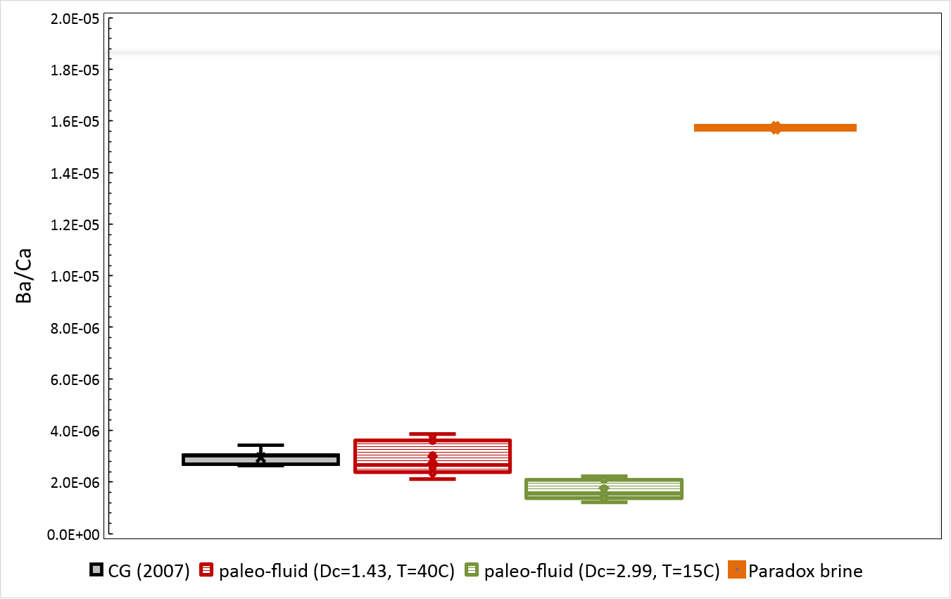
b. Calculate the composition of the paleo-fluid using distribution coefficients: Each element will partition between solid and liquid to make its chemical potential equal in each phase.
$D_{i}^{Mineral/Fluid}=\frac{X_{i}^{Mineral}}{X_{i}^{Fluid}}$ Nernst partition coefficient
`
Conclusion：
a. Fault sealing during time
b. The composition of the fluid has not been changed!
Notes:
During crystal growth, element substitution within the crystal and partition between the crystal and the solution occurs. Each element will partition between solid and liquid to make its chemical potential equal in each phase. The result of the comparison reveals the composition of the paleo-fluid is very similar to the erupted spring water. So, we coulld confidently say that the fluid of 40,000-50,000 years that deposited the carbonate veins is the same as present spring water.

Slide 10
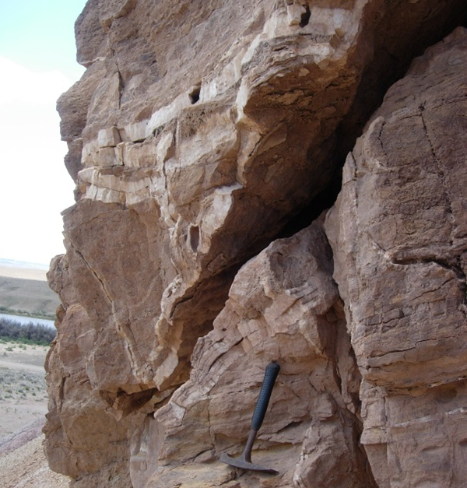
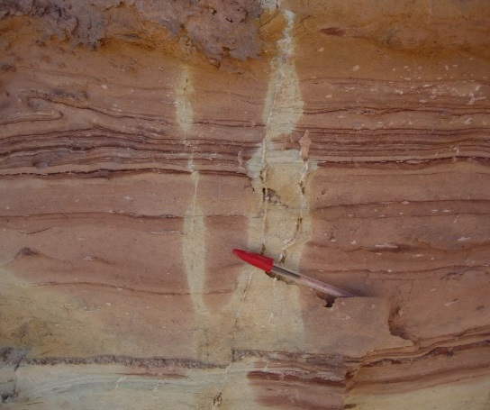
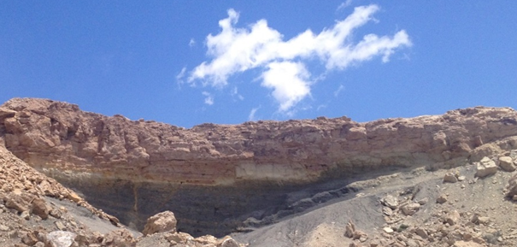
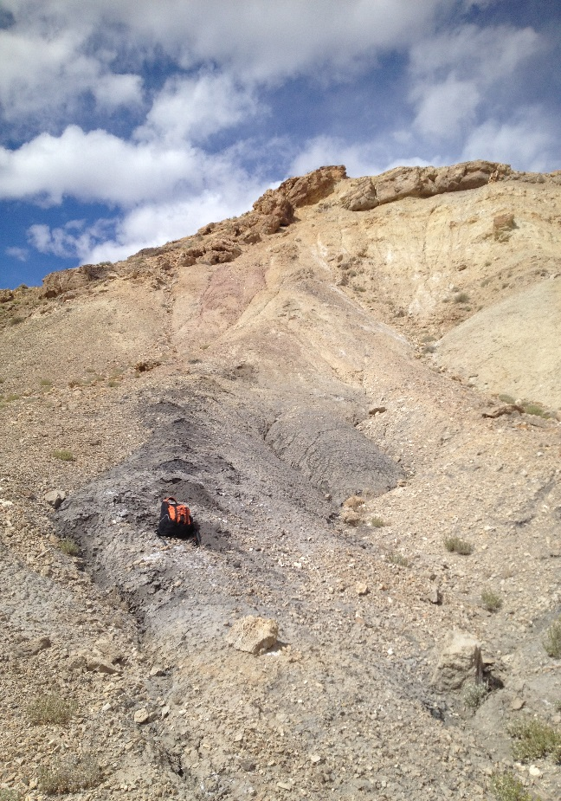
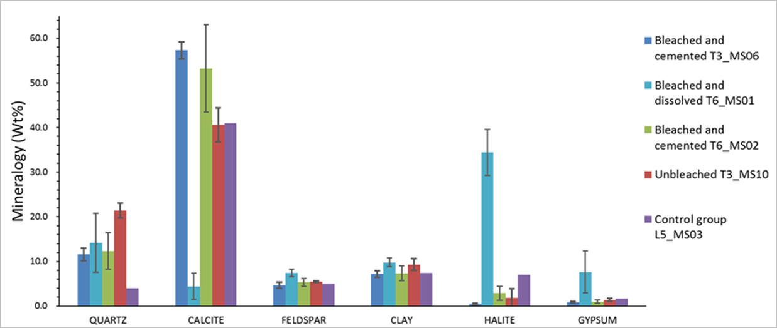
Fluid circulation in the damaged zone of the Little Grand Wash fault
N
$${Fe}_{2}O_{3}+hydrocarbon+{CO}_{2}+H_{2}O→{Fe}^{2+}+{HCO}_{3}^{−}$$
Conclusion：CO₂ has involved in bleaching
Notes:
Multiple evidences that CO2 has circulated in the sandstone footwall, and altered the host rock
The fault fluid could induce the bleach the formations. The potential reduction fluid capable of reducing hematite include: hydrocarbons, CO2 and hydrogen sulphide (H2S) and bisulfide. Argument about the reduction : whether CO2 has been involved in the reduction? Isotopic data and modeling show that bleaching of red sandstones is distinct from hydrocarbon-related bleaching elsewhere on the Colorado, so hydrocarbon reduction has been ruled out. But whether CO2 has involved in the reduction is still under discussion.
The vertical veins are evidence for CO2-rich fluid association. They are very pervasive in footwall of the fault. thick calcite veins growing gradually vertically to horizontally

Slide 11
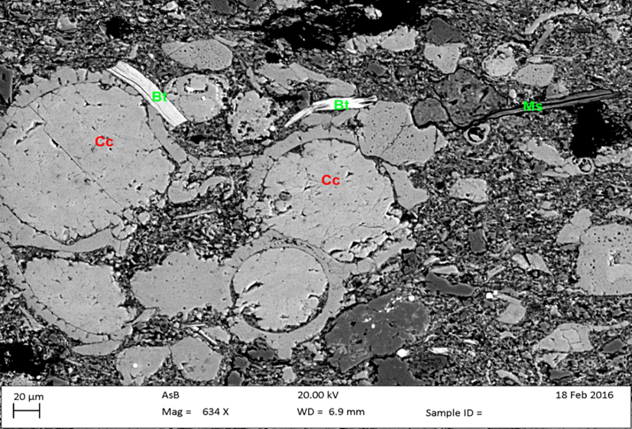
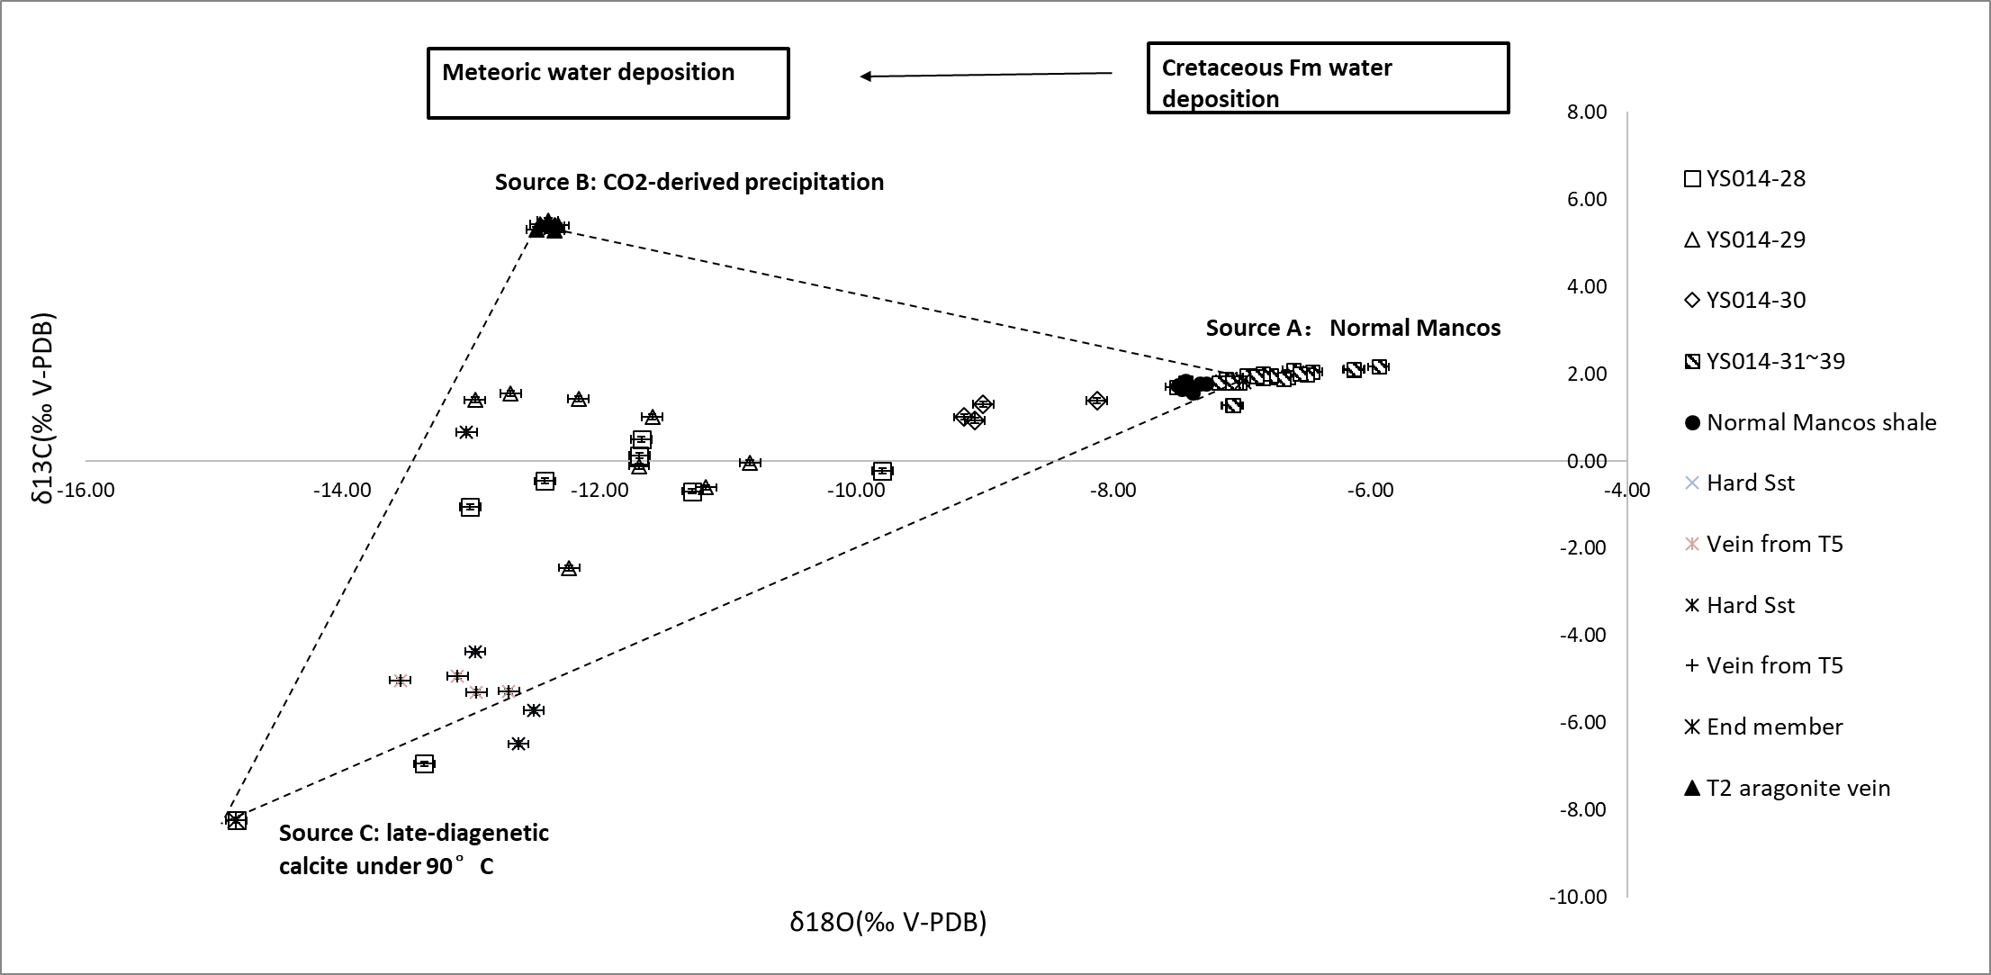
Three source model to distinguish diagenetic carbonates and sequestered carbonates:
Dissolved Mancos (14m)
Porosity>14%
Normal Mancos
Porosity=5.9%~6.7%
Precipitated Mancos (15m)
Porosity=1%~5%
Notes:
Based on the isotope studies and deposition environment analysis, coupled with the SEM studies on the morphologies of different types of calcite cements, end-members of the calcite cements that are from three different mechanisms are proposed.
foraminifera shells
Three source model: each source has unique carbon/oxygen isotope: Source A: depositional carbonates (fossils and early diagenetic). Source B: carbonate deposits from CO2-rich fluid. Source 3: diagenetic carbons from hydrocarbon thermal degradation
Sample 33: unaltered Mancos. Primary calcite, complete fossils, no visible fractures,
Sample 29: the nearest to the fault (14m): fractured in the same direction. Dissolved carbonates (white bits),
Sample 31: only a few meters away from the sample 29, heavily cemented with secondary calcites.

Slide 12
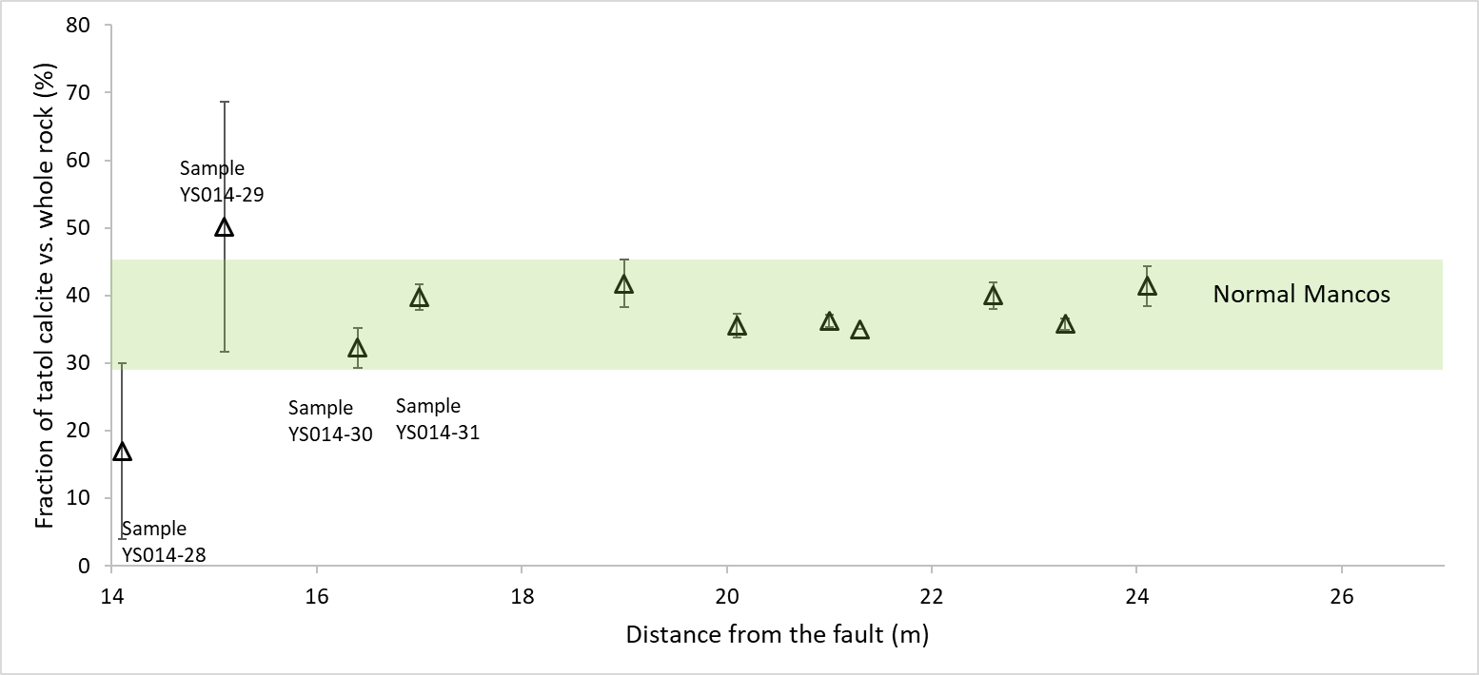
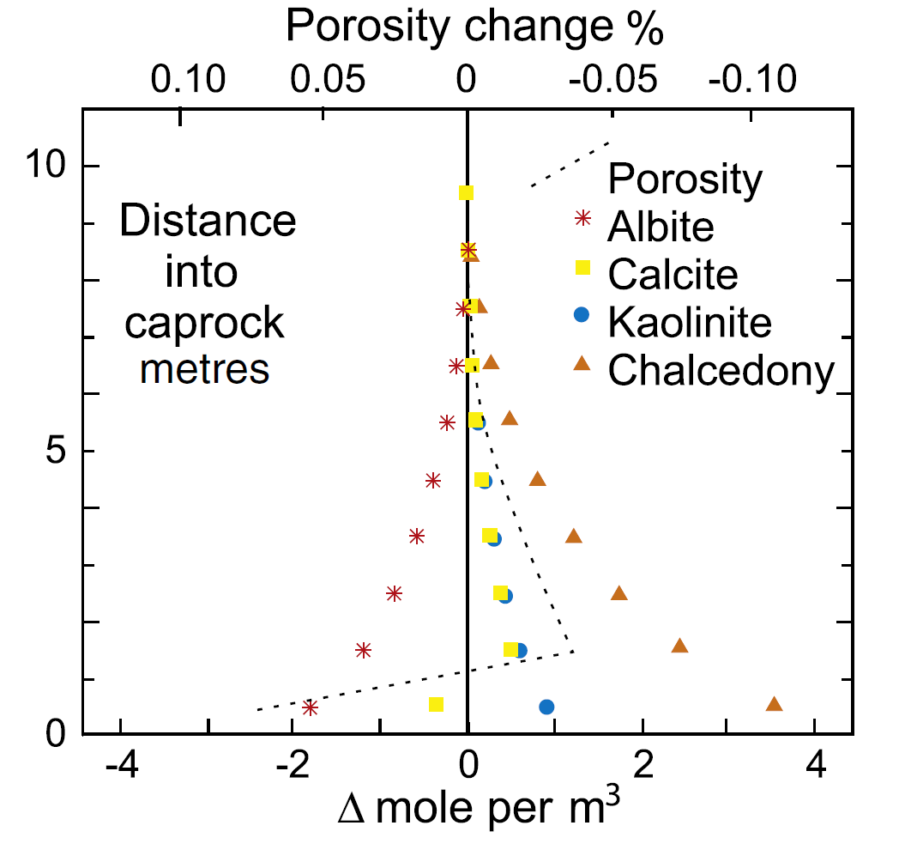
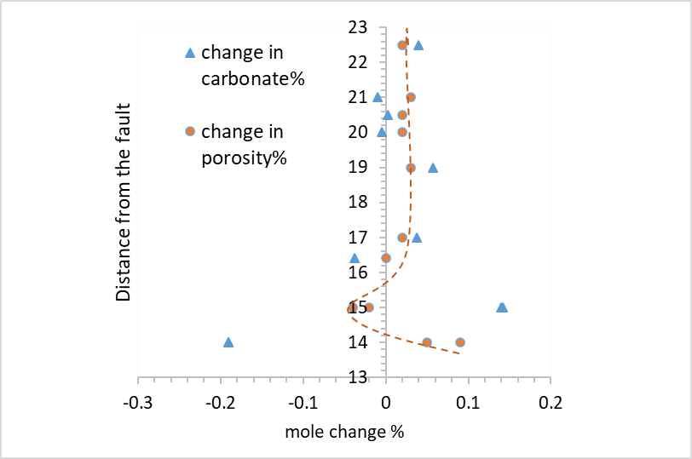
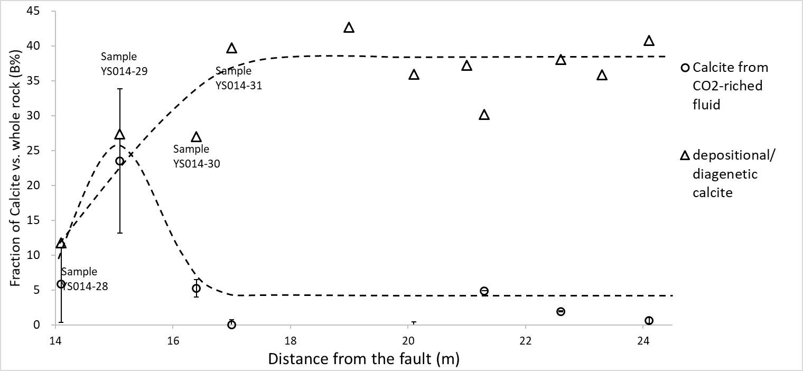
Gaus et al. (2005).
Dissolution
zone
Precipitation
zone
Un-alternated Mancos
Sample YS014-29 contains the most secondary calcite, that 24% of the total rock is derived from CO₂ sequestered calcite.
Notes:
.CO2-rich fluid has penetrated the fault zone and deposited carbonates in the hanging wall of the main fault. But the influencing radius is limited for less than 17m. Samples further than 17m away from the fault are unaltered. The fluid could only alter the host rocks that have already fractured. Cannot dissolve or deposit carbonates in unaltered Mancos
和实验不同：1. 空间尺度不同（大尺度）；3. 时间尺度不同（上万年vs.90天）2. 流态不同（层流，扩散）；3.温压条件不同（常温常压）
calcite fraction vs. distance from the main fault. Sample YS014-28 contains especially low total calcite because of massive dissolution, and Sample YS014-29 contains exceptional high calcite because of deposition of secondary calcites.

Slide 13
Implications:
The CO₂-rich fluid could only influence the damaged Mancos shale (deformed and fractured), with very limited influencing distance (less than 17m)
The CO₂-rich fluid induces dissolution zone and precipitation zone in shale Fm.
The CO₂-rich fluid deposited up to 24% of calcite in Mancos shale (%weight against the whole rock)
Significance for engineered carbon storage:
The influencing radius for CO₂-rich fluid is limited. The migration will be inhibited by precipitation zone.
The formation of precipitation zone reduces the leakage risk in damaged zone for geological carbon storage.
c. The density and connectivity of the faults/fractures are very important for the security of the carbon storage.

Slide 14
Q&A Thanks!

