Slide 1
GSA Annual Meeting
September 22, 2019
Marcus P. Borom, PhD
Materials Scientist – Retired
Enhanced version
Without a 12 minute limit

Slide 2
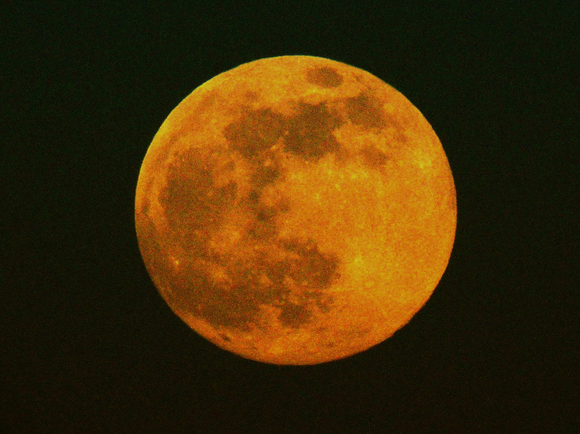
THE ROLE OF EARTH-MOON ROTATIONAL DYNAMICS IN THE SHAPING OF THE SURFACE OF OUR PLANET

Slide 3
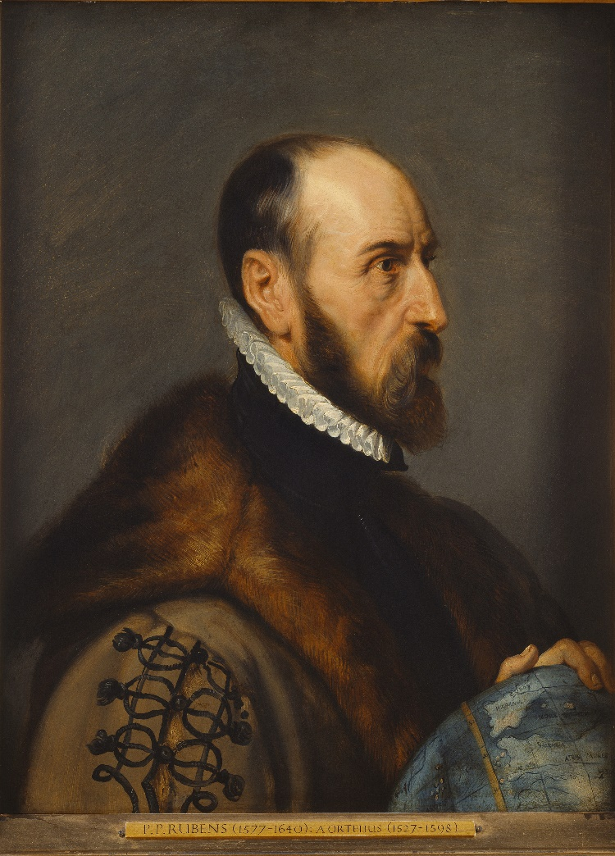
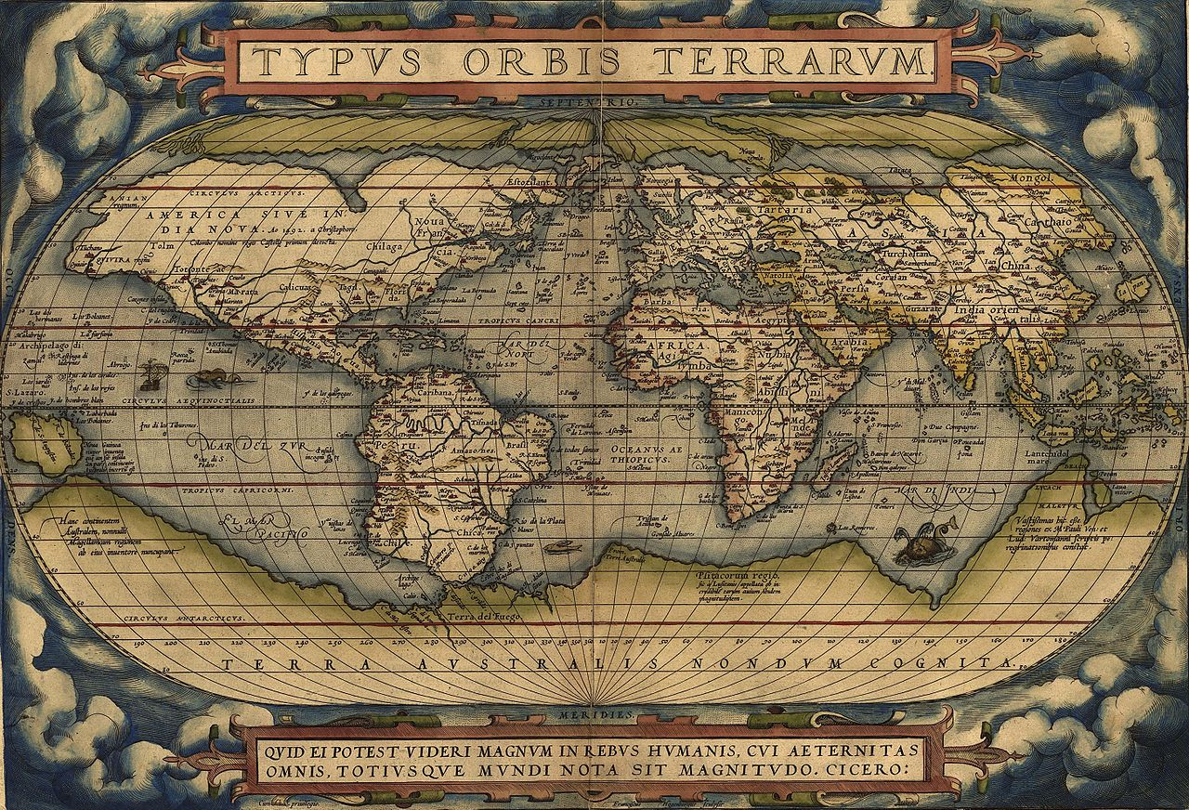
A short journey through the history of continents
Abraham Ortelius Prominent Dutch Cartographer
Noted in 1587 that the east and west Atlantic coastlines must have previously been joined.

Slide 4
328 Years
after Ortelius
Herr Doktor Professor Alfred Wegener
Meteorologist (not a Geologist)
Was about to shock the
Geophysical World

Slide 5
328 Years
after Ortelius
Herr Doktor Professor Alfred Wegener
Meteorologist (not a Geologist)
Was about to shock the
Geophysical World
Note:
at this point in history geologists firmly adhered to the
“conventional wisdom”
that continents were
stationary, immobile landmasses.

Slide 6
328 Years
after Ortelius
Herr Doktor Professor Alfred Wegener
Published a book in 1915
(104 years ago)
In Germany at the beginning of
World War I

Slide 7
328 Years
after Ortelius
Herr Doktor Professor Alfred Wegener
Published a book in 1915
The Origin of Oceans and
Continents

Slide 8
328 Years
after Ortelius
Herr Doktor Professor Alfred Wegener
Published a book in 1915
The Origin of Oceans and
Continents

Slide 9
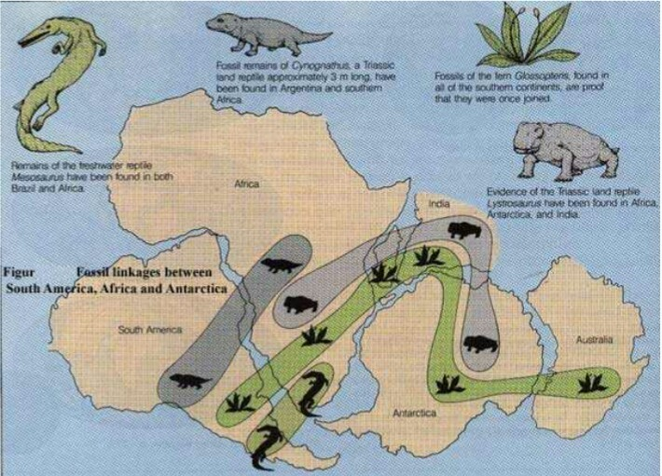
328 Years
after Ortelius
Herr Doktor Professor Alfred Wegener
Published a book in 1915
The Origin of Oceans and
Continents

Slide 10
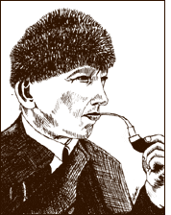
Reaction of the Scientific Community
Wegener was vilified. His hypothesis was ridiculed

Slide 11
Reaction of the Scientific Community
Wegener was vilified. His hypothesis was ridiculed
When asked the Question,
What was the driving force at play??
Wegener did not
have an answer!

Slide 12
Reaction of the Scientific Community
Wegener was vilified. His hypothesis was ridiculed
When asked the Question,
What was the driving force at play??
Wegener did not
have an answer!

Slide 13
Reaction of the Scientific Community
Wegener was vilified. His hypothesis was ridiculed
Comments from prominent scientists:
"Utter, damned rot!"

Slide 14
Reaction of the Scientific Community
Wegener was vilified. His hypothesis was ridiculed
Comments from prominent scientists:
"If we are to believe [this] hypothesis, we
must forget everything we have learned in the last 70 years
and start all over again.”

Slide 15
Reaction of the Scientific Community
Wegener was vilified. His hypothesis was ridiculed
Comments from prominent scientists:
Anyone who "values his reputation for scientific sanity" would never dare support such a theory,

Slide 16
Fifteen years later
In 1930, at age 50
Wegener froze to death on a solo weather research project in the Arctic.

Slide 17
Fifteen years later
In 1930, at age 50
Wegener froze to death on a solo weather research project in the Arctic.
His ideas remained frozen for almost 40 years
until 1954.

Slide 18
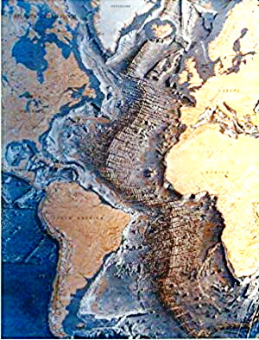


Harry Hammond Hess – Geologist
Princeton U. Professor and
Rear Admiral in the US Navy
Studied Sonar Maps of the Ocean Floor.
In 1954 he Introduced the concept of
SEA-FLOOR SPREADING
and linked the Mid-Atlantic Ridge
to Wegener’s
.

Slide 19
Harry Hammond Hess – Geologist
Princeton U. Professor and
Rear Admiral in the US Navy
Studied Sonar Maps of the Ocean Floor.
In 1954 he Introduced the concept of
SEA-FLOOR SPREADING
and linked the Mid-Atlantic Ridge
to Wegener’s
Kontinentverschiebung.

Slide 20
Harry Hammond Hess – Geologist
Princeton U. Professor and
Rear Admiral in the US Navy
ONR Reports (1954, -55, -60)
Provided scientific credence to revitalize
Kontinentvershiebung
as
Continental Drift
Hess’ papers and additional studies of others such as resolving the mystery of paleomagnetism
Opened the door for Plate Tectonics

Slide 21
Harry Hammond Hess – Geologist
Princeton U. Professor and
Rear Admiral in the US Navy
ONR Reports (1954, -55, -60)
Provided scientific credence to revitalize
Kontinentvershiebung
as
Continental Drift
Hess’ papers and additional studies of others such as resolving the mystery of paleomagnetism
Opened the door for Plate Tectonics

Slide 22
Harry Hammond Hess – Geologist
Princeton U. Professor and
Rear Admiral in the US Navy
ONR Reports (1954, -55, -60)
Provided scientific credence to revitalize
Kontinentvershiebung
as
Continental Drift
Hess’ papers and additional studies of others such as resolving the mystery of paleomagnetism
Opened the door for Plate Tectonics

Slide 23
Continental Drift and Plate Tectonics
Had finally become mainstream, geoscience by 1970.
BUT ALMOST 50 YEARS LATER
We are still left with Unanswered Questions.

Slide 24
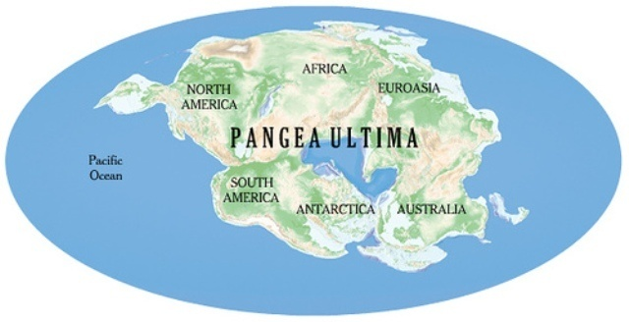
Continental Drift and Plate Tectonics
Had finally become mainstream by 1970.
BUT ALMOST 50 YEARS LATER
We are still left with Unanswered Questions.
How and Why did Pangaea form on only ONE hemisphere?

Slide 25
Continental Drift and Plate Tectonics
Had finally become mainstream by 1970.
BUT ALMOST 50 YEARS LATER
We are still left with Unanswered Questions.
Why did Pangaea begin to fracture?

Slide 26
Continental Drift and Plate Tectonics
Had finally become mainstream by 1970.
BUT ALMOST 50 YEARS LATER
We are still left with Unanswered Questions.
Why did the continents begin to drift apart
only 200 Mya?

Slide 27
Continental Drift and Plate Tectonics
Had finally become mainstream by 1970.
BUT ALMOST 50 YEARS LATER
We are still left with Unanswered Questions.
What are the driving forces
for each of these events?
Each is probably different!

Slide 28
Continental Drift and Plate Tectonics
Finally became mainstream by 1970.
BUT ALMOST 50 YEARS LATER
We are still left with Unanswered Questions.
What are the driving forces
for each of these events?
And
Each is probably different!

Slide 29
Today
I will provide answers for each of those questions.

Slide 30
And
It all starts with
the
MOON

Slide 31
The Big Astrophysical
Question
In the 1960s:

Slide 32
The Big Astrophysical
Question
In the 1960s:
When, Where, and How
Did the moon form?

Slide 33
In 1956
Clair Patterson determined that
Earth was
4.56 Gy old

Slide 34
In 1956
Clair Patterson determined that
Earth was
4.56 Gy old
BUT
in the 1960s
The age of the moon
was still an unknown

Slide 35
The age problem of the moon
was addressed by Geophysicists by deriving
An Equation to calculate
Lunar Orbital Evolution
With the goal of determining
Earth-Moon Coincidence
and, therefore,
the age of the Moon

Slide 36
The age problem of the moon
was addressed by Geophysicists by deriving
An Equation to calculate
Lunar Orbital Evolution
With the goal of determining
Earth-Moon Coincidence
and, therefore,
the age of the Moon

Slide 37
The age problem of the moon
was addressed by Geophysicists by deriving
An Equation to calculate
Lunar Orbital Evolution
With the goal of determining the time of
Earth-Moon Coincidence
and, therefore,
the age of the Moon

Slide 38
The age problem of the moon
was addressed by Geophysicists by deriving
An Equation to calculate
Lunar Orbital Evolution
With the goal of determining
Earth-Moon Coincidence
and, therefore,
the age of the Moon

Slide 39
Gordon MacDonald – Geophysicist
Tidal Friction – 1964
Assumptions:
1. Orbital mode remains unchanged for the full history of the moon.
i.e. A tidally locked Moon orbiting an independently rotating Earth
Earth-moon coincidence occurs at the time of origin
2. Orbital changes occur due to friction from lunar and solar tides.
Tidal Friction slows Earth rotation.
Conservation of angular momentum demands increases in both
Earth-Moon separation distance and
the Lunar orbital period

Slide 40
Gordon MacDonald – Geophysicist
Tidal Friction – 1964
Assumptions:
1. Orbital mode remains unchanged for the full history of the moon.
i.e. A tidally locked Moon orbiting an independently rotating Earth
Earth-moon coincidence occurs at the time of origin
2. Orbital changes occur due to friction from lunar and solar tides.
Tidal Friction slows Earth rotation.
Conservation of angular momentum demands increases in both
Earth-Moon separation distance and
the Lunar orbital period

Slide 41
Gordon MacDonald – Geophysicist
Tidal Friction – 1964
Assumptions:
1. Orbital mode remains unchanged for the full history of the moon.
i.e. A tidally locked Moon orbiting an independently rotating Earth
Earth-moon coincidence occurs at the time of origin
2. Orbital changes occur due to friction from lunar and solar tides.
Tidal Friction slows Earth rotation.
Conservation of angular momentum demands increases in both
Earth-Moon separation distance and
the Lunar orbital period

Slide 42
Gordon MacDonald – Geophysicist
Tidal Friction – 1964
Assumptions:
1. Orbital mode remains unchanged for the full history of the moon.
i.e. A tidally locked Moon orbiting an independently rotating Earth
Earth-moon coincidence occurs at the time of origin
2. Orbital changes occur due to friction from lunar and solar tides.
Tidal Friction slows Earth rotation.
Conservation of angular momentum demands increases in both
Earth-Moon separation distance and
the Lunar orbital period

Slide 43
Gordon MacDonald – Geophysicist
Tidal Friction – 1964
Assumptions:
1. Orbital mode remains unchanged for the full history of the moon.
i.e. A tidally locked Moon orbiting an independently rotating Earth
Earth-moon coincidence occurs at the time of origin
2. Orbital changes occur due to friction from lunar and solar tides.
Tidal Friction slows Earth rotation.
Conservation of angular momentum demands increases in both
Earth-Moon separation distance and
the Lunar orbital period

Slide 44
Gordon MacDonald – Geophysicist
Tidal Friction – 1964
Assumptions:
1. Orbital mode remains unchanged for the full history of the moon.
i.e. A tidally locked Moon orbiting an independently rotating Earth
Earth-moon coincidence occurs at the time of origin
2. Orbital changes occur due to friction from lunar and solar tides.
Tidal Friction slows Earth rotation.
Conservation of angular momentum demands increases in both
Earth-Moon separation distance and
the Lunar orbital period

Slide 45
Gordon MacDonald – Geophysicist
Tidal Friction – 1964
Performed a complicated derivation
That yielded a SIMPLE SOLUTION
In his 85th Equation

Slide 46

Gordon MacDonald – Geophysicist
Tidal Friction – 1964
da/dt = k/a^{11/2}
Where: t = time of orbital evolution
a = separation between the moon and the earth, and
k = $3\frac{lm}{QM}$R⁵µ^{1/2} where: m = the Moon's mass,
M = Earth's mass
R = Earth's radius,
l = an effective Earth + ocean, tidal Love number,
Q = Dissipation equality factor, and
Q = 1/tan 2δ,
δ is the tidal lag angle
µ = G (M + m),

Slide 47

Gordon MacDonald – Geophysicist
Tidal Friction – 1964
da/dt = k/a^{11/2}
Where: t = time of orbital evolution
a = separation between the moon and the earth, and
k = $3\frac{lm}{QM}$R⁵µ^{1/2} where: m = the Moon's mass,
M = Earth's mass
R = Earth's radius,
l = an effective Earth + ocean, tidal Love number,
Q = Dissipation equality factor
All are known values

Slide 48

Gordon MacDonald – Geophysicist
Tidal Friction – 1964
da/dt = k/a^{11/2}
Where: t = time of orbital evolution
a = separation between the moon and the earth, and
k = $3\frac{lm}{QM}$R⁵µ^{1/2} where: m = the Moon's mass,
M = Earth's mass
R = Earth's radius,
l = an effective Earth + ocean, tidal Love number,
Q = Dissipation equality factor
All are known values
Values are subject
to variation

Slide 49
Period of Unlocked Earth
Rotation

Slide 50
Earth-Moon coincidence at 1.55 to 1.78 Gya
Period of Unlocked Earth
Rotation

Slide 51
Earth-Moon coincidence at 1.55 to 1.78 Gya
Period of Unlocked Earth
Rotation

Slide 52
Earth-Moon coincidence at 1.55 to 1.78 Gya
Period of Unlocked Earth
Rotation

Slide 53
Earth-Moon coincidence at 1.55 to 1.78 Gya
Period of Unlocked Earth
Rotation

Slide 54
Earth-Moon coincidence at 1.55 to 1.78 Gya
Period of Unlocked Earth
Rotation

Slide 55
Earth-Moon coincidence at 1.55 to 1.78 Gya
Period of Unlocked Earth
Rotation

Slide 56
Earth-Moon coincidence at 1.55 to 1.78 Gya
Period of Unlocked Earth
Rotation

Slide 57
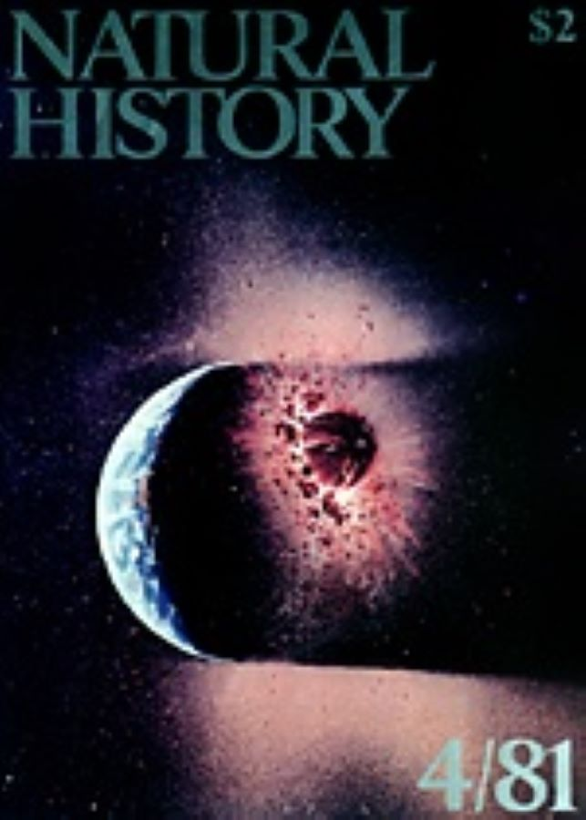
In 1975
Eleven years after MacDonald
and 3 yrs after the last man on the moon
Bill Hartmann & Donald Davis
(LPL- UA)
Introduced the
Giant Impact
As a new model for the formation of the moon.
The Giant Impact, as pictured in a painting by William K. Hartmann on the cover of Natural History Magazine in 1981. Copyright William K. Hartmann

Slide 58
In 1975
Eleven years after MacDonald
and 3 yrs after the last man on the moon
The
Giant Impact Model
Was not immediately embraced by the Astrophysical Community
The Giant Impact, as pictured in a painting by William K. Hartmann on the cover of Natural History Magazine in 1981. Copyright William K. Hartmann

Slide 59
26 years later
Robin Canup &
Erik Asphaug - 2001
Published Computer model of
the Giant Impact:
Picture from Canup & Asphaug –
NATURE |VOL 412 | 16 AUGUST 2001

Slide 60
26 years later
Robin Canup &
Erik Asphaug - 2001
Published Computer model of
the Giant Impact:
Giant Impact has become the widely accepted model for formation of the moon

Slide 61
Robin Canup &
Erik Asphaug - 2001
Published Computer model of
the Giant Impact:
Results of Impact
Earth’s axis was tilted
Debris was ejected beyond the
Roche radius.
Earth with associated debris disc
spun at five hours/revolution
Moon formed 22,000 km from Earth in a 9.1 hour orbit
Giant Impact has become the widely accepted model for formation of the moon

Slide 62
Robin Canup &
Erik Asphaug - 2001
Published Computer model of
the Giant Impact:
Results of Impact
Earth’s axis was tilted
Debris was ejected beyond the
Roche radius.
Earth with associated debris disc
spun at five hours / revolution
Moon formed 22,000 km from Earth in a 9.1 hour orbit
Their calculations established the
starting point and parameters for the evolution of the
LUNAR
ORBIT

Slide 63
Robin Canup &
Erik Asphaug - 2001
Published Computer model of
the Giant Impact:
Results of Impact
Earth’s axis was tilted
Debris was ejected beyond the
Roche radius.
Earth with associated debris disc
spun at five hours / revolution
Moon formed 22,000 km from Earth in a 9.1 hour orbit
New Consideration:
(my outrageous Hypothesis)
With Earth & Moon,
in such close
Proximity they
became

Slide 64
Robin Canup &
Erik Asphaug - 2001
Published Computer model of
the Giant Impact:
Results of Impact
Earth’s axis was tilted
Debris was ejected beyond the
Roche radius.
Earth with associated debris disc
spun at five hours / revolution
Moon formed 22,000 km from Earth in a 9.1 hour orbit
New Consideration:
(my outrageous Hypothesis)
With Earth & Moon,
in such close
Proximity they
became
Mutually, Tidally Locked

Slide 65
Mutually, Tidally Locked means that
Earth and Moon function as a Binary Planet

Slide 66
Mutually, Tidally Locked means that
Earth and Moon function as a Binary Planet
THEY DO NOT ROTATE ON THEIR RESPECTIVE, GEOMETRIC AXES

Slide 67
Mutually, Tidally Locked means that
Earth and Moon function as a Binary Planet
THEY DO NOT ROTATE ON THEIR RESPECTIVE, GEOMETRIC AXES
THEY ROTATE AROUND THEIR CENTER OF MASS – BARYCENTER

Slide 68
Using data from Canup/Asphaug and the integrated form of
MacDonald’s
Eq. 85
Period of Unlocked Earth Rotation

Slide 69
Using data from Canup/Asphaug and the integrated form of
MacDonald’s
Eq. 85
Period of Unlocked Earth Rotation

Slide 70
Period of Mutually- Tidally-Locked Earth-Moon Rotation
Period of Unlocked Earth Rotation

Slide 71
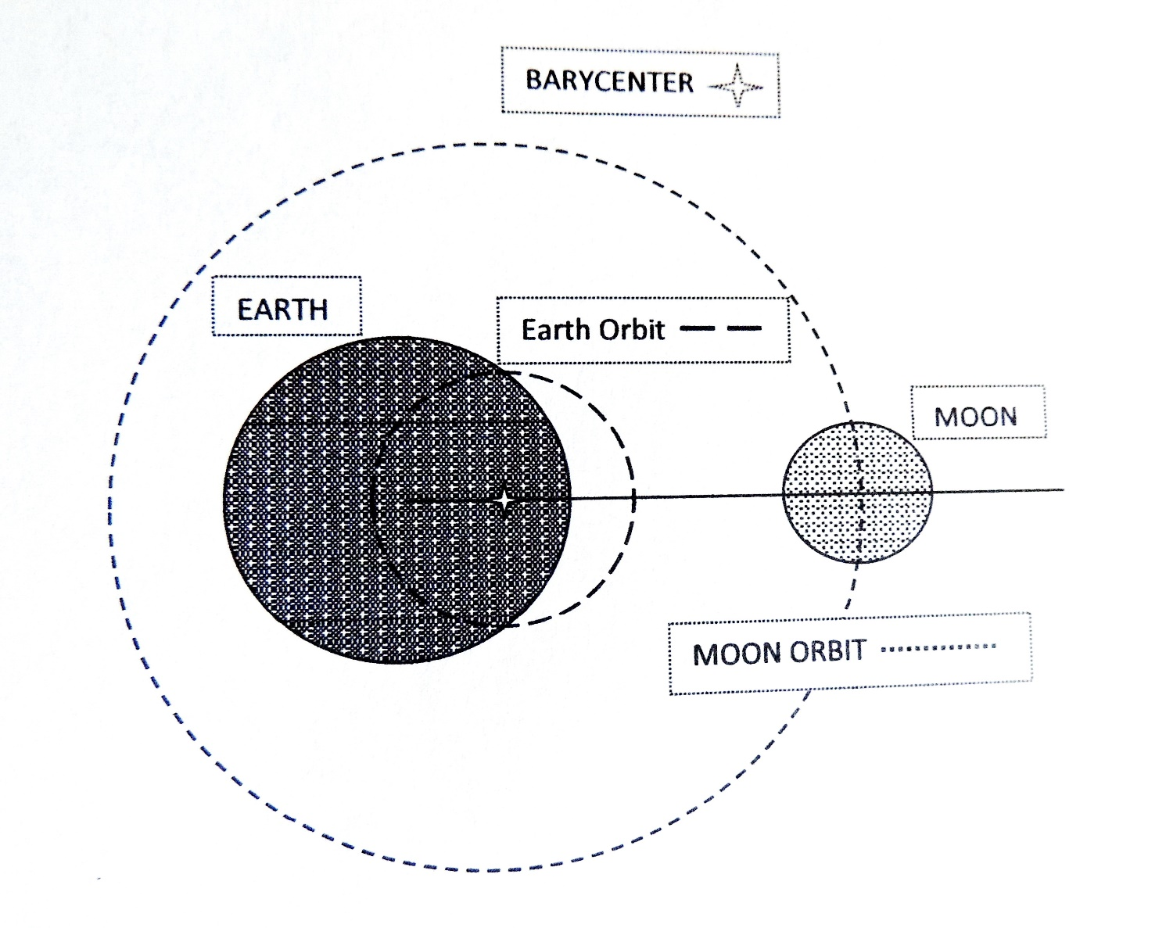
How
Barycentric Rotation
Works.

Slide 72
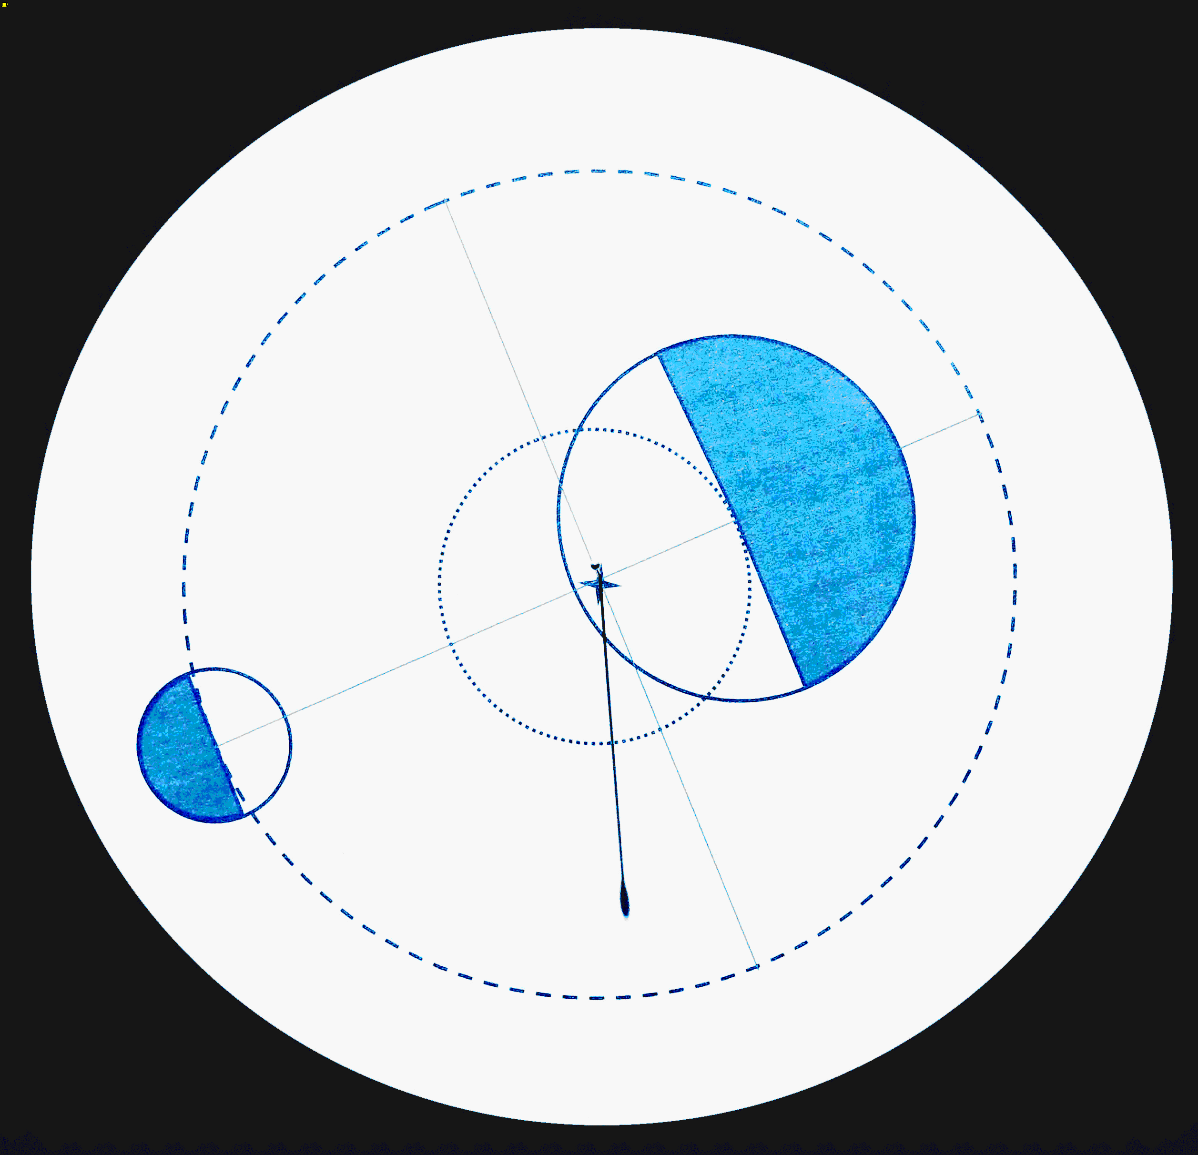
How
Barycentric Rotation
Works.

Slide 73
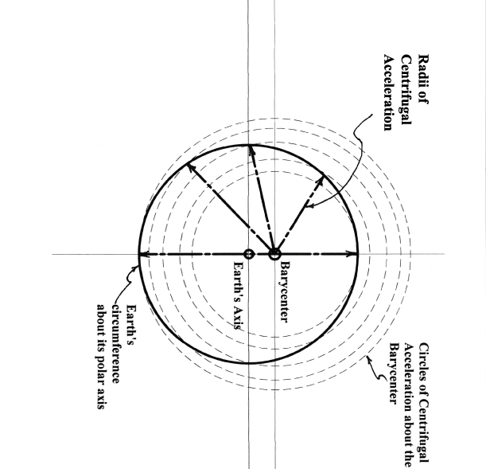
Consequences of
Barycentric Rotation
Radii of
Barycentric, Centrifugal
Acceleration
Earth’s Axis
Barycenter
Line joining Earth-Moon Centers
Earth’s
Circumference
about its polar axis
Circles of Centrifugal
Acceleration about the Barycenter

Slide 74
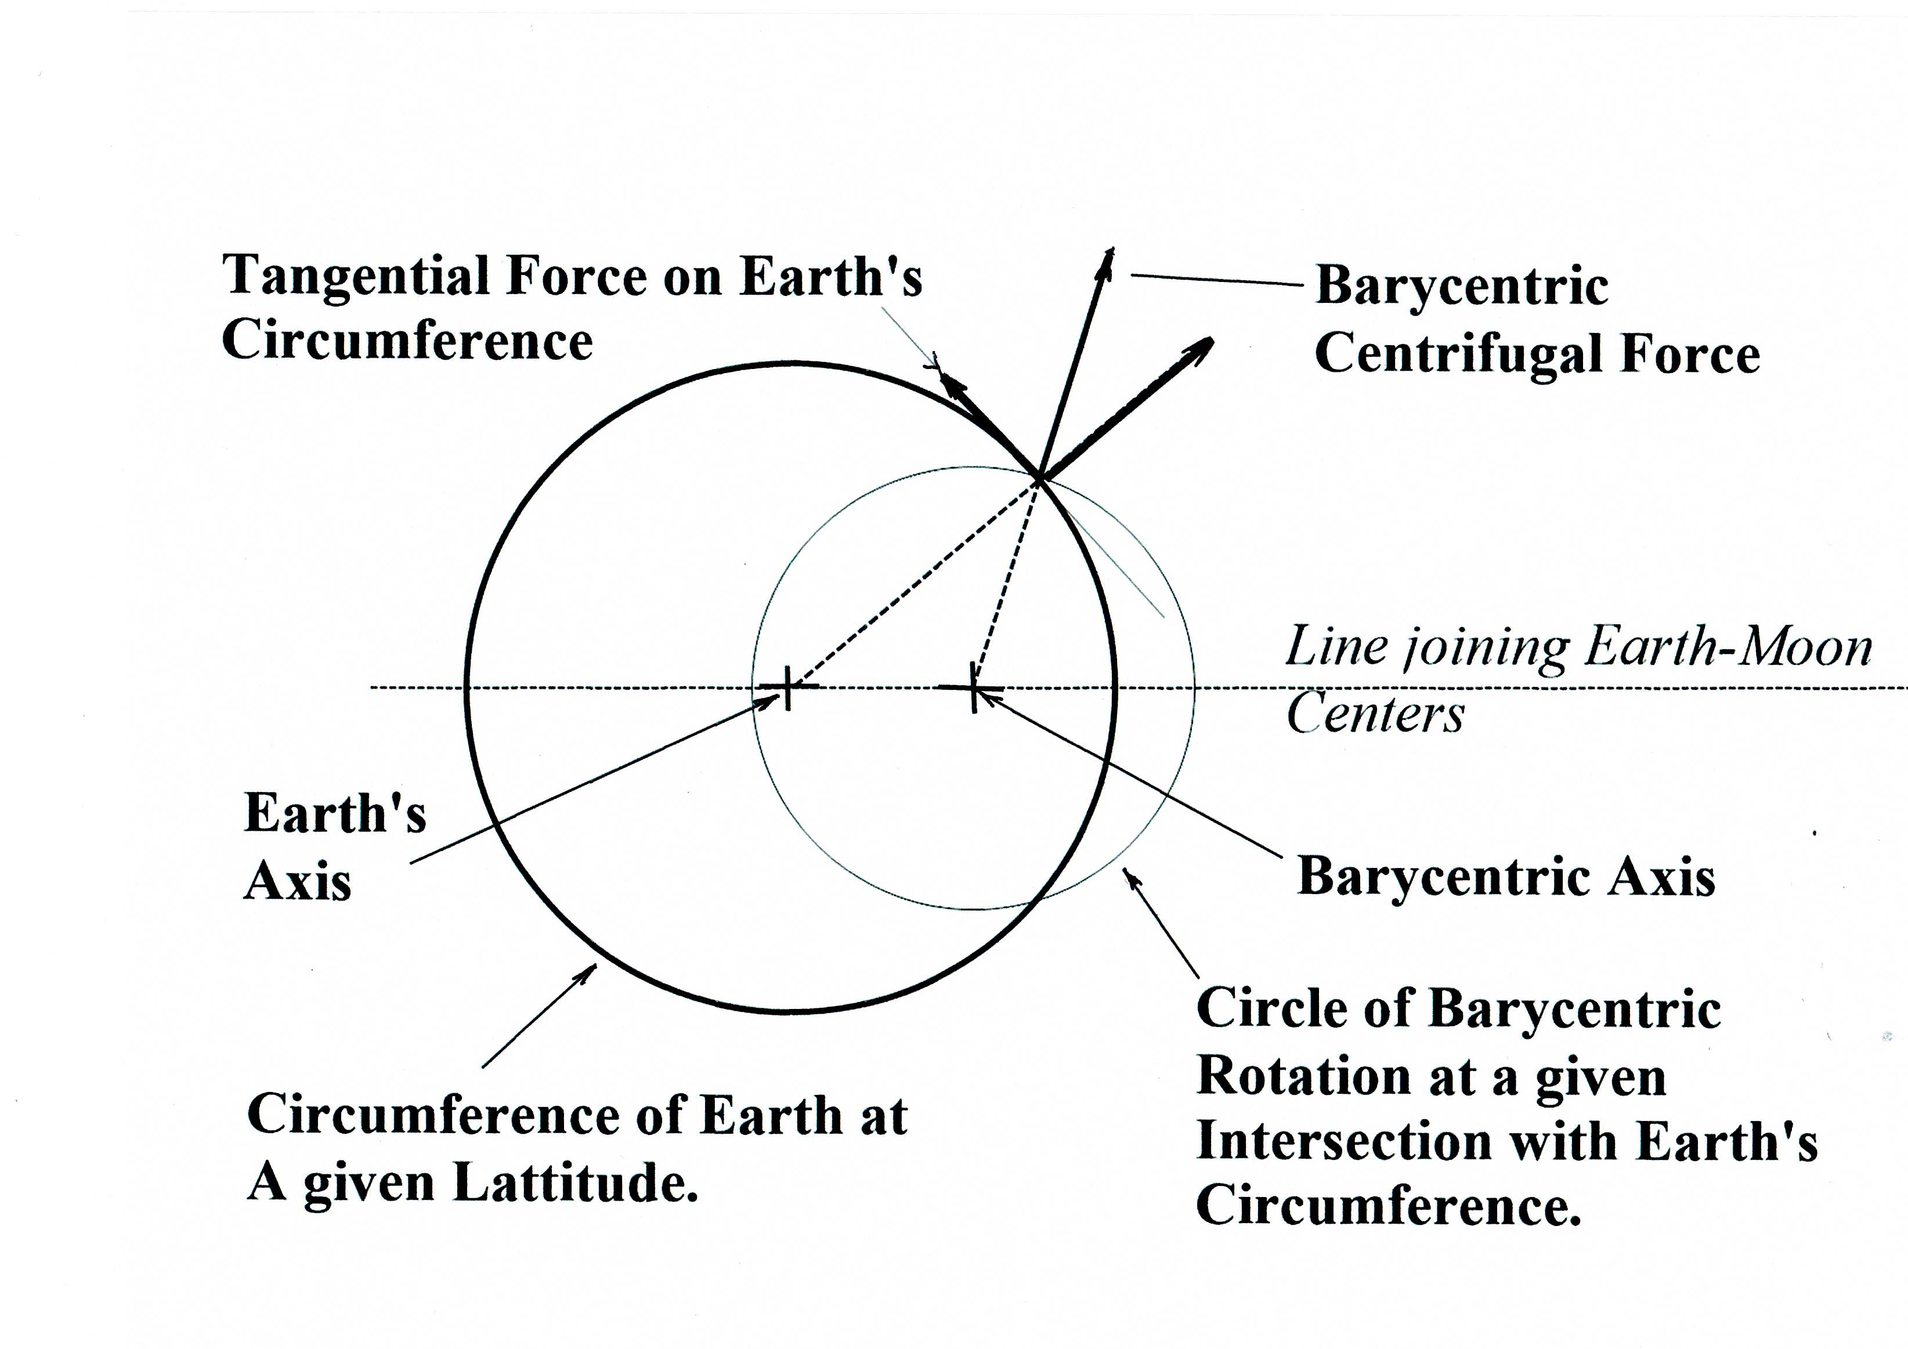
Consequences of
Barycentric Rotation

Slide 75
Period of Mutually- Tidally-Locked Earth-Moon Rotation
Period of Unlocked Earth Rotation

Slide 76
STAGE I - During the period of
Mutually, Tidally Locked System Rotation
1. BARYCENTRIC, tangential, centrifugal forces were active for 3 Gy
Continent building, solid FELSIC minerals were transported on a molten MAFIC ocean to the far side of Earth to form PANGAEA
LUNAR HIGHLANDS were formed in a similar manner.
2. There were no LUNAR tides – only minor SOLAR tides
Seas on shallow continental shelves were CALM Cyanobacteria proliferated (STROMATOLITES)
Cyanobacteria enriched the Atmosphere in Oxygen
and opened the gateway for oxygen-breathing life forms.

Slide 77
STAGE I - During the period of
Mutually, Tidally Locked System Rotation
1. BARYCENTRIC, tangential, centrifugal forces were active for 3 Gy
Continent building, solid FELSIC minerals were transported on a molten MAFIC ocean to the far side of Earth to form PANGAEA
LUNAR HIGHLANDS were formed in a similar manner.
2. There were no LUNAR tides – only minor SOLAR tides
Seas on shallow continental shelves were CALM Cyanobacteria proliferated (STROMATOLITES)
Cyanobacteria enriched the Atmosphere in Oxygen
and opened the gateway for oxygen-breathing life forms.

Slide 78
STAGE I - During the period of
Mutually, Tidally Locked System Rotation
1. BARYCENTRIC, tangential, centrifugal forces were active for 3 Gy
Continent building, solid FELSIC minerals were transported on a molten MAFIC ocean to the far side of Earth to form PANGAEA
LUNAR HIGHLANDS were formed in a similar manner.
2. There were no LUNAR tides – only minor SOLAR tides
Seas on shallow continental shelves were CALM Cyanobacteria proliferated (STROMATOLITES)
Cyanobacteria enriched the Atmosphere in Oxygen
and opened the gateway for oxygen-breathing life forms.

Slide 79
STAGE I - During the period of
Mutually, Tidally Locked System Rotation
1. BARYCENTRIC, tangential, centrifugal forces were active for 3 Gy
Continent building, solid FELSIC minerals were transported on a molten MAFIC ocean to the far side of Earth to form PANGAEA
LUNAR HIGHLANDS were formed in a similar manner.
2. There were no LUNAR tides – only minor SOLAR tides
Seas on shallow continental shelves were CALM Cyanobacteria proliferated (STROMATOLITES)
Cyanobacteria enriched the Atmosphere in Oxygen
and opened the gateway for oxygen-breathing life forms.

Slide 80
Period of Mutually- Tidally-Locked Earth-Moon Rotation
Period of Unlocked Earth Rotation

Slide 81
Transition from Stage I to Stage II
Occurs
When Earth-Moon
Separation Distance
becomes so great that
Moon’s gravitational acceleration is no
longer sufficient to
Tidally Lock Earth.
Earth begins to rotate
Stage I
Stage II
Period of Mutually-Tidally-Locked
Earth-Moon Rotation

Slide 82
Transition from Stage I to Stage II
Occurs
When Earth-Moon
Separation Distance
becomes so great that
Moon’s gravitational acceleration is no
longer sufficient to
Tidally Lock Earth.
Earth begins to rotate
Stage I
Stage II
Period of Mutually-Tidally-Locked
Earth-Moon Rotation
Period of Unlocked Earth Rotation
begins

Slide 83
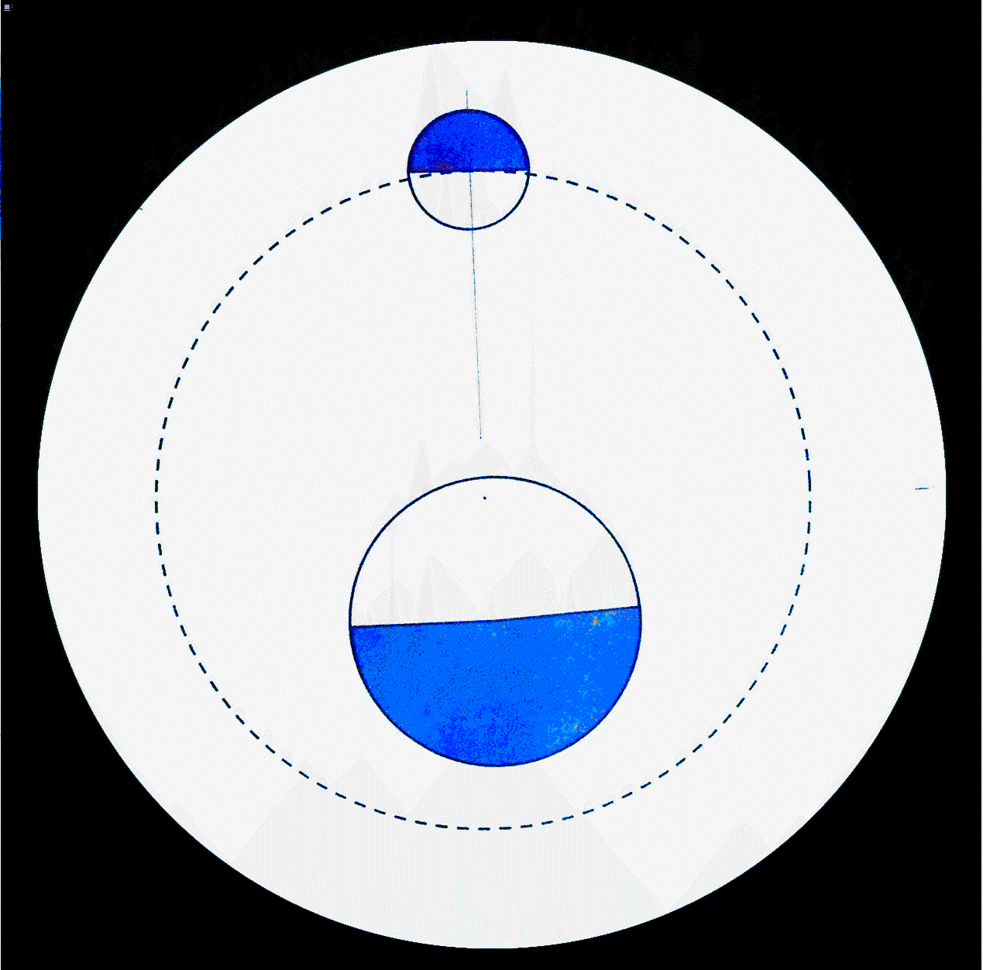
STAGE II - The Period of Unlocked Earth Rotation

Slide 84
STAGE II - The Period of Unlocked Earth Rotation
Note that Earth still experiences
barycentric centrifugal forces

Slide 85
STAGE II - The period of Unlocked Earth Rotation
LUNAR TIDES, initially, were horrific – 800 m
Cyanobacteria were driven almost into extinction.

Slide 86
STAGE II - The period of Unlocked Earth Rotation
LUNAR TIDES, initially, were horrific – 800 m
Cyanobacteria were driven almost into extinction.
BODILY EARTH TIDES created magnitude 9 earthquakes - twice daily

Slide 87
STAGE II - The period of Unlocked Earth Rotation
LUNAR TIDES, initially, were horrific – 800 m
Cyanobacteria were driven almost into extinction.
BODILY EARTH TIDES created magnitude 9 earthquakes - twice daily
Good News - EARTH’s Extreme tides diminished after ~ 200 My as Earth-Moon separation distance increased

Slide 88
STAGE II - The period of Unlocked Earth Rotation
LUNAR TIDES, initially, were horrific – 800 m
Cyanobacteria were driven almost into extinction.
BODILY EARTH TIDES created magnitude 9 earthquakes twice daily
Good News - EARTH’s Extreme tides diminished after ~ 200 My as Earth-Moon separation distance increased
EARTH is now in a state of imbalance due to PANGAEA’s location
IMBALANCED ROTATION of EARTH produced disruptive stresses that Caused PANGAEA to crack and fracture, and
REBALANCING FORCES became, and REMAIN, the driving force for continental drift.
Not convection currents in the asthenosphere

Slide 89
STAGE II - The period of Unlocked Earth Rotation
LUNAR TIDES, initially, were horrific – 800 m
Cyanobacteria were driven almost into extinction.
BODILY EARTH TIDES created magnitude 9 earthquakes twice daily
Good News - EARTH’s Extreme tides diminished after ~ 200 My as Earth-Moon separation distance increased
EARTH is now in a state of imbalance due to PANGAEA’s location
IMBALANCED ROTATION of EARTH produced disruptive stresses that caused PANGAEA to crack and fracture, and
REBALANCING FORCES became, and REMAIN, the driving force for continental drift.
Not convection currents in the asthenosphere

Slide 90
STAGE II - The period of Unlocked Earth Rotation
LUNAR TIDES, initially, were horrific – 800 m
Cyanobacteria were driven almost into extinction.
BODILY EARTH TIDES created magnitude 9 earthquakes twice daily
Good News - EARTH’s Extreme tides diminished after ~ 200 My as Earth-Moon separation distance increased
EARTH is now in a state of imbalance due to PANGAEA’s location
IMBALANCED ROTATION of EARTH produced disruptive stresses that caused PANGAEA to crack and fracture, and
REBALANCING FORCES became, and REMAIN, the driving force for continental drift.
Not convection currents in the asthenosphere

Slide 91
STAGE II - The period of Unlocked Earth Rotation
LUNAR TIDES, initially, were horrific – 800 m
Cyanobacteria were driven almost into extinction.
BODILY EARTH TIDES created magnitude 9 earthquakes twice daily
Good News - EARTH’s Extreme tides diminished after ~ 200 My as Earth-Moon separation distance increased
EARTH is now in a state of imbalance due to PANGAEA’s location
IMBALANCED ROTATION of EARTH produced disruptive stresses that Caused PANGAEA to crack and fracture, and
REBALANCING FORCES became, and REMAIN, the driving force for continental drift.
Not convection currents in the asthenosphere

Slide 92
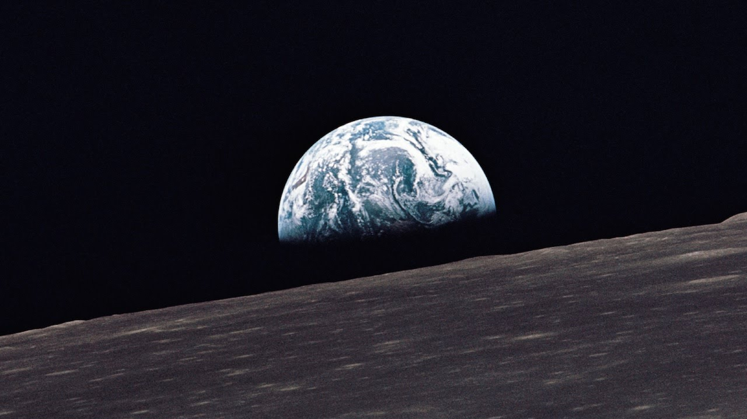
This is the
HOW and WHY
of
CONTINENTAL DRIFT &
PLATE TECTONICS

Slide 93
Thank you for
Your time and attention.

