Slide 1
Testing the Height and Extent of the Lower Ordovician (Sauk) Transgression Using the Rock Record Across Three Continents
Timothy L. Clarey and Aedan C. Parkes
The King’s University and North Lake College

Slide 2
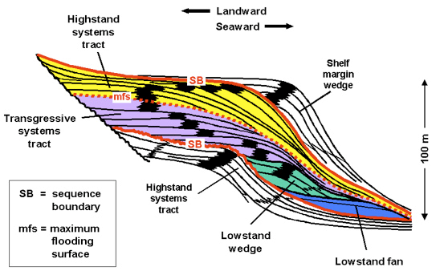
Sequences
Defined by Sloss (1963, 1959, 1949)
Major ocean transgression cycle, beginning on continental margins (best preserved)
Followed by major regression (poorly preserved)
Top and bottom marked by
erosional boundary
or unconformity surface

Slide 3
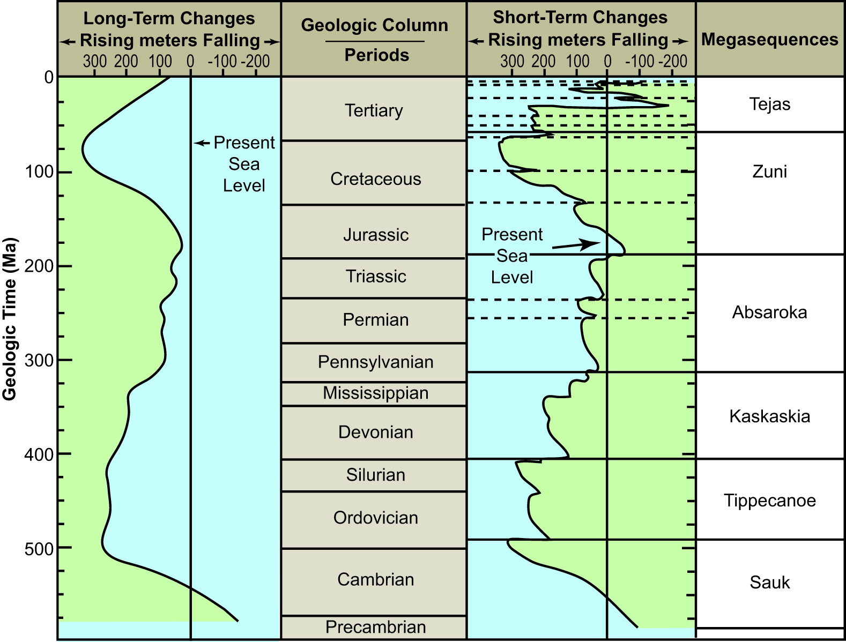
Sloss Sequences Vail and Mitchum, 1979

Slide 4
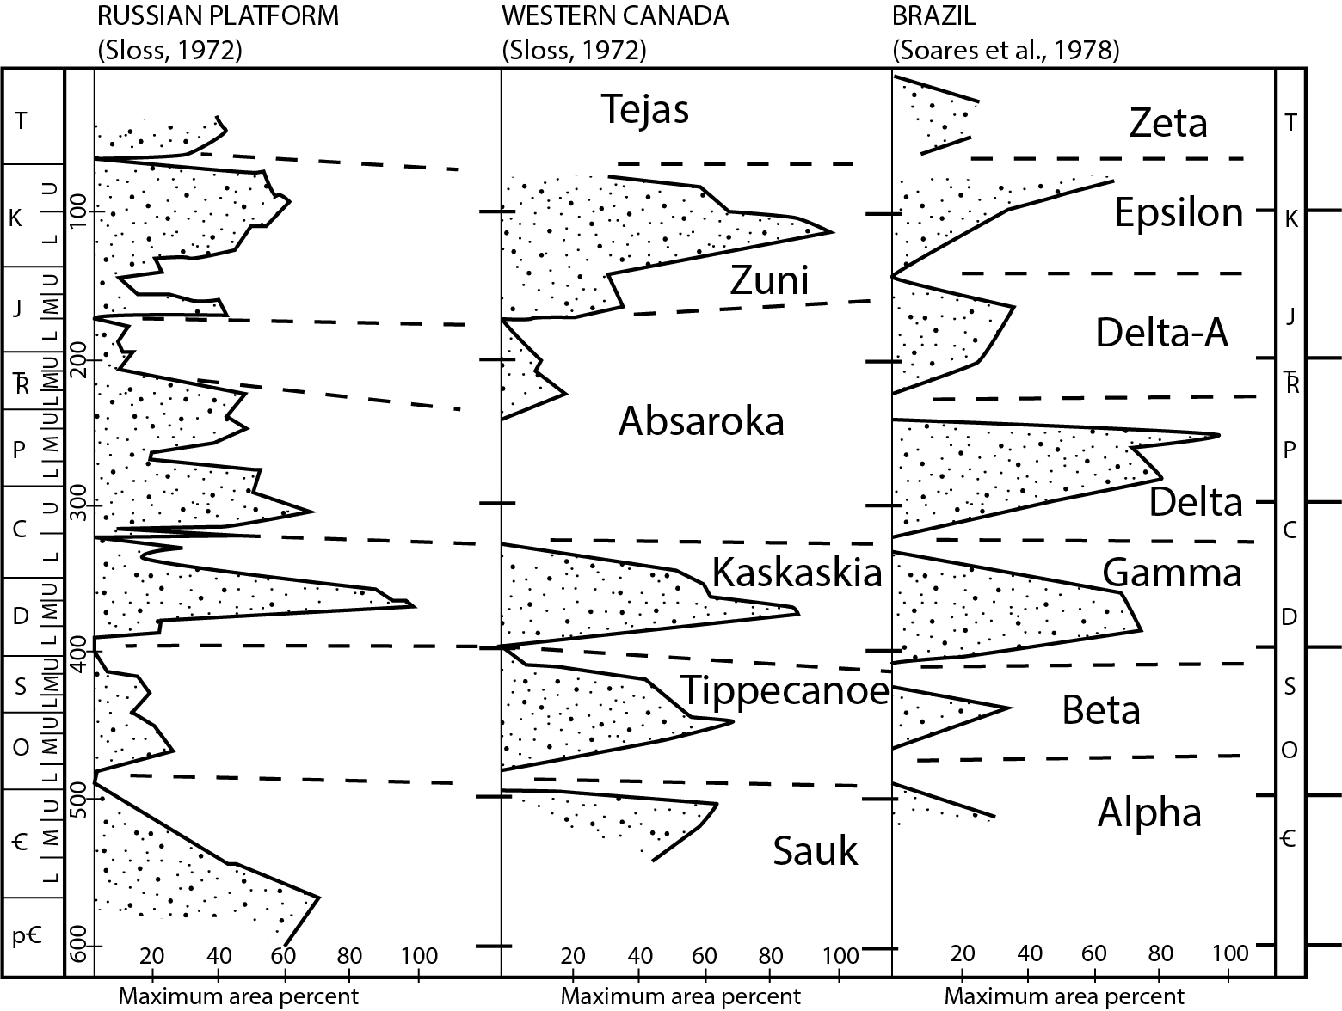
Correlation of Sequences
North and South America,
and Europe

Slide 5
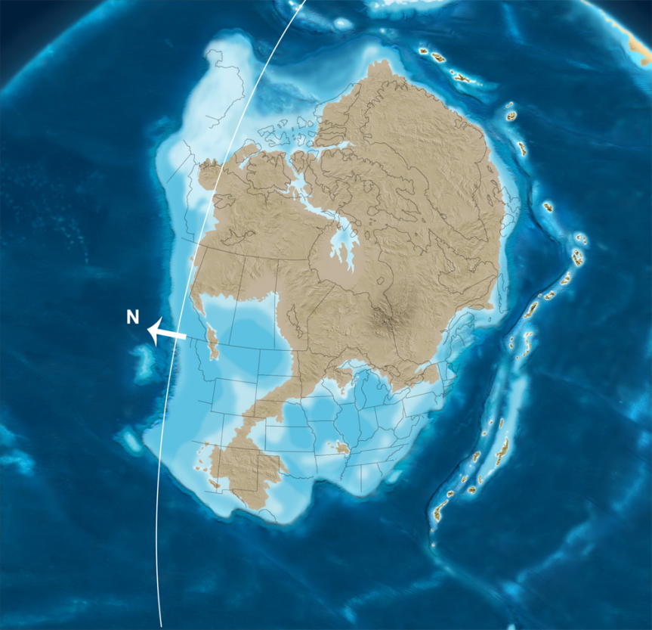
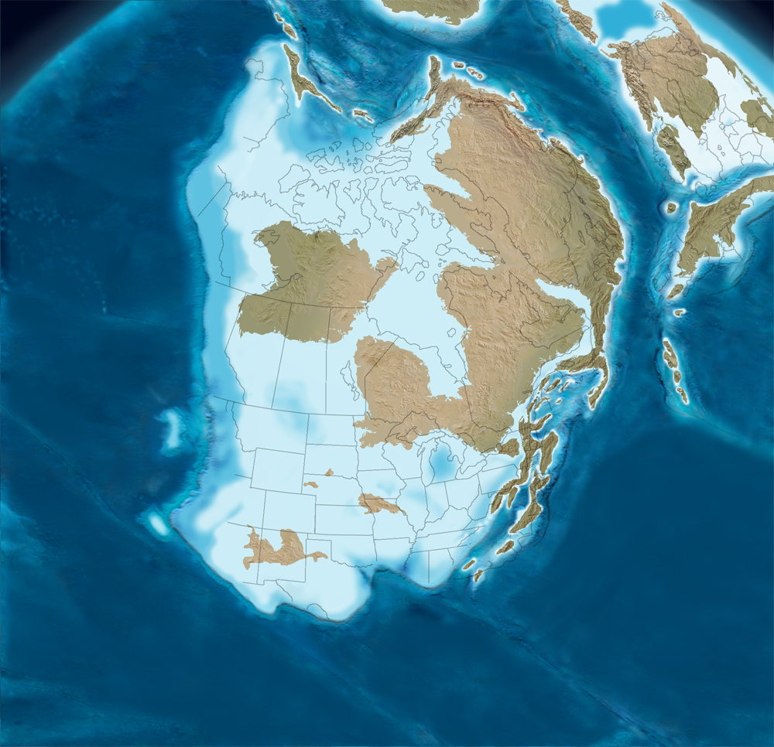
What We’re Taught
Sauk Sequence
Tippecanoe Sequence

Slide 6
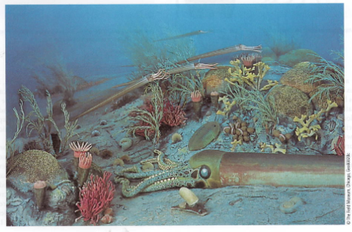
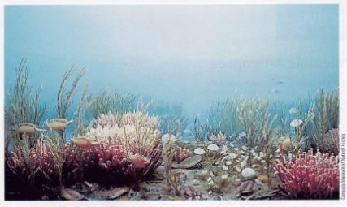
Ordovician “Waterworld”
Sauk Sequence
Tippecanoe Sequence

Slide 7
Depositional or Erosional?
“For almost a century, it has been recognized that the present-day thickness and areal extent of Phanerozoic sedimentary strata increase progressively with decreasing geologic age.
This pattern has been interpreted as reflecting an increase in the rate of sedimentation toward the present or as resulting from better preservation of the younger part of the geologic record.”
Veizer and Mackenzie, 2013, Evolution of Sedimentary Rocks, p. 399.

Slide 8
Methods To Answer This Question
1. Compiled Strat Columns across multiple continents
2. Used Sloss Sequences to map out stratigraphy
3. Compared Extent and Volume sequence-by- sequence

Slide 9
Data Base Methods
Used COSUNA data for USA
Supplemented with Oil Well Data
Used Cross-sections/Seismic Data
Utilized Measured Sections
100s of Papers/Powerpoints
80-85% Reproducible

Slide 10
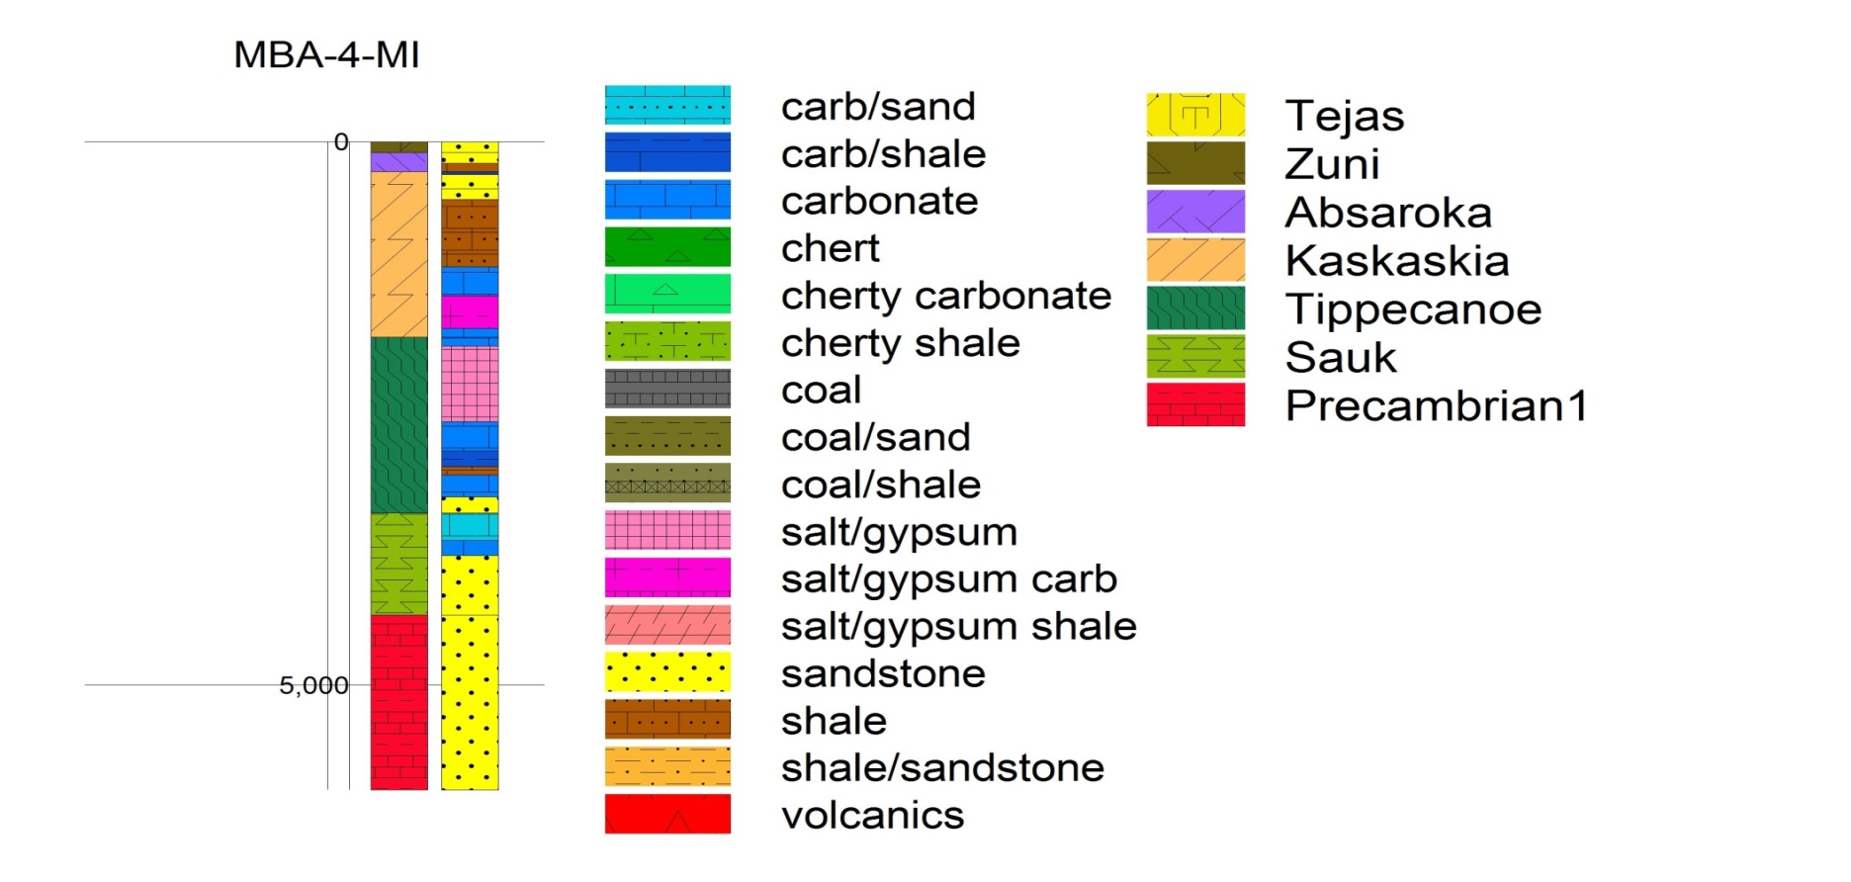
2000+ Columns Globally
Lithology
Sequence
Pre-Sauk

Slide 11
Sauk-Tippecanoe Sequences

Slide 12
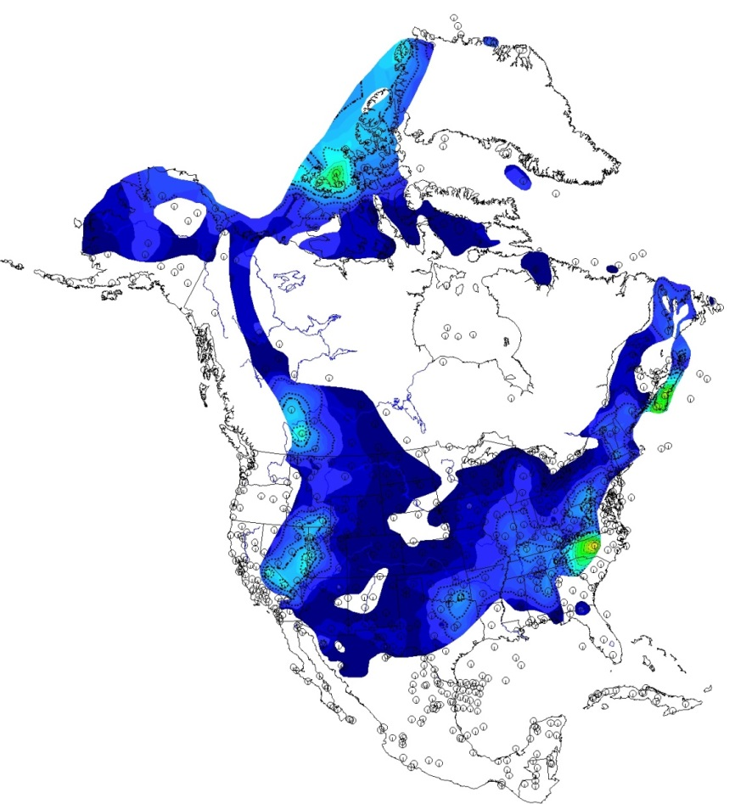
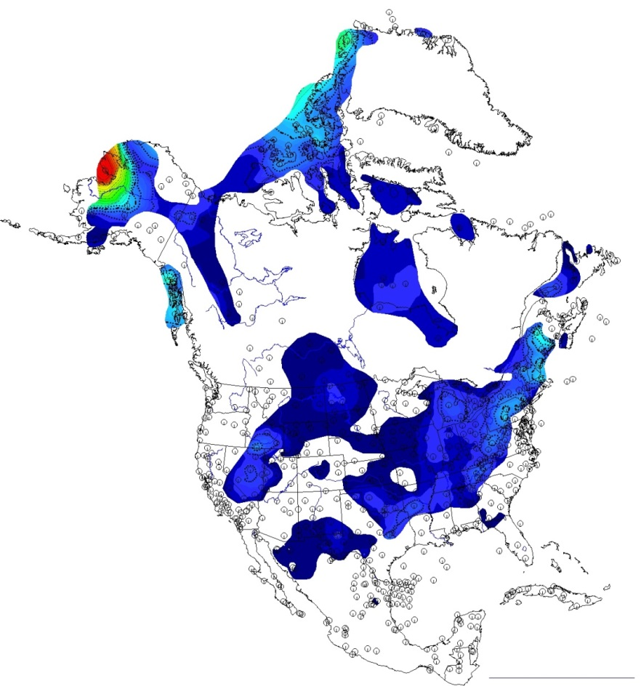
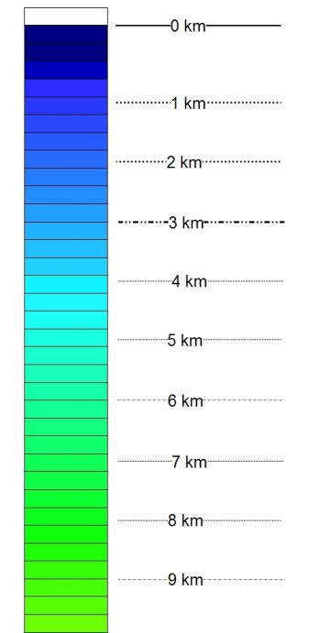
Sauk Tippecanoe

Slide 13
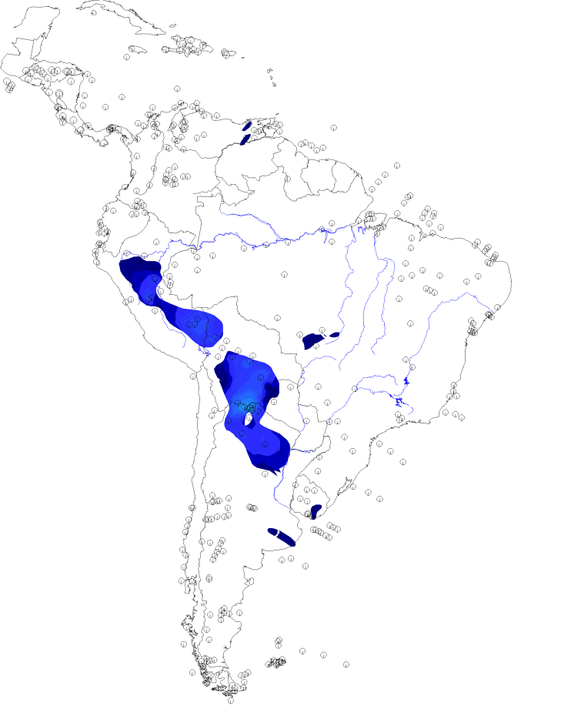
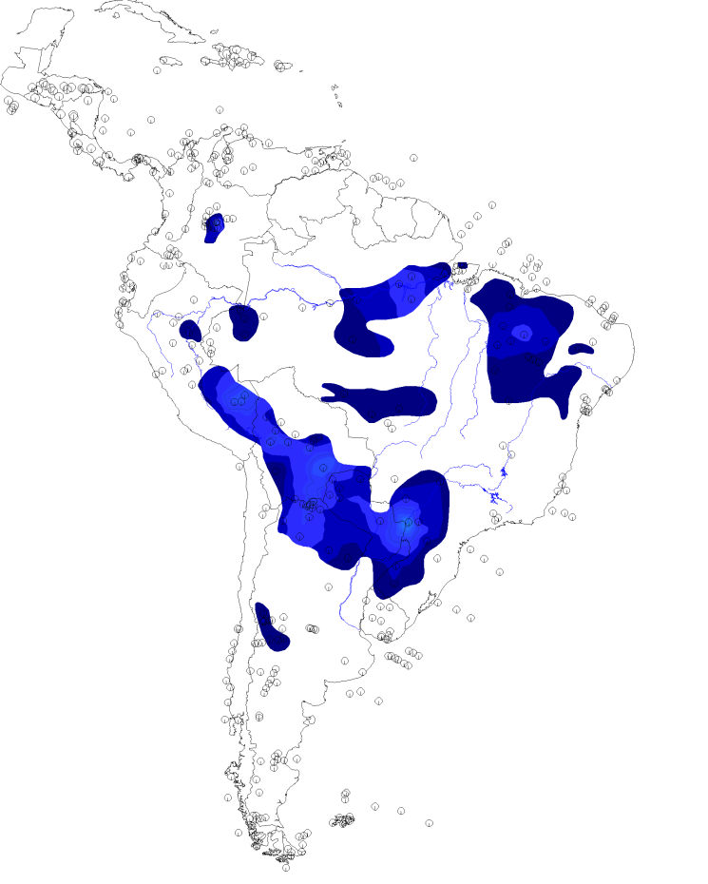
Sauk Tippecanoe

Slide 14
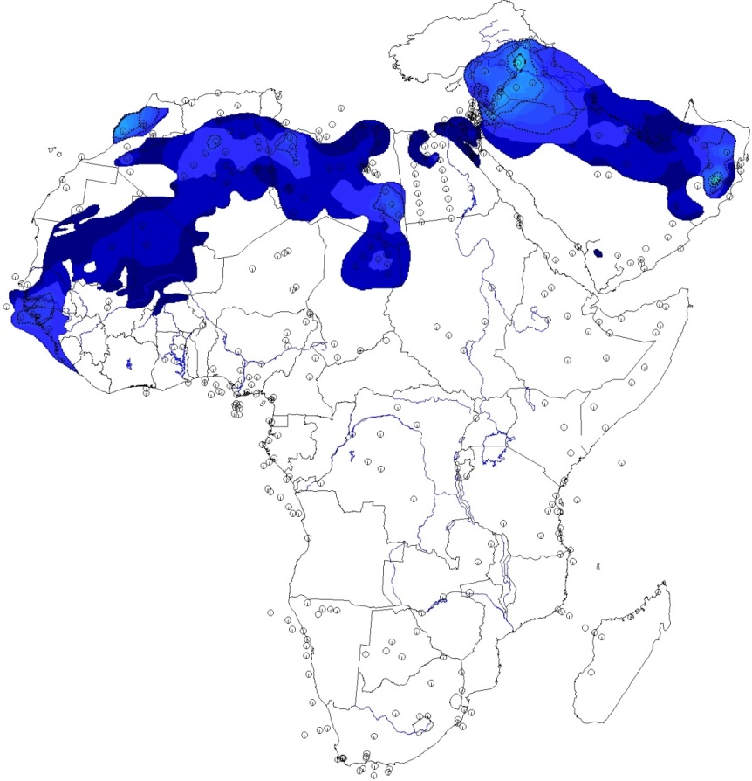
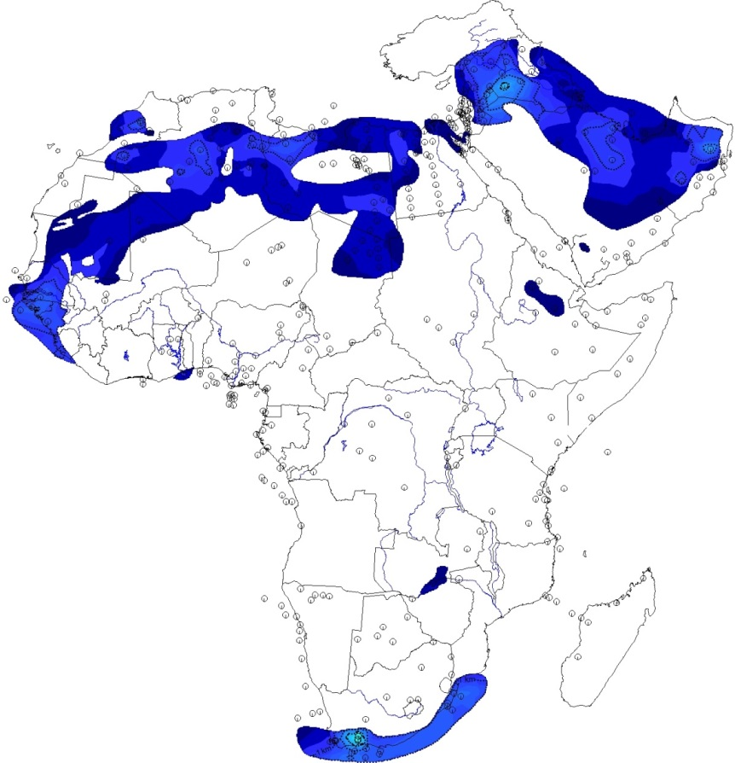
Sauk Tippecanoe

Slide 15
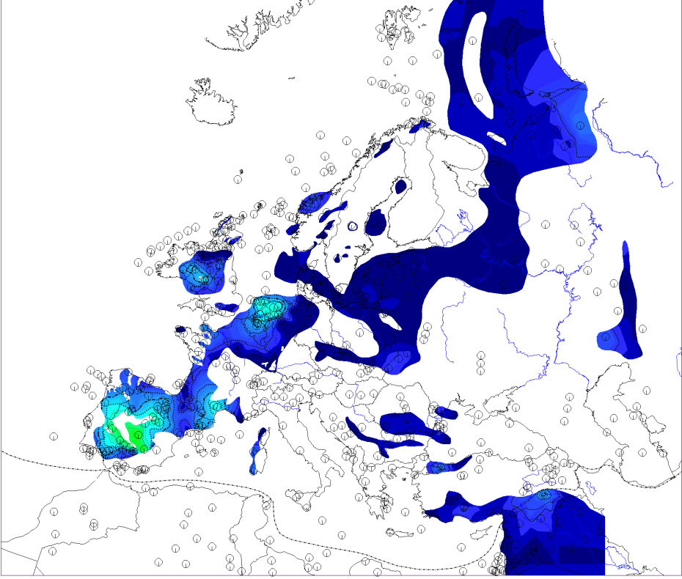
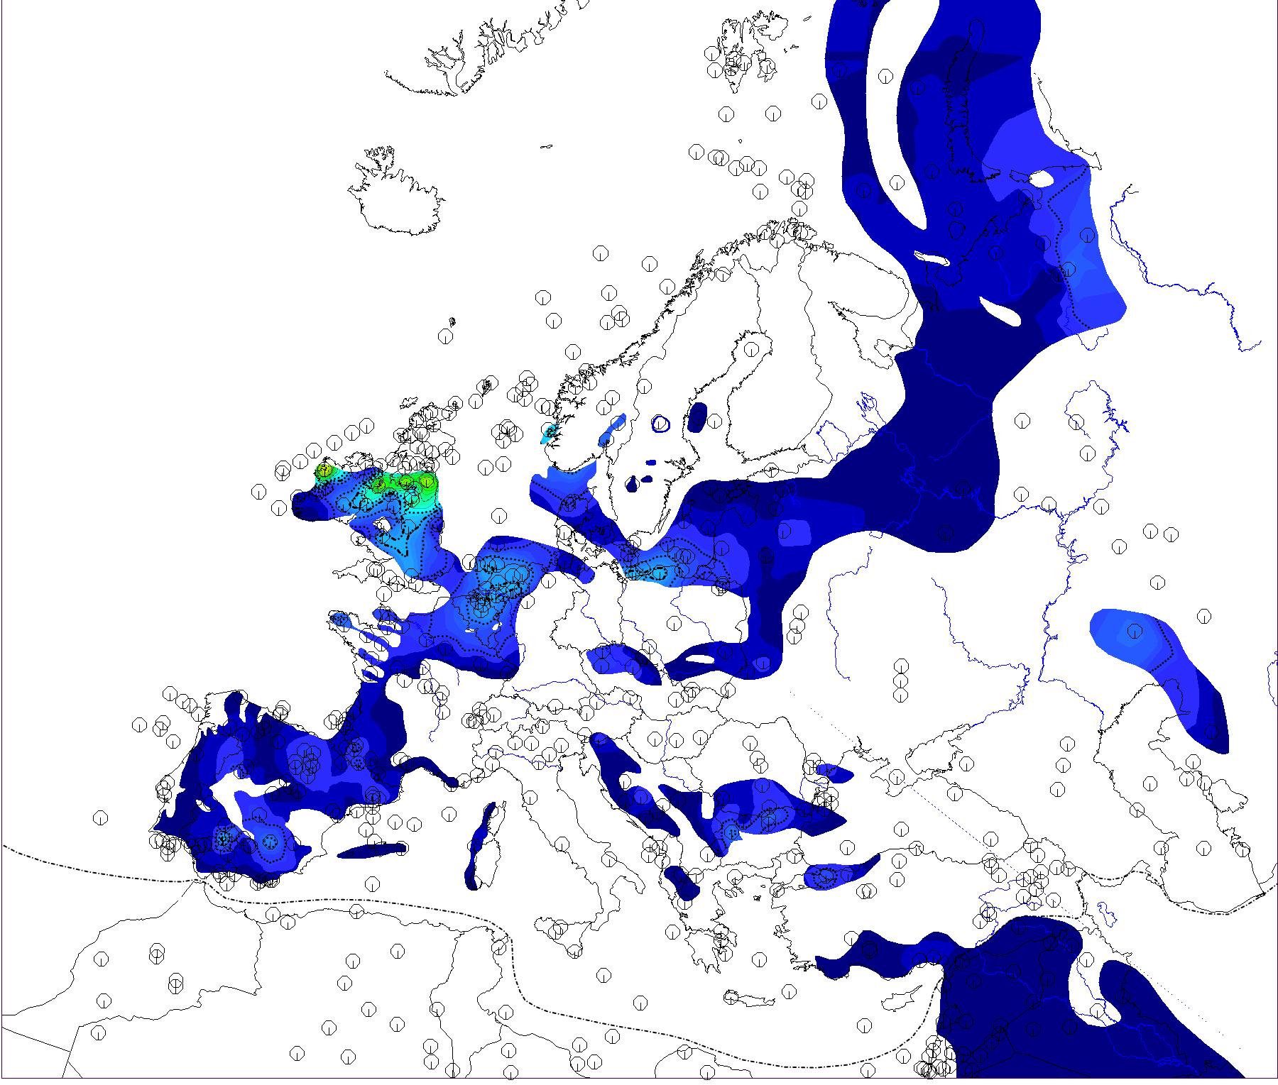
Sauk Tippecanoe

Slide 18
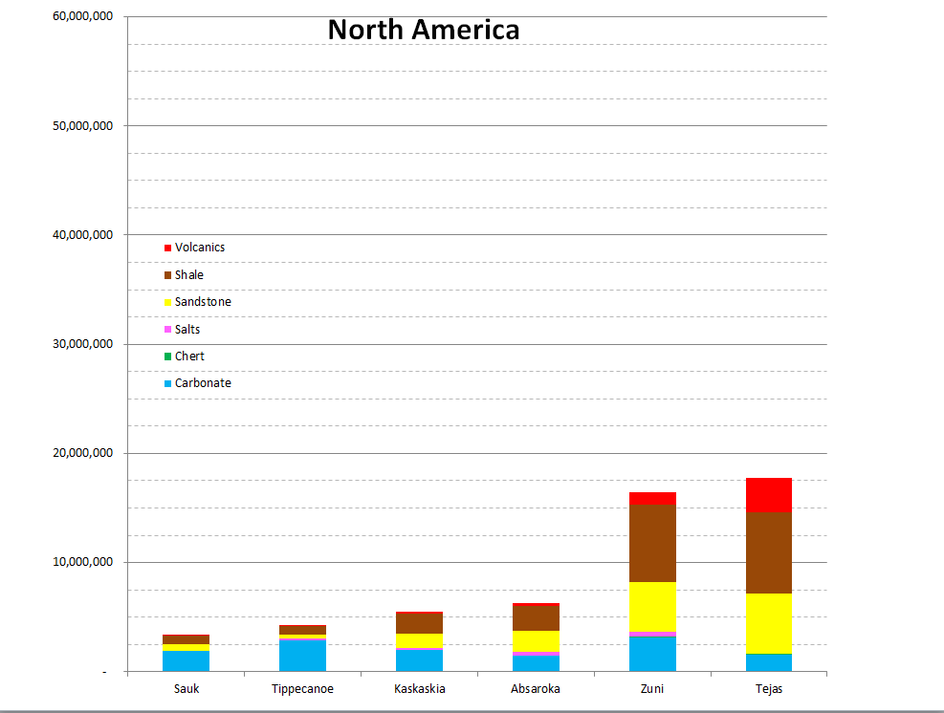

Slide 19
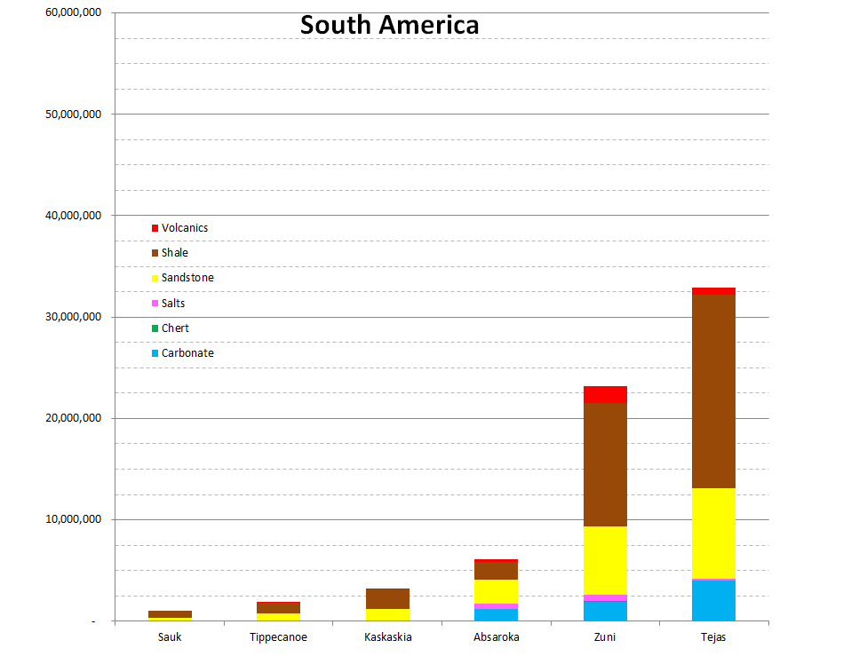

Slide 23
Conclusions
Stratigraphic data indicate that similar areas were flooded in both Sauk and Tippecanoe sequences
Sediment thickness and surface extent increase upward
Reflects minimal/limited sea level rise in early sequences

Slide 24
Not Real?

Slide 25
Original Question: Erosion or Deposition?
“reflecting an increase in the rate of sedimentation toward the present
or
as resulting from better preservation of the younger part of the geologic record.”

Slide 26
Answer Seems Clearer
“increase in the rate of sedimentation toward the present.”

Slide 27
High Cambrian-Lower Ordo. Sea Level?
We suggest global sea level did not rise as high as previously thought
A re-evaluation of the Lower Paleozoic sea level curve seems justified
Have we been teaching myths?

