Slide 1
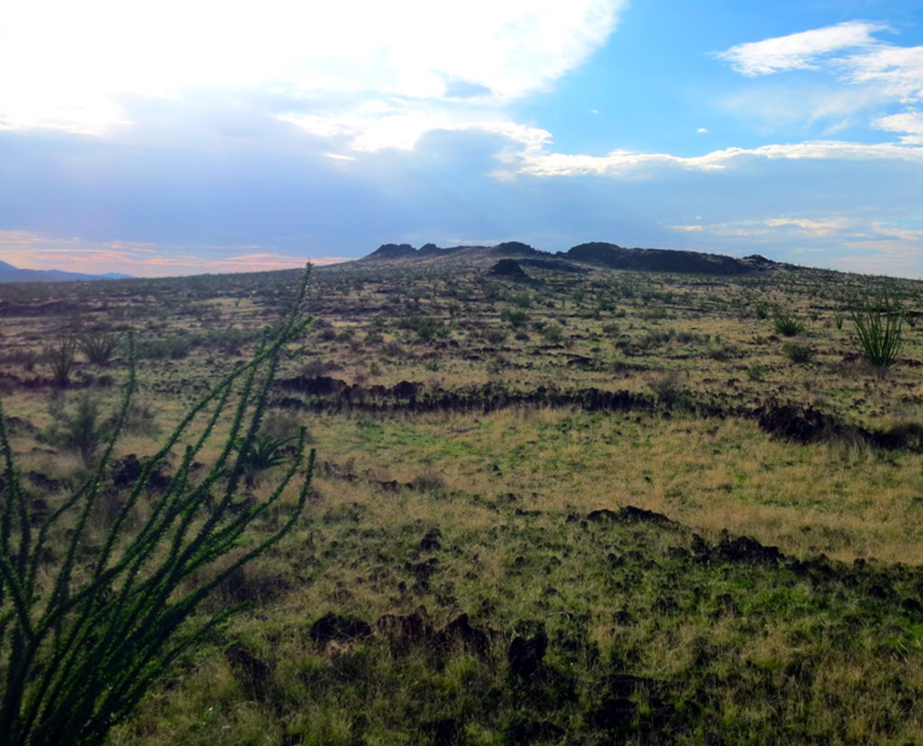


ADEN LAVA FLOWS
R.A. De Hon and R. A. Earl

Slide 2
The Objective
To produce a geologic facies map of the Aden shield and its associated flows.
Flow facies are based characteristics related to the fluid properties of the of the lava.
Mapping units in the flow field are based on the inflation characteristic as described by Walker, 1991.

Slide 3
SELECTED STUDIES
ANTHONY E. Y., POTHS J., 1992, ³He surface exposure dating and its implications for magma evolution in the Potrillo volcanic field, Rio Grande Rift, New Mexico, USA. Geochimica et Cosmochimica Acta, 56, 4105-4108.
DARTON, N. H., 1916, Explosion Craters: Science Monthly 3, 417 - 430 .
DE HON, R. A. and R. A. EARL, 2018a, The Aden lava flows, Doña Ana County, New Mexico; NMGS Fall Field Conference Guidebook 69, 197-202
_______, 2018b, Reassessment of features in the Aden Crater lava flows… Bull. New Mexico Geology, 40, 17-26.
DE HON, R. A., 1965, The Aden Crater lava cone; Compass, 43, 34-40.
_______, 1965, Maare of La Mesa, NMGS Field Conf. Guidebook 16, New Mexico Geol. Soc., 204- 209.
HOFFER, J. M.; KAHN, P. A.; and SUMMEROUR, J. H., 1990, Geology of Aden Crater; Geological Excursions of the El Paso area: Volume 1 – Aden Crater and vicinity, New Mexico; El Paso Geological Society, 25 – 31, Hoffer, Jerry M. (Ed.)
HOFFER, J. M., 1975, The Aden-Afton basalt field, southcentral New Mexico: Texas Jour. Sci.,…
______, 1975, A note of the volcanic features of the Aden Crater area, Field Conf., Guidebook 26, 131-134
KAHN, P. A., 1987, Geology of Aden Crater, Dona Ana Co., NM, MS Thesis, UTEP, 90p.
SEAGER, W. R., 1989, Geology beneath and around the West Potrillo Basalts, Doña Ana and Luna Counties, New Mexico. Bull. New Mexico Geology, 11(3), 53-58.
SUMMEROUR, J. H., 1990, The geology of five unusual craters, Aden basalt, Dona Ana Co. NM, MS Thesis, UTEP, 129 p.

Slide 4
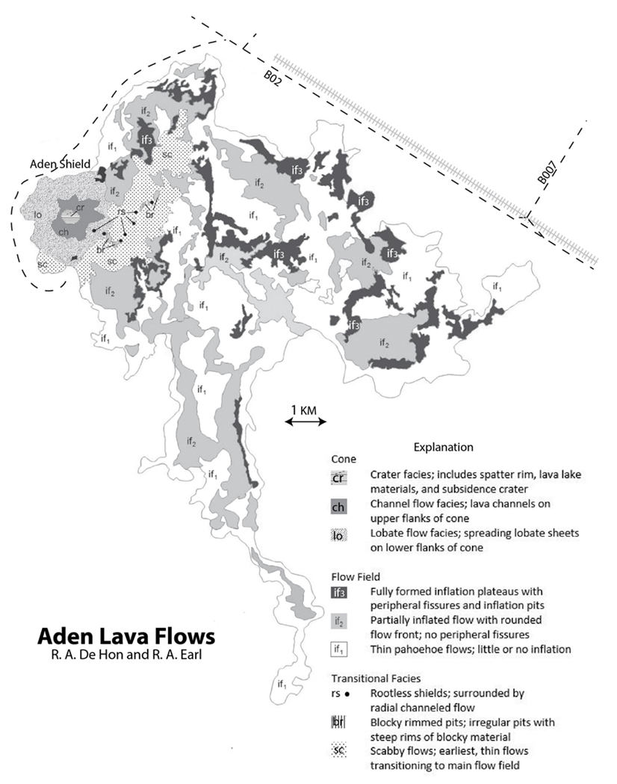
Geologic facies map of the lava field and shield.
Black and white version of the map prepared for N.M. Geol. Soc. 2018 Field Conf.
The Results

Slide 5
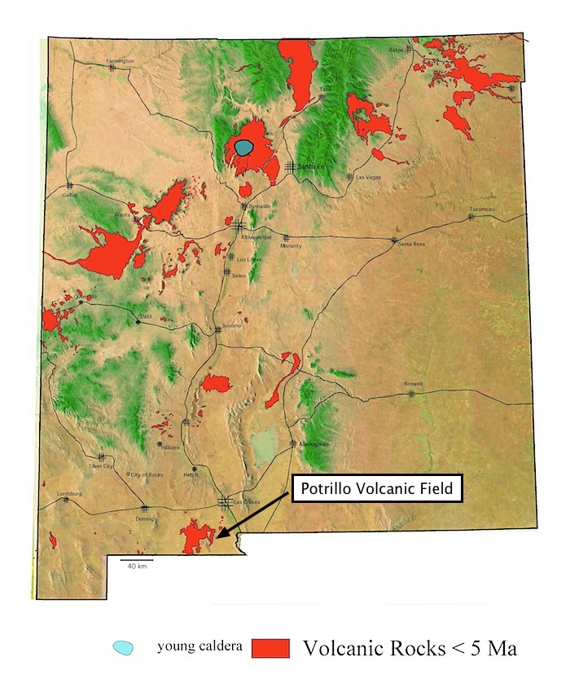

Slide 6
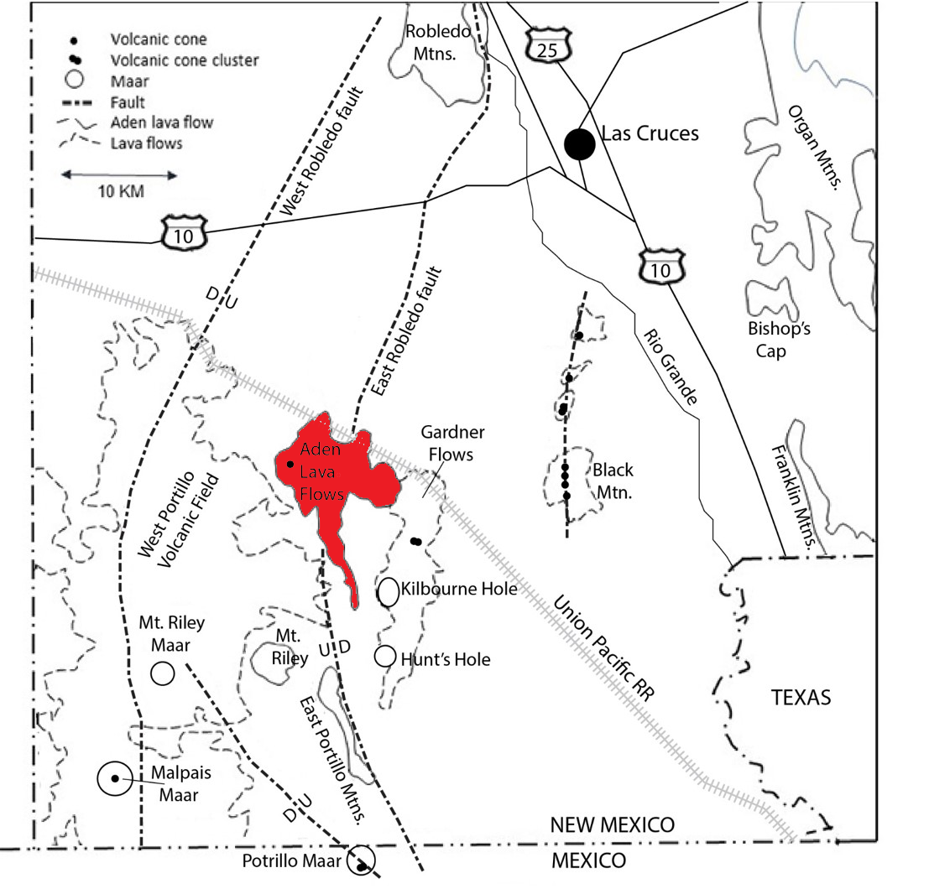

Slide 7
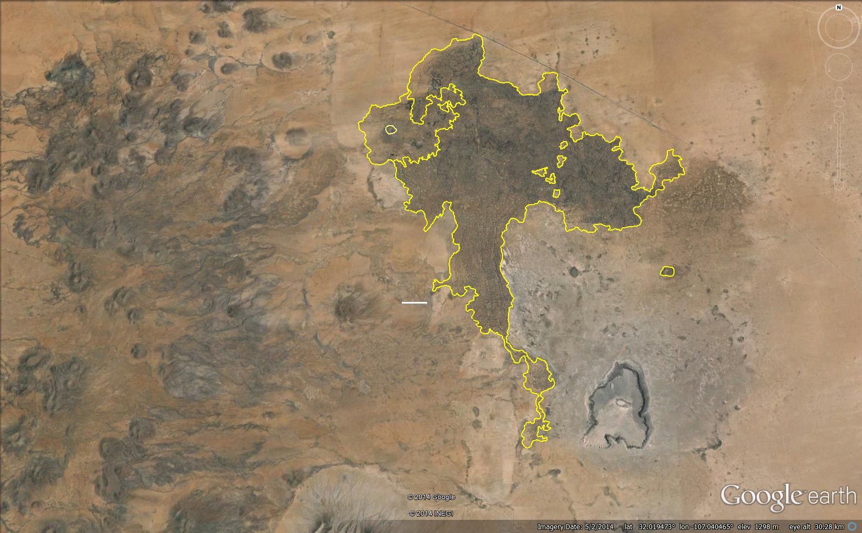
Camp Rice
700 ka
Aden cone
Aden flows
18-16 ka
Gardner
Cone cluster
81-72 ka
West Potrillo Mtns
916-262 ka
1 km
Afton flows
Kilbourne Maar
22 ka
Mt. Riley
≥ 600 ka
The Aden shield is the youngest feature in the diverse Potrillo Volcanic Field.

Slide 8
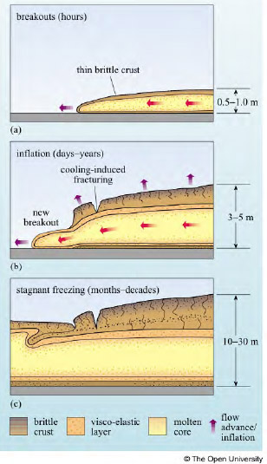
LAVA FLOW INFLATION
Thin mobile flow; thin elastic crust; ropy, upper surface.
Thickened crust retards advance; flow inflates (thickens). Breakout may extend flow.
Final thickness reached by continued inflation. Upper flow surface is level. Flow margins are steep, slabby or blocky.
Walker, G.P.L., 1991, Bull. of Volcanology, 53, 7, 546-558.

Slide 9
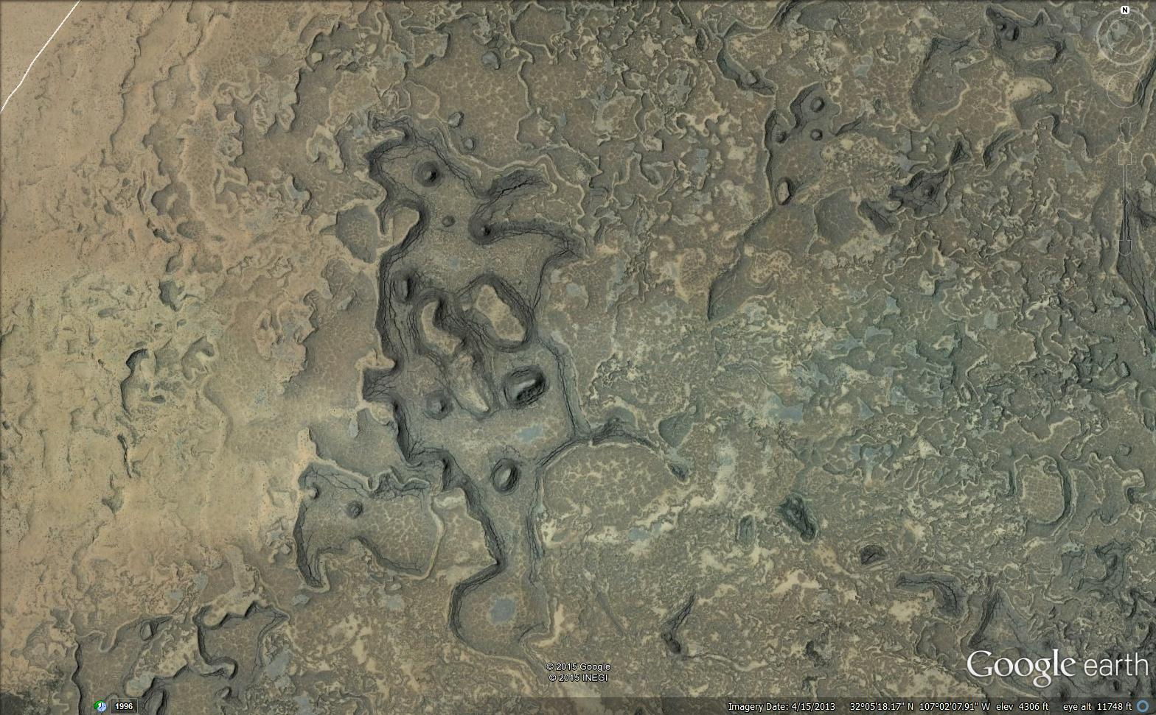
Inflation plateau
(Lava rise plateau)
Steep, blocky margins
Flat upper surface
Upper surface has tension joints
Inflation pits

Slide 10
Initial eruption of fluid basalt: Scabby Facies (sc)
sc
sh = shield facies
if = Inflated flow facies
sc =scabby facies
1 km
Kilbourne Hole (maar)
ADEN: A brief history in cartoons

Slide 11
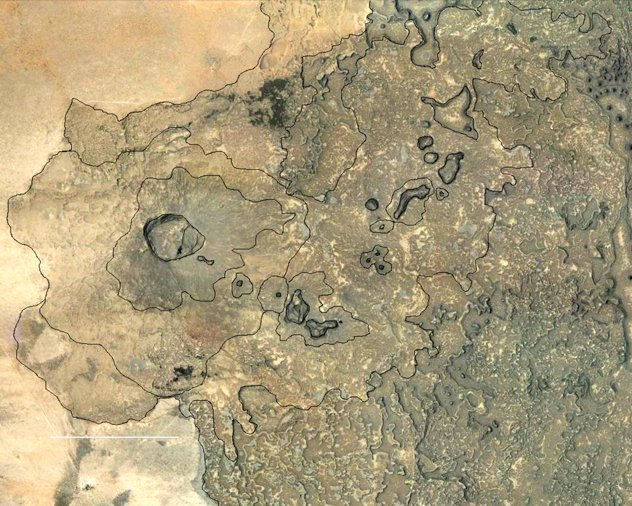
SCABBY FACIES
rs = rootless shields
br = blocky rimmed pits
sc = scabby facies
sc
if
if
sc
sc
if
br
cc
ch
lo
rs
sc
cp
br
rs
if
sc
sc
1 km
if

Slide 12
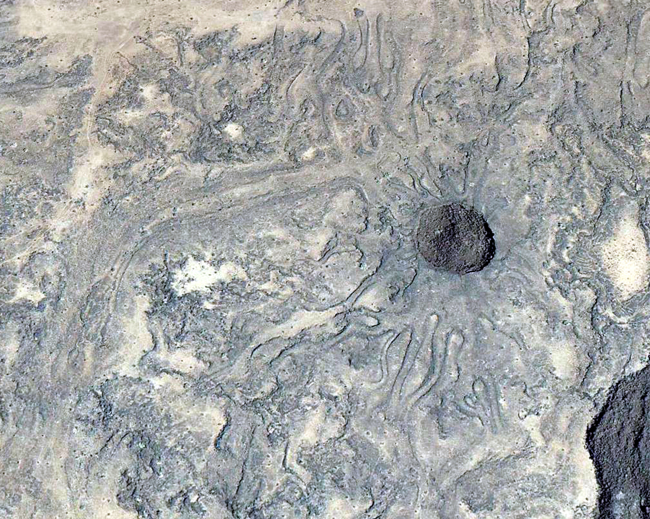
ROOTLESS SHIELD
Rootless shields form on the surface of the scabby flow as blisters that break to allow fluid lava to escape tand flow across the solidified crust.
100 m

Slide 13
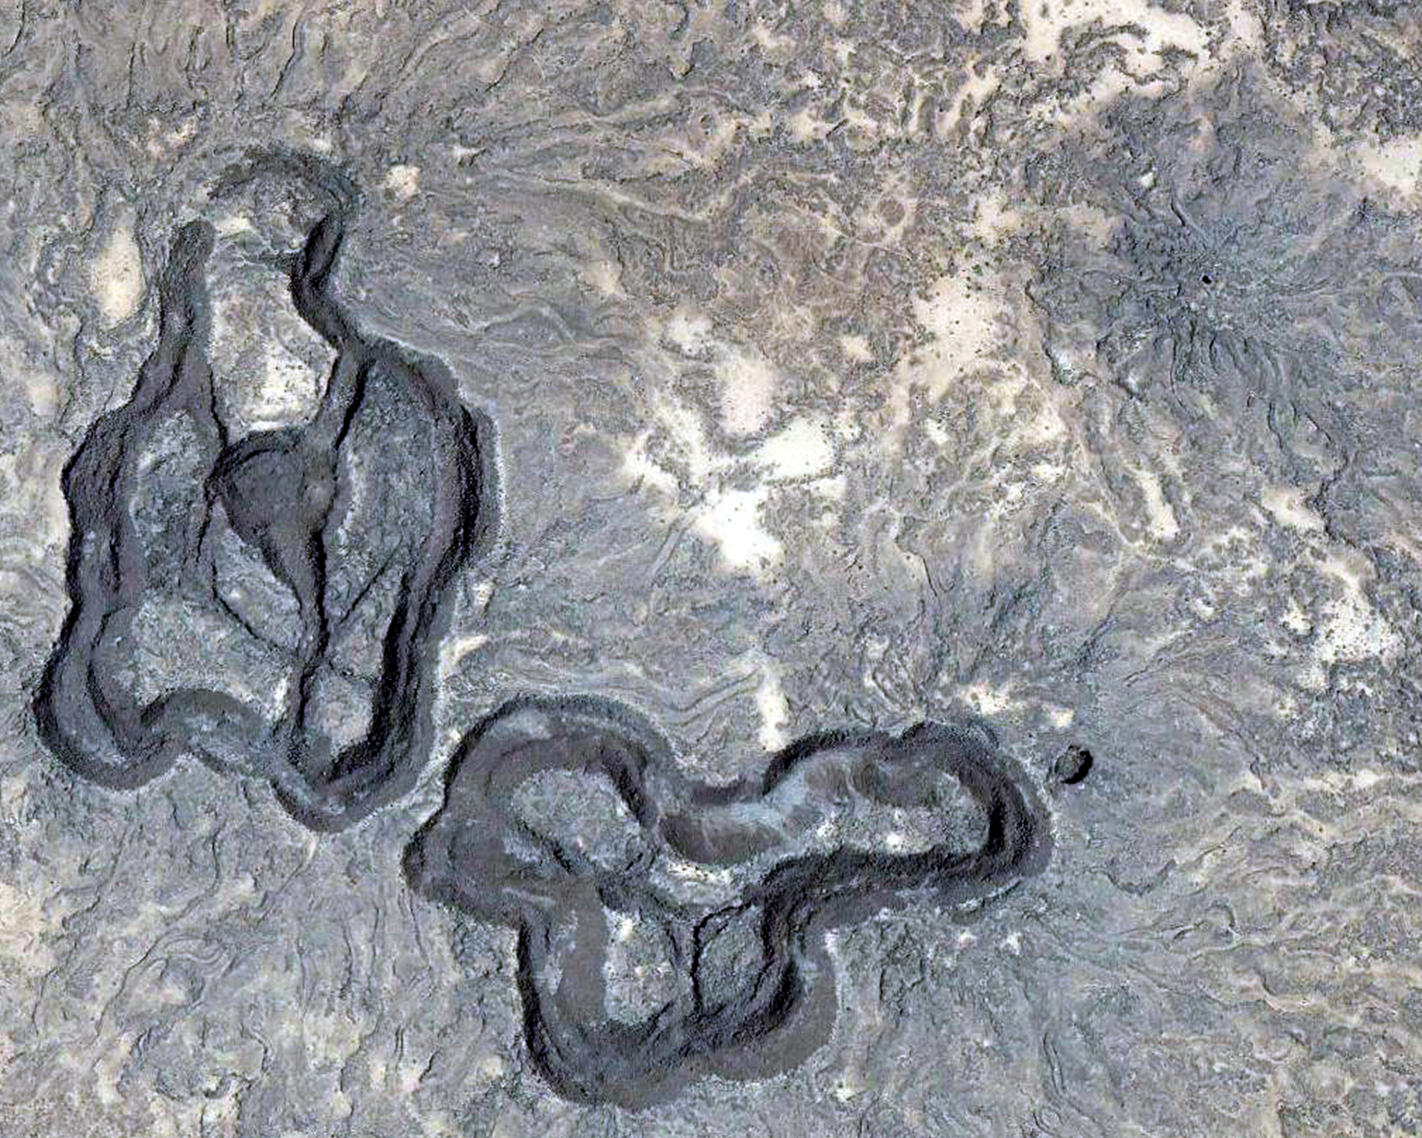
BLOCKY RIMMED PITS
(Failed inflation plateaus)
Smooth floor material (Elev. = exterior)
Blocky rim (double crested)
Floor fractures
Radial channels
Rootless shield
100 m
See De Hon and Earl, 2018, NMBGMR

Slide 14
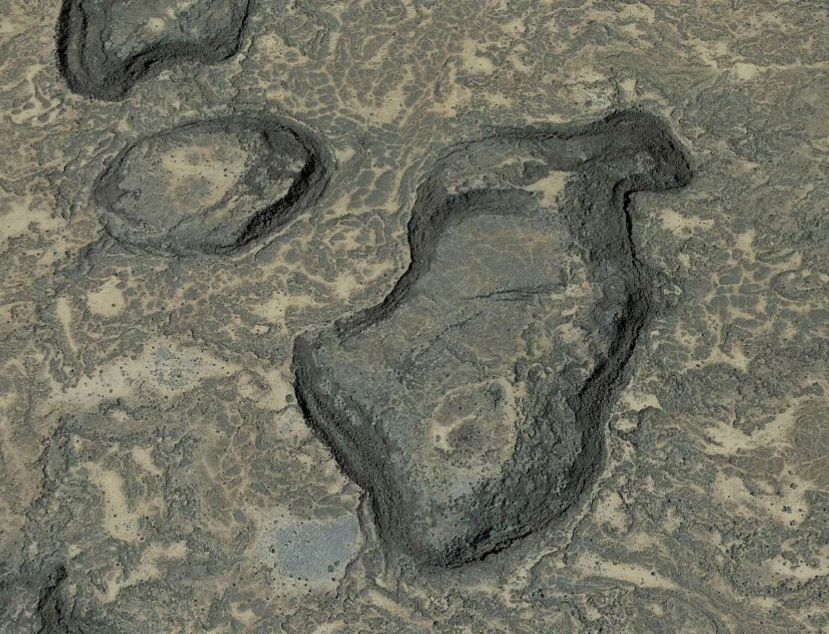
PARTIALLY DEFLATED PLATEAU
Tension joints
Raised edge of plateau
(steep flow margin)
Sloping plateau surface
Loss of internal fluids resulted in collapse of plateau. Blocky rim is formed where deflation occurred.
Blocky raised rim
(Double crested)
100 m

Slide 15
sc—Earliest flows of very fluid lavas, unable to form inflation plateaus because of weak, thin crust.
1 km

Slide 16
Flow spreads northward….Inflated Flow Facies
if
sc
sh = shield facies
if = Inflated flow facies
sc = scabby facies
1 km
Kilbourne Hole
ADEN: A brief history in cartoons

Slide 17

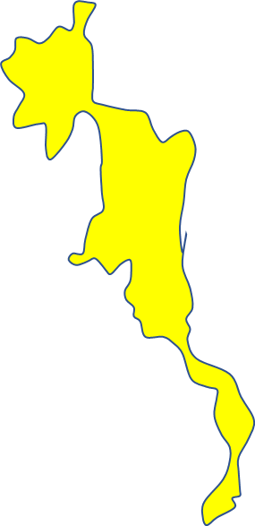
…southward….
if
sc
if
sh = shield facies
if = Inflated flow facies
sc = scabby facies
1 km
Kilbourne Hole
ADEN: A brief history in cartoons

Slide 18
…and westward.
sc
if
sh = shield facies
if = Inflated flow facies
sc = scabby facies
1 km
Kilbourne Hole
ADEN: A brief history in cartoons

Slide 19
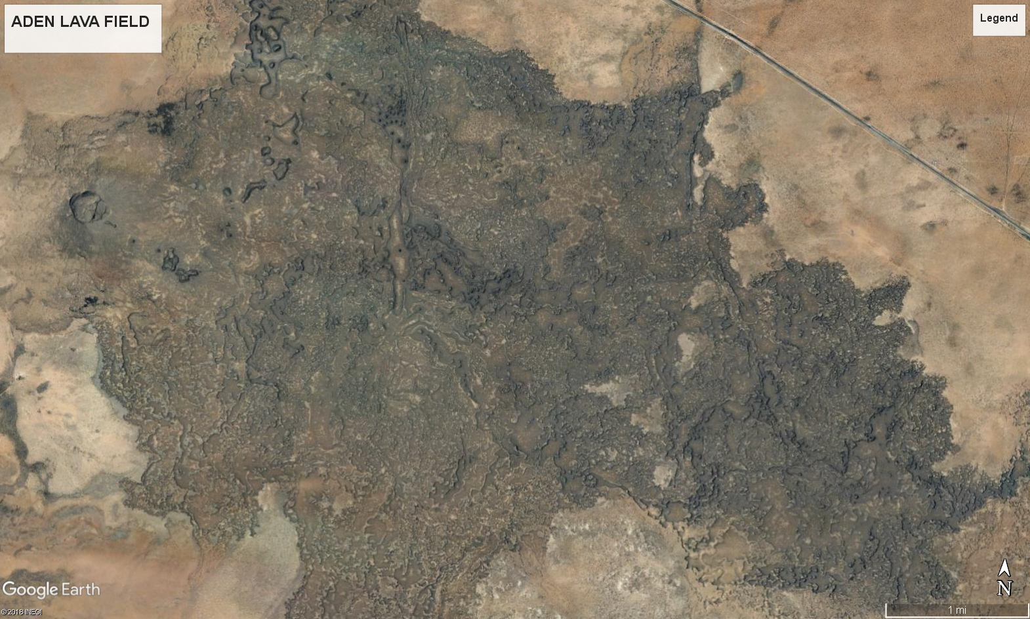
Image 20
The bulk of the lavas that spread from the Aden vent constitute a rugged surface of mixed, thin, ropy flows and inflation, thickened flows.

Slide 20
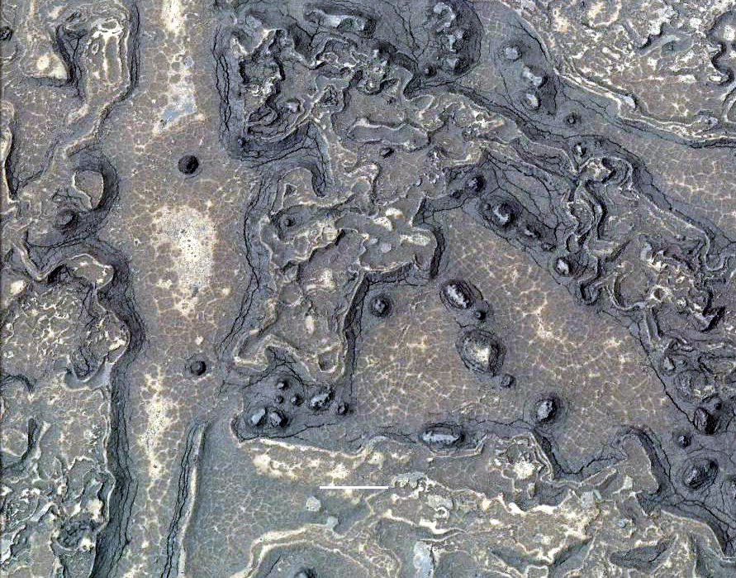
Tension joints
Inflation Plateau
Inflation pits
if₃
Peripheral fractures
100 m

Slide 21
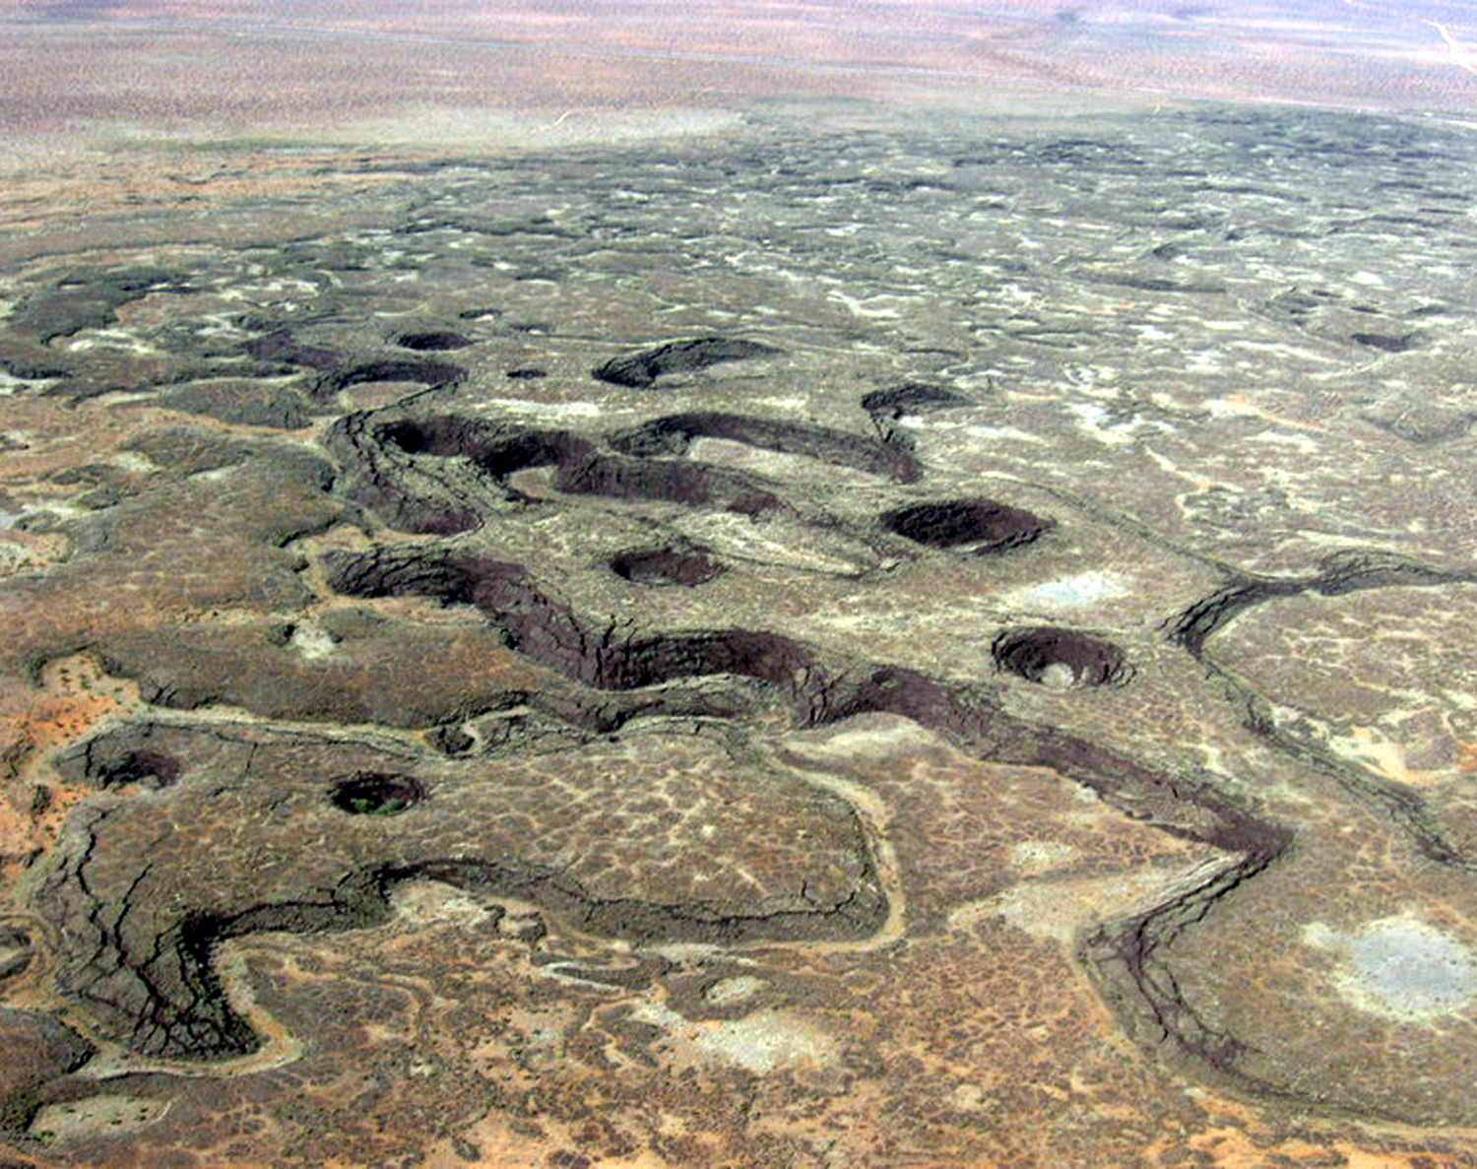

ADEN FLOWS (Mapping Subfacies)
Inflation pits
if₂
if₃
Inflation plateau
if₁

Slide 22
Inflated flow facies
if₃: Maximum inflation. Flow is ca. 5 m thick; steep, blocky margins; and prominent inflation pits.
if₂: Partial inflation. Flow is ca. 2-3 m thick with rounded flow margins.
if₁: Thin, ropy flows less than one m thick. Most are partially covered by blow sand.
Steep-sided ravines are formed where adjacent flow margins face each other.

Slide 23
if—Inflated flows form the bulk of the lava which developed a stronger, thicker crust that allowed inflation.

Slide 24
Finally: The shield (sh) is built of less fluid lava.
sh
sc
if
sh = shield facies
if = Inflated flow facies
sc = scabby facies
1 km
Kilbourne Hole
ADEN: A brief history in cartoons

Slide 25
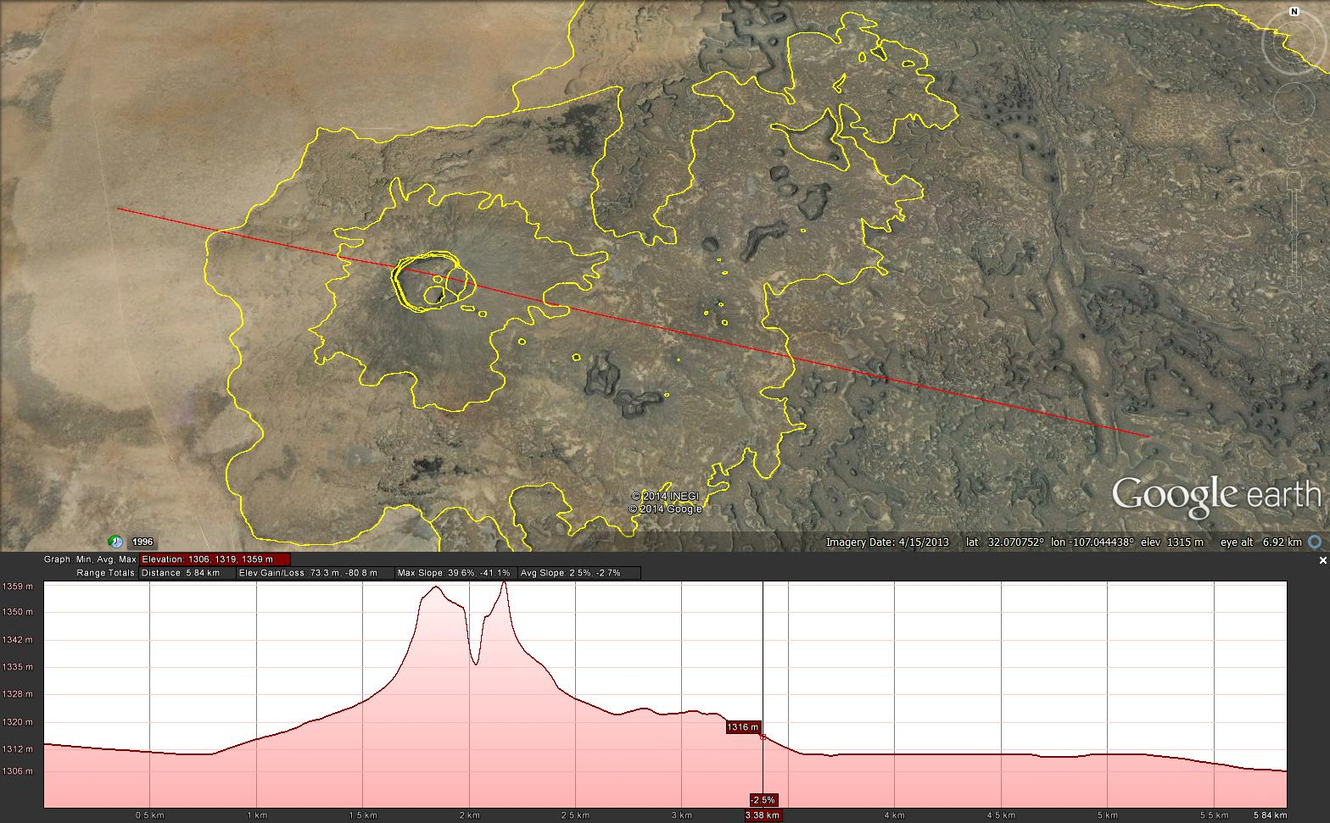
10-20%
Blocky rimmed pits
2-6%
`Limited elevation data

Slide 26
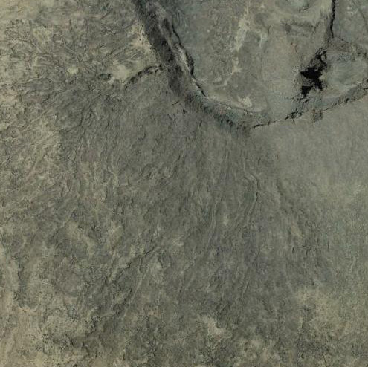
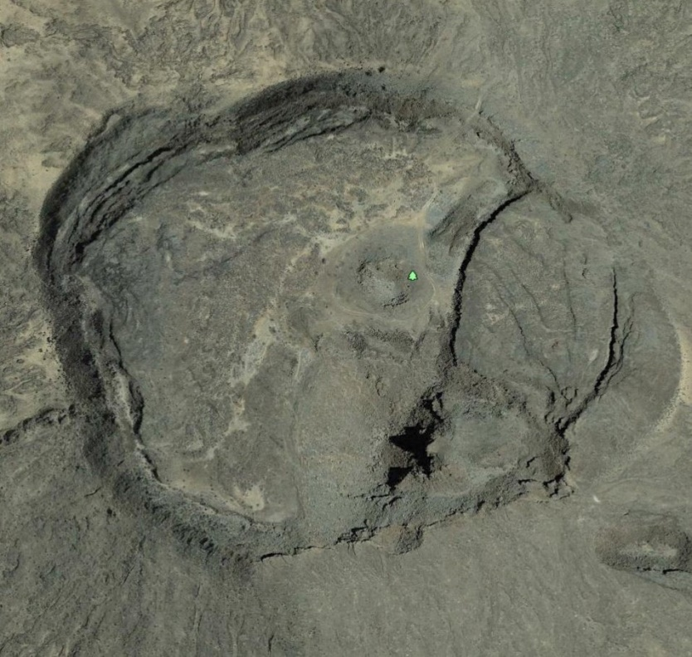
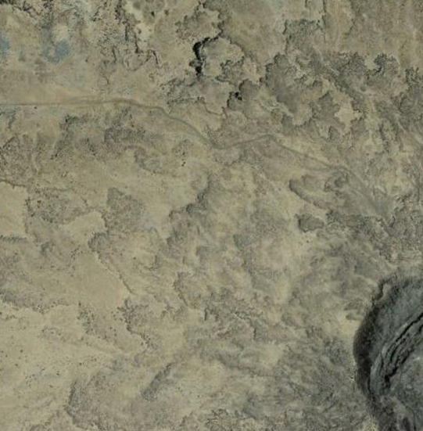
Upper slopes
Channeled flow (ch)
Scabby flow (sc)
Outer slopes
Crater (cr)
Lobate flow (lo)
SHIELD FACIES
The flanks of the cone are mapped as three facies that are largely controlled by lava temperature and surface slope.

Slide 27
SHIELD FACIES MAP
cr – crater
ch – channel flow
lo – lobate flows
sc
if
if
sc
sc
if
br
cr
ch
rs
sc
lo
cp
br
rs
if
sc
sc
1 km
if

Slide 28
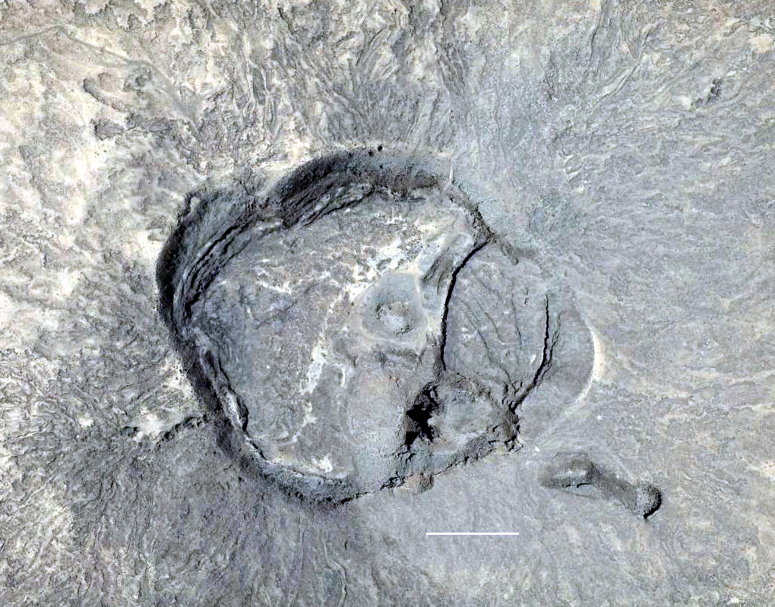
ADEN CRATER
Circumferential fractures
Spatter cone
Spatter rim
Crater lava lake
Inner crater
Fumarole
Hornitoes
Collapse pits
Lava channels
Back to cars
100 m
To br pits

Slide 29
Mapping Units
Shield Facies
  cr Crater
  ch Channel flows
  lo Lobate flows
Flow Facies
  if _{(1,2,3)} Inflated flows
  sc Scabby flows
  Pits
    cp Collapse pits
    ip Inflation pits
    rs Rootless shields
    br Blocky rimmed pits
A continuum of the same process on scabby flows

Slide 30
1 km

Slide 31
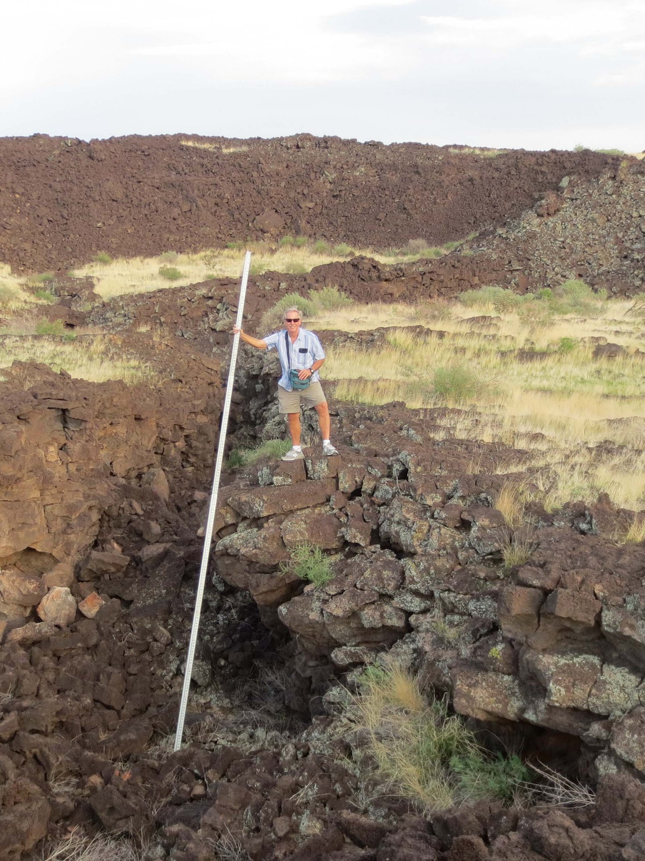
This picture is of the interior of one of the blocky rimmed pits. The flow of the crater-form feature is smooth basalt broken by fissures. The blocky rim material over-lies floor material. See De Hon, R. A. and R. A. Earl, 2018b.
Coauthor: Richard Earl

Slide 32

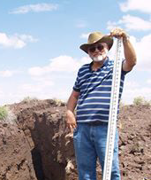
THANK YOU
Then (1964)
Now (2014)

