Slide 1
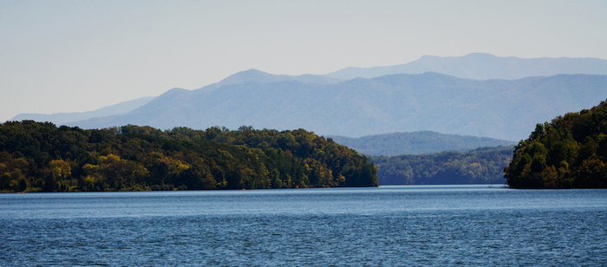




Possible contribution to southern Blue Ridge relief from Quaternary faulting in the eastern Tennessee seismic zone
Randel Tom Cox, Robert D. Hatcher, Jr., Steven L. Forman, and Ronald Counts
Smoky Mountains from Lake Tellico near Vonore Tennessee

Slide 2


Possible contribution to southern Blue Ridge relief from Quaternary faulting in the eastern Tennessee seismic zone
Randel Tom Cox, Robert D. Hatcher, Jr., Steven L. Forman, and Ronald Counts
Funding provided by
Smoky Mountains from Lake Tellico near Vonore Tennessee

Slide 3
Additional Contributors:
Taylor Armstrong
Lian Feng
Eric Gamble
Jake Glasbrenner
Steve Obermeier
Jim Vaughn
Kathleen Warrell

Slide 4
OUTLINE:

Slide 5
OUTLINE:
Regional seismicity

Slide 6
OUTLINE:
Regional seismicity
Tectonic setting

Slide 7
OUTLINE:
Regional seismicity
Tectonic setting
Seismicity alignments

Slide 8
OUTLINE:
Regional seismicity
Tectonic setting
Seismicity alignments
Quaternary faulting

Slide 9
OUTLINE:
Regional seismicity
Tectonic setting
Seismicity alignments
Quaternary faulting
Dynamic topography?

Slide 10
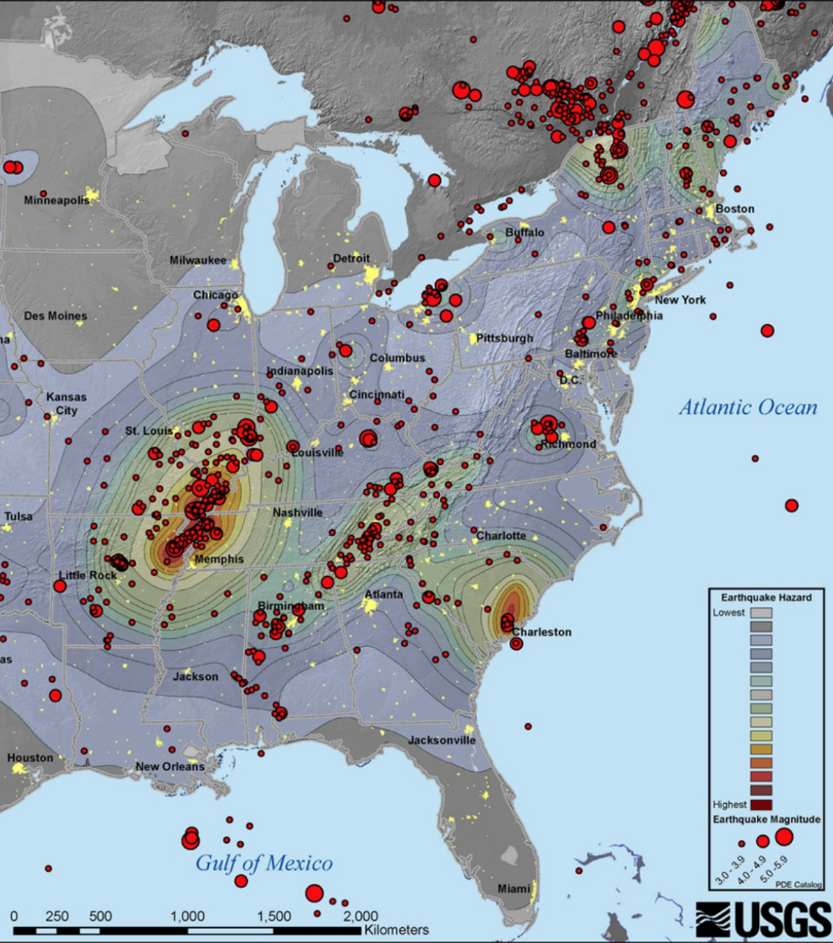
EASTERN NORTH AMERICA INTRAPLATE SEISMICITY
EASTERN
TENNESSEE
SEISMIC
ZONE

Slide 11
TECTONIC SETTING
Eastern Tennessee
Seismic zone
epicenters

Slide 12
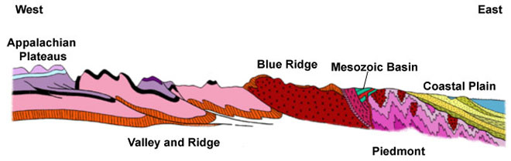
Eastern TN Seismic Zone

Slide 13
Eastern TN Seismic Zone
Hypocenters

Slide 14
So, is there surface faulting?
Eastern TN Seismic Zone
Hypocenters

Slide 15
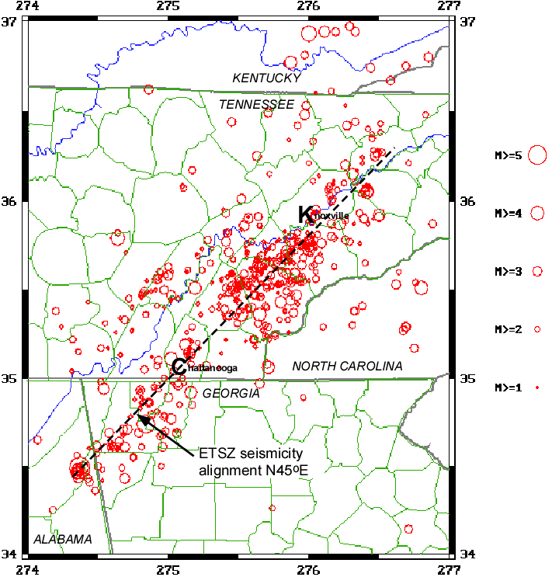
SEISMICITY
ALIGNMENTS

Slide 16
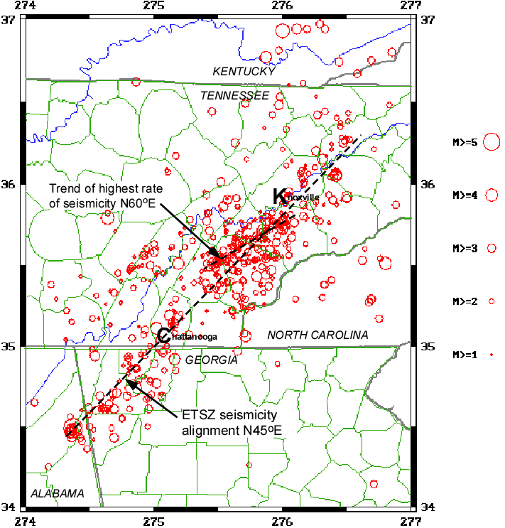
SEISMICITY
ALIGNMENTS

Slide 17
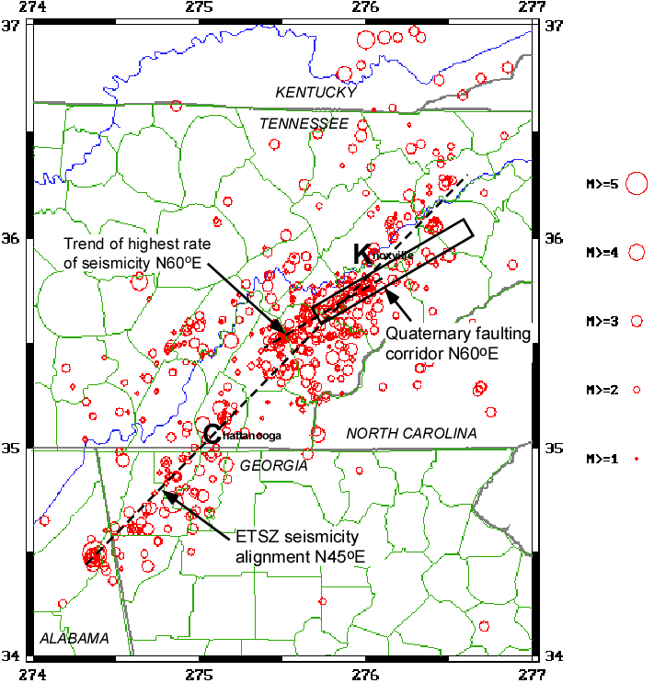
SEISMICITY
ALIGNMENTS
Area reconnoitered for
Quaternary faulting
Quaternary faulting
Corridor N60ºE

Slide 18
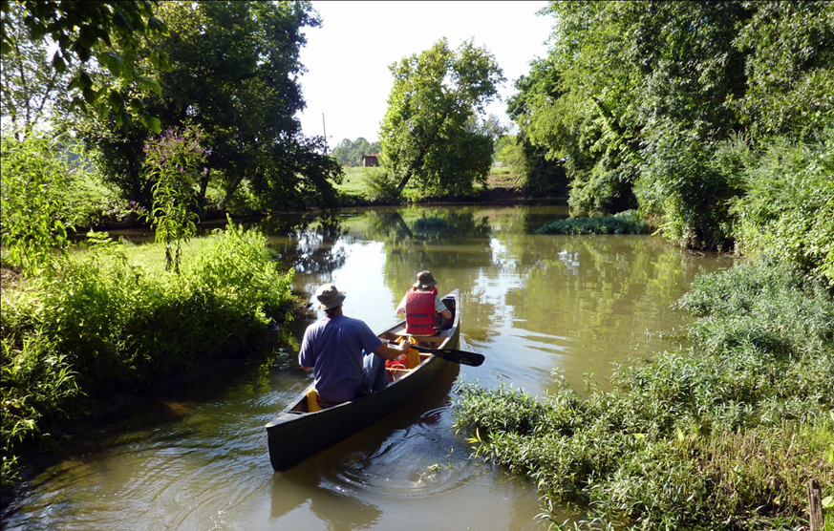
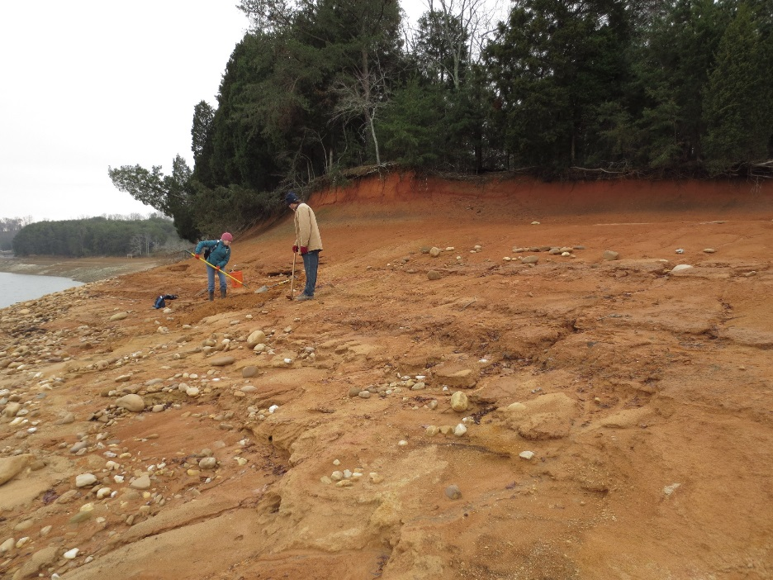
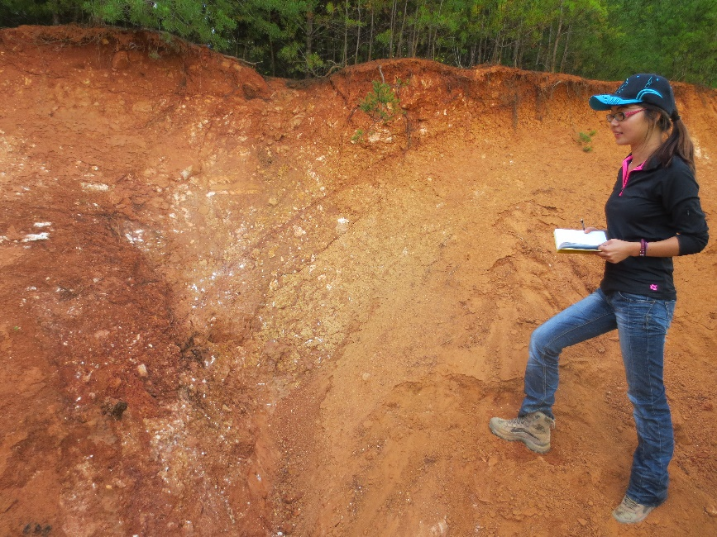
PALEOSEISMOLOGY
River bank surveys
Lake shore surveys
Quarry/excavation site surveys

Slide 19
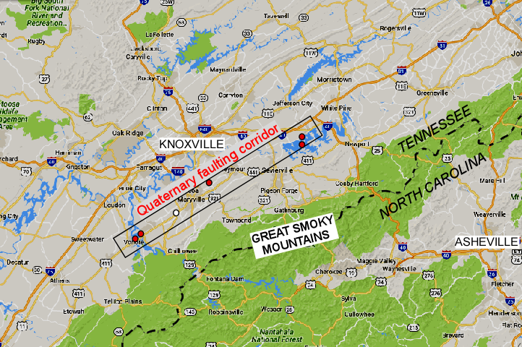
Sites of Quaternary faulting
Map of corridor showing field sites labeled
0 100 km

Slide 20
Sites of Quaternary faulting
Dandridge
North & South
Map of corridor showing field sites labeled
0 100 km

Slide 21
Sites of Quaternary faulting
Map of corridor showing field sites labeled
Brakebill Island
0 100 km

Slide 22
Sites of Quaternary faulting
Map of corridor showing field sites labeled
Vonore
0 100 km

Slide 23
Sites of Quaternary faulting
Dandridge
North & South
Map of corridor showing field sites labeled
0 100 km

Slide 24
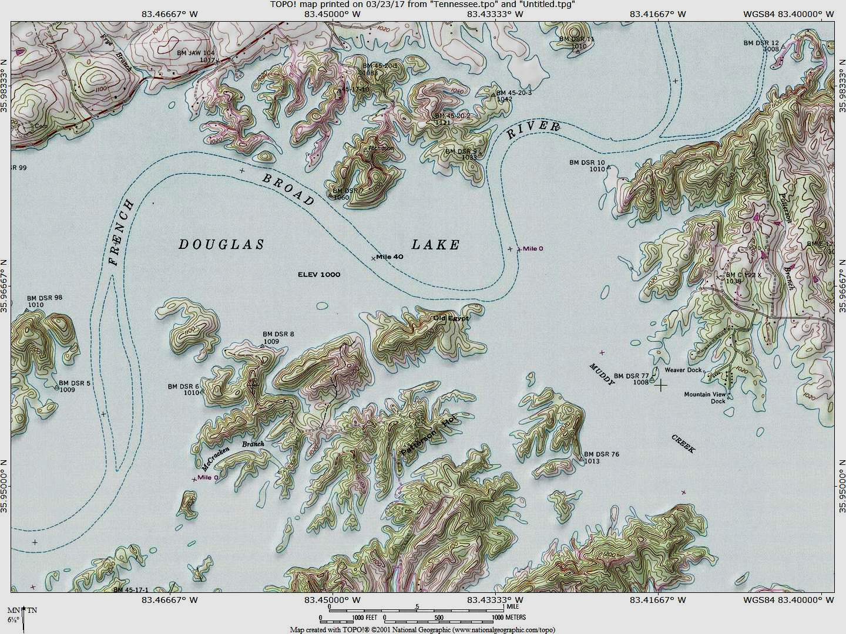
Pleistocene terrace
deformation
Dandridge
North & South

Slide 25
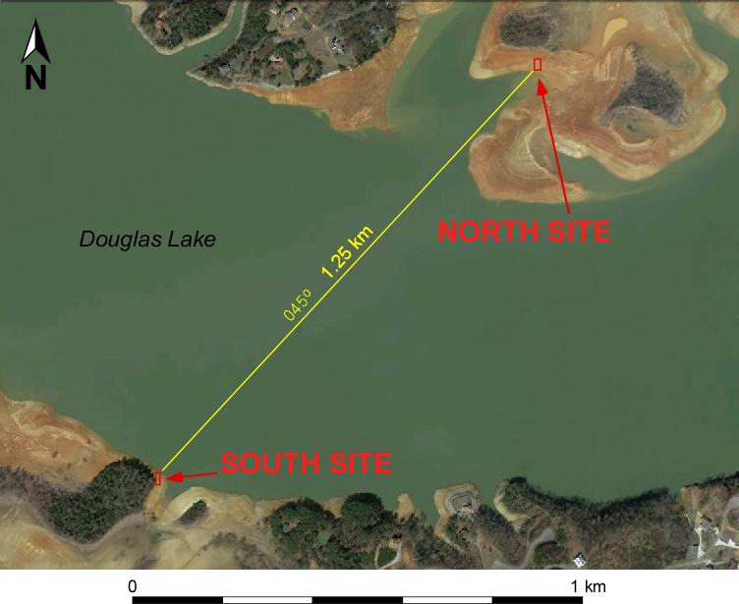
DOWN
UP

Slide 26
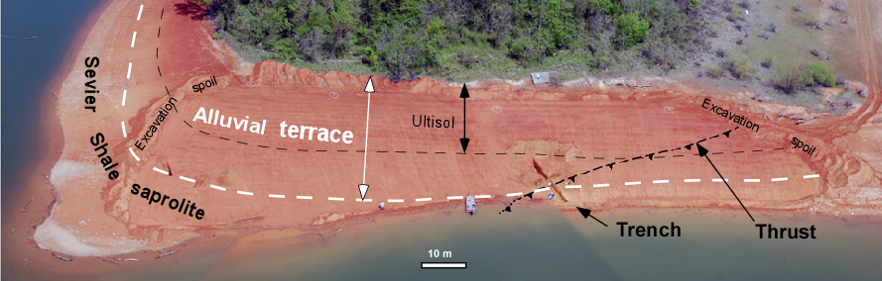
Dandridge North
Area Cleared and Trenched on Douglas Lake shore
(Warrell et al, 2017)

Slide 27
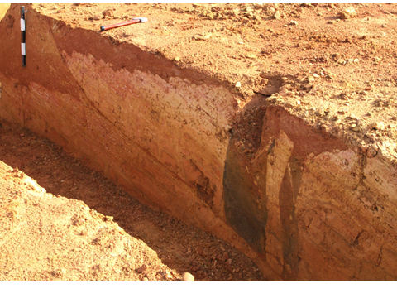
WEST
NE Wall of Trench
EAST
ALLUVIUM
ALLUVIUM-FILLED FISSURES
PLEISTOCENE
ORDOVICIAN SHALE
SAPROLITE

Slide 28
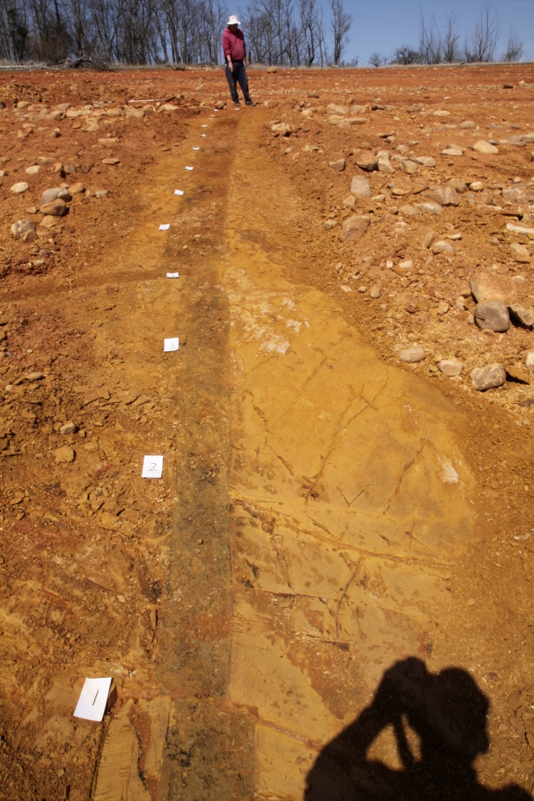
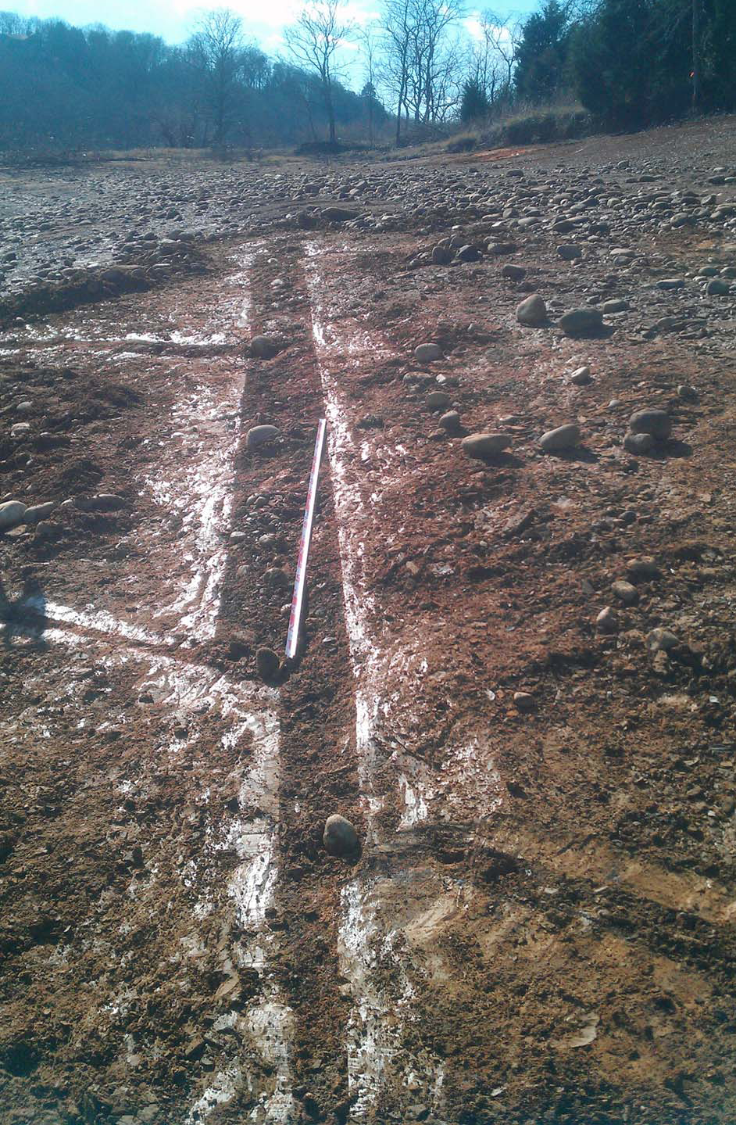
DOUGLAS LAKE,
NORTH SHORE
ALLUVIUM-FILLED
FISSURE
DOUGLAS LAKE,
SOUTH SHORE
ALLUVIUM-FILLED
FISSURE

Slide 29
Map of corridor showing field sites labeled
Brakebill Island

Slide 30
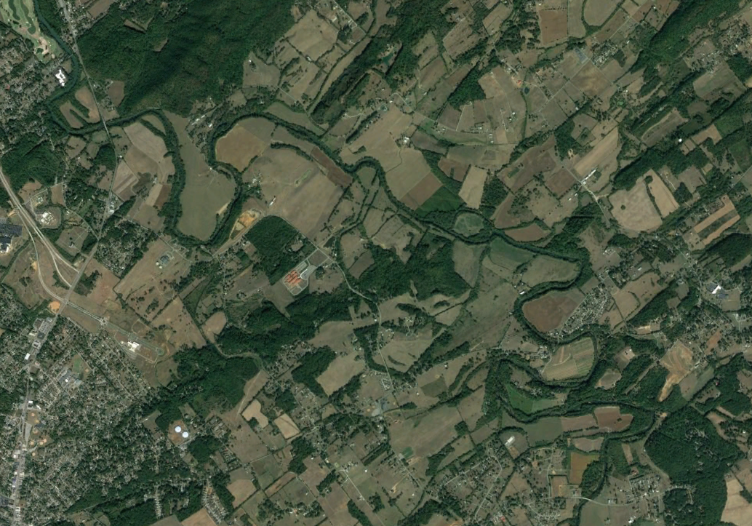
Little River
Brakebill Is.

Slide 31
Little River
Brakebill Is.
D
U

Slide 32
Little River
Brakebill Is.
D
U

Slide 33
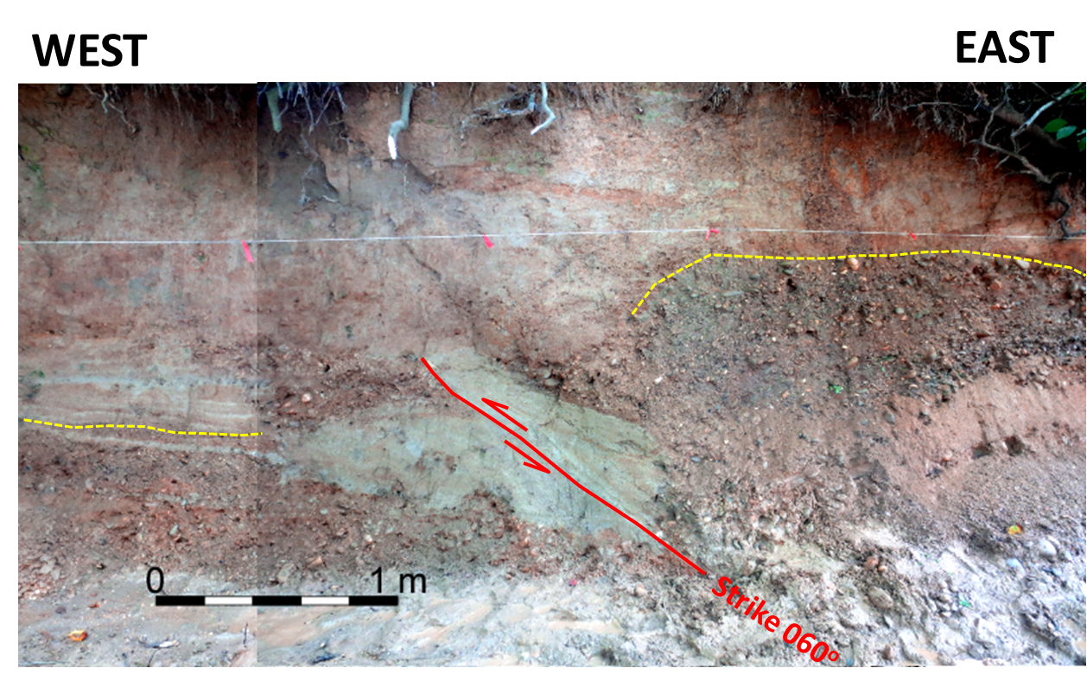

Slide 34
Deformation steps

Slide 37
Event 1 colluvial wedge
gravel sand

Slide 38
Event 2 scarp

Slide 40
~11 ka
Today

Slide 41
Map of corridor showing field sites labeled
Vonore

Slide 42
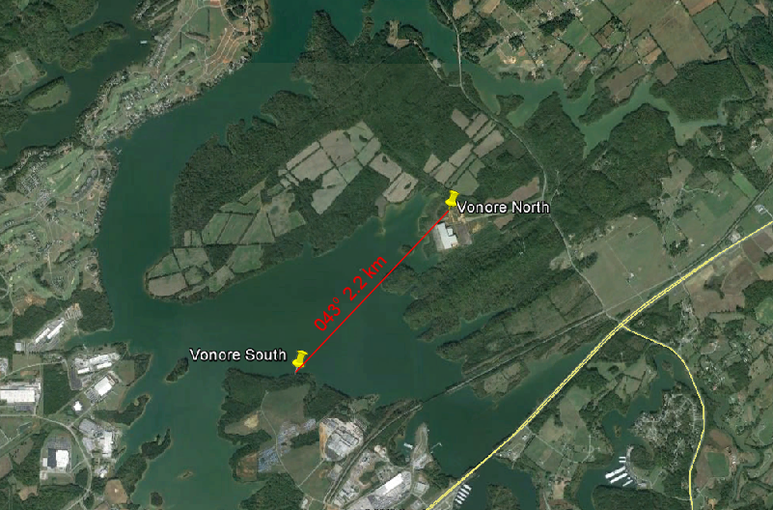
Tranpressional? fault
Normal fault

Slide 43
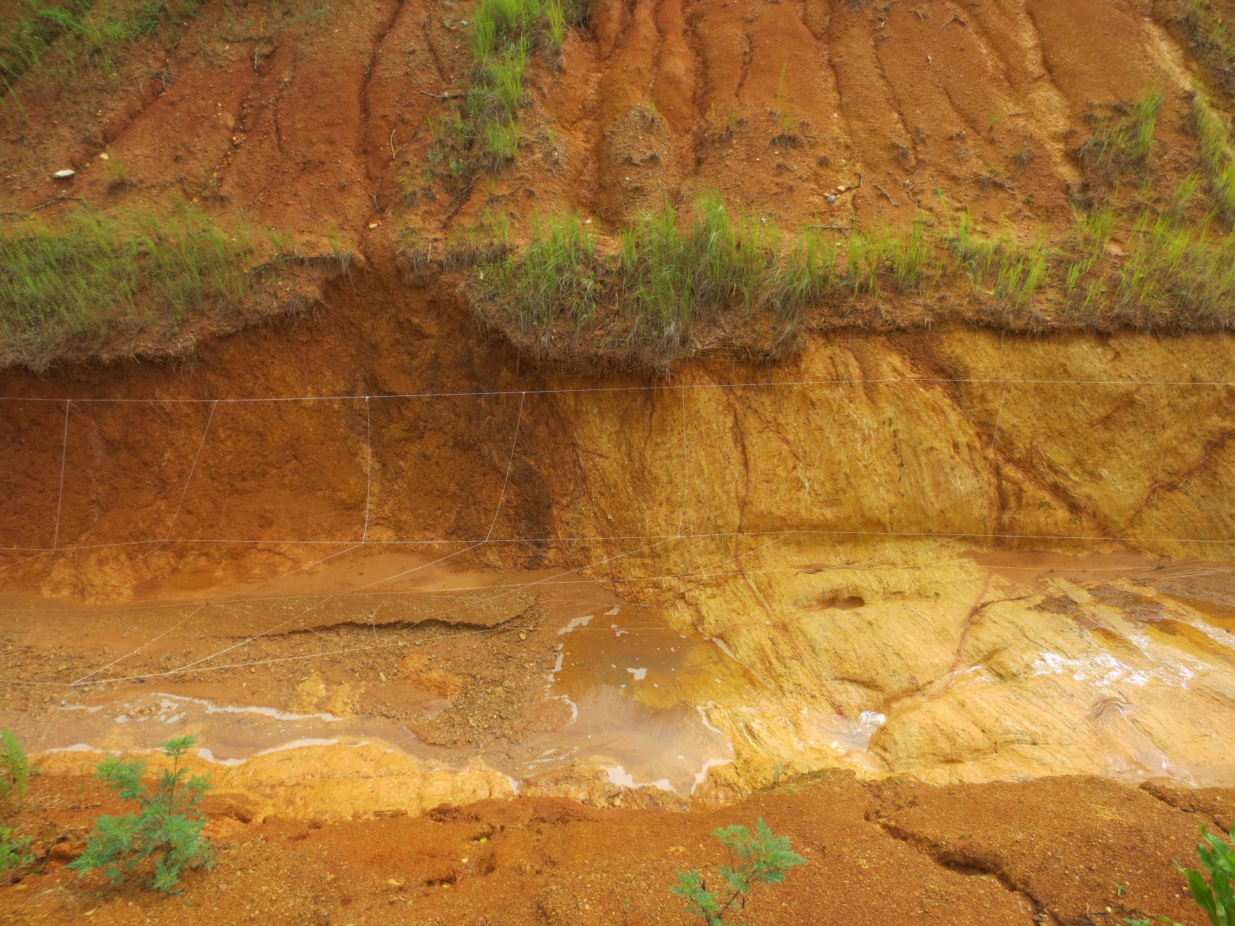
WEST
EAST
TRANSPRESSIONAL? FAULT AT VONORE NORTH
PLEISTOCENE COLLUVIUM
CAMBRIAN SHALE
SAPROLITE
1 m
Strike 057º

Slide 44
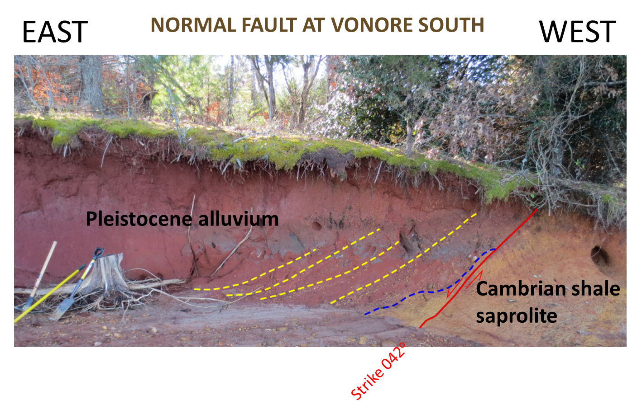

Slide 45
Bending moment fault?

Slide 46
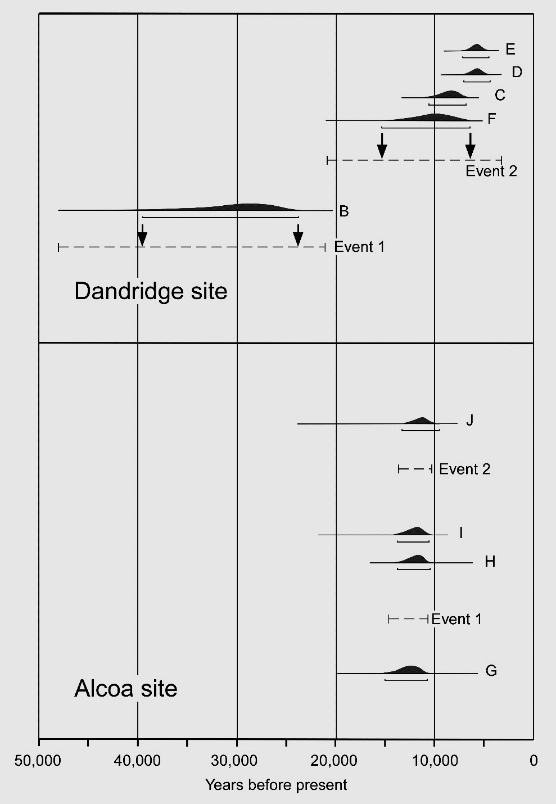
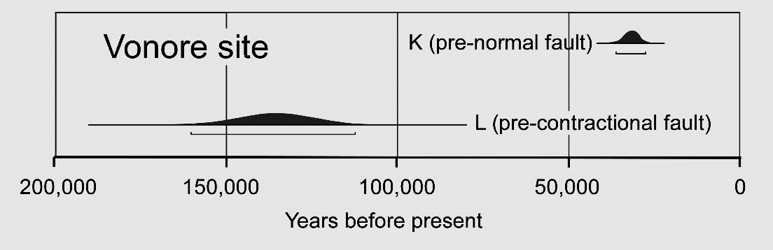
Thrust faulting
OSL age constraints on
Quaternary faulting
Thrust faulting

Slide 47
Thrust faulting
OSL age constraints on
Quaternary faulting
Thrust faulting
~11 to 14 ka
~11 to 14 ka

Slide 48
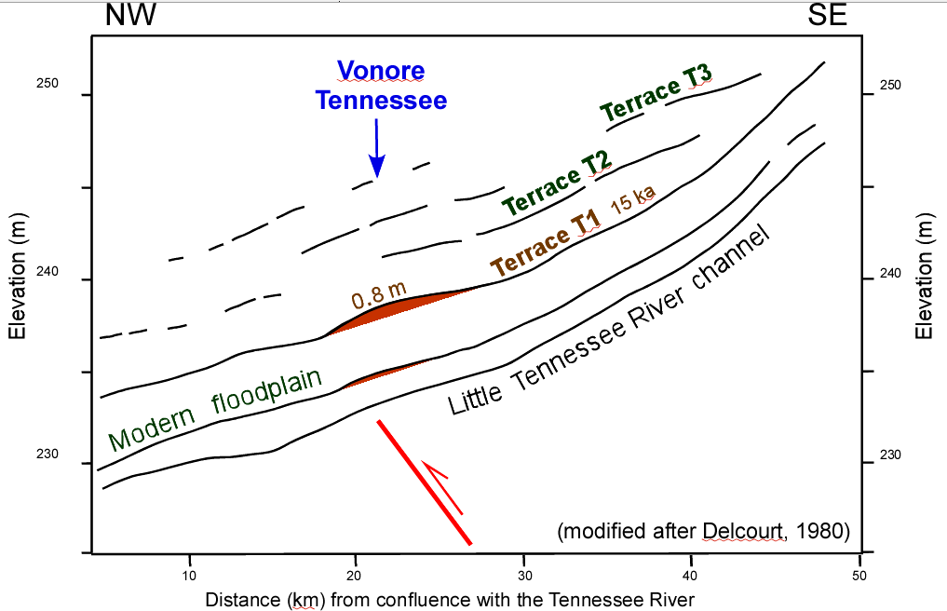

Slide 49
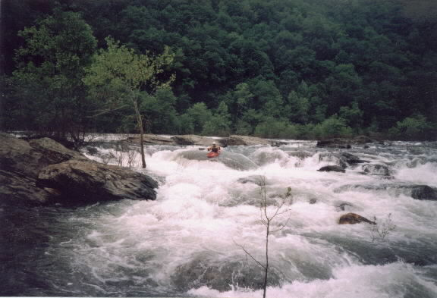
Blue Ridge rejuvenation?
Delamination
Mantle flow
Erosional unloading

Slide 50
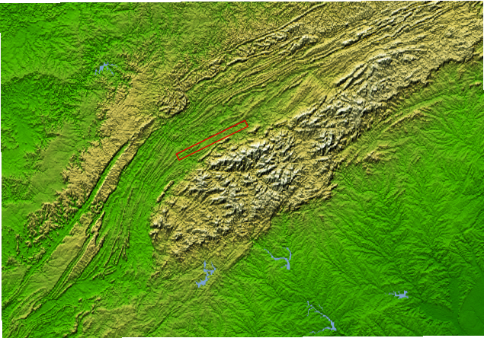
QUATERNARY FAULTING CORRIDOR
SMOKY MOUNTAINS

Slide 51
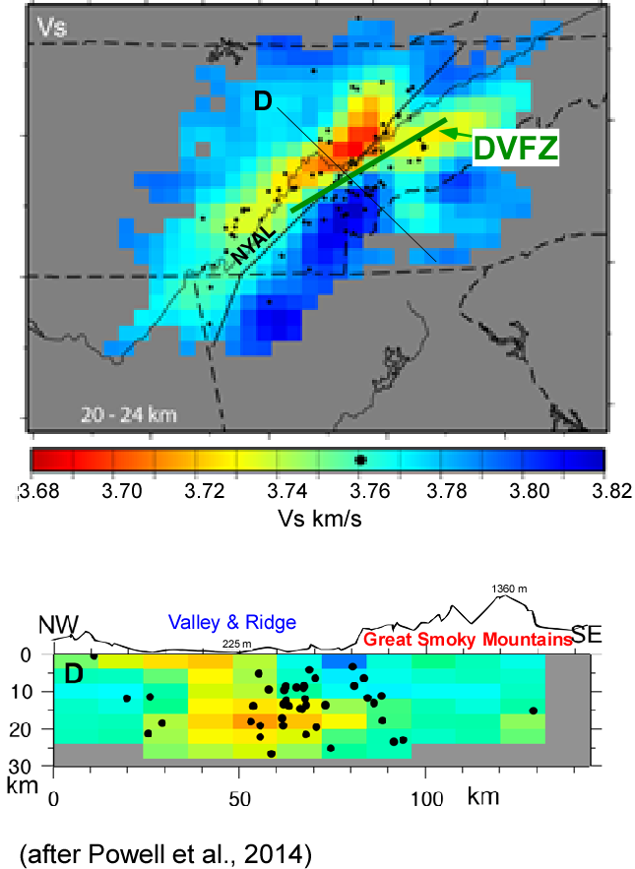
SUBSURFACE
Quaternary faulting corridor
Seismic S-wave velocity
at 20 to 24 km depth
(from Powell et al., 2014)
D’
Quaternary
faulting
D’
hypocenters

Slide 52
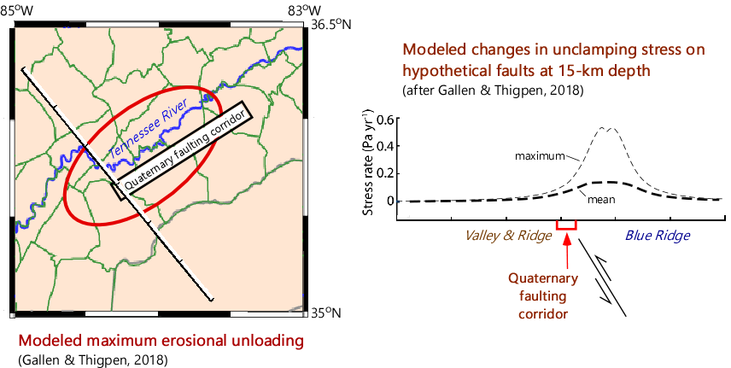
TRIGGERING STRESS FOR FAULT MOVEMENT

Slide 53
Uplift rate
Average of up-to-the-southeast throw on post 15 ka faulting events at Dandridge and Alcoa (0.7 m) = 0.05 mm/yr = 50 m/m.y.

Slide 54
Uplift rate
Average of up-to-the-southeast throw on post 15 ka faulting events at Dandridge and Alcoa (0.7 m) = 0.05 mm/yr = 50 m/m.y.
River terrace convexity at Vonore 0.8 m in 15 ka = 0.05 mm/yr = 50 m/m.y.

Slide 55
Uplift rate
Average of up-to-the-southeast throw on post 15 ka faulting events at Dandridge and Alcoa (0.7 m) = 0.05 mm/yr = 50 m/ma
River terrace convexity at Vonore (0.8 m in 15 ka) = 0.05 mm/yr = 50 m/ma
Erosion rate of summits in the Appalachians estimated from in situ cosmogenic ¹⁰Be (Hancock and Kirwan, 2007; Linari et al., 2017) = 6 to 20 m/ma

Slide 56
Conclusion:
So, in addition to isostatic uplift, the up-to-the-southeast slip rate on the fault corridor could have contributed a 30 to 45 m/ma increase in elevation of the Blue Ridge summits over the late Cenozoic.

Slide 57

?’s

Slide 59
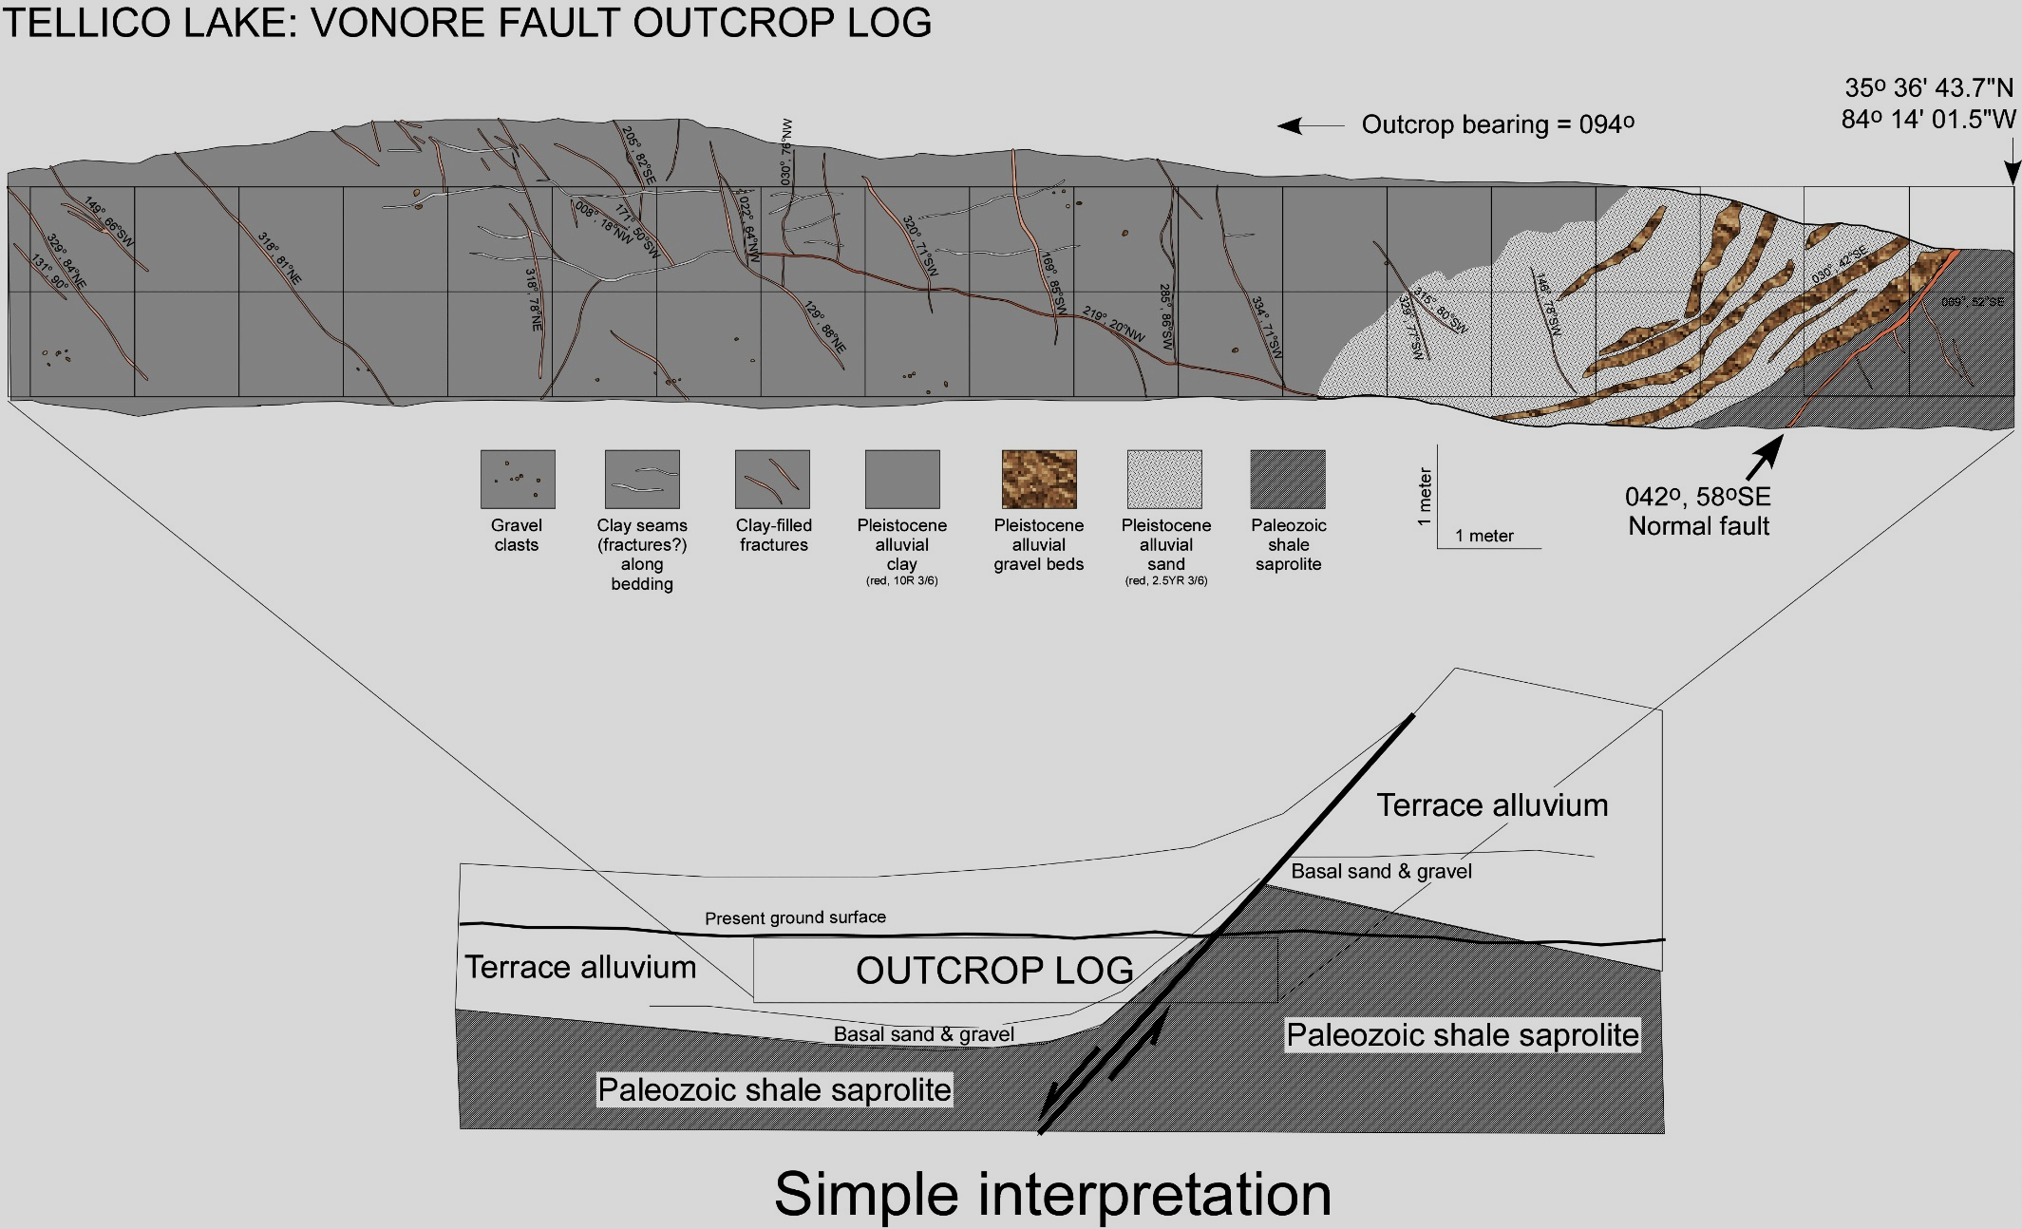
Late Pleistocene alluvium
Bedrock
Present ground level
Present ground level

Slide 60
Map of corridor showing field sites labeled
Maryville

Slide 61

EAST
POSSIBLE FAULT AT MARYVILLE
WEST
CHERT-POOR
RESIDUUM
CHERT-RICH
RESIDUUM
CHERT-POOR
RESIDUUM
Maryville pit fault photo?
CHERT-RICH
RESIDUUM
COLLUVIUM
COLLUVIUM

Slide 62
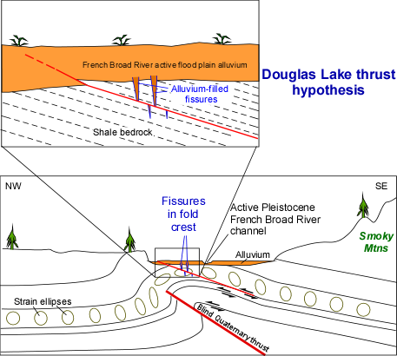
Flexural slip bedding-plane fault hypothesis for Dandridge thrust
Fissure

Slide 63
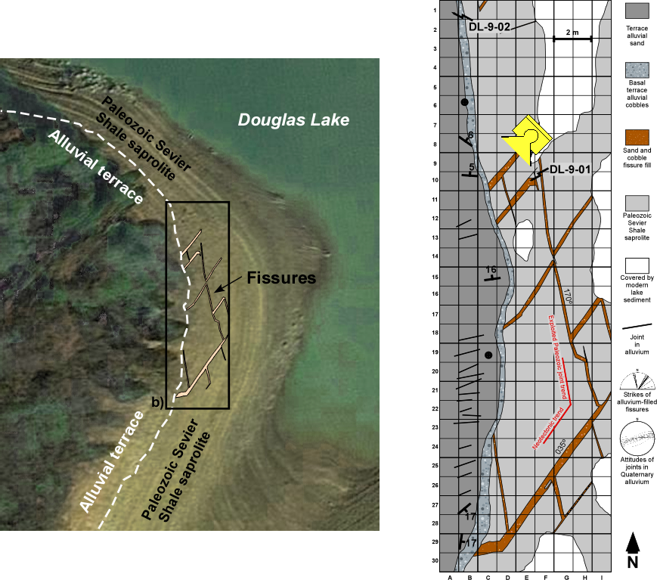

Slide 64
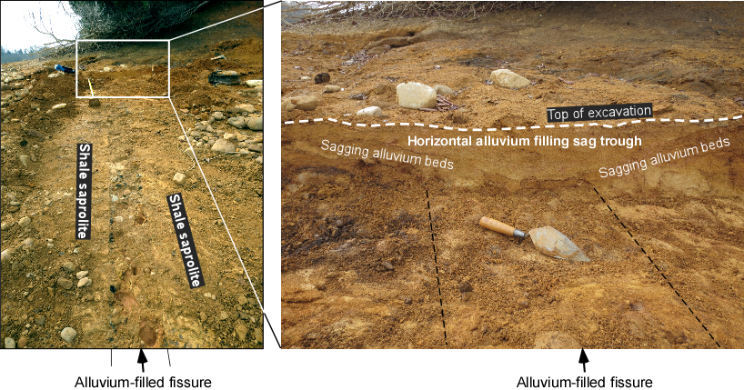
EVIDENCE FISSURING HAPPENED DURING PLEISTOCENE

Slide 65
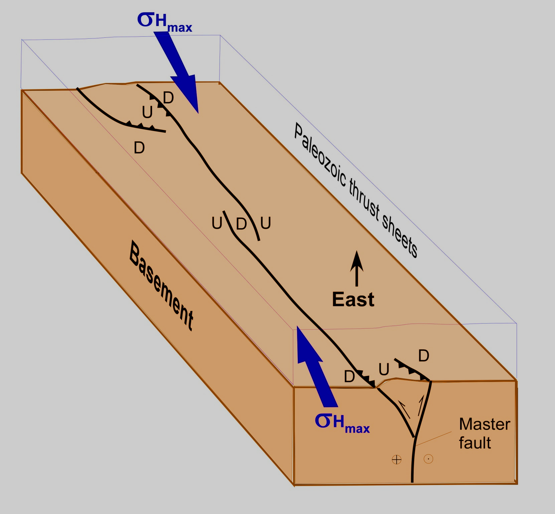
Speculative Model

Slide 66
Smoky Mountains rejuvenation?

Slide 67
OSL age constraints on
Quaternary faulting

Slide 68
SEISMICITY ALIGNMENTS

Slide 69
Tectonic setting

Slide 70
PALEOSEISMOLOGY

Slide 71
Deformation steps

Slide 72
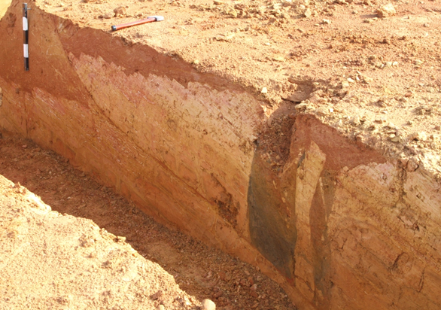
Dandridge thrust
Parallel Alluvium-filled fissure
2 m
N

Slide 73
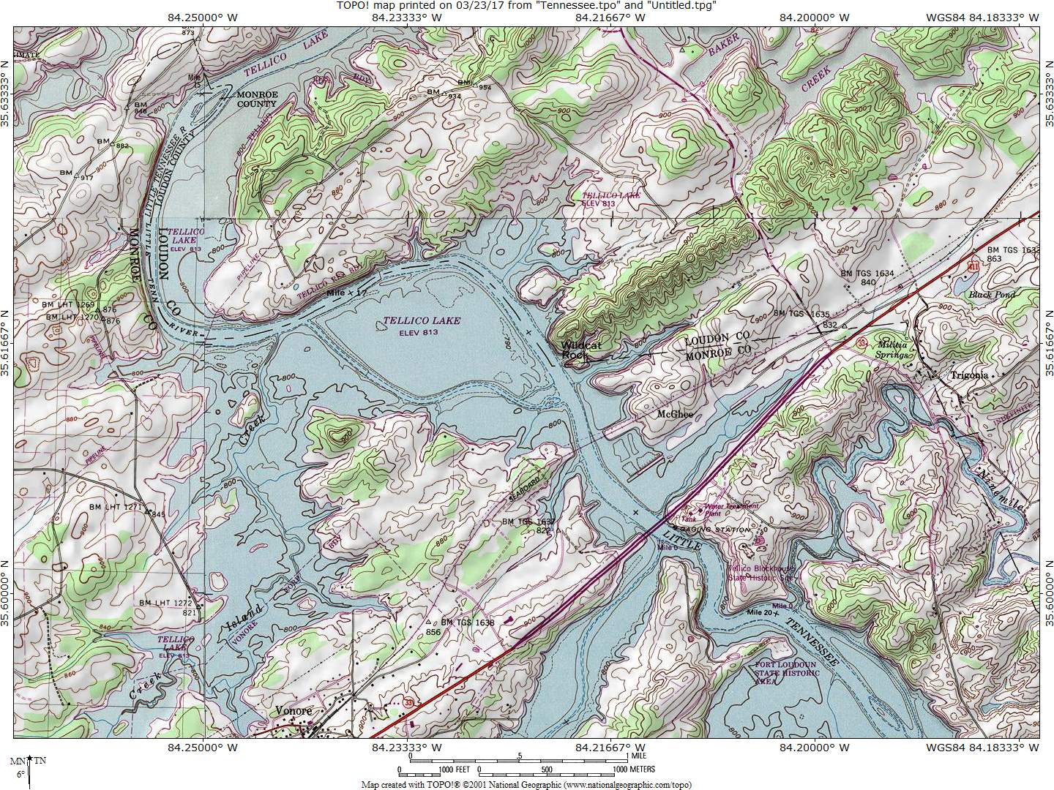
Pleistocene terrace
deformation

Slide 74
SEISMICITY
ALIGNMENTS
Area reconnoitered for
Quaternary faulting

Slide 75
SEISMICITY
ALIGNMENTS
Area reconnoitered for
Quaternary faulting
80 km
Quaternary faulting
Corridor N60ºE

Slide 76
SEISMICITY
ALIGNMENTS
Area reconnoitered for
Quaternary faulting
110 km
Quaternary faulting
Corridor N60ºE

Slide 77
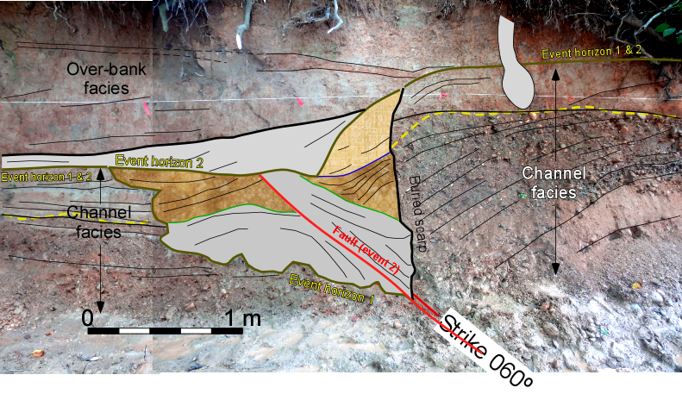
Strike 060º
Today

