Slide 1
Geological Survey of Canada Scientific Presentation Geoenvironmental characterization of mine wastes from carbonatite-hosted niobium deposits: ferroniobium slag A.J Desbarats and J.B. Percival 2019

Slide 2
Carbonatites
Plug-shaped intrusions consisting of > 50% carbonate minerals (calcite, dolomite, ankerite)
Enriched in incompatible elements (REE, U, Th, Nb, Ta, Zr)
Attractive exploration targets for REE and Nb
Little published information on the environmental signature of mining carbonatites for REE or Nb

Slide 3
Case study St-Lawrence Columbium mine, Oka, Quebec
Archetypal carbonatite-hosted Nb deposit mined between 1961 and 1976
Different types of mine wastes and mine waters: pit lakes, waste rock, tailings, ferroniobium slag
Focus here on ferroniobium slag: its mineralogy, (radio)chemistry, and leachate chemistry
What are issues of potential environmental concern associated with the slag?

Slide 4
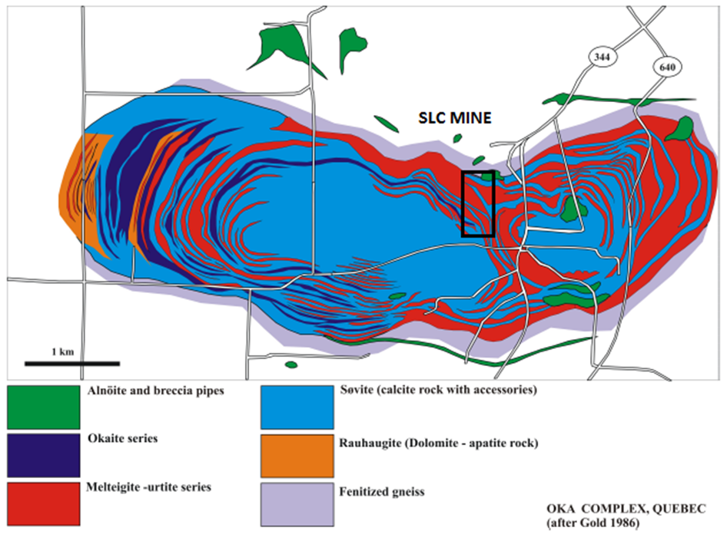
Simplified geology of the Oka carbonatite complex (from Lentz, 2006)

Slide 5
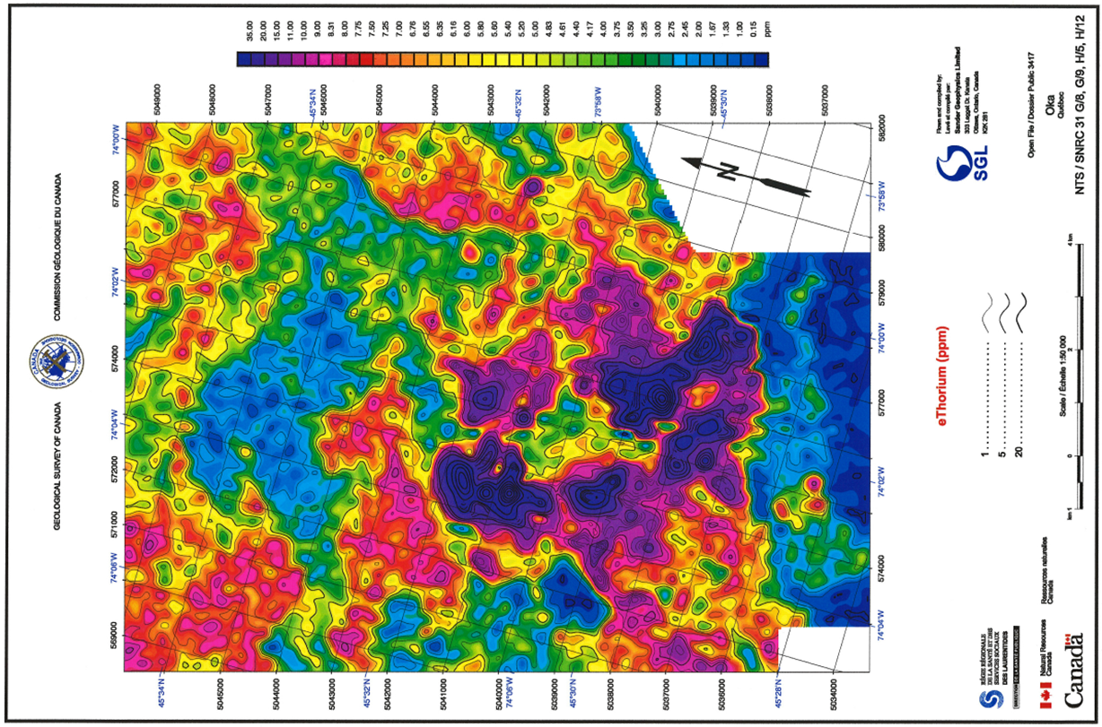
Airborne radiometric survey of the study area: equivalent thorium

Slide 6
Pyrochlore : Nb ore mineral
Formula: A_{2-x}B₂O₆(OH,F)
A: Na, Ca, Mn, Sr, U, Th, REE
B: Nb, Ta, Ti, Al, Fe, Zr
Oka example (Petruk & Owens, 1975):
Na_{.15}Ca_{.48}Sr_{.01}Mn_{.01}Fe_{.16}U_{.38}Ce_{.08}Nd_{.01}La_{.02}Nb_{1.66} Ta_{.05}Ti_{.27}Zr_{.01}O₆ (OH,F)

Slide 7
Ferroniobium (FeNb) production via aluminothermic reduction of pyrochlore concentrate
Pyrochlore concentrate (> 50% Nb₂O₅) contains pyrochlore ± apatite, mica, sulphide minerals
Reaction:
concentrate + Fe₂O₃ + Al + NaClO₃ + CaF₂ + CaO = FeNb + slag
FeNb is quite pure
Slag contains all the U and Th (and everything else)

Slide 8
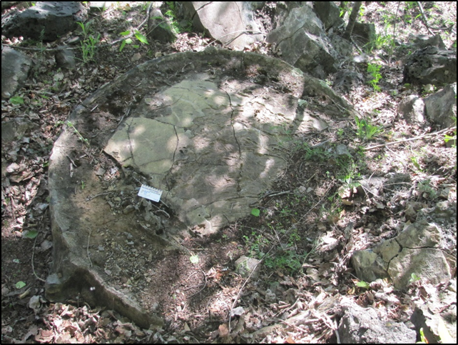
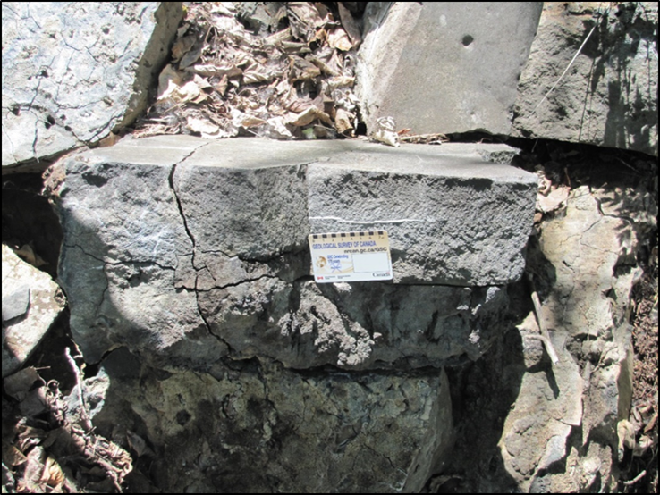
Slag melt button

Slide 9
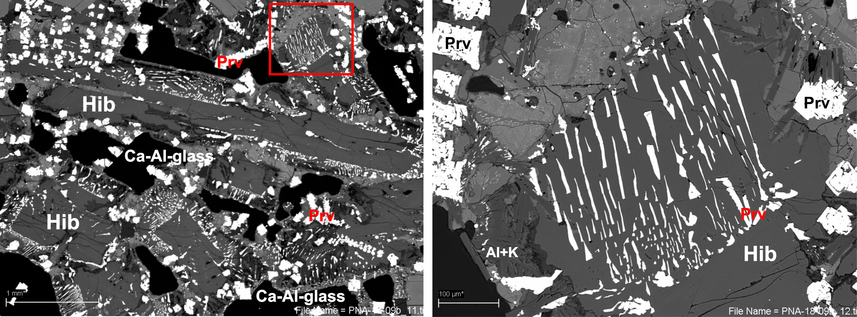
Slag Mineralogy
Hib: hibonite calcium zirconate (not shown)
Prv: REE-Al-Ca-Ti-perovskite Mg-K-beta alumina
Ca-Al-glass

Slide 10
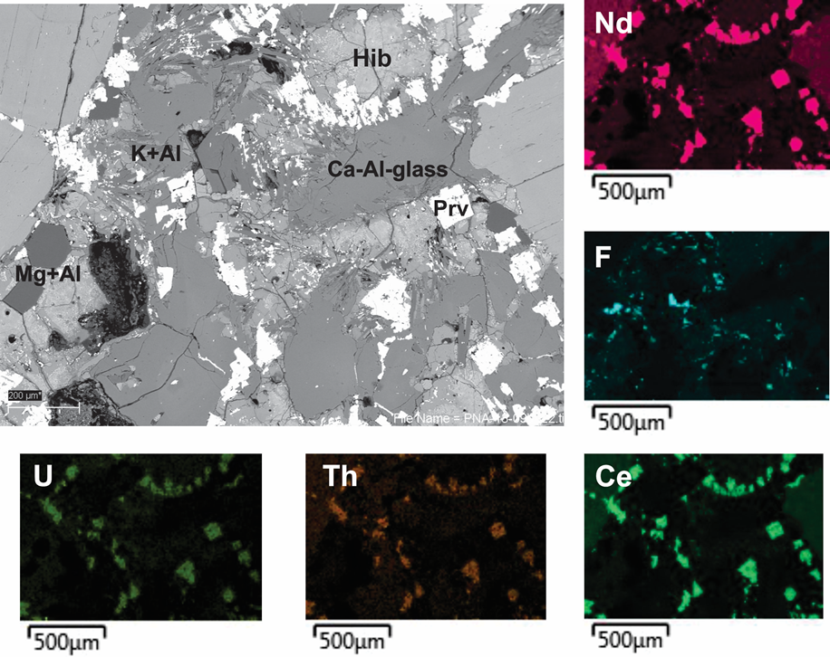
Slag Mineralogy

Slide 11
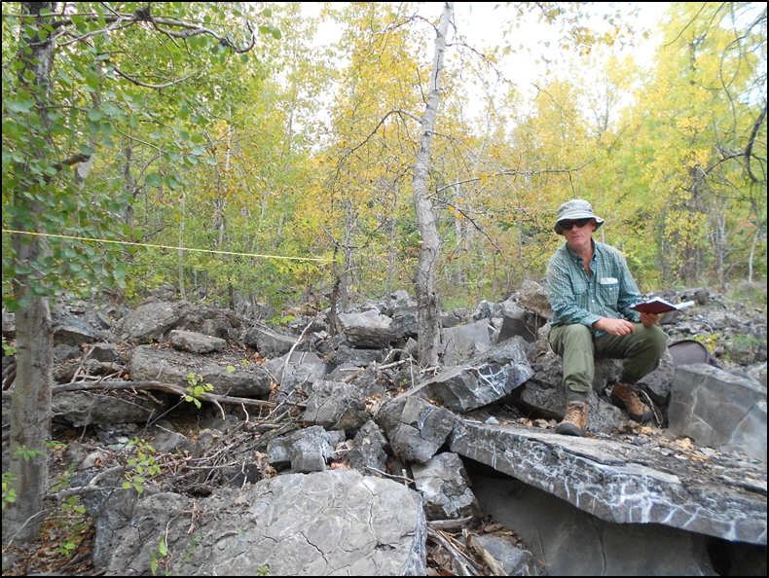
Radiometric survey of the slag disposal area

Slide 12
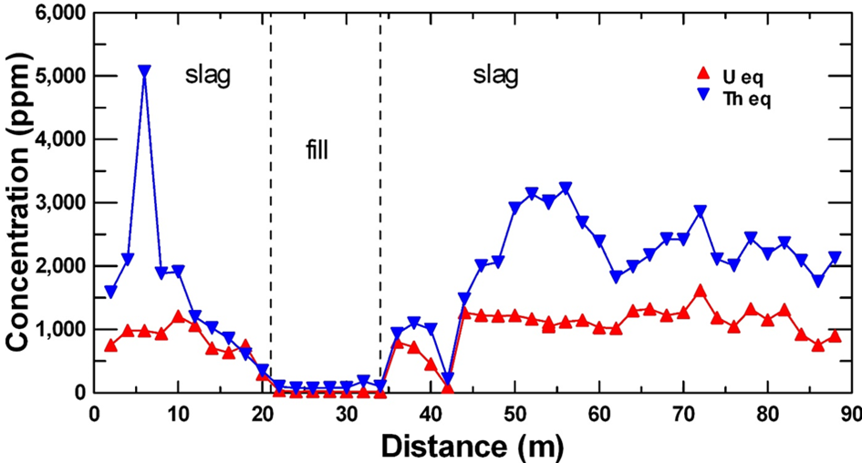
Longitudinal radiometric profile of slag disposal area

Slide 13
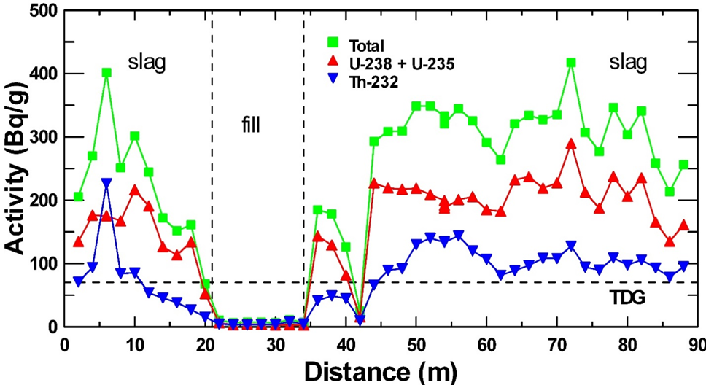
Longitudinal radiometric profile of slag disposal area

Slide 14
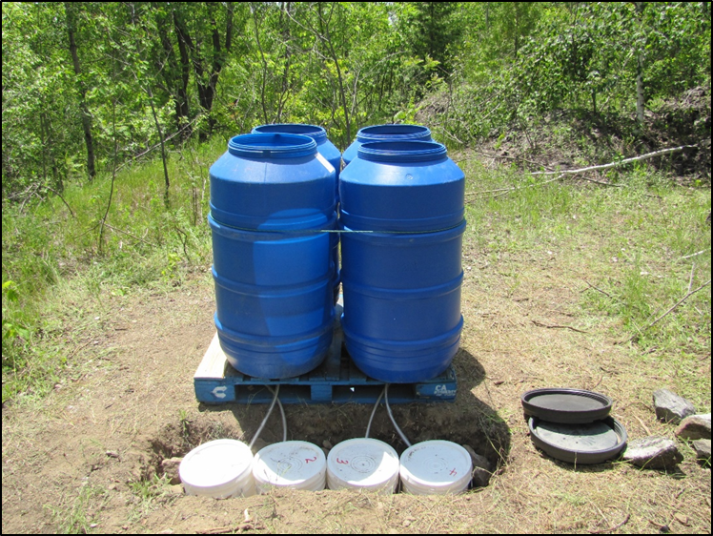
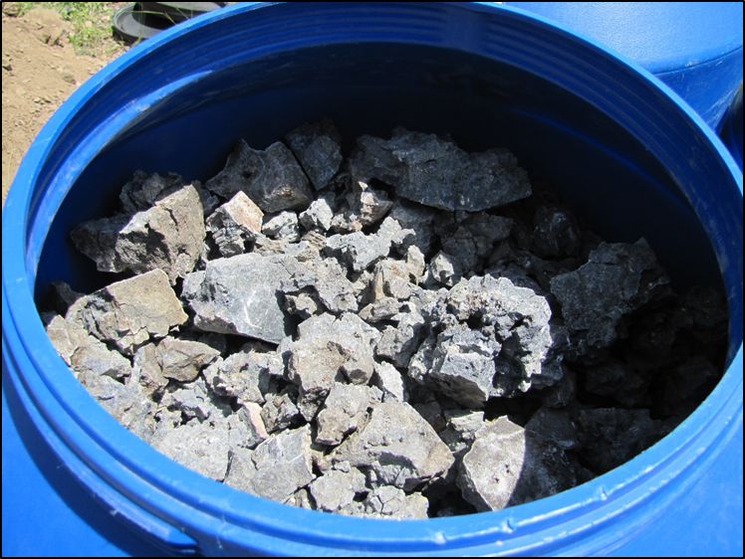
Field-scale slag leach experiment

Slide 15
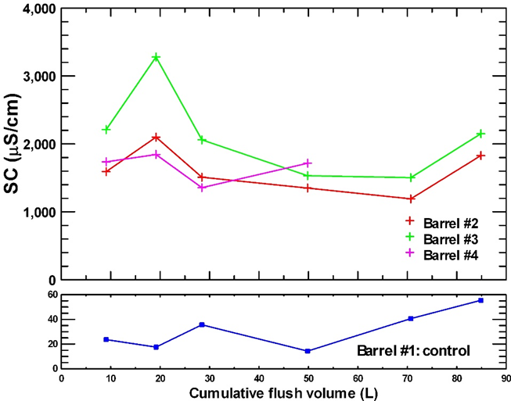
Evolution of leachate chemistry: conductivity Na-HCO₃ type water

Slide 16
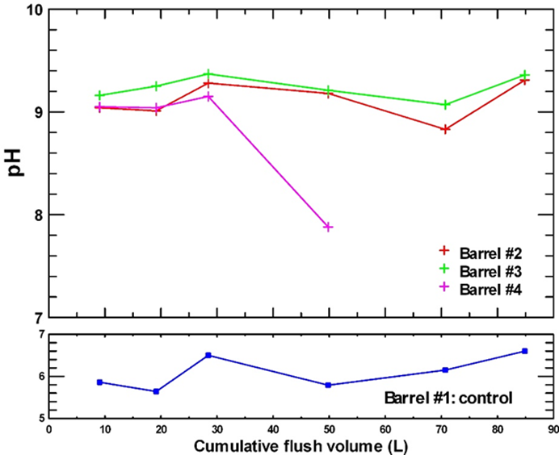
Evolution of leachate chemistry: pH

Slide 17
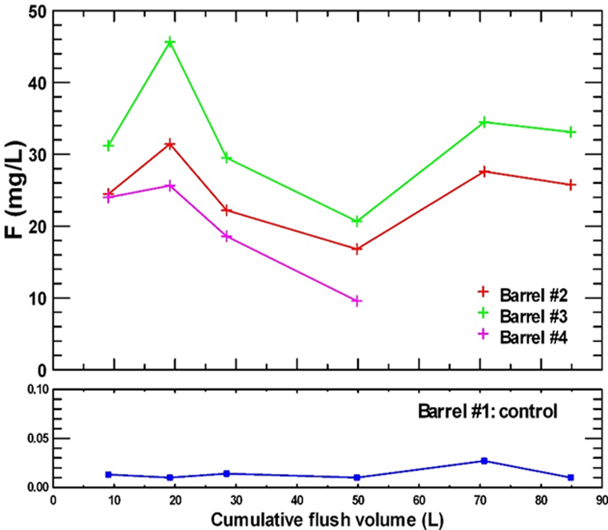
Evolution of leachate chemistry: F

Slide 18
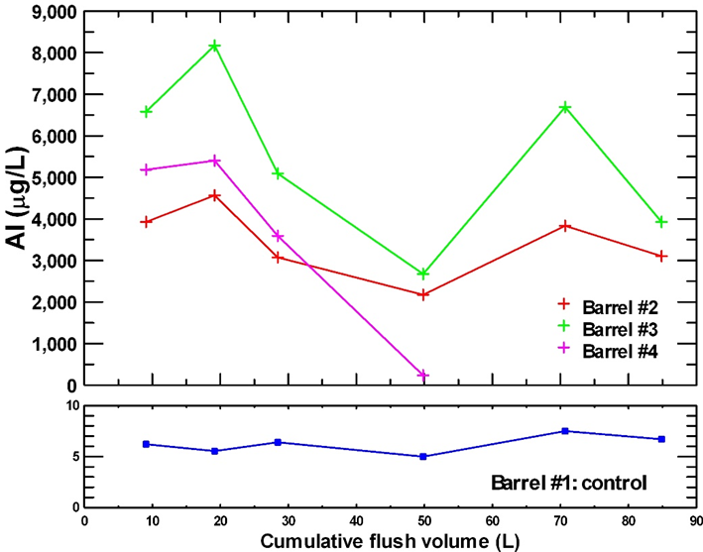
Evolution of leachate chemistry: Al

Slide 19
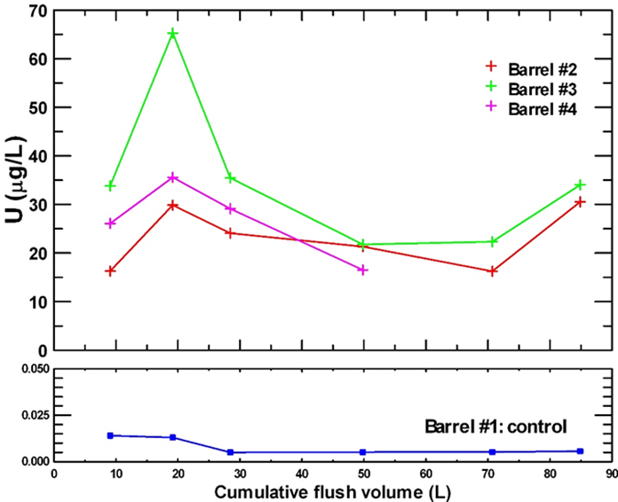
Evolution of leachate chemistry: U

Slide 20
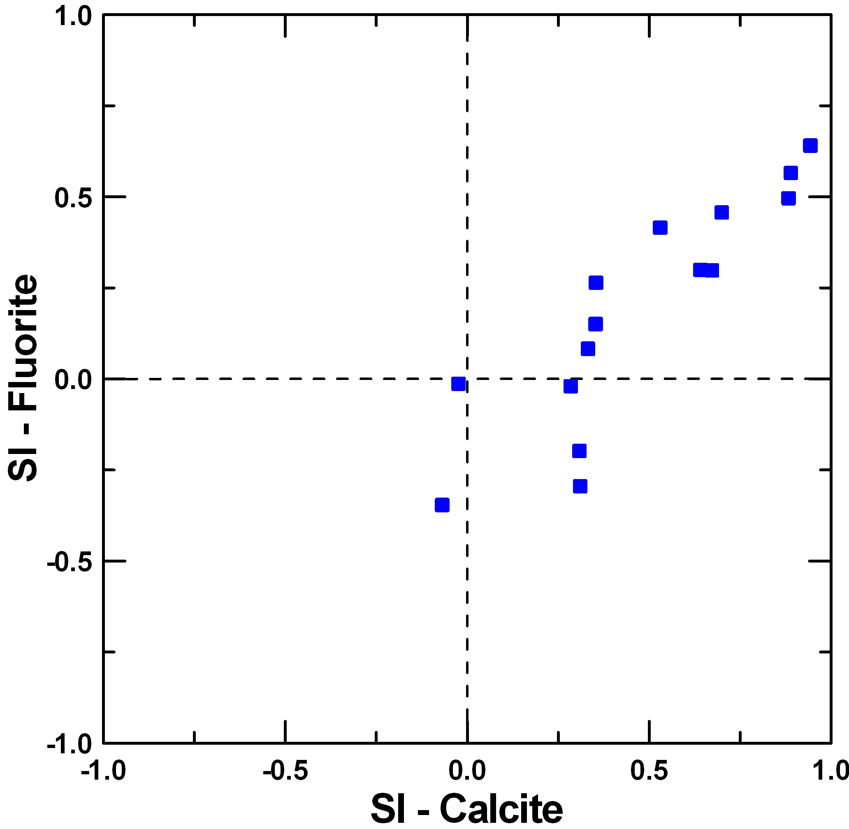
Controls on leachate chemistry: F

Slide 21
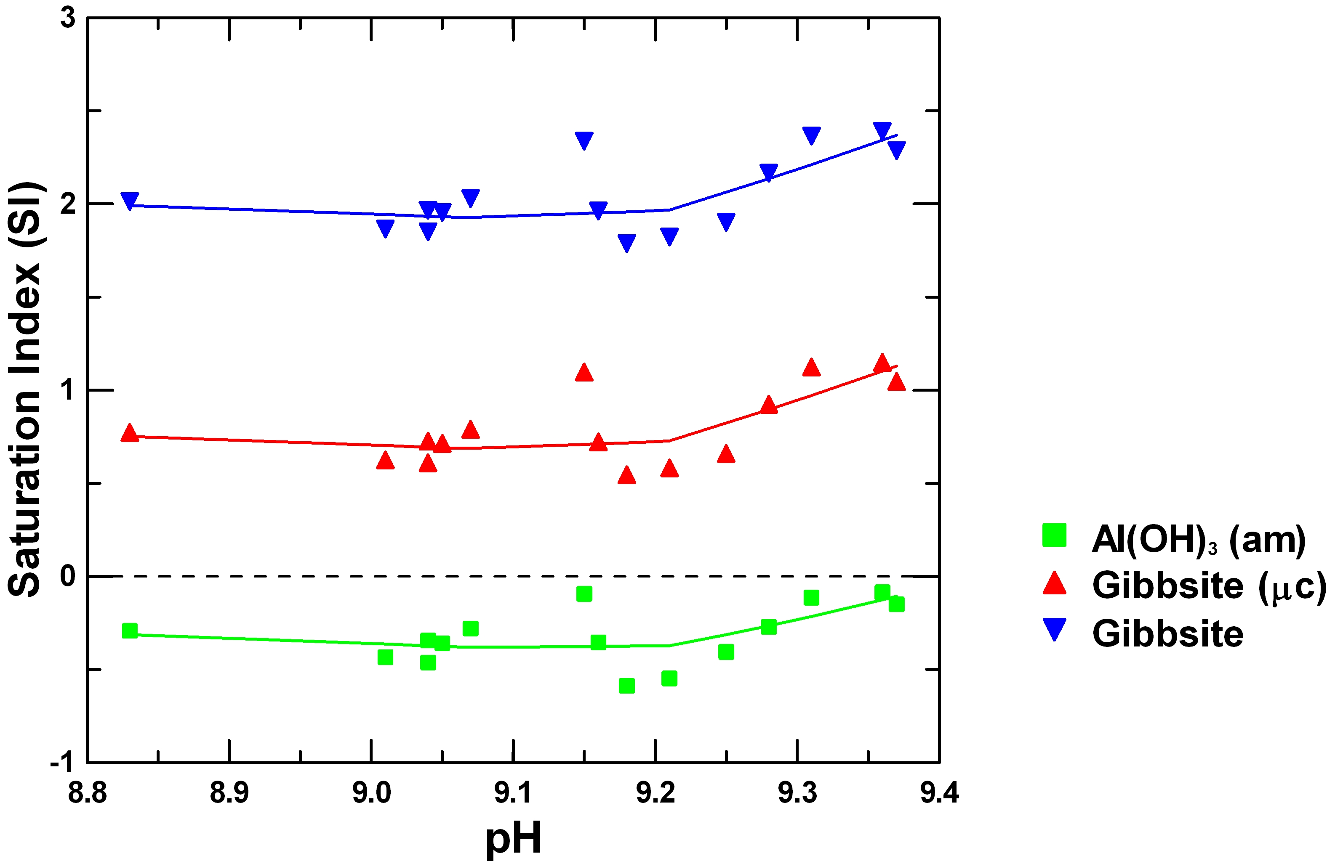
Controls on leachate chemistry: Al

Slide 22
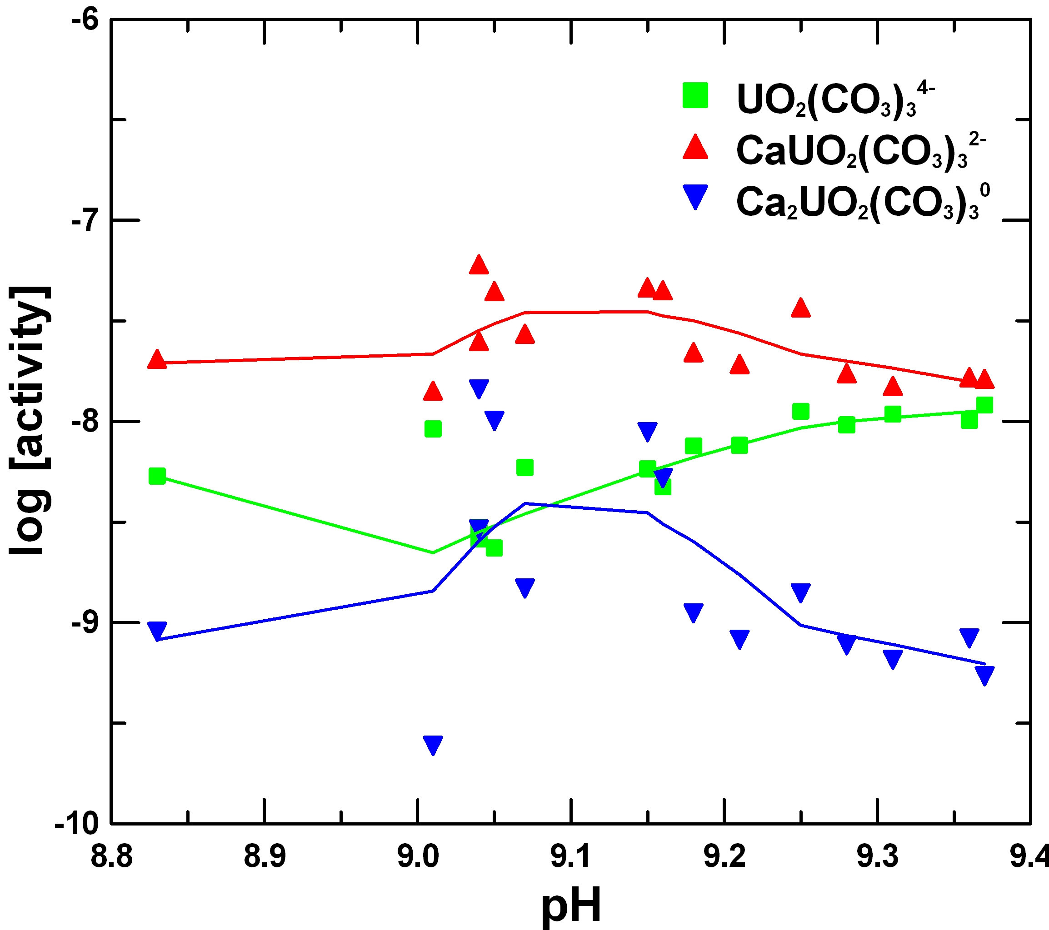
Controls on leachate chemistry: U speciation

Slide 23
Conclusions
Ferroniobium slag contains U (mean 1069 ppm) and Th (mean 1574 ppm) with total average specific activity of ≈ 300 Bq/g
45 year old slag exhibits significant chemical and physical weathering
Slag is composed mainly of hibonite, perovskite, and glass
Glass and perovskite phases are the most unstable under oxidizing, near surface conditions

Slide 24
Conclusions
Slag leachate is alkaline (pH 9) and contains very high concentrations of Al (2.5-8.5 mg/L), F (18-46 mg/L), and moderate levels of U (15-65 µg/L)
Ferroniobium slag is a Technologically Enhanced Naturally Occurring Radioactive Material (TENORM) requiring environmental management

Slide 25
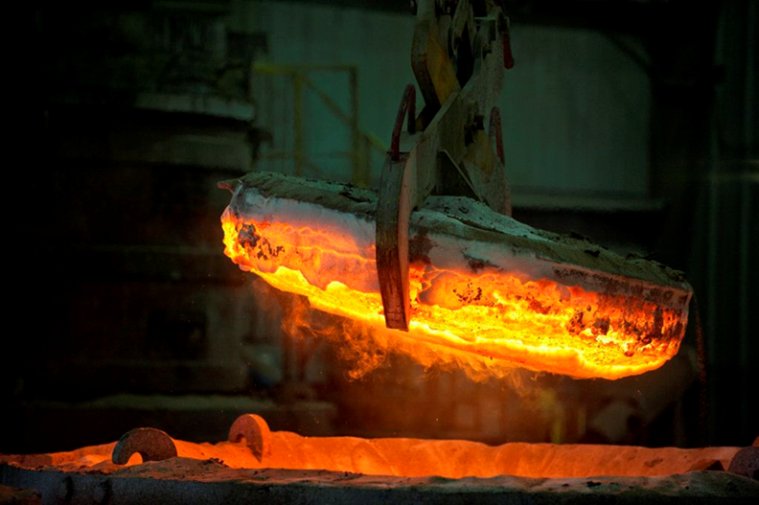
Questions?
http://niobec.com/2014/11/20-ans-transformation-niobec/.

