Slide 1
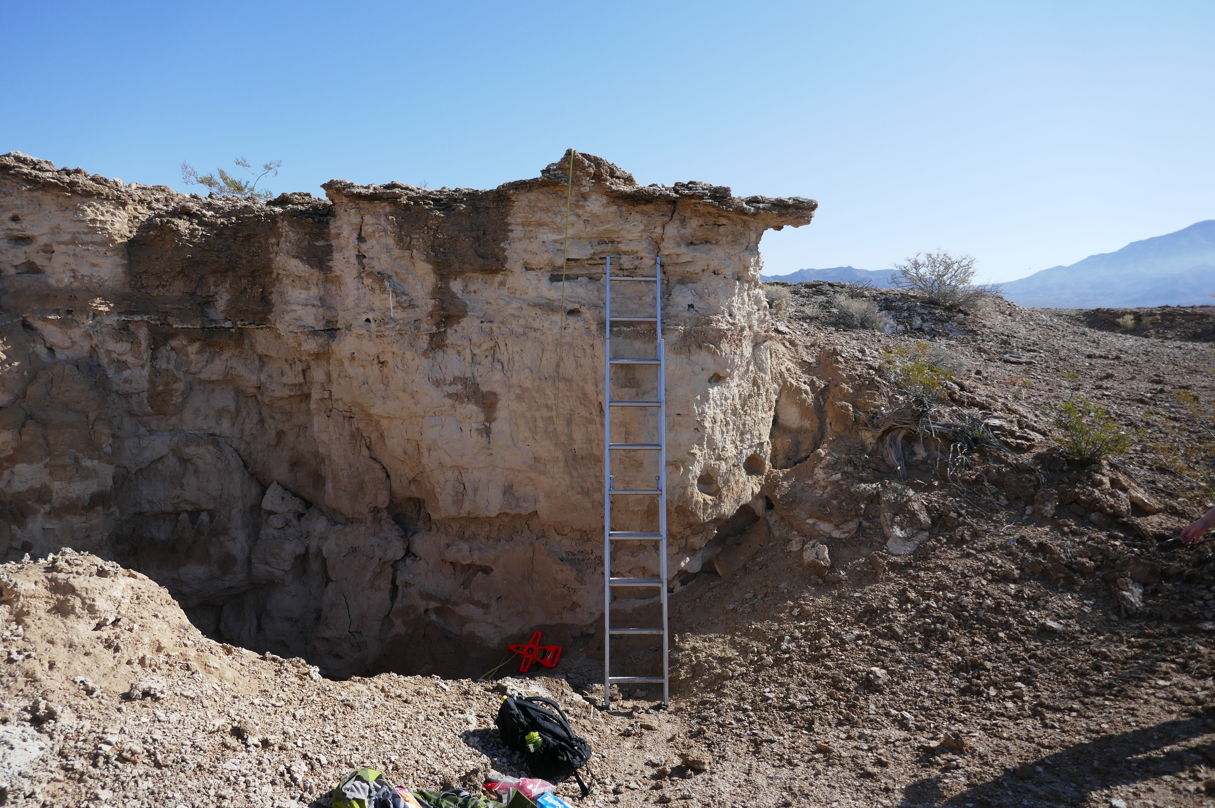
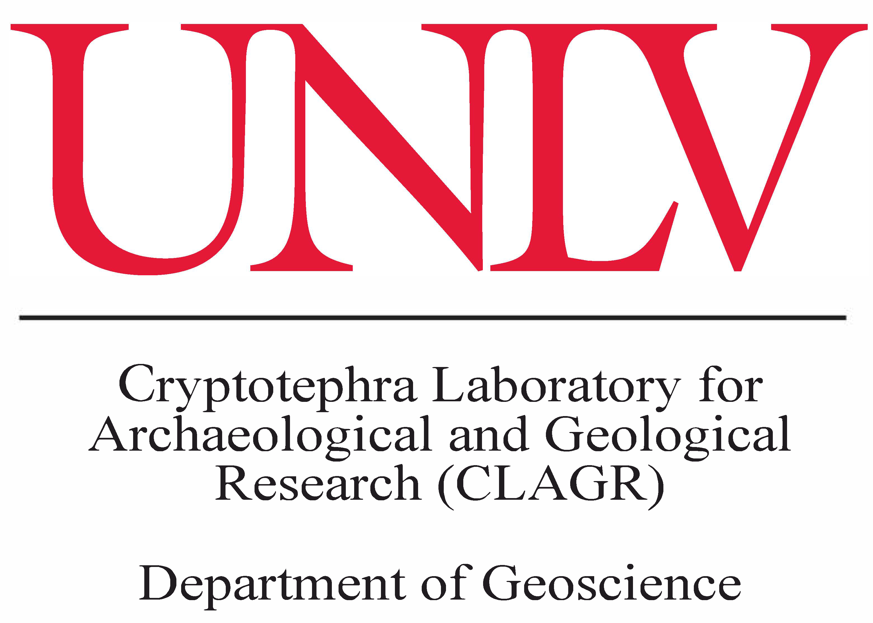

FIRST REPORT OF CRYPTOTEPHRA FROM THE LAS VEGAS FORMATION, TULE SPRINGS FOSSIL BEDS NATIONAL MONUMENT, NEVADA
Eugene Smith
Stephen Rowland
Racheal Johnsen
Minghua ren
Shelby fitch

Slide 2
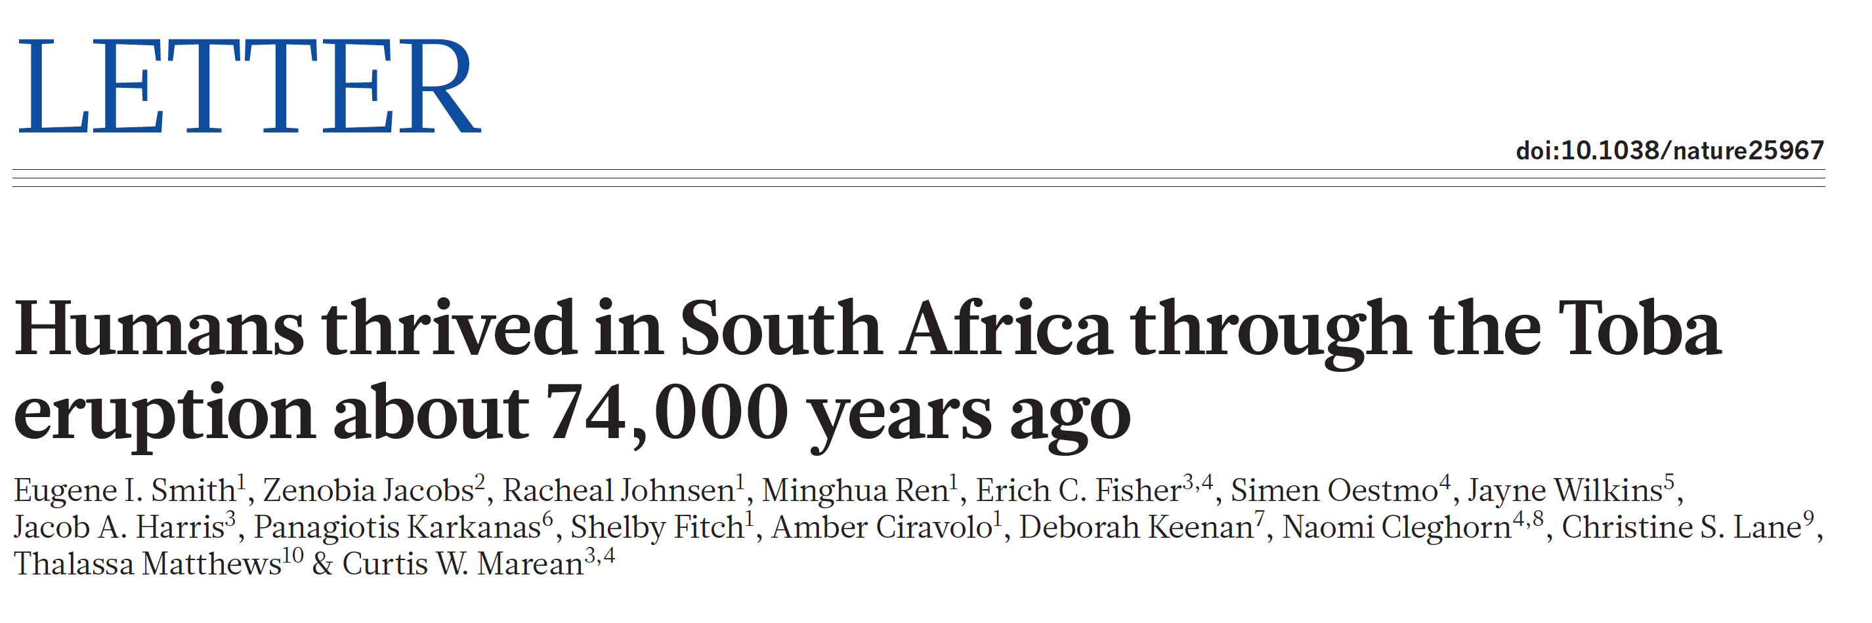
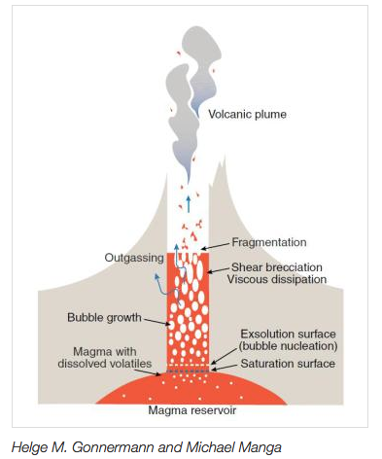
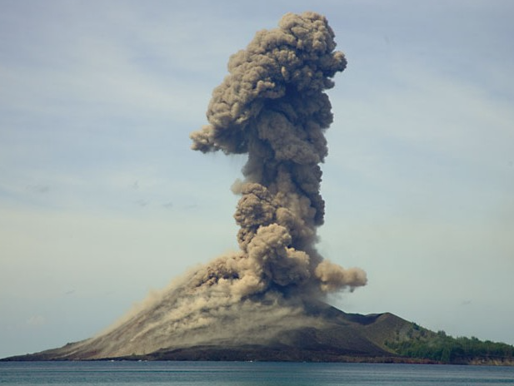
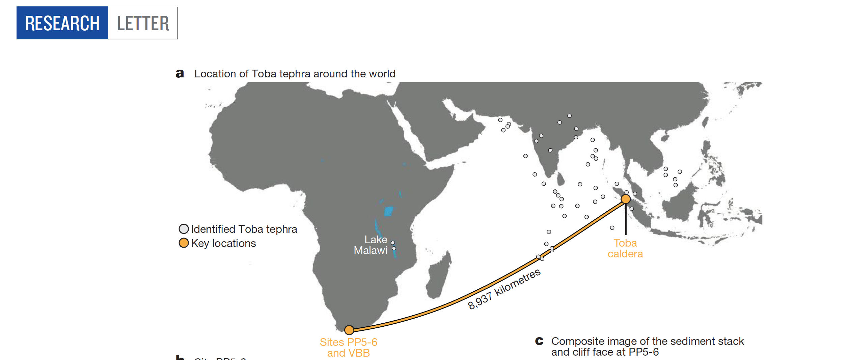
Formation of glass shards
What is Cryptotephra?
Tephra (Shards and pyroclastic material) are deposited “geologically’
instantaneously over large areas. Tephra layer or horizon provides a time
Line—an isochron—that can be used precisely date the enclosing sediment.

Slide 3
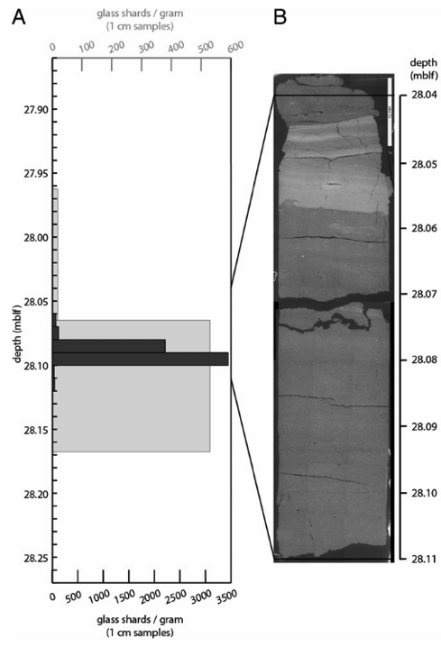
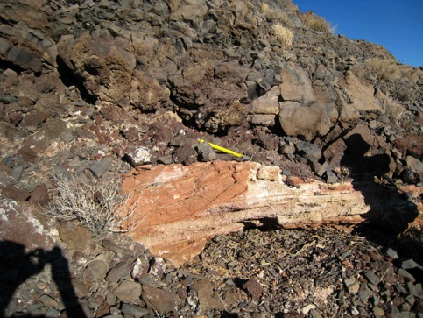
Types of Tephra Studies
Visible tephra layers—nearly pure volcanic material.
Cryptotephra—not visible, but 100s to 1000s of shards/gram
Extremely low abundance cryptotephra (ELA)-----less than 10 shards/gram. Shards are small (< 100 microns in size) and difficult to find and analyze.
LAKE MALAWI
CORE; Lane et al. 2013
Lake Malawi Core; Lane et al. 2013

Slide 4
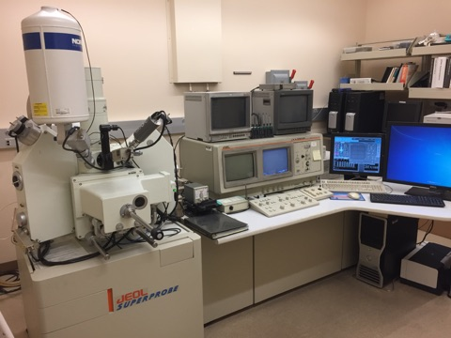
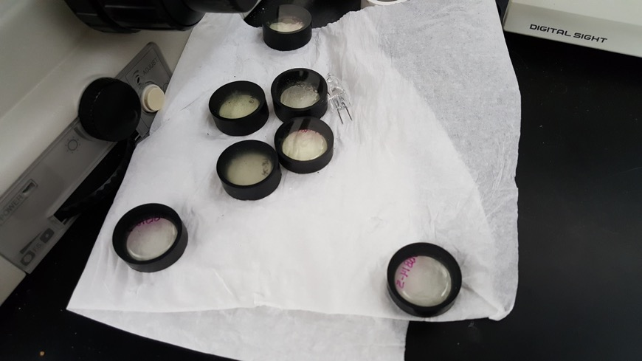
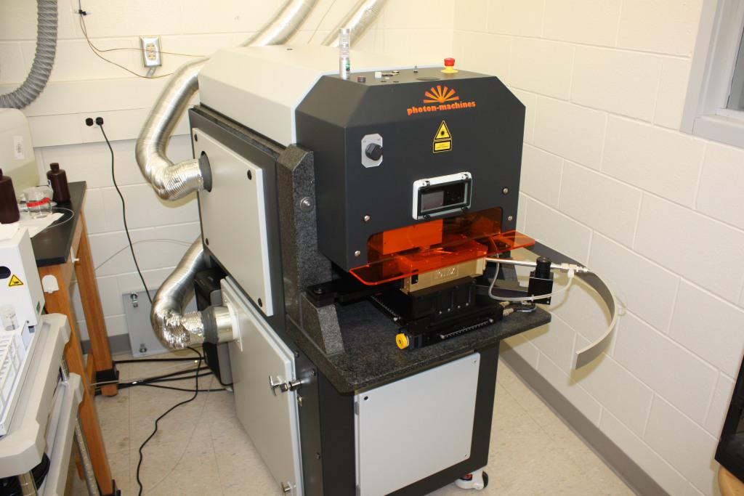
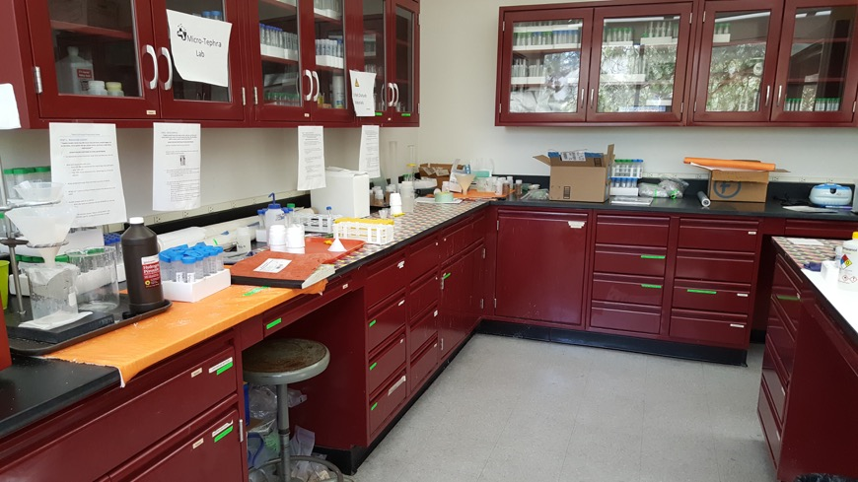
Sample Processing
Sample processing and grain identification in the CLAGR Lab at UNLV.
Acid digestion using 1 M (10 %) HCl.
Sieving at 80 and 20 micrometers.
Density separation using LMT (Lithium Metatungstate).
Grains placed on epoxy rounds.
Identification of isotropic grains using petrographic microscope. Epoxy rounds are polished and analyzed by EPMA at UNLV for major elements and LA-ICP-MS at Michigan State University for trace elements.
JEOL JXA-8900 Microprobe.
Thermo Scientific ICAP Q quadrapole ICP-MS coupled to a Photo Machines Analyte G2 193 nm eximer laser.
Notes:
Samples were processed first at Oxford University by Amber Ciravolo with the help of Christine Lane using techniques modified from those of Blockley et al. Ciravolo set up a lab based on the Oxford lab at UNLV and is now processing samples.

Slide 5
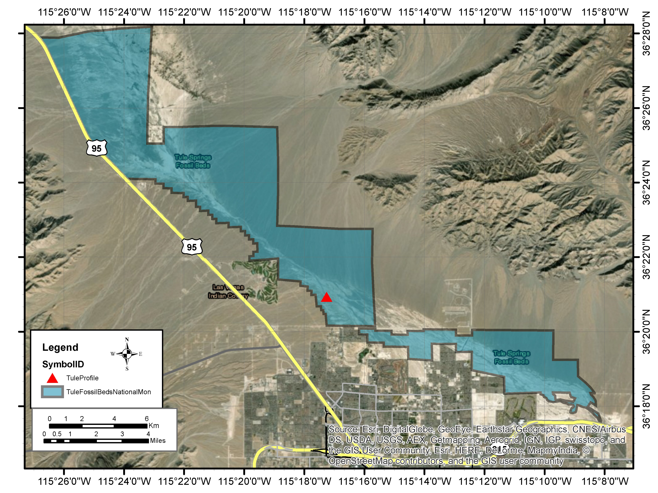
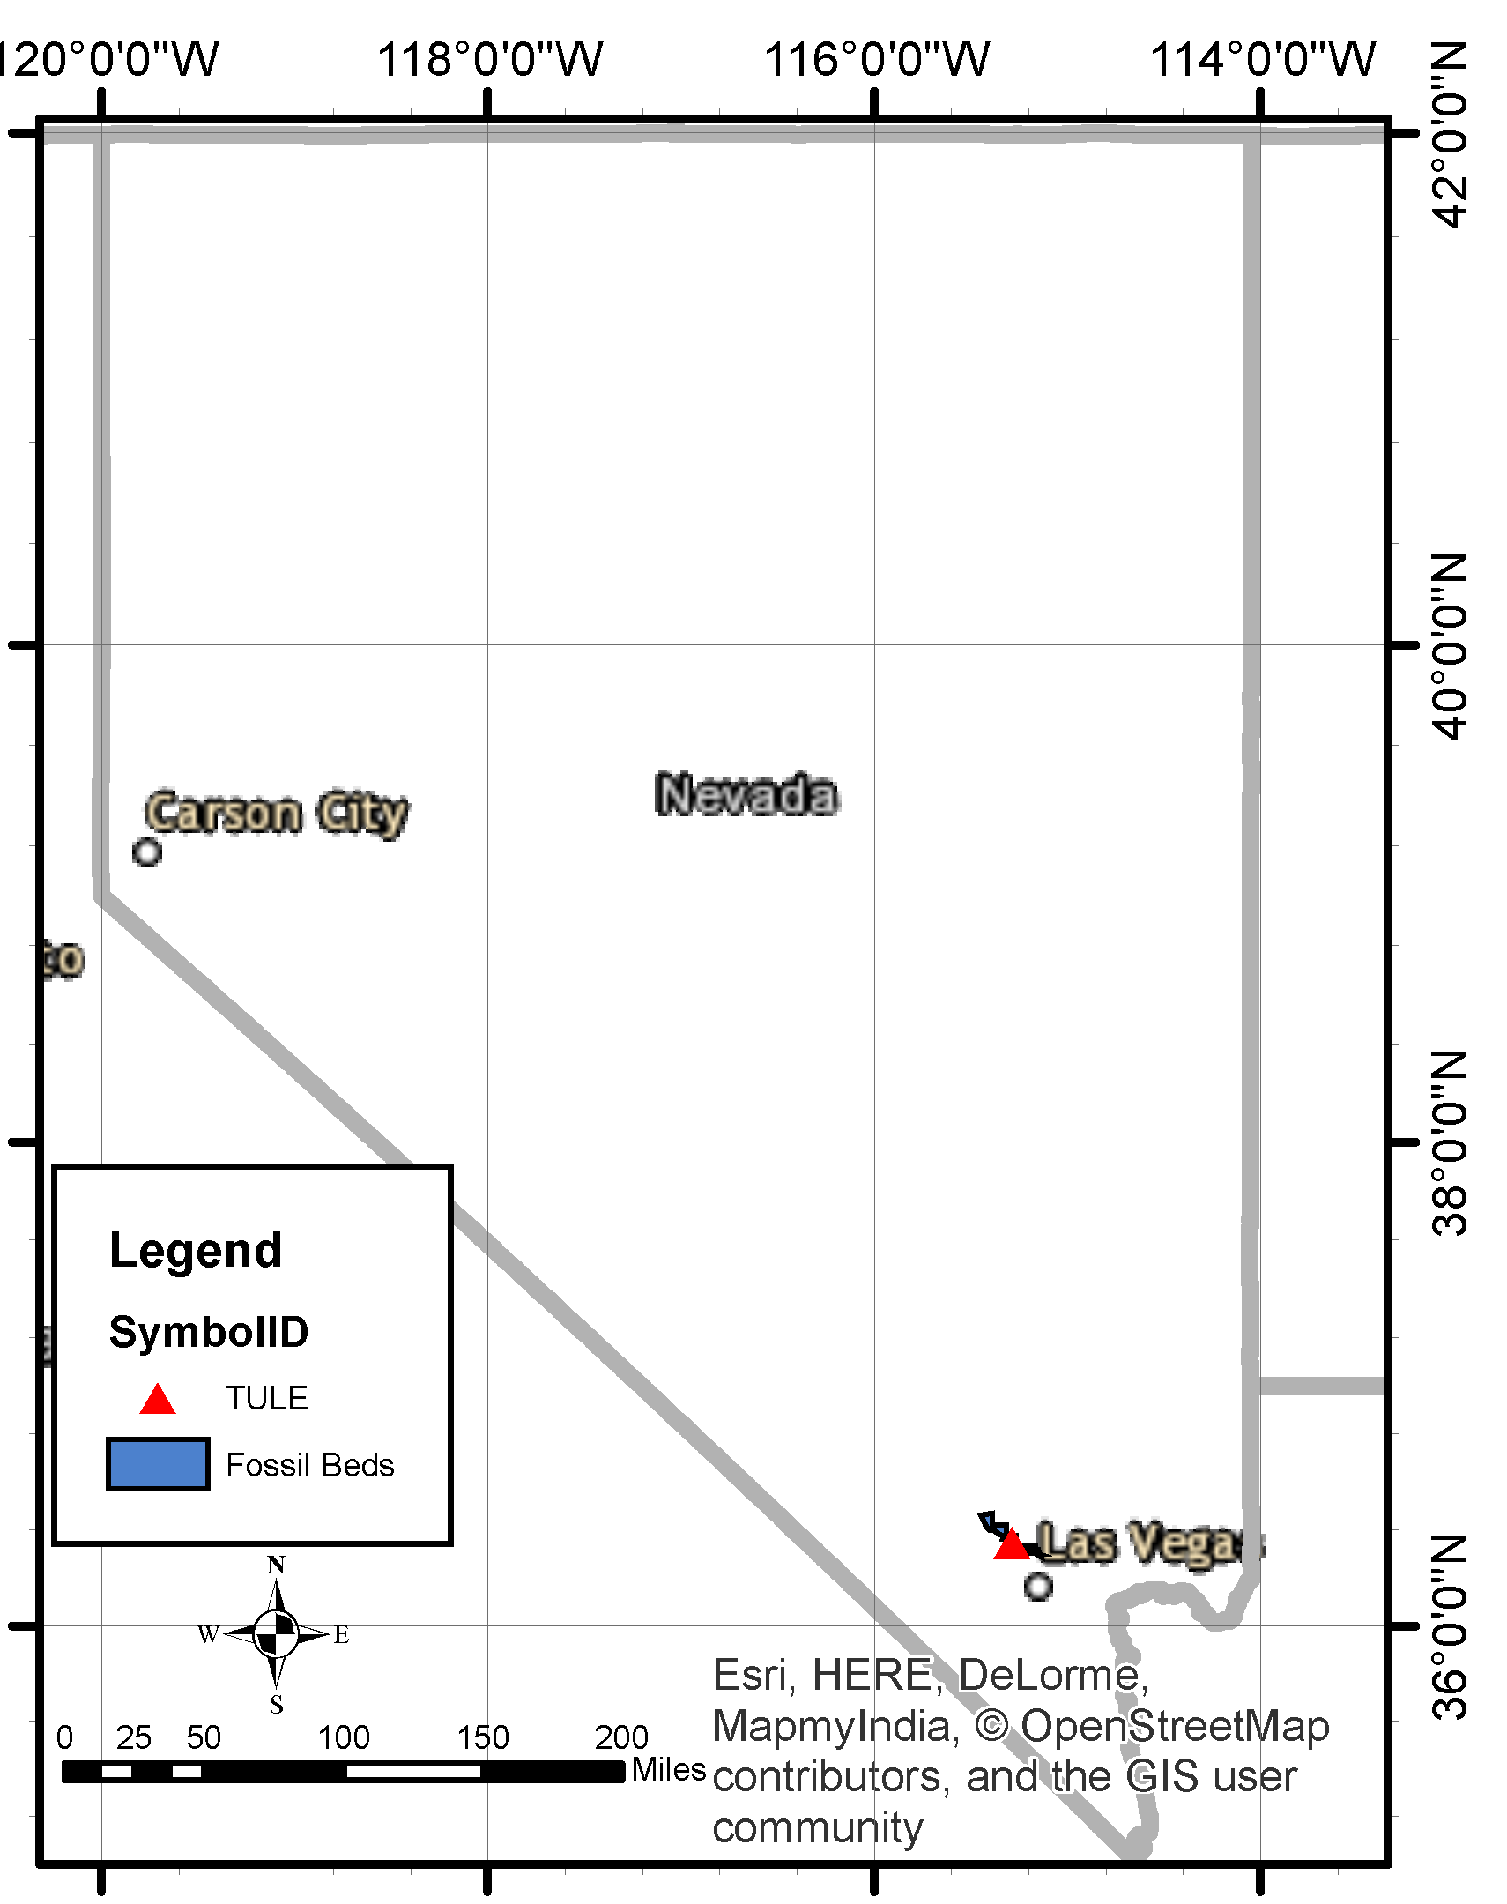
Tule Springs Fossil beds national monument

Slide 6
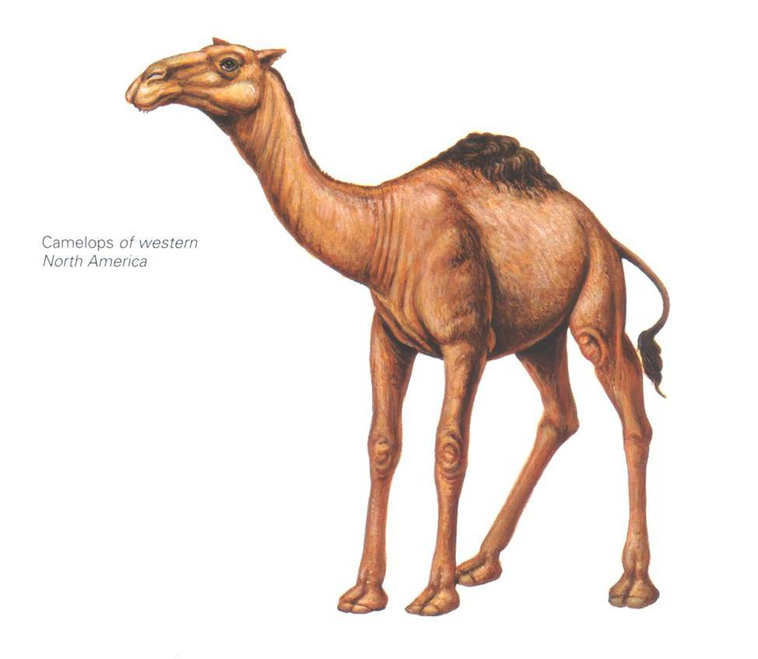
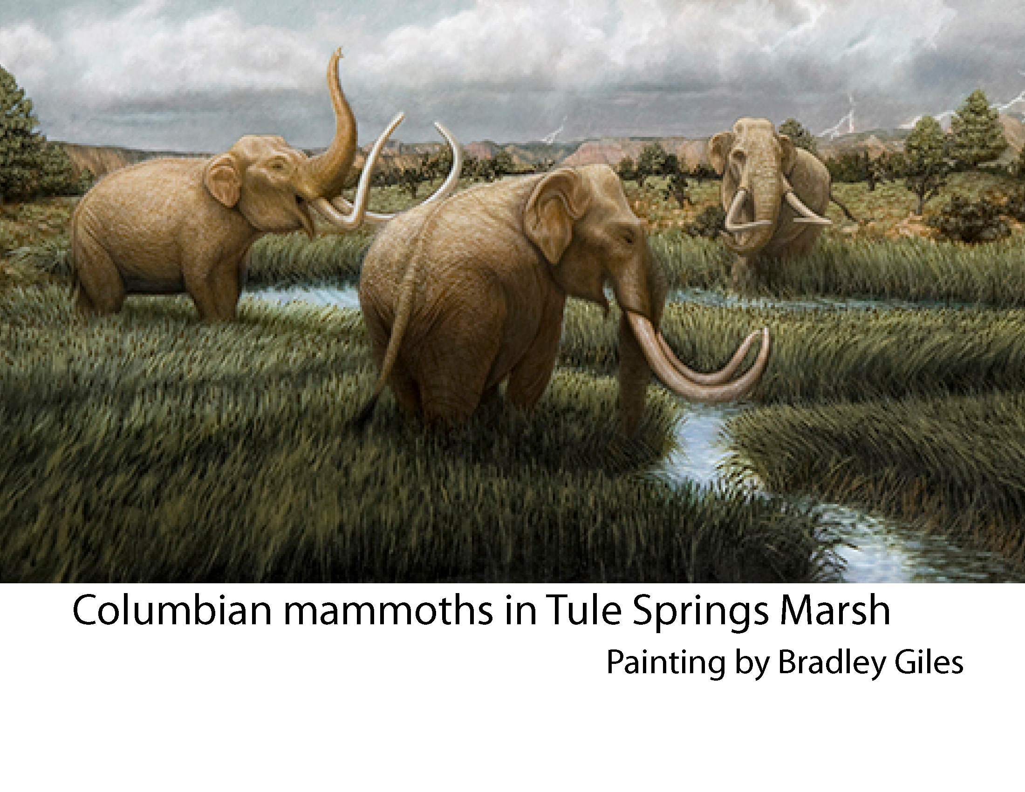
Importance of Las Vegas Formation at Tule Springs
Middle Pleistocene to early Holocene in age (573-8.53 ka; Springer et al. 2018)
Preserves the deposits of an extensive desert wetland ecosystem that responded to past episodes of groundwater discharge (paleowetlands)
Contains a diverse fossil fauna dominated by Mammuthus columbi (Columbian mammoth) and Camelops hesternus (yesterday’s camel) but with many other species
The best studied reference section in the Southwest for the study of Late Pleistocene hydrologic and climatic changes
Important for communicating climate science and related fields to the general public as Tule Springs Fossil Beds National Monument and Ice Age Fossils State Park develop exhibits and interpretive trails

Slide 7
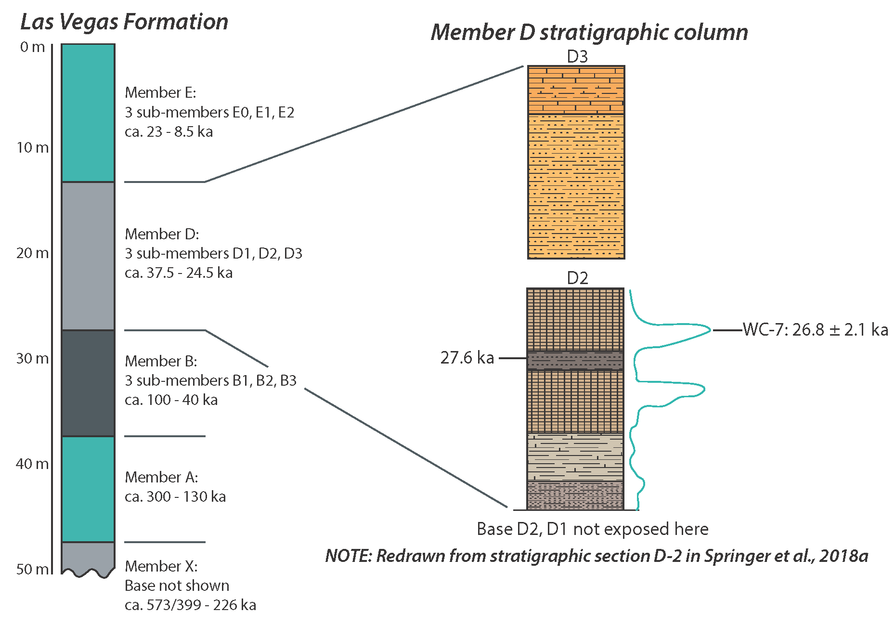
Las Vegas Formation Stratigraphy; Springer et al., 2018
26 ka

Slide 8
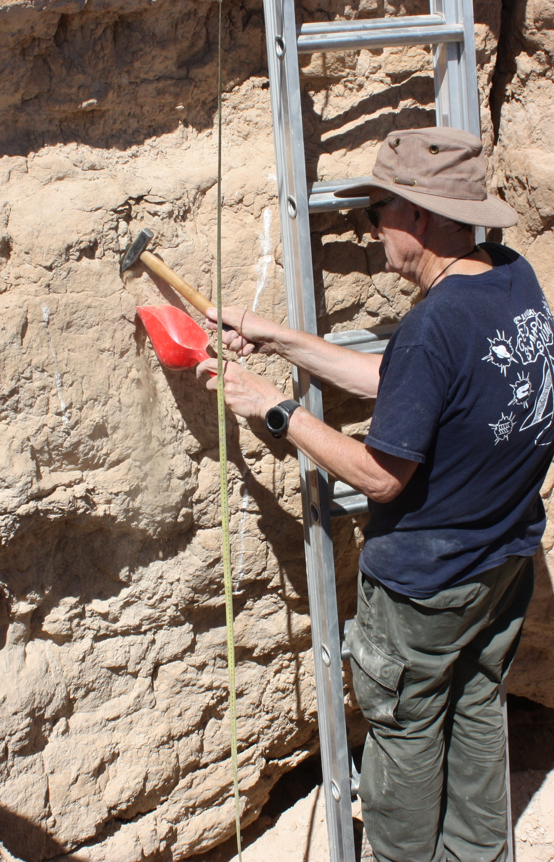
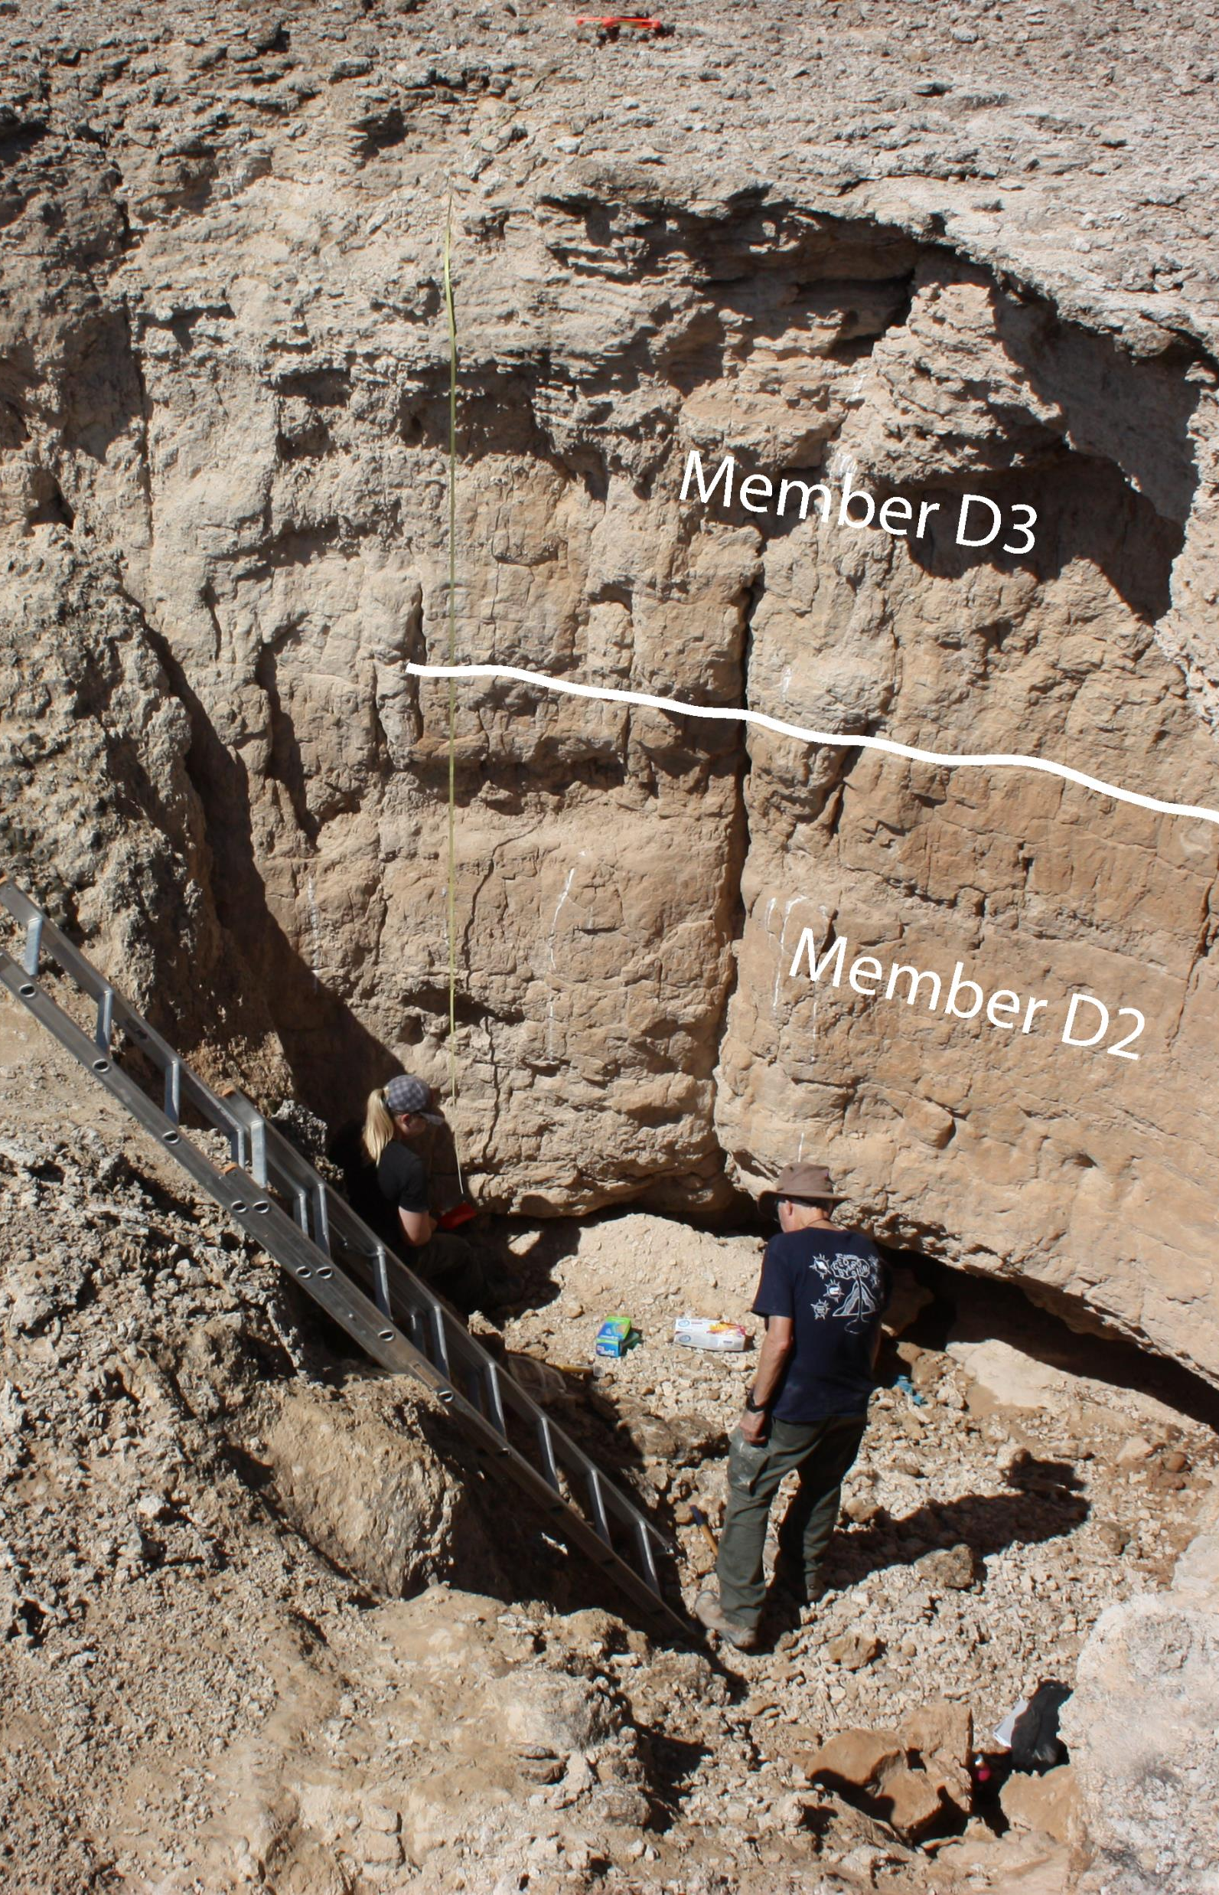
Sample collection

Slide 9
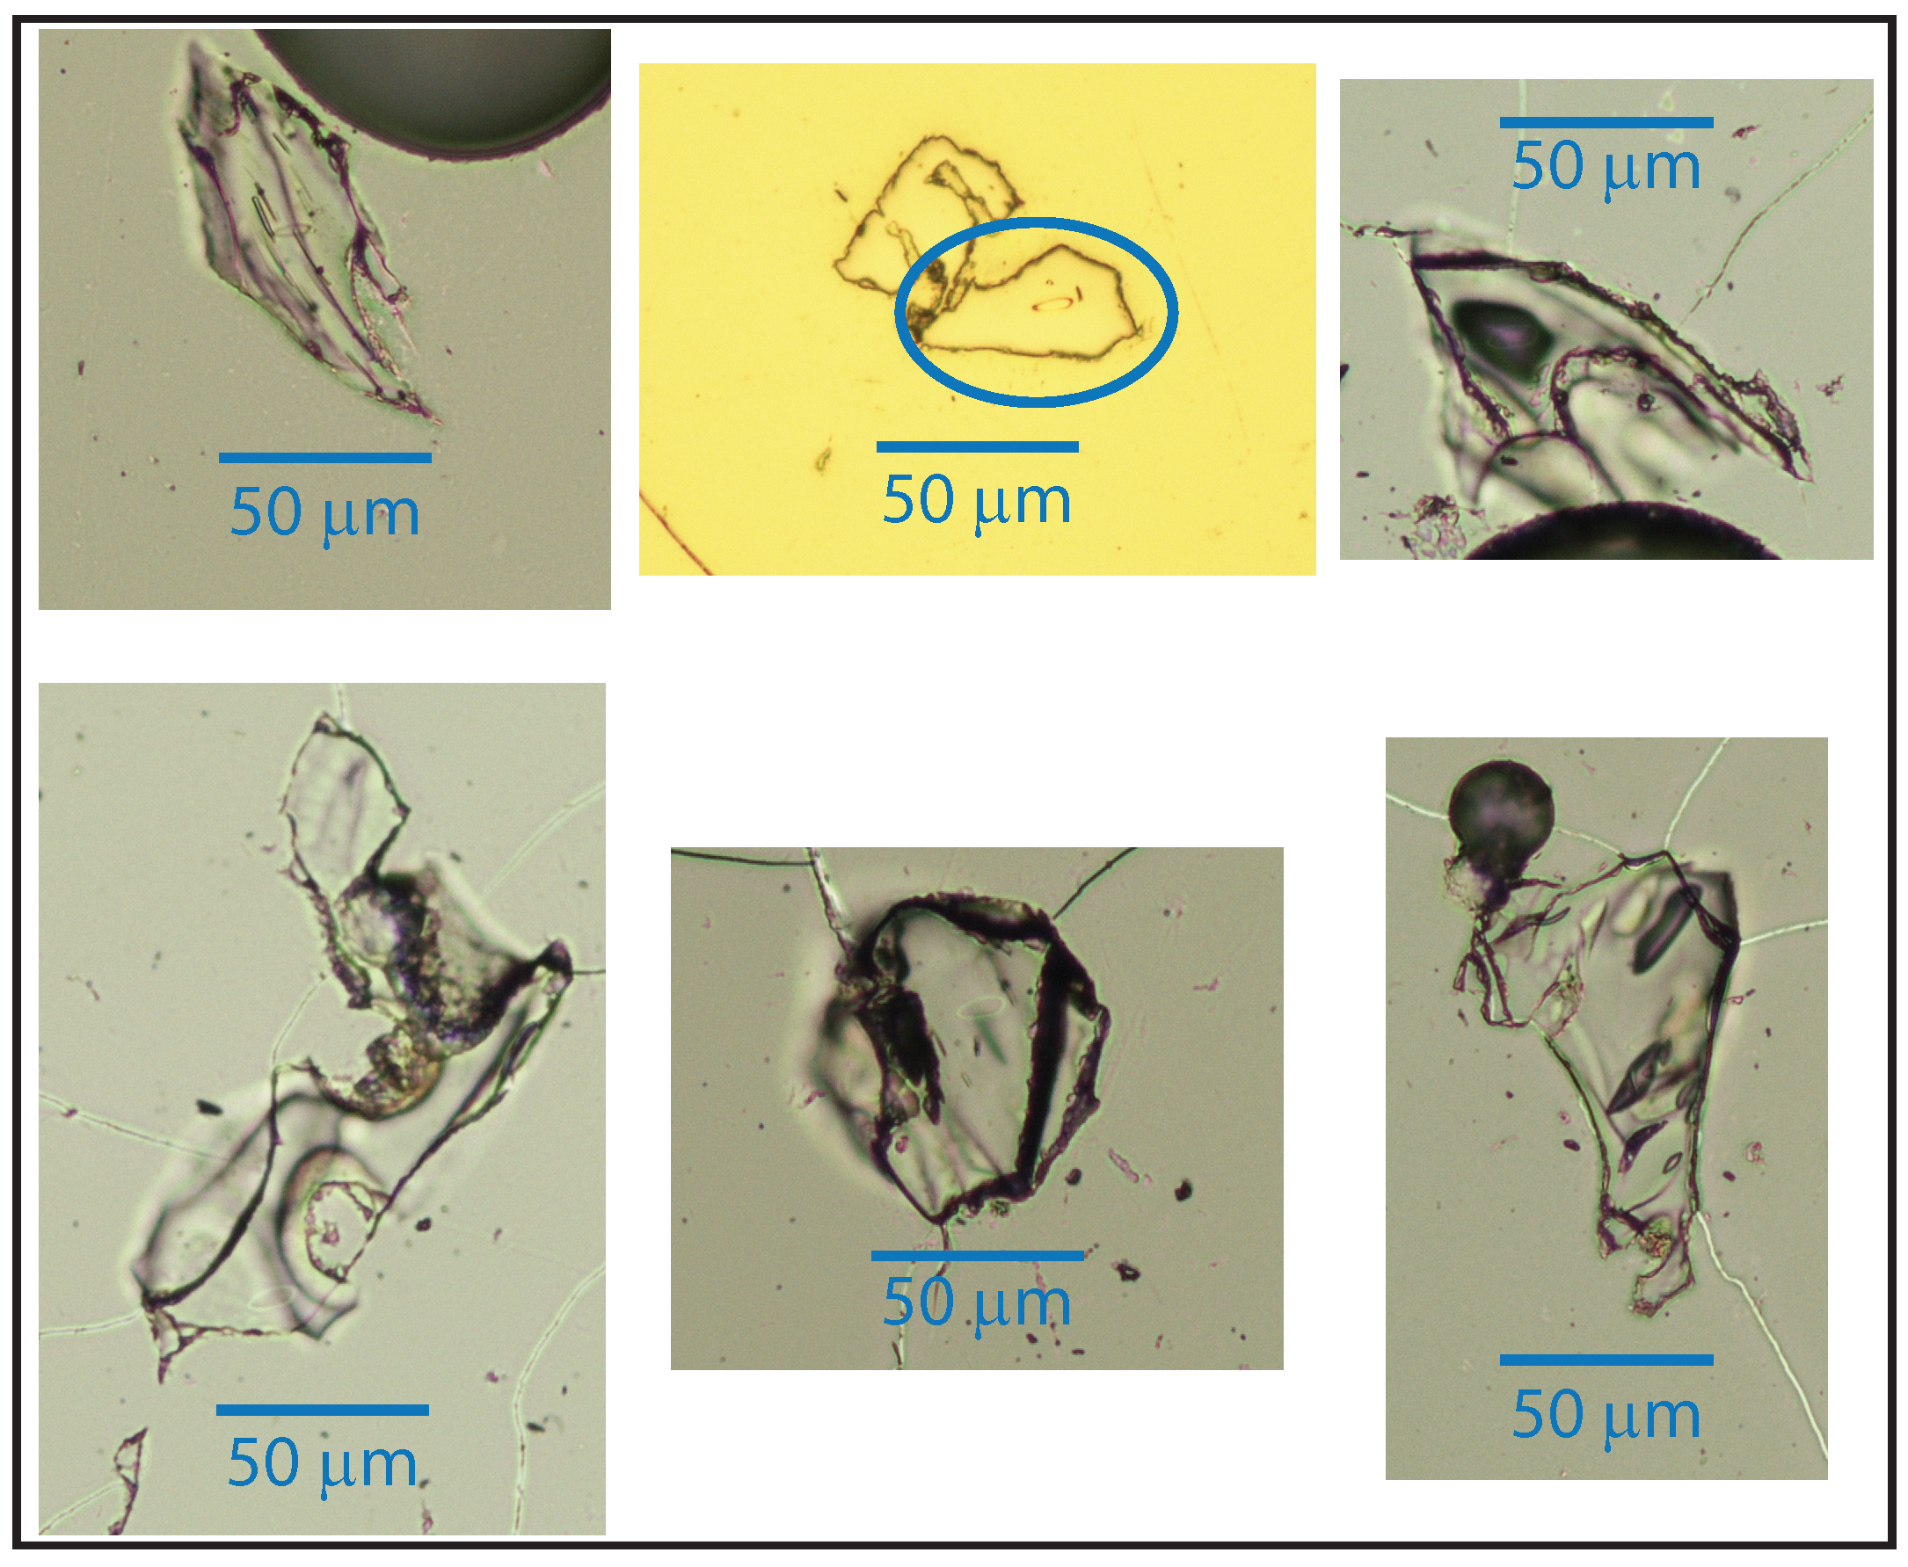
Images of Tule Springs Shards

Slide 10
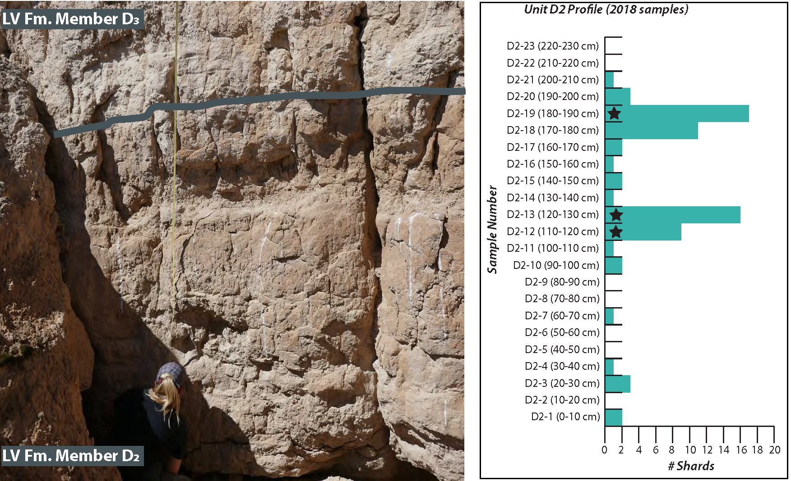

Slide 11
Geochemistry
Major and Trace element chemistry.
Shards are mainly glass and provide excellent chemistry but are easily altered by both chemical and physical processes.
Comparison of chemistry of shards to possible source areas. Rule out certain areas, accept others.
A convincing geochemical match must involve the use of many major and trace elements.
With small data sets, a match is based on visual comparison. Bayesian statistics are useful in documenting source.

Slide 12
D2-31.68-27.58; Springer
et al. 2018
20 to 60 ka
575 ka

Slide 13
Wilson creek tephra-mono craters
19 tephra units representing eruptions from Mono Craters domes (Marcaida et al. 2019)
Age < 23 to 62 ka
Units indistinguishable based on major element chemistry, high silica rhyolites
Use trace elements or titanomagnetite compositions (Marcaida et al. 2014)
But titanomagnetite not present in distal deposits so rely on trace elements.

Slide 14
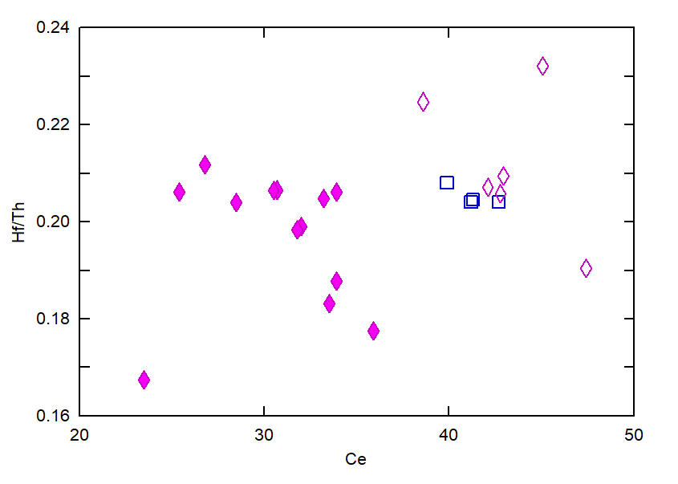
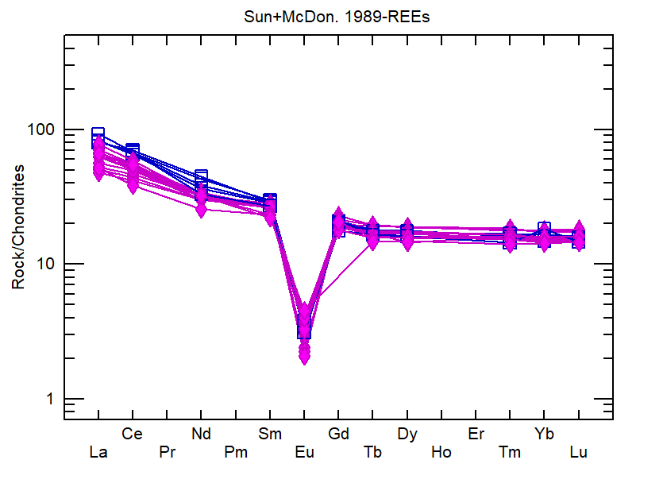
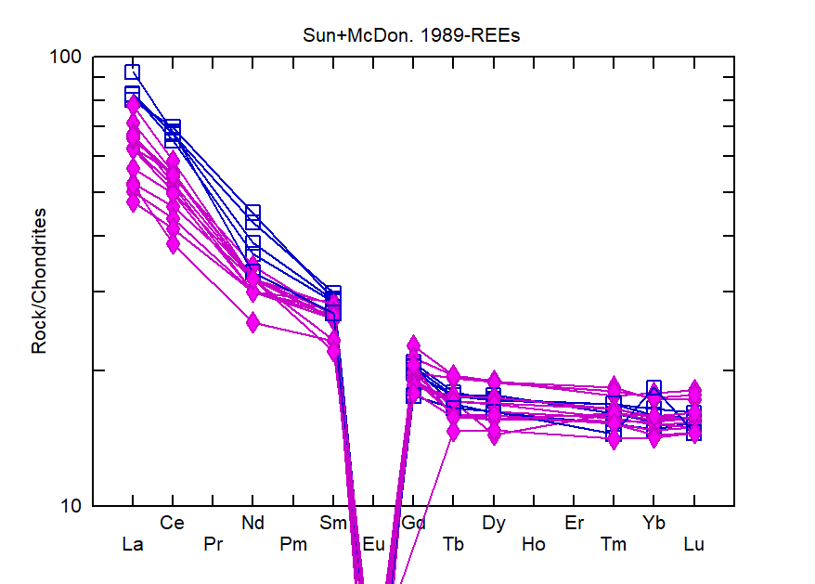
Wilson Creek Tephra from the Mono Craters, California
WC-6
WC-15
Tule Springs
WC-5
WC-1
WC-7
REE data INAA from Andrei Sarna-Wojcicki and UNLV for WC-15

Slide 15
Wilson Creek Tephra Unit | Age U-Th Marcaida et al. 2019; Vazquez & Lidzbarski 2012 | Tule Springs D2 Springer et al. 2017
WC-1 | <23 ka
WC-5 | ~23 ka
WC-6 | ~23-27 ka
WC-7 | 26.8 +/-2.1 ka | 31.68-27.58 ka
WC-8 | 34.1 +/- 1.2 ka
WC-15 | 40.8 +/- 1.9 ka

Slide 16
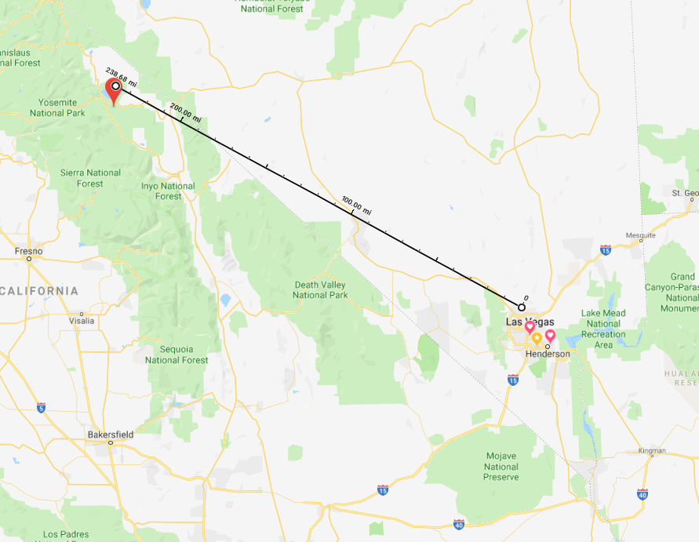
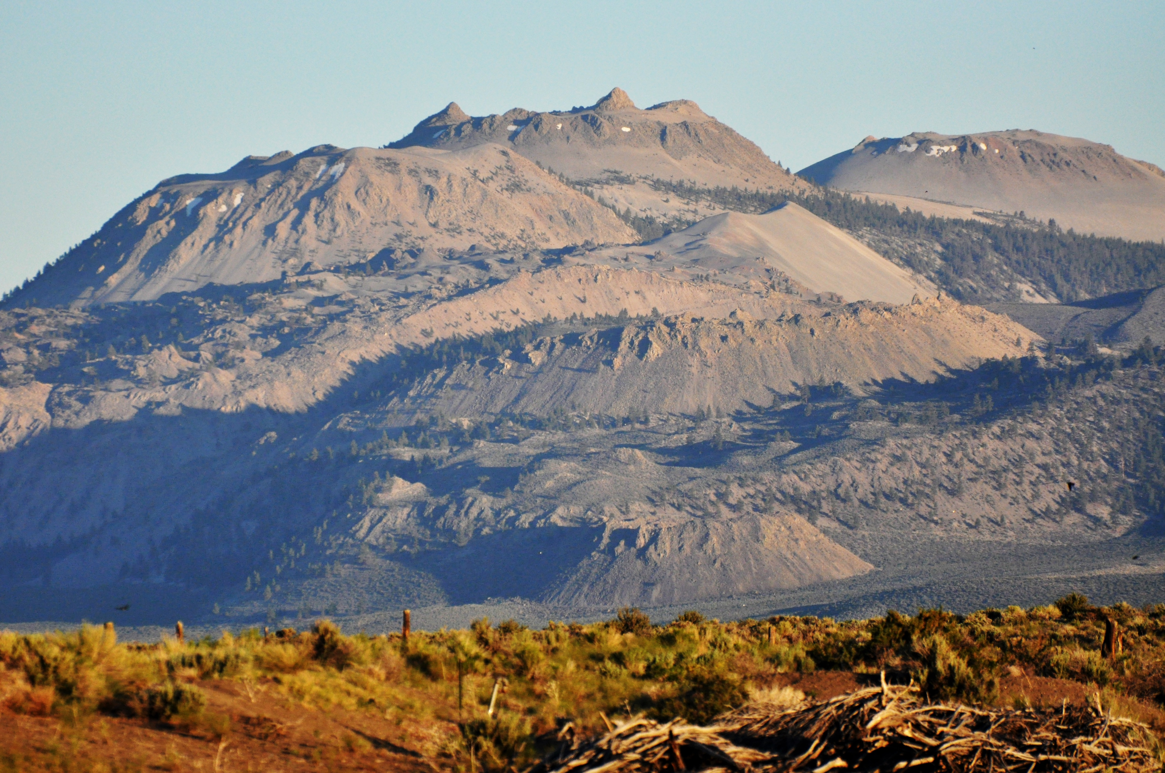
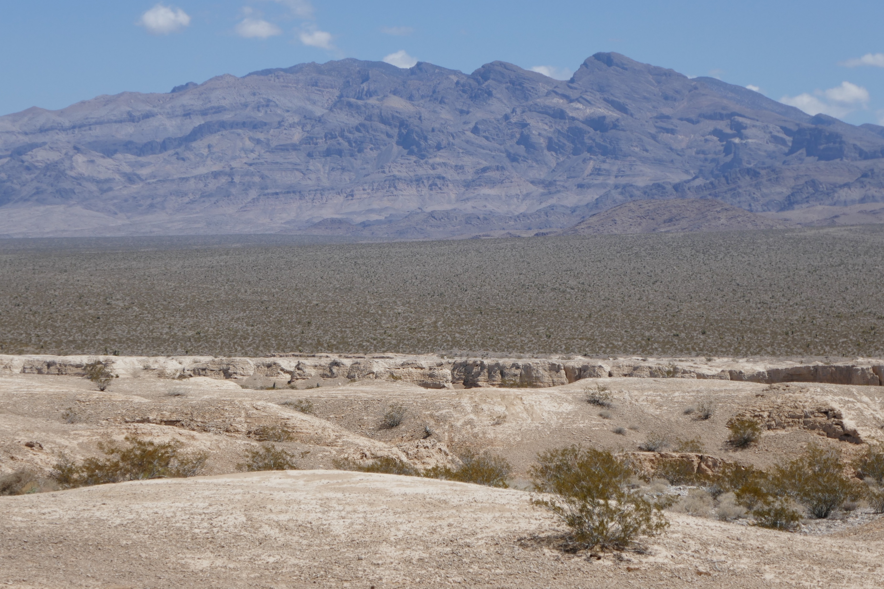
Summary
First report of shards at Tule Springs
Best match is WC-7
Extends the range of Wilson Creek tephra
into southern Nevada
Small differences in light REE content may
help distinguish Wilson Creek units
Shards from eruption
transported ~370 km
Deposited in paleowetlands
At Tule Springs
Eruption 26.8 ka from the
Mono Craters

Slide 17
Summary
Cryptotephra provide a precise timeline or isochron to date and correlate sediments and test existing age models.
26 ka

Slide 18
acknowlegements
NSF Grant BCS 1917173.
Elmira Wan and Andrei Sarna-Wojcicki for sharing data and providing a sample of WC-15.
Jeff Knott for discussions and sharing data.
Tule Springs Fossil Beds National Monument for sampling permit

