Slide 1


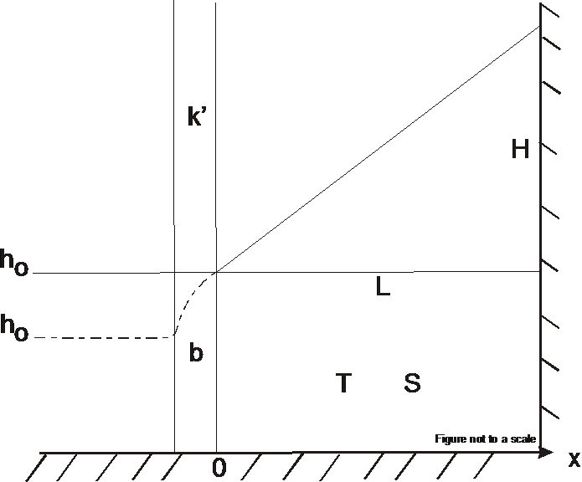
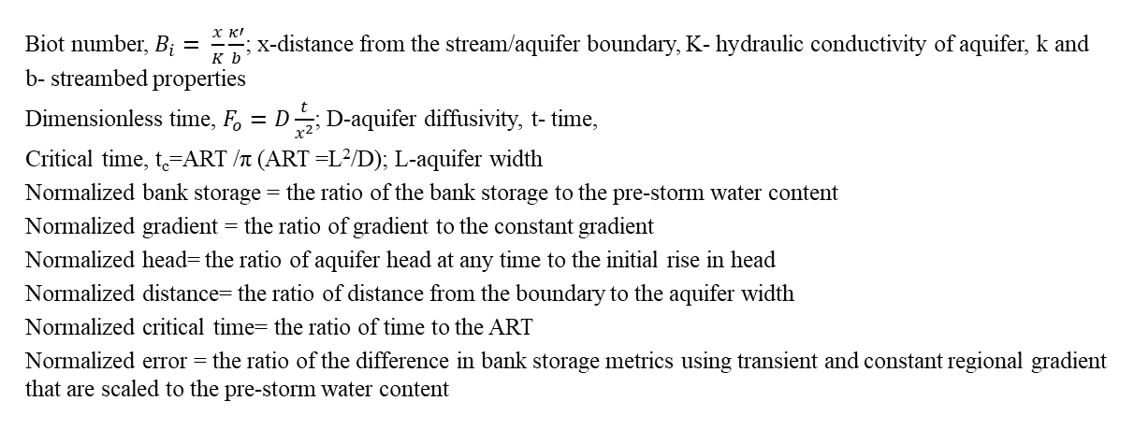
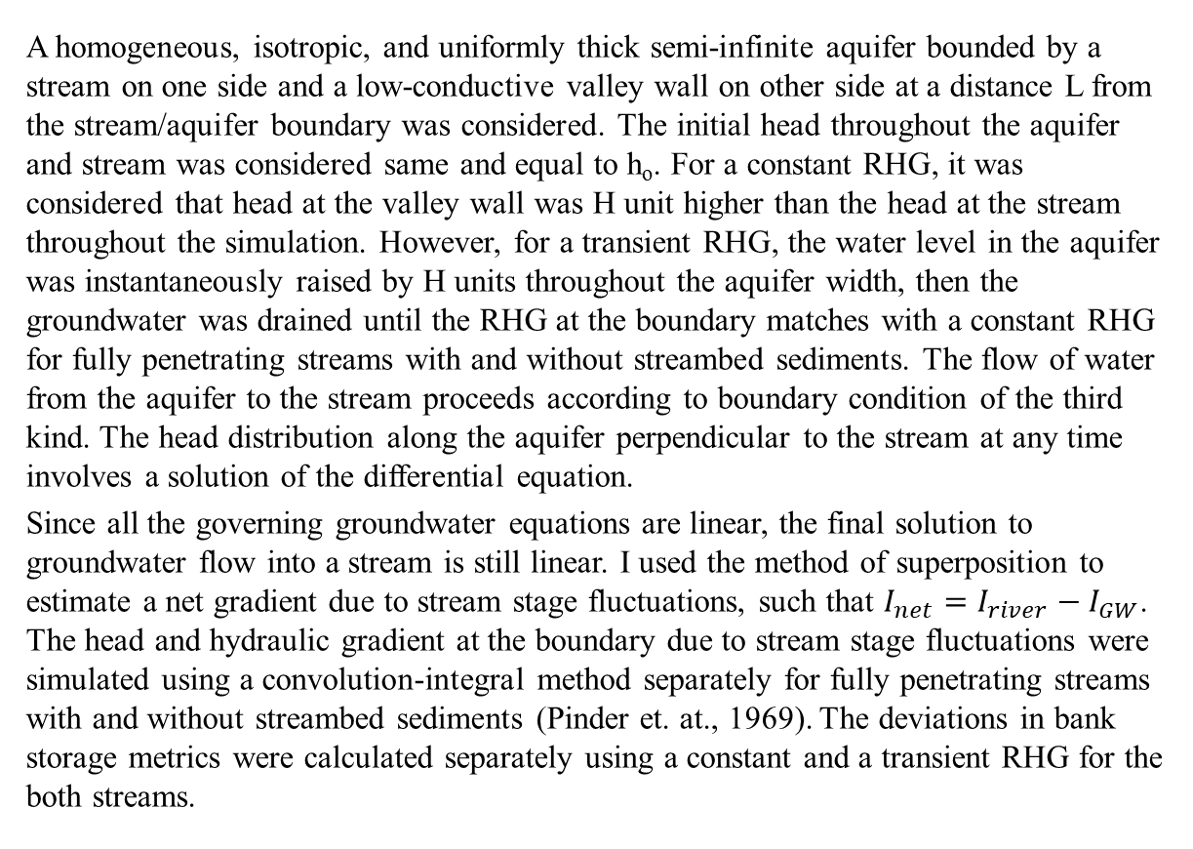
DIVERGENCE IN BANK STORAGE METRICS:
CONSTANT VERSUS TRANSIENT HYDRAULIC GRADIENT
Madan Maharjan, University of North Carolina at Pembroke
ABSTRACT
RESULTS
METHODS
The hydraulic gradient along stream/aquifer boundary is one of the most variable parameters in a stream/aquifer system. The regional hydraulic gradient (RHG) towards a stream had been often neglected or considered linear and static while estimating bank storage. In this study, I used a non-linear, transient RHG to estimate the bank storage in response to a hypothetical flood wave. The purpose of this study was to compute bank storage using a constant vs a transient RHG separately and estimate the difference between two corresponding results. For a constant RHG, it was considered that head at the valley wall was H unit higher than the head at the stream throughout the simulation. However, for a transient RHG, the water level in the aquifer was instantaneously raised by H units throughout the aquifer width, then the groundwater was drained under a natural gradient until the transient RHG at the stream/aquifer boundary matches with the constant RHG for fully penetrating streams with and without streambed sediments. Water table thus obtained was slightly different from that of the constant RHG. A convolution-integral method was used to estimate flux across the stream/aquifer boundary. Results showed that bank storage was larger and baseflow started later in time for the transient RHG than that for the constant RHG. Furthermore, the difference in bank storage between the two RHG diverged significantly and increased after the critical time. Flood duration longer than the critical time requires consideration of a transient RHG for better estimation of bank storage, especially for narrow but high transmissive alluvial aquifers.
A homogeneous, isotropic, and uniformly thick semi-infinite aquifer bounded by a stream on one side and a low-conductive valley wall on other side at a distance L from the stream/aquifer boundary was considered. The initial head throughout the aquifer and stream was considered same and equal to h_{o}. For a constant RHG, it was considered that head at the valley wall was H unit higher than the head at the stream throughout the simulation. However, for a transient RHG, the water level in the aquifer was instantaneously raised by H units throughout the aquifer width, then the groundwater was drained until the RHG at the boundary matches with a constant RHG for fully penetrating streams with and without streambed sediments. The flow of water from the aquifer to the stream proceeds according to boundary condition of the third kind. The head distribution along the aquifer perpendicular to the stream at any time involves a solution of the differential equation.
Since all the governing groundwater equations are linear, the final solution to groundwater flow into a stream is still linear. I used the method of superposition to estimate a net gradient due to stream stage fluctuations, such that $I_{net}=I_{river}−I_{GW}$. The head and hydraulic gradient at the boundary due to stream stage fluctuations were simulated using a convolution-integral method separately for fully penetrating streams with and without streambed sediments (Pinder et. at., 1969). The deviations in bank storage metrics were calculated separately using a constant and a transient RHG for the both streams.
INTRODUCTION & OBJECTIVES
Figure 2. Head distribution (h/H) along the aquifer width (x/L) next to (a) a fully penetrating stream without sediment and with a thin layer of low conductive stream sediments defined by a biot number (b) 10, (c) 5, and (d) 2.
CONCLUSIONS
Bank storage is referred to the process of stream water being temporarily stored in a stream bank and discharge the stored water back to the stream (Squillace, 1996). It attenuates a flood wave (Pinder and Sauer, 1971; Hunt, 1990), contributes substantial discharge to streams during base flow periods (Cooper and Rorabaugh, 1963) and retains for months depending upon connectivity between a river and an aquifer (Simpson and Meixner, 2012).
The hydraulic gradient along stream/aquifer boundary is one of the most variable parameters in a stream/aquifer system. Water exchanges between stream and aquifer according to the hydraulic gradient at their interface (Boutt and Fleming, 2009). Bank storage remains unaffected at a lower regional hydraulic gradient (RHG) (Chen and Chen, 2003) but is significantly reduced at higher RHG (Chen et al., 2006). Despite the importance of the RHG, it had often been neglected while calculating bank storage up until sixties. Rorabaugh (1964) showed the RHG is neither a linear nor a static for a finite aquifer. Yet, the RHG is considered a linear and static for a simplicity hence miscalculating bank storage metrics.
In this study, I used a non-linear, transient RHG to estimate bank storage in response to a hypothetical flood wave that has longer flood duration than the critical time defined as L²/πD (L=aquifer width and D= aquifer diffusivity). The purpose of this study was to calculate the divergence in bank storage metrics next to fully penetrating streams with and without streambed sediments using a constant vs a transient RHG. Such analysis shows the spatiotemporal distribution of bank storage and improves our understanding of groundwater and surface water interactions and sheds light on potential biogeochemical reactions and contaminant transport in the bank storage zone. Such knowledge allows us to make well-informed decisions towards environment protection and resource management.
Figure 5. Normalized bank storage estimated next to a fully penetrating stream without streambed sediments for different a) transmissivity, b) aquifer widths, c) flood wave duration, and d) flood height.
The water table at the critical time under the transient gradient is different from the constant gradient though the gradient at the boundary is same for both water tables. The water table for transient gradient has steep gradient near stream and gentle gradient at the valley wall.
The F_{o} number is a measure of time and shows that aquifer with high diffusivity responds faster than those with a low diffusivity; wider aquifer responds more slowly than the narrow ones.
The aquifer response to a low B_{i} number is dominated by streambed resistance while those with a large B_{i} number are dominated by the aquifer resistance. For a high B_{i} number, the transient gradient for fully penetrating streams with streambed sediments approximately equal to that for a fully penetrating stream without streambed sediments.
For a high-transmissive aquifer, a streambed material of low transmissivity can have a very marked effect but for a low-transmissive aquifer, the effect of streambed is much less important.
RHG cannot be neglected while estimating bank storage next to a finite-width aquifer. Steady-state Darcy flux from aquifer to river overestimates groundwater discharge and could produce erroneous results if used for a longer period where lateral seepage is absent.
MATHEMATICAL NOTATIONS
Biot number, $B_{i}= \frac{x}{K}\frac{κ′}{b}$; x-distance from the stream/aquifer boundary, K- hydraulic conductivity of aquifer, k and b- streambed properties
Dimensionless time, $F_{o}=D\frac{t}{x^{2}}$; D-aquifer diffusivity, t- time,
Critical time, t_{c}=ART /π (ART =L²/D); L-aquifer width
Normalized bank storage = the ratio of the bank storage to the pre-storm water content
Normalized gradient = the ratio of gradient to the constant gradient
Normalized head= the ratio of aquifer head at any time to the initial rise in head
Normalized distance= the ratio of distance from the boundary to the aquifer width
Normalized critical time= the ratio of time to the ART
Normalized error = the ratio of the difference in bank storage metrics using transient and constant regional gradient that are scaled to the pre-storm water content
Figure 3. Normalized bank storage next to (a) a fully penetrating stream with no sediments and with a low conductive layer of stream sediments defined by a biot number (b) 10, (c) 5, and (d) 2 in the presence of zero, transient, and constant regional gradient as well as recharge against dimensionless time.
Figure 6. Normalized dimensionless gradient versus dimensionless time for an aquifer next to a fully penetrating stream with no streambed sediment (black) and with a sediment layer of different thicknesses.
REFERENCES
Boutt, D. F., and B. J. Fleming, 2009, Implications of anthropogenic river stage fluctuations on mass transport in a valley fill aquifer: Water Resources Research, v. 45, p. 14.
Chen, X., D. Q. Y. Chen, and X. H. Chen, 2006, Simulation of baseflow accounting for the effect of bank storage and its implication in baseflow separation: Journal of Hydrology, v. 327, p. 539-549.
Chen, X. H., 2003, Analysis of pumping-induced stream-aquifer interactions for gaining streams: Journal of Hydrology, v. 275, p. 1-11.
Cooper, H. H., and M. I. Rorabaugh, 1963, Ground-water movements and bank storage due to flood stages in surface streams, Ground-water hydraulics, Washington, U.S. Geological Survey, p. 343-366.
Hunt, B., 1990, An approximation for the bank storage effect: Water Resources Research, v. 26, p. 2769-2775.
Pinder, G. F., J. D. Bredehoeft, and H. H. Cooper, 1969, Determination of aquifer diffusivity from aquifer response to fluctuations in river stage: Water Resources Research, v. 5, p. 850-855.
Pinder, G. F., and S. P. Sauer, 1971, Numerical simulation of flood wave modification due to bank storage effects: Water Resources Research, v. 7, p. 63-70.
Rorabaugh, M. I., 1964, Estimating changes in bank storage and groundwater contribution to streamflow: International Association of Scientific Hydrology, v. 63, p. 432-441.
Simpson, S., and T. Meixner, 2013, The influence of local hydrogeological forcing on near stream event water recharge and retention (Upper San Pedro River, Arizona): Hydrological Processes, v. 27, p. 617-327.
Squillace, P. J., 1996, Observed and simulated movement of bank-storage water: Ground Water, v. 34, p. 121-134.
Figure 1. A conceptual diagram of a constant RHG for a fully penetrating stream with and without streambed materials.
Figure 4. Normalized critical time as a function of 1/Bi.
Figure 7. Normalized errors between transient and constant regional gradient for different biot numbers.
Notes:
Printing in double size (200%)

