Slide 1
Observations of Post impact volcanism Hiatus Within the largest Impact Craters
Connelly, Daniel P., MAPCIS Research
The hypothesis that large impacts initiate post impact volcanism is hotly debated. This is a presentation of observations of post impact volcanism within the presumed crater rims of the largest known and some suspected impact craters on continental crust. Since 2007, I researched MAPCIS, a large impact crater in Australia of a presumed age between ~550Ma – 535Ma. It is surrounded by Kalkarindji LIP ~510Ma and Mooracoochie volcanics ~517Ma. Upon review of 1:250,000 geology maps and the literature, I found no evidence of volcanism in an area of over 300,000 km² within MAPCIS crater rim younger than the presumed impact event. A review of the known largest confirmed impacts of Vredefort 2023Ma, Sudbury 1850Ma, Chicxulub 65Ma, and Acraman 590Ma as well as others such as Chesapeake Bay 35Ma and Beaverhead 600Ma show an absence or significant hiatus of volcanism post impact within the presumed crater rims. Beaverhead impact in Idaho is interesting as it surrounded by volcanic events of the Northwest USA including the Yellowstone hotspot. Gravity images suggest that hotspot volcanism may have been deflected around the area of Beaverhead impact. If these observations hold true, it could have implications in our understanding of the formation of stable buoyant continental crust. Are large impacts part of the process necessary to form continental crustal cores or cratons and what could be the impact physics underlying it? This opens this question to worldwide research to combine many disciplines of geology.

Slide 2
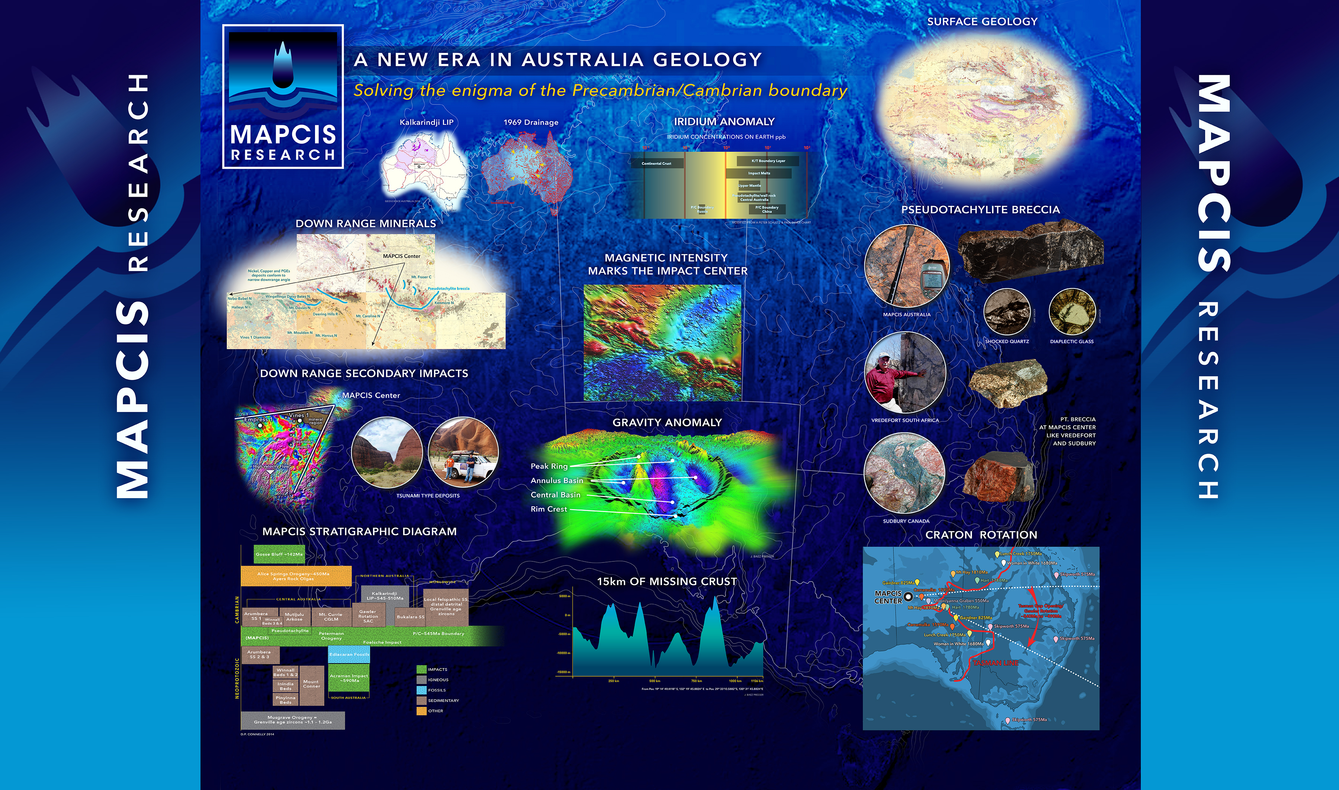

Slide 3
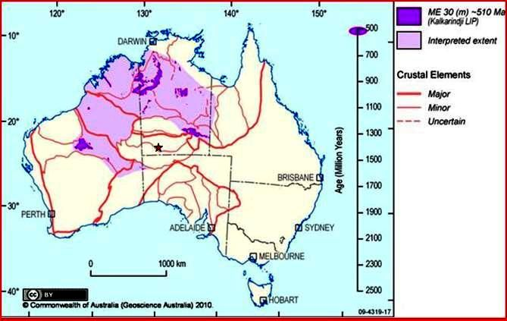
Mooracoochie 517Ma
Warnie 170Ma

Slide 4
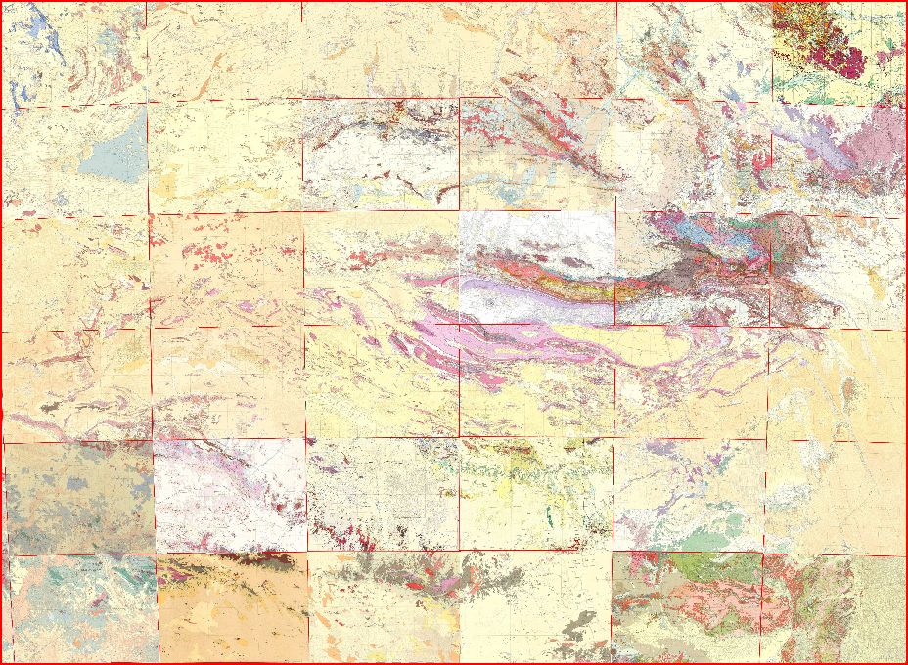
MAPCIS impact
~542Ma
36 Geoscience Australia
1:250,000 surface geology maps

Slide 5
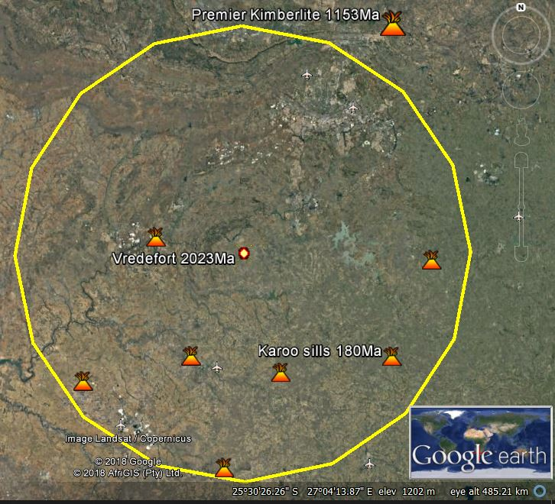
Vredefort Impact 300km diameter ~2028 ma, An exception to the observation???
Karoo sills~180Ma, part of the Karoo LIP still leave a hiatus of volcanic events of ~1850 Ma

Slide 6
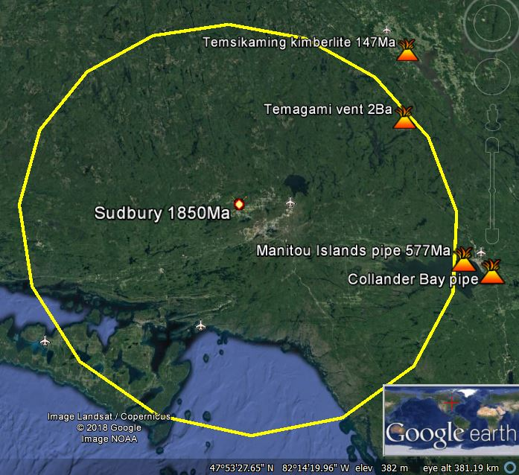
Sudbury Impact second largest at 200km~1850MA appears to hold to the observation
SBDS ~1.23Ga
Ages of volcanism:
Temsikaming ~147Ma
Temagami ~2000Ma
Manitou and Collander Bay ~577Ma
The Sudbury Dyke Swarm ~1.23Ga was brought to my attention after the session talk. Although this is not an exception to the rule. It shortens the known hiatus of volcanism to about 620 million years.

Slide 7
Does the observation hold true for other confirmed large impacts? Yes.
Chicxulub third largest
Popigai fourth largest
Acraman fifth largest
Beaverhead 9th largest
Tookoonooka 10th largest
Chesapeake 19th largest

Slide 8
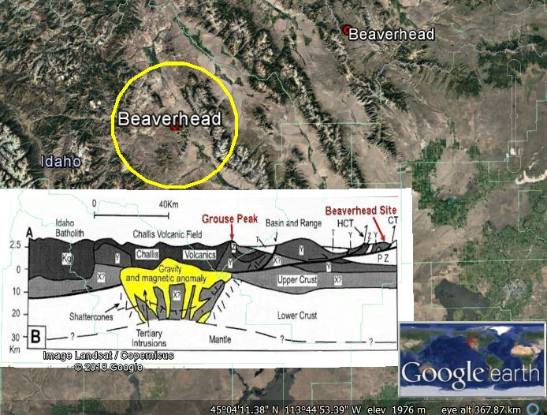
Beaverhead impact Idaho 60km diameter ~600ma surrounded by: Columbia River basalts LIP Cascade volcanics Challis volcanics Craters of the moon lava field and The Yellowstone hot spot
McCafferty. A.E. , (1995),

Slide 9
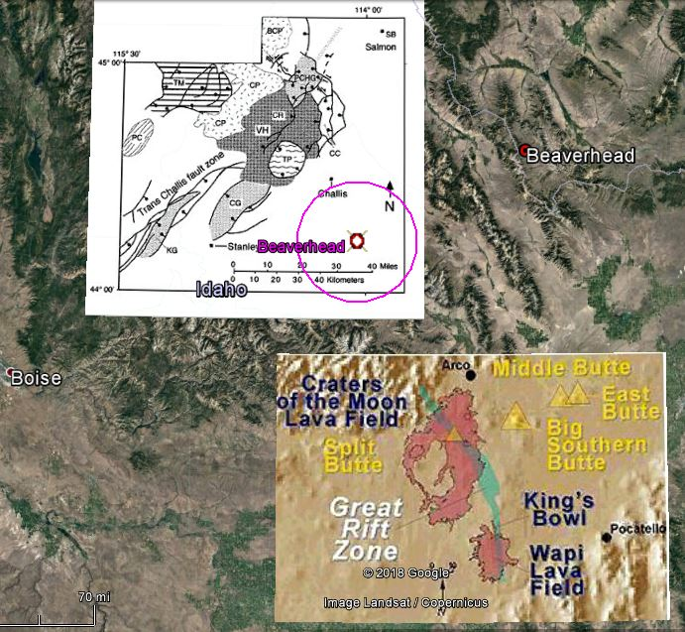
From Link and Janecke, 1999
Challis volcanics overtop Beaverhead but do not appear to penetrate the core.
Craters of the Moon lava field and the Great Rift Zone do not appear to penetrate the core.
Digital Atlas of Idaho

Slide 10
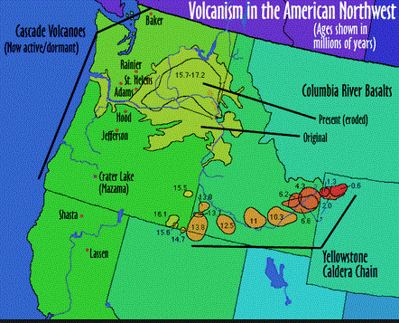
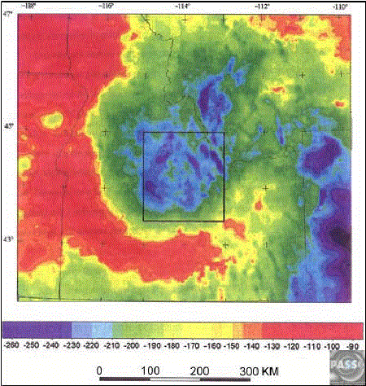
Volcanism map of Pacific northwest and the Bouguer Gravity map of the Beaverhead region
ttp://www.mmdtkw.org/ALRIVes0904NWUSVolcanism.jpg

Slide 11
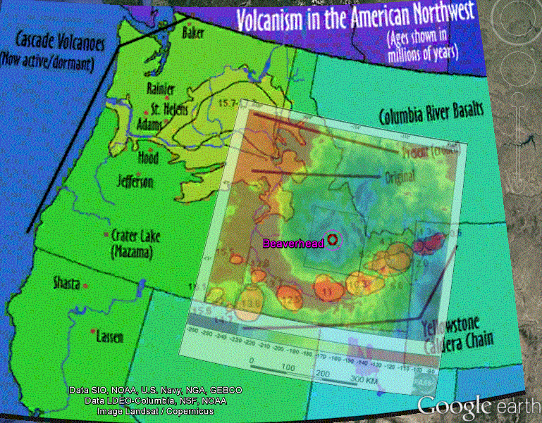
The maps together give a clearer picture

Slide 12
Biases
1. Selection bias: I studied the impacts I am familiar with and had the possibility of good volcanic mapping.
2. Survivor bias: Impacts destroyed partially or completely by subsequent volcanism are less likely to be found or confirmed.
Question:
Do large impacts survive because the target rock is tough and stable or does the target rock become tough and stable because of the impact?

Slide 13
Importance if the observation holds true
1. Plate tectonics need stable buoyant long-lasting cratons. Is impact cratering a part of this process?
2. As mapping volcanic provinces improves, it may be useful diagnostic in ruling out suspected buried impacts.

Slide 14
Thank you: In the memory of Warren B. Hamilton and Thank you to the session advocates Gillian Foulger, K. Howard & Donna M. Jurdy,
Special thanks to my mentor Arif Sikder and my sponsor Malgorzata Piszcz-Connelly

