Slide 1
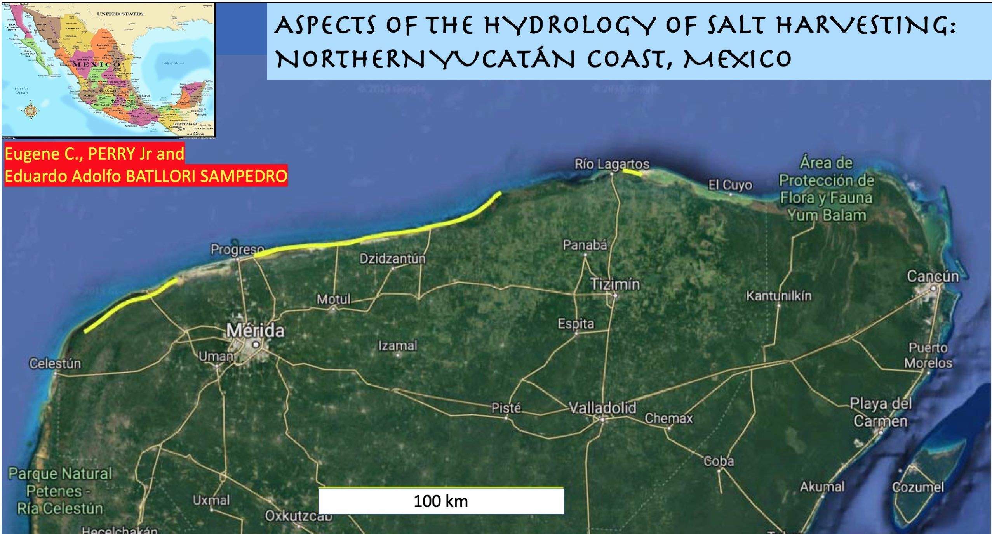

Slide 2
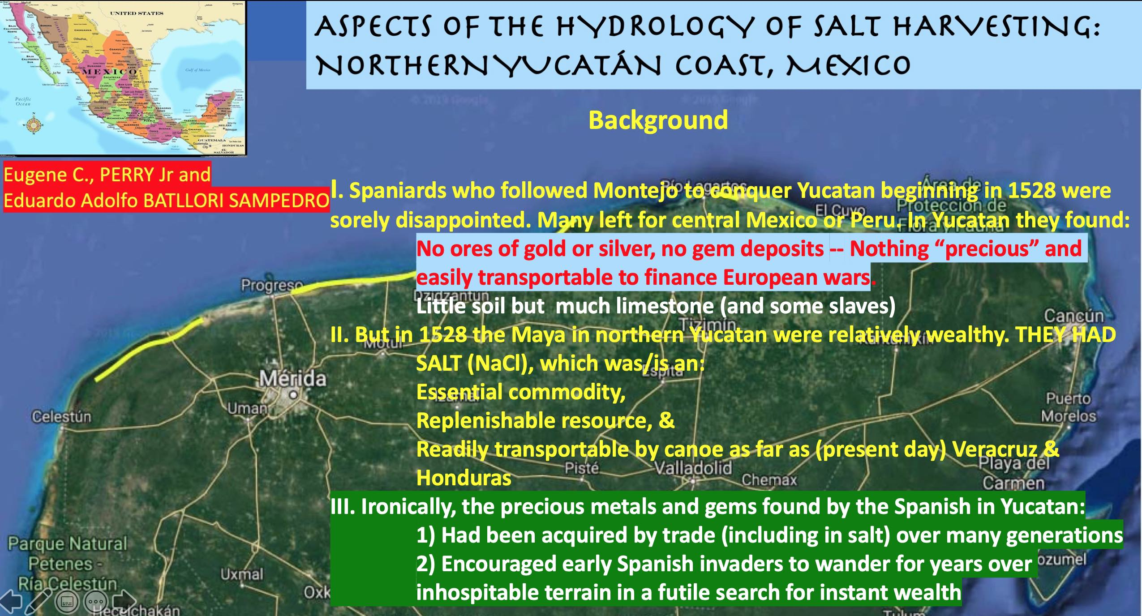

Slide 3
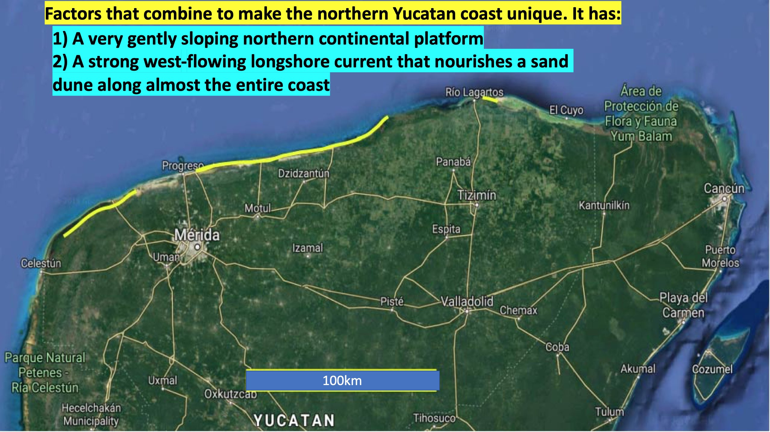

Slide 4
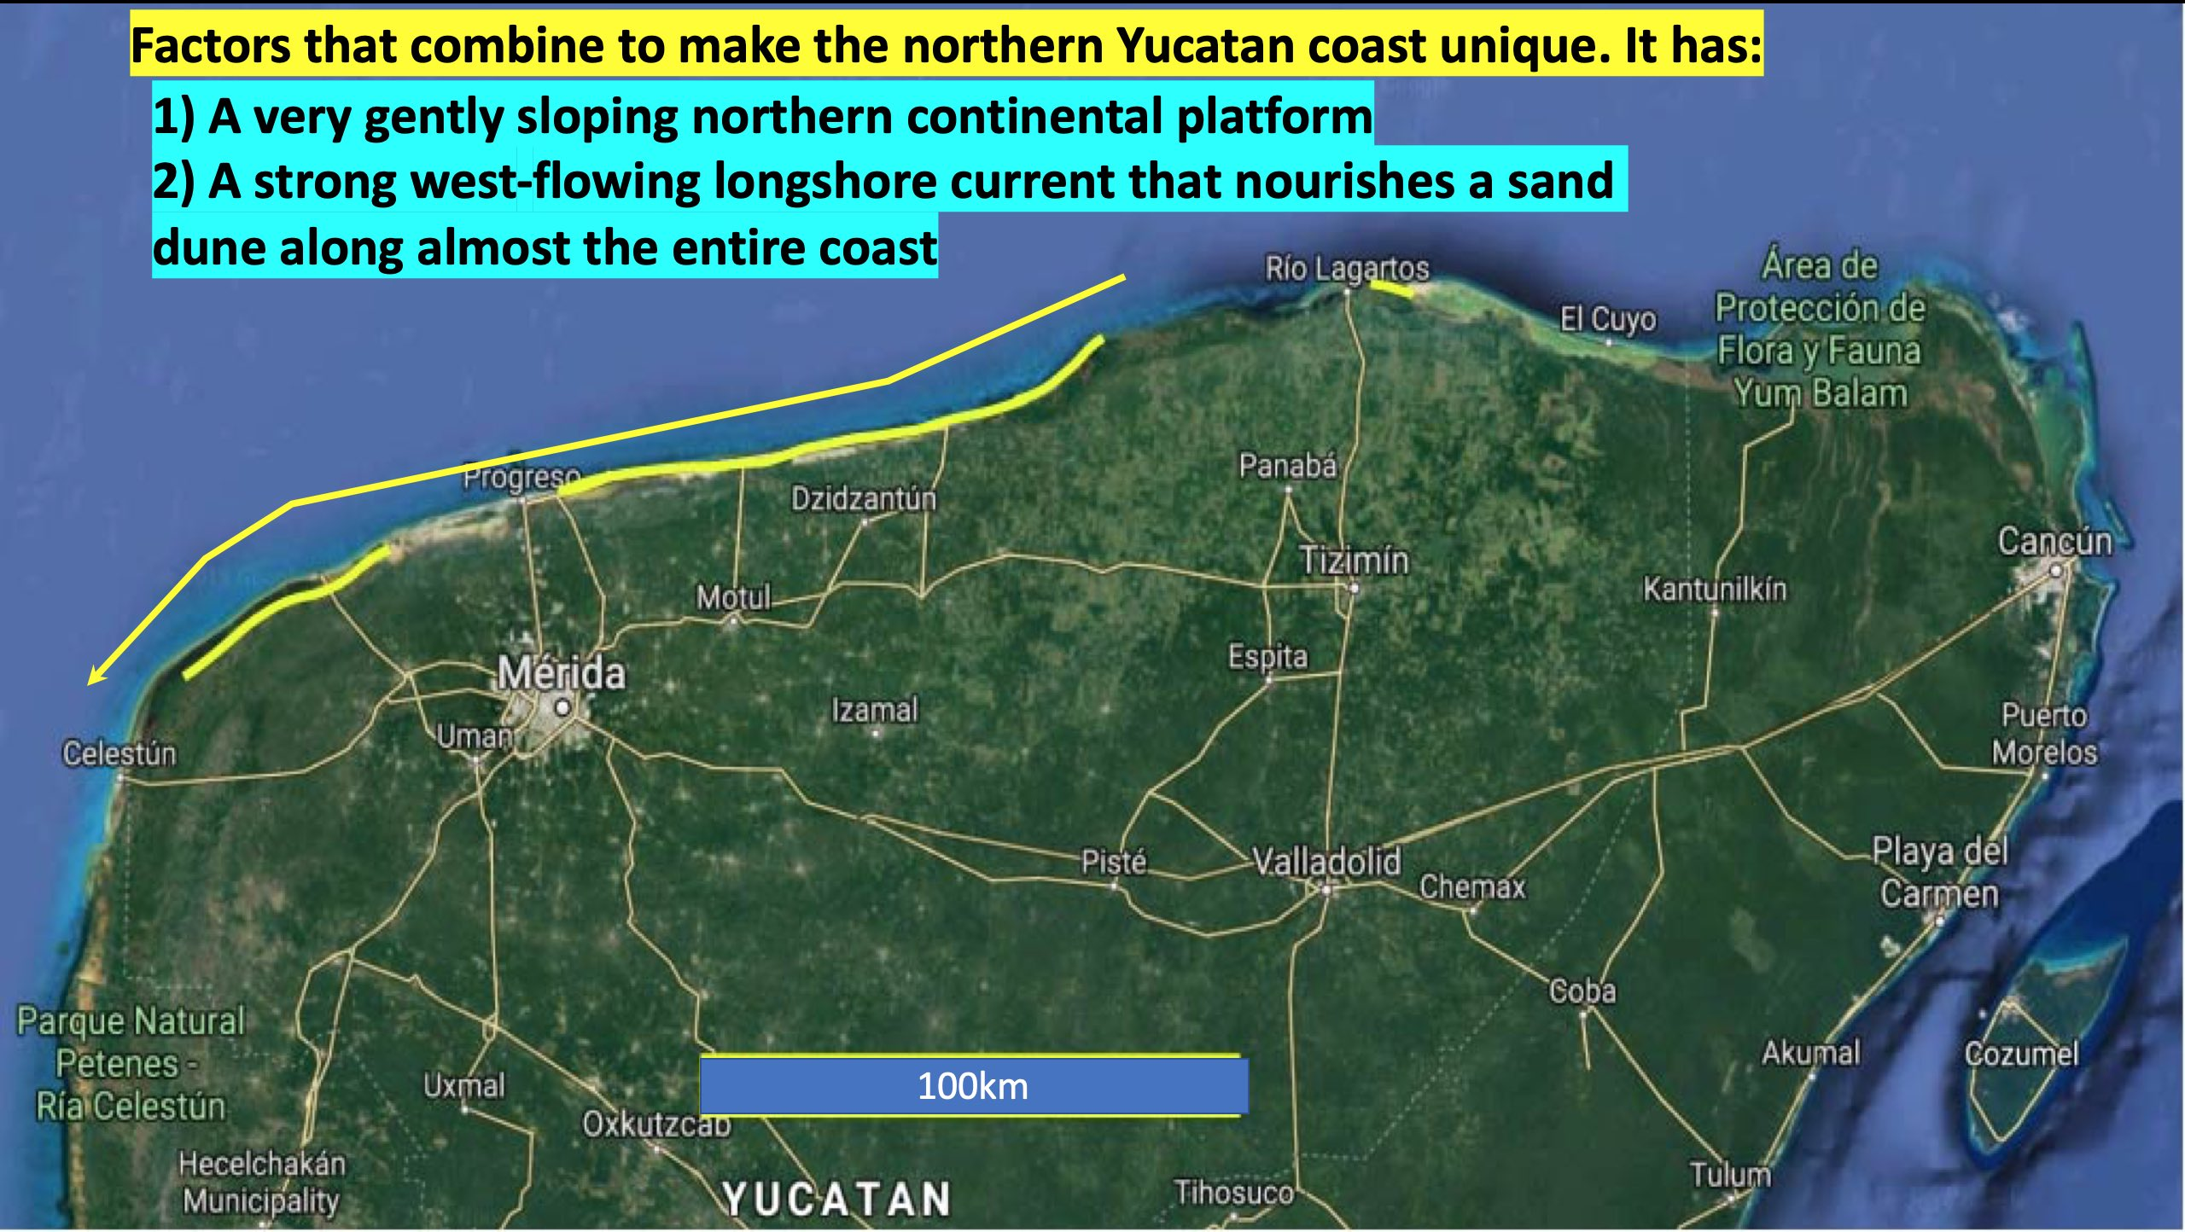

Slide 5
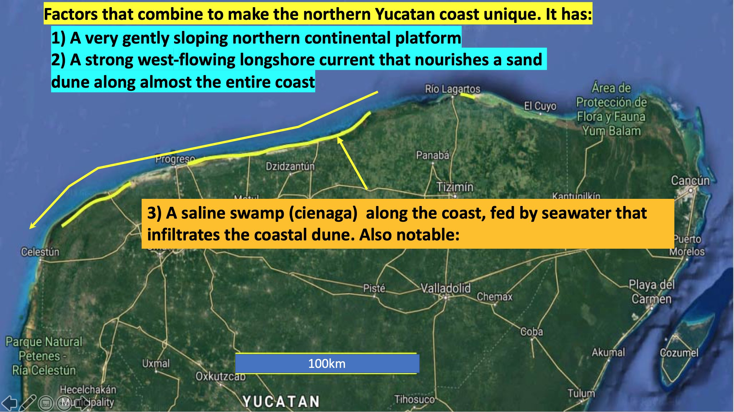

Slide 6
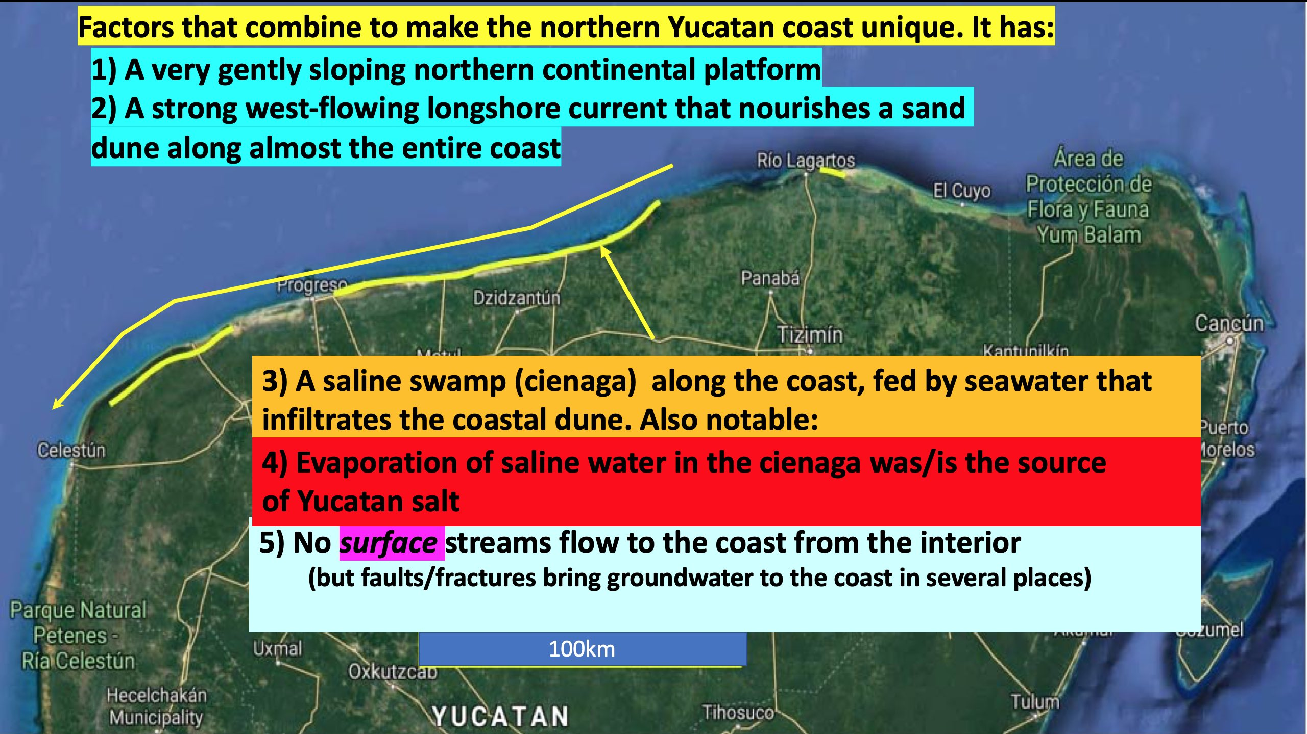

Slide 7
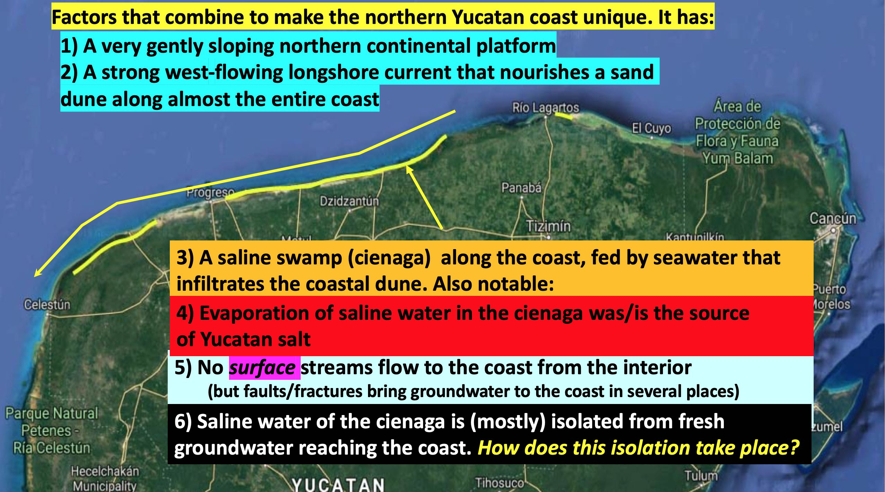

Slide 8
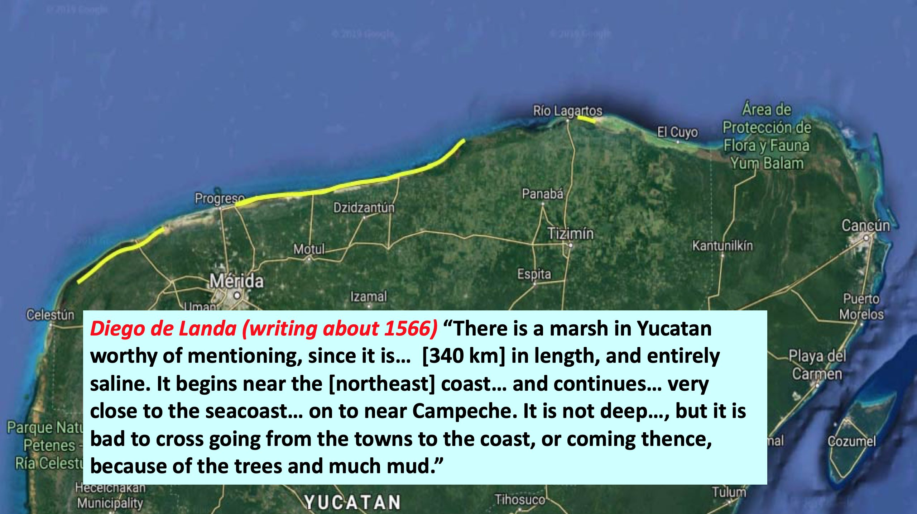
1570

Slide 9
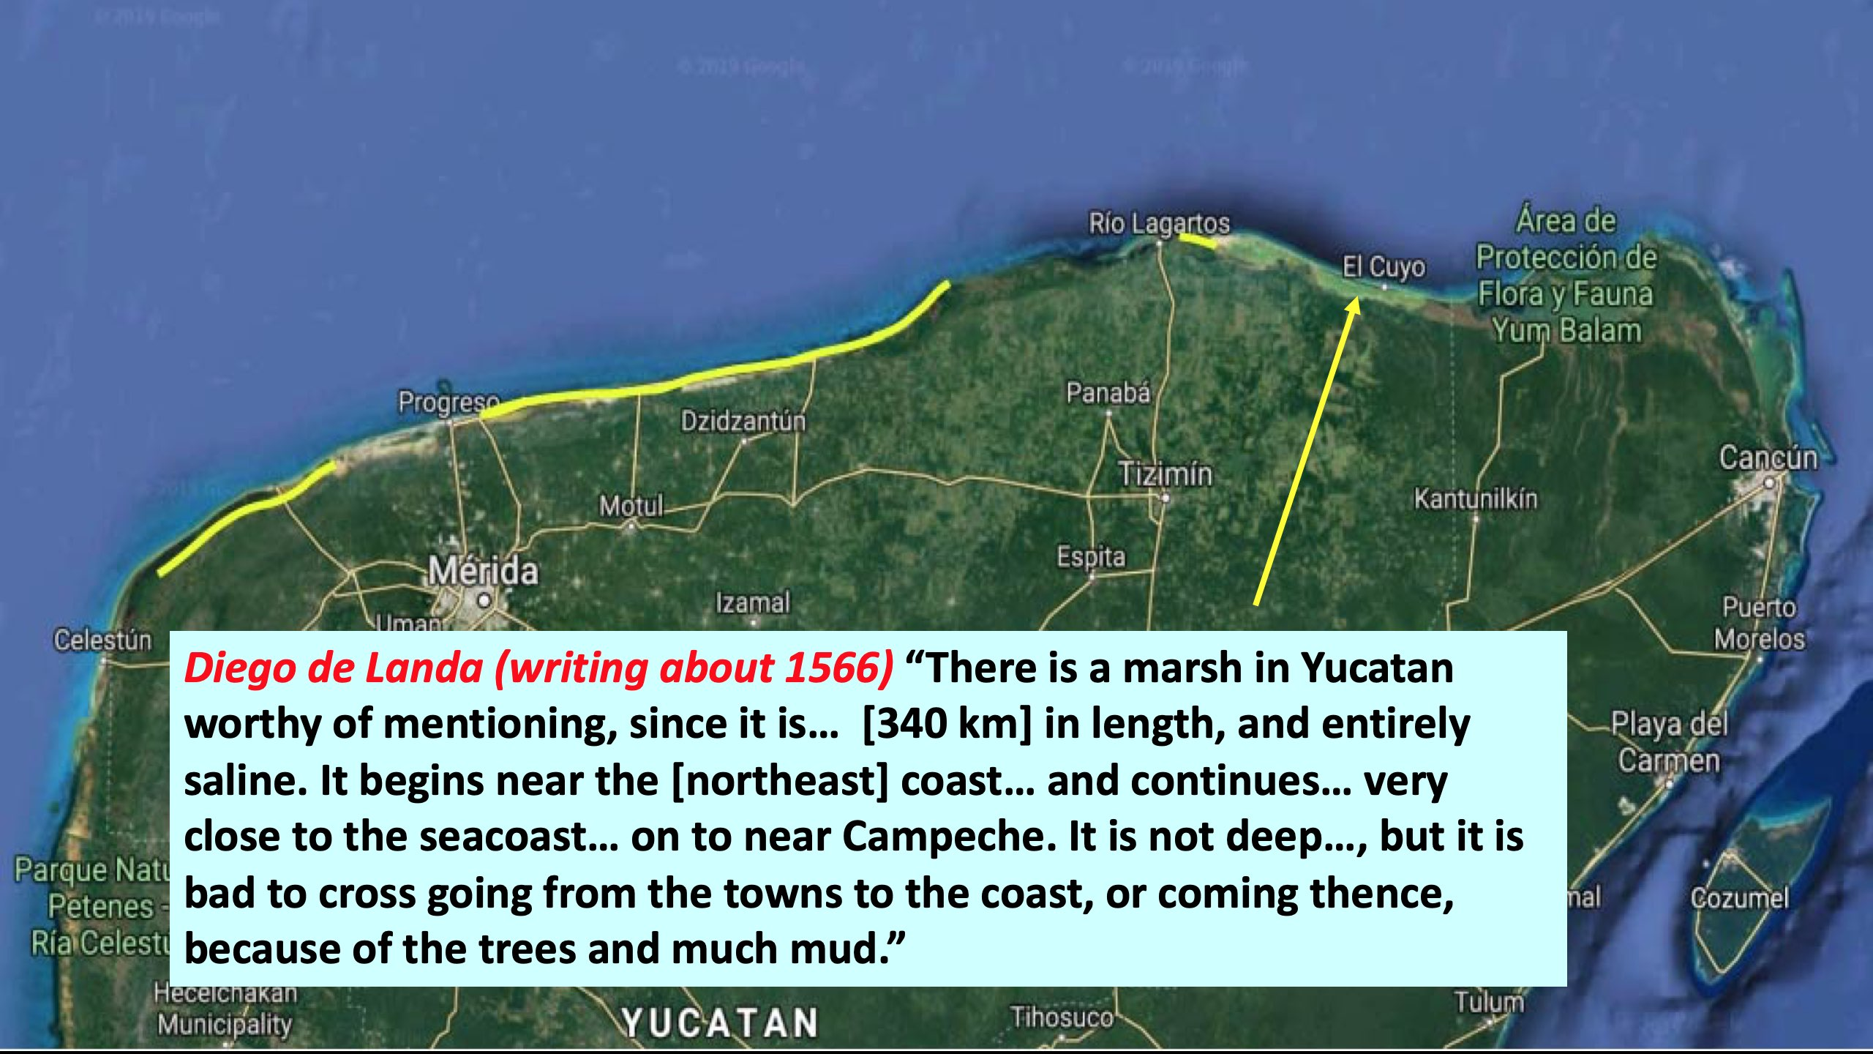
1570

Slide 10

1570

Slide 11

1570
(And alligators)

Slide 12
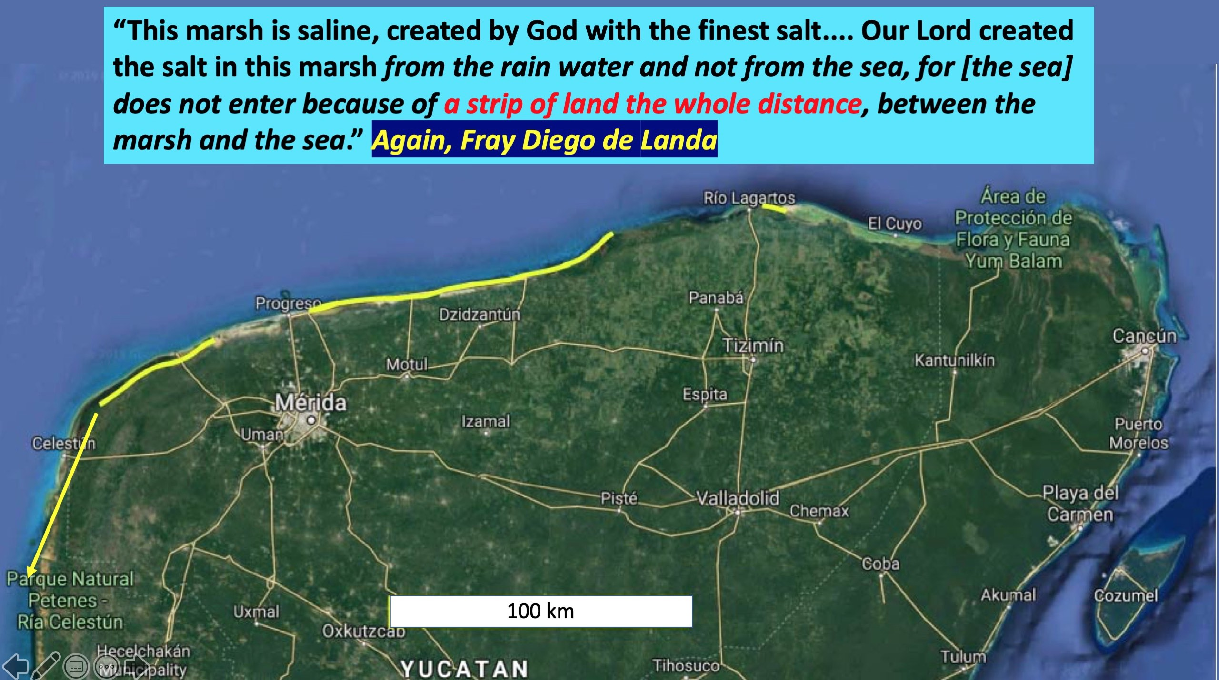

Slide 13
Notes on de landa:
Landa was a spanish priest who catalogued much of what is known about maya culture in a book: Relacion de las Cosas de Yucatan (~1570).
he is notorious for having ordered the collection and destruction of all maya books (codices) known at the time of his administration – the entire maya written record.
De landa was a keen observer. His inference that “our lord” created salt from rainwater was consistent with his implicit belief in the miracle of jesus converting water to wine.
FOR PERSPECTIVE: IT WASN’T UNTIL ABOUT 200 YEARS AFTER DE LANDA THAT THE PARIS ACADEMY FIGURED OUT THAT THE SEINE R. IS FED BY RAINWATER.

Slide 14
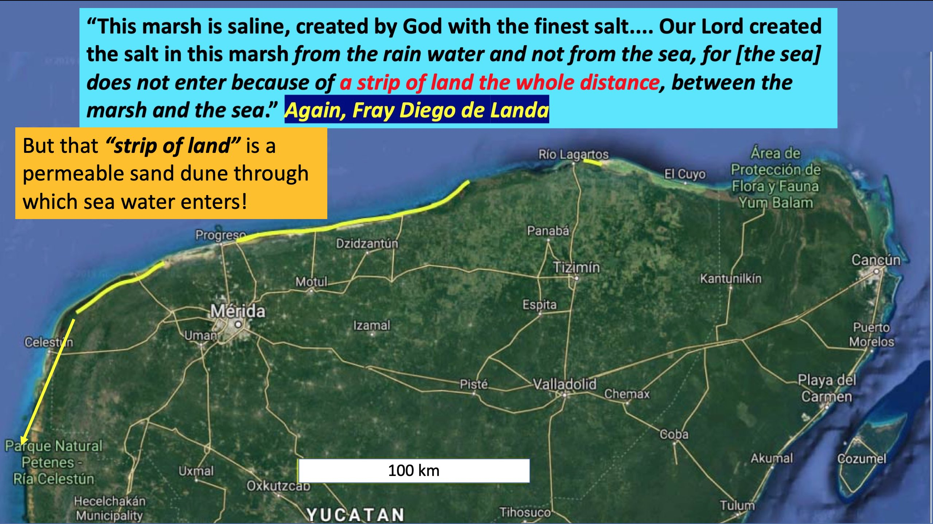

Slide 15
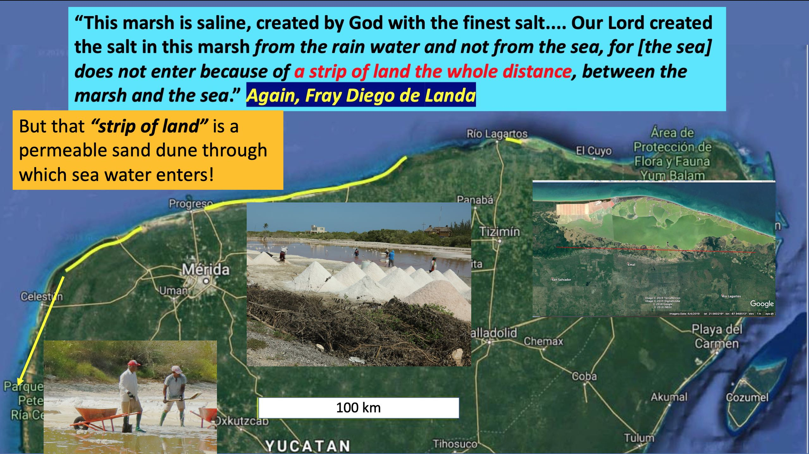

Slide 16
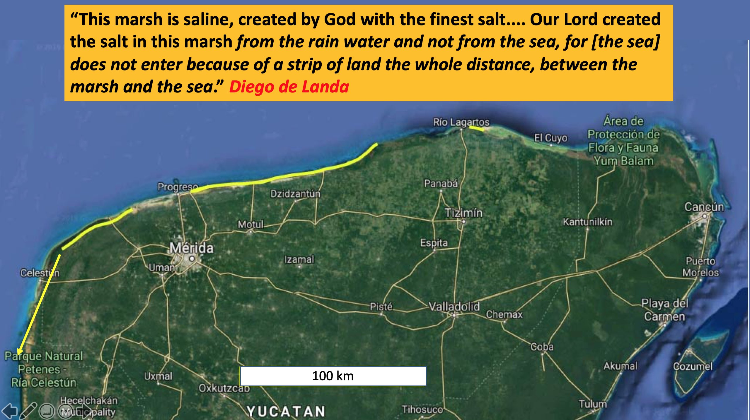

Slide 17
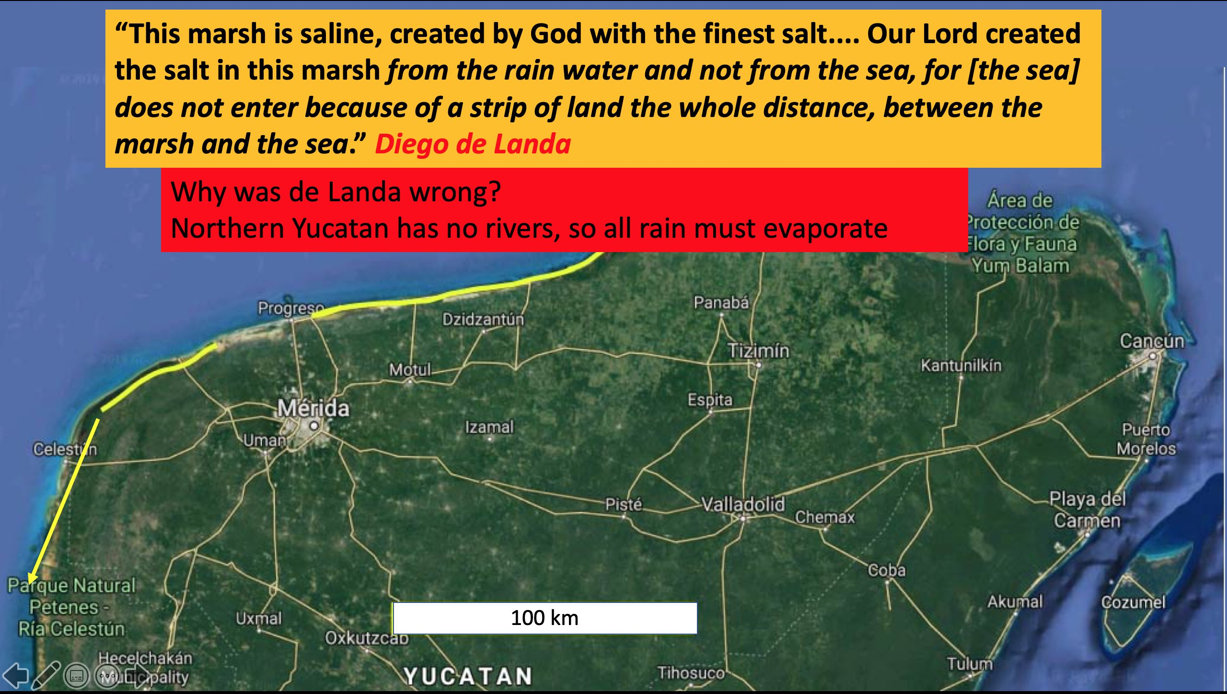

Slide 18
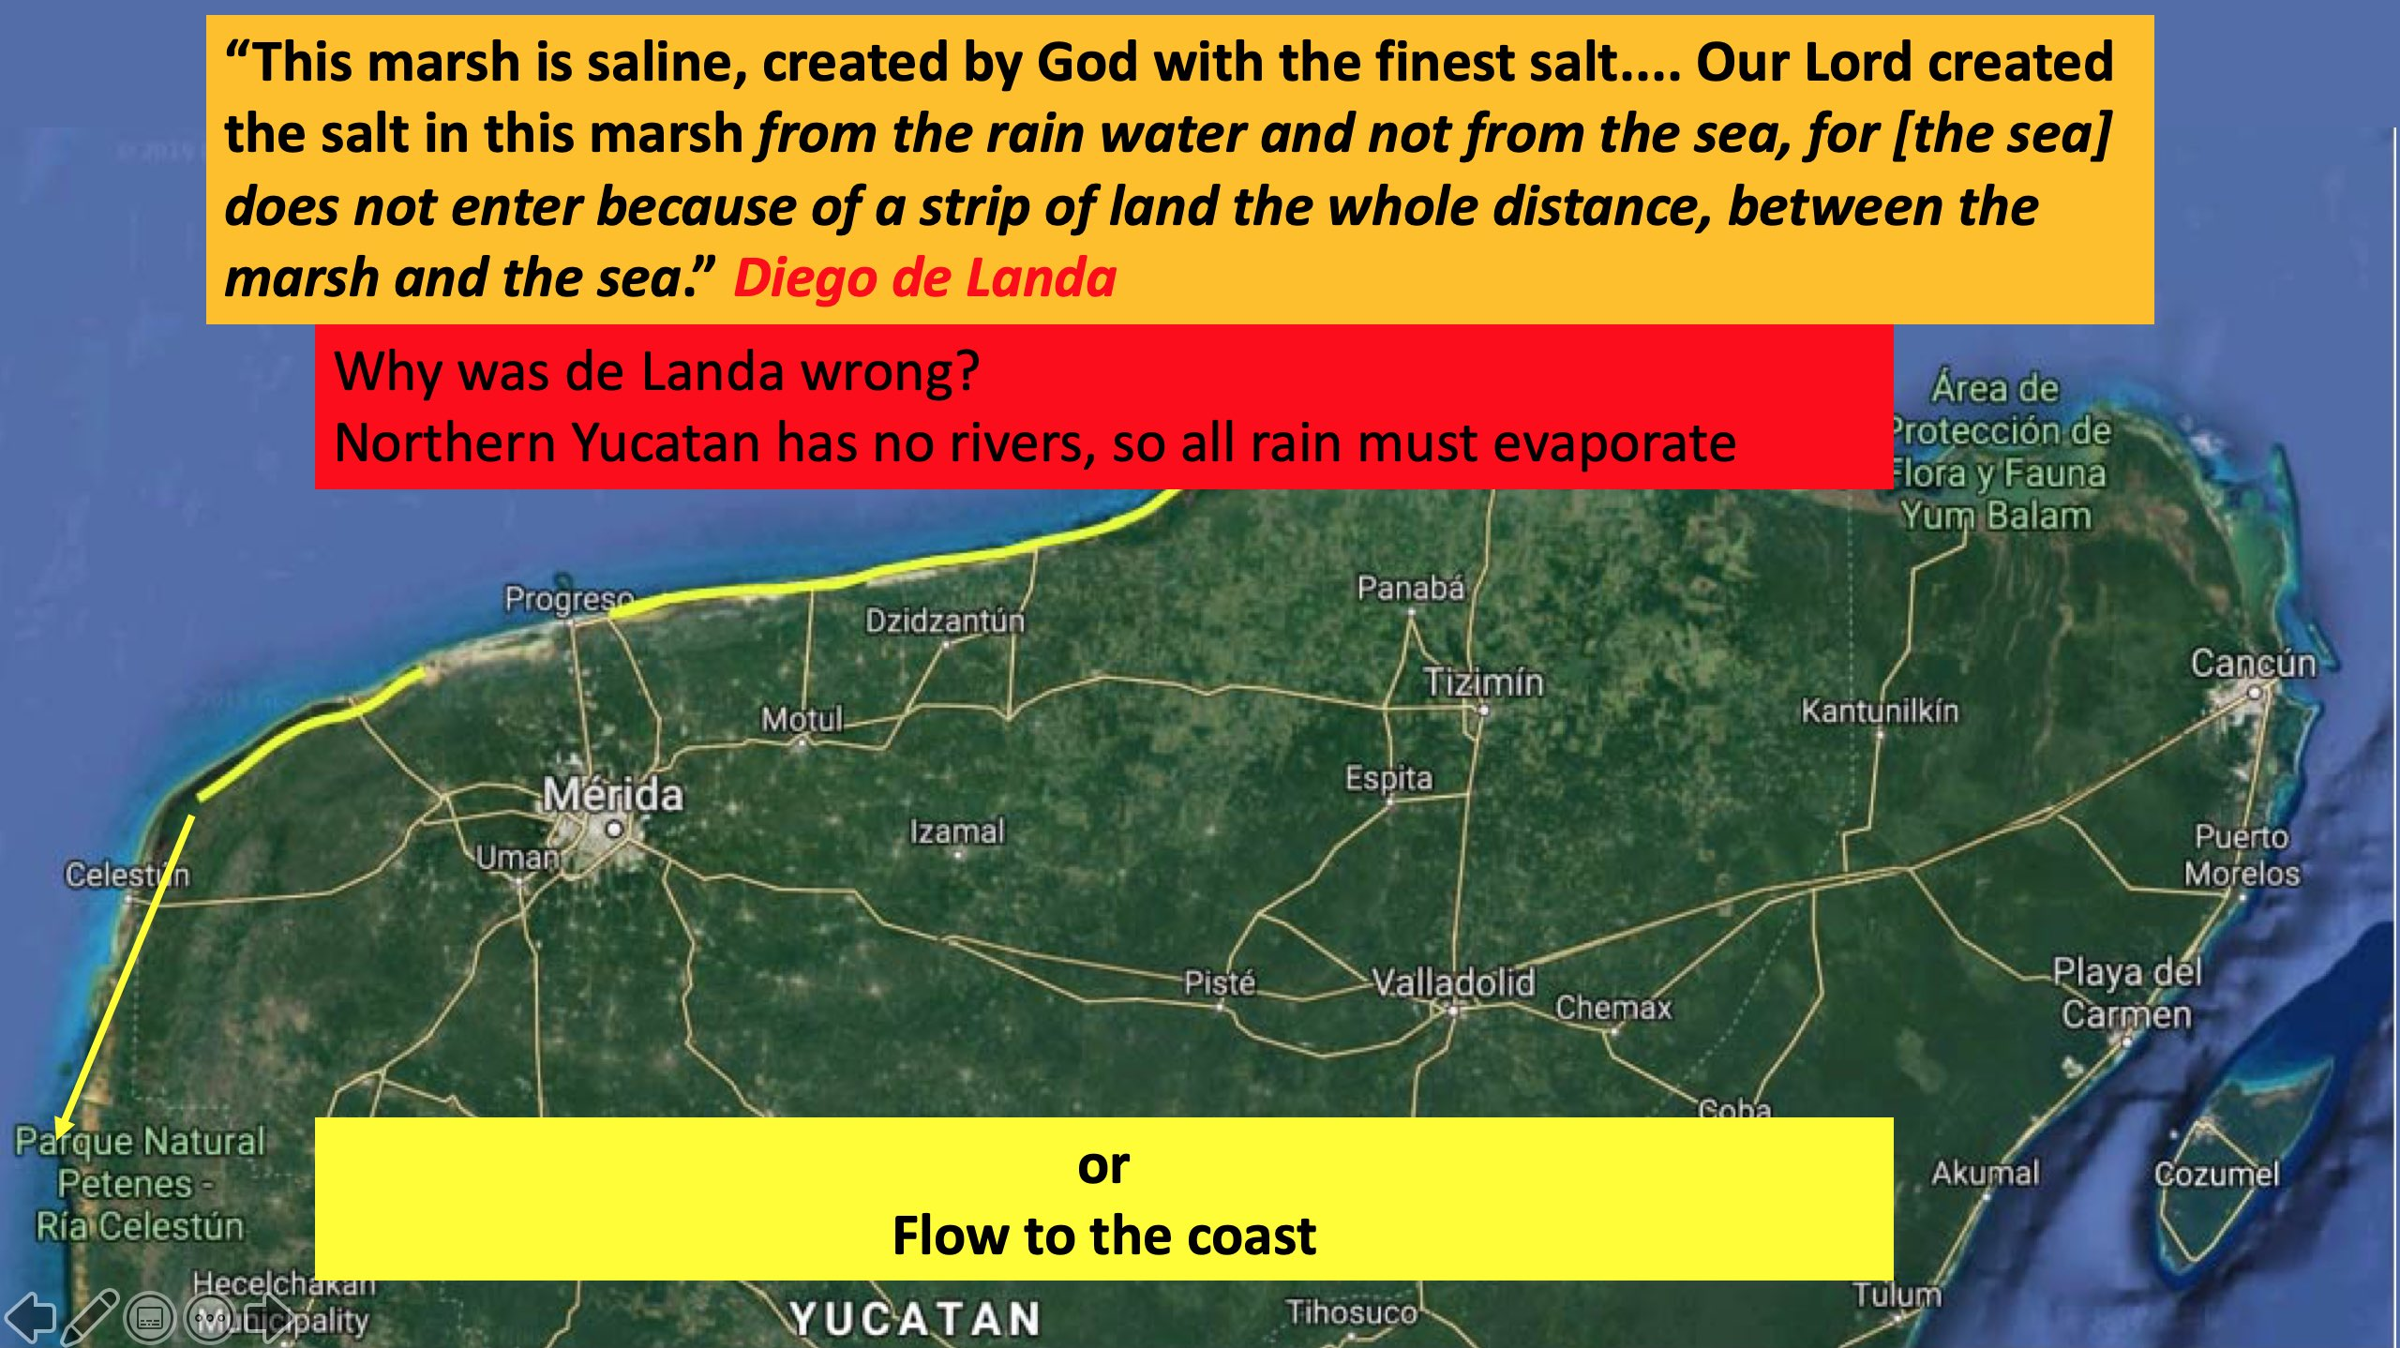

Slide 19
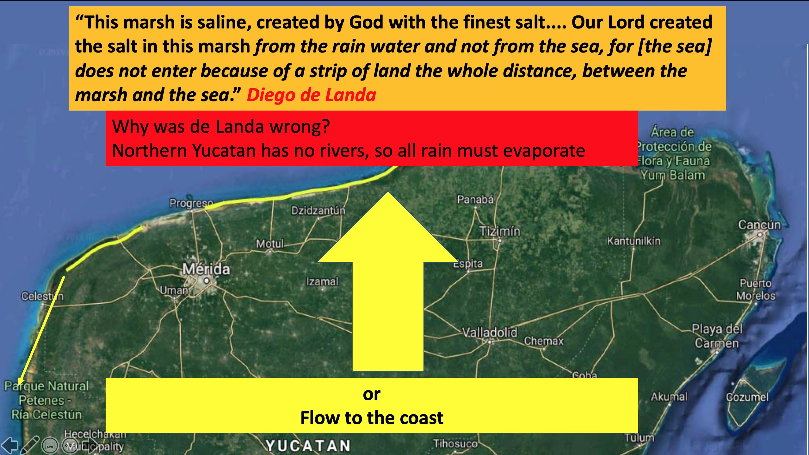

Slide 20
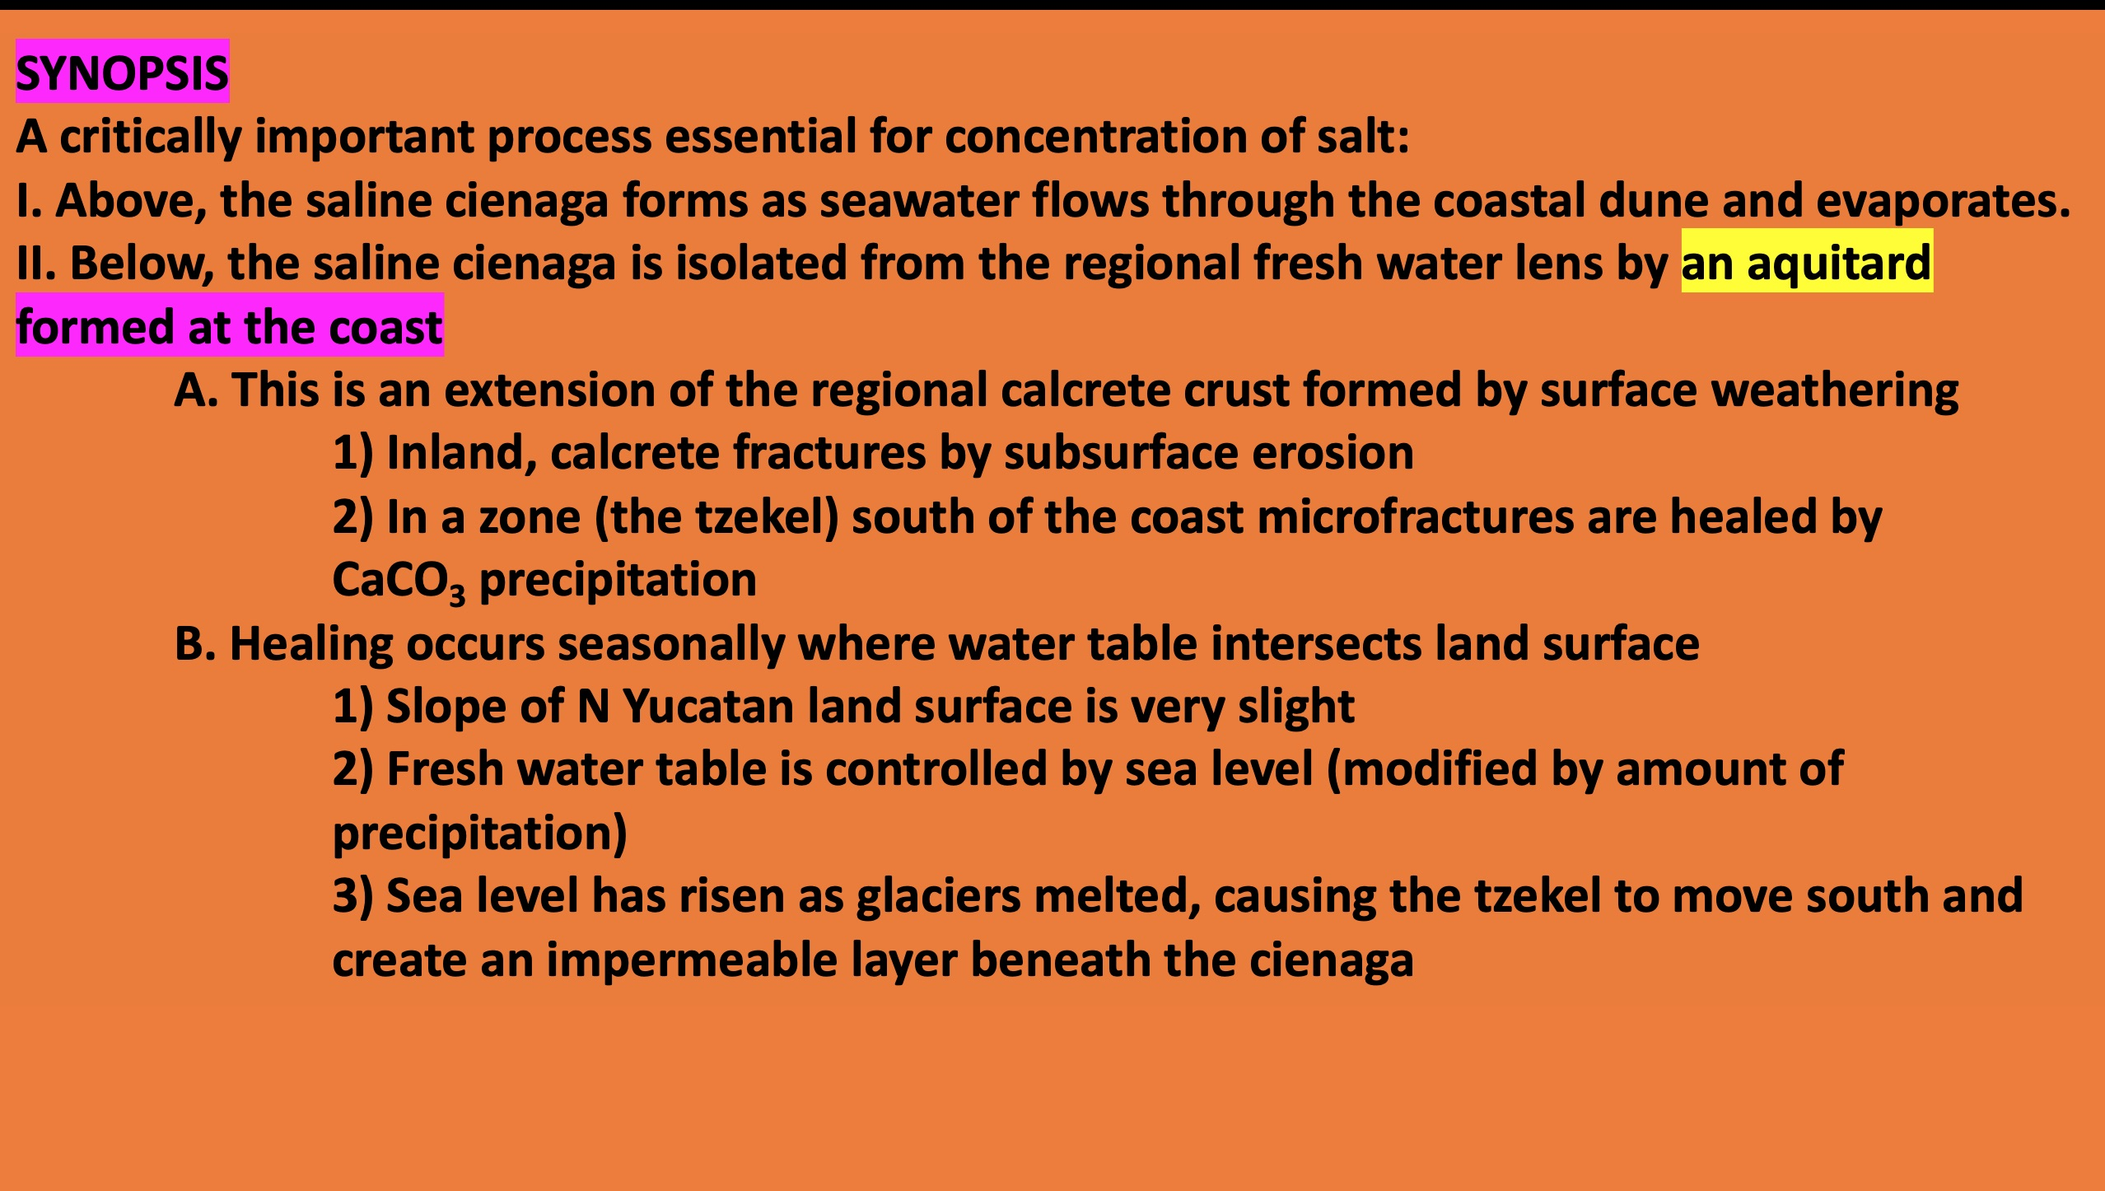

Slide 21
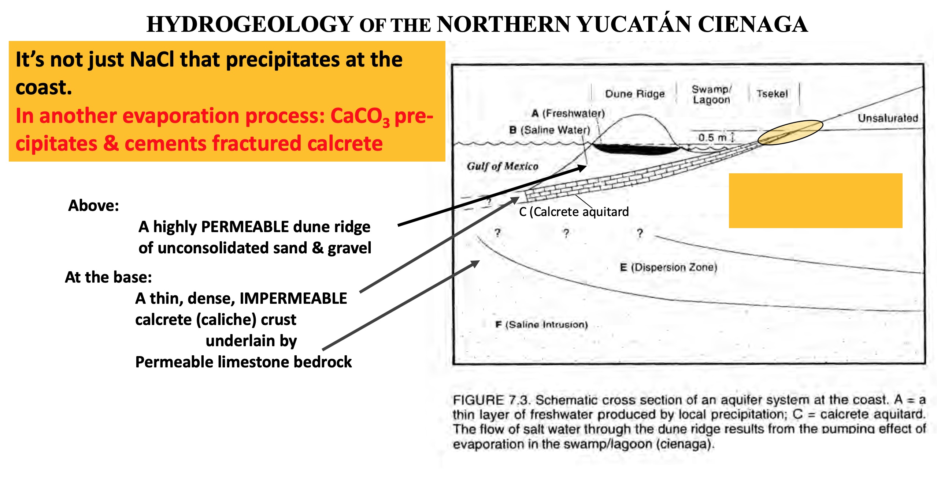

Slide 22
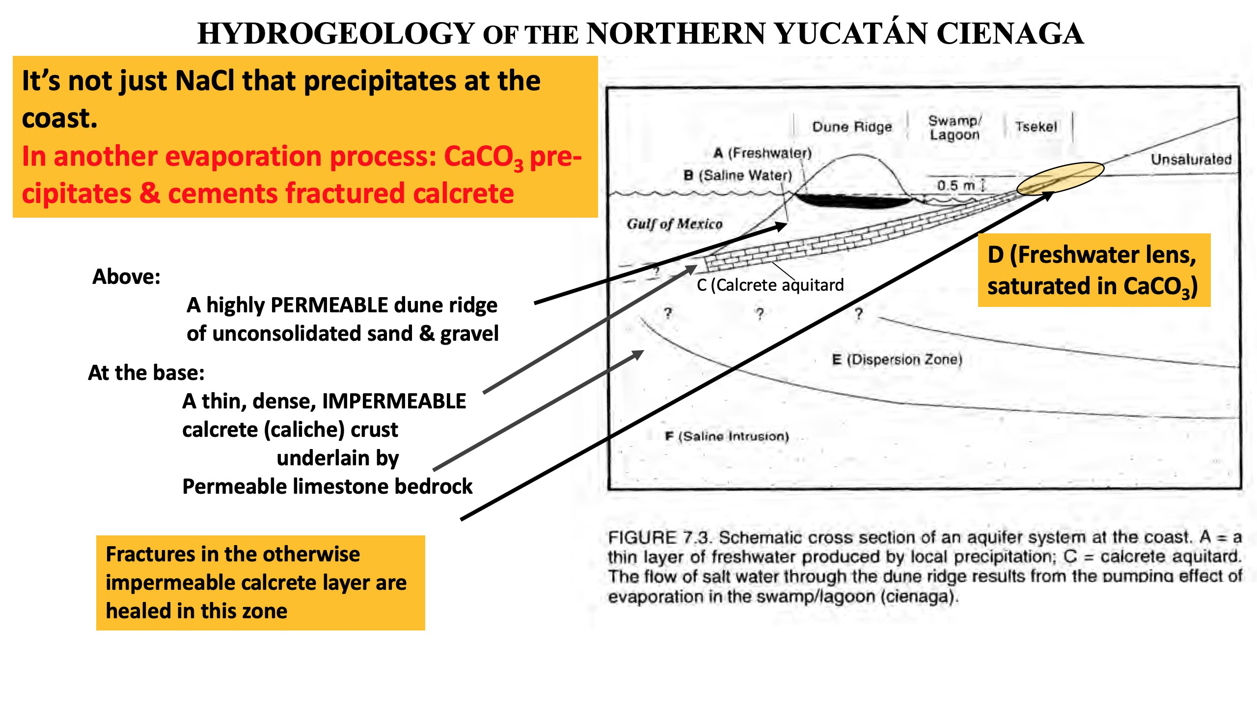

Slide 23
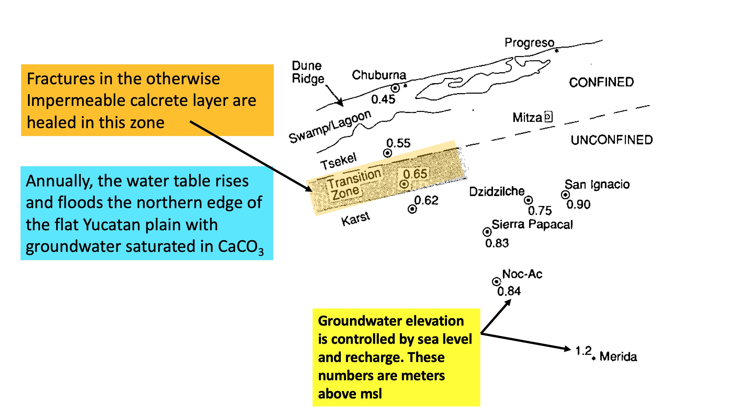

Slide 24
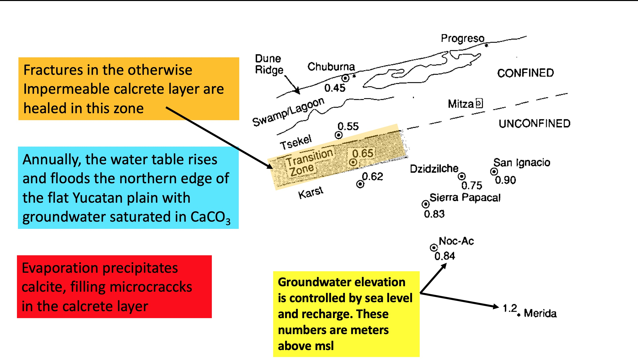

Slide 25
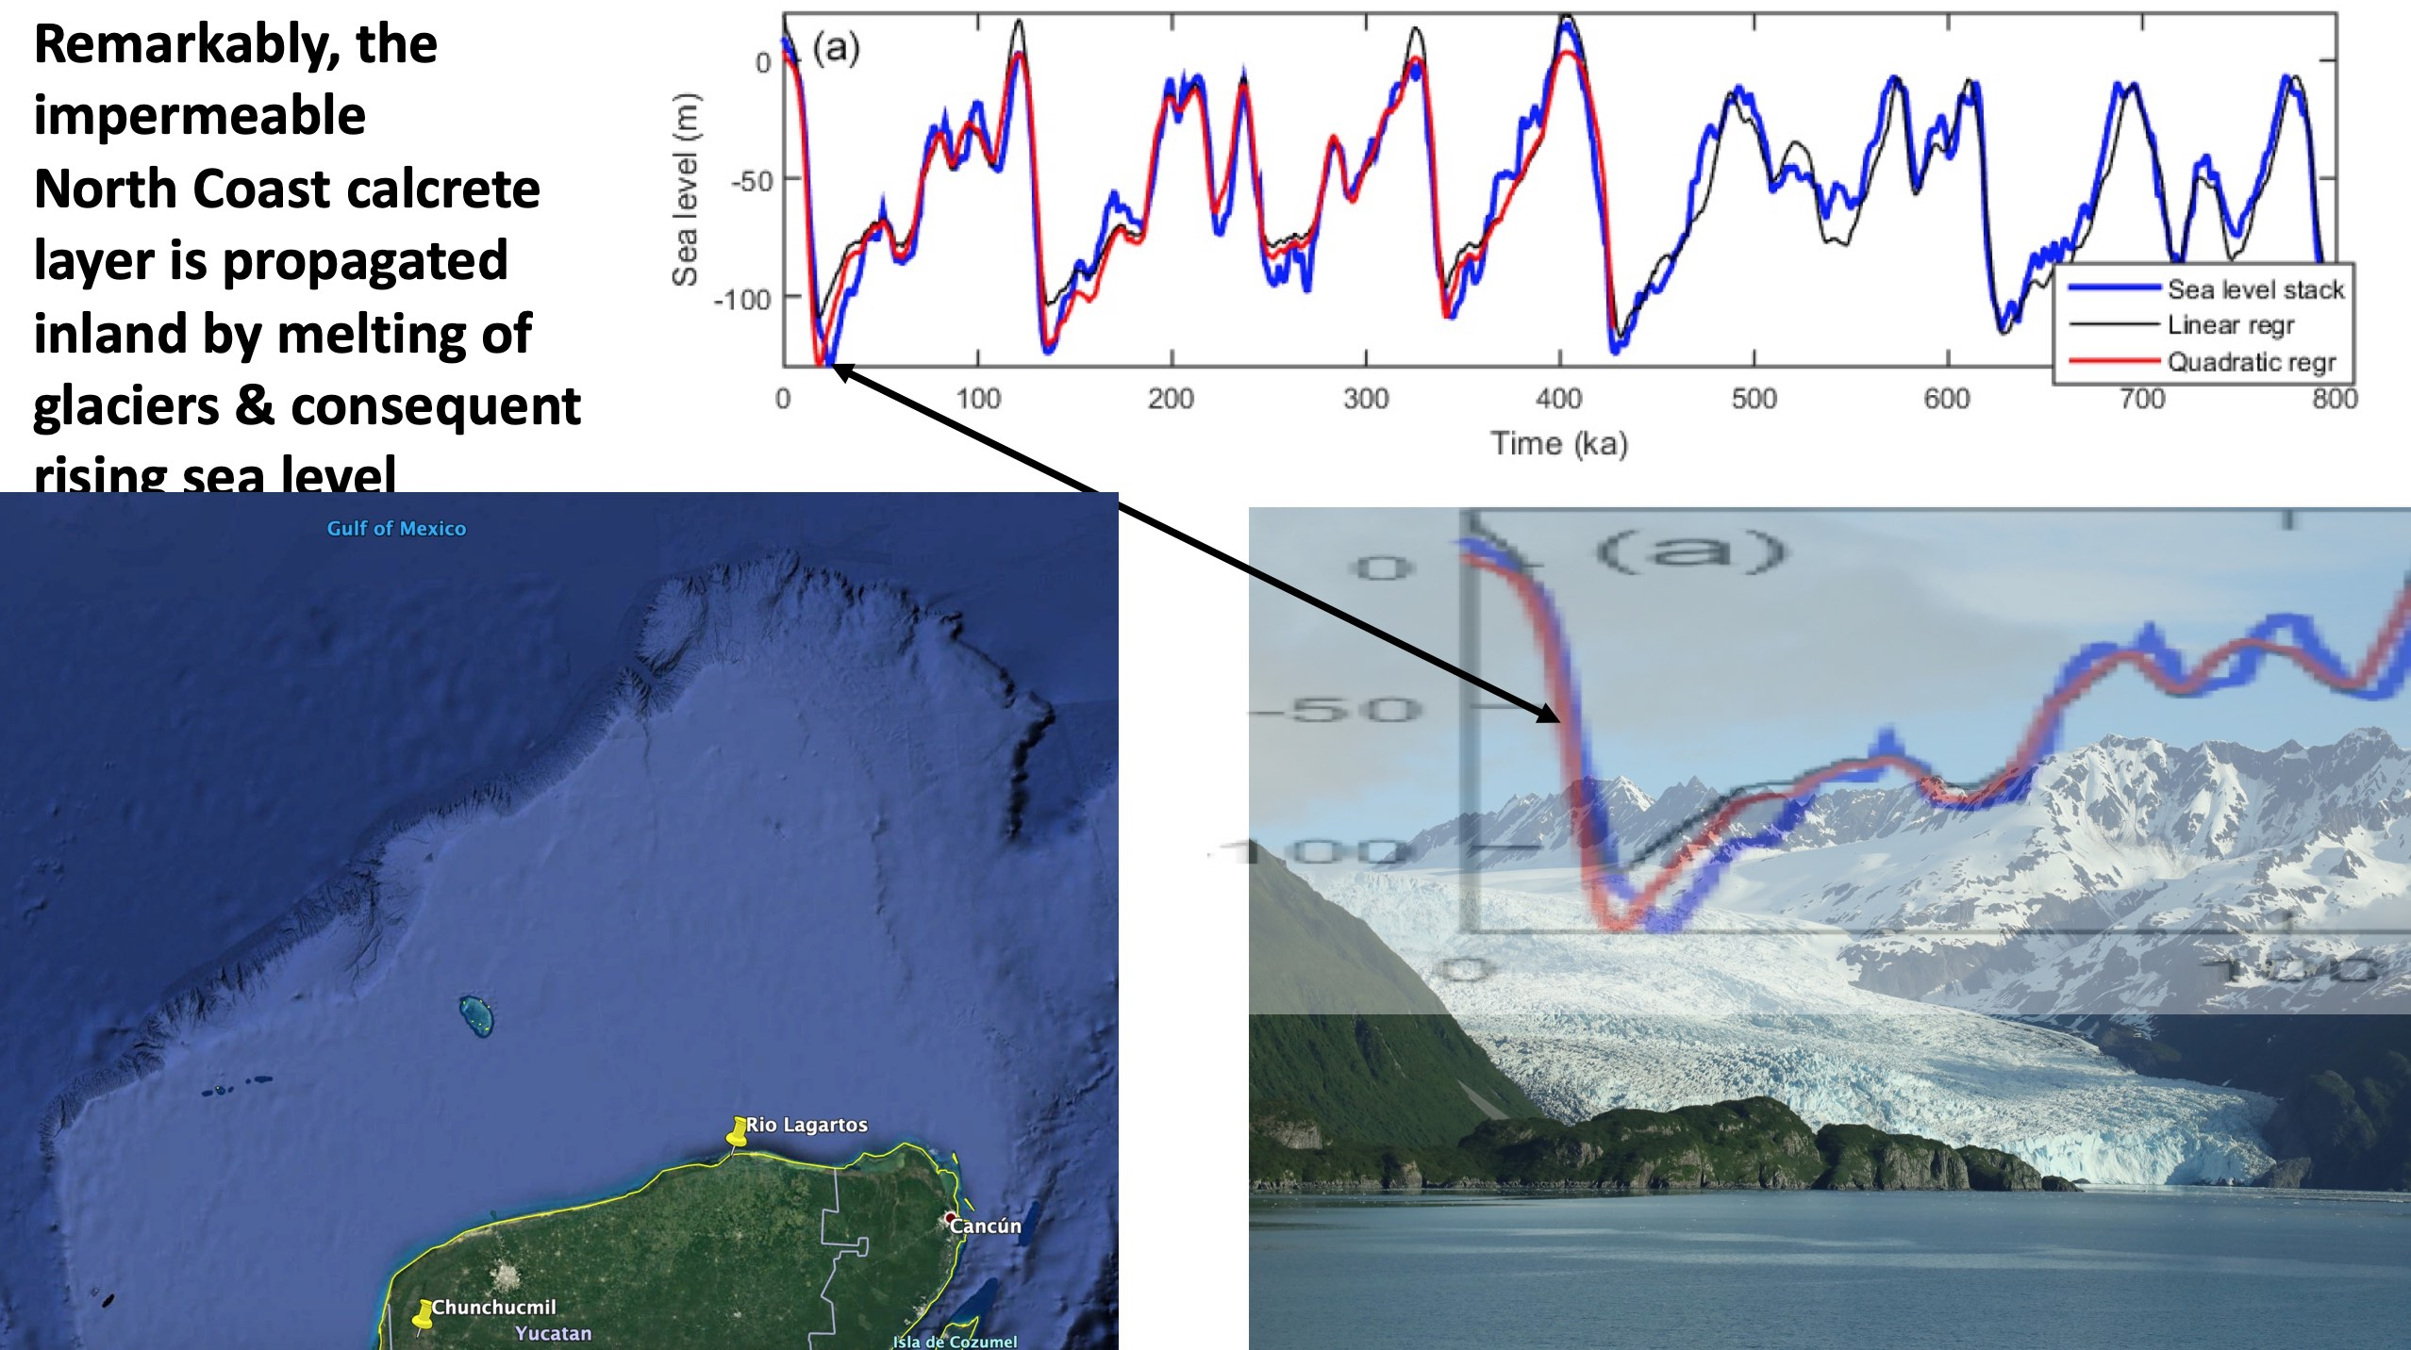

Slide 26
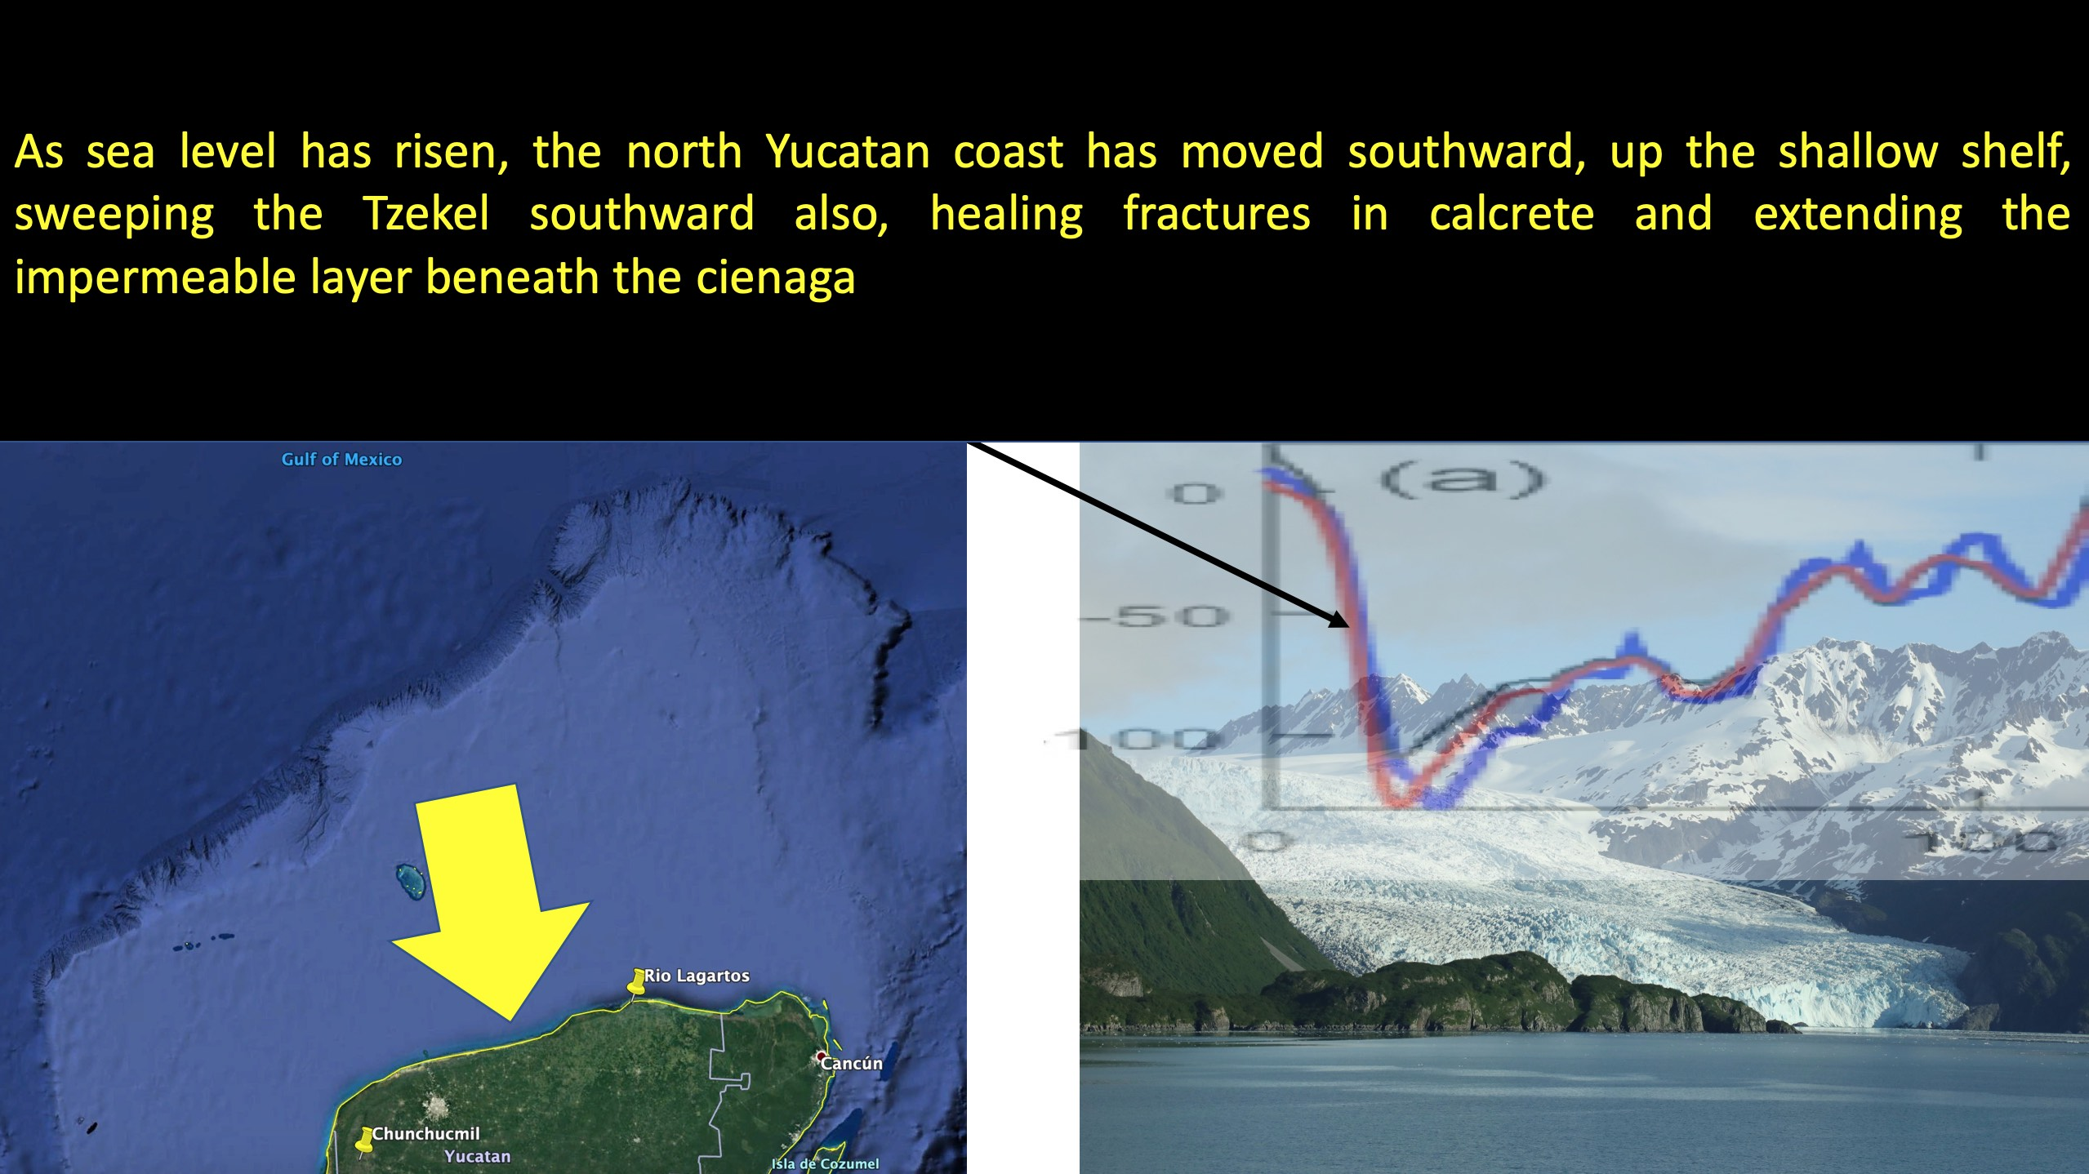

Slide 27
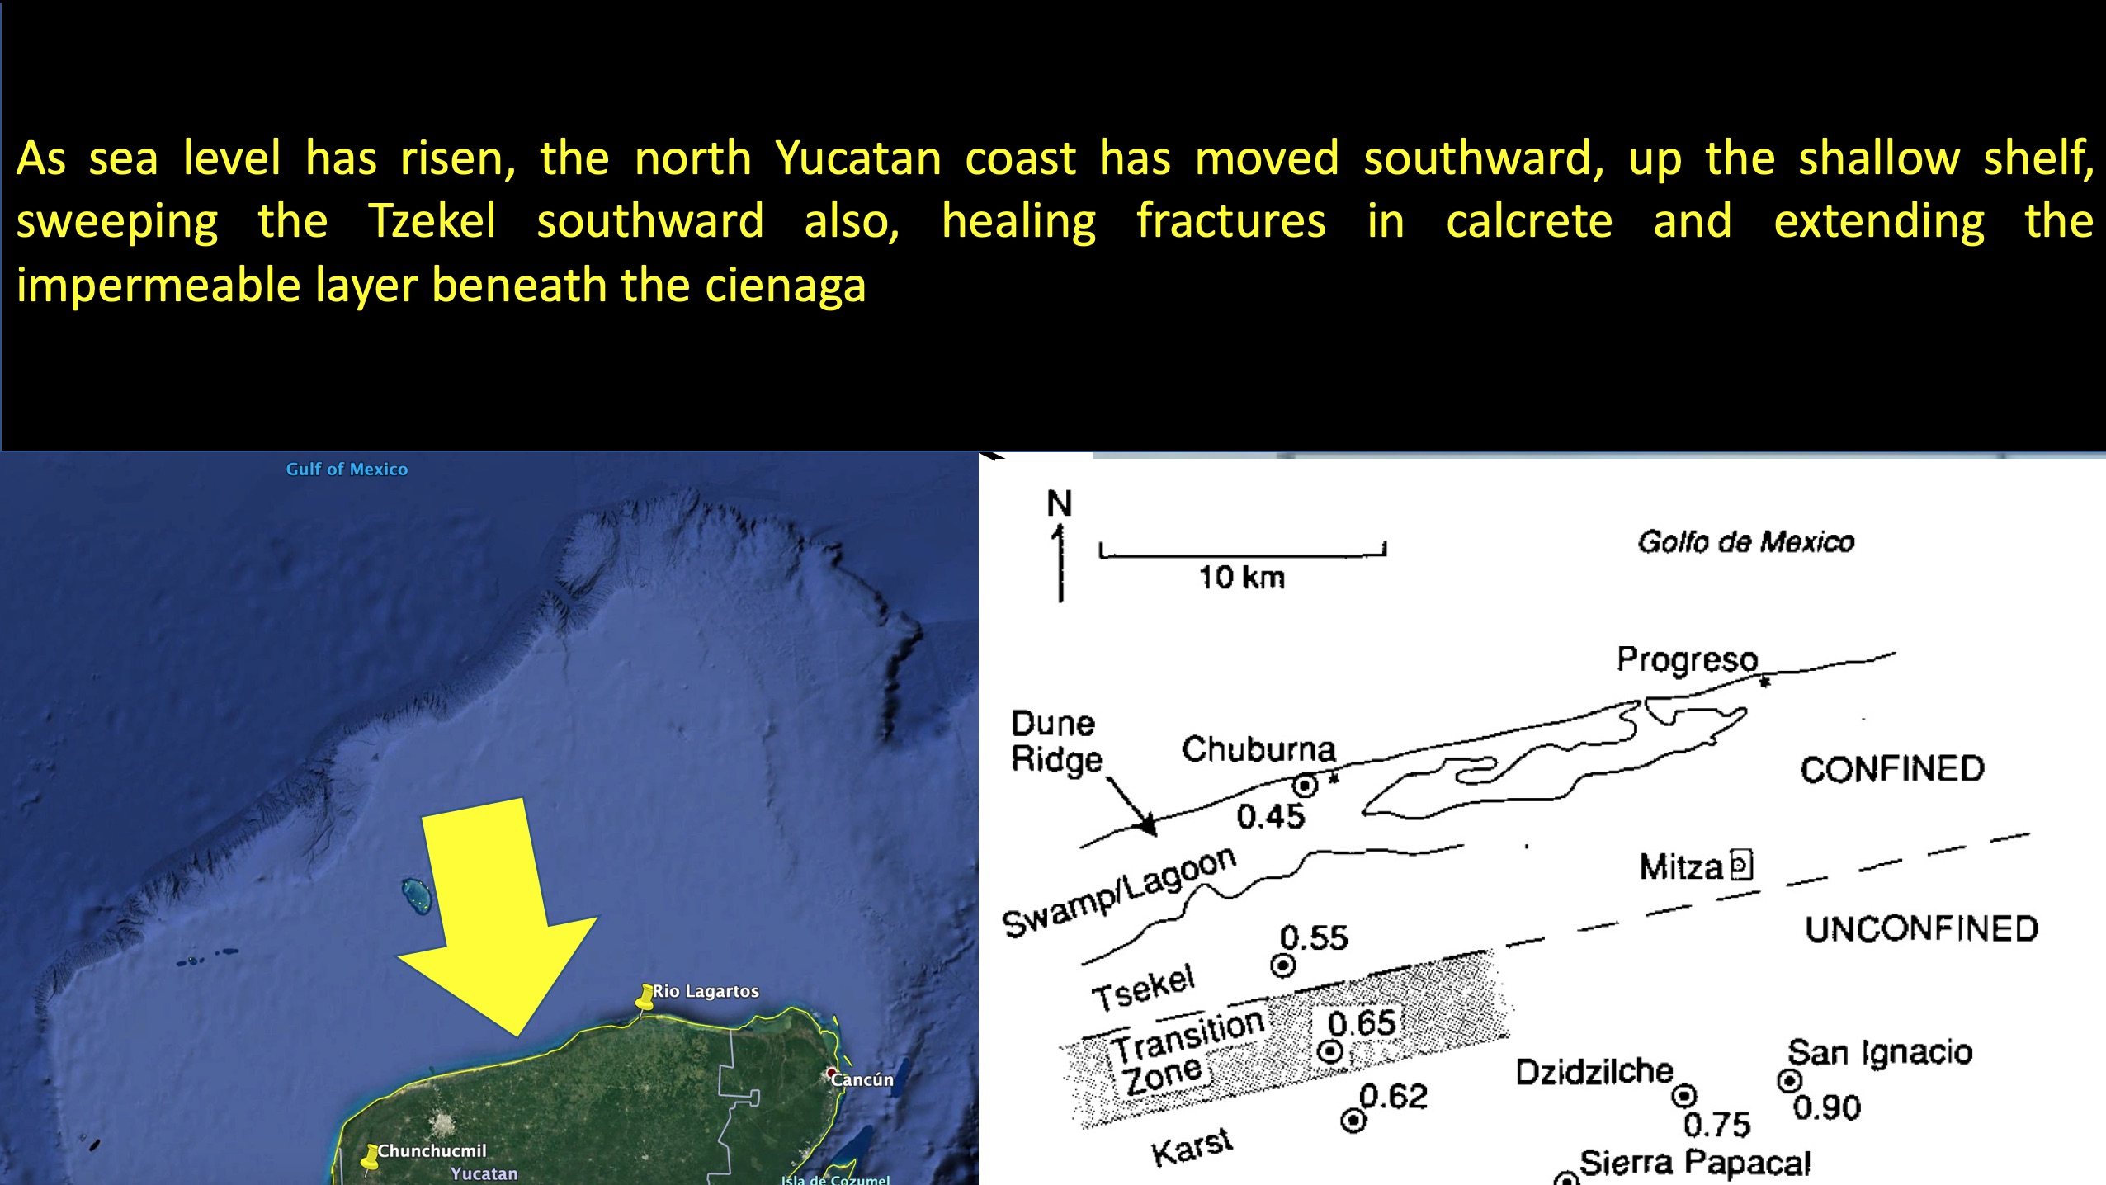

Slide 28
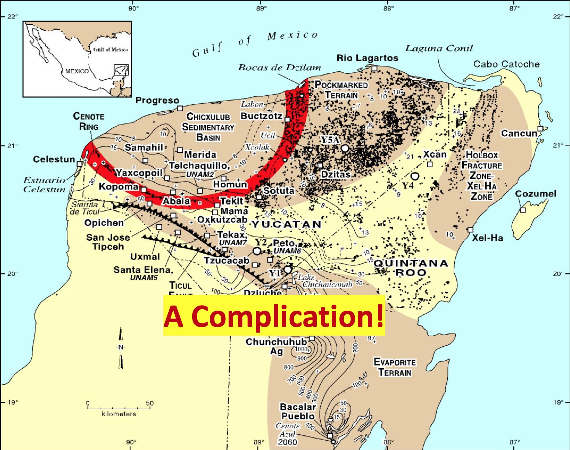

Slide 29
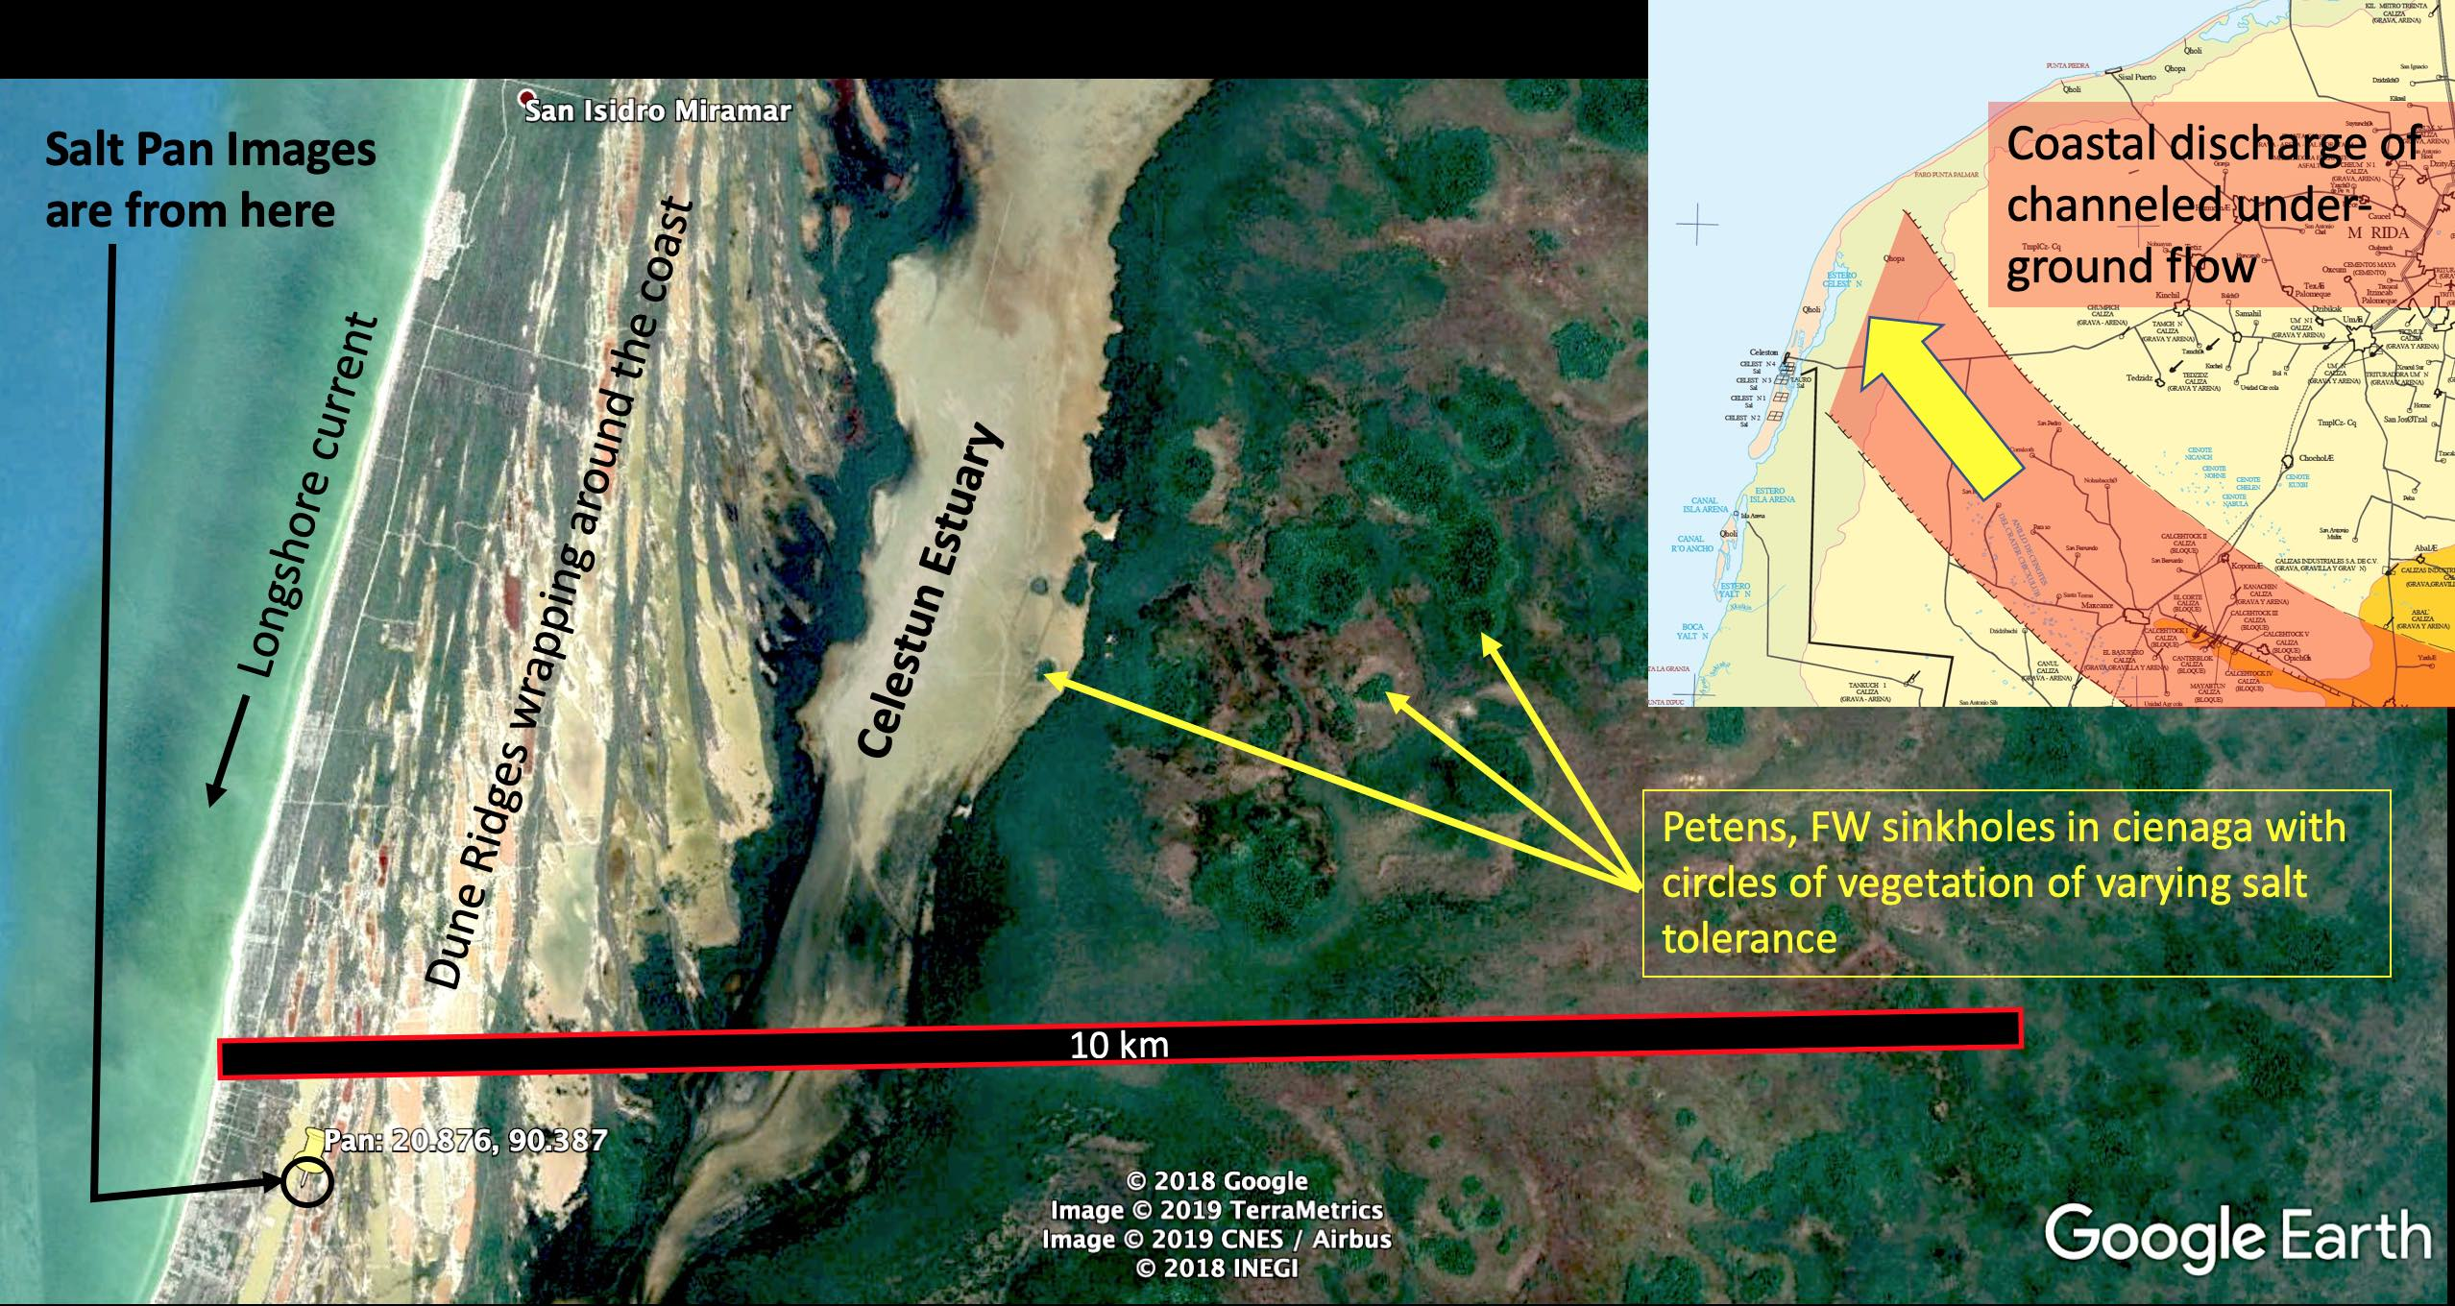
are

Slide 30
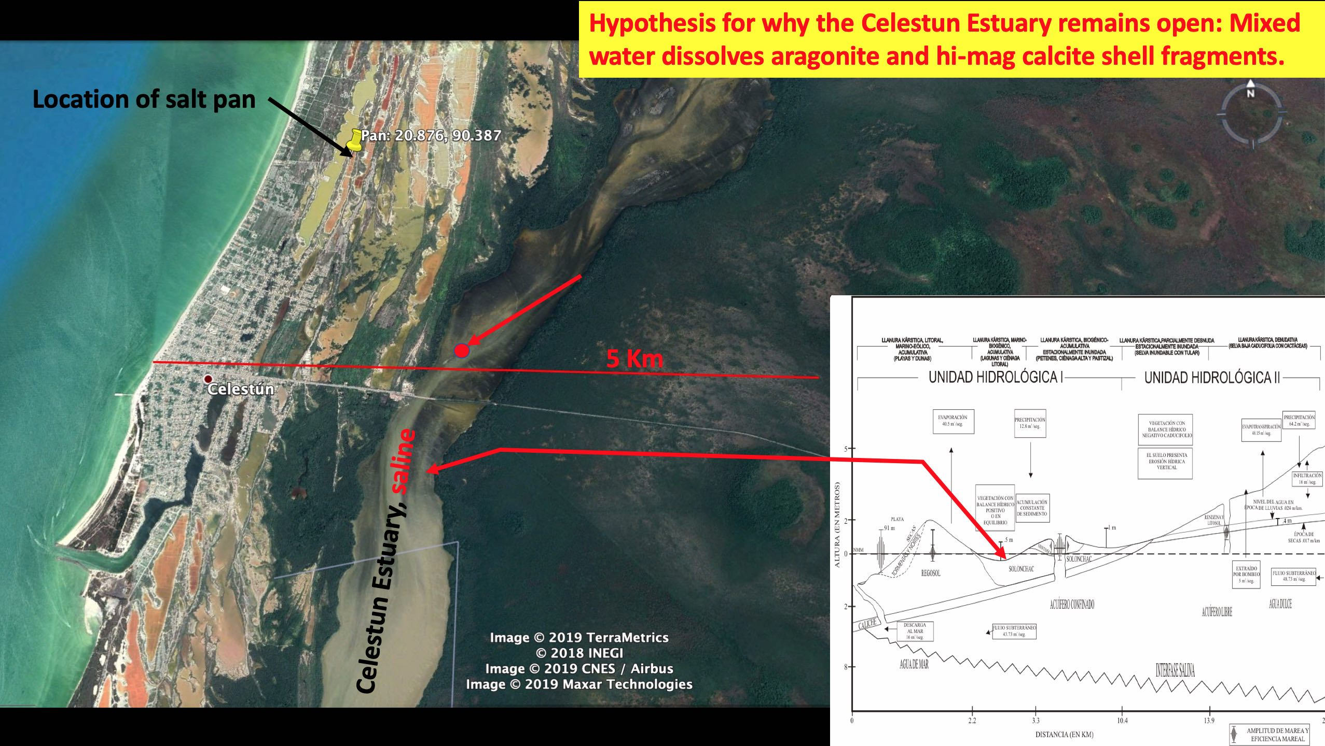

Slide 32
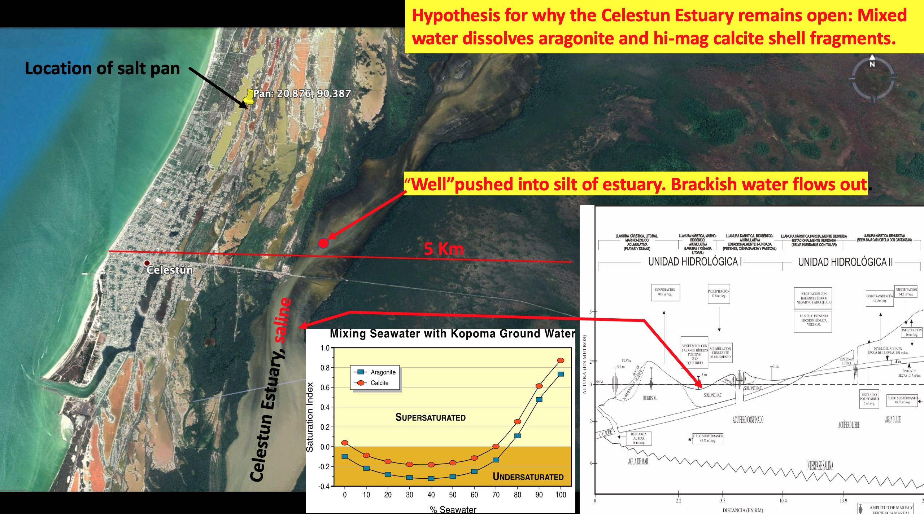

Slide 33
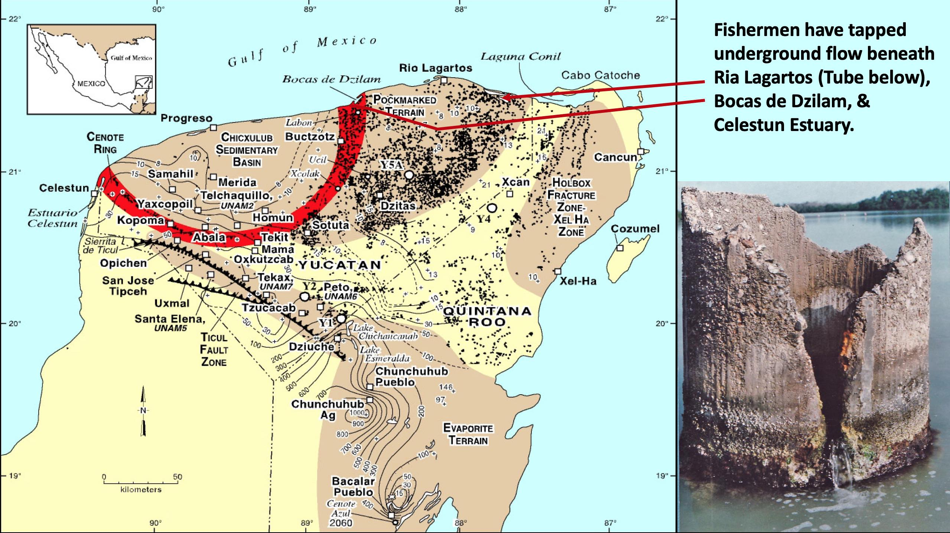

Slide 34


Slide 35
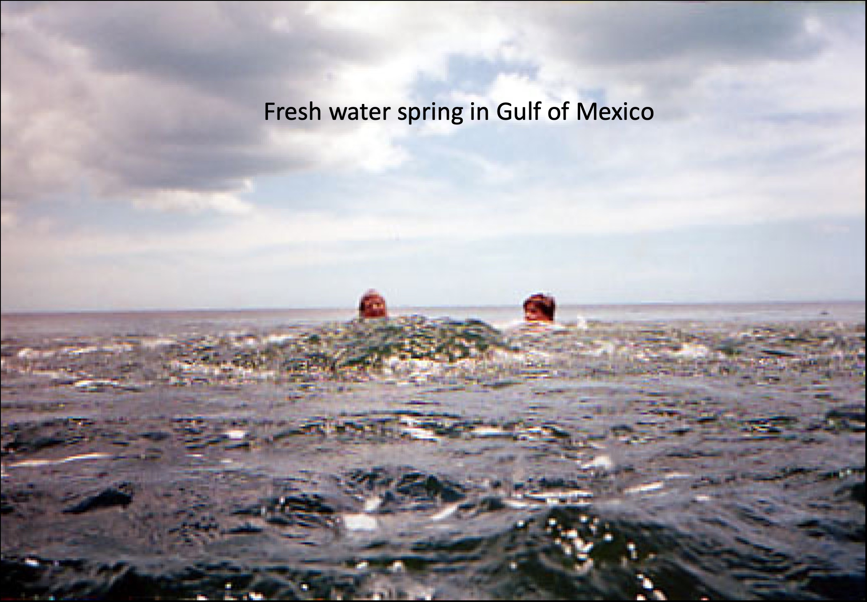

Slide 36
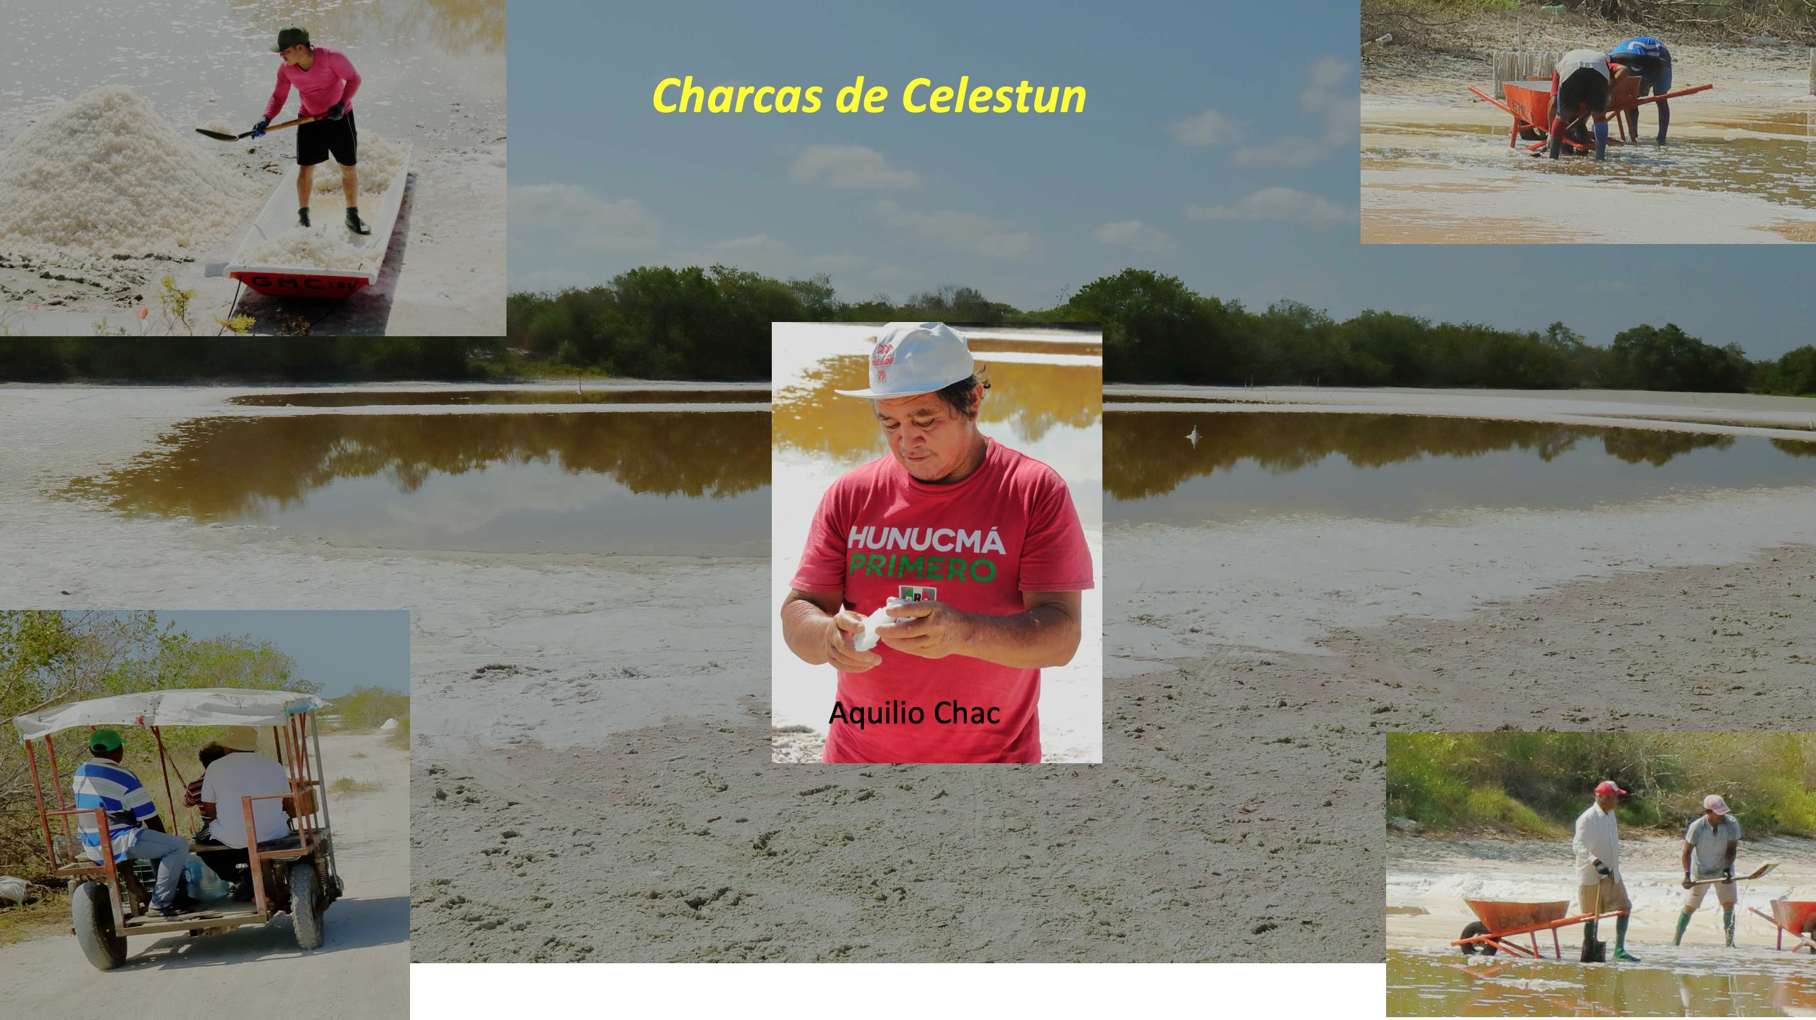
ARTISANAL SALT HARVESTING: MAYA TECHNIQUE
BUT WITH NEW TOOLS

Slide 37
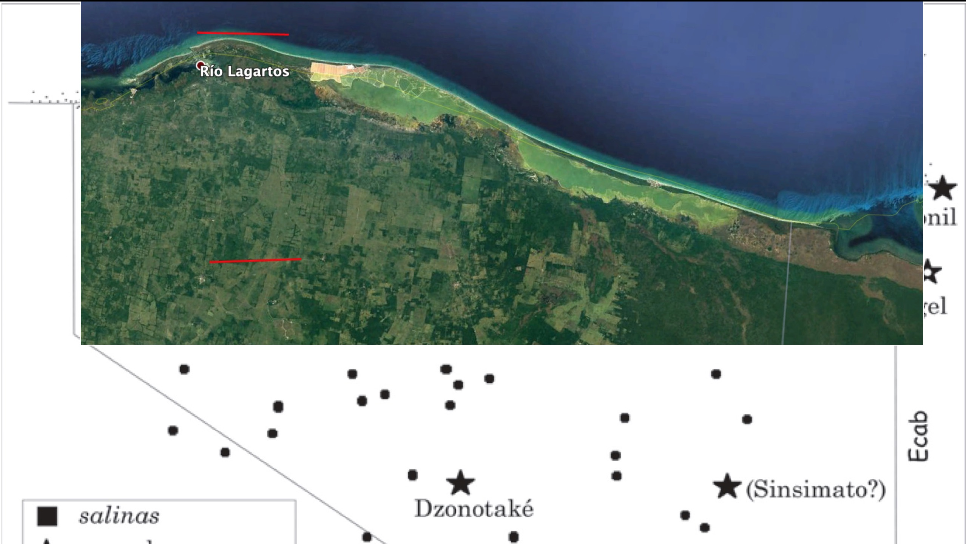
Modern industrial salt works

Slide 38
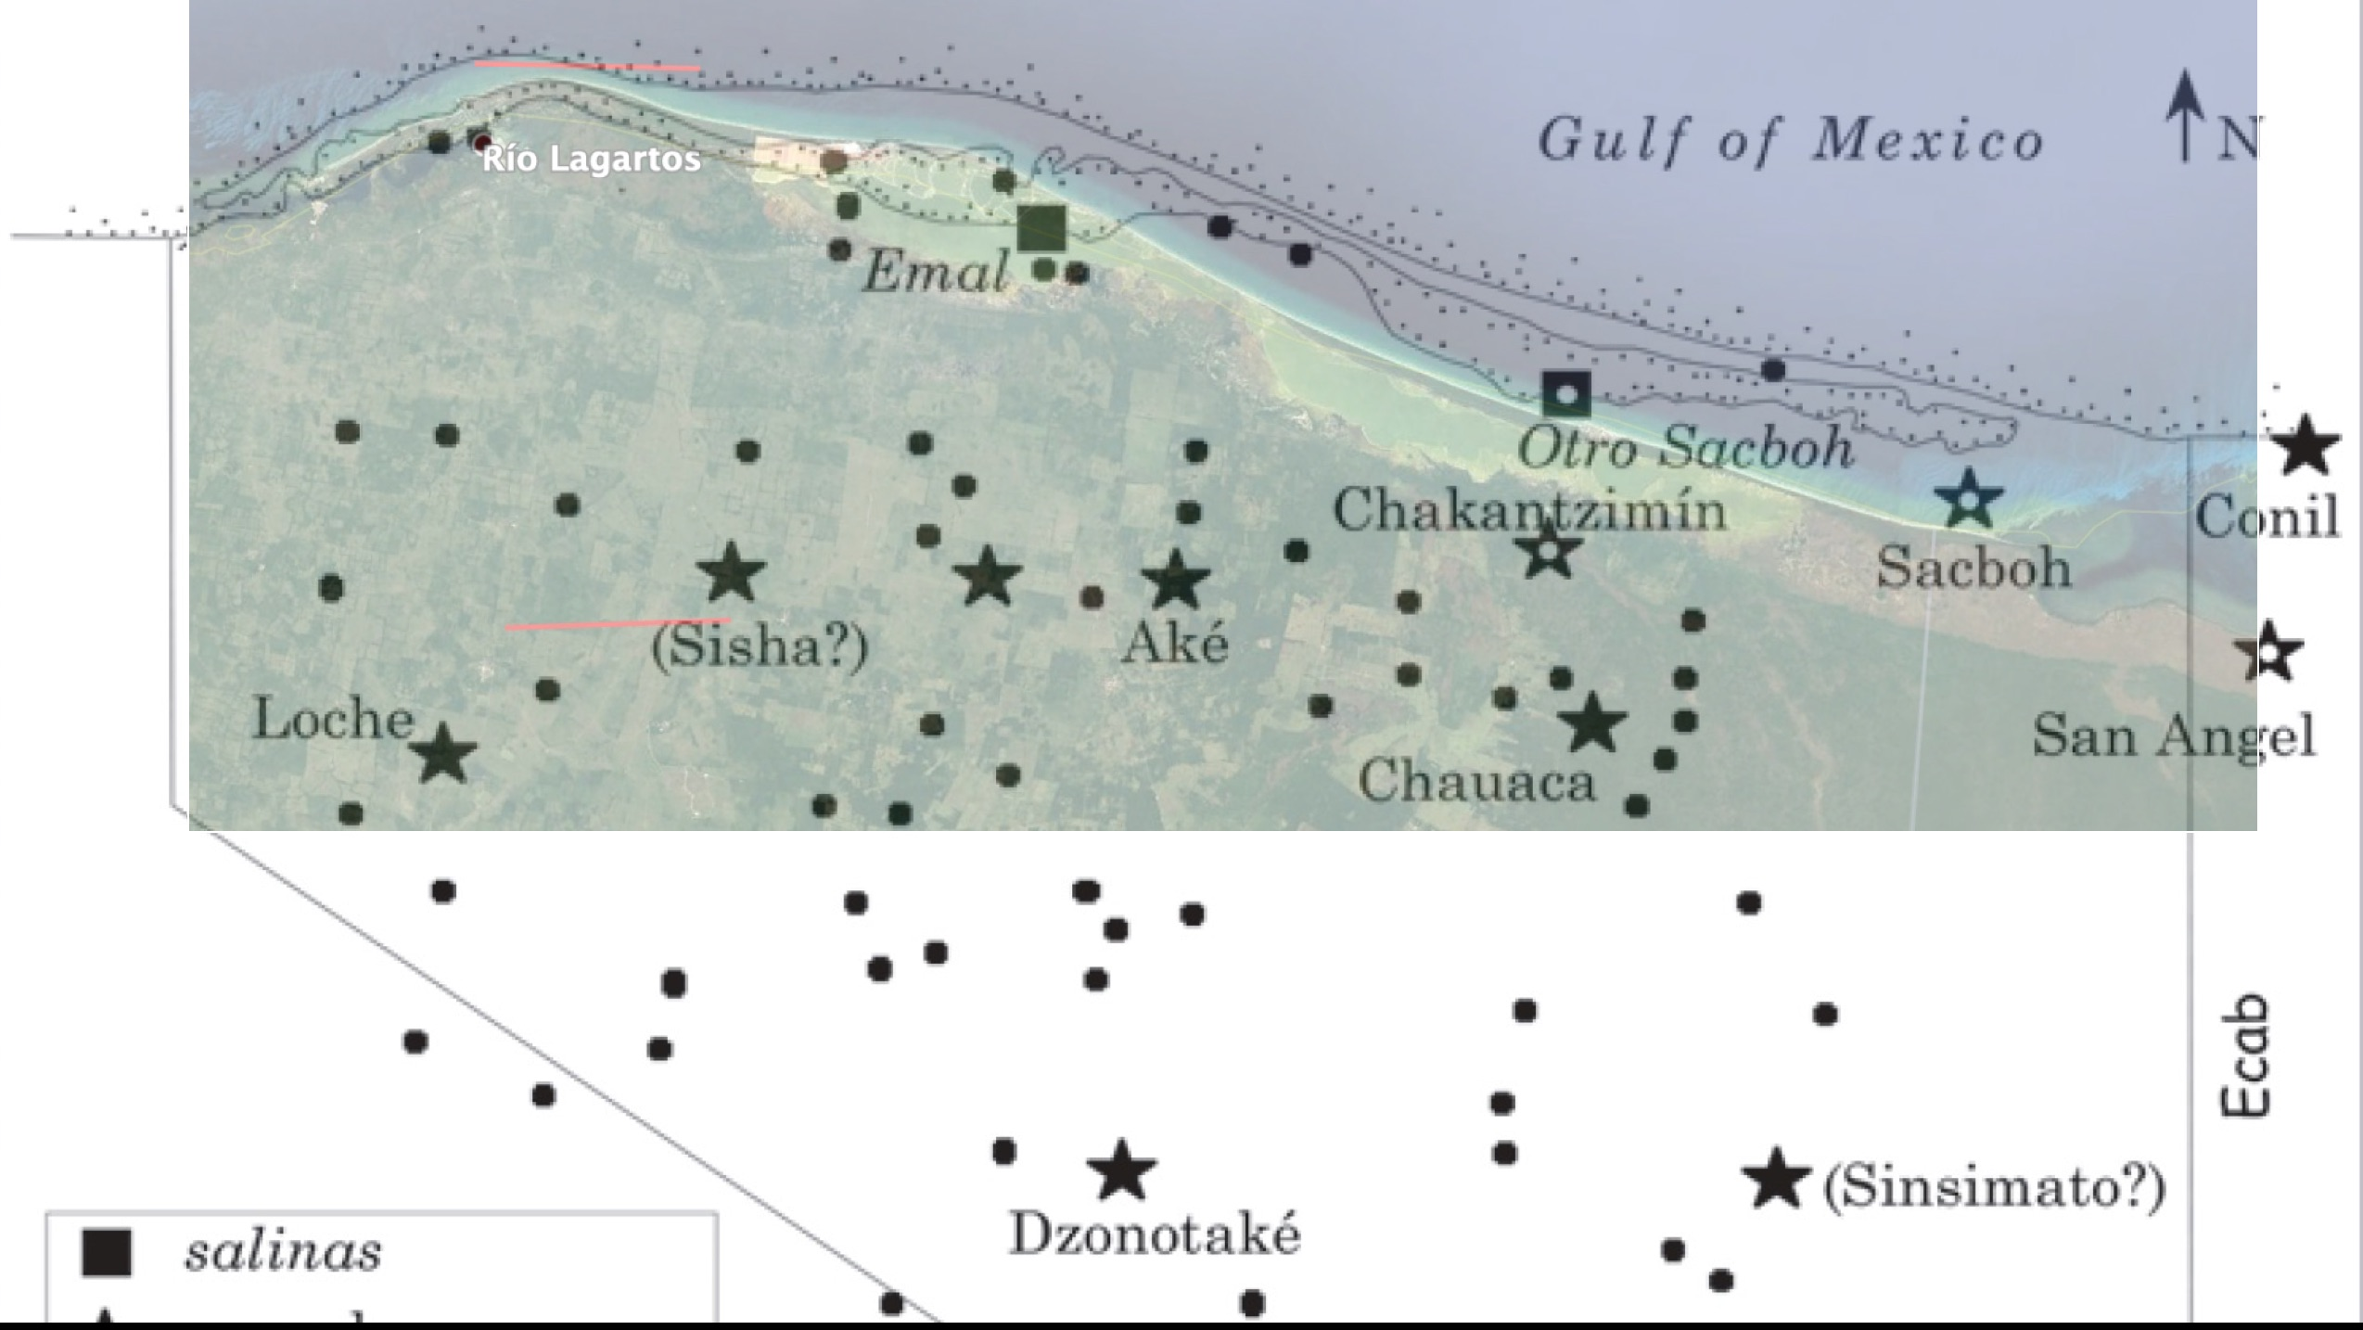

Slide 39
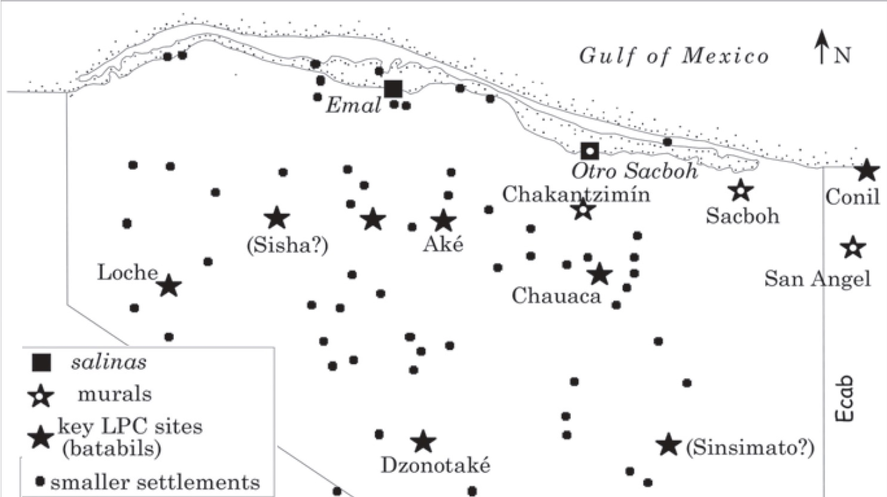
Maya Sites Now Unoccupied

Slide 40
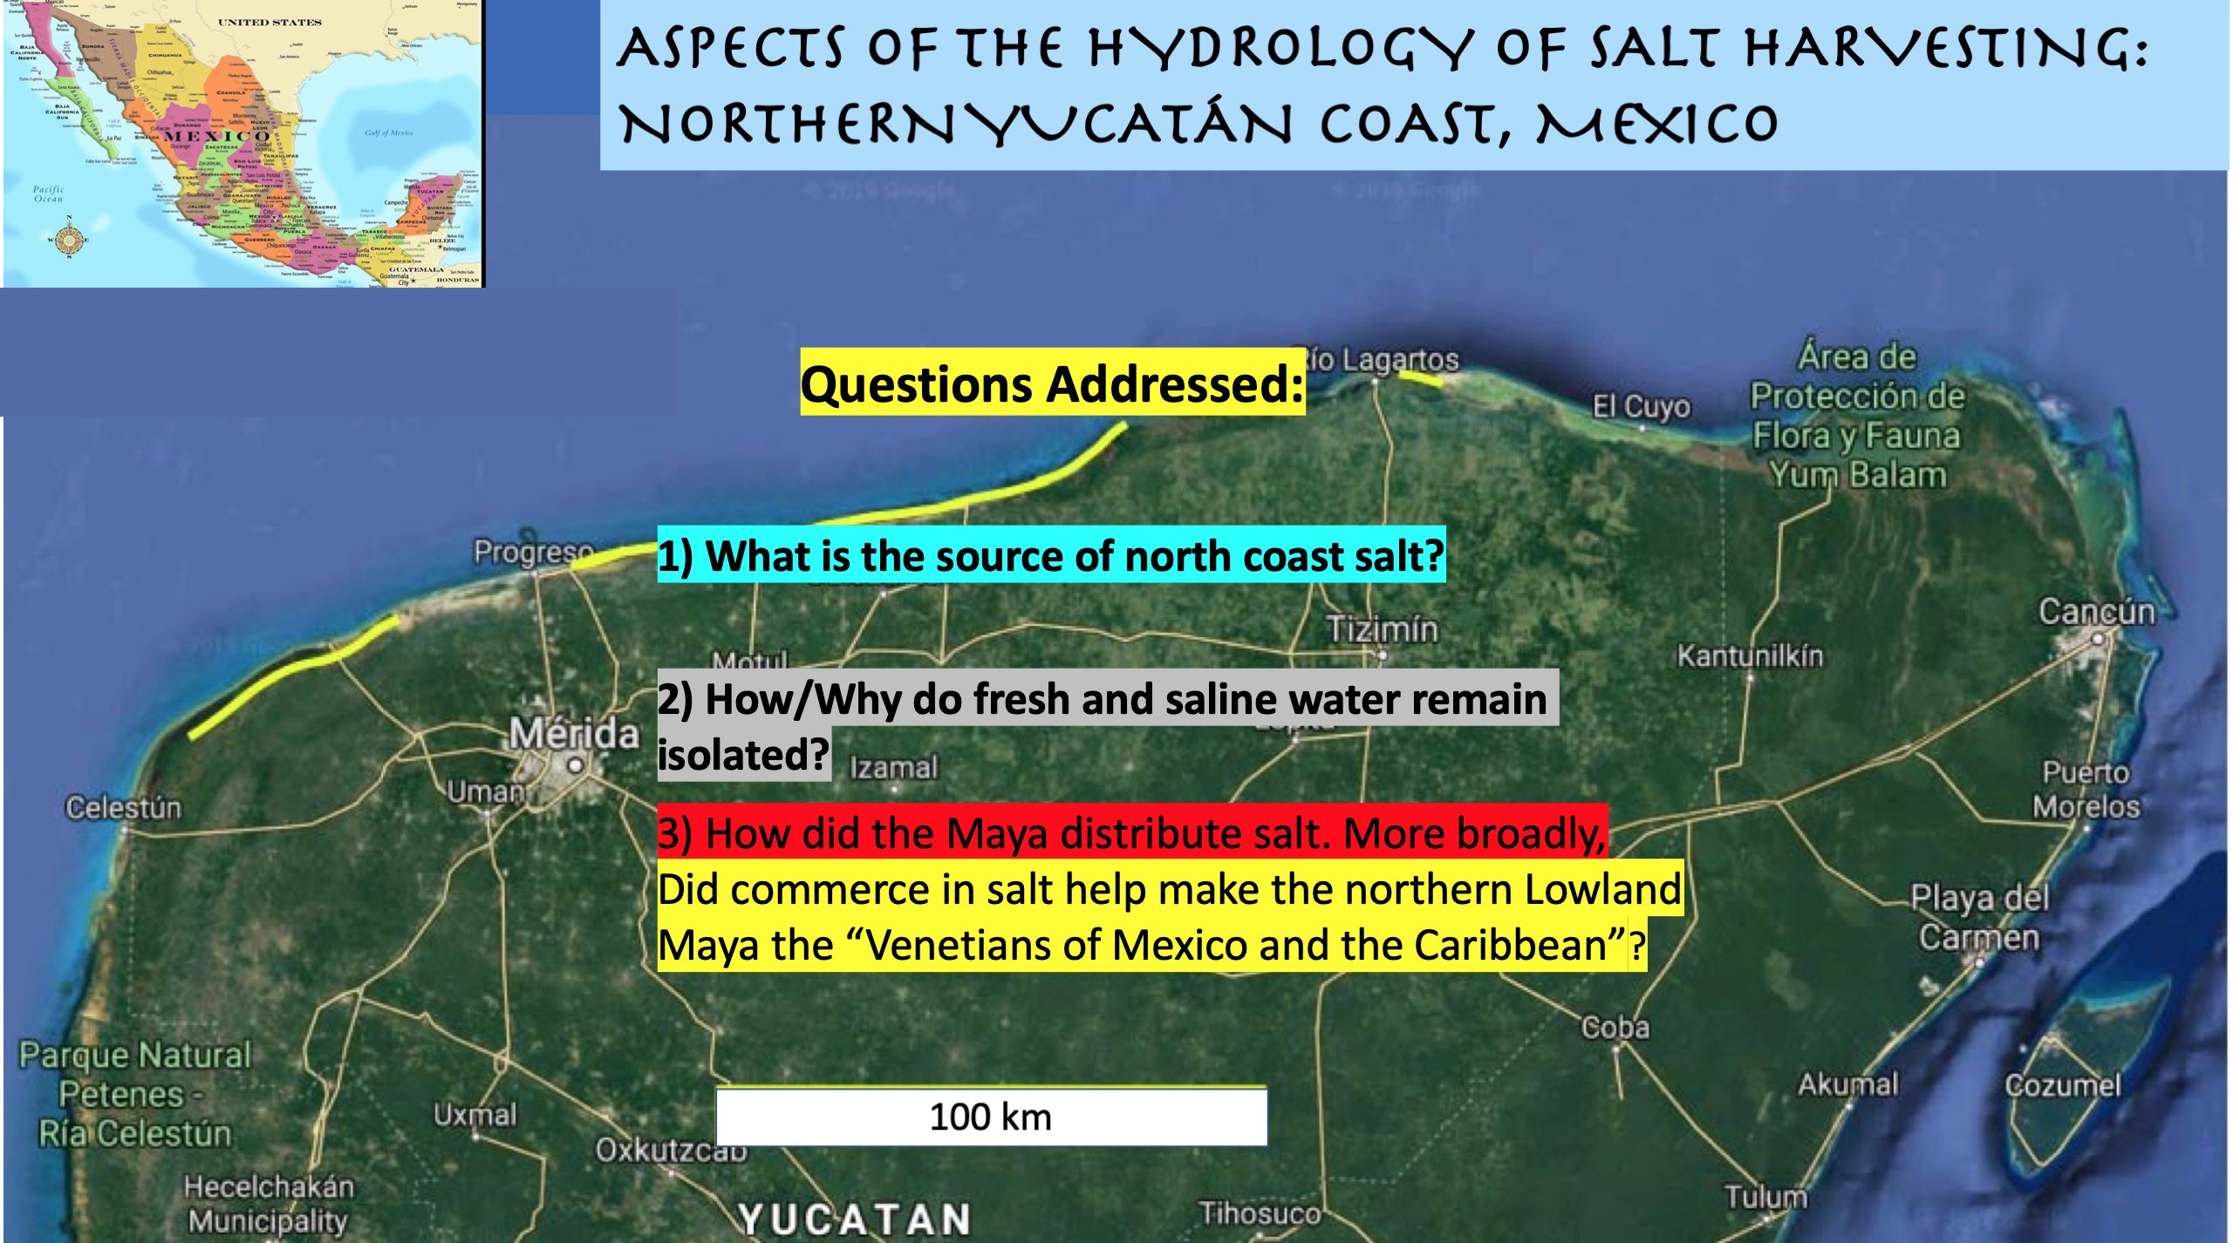

Slide 41
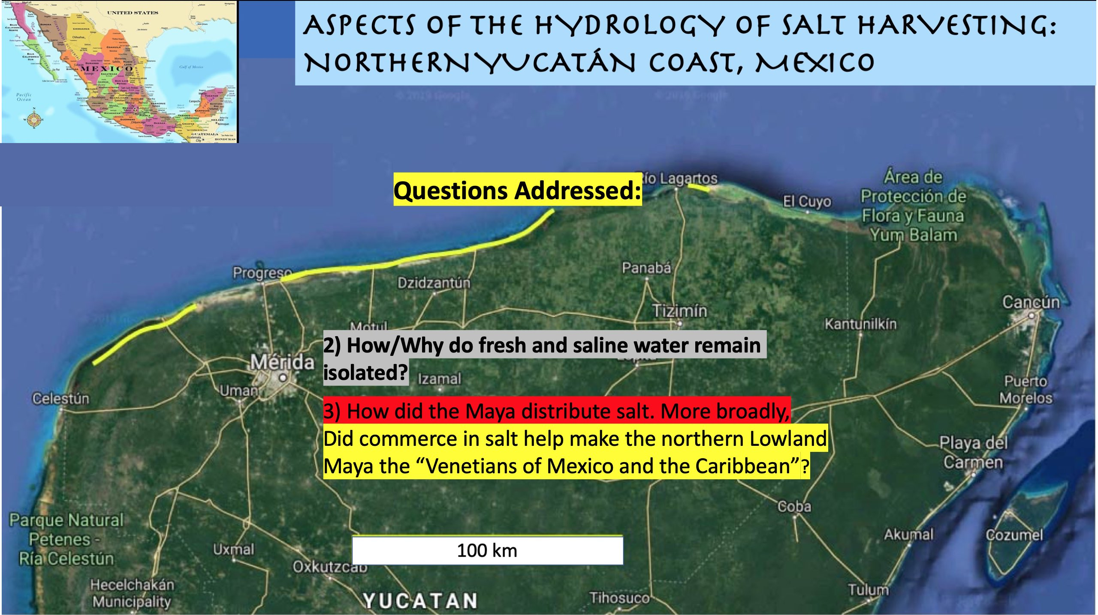

Slide 42
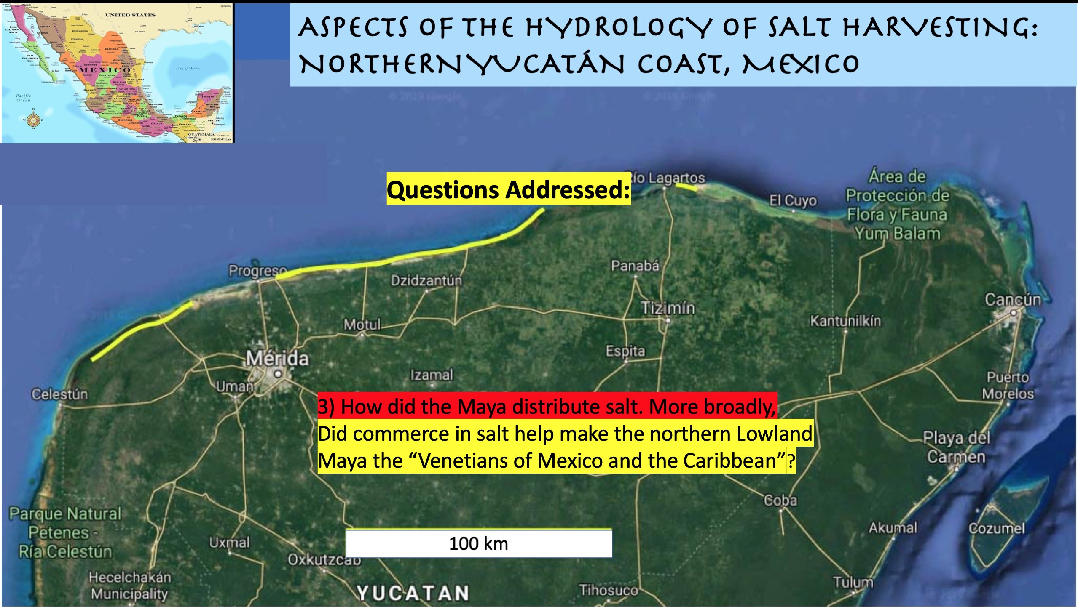

Slide 43
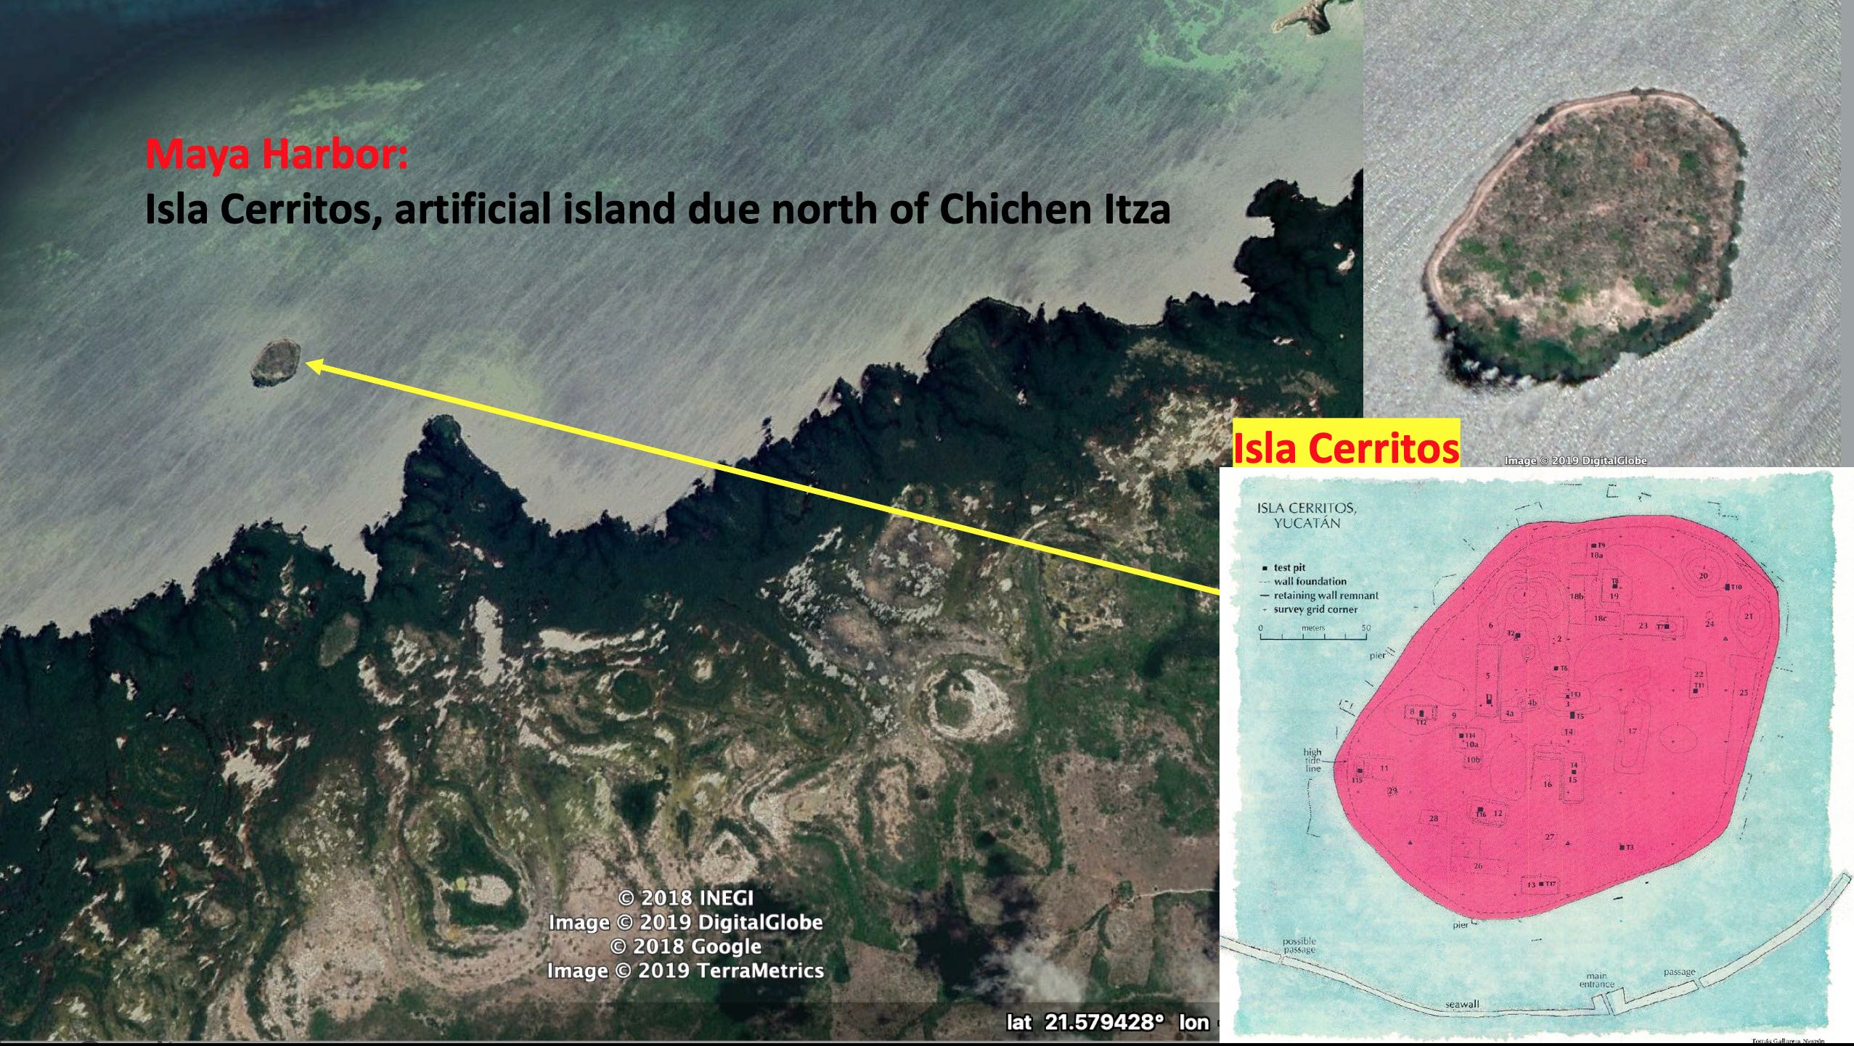

Slide 44
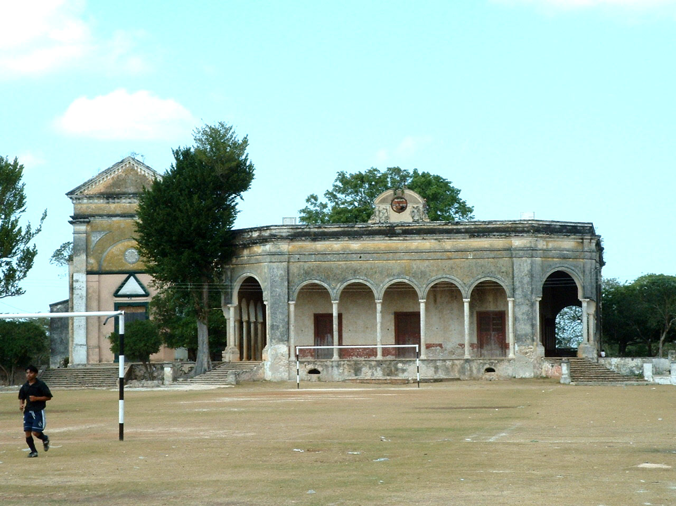
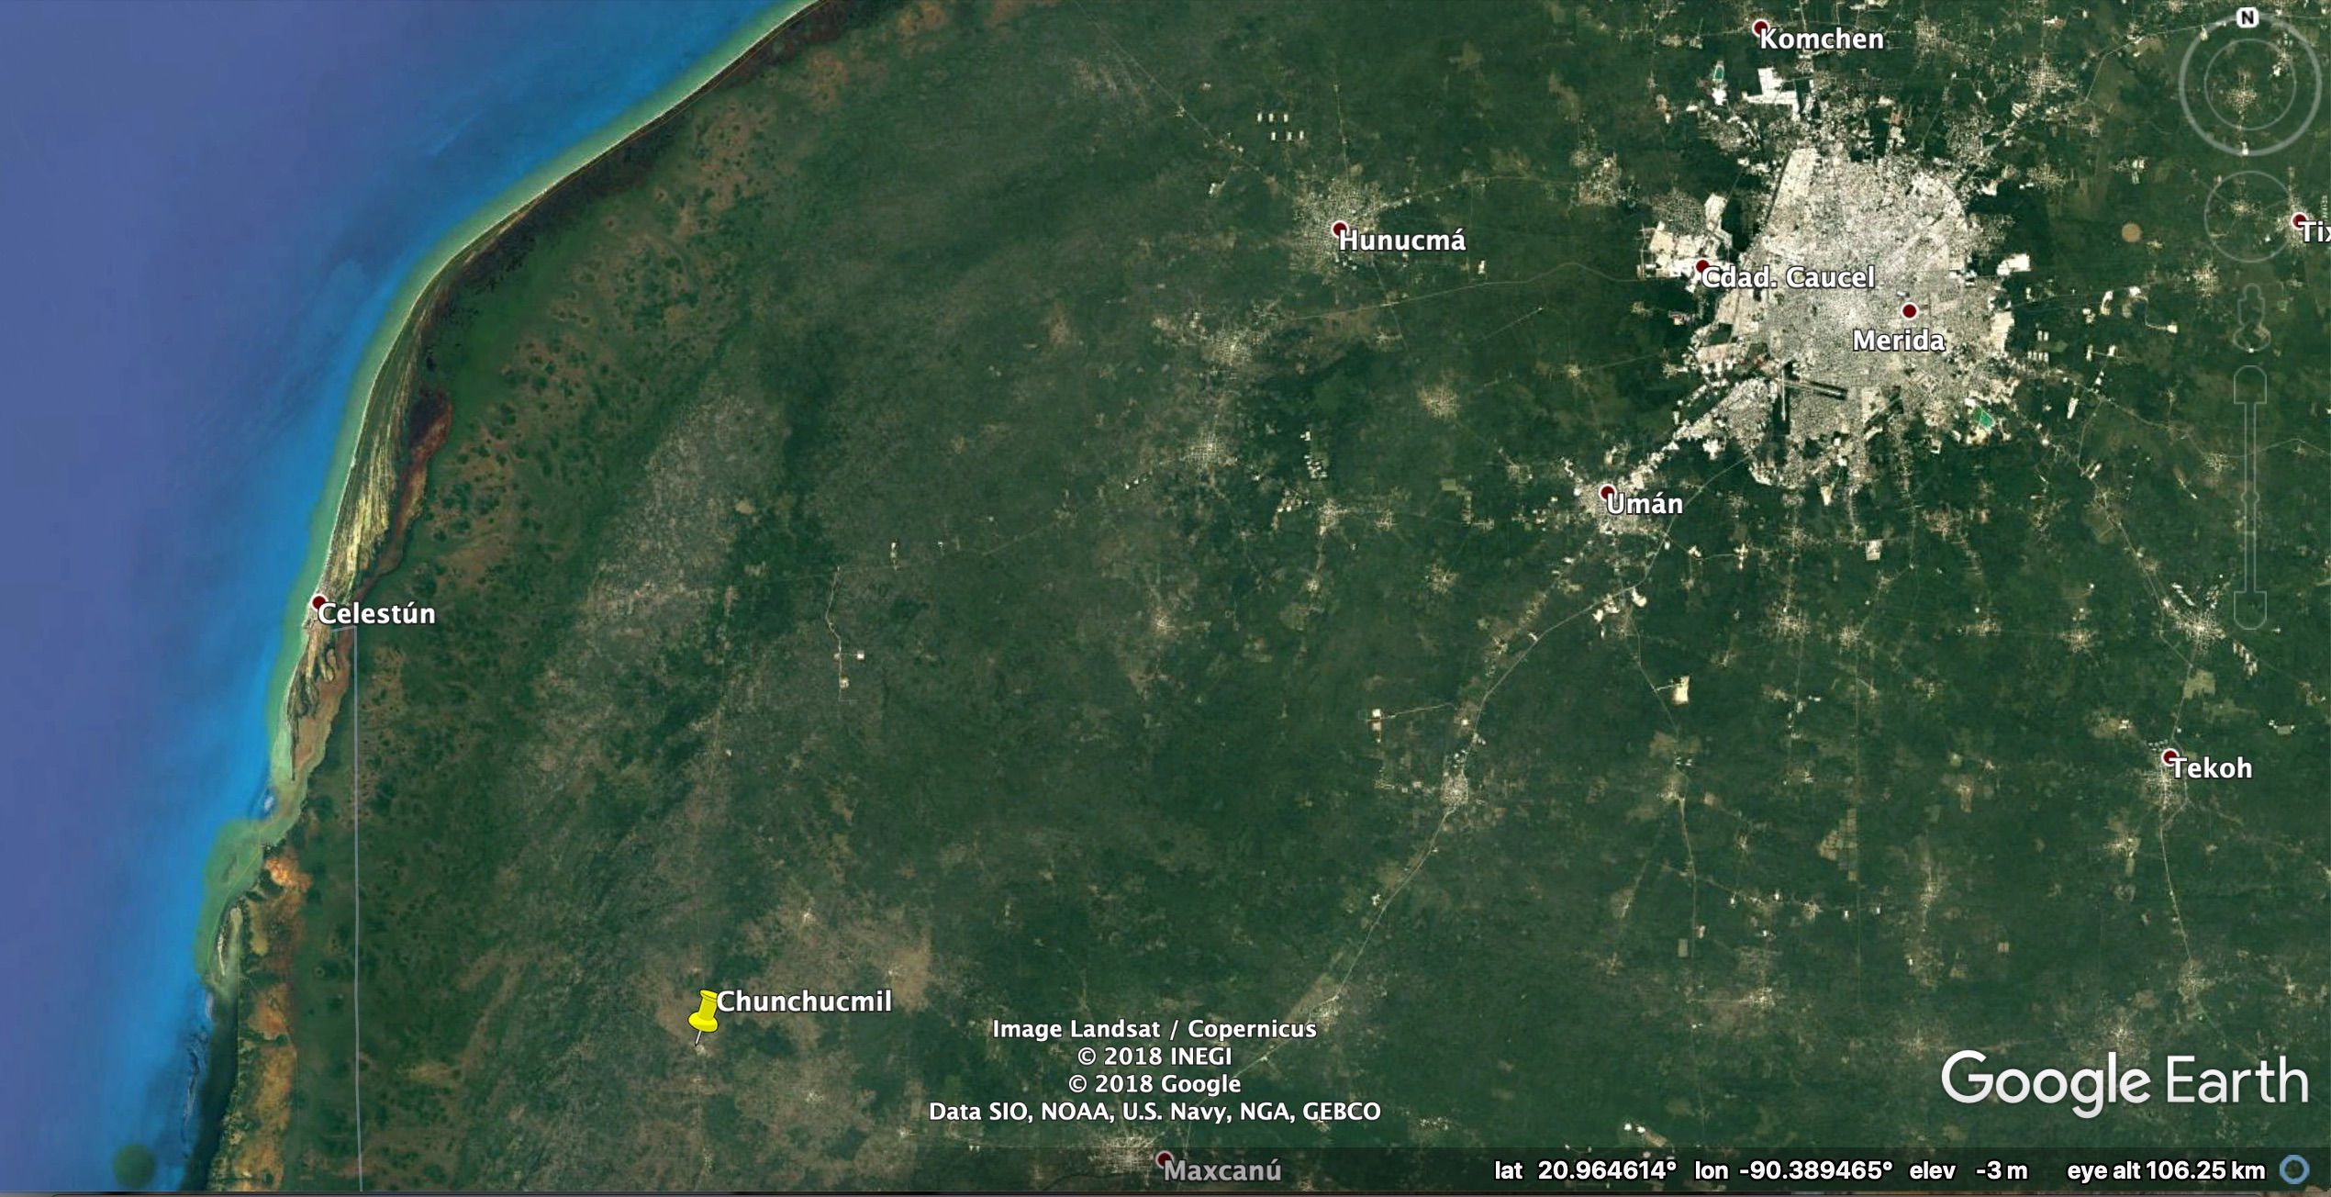
Hacienda on the site of Chunchucmil, a large Maya
market town in a rocky area without food
resources & no ostentatious monuments

Slide 45
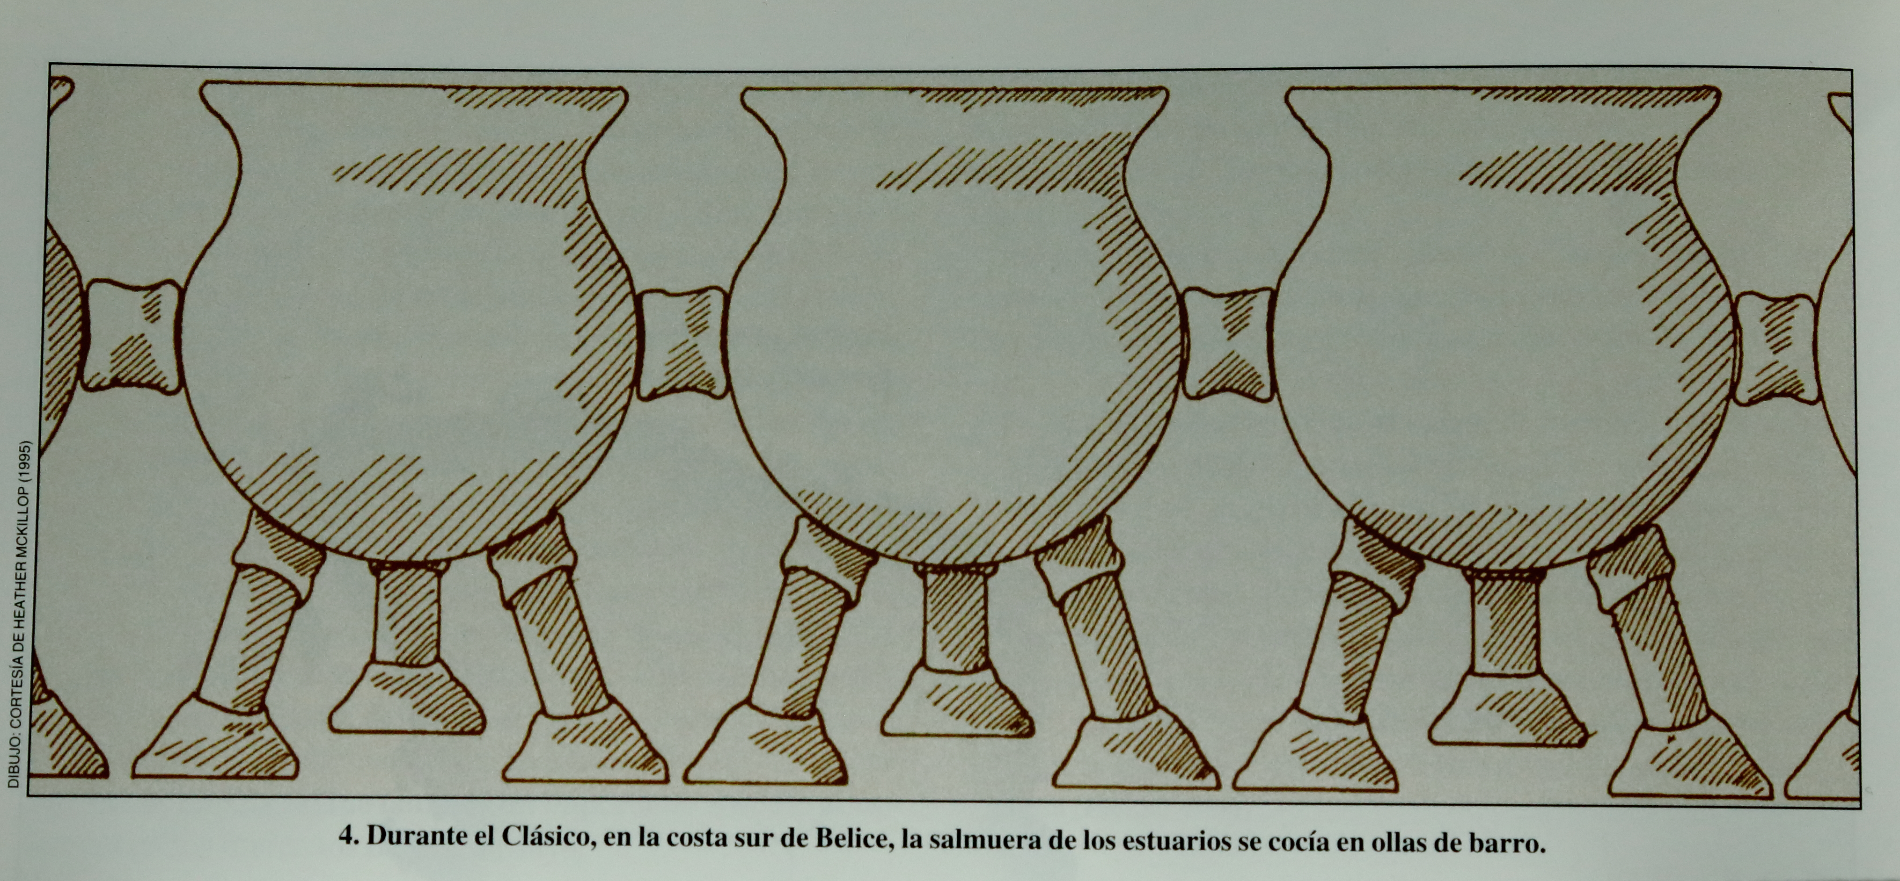
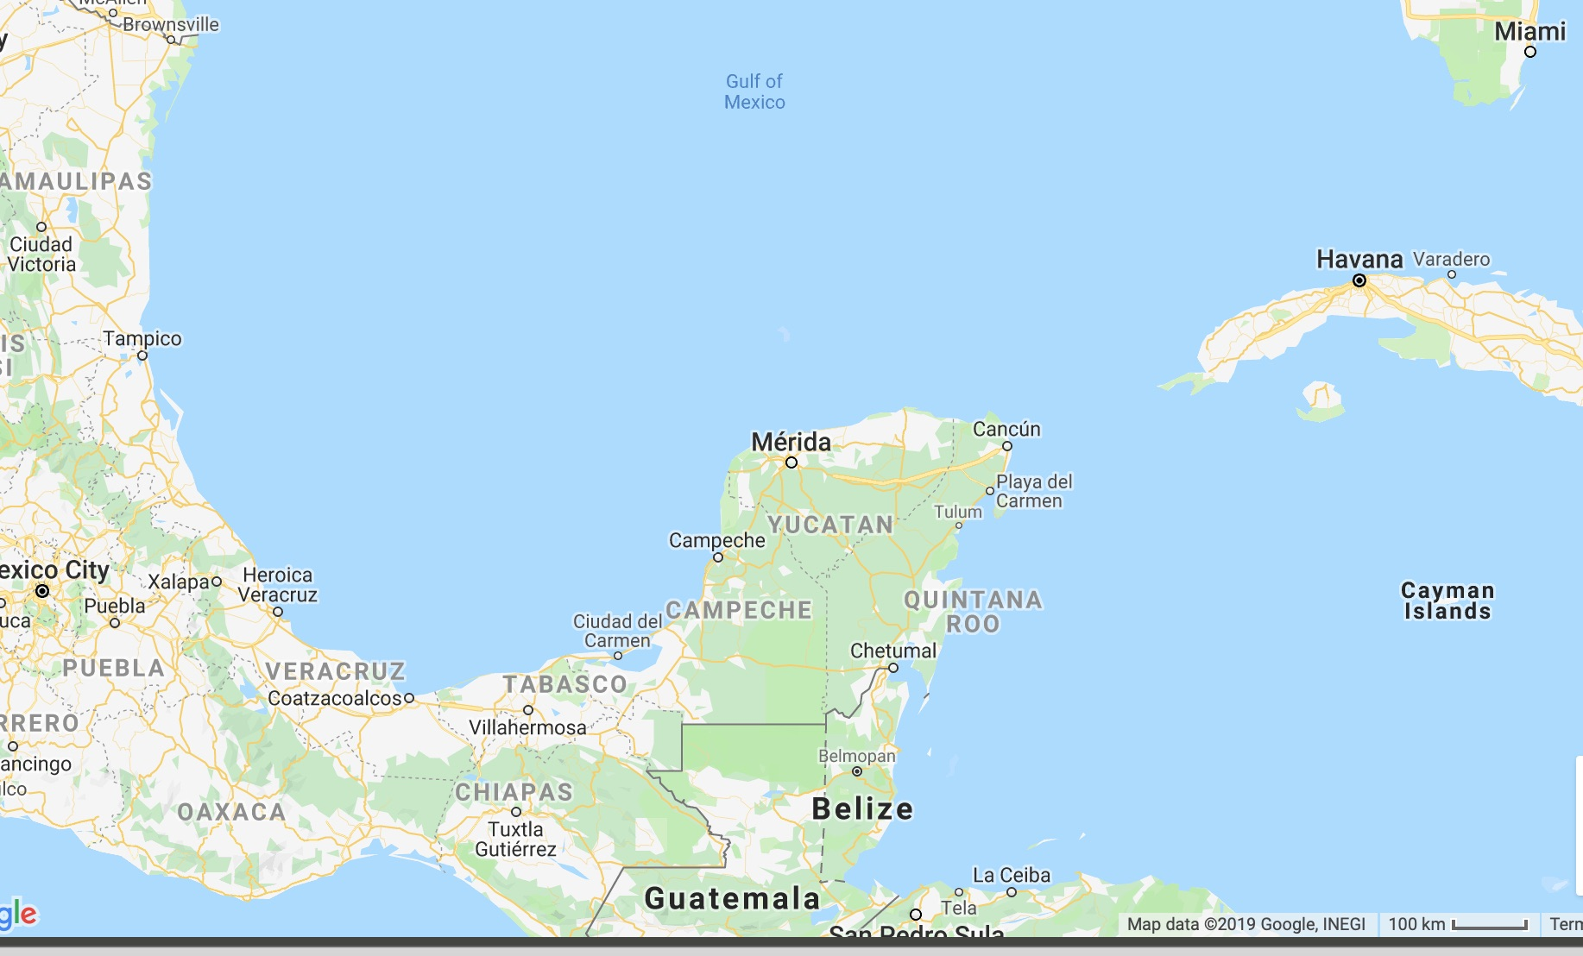
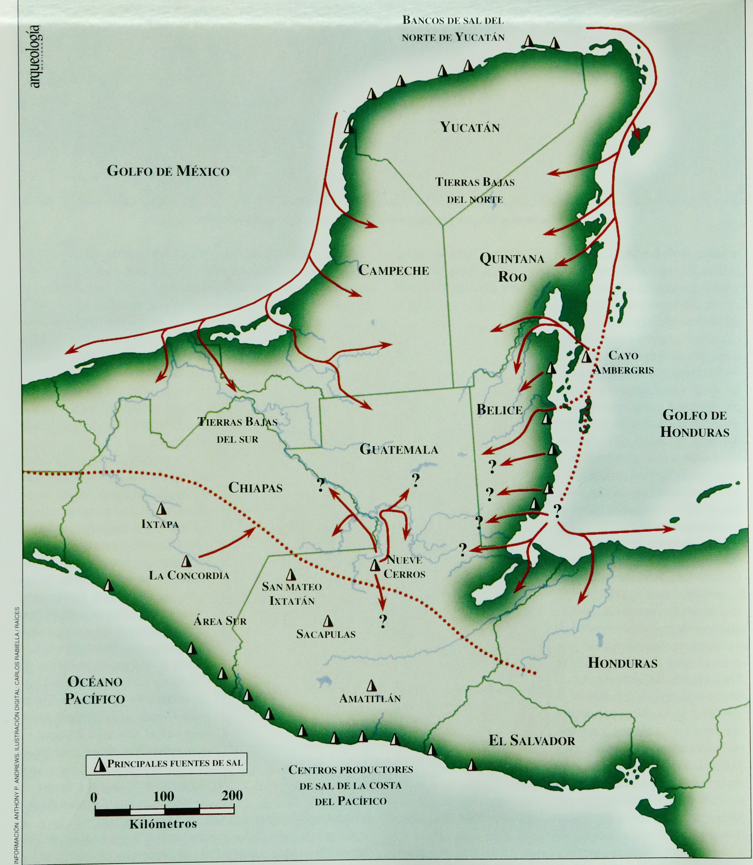
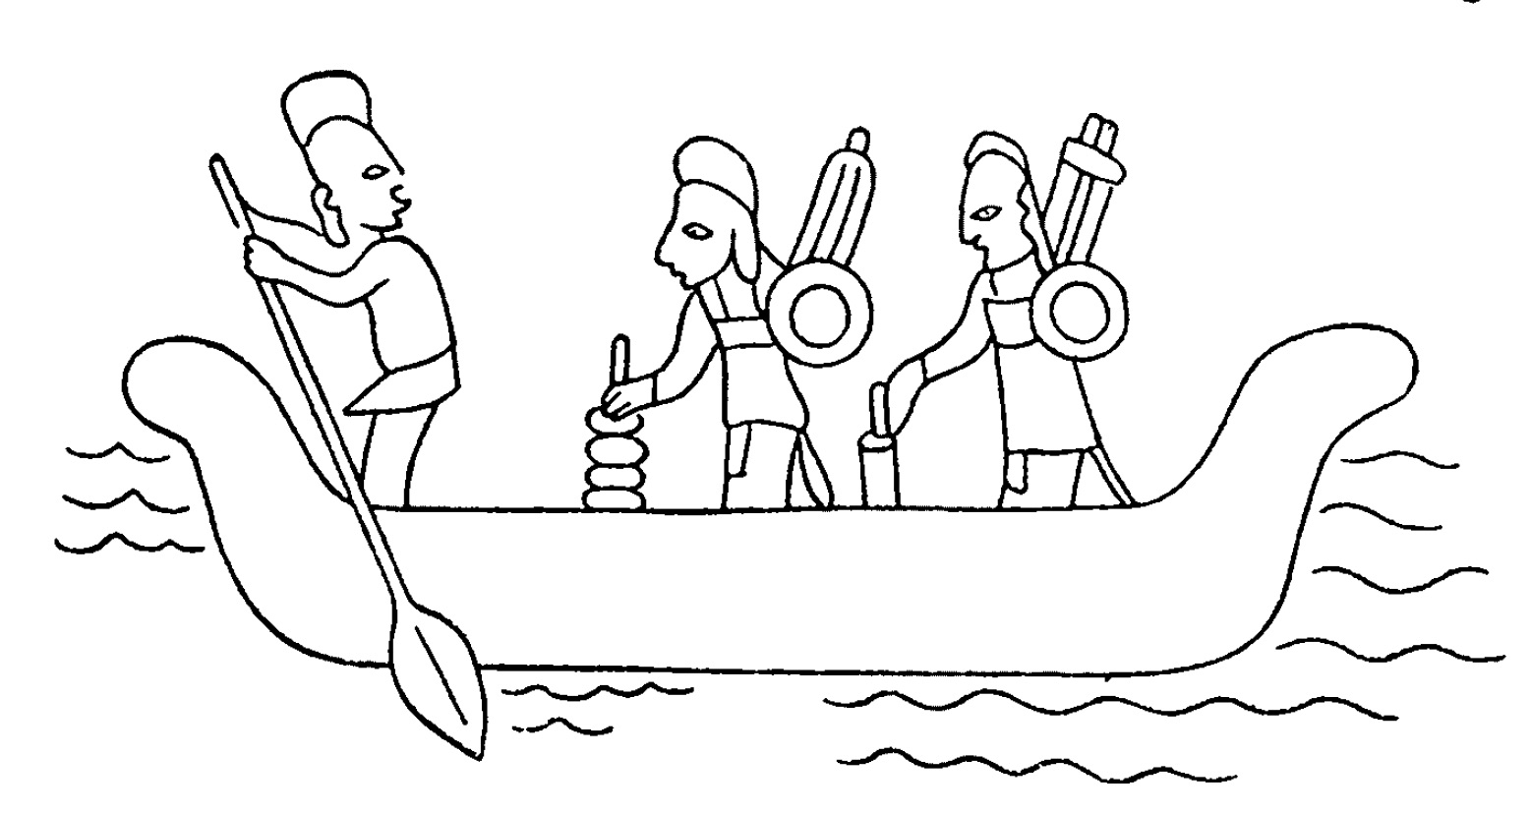
Canoe Observed by Columbus in the Gulf of Honduras (1502): ”There arrived a canoe full of Indians, as long as a galley and eight feet (2.5 m) wide. It was loaded with merchandise from the west, almost certainly from the land of Yucatan thirty leagues or a little more [away] [i.e. >170 km]…. There were in the canoe up to twenty-five men" (Las Casas, Historia de las Indias)
Observed and possible range of Maya merchant canoes
In Belize there was
some competition from labor-intensive salt production by boiling of estuary sediments
Gulf of Mexico
Salt harvesting
?
Veracruz
Gulf of
Honduras

Slide 46
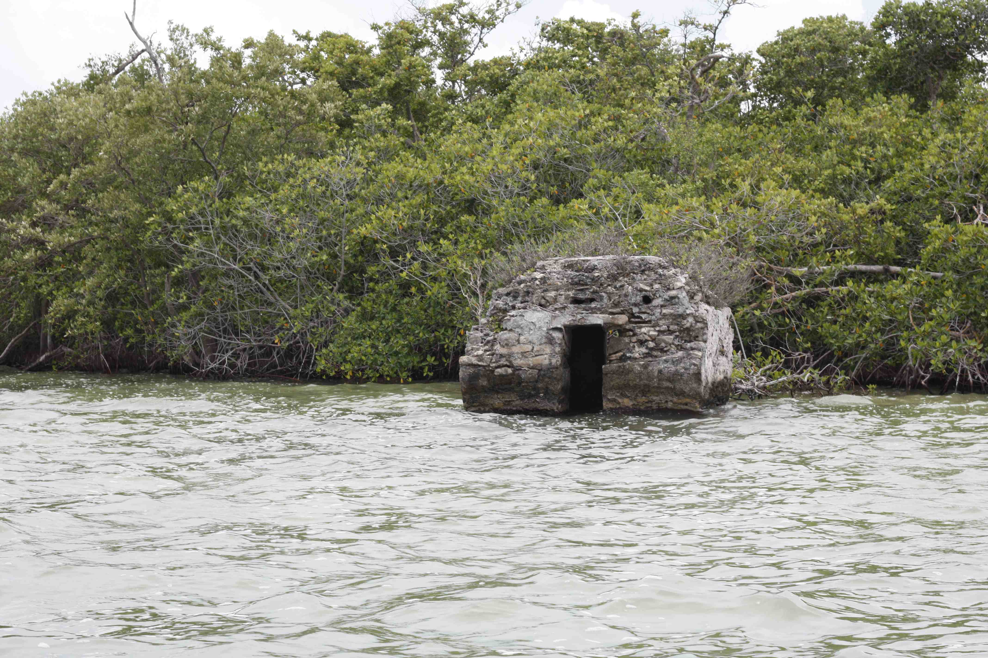
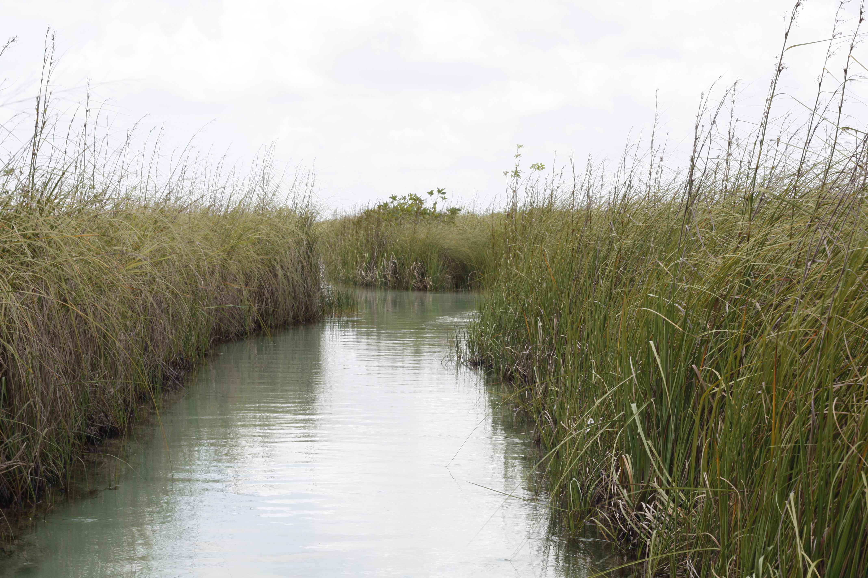
A “two-fer”: building shows
1) Canal system is old,
2) Possible sea level rise
Eastern Quintana Roo canal system

Slide 47
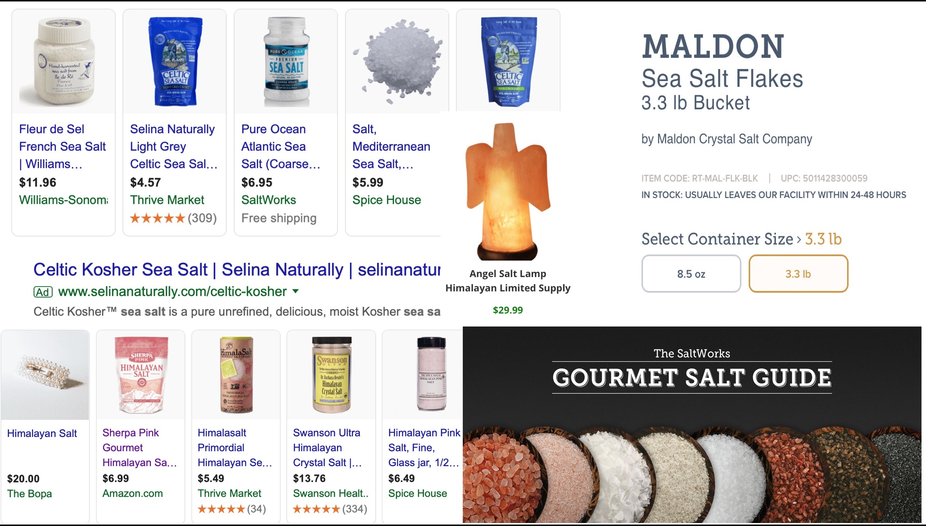
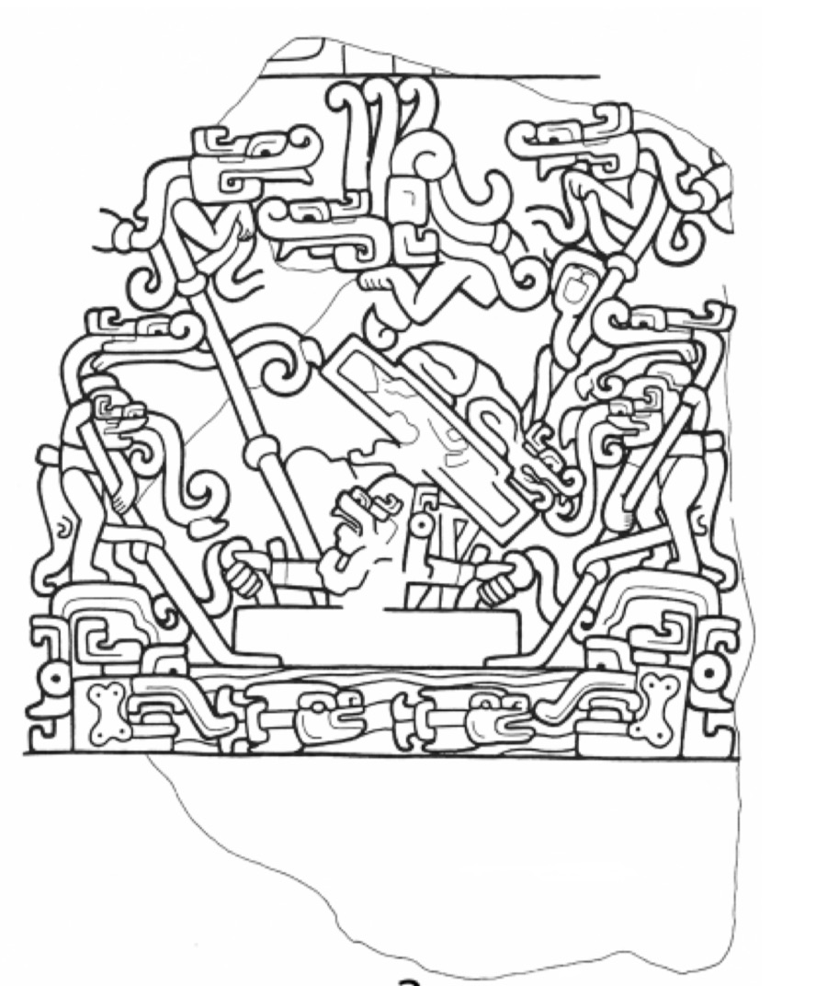
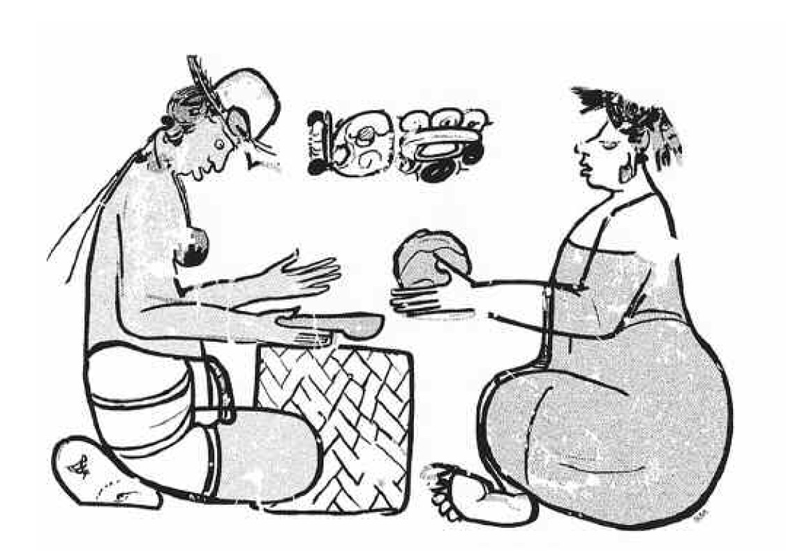
There is some evidence that salt had ritual
significance.
Salt still has ritual significance.
Some people pay $$$
for colored salt from the
Himalayas.

Slide 48
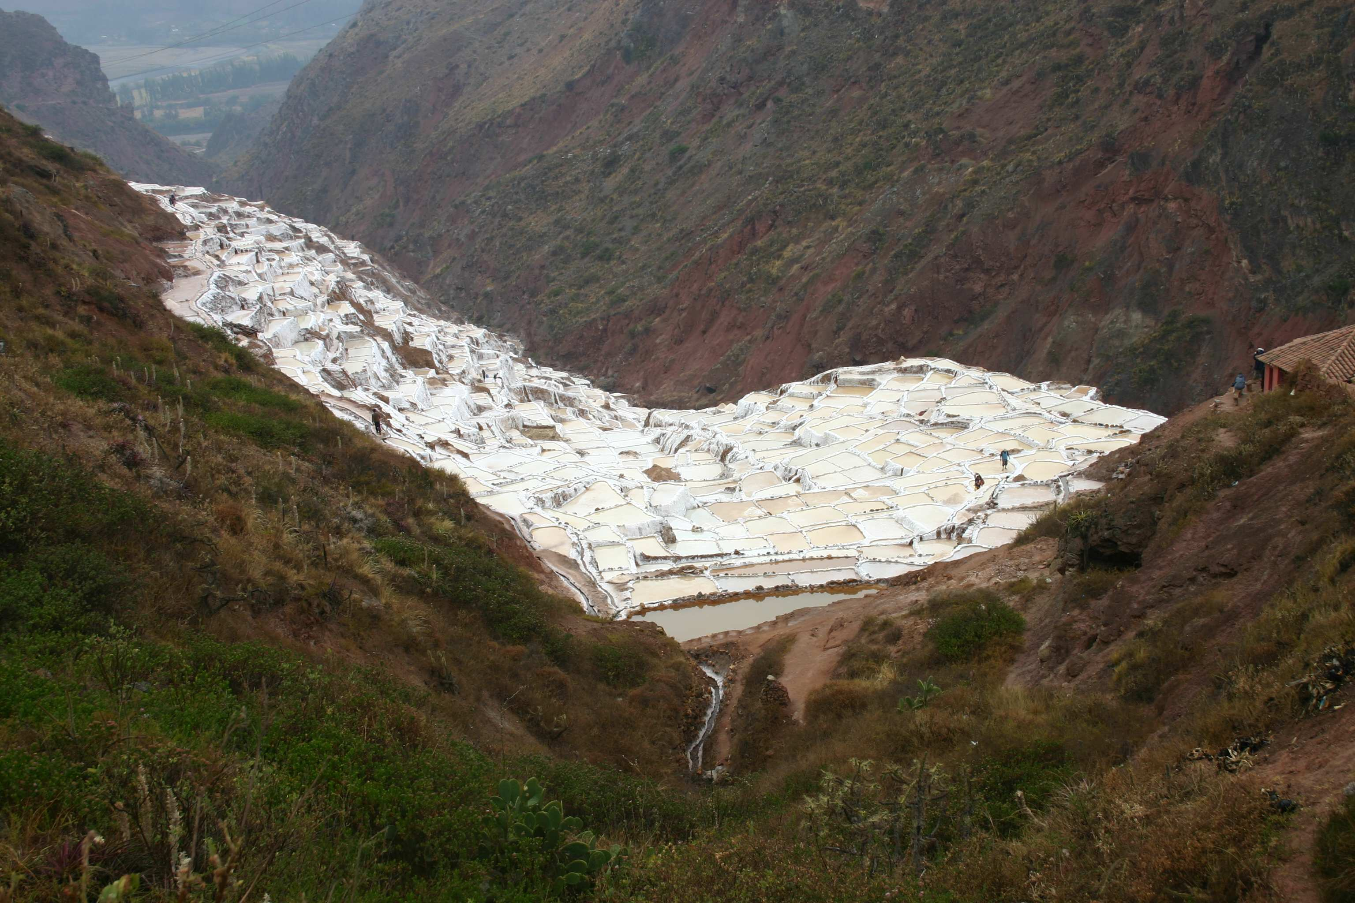

Another example of artisanal salt production:
Peru

Slide 49
Gracias

