Slide 1


Vertical land motion along the coast of California: Implication for flooding and inundation hazards
Em Blackwell, Manoochehr Shirzaei, Chandrakanta Ojha, Susanna Werth

Slide 2
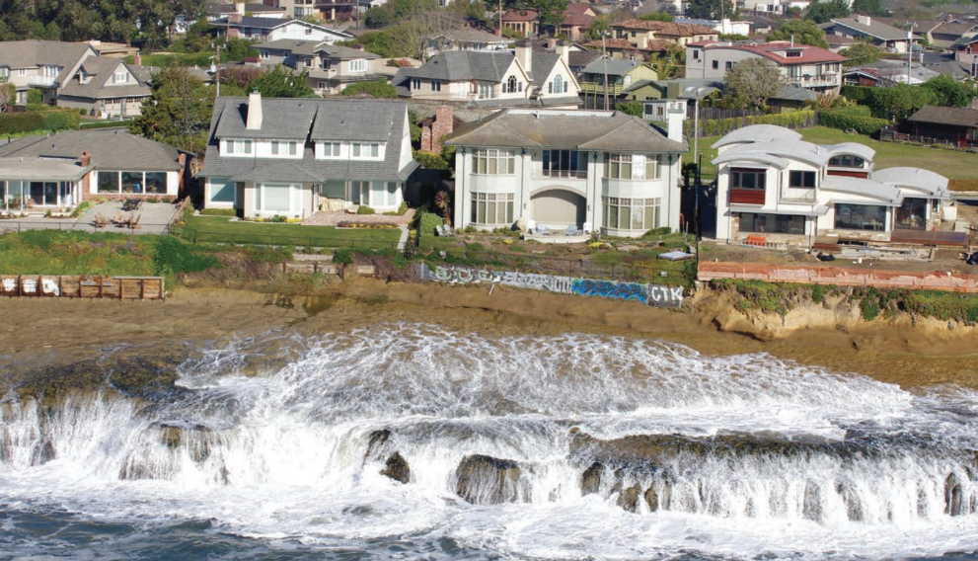
Sea level rise
Hazards:
Flooding
Increased erosion
Saltwater intrusion
Habitat loss
(Griggs et al., 2017)
Notes:
Increased storm surge height
Loss of biodiversity

Slide 3
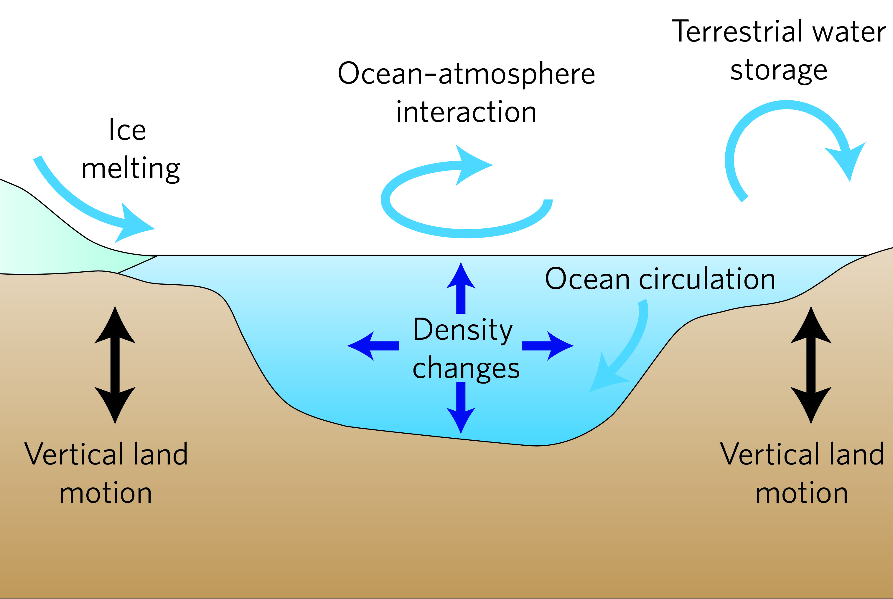
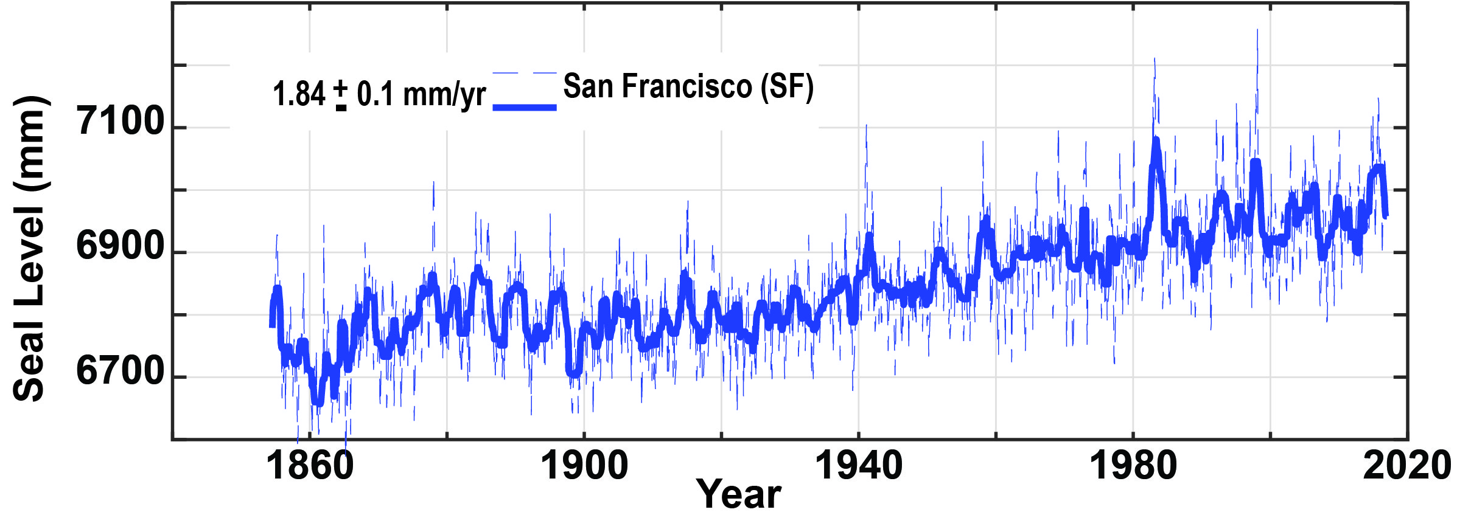
Sea level rise
Causes:
Ice sheet melt
Thermal expansion
Circulatory patterns
Vertical land motion
(Milne et al., 2009)
(Shirzaei and Burgmann, 2018)
Notes:
GMSLR = 3.2 mm/yr
Rates accelerating

Slide 4
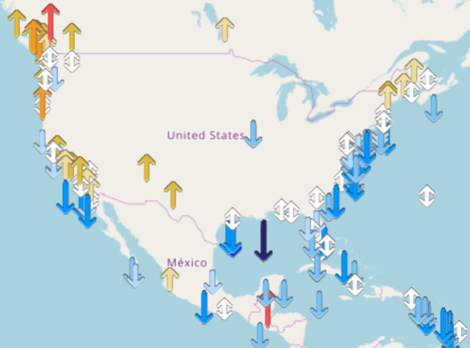

Vertical land motion
Causes:
Glacial isostatic adjustment
Earthquakes
Hydrocarbon reservoir compaction
Aquifer compaction
Source: SONEL

Slide 5
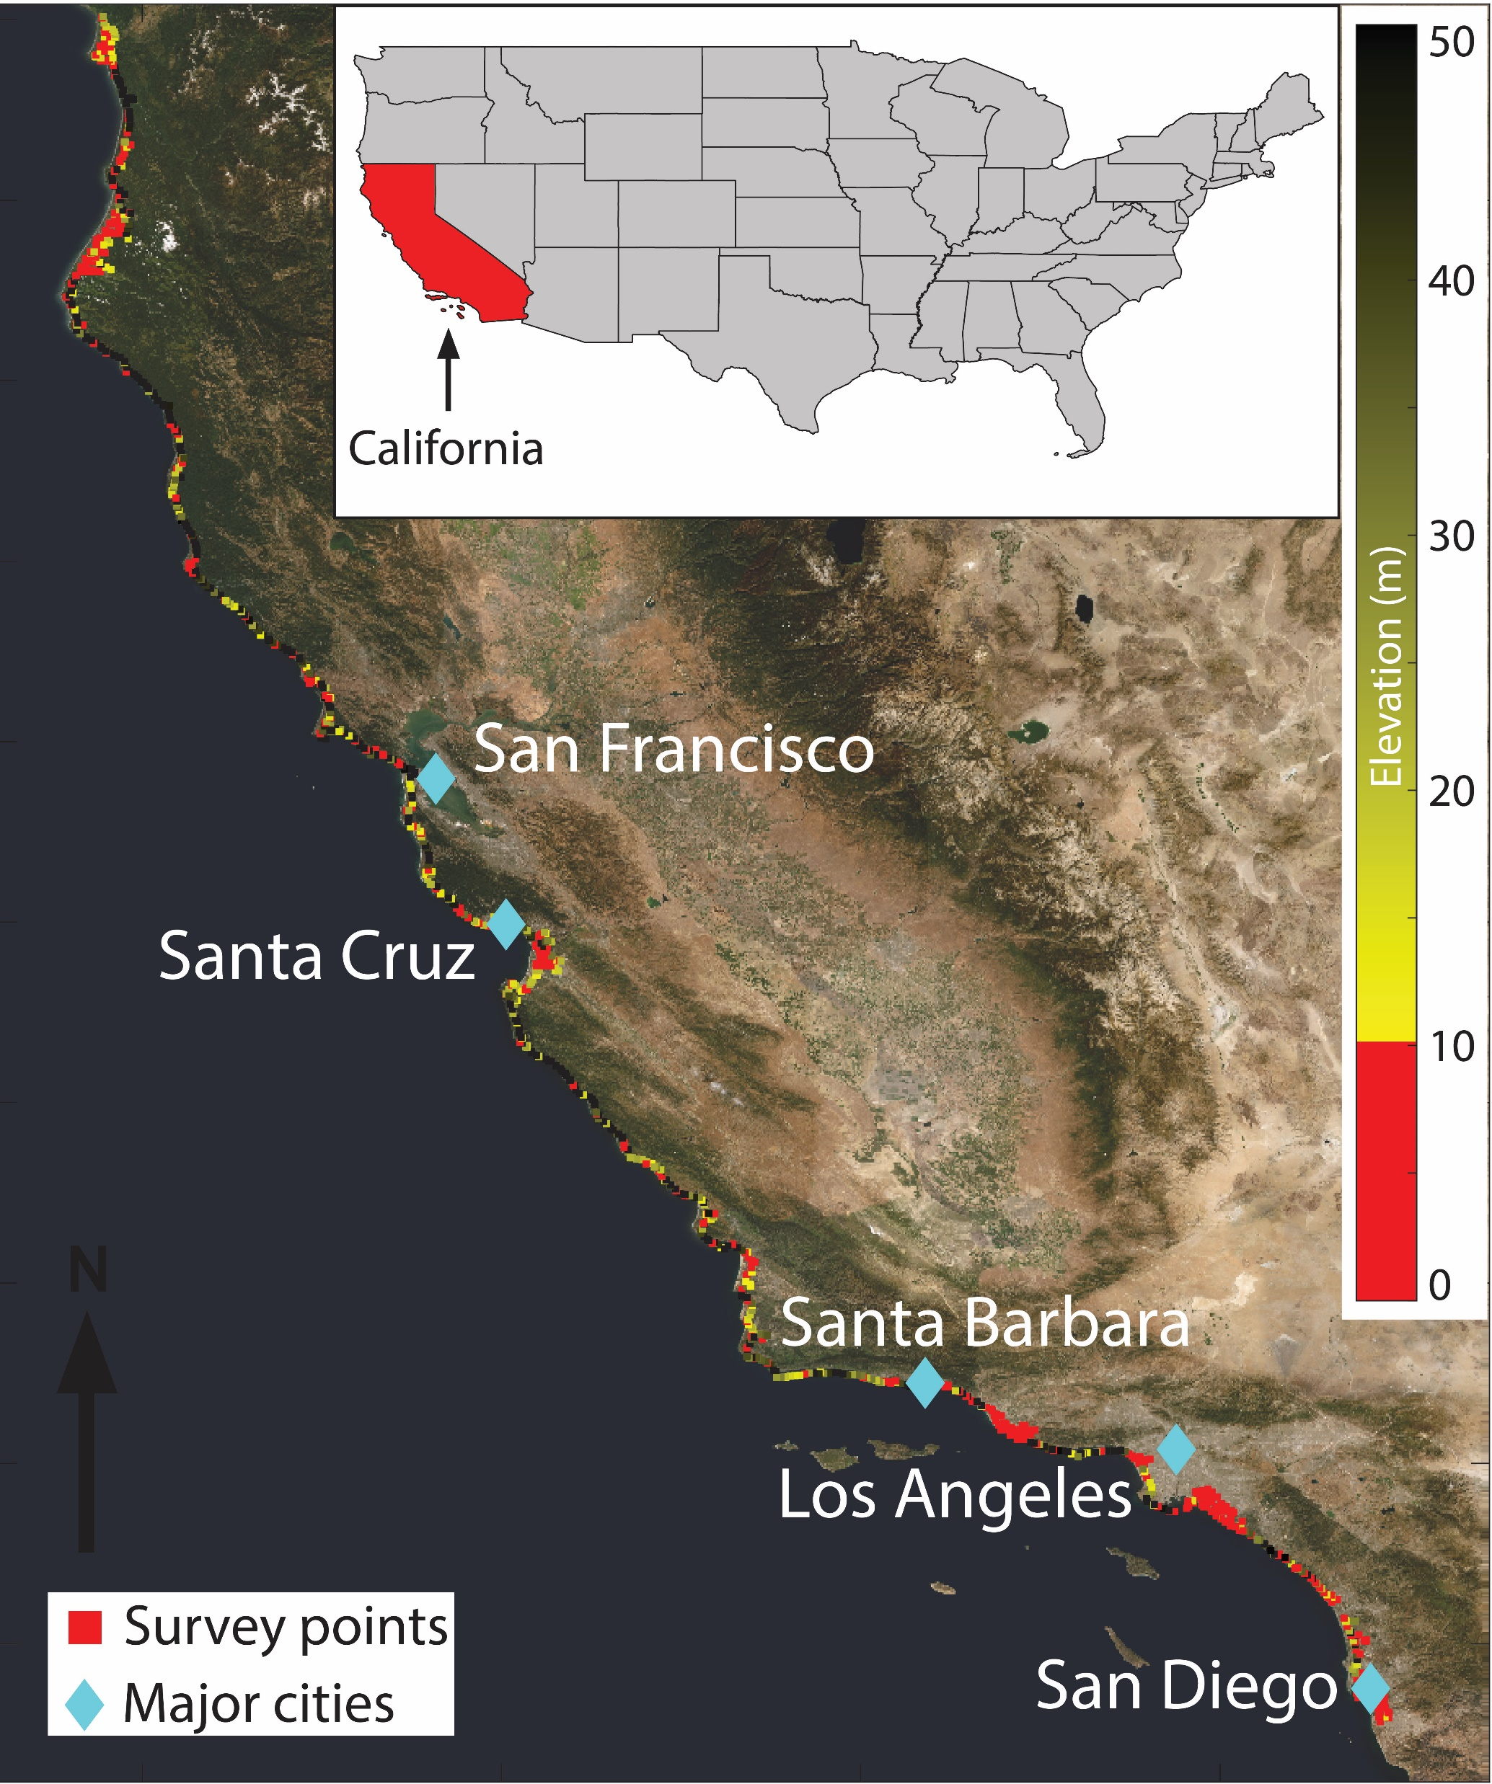
We combine three InSAR data sets with measurements from ground-based stations to determine patterns of coastal subsidence and their implications

Slide 6
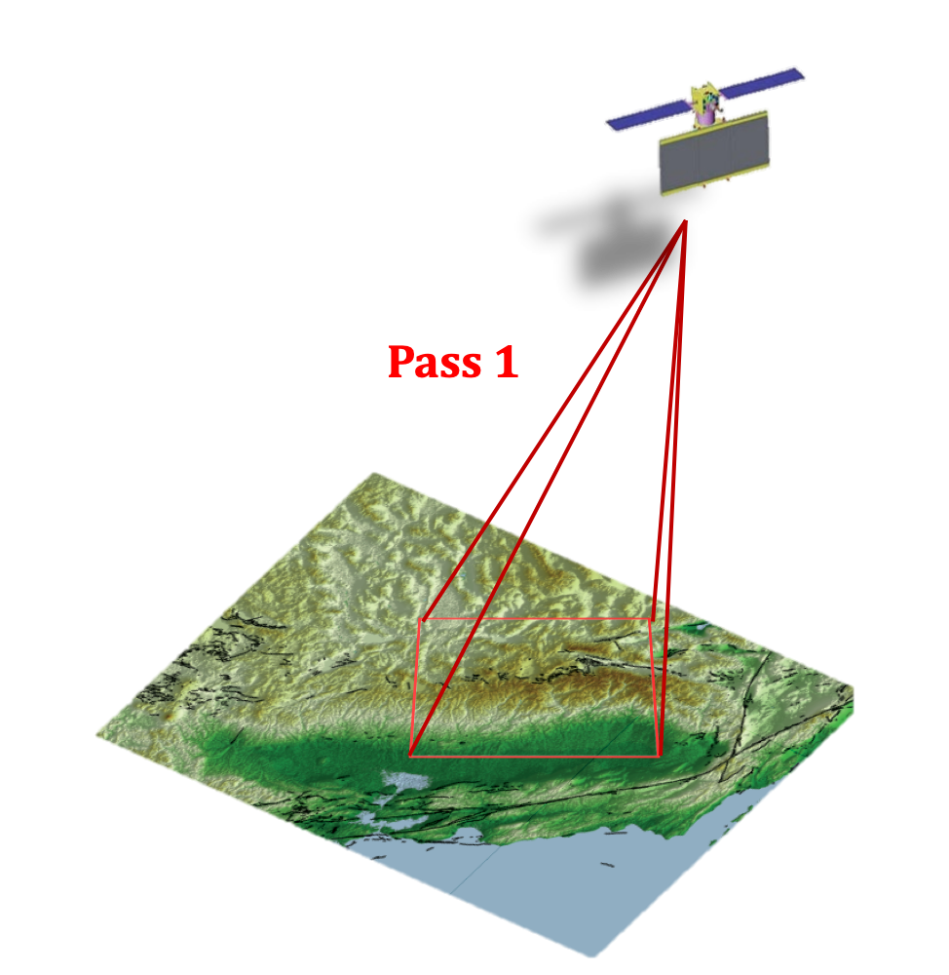
Interferometric synthetic aperture radar (InSAR)
Collect phase and amplitude of backscatter

Slide 7
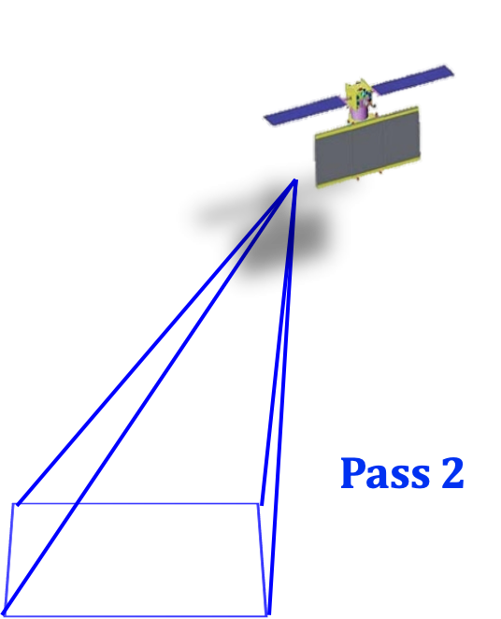
Interferometric synthetic aperture radar (InSAR)
Collect phase and amplitude of backscatter

Slide 8
Interferometric synthetic aperture radar (InSAR)
Collect phase and amplitude of backscatter
Calculate phase difference between passes

Slide 9
Interferometric synthetic aperture radar (InSAR)
Collect phase and amplitude of backscatter
Calculate phase difference between passes
Use many passes referenced to one another to determine long term trend

Slide 10
Data
ALOS ascending 2007-2011
Sentinel-1 ascending and descending 2014-2018
Global Navigation Satellite System (GNSS)
Notes:
Add California population

Slide 11
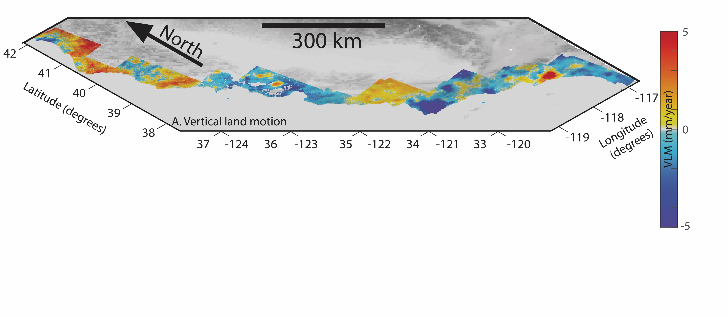
Results
Notes:
VLM with respect to NA12 reference frame!!!!

Slide 12
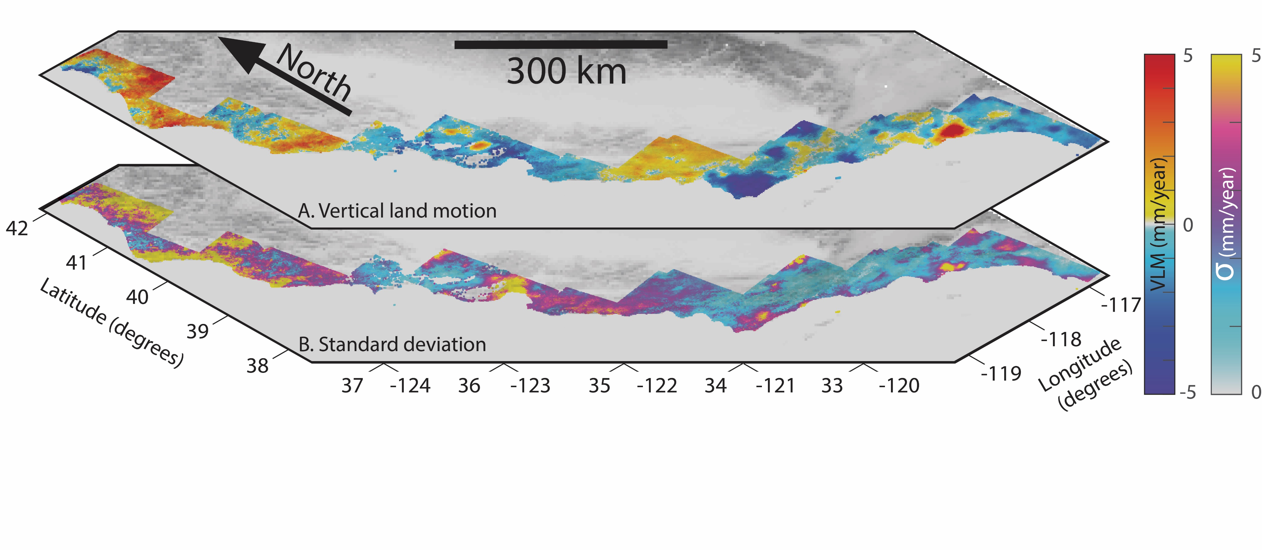
Results

Slide 13
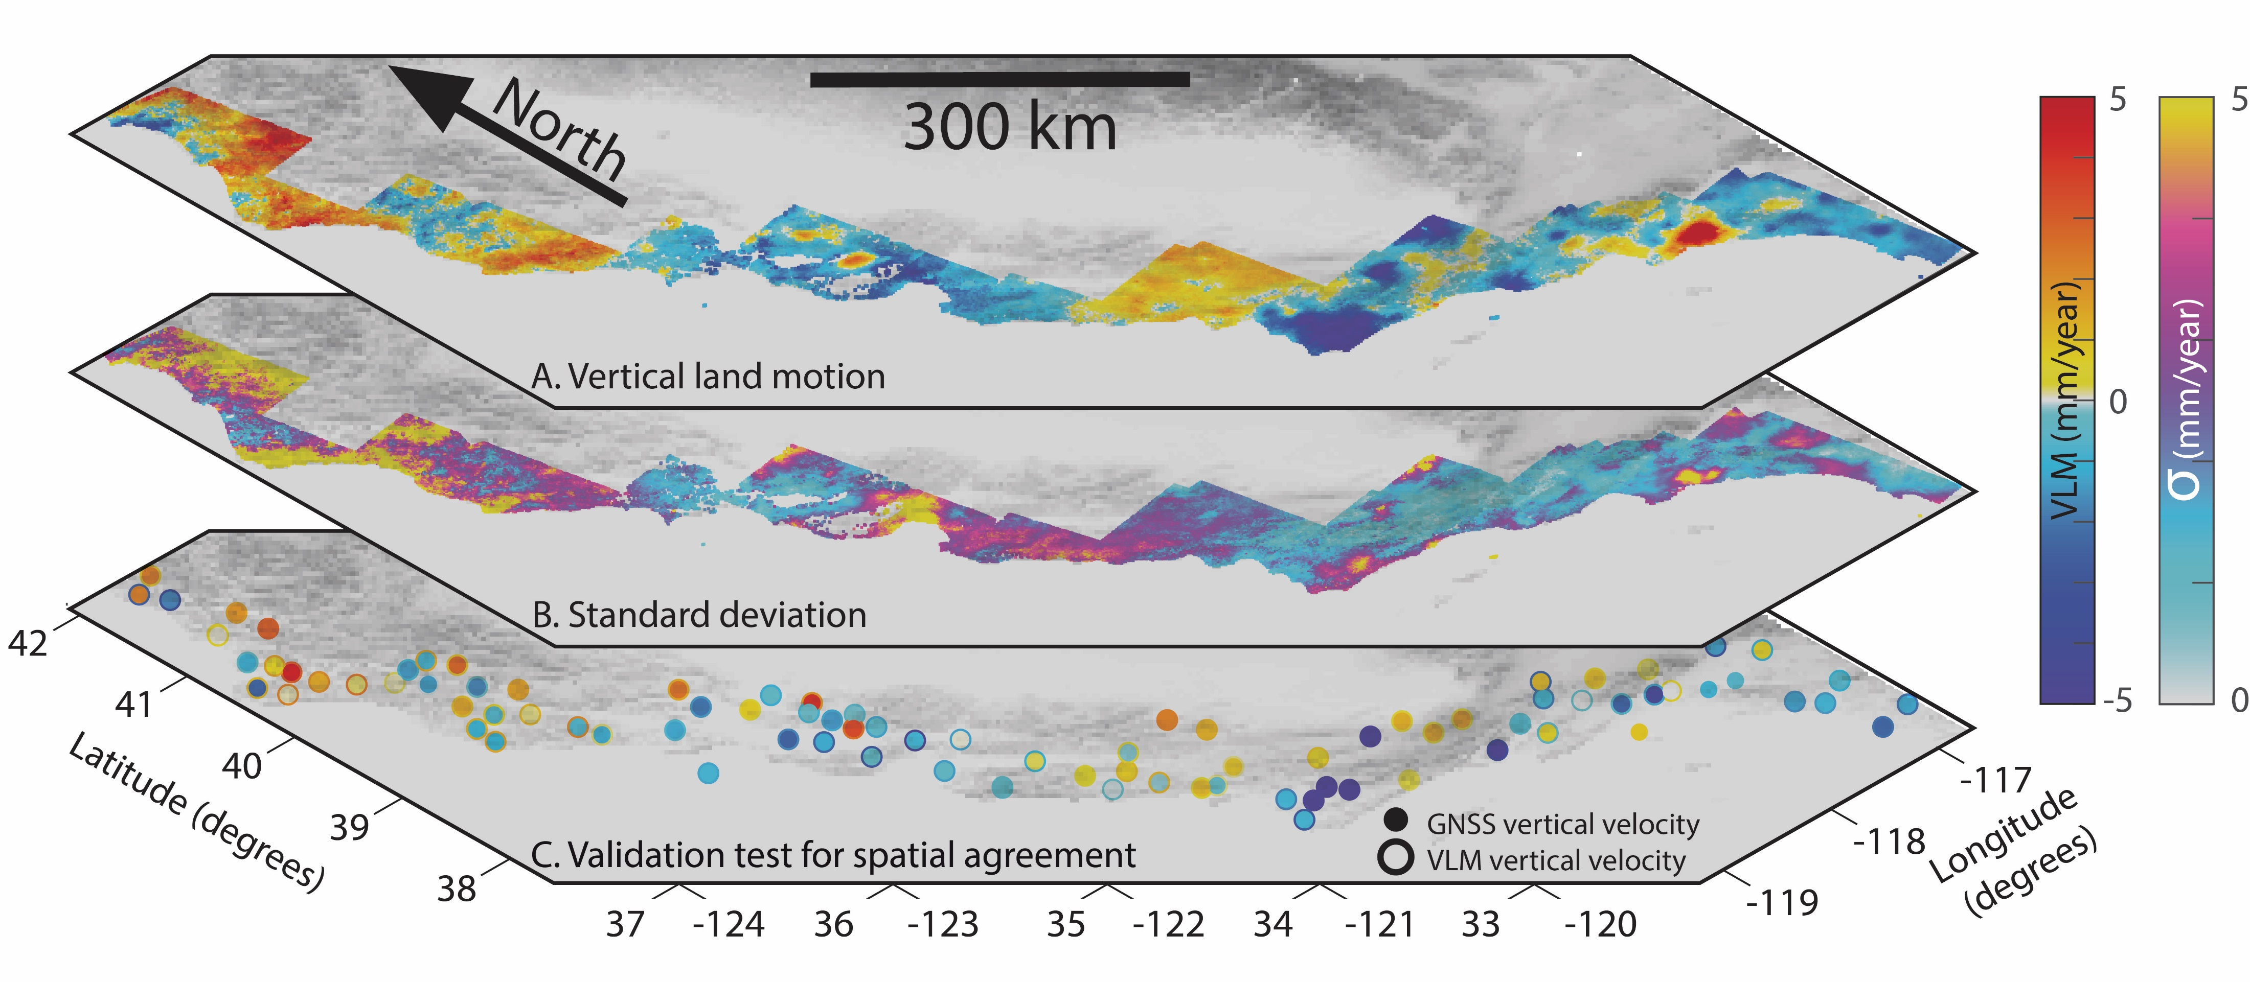
Results

Slide 14
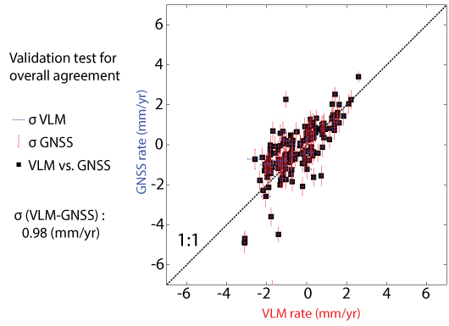
Validation test

Slide 15
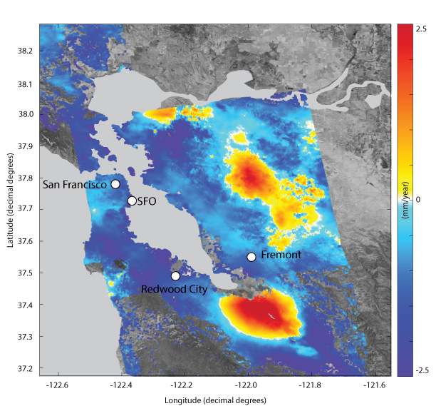
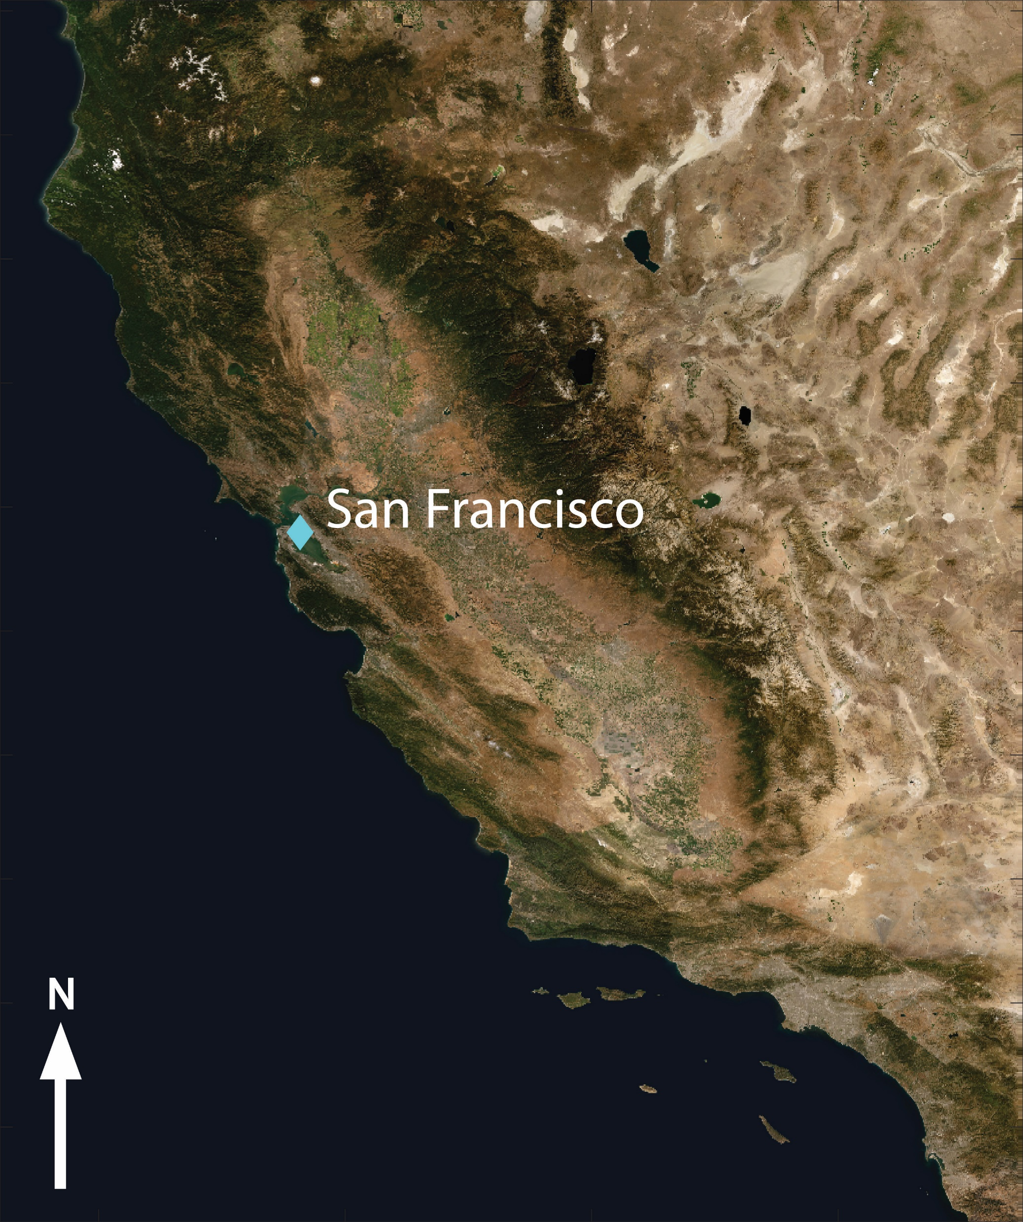
San Francisco Bay Area
Notes:
-5.9

Slide 16
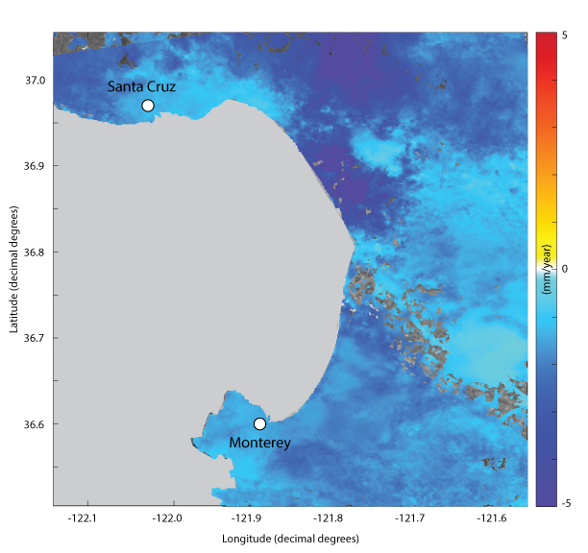
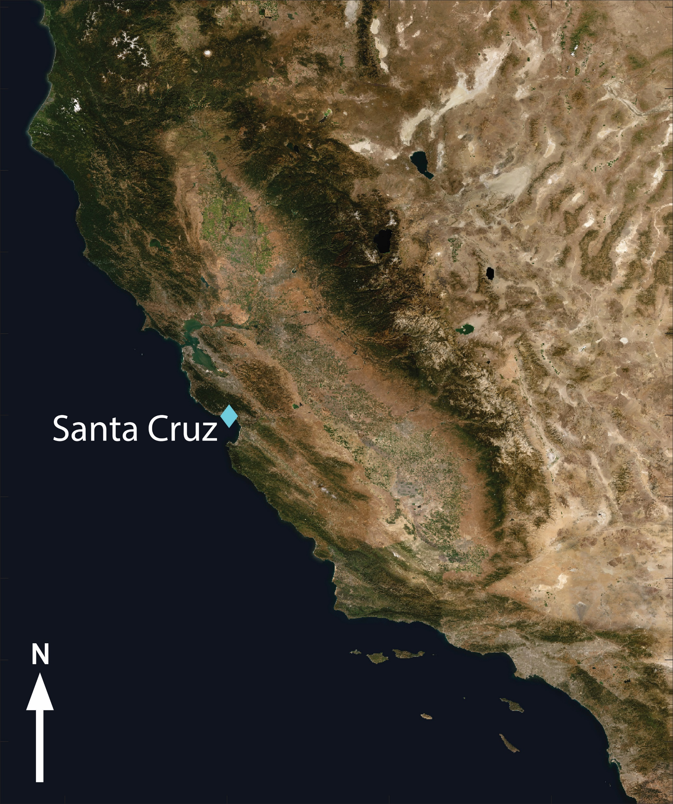
Monterey Bay Area
Notes:
-8.7

Slide 17
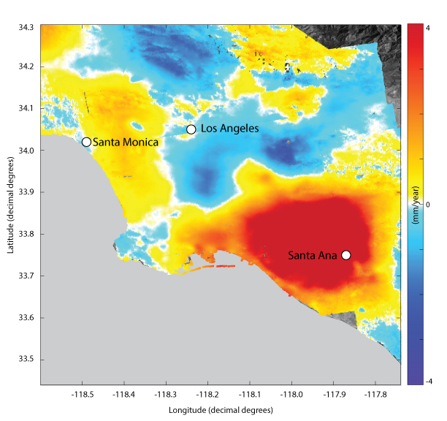
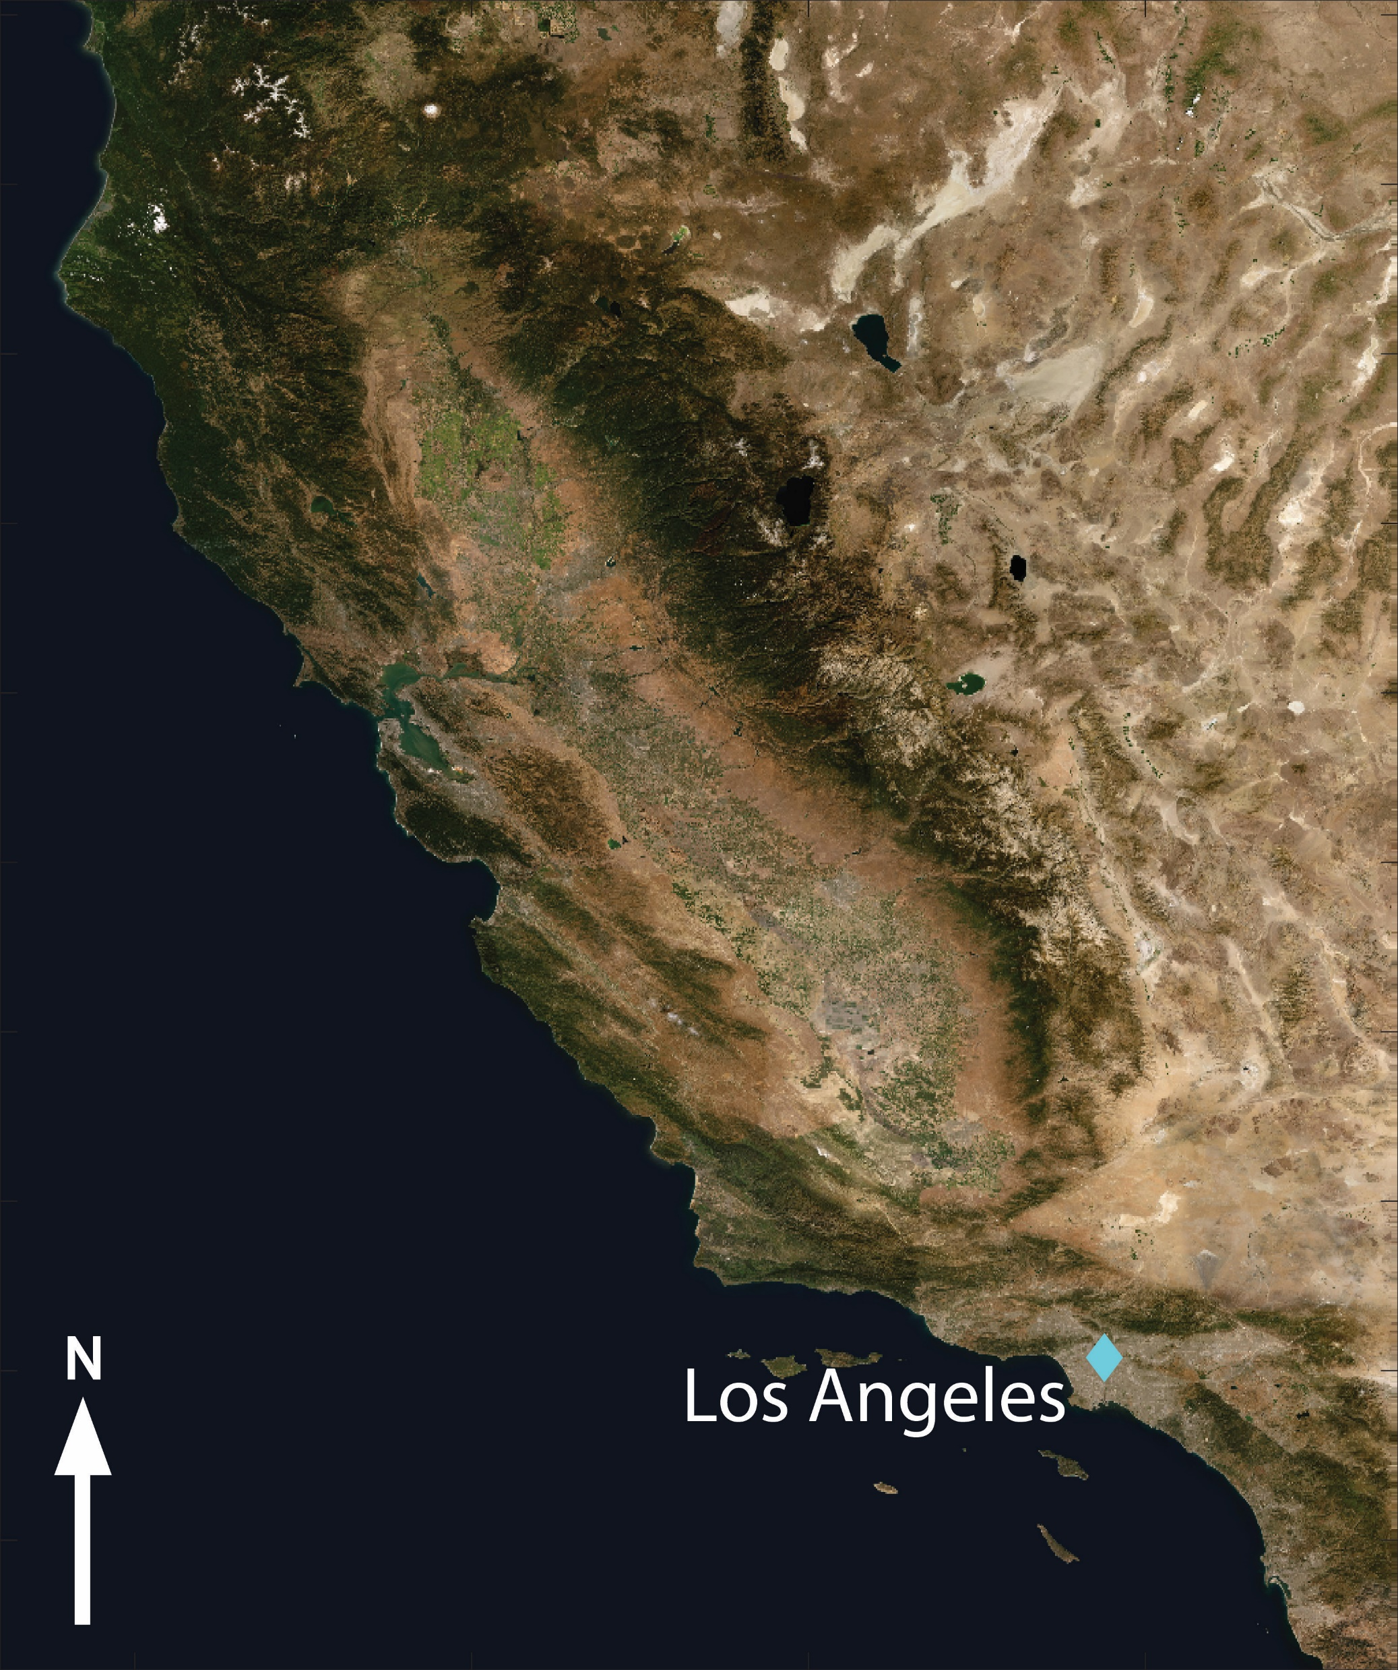
Los Angeles
Notes:
-3.0

Slide 18
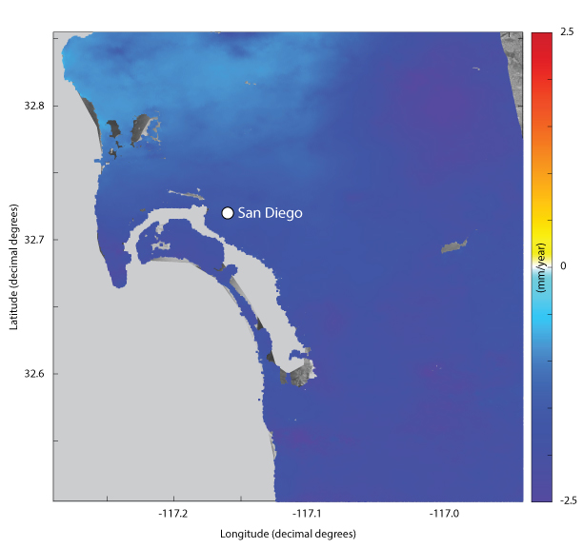
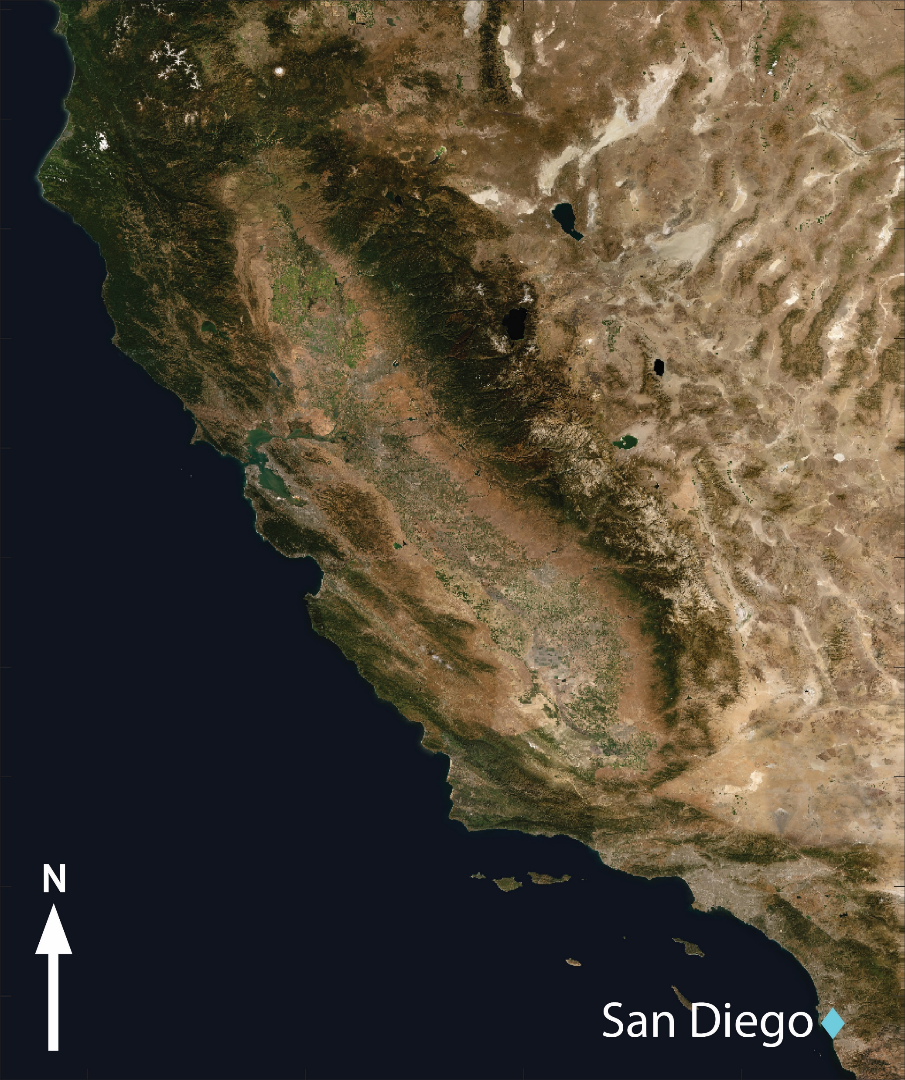
San Diego
Notes:
-2.7

Slide 19
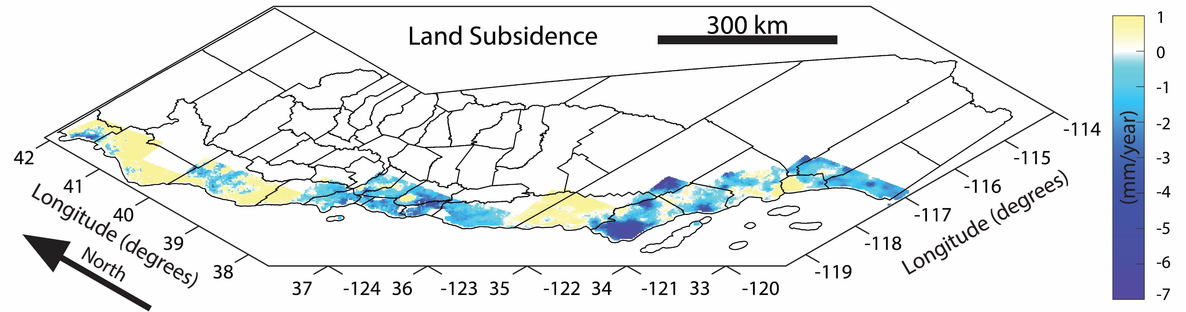
Exposure

Slide 20
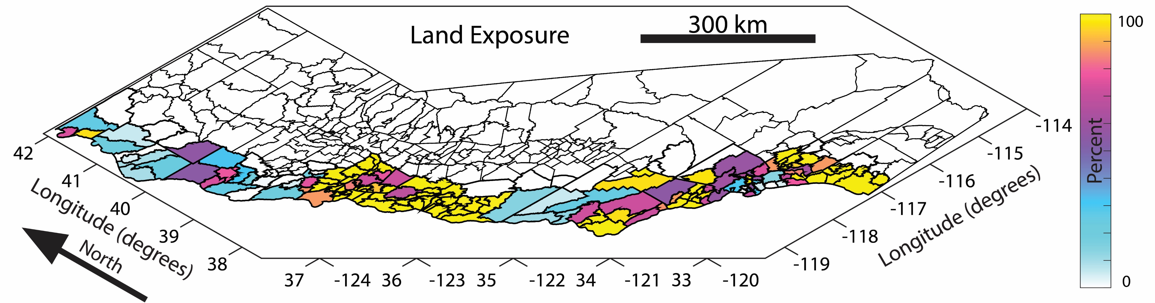
Exposure

Slide 21
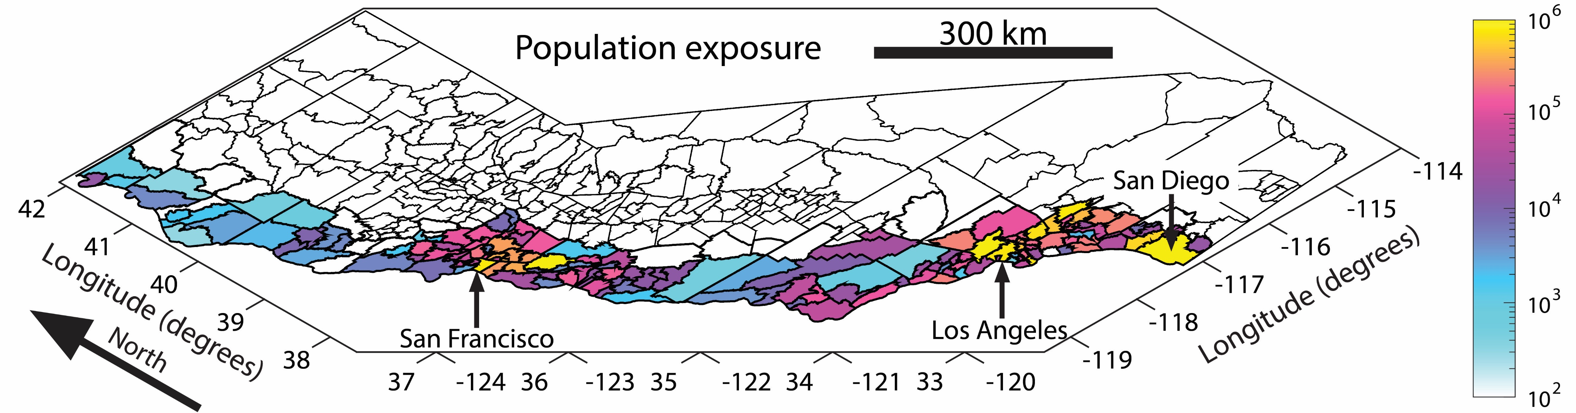
Exposure
Notes:
Uniform dist. Of pop.

Slide 22
Summary
Combination of multi-track InSAR and GNSS data enables measuring VLM at 1000km extent, 100m resolution, and mm level accuracy
Many highly populated, low elevation coastal communities in California are subsiding with rates up to 8.7 mm/year
These communities have elevated climate change related hazards

Slide 23
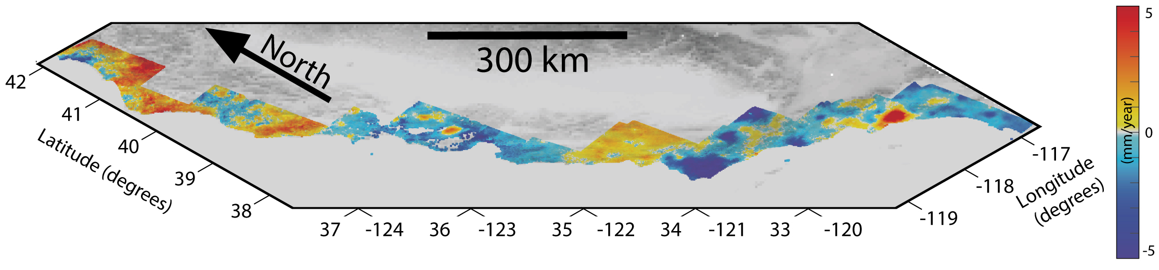
Thank you

Slide 24
Bibliography
Church, J. A., Clark, P. U., Cazenave, A., Gregory, J. M., Jevrejeva, S., Levermann, A., ... & Payne, A. J. (2013). Sea-level rise by 2100. Science, 342(6165), 1445-1445.
Griggs, G, Árvai, J, Cayan, D, DeConto, R, Fox, J, Fricker, HA, Kopp, RE, Tebaldi, C, Whiteman, EA (California Ocean Protection Council Science Advisory Team Working Group). (2017) Rising Seas in California: An Update on Sea-Level Rise Science. California Ocean Science Trust.
Milne, G. A., Gehrels, W. R., Hughes, C. W., & Tamisiea, M. E. (2009). Identifying the causes of sea-level change. Nature Geoscience, 2(7), 471.
Shirzaei, Manoochehr, & Bürgmann, Roland. (2018). Global climate change and local land subsidence exacerbate inundation risk to the San Francisco Bay Area. Science advances, 4(3), eaap9234.

