Slide 1





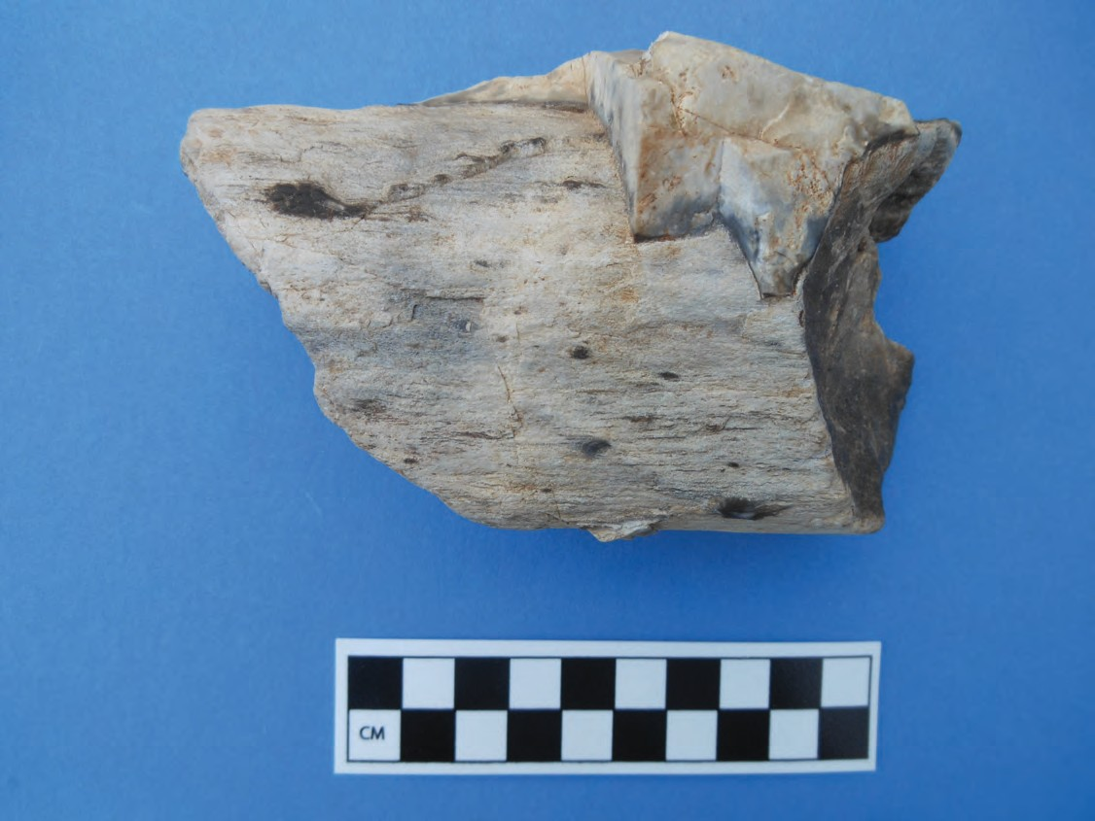
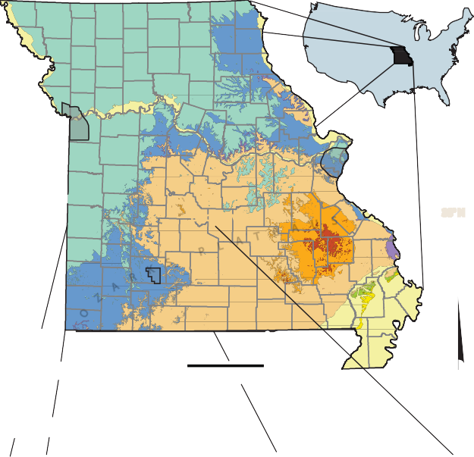
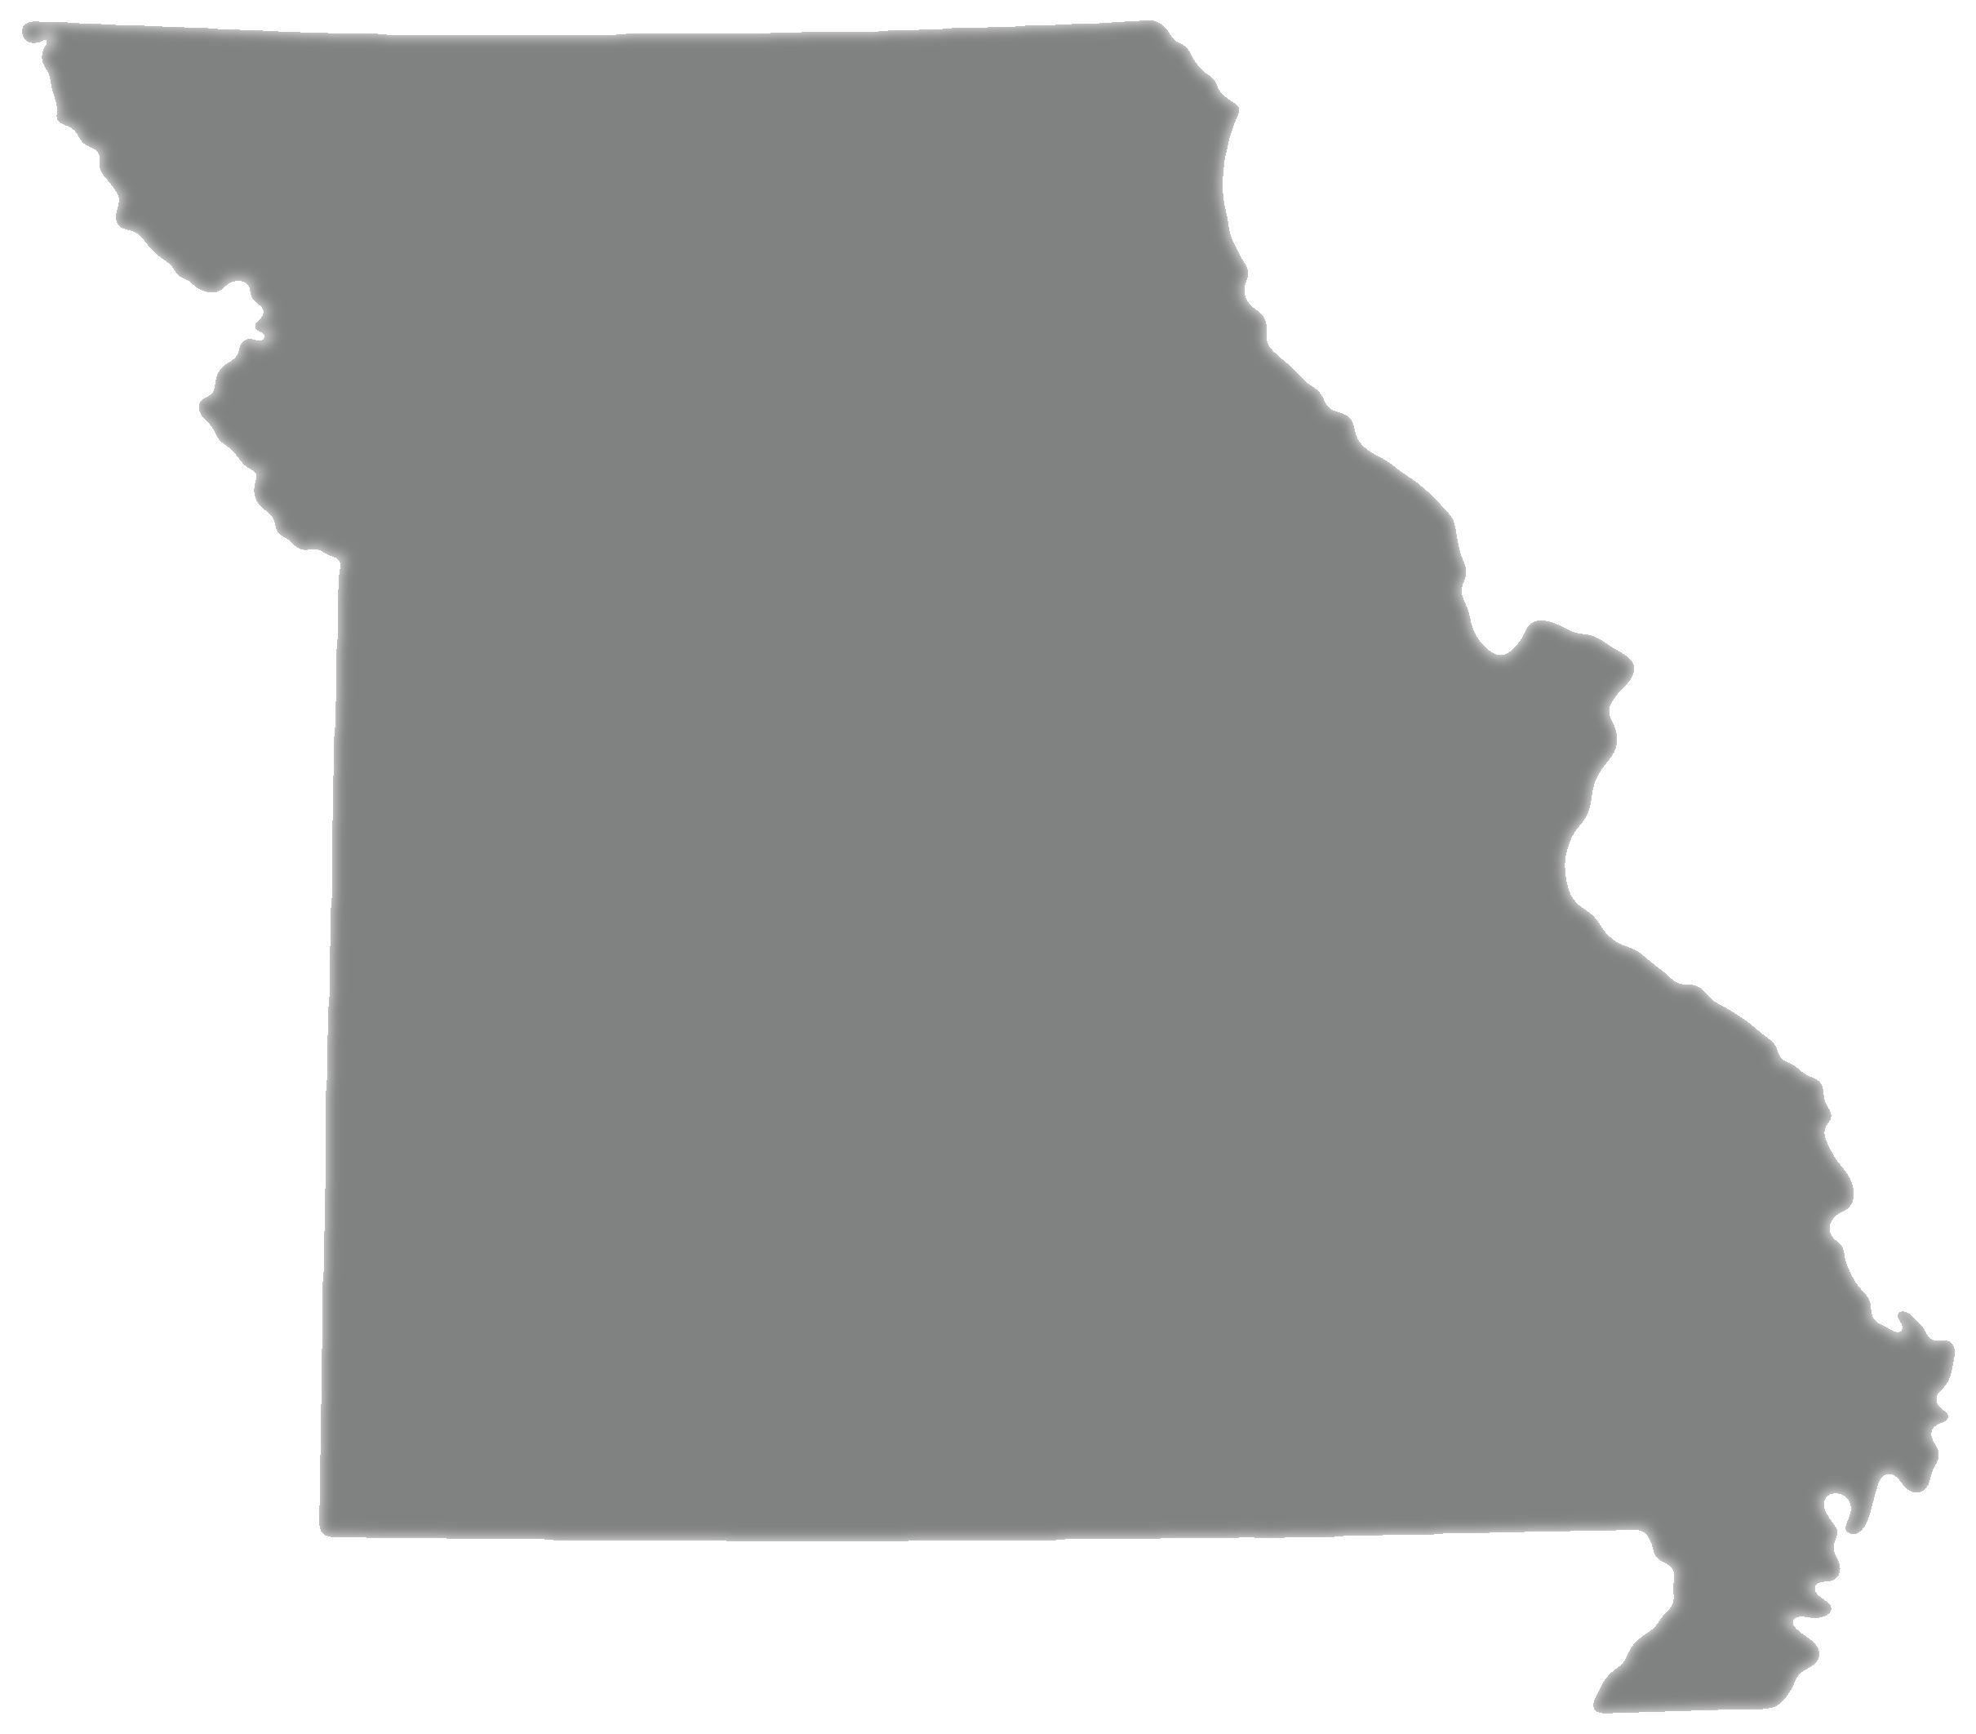





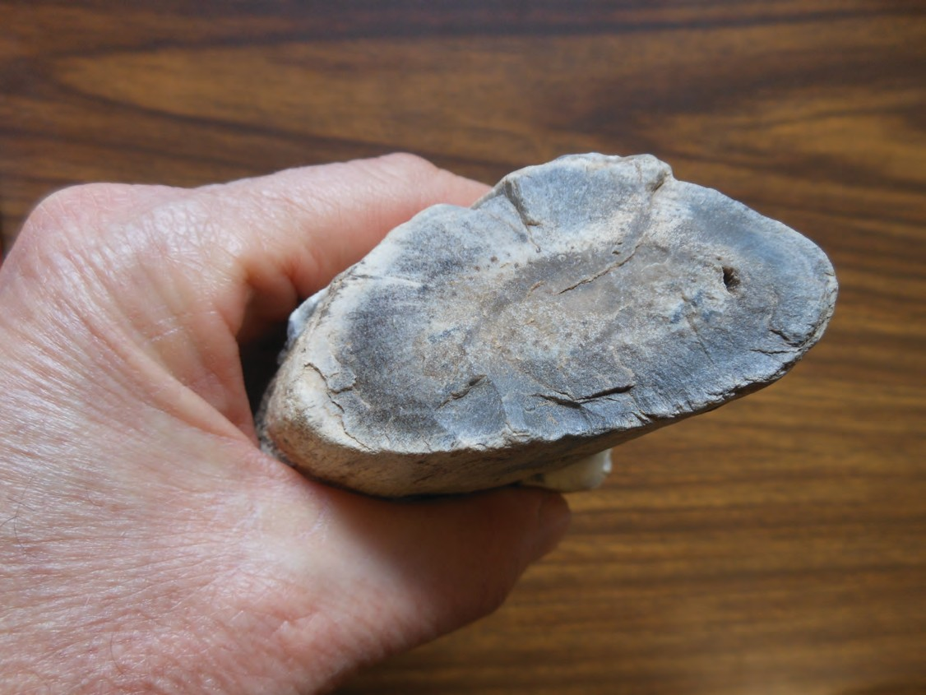


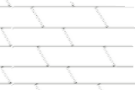


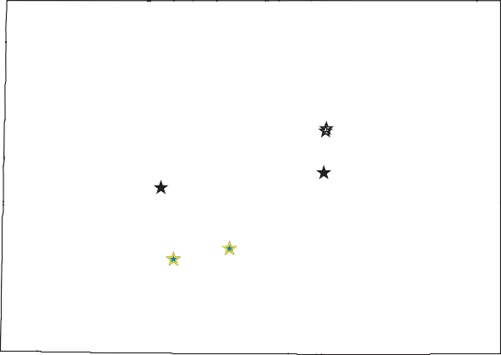
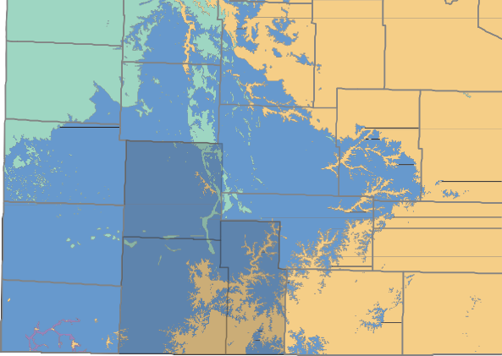

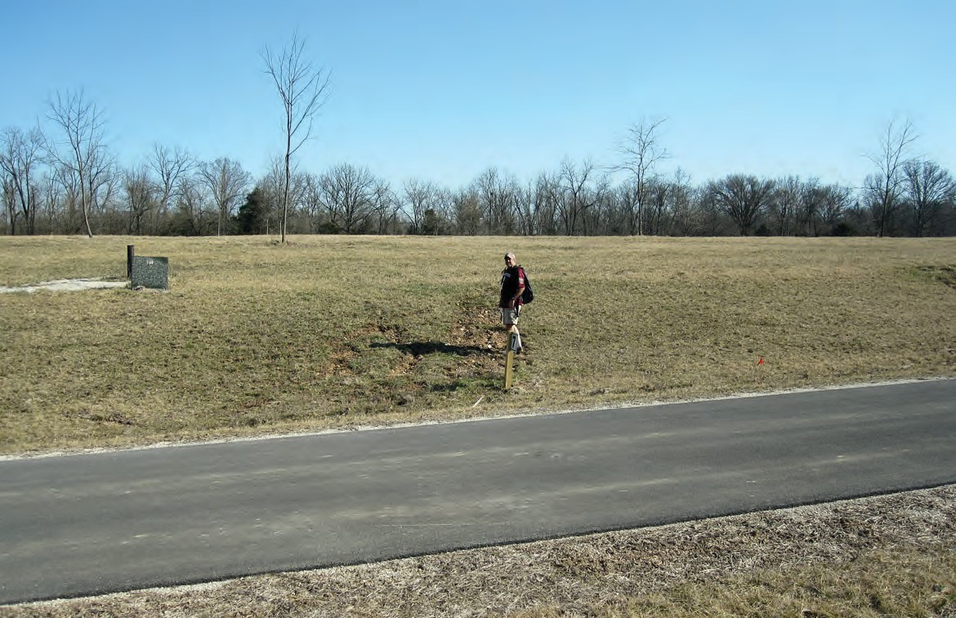
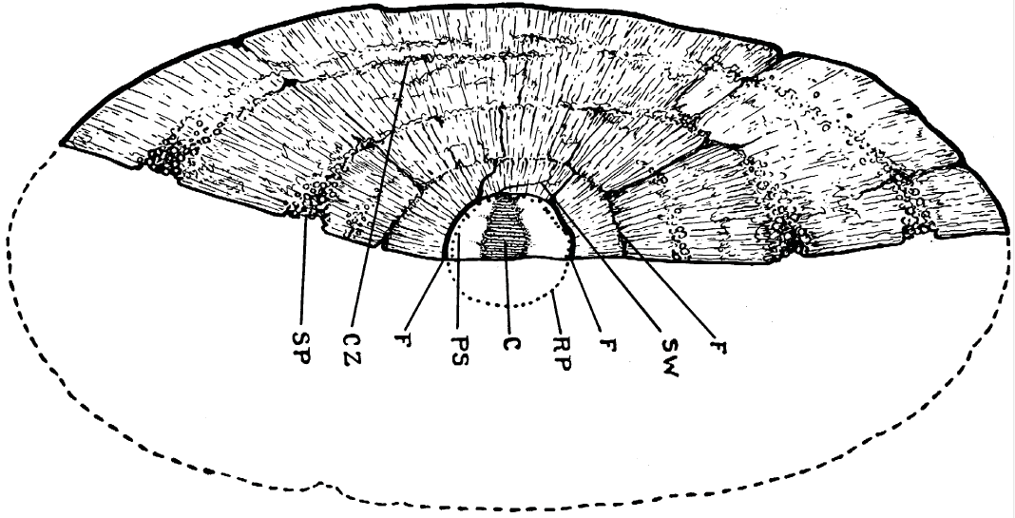







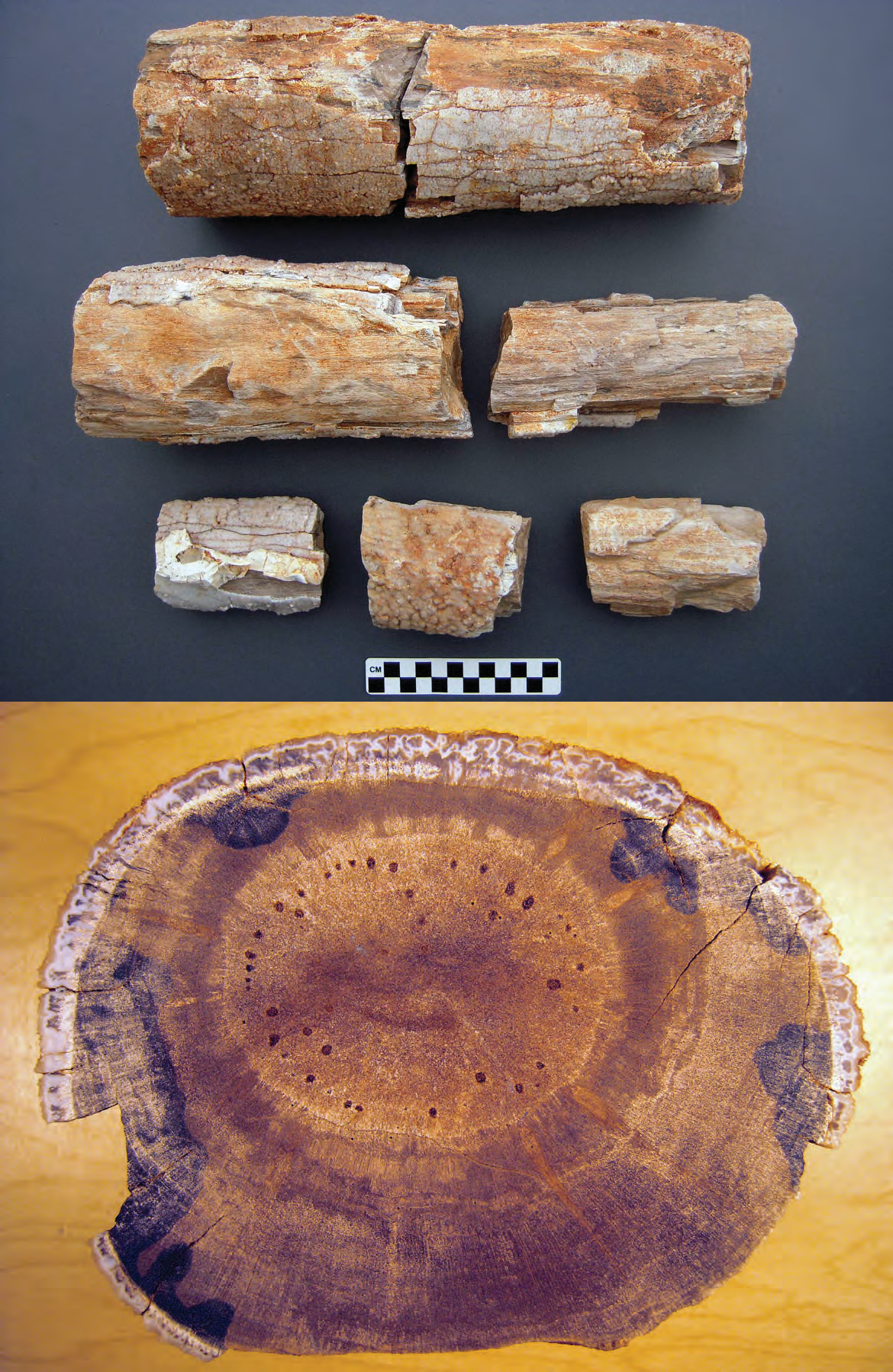







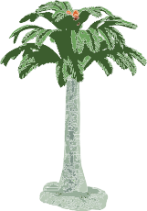
New Occurrences of Pteridospermatophyte Driftwood in the Mississippian Subsystem (Osagean Series) of South- western Missouri, USA
Kevin Ray Evans ¹, Toby J. Dogwiler ¹, and Jack H. Ray ² ¹ Department of Geography, Geology, and Planning
² Center for Archaeological Research Missouri State University
901 S. National Avenue,
Springfield, Missouri 65897 USA; kevinevans@missouristate.edu
ABSTRACT
Occurrences of waterlogged driftwood have been documented from different time periods and depositional settings, and several localities around the world. Pteridospermatophyta (extinct seed ferns) range from late Devonian to Paleogene periods. Two specimens, provisionally identified as pteridosperma- tophytes, collected several years ago recently were re- ported from surficial float derived from the Mississip- pian Elsey Formation in northeastern Greene County between the towns of Fair Grove and Strafford. An- other float specimen from either the Elsey or Reeds Spring Formation was found in a stream bed in east- ern Lawrence County, west of Springfield. These oc- currences follow a 2010 published report of discovery of several pteridosperm fragments from chert residu- um in an area mapped as Elsey Formation in south- eastern Greene County, just east of Springfield. Previ- ous investigators have noted the occurrences of fossil pteridosperms in the Reeds Spring Formation near Crane in northern Tany and Stone counties. Another specimen from northern Stone County, slightly longer than four meters, was reported from the upper part of the Burlington Limestone.
Both the Reeds Spring and Elsey formations are composed of mixed lime mudstone to wackestone and chert and are interpreted to have been deposited in a fully marine, mid-shelf setting. The Reeds Spring in its type area is overlain by the Elsey Formation. The Reeds Spring typically has nodules and anastomosing masses of chert, whereas chert in the Elsey Formation typically is lenticular to bedded. In places the strati- graphic units are not distinguishable from one anoth- er, but in extreme southwestern Missouri, the units are identified by color. The Reeds Spring is composed of dark chert and medium gray lime mudstone. The Elsey has white chert with dark brown-gray lime mudstone and includes tripolitic chert in the upper- most part. Both units are regarded as facies of the Bur- lington Limestone. Collectively, these somewhat rare pteridosperatophytes specimens represent post-mor- tem dispersal and subsequent deposition of fossil pteridospermatophytes as waterlogged driftwood across the southern margin of Laurentia.
Sys.
Sub.
Ser.
Lawrence County 1 piece Elsey Fm.? | Northeastern Greene County 2 piece Elsey Fm.? | Cribbs (1935, Plate 1) Stone County Burlington Limestone Cordaites missouriense Cribbs 1935
 | Cribbs (1935, Fig. 1) Stone County Burlington Limestone Cribbs (1935, Fig. 1) Stone County Burlington Limestone Cordaites missouriense Cribbs 1935
(location same as above)
Southeastern Greene County 7 pieces Elsey Formation
 | Cribbs (1938, Fig. 1) Taney County Reeds Spring Formation Pycnoxylon leptodesmo Cribbs 1938
 |  | Cribbs (1935, 1938) described a new genus and species and new species of Cordaites from materials collected in southwestern Missouri. New collections show some varia- tion from those collected by Cribbs. This is a public service announcement: if you or someone you know is a paleobotanist, who specializes in early pteridospermatophytes, new specimens from Missouri may
(location same as above)
(location same as above) Pith
PENN.
Meramec. Desm.
Warner Sandstone (channel sandstone)
ls
Kansas City
Warsaw Formation
Short Creek Oölite Mbr.
M I S S O U R I
St. Louis
M ISS I SS I PP I A N
O sa g e a n
Burlington-Keokuk limestones (undivided)
Cribbs (1935)
Decaturville
Av n
38° N
EXPLANATION
Quaternary Tertiary Cretaceous Pennsylvanian
Spring eld
St. Francois Mts.
Recent collections (parautochthonous oat (Greene County) and a detrital clast in stream sediment (Lawrence County)
Elsey Formation
Cribbs (1938)
Reeds Spring Formation
Pierson Limestone
Mississippian Silurian-Devonian Ordovician Cambrian Precambrian
(Pleistocene drift and loess not shown)
Kind.
Northview Formation
Compton Limestone
100 km
N
Bachelor Formation
“Swan Creek Sandstone” Mbr.
ORD O VICIA N
I b e x ia n
Cotter Dolomite
Greene County
Lawrence County
Rockaway Conglomerate Mbr.
base not reached
Jefferson City Dolomite
Stone County
Taney County
Sandstone
Cherty limestone
20 km
Siltstone and Shale
Dolomite
These weathered and disarticulat- ed, angular pieces show that the specimens have not been trans- ported any signi cant distance.
help to show the diversity and variation in this important group. Please, contact Kevin Ray Evans: kevinevans@missouristate.edu for more information.
Recent fossil wood discovery locality
Cribbs’ (1935, 1938) localities {no precise localities given in northern Stone and Taney counties)
Limestone
Cherty dolomite
Figure 1. Index map showing location of Missouri, geologic map of the State, and inset of southwestern Missouri, showing locations of Mississippian fossil wood localities (modi ed from Middendorf et al. 2003).
Oölitic limestone Breccia
Figure 2. Stratigraphic succession near Spring eld in southwestern Missouri (modifed from Thomson, 1986).
The three largest fragments are intact segments of a trunk. Two segments re t and measure 0.33 m in length, whereas the third is
0.22 m long. They have a diameter of 78–105 mm with an exception- ally wide pith, 35–50 mm diame- ter, that exhibits prominent scle- rotic nests. The surface of the specimen is covered by druse-like quartz crystals up to 5 mm thick that cover the woody axis. Adher- ing to the quartz crystals on one fragment is an 11 mm thick deposit of mottled white and light gray chert that is comparable to chert in the Elsey Formation. The woody part of the specimen is medium to dark grayish brown and comprises several quasi-con- centric rings.
ACKNOWLEDGEMENTS
We thank Howard J. Falcon-Lang, Royal Holloway, University of London for his efforts in describing samples from southeastern Greene County (Ray et al. 2010); Tom Thompson for information on early collections; Tom Plymate for sample preparation; local collectors, Tony Barnes, Jami Lewis, Chris Maples, Norma Maples, John Reynolds, for making the material available for study; Missouri State University Center for Archaeological Research and De- partment of Geography, Geology, and Planning for research facilities.
INTRODUCTION
Pteridospermatophytes are fossil “seed ferns” that range from late Devonian to late Cretaceous and Paleogene in refugium (Tasmania). They morphologi- cally are intermediate between ferns and cycads. Early Carboniferous species are uncommon and important in our understanding of the early evolution of this group. New collections are important. Here, we report discoveries from new localities in Missouri, when combined with published literature (Cribbs 1935, 1938) and an earlier report (Ray et al. 2010), provide evidence of their occurrence as fossil driftwood along the southern margin of Laurentia.
LOCALITIES
Locations of lower Carboniferous wood collections are shown on the geologic map in Figure 1. Figure 2 shows the stratigraphic succession of strata exposed and in the shallow subsurface in southwestern Missouri in the vicinity of Springfield (Thomson, 1986). Starred horizons indicate the approximate levels where silicified wood was collected.Cribbs (1935) noted the occurence of Cordaites missouriense in chert within the Burlington Limestone at the C.T. Steele farm in northern Stone County. The speci- men was approximately 4 m long with a cross-section of 16 x 26 cm and seemingly flattened parallel to bedding, Cribbs (1938) reported occurrence of another specimen,
0.7 m long and 8 x 16 cm in cross section, near the town of Crane in northern Taney County. The precise locations of both specimens was not published. More recently sev- eral fragments of a disarticulated whole specimen were collected in southeastern Greene County from float in parauthochthonous chert residuum at approximately the stratigraphic level of the Elsey Formation. The area was mapped as Elsey Formation by Fellows (1970). The Elsey is reported to be about 80 ft thick near Turners Station (Thompson, 1986). A small gully north of the collection site exposes the Pierson-Elsey contact about 20 ft below the projected collection interval (see field photo). One recent allochthonous collection of a single water-worn
piece was made from stream gravel in a tributary of the Spring River, approximately 7.3 km west of the town of Mt. Vernon in Lawrence County. Two additional pieces of fossil wood were reported from float in northeastern Greene County, approximately 5.7 km north of the town of Strafford. These specimens had been collected several decades ago by a private collector.
All of these units that appear to be associated with Mississippian fossil wood are marine in origin and distant from the paleogeographic shoreline. Fossil driftwood is relatively rare, and these occurrences in southwestern Missouri help to underscore the need for context in inter- pretations of ancient depositional environments.
REFERENCES
Cribbs, J.E., 1935, Cordaites missouriense from the lower Carboniferous of Missouri: American Journal of Botany, v. 22(4), p. 427-438.
Cribbs, J.E., 1938, A new fossil plant from the Reeds Spring Formation of southwestern Missouri: American Journal of Botany, v. 25(5), pp. 311-321.
Fellow, L.D., 1970, Geology of the Galloway Quadrangle, Greene County, Missouri: Missouri Geological Survey and Water Resources, GQ-5, 15 p. and 1 sheet.
Middendorf, M.A., and others, 2003, Geological map of Missouri: Sesquicentennial Edition: Missouri Department of Natural Resources, Division of Geology and Land Survey, Rolla, SGM-2003, 1 sheet.
Ray, J.H., Falcon-Lang, H.J., Evans, K.R., and Miller, J.F., 2010, A rare silicified pteridosperm recovered from the Elsey Formation (Mississippian Subsystem, Osagean series), Greene County, Missouri, USA: Transactions of the Missouri Academy of Sciences, v. 44/45 (2010/2011), p. 61.
Thompson, T.L., 1986, Paleozoic succession in Missouri, Part 4—Mississippian System: Missouri Department of Natural Resources, Division of Geology and Land Survey, Report of Investigations 70(4), 189 p.
A thick pith and well developed sclerotic nests are unusal features of the largest of the collection.
Cycad

