Slide 1
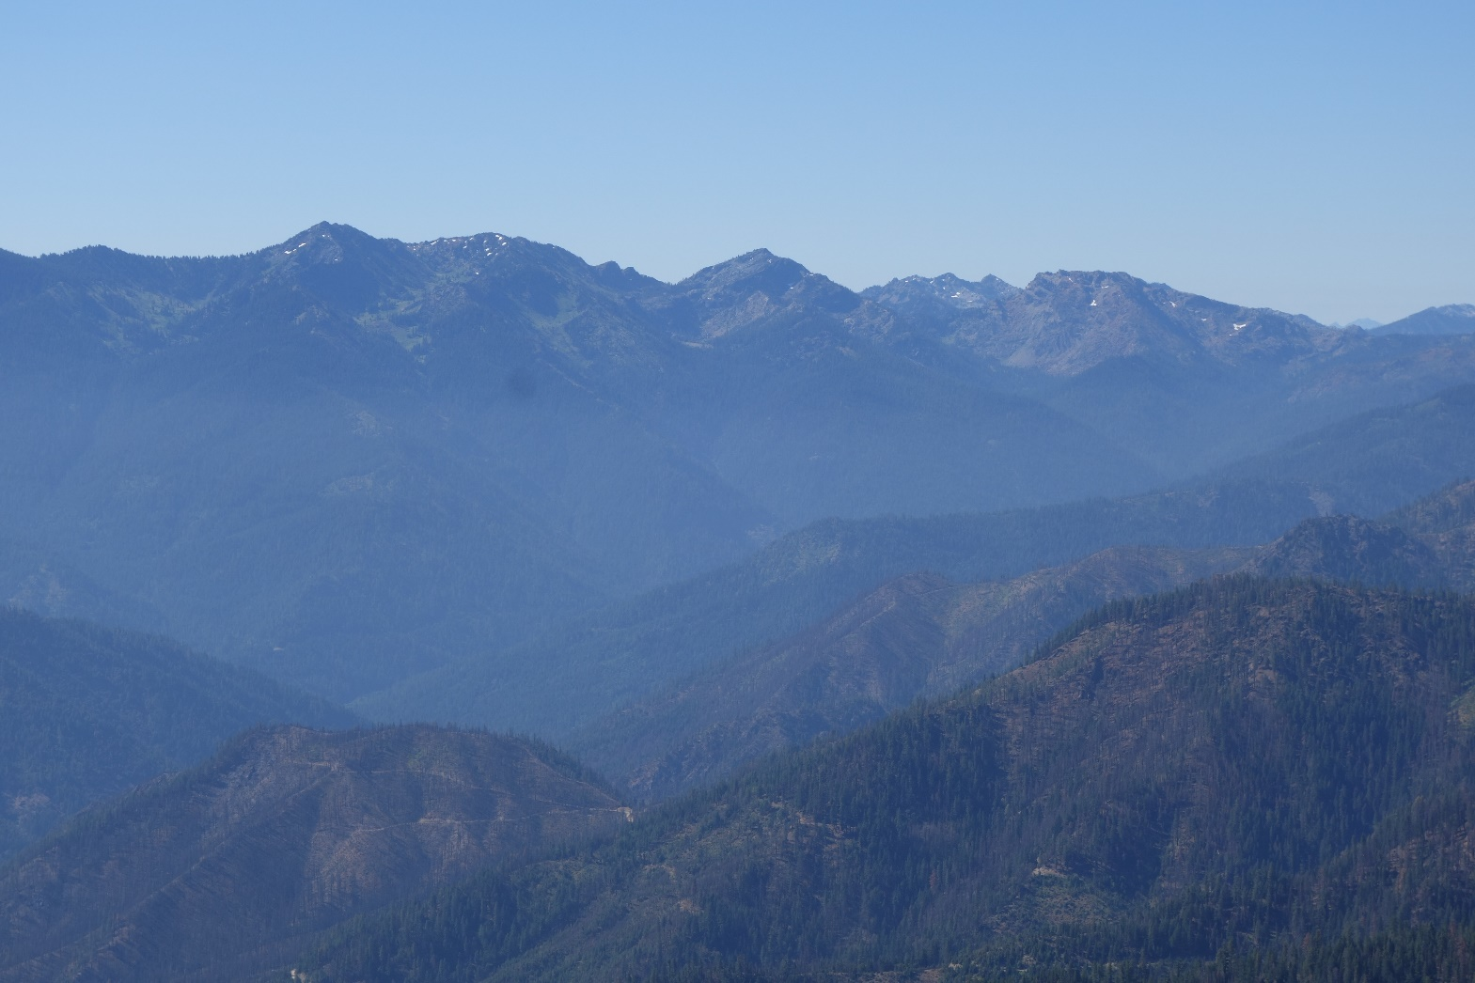



Evidence for the initiation of the Nevadan orogeny from partial melting of Rattlesnake Creek amphibolite, Klamath Mountains
Shane Dailey, Cal Barnes, Susan Leib, Katie Gates, Blair Schoene
Marble Mountains from Lake Mountain, C. Barnes

Slide 2
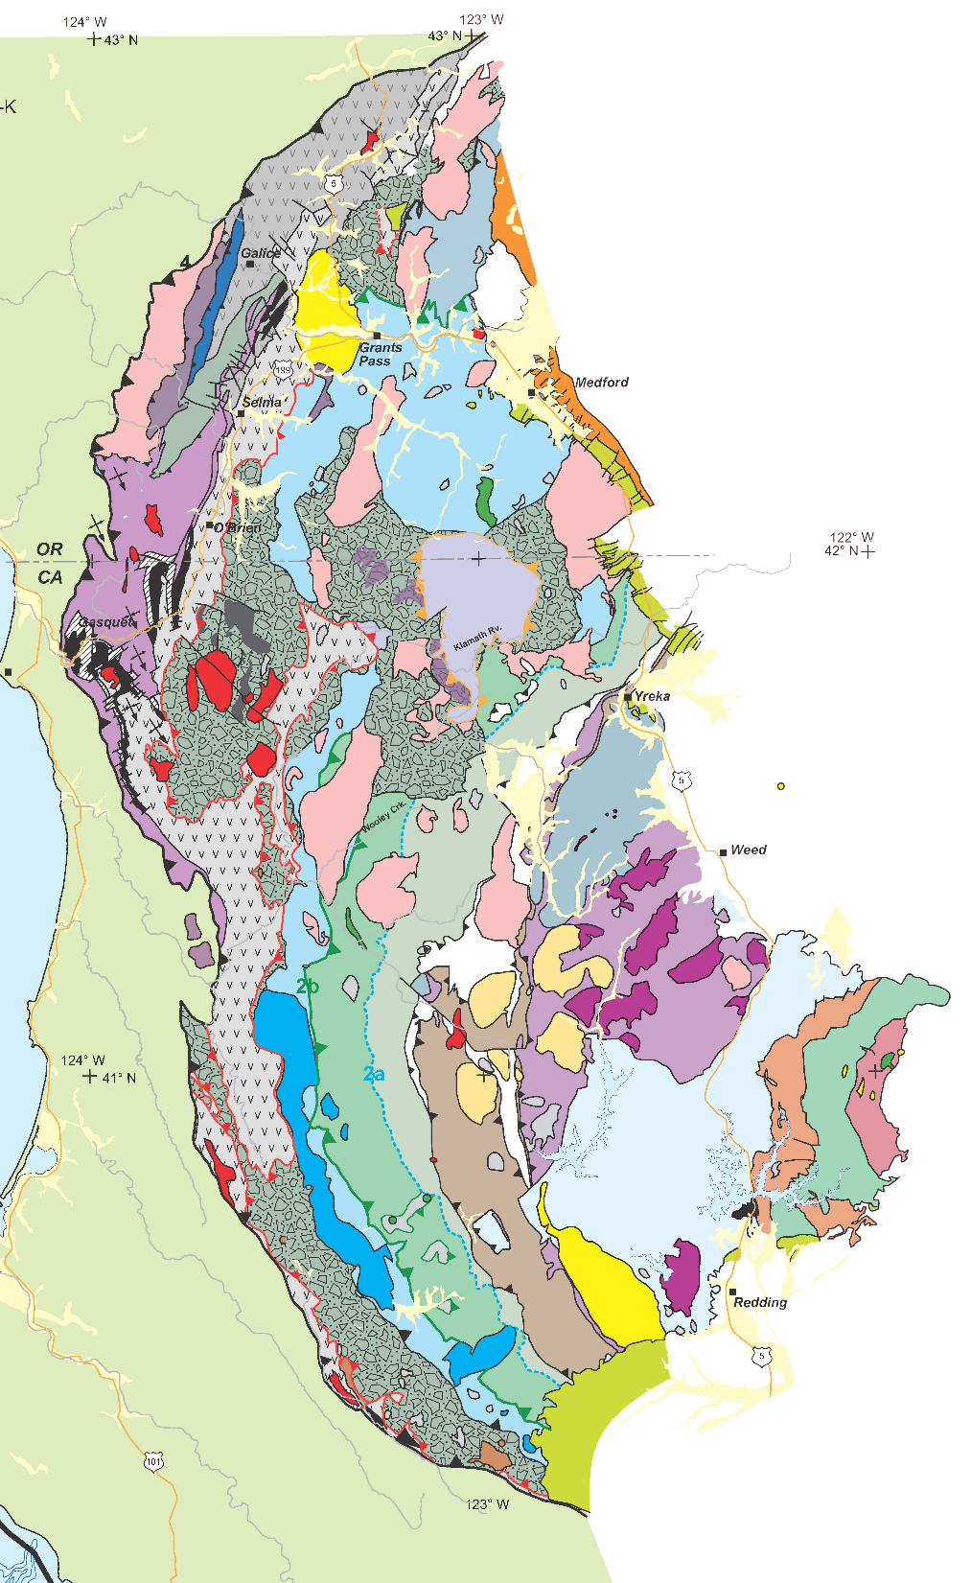
After from Irwin, 1994

Slide 3
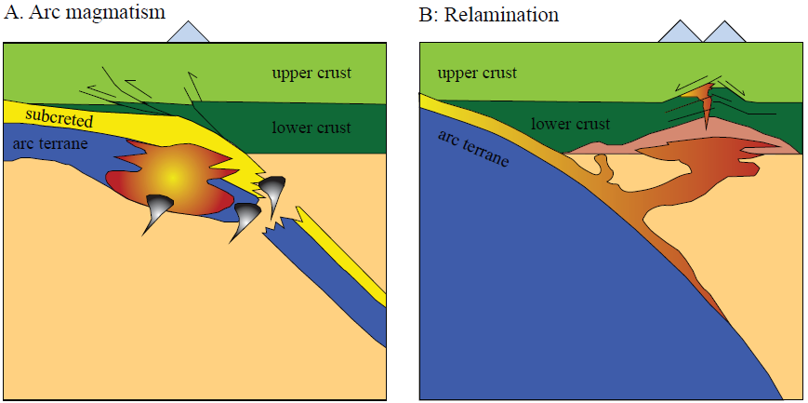
Subcretion
Relamination
Modified from Hacker et al., 2011
Notes:
2 models for accretion
Subcretion = emplacement of colder, young terranes beneath older terranes via thrusting, although this is not always the case.
Relamination = detachment and transfer of relatively low-density rocks from subducting slabs, through the mantle wedge, to the base of the crust
Subrection
Bimodal compositions of magmas
TTG suite from PM of metabasic rocks
Peraluminous from PM of metased rocks
Bimodal Hf signatures of isotopically variable sources
TTG = mantle-like
Peraluminous = continental
Inherited zircons not destroyed by heat
Relamination
Metasedimentary rocks rise through mantle wedge
Undergo high T and P metamorphism (Grt-stable)
Undergo PM
Peraluminous, high δ18O magmas from metased
Hf values characteristic of variable metased components
Peritectic Zrn xtllize in presence of Grt
Mid- to lower-crustal modification/contamination
Higher ⁸⁷/⁸⁶Sr and δ¹⁸O and lower εNd and εHf values than subcreted arc material

Slide 4
After from Irwin, 1994

Slide 5
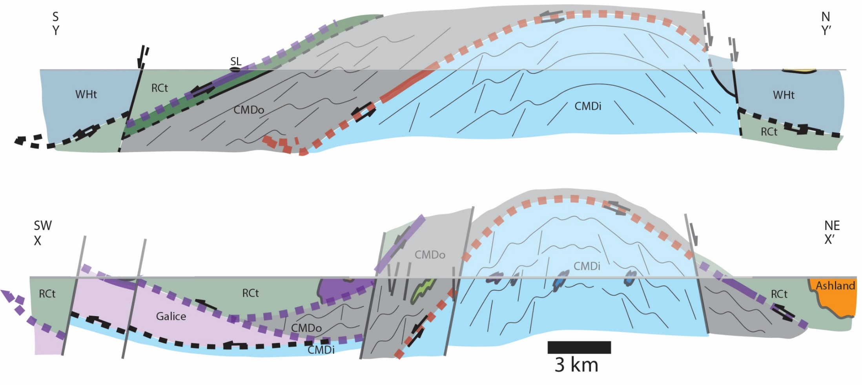
Condrey Mountain Dome
exterior
Condrey Mountain Dome
interior
Rattlesnake Creek
terrane
Western Hayfork
terrane
Modified from Gates et al., 2019

Slide 6
Western Hayfork
terrane
Condrey Mountain
Rattlesnake Creek
terrane
Eastern Hayfork
terrane
Modified from Gates et al., 2019

Slide 7
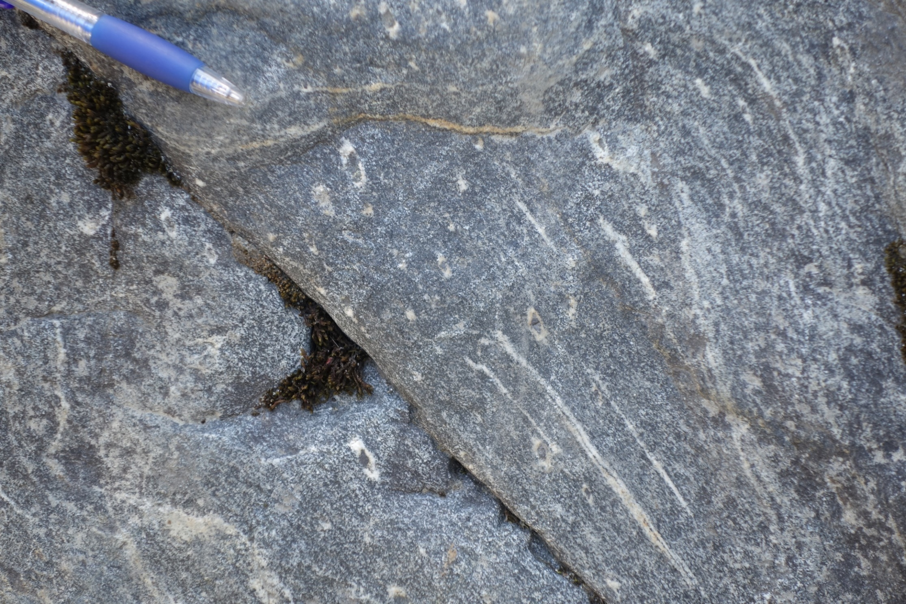
Applegate River

Slide 8
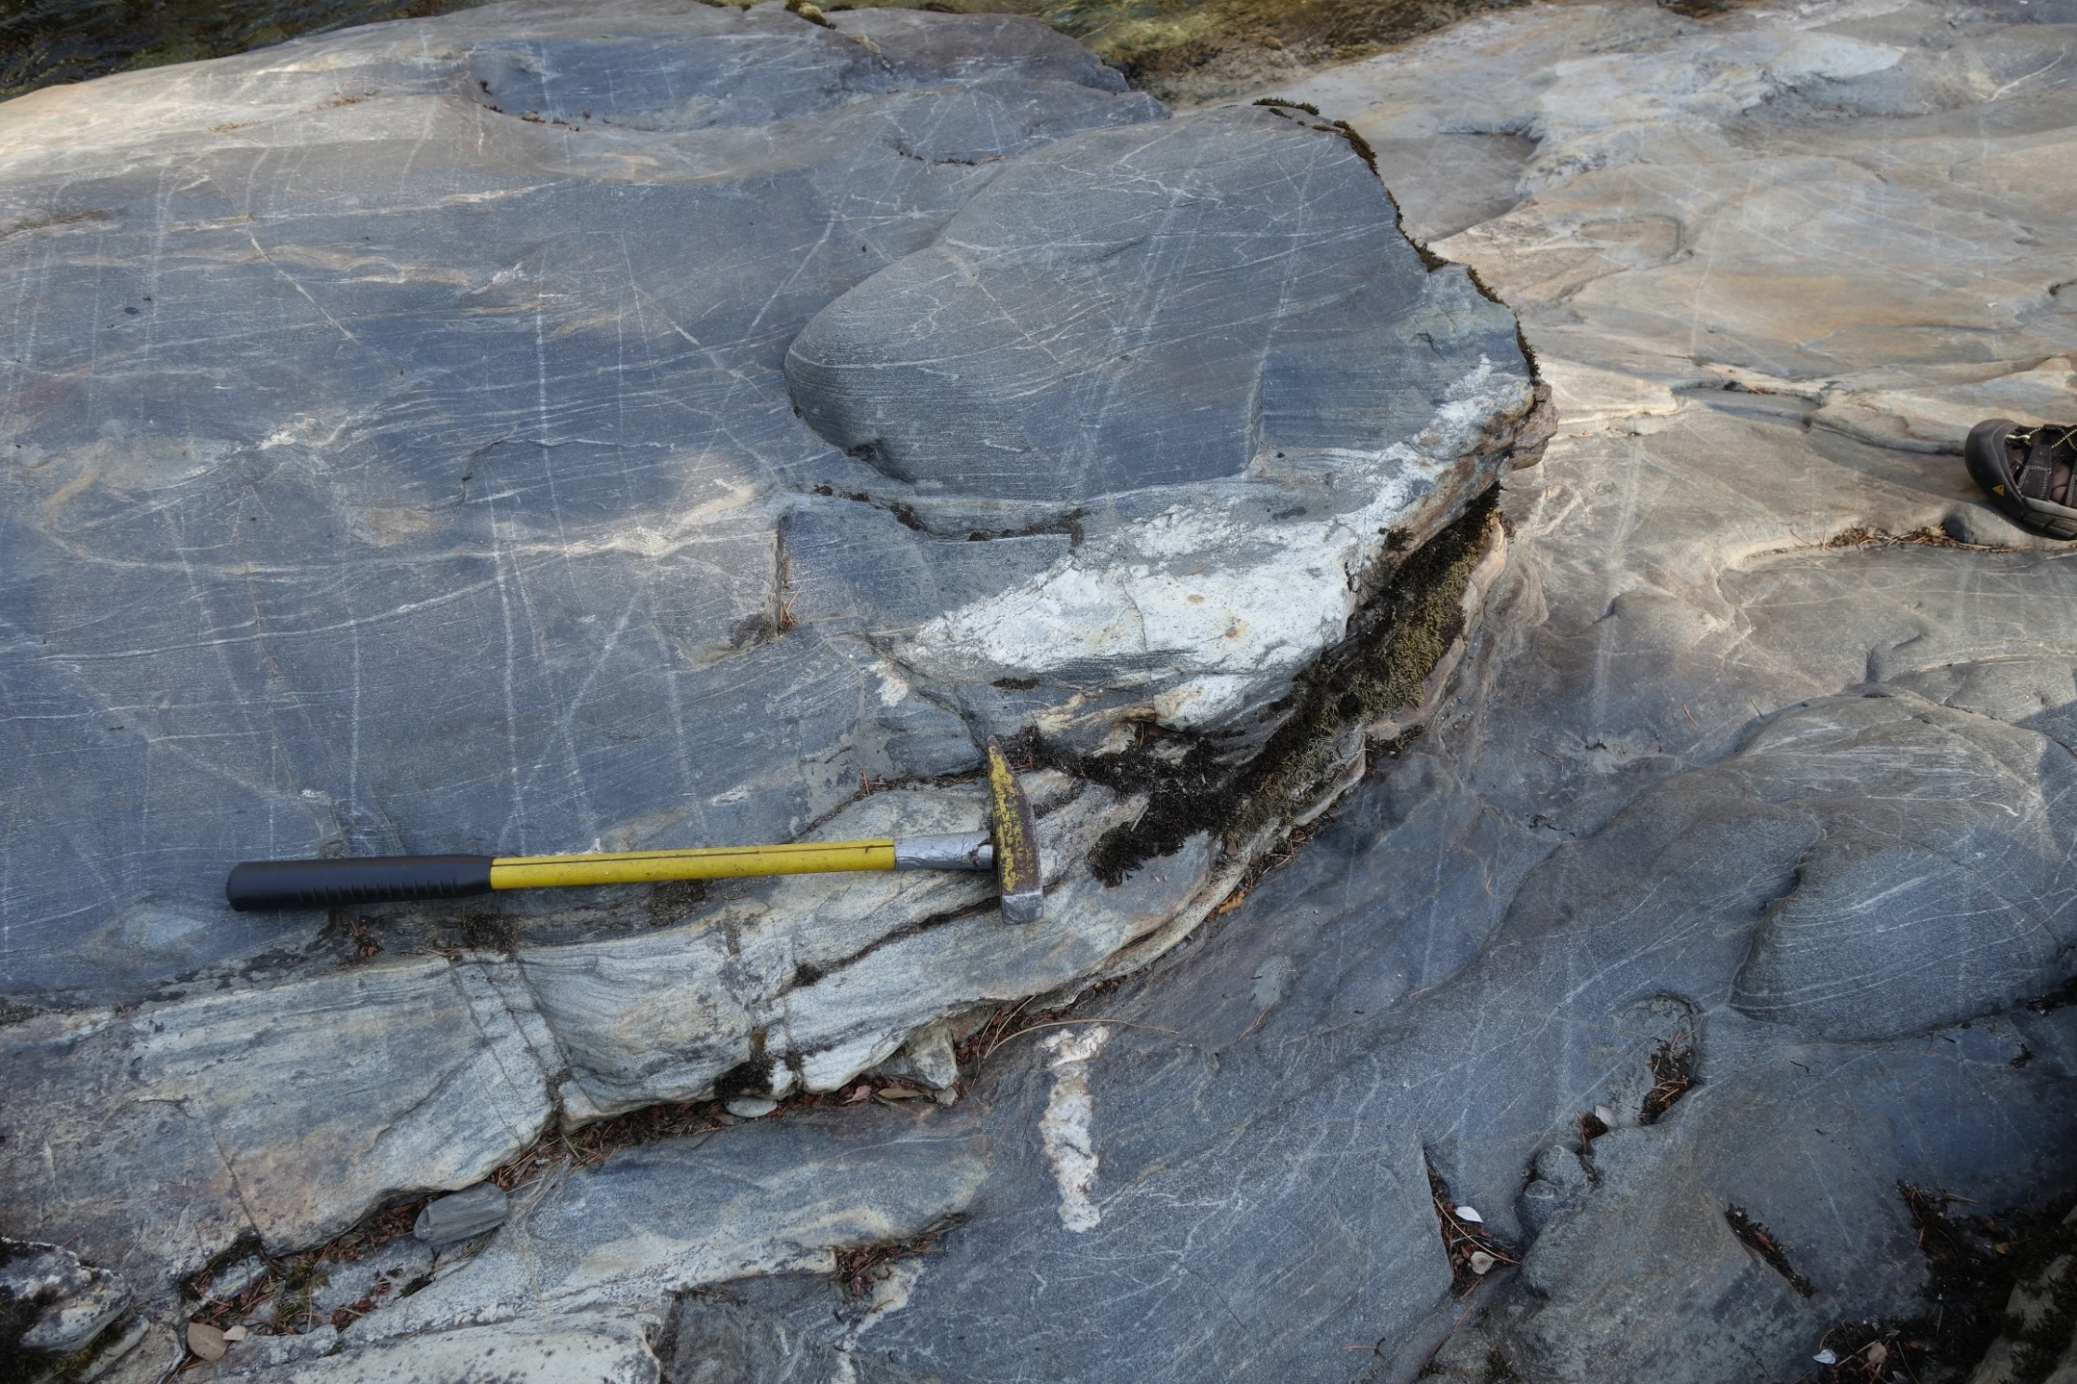
Applegate River

Slide 9
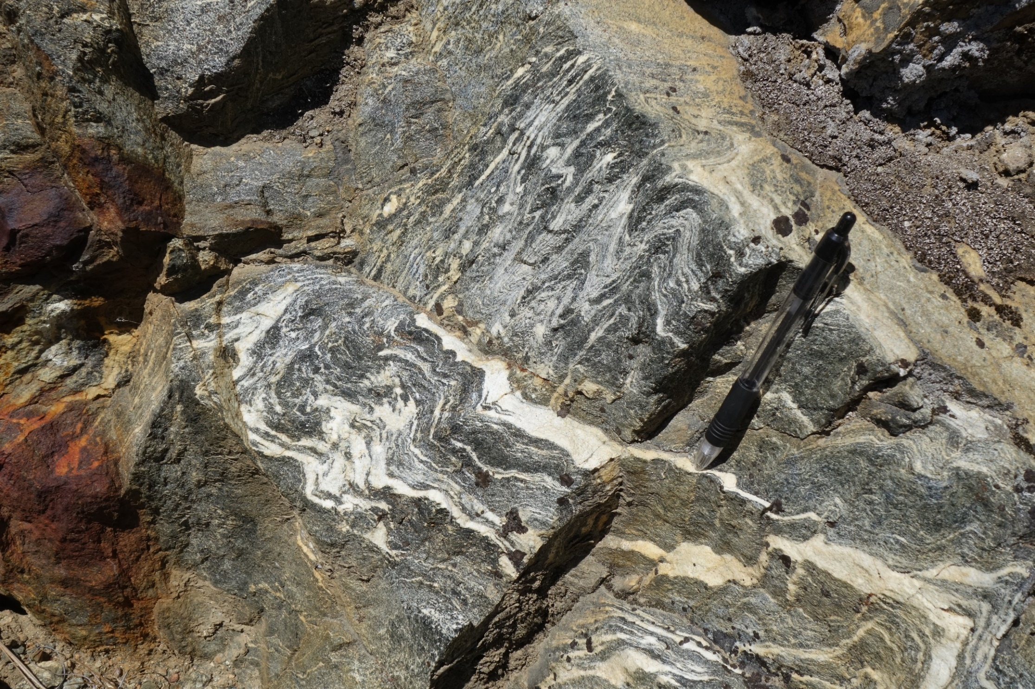
Applegate River

Slide 10
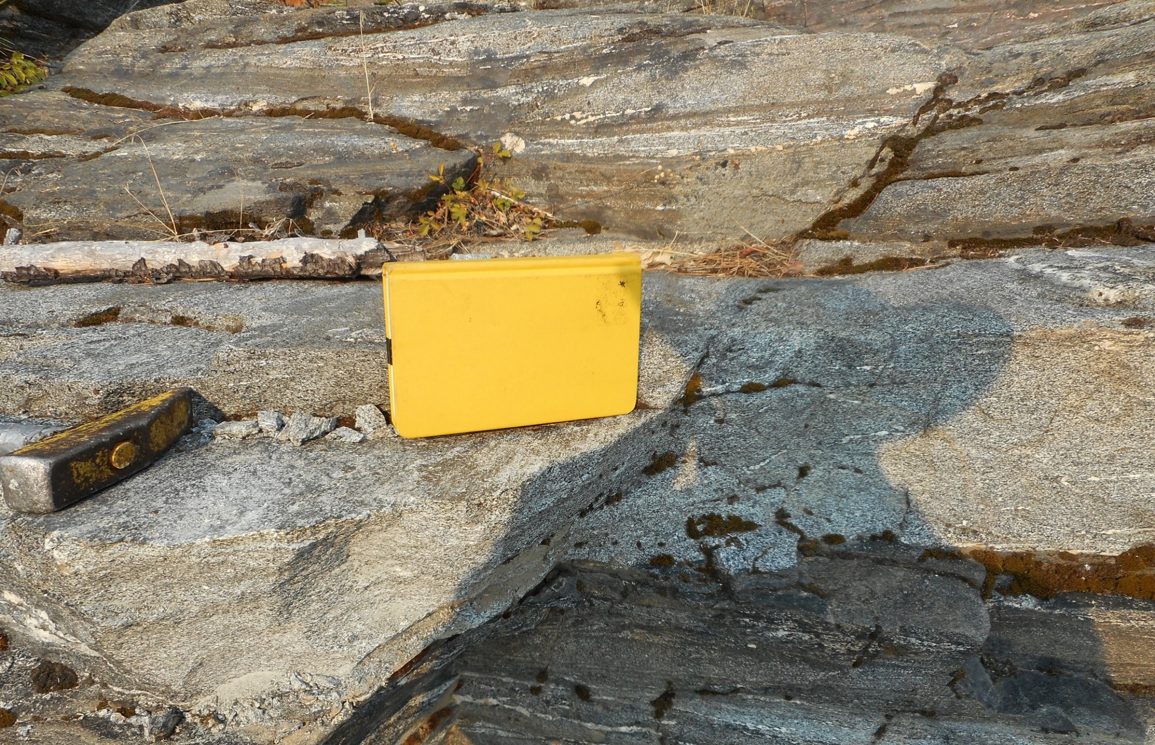
Gold Flat – Garnet Amphibolite

Slide 11
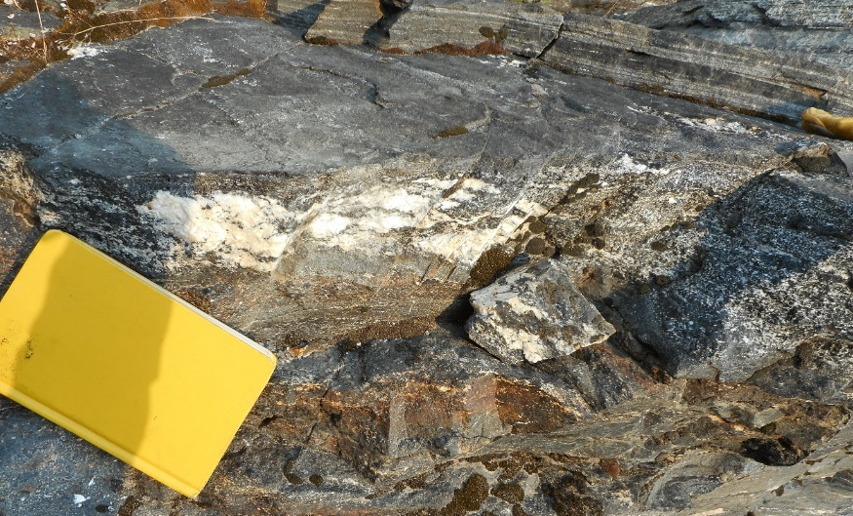
Gold Flat – Garnet Amphibolite

Slide 12
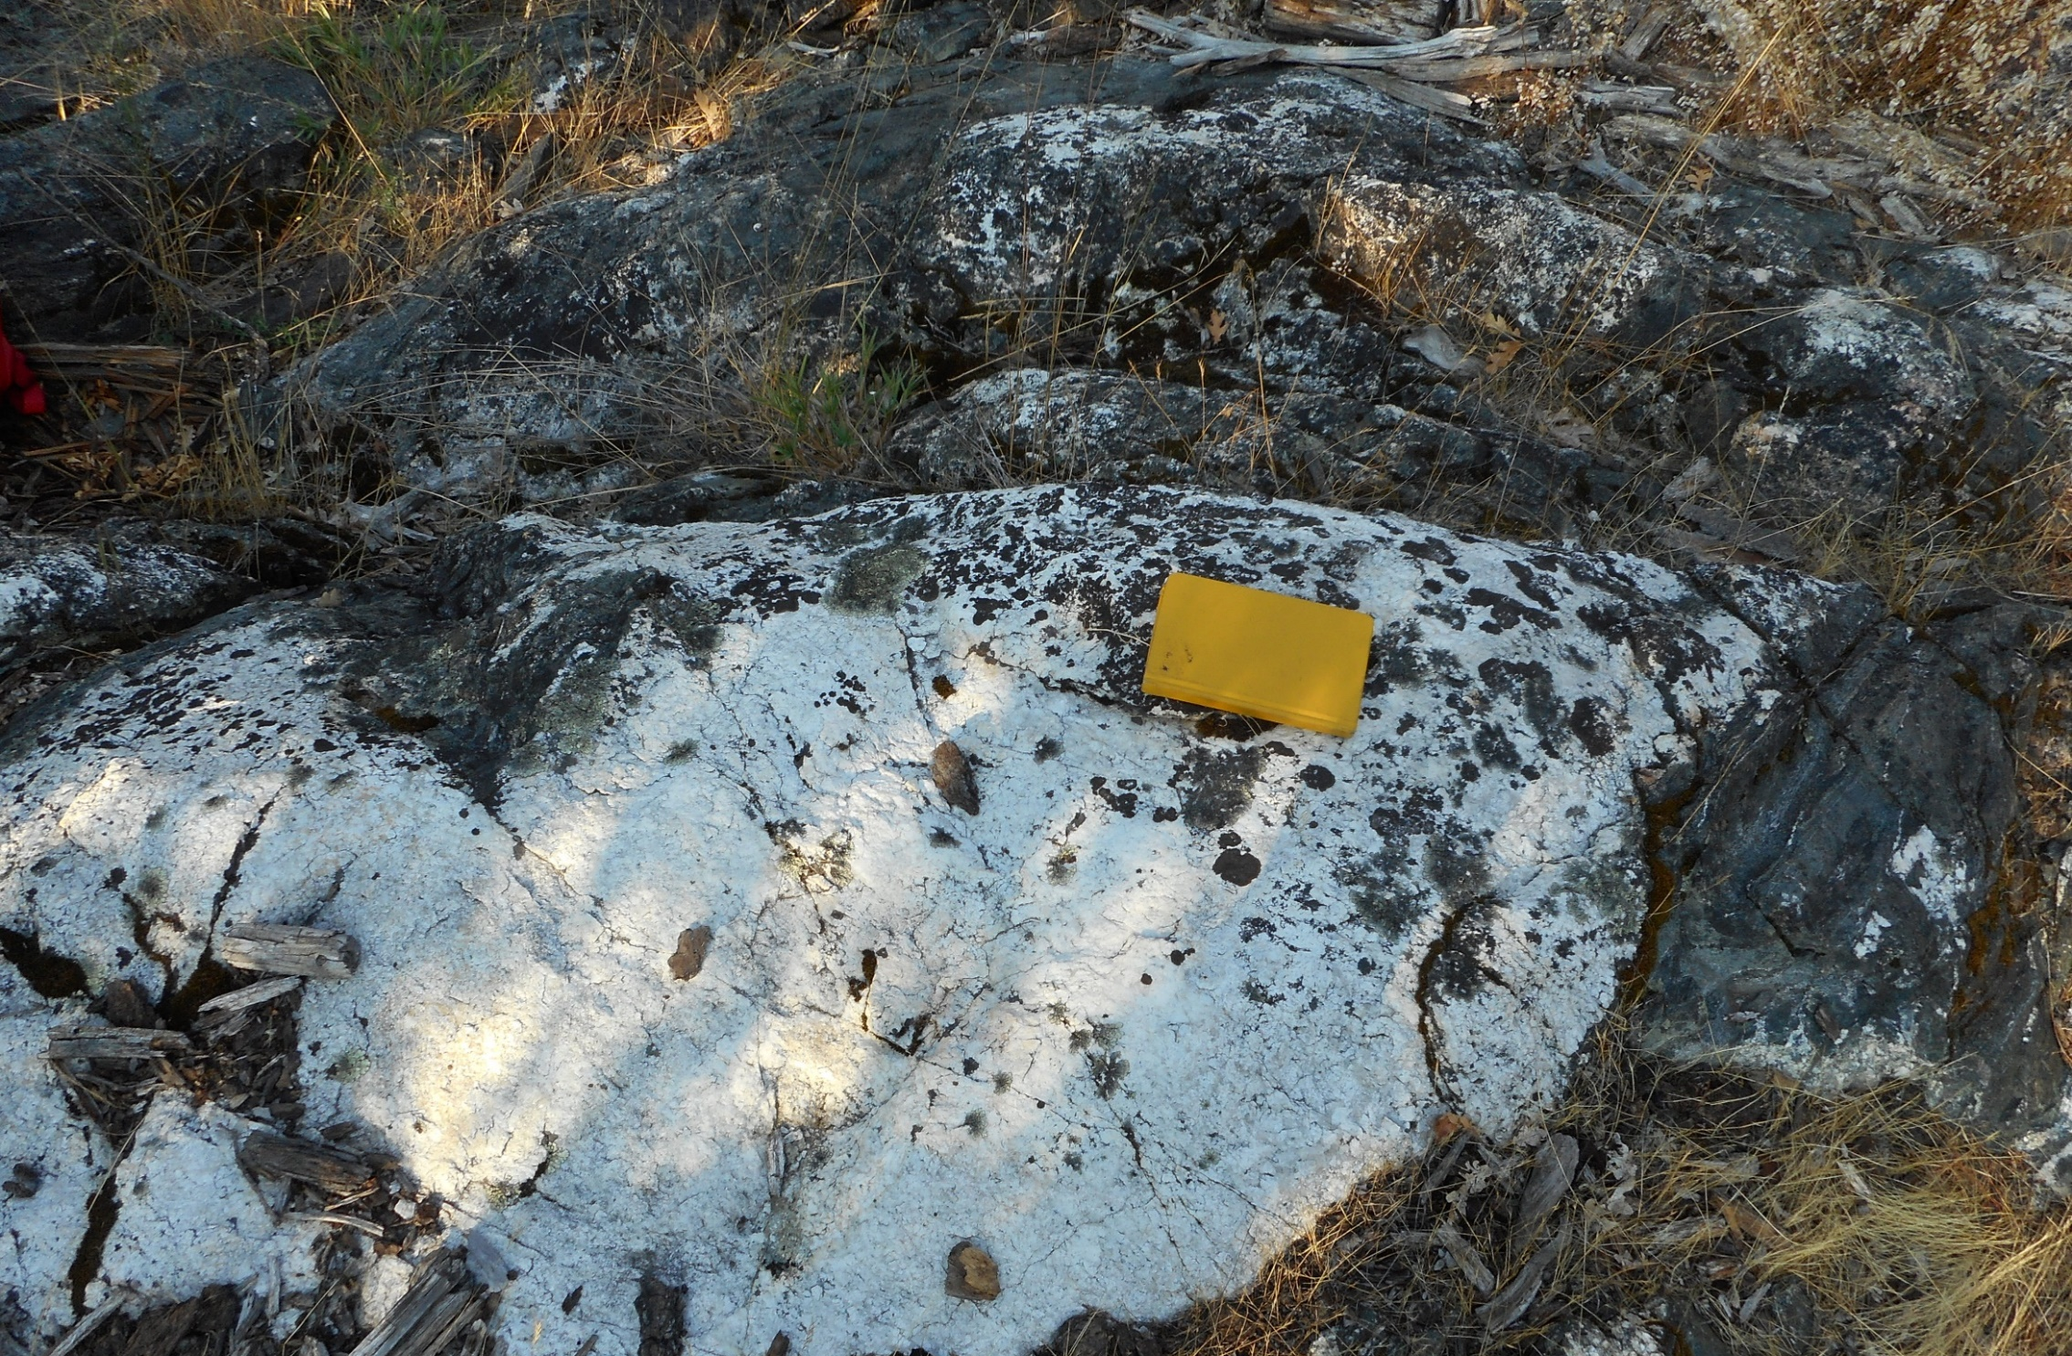
Gold Flat – Epidote Amphibolite

Slide 13
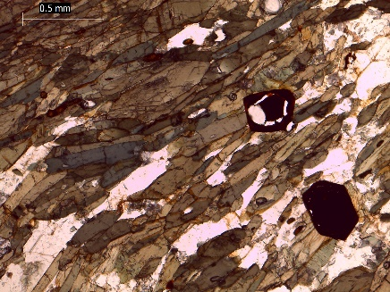
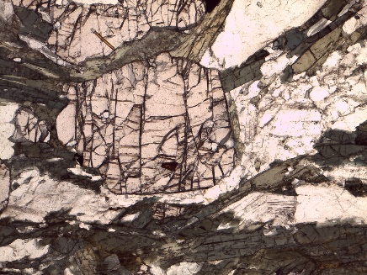
Greenschist-Blueschist
Greenschist
Epidote amphibolite
Garnet amphibolite

Slide 14
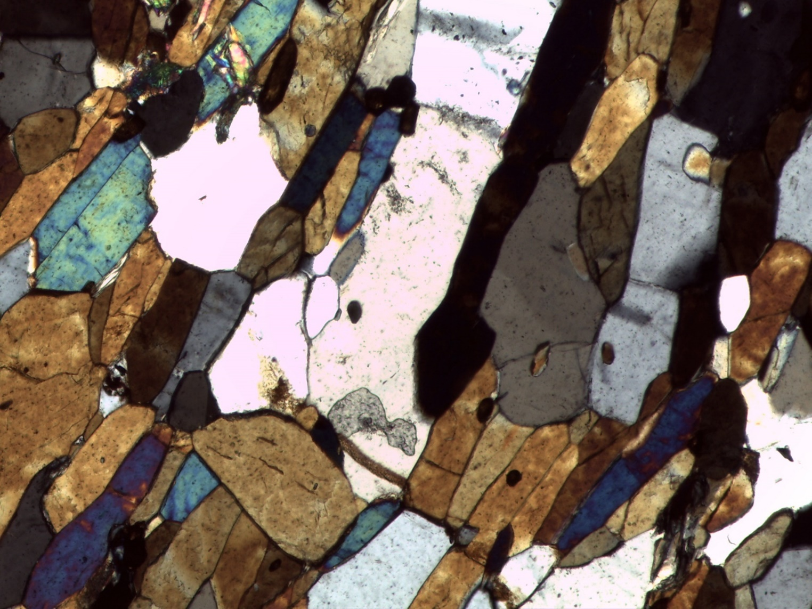
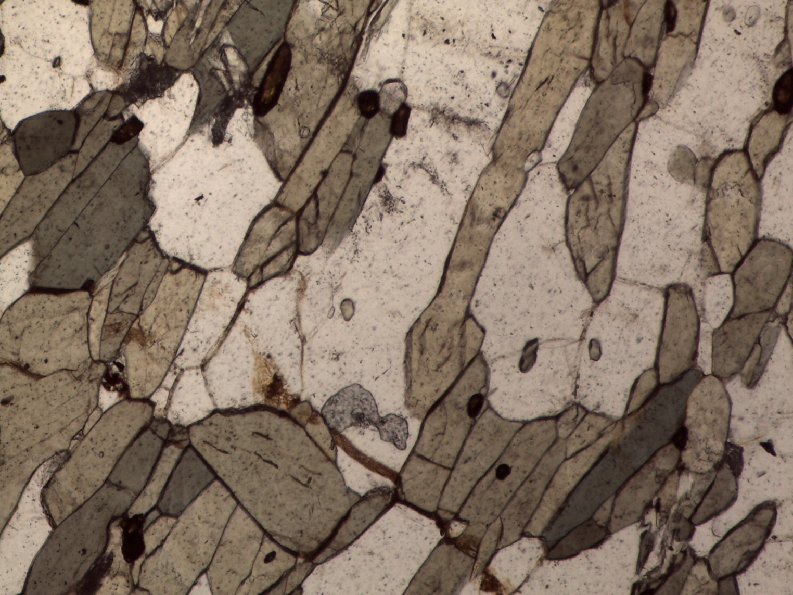
+ Zircon
- Garnet
- Epidote
- Rutile
Applegate River

Slide 15
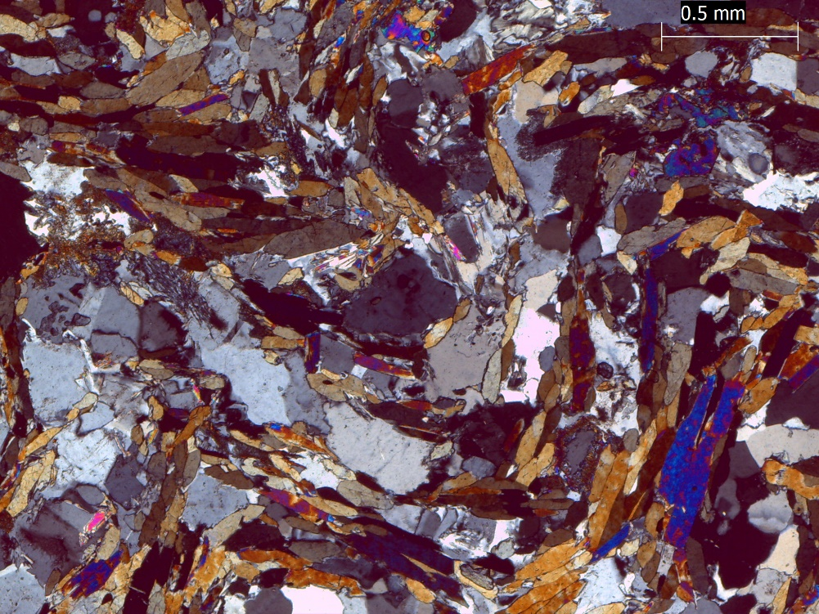
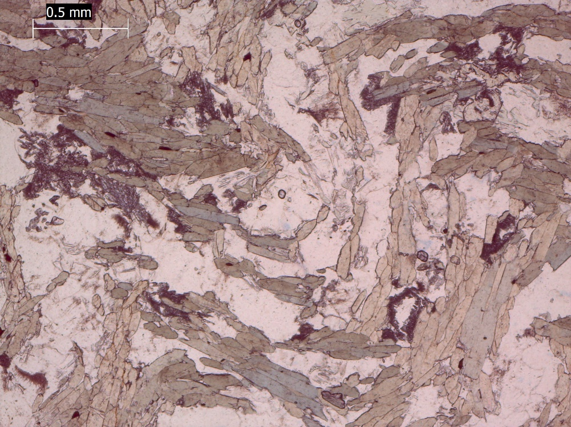
+ Epidote
+ Rutile
- Garnet
- Zircon
Gold Flat - Epidote Amphibolite

Slide 16
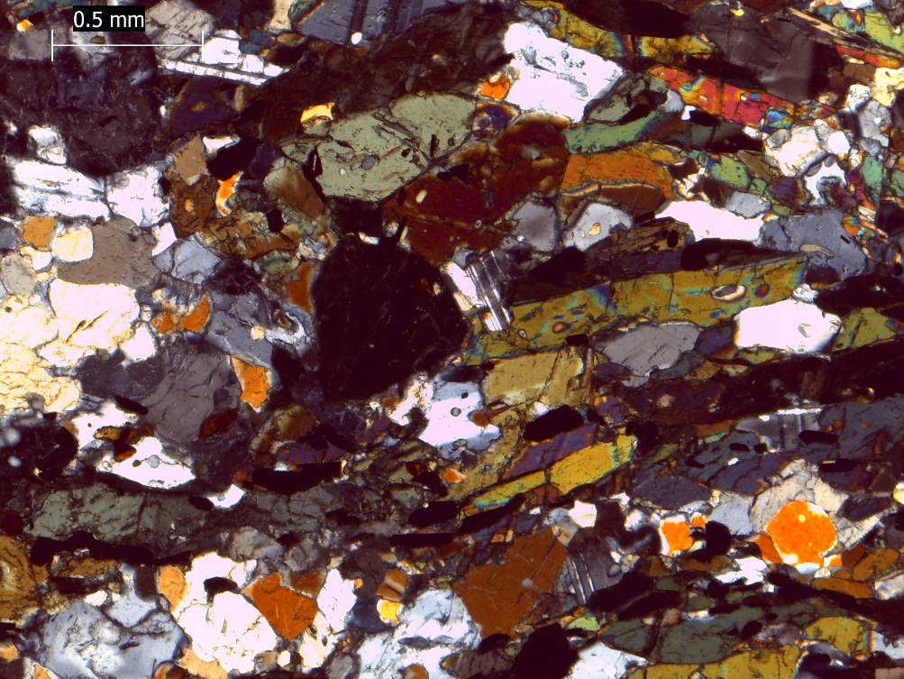
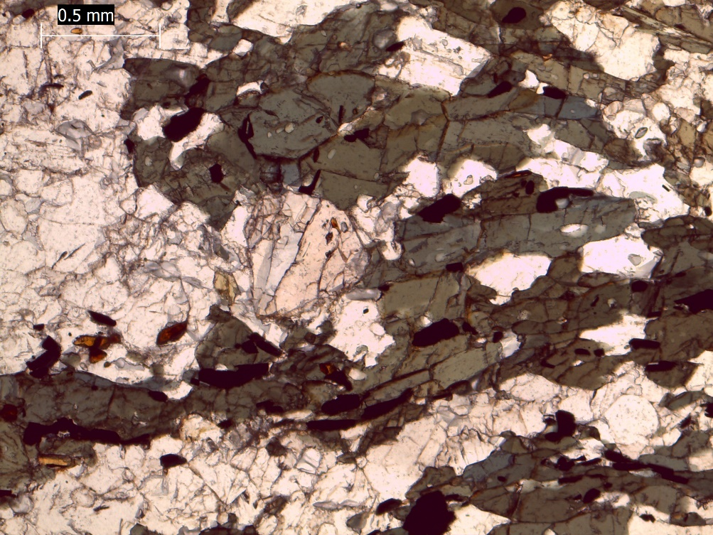
+ Zircon
+ Garnet
+ Rutile
- Epidote
Gold Flat - Garnet Amphibolite

Slide 17
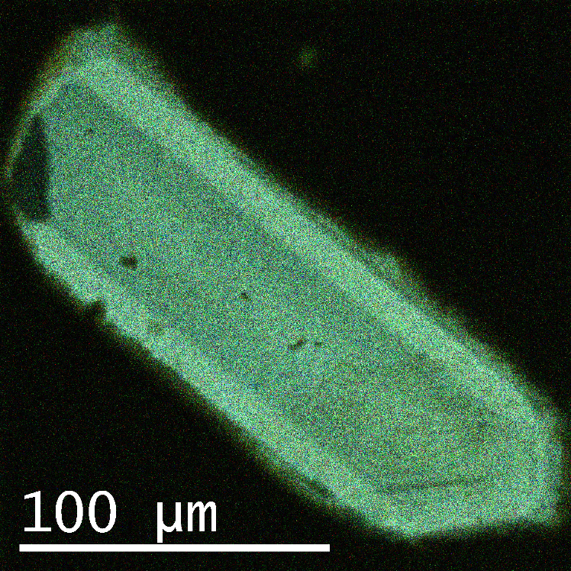
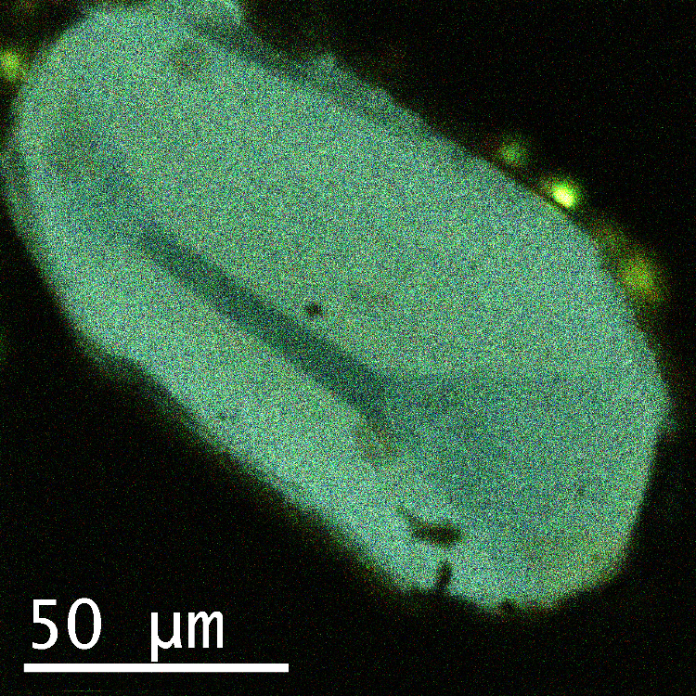
649 °C
671 °C
Applegate River

Slide 18
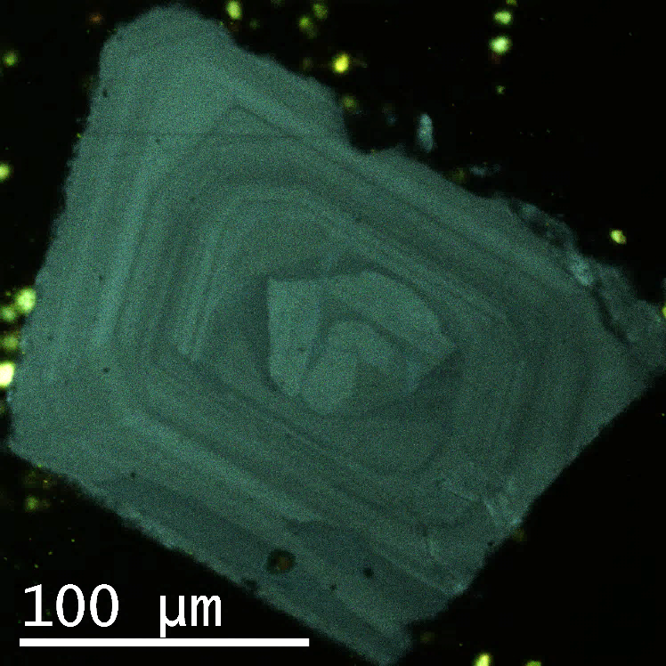
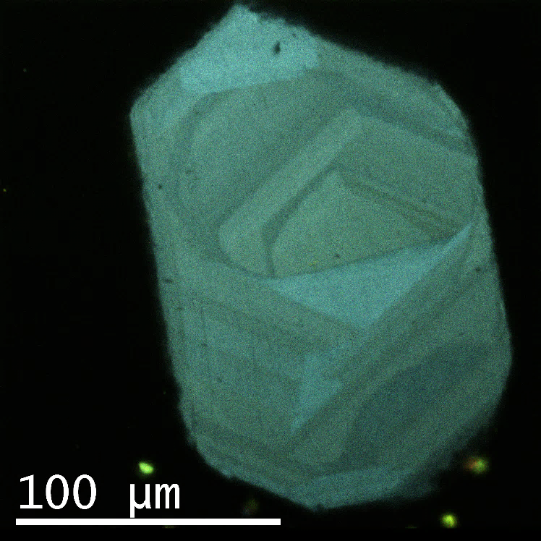
636 °C
627 °C
632 °C
643 °C
Gold Flat

Slide 19
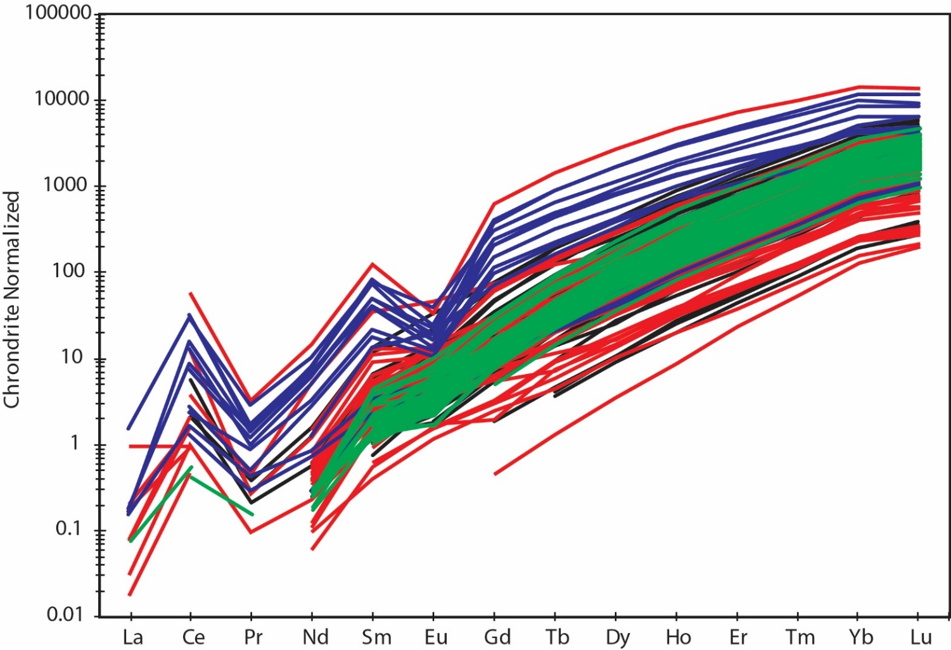
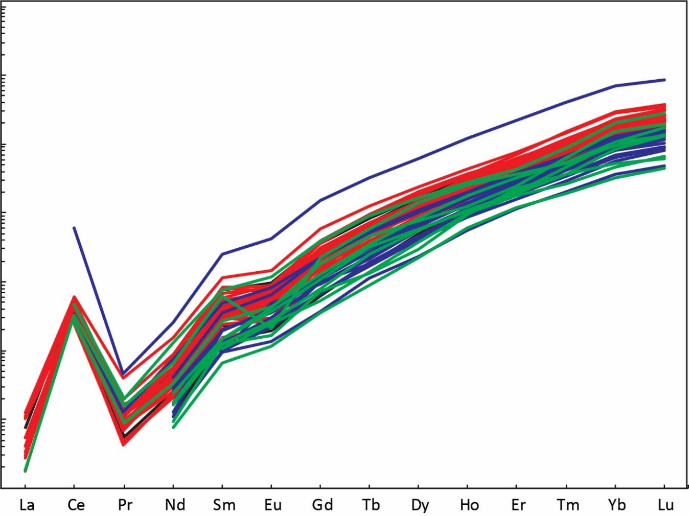
Gold Flat
Applegate River
Colors are different samples
Notes:
Gold Flat has garnet, Applegate does not.
Garnet and zircon not from same event?
Garnet in Applegate?

Slide 20
Gold Flat
Applegate River

Slide 21
Gold Flat
Applegate River
Ti-in-Zrn
aTiO₂ = 1.0
Ave = 626 ± 27 °C
n = 99
Zrn Saturation
Ave = 598 ± 33 °C
n = 11
Ti-in-Zrn
aTiO₂ = 0.5
Ave = 655 ± 18 °C
n = 56
Zrn Saturation
Ave = 646 ± 23 °C
n = 5
Ti-in-Zrn: Ferry and Watson, 2007
Zrn saturation: Watson and Harrison, 1983

Slide 22
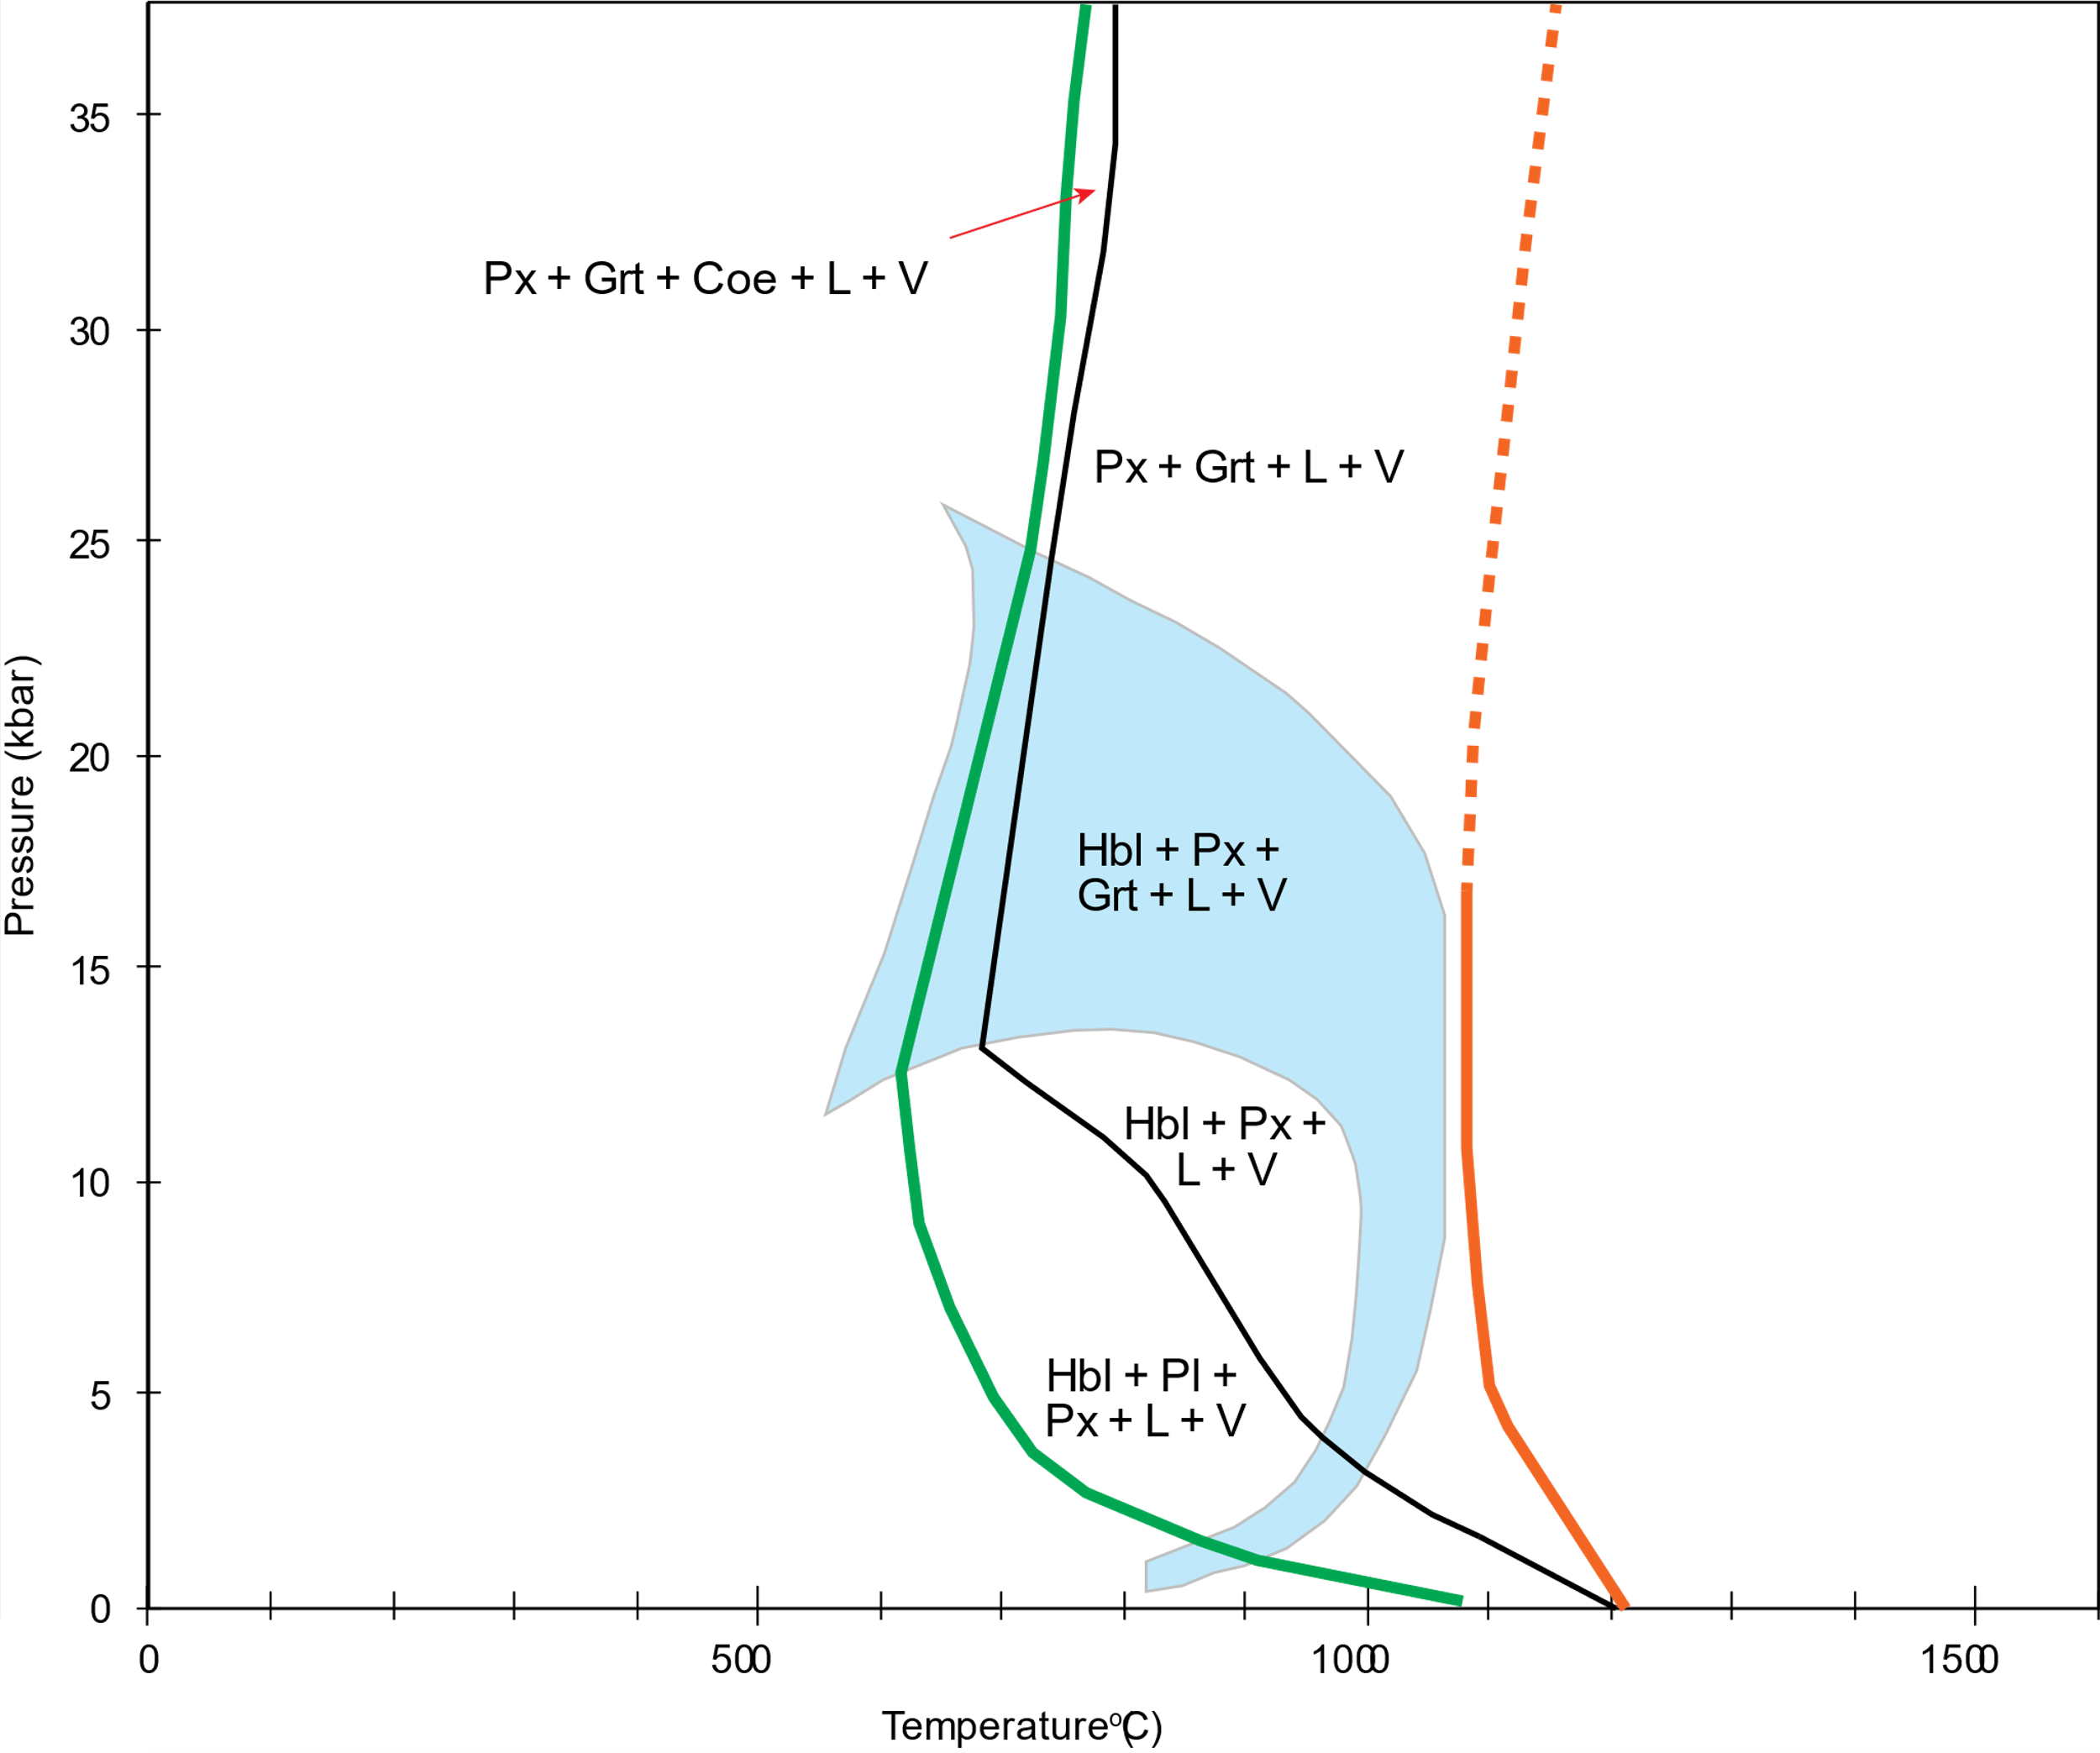
Wet Solidus
Dry Solidus
Modified from Lambert and Wyllie (1972).

Slide 23
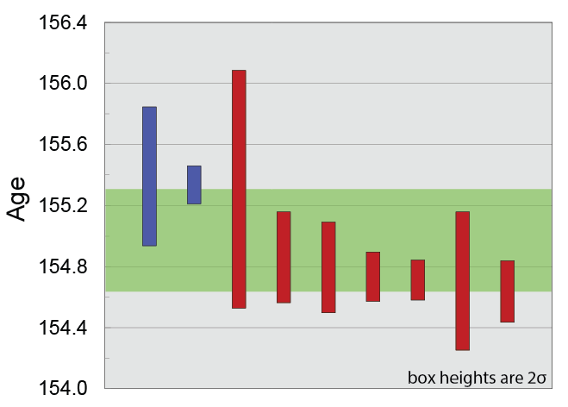
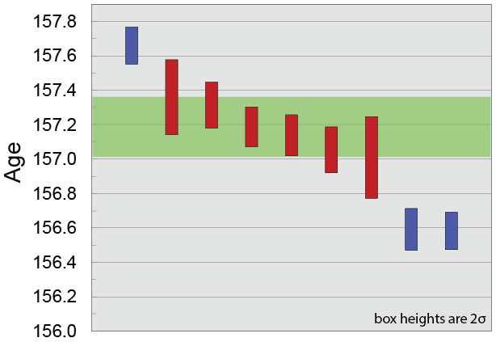
CA-ID-TIMS ²⁰⁶Pb/²³⁸U ages
Gold Flat
Applegate River
154.92 ± 0.24 Ma
157.10 ± 0.30 Ma
Notes:
Concordant
Without big error bar for Gold Flat: 154.76 +/- 0.14 Ma

Slide 24
Nevadan Orogeny: 157-150 Ma
Wooley Creek
Suite (168–157 Ma)
Eastern Hayfork
terrane
Rogue-Chetco
Galice Formation
Western Hayfork
terrane
Rattlesnake Creek
terrane
Josephine Ophiolite
Trench
Condrey Mountain Schist
Metasedimentary unit

Slide 25
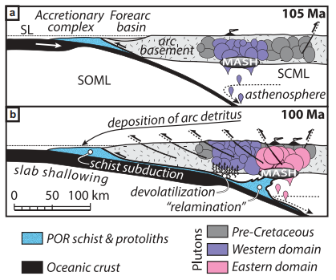
Modified from Chapman, 2016

Slide 26
Conclusions
Inverse metamorphic gradient recorded near boundary between the Gold Flat amphibolite and Condrey Mountain Schist
Titanium-in-zircon and zircon saturation thermometry provide support that the leucosomes did not travel far from their sources
Zircon in the RCt crystallized at ~630-660 °C
Zircon from leucosomes record separate ages of melting, 157.10 ± 0.30 Ma at Applegate River and 154.92 ± 0.24 Ma at Gold Flat
Thrusting of the CMS under the RCt provided enough fluids for the RCt to partially melt
It is possible that initiation of the Nevadan orogeny began as the CMS was thrust under the RCt at 157 Ma

