Slide 1







Nitrogen Dynamics in Riverine Wetlands: An Emerging Case Study of the Upper Mississippi River
Joe Krienert, Liliana Lefticariu,
Jonathan Remo, and Noah Scalero
Research Supported by

Slide 2
Rationale
Hydrologically connected floodplain wetlands of the Upper Mississippi River (MR) were found to reduce nitrate with 5x greater efficiency than other landuse strategies (1, 2).
Does this indicate wetland rehabilitation along other MR corridors may help abate the problem of high nitrate loading and eutrophication entering the Gulf of Mexico (GOM)?
To answer this, we’re investigating wetlands along the MR between the Kaskaskia and Ohio River confluences, a gateway for ~45% of the rivers total nitrate discharge into the GOM (3).
Schramm, H.L., et al. 2009. Wetlands 29: 476.
Hansen, A.T., et al. 2018. Nature Geoscience 11:127–132.
Robertson, D. M., et al. 2013. Journal of Environmental Quality 42(5): 1422-1440.

Slide 3
Hypotheses
River connectivity governs interactions of surface-water and groundwater flow in floodplain wetlands.
Integrating geochemical and isotopic observations can accurately reveal nitrogen sources, sinks, and transformations in wetlands.
By combining 1) and 2), the optimized conditions for reducing nitrate concentrations in riverine wetlands of the MR can be identified.

Slide 4
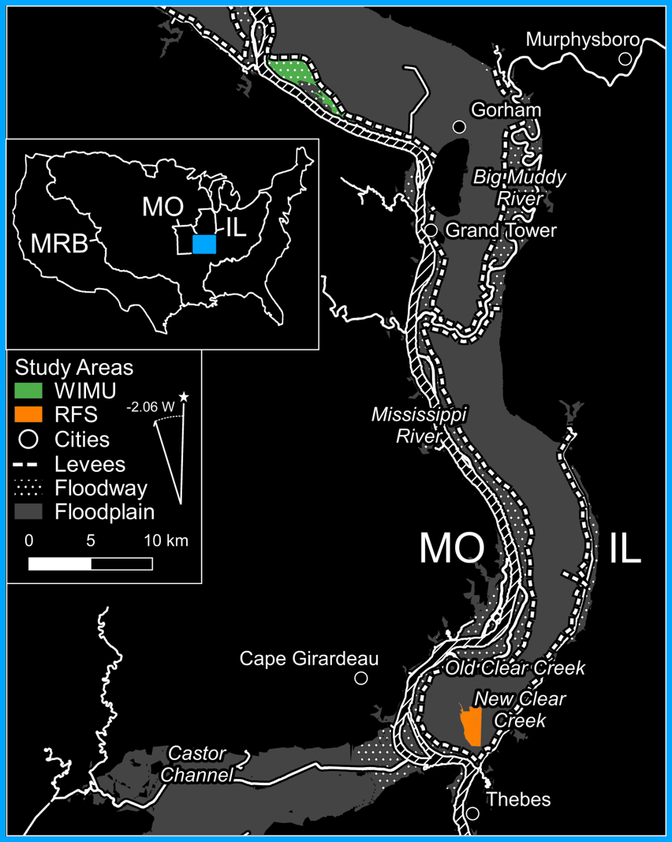
Study Area
WIMU(Wilkinson Island Management Unit)
1240 hectares of 55% forested, and 44% backswamp wetlands; σ ± 5%.
Hydrostratigraphy of 8m confining, and 30m aquifer; σ ± 1.5m.
RFS_{(Research Field Station)}
450 hectares of 67% backswamp, and 14% forested wetlands; σ ± 5%.
Hydrostratigraphy of 6m confining, and 25m aquifer; σ ± 1.5m.

Slide 5
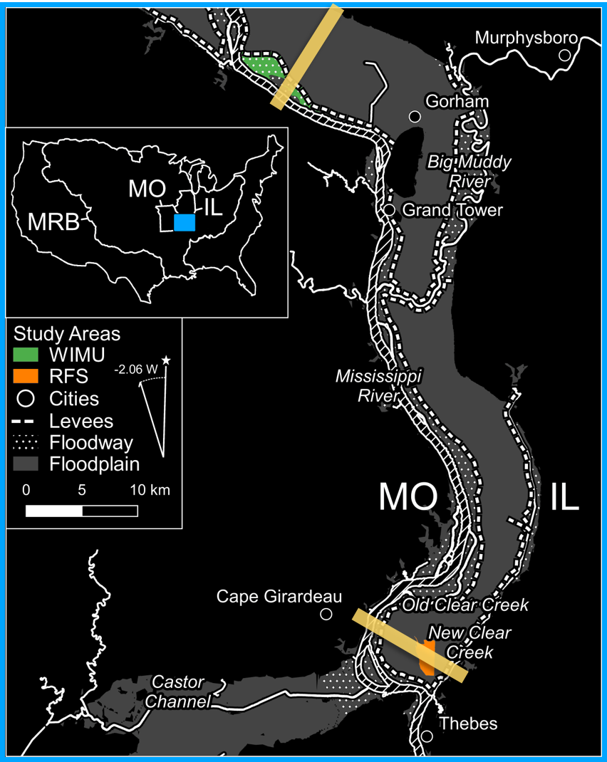
Study Area
WIMU(Wilkinson Island Management Unit)
1240 hectares of 55% forested, and 44% backswamp wetlands; σ ± 5%.
Hydrostratigraphy of 8m confining, and 30m aquifer; σ ± 1.5m.
RFS_{(Research Field Station)}
450 hectares of 67% backswamp, and 14% forested wetlands; σ ± 5%.
Hydrostratigraphy of 6m confining, and 25m aquifer; σ ± 1.5m.

Slide 6
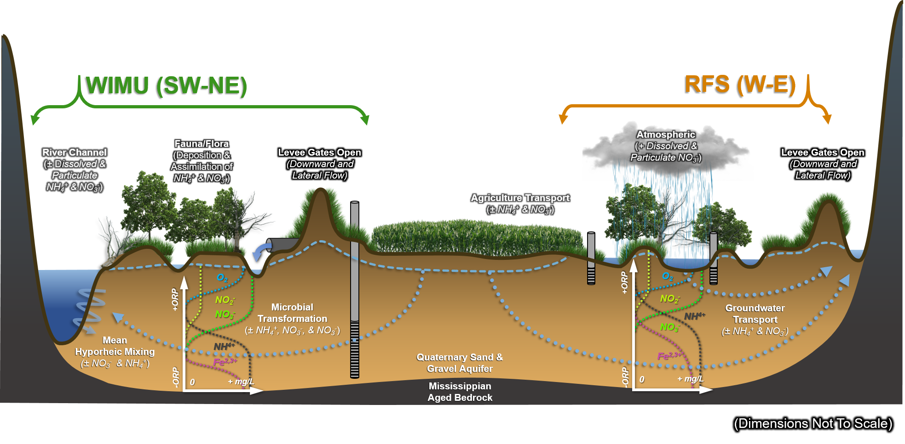
Conceptual Model_{(Non-Flooded)}

Slide 7
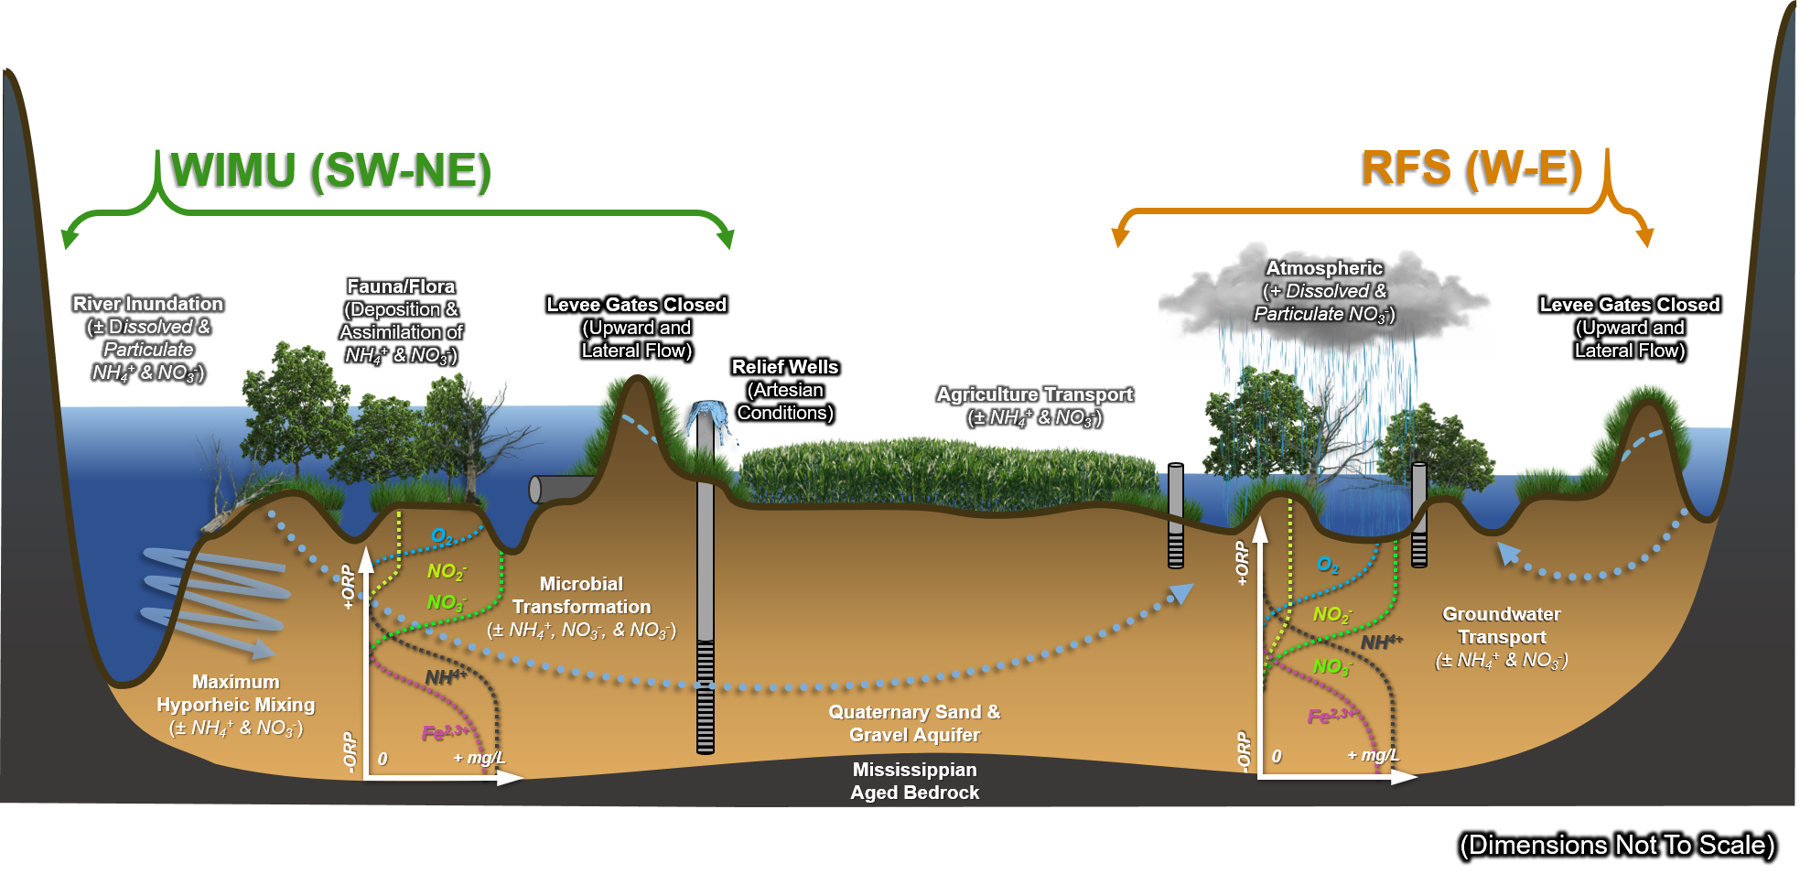
Conceptual Model_{(Flooded)}

Slide 8
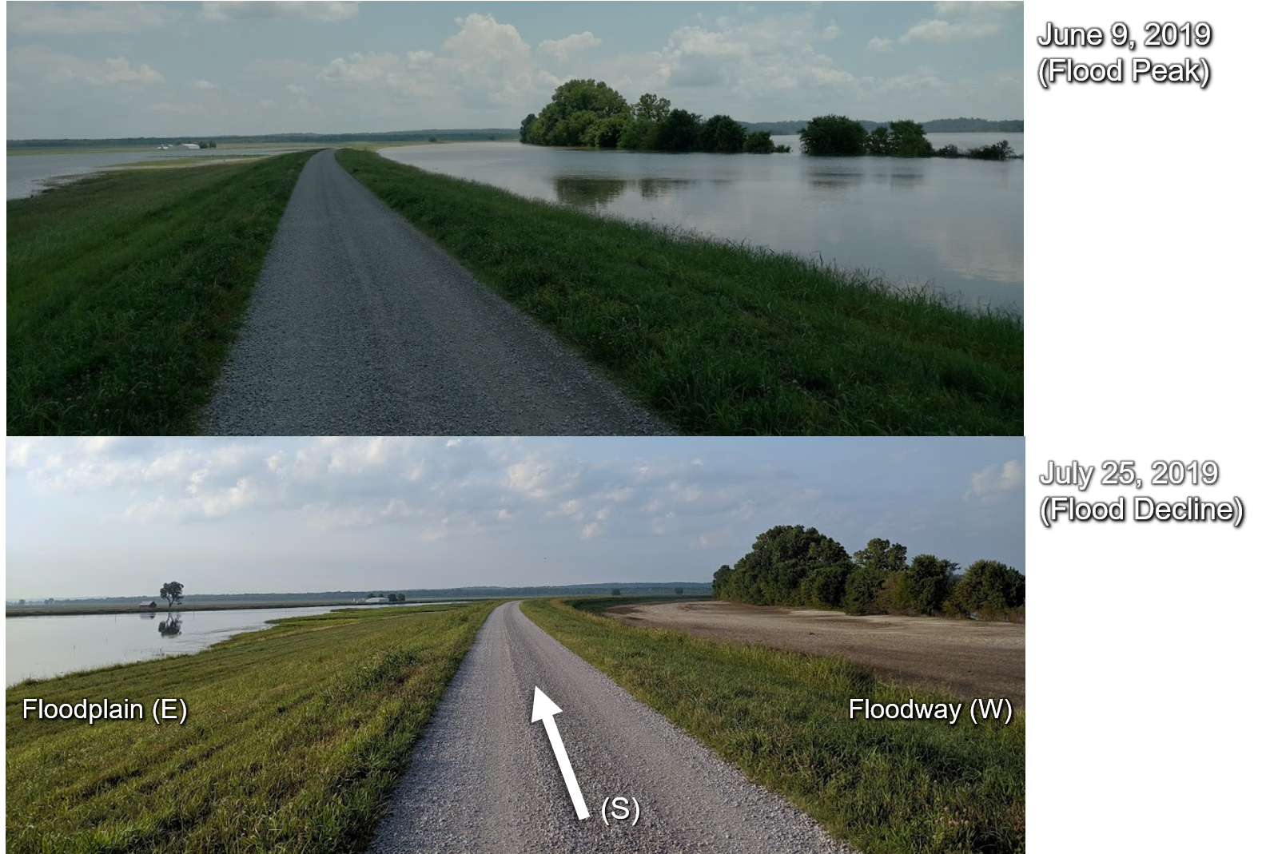
WIMU Levee [rkm 152]

Slide 9
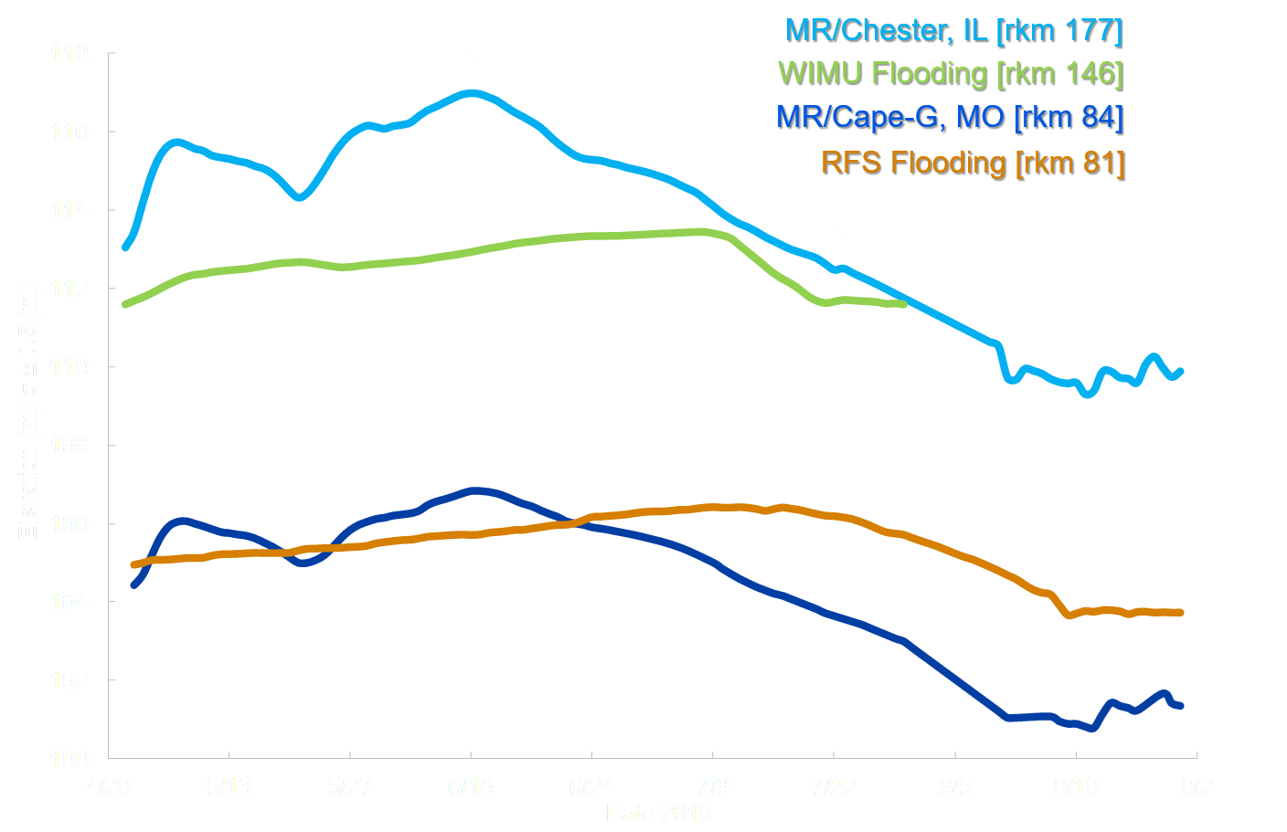
2019 Flood
Hydrograph
Flood limb slopes at WIMU are generally > RFS.
Peak stage duration at RFS was > WIMU.
Notes:
Normally on the dry side of the levee inundation would be less-so, however during this flood event, that was not observed. Mention water sources per area (GW>SW, upward flow at RFS and SW>GW, downward flow at WIMU)

Slide 10
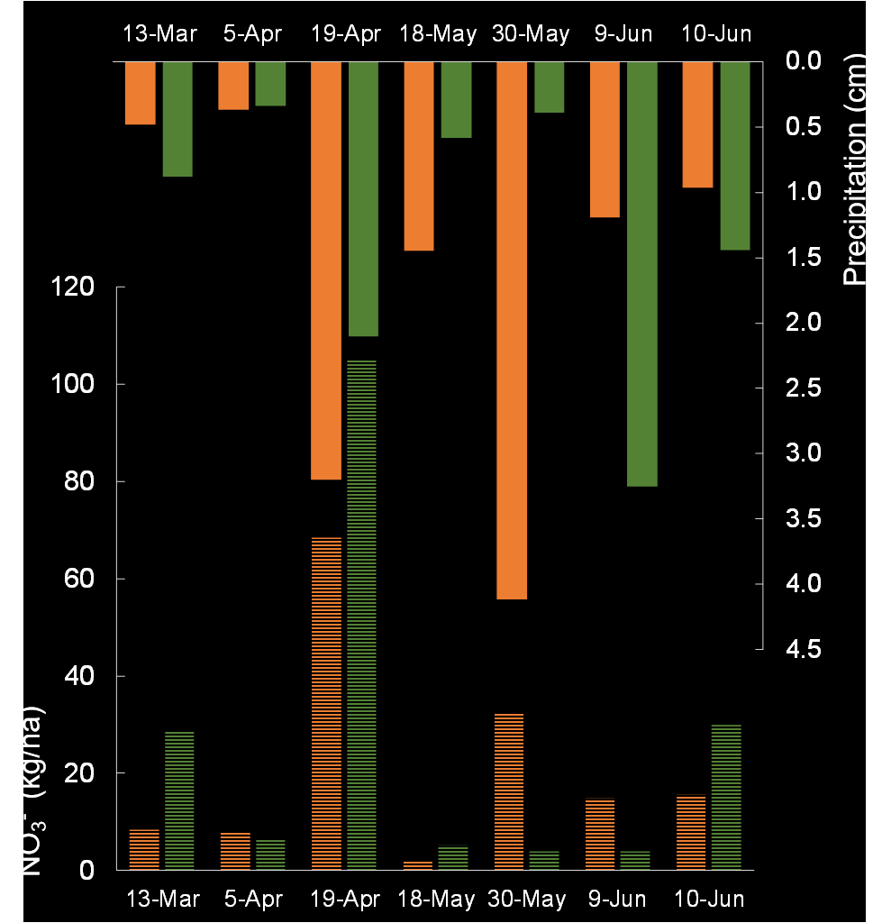
2019 Flood
Hyetograph w/ Nitrate-Deposition
Sum of precipitation nitrate deposited per area at WIMU was > than RFS over 3 months.
183 kg/ha at WIMU (σ ± 35 kg/ha).
149 kg/ha at RFS (σ ± 22 kg/ha).

Slide 11
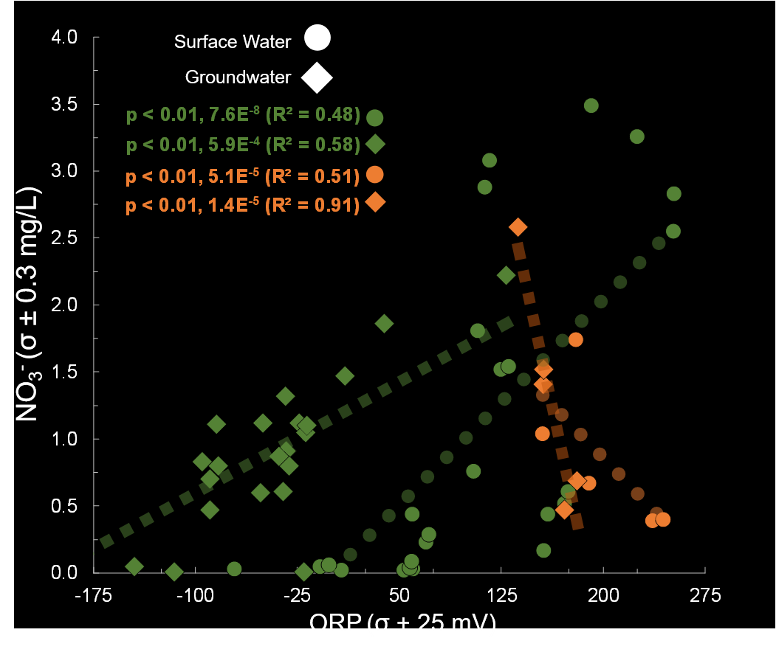
Geochemistry
Nitrate (NO₃⁻) vs Oxygen Reductive Potential (ORP)
Surface water to groundwater nitrate concentrations fell at WIMU (6.0 to BDL, σ ± 0.9 mg/L).
Surface water to groundwater nitrate concentrations rose at RFS (0.7 to 1.3, σ ± 0.3 mg/L).

Slide 12
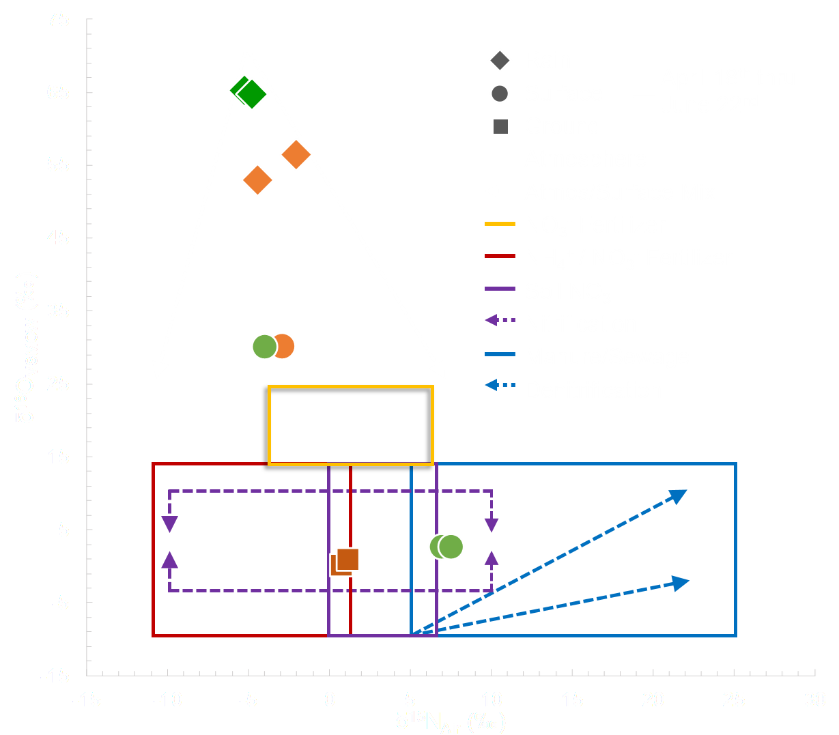
Isotopes
Nitrate (NO₃⁻) δ¹⁸O/δ¹⁵N Analysis from Apr - Jun 2019
All deep WIMU groundwater samples were BDL for NO₃⁻.
NO₃⁻ present in WIMU surface water and RFS groundwater is a product of nitrification.
UC Davis, (2019). SIF, Laboratory Analysis.
Kendall, C. 1998. From Isotope tracers in catchment hydrology. Elsevier. pp. 534–569.
Moore, K., et al. 2004. Appl. Geochem., 21(6): 1016-1029.

Slide 13
Conclusions_{(After} _{1 Year Observations)}
Inundation driven by surface water at WIMU, and groundwater at RFS.
Duration at WIMU was < than RFS.
Limbs at WIMU were steeper than at RFS.
Vertical flow was downward at WIMU, and upward at RFS.
Nitrogen transformation occurring at both wetlands.
Precipitation is an important nitrate source at both sites.
Surface water to groundwater NO₃⁻ fell at WIMU, and rose at RFS.
Significant correlation of groundwater NO₃⁻ / ORP at both sites.
Notes:
So far, its clear (and agrees with hypothesis) that river control structures alter channel AND floodplain flow regimes in surface water and groundwater systems.

Slide 14
Acknowledgements
Robert Jacobson _{(USGS Supervisory Hydrologist)}
Garth A. Lindner _{(Mizzou Post-Doc)}
Steve P. Esling _{(SIUC Hydrogeologist)}
Justin Schoof _{(SIUC Climatologist)}
Scott Hamilton-Brehm _{(SIUC Geomicrobiologist)}
Tomas Corcoran and Daniel Mercado _{(SIUC Undergraduates)}

