Slide 1
Rhyolite ignimbrite boulders and cobbles in the Middle Jurassic Carmel Formation of Utah and Arizona
Bart J. Kowallis¹, Douglas A. Sprinkel², Eric H Christiansen¹, Skylor Steed¹, and David F. Wheatley³
¹Department of Geological Sciences, Brigham Young University, Provo, UT 84604 (bkowallis@byu.edu)
²Utah Geological Survey, P.O. Box 146100, Salt Lake City, UT 84114
³Department of Geology and Geophysics, University of Utah, Salt Lake City, UT 84112

Slide 2
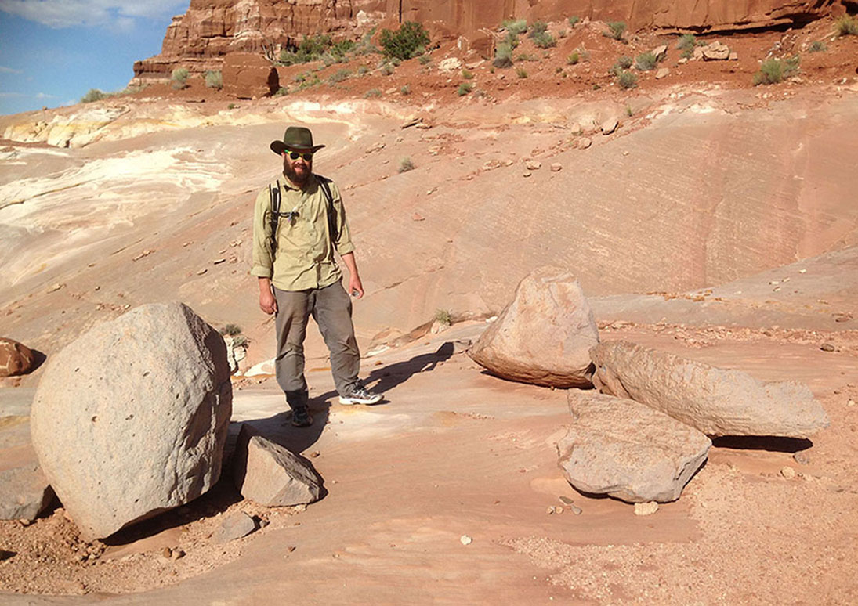

Slide 3
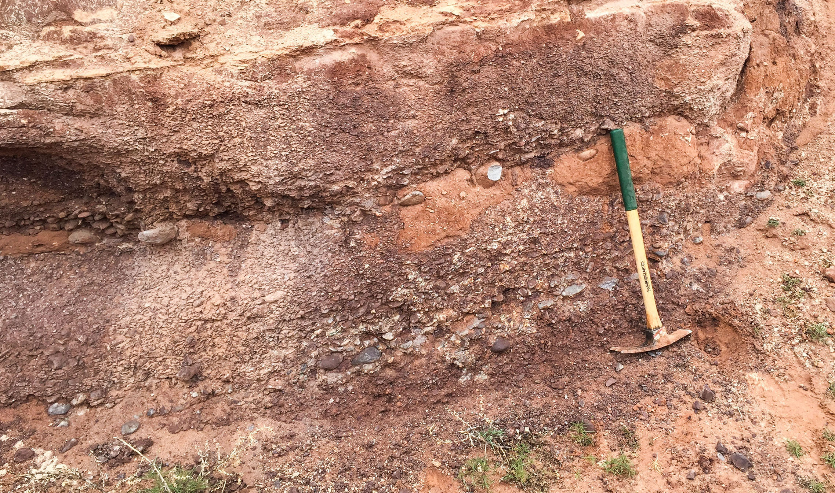

Slide 4
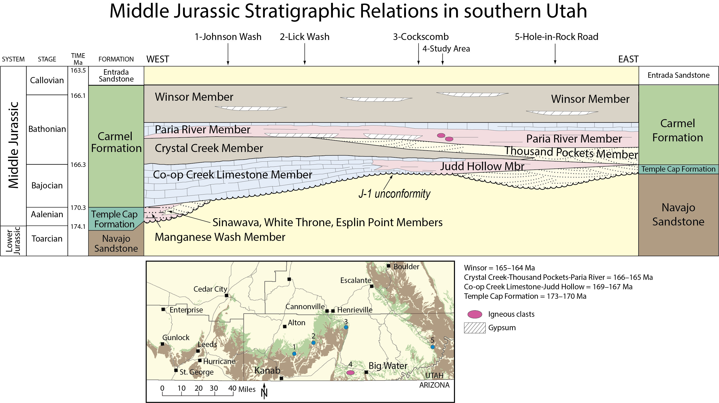

Slide 5
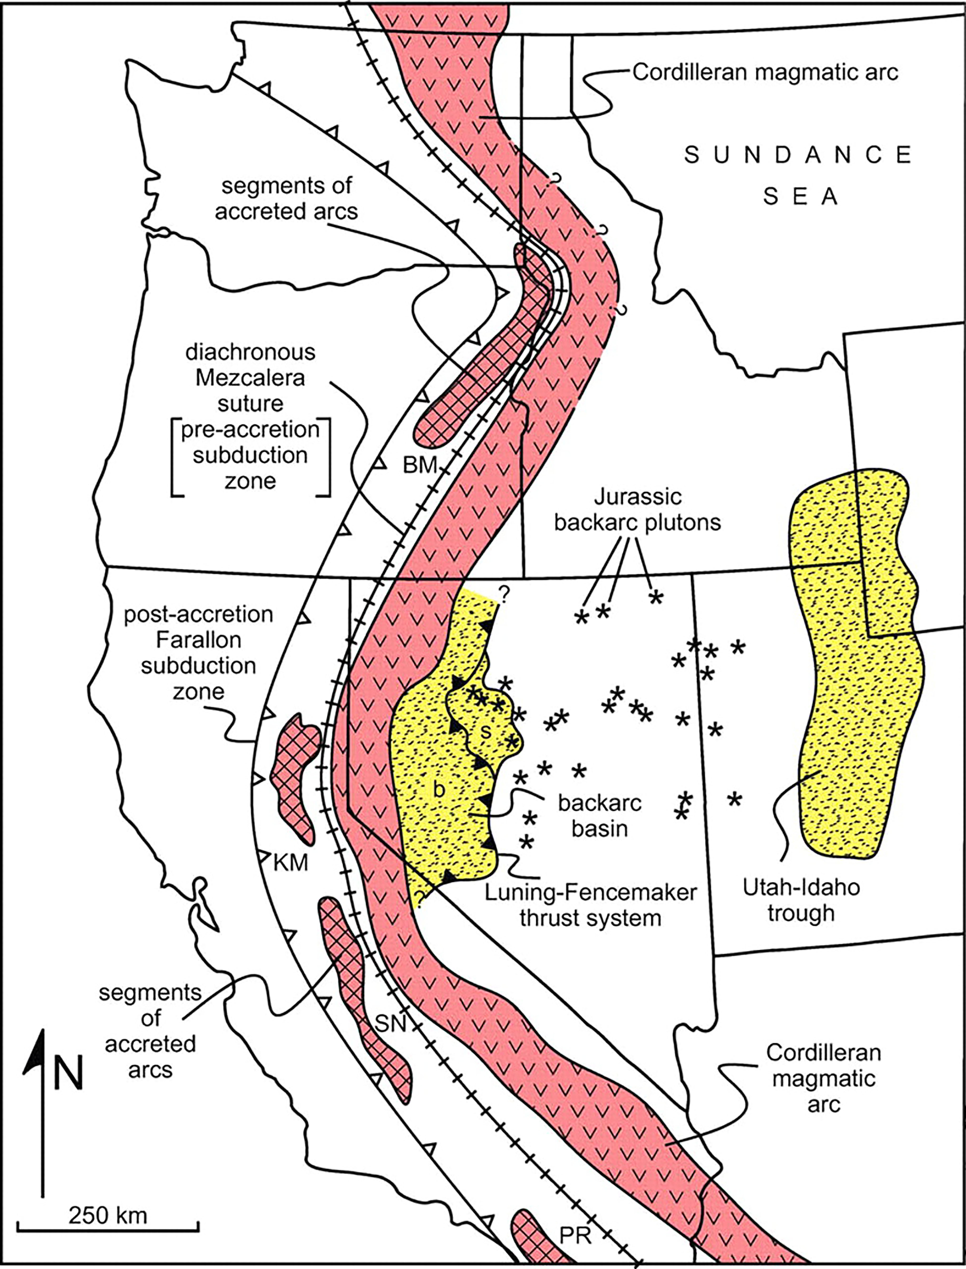
Jurassic clast
locality
Map from Dickinson (2006)

Slide 6
Previous Work
Chapman (1987, 1989, 1993)
Marzolf (1990)
Blakey and Parnell (1995)
These authors all reported on and studied these volcanic clasts.

Slide 7
Chapman (1993)
Welded tuff clasts
Debris flows generated by huge flood/s
Boulders and cobbles transported 250-300 km
Also, examined several other possible scenarios
Blakey & Parnell (1995)
Tuff outcrops were likely only several km away

Slide 8
Conclusions
Tuffs were not strongly welded
The clasts come from multiple tuff eruptions
Tuff clasts are several million years older (~171 Ma) than the enclosing sediments (~166 Ma).
Original emplacement of tuffs likely occurred in distal lobes confined in paleovalleys
The Jurassic tectonic setting may be similar to modern Central America

Slide 9
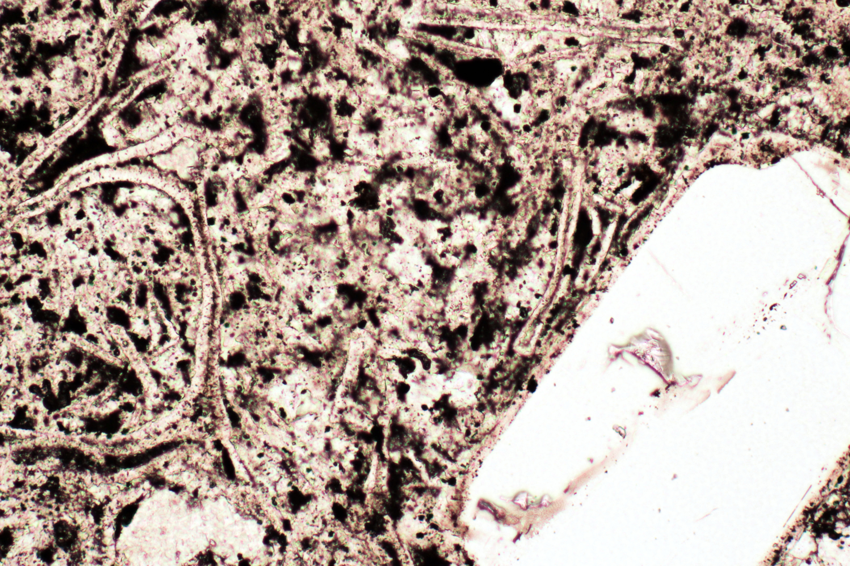
Glass shards show lack of welding
Wide dimension on photo is 1 mm

Slide 10
Pumice are also not compressed or welded
Wide dimension on photos is 1 mm, except B, which is 0.5 mm.

Slide 11
Conclusions
Tuffs were not strongly welded
The clasts come from multiple tuff eruptions
Tuff clasts are several million years older (~171 Ma) than the enclosing sediments (~166 Ma).
Original emplacement of tuffs likely occurred in distal lobes confined in paleovalleys
The Jurassic tectonic setting may be similar to modern Central America

Slide 12
Whole-rock
Composition

Slide 13
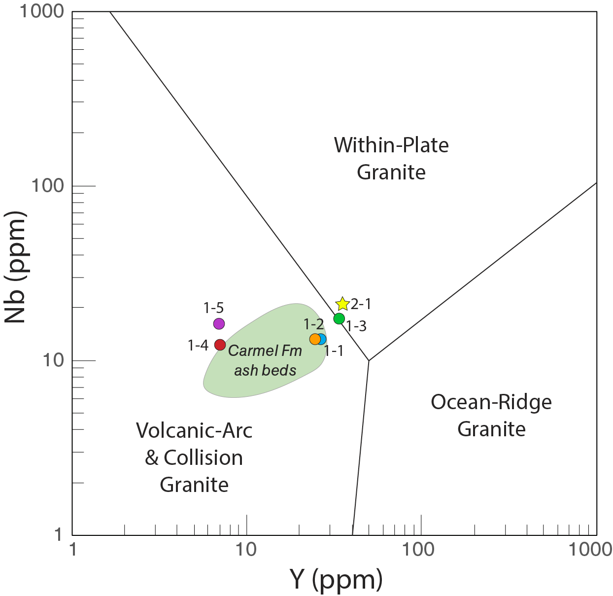
Whole-rock
Composition

Slide 14
K-Feldspar Composition

Slide 15
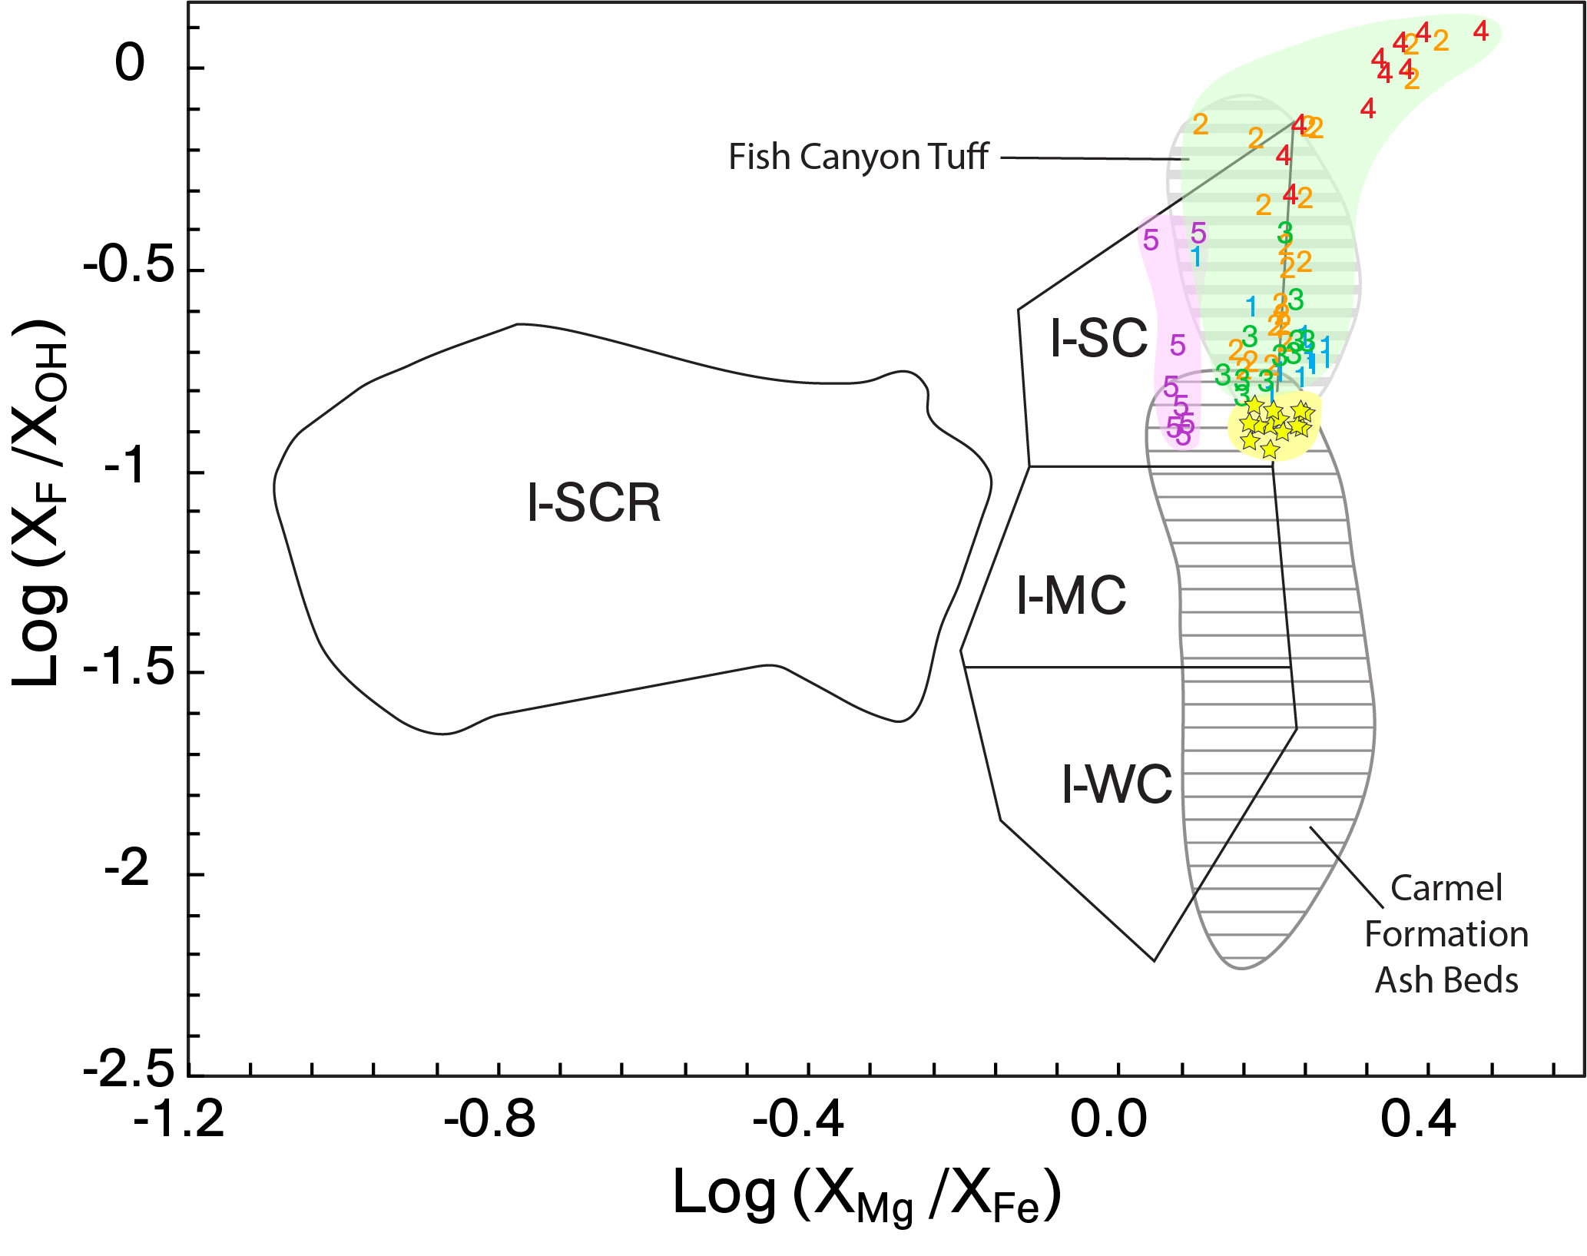
Biotite
Composition

Slide 16
Conclusions
Tuffs were not strongly welded
The clasts come from multiple tuff eruptions
Tuff clasts are several million years older (~171 Ma) than the enclosing sediments (~166 Ma)
Original emplacement of tuffs likely occurred in distal lobes confined in paleovalleys
The Jurassic tectonic setting may be similar to modern Central America

Slide 17
Sanidine ⁴⁰Ar/³⁹Ar single-crystal, laser probe ages from clast 1-1

Slide 18
Zircon U-Pb single-crystal ages from clast WH-2

Slide 19
Zircon U-Pb single-crystal ages from ash bed stratigraphically near the clast layer
163.9 +/- 3.3 Ma
Age of tuff bed from the base of the overlying Winsor Member of Carmel Fm.
163 to 169 Ma
Range of ages from ash beds found in all members of Carmel Formation

Slide 20
Conclusions
Tuffs were not strongly welded
The clasts come from multiple tuff eruptions
Tuff clasts are several million years older (~171 Ma) than the enclosing sediments (~166 Ma).
Original emplacement of tuffs likely occurred in distal lobes confined in paleovalleys
The Jurassic tectonic setting may be similar to modern Central America

Slide 22
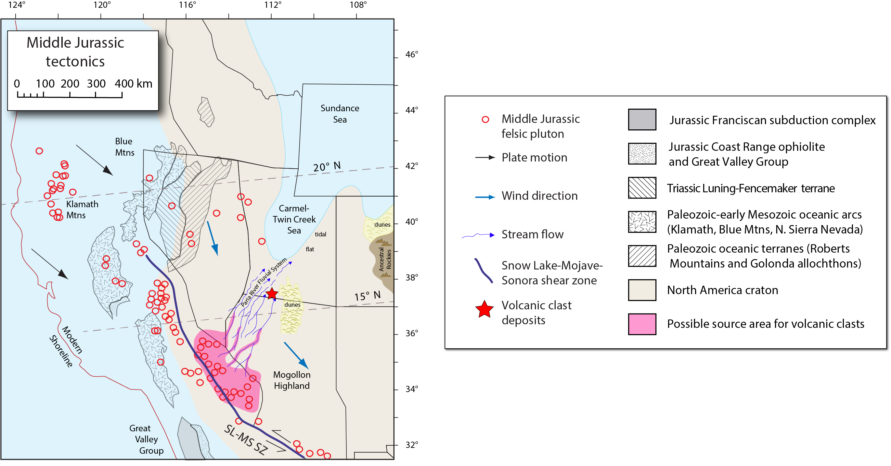
Notes:
Several eruptions produced tuffs than were deposited in distal channels, perhaps as far as 200 km from the source terrain. After deposition the tuffs remained in place for several million years before being reactivated in mud flows that brought them to the depositional site. Their low densities, due to lack of welding, was an important factor in allowing large boulders and cobbles to be moved over a fairly gentle slope.

Slide 23
Conclusions
Tuffs were not strongly welded
The clasts come from multiple tuff eruptions
Tuff clasts are several million years older (~171 Ma) than the enclosing sediments (~166 Ma).
Original emplacement of tuffs likely occurred in distal lobes confined in paleovalleys
The Jurassic tectonic setting may be similar to modern Central America

Slide 24
