Slide 1
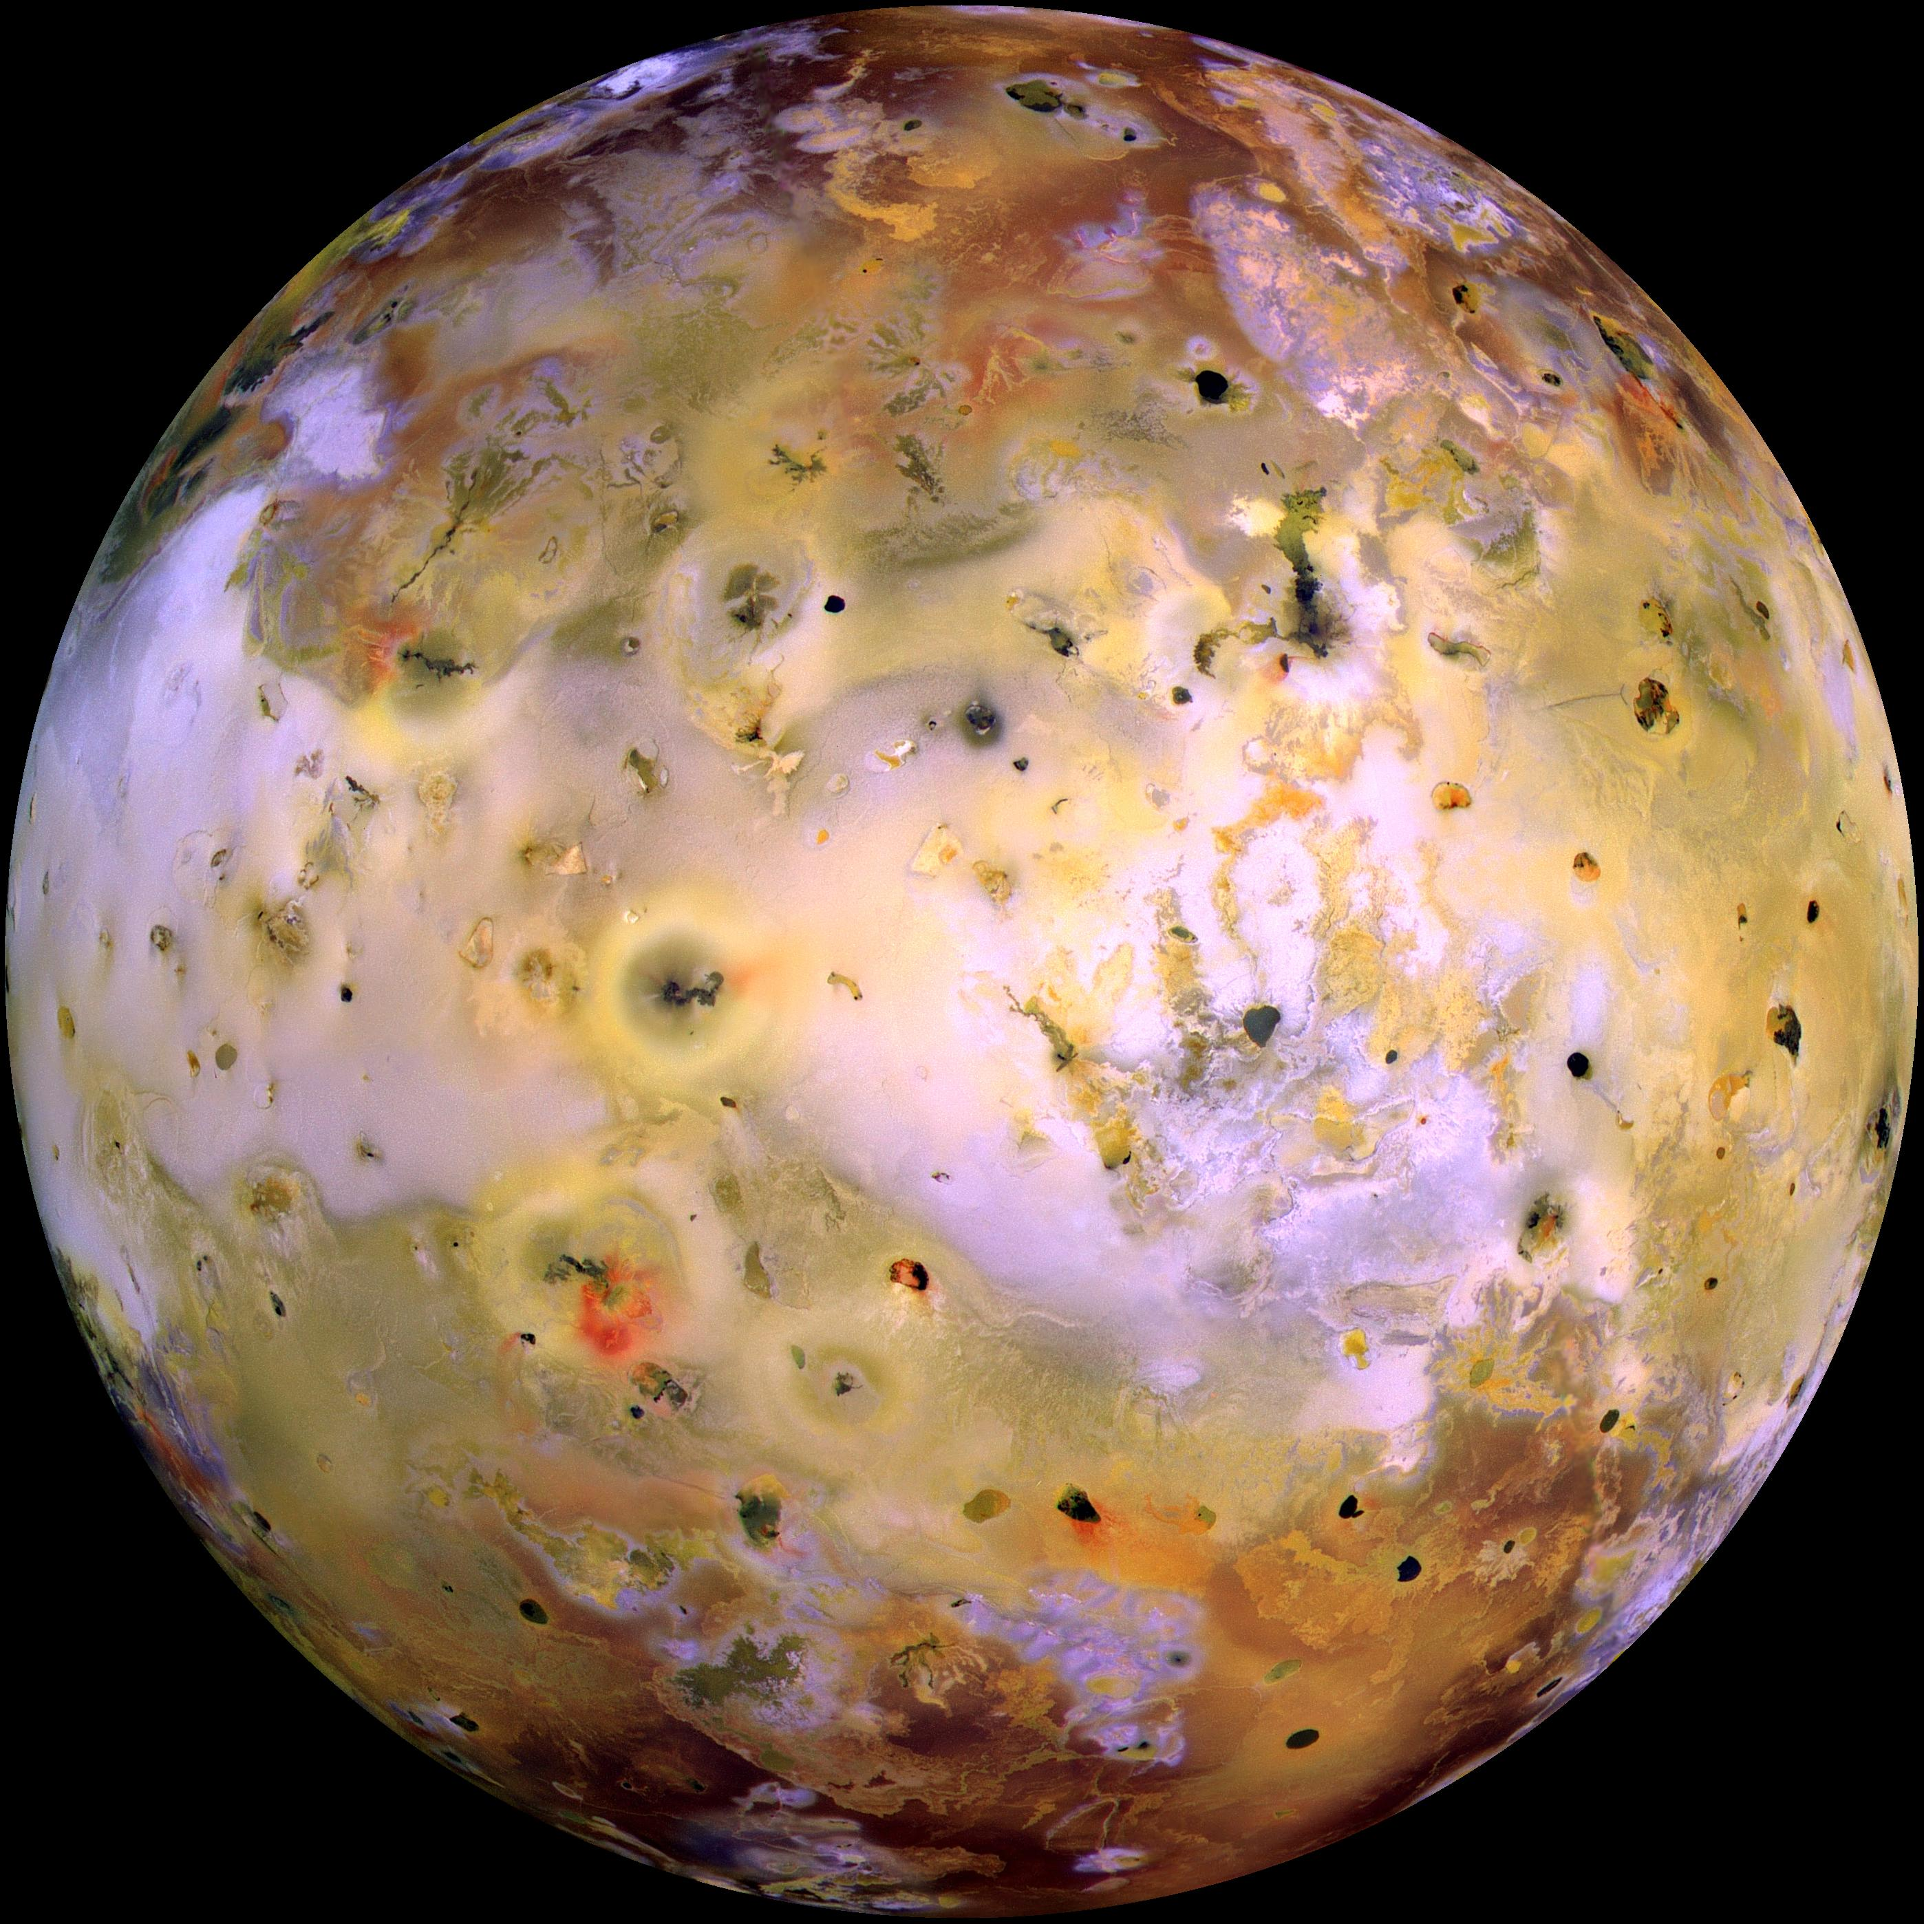
Thrilling Discoveries about the Tidally Tortured Volcanic Wonderland Io
Alfred McEwen
GSA Gilbert session, 2019
Notes:
Least active centers comparable to most active region of Earth, such as Kilauea

Slide 2
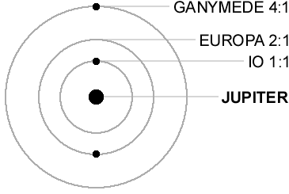
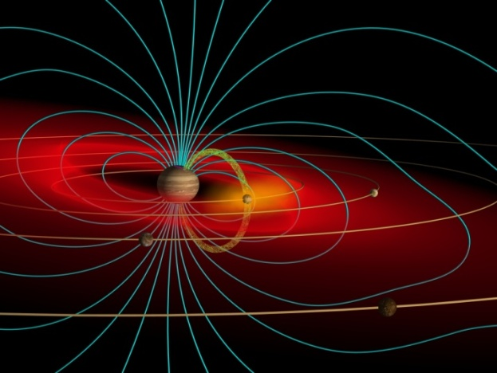
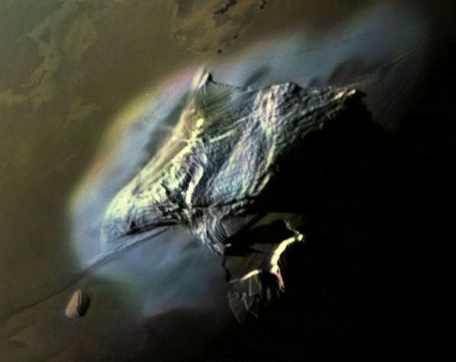
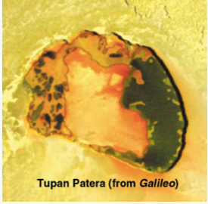
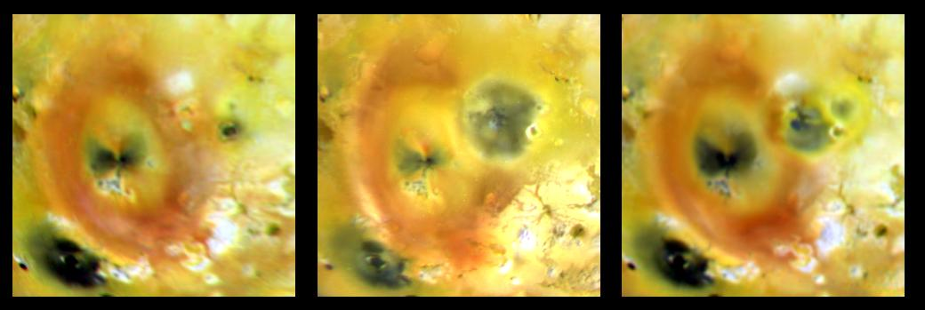
Io is Special
Io’s intense volcanism driven by tidal heating from 4:2:1 orbital resonance of Io-Europa-Ganymede
Best place to understand the tidal heating as a fundamental planetary process
  We can easily measure the heat flow, lava temperatures, tides, interior (erupted) compositions, magnetic induction, etc.
Only place to watch large-scale silicate and potential ultramafic volcanism that has been a key process on all of the terrestrial planets
Best place to understand heat-pipe tectonic end-member, relevant to early terrestrial planets and present-day exoplanets
Laplace resonance
Plasma Torus
Plume deposits covering areas of Texas and Arizona
Mountains >10 km high

Slide 3
Io has Hundreds of extremely active* volcanic centers *More active than Kilauea
Thermal
emission
Davies et al., 2015, Icarus, 262, 67-78.
Also >400 Dark paterae and flow fields without measured thermal emission but that must have elevated heat flow to prevent SO₂ condensation.

Slide 4
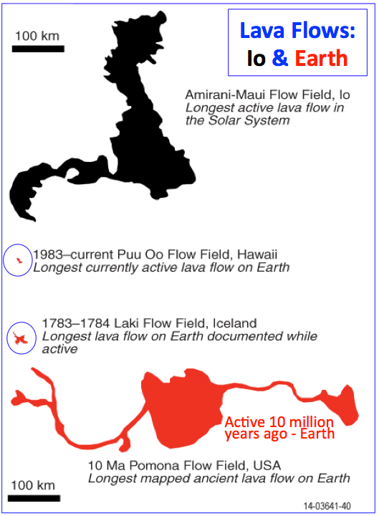
Effusion rates are 10-100x greater on Io than on Earth (today) for comparable eruption styles.
Effusion rate comparisons – contemporary eruptions
^{(All to the same scale)}
Effusion rate, m³/s
No terrestrial equivalent
Notes:
1783 Laki = year w/o summer, Mississippi river froze

Slide 5

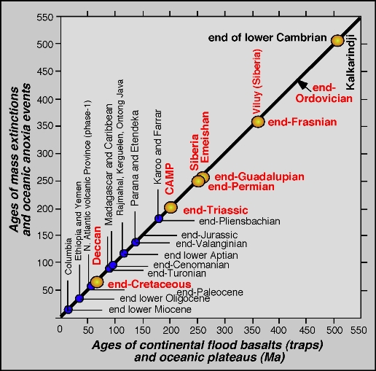
Large pulses in flood volcanism caused mass extinctions
Radiometric age dates closely tie major pulses in volcanism to 4 of the 5 Phanerozoic mass extinctions and to multiple other ocean anoxia events.
This close match in ages cannot be a coincidence!
Io is the only place in the solar system where we can directly observe such high effusion rates.

Slide 6
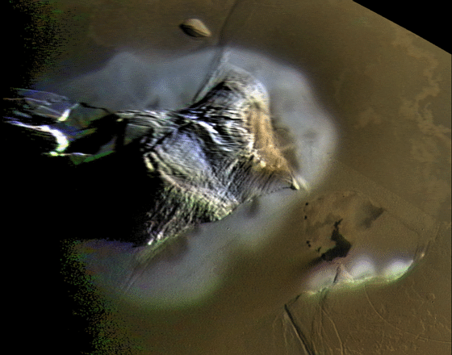
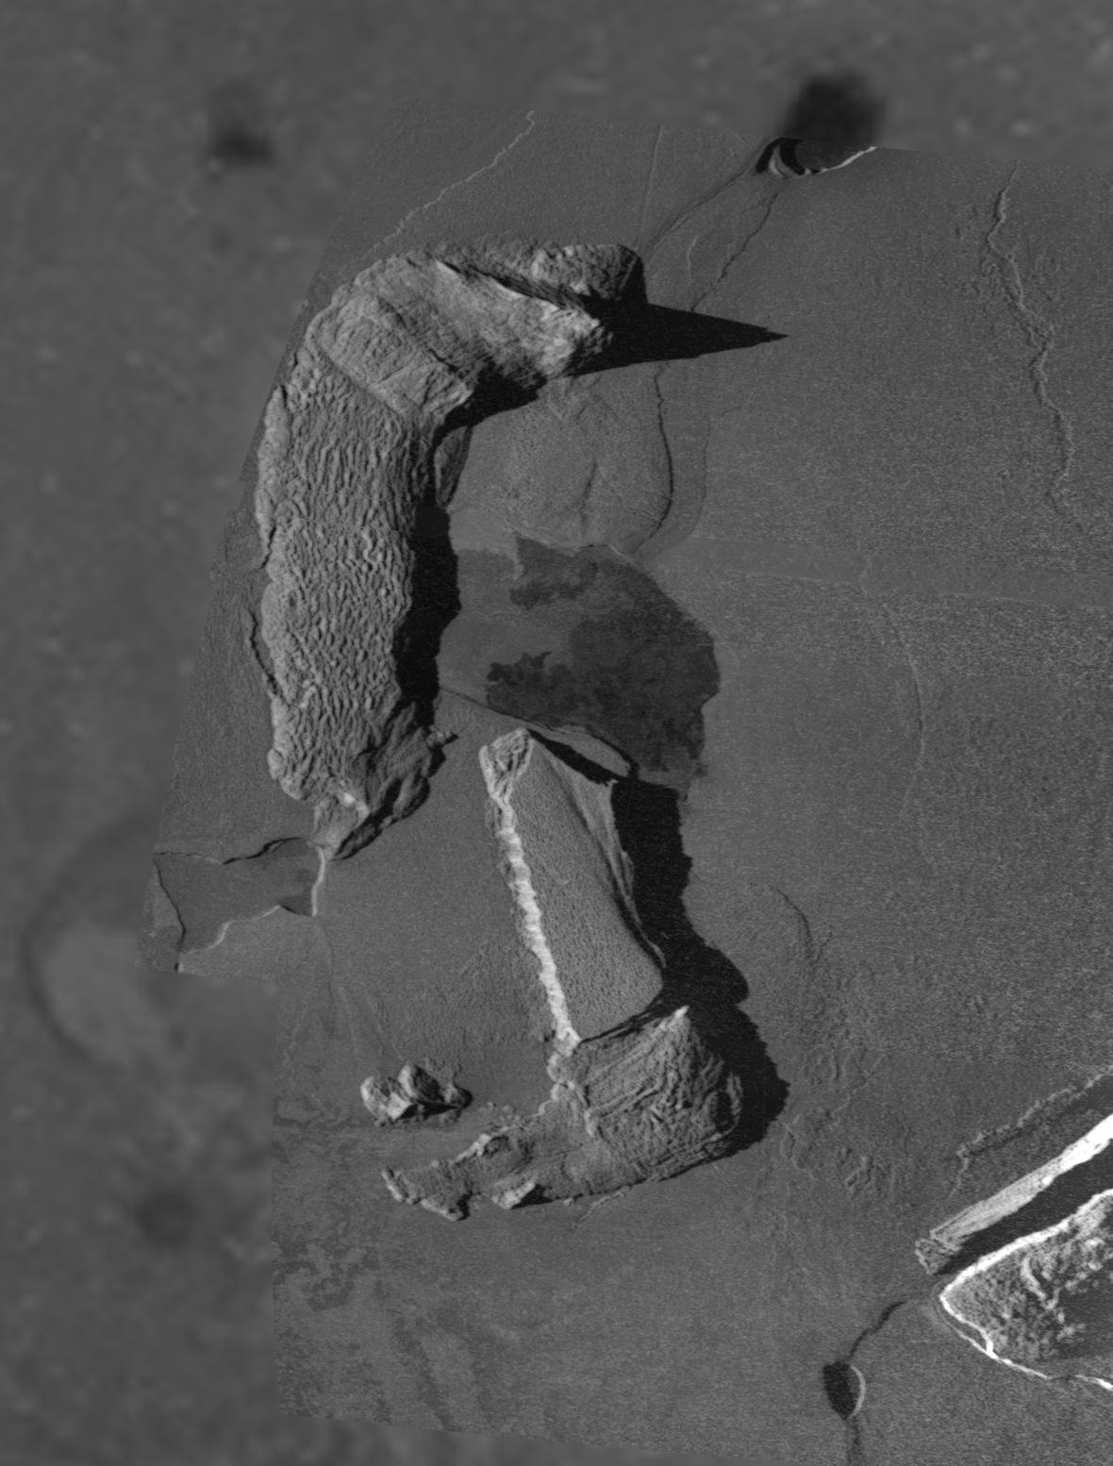
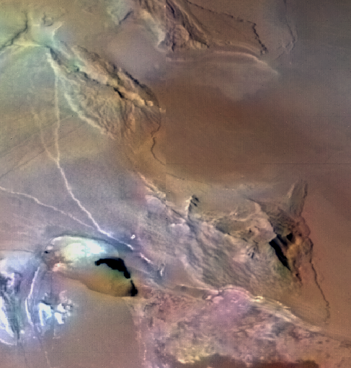
Early History of Io Discoveries
1610: Galileo Galilei discovered the Galilean Satellites
1771: Laplace described the 4:2:1 resonance
  Significance realized 200 years later
1979:
Transient IR brightening of Io observed by Witteborn et al (1979)
  An eruption of that magnitude has never been observed on Earth, so they favored a non-volcanic interpretation
Peale et al. (1979) “Melting of Io by Tidal Dissipation”
  Laplace resonance creates significant forced eccentricity in orbits of Io and Europa, so they are periodically deformed by massive Jupiter, generating internal heat
  Predicted runaway melting of the interior of Io, thinning the lithosphere so that it could conduct away the heat.
  Predicted that Voyager spacecraft might observe widespread and recurrent volcanism
Widespread volcanism prediction confirmed a few months later by Voyager 1
  Discovered many signs of active volcanism
  But also that Io has large mountains up to 17 km high!
    How is that possible with a thin lithosphere over a molten interior?

Slide 7
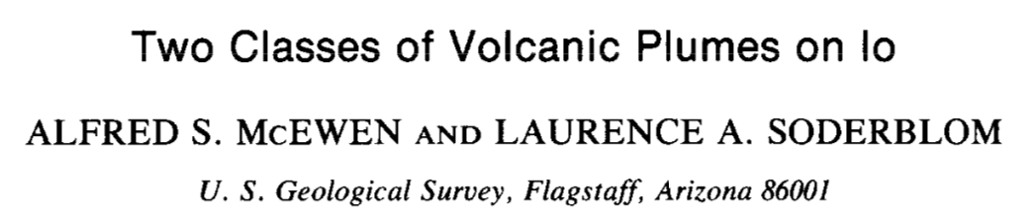
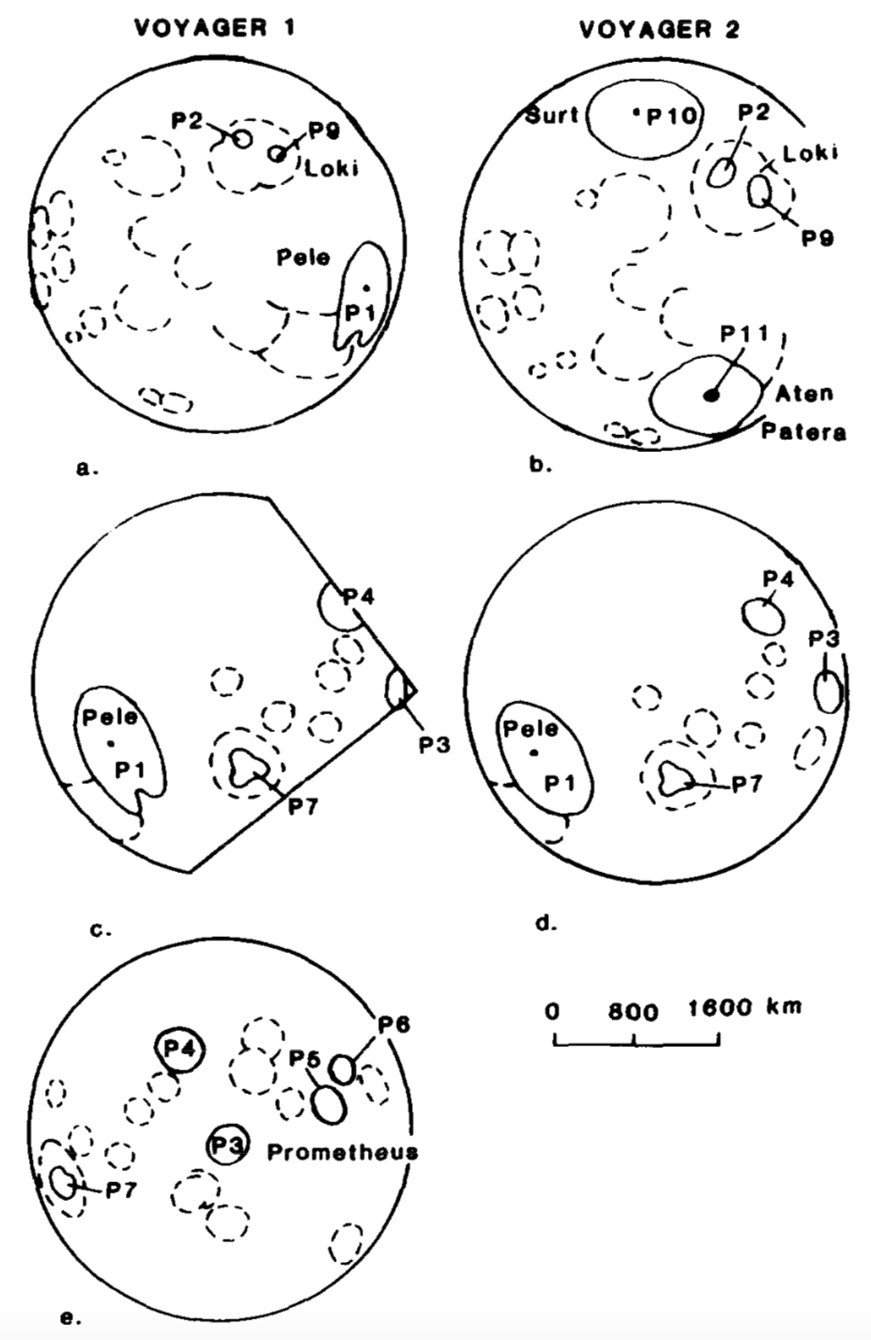
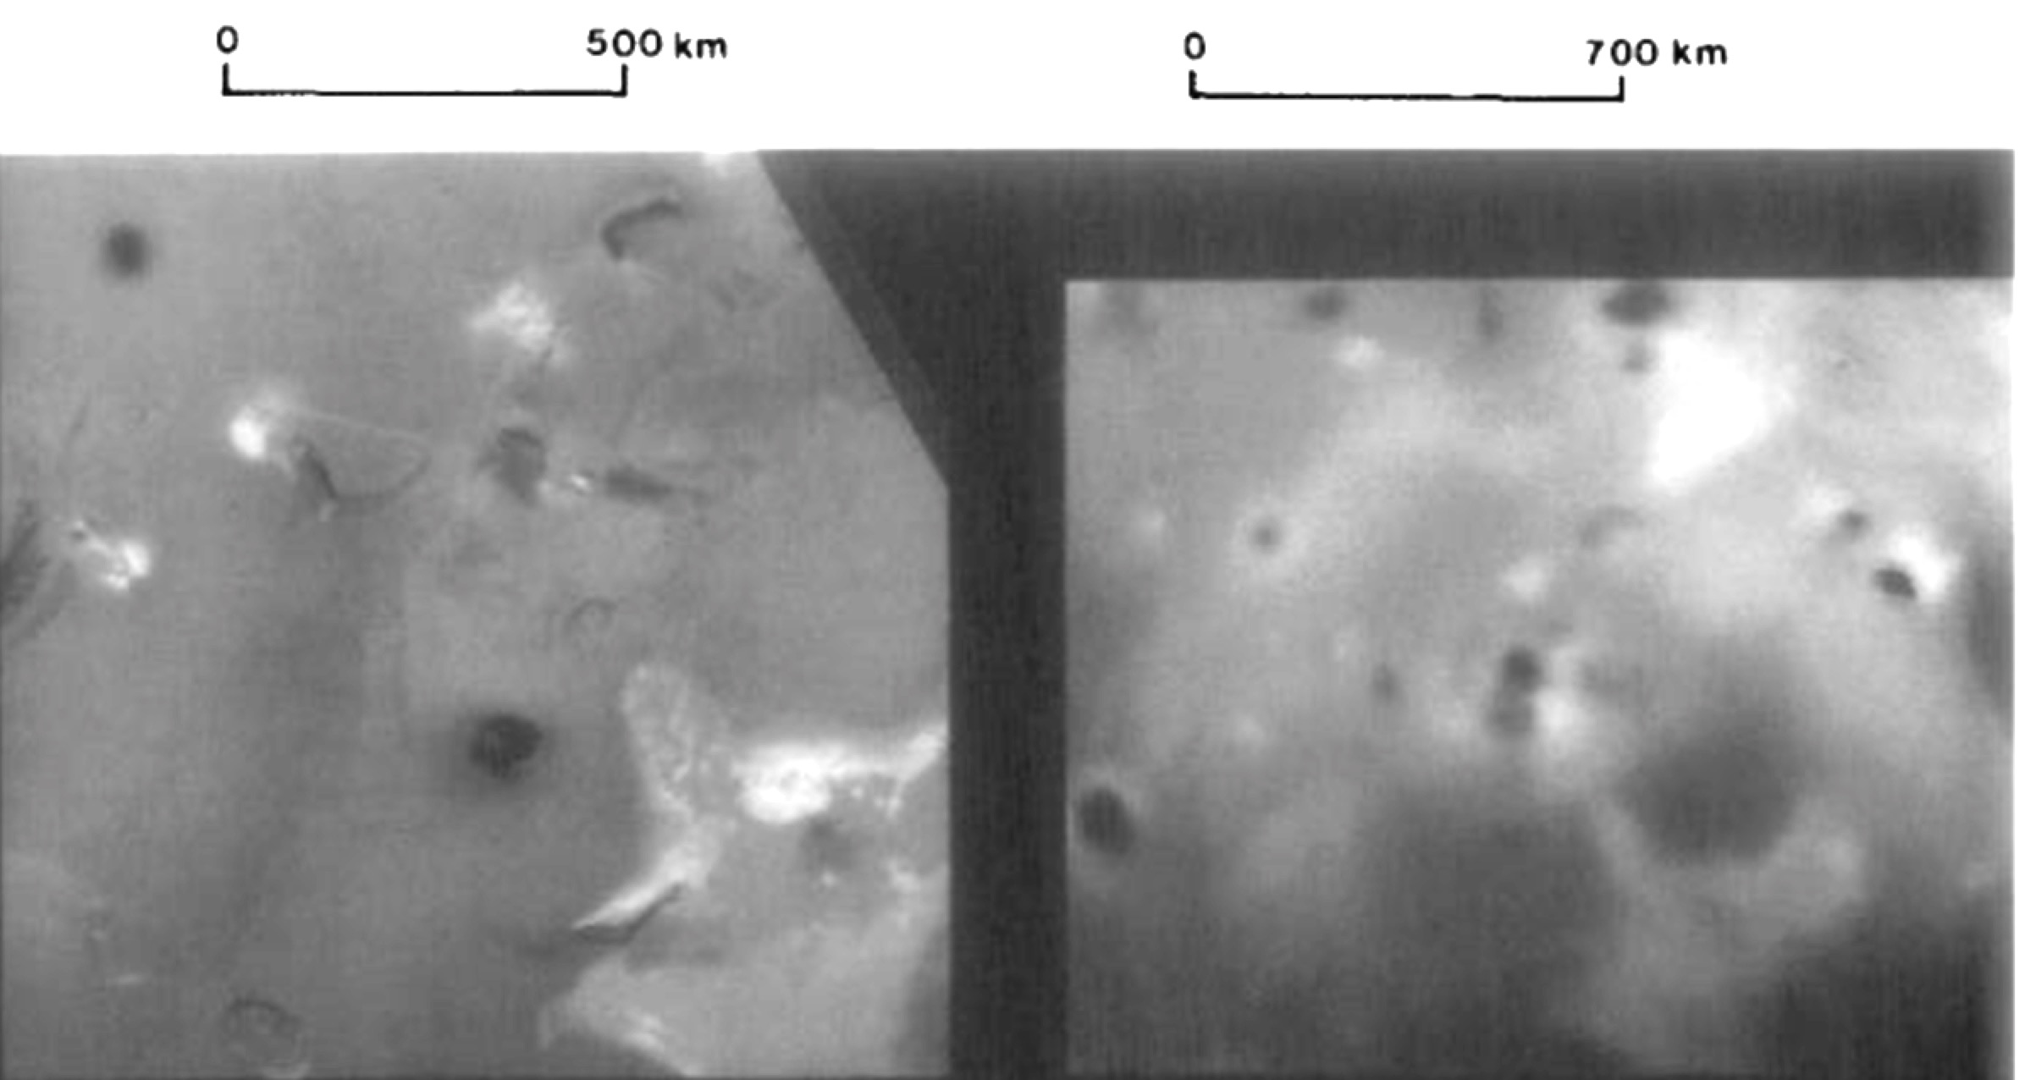

Surt, Aten, Pele, Loki, plus markings of past plumes revealed a global dichotomy: Large plumes (and 5-micron outbursts?) concentrated on trailing hemisphere
Voyager 1
Voyager 2
In 4 months between Voyager 1 and Voyager 2 encounters, new 1400-km plume deposits formed around both Surt and Aten Paterae, whose floors darkened, and a 5-micron outburst was observed from Earth (Sinton 1980).

Slide 8
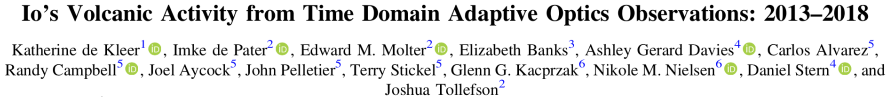
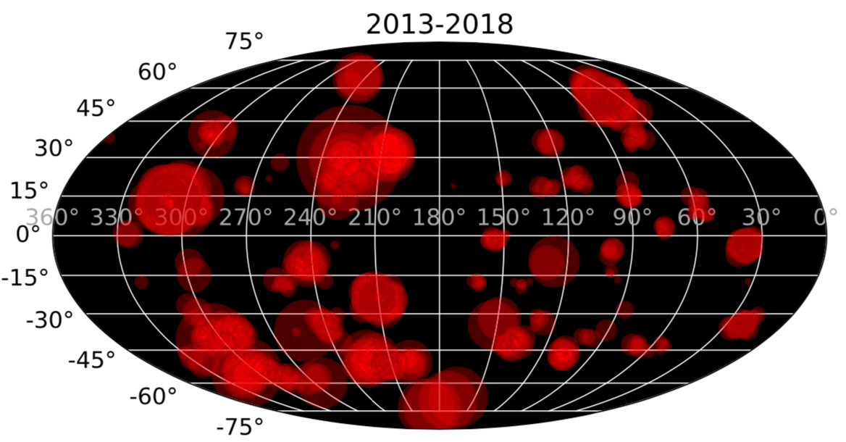
“…the preference for bright eruptions to occur on Io’s trailing hemisphere ... remains unexplained.”
circle size proportional to the log of the 3.8 μm intensity

Slide 9
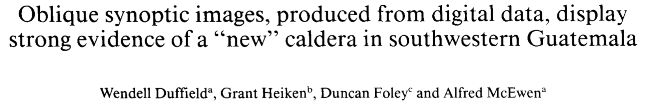
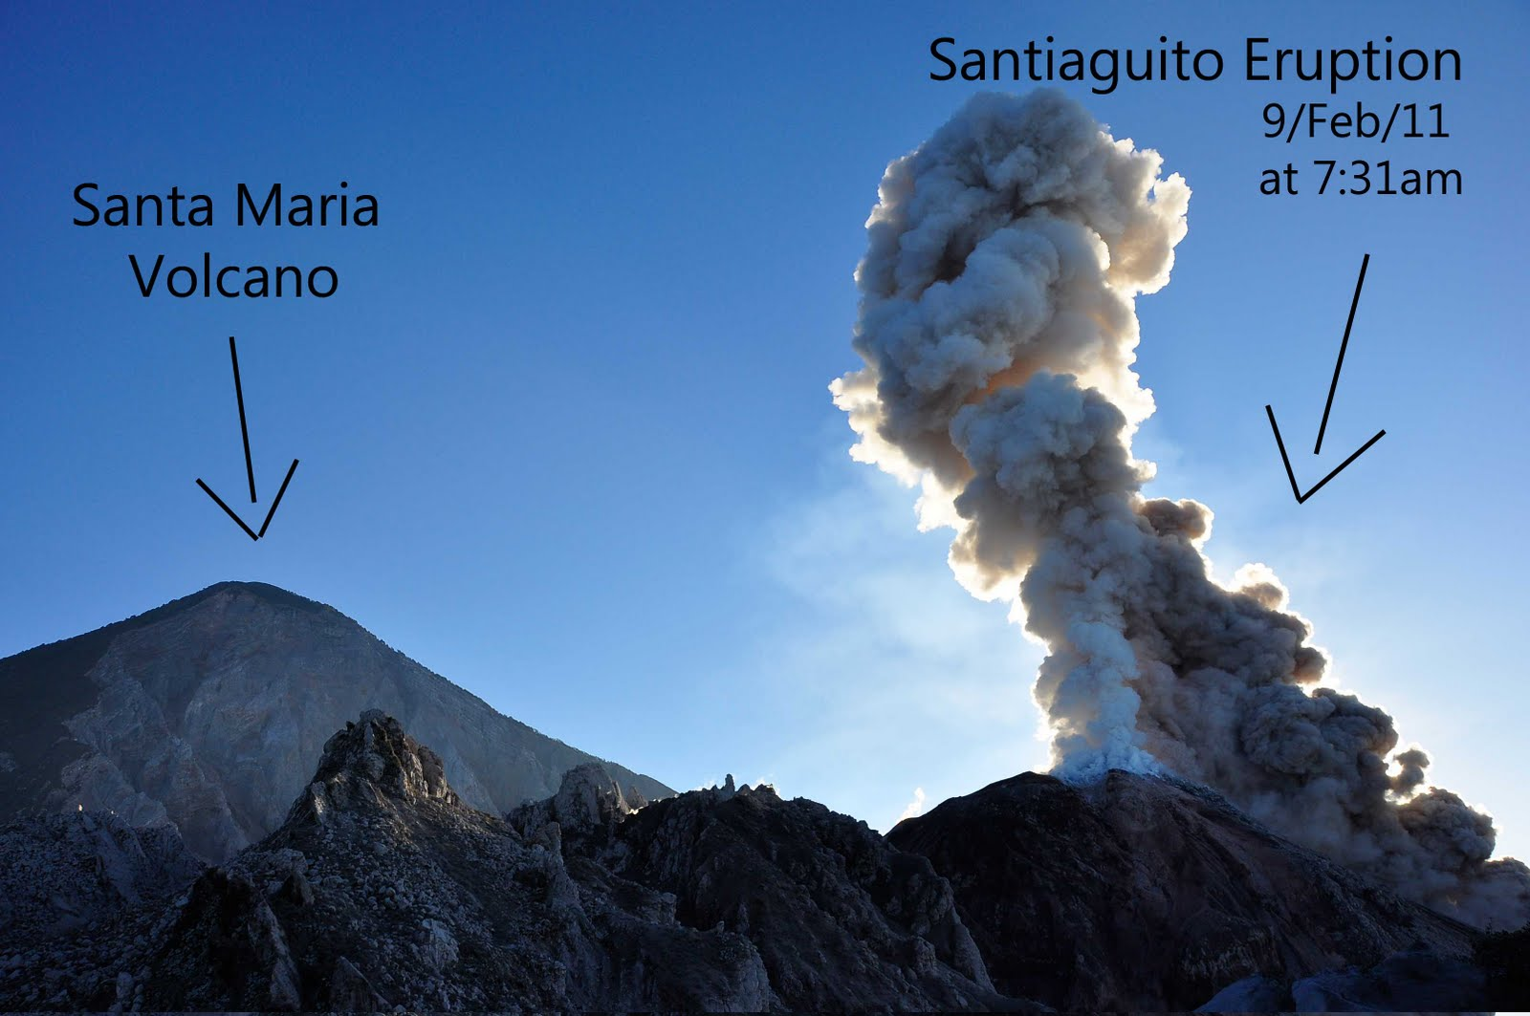
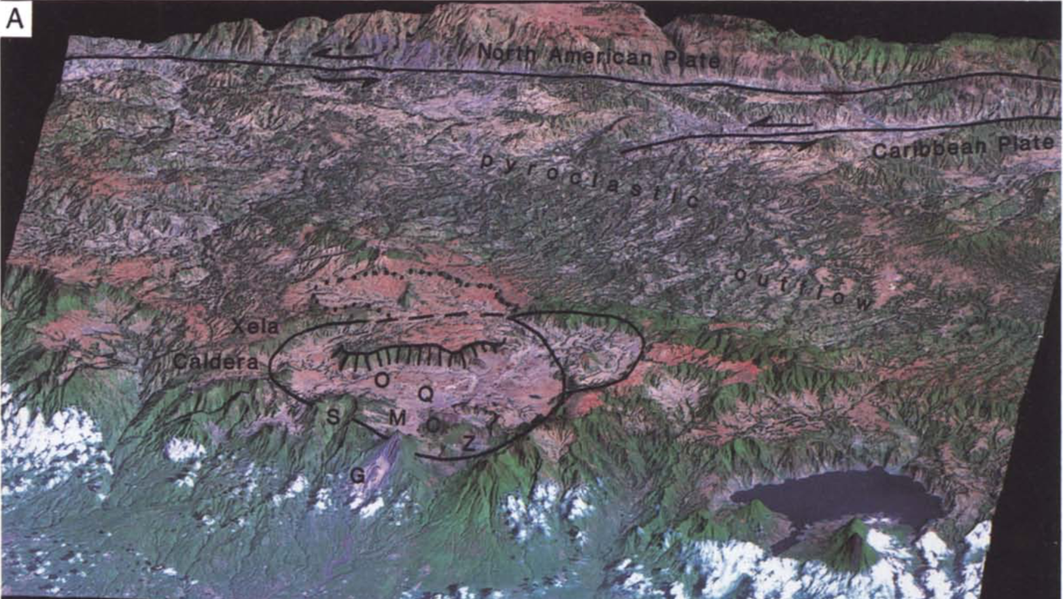
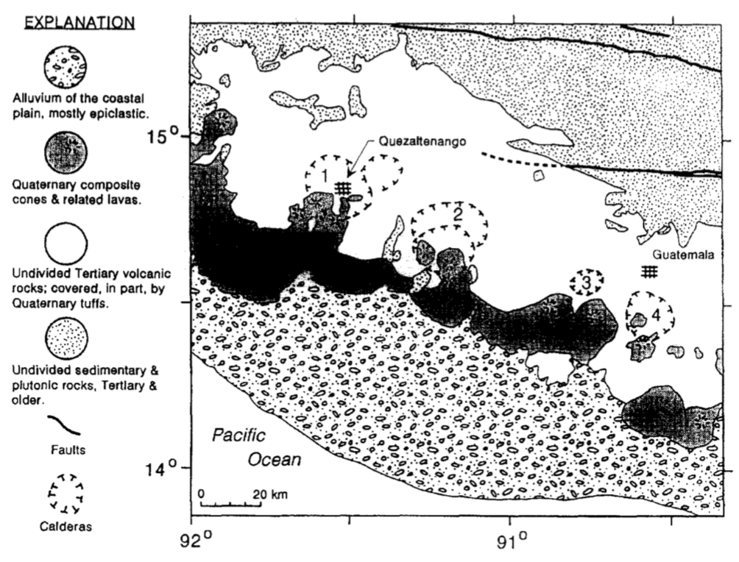
My introduction to active geology: Guatemala, 1975-77
Santa Maria
Zunil

Slide 10
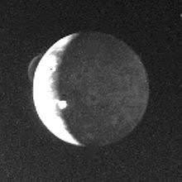
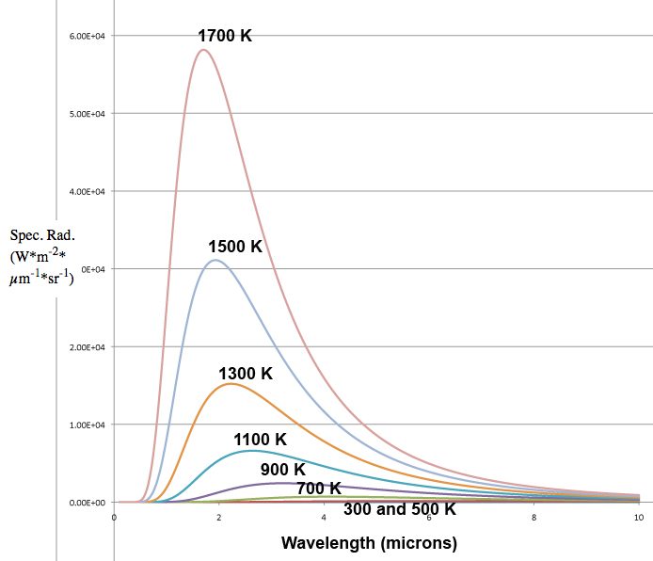
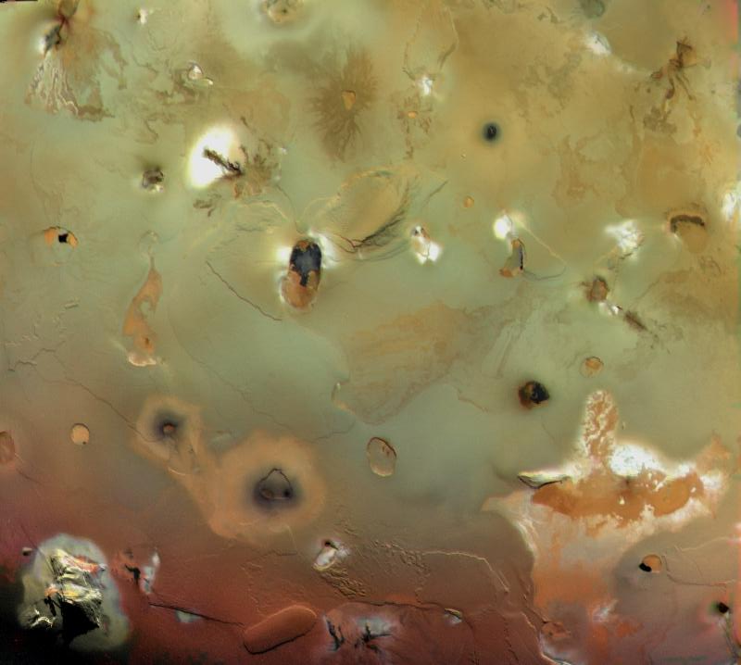
Sulfur v. Silicate Eruptions
Voyager 1 (1979) discovered the active volcanism, but just missed detection of silicate lava temperatures. Earth-based and Galileo observations showed that Io’s heat flow is dominated by eruption of silicate lava.
Voyager camera sensitivity <600 nm
Voyager IRIS sensitive from ~5-50 microns, but the shapes of the Planck functions are too similar to identify temperatures >800 K.

Slide 11
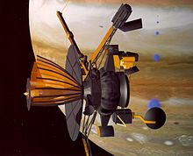
1996: Thrilling Discoveries by Galileo Spacecraft
(but not people on Earth)
Only planned close flyby of Io was just before Jupiter Orbit Insertion.
We carefully planned remote-sensing observations of our favorite Io targets
Due to sticky tape recorder, project decided to not record the Io remote-sensing data (to protect Jupiter probe data)
Entire sequence executed perfectly
Later, engineers realized that the tape recorder just needed to be exercised more!
We’ll never know what the instruments recorded!
There were close flybys of Io in the late extended mission, but instrument functionality had been lost, and they didn’t cover the region observed by Voyager at the highest resolution

Slide 12
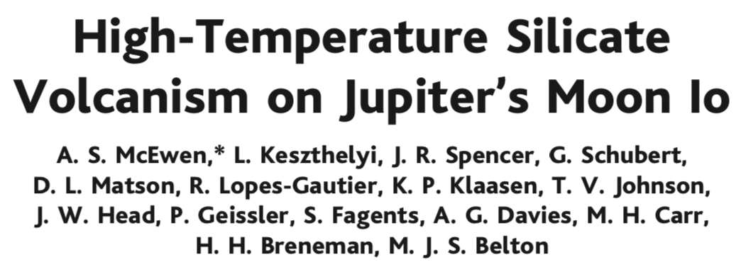

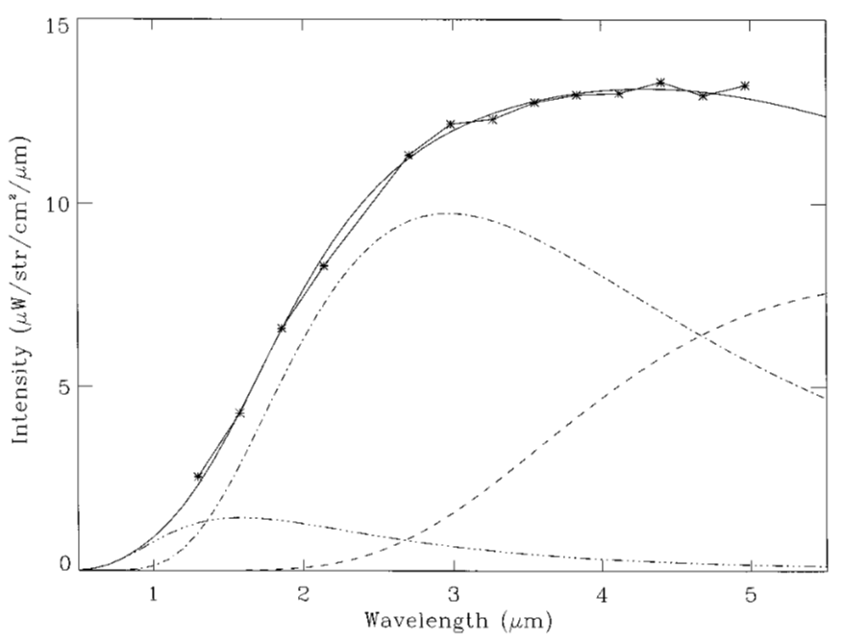
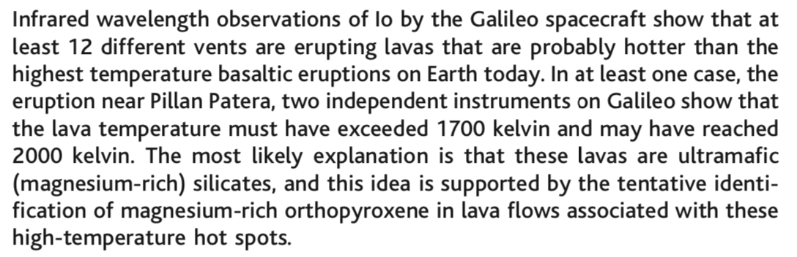
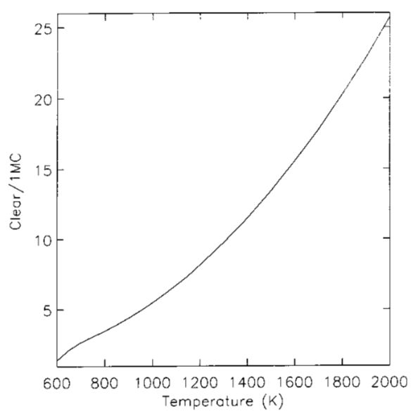
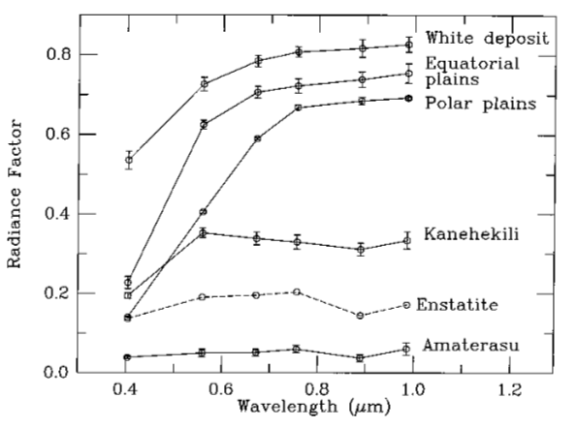
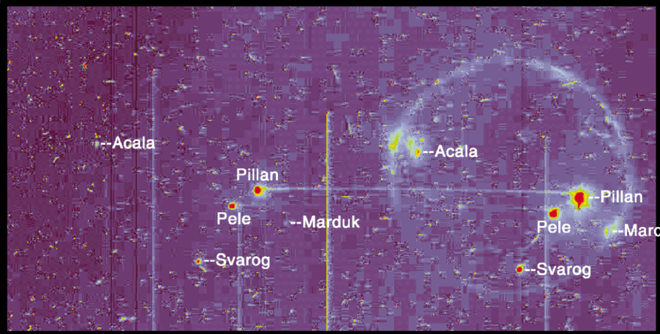
NIMS data
SSI data
1-micron image clear bandpass image

Slide 13
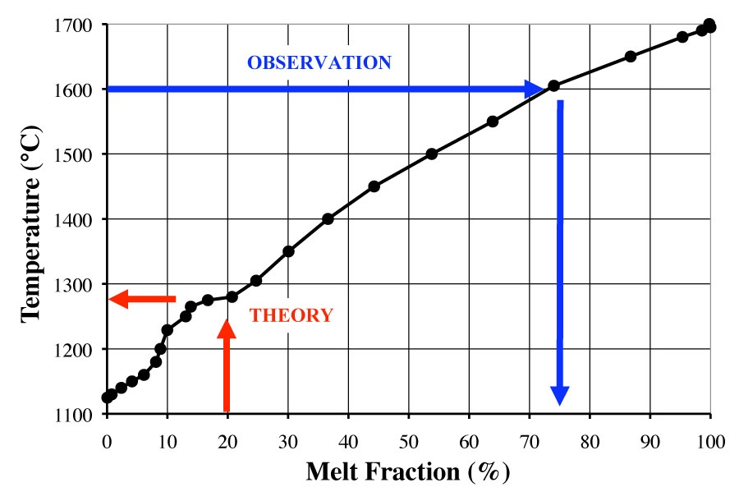
High lava temperatures → High degree of partial melting
Peak temperature reports up to 1600ºC (McEwen et al., 1998; Davies, 2007 de Kleer et al., 2014)
These temperatures suggest Io’s mantle has a high degree of melt (Keszthelyi et al. 2007), but the low viscosity could lead to insufficient tidal heating.
Could a high melt fraction be stable?
  Expect rapid melt migration as it approaches 10% melt fraction
  Io’s thick lithosphere is under compression, may trap lava?
  Magnetic induction data explained by at least 20% melt (Khurana et al., 2011)
Temperature measurements may be wrong.
  Extremely rapid cooling possible between acquisition of 2 colors
(Moore et al, 2001)
8

Slide 14
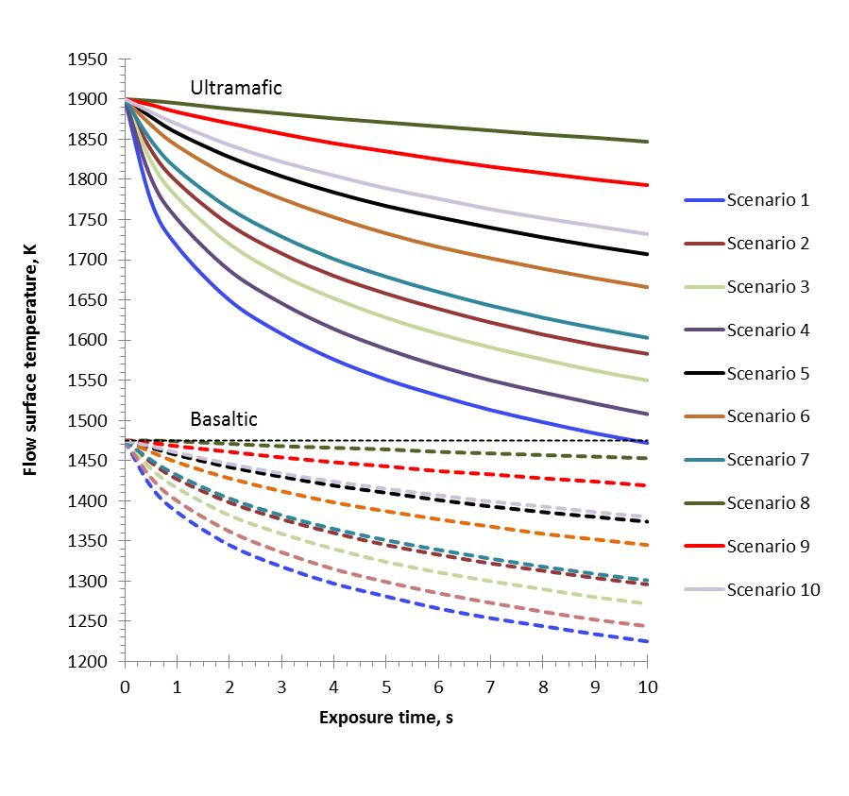
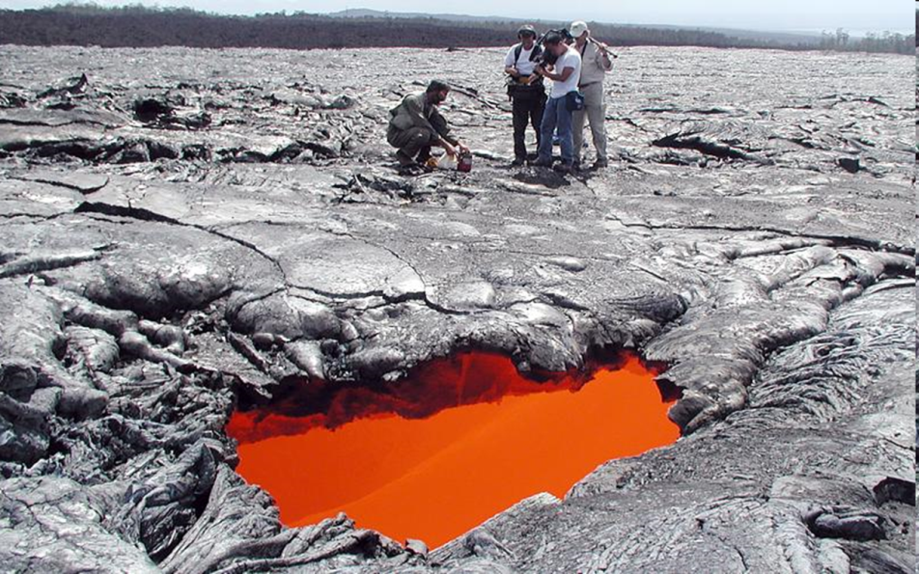
Lava Tube Skylights
(Davies et al., 2016)
Ideal way to measure lava Ts remotely, as the lava is exposed just long enough to measure it, but not to cool off significantly.
Long, insulated flows are abundant on Io, so skylights are likely
  Up to 10x larger than on Earth, due to lower g
Ultramafic lavas clearly distinguished from basaltic lavas for surface exposure times <10 s.
Hawai’i lava tube skylight a few m across through which the lava stream can be viewed.

Slide 15
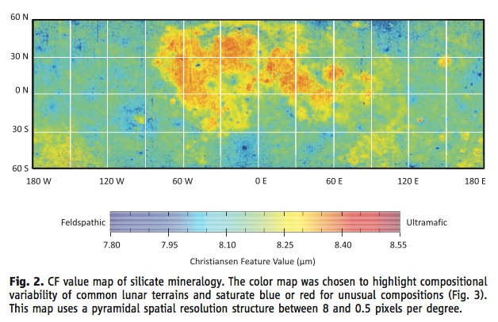
Mapping Christiansen Feature (CF) demonstrated by LRO Diviner and with field spectrometers on cooling lavas in Hawaii
Best remote-sensing method to determine composition of fresh glassy lavas (glass reduces NIR absorptions).
Global Silicate Mineralogy of the Moon from the Diviner Lunar Radiometer, Greenhagen et al., Science 329, 2010

Slide 16
Ultramafic volcanism was common on the terrestrial planets
Earth: Arndt & Nisbet 2012; Andrault et al. 2018; Ernst 2017
Moon: Hurwitz et al. 2012; Klima et al. 2011; Elardo et al. 2015
Mars: Morris et al. 2008; Rampey & Harvey 2012; Baumgartner et al., 2017; Barrat and Bachèlery 2019
Mercury: Stockstill-Cahill et al. 2012; Denevi et al., 2013; Namur and Charlier, 2017; Mojzsis et al. 2018
Venus: poorly known

Slide 17
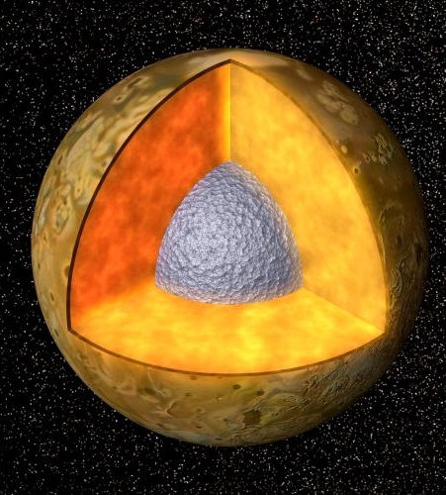
Io’s Interior structure is key to understanding tidal heating and melt production
Bulk Density of Io
  3530 kg m⁻³ (dominantly silicate)
Bulk structure
  Moment of inertia C/MR² = 0.371-0.380 based on shape & gravity measurements (Thomas et al. 1998, Anderson et al. 2001)
  Large Fe-rich core + silicate mantle
Global average minimum heat output ~2.5 Wm⁻²
  >20x heat flow of Earth
Internal magnetic field (if present at all) is very weak (< few hundred nT)
  Core not convecting because Io isn’t cooling
Induced magnetic signature interpreted as due to a global layer with >20% melt (Khurana et al., 2011)
  Has been controversial

Slide 18
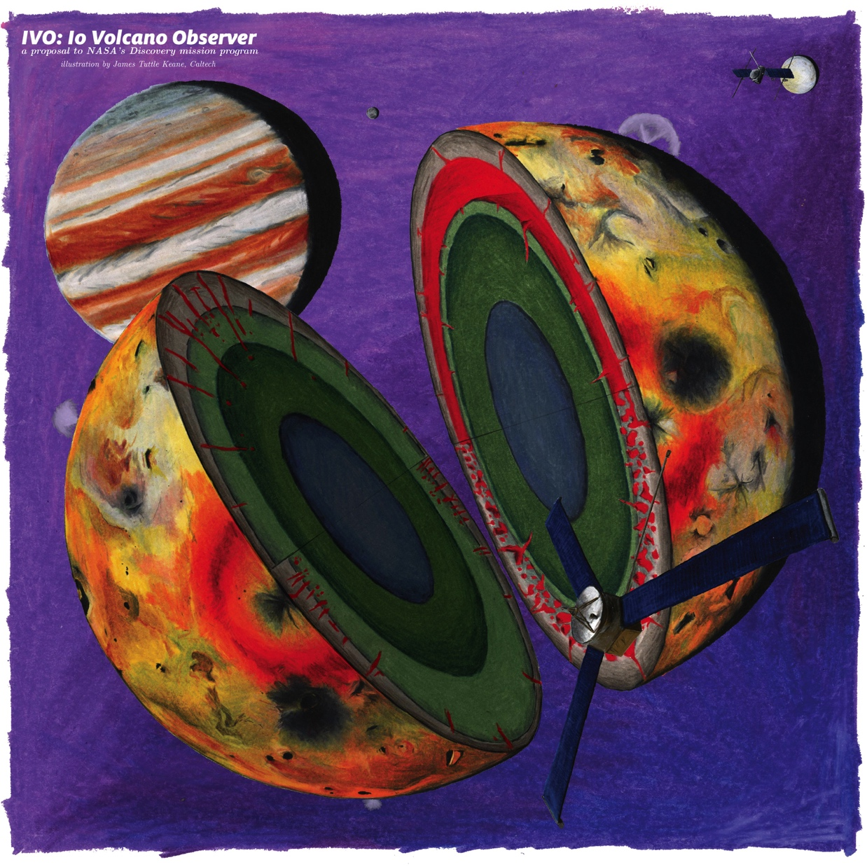

Io Volcano Observer
Understand tidal heating as a fundamental planetary process
Follow the Heat!
Major Partners:
University of Arizona: Science operations, student collaboration camera
JHU APL: Mission and spacecraft design, build, and management; narrow-angle camera (NAC); Plasma Instrument for Magnetic Sounding (PIMS)
UCLA: Dual fluxgate magnetometers
JPL: Radio science, navigation
German Aerospace Center (DLR): Thermal Mapper
University of Bern: Ion and Neutral Mass Spectrometer (INMS)
Art by James Tuttle Keane

Slide 19
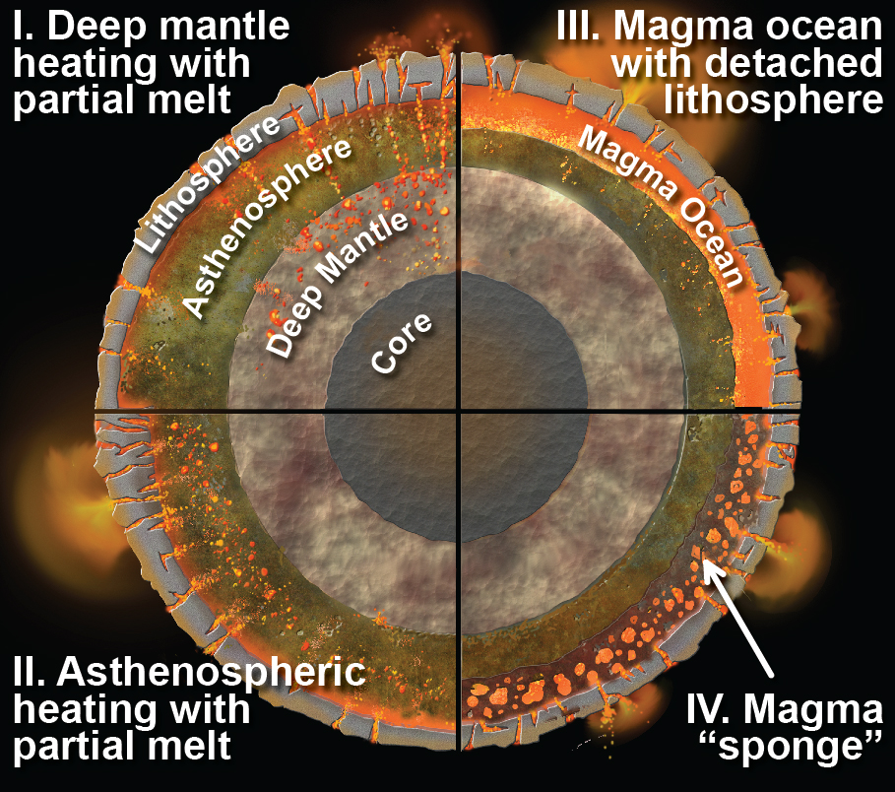
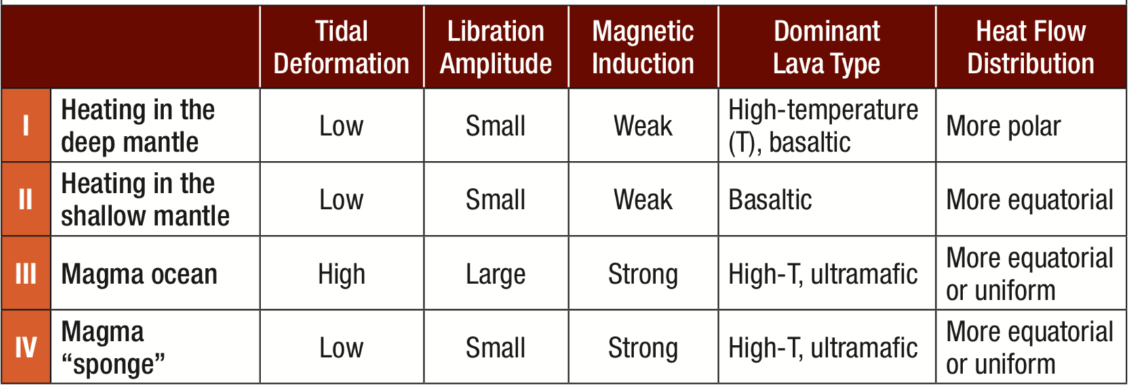
Io’s interior structure
Melt distribution is key to understanding tidal heating
IVO can measure tidal k₂, libration amplitude, magnetic induction response, lava compositions, and map Io’s volcanism and heat flow to test these four interior hypotheses.

Slide 20
Why is Tidal Heating Important?
Tidal heating expands the habitable zone beyond the region where liquid water can exist on the surface
Tidal heating is important for tidally locked exoplanets
Active volcanism!

Slide 21
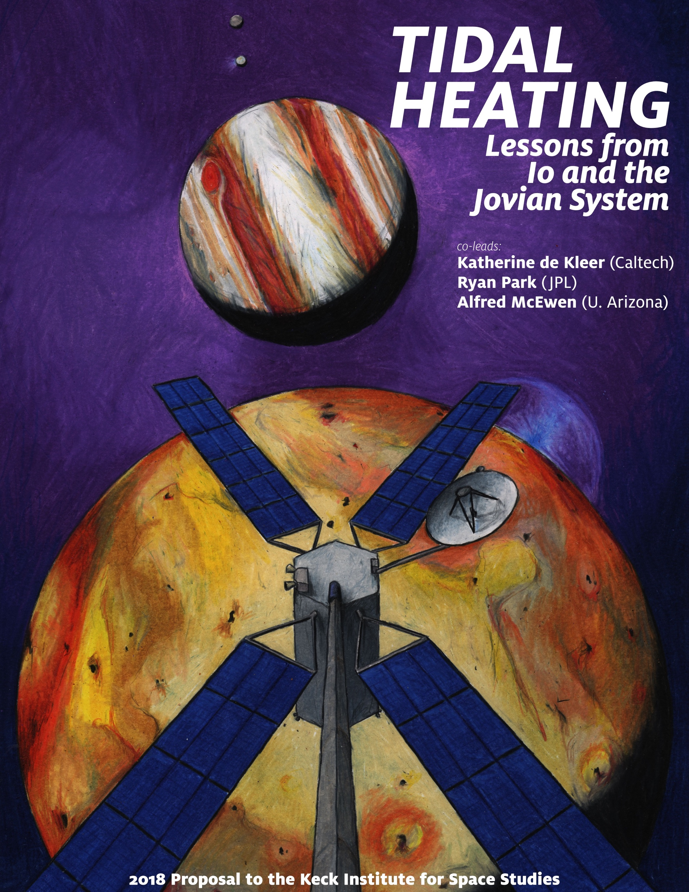

Keck Institute workshop on Tidal Heating October 15-19, 2018 http://kiss.caltech.edu/programs.html#tidal_heating
Identified 5 key questions:
1. What do volcanic eruptions tell us about the interior?
2. How is dissipation partitioned between solid and fluid layers?
3. Does Io have a melt-rich layer (magma ocean) that decouples the lithosphere?
4. Is the Jupiter/Laplace system in equilibrium?
5. Can stable isotopes inform long-term evolution?
IVO can help address all 5 questions

Slide 22
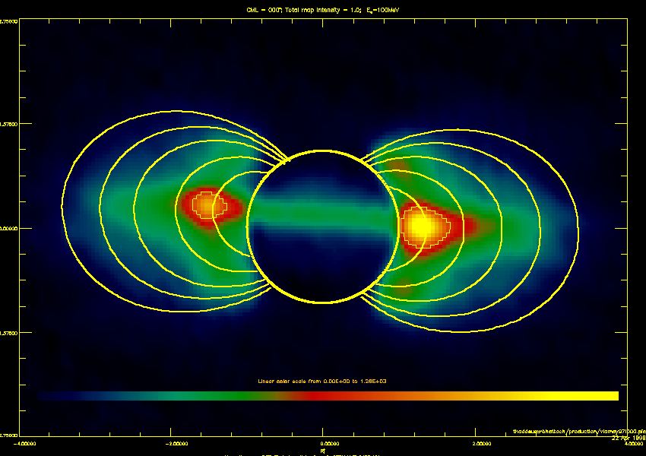
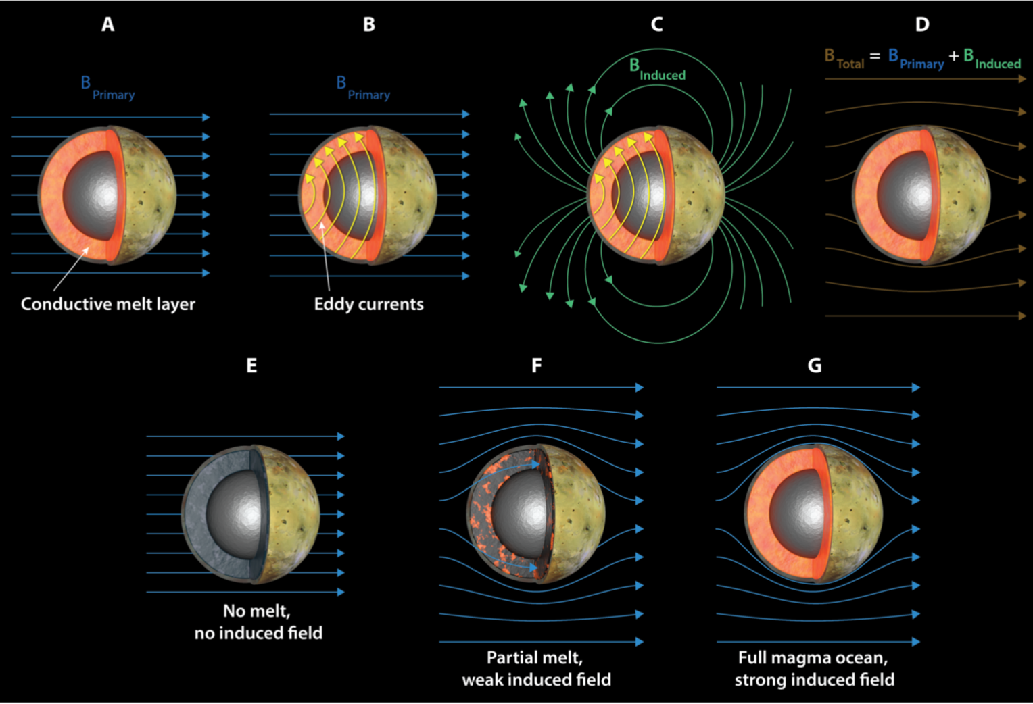
Jovian Magnetic Field Probes Io’s Interior
The ~10°tilt of the Jovian dipole moment relative to planetary rotation axis yields a variable field at Io.
Over one Jovian rotation (13 hours in Io frame), the radial component of the field (By) at Io varies by ~1500 nT.
This imposed variable field causes an induction response in Io’s electrically conducting mantle.

Slide 23
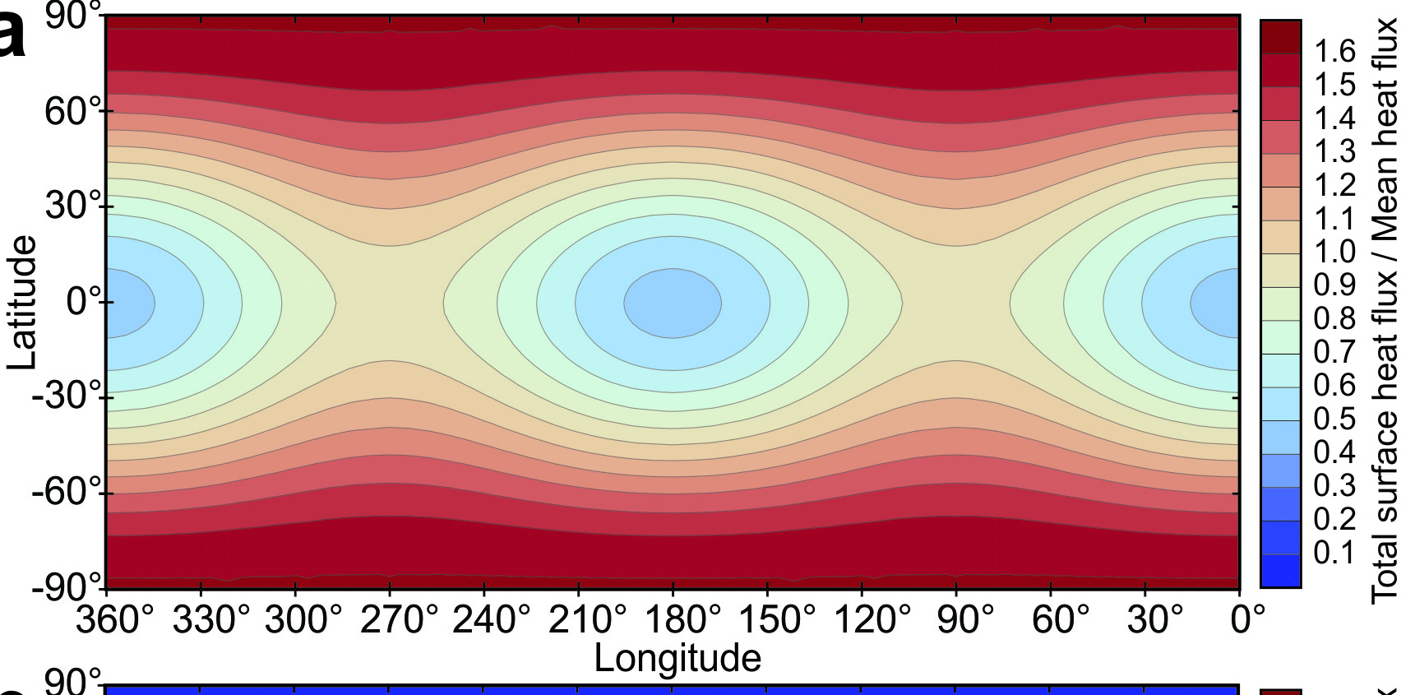
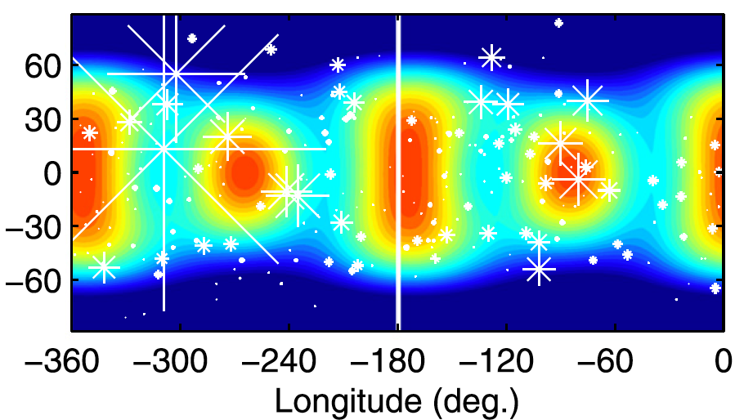

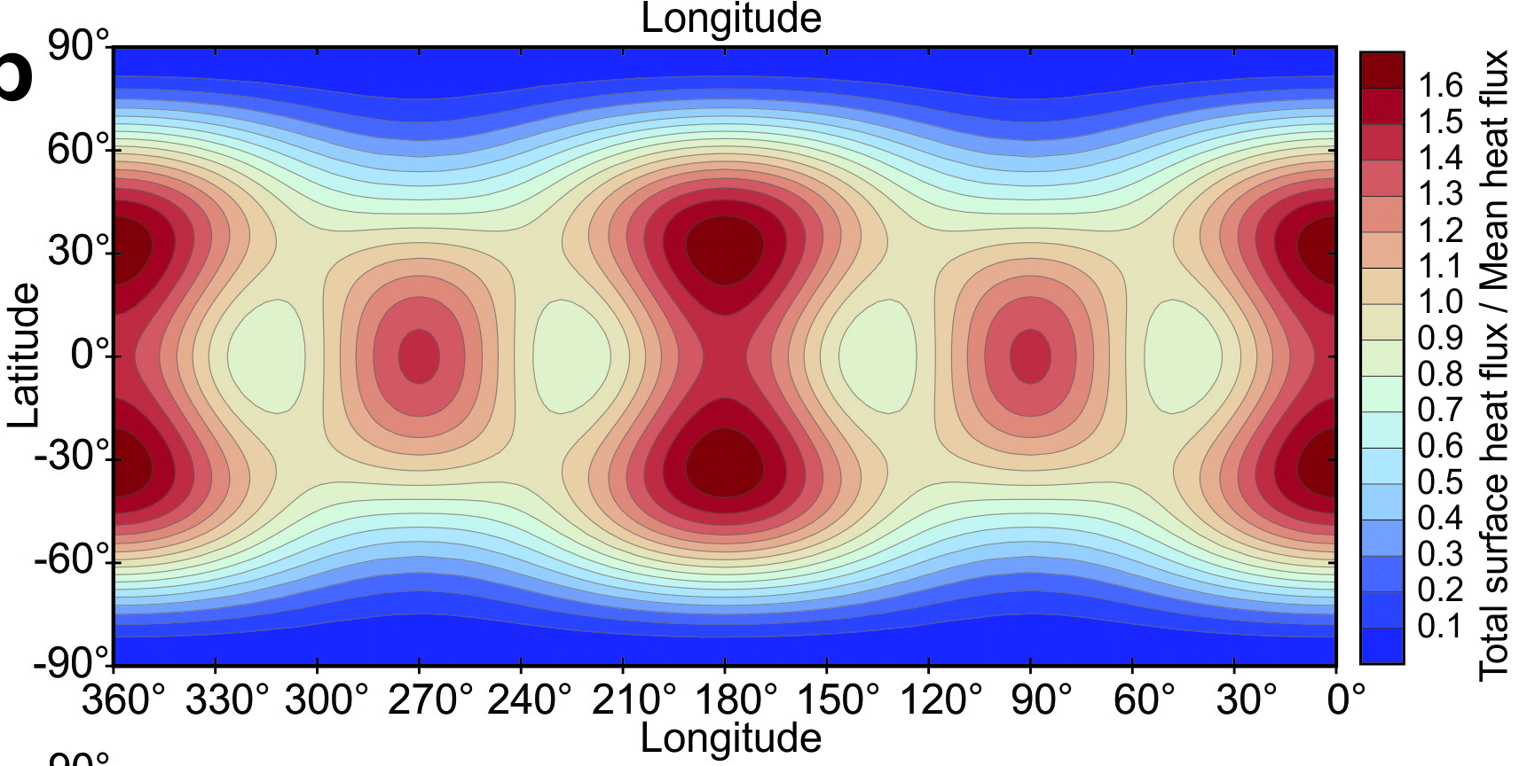
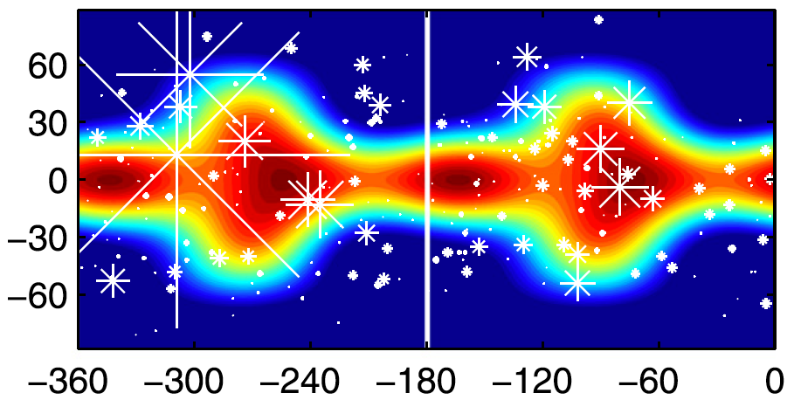
Global patterns of heat flow and volcanic eruption style to test interior heating models
Deep-mantle heating end-member
Low-Q (Creeping Flow in Asthenosphere)
4
3
2
1
Asthenospheric heating end-member
High-Q (Fluidal Asthenosphere)
4
3
2
1
(Hamilton et al., 2013)
(Tyler et al., 2015)
11

Slide 24
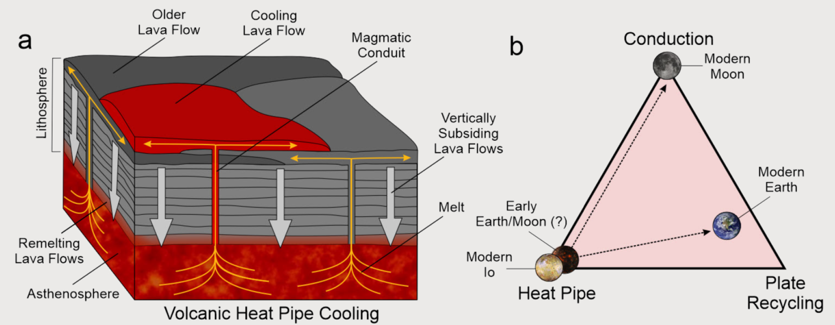
The Heat Pipe end-member for how planets lose heat
After early planetary magma oceans cool and solidify, they may lose heat primarily via heat pipes like we envision for Io today (Moore et al. papers).
Conduction cannot keep pace with subsidence rate, so lithosphere is cold and rigid

Slide 25
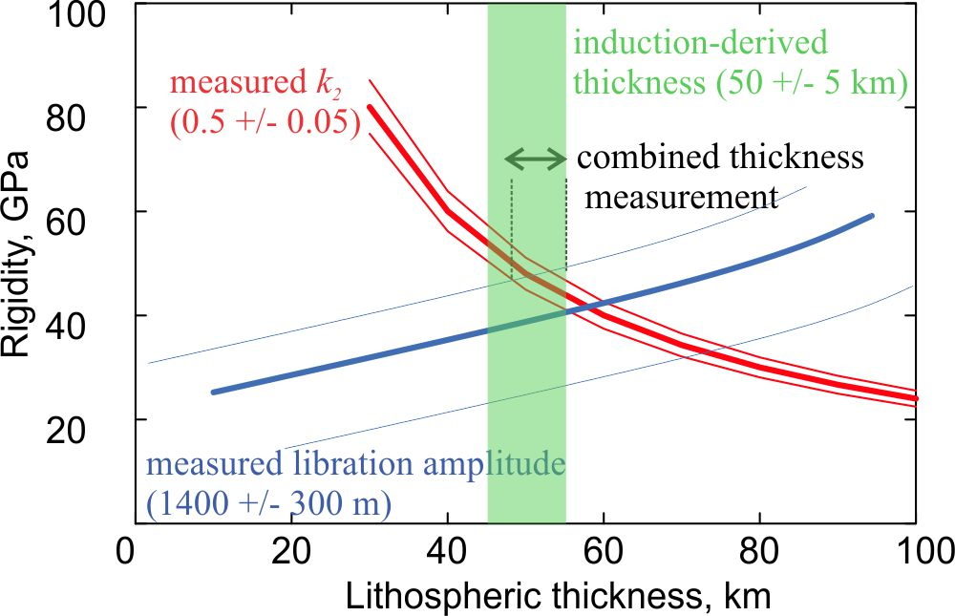
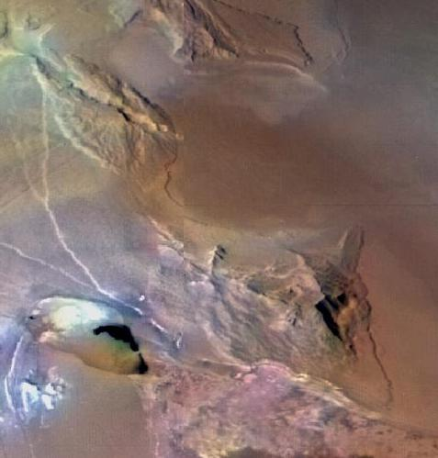
How thick and rigid is Io’s lithosphere?
(Test of heat-pipe model)
Hypothetical example
Combined measurements of k₂, libration amplitude, and lithospheric thickness from magnetic induction tightly constrain the lithosphere’s thickness and rigidity. Low rigidity not expected from heat-pipe model.

Slide 26
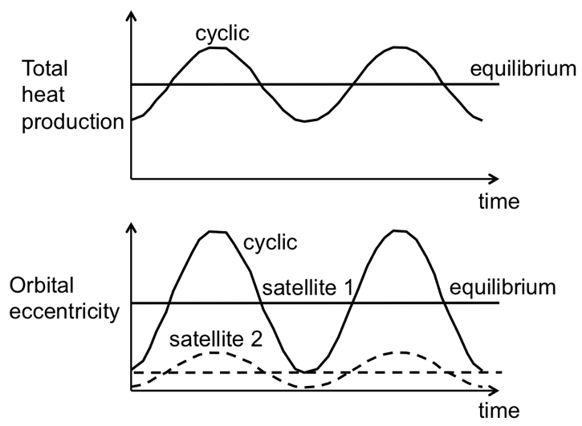
Is the tidal heating and orbital evolution of Io-Europa-Ganymede in Equilibrium?
Io astrometry will be the weak link (with JUICE and Europa Clipper data) in understanding orbital evolution and tidal heating of Io-Europa-Ganymede.
Radiometric ranging (spacecraft-Earth) via radio science directly measures center of mass.
  Need multiple close flybys

Slide 27
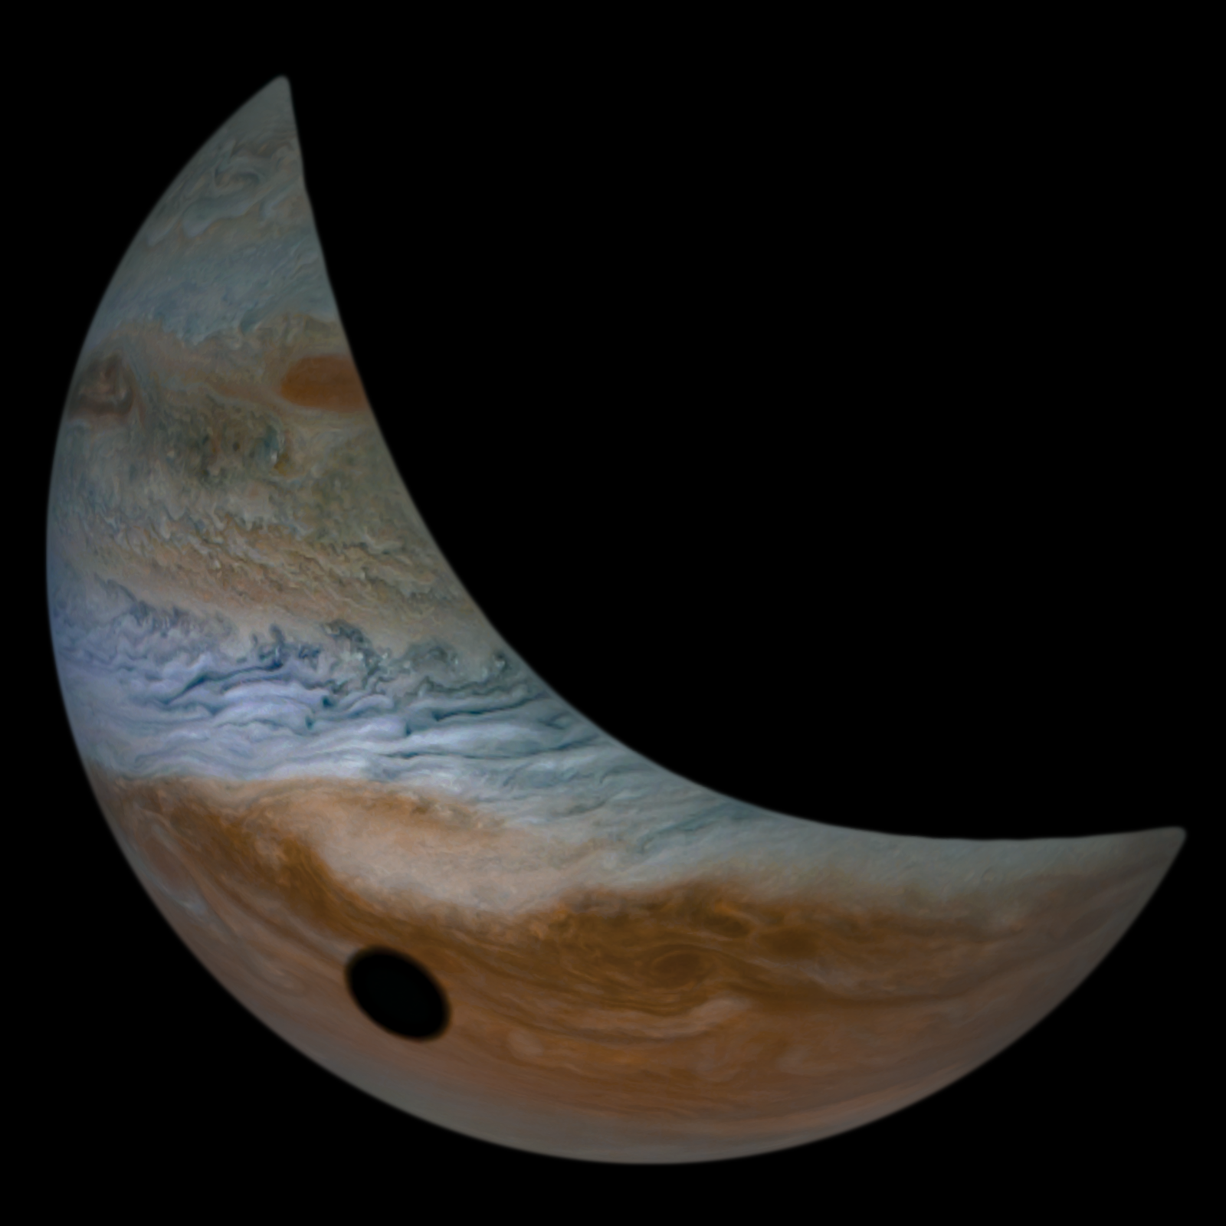
Conclusion: I want IVO!
Thrilling Discoveries about the Tidally Tortured Volcanic Wonderland Io
Juno image of Io’s shadow on Jupiter
Credit : NASA / SwRI / MSSS / Tanya Oleksuik © cc by
Don’t let Io be a hole in our understanding of the interrelated Jupiter system
See The Io Volcano Observer: Follow the Heat!
Poster 272 Tomorrow
Thanks for listening

