Slide 1
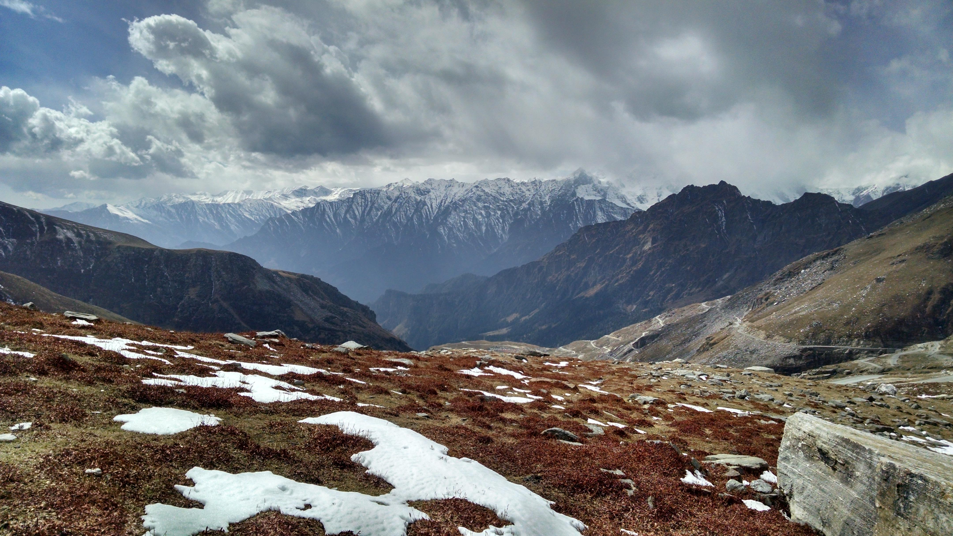



Spaceborne Polarimetric SAR Interferometry for Snow Depth Retrieval in the Northwestern Himalayan Watershed
*Sayantan Majumdar, Praveen K. Thakur, Ling Chang, Shashi Kumar, Ryan Smith

Slide 2
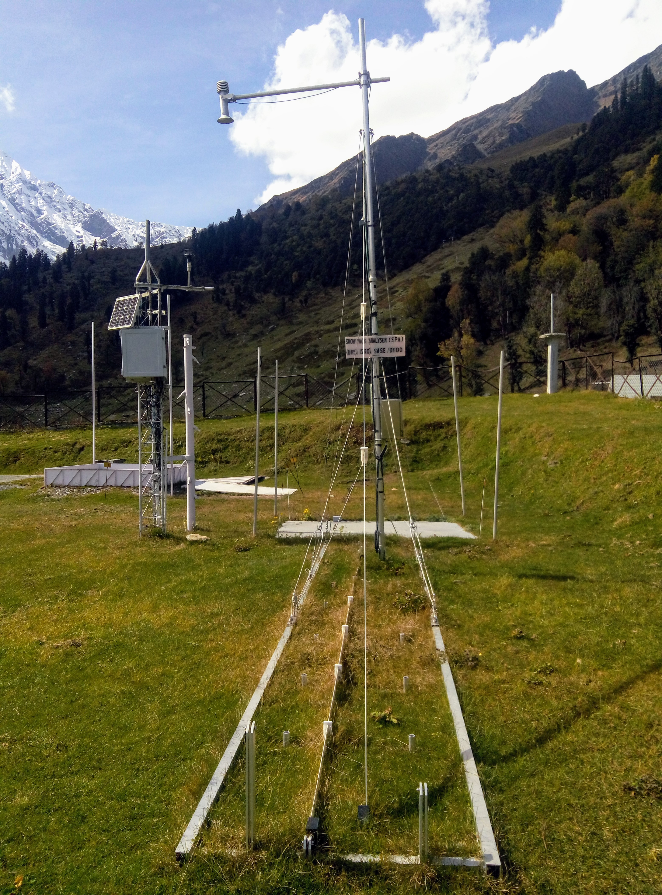
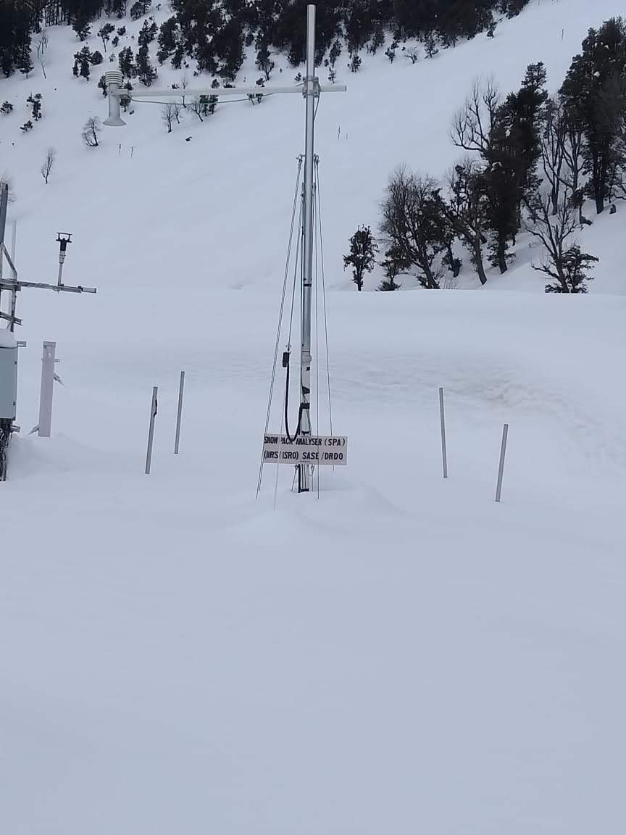
INTRODUCTION
Snow depth (SD) / snow height and snow water equivalent (SWE) are two of the most important physical properties of snow.
Source: WRD, IIRS Fieldwork, 2018-19
Dhundi in snow-free (Oct 2018) and snow-covered conditions (Feb 2019)

Slide 3
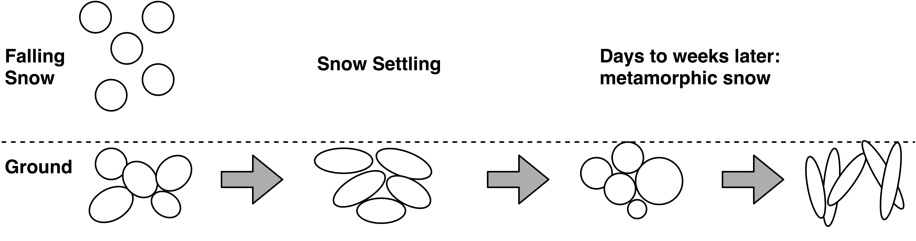
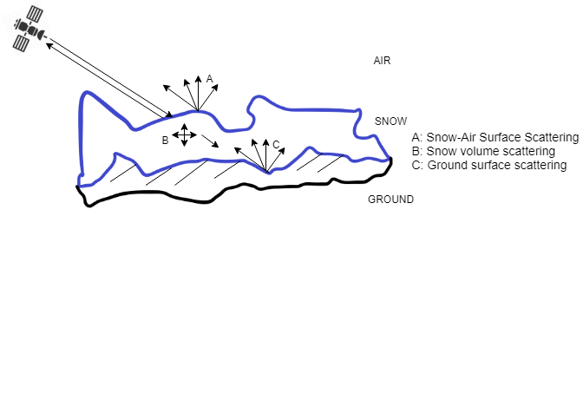
SAR & SNOW
PolSAR | InSAR | Pol-InSAR
Used for classifying dry and wet snow, measuring snow wetness and snow density. Recently, fresh SD has been measured using copolar phase difference (CPD). | Used for estimating dry SD and SWE. Works on the concept of phase difference. | Allows arbitrary polarisation selection for interferogram generation. Extensively used for tree height estimation.
PolSAR: Polarimetric Synthetic Aperture Radar
InSAR: Interferometric SAR
Pol-InSAR: Polarimetric InSAR

Slide 4
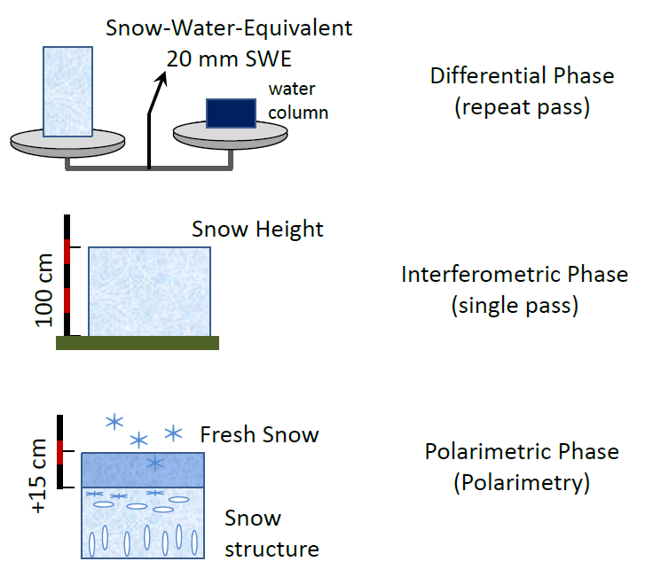
RESEARCH OBJECTIVE
Estimating standing (or old) snow depth (SSD) and its corresponding SWE using Pol-InSAR.
Which Pol-InSAR height inversion model should be chosen?
How to optimise the free parameters for accurate SSD retrieval?
How to find the potential uncertainty sources?
How to validate the results?
http://seom.esa.int/polinsar-biomass2015/files/D3S3_Cryosphere_5.pdf

Slide 5
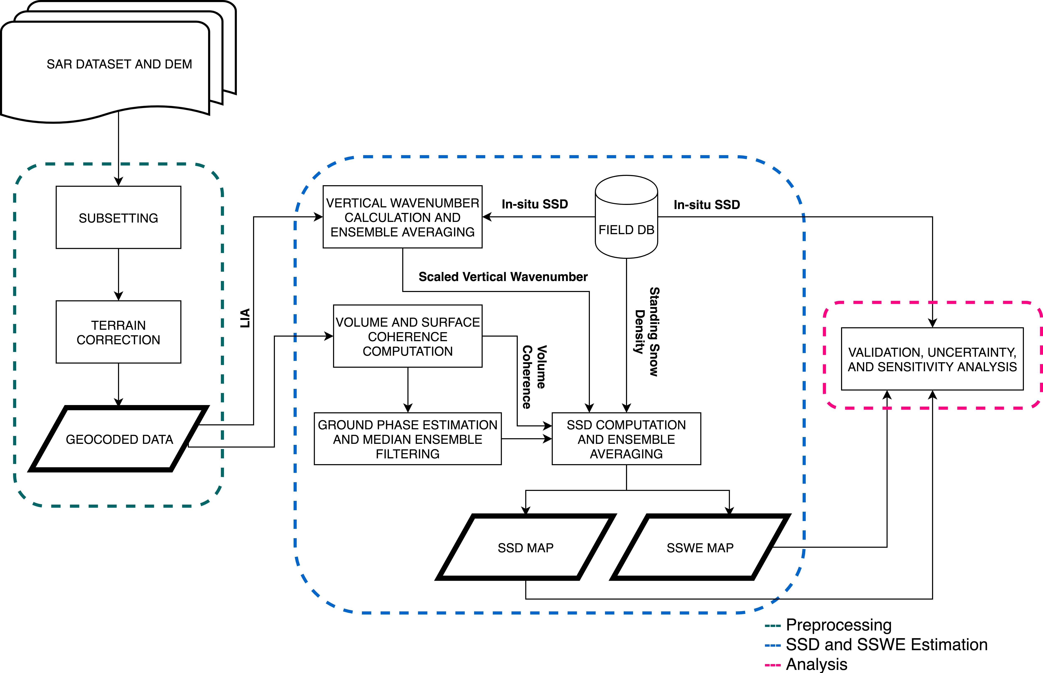
METHODOLOGY

Slide 6
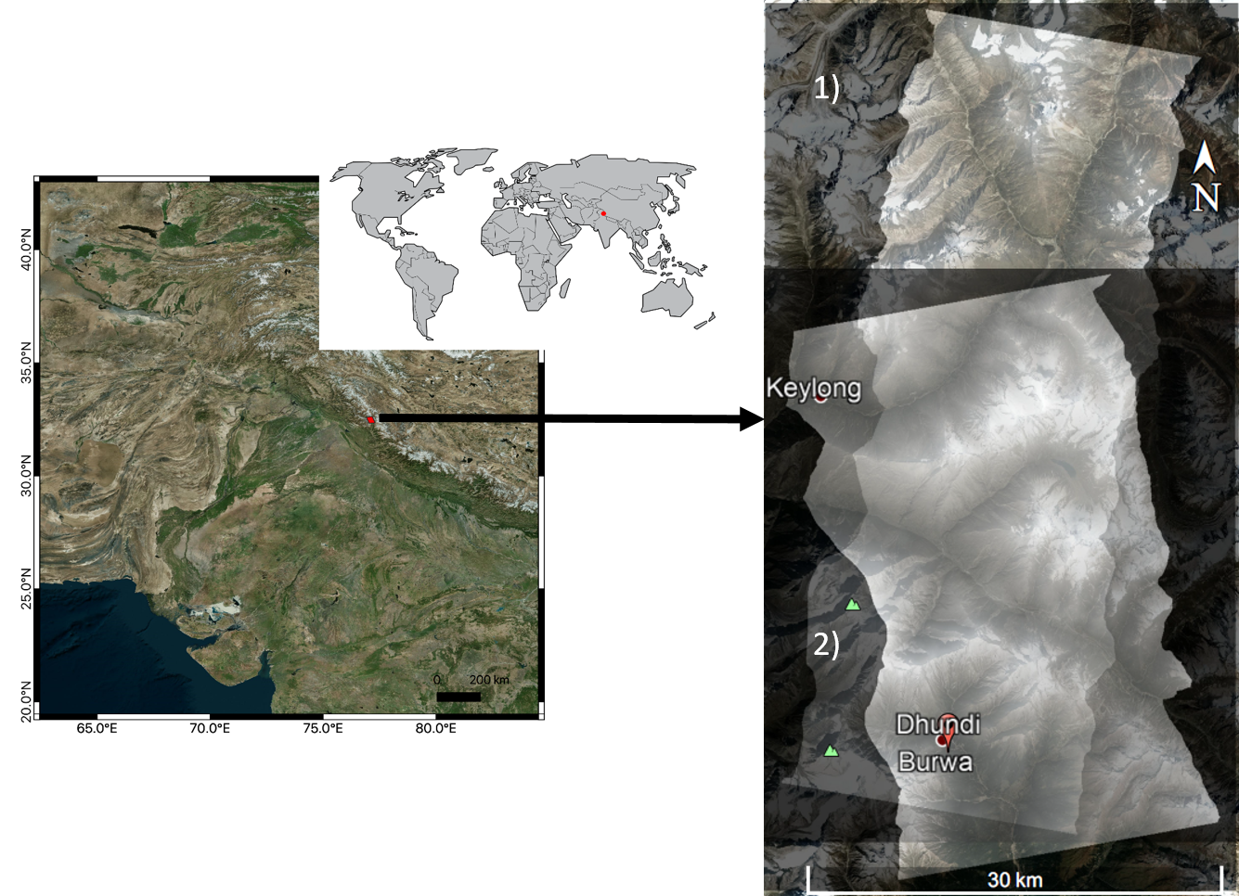
STUDY AREA & DATA
Manali Area, India (UTM 43N)
Jan 8, 2016 (TSX/TDX Desc)
Apr 15, 2017 (TSX/TDX Asc)
Jan 8, 2016, Desc
Apr 15, 2017, Asc

Slide 7
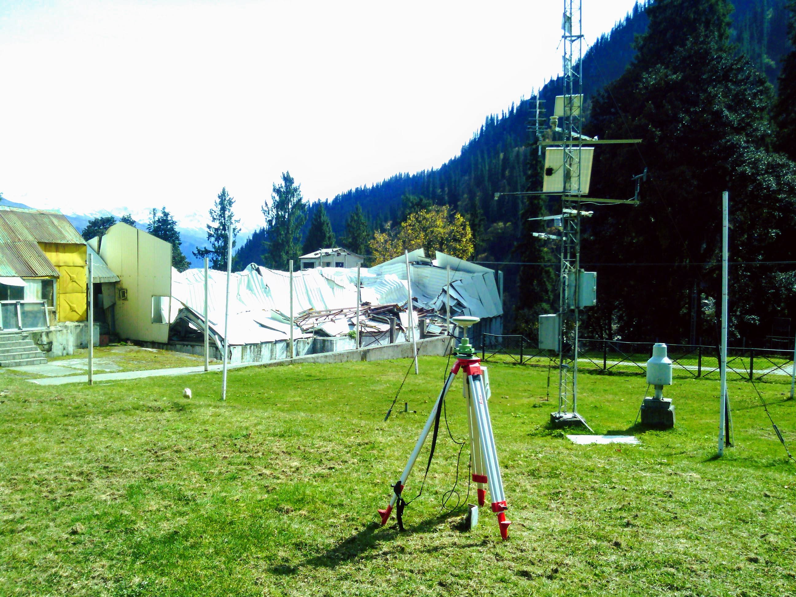
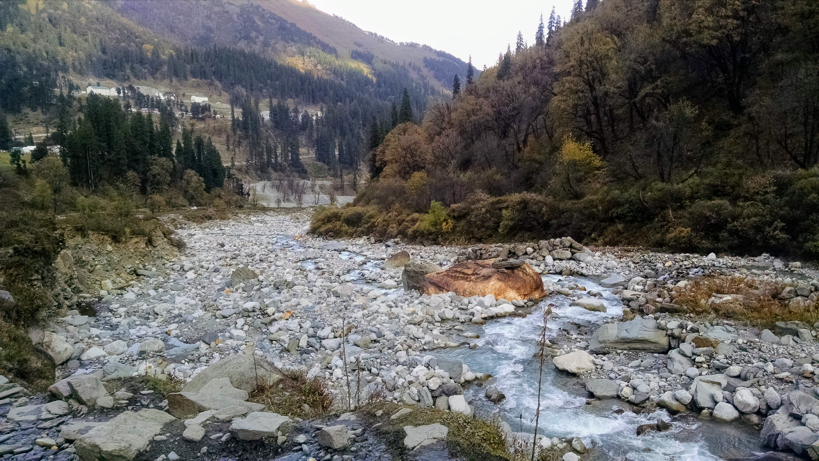
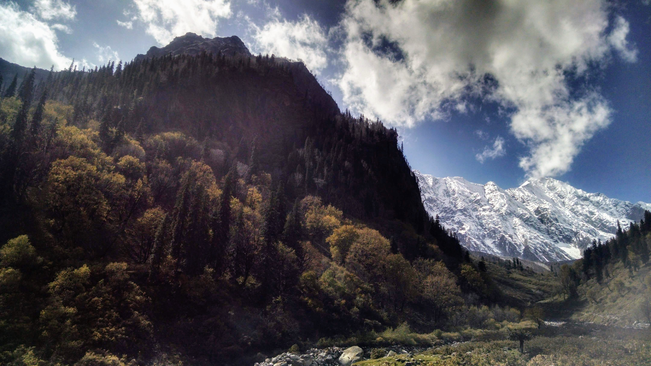
FIELD WORK PHOTOS (OCT 14-21, 2018)

Slide 8
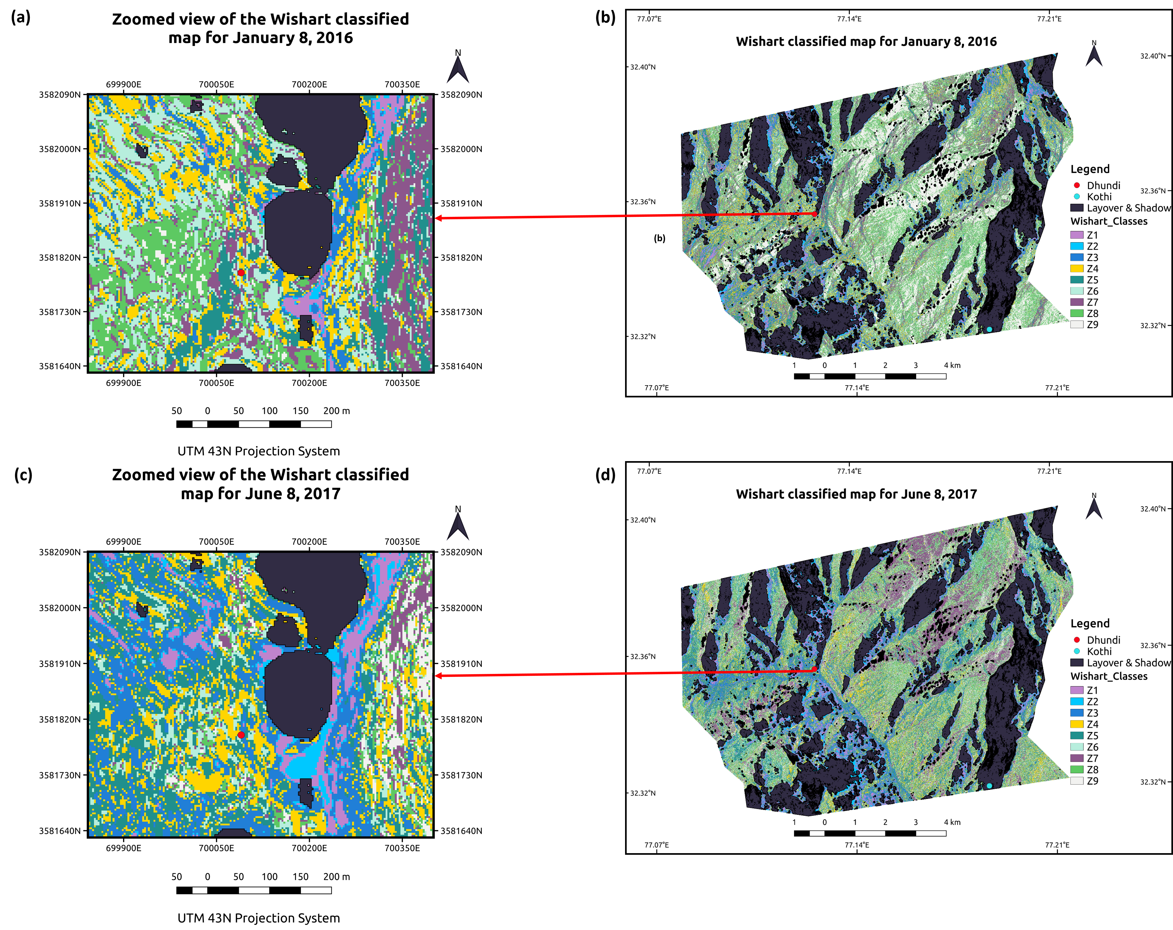
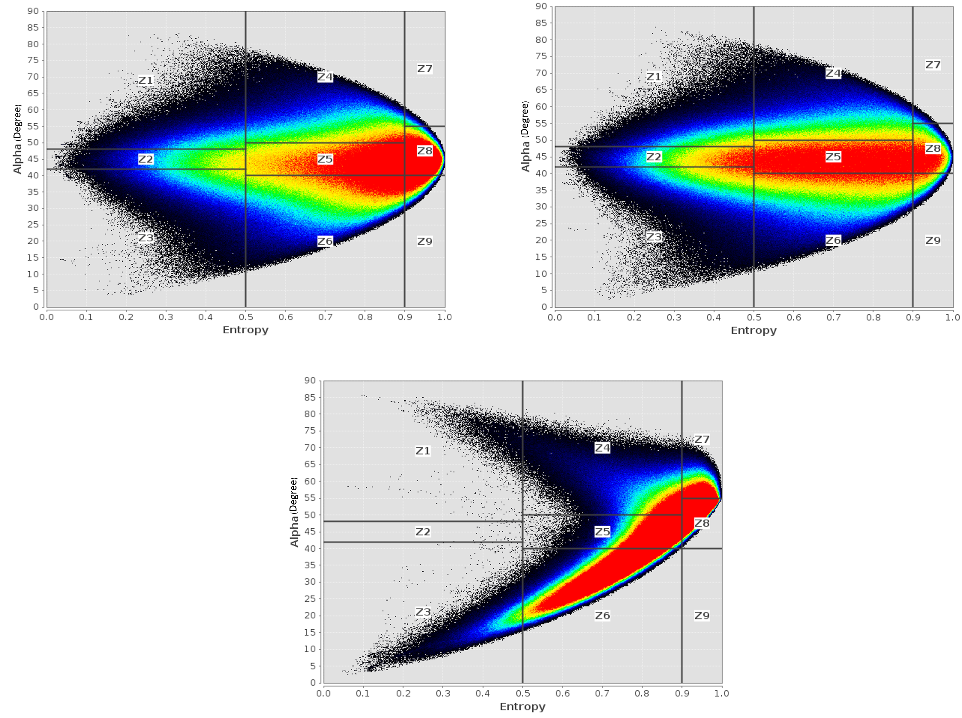
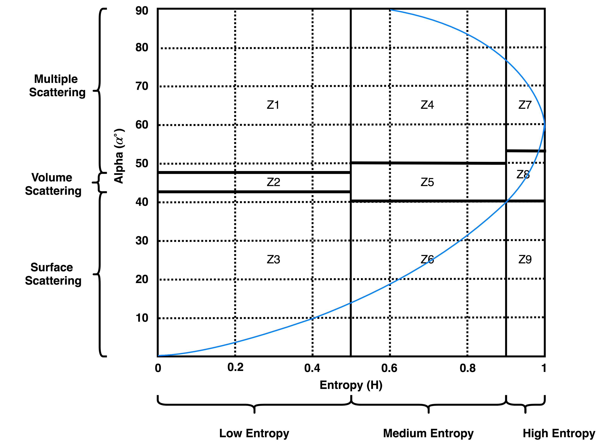
UNCERTAINTY SOURCES
January 8, 2016
June 8, 2017
January 8, 2016 Quad-pol

Slide 9
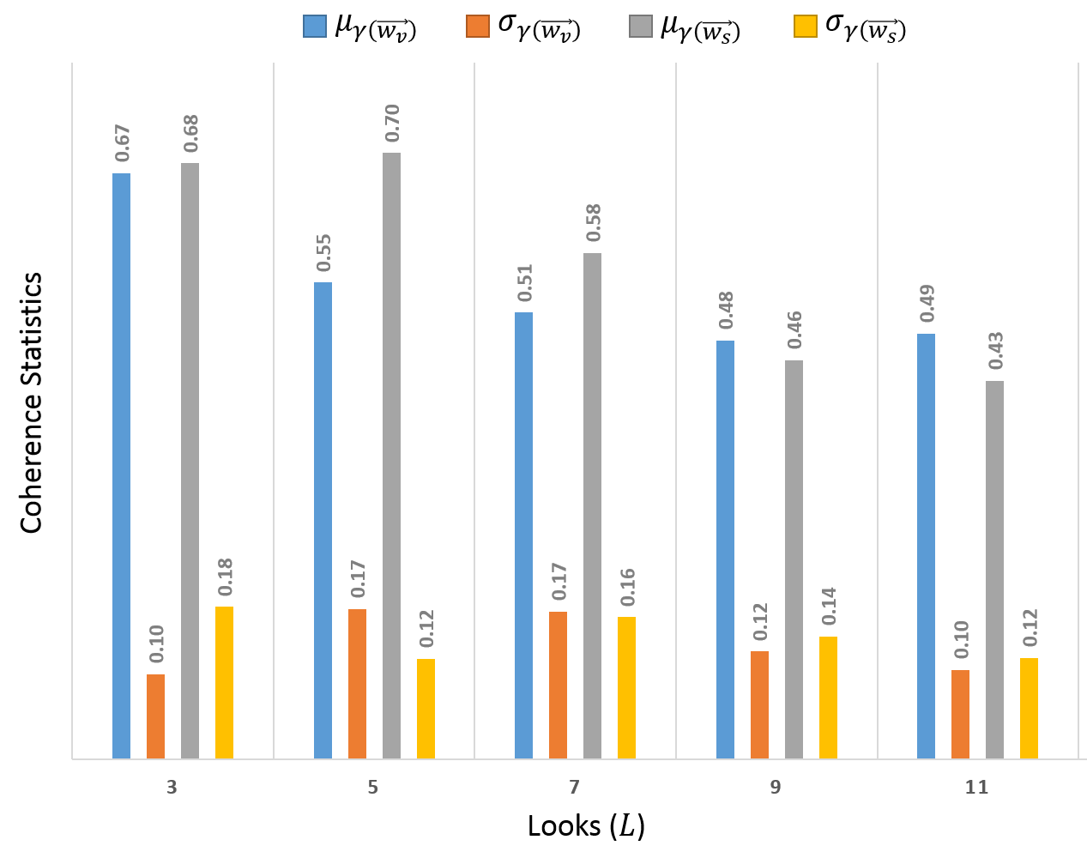
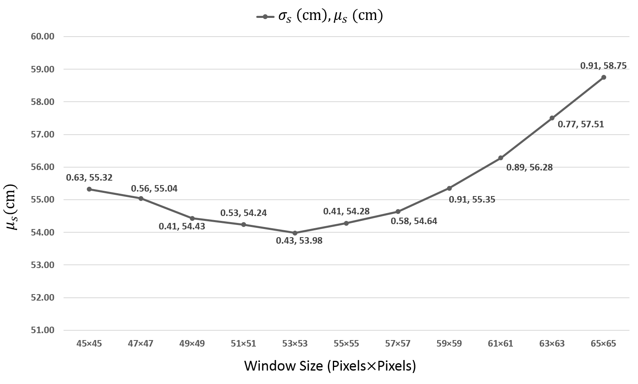
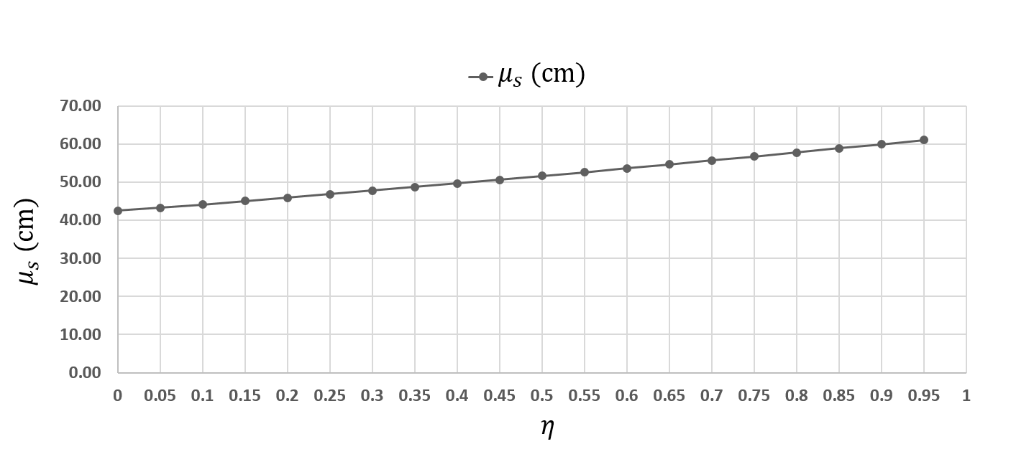
SENSITIVITY ANALYSIS

Slide 10
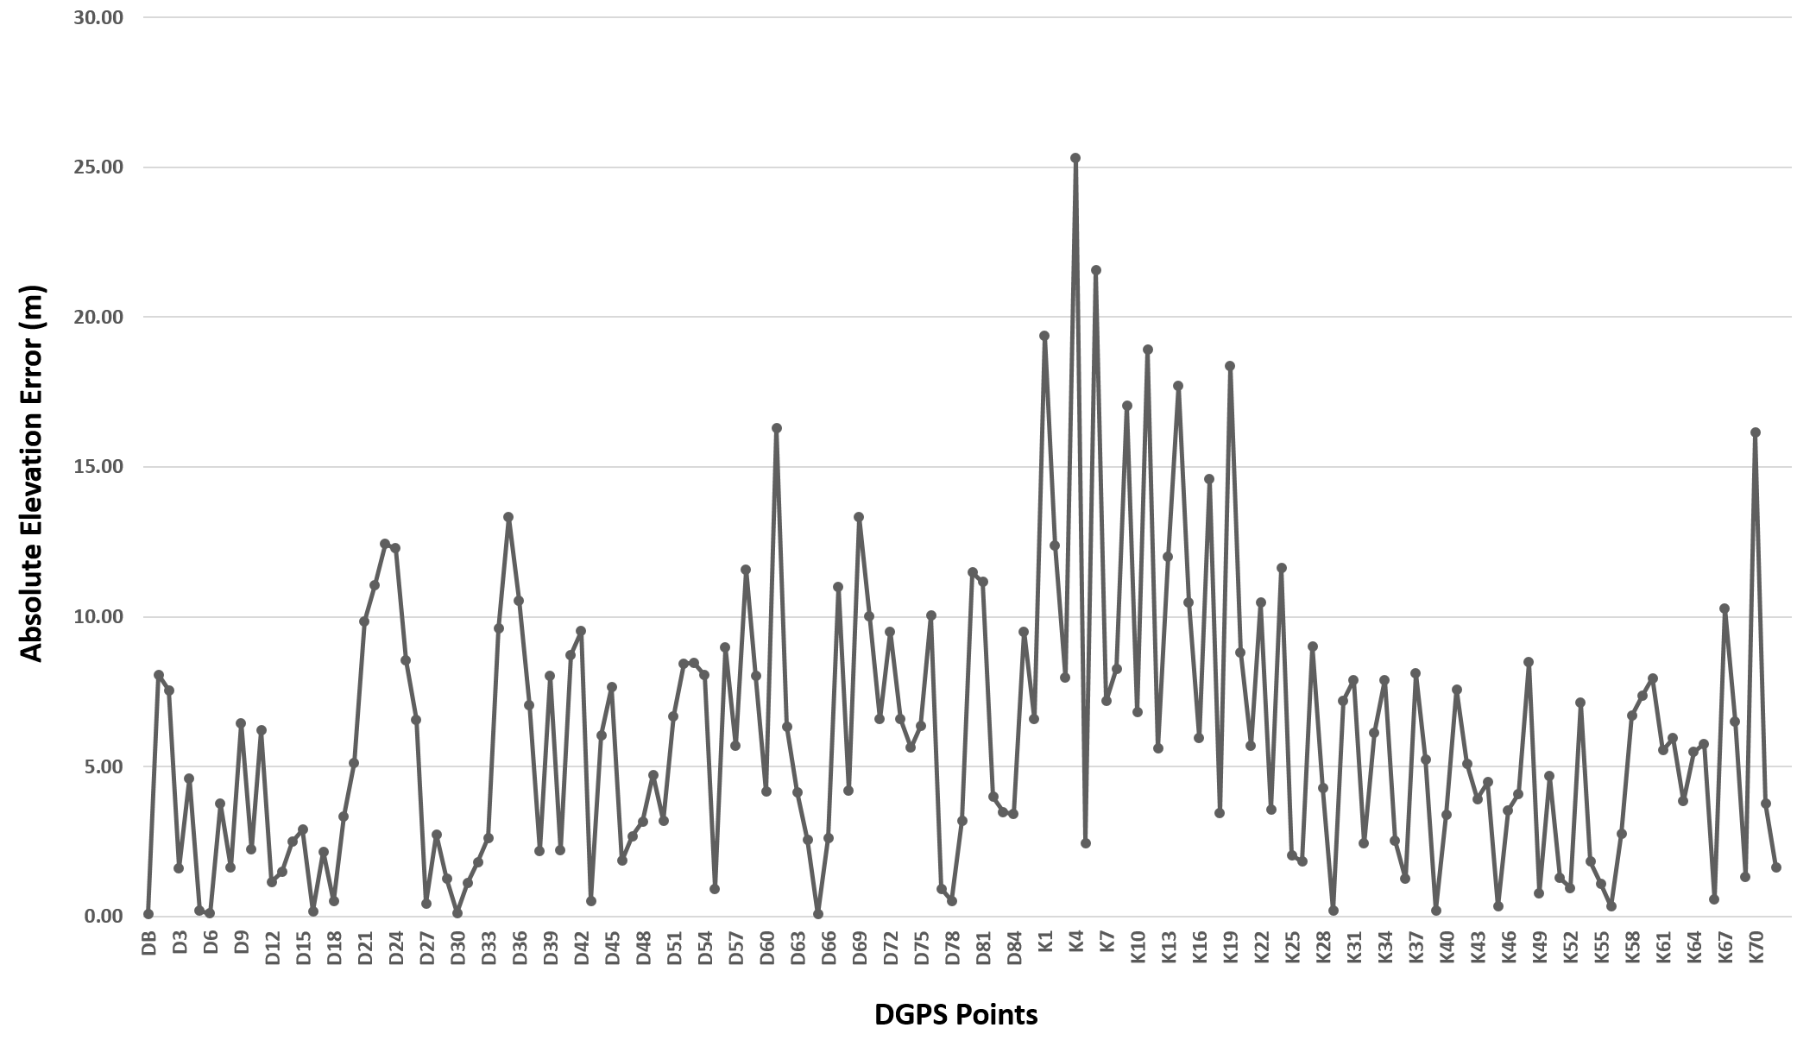
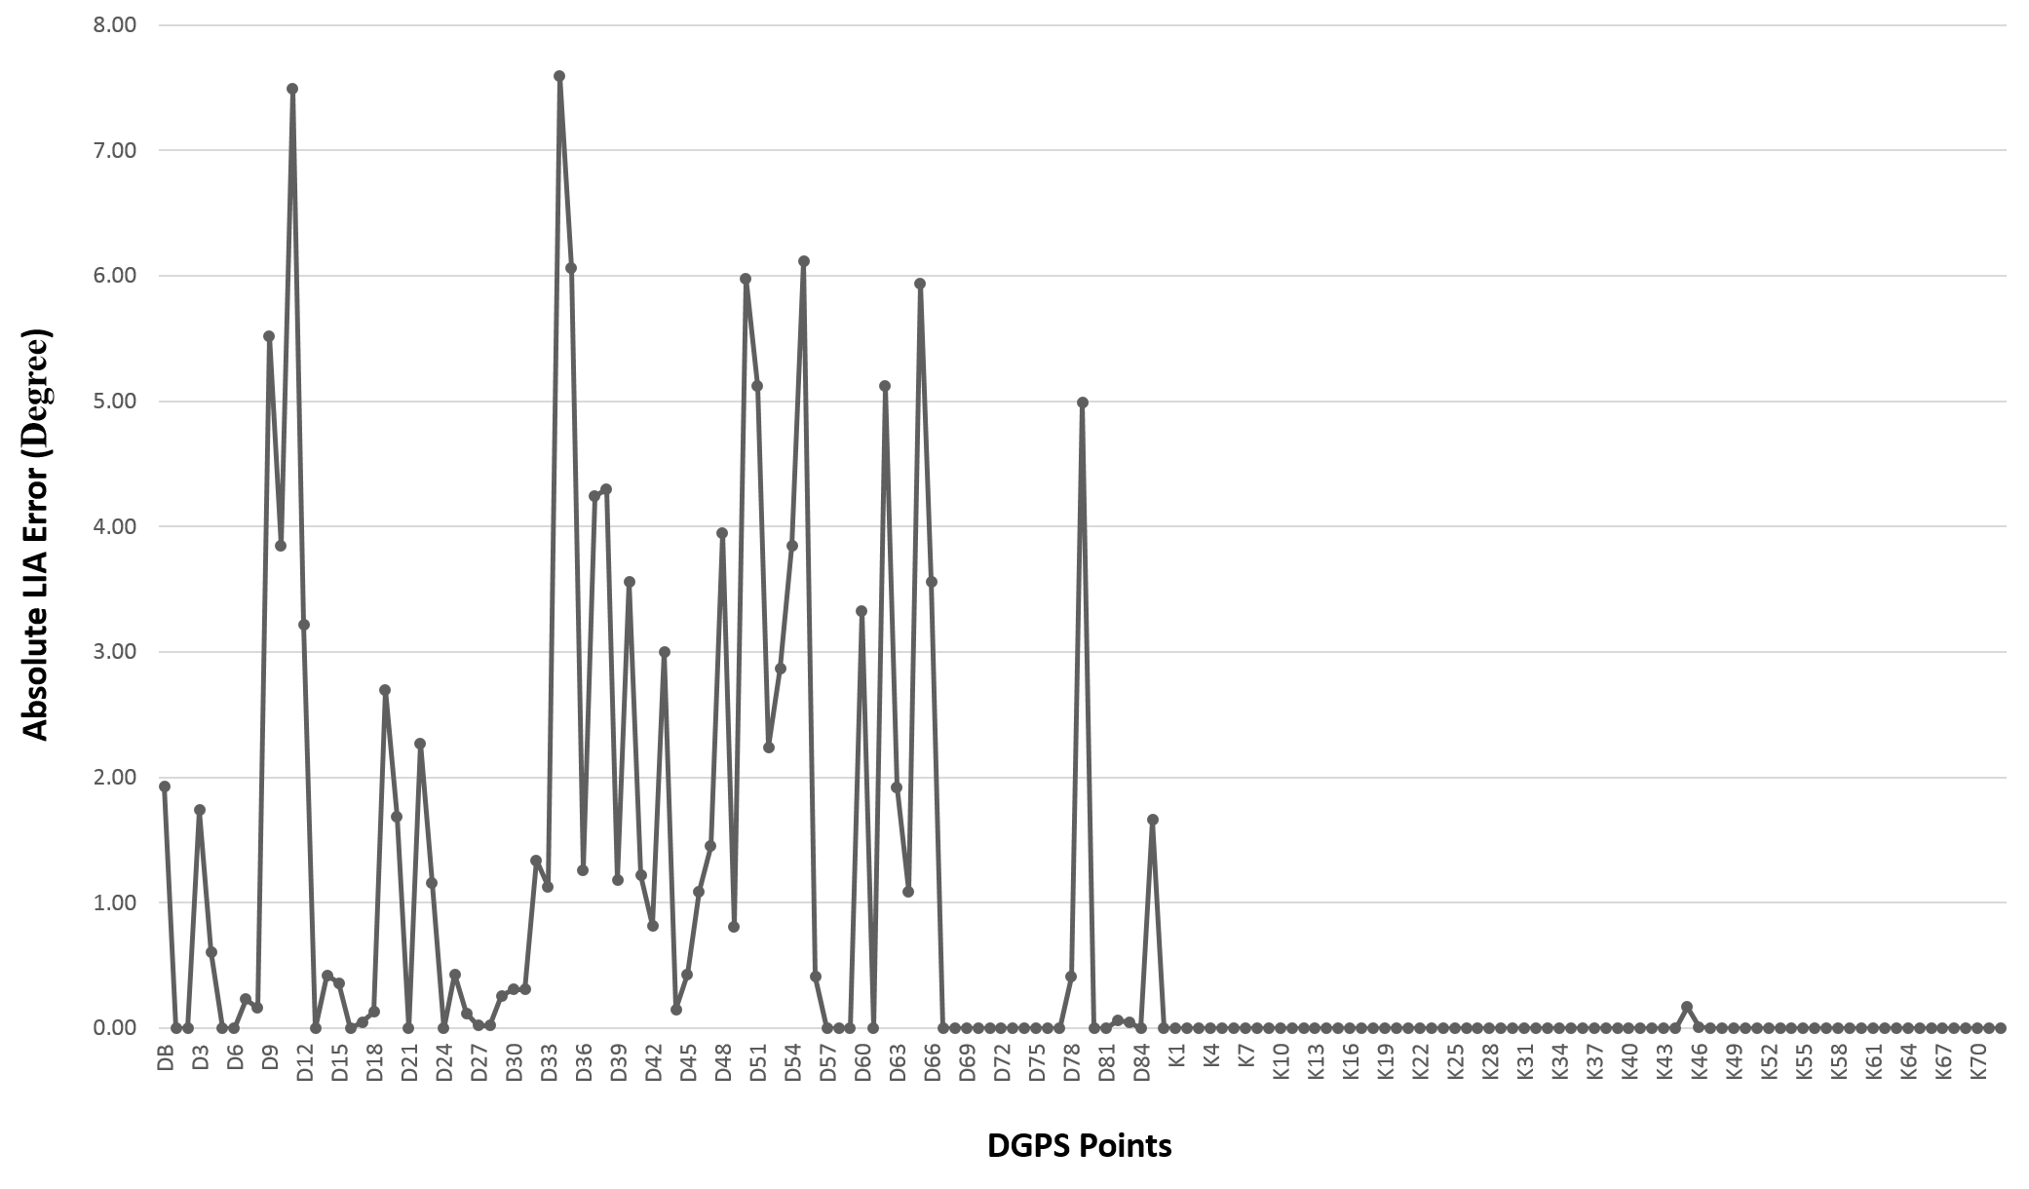
DEM ERROR ANALYSIS
Dhundi RMSE = 6.71 m
Kothi RMSE = 8.8 m
Low impact of LIA errors

Slide 11
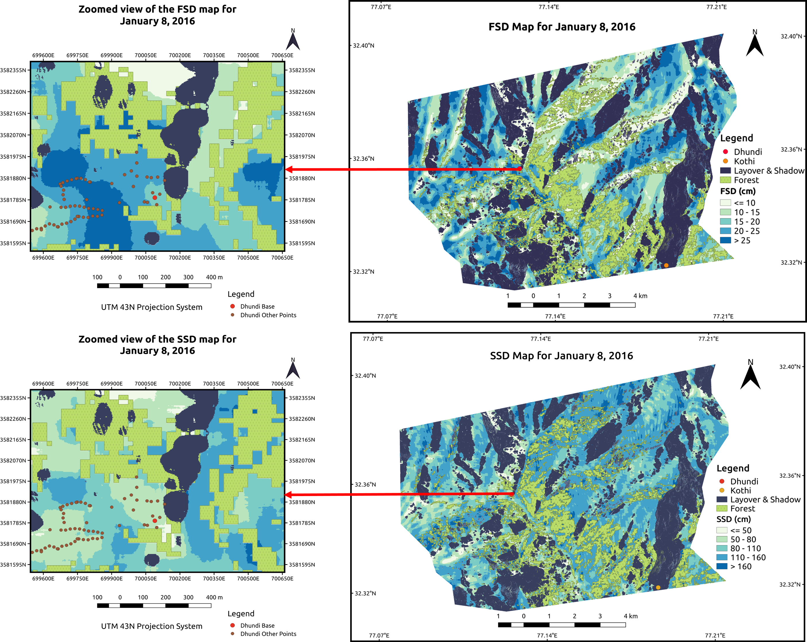
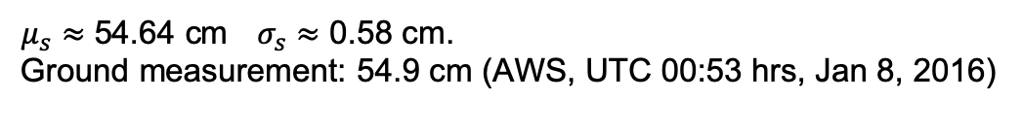
RESULTS
$μ_{s}≈$ 54.64 cm$σ_{s}≈$ 0.58 cm.
Ground measurement: 54.9 cm (AWS, UTC 00:53 hrs, Jan 8, 2016)

Slide 12
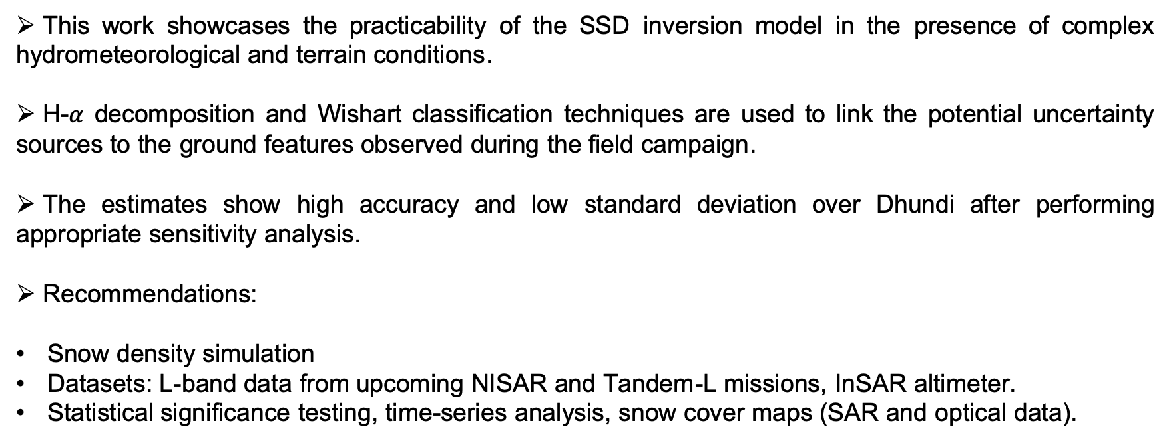
CONCLUSION
This work showcases the practicability of the SSD inversion model in the presence of complex hydrometeorological and terrain conditions.
H-$α$ decomposition and Wishart classification techniques are used to link the potential uncertainty sources to the ground features observed during the field campaign.
The estimates show high accuracy and low standard deviation over Dhundi after performing appropriate sensitivity analysis.
Recommendations:
Snow density simulation
Datasets: L-band data from upcoming NISAR and Tandem-L missions, InSAR altimeter.
Statistical significance testing, time-series analysis, snow cover maps (SAR and optical data).

Slide 13
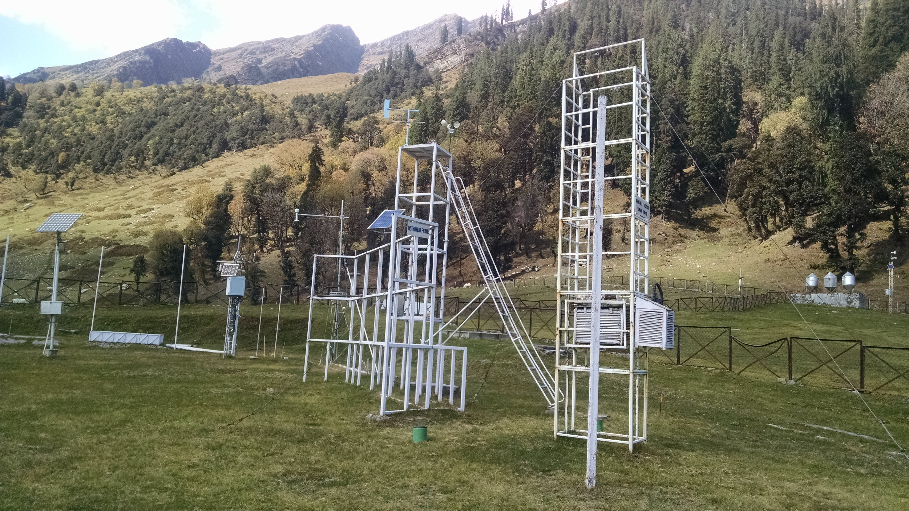
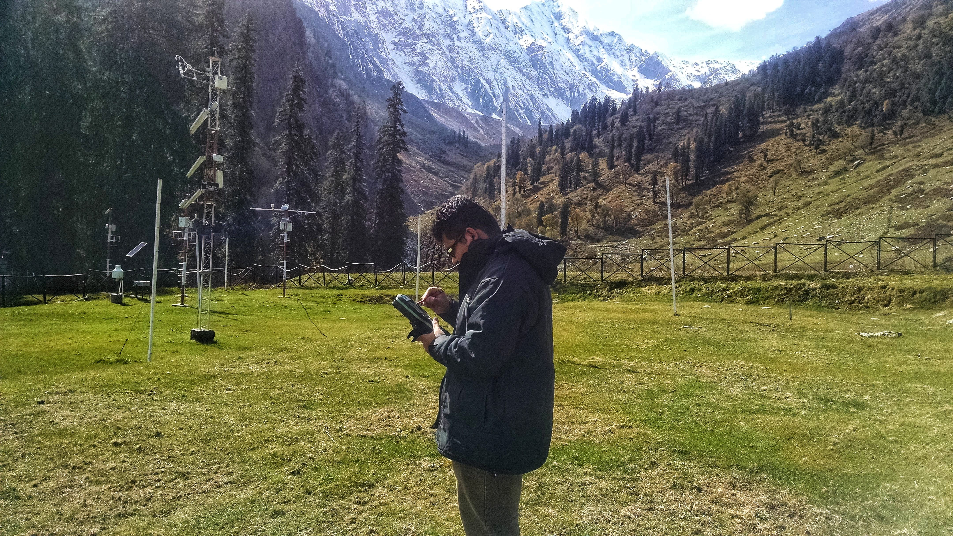
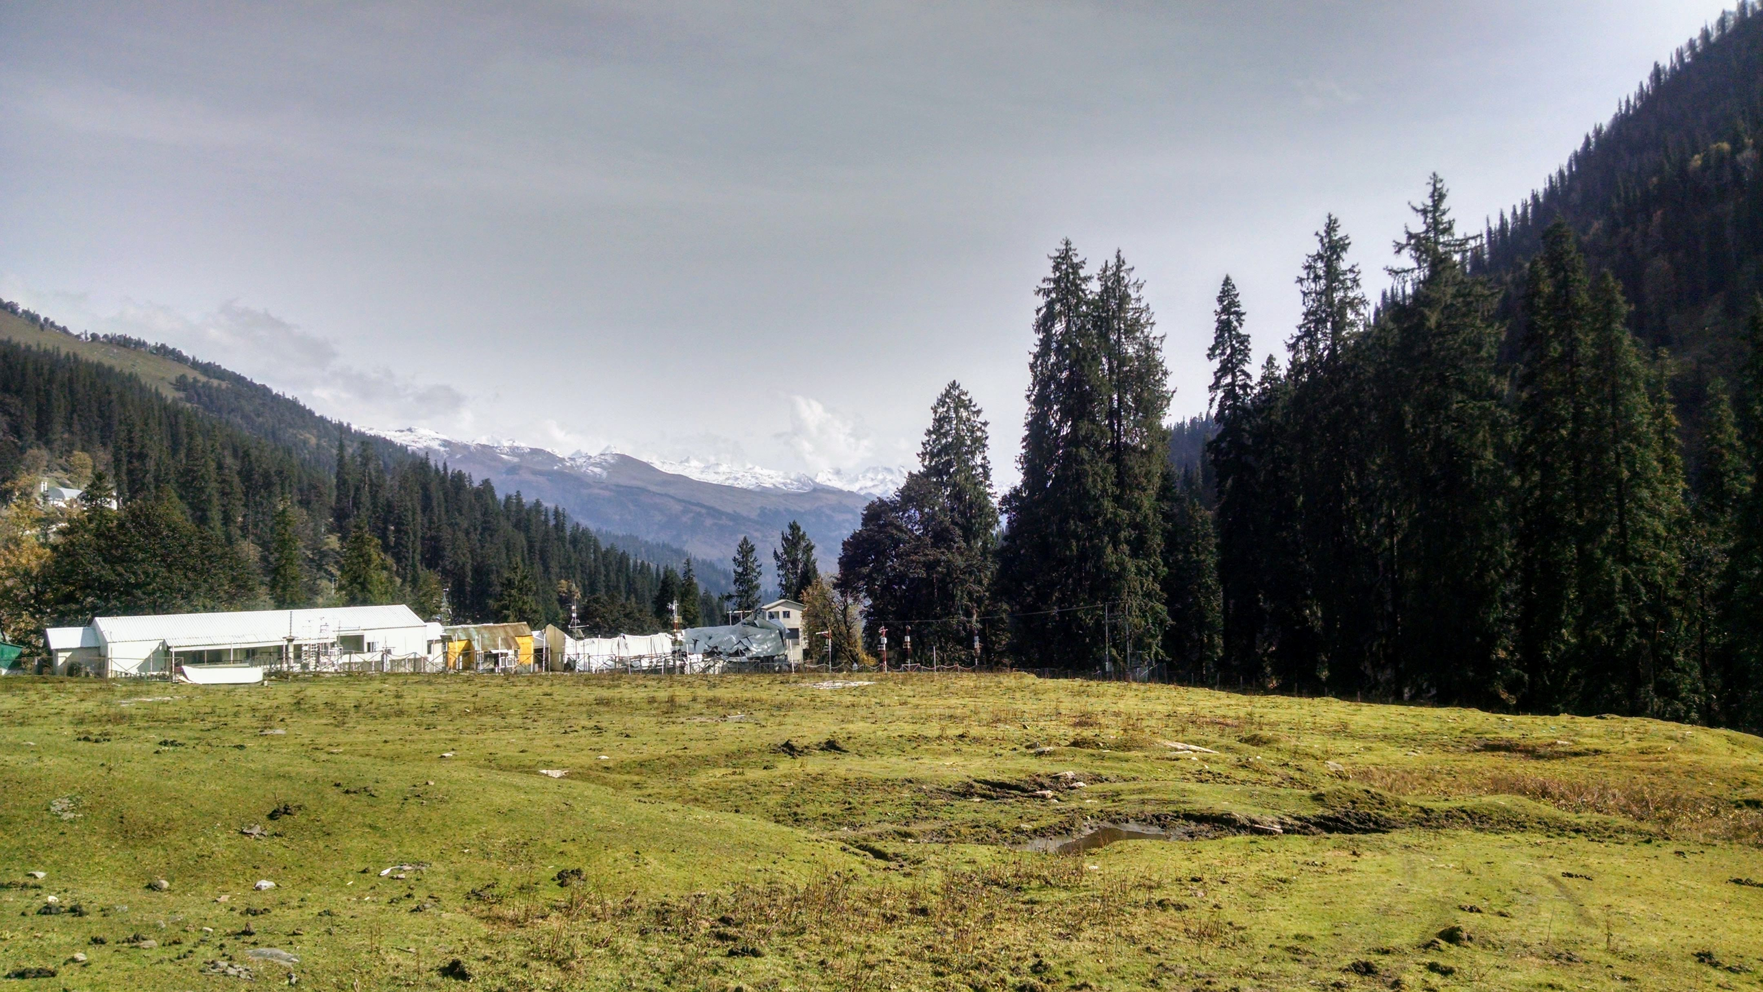
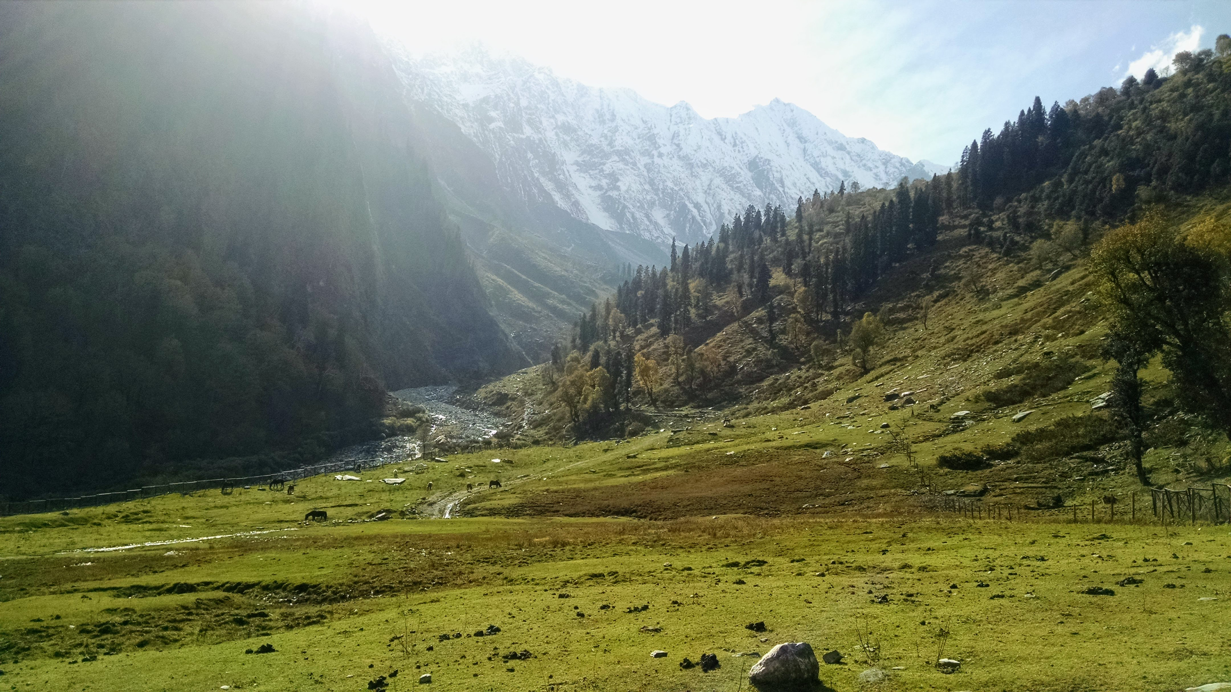
MORE FIELD PHOTOS (OCT 14-21, 2018)

Slide 14
RELATED PUBLICATIONS
[1] S. Majumdar, P. K. Thakur, L. Chang, and S. Kumar, “X-band Polarimetric SAR Copolar Phase Difference for Fresh Snow Depth Estimation in the Northwestern Himalayan Watershed.” Presented at the IEEE Geoscience and Remote Sensing Symposium (IGARSS) 2019, Yokohama, Japan, July 28-Aug 2, 2019.
Link: https://igarss2019.org/Papers/ViewPapers.asp?PaperNum=3115
[2] S. Majumdar, P. K. Thakur, L. Chang, S. Kumar, and S. Mani, “Pol-InSAR and PolSAR based Inversion Modelling for Snow Depth and SWE Estimation in the Northwestern Himalayan Watershed (under review, Cold Regions Science and Technology),” 2019. Preprint available on EarthArXiv: https://doi.org/10.31223/osf.io/6v4h3
[3] S. Majumdar, “Snow Depth and SWE Estimation using Spaceborne Polarimetric and Interferometric Synthetic Aperture Radar” (MSc Thesis). Available at https://library.itc.utwente.nl/papers_2019/msc/gfm/majumdar.pdf

Slide 15
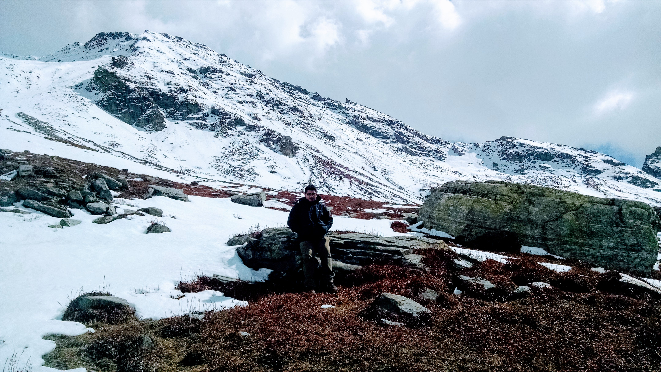
THANK YOU

Slide 16
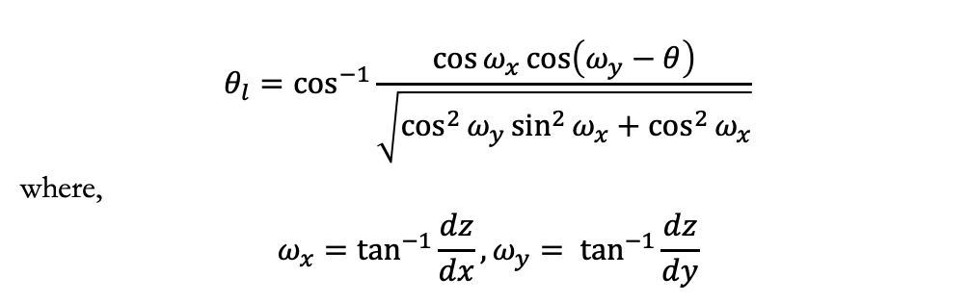
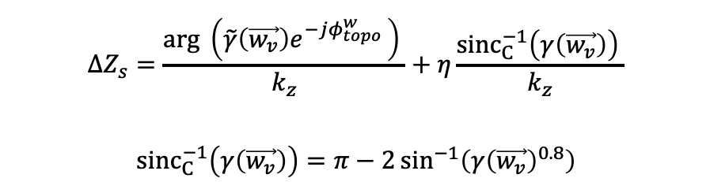
FORMULAS & MODELS (I)
$$ΔZ_{s}=\frac{arg \left(\tilde{γ}\left(\vec{w_{v}}\right)e^{−jφ_{topo}^{w} }\right) }{k_{z}}+η\frac{{sinc}_{C}^{−1}\left(γ\left(\vec{w_{v}}\right)\right) }{k_{z}}$$
$${sinc}_{C}^{−1}\left(γ\left(\vec{w_{v}}\right)\right)=π−2\sin^{−1}\left({γ\left(\vec{w_{v}}\right)}^{0.8}\right)$$
$$θ_{l}=\cos^{−1}{\frac{\cos{ω_{x}}\cos\left(ω_{y}−θ\right)}{\sqrt{\cos^{2}{ω_{y}}\sin^{2}{ω_{x}}+\cos^{2}{ω_{x}}}}}$$
where,
$$ω_{x}=\tan^{−1}{\frac{dz}{dx}}, ω_{y}= \tan^{−1}{\frac{dz}{dy}}$$

Slide 17
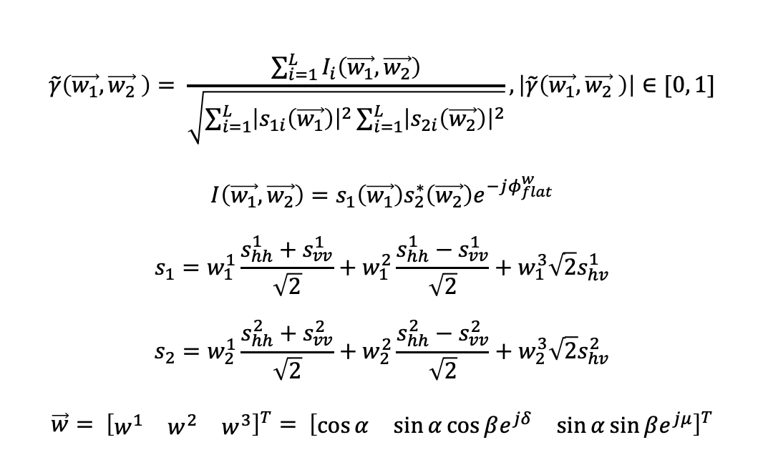
FORMULAS & MODELS (II)
$$\tilde{γ}\left(\vec{w_{1}},\vec{w_{2}} \right)= \frac{\sum_{i=1}^{L}{I_{i}\left(\vec{w_{1}},\vec{w_{2}}\right)}}{\sqrt{\sum_{i=1}^{L}{{\left|s_{1i}\left(\vec{w_{1}}\right)\right|}^{2}}\sum_{i=1}^{L}{{\left|s_{2i}\left(\vec{w_{2}}\right)\right|}^{2}}}}, \left|\tilde{γ}\left(\vec{w_{1}},\vec{w_{2}} \right)\right|∈[0, 1]$$
$$I\left(\vec{w_{1}},\vec{w_{2}}\right)=s_{1}\left(\vec{w_{1}}\right)s_{2}^{∗}\left(\vec{w_{2}}\right)e^{−jφ_{flat}^{w}}$$
$$s_{1}=w_{1}^{1}\frac{s_{hh}^{1}+s_{vv}^{1}}{\sqrt{2}}+w_{1}^{2}\frac{s_{hh}^{1}−s_{vv}^{1}}{\sqrt{2}}+w_{1}^{3}\sqrt{2}s_{hv}^{1}$$
$$s_{2}=w_{2}^{1}\frac{s_{hh}^{2}+s_{vv}^{2}}{\sqrt{2}}+w_{2}^{2}\frac{s_{hh}^{2}−s_{vv}^{2}}{\sqrt{2}}+w_{2}^{3}\sqrt{2}s_{hv}^{2}$$
$$\vec{w}= {\left[\begin{matrix}w^{1} & w^{2} & w^{3}\end{matrix}\right]}^{T}= {\left[\begin{matrix}\cos{α} & \sin{α\cos{βe^{jδ}}} & \sin{α\sin{βe^{jμ}}}\end{matrix}\right]}^{T}$$
Secant Method

Slide 18

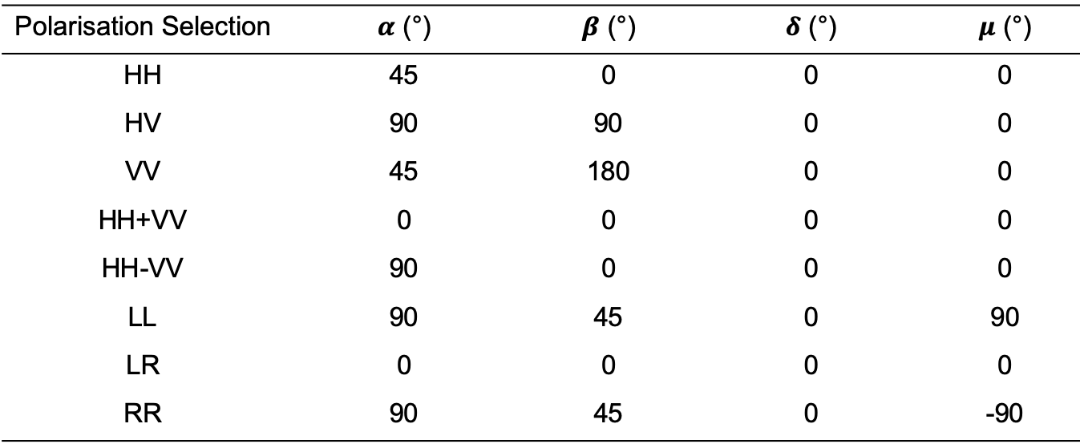

FORMULAS & MODELS (III)
Polarisation Selection | $α$ (°) | $β$ (°) | $δ$ (°) | $μ$ (°)
HH | 45 | 0 | 0 | 0
HV | 90 | 90 | 0 | 0
VV | 45 | 180 | 0 | 0
HH+VV | 0 | 0 | 0 | 0
HH-VV | 90 | 0 | 0 | 0
LL | 90 | 45 | 0 | 90
LR | 0 | 0 | 0 | 0
RR | 90 | 45 | 0 | -90
$$\vec{w_{v}}= {\left[\begin{matrix}0 & 0 & 1\end{matrix}\right]}^{T}$$
$$\vec{w_{s}}= {\left[\begin{matrix}1 & 0 & 0\end{matrix}\right]}^{T}$$

Slide 19
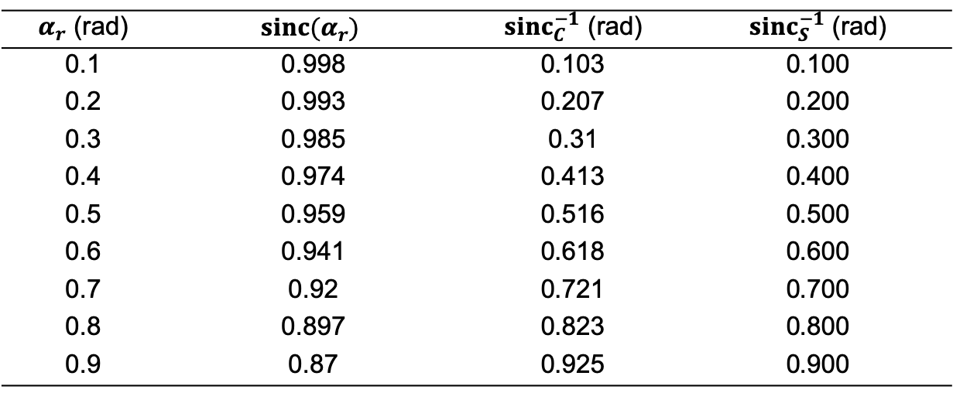
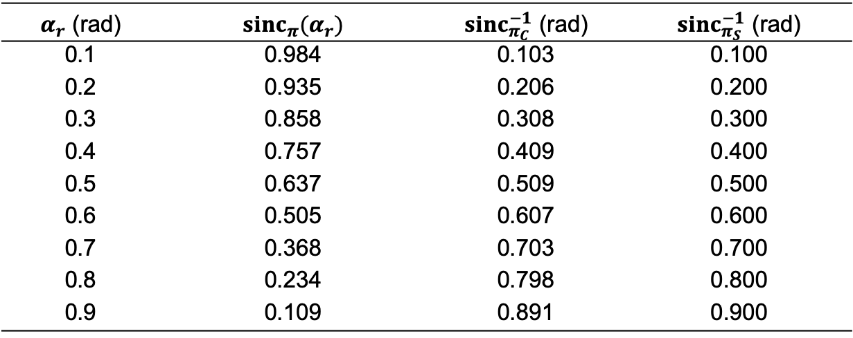
SINC & SINC INVERSE
$α_{r}$ (rad) | $$sinc(α_{r})$$ | ${sinc}_{C}^{−1}$ (rad) | ${sinc}_{S}^{−1}$ (rad)
0.1 | 0.998 | 0.103 | 0.100
0.2 | 0.993 | 0.207 | 0.200
0.3 | 0.985 | 0.31 | 0.300
0.4 | 0.974 | 0.413 | 0.400
0.5 | 0.959 | 0.516 | 0.500
0.6 | 0.941 | 0.618 | 0.600
0.7 | 0.92 | 0.721 | 0.700
0.8 | 0.897 | 0.823 | 0.800
0.9 | 0.87 | 0.925 | 0.900
$α_{r}$ (rad) | ${sinc}_{π}(α_{r})$ | ${sinc}_{π_{C}}^{−1}$ (rad) | ${sinc}_{π_{S}}^{−1}$ (rad)
0.1 | 0.984 | 0.103 | 0.100
0.2 | 0.935 | 0.206 | 0.200
0.3 | 0.858 | 0.308 | 0.300
0.4 | 0.757 | 0.409 | 0.400
0.5 | 0.637 | 0.509 | 0.500
0.6 | 0.505 | 0.607 | 0.600
0.7 | 0.368 | 0.703 | 0.700
0.8 | 0.234 | 0.798 | 0.800
0.9 | 0.109 | 0.891 | 0.900

Slide 20
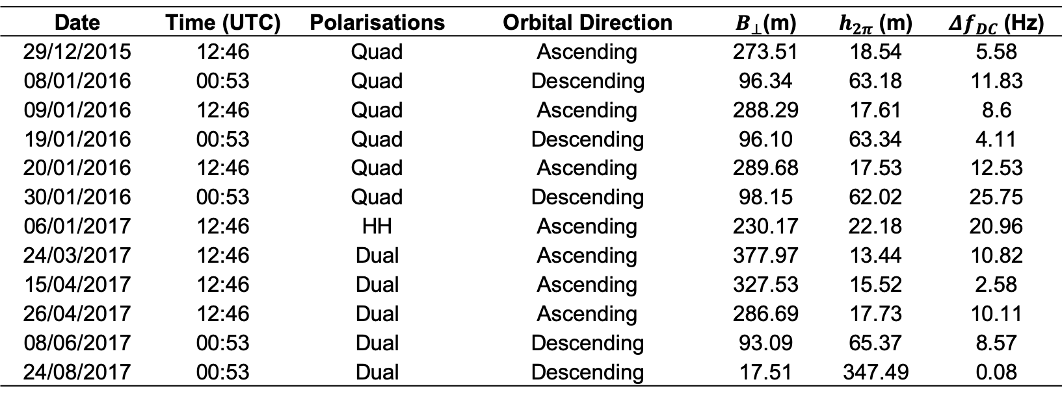
AVAILABLE DATASETS
Date | Time (UTC) | Polarisations | Orbital Direction | $B_{⊥}$(m) | $h_{2π}$ (m) | $Δf_{DC}$ (Hz)
29/12/2015 | 12:46 | Quad | Ascending | 273.51 | 18.54 | 5.58
08/01/2016 | 00:53 | Quad | Descending | 96.34 | 63.18 | 11.83
09/01/2016 | 12:46 | Quad | Ascending | 288.29 | 17.61 | 8.6
19/01/2016 | 00:53 | Quad | Descending | 96.10 | 63.34 | 4.11
20/01/2016 | 12:46 | Quad | Ascending | 289.68 | 17.53 | 12.53
30/01/2016 | 00:53 | Quad | Descending | 98.15 | 62.02 | 25.75
06/01/2017 | 12:46 | HH | Ascending | 230.17 | 22.18 | 20.96
24/03/2017 | 12:46 | Dual | Ascending | 377.97 | 13.44 | 10.82
15/04/2017 | 12:46 | Dual | Ascending | 327.53 | 15.52 | 2.58
26/04/2017 | 12:46 | Dual | Ascending | 286.69 | 17.73 | 10.11
08/06/2017 | 00:53 | Dual | Descending | 93.09 | 65.37 | 8.57
24/08/2017 | 00:53 | Dual | Descending | 17.51 | 347.49 | 0.08
TerraSAR-X (TSX), TanDEM-X (TDX) CoSSC Products (Thanks to DLR!)

