Slide 1
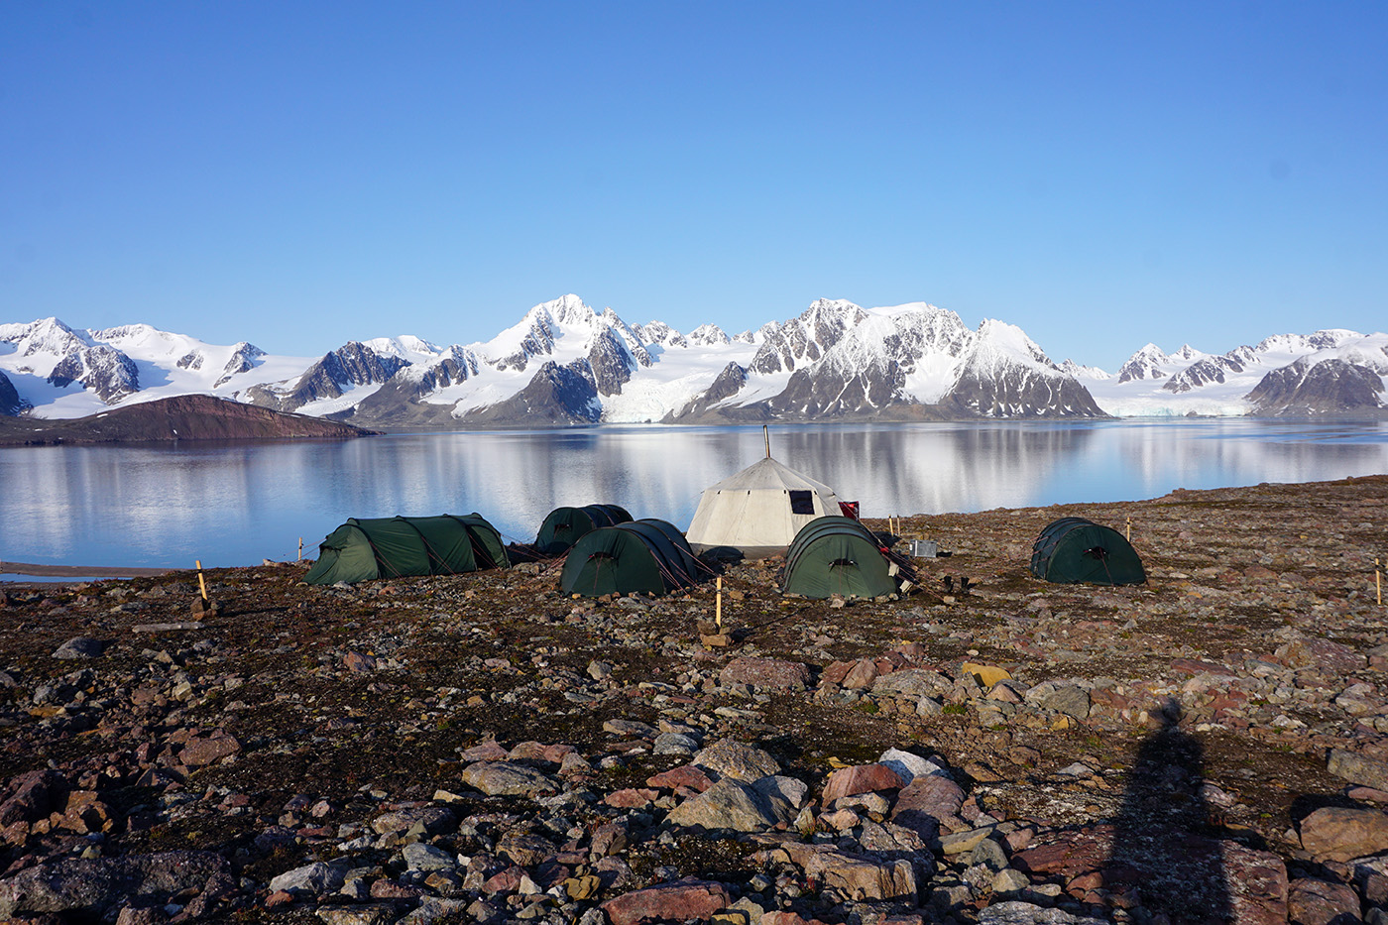
Keiserhjelmen Detachment fault rock development, NW Spitsbergen
Harmon Maher, Sara Parcher, Alvar Braathen, Morgan Ganerød, Per Terje Osmundsen, Tim Redfield
harmon_maher@unomaha.edu, sparcher@gmav.unomaha.edu, Dept. of Geography & Geology, Univ. of Nebraska at Omaha
alvar.braathen@geo.uio.no, Department of Geoscience, University of Oslo, N-0316 Oslo, Norway
Morgan.Ganerod@NGU.NO Tim.Redfield@NGU.NO, Geological Survey of Norway, Tromsø, N-7491, Norway
per.t.osmundsen@ntnu.no, Dept. of Geoscience & Petroleum, Norwegian University of Science & Technology (NTNU), 7491
Caledonian migmatites and late granites
Keiserhjelmen detachment
Devonian strata
Talk organization
- Svalbard’s Late Silurian to Early Devonian plate setting
- Keiserhjelmen Detachment’s location and geologic context.
- Ascend through the detachment in outcrop and thin section.
- Conclusions
Notes:
.

Slide 2
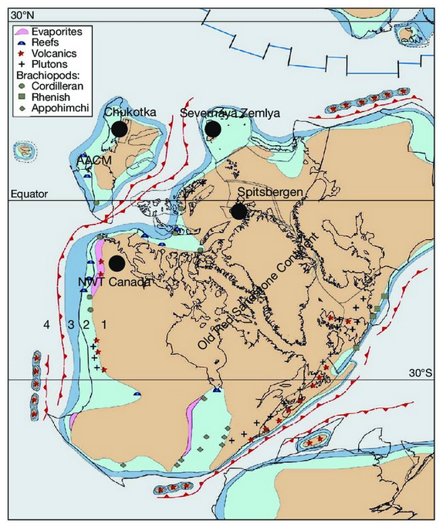
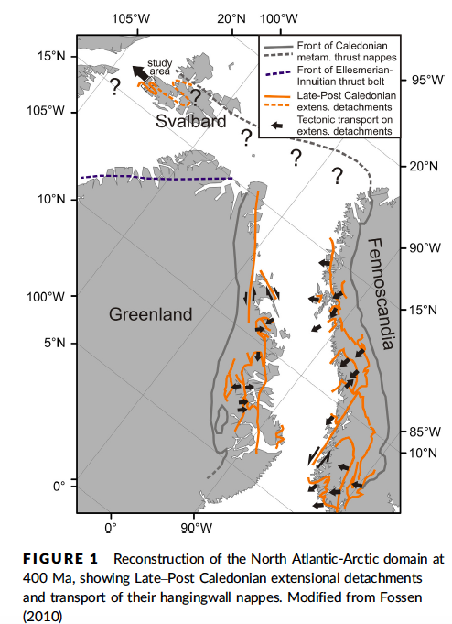
Left: from Cocks and Torsvik 2011, Early Devonian.
Below: from Braathen et al. 2017
Continued intra-continental
tectonism along suture.

Slide 3
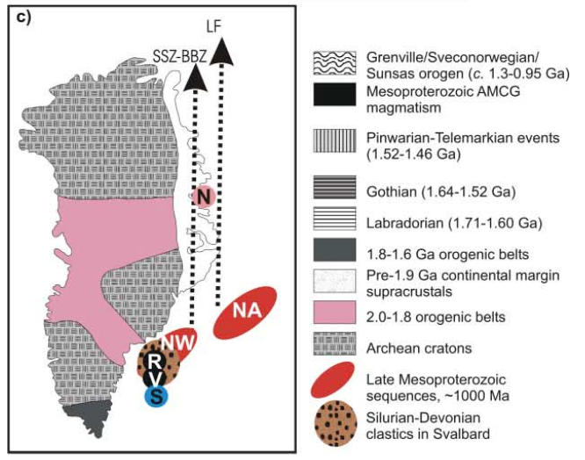
From: Pettersson et al. https://jgs.lyellcollection.org/content/jgs/167/5/1019.full.pdf

Slide 4
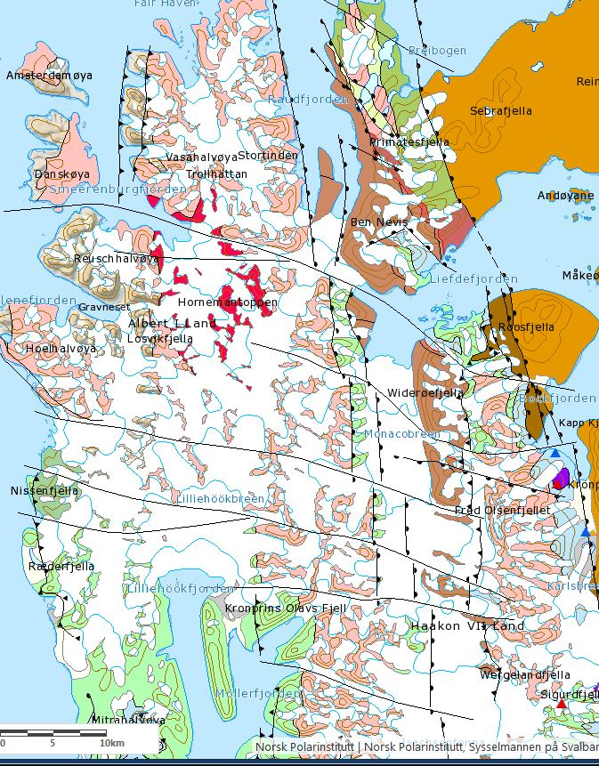
Keiserhjelmen Detachment
Rabotdalen fault
sample/data
locality
upper plate
movement
Hornetoppen Late Silurian to
Devonian granite
basement
antiform
Detachment mylonites

Slide 5
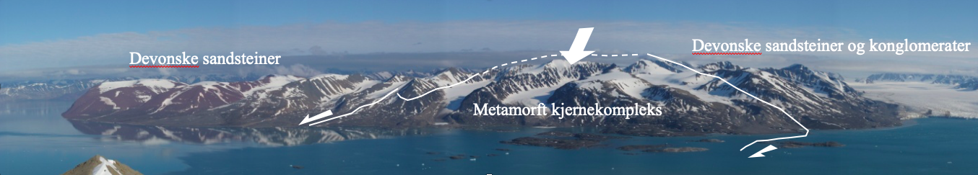
discordant Devonian strata
mylonites
discordant Devonian strata
upper brittle fault
Devonian strata
mylonites

Slide 6
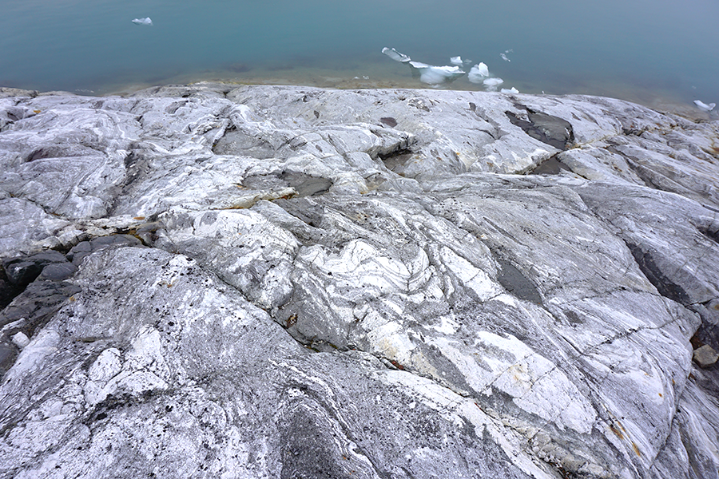
Biotite migmatite w aplite & biotite granite leucosome, & deformed amphibolite xenoliths, from the W side of Raudfjorden several hundred meters from the detachment base.

Slide 7
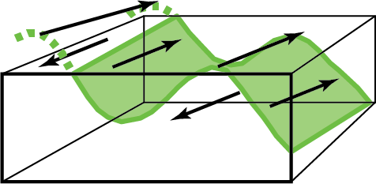
Coarser biotite-garnet mylonite with sinistral composite surfaces from near the bottom of detachment zone, SW Raudfjorden.

Slide 8
Typical dark mylonite with sheared quartz vein material. North to left, on E limb near top of antiform, south of Liefdefjorden.

Slide 9
Dextral sense of shear in mylonites on antiform’s W side, S of Liefdefjorden, a shear sense consistent with top to N kinematics.

Slide 10
Granitic sheets dismembered within the mylonite, S shore of Liefdefjorden.

Slide 11
Lineated late kinematic granite with composite surfaces & elongation lineation near base of shear zone, W side of Raudfjorden.

Slide 12
Folded foliated cataclasite, E limb of Liefdefjorden antiform, top of detachment, looking N.
Devonian
clastics

Slide 13
Polished fault surface and pseudotachylite, top of shear zone, SW Raudfjorden

Slide 14
Devonian coarse conglomerate (light green) deformed within and on top of dark cataclasites at very top of the detachment, W Raudfjorden

Slide 15
Top of
detachment
Middle of
detachment
Bottom of
detachment
Typical quartz grain size and structures from top to bottom from the SW Raudfjorden transect, all at same scale

Slide 16
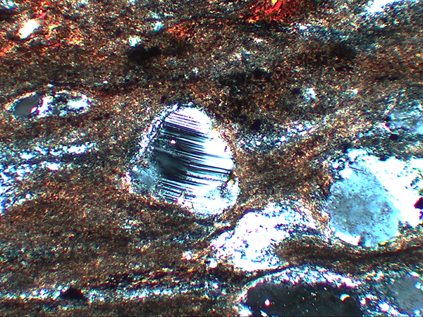
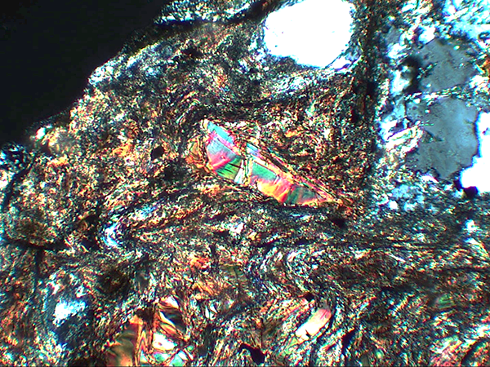
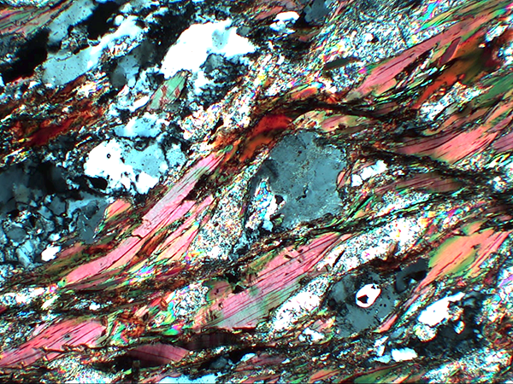
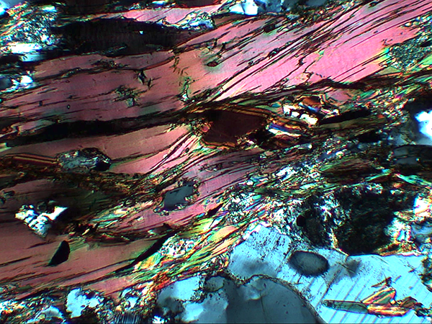
Top of
detachment
Middle of
detachment
Bottom of
detachment

Slide 17
End of part 1 (due to file size restrictions) – please download/view part 2.

