Slide 1
Keiserhjelmen Detachment fault rock development, NW Spitsbergen
Harmon Maher, Sara Parcher, Alvar Braathen, Morgan Ganerød, Per Terje Osmundsen, Tim Redfield
harmon_maher@unomaha.edu, sparcher@gmav.unomaha.edu, Dept. of Geography & Geology, Univ. of Nebraska at Omaha
alvar.braathen@geo.uio.no, Department of Geoscience, University of Oslo, N-0316 Oslo, Norway
Morgan.Ganerod@NGU.NO Tim.Redfield@NGU.NO, Geological Survey of Norway, Tromsø, N-7491, Norway
per.t.osmundsen@ntnu.no, Dept. of Geoscience & Petroleum, Norwegian University of Science & Technology (NTNU), 7491
This is part 2 of this presentation, which was divided because of file size limitations.

Slide 2
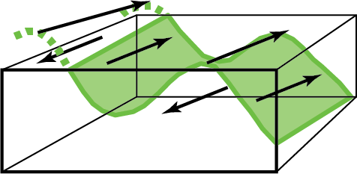
Asymmetric and ductile micro-boudinage of feldspar. Top: specimen 11HM111, bottom: specimen 11HM131.

Slide 3
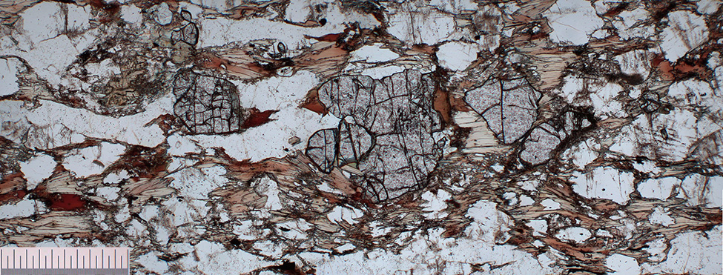
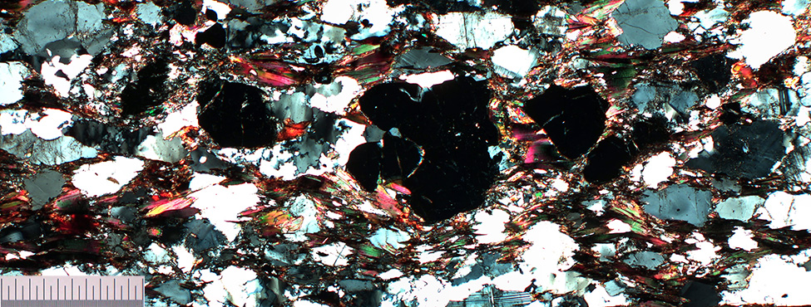
Brittlely pulled apart garnet porphyroclast with biotite in ‘gaps’. Mylonite sample 18HM18 from SW Raudfjorden.

Slide 4
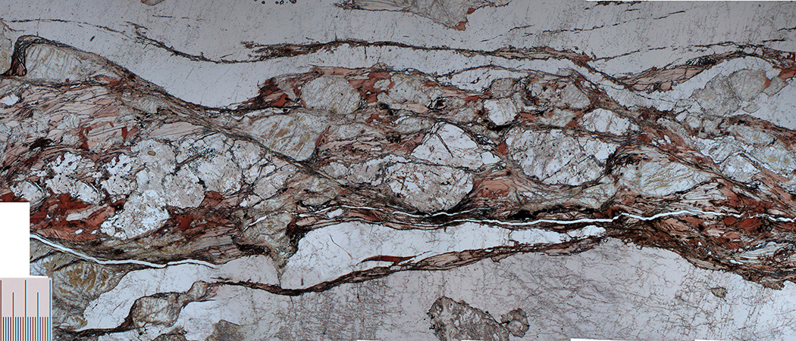
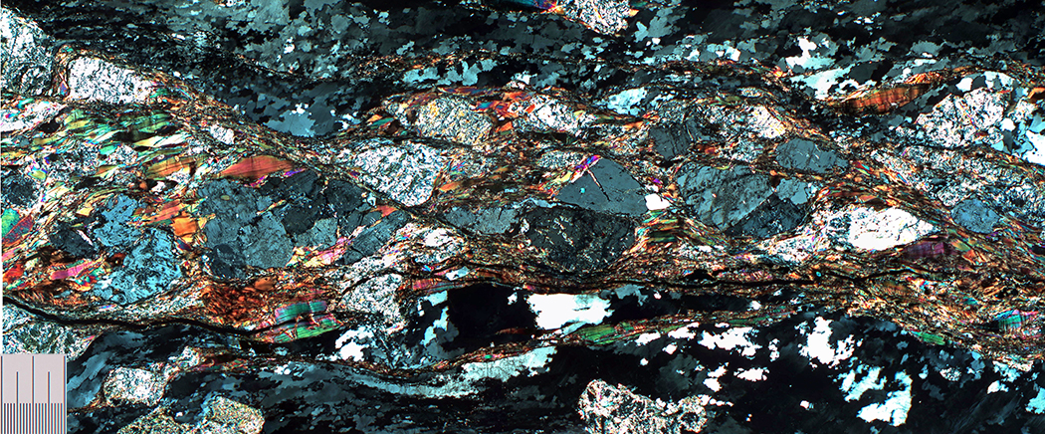
AC
AC
Sheared biotite cordierite migmatitic gneiss from SW Raudfjorden
AC
AC

Slide 5
m
m
m
Specimen 14HM09 – dark mylonite w well developed dextral composite shear surfaces. Muscovite forms porphyroclast mica fish (m) while finer grained biotite tends to adorn the slip surfaces (red dashed) lines.

Slide 6
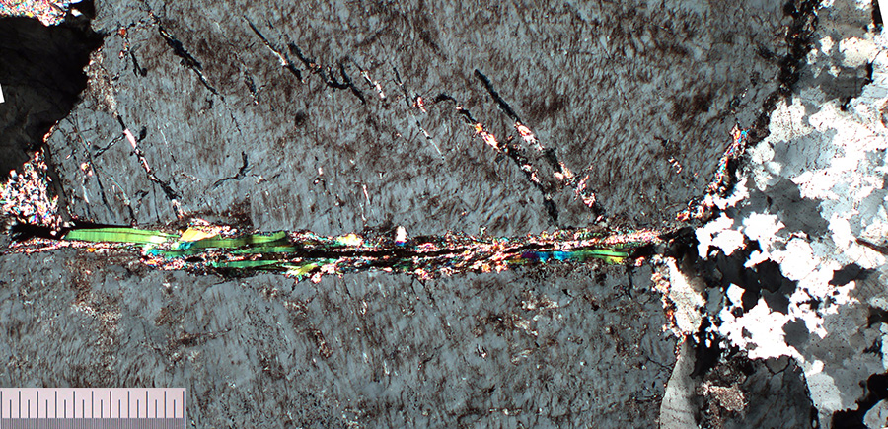
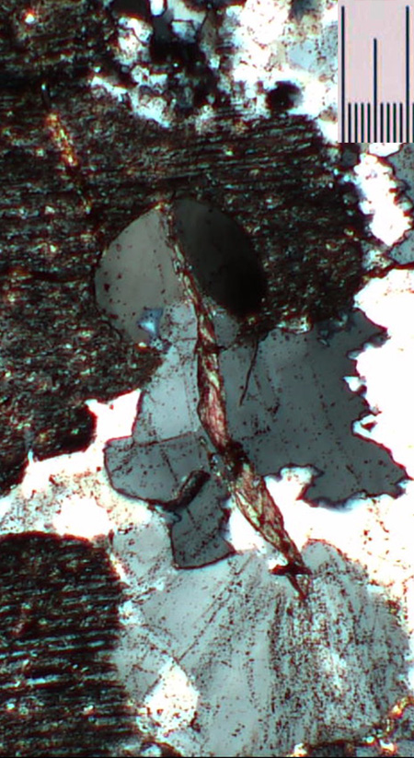
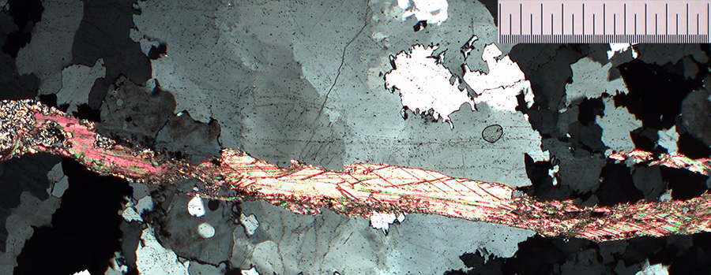
25HM18A SW Raudfjorden:
Top: muscovite in feldspar microvein.
Bottom: calcite microvein parallel to fluid inclusion planes.

Slide 7
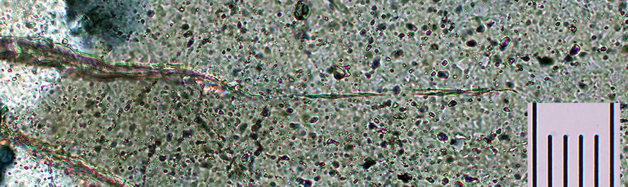
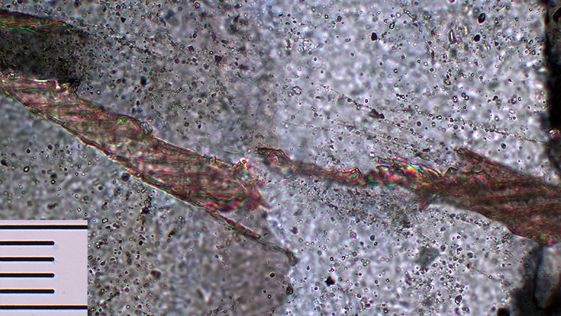
Calcite microvien
tips and fluid inclusion planes in deformed quartz veins in ultramylonite (60HM2011, W side of Liefdefjorden).
What volume % of quartz is fluid inclusions?

Slide 8
Ultramylonite from N side of Liefdefjorden, E limb of folded detachment with discrete reverse slip surface and associated en echelon chlorite veins.

Slide 9
60HM2011 Ultramylonite from W limb of detachment synform, Liefdefjorden. Both lower angle sinistral (yellow) slip surfaces & subordinate higher angle dextral (red) slip surfaces occur.

Slide 10
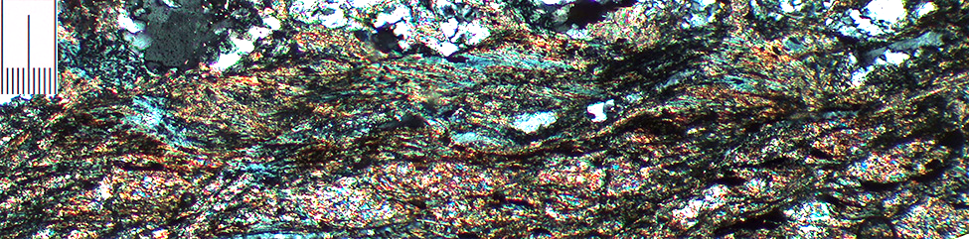
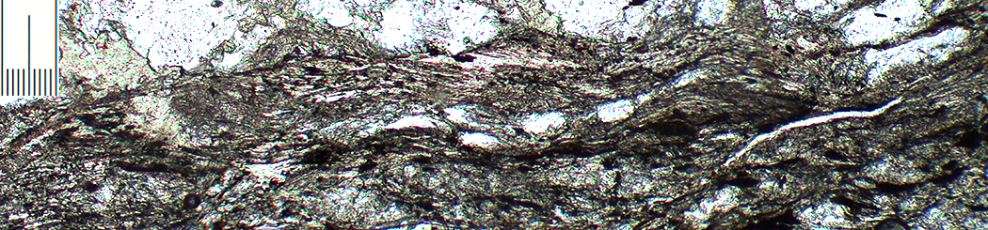
Photomicrographs of 60HM2011 ulramylonite from western Liefdefjorden exposure of Keiserhjelmen Detachment with biotite-chlorite mica seam with sinistral fabric.
Blue low bierefrigence of chlorite, interleaved with biotite.

Slide 11
Brittle-ductile shear zone in orthogneiss, w significant grain size reduction & increase of opaques (pressure solution).

Slide 12
chlorite vein
shredded biotite
rounded feldspar porphyroclast
garnet porphyroclast
Foliated cataclasite – 09SV4D – W side of Liefdefjorden.

Slide 13
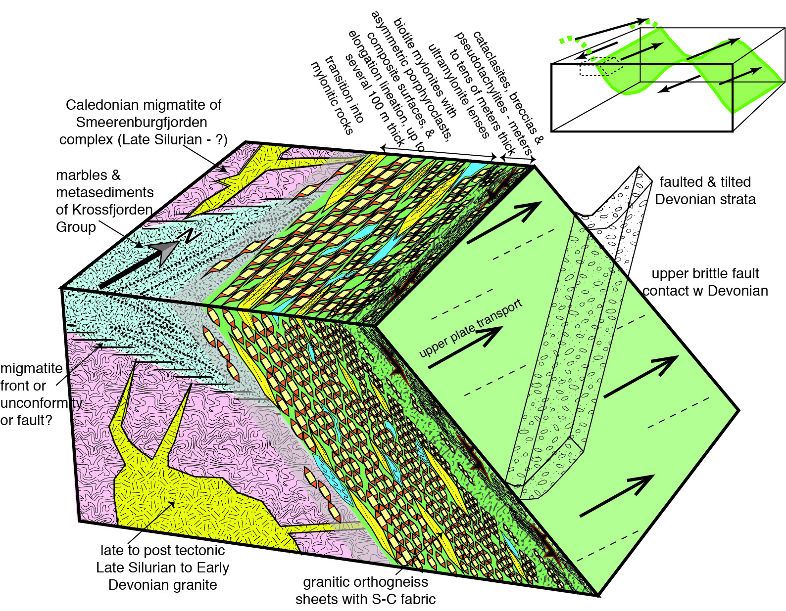

Slide 14
Summary of retrogression in Keiserhjelmen Detachment
cordierite
muscovite
growth syn-mylonitization, along C-surfaces and asymmetric porphyroclasts
K-feldspar
sericite
plagioclase
Biotite grain enclosed in feldspar with partial retrogression to chlorite in migmatite in footwall plate from S of Liefdefjorden (specimen 123HM09).
garnet
chlorite
biotite
opaques
Fault strain likely localized upwards with time due to feedback between dynamic grain size reduction and softening, whereas retrogression likely migrated downwards.
chl

Slide 15
Conclusions
The Keiserhjelmen Detachment’s length (>150 km), thickness, & degree of fault rock development indicate it is a major feature in Svalbard’s transition from the end Caledonian into Devonian basin formation.
A consistent bottom-top, ductile-brittle fault architecture exists.
Detachment retrogression was likely associated with significant cross and along fault fluid transport.
Biotite played a crucial role in evolving fault rheology.
Traits are consistent w those of a metamorphic core complex that formed soon after Caledonian crustal thickening, intrusion & migmatization, during sinistral transtension.

Slide 16
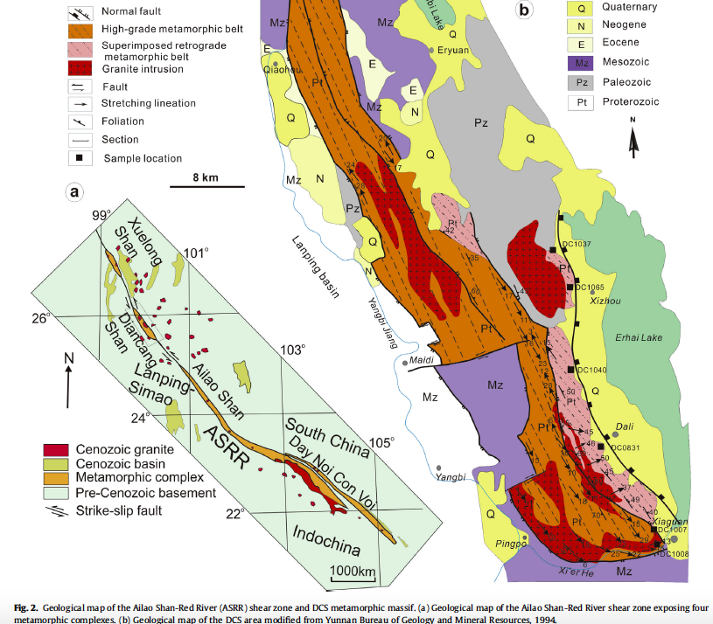
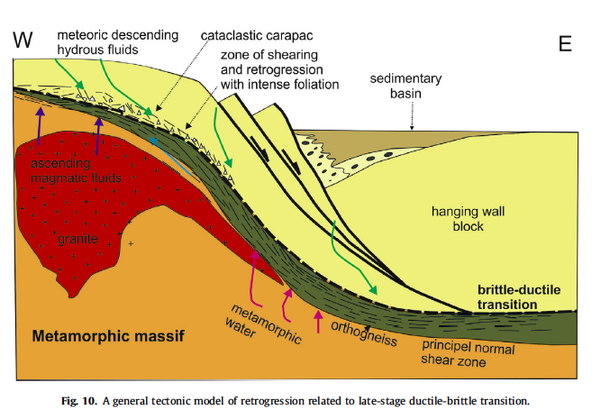
Diagrams from Cao et al. 2017 for retrogression in SE Asia Cenozoic sinistral core complex, with antiform parallel transport.
toward
away
Notes:
Shuyun Cao, Franz Neubauer, Junlai Liu, Manfred Bernroider, Xuemei Cheng, Junyu Li, Zunpu Yu, Johann Genser,, Rheological weakening of high-grade mylonites during low-temperature retrogression: The exhumed continental Ailao Shan-Red River fault zone, SE Asia, Journal of Asian Earth Sciences, Volume 139, 2017, Pages 40-60, https://www.sciencedirect.com/science/article/pii/S1367912016303030

