Slide 1
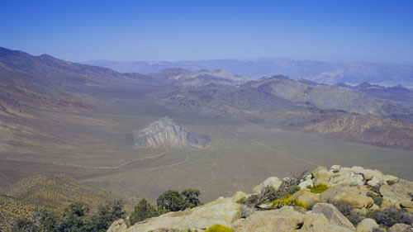
Deciphering the polyphase tectonic evolution of the Jurassic-Cretaceous arc in the Death Valley region by revisiting the enigmatic Butte Valley fault, Panamint Range, California
J. Andrew
University of Kansas
Notes:
Search engine optimized

Slide 2
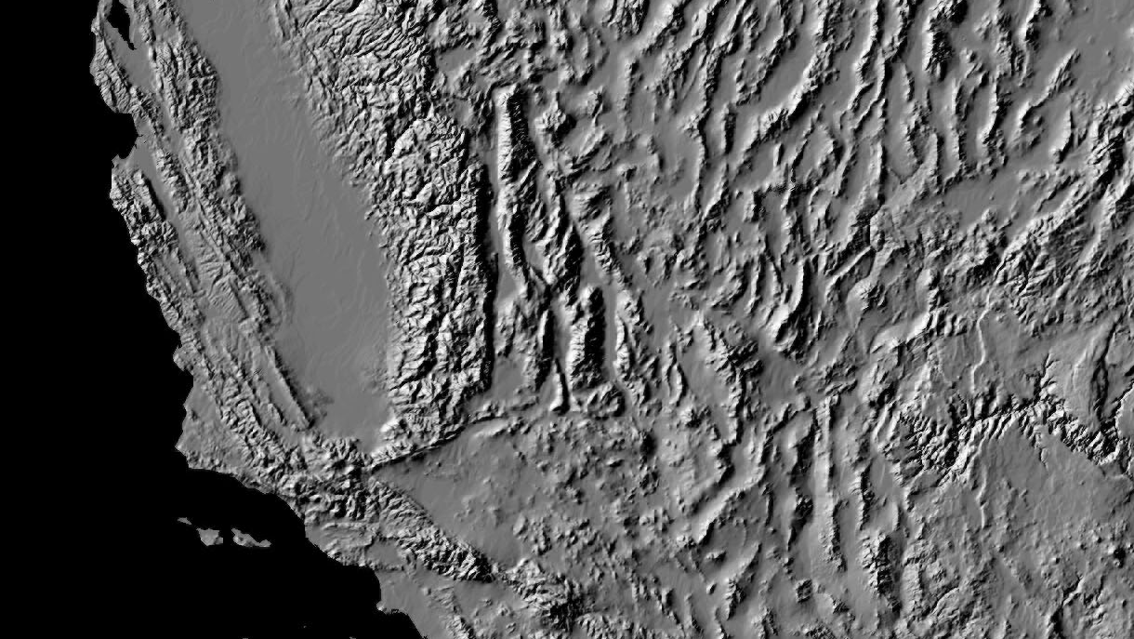
Mesozoic Cordilleran arc
Mesozoic arc batholith
Death Valley extensional region
PR
Las Vegas
More
More
Los Angeles
Notes:
Active San Andreas, Garlock faults; Eastern California shear zone; Basin and range; Inboard arc deformation zone; Panamint big block; Death Valley ext

Slide 3
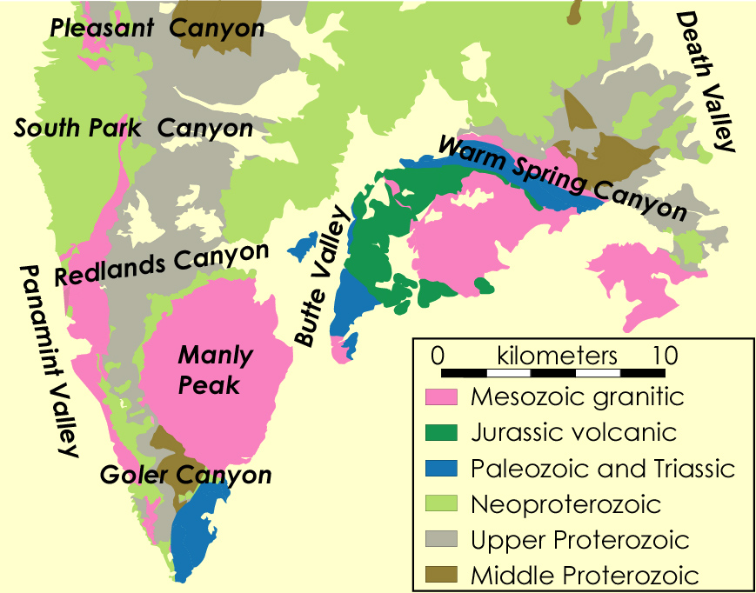
Butte Valley fault
(Johnson, 1957; Wrucke, 1966; Wrucke et al., 1997 & 2007)
Anomalous
  Trace
  Unexposed
  Vector
  >5 km offset
  Few subsidiary
Alternatives?
  Caldera
Mz plutonic
J volcanic
Pz + Tr sedimentary
Zn, Zj, & Zs metased
Yc + Zk metased
XY basement
Revisit
  Mapping
  U-Pb zircon
  structural

Slide 4
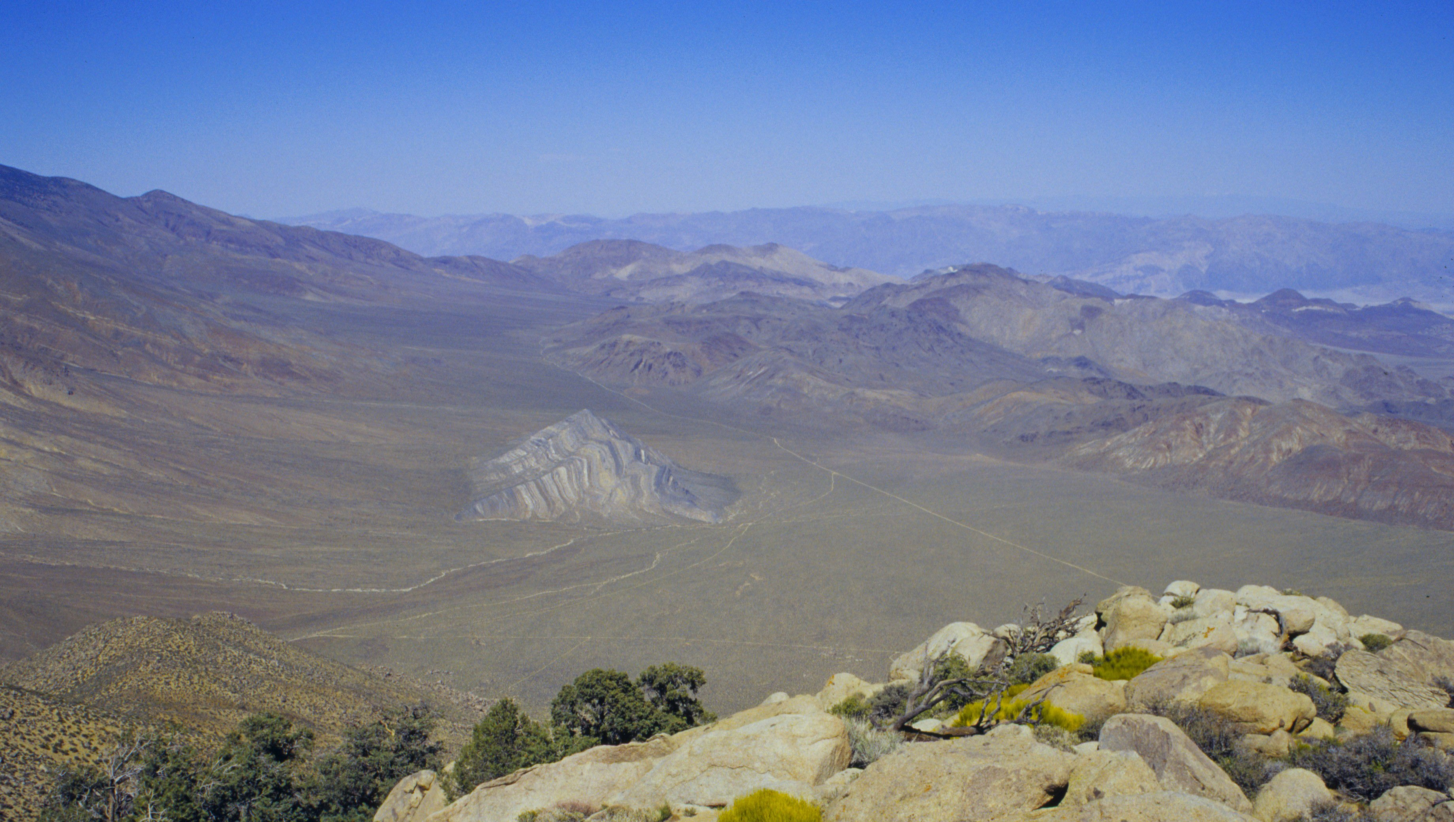
Importance
  Cordillera history
  Apparent uniqueness
    Restoration marker
      Neogene DV
      Mz arc
      Z glacial-tectonic

Slide 5
Butte Valley & Striped Butte
WSC
Zs
Jw
qmz
Trb
Zj
PPb
Notes:
Alternative caldera collapse, linked normal-ss fault system; look North = Butte Valley, Striped Butte; Johnnie Fm, Stirling Qzt; Bird Spring Fm., Butte Valley Fm., Warm Spring Fm., Manly Peak qz monzonite

Slide 6
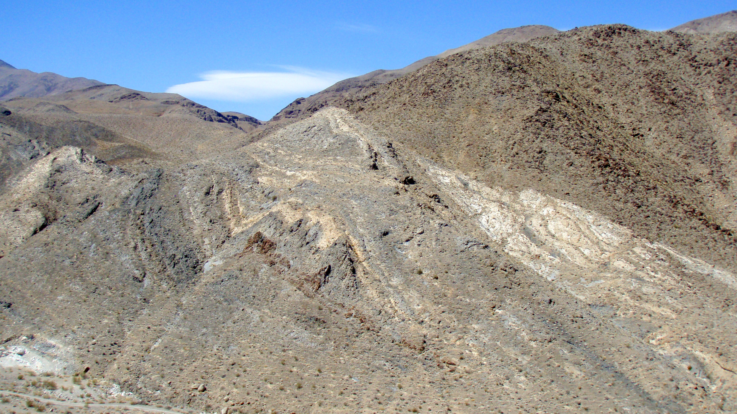
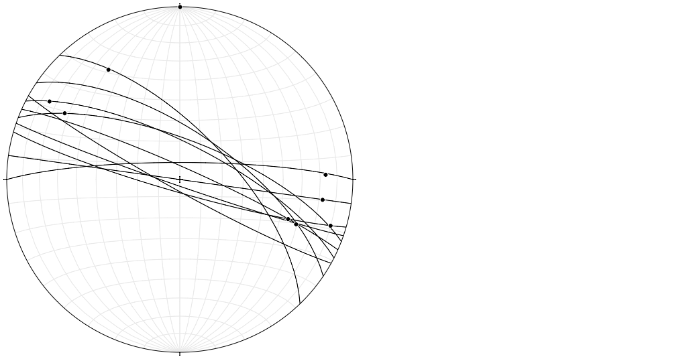
Fault, not intrusive
  Sinistral = WSCF
qzd
Msr
PPb
Notes:
Faults and striae

Slide 7
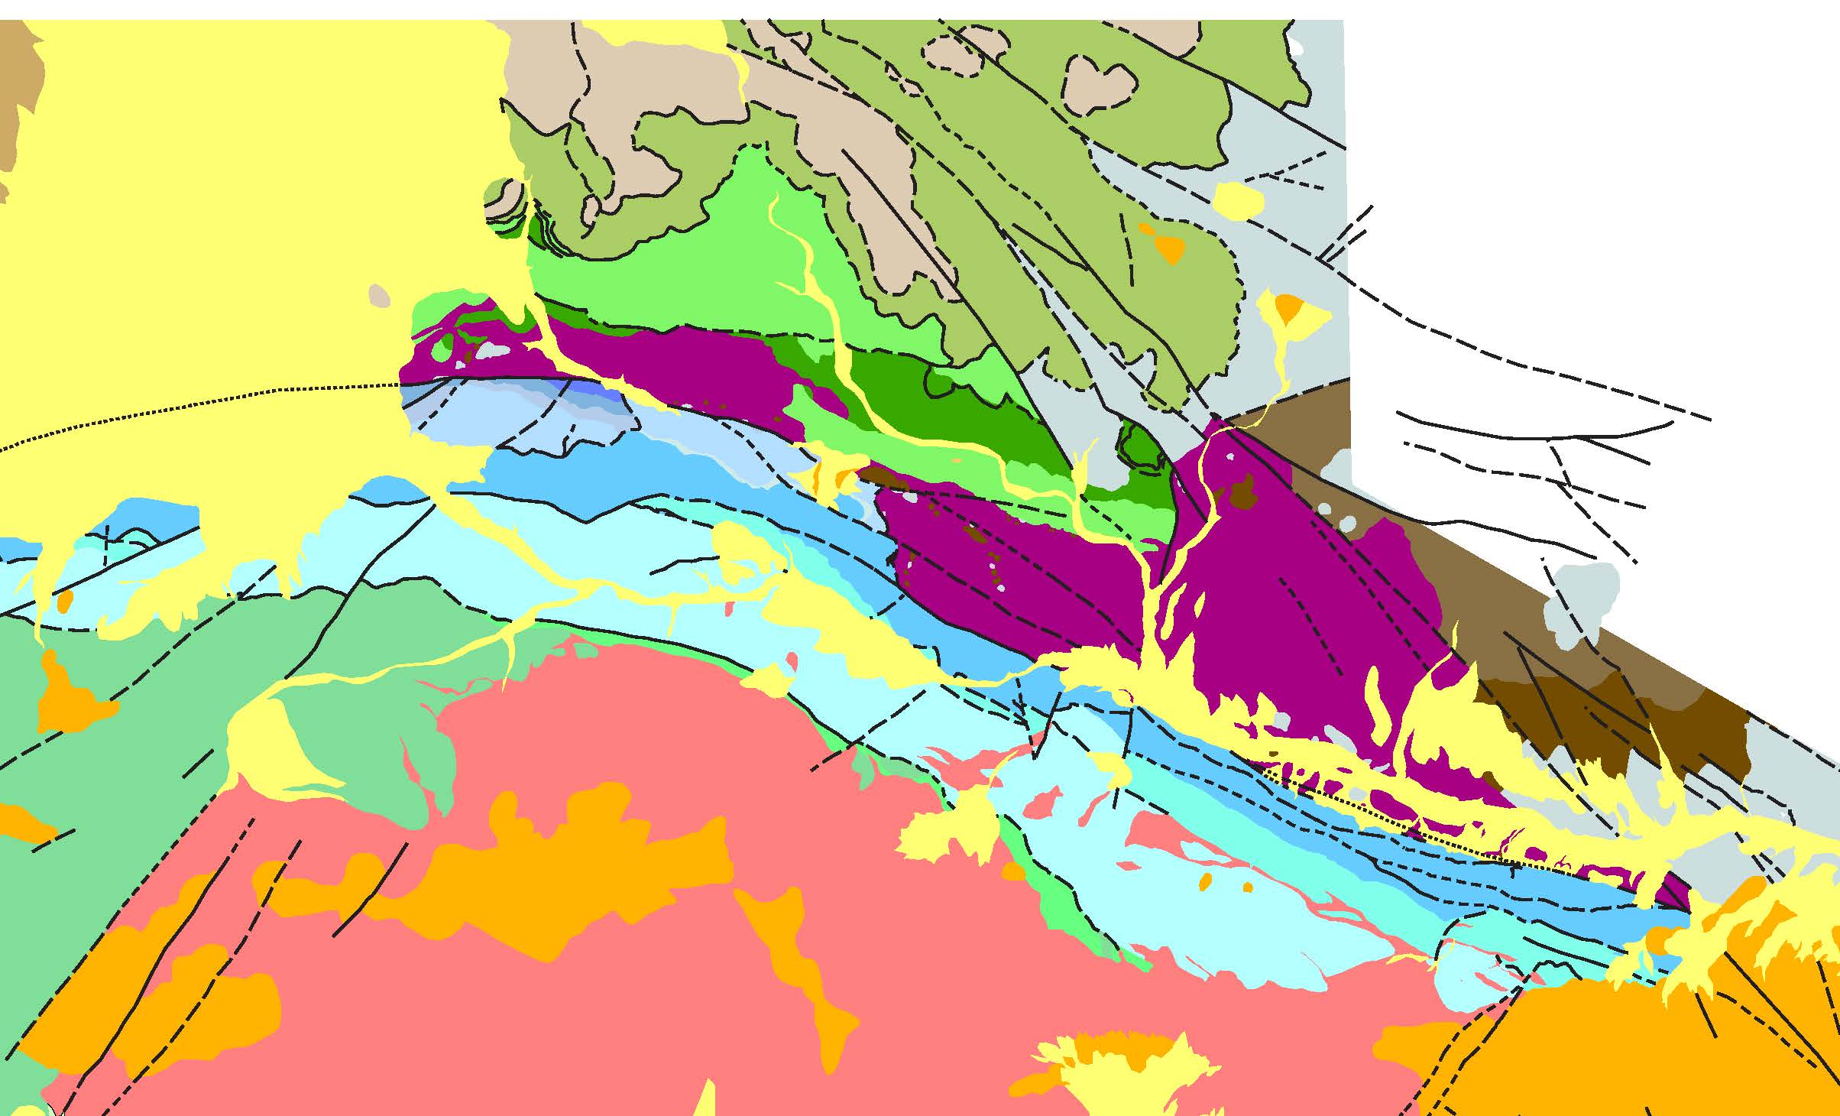
  Bedding parallel faults
    -Top-NW, Excisional
Z
  Top-NE thrusts & folds
    Overprint by top–NW folds
  S-facing fold
Pz
qzd
X
Jw
qmz

Slide 8
Warm Spring Canyon
Order of events
Top-NE compression
Top-NW extension
Jv
S-facing fold
Intrusion qzd & qmz
Sinistral WSCF
Miocene volcanics
qzd = 151.23 ±0.13 Ma
Jv = 151.54 ±0.62 Ma
qmz = 151.21 ±0.074 Ma

Slide 9
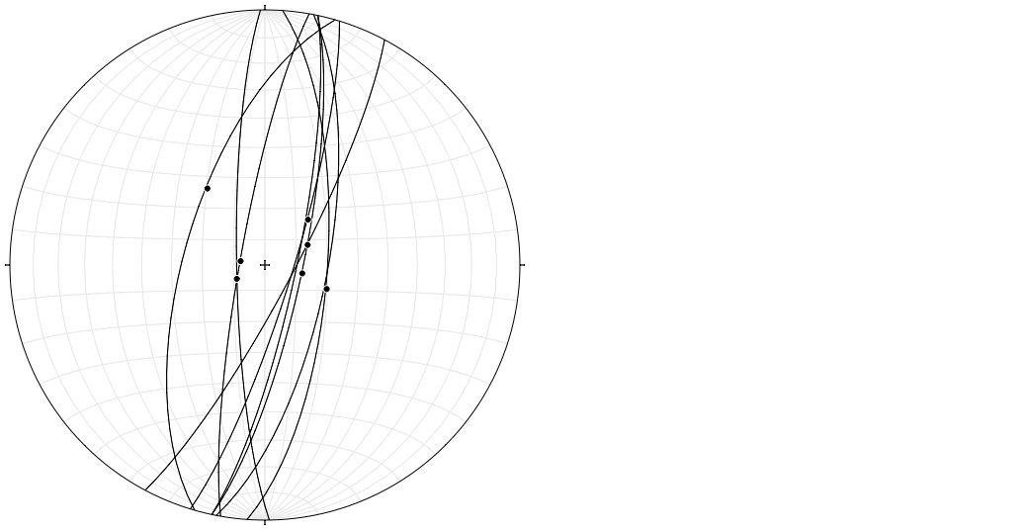
-Butte Valley
-BVF cuts qmz
-Steep limb fold along qmz
Mz plutonic
J volcanic
Pz + Tr sedimentary
Zn, Zj, & Zs metased
Yc + Zk metased
XY basement
BVF fault
& striae
Notes:
-Faults cuts Zj & Zs
& ~151 Ma IDS

Slide 10
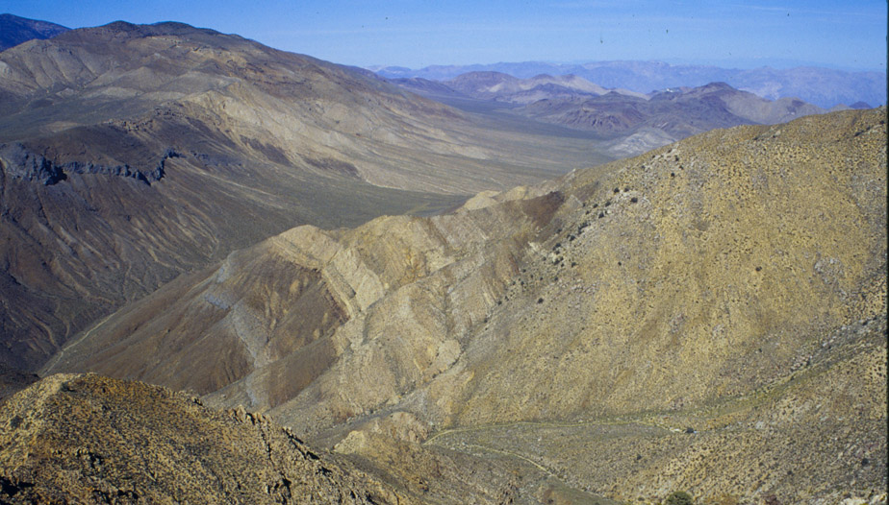
Manly Peak rim syncline
Zj
Zs
Zn
Zk
Zj
qmz
Zn
Zk
Late-stage pluton sinking
(Glazner & Miller, 1997)

Slide 11
- Goler Wash
Mz plutonic
J volcanic
Pz + Tr sedimentary
Zn, Zj, & Zs metased
Yc + Zk metased
XY basement

Slide 12
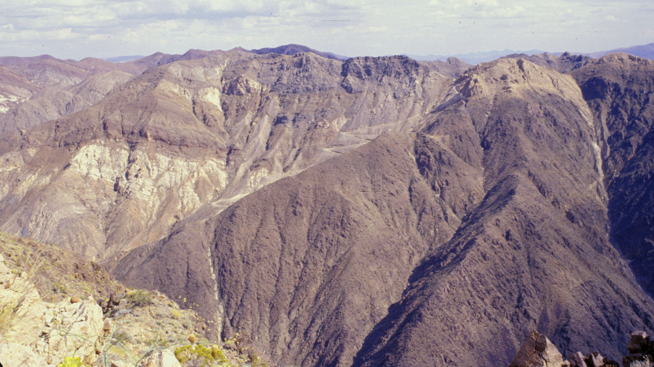
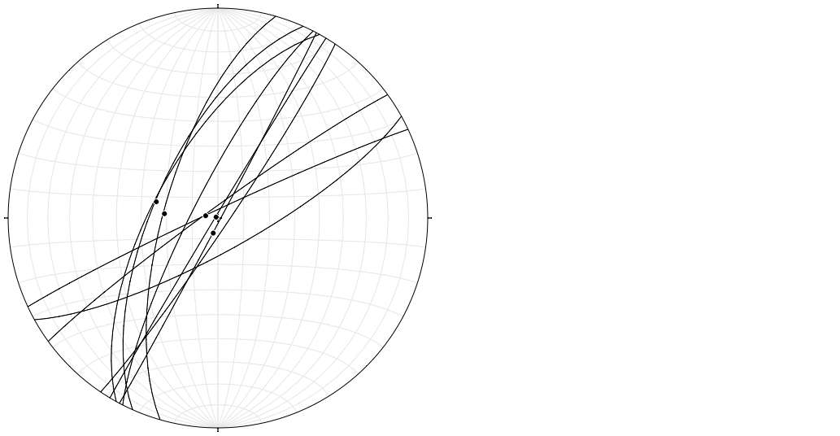
\
BVF in Goler Wash
Cb
Cc
Zn
Cz
Zk
Cw
Zs
Xg
BVF fault & striae

Slide 13
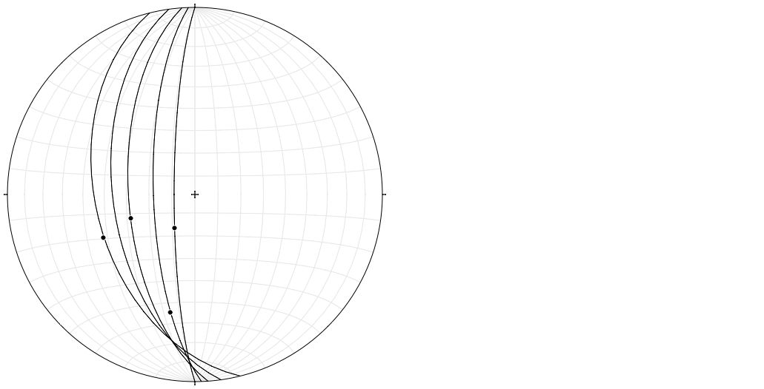
-Crescent Mines
BVF fault & striae
Mz plutonic
J volcanic
Pz + Tr sedimentary
Zn, Zj, & Zs metased
Yc + Zk metased
XY basement

Slide 14
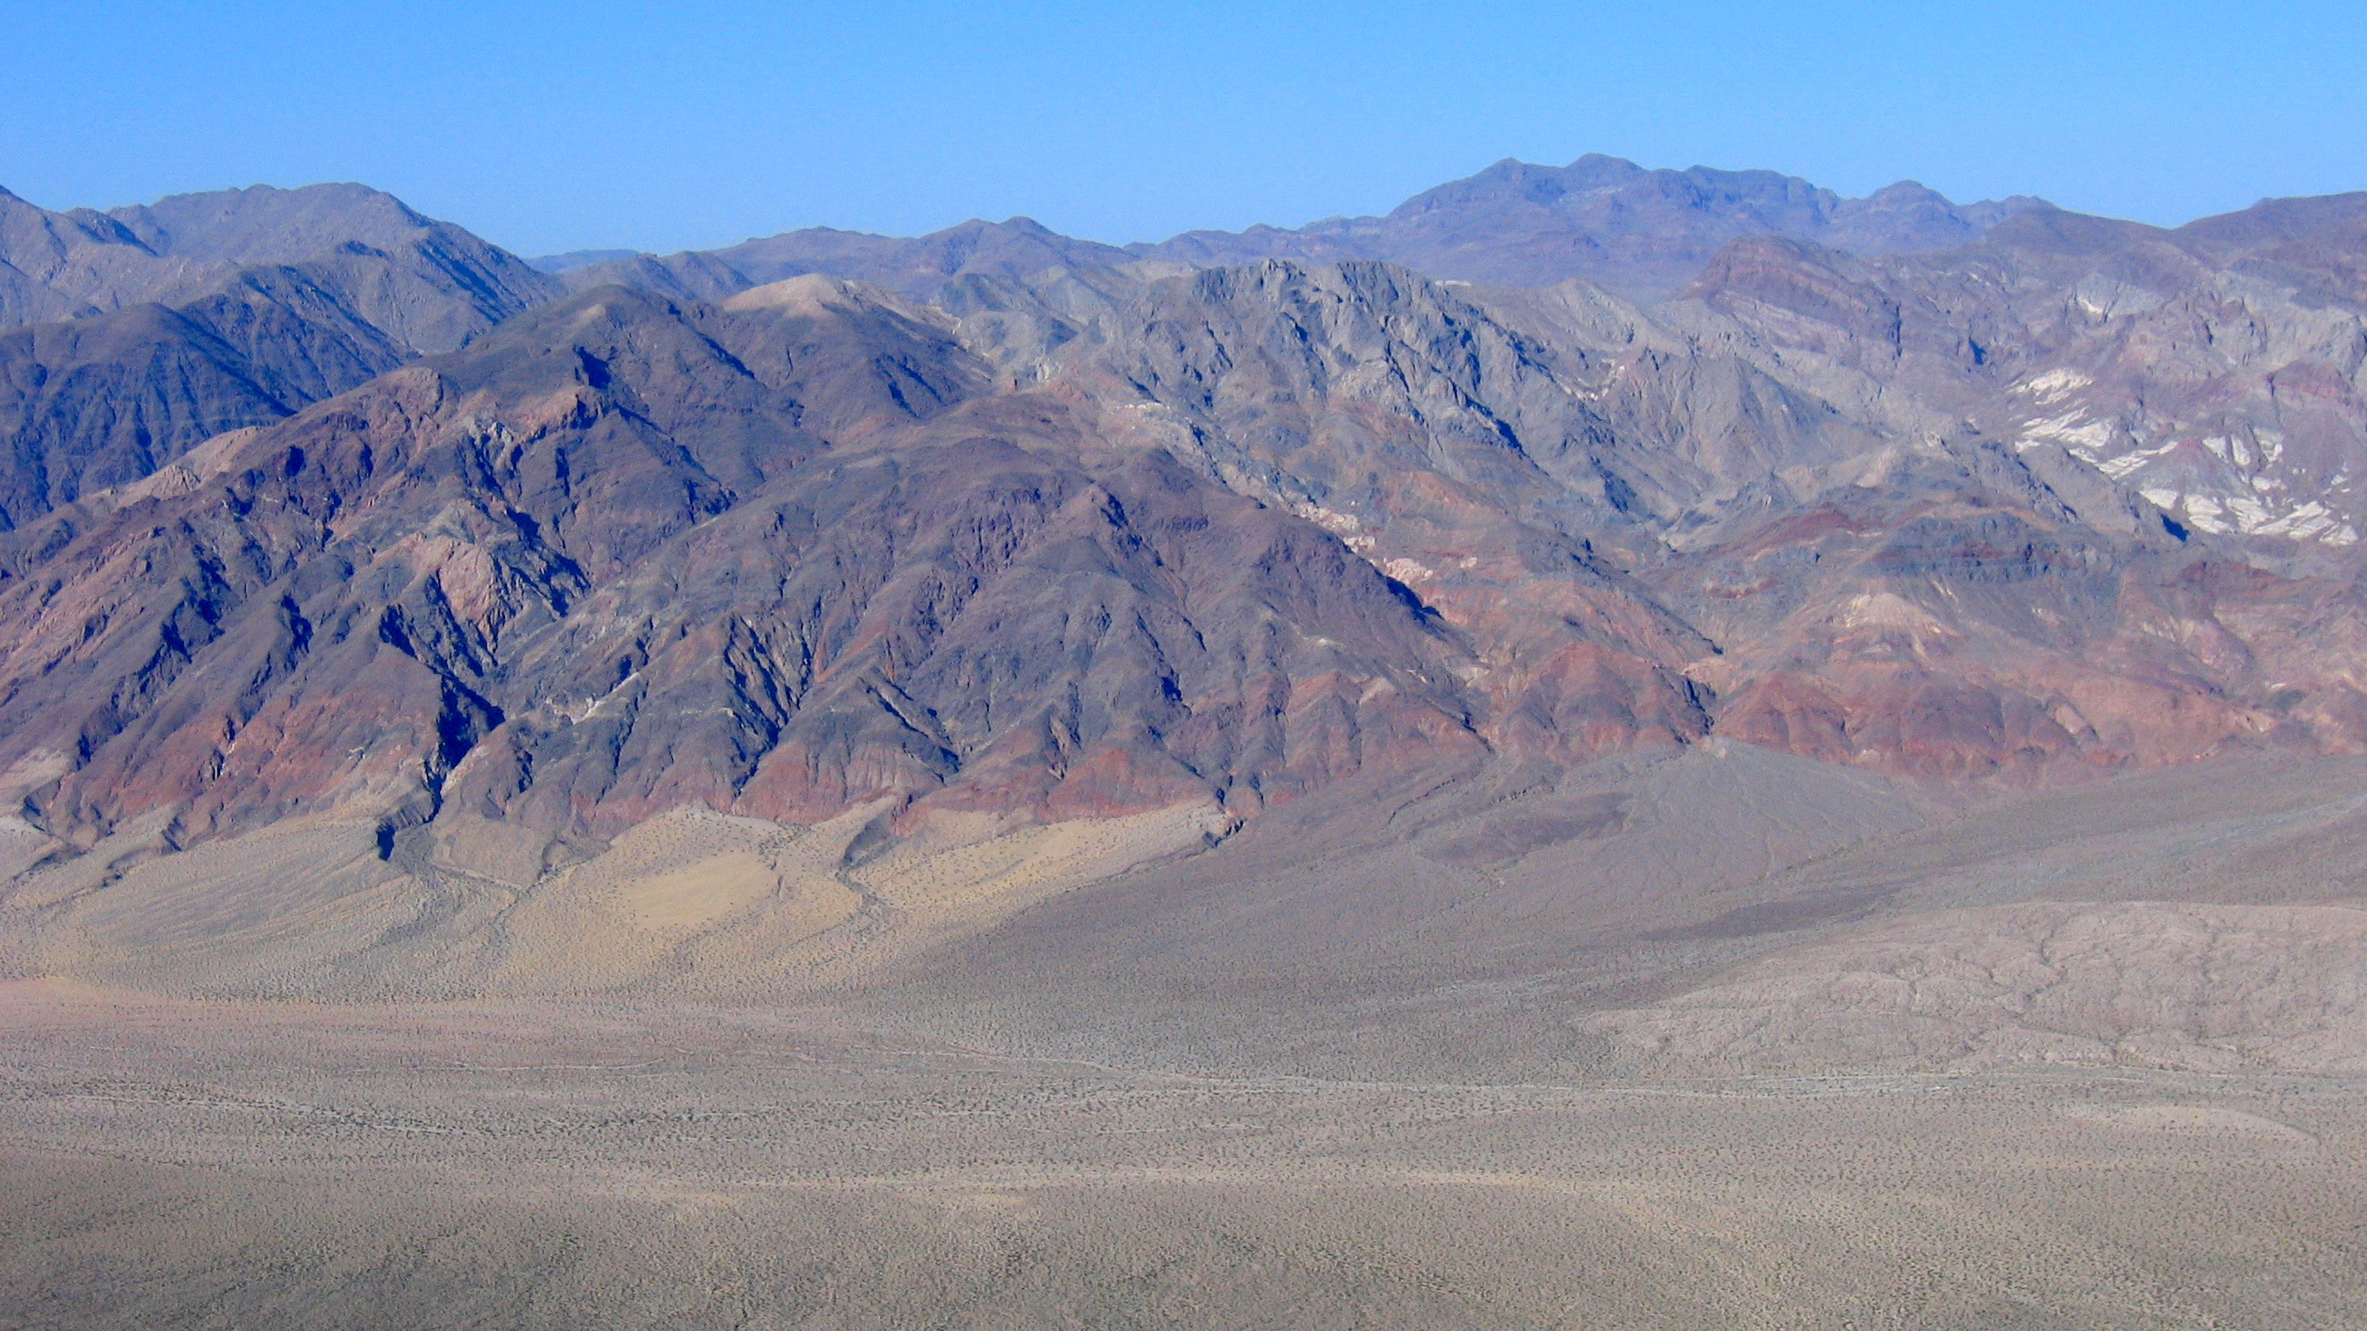
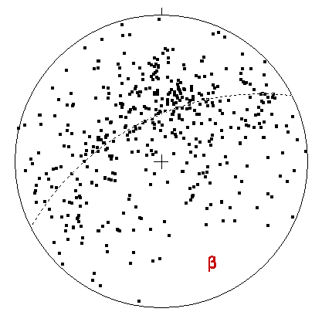
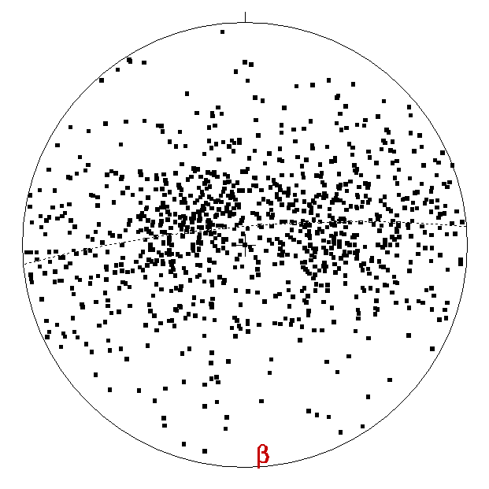
Crescent Mine
Zn
Cb
Zk
BVF
Yc
Top-NE
Yc
Cc
Gold Bug
Cz
Cc
Top-E
Zk
Zk
Zk
Zk
Top-E
Follow thrust northward: X & Y over Z
Kpc is mylonitic granodiorite with top-east fabrics
Kpc = 82.536 ±0.048 Ma
Therefore BVF faulting between 151 & 83 Ma
Notes:
BVF cuts top-NE (J) thrust faults in Cambrian
then curves to south with west dips
intersection with top-E (LK) thrust system along W range flank
Jh = 177.721 ±0.074 Ma, Ksp = 109±1 Ma &

Slide 15
BVF-WSCF
Connect BVF & WSCF
-magnitude offset
-relative timing
Mz plutonic
J volcanic
Pz + Tr sedimentary
Zn, Zj, & Zs metased
Yc + Zk metased
XY basement

Slide 16
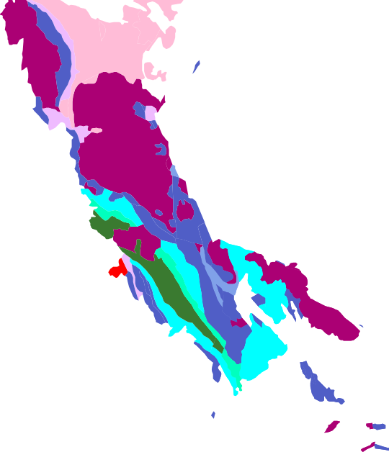
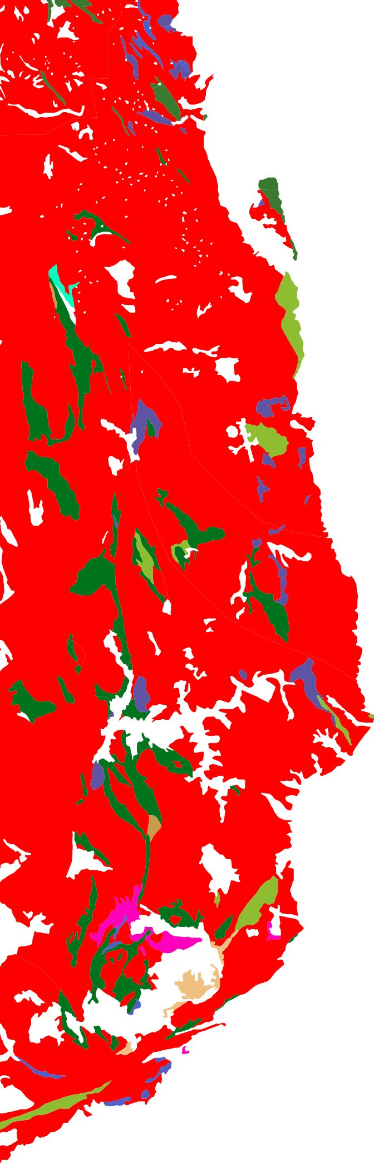
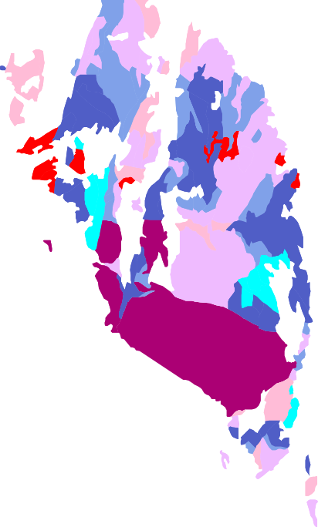
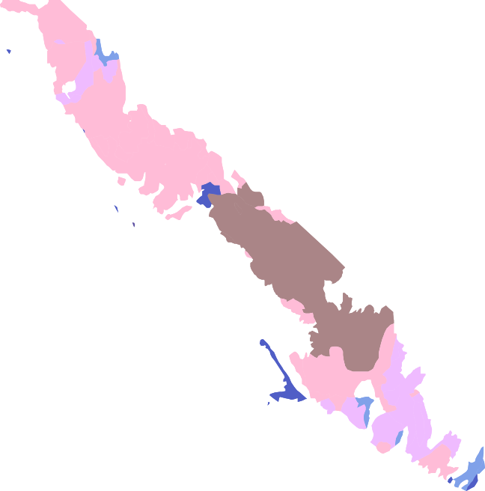
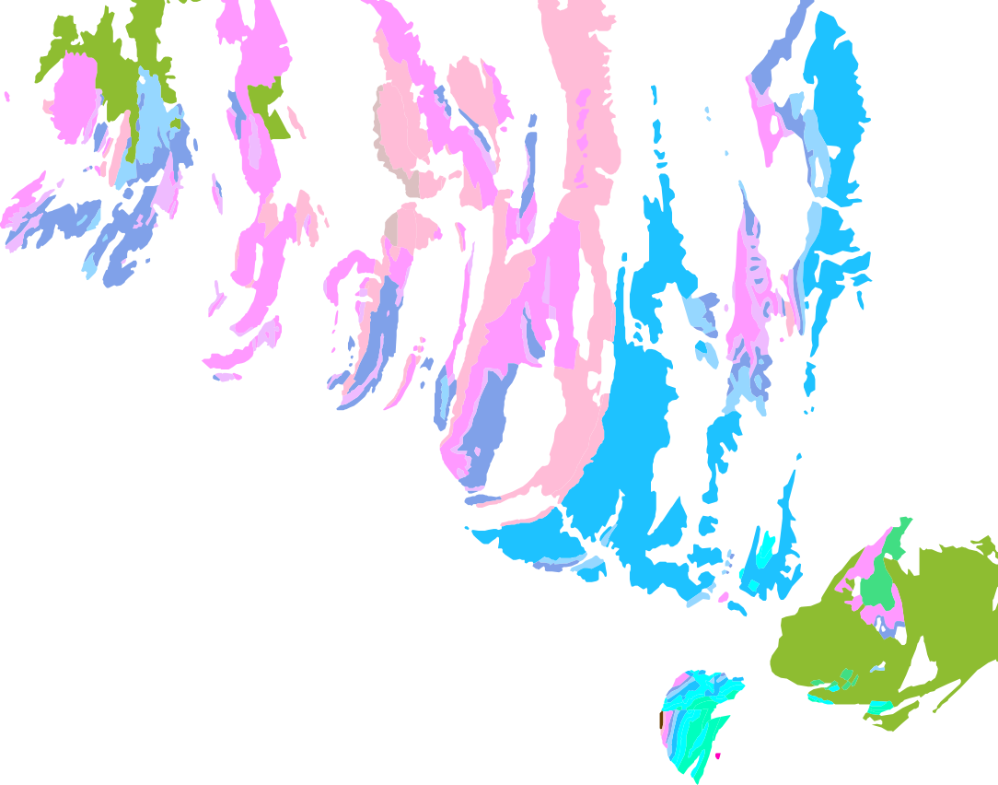
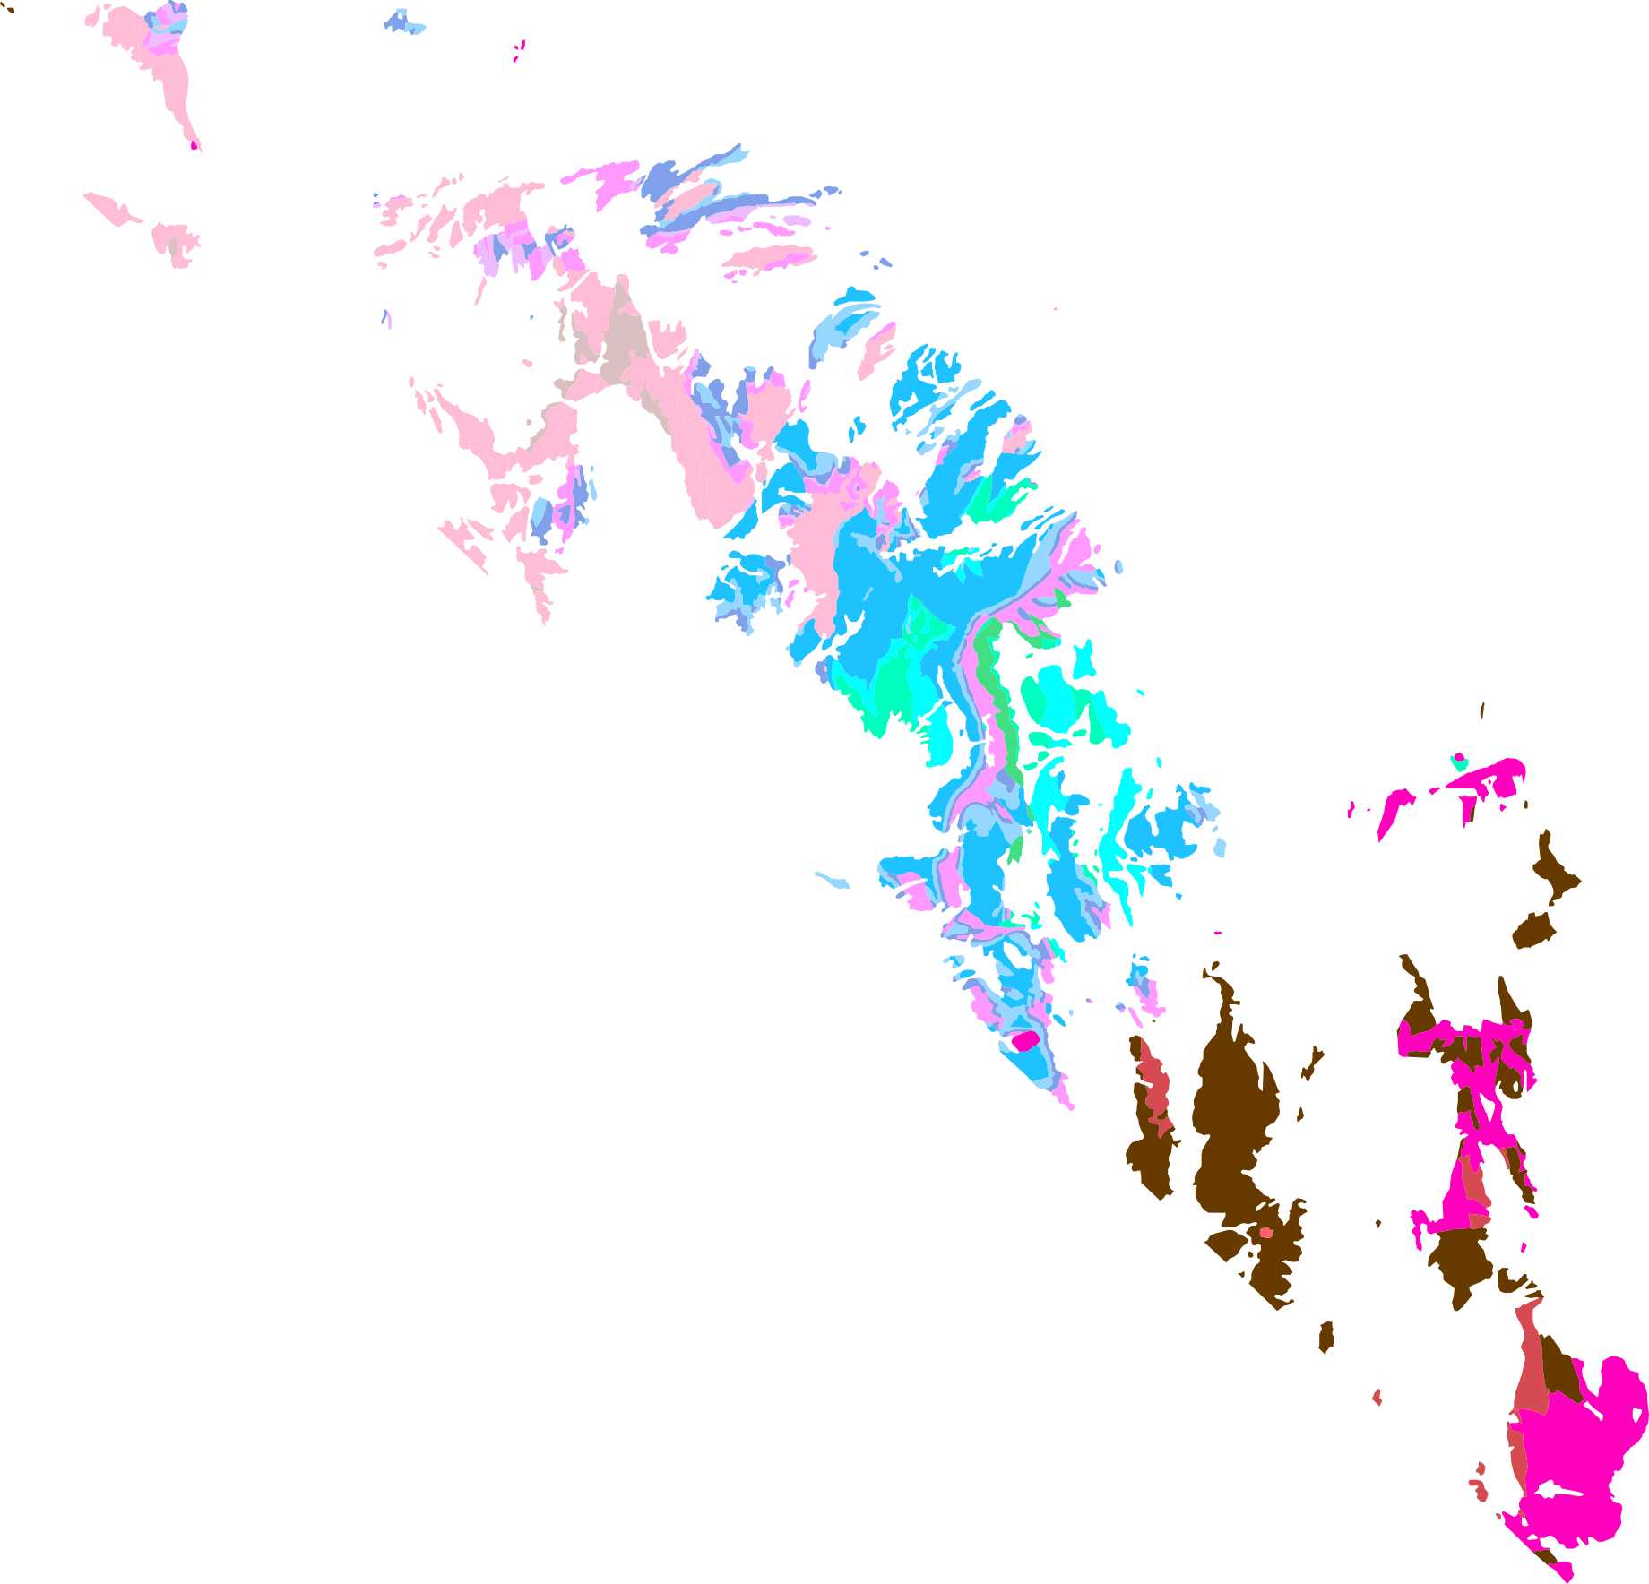
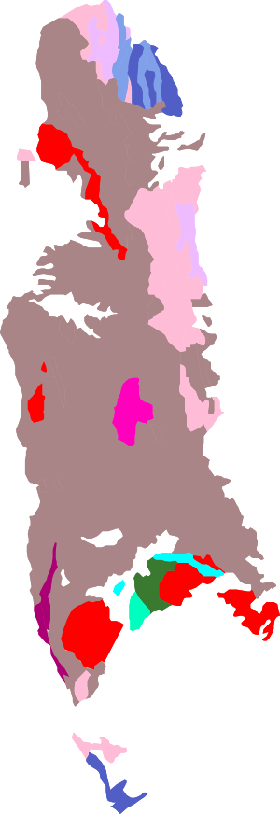
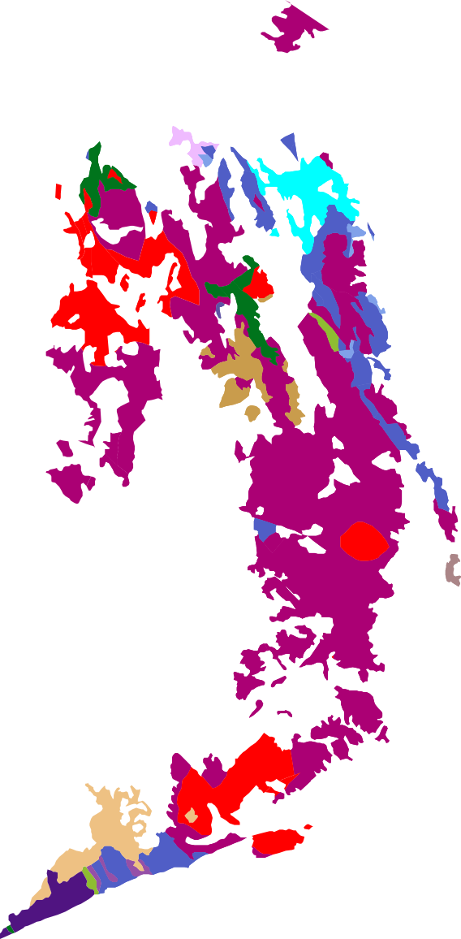
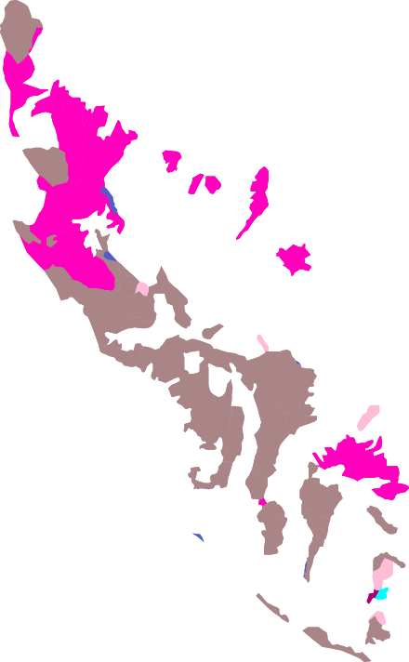
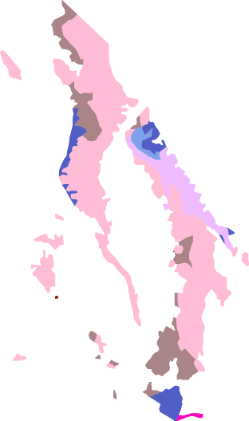
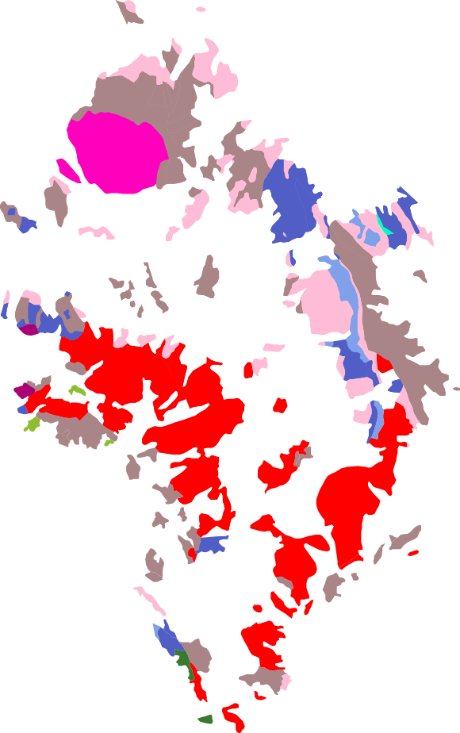
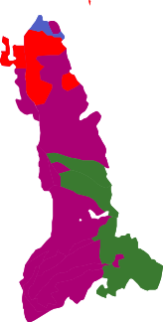
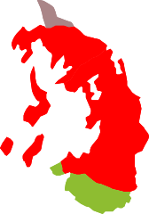


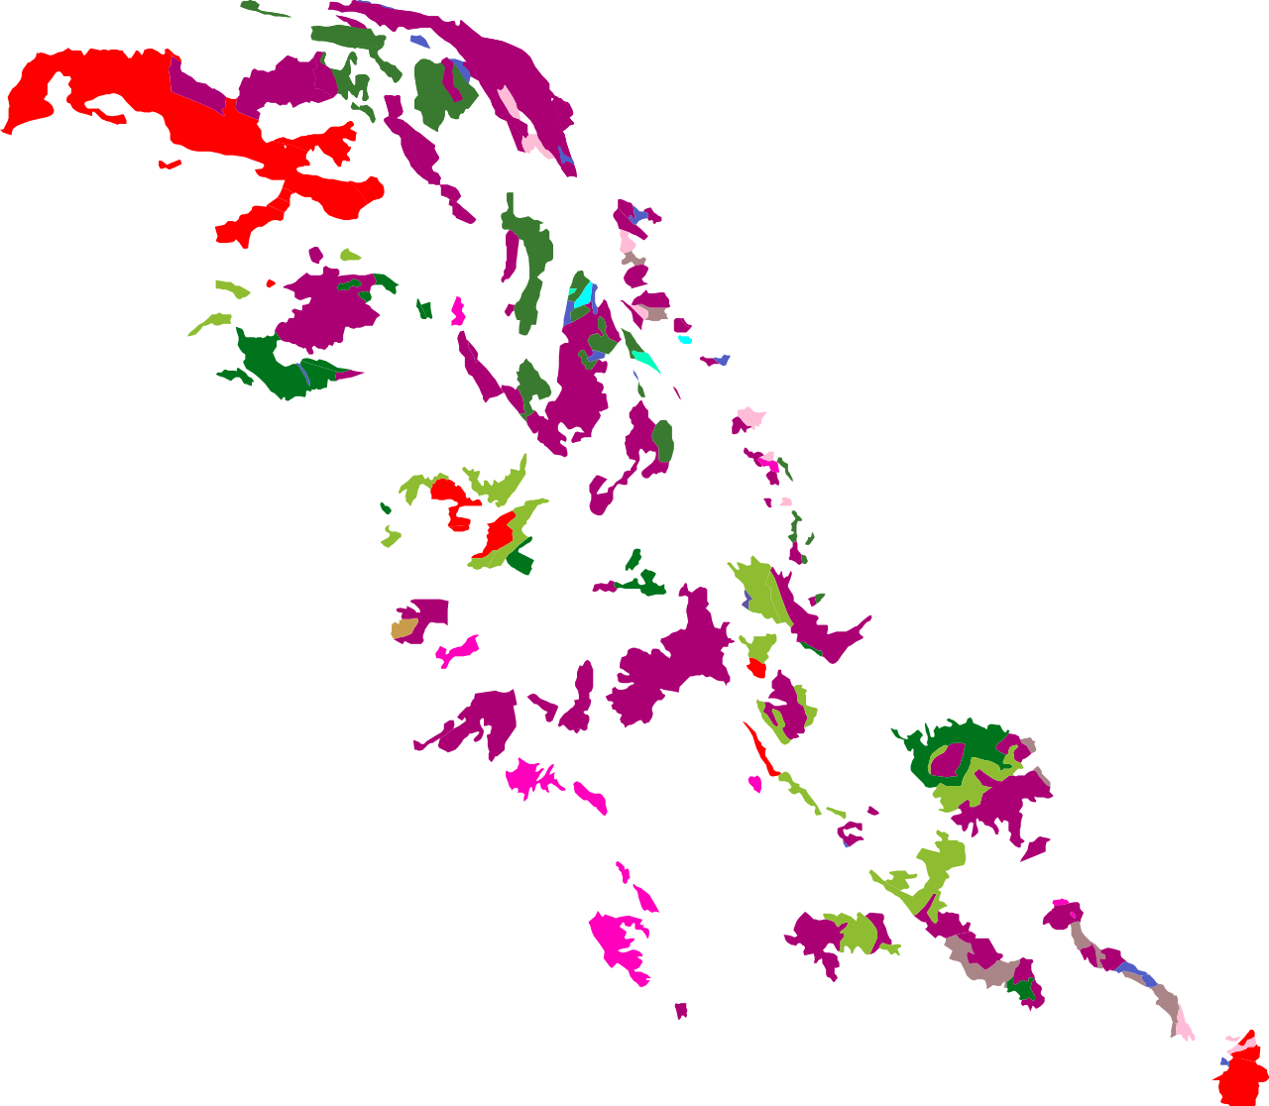
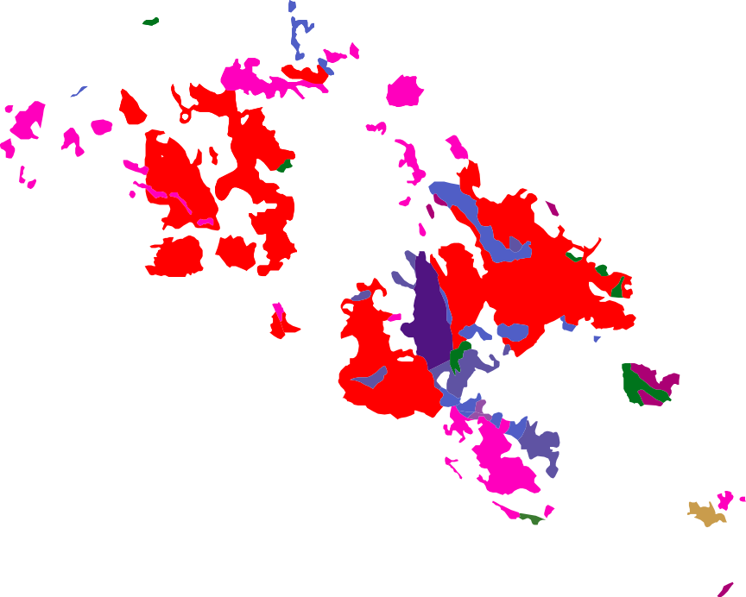
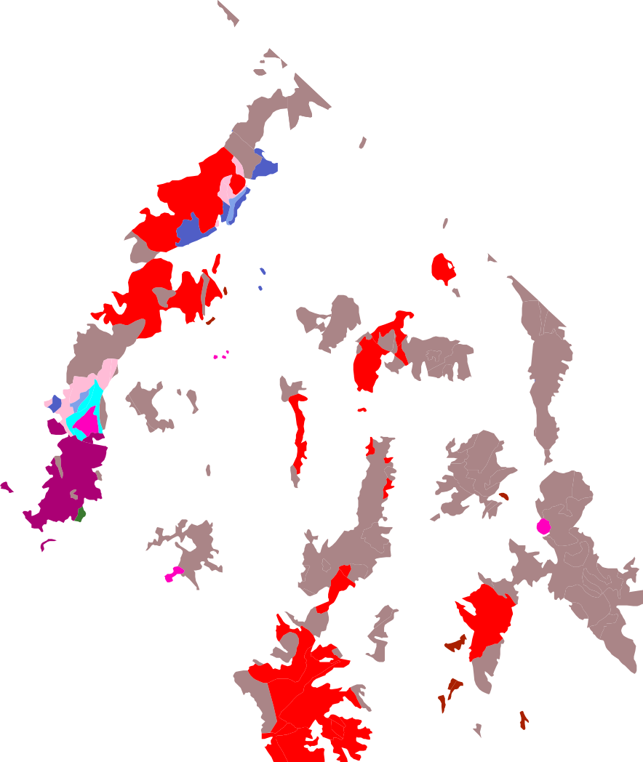
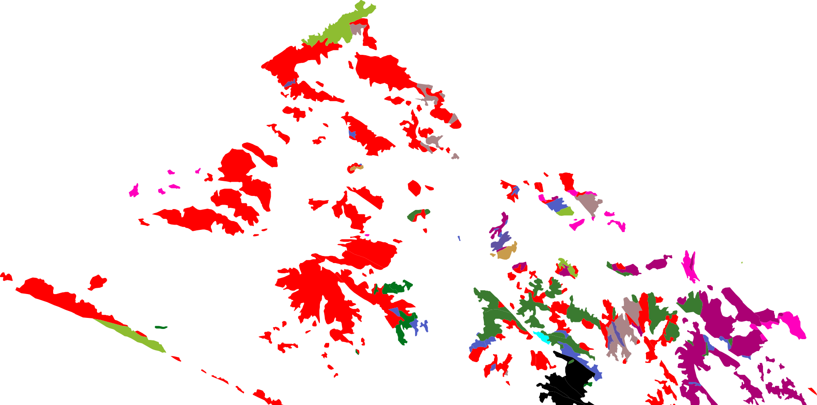
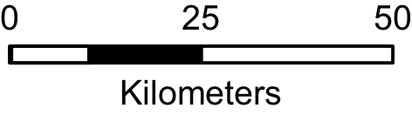
Similar faults to BVF-WSCF?
I-15
100 km

Slide 17
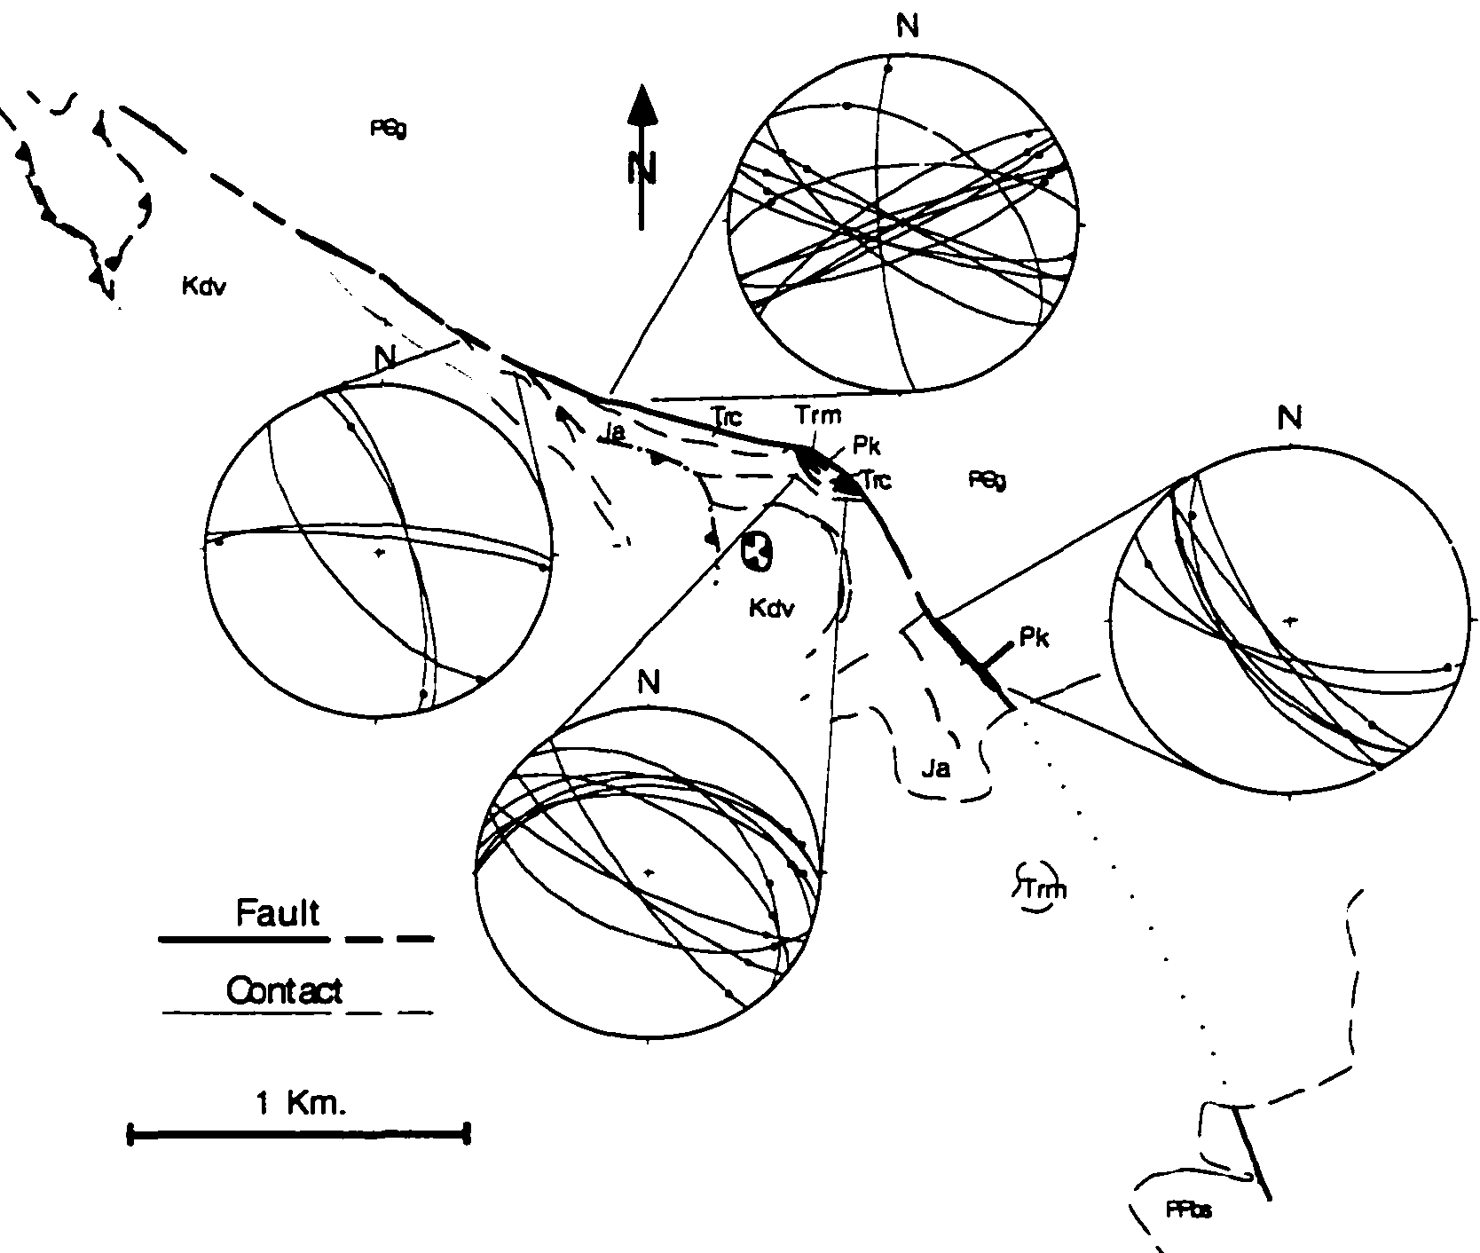
South & Kokoweef fault system
(Ramsdell, 1999)
100 & 83 Ma
(Ramsdell, 1999)
Implications
Linked normal-sinistral at 100-83 Ma
Restoration marker
  Vector = azimuth
  <100 km displacement of DV?
Notes:
Few similar structures of this age & style in region
One potential match is at Mountain Pass (I-15)
South-Kokoweef-Slaughterhouse fault system
Subvertical, ESE to SSE strikes
Sinistral slip
Cuts 100.5 Ma volcanics (Fleck et al., 1994)
Nearby Late K thrusting between 100 & 83 Ma (Fleck et al., 1994)
Thrusting interpreted to deform South fault (Ramsdell, 1999)
This area also has J & K plutons & J & K thrusts (Walker et al., 1995)

Slide 18
Restoration Model

