Slide 1
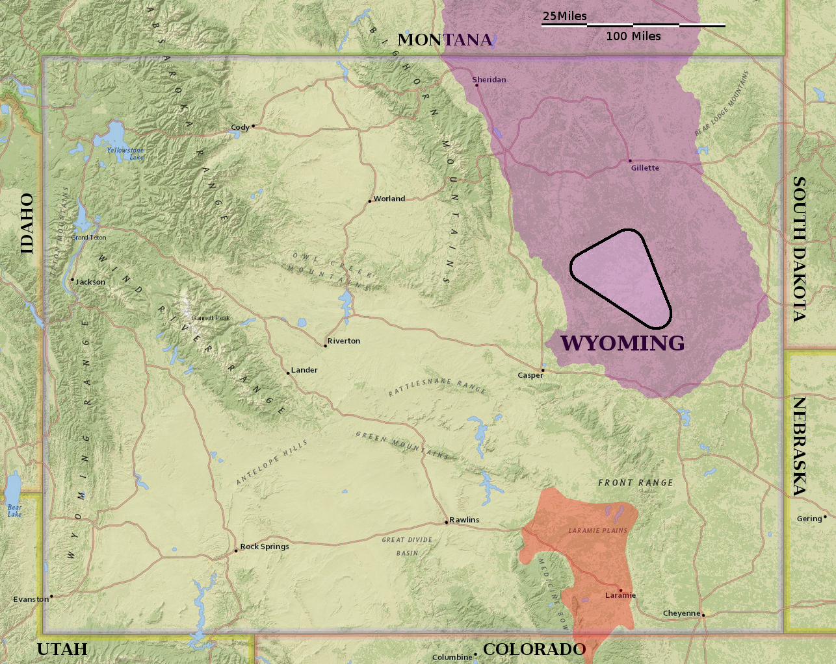
Water chemistries associated with light and heavy oils in the Powder River Basin and Laramie Basin, Wyoming
Charles Nye and Mahdi Shahabadi
University of Wyoming

Slide 2
Southern
Powder
River
Basin
Laramie
Basin

Slide 3
Expectations and Conclusions
In Wyoming’s Powder River Basin:
In Wyoming’s Laramie Basin:
  30 waters
  7 formations
  50 miles apart
  All Cretaceous
  11 waters
  2 formations
  1 mile apart
  Mesozoic and Paleozoic
Expected to be diverse
Expected to be similar
Result: Remarkably similar in major ions
Result: Forms two distinct groups matching the two formations

Slide 4
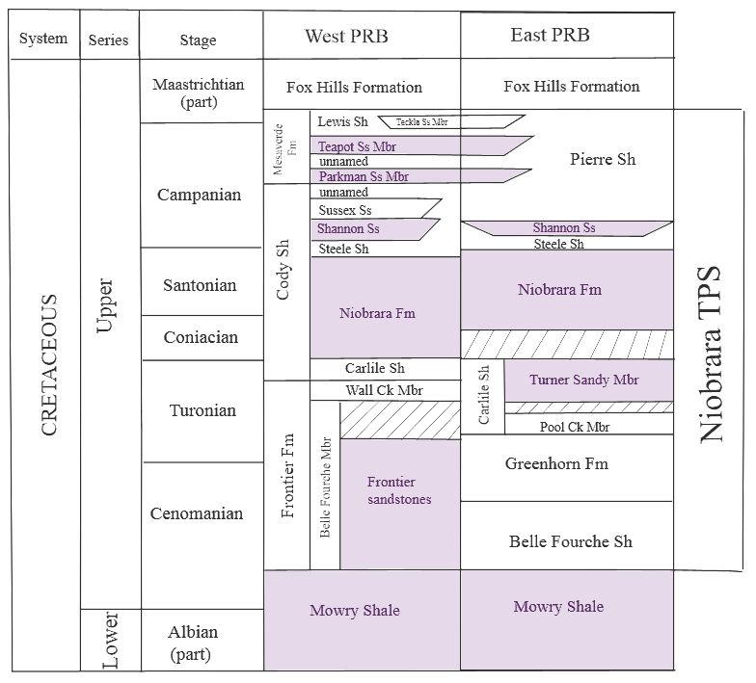
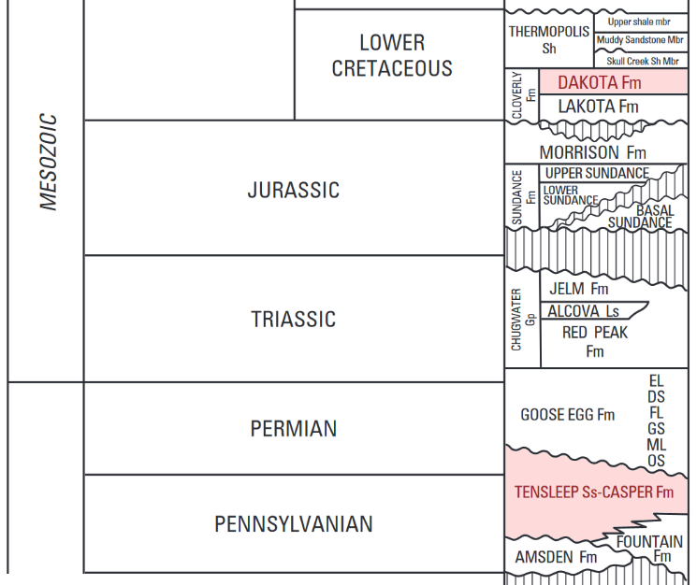
Strata sampled
Powder River Basin:
Laramie Basin:
Teapot
Parkman
Shannon
Niobrara
Turner
Frontier
Mowry
Light Oil (condensate)
  Dakota
  Tensleep
  Heavy Oil (tar)
Top modified from Lawrence O. Anna,
Bottom modified from Thaddeus S. Dyman and Steven M. Condon

Slide 5
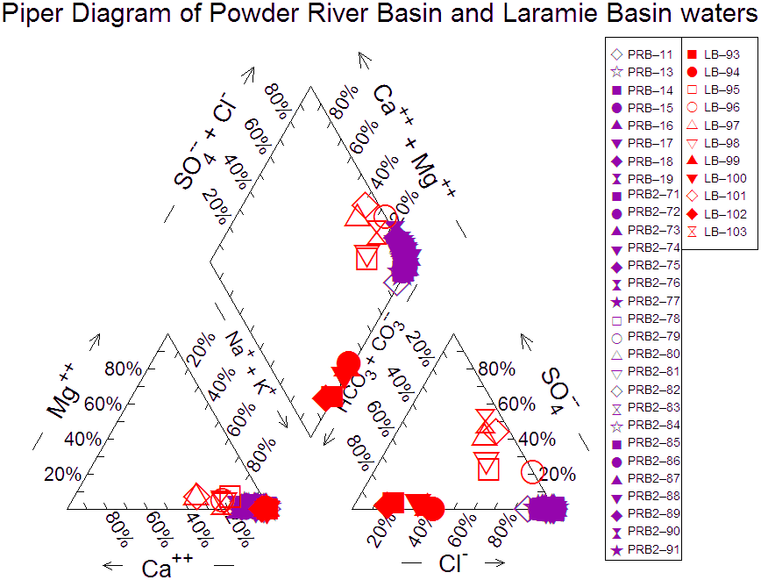
Two basins, three distinct groups.
All Powder River Basin waters are NaCL-type.
Some Powder River Basin samples have minor HCO₃⁻ and Ca⁺.
The Laramie Basin waters form two distinct groups.
One group is SO₄⁻⁻ rich, and the other is HCO₃⁻ rich.
This points to two distinct reservoirs.

Slide 6
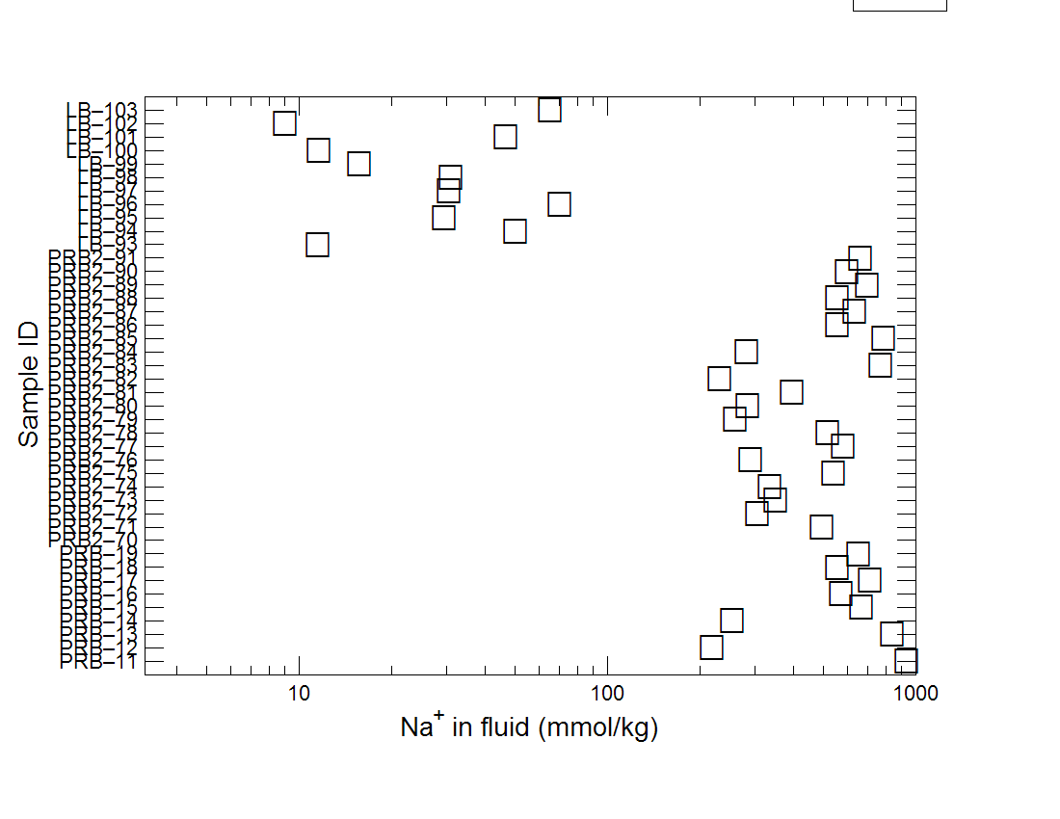
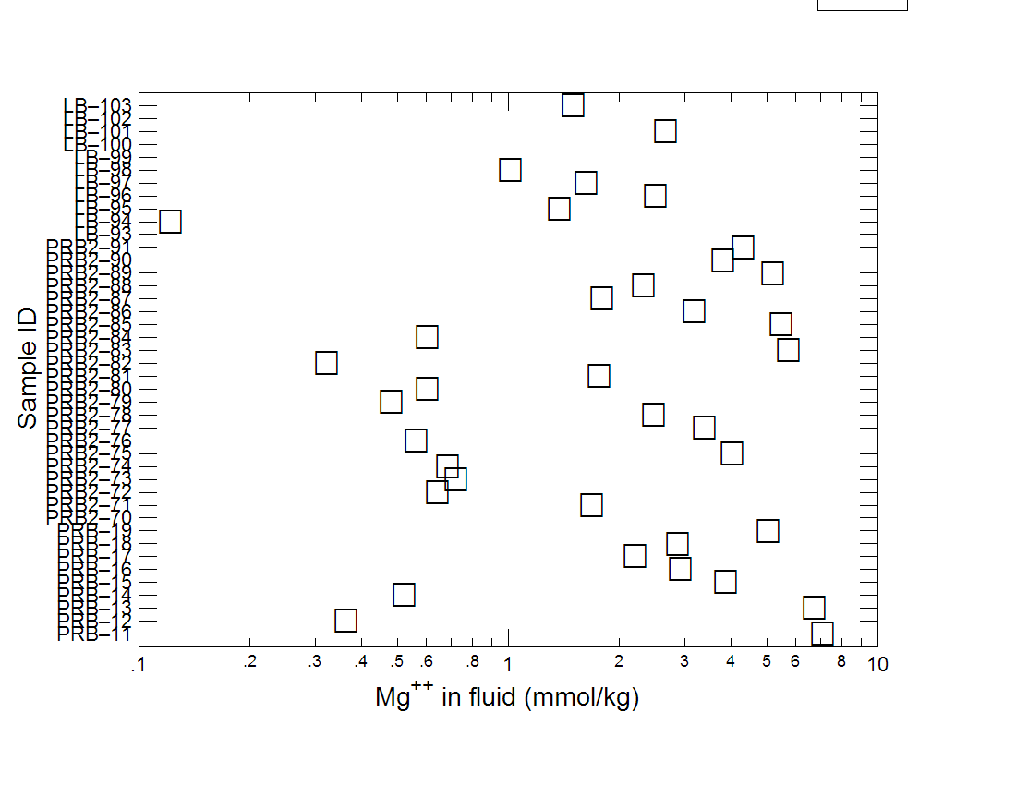
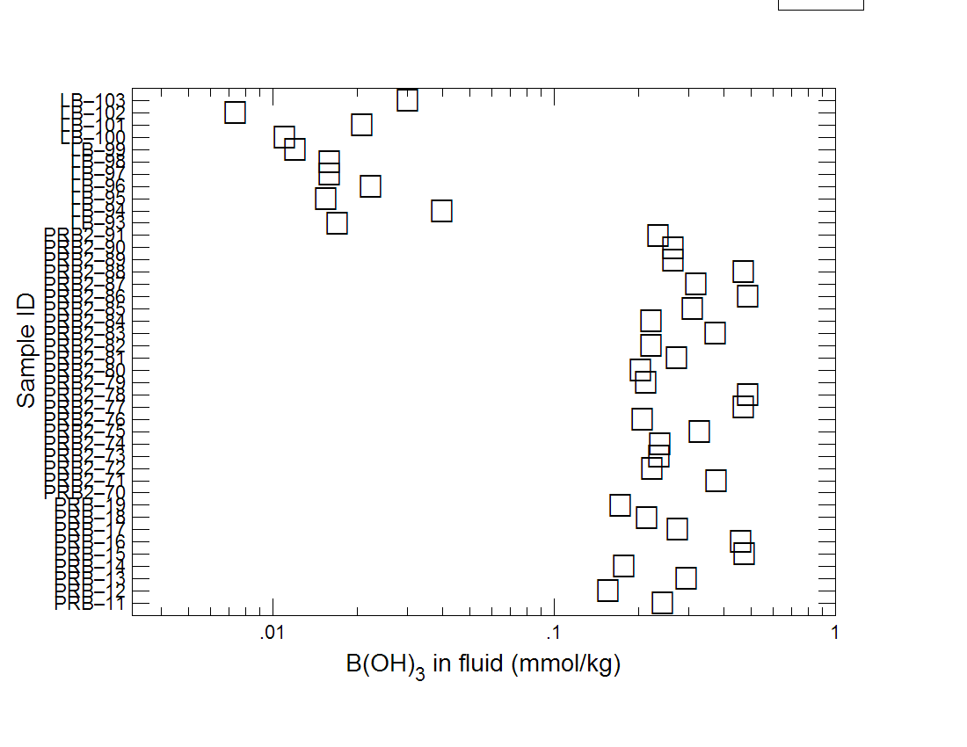
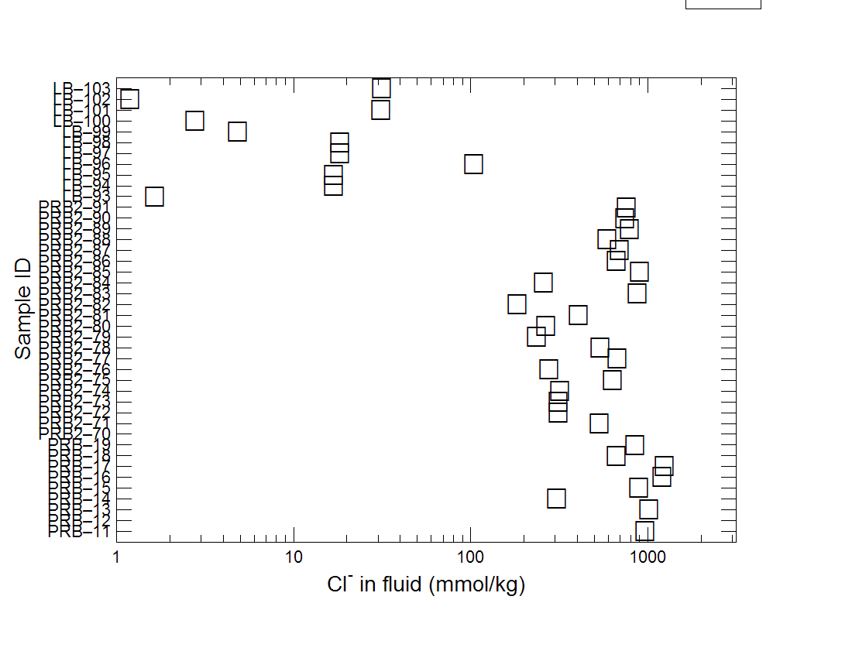
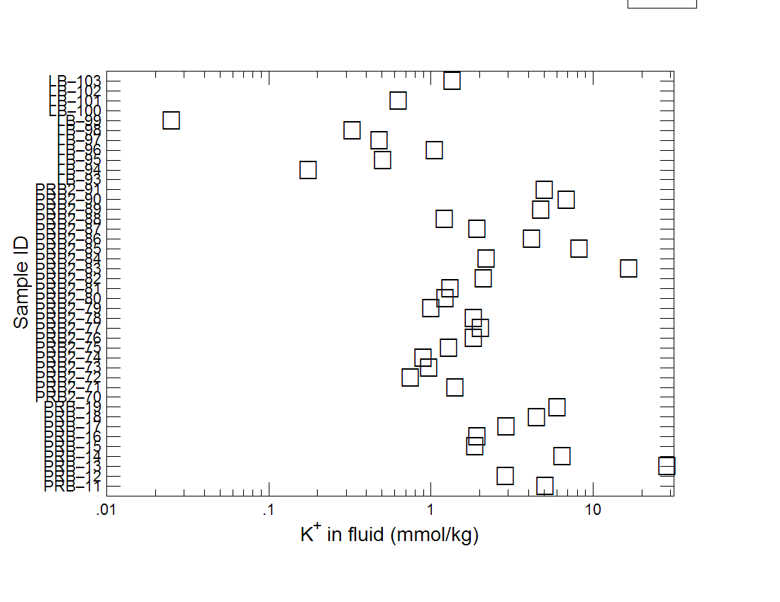
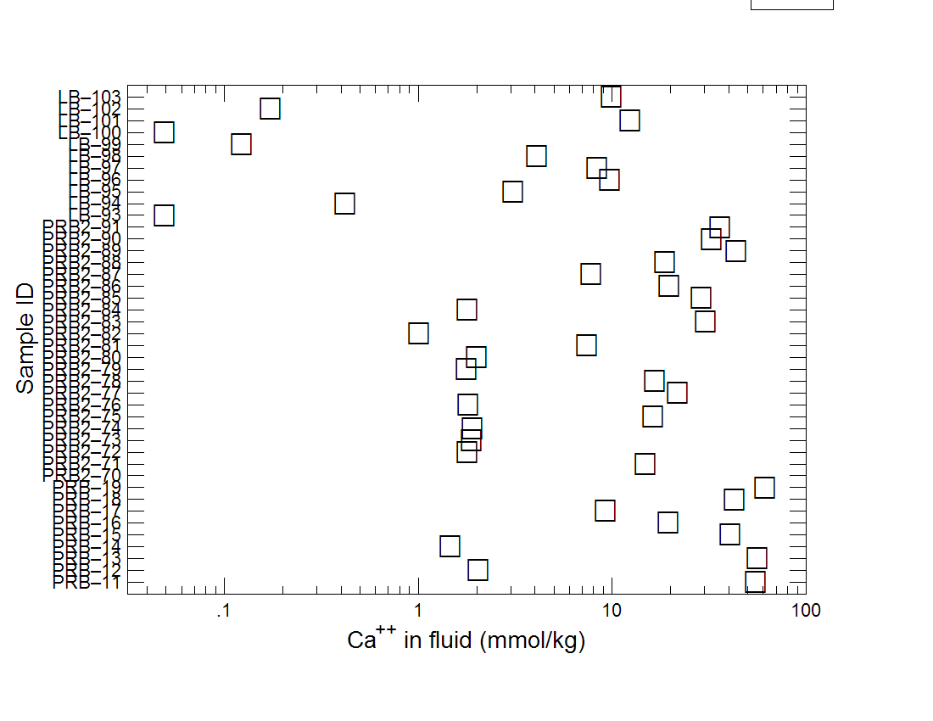
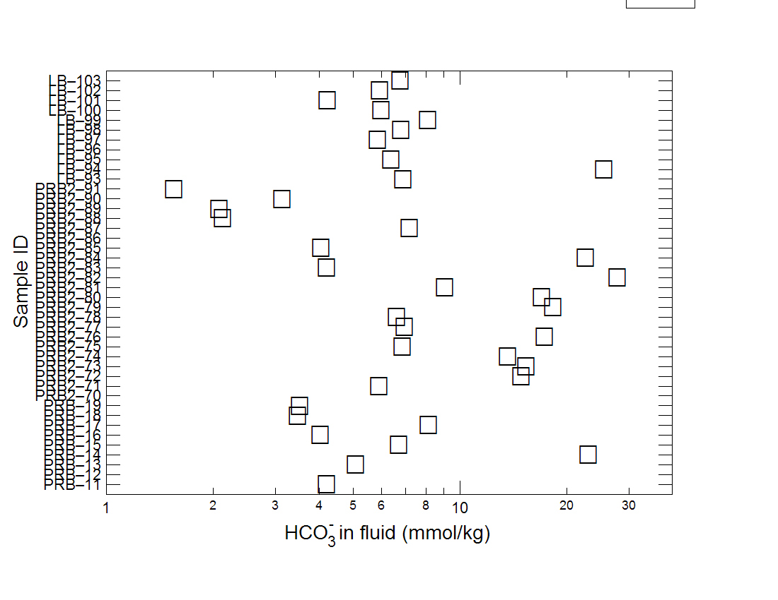
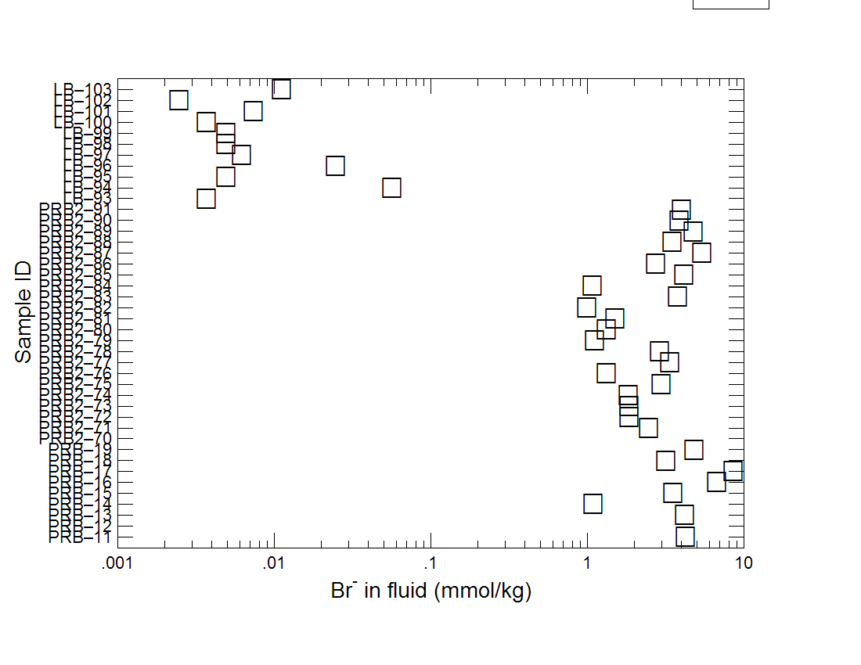
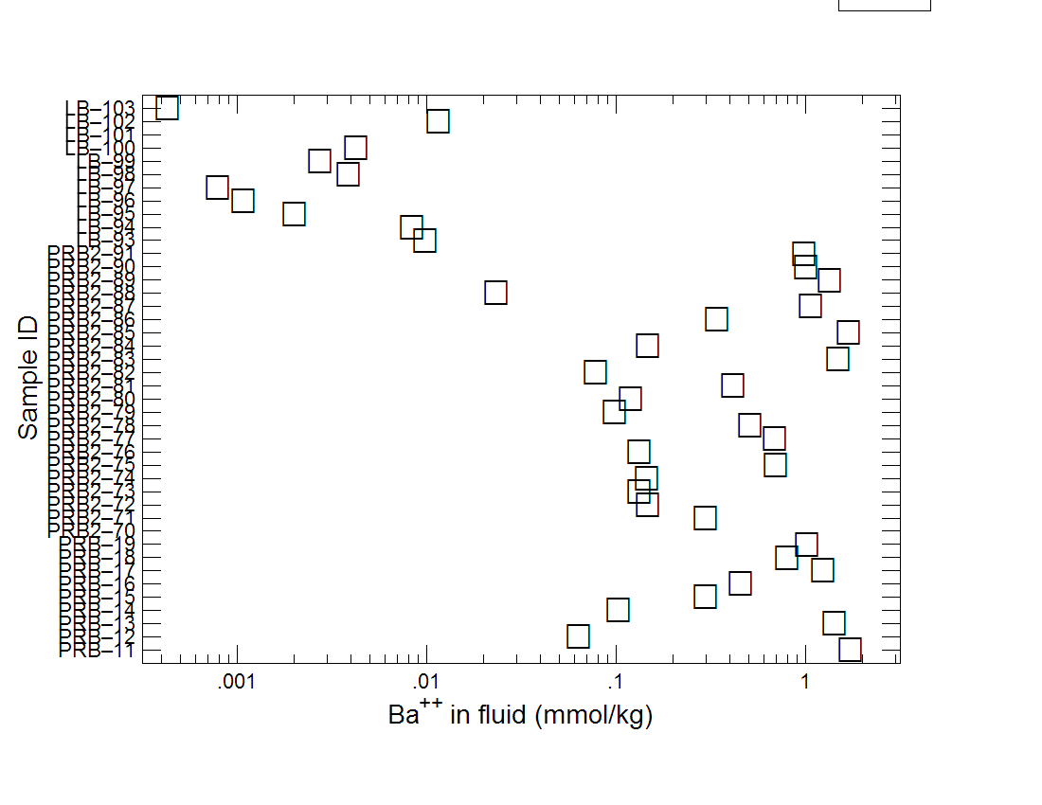
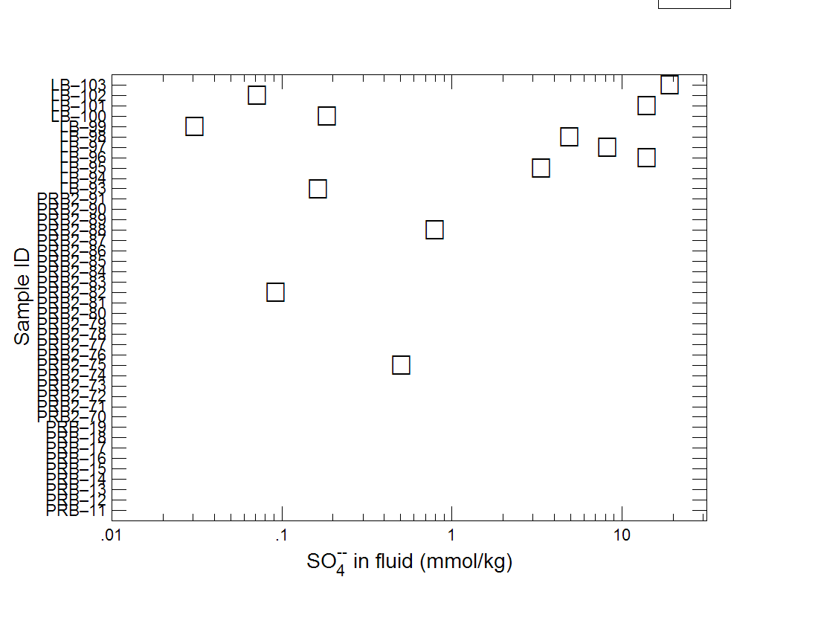
LAR and PRB split on:
Na, B, Cl, Br, and Ba
LAR’s halves split on:
Mg, Ca, SO4, K*, and HCO3*
*hard to see here

Slide 7
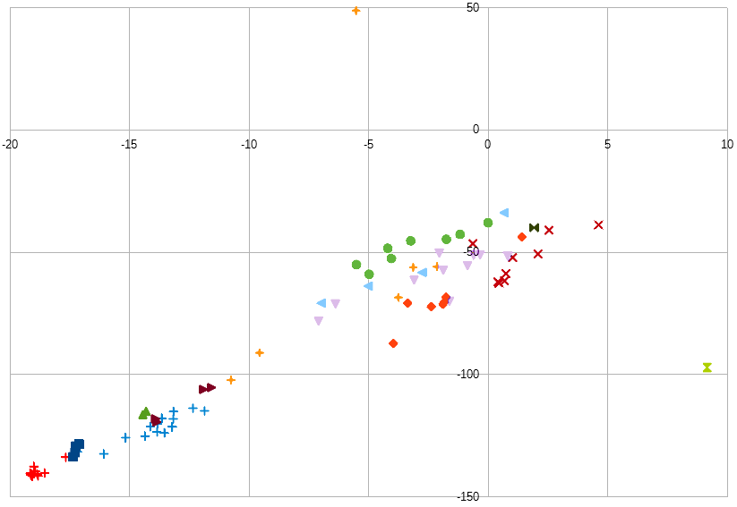
Stable isotopes of water
Laramie Basin samples plot alongside the Blanks made from Laramie Municipal Water, this is slightly right of the local meteoric water line.
Powder River Basin samples are slightly right of the local meteoric water line.
Blanks

Slide 8
Explanation
Powder River Basin:
Laramie Basin:
More saline, to the point that is all that manifests in the data.
Many formations, same time-series of deposition.
Similar water history
Less saline, allowing more nuanced chemistry to be seen.
Only two formations, but very different: Dakota-Tensleep
Acidic vs neutral-acidic
Sweet vs sour crude oil?
Possible fast recharge, Rock ctrl?

Slide 9





Thank you
This work:
University of Wyoming
Office of Water Programs
Past work:

