Slide 1




Hydrogen Fractionation during Earth’s Core Formation: High-Pressure TEM Experiments
Jun Wu^{1,2}, Helene Piet¹, Sang-Heon (Dan) Shim¹, Kurt Leinenweber², Peter R. Buseck^{1,2}
¹School of Earth and Space Exploration & ²School of Molecular Sciences
Arizona State University
Notes:
Good afternoon, everyone. First of all, I would like to thank the session organizers for giving me such a great opportunity to stand here. In this talk I am honored to present a research that I am collaborating with Professor Peter Buseck, and its title is as displayed here --- Hydrogen Fractionation during Earth’s Core Formation: High-Pressure TEM Experiments.

Slide 2

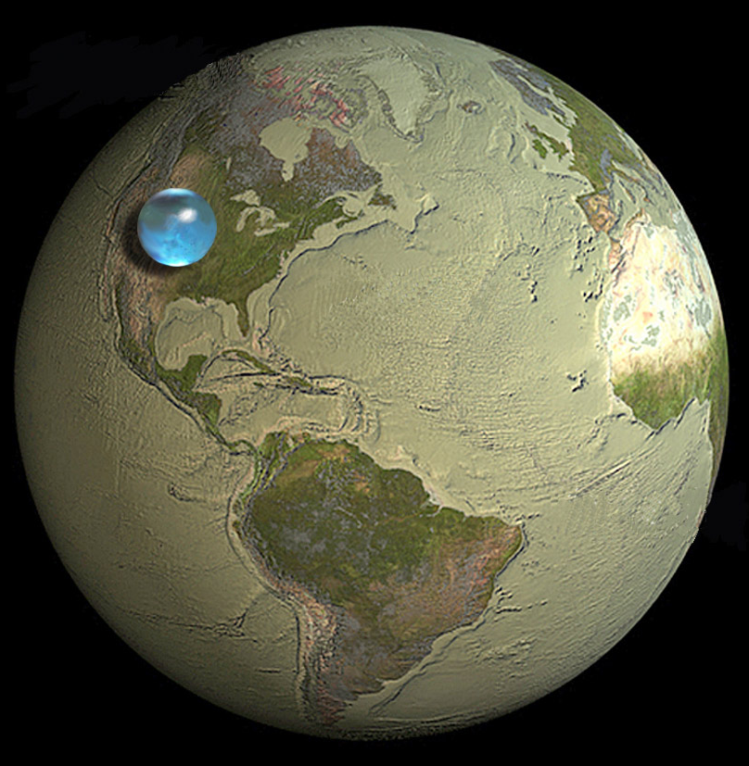

Earth: Ocean Planet with Hidden “Water”
Credit: NASA
Credit: USGS
Surface (H₂O)
Mantle (OH)
Core (FeH_{x})
?
?
Understanding the origin of water requires understanding the origin of hydrogen
Notes:
Earth is our home planet covered with vast water bodies on its surface. If all the surface water is accumulated into a gigantic sphere, its diameter would be about 860 miles, less than half of the width of the North America continent. This sounds perhaps not a big amount. However, scientists now realize there may be even more water underneath. If we define the amount of water in this gigantic sphere as one ocean, Earth’s silicate mantle, particularly the transition zone, can hold as much water as two oceans in the form of hydroxyl, according to both geophysical and geochemical evidences. Considering the importance of water, an interesting question would be raised naturally --- where did all this water come from? In fact, this question emerged centuries ago and nowadays it is still being constantly asked.
We know water is made of hydrogen and oxygen. As Earth has abundant oxygen, the question on the origin of Earth’s water is equivalent to that on the origin of Earth’s hydrogen. In terms of this viewpoint, the question is likely further complicated by possible existence of a substantial amount of hydrogen in Earth’s core, which is expected to occur in the form of iron hydride. However, nobody knows exactly how much hydrogen is there, and current estimates range from a trace amount up to 100 oceans.

Slide 3
Origin of Earth's Water: Chondritic Inheritance + Nebular Ingassing
1 – 2 Myr
Wu et al. (2018, JGR-Planets)
Notes:
Recently we brought up a new model on origin of Earth’s water, in which we consider both chondritic contribution and nebular ingassing of hydrogen. The model integrates into the framework of planetary formation theory, and is consistent with our current understanding of the earliest Earth as well as some geochemical data. Basically, the formation of Earth is divided into six stages, first of which is idealized by occurrence of a number of planetary embryos during the first 1 to 2 million years of the solar system. They collectively contained about 7 to 8 oceans of chondritic water.

Slide 4
Origin of Earth's Water: Chondritic Inheritance + Nebular Ingassing
By 2 Myr
Wu et al. (2018, JGR-Planets)
Notes:
By 2 million years, planetary cores formed inside these embryos, during which majority of their hydrogen was delivered to the cores through iron hydrogenation. At the same time, negative isotopic fractionation of hydrogen occurred, putting light hydrogen or protium to the core and leaving heavy deuterium behind in the mantle.

Slide 5
Origin of Earth's Water: Chondritic Inheritance + Nebular Ingassing
2 – 3 Myr
Wu et al. (2018, JGR-Planets)
Notes:
Between 2 and 3 million years, the largest embryo ingassed a small but considerable amount of nebular gases, including hydrogen with a very low D/H ratio, into a magma ocean on its surface.

Slide 6
Origin of Earth's Water: Chondritic Inheritance + Nebular Ingassing
> 3 Myr
Wu et al. (2018, JGR-Planets)
Notes:
As the magma ocean solidified, its overturn entrained some low-D/H component to the core-mantle boundary, and convection mixed most of it with the mantle.

Slide 7
Origin of Earth's Water: Chondritic Inheritance + Nebular Ingassing
10 – 100 Myr
Wu et al. (2018, JGR-Planets)
Notes:
During the first 10 to 100 million years, these embryos impacted, cores merged, and mantles mixed, leading to formation of an Earth which is close to what we have now.

Slide 8
Origin of Earth's Water: Chondritic Inheritance + Nebular Ingassing
Today
Wu et al. (2018, JGR-Planets)
Notes:
According to our modeling results, the present Earth stores approximately 60% of its total hydrogen in the core, and the core has a considerably lower D/H ratio than the mantle. Besides, the more important outcome probably is that one to two percent of Earth’s total water is determined to have originated from nebula hydrogen. Nevertheless, it should be stressed that these numbers are calculated based on some typical chemical properties of the iron-hydrogen system at relatively low pressures and temperature. To validate this model with best confidence, experimental measurements of those properties are needed.

Slide 9

Dependence of Ingassing Model on Hydrogen Fractionation
⎯ Fractionation factor: $α= \frac{{\left(\frac{D}{H}\right)}_{iron }}{{\left(\frac{D}{H}\right)}_{mantle}}$ $≈\frac{{\left(\frac{D}{H}\right)}_{iron}}{{\left(\frac{D}{H}\right)}_{H_{2}} }$
⎯ The ingassing model requires α < 0.92
⎯ A low α implies an increasing nebular contribution to Earth’s water
Notes:
Among those chemical properties, isotopic fractionation factor of hydrogen between iron and magma ocean is particularly important. We have shown that this property is approximate to that between iron and molecular hydrogen. In our modeling, we notice that this factor is required to be less than 0.92; otherwise, the model has no solutions. The smaller alpha is, the greater nebular contribution to Earth’s water is found.

Slide 10
Experimental test of nebular ingassing model requires:
1) α at magma-ocean conditions
⎯ most difficult because FeH_{x} decomposes quickly at low pressure
⎯ no experimental data exist
2) hydrogen solubility in iron under same conditions
⎯ estimated from volume fraction of “bubbles” (Okuchi, 1997, Science)
× 5
50 μm
Notes:
As a result, experimental test of the nebular ingassing model requires direct measurement of alpha. Unfortunately, this task is highly challenging because iron hydride, the product of hydrogen dissolution in iron, decomposes quickly once pressure is removed. Similar problems exist for measurement of hydrogen solubility in iron at high pressure, although Okuchi made an effort to obtain an indirect estimate by resorting to the volume fraction of bubbles that were generated during hydrogen escape from the surface of a quenched sample.

Slide 11
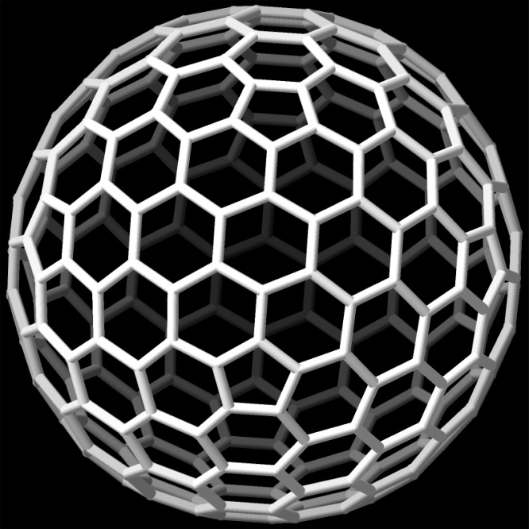
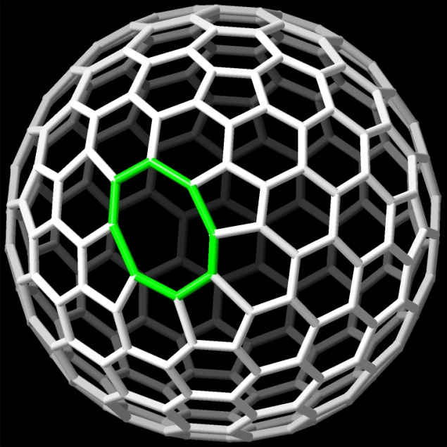
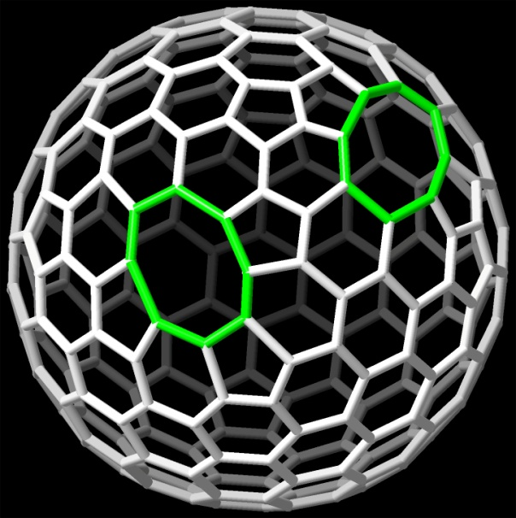
Carbon Nano-Onions (CNOs)
di-vacancies
electron irradiation dose
⎯ Prolonged electron irradiation creates di-vacancies in CNO walls
⎯ Structural reconstruction around vacancies produces CNO shrinkage and thus wall tension
⎯ Inward pressure is established in terms of Laplace’s law, thus inversely proportional to the CNO radius
⎯ Internal pressure is maintained while CNOs are transferred from an electron microscope to other
instruments (e.g., mass spectrometer)
Wu and Buseck (2014, Am. Mineral.)
Notes:
In order to tackle this problem, we are taking advantage of remarkable properties of carbon nano-onions, or CNOs, which are multi-layered spherical, closed shells made of graphitic carbon.
Let us look at how these CNOs work for us. For clarity here we only show one layer of carbon shell. Energetic electrons in an electron microscope displace carbon atoms from the CNO wall and thus create vacancies in the regular graphitic networks. Then with necessary heating assistance, spontaneous structural reorganization around these vacancies causes a decrease in the perimeter of the closed, spherical graphitic networks, generating tension in the CNO wall. Continued electron irradiation creates an increased number of vacancies, leading to further CNO shrinkage and larger wall tension. Therefore, according to Laplace’s law, an inward pressure is established and will act on the encapsulated particle if there is one. In addition, the internal pressure will be maintained when we transfer the CNO between different instruments.

Slide 12
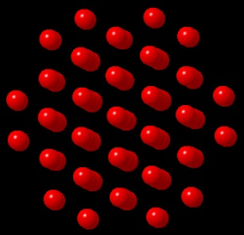

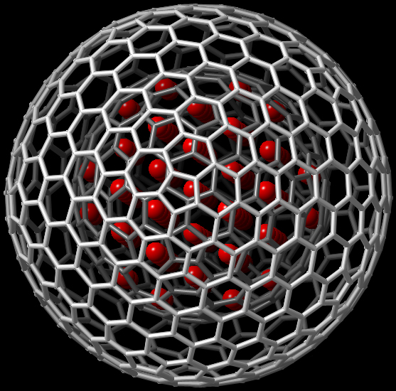
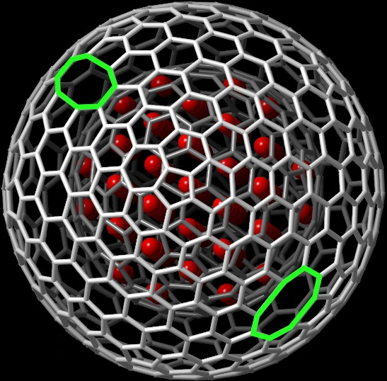










Experimental Procedure
Mass
Spectrometry
Fe
bcc-Fe
Fe
H
arc discharge
Fe@CNO
e⁻ irradiation
(TEM)
contracted Fe@CNO
hydrogenation at HP
(gas-loading diamond-anvil cell)
contracted FeH_{x}@CNO
Notes:
We start with bcc-structured iron and use an arc-discharge technique to load iron nanoparticles into CNOs. Then irradiate these CNOs in an electron microscope to induce their contraction and produce compression of encapsulated iron. The next step is to hydrogenate the CNO-compressed iron using a hydrogen-loading diamond-anvil cell at high pressure and temperature. Finally, the resulting hydride product will be transferred to a mass spectroscopy for both elemental and isotopic analyses.

Slide 13
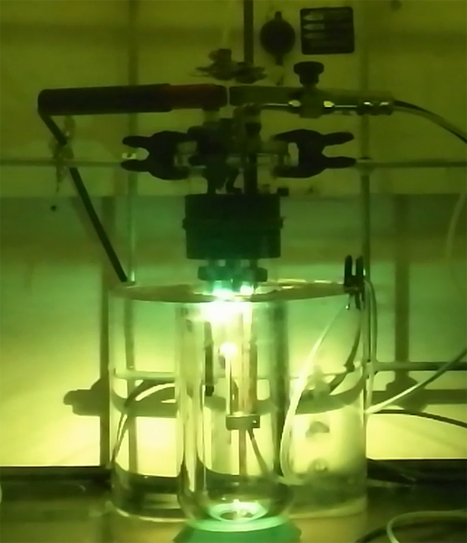
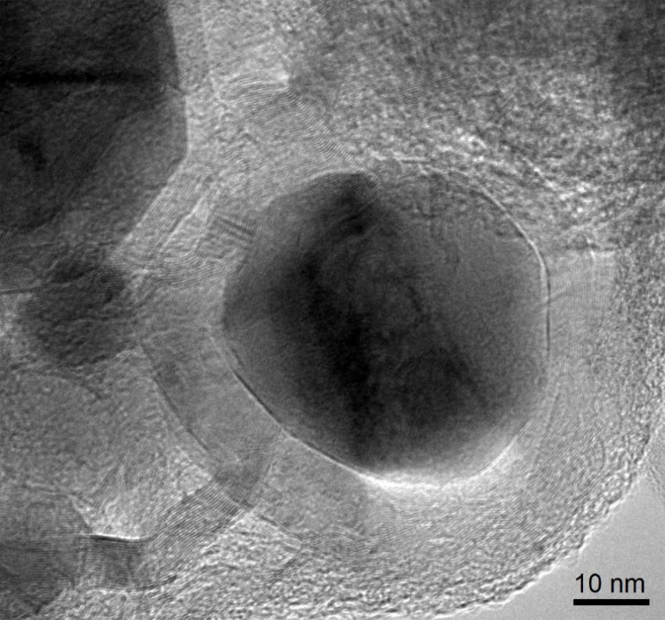
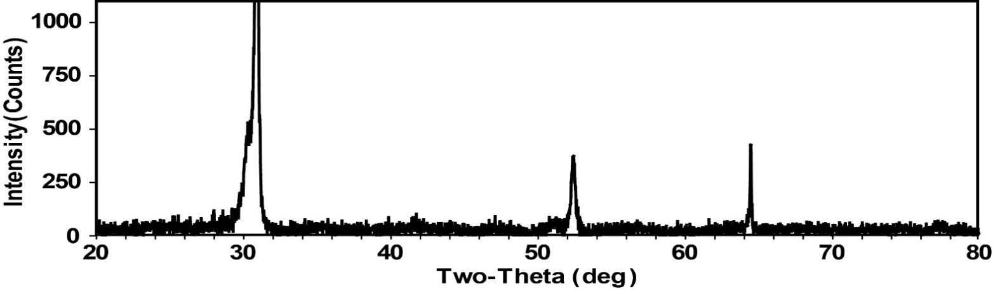
Arc-Discharge Loading of Fe into CNOs
Fe
CNO
C(002)
Fe(011)
C(004)
Primary challenge ⎯ removal of iron carbide phases
Notes:
Here we show some quick pictures related to arc-discharge loading of iron into CNOs. After removing iron carbides, the product is a mixture of Fe@CNOs and some graphitic carbon only, as this x-ray diffraction pattern illustrates.

Slide 14
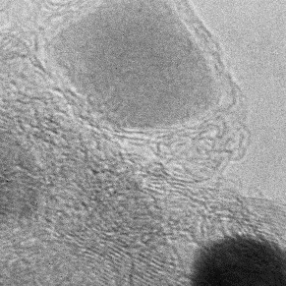
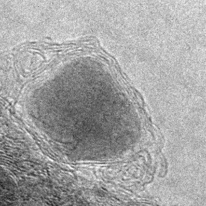
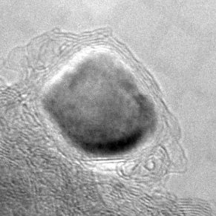
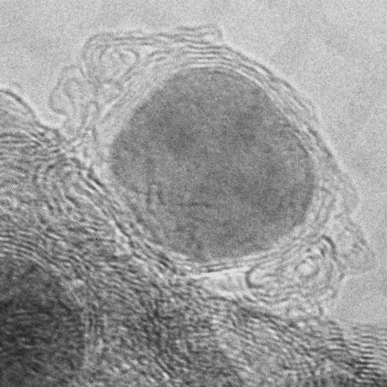
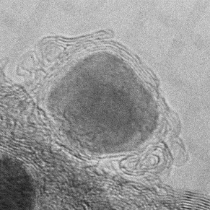
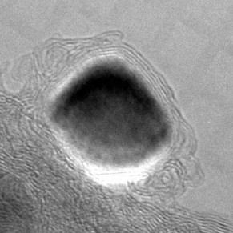
Electron-irradiation-induced Self-compression of Fe@CNO
0 s
122 s
286 s
5 nm
5 nm
5 nm
(e⁻ current density ~ 13 A/cm²; T ~ 324 °C)
634 s
459 s
373 s
5 nm
5 nm
5 nm
Notes:
Under an electron microscope, we can track electron-irradiation-induced self-compression of Fe@CNO particles. Here is an example. After about 10-minute intensive irradiation at 324 Celsius degrees, it is evident that the originally irregularly shaped nanoparticle of iron became much more spherical, as marked by these blue arrows. Since the temperature is much lower than the melting point of iron, the only action to produce this shape change was compression. This judgement was also supported by lattice spacing measurements based on fast-Fourier-transform-derived diffractograms. Using equation of state of iron, we further estimated internal pressure of the iron particle in each panel. The result is plotted in the next slide.

Slide 15
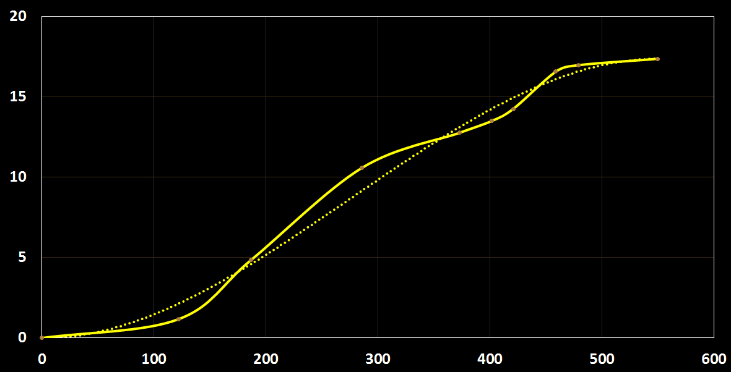
Pressure inside CNO Increases with Irradiation Duration
CNO diameter ~ 10 nm; e⁻ current density ~ 13 A/cm²; T ~ 324 °C
Internal Pressure (GPa)
experimental data
fitting curve
Duration of Electron Irradiation (s)
Notes:
The pressure experienced by the iron nanoparticle is seen to increase with irradiation duration. Within only 10 minutes, the internal pressure reached about 17 GPa, a value significantly greater than what we need for our intended measurements.

Slide 16
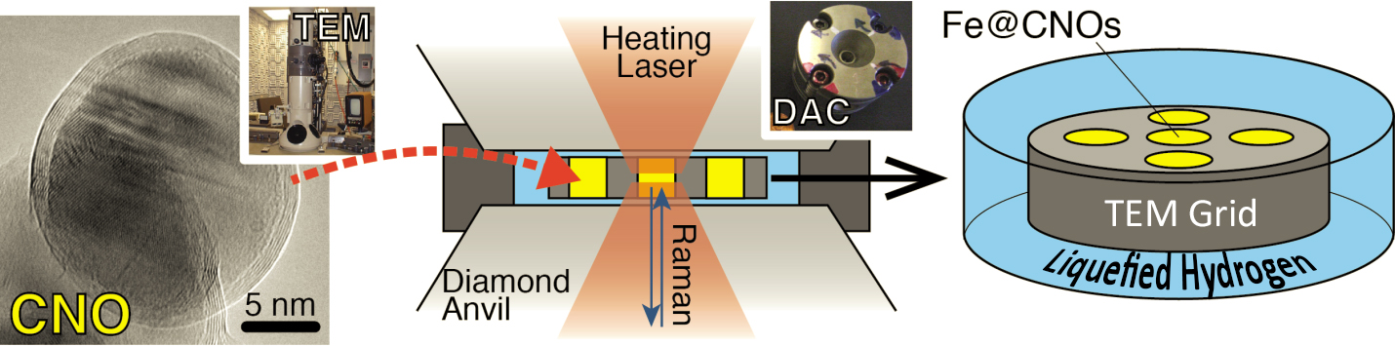
Hydrogen Loading with Fe@CNOs Sample
DAC Assembly
Hydrogen
Loading
System
at ASU
Notes:
Here we show a sketch of the diamond-anvil cell assembly that we use for hydrogenation run. Once this assembly is ready, we place it in the hydrogen loading system displayed below. By the way, it is also possible to use a lithium aluminum hydride-supplied multi-anvil press to load hydrogen when very high temperatures are not needed.

Slide 17
Preliminary Results from Hydrogenation of Unirradiated Fe@CNOs
Synchrotron
Results
⎯ Hydrogenation of Fe inside CNOs occurred at 23 GPa and 300 K
⎯ Iron carbides formed at 1300 K while hydride content decreased,
indicating that iron carburization is preferred over iron hydrogenation
in Fe-C-H at high pressure and temperature
⎯ Inhibition of iron carburization is required, and one way
to achieve this goal is to have an interlayer coating
between Fe and CNO (e.g., Fe@Ag@CNO)
Fe
Ag
CNO
Notes:
We conducted hydrogenation of non-irradiated Fe@CNOs inside a DAC and acquired in-situ synchrotron data. A few key results are listed here. Firstly, hydrogenation of Fe inside CNOs occurred at 23 GPa and 300 K, as indicated by the occurrence of peaks of double hexagonal close-packed (dhcp) iron hydride. Secondly, iron carbides formed at 1300 K while the hydride peaks became lower, indicating that iron carburization is preferred over iron hydrogenation in the iron-carbon-hydrogen system at high pressure and high temperature. This result is consistent with the reported incompatibility of hydrogen and carbon in iron metal. As a result, inhibition of iron carburization is required, and one possible way to achieve this goal is to place an interlayer coating between iron and CNO, with silver being an example illustrated here.

Slide 18
Conclusions
Our ingassing model suggests a small but significant amount of nebular hydrogen contributed to formation of Earth’s water.
Experimental testing of this model requires direct measurements of hydrogen solubility and fractionation in iron at mantle conditions.
These previously impossible measurements become possible by using CNO cells that experienced irradiation-induced contraction.
Hydrogen molecules penetrate CNO walls and react with encapsulated iron to form hydrides, which are transferable for mass spectroscopy.
Carburization of iron competes with its hydrogenation, producing a need for an interlayer coating; ongoing work involves using silver for the purpose.
Notes:
Finally conclusions. First, our ingassing model suggests a small but significant amount of nebular hydrogen contributed to formation of Earth’s water. Second, experimental testing of this model requires direct measurements of hydrogen solubility and fractionation in iron at magma-ocean conditions. Third, these previously impossible measurements are possible by using CNOs that contract under electron irradiation and thereby serve as pressure cells. Next, hydrogen molecules can penetrate CNO walls and react with encapsulated iron to form hydrides, which will be transferable for mass spectroscopy. Lastly, carburization of iron competes with its hydrogenation, calling for an interlayer coating between iron and CNO walls. Such work using silver is now under way.

Slide 19
THE END
Thanks to W. M. Keck Foundation
Notes:
Thank you!

