Slide 1
EXPLORING AND CATEGORIZING DIVERSITY IN THE TECHNOLOGICAL AND PEDAGOGICAL APPROACHES OF VIRTUAL FIELWORK EXPERIENCES
Don Haas,* (dad55@cornell.edu) Robert M. Ross,* and Lisa D. White†
*The Paleontological Research Institution, Ithaca, NY
†Museum of Paleontology, University of California, Berkeley, Berkeley, CA

Slide 2
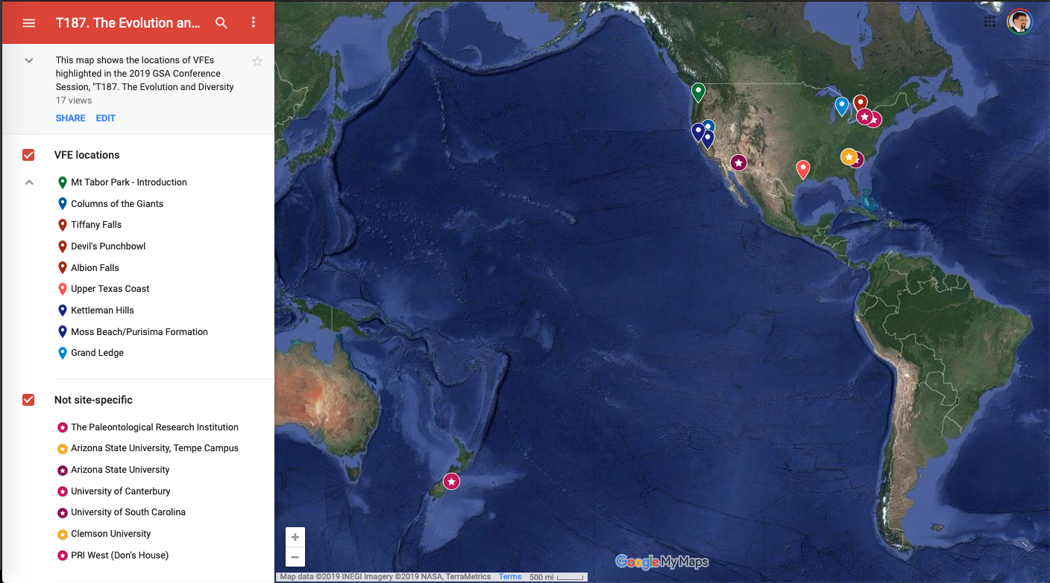
A map of the session.
http://bit.ly/GSA2019-VFEevolution

Slide 3
Find the presentation for this abstract (a Prezi) here:
http://bit.ly/VFE-GSA2019

