Slide 1
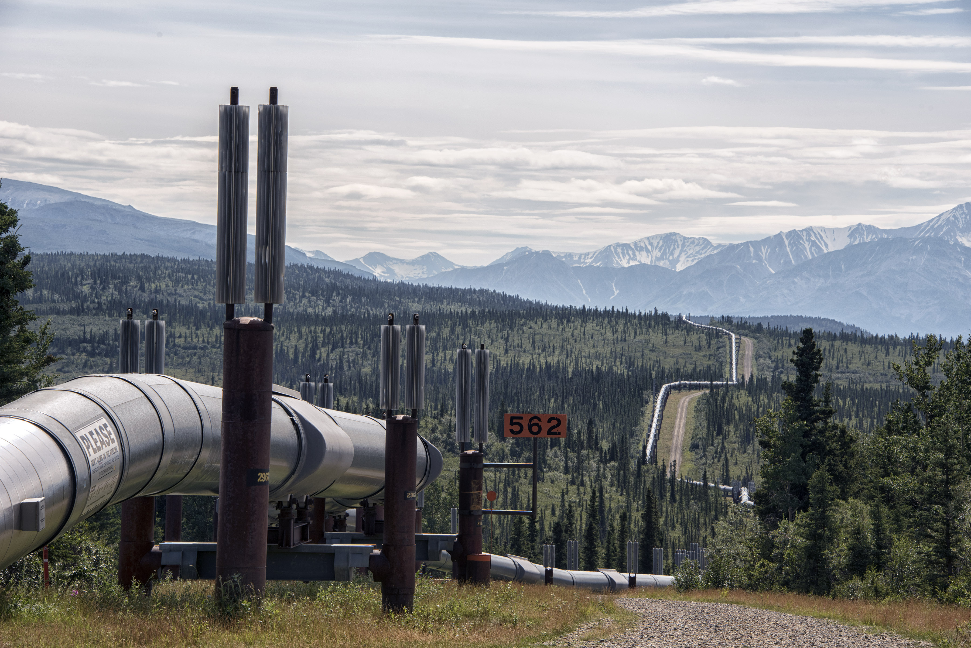
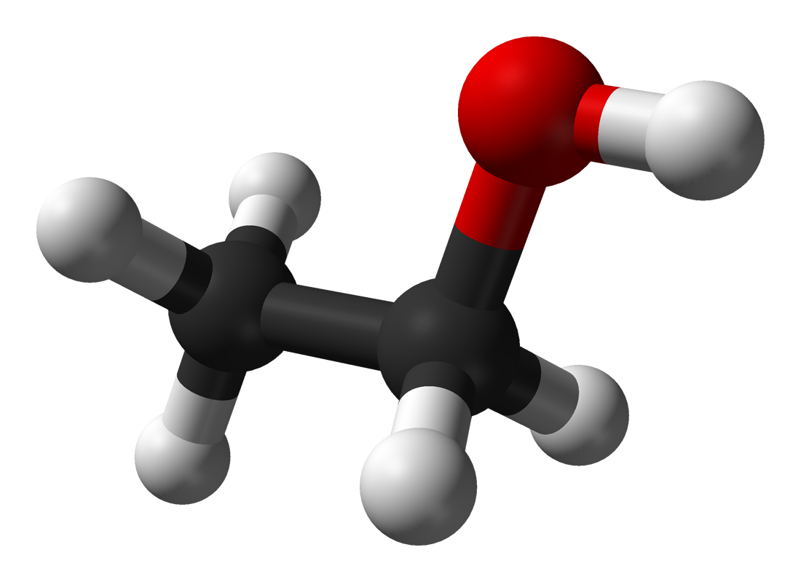
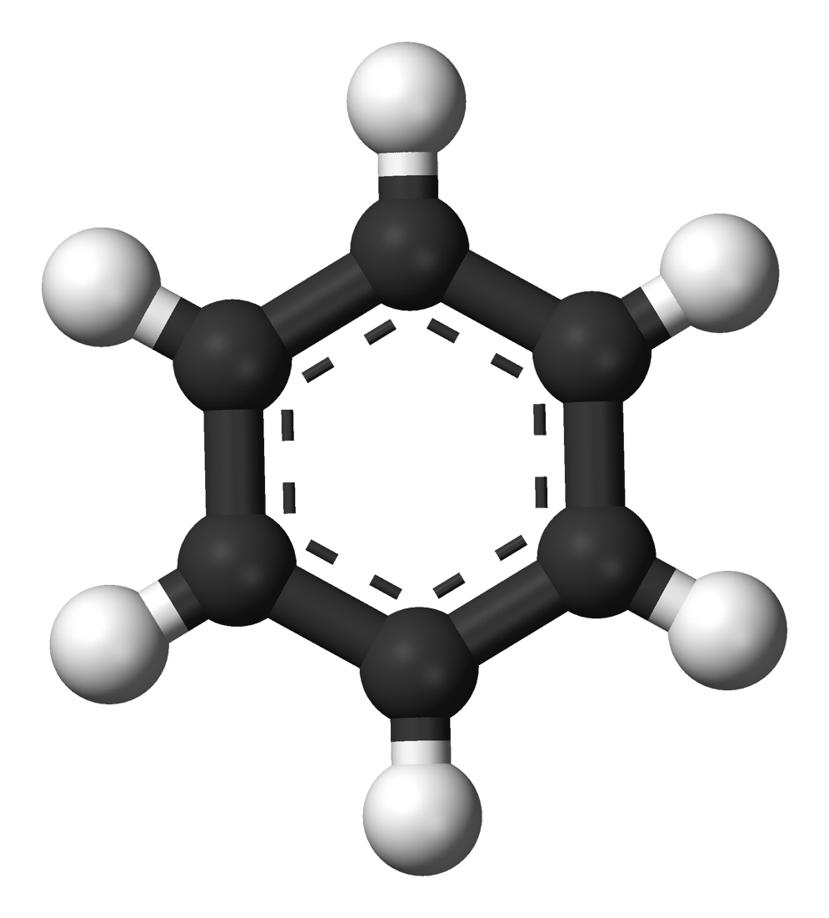
How Does the Presence of Co-Contaminant Ethanol Affect BTEX Attenuation at Hydrocarbon Spill Sites?
Jack Koellmann

Slide 2
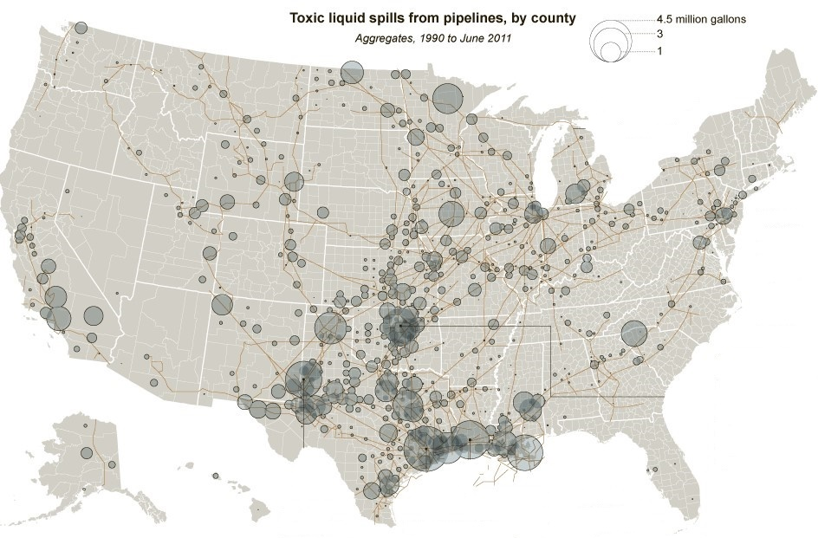
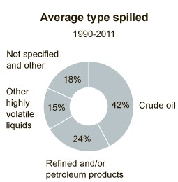
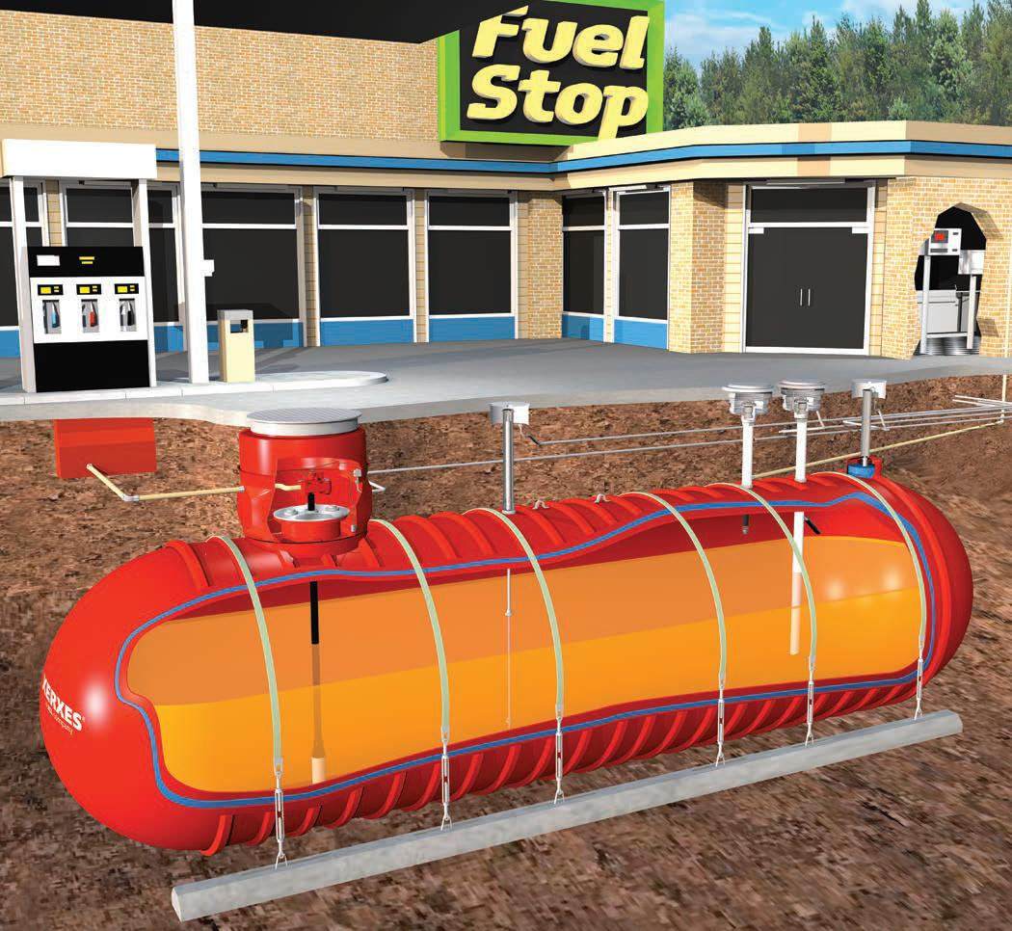
*This is a common environmental contaminant*
Leaky underground storage tanks (LUSTs)

Slide 3
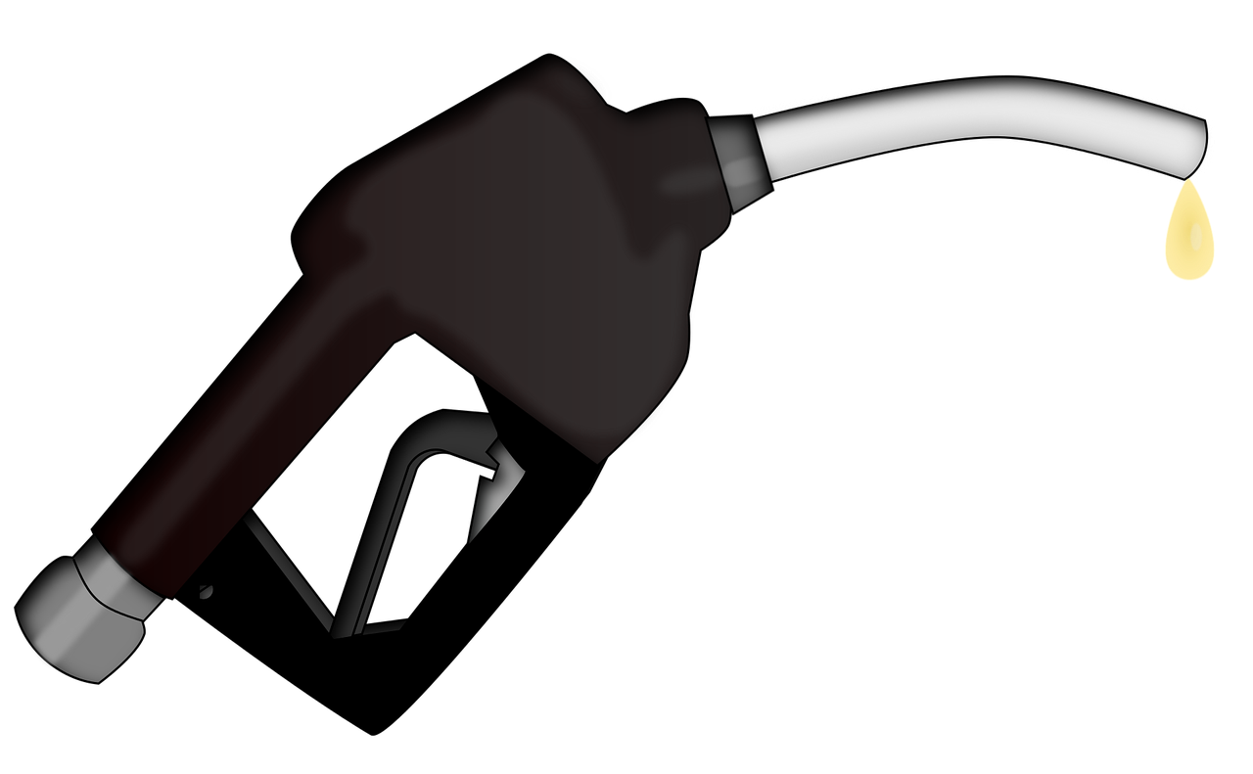

What is gasoline made of?
+ additives
(IARC, 1989)
BTEX

Slide 4
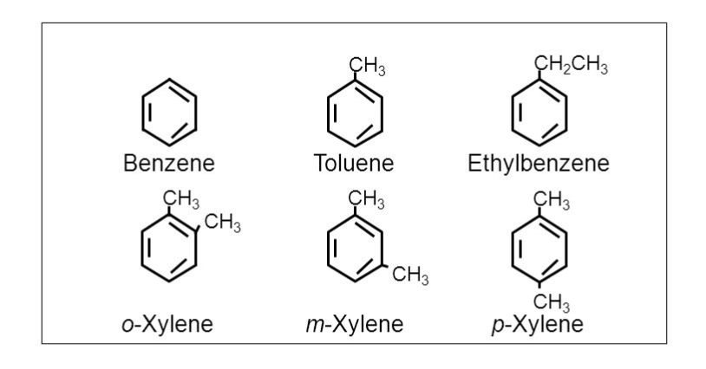
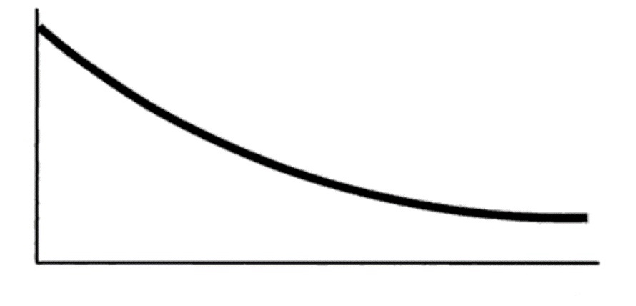
BTEX can be remediated by natural processes
Benzene is a carcinogen at very low concentrations
What can we do?
Nothing!
Natural attenuation
Biotic processes: biodegradation
Abiotic processes – BTEX could be
  Diluted by advection
  Sorbed to aquifer minerals/organic matter
Concentration of BTEX
Time (t)

Slide 5

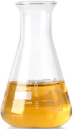
BTEX Dissolution into ethanol
Co-solvency increases dissolution
Benzene (BTEX)
Ethanol
Groundwater

Slide 6
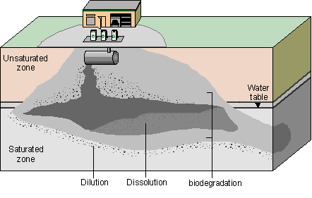
BTEX attenuation is very complex
Gasoline can vary widely in composition
There are many processes that control how BTEX is removed from an aquifer
Modified from Bekins, Rittmann, and MacDonald (2001)
Biodegradation
Advection
Sorption
Ethanol co-solvency

Slide 7

My research questions
When BTEX enters the groundwater, what happens to it?
1. Does ethanol impact physical transport of BTEX?
2. How do ethanol and nitrate affect BTEX biodegradation rates?
3. Timing: when do these processes occur?

Slide 8
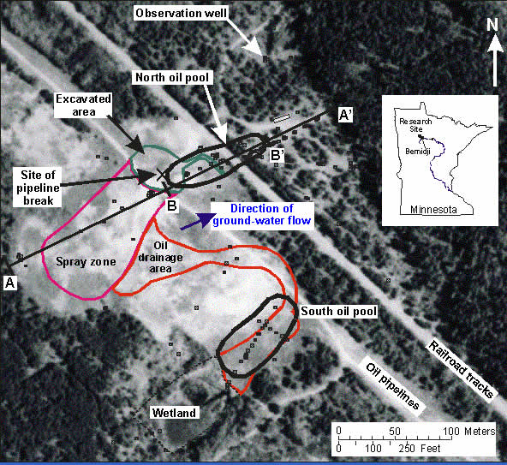
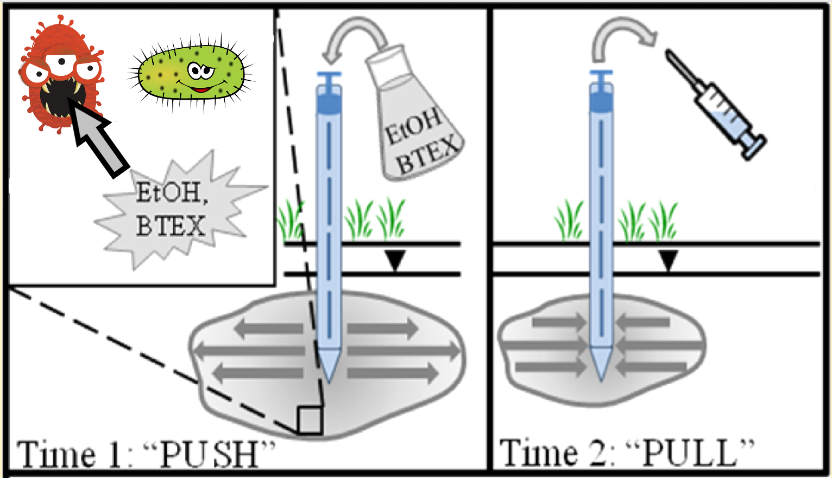
Data collection
In 1979, 10,700 barrels of oil spilled (ruptured pipeline)
In 2012, a push-pull test was conducted in the wetland by Ziegler, et al.
microbes
Modified from Ziegler, McGuire, and Cozzarrelli (2015)
= 2012 test site
McGuire et al. (2012)

Slide 9
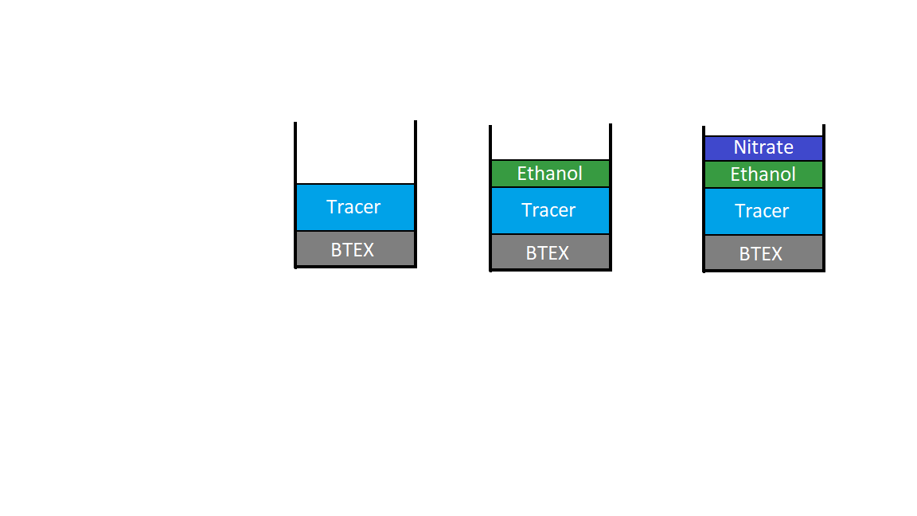
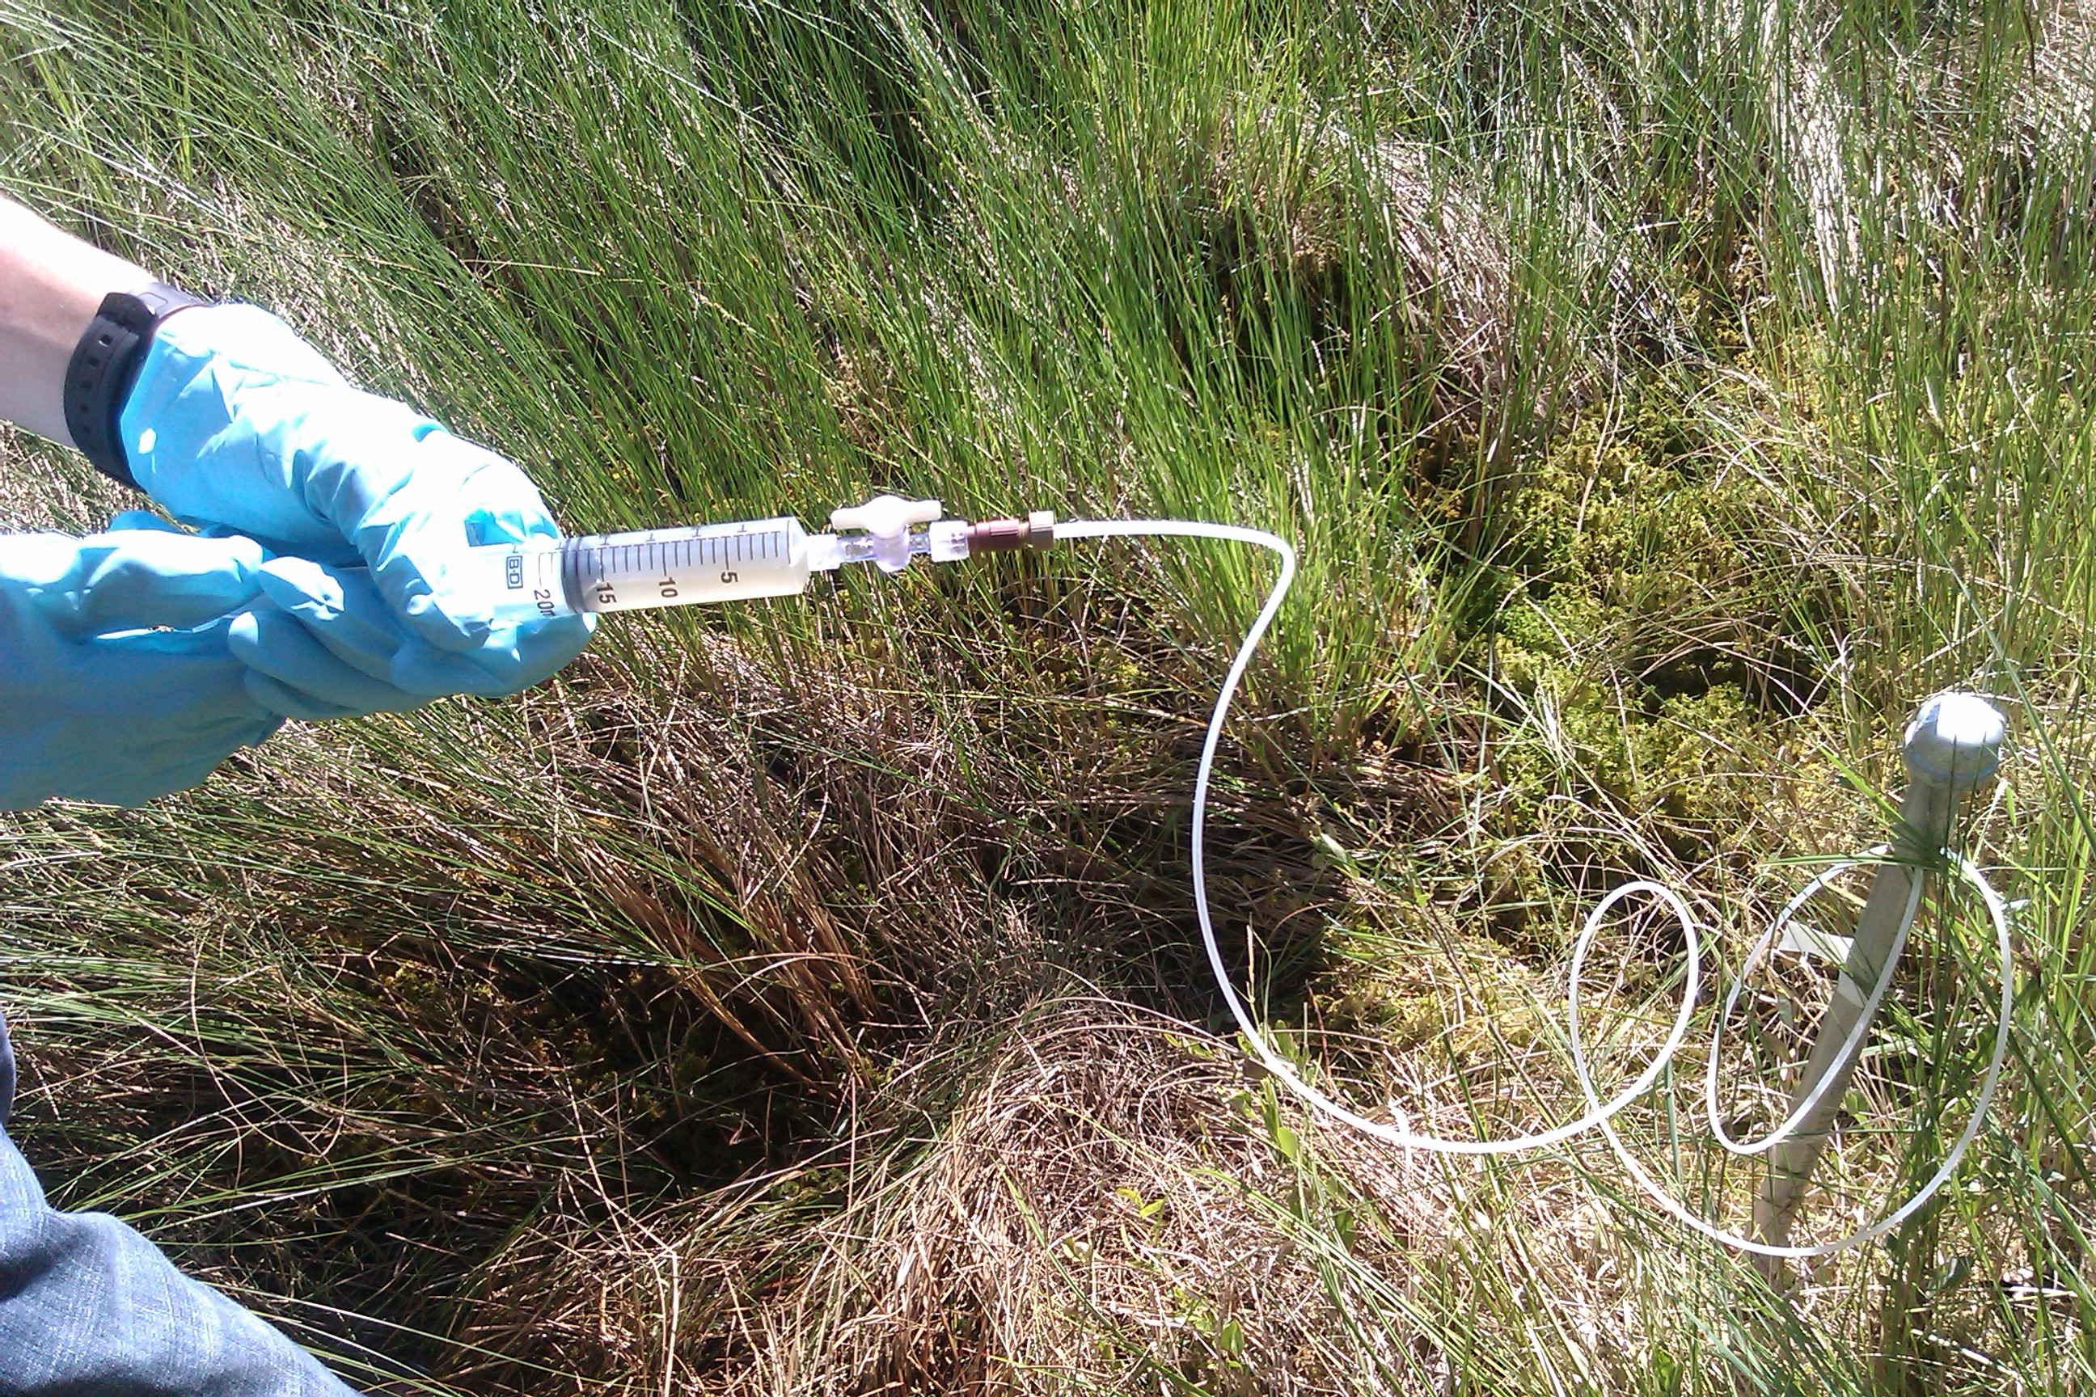
Phase 1: push – 30 minutes
Well #1
Well #2
Well #3
Phase 2: pull – 63 days
Researcher Ryan Streitz “pulling” water from one of the three wells (Ziegler, 2012).

Slide 10
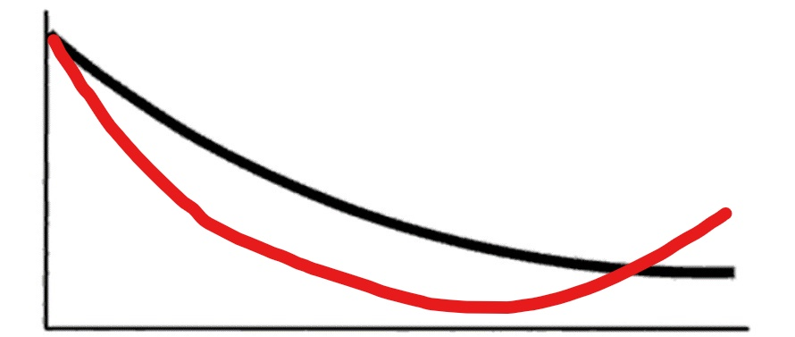
Non-conservative processes can be revealed by differential transport
Concentration
BTEX
Tracer
_
+
0
Time (t)
Processes that could cause an increase in BTEX relative to the tracer:
De-sorption back into solution
Retarded transport (non-aqueous phase)
Processes that could cause a decrease in BTEX relative to the tracer:
Sorption
Biodegradation
Processes that could cause no change in BTEX relative to the tracer:
Ethanol co-solvency

Slide 11
How does ethanol affect physical transport of BTEX?
Tracer (green) represents advection
Benzene:
First stage: rapid sorption
Second stage: dissolution into groundwater
1
2
3
Third stage: de-sorption

Slide 12
How does ethanol affect physical transport of BTEX?
BTEX tracks tracer much more closely

Slide 13
How does ethanol affect physical transport of BTEX?
BTEX tracks tracer much more closely
benzene

Slide 14
How does ethanol affect physical transport of BTEX?
BTEX tracks tracer much more closely
benzene
nitrate

Slide 15
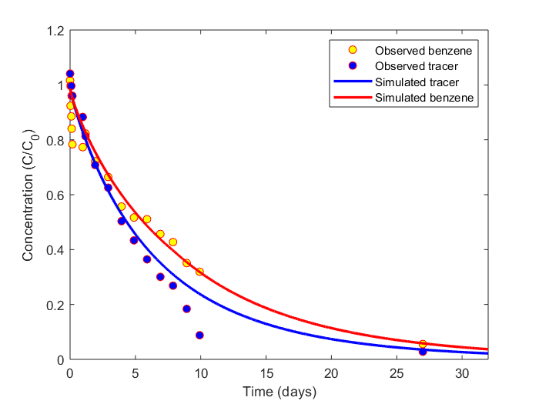
When, and at what rate, do these processes occur?
PPTEST: a numerical model by Phanikumar and McGuire (2010)
Test #1: BTEX and tracer; benzene
Parameters:
Sorption model:
  Freundlich
  S = aC^{(1/b)}
Sorption:
  a = 1.37 x 10⁻¹⁰
  b = 1.1
Biodegradation:
  time = 8.0 days
  First order, K = 0.01 d⁻¹

Slide 16
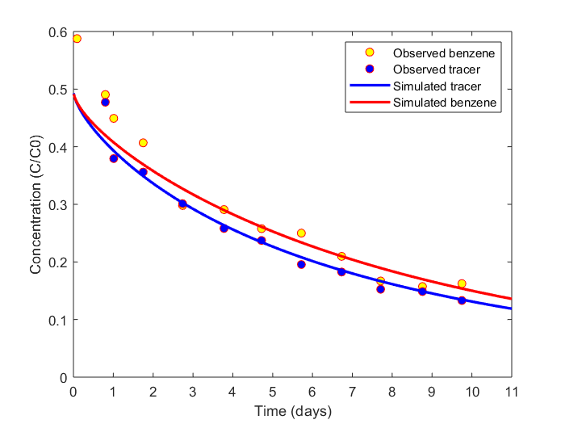
Effect of co-contaminant ethanol
Test #3: BTEX, tracer, ethanol, and nitrate; benzene
Parameters:
Sorption model:
  Freundlich
  S = aC^{(1/b)}
Sorption:
  a = 1.27 x 10⁻¹⁰
  b = 2.0
Biodegradation:
  None

Slide 17
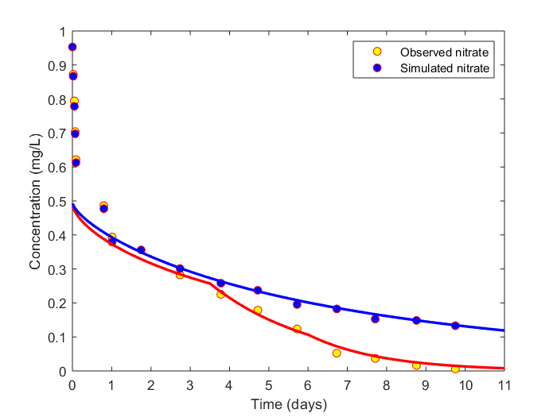
Evidence of nitrate reduction
Test #3: BTEX, tracer, ethanol, and nitrate; nitrate
Parameters:
Sorption model:
  Linear
  S = KC
Sorption:
  a = 2.27 x 10⁻¹⁰
  b = 1.0
Biodegradation:
  At t = 3.5, K = 0.5 d⁻¹
  At t = 6.0, K = 0.9 d⁻¹

Slide 18
Implications
The biodegradation of BTEX is very complex, and can happen very differently depending on which chemicals are present.
The numerical model PPTEST can provide more information than simpler analytical methods.
  Helps us model multiple important processes at the same time
  However, it may not be able to account for all important processes, like solubility changes
The presence of BTEX in ethanol helps these toxins travel faster, and biodegrade slower, than they would otherwise.
  Could be more of a problem as the use of ethanol in fuel becomes more common.

Slide 19
Acknowledgements
I wish to thank Brady Ziegler for his generous help with my project, as well as Mantha Phanikumar for his open communication and support during my effort to use PPTEST.
I also wish to thank Brady Ziegler (again), Jennifer McGuire, and Isabelle Cozzarelli for letting me analyze the data that they collected for their publications in 2012 and 2015. I also appreciate their help organizing my abstract for submission to GSA 2019.

Slide 20
References
(1989). Diesel Fuels. International Agency for Research on Cancer, Vol. 45, pp. 219.
Frosch, D., & Roberts, J. (2011, September 10). Pipeline Spills Put Safeguards Under Scrutiny. Retrieved from https://www.nytimes.com/2011/09/10/business/energy-environment/agency-struggles-to-safeguard-pipeline-system.html
McGuire, J.T., et al. (2012). Evaluating the effect of ethanol and nitrate as co-contaminants on biodegradation of BTEX at an aquifer-wetland interface using modified push-pull tests. GSA 2012, Charlotte, NC.
Phanikumar, M.S., and McGuire, J.T. (2010). A multi-species reactive transport model to estimate biogeochemical rates based on single-well push-pull test data. Computers & Geosciences, Vol. 36, No. 8, pp. 997-1004.
Ziegler, B.A., McGuire, J.T., and Cozzarelli, I.M. (2015). Rates of As and Trace-Element Mobilization Caused by Fe Reduction in Mixed BTEX—Ethanol Experimental Plumes. Environ. Sci. Technol. 2015, 49, 13179−13189.

