Slide 1




HICKS BUTTE COMPLEX, CENTRAL CASCADES, WASHINGTON: A RECORD OF LATE JURASSIC ISLAND ARC FORMATION AND SUBSEQUENT CRETACEOUS ADAKITE GENERATION FROM ARC ROOT MELTING
Jamie MacDonald, Florida Gulf Coast University
Peter Davis, Pacific Lutheran University
&
Mark Pecha, University of Arizona

Slide 2
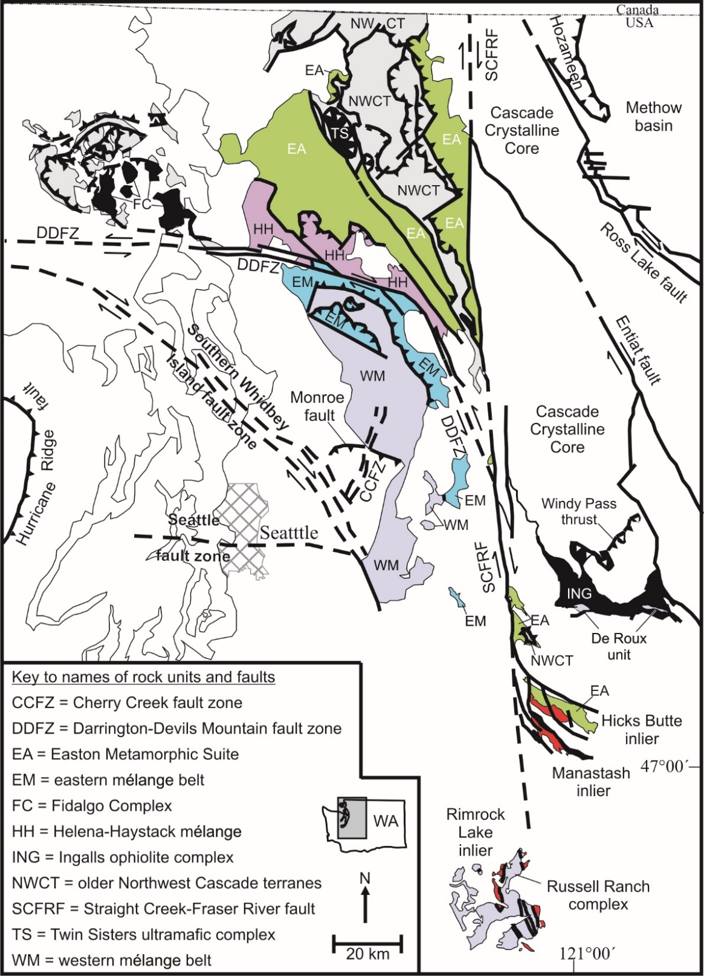
Regional geologic map of northwestern Washington.
Note the Hicks Butte inlier, identified by the red box on the map.
Also note the Easton Metamorphic Suite (EA), which is located on both the eastern and western sides of the SCFRF.
Diagram modified from Brown and Dragovich (2003) and MacDonald et al. (2017)

Slide 3
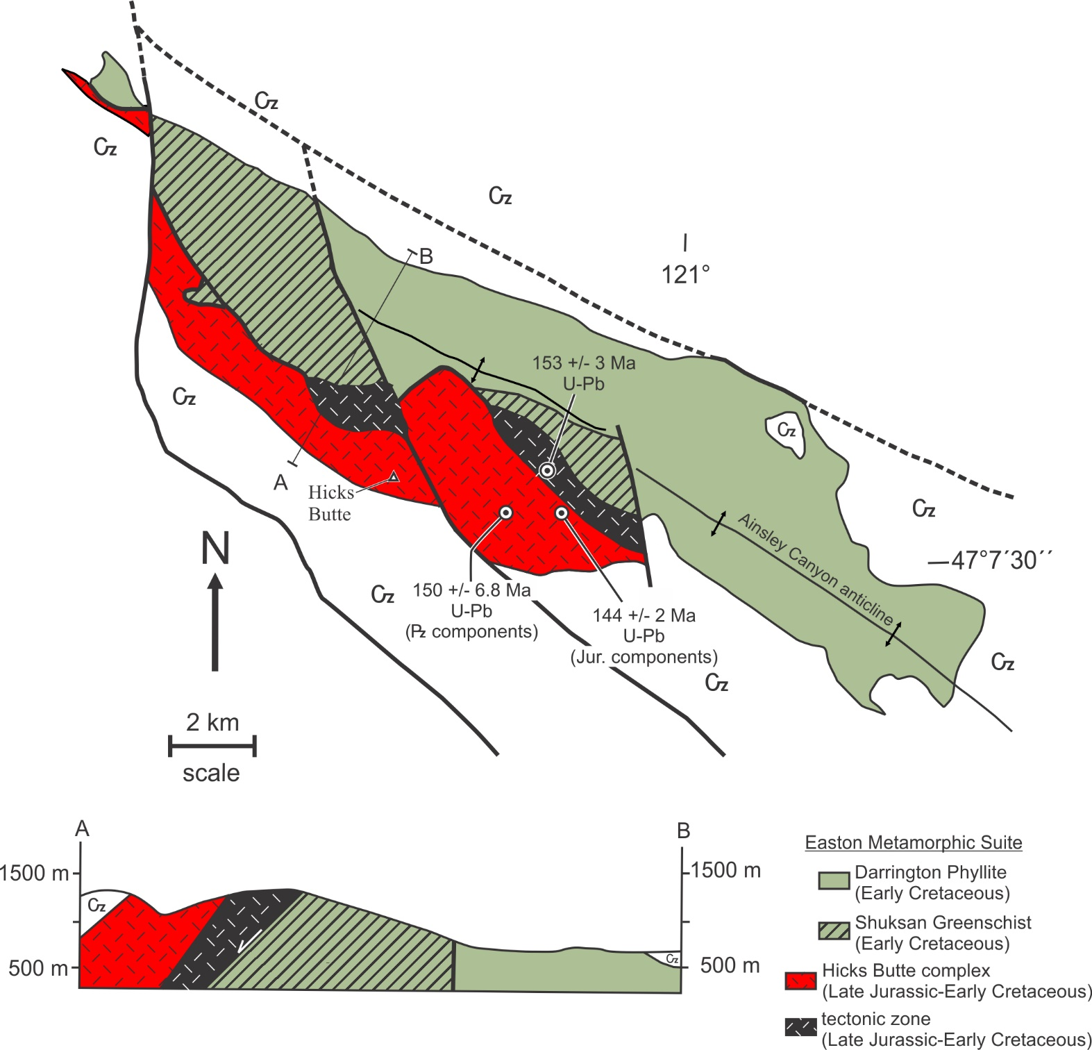
Geologic map of the Hicks Butte inlier.
Note the variably deformed igneous rocks of the Hicks Butte complex along the southern portion of the inlier.
Note the fault contact between the complex and the Easton.
Diagram modified from Miller et al. (1993) & MacDonald et al. (2017).

Slide 4
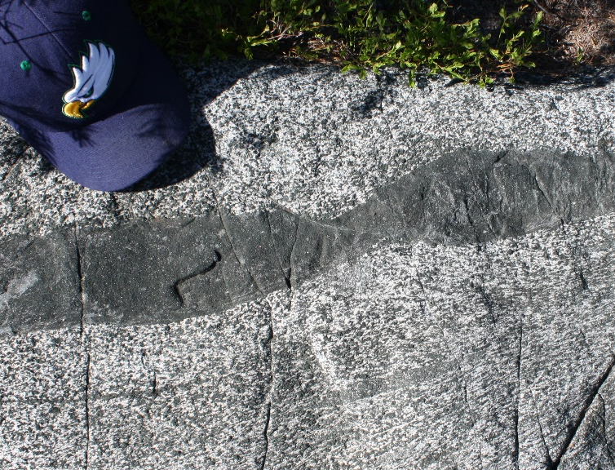
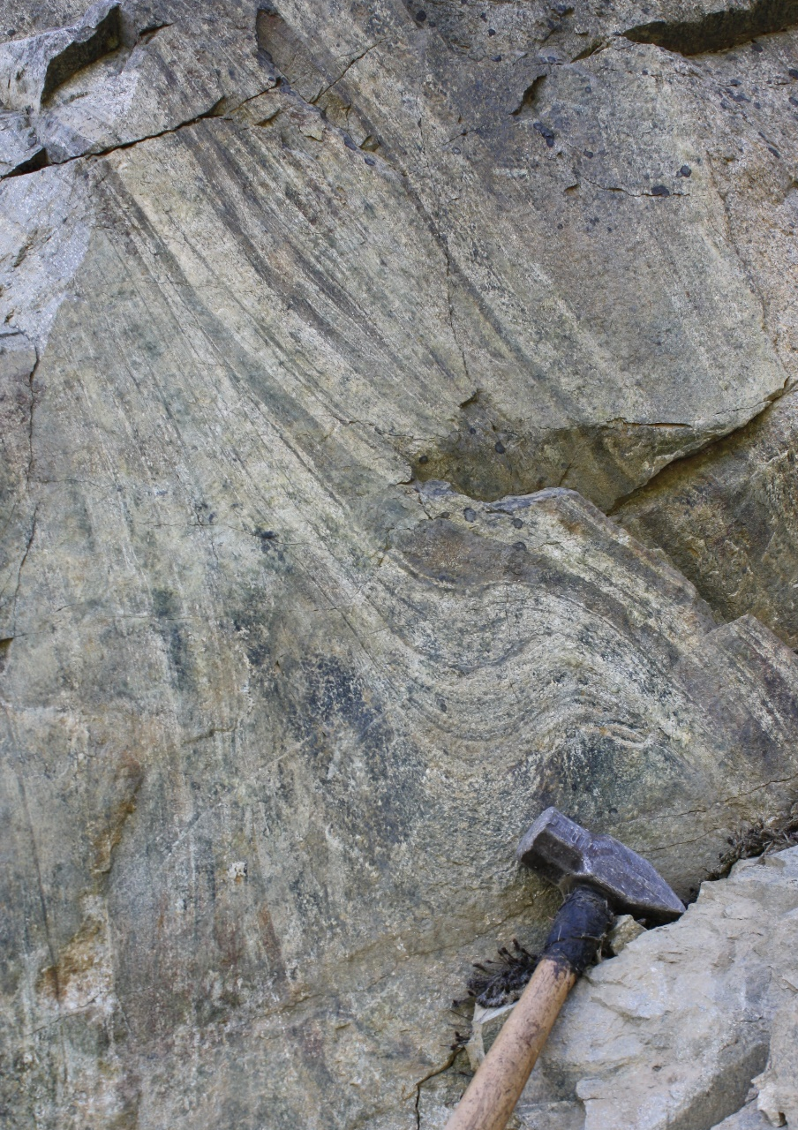
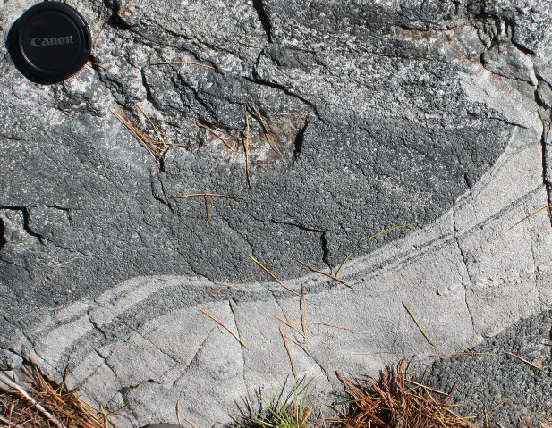

Slide 5
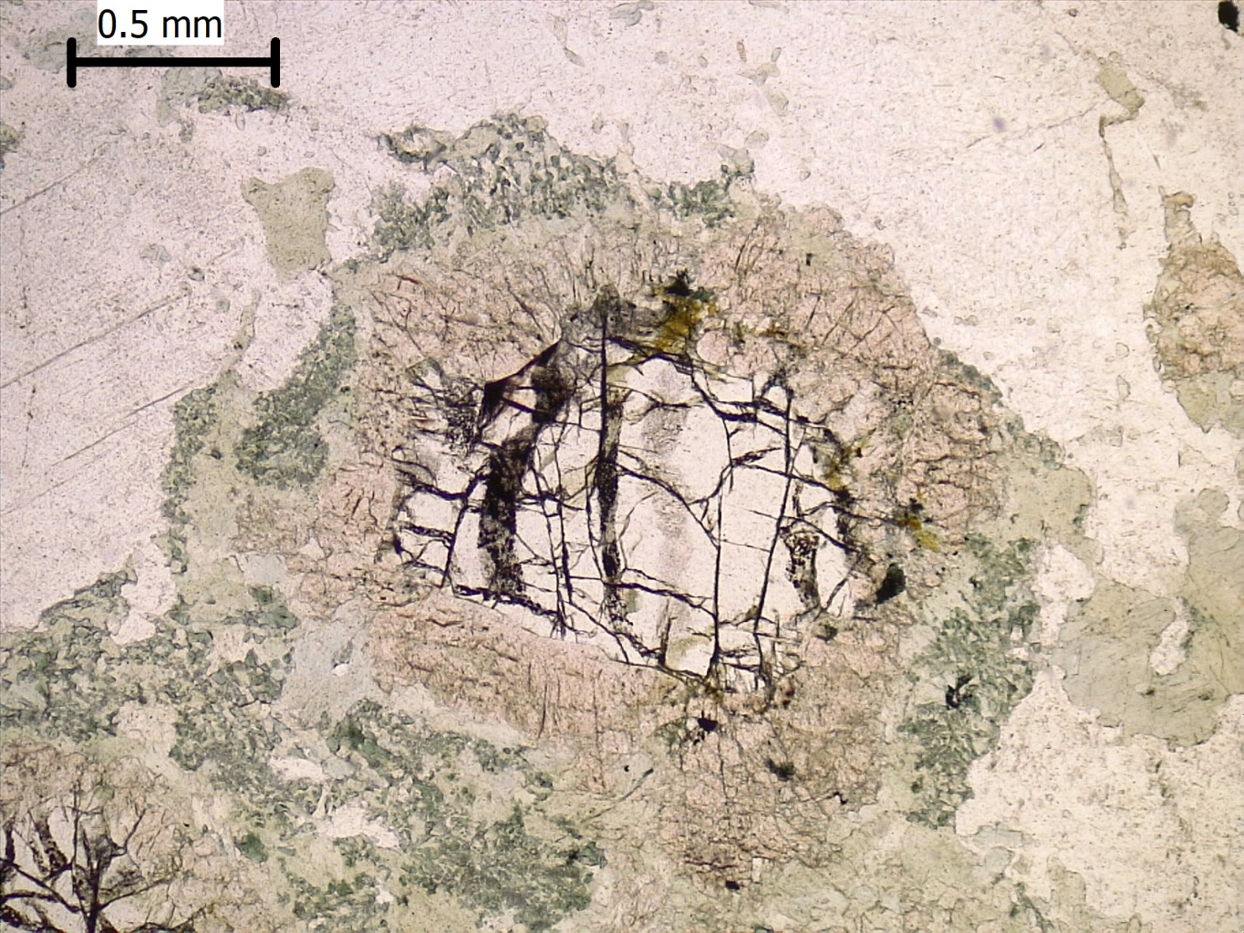
Symplectite and corona textures from Hicks Butte complex gabbros
Olivine is mantled by pyroxene and lesser amphibole.
Opx + Hbl +/- Spinel (hercynite) + Mt on igneous Ol + Pl assemblage suggests rapid cooling from 1100˚C to around 700-800˚C at pressures between 6-8 kbars (Claeson, 1998)

Slide 6
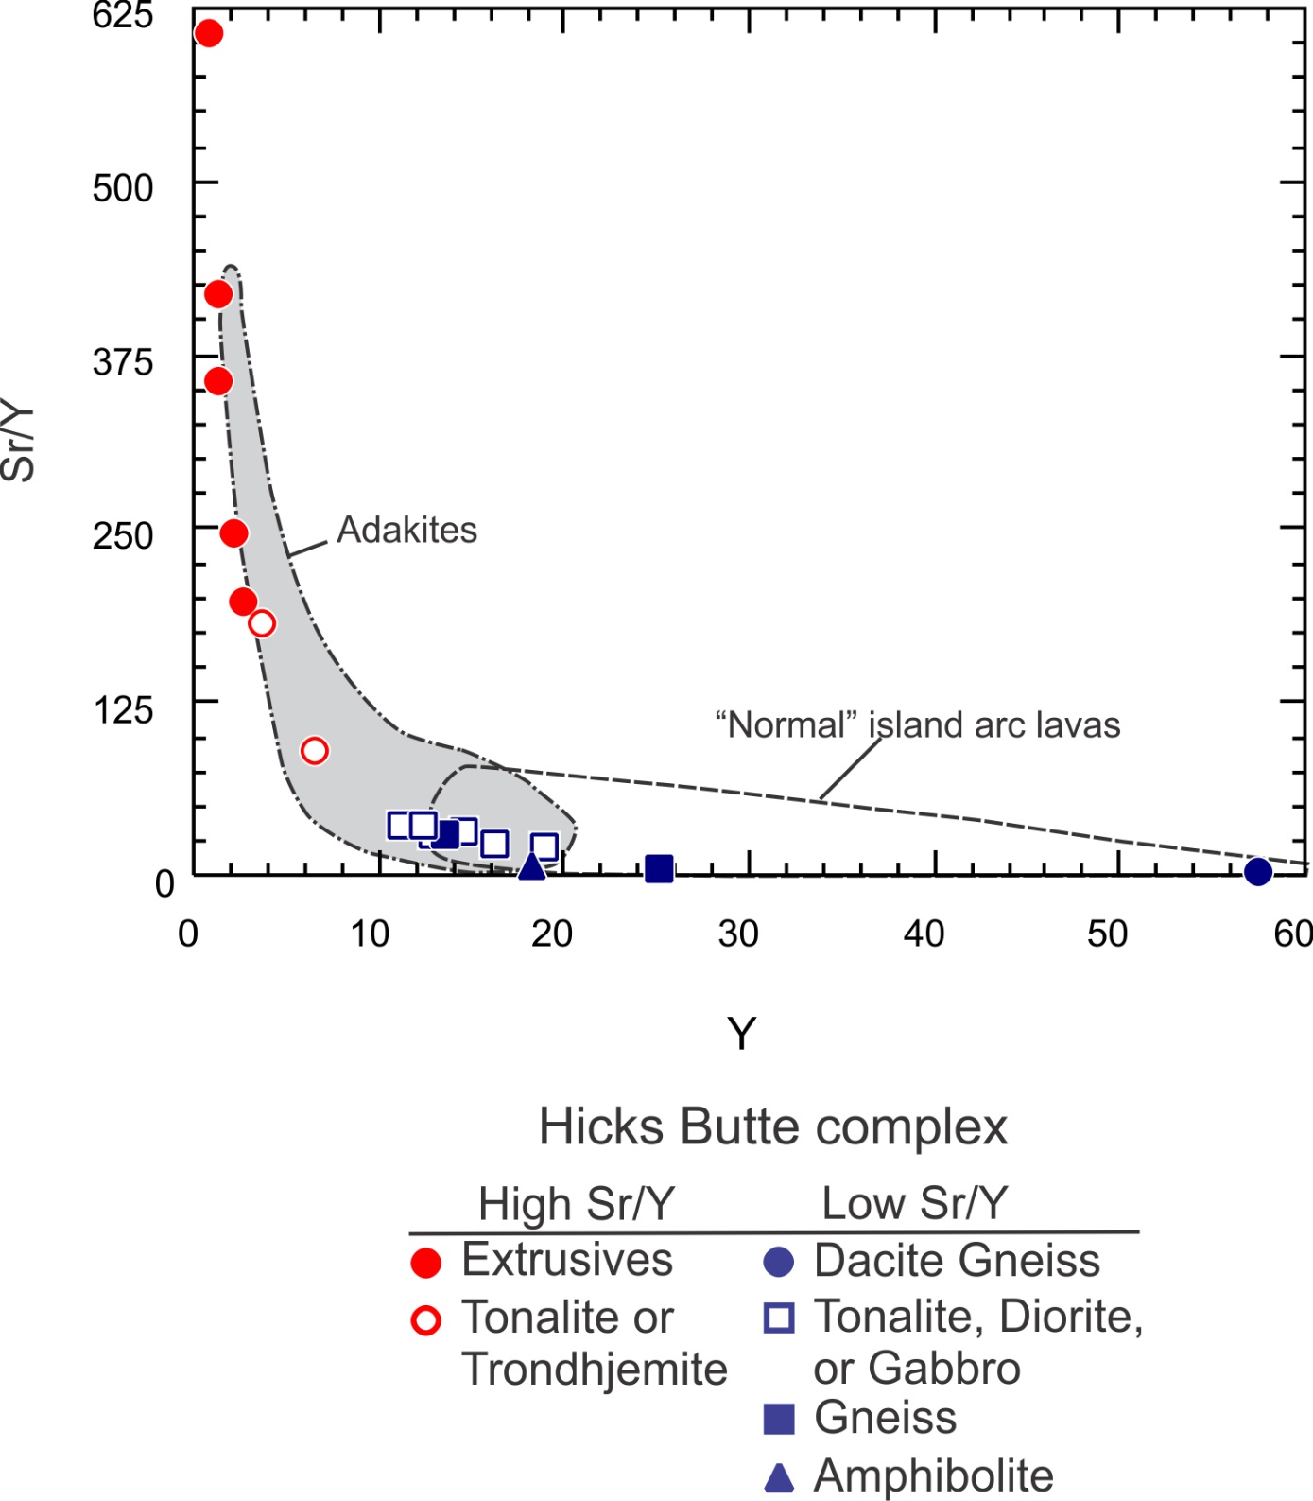
Sr/Y vs. Y diagram for Hicks Butte complex samples.
Note the samples can be divided into two groups: high Sr/Y and low Sr/Y ratios
The high Sr/Y are predominantly extrusive
Diagram modified from Defant & Drummond, 1990

Slide 7
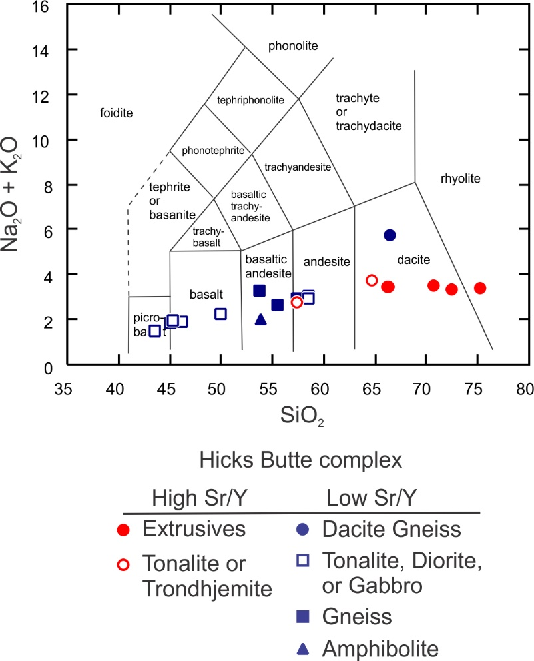
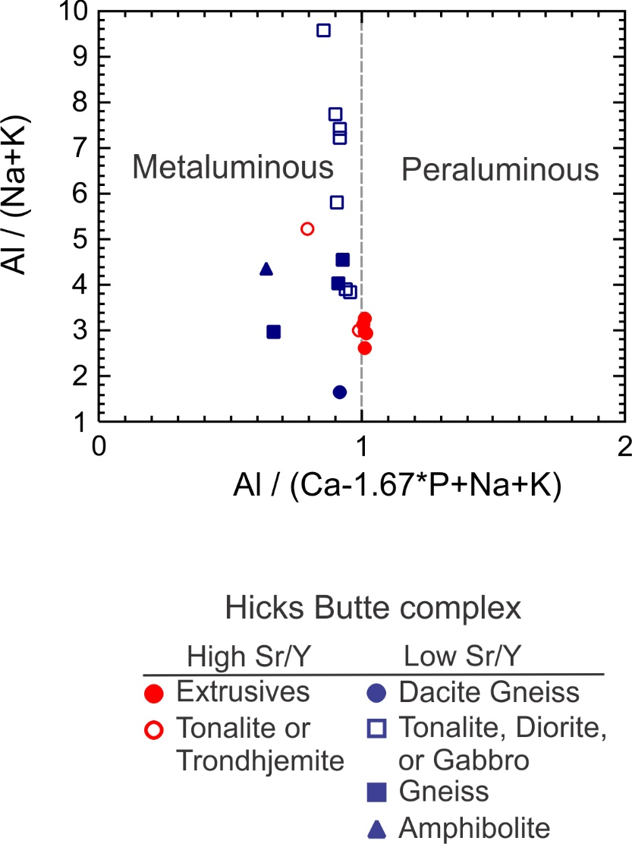
(Le Maitre, 2002)
(Frost et al., 2001)

Slide 8
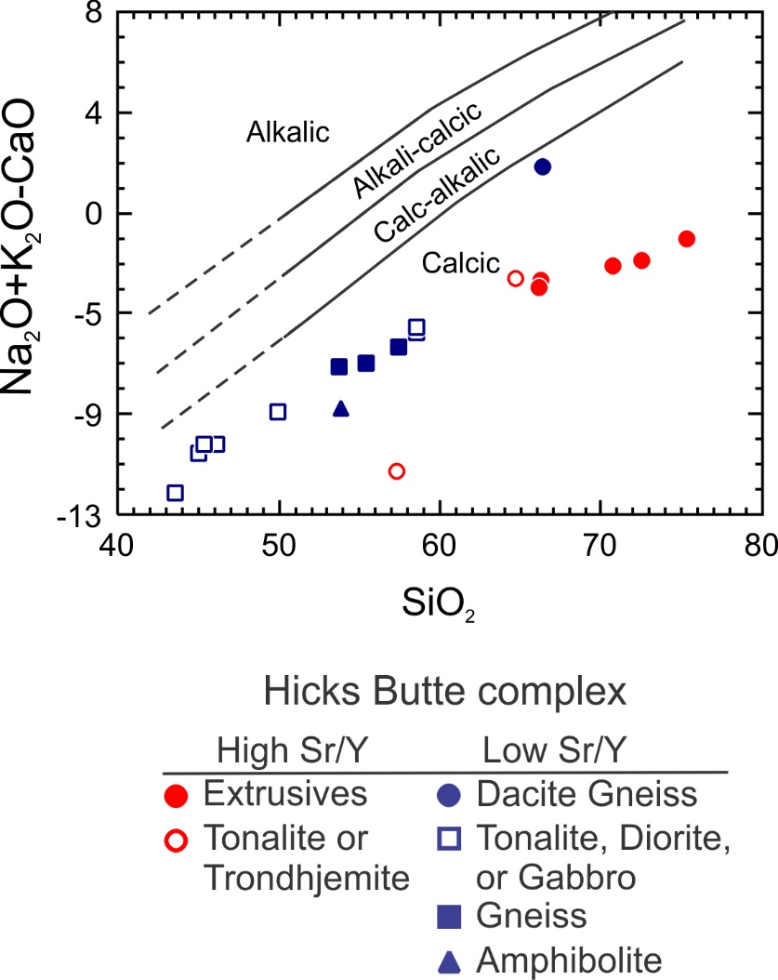
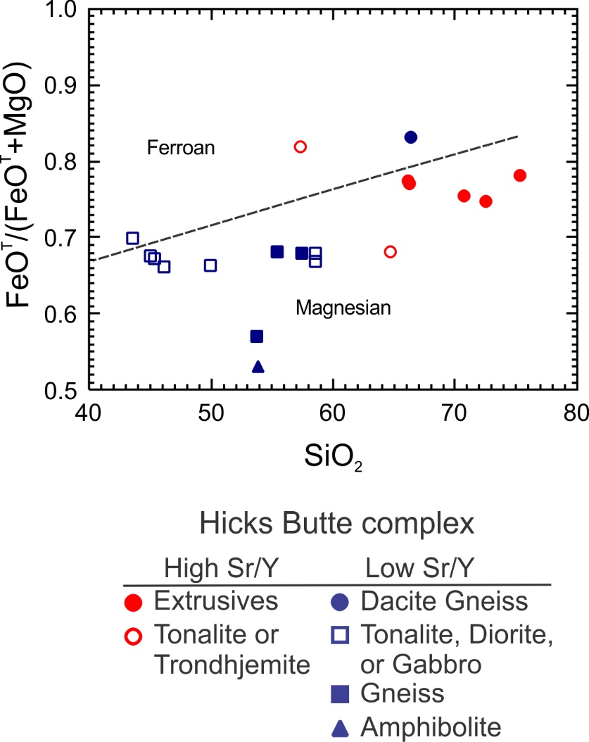
(Frost et al., 2001)
(Frost et al., 2001)

Slide 9
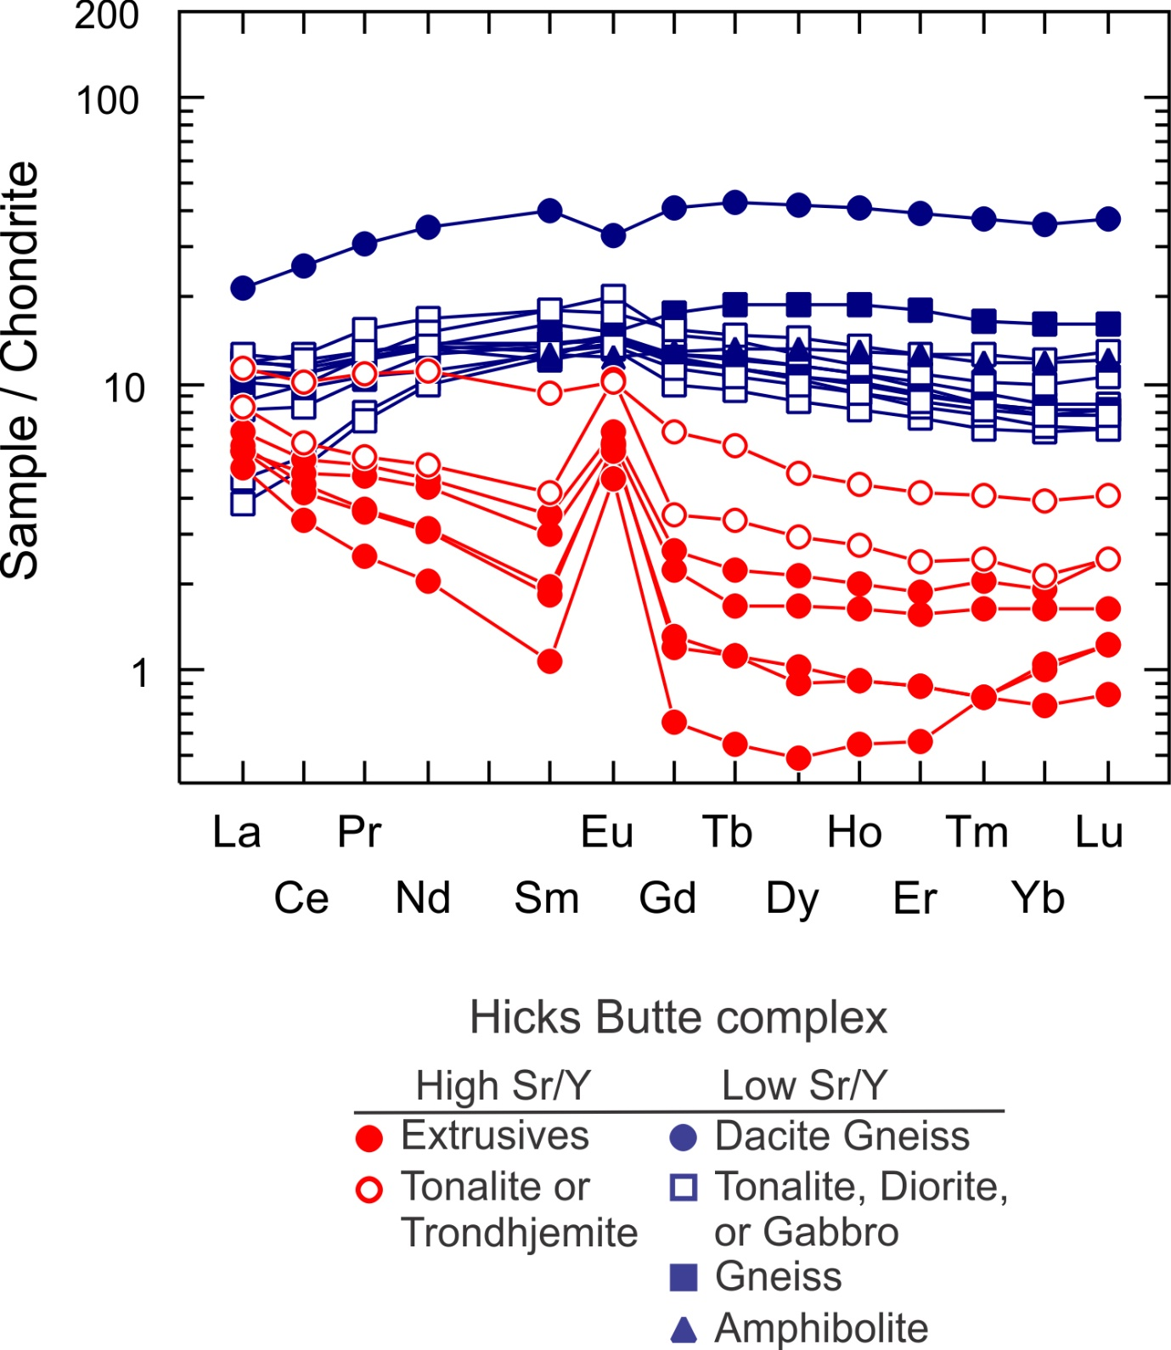
Chondrite normalized diagram for Hicks Butte complex samples.
Low Sr/Y ratios samples have depleted LREE.
High Sr/Y ratio samples have very depleted HREE with a strong positive Eu anomaly.
Chondrite normalized values from McDonough and Sun (1995)

Slide 10
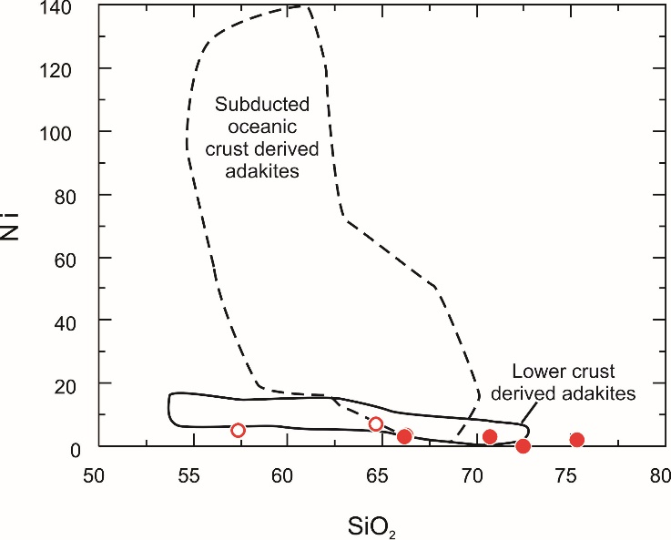
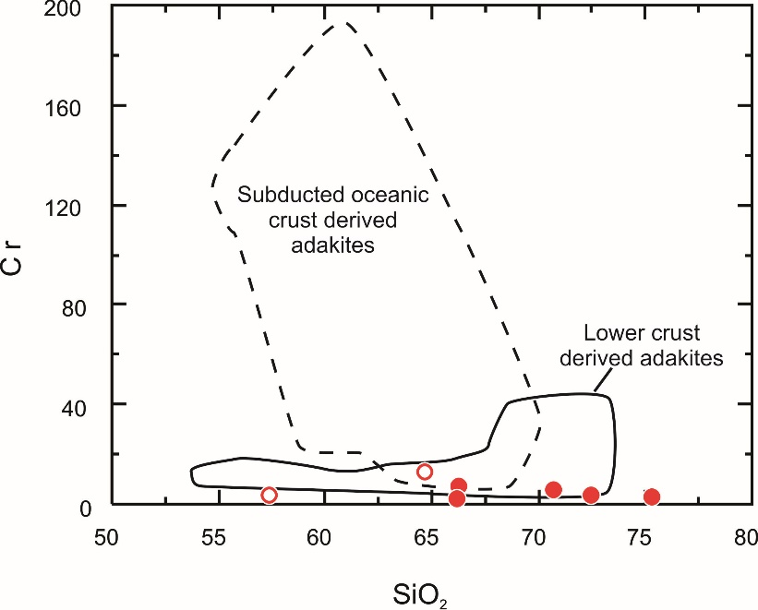
Only high Sr/Y ratio Hicks Butte samples plotted on Ni vs. SiO₂ and Cr vs. SiO₂ suggesting they were derived from the melting of lower crust and not oceanic crust. These high Sr/Y samples also have low Mg#
Diagrams modified from Wang et al. (2006)

Slide 11
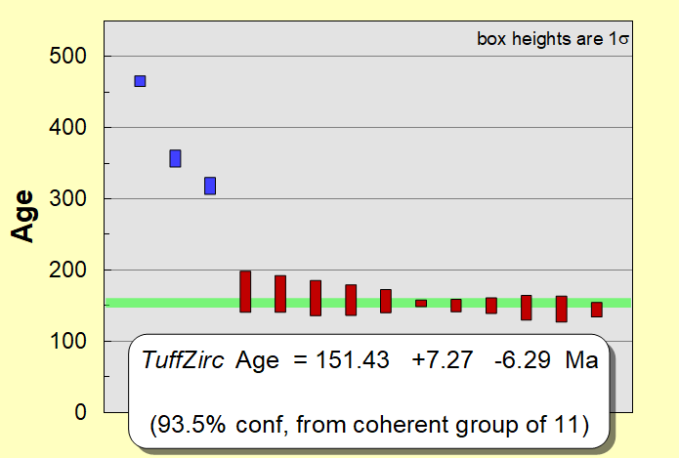
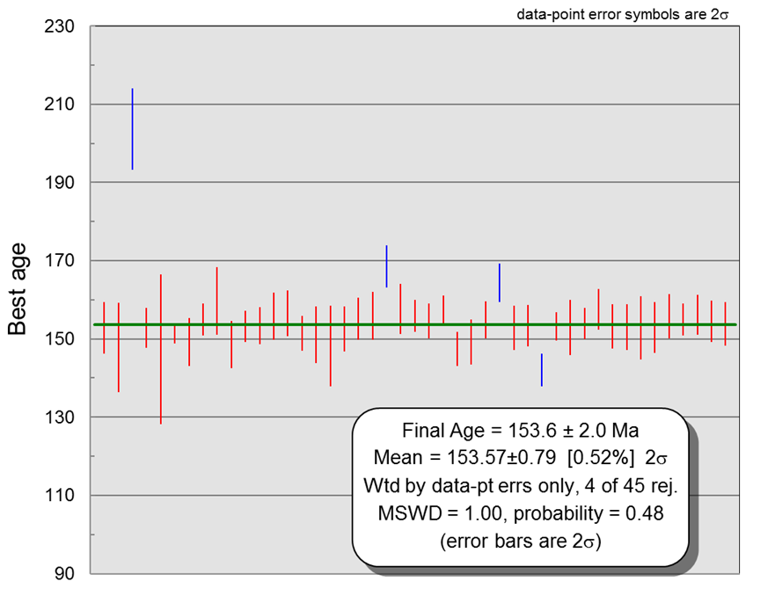
Final Age = 150 ± 6.8 Ma 2σ
Wtd by data-pt errs only, 3 of 13 rej.
MSWD = 0.2, probability = 1.0
150.0 ± 6.8 Ma LA-ICP-MS U-Pb zircon age for a hornblende quartz diorite.
The 317 Ma, 356 Ma, and 464 Ma zircons have igneous U/Th ratios.
153.6 ± 2.0 Ma LA-ICP-MS U-Pb zircon age for a gabbro.
204 Ma zircon has an igneous U/Th ratio .

Slide 12
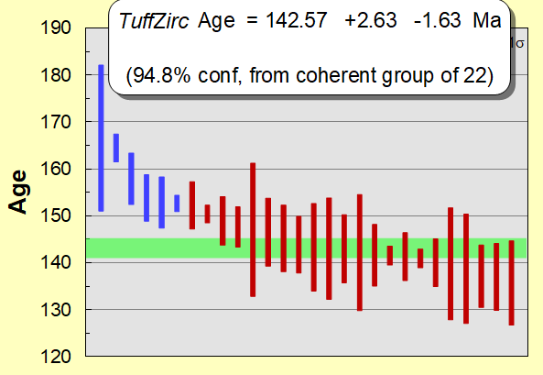
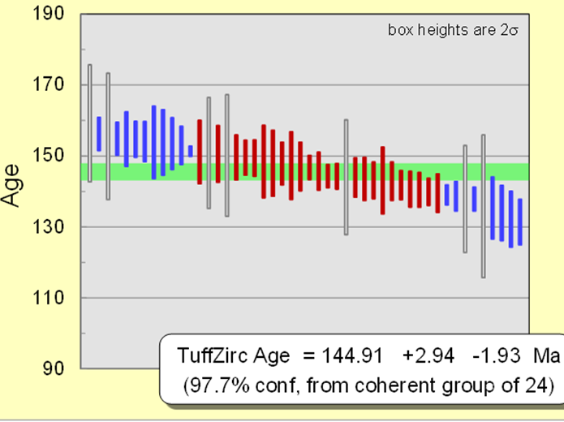
Final Age = 144 ± 2.4 Ma 2σ
Wtd by data-pt errs only, 6 of 27 rej.
MSWD = 1.1, probability = 0.4
144 ± 2.4 Ma LA-ICP-MS U-Pb zircon age for a dacite.
Most Jurassic age zircons have igneous U/Th ratios.
Complex LA-ICP-MS U-Pb zircon age for a dacite.

Slide 13
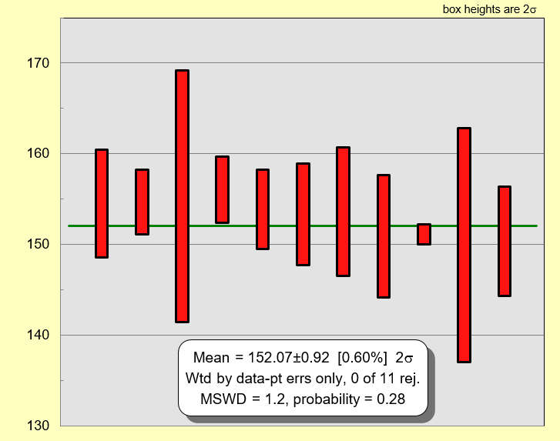
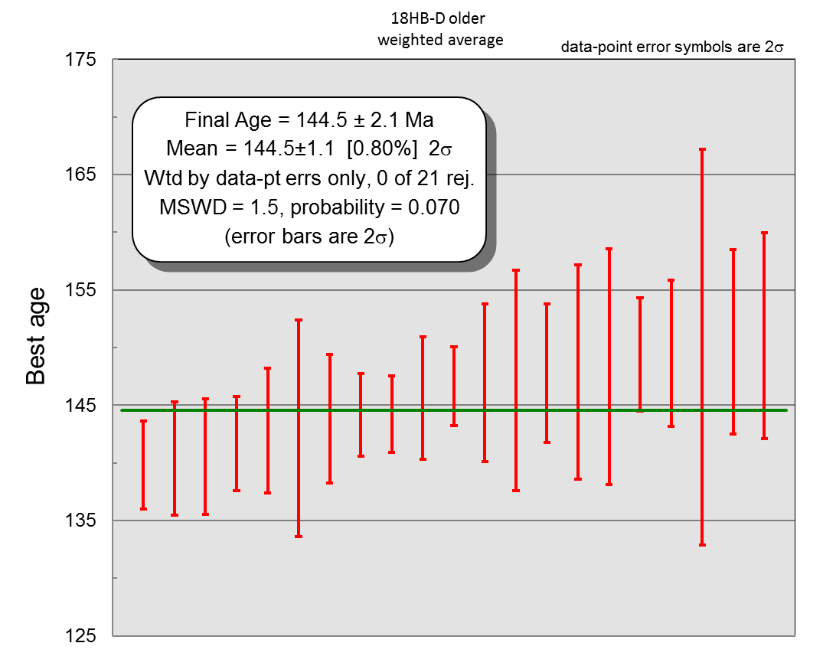
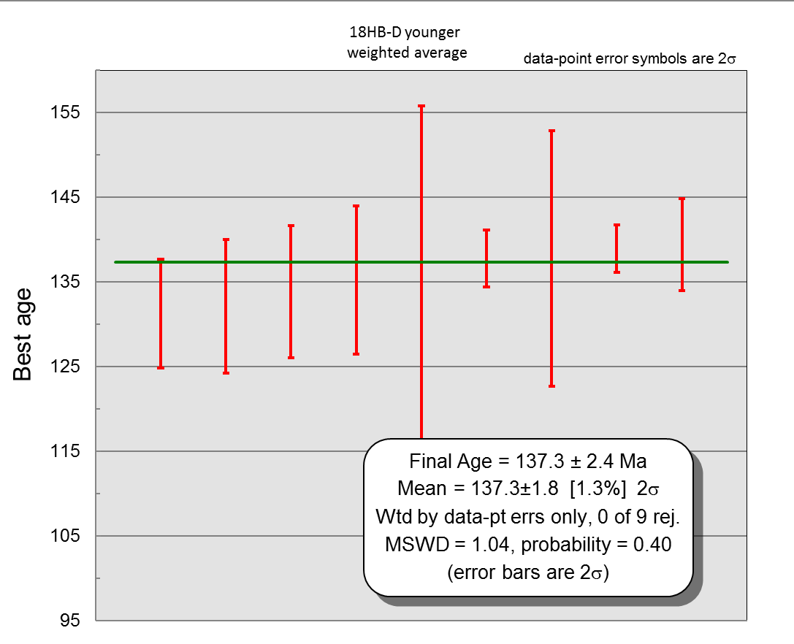
Complex LA-ICP-MS U-Pb zircon age for a dacite broken out by group.
152.07 ± 1.0 Ma LA-ICP-MS U-Pb zircon age for oldest 11 zircons from the complex age dacite.
144.5 ± 2.1 Ma LA-ICP-MS U-Pb zircon age for “middle” 21 zircons from the complex age dacite.
137.3 ± 2.4 Ma LA-ICP-MS U-Pb zircon age for youngest 9 zircons from the complex age dacite.

Slide 14
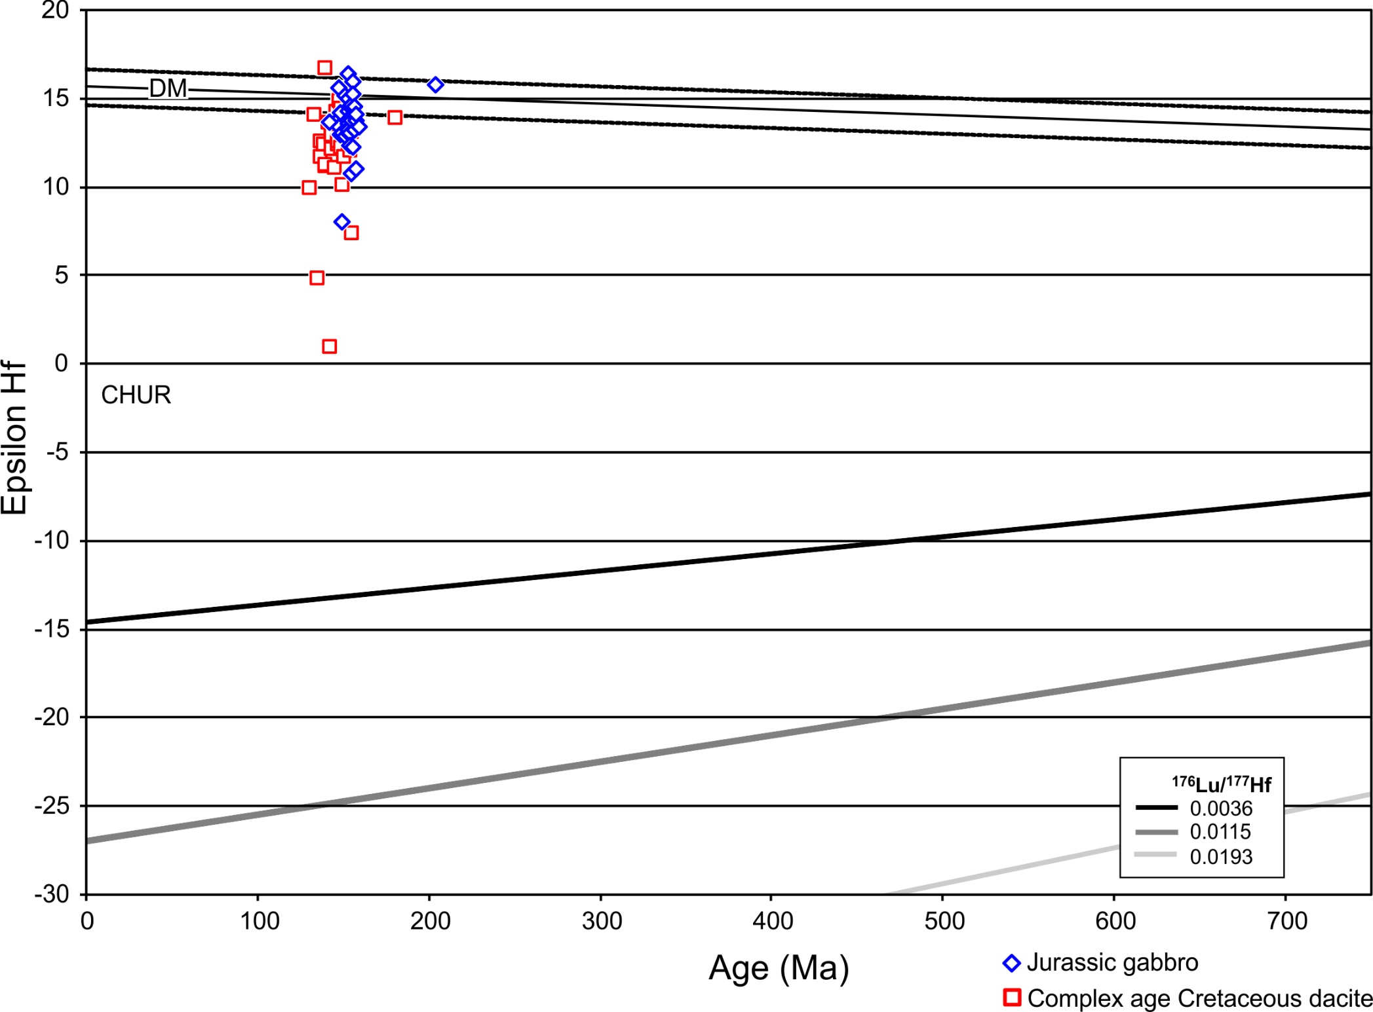
εHf(t) vs. age for zircons from the 154 Ma gabbro and the complex age Cretaceous dacite.
154 Ma gabbro εHf(t) range from +16.4 to +8
Complex age Cretaceous dacite εHf(t) range from +16.7 to +0.9

Slide 15
INTERPRETATIONS
The Hicks Butte complex is polygenetic, consisting of a Late Jurassic and Early Cretaceous arc rocks.
The geochemistry of the Late Jurassic portion of the Hicks Butte complex suggests it formed in an island arc setting. This is support by the primarily juvenile εHf(t) zircon values.
The geochemistry of the Early Cretaceous portion of the Hicks Butte complex suggests it formed from melting of mafic lower crust. This is support by the εHf(t) zircon values which could have been generated from melting older juvenile Jurassic as well as Paleozoic (& Neoproterozoic?) crust.

Slide 16
INTERPRETATIONS
The root of the Jurassic island arc could have melted to produce the Early Cretaceous adakitic rocks as the result of arc underthrusting
Alternatively, the Early Cretaceous adakitic rocks could be the result hydration from adjacent Easton Metamorphic suite due to subduction erosion. The ages of the Early Cretaceous rocks (~144 Ma and 137 Ma) overlap the end of high grade metamorphism of the Easton Metamorphic suite (see Cordova et al., 2018).

Slide 17
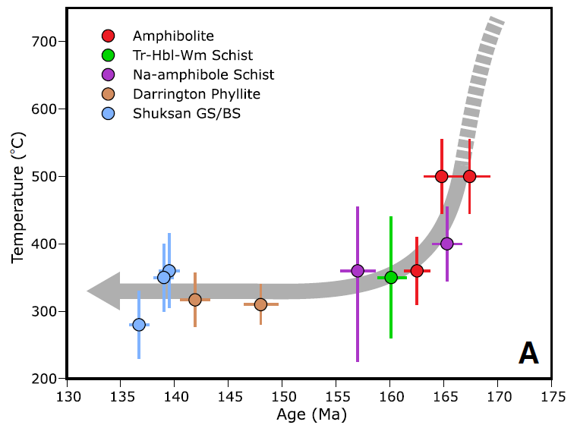
Cordova et al. (2018)

Slide 18
Zircons from complex age dacite

