Slide 1

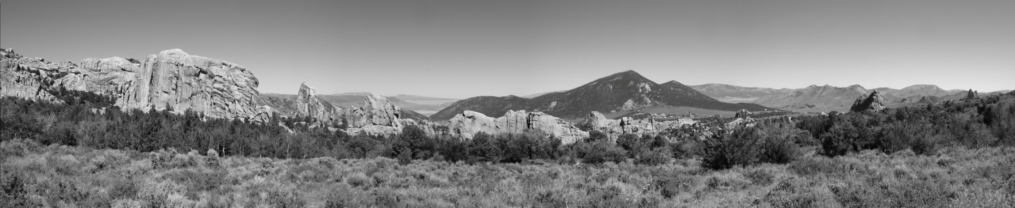
Syn-extensional topography, basin evolution and magmatism: Three overlooked aspects of metamorphic core complexes.
Friday, May 10, 2019
Alexandros Konstantinou
GSA Cordilleran Section conference 2019 T1. Cordilleran Tectonics from the Basin and Range to Alaska and the Arctic I: A Celebration of Elizabeth Miller’s Career

Slide 2
Agenda
Are there “overlooked” aspects of MCCs?
Topography around MCCs
Syn-extensional basin inversion at MCCs
Syn-extensional magmatic evolution of MCCs
Global observations of MCCs
Plutonic exposures and pluton sizes in MCCs
Effect of magmatism in structural evolution
Effect of magmatic additions to crustal thickness estimates
Effect of magmatic additions to topographic evolution during extension
Conclusions
Questions

Slide 3
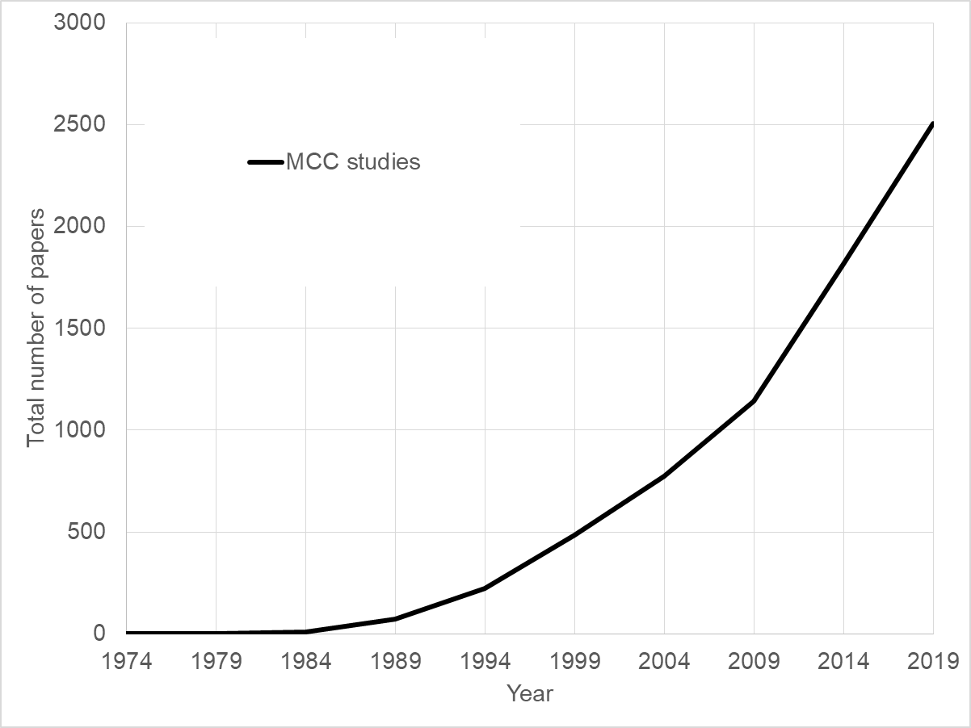
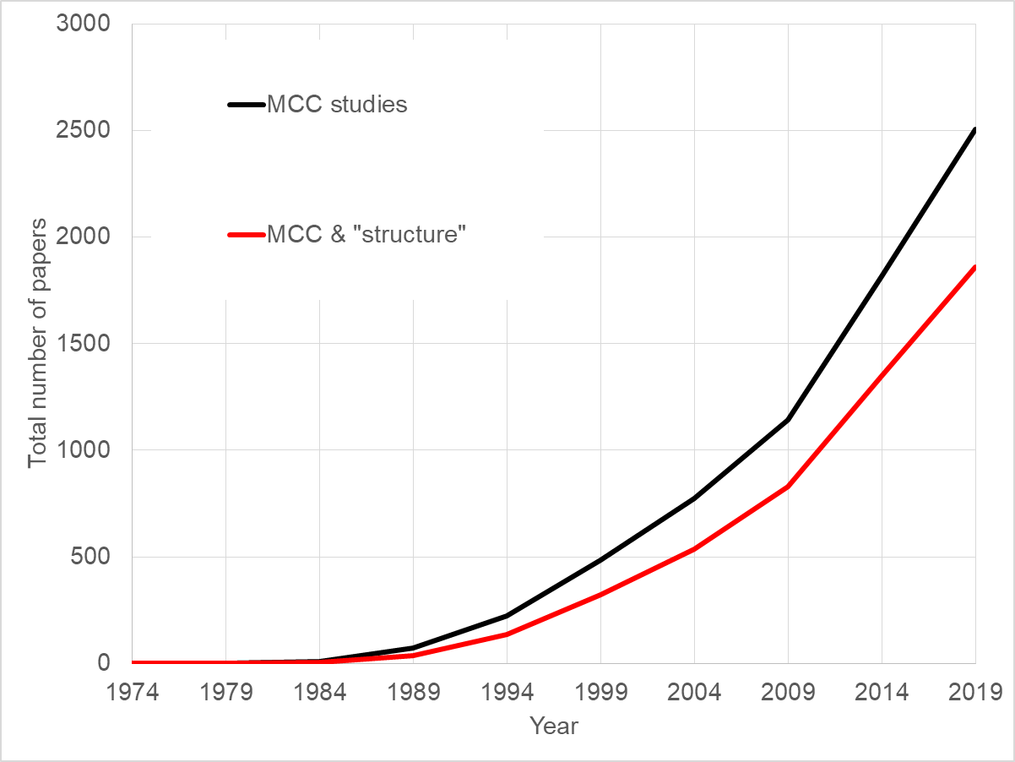
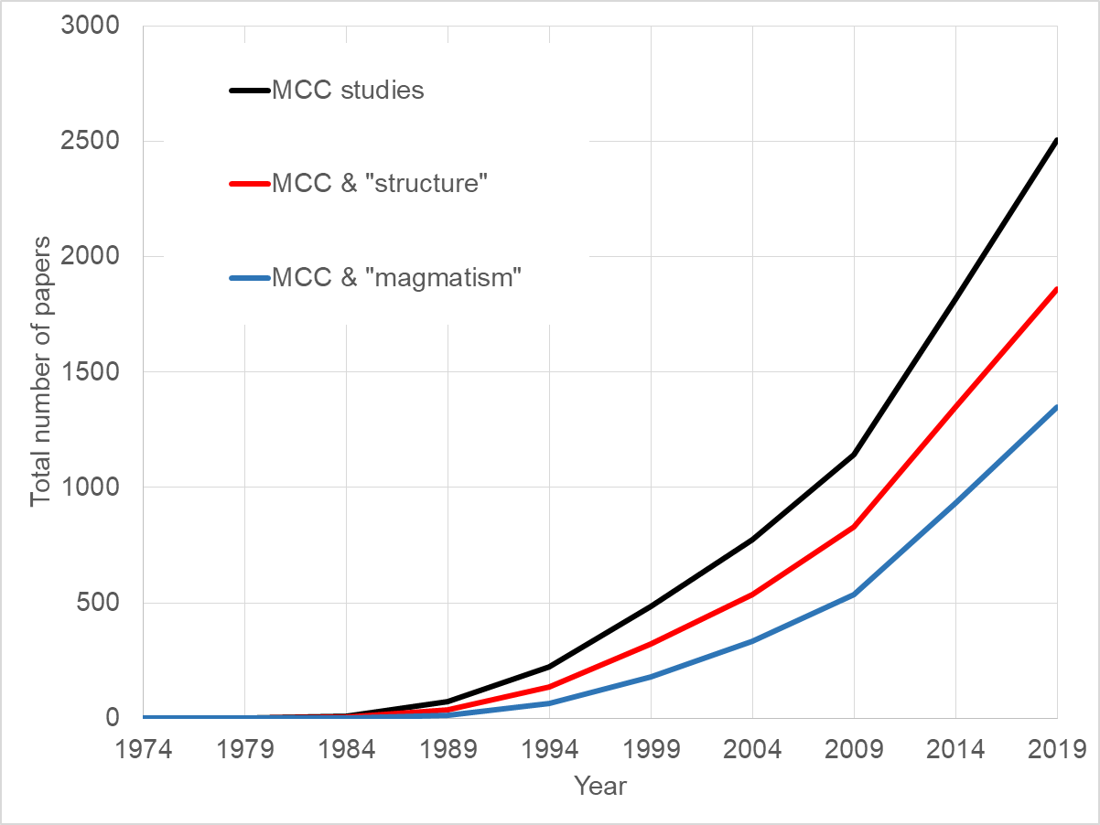
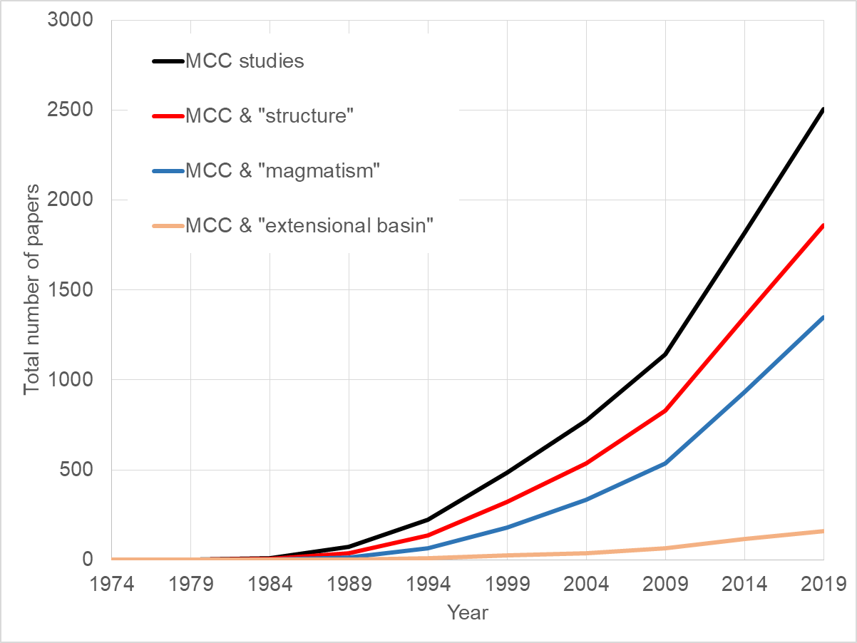
Studies of metamorphic core complexes

Slide 4
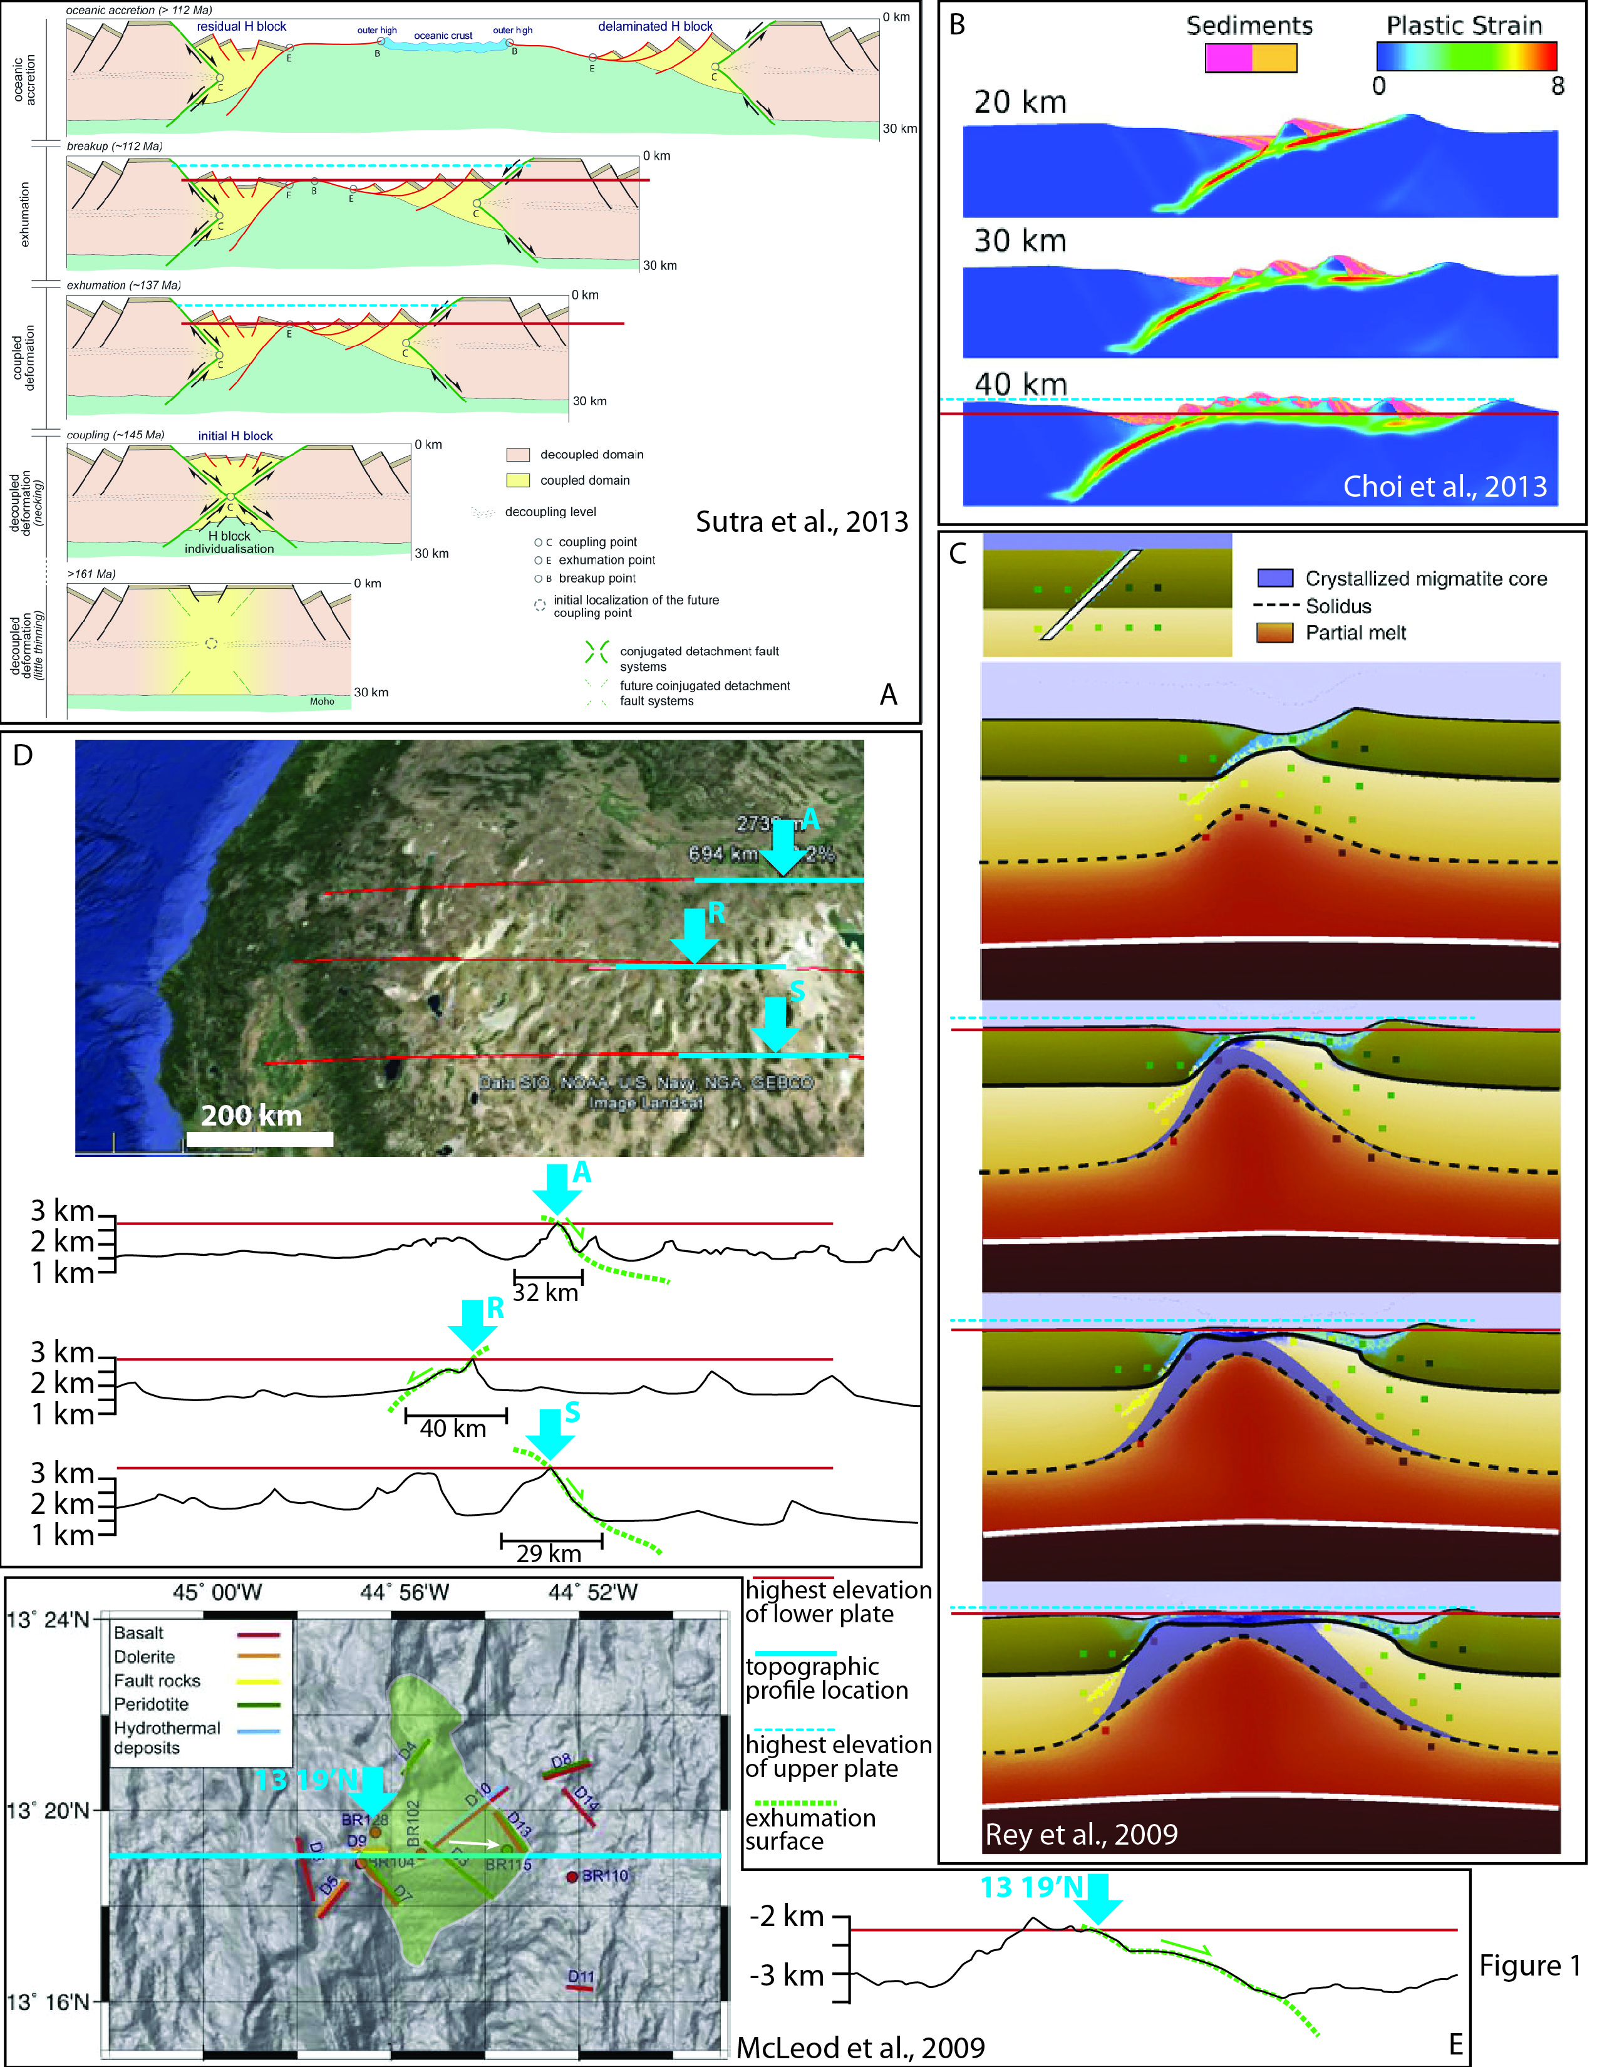
Topography of MCCs
The lower plate of MCCs is a regional topographic high
Most dynamic models predict the exhumed lower plate to be a basin

Slide 5
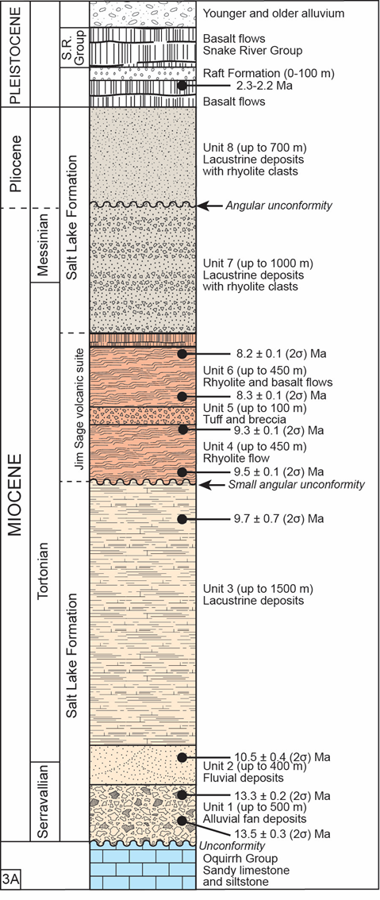
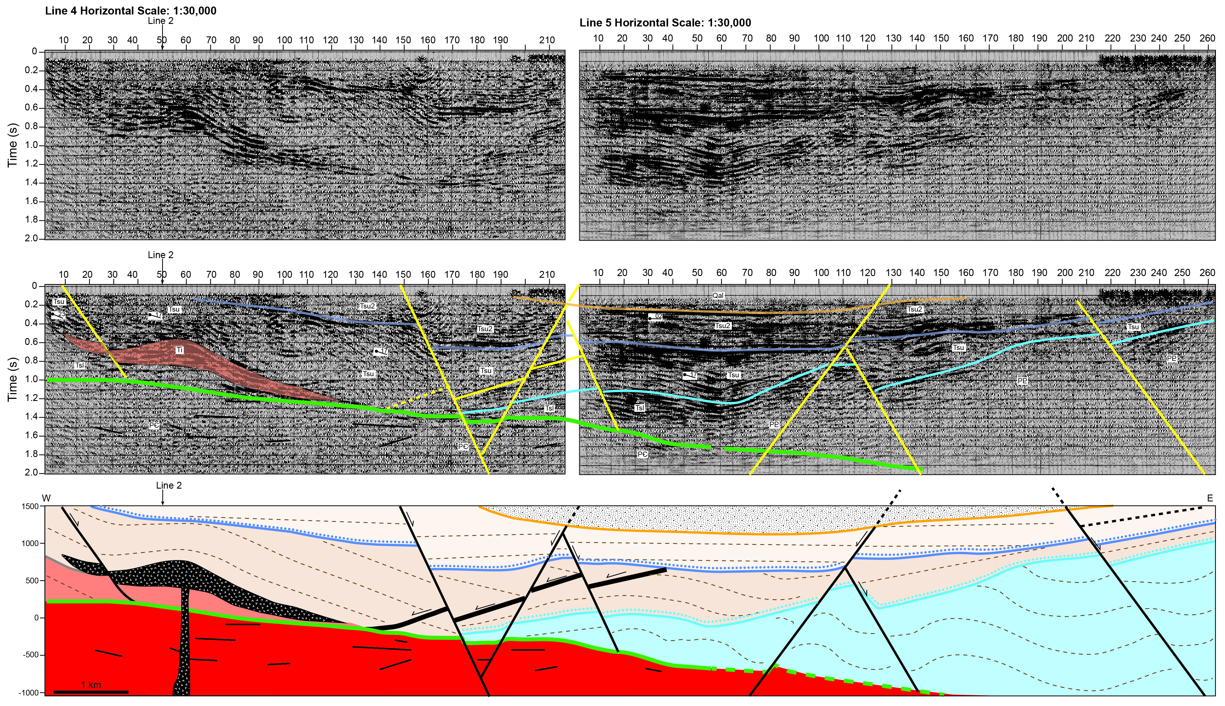
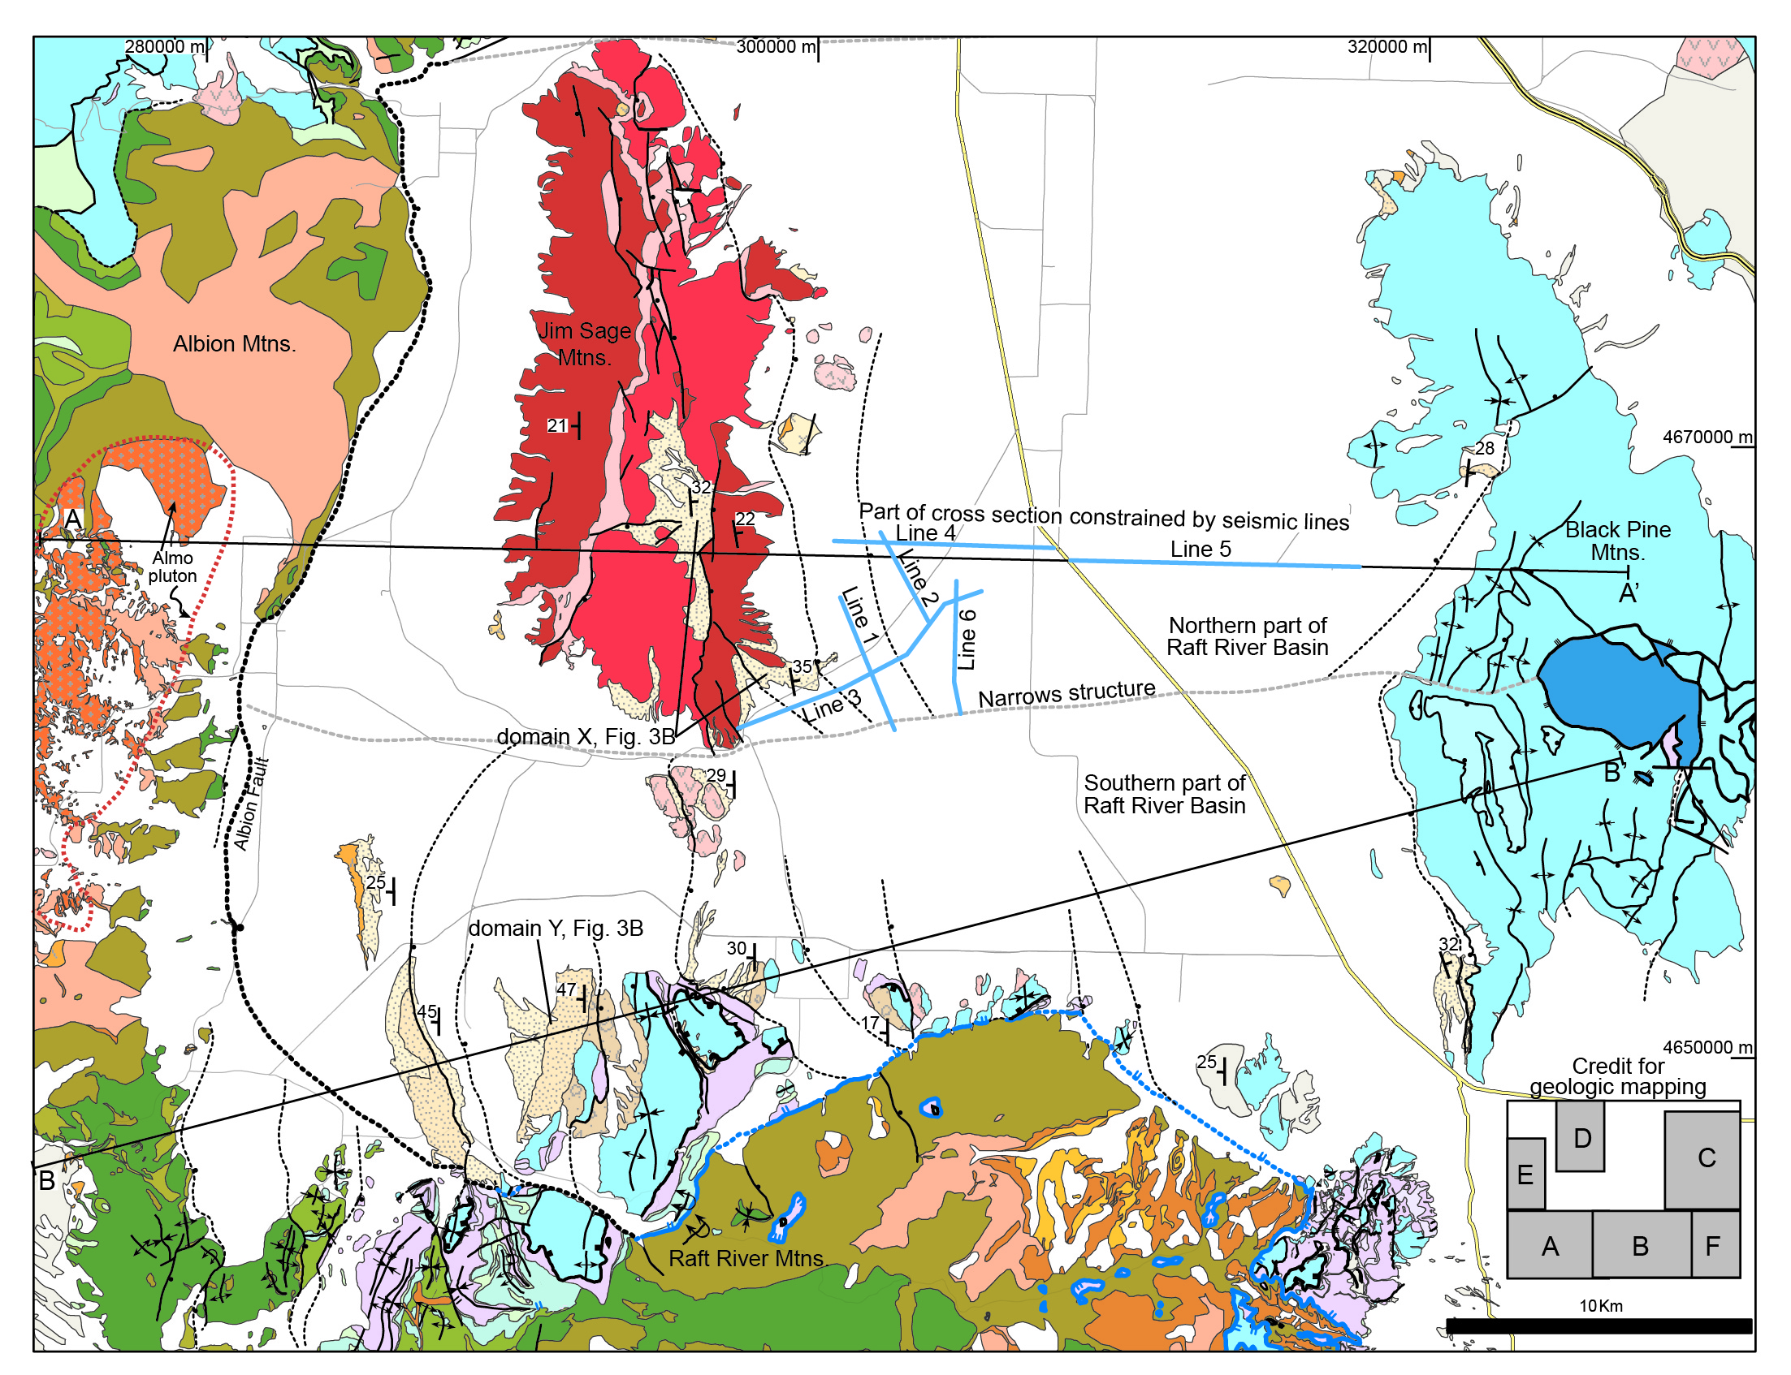
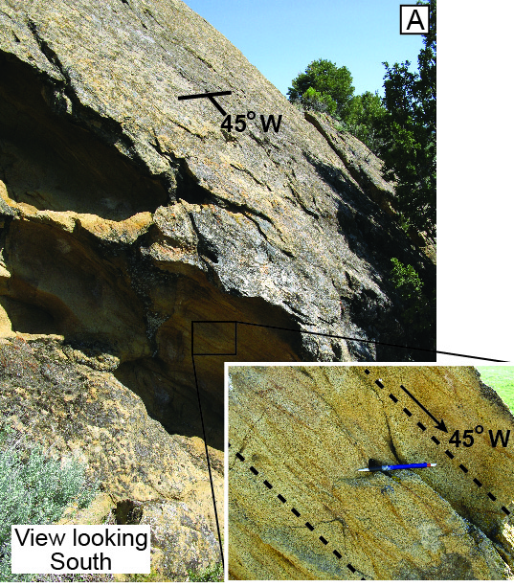
Syn-extensional basin inversion
The syn-extensional basin is uplifted, exposed and eroded during the extensional history of the region
Examples from the Northern Basin and Range:
Raft River basin
Elko basin
Sacramento Pass basin
Seismic data from Covington et al., 1983

Slide 6
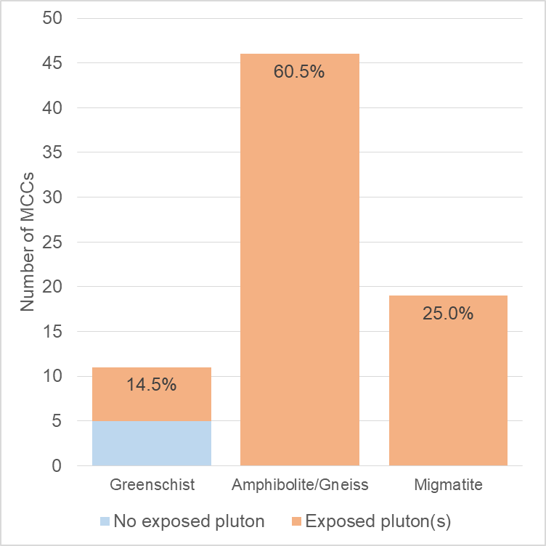
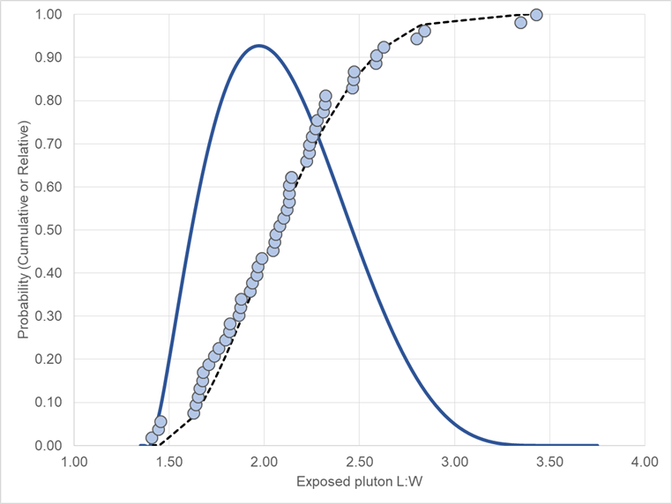
Magmatism at MCC: A global perspective
Compiled examples of MCC globally (n= 76)
Identified the metamorphic grade of extensional deformation
Identified MCCs with syn-extensional plutons in the lower plate (n=71)
Estimated the ratio of exposed plutons relative to the lower plate (n=48)
Estimated the length:width of the plutons (n=53)
Extensional deformation grade of MCCs
Exposed pluton Length:Width
Most common MCCs are “gneiss domes”
93.4% of MCCs have
syn-extensional plutons!
Plutons in MCCs are asymmetric with a most typical L:W of ~2

Slide 7
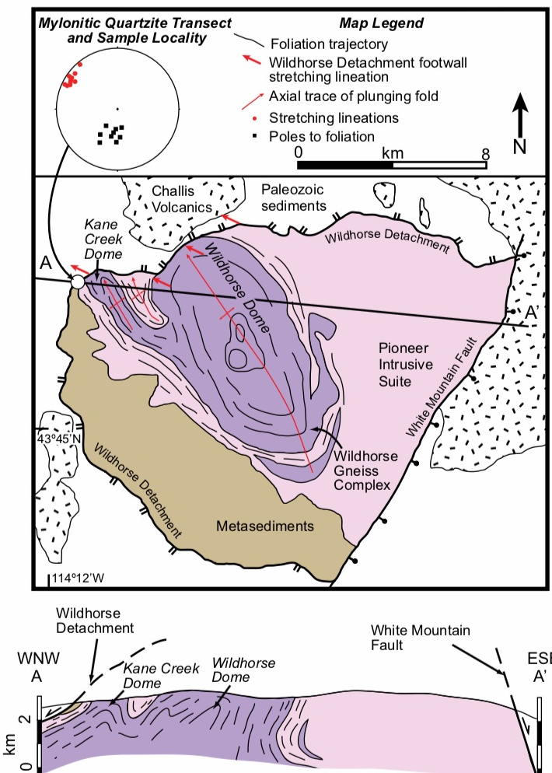
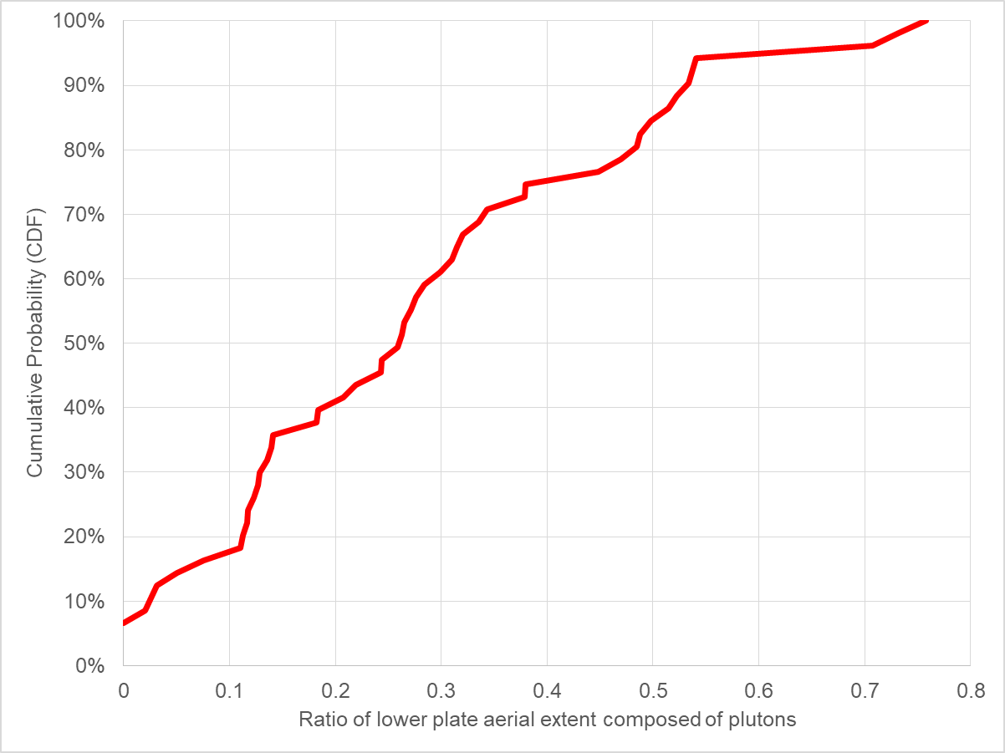
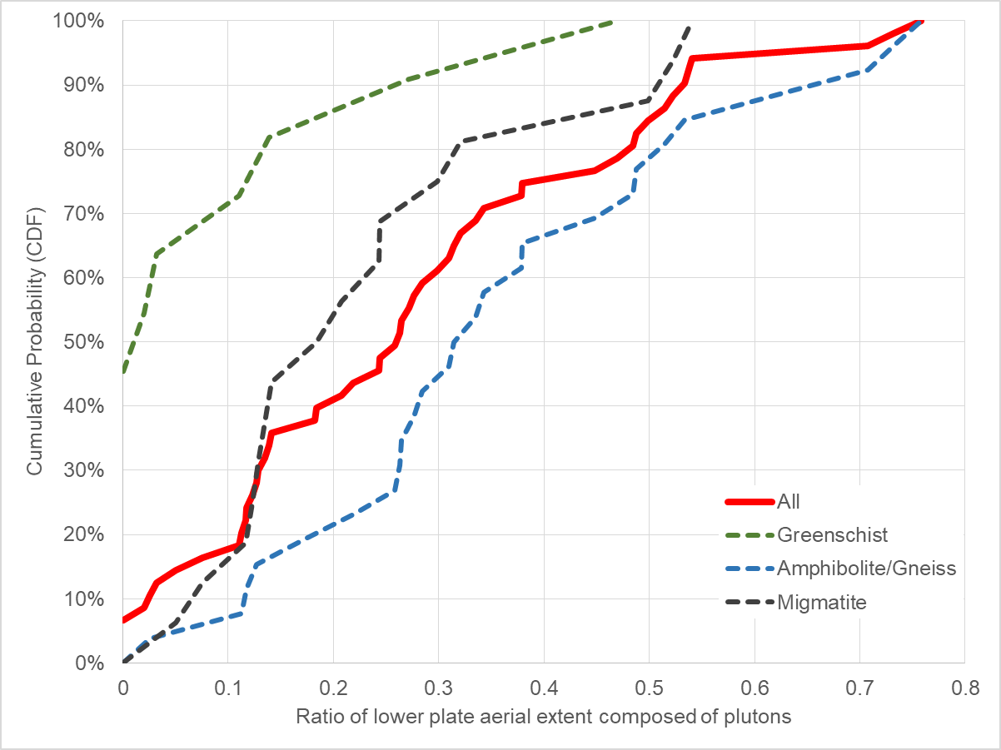
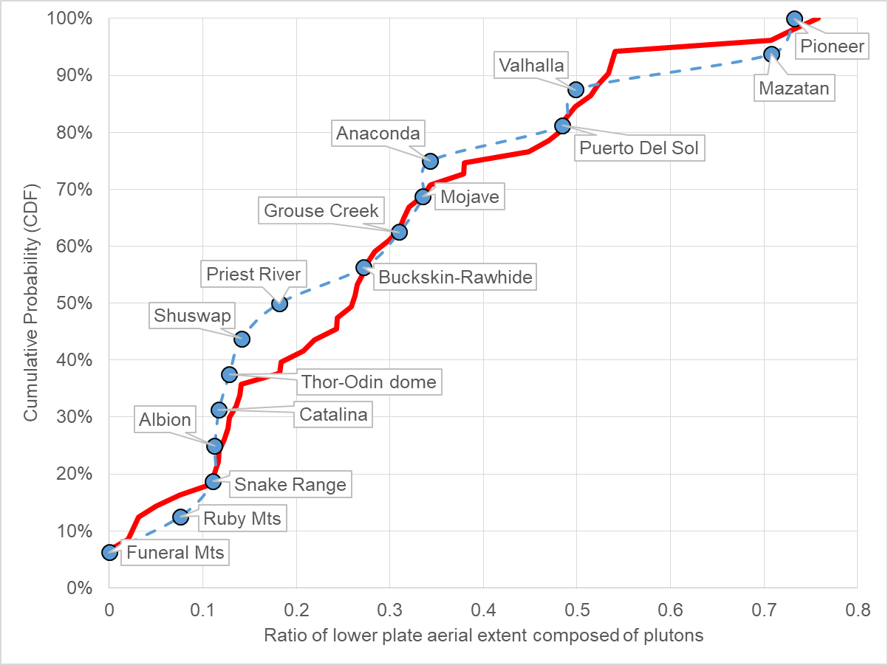
Magmatism at MCCs: A global perspective
Globally, pluton exposure in the lower plates of MCCs ranges from <5% to up to 76%
Amphibolite grade (~gneiss domes) have the largest aerial proportion of plutons exposed in the lower plate
Basin and Range MCCs are a random subset of the global population
K-S P value of 0.96 between global and B&R populations
K-S P value of 0.02 between gneiss and migmatite populations
Example from the Pioneer core complex

Slide 8
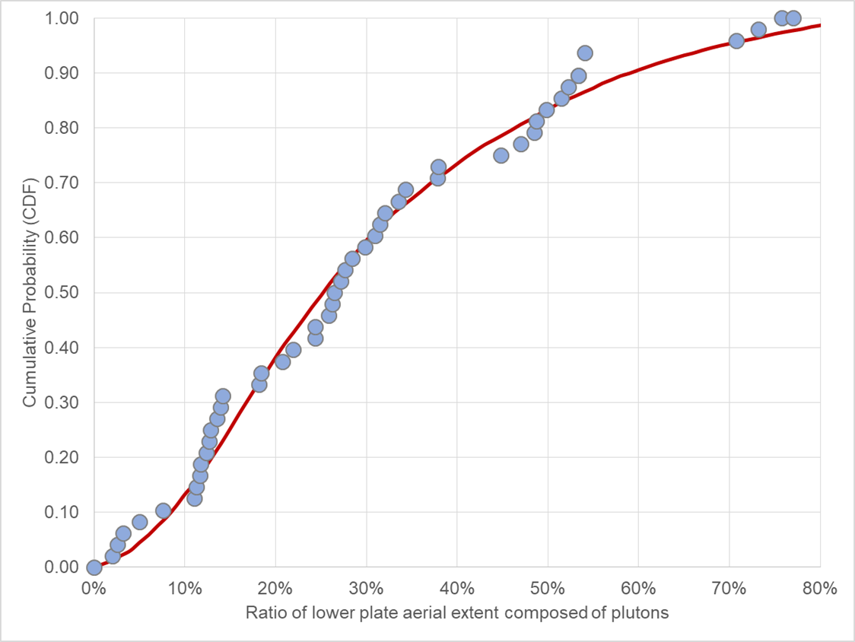

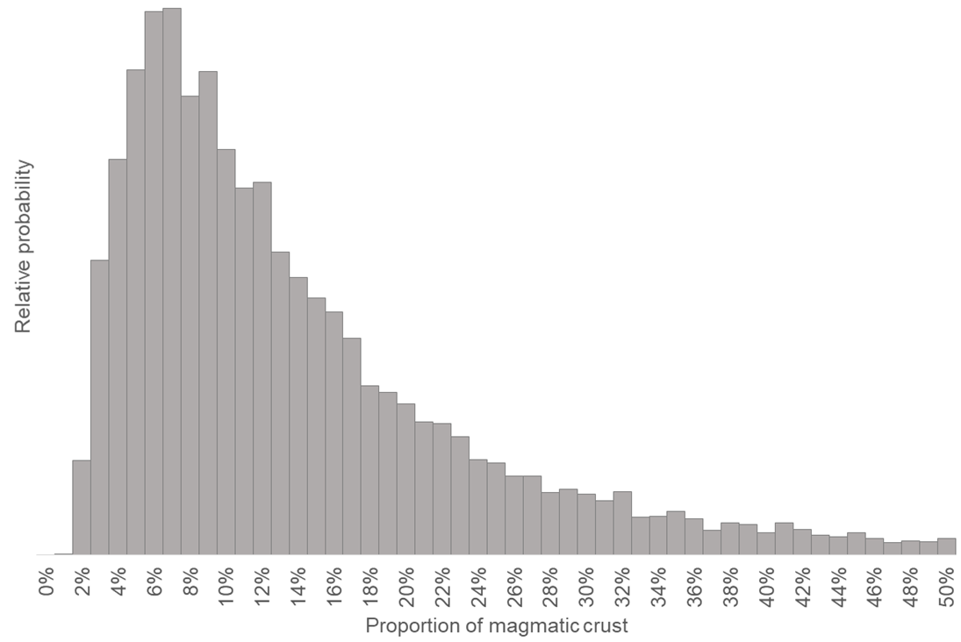
Magmatism at MCCs: How much magma?
A stochastic approach to estimating proportion of magmatic crust:
Plutons in MCCs are representative of the post-extensional deep crustal structure
Plutons are present in all MCCs, they are ~ ellipsoidal and they follow empirical observations of Thickness : Length and Length : Width
MCCs as mapped are “random” depth sections of similar crustal structures
Detachment fault
Monte Carlo simulation parameters
Global empirical observations
Upper crust
BDTZ
d
Distribution est. | Low | M.L. | High
Pluton Thickness (km) | 7.0 | 9.4 | 12.6
Top pluton depth (km) | 15 | 18 | 22
Random line depth (km) | 12 | 23 | 28
MCC L:W | 1.5 | 4.1 | 7
Best-fit
Monte Carlo model
Plutons
Pluton intrusion depth
Lower crust
Prob. of “random” cross section
W
T
Insights
3 to >40% of crust can be magmatic
Mean of magmatic crust is ~15%
MCCs without exposed plutons (6.5%) are explained by shallow random cross sections
Mode: ~7%,
Mean: ~15%
of extended crust is magmatic
Pluton size:
T=0.6*L^{0.6}
MCC map view
L:W from empirical distribution
No pluton exposed
90% confidence interval is 3-33%
Cruden and McGaffrey, 2000

Slide 9
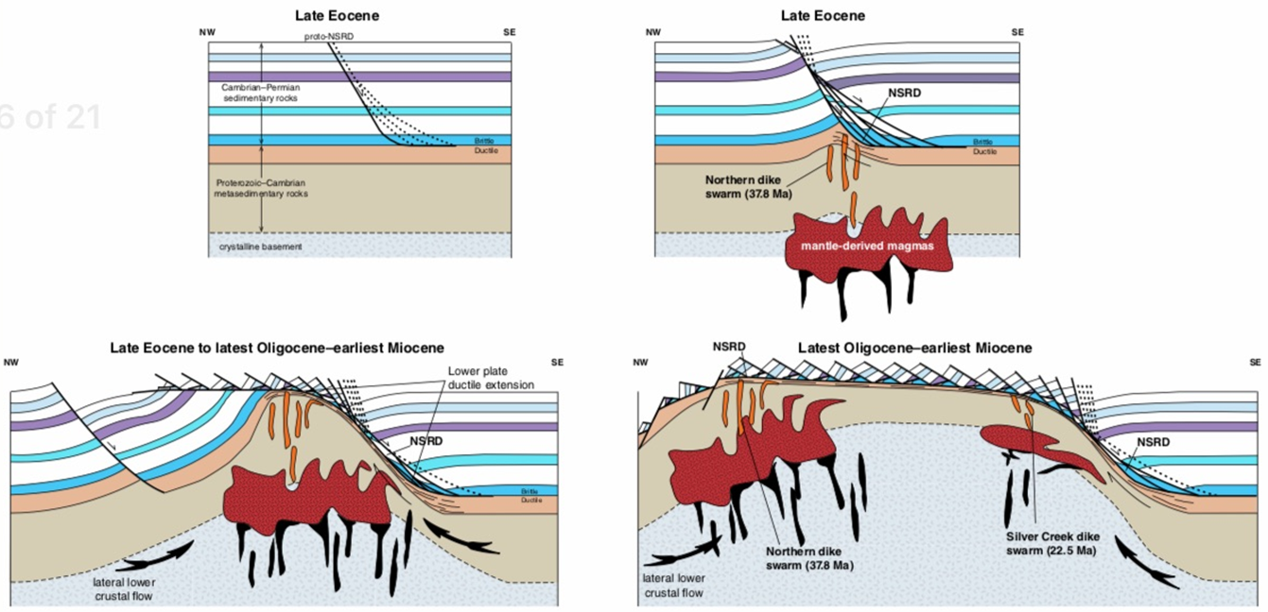
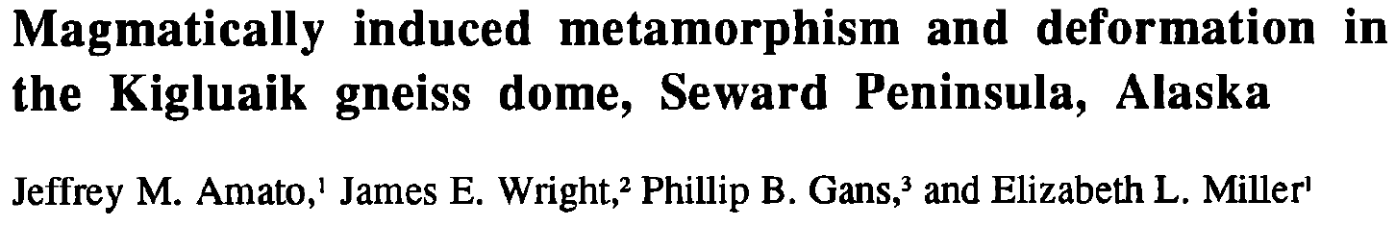
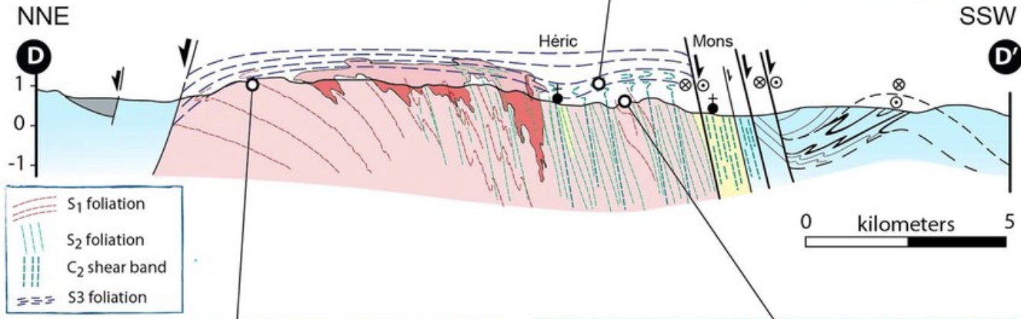
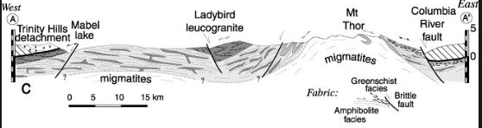
Magmatism at MCCs: Structural implications
Magmatism plays a fundamental role in weakening the lower crust during MCC formation
Plutons act as density “instabilities” that result in the uplift and exhumation of the MCCs
Are some of the migmatite domes the “damage zones” through which plutons intruded?
i.e. the exposed pluton(s) are the bases of larger, mostly eroded plutons
Snake Range
(Lee et al., 2017)
Pluton mostly eroded away
Montagne Noir massif (Rabin et al., 2015)
Pluton mostly eroded away
Thor-Odin dome (Norlander et al., 2002)

Slide 10
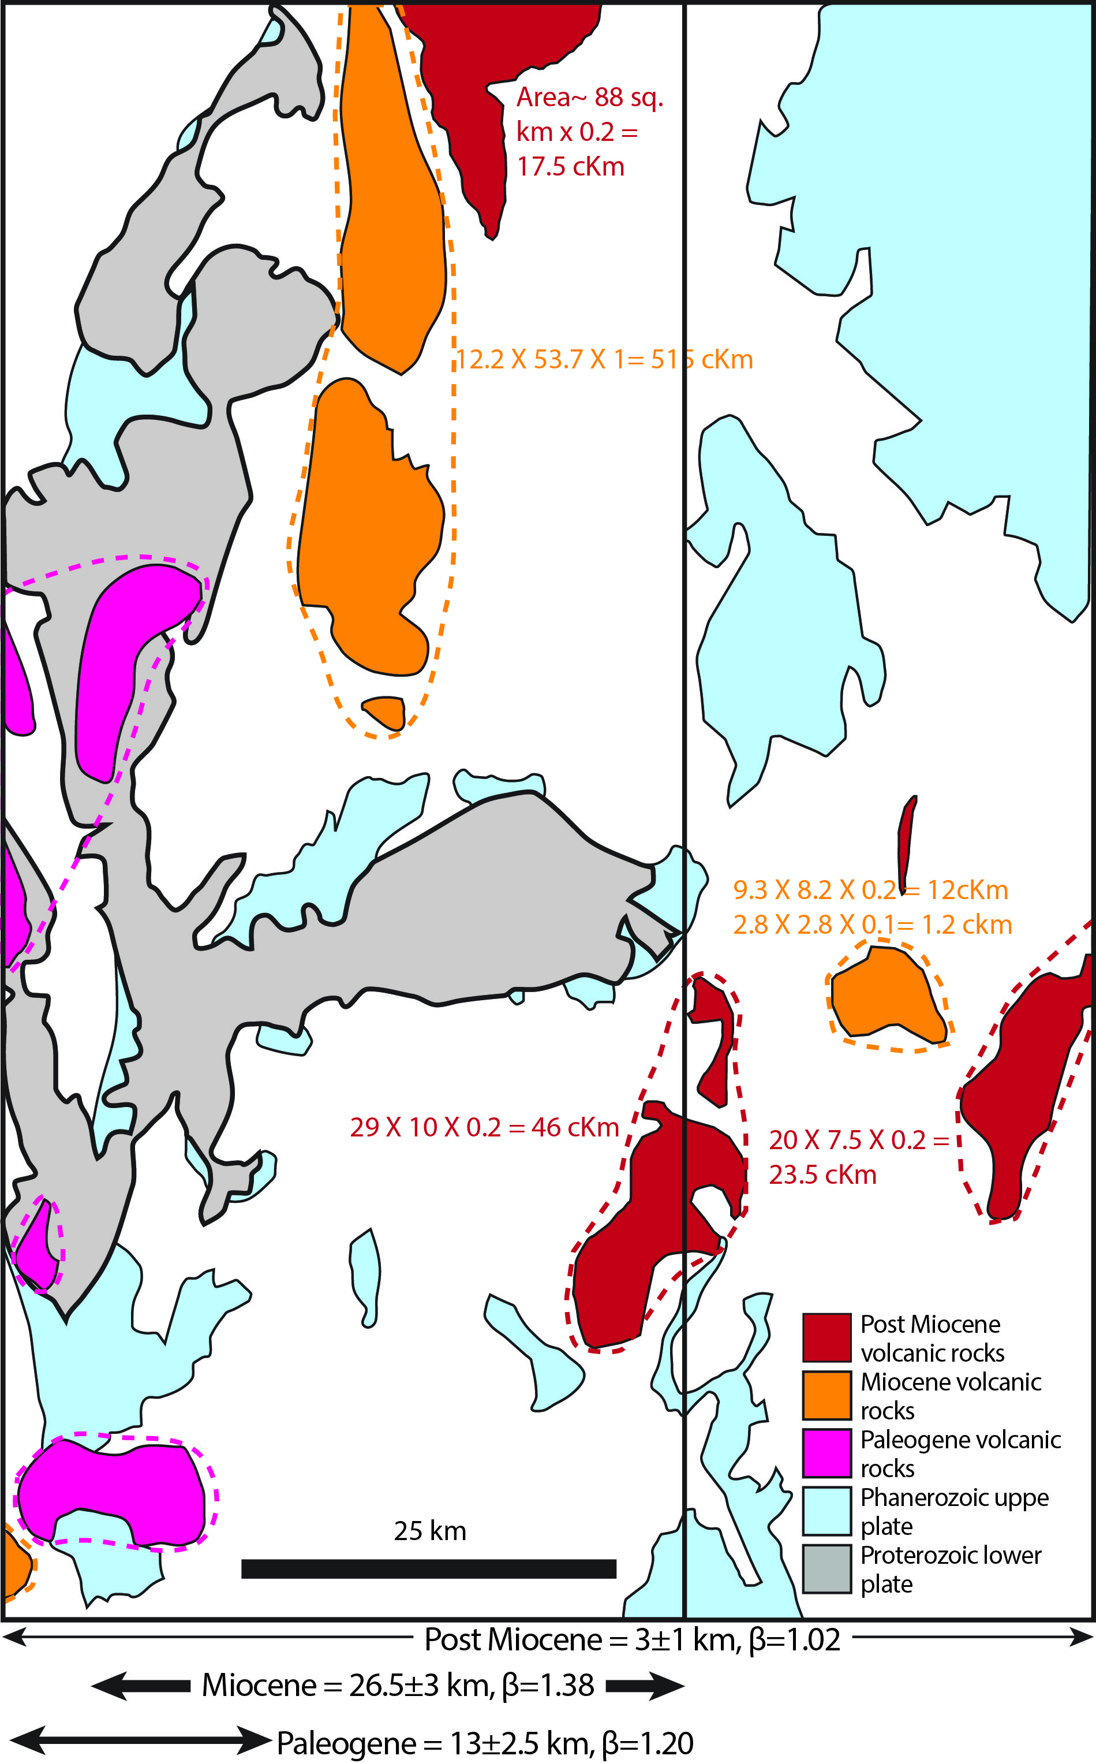
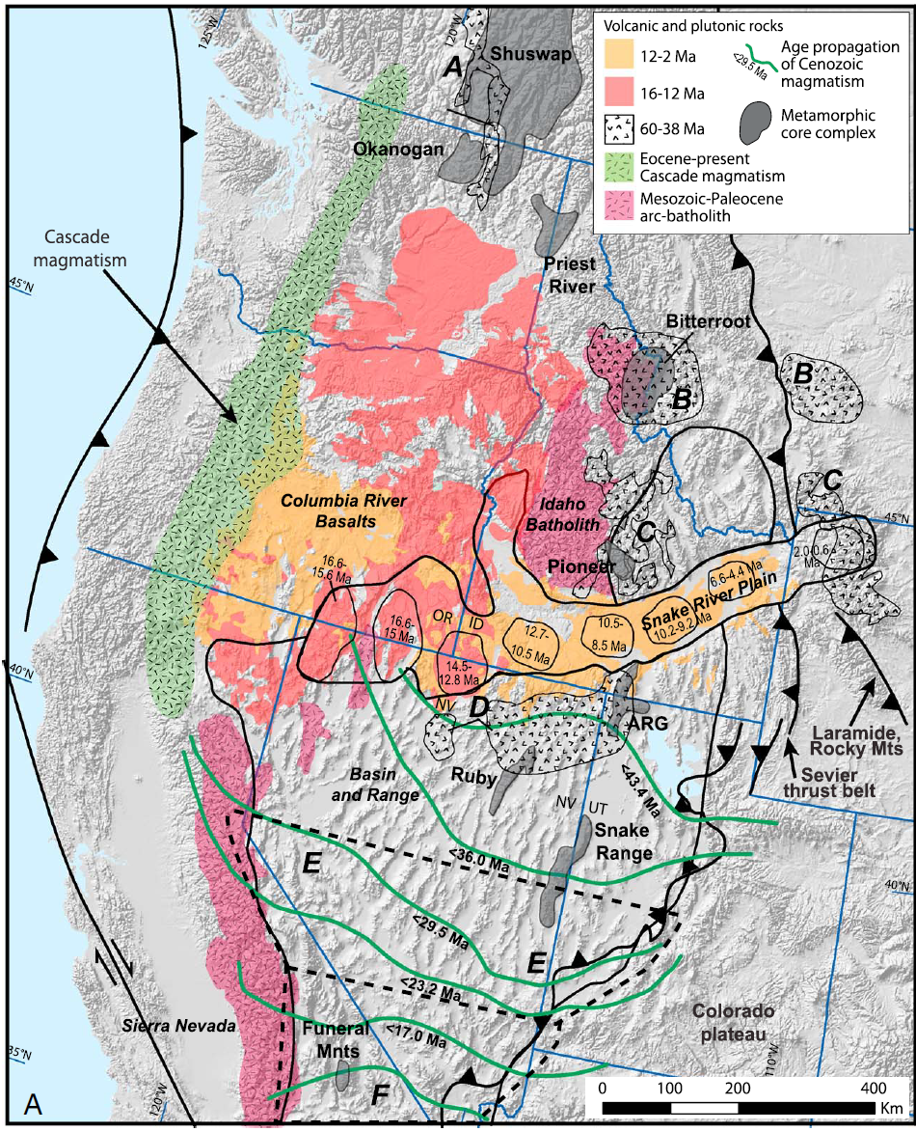
Magmatism and extensional crustal evolution
Highly simplified map of the ARG region
Focus on the NE Basin and Range, around the ARG MCC
Three extensional and three magmatic episodes
Paleogene, Miocene and Post Miocene
Cumulative ~43 to 50 km of extension over a region of 100 km wide
Most extension (~27km) is Miocene
Most voluminous magmatic events are Paleogene and Miocene
Key questions:
How much of the magma is mantle derived?
How does magmatism affect crustal thickness estimates?

Slide 11
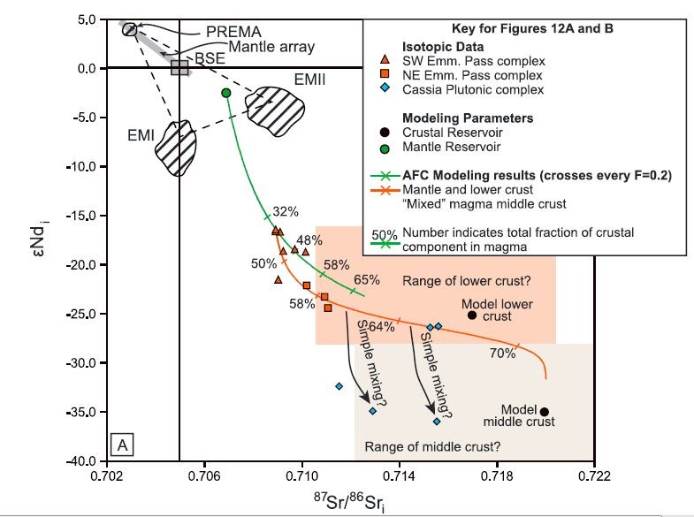
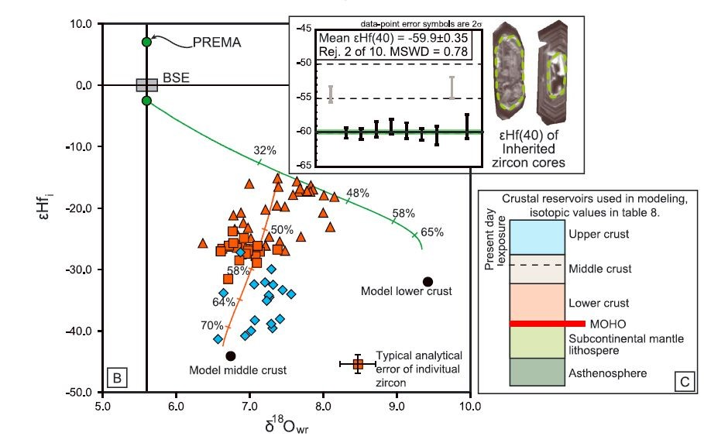
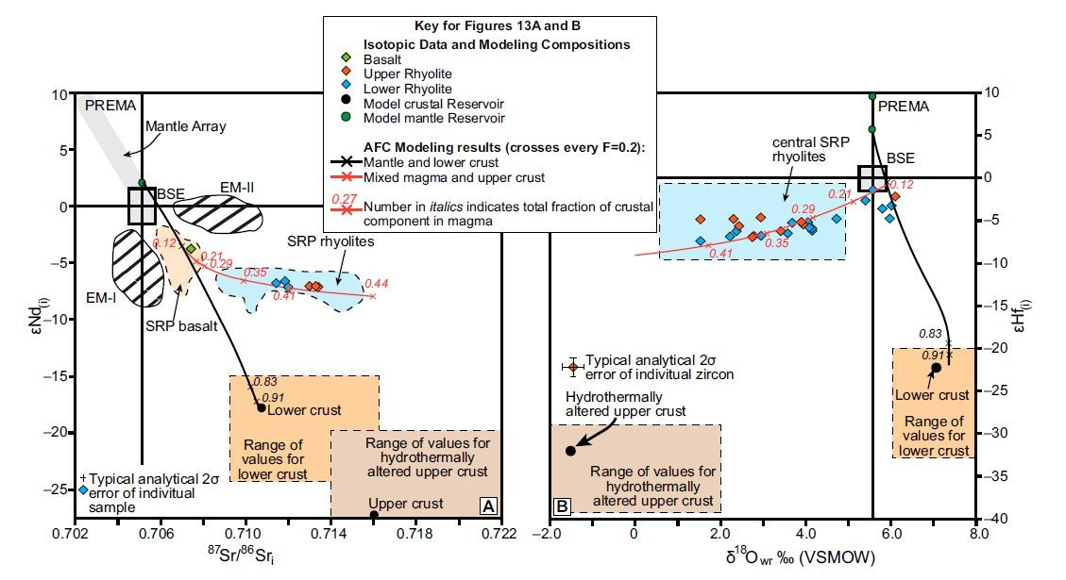
Mantle Vs Crustal component at ARG’s magma
Paleogene magmatism
Sr, Nd, Hf and O isotopic modeling from Paleogene and Miocene magmas
Paleogene mantle component: 65-30%
Miocene mantle component: 85-60%
Miocene magmatism
Konstantinou et al., 2013 (Tectonics)
Konstantinou et al., 2013 (Geosphere)

Slide 12
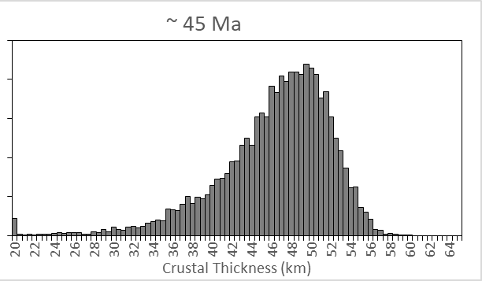
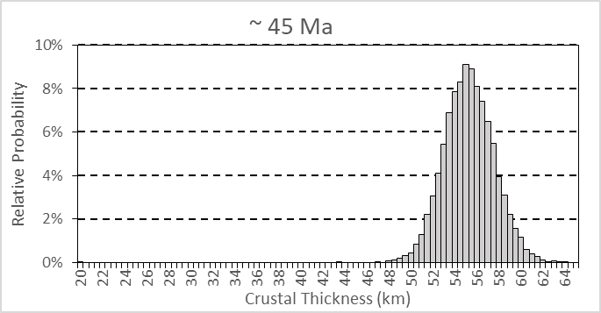
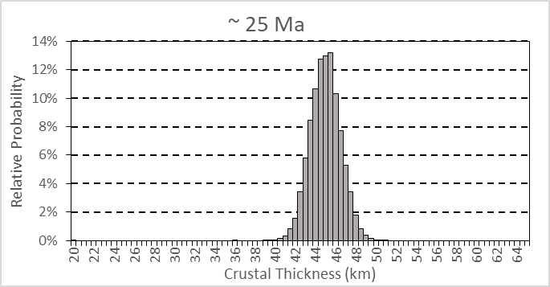
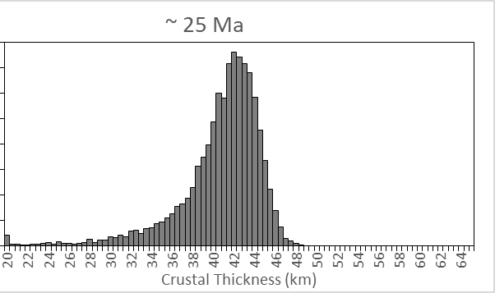
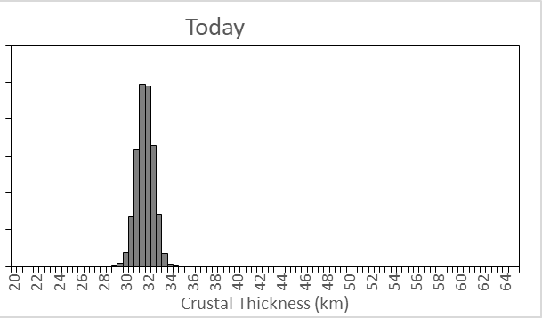
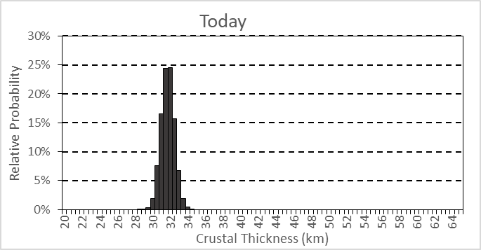
Effect of magmatism on crustal thickness
Long, 2018 (avg. Central B&R)
A stochastic approach to estimating crustal thickness through time:
Assumes lower plate and upper plate decoupling for ~100 km wide area
Reconstruct extensional history through time and assume regional mass balancing
Account for estimates of magmatic component of crust
Account for estimates of mantle-derived material added to the crust
Tests two scenarios:
First no magmatic addition to the crust (closed system)
Second scenario assumes new mantle-derived material added to the crust (open system)
Key point: Crustal thickness is ~17 to 30% lower when mantle-derived material is taken to account!
Inc. magmatism: Mode: 48.5 km
Mean: 46.1 km
Bahadori et al., 2018
Inc. magmatism: Mode: 42.5 km
Mean: 40.5 km
Bahadori et al., 2018
Scenario 1: no magmatism
Scenario 2: with magmatism

Slide 13
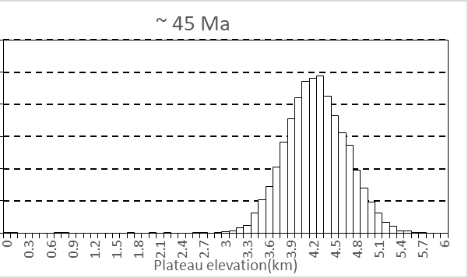
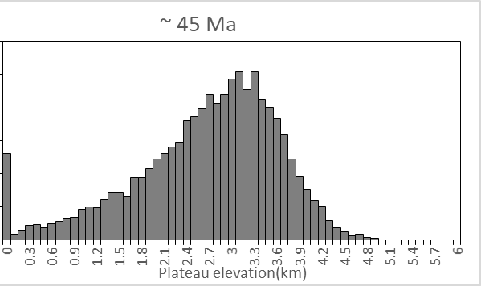
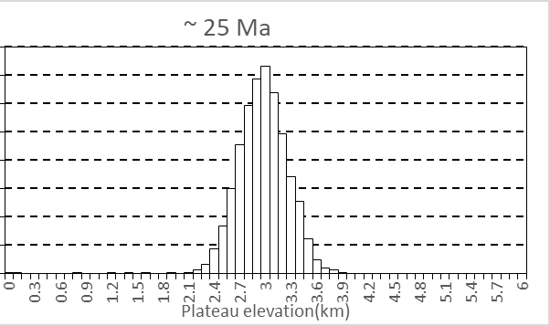
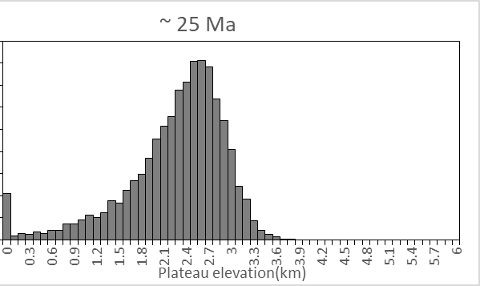
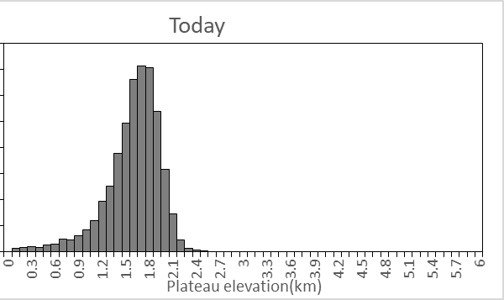
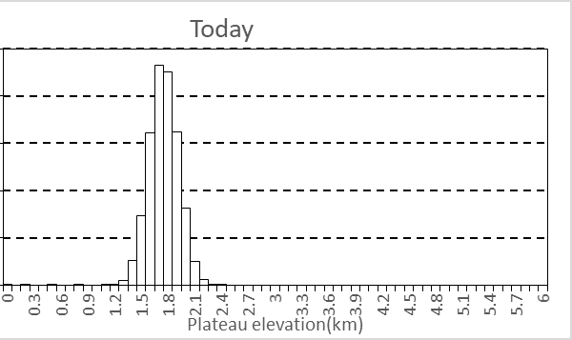
Effect of magmatism on elevation
A stochastic forward modeling approach to regional elevation:
Present-day topography is an output, not an assumption
Assumes initial local isostasy (Airy)
Estimates initial tectonic and thermal subsistence after each extensional event (Eq. from Allen and Allen, 2013)
Estimates uplift from magmatic addition
Uses regional crustal extensional factors (β-factor)
Tests two scenarios:
First no magmatic addition to the crust (closed system)
Second scenario assumes new mantle-derived material added to the crust (open system)
Key point: Elevation is ~20-35% lower when mantle-derived material is taken to account!
Inc. magmatism: Mode: 3.1 km
Mean: 2.7 km
Bahadori et al., 2018
Cassel et al., 2018
Inc. magmatism: Mode: 2.6 km
Mean:2.2 km
Bahadori et al., 2018
Cassel et al., 2018
~Average elevation in NE Basin and Range
Scenario 1: no magmatism
Scenario 2: With magmatism
Inc. magmatism: Mode: 1.7 km
Mean:1.7 km

Slide 14
Conclusions
MCCs are regional topographic highs; there is no dynamic model to explain these topographic observations
The syn-extensional basins of MCCs appear to be inverted as recorded by exposure of the basins and regional unconformities
Magmatism plays a crucial role in many aspects of MCC evolution
Global observations of syn-extensional plutons in MCCs imply that a significant portion of the crust is magmatic (mean is 15%)
Understanding magmatism is fundamental in deciphering the mechanical and thermal evolution of the lower crust
Mantle-derived magmatic additions to the NE Basin and Range crust decreases initial thickness estimates by 15-30%, and estimated plateau elevations by 20-35%
The average pre-extensional crustal thickness of the NE Basin and Range is ~46.1 km, and the plateau elevation is ~2.7 km

Slide 15
Questions?

Slide 16
Backup

Slide 17
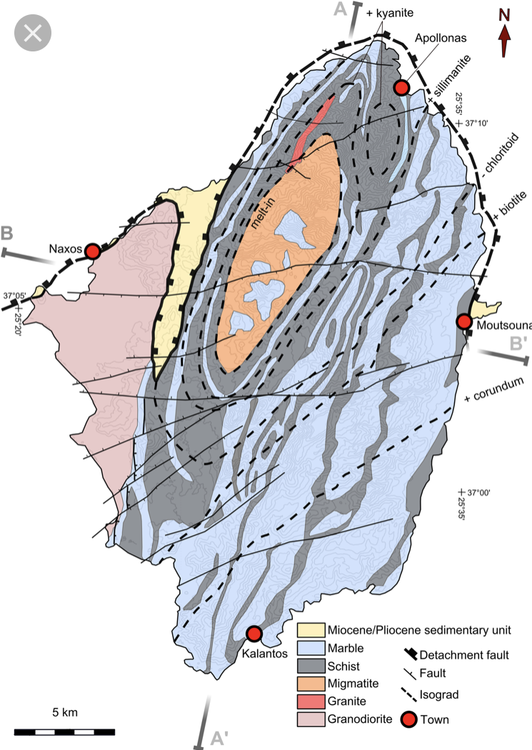
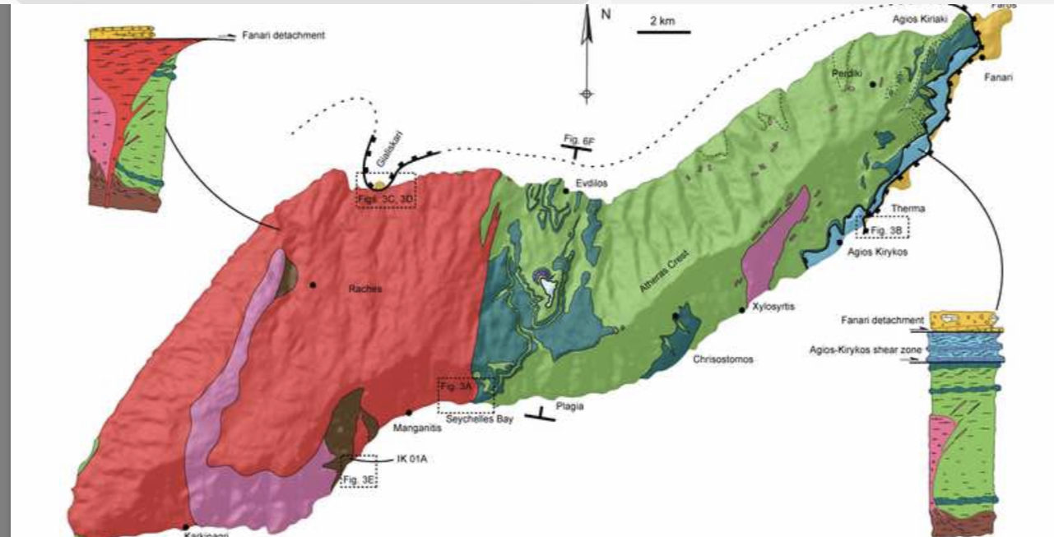
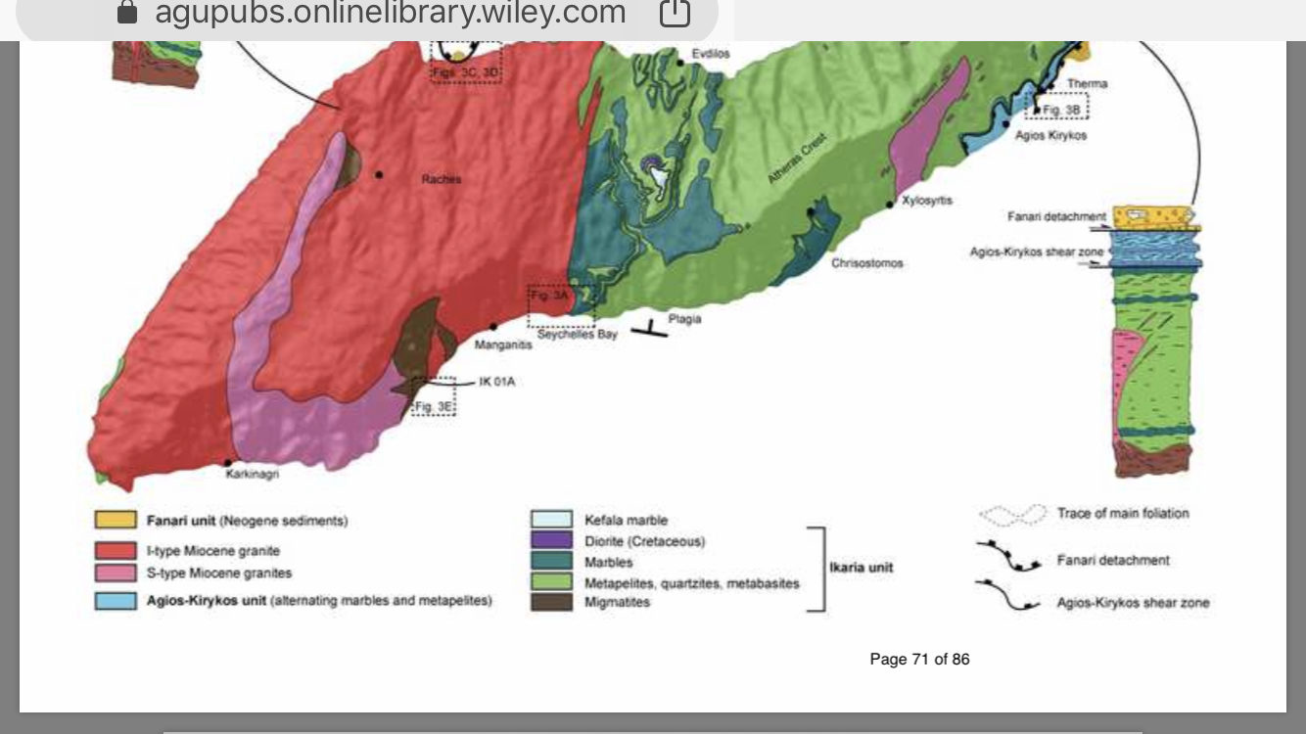
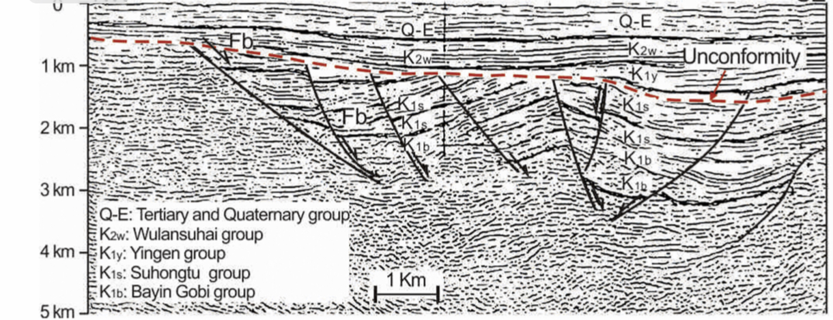
Syn-extensional basin inversion
This is a phenomenon in MCCs globally. Some other examples include:
Uplifted and exposed Fanari Unit at Ikaria core complex
Miocene/Pliocene strata uplifted and exposed at Naxos dome (Linnros et al., 2018)
Beaudoin et al., 2015
Erosional unconformity between syn-extensional and post-extensional strata at Yingba MCC
Tao, 2003

Slide 18
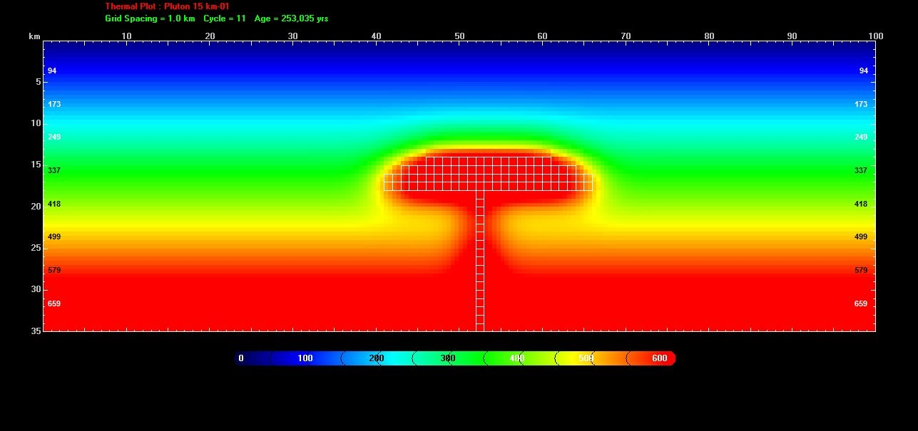
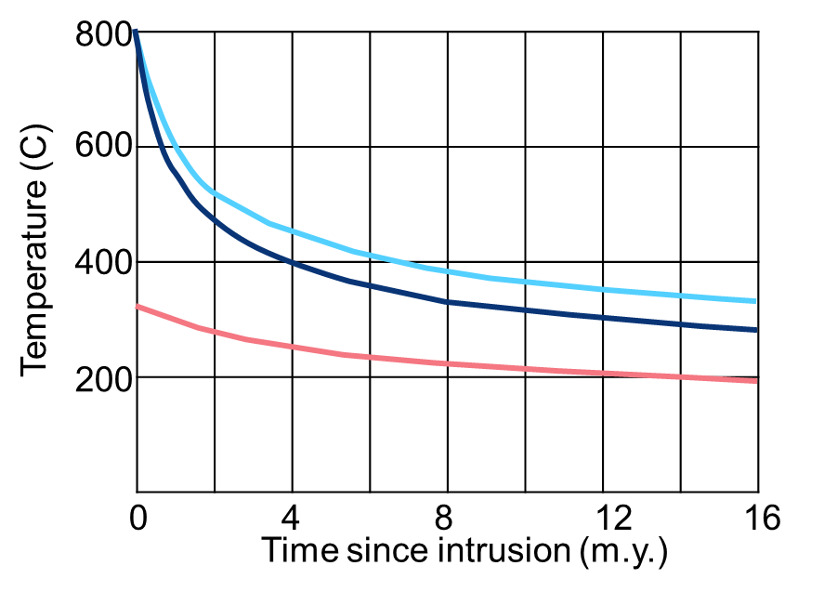
Magmatism at MCCs: Implication for T-t paths
Finite element modeling of plutons indicate:
Large plutons at static (non-exhuming) conditions can take >10 m.y. to cool
Pluton intrusion can affect thermal history of country rocks quite far away
Effect is amplified for larger plutons intruding the lower crust (>12 km depth)
Snapshot at 0.25 m.y.
15 km
30 km
10ºc/m.y.
4 km
20ºc/m.y.
50ºc/m.y.
25 km
360ºC
*Thermochronology studies of MCCs should be locally “calibrated” to the thermal evolution of the plutons

Slide 19
Magmatism at MCCs: How much magma?
Assumption: MCCs are representative of the post-extensional deep crustal structure
What if they are not? How reasonable is that assumption?
Moderately magmatic
My best guess
Highly magmatic
Magma-poor
Detachment fault
Detachment fault
Detachment fault
Upper crust
Upper crust
Upper crust
BDTZ
BDTZ
BDTZ
Plutons
Plutons
Plutons
Lower crust
Lower crust
Lower crust
Magmatism only at MCCs
Implication: Igneous activity drives the differences in extension between MCCs and neighboring regions
Reasonable?: Unlikely given regional extent of volcanism in rifts
Magmatism at MCCs = Regional magmatism
Implication: Extended crust is made up from 3-33% of plutons. Some extension reflects magmatic addition to the crust
Reasonable?: Yes and likely close to reality
Magmatism at MCCs << Regional magmatism
Implication: Extended crust is made up from much more than 7% of plutons. Extension reflects magmatic addition only.
Reasonable?: Maybe, especially in some extended provinces. Likely not at the Basin and Range

Slide 20
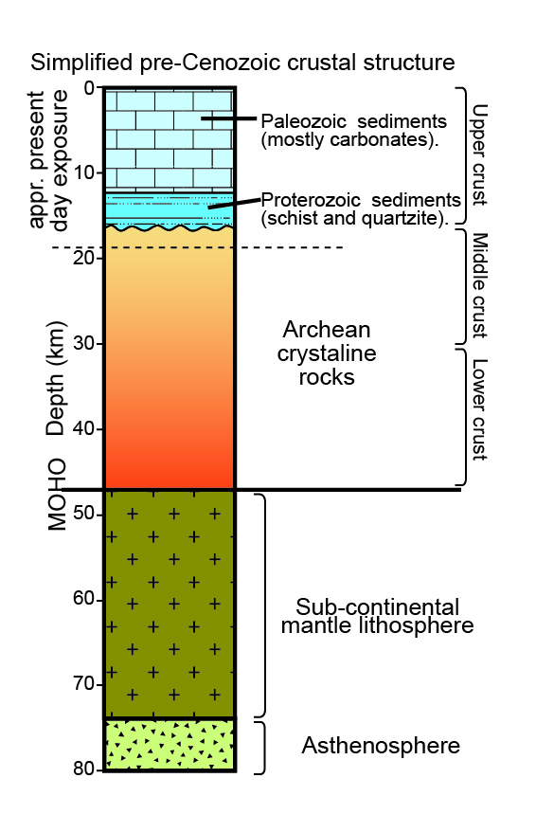
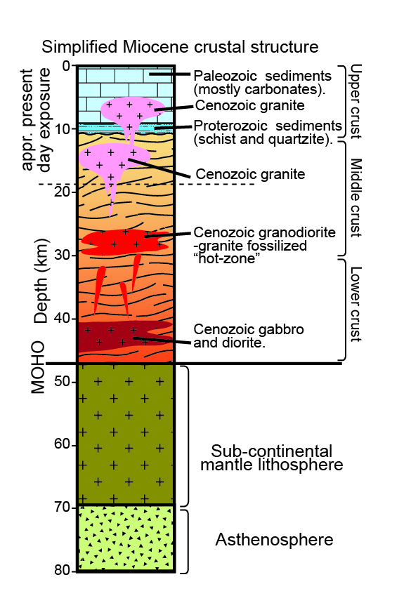
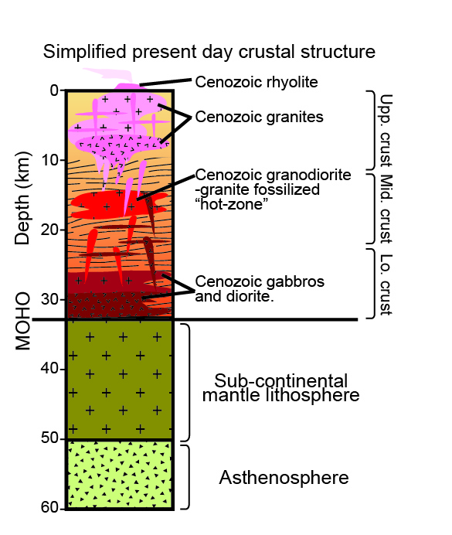
Crustal evolution of NE Basin and Range
~45 Ma
~25 Ma
Today
100
100
150
150
200
200
Crustal structure based on ARG exposures
Paleogene magmatism and extension
Miocene magmatism, extension, and significant lithospheric thinning

Slide 21
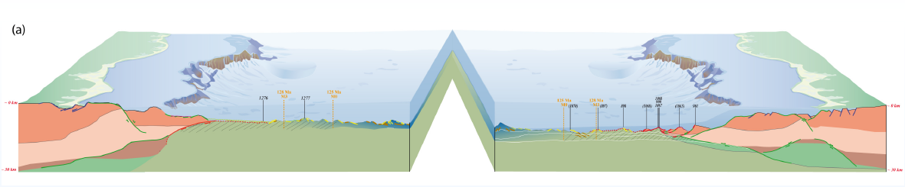
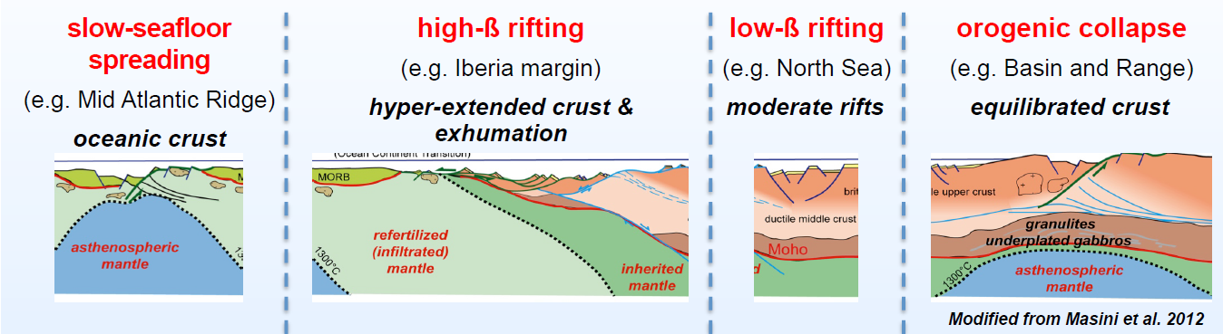

Slide 22





Crustal thickness

Slide 23








Elevation

