Slide 1
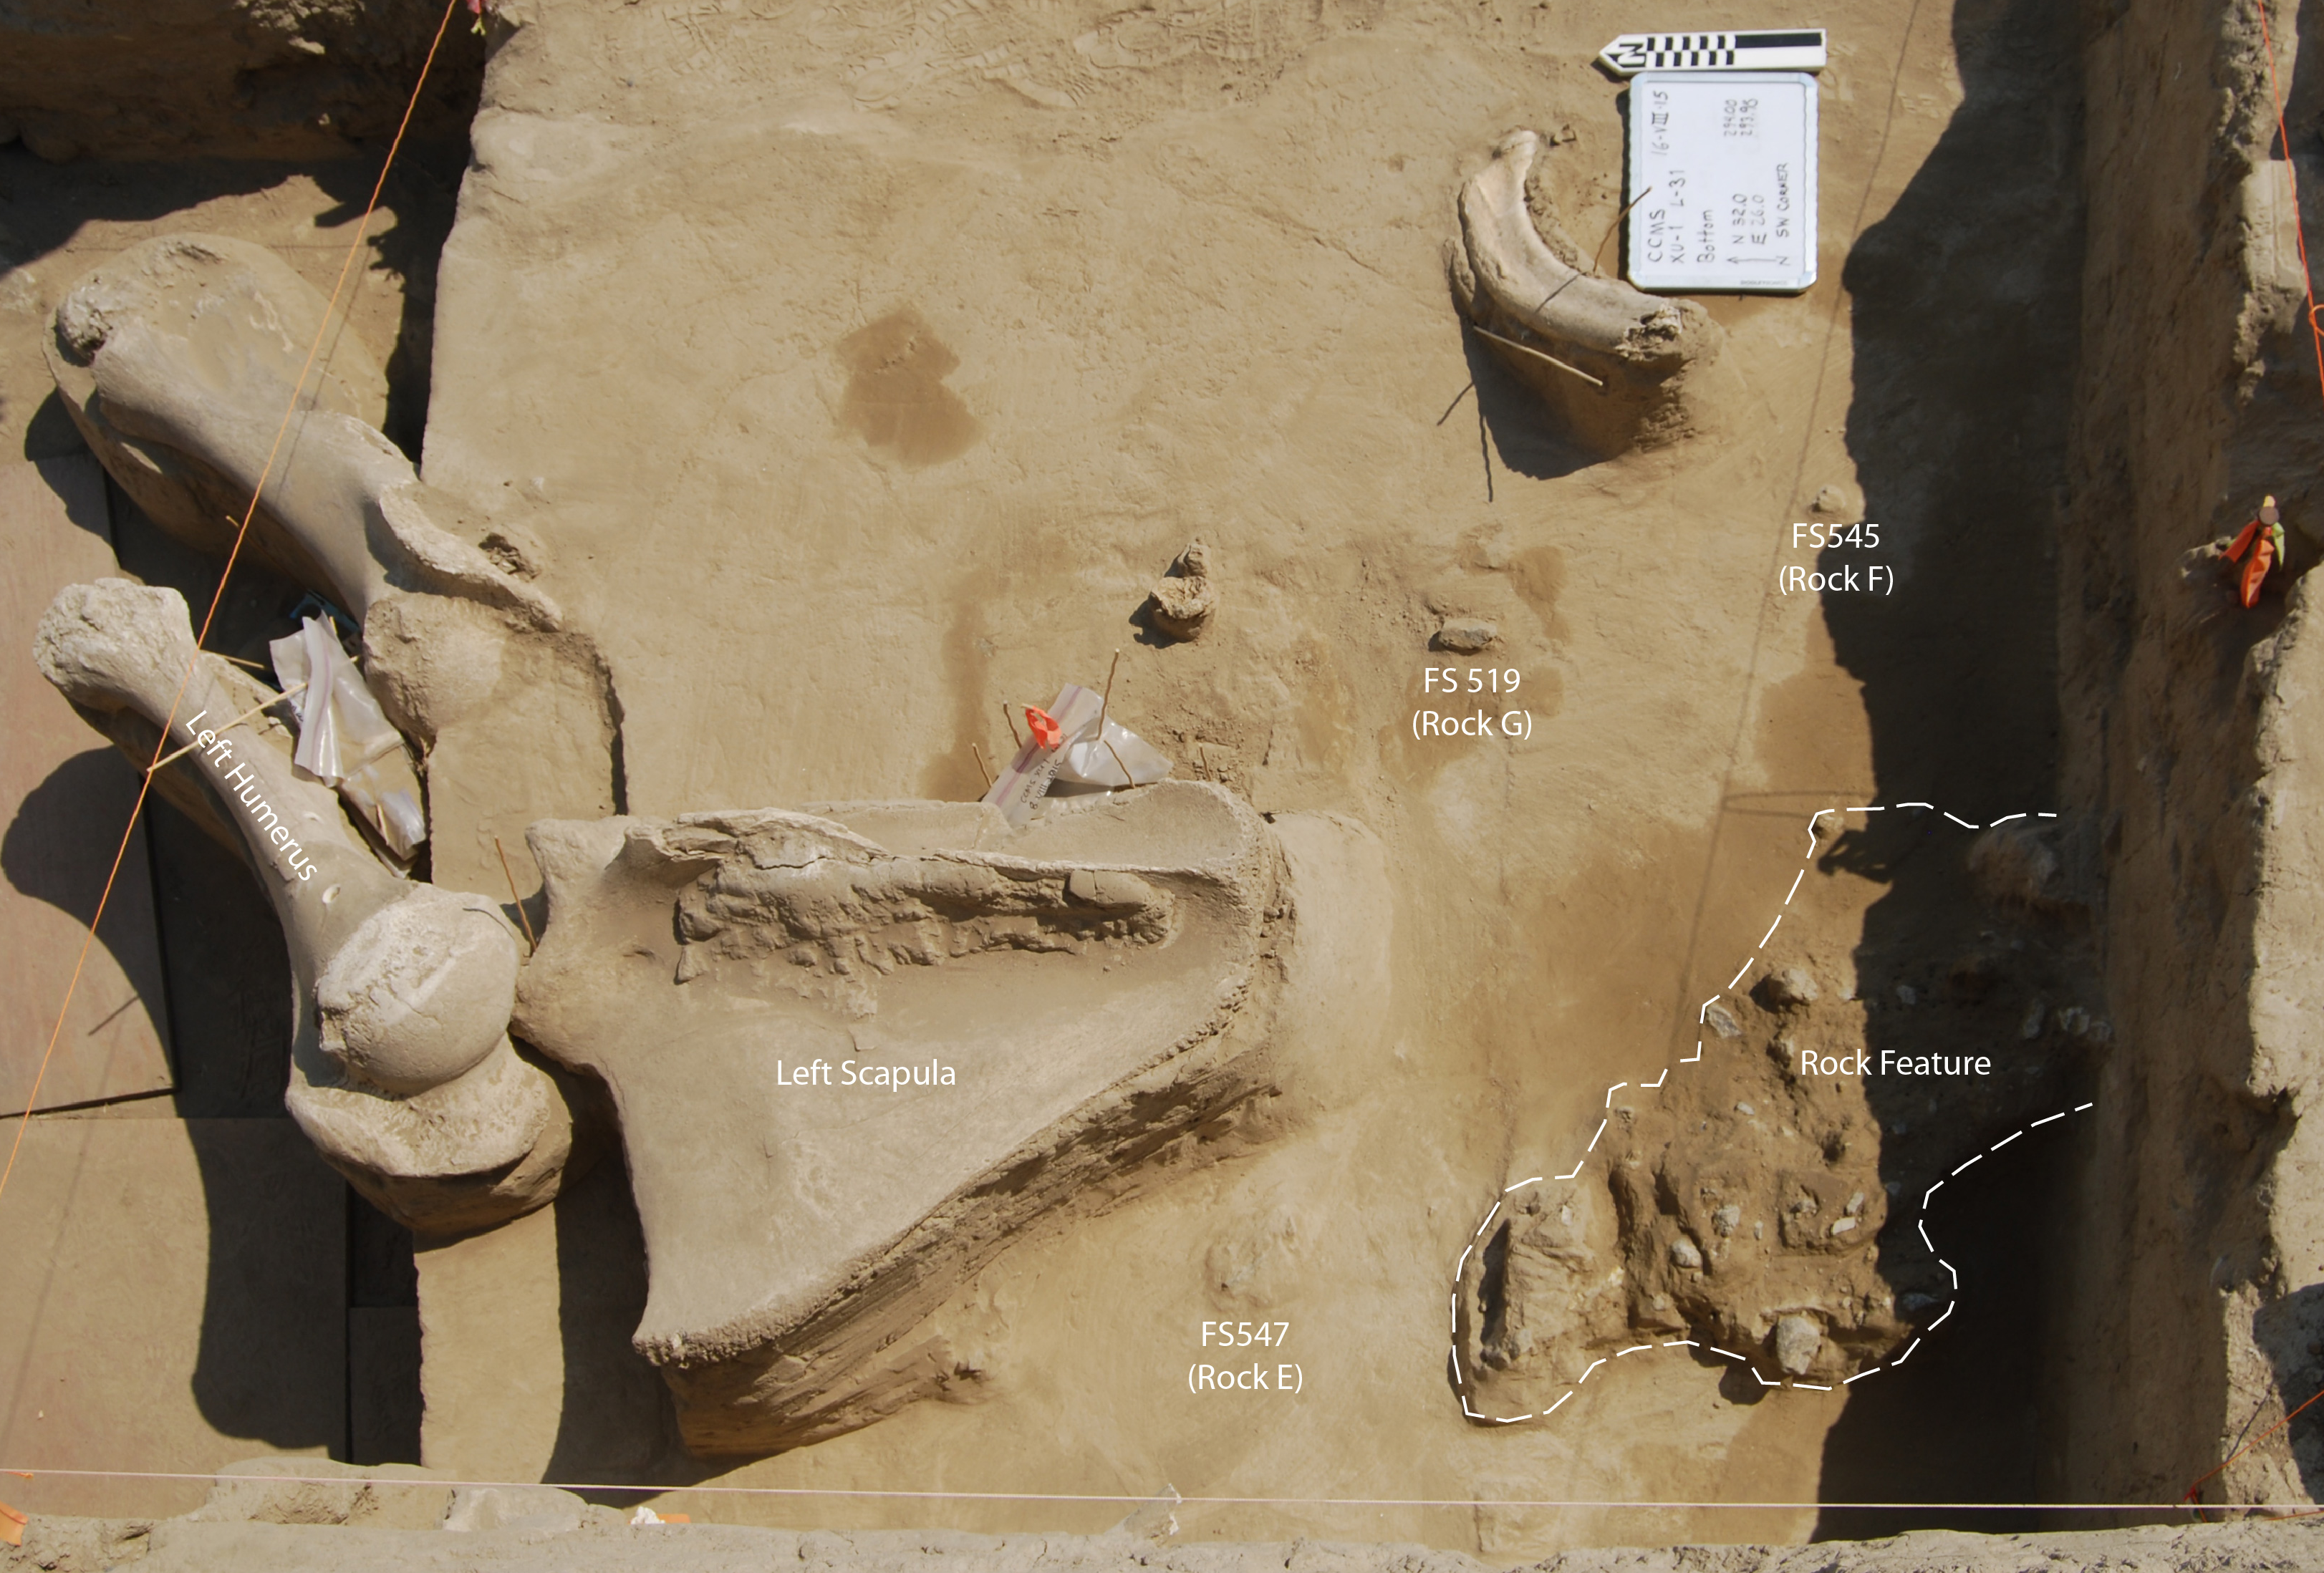
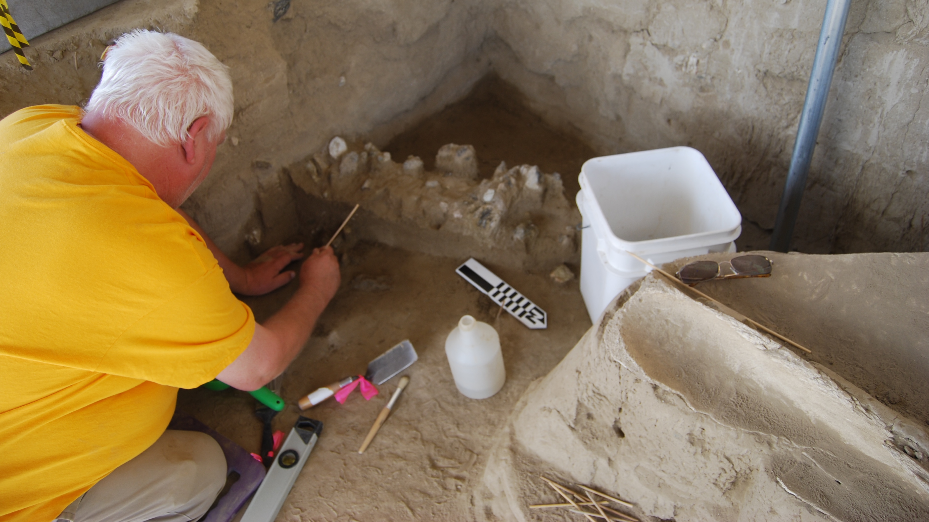
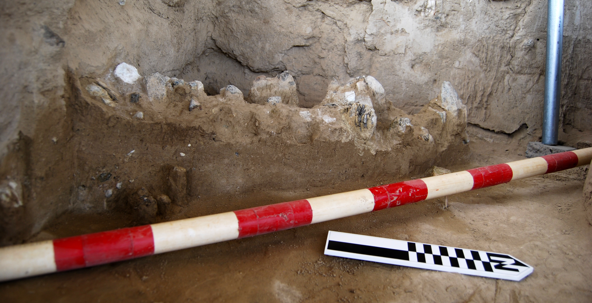
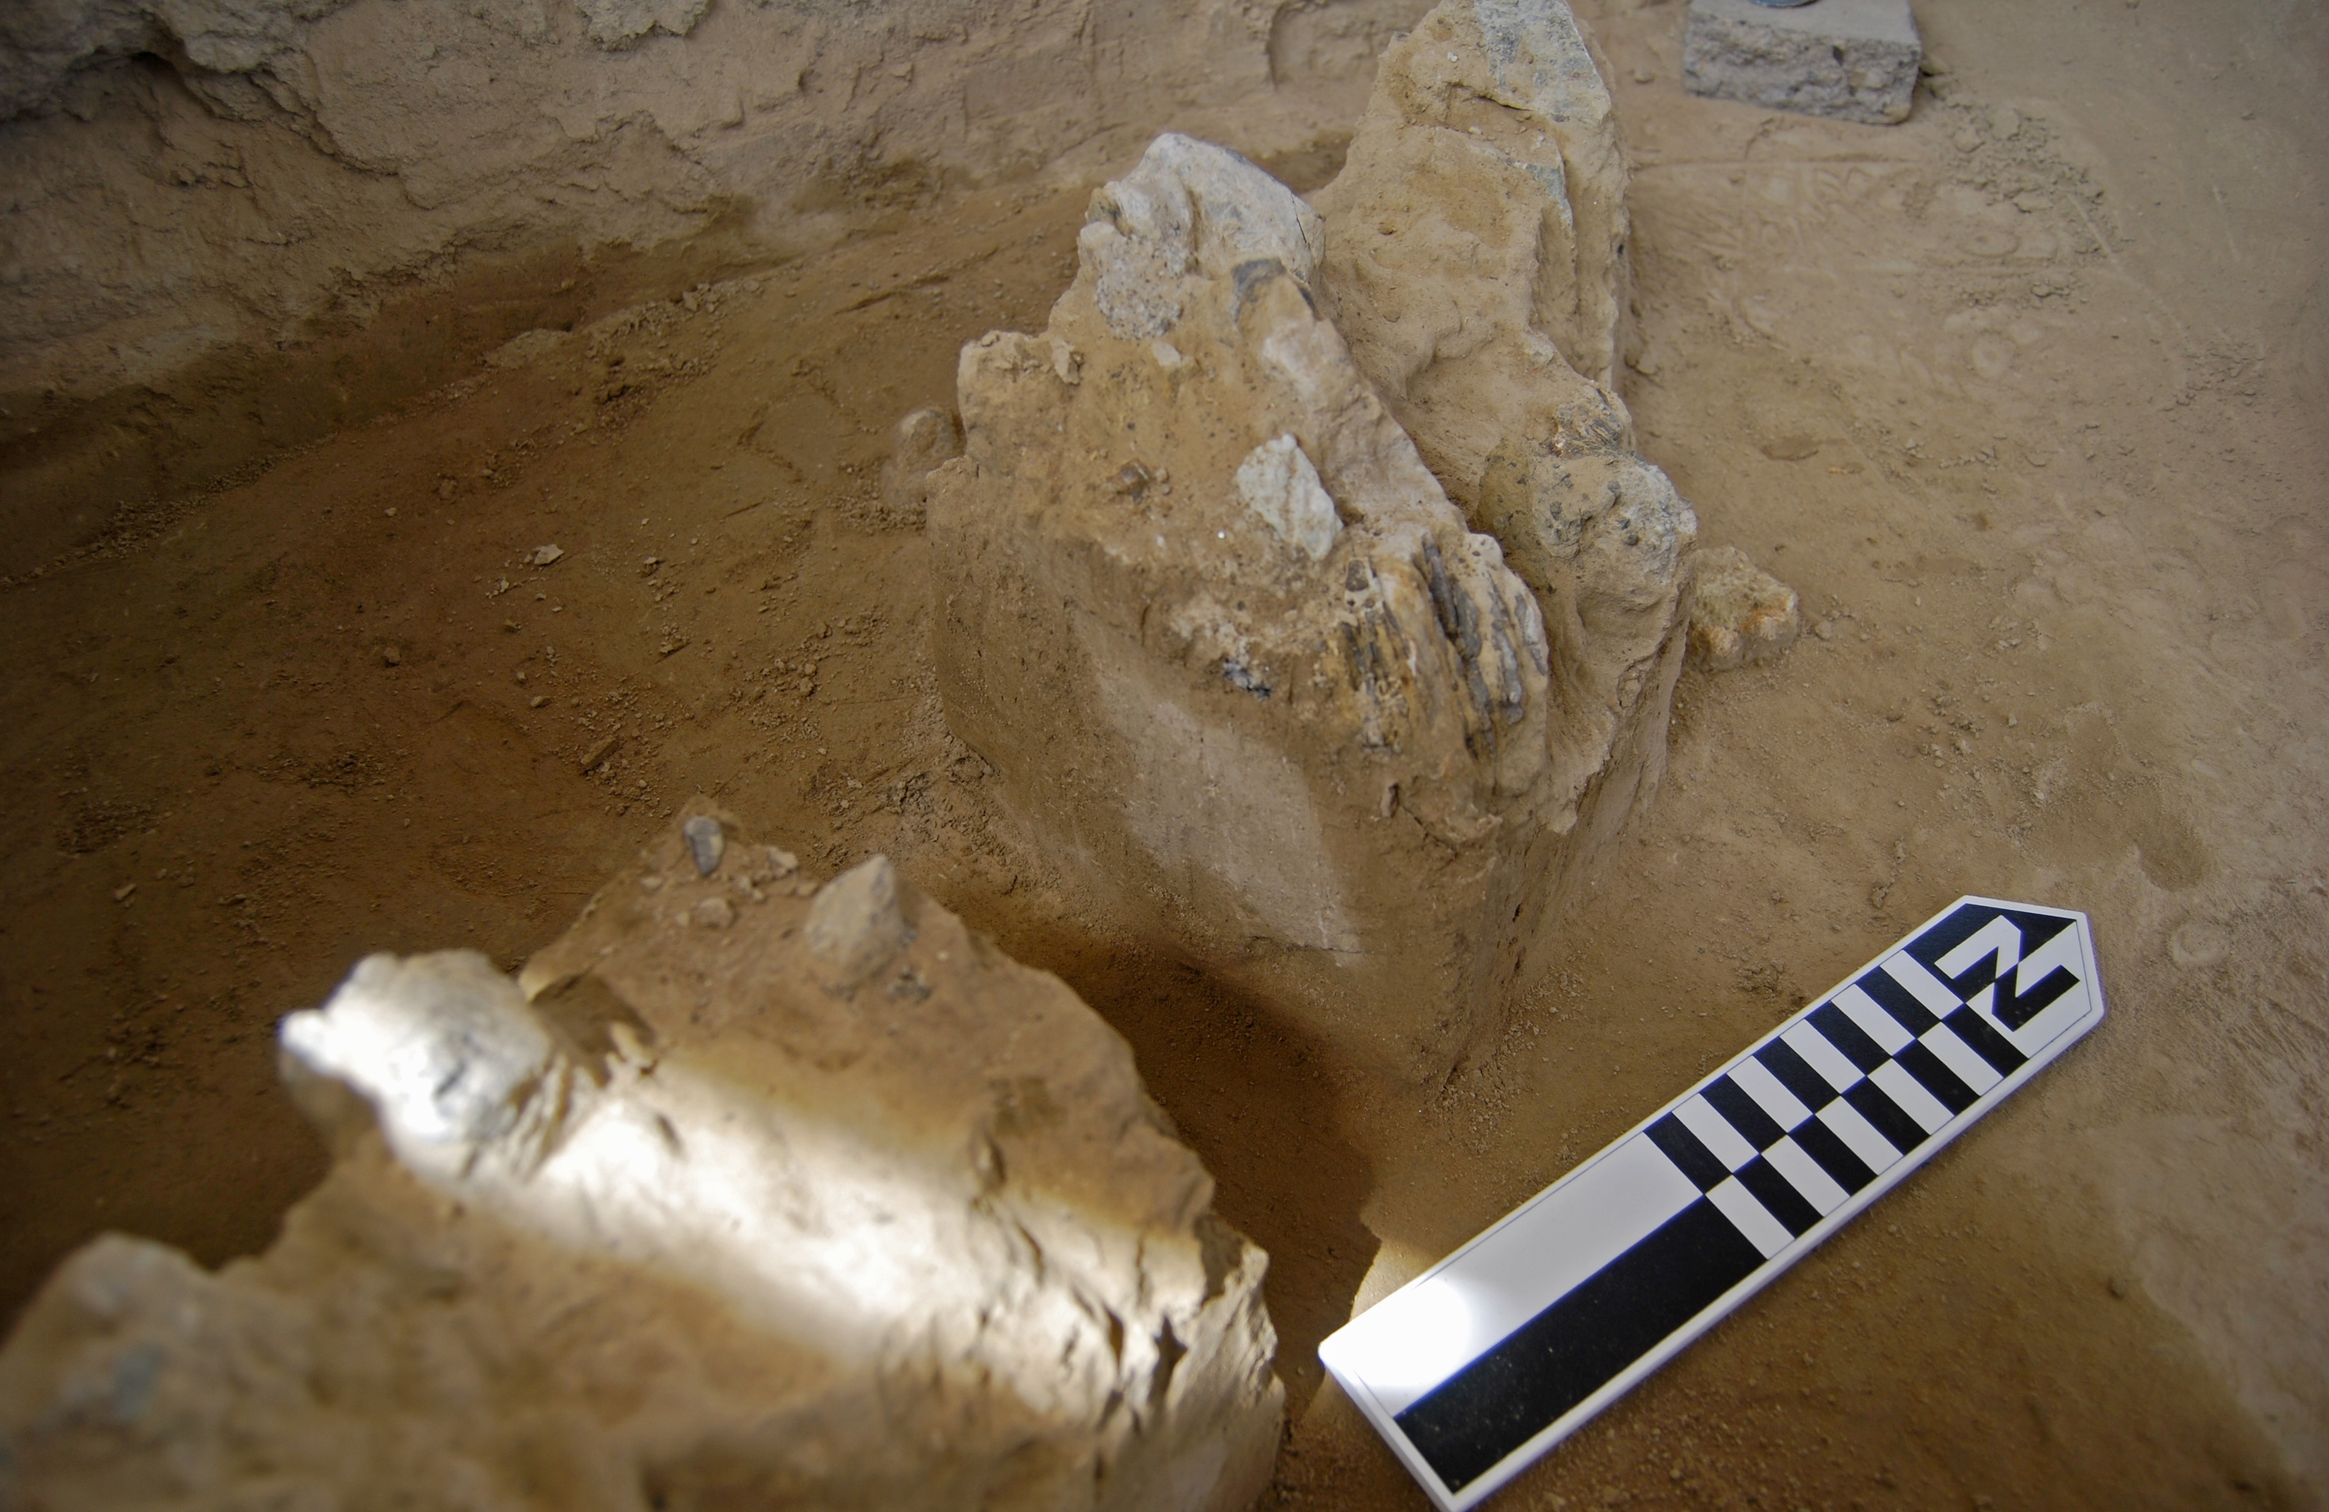
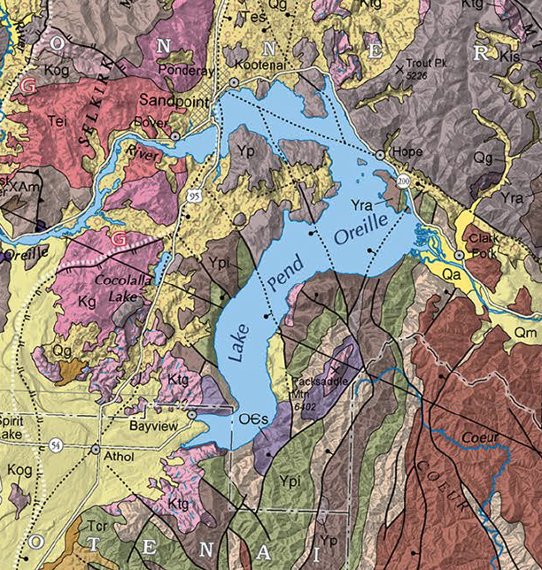
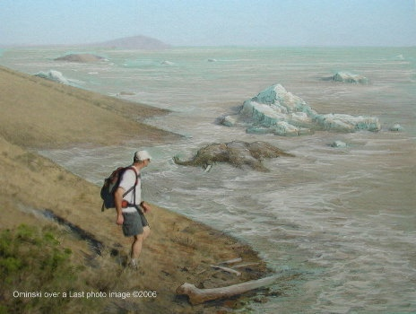
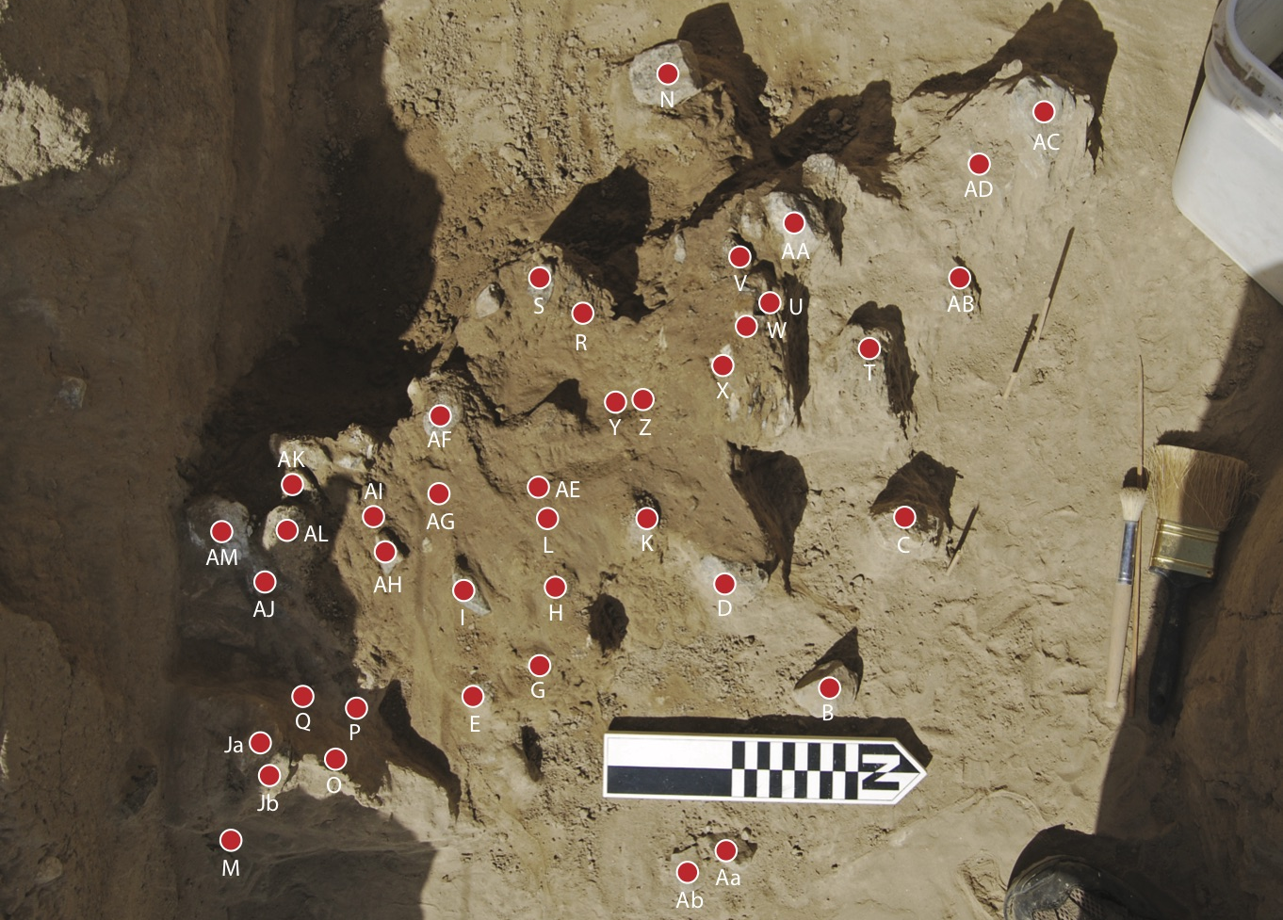
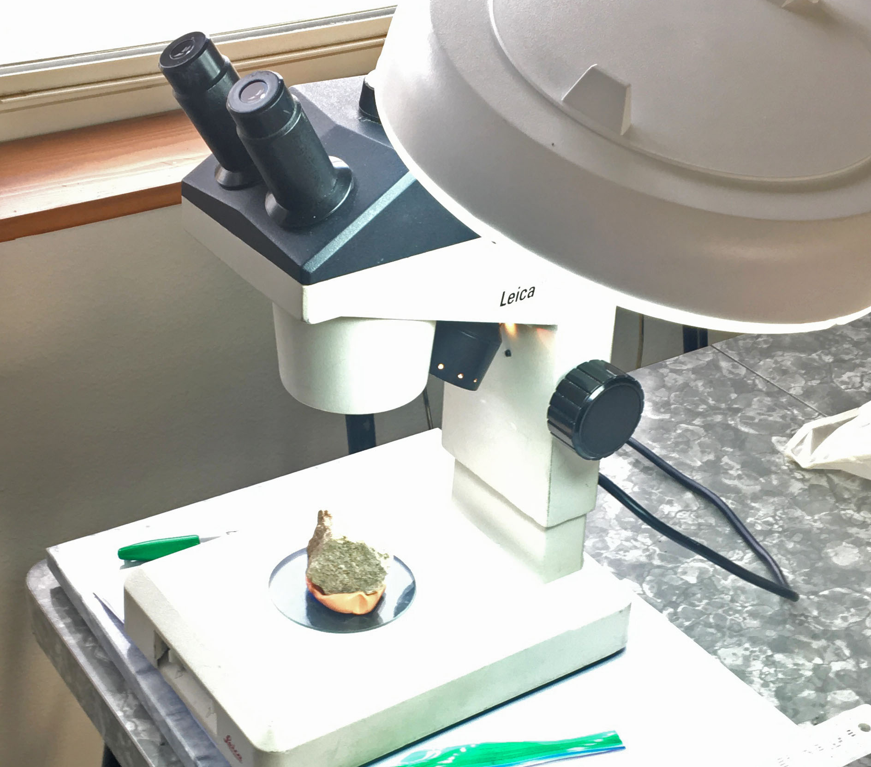
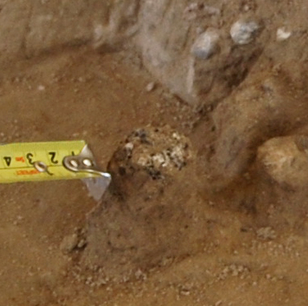
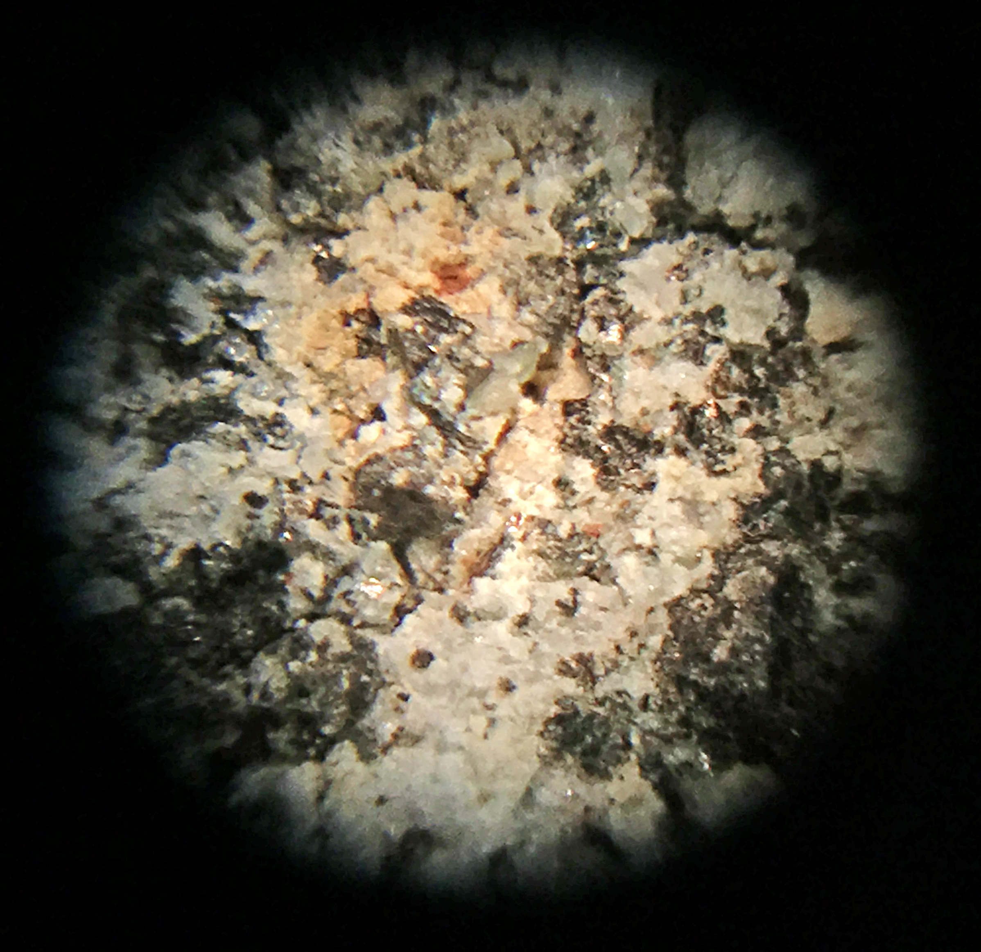
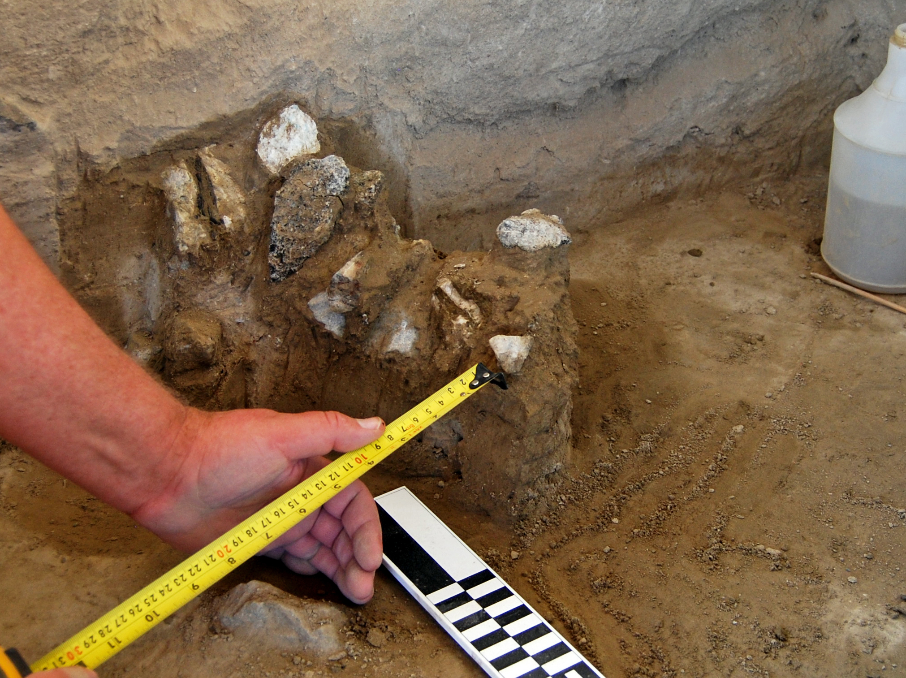
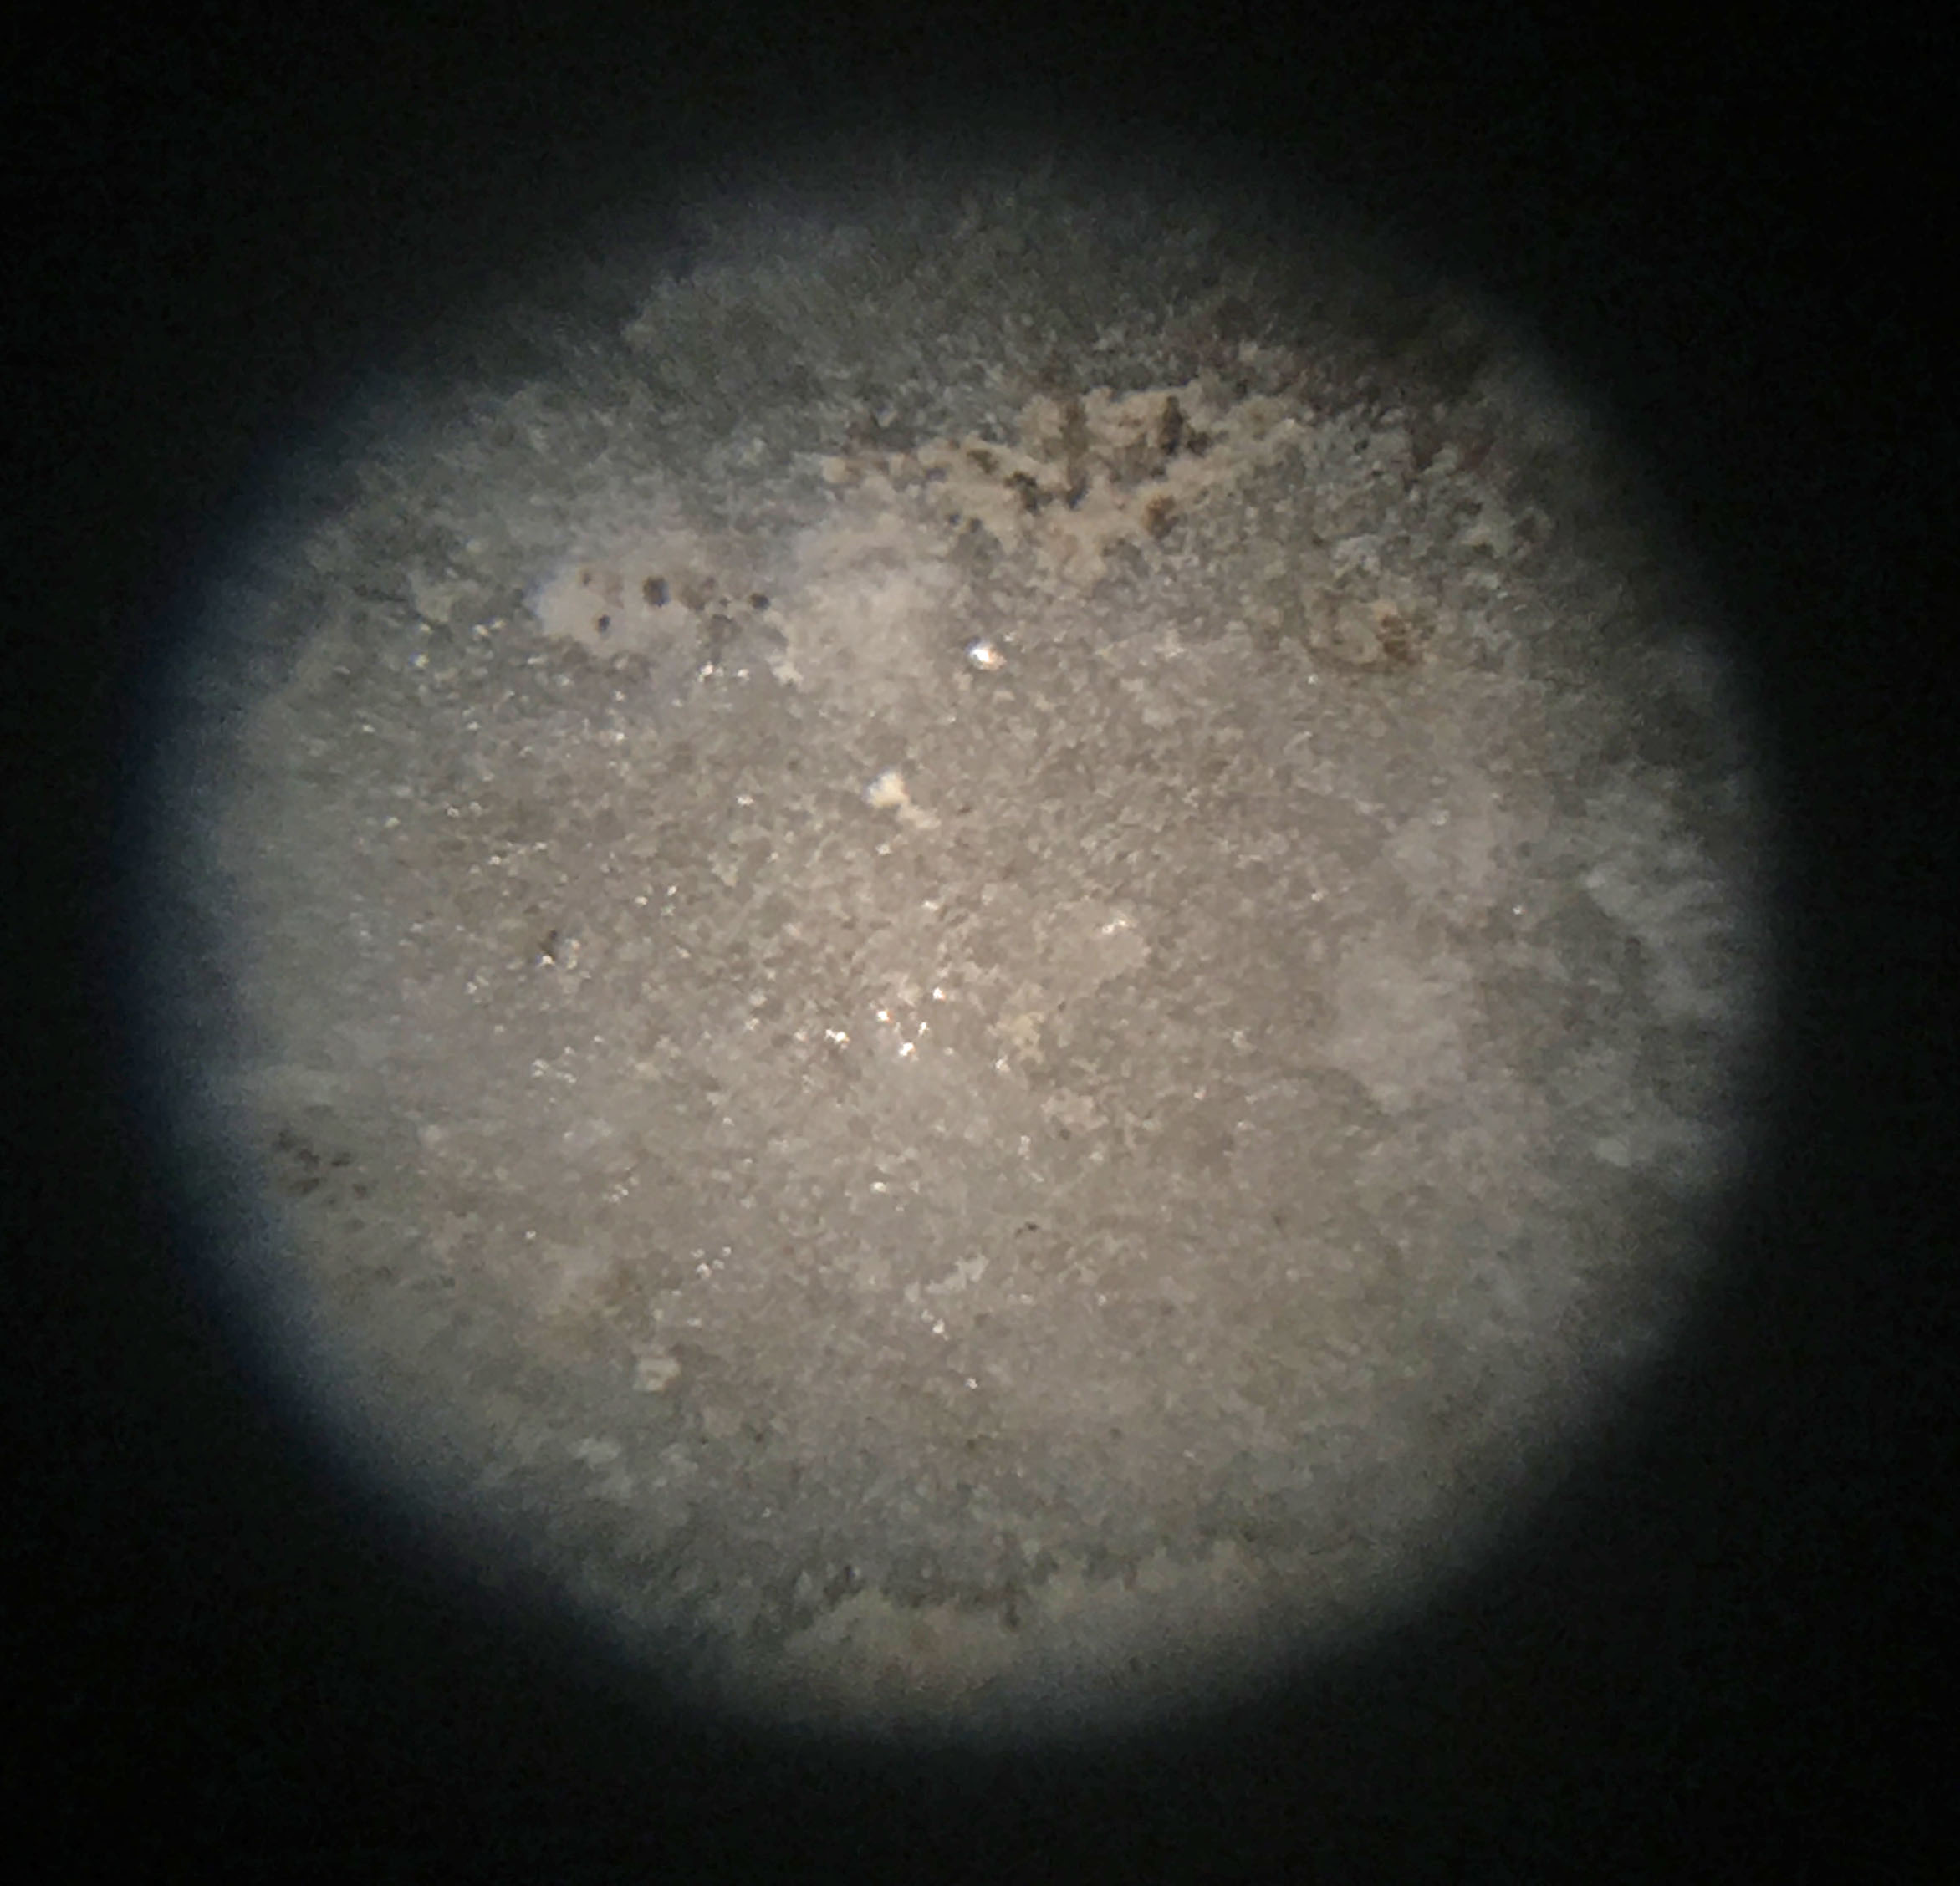
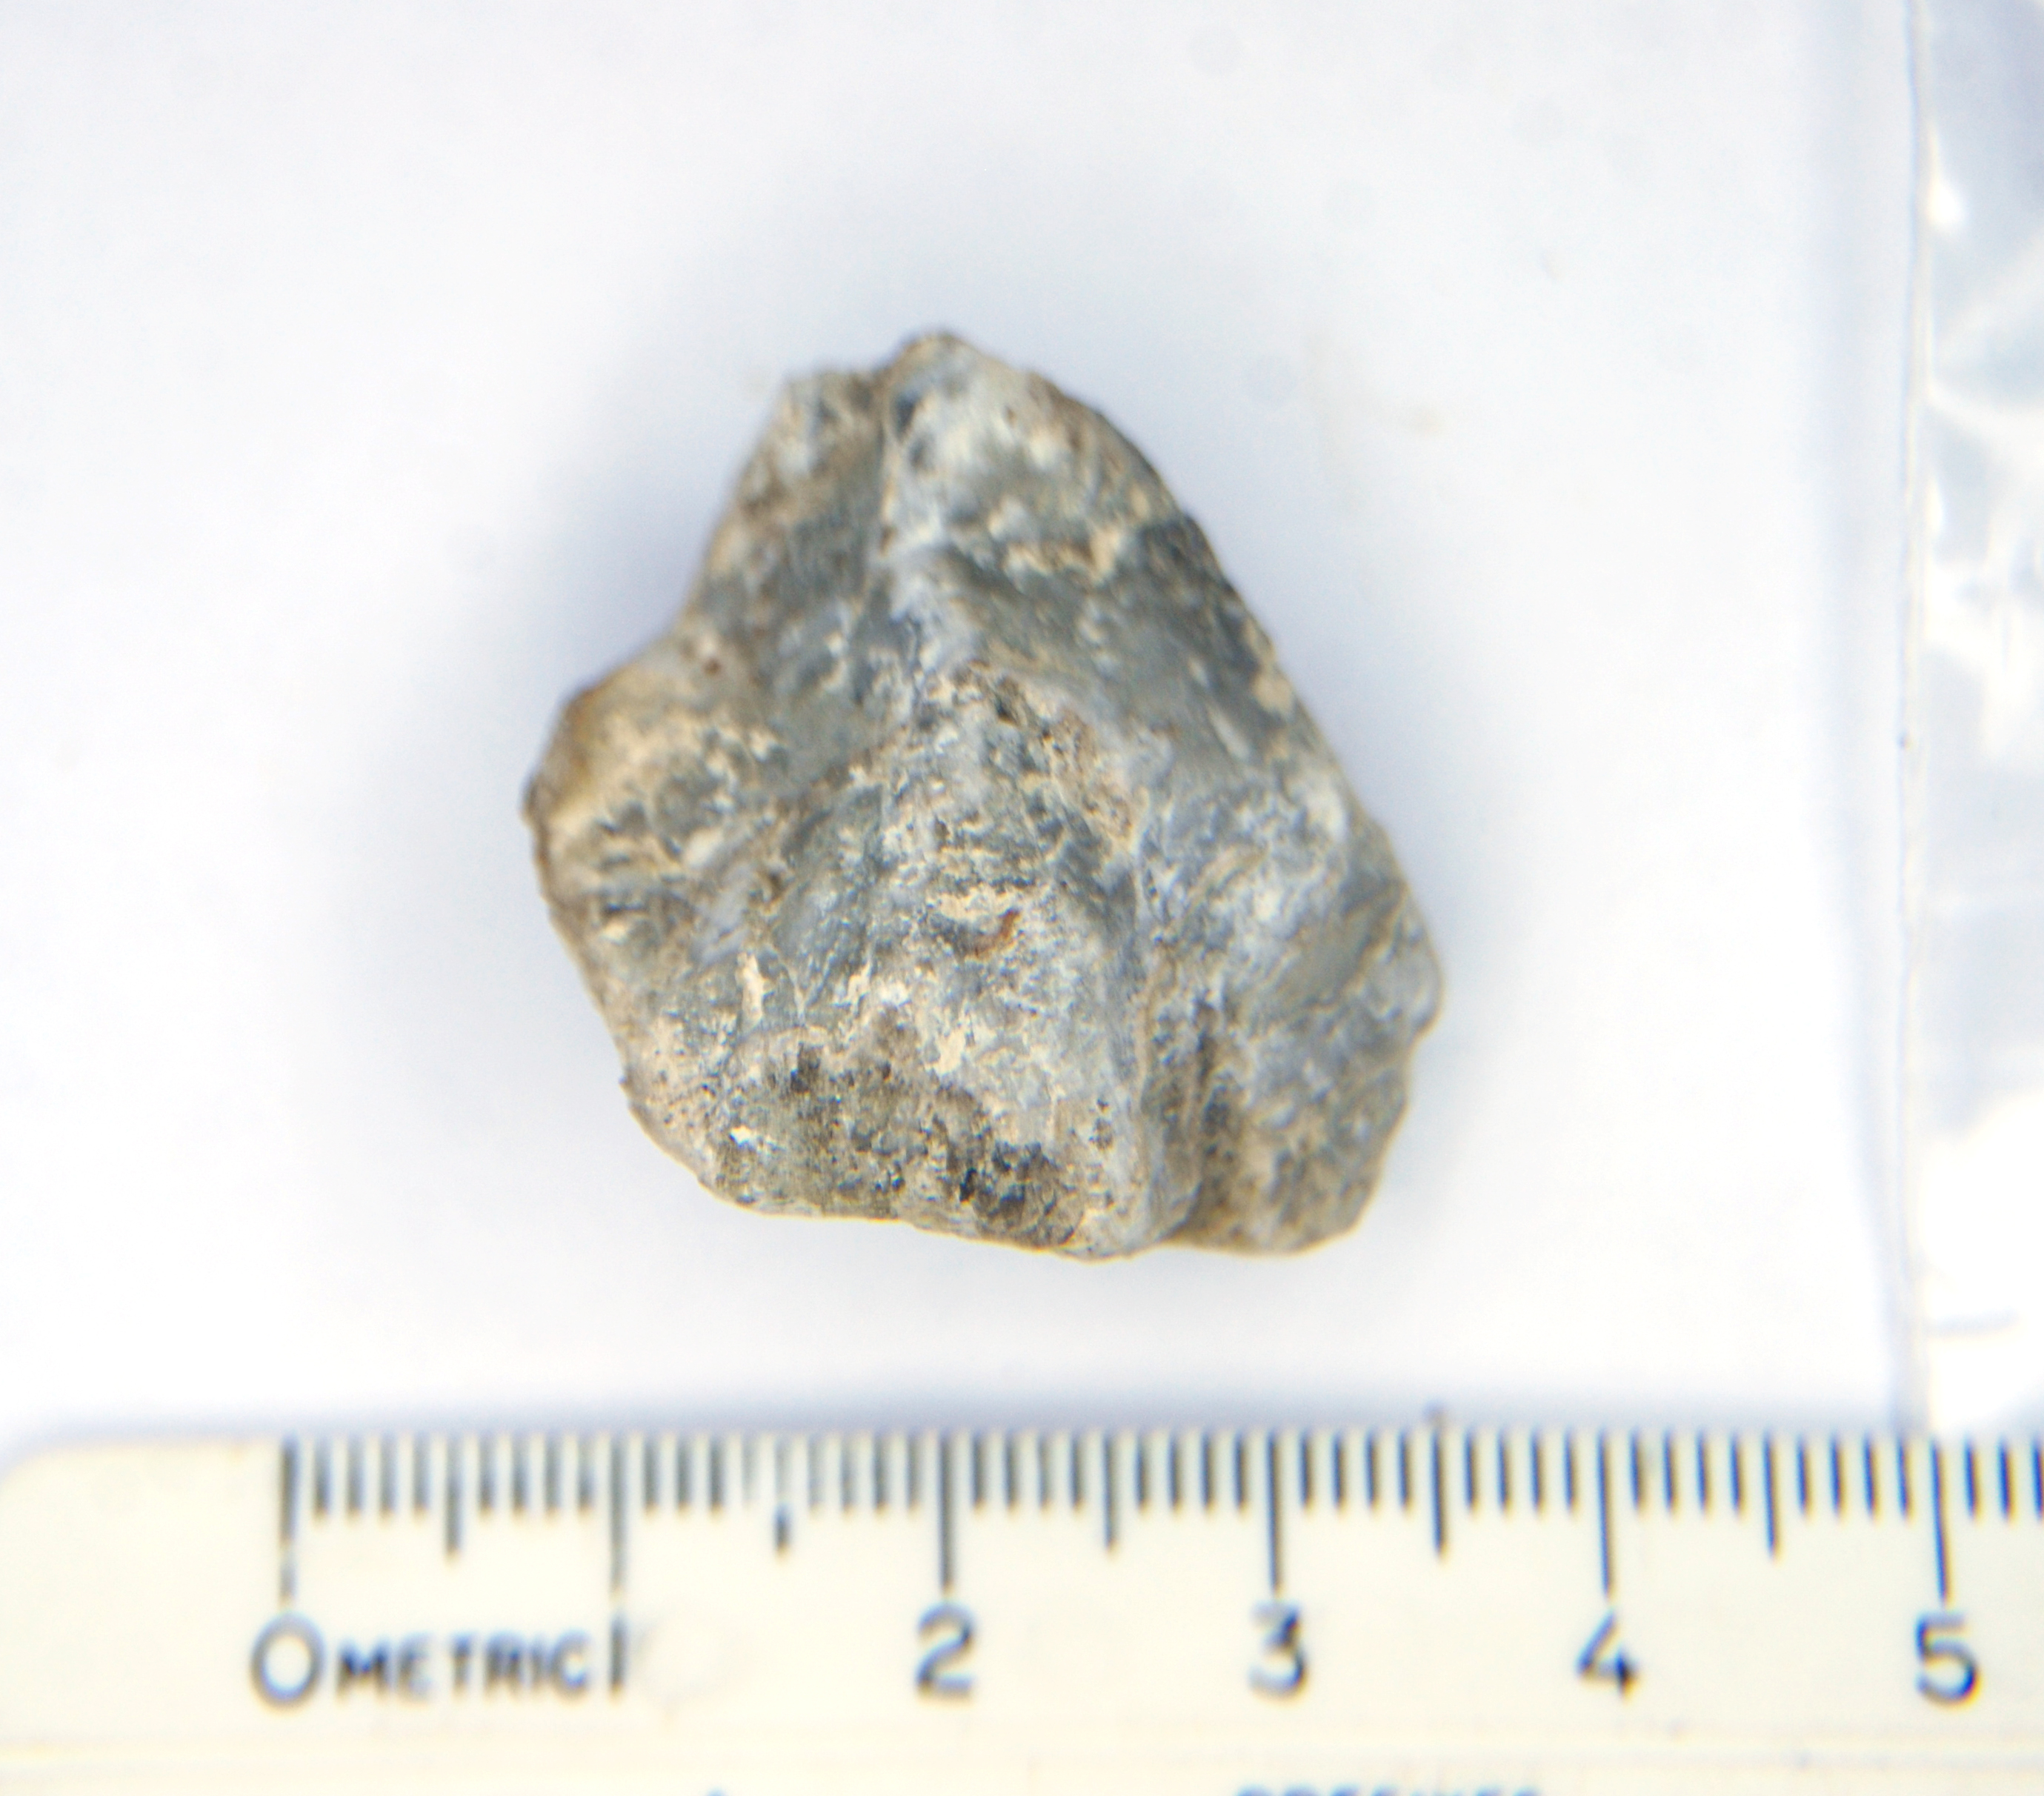
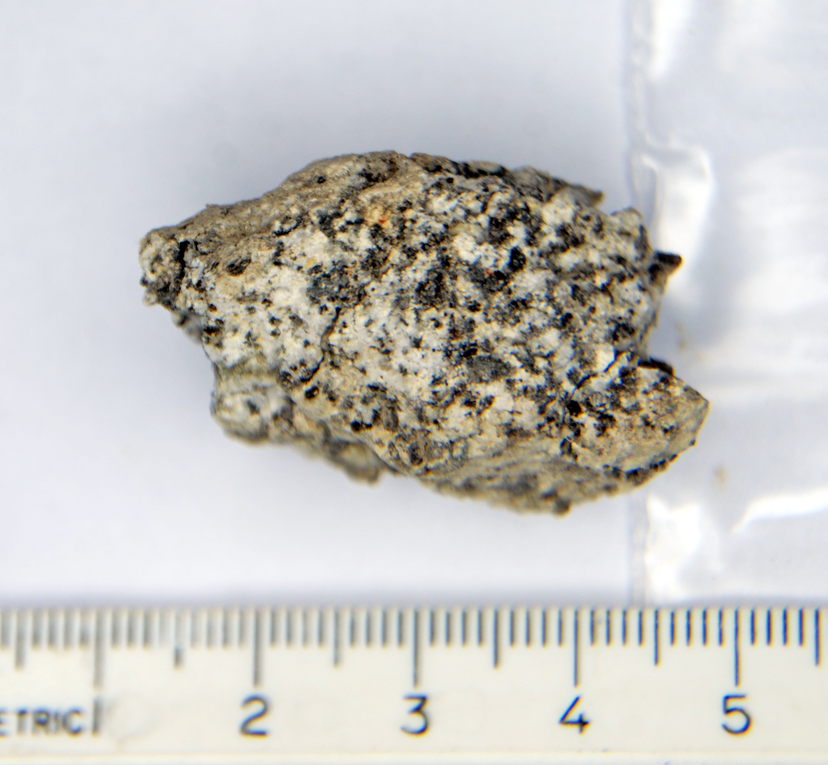

Lithology and Provenance of Erratic Pebbles Found at the Coyote Canyon Mammoth Site, Kennewick, Washington
Anne E. Maughan ^{1, 2}
George V. Last ¹ (gvlast@charter.net)*
Curtis J. Austin ¹
Bax R. Barton ^{1, 3}
¹ Mid-Columbia Basin Old Natural Education Sciences (MCBONES) Research Center Foundation, Kennewick, WA 99338
² Geology Department, Brigham Young University-Idaho, Rexburg, ID 83460
³ Burke Museum of Natural History and Culture and Quaternary Research Center, University of Washington, Seattle, WA, 99145
* Corresponding author
Background
Lithology
Conclusions
Ice-Rafted erratics, including a large number of pebbles co-located in a small rock feature, were found in Ice Age (Missoula) Flood deposits, adjacent to Columbian mammoth (Mammuthus columbi) bones dated at 17,146 to 17,795 calBP (Barton et al. 2012).
We classified the specimens into seven lithologic groups:
10 specimens (26%) were classified as limestone (often interlayered with sandy silt).ª
10 specimens (26%) were classified as interbedded limestone and siltite. ^{b}
7 specimens (18%) were classified as granitoid (granodiorite/tonalite).
5 specimens (13%) were classified as altered (metamorphosed) granitoid.
4 specimens (10%) were classified as quartzite.
2 specimens (5%) were classified as siltite.ª
1 specimen was classified as marble.
ª Note that some of the limestone and/or siltite samples, might actually represent separated layers of interbedded limestone/siltite.
^{b} A few of these clasts appeared to be more dense, suggesting that perhaps the limestone layers could actually be magnesite (or barite or dolomite).
The lithologies found in the 39 erratic pebbles were only partially consistent with those found by Bjornstad (2014) and Karlson (2006). Like Bjornstad and Karlson, we found relatively high percentages of granitic and quartzite erratics; Bjornstad and Karlson both found that 75-80% of the erratics they studied were granitic, whereas we found about 31% of the erratics in this study were granitic (granitoid and altered granitoid). Bjornstad and Karlson found that 7-8% of the erratics were quartzite, while we found about 10% were quartzite.
However, unlike Bjornstad and Karlson, who did not identify any calcareous (e.g. limestone) erratics, the majority (54%) of the erratics in this study were calcareous (limestone, interbedded limestone, or marble. To our knowledge, this study provides only the second documented occurrence of limestone (or other calcareous rocks) among any erratics studied. However, most erratic studies have focused on boulder-size erratics.
Careful excavation and sampling revealed a poorly sorted till like composition of erratic pebbles and very-fine grained (silt to clay sediment) as well as the near vertical orientation of some tabular / laminated clasts. This supports the interpretation that this rock feature was deposited by a single iceberg left stranded next to the mammoth carcass.
17,146-17,795 calBP
FS592
Limestone (26%)
Interbedded Limestone and Siltite (26%)
^{b}
Very fine grained (silt size) with clastic to sub-crystalline, sugary texture. White to light gray. Often soft and friable. Reacts strongly to 10% HCl. Specific gravity 2.5 – 2.9.
^{b}
^{b}
^{b}
Marble
Layered (stratified), consisting of light colored (white, pale yellow, light gray) limestone and darker colored (gray to dark gray) siltite. Overall specific gravity ranges from 2.8 to 3.5^{b}.
Abstract
A cluster of forty ice-rafted erratics were found adjacent to skeletal remains of a Columbian Mammoth at the Coyote Canyon Mammoth Site, Kennewick, Washington. Both the mammoth remains and erratics are entrained in late Pleistocene outburst flood deposits, presumably from Glacial Lake Missoula. The cluster of pebble-size erratic clasts are interpreted as having been deposited by a small, solitary iceberg that may have come from the breakup of an ice dam formed by the Purcell Lobe of the Cordilleran Ice Sheet. Thus, the set of lithologies in this cluster of erratics were expected to reflect the bedrock in contact with the ice dam located at present-day Lake Pend Oreille, Idaho.
Visual examination of the pebble-sized erratics found similar lithologies to those identified by Bjornstad (2014) and Karlson (2006), who had focused on boulder-size erratics. Bjornstad and Karlson both found that 75-80% of the erratics they studied were granitic, while we found that only about 31% of the erratics in our study were granitic (granitoids or altered granitoid). All three studies yielded very similar percentages of quartzite (7-10%). However, neither Bjornstad or Karlson identified any calcareous (e.g. limestone) erratics, while we found that the majority (54%) of the erratics in our study were limestone, interbedded limestone, or marble. To our knowledge, this study provides only the second documented occurrence of limestone (or other calcareous rocks) among erratics studied in relation to these outburst floods. Additionally, we found that eleven of the forty samples (consisting of four different lithologies) could be associated with limestone, plutonic, and Belt Supergroup metasedimentary rocks surrounding Lake Pend Oreille, Idaho (site of the ice dams that created Glacial Lake Missoula).
Competent and light-colored with a crystalline texture. It is hard but can be scratched with a knife. The resulting rock powder reacts (effervesces) strongly to 10% HCl. The overall specific gravity is about 2.9.
The tentative provenance associations of eleven samples (representing four different lithologies – limestone, granitoid, quartzite, and siltite) collectively suggest a common source area that is consistent with the bedrock geology surrounding the southern portion of Lake Pend Oreille (the site of the Purcell lobe ice dams). Thus, our working hypothesis, that the erratic clasts found clustered together in a single rock feature, juxtaposed to the Coyote Canyon mammoth, may have been part of the Purcell Lobe ice dam and the Ice Age flood that killed the mammoth, remains valid.
Granitoid (18%)
Limestone are layers similar to the limestone described earlier. Siltite layers are typically gray (5Y5/1) to dark gray (2.5Y4/1) with a very fine-grained (silt size) crystalline texture. They are hard (not easily scratched with a knife) and exhibit no reaction to 10% HCl. These layers are also internally laminated and exhibit some degree of fissility or slaty cleavage.
8/13/2016
Altered Granitoid (13%)
8/13/2016
Many the of ice-rafted erratics, including some within the iceberg feature, have been found to be limestone, a rock type rarely documented by Ice-rafted erratic studies. The presence of limestone clasts as well as several other lithologies within this single iceberg feature led to some speculation that perhaps this set of lithologies could be traced to their origin.
Rattlesnake Mountain
17,450 ya Missoula Flood
8/13/2016
Coarse-grained (phaneritic) equigranular crystalline texture with felsic to intermediate composition (15-40% mafic minerals). The felsic minerals are dominated by plagioclase feldspars rather than quartz. Some clasts are pretty friable and brake up easily into individual crystals (grus). Where not friable, the clasts are very hard and exhibit no reaction to 10% HCl. Specific gravity ranges from 2.8 to 3.1.
Typically gray (5Y6/1) to very dark gray (2.5Y3/1) with a fine to coarse-grained crystalline texture. Very hard with no reaction to 10% HCl. Specific gravity ranges from 2.7 to 3.1. A couple samples appear to have a sugary re-crystallized appearance, and/or exhibited some weak layering or foliation (e.g. Rock M). One sample (Rock I) had an overall greenish gray (GLEY 1 5/5GY) coloration. This suggests that a low degree of metamorphism may have altered the parent rock (granitoid).
Purpose
From the Purcell Lobe ice dam.
The purpose of this study was to identify the different lithologies and potential provenances of the ice-rafted erratics within this single iceberg feature, thereby inferring the potential origin of the 17,450 year old Ice Age flood believed to have killed the Coyote Canyon mammoth.
The primary working hypothesis was that the iceberg (and its entrained erratics) was most likely derived from the breakup of an ice dam that created Glacial Lake Missoula. Thus, the set of lithologies would be expected to reflect the bedrock in direct contact with the Purcell Lobe of the Cordilleran Ice Sheet that covered the area surrounding present-day Lake Pend Oreille in northern Idaho. Alternatively, it is also possible that the iceberg may have originated from the spalling of glaciers into Glacial Lake Missoula and/or Glacial Lake Columbia.
Quartzite (10%)
Siltite (5%)
Typically light gray to gray (5Y7/1 to 5Y6/1). Rock R has a light yellowish-brown (2.5Y6/3) color on its weathered surface. Very fine to fine-grained crystalline texture -- recrystallized with weak internal laminations or foliation. They are hard to very hard with no reaction to 10% HCl (except on some weathered surfaces with secondary calcite mineralization). Specific gravity ranges from 2.6 to 3.3 with an average of 3.0.
Typically gray (5Y5/1 to GLEY 1 5/N) with very fine-grained crystalline (recrystallized) texture. Internally laminated (e.g. Rock D) and somewhat fissile, with Rock T breaking apart easily along flat slaty cleavage planes. The clasts are hard (not easily scratched with a knife) and exhibit no reaction to 10% HCl, except on weathered surfaces with secondary calcite mineralization. Specific gravity (measured only on Rock D) is about 2.8.
Discussion
Methodology
We focused on the set of 40 pebble size clasts that had been previously sampled from this “rock feature” with each specimen assigned the field specimen number FS592, and further designated with a letter (e.g. FS592 Rock A). After examination, we combined two of these specimens (Rock Ja and Jb), that fit together, yielding 39 samples to be used in the study.
Tentatively identified as similar to the Cambrian (542-488 Ma) age Lakeview Limestone of Lewis et al. (2002) and Browne (2012), and included in the Sedimentary rocks (Ordovician and Cambrian) (O€s) (542-444 Ma) of Lewis et al. (2012).
Possibly magnesite, barite or dolomite from an unidentified formation.
Tentatively identified as similar to the Cretaceous (146-65.5 Ma) tonalite, granodiorite and quartz diorite (Ktg) of Lewis et al. (2012). Browne (2012) described these map units as granodiorite, consisting of fine to medium-grained hornblende-biotite granodiorite.
Tentatively identified as similar to lithologies of the Mesoproterozoic [1600-1000 Ma] Belt Supergroup of Lewis et al. (2012).
The potential that some of the calcareous clasts could be magnesite, barite, or dolomite, raises the question that perhaps some of these erratic clasts may have originated from northeastern Washington. Shaw et al. (1999) cited paleo flow directions in the Sanpoil arm of glacial Lake Columbia as indicating that high-magnitude drainage from beneath the Cordilleran ice sheet could have passed down the Okanagan Valley (northeastern Washington) and across the western Scablands. Peters (2003) also described exposures of gravel foresets in northeastern Washington as evidence of floods from sources other than glacial Lake Missoula, noting that Belt Supergroup rocks were notably rare. However, Hanson and Clague (2016) found no evidence of large-scale flooding from northeastern Washington (although they did not rule it out).
We recommend detailed geochemical analyses be conducted on the suspect magnesite, barite, or dolomite samples. We also recommend evaluation of potential sources areas in northeastern Washington that may have contributed the complete set of lithologies, as well as lithologic analyses of other ice-rafted erratic clasts juxtapose to the Coyote Canyon mammoth skeleton.
Each sample was cleaned and visually examined in hand specimen and under binocular microscope for determination of its lithology.
^{b}
Provenance
Example descriptions for two of the samples are presented below.
Four of the limestone/interbedded limestone samples were tentatively identified as similar to the Cambrian age Lakeview Limestone (€l) and included in the Sedimentary rocks (Ordovician and Cambrian) (O€s) of the southern Lake Pend Oreille area. The observed heft (density) of some of the interbedded limestone samples led to speculation that some of the carbonate layers may consist of magnesite, or perhaps barite or dolomite equivalent to rocks in the Colville, WA area. Other studies suggest that magnesite deposits in the Colville (Stevens County) area are prominent in the Paleozoic Stensgar dolomite of the Deer Trail group, most likely resulting from replacement of dolomite by hydrothermal solutions from granitic batholiths.
Other samples, classified as quartzite, and one sample, classified as siltite, were tentatively identified as similar to lithologies of the Mesoproterozoic Belt Supergroup of Lewis et al. (2012). Lewis subdivides this supergroup into 6 units: the Upper Missoula group (Ymiu), the Lower Missoula Group (Ymil), the Piegan Group (Ypi), the Ravalli Group (Yra), the Prichard Formation (Yp), and gneiss, schist, and quartzite (Ygs).
Three of the granitoid classified samples were tentatively identified as similar to the Cretaceous tonalite, granodiorite and quartz diorite (Ktg) of Lewis et al. (2012). Browne (2012) described these map units in the Bayview and Lakeview Quadrangles as granodiorite (Kgd), consisting of fine to medium-grained hornblende-biotite granodiorite.
7/17/2016
(a)
(c)
(a)
(c)
Works Cited
(b)
Bjornstad, B. N. 2014. Ice-Rafted Erratics and Bergmounds from Pleistocene Outburst Floods, Rattlesnake Mountain, Washington, USA. E&G Quaternary Science Journal, v. 63: Number 1: 2014: p. 44-59. DOI 10.3285/eg.63.1.03.
Browne, James L. 2012. Geologic Map of The Bayview And Lakeview Quadrangles, Kootenai And Bonner Counties, Idaho: Technical Report 12-3. Idaho Geological Survey, Moscow-Boise Pocatello, ID.
Hanson, M. A., and J. J. Clague. 2016. Record of glacial Lake Missoula floods in glacial Lake Columbia, Washington. Quaternary Science Reviews, v.133: p. 62-76.
Karlson, R. C. 2006. Investigation of Ice Age Flood Geomorphology and Stratigraphy in Ginkgo Petrified Forest State Park, Washington: Implications for Park Interpretation: Thesis. Central Washington University, Ellensburg, WA.
Lewis, R. S., P. K. Link, L. R. Stanford, and S. P. Long. 2012. Geologic Map of Idaho. Idaho Geological Survey, Moscow, ID.
Peters, E.K. 2003. Evidence for two out-burst floods of non-Missoula origin in NE Washington State. Geol. Soc. Am. Abstr. Progr. 35, 217.
Shaw, J., M. Munro-Stasiuk, B. Sawyer, C. Beaney, J. E. Lesemann, A. Musacchio, B. Rains, and R. R. Young, R.R. 1999. The channeled Scabland: Back to Bretz? Geology, v. 27: p. 605-608.
(b)
10x
7x
FS592 ROCK AE (Limestone). A light gray (5Y7/1) subangular pebble. It is fairly competent and hard (not easily scratched with dental tools). It reacts strongly to 10% HCl, and has a very fine-grained (silt-size) clastic to sub-crystalline texture, with a specific gravity of ~2.8.
FS592 ROCK O (Granitoid). One small clast (2 cm diameter) with lots of very small fragments (grus). It is black and white (salt and pepper) colored with a coarse-grained crystalline (phaneritic) texture. It is composed of about 25% mafic minerals (MCI = 25), with most (or nearly all) the felsic minerals being plagioclase feldspar (white) - not much quartz (gray). It is very friable, with no reaction to 10% HCl.
Acknowledgements
This research was supported by the Mid-Columbia Basin Old Natural Education Sciences (MCBONES) Research Center Foundation.
Special thanks go to Reed Lewis (and John Bush) for advice on the lithologies and potential provenance associations.
We also want to thank Mark Amara, Bruce Bjornstad, and Reed Lewis for their technical reviews, comments, and suggestions during the course of this study.
We also met with Reed Lewis (and John Bush) of the Idaho State Geological Survey, to visually examine the specimens and solicit their opinions on the lithologies relative to the geologic formations around Lake Pend Oreille.
Geologic Map of Idaho (Lewis et al. 2012) showing tentative provenance associations.

