Slide 1
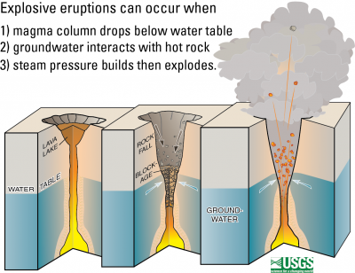
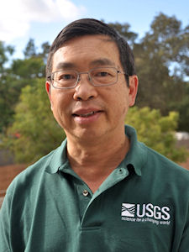

Groundwater inflow toward a preheated volcanic conduit: Application to the 2018 eruption at Kīlauea Volcano, Hawai’i
Paul Hsieh
Paul Hsieh and Steve Ingebritsen
U.S. Geological Survey
Menlo Park, California

Slide 2
Hydrogeology of basaltic terrane
Conceptual model for explosive eruptions at Kīlauea Volcano, Hawai’i
Computational model
Modeling results
What comes next?

Slide 3

[H]ydrologic conditions [in volcanic terrane] seem to be freakish in every respect ... Generally speaking, the lava rock is like a sieve ... The hydrologic consequences of the widespread occurrence of this very permeable rock are obvious – rapid absorption and downward percolation of the rain water; small and flashy runoff ... great ground-water recharge and large supply of ground water; very low and flat water table with great depths to ground water in most places; copious springs in the low valleys…
O.E. Meinzer (1930)

Slide 4
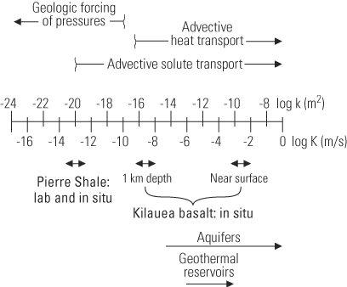
Basalt flows are the most permeable rocks widely exposed at the Earth’s surface. Permeability of young, unaltered basalt flows is on the order of 10⁻¹¹ to 10⁻⁹ m² in geologic settings as diverse as the flanks of the mid-ocean ridge, ocean islands, and continental volcanic arcs
But permeability is also very heterogeneous because of….

Slide 5
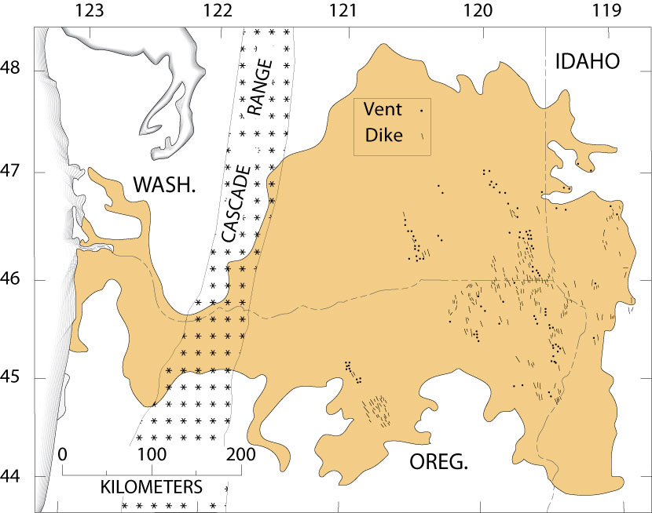
Heterogeneity –
Effect of stratigraphic layering
CRB
After Sherrod and others (1996)

Slide 6
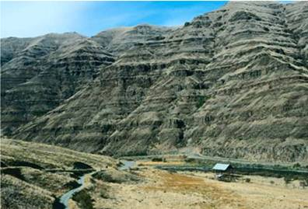
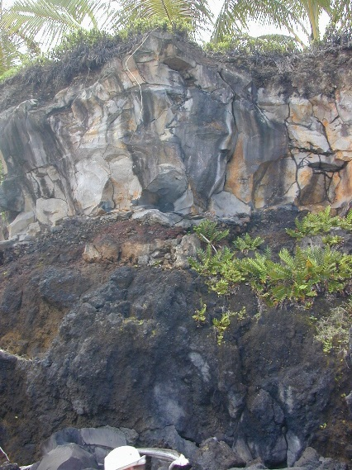
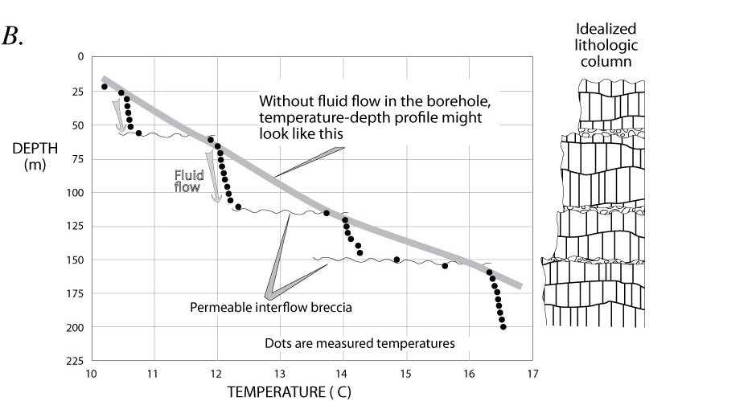
Columbia River
basalt (CRB)
Maui
Temperature
profile in
CRB SE of
Portland
B after Sherrod and others (1996)

Slide 7
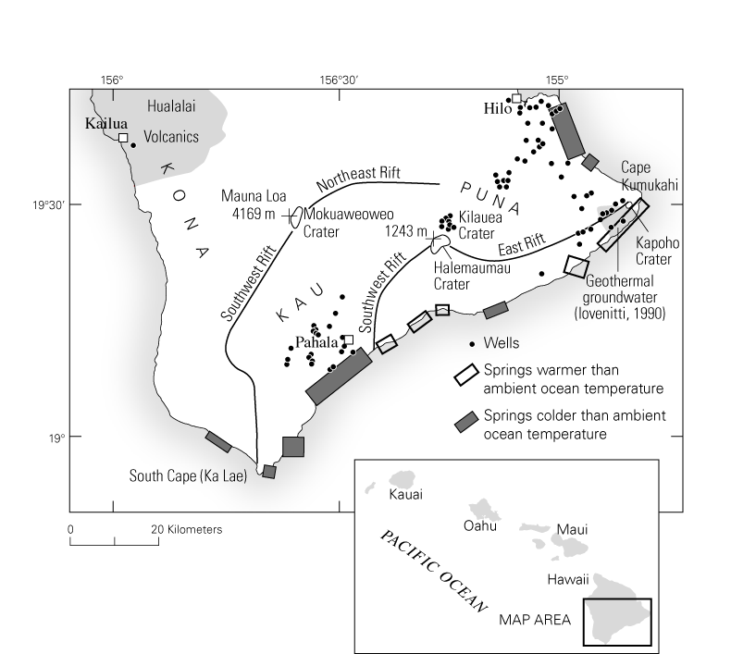
Heterogeneity – Effect of dikes
Cross section from Martha Scholl, USGS/Reston

Slide 8
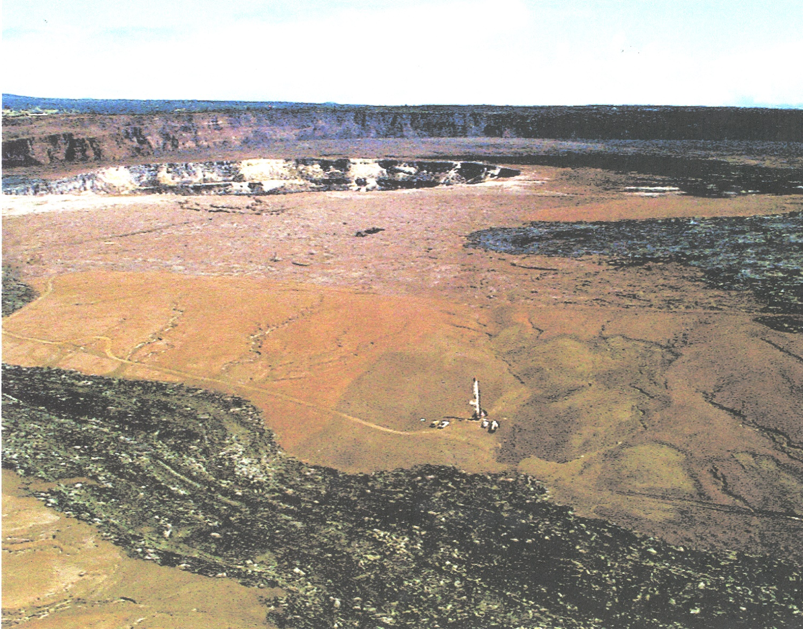
Heterogeneity –
Effects of hydrothermal alteration
Kilauea caldera, Hawai’i

Slide 9
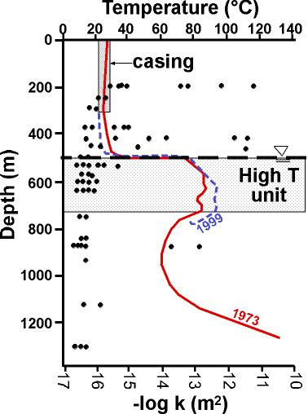
Heterogeneity – Effects of hydrothermal alteration
Unaltered and no secondary minerals
Alteration of pyroxene to serpentinite
Secondary hematite, smectite, quartz,
calcite, zeolite, chlorite
Keller and others (1979)
Hurwitz and others (2002)

Slide 11
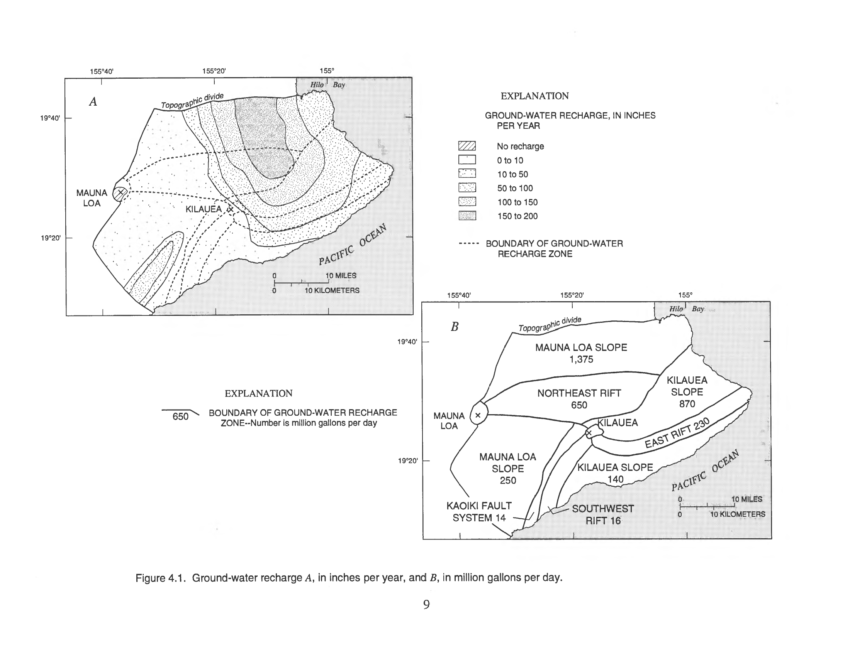
Groundwater recharge rates can be extraordinary
P = RO + ET + RECHARGE
From Takasaki (1993)

Slide 12
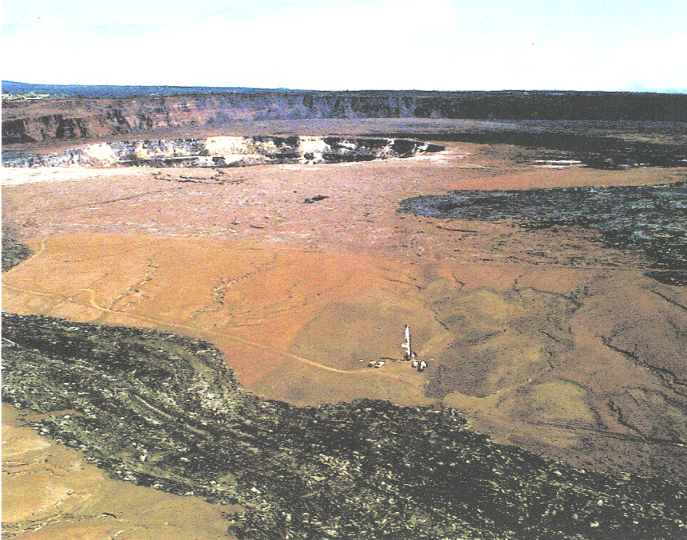
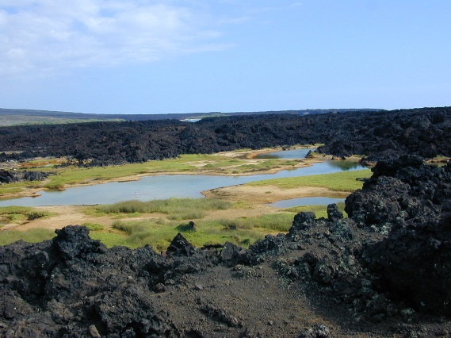
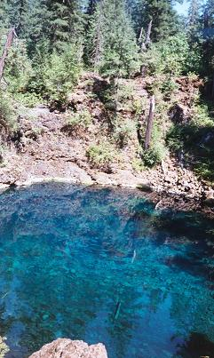
Recharge
~1 m/yr
Kilauea caldera, Hawai’i
Recharge ~2 m/yr
Little Belknap shield, Oregon

Slide 13
Vertical downflow fluxes of only a few cm per year are sufficient to entirely suppress near-surface heat flow, so that large areas of the mid-ocean ridge, Kilauea caldera, and the Quaternary volcanic fields of the continents are characterized by near-zero near-surface conductive heat flow, despite being directly underlain by magmatic heat sources. Much of the underlying heat is advected laterally and eventually discharged by large springs km to tens of km distant ...
Bredehoeft and
Papadopulos (1965)

Slide 14
Thus conductive heat flow “missing” at Kilauea

Slide 15
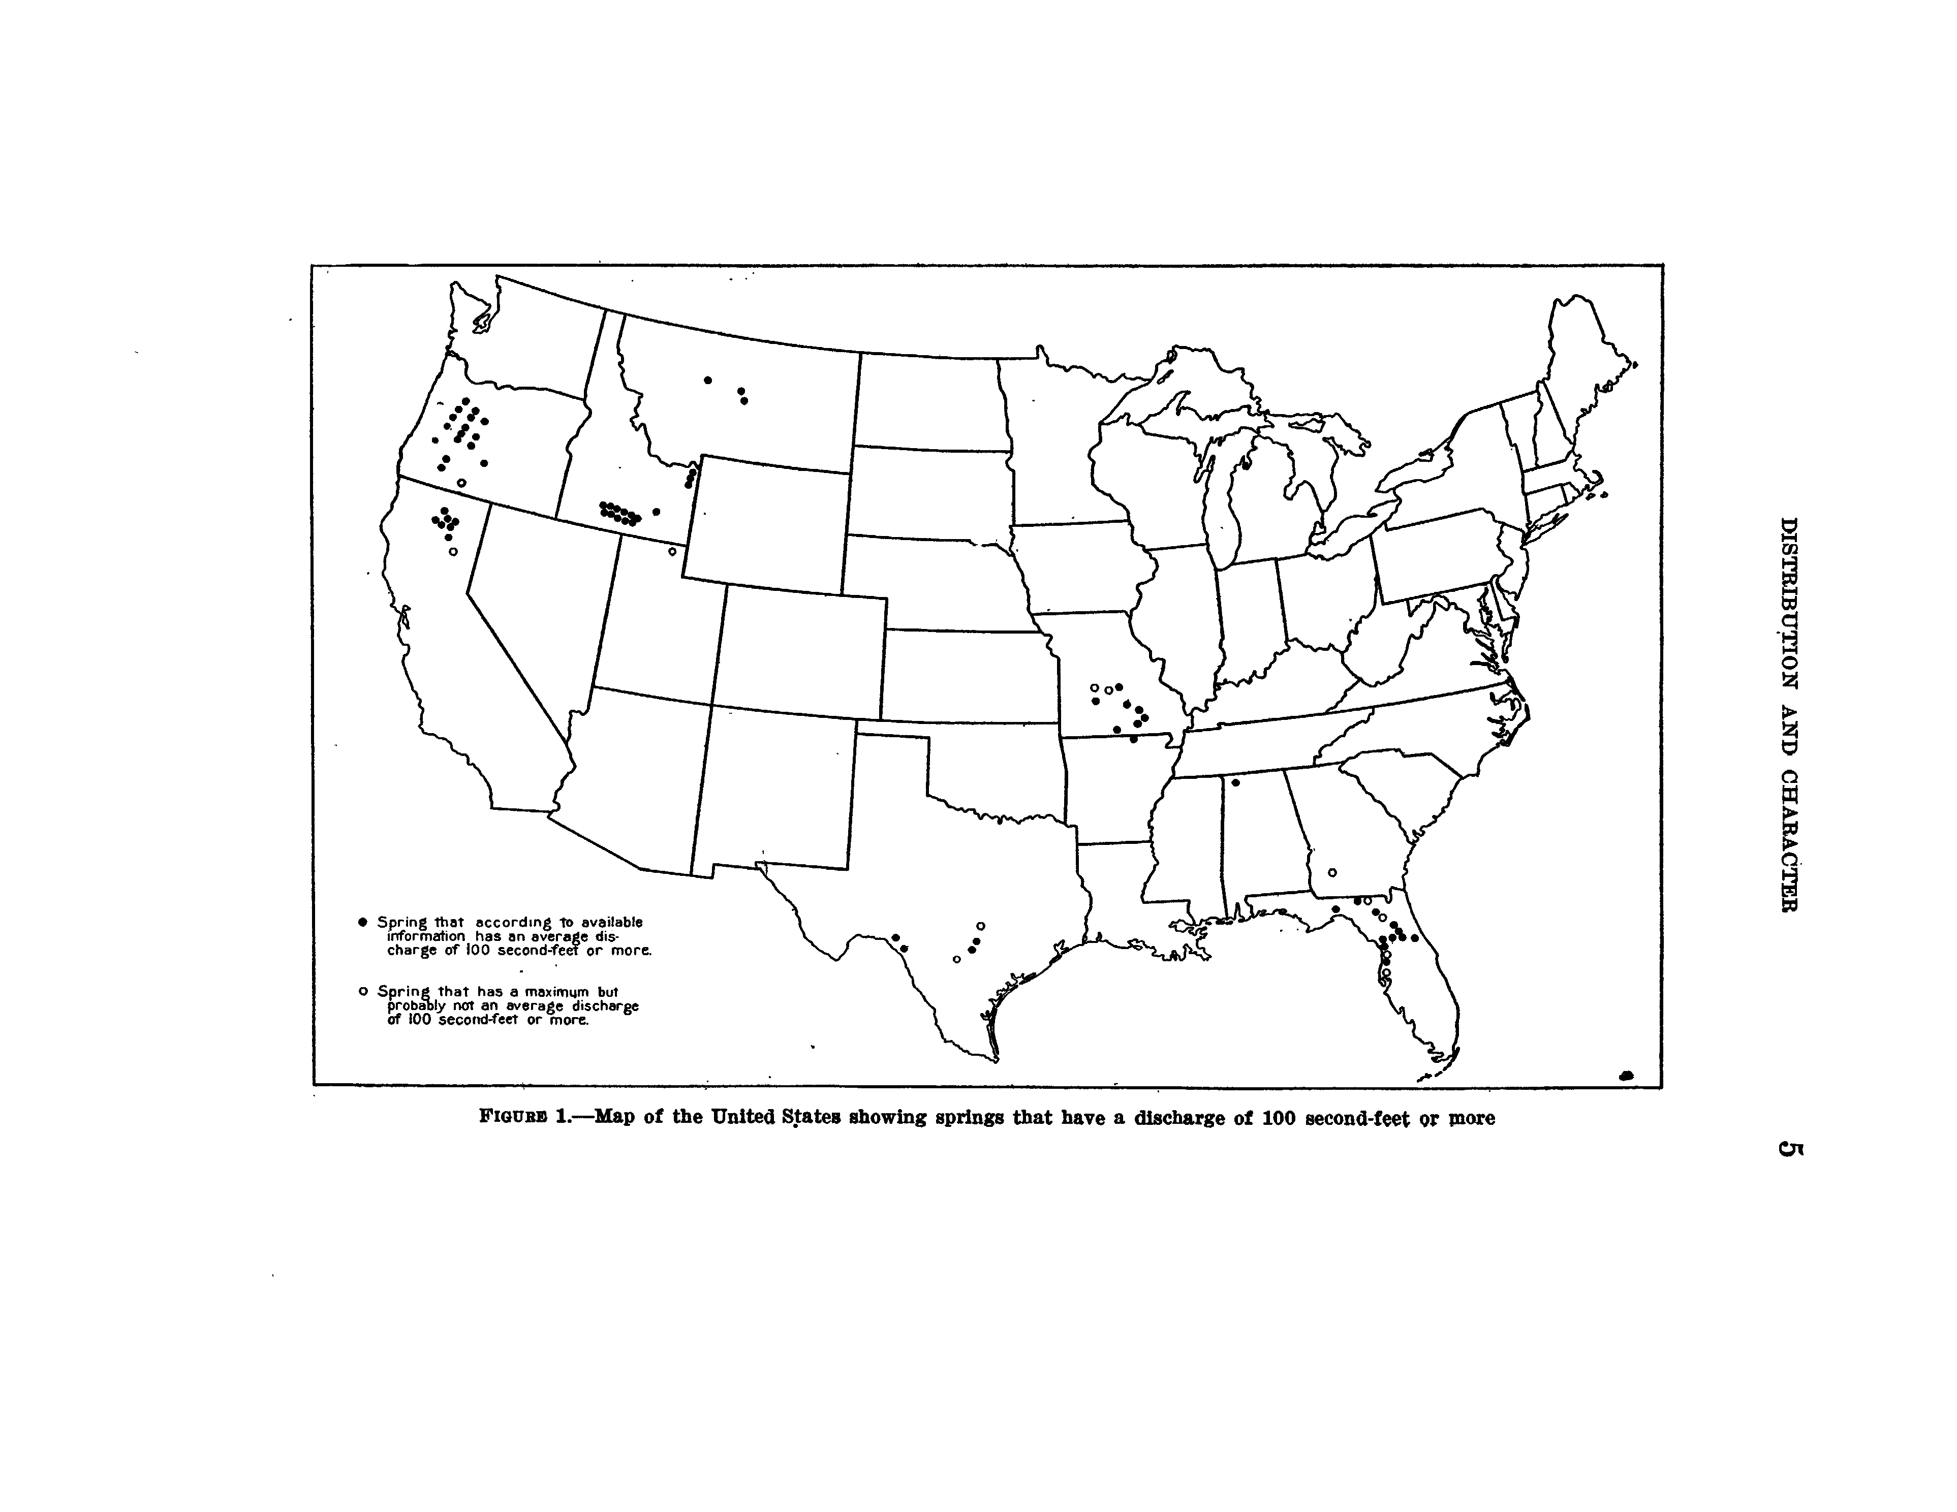
Meinzer (1927), USGS Water-Supply Paper 557
Over half of the large (>100 cfs) springs of the conterminous United States (as inventoried by O. E. Meinzer, 1927) occur in volcanic terrane of Oregon, northern California, and southern Idaho

Slide 16
Hydrogeology of basaltic terrane
Conceptual model for explosive eruptions at Kīlauea Volcano
Computational model
Modeling results
What comes next?

Slide 18
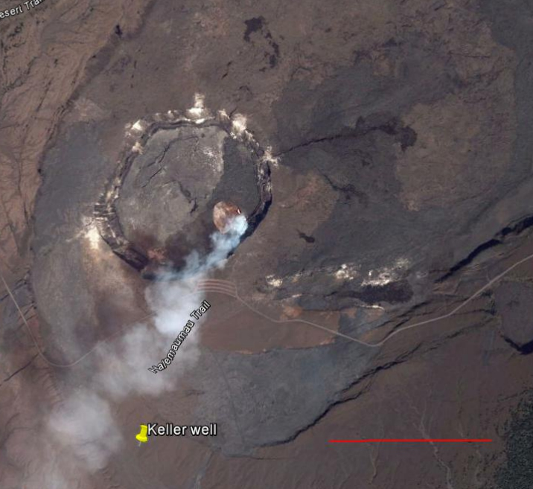
Hydrogeology of basaltic terrane
Conceptual model for explosive eruptions at Kīlauea Volcano, Hawai’i
Computational model
Modeling results
What comes next?

Slide 19
Quantitative model and parameterization
Mass balance
Cecile Coulon
ENS-Paris
MS project
Energy balance
HYDROTHERM (https://volcanoes.usgs.gov/software/hydrotherm/)
A Computer Code for Simulation of Two-Phase Ground-Water Flow and Heat Transport in the Temperature Range of 0 to 1200 Degrees Celsius

Slide 20
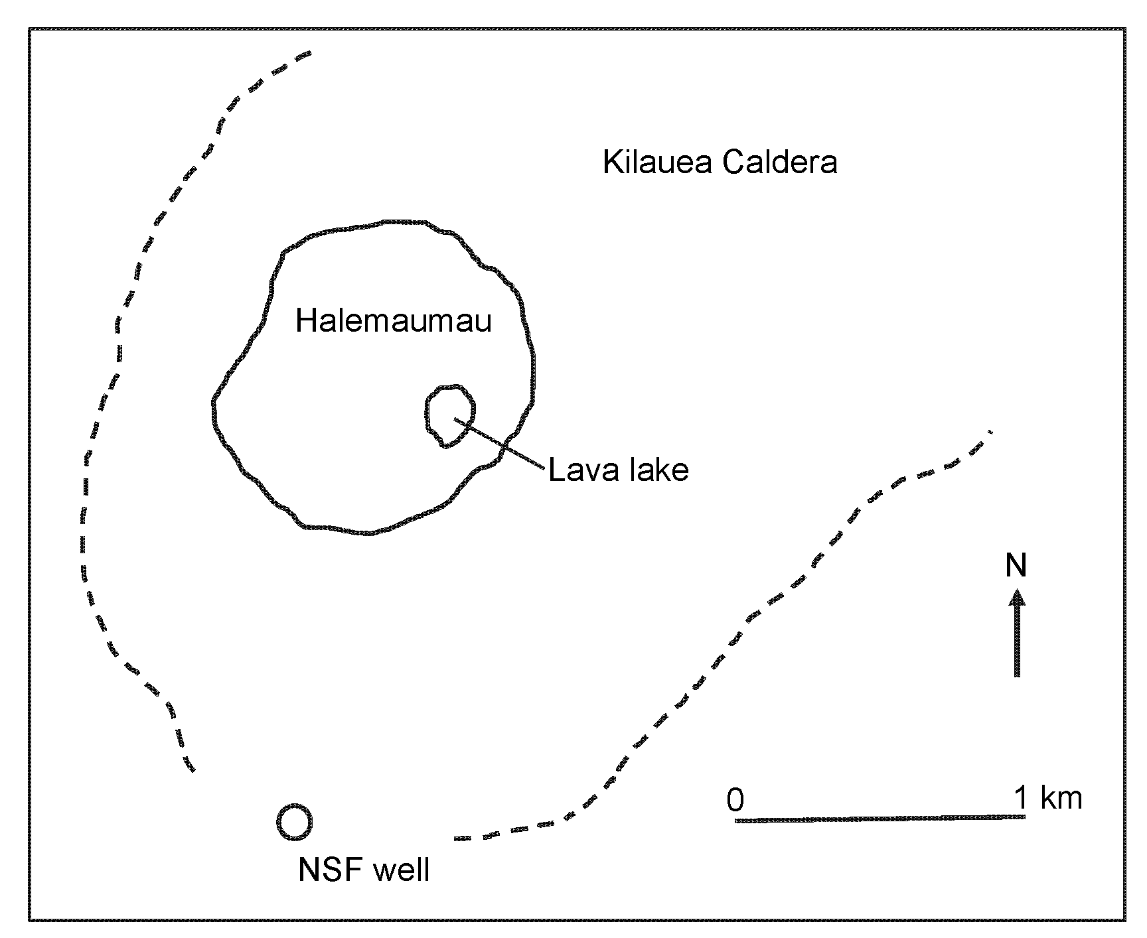
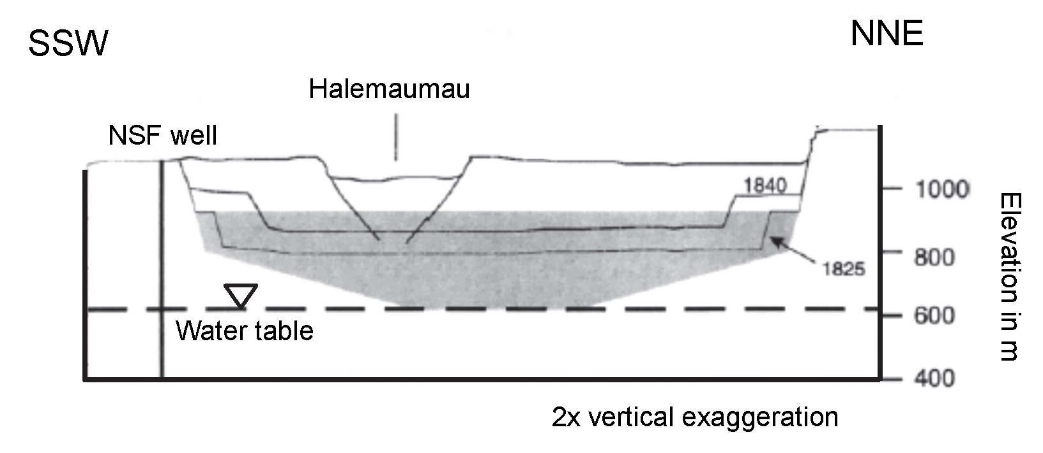

Slide 21
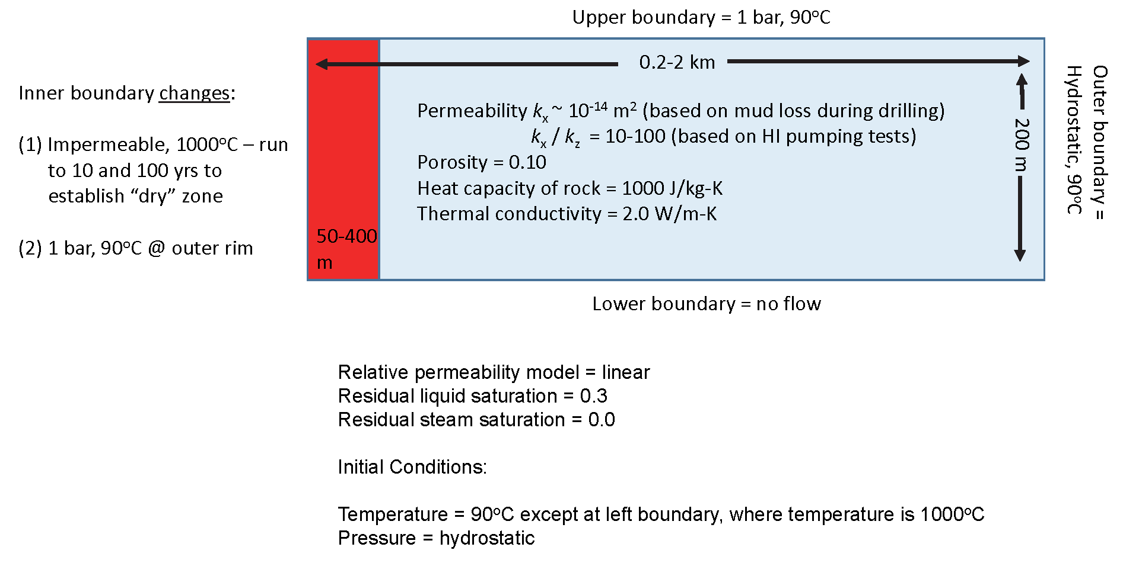

Slide 22
Hydrogeology of basaltic terrane
Conceptual model for explosive eruptions at Kīlauea Volcano, Hawai’i
Computational model
Modeling results
What comes next?

Slide 23
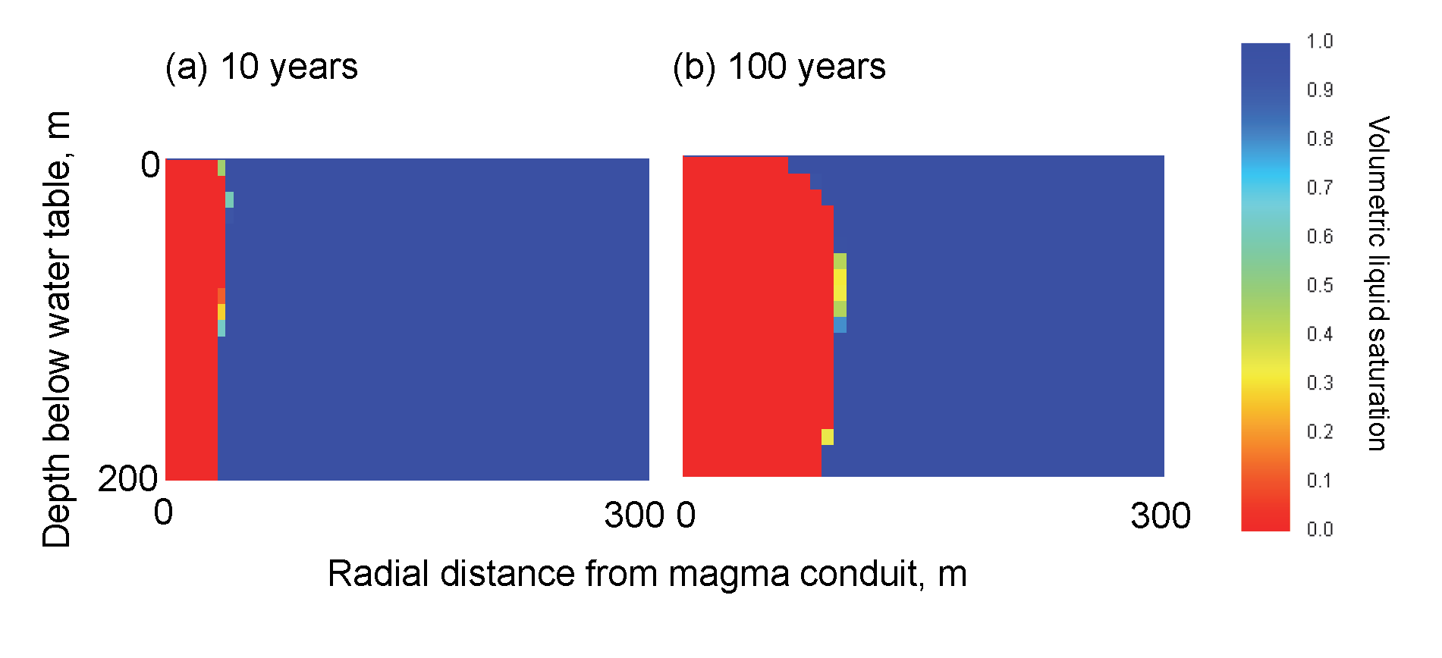
Heating stage

Slide 24
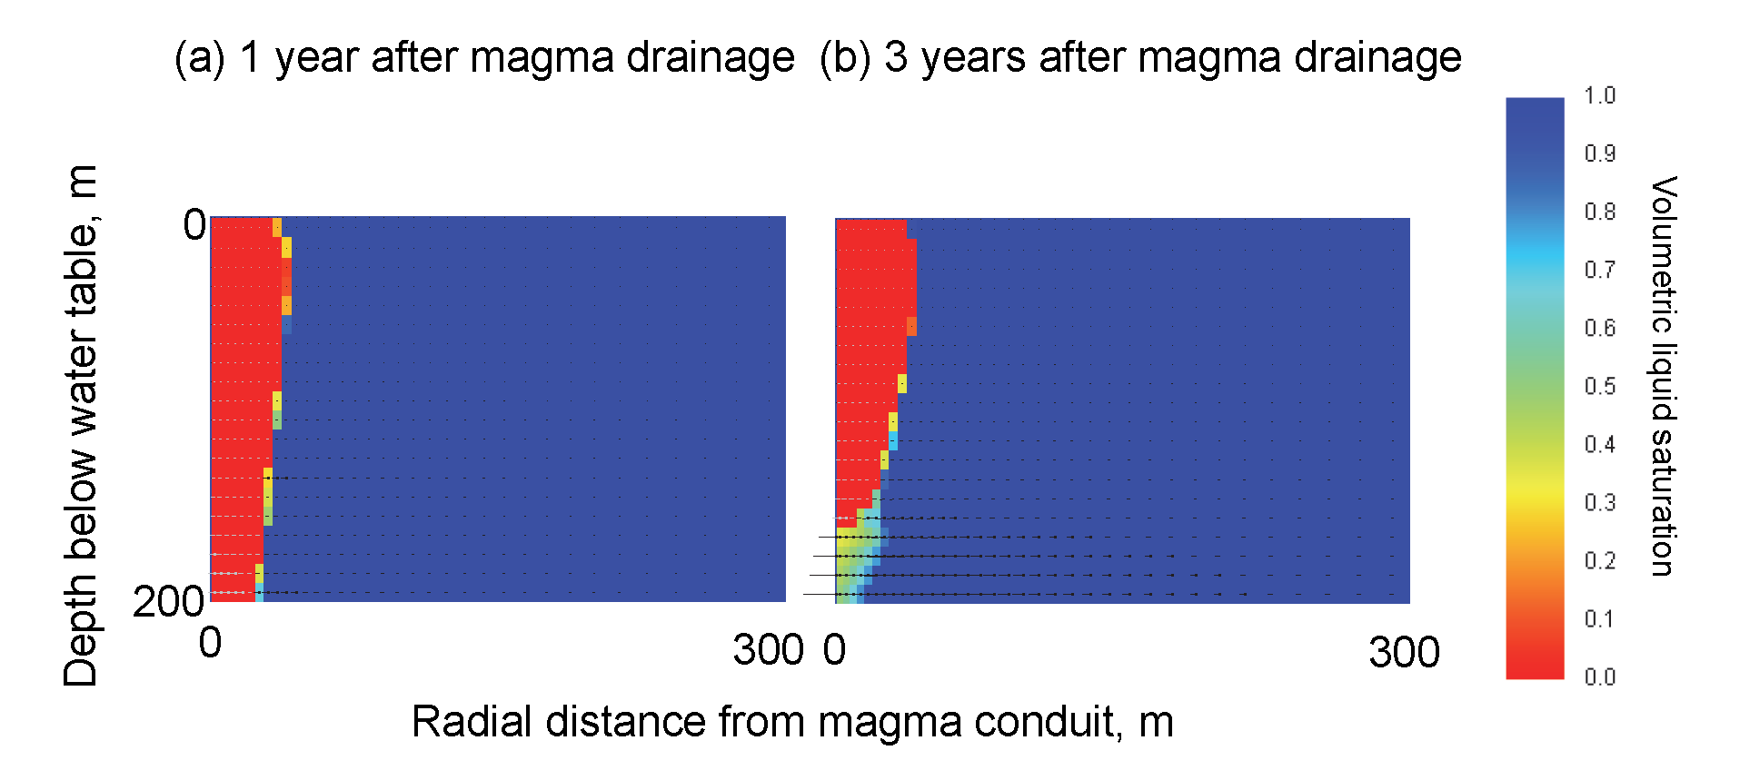
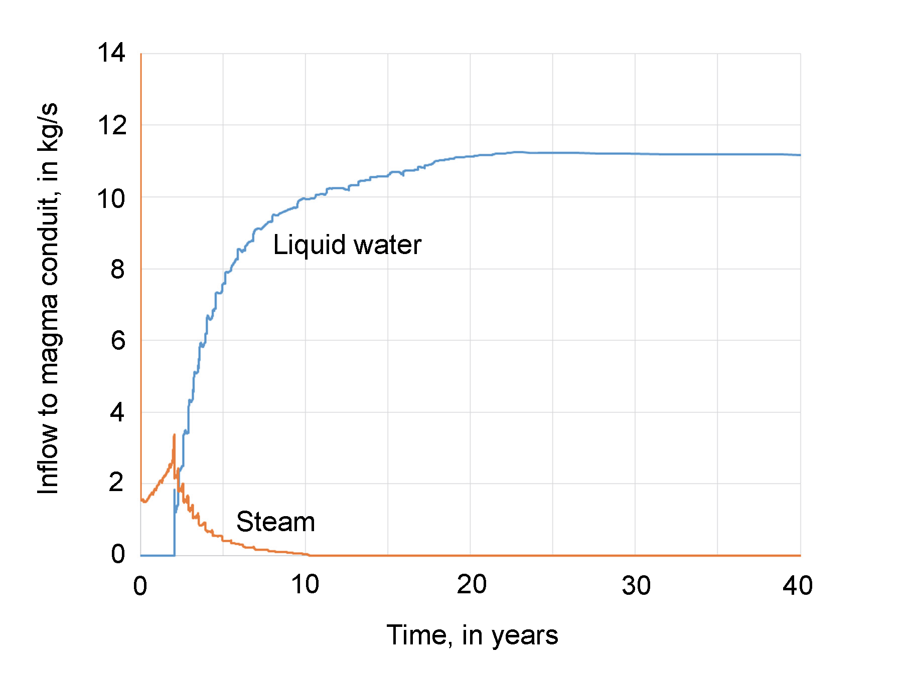
After magma drainage

Slide 25
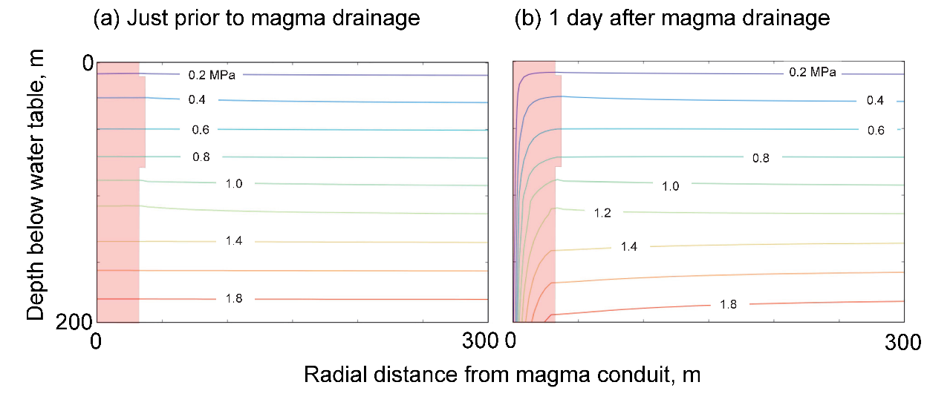

Slide 26
Hydrogeology of basaltic terrane
Conceptual model for explosive eruptions at Kīlauea Volcano, Hawai’i
Computational model
Modeling results
What comes next?

Slide 27
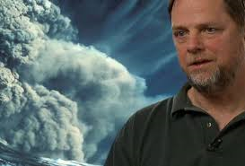

Slide 28
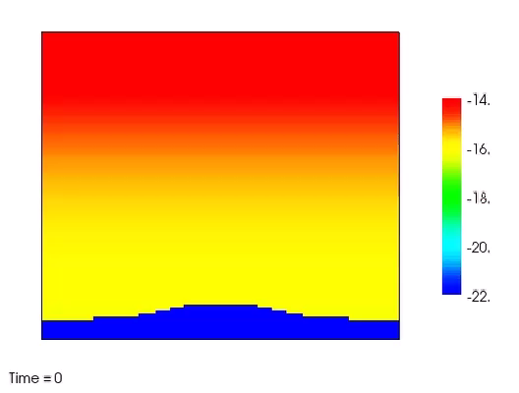
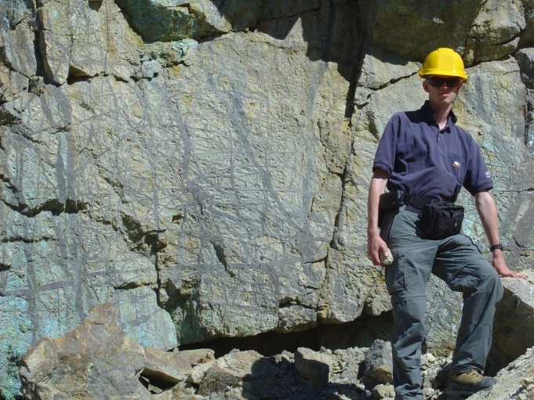
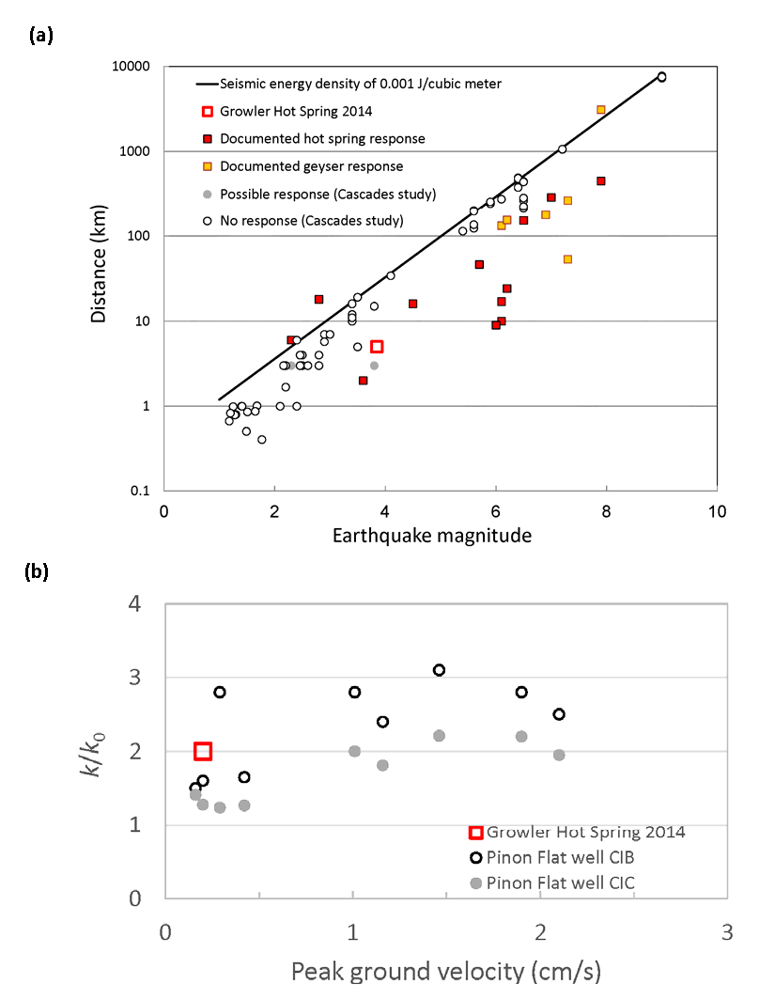

Slide 29
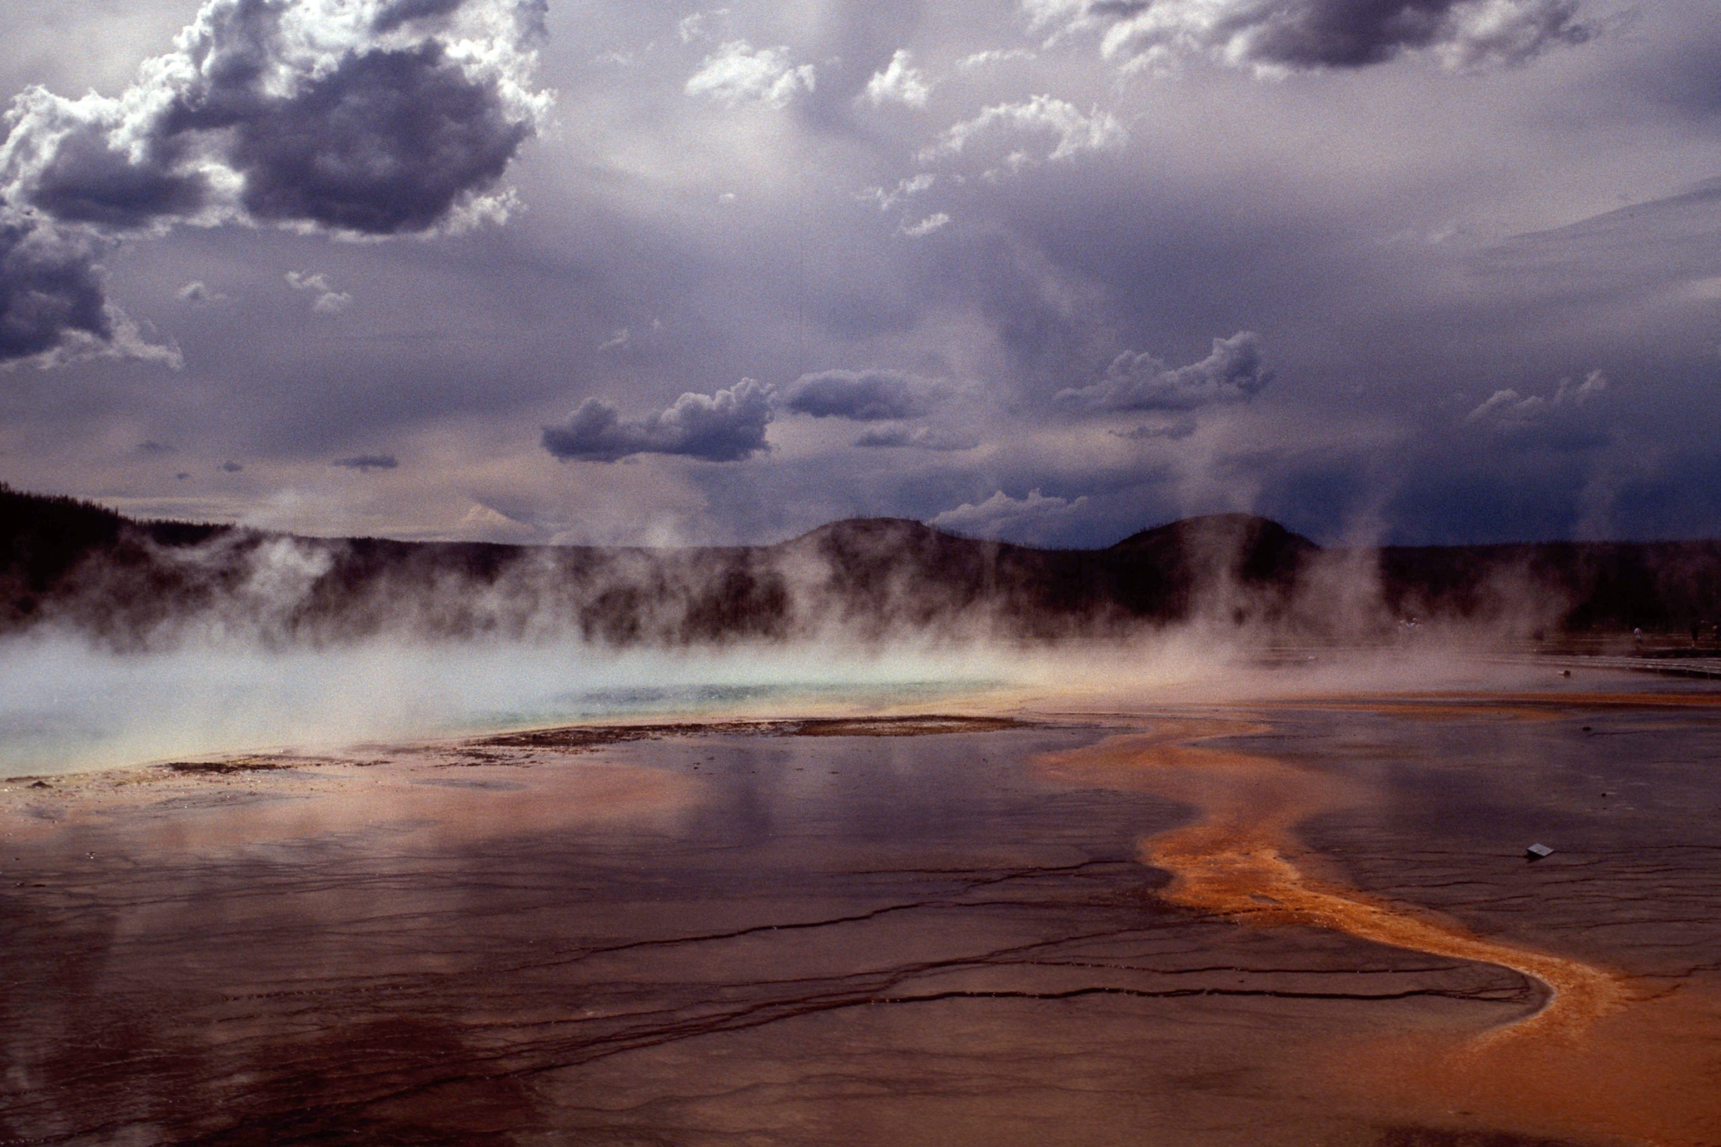
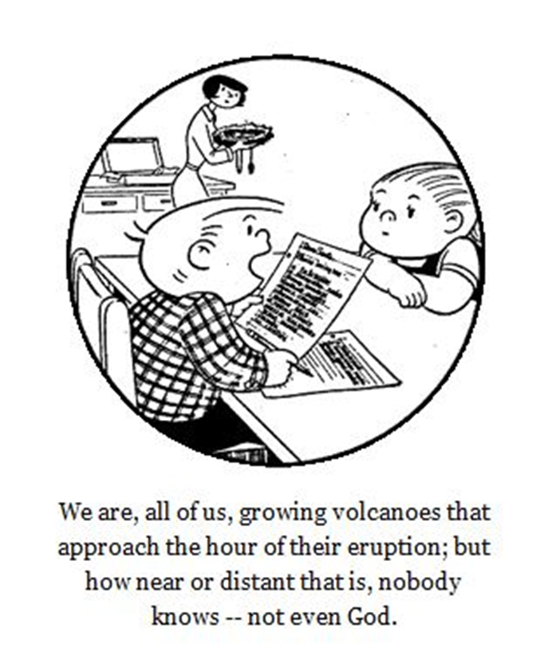
Photo by R.O. Fournier

