Slide 1




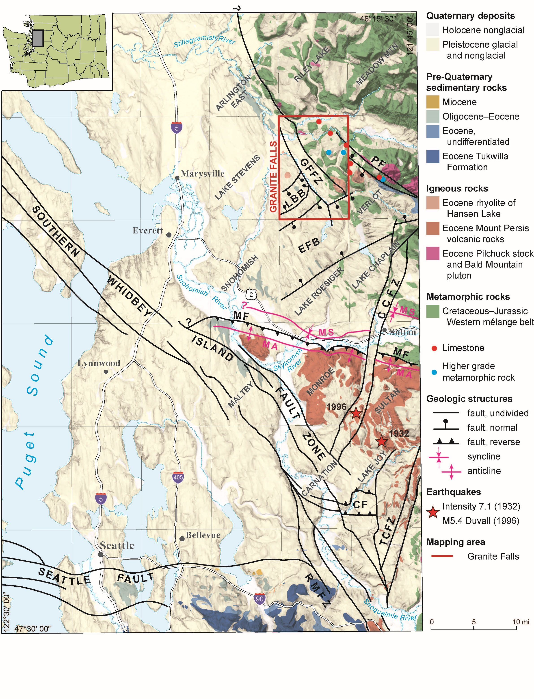
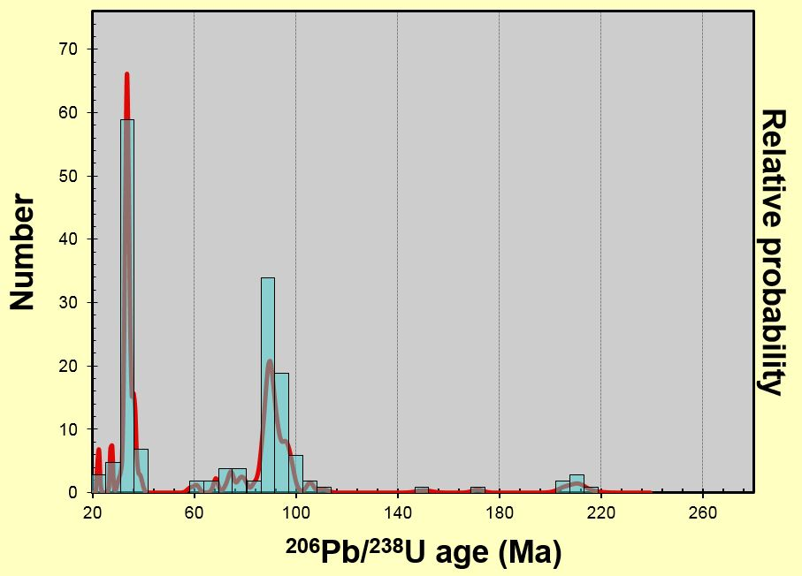
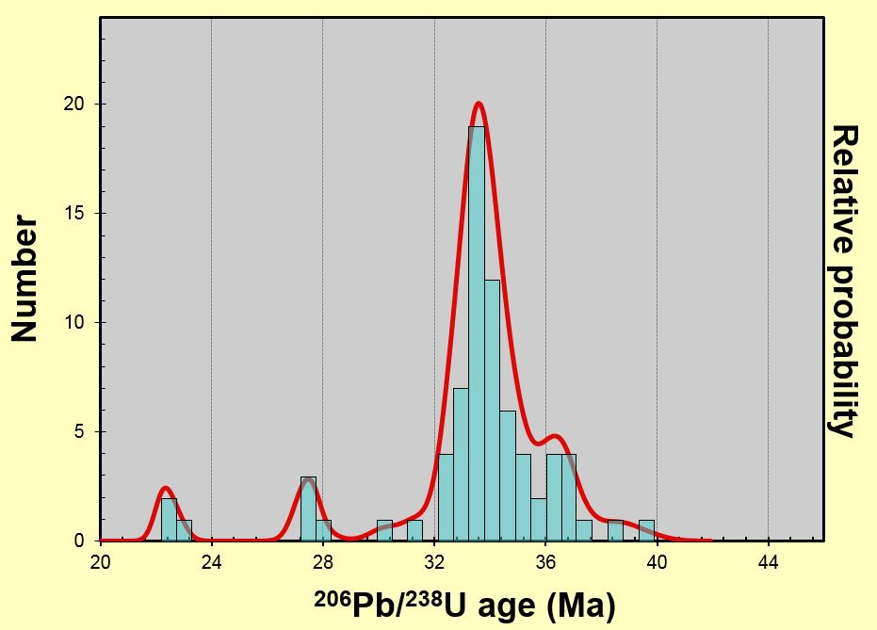
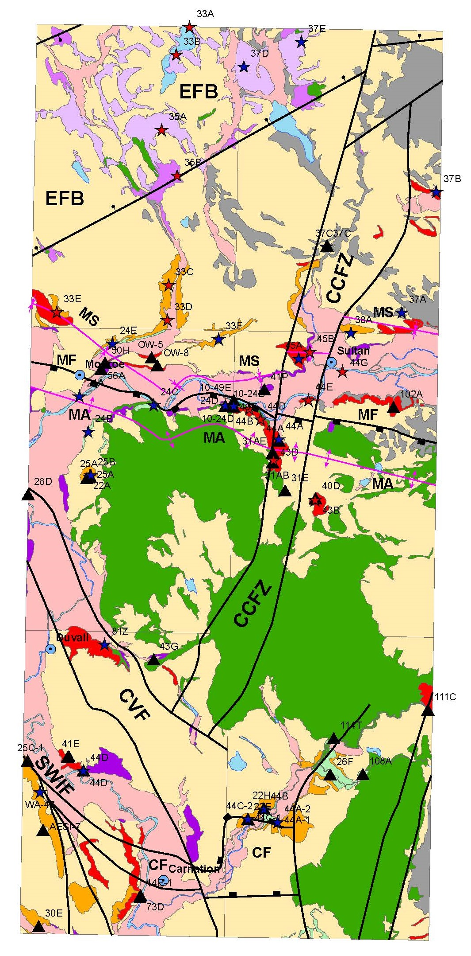
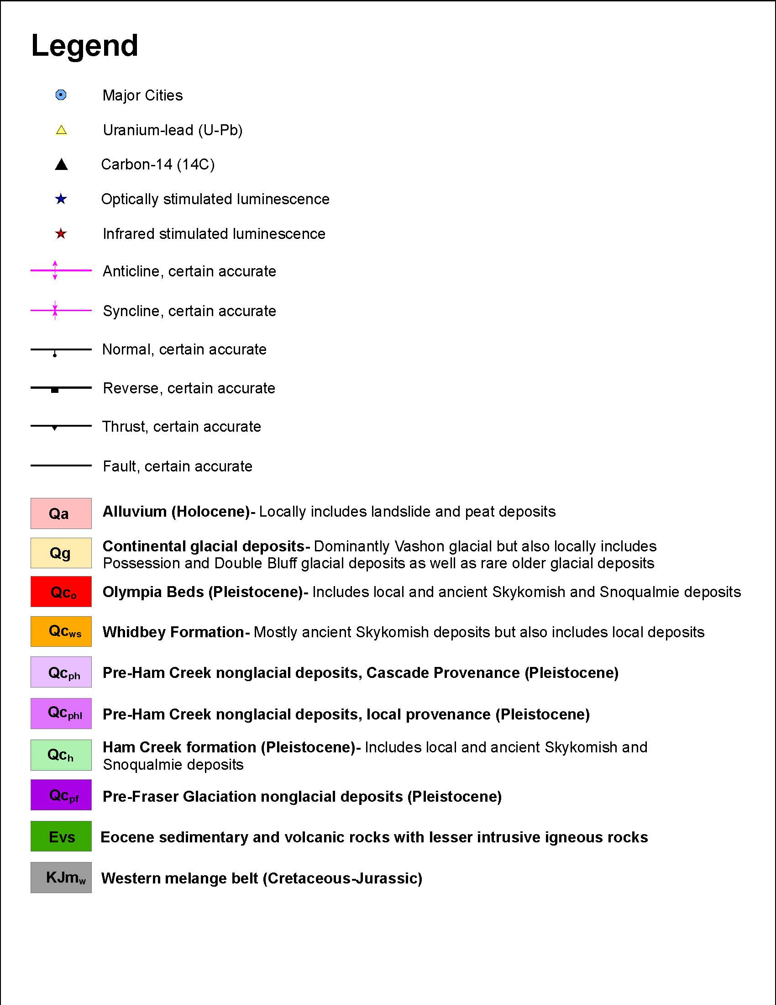
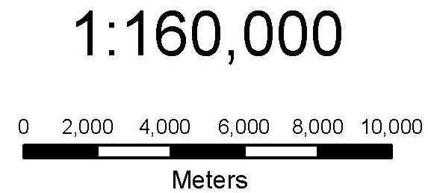
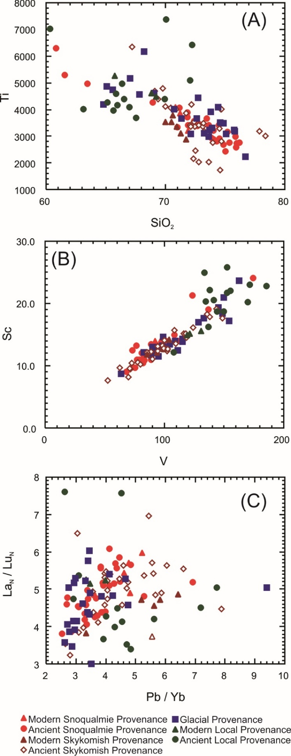
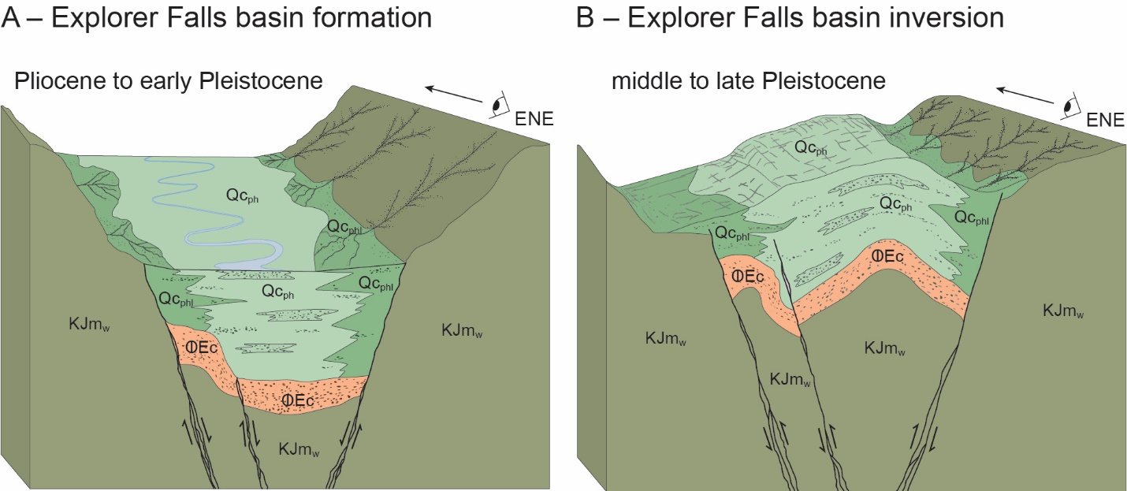
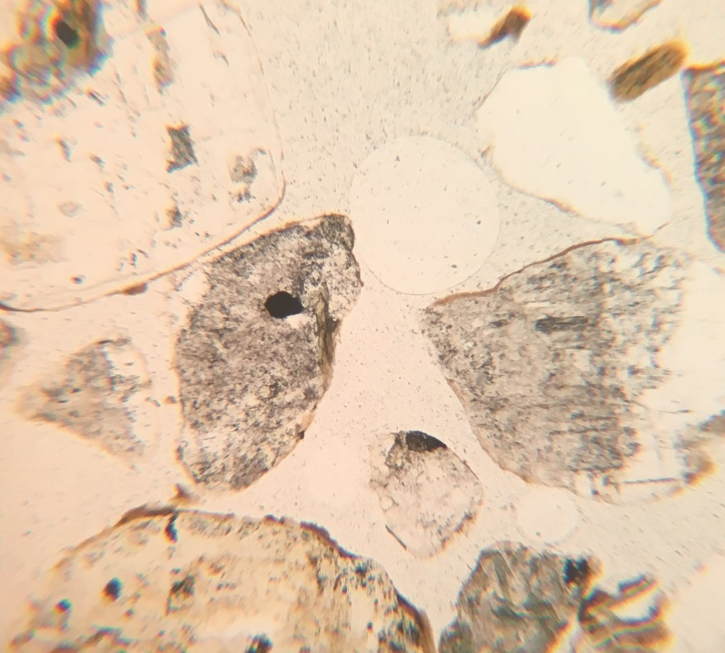
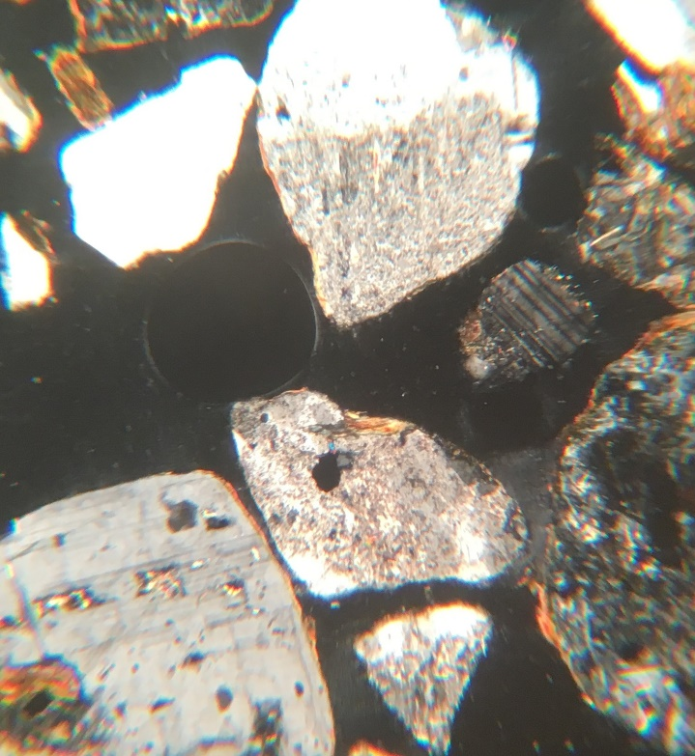
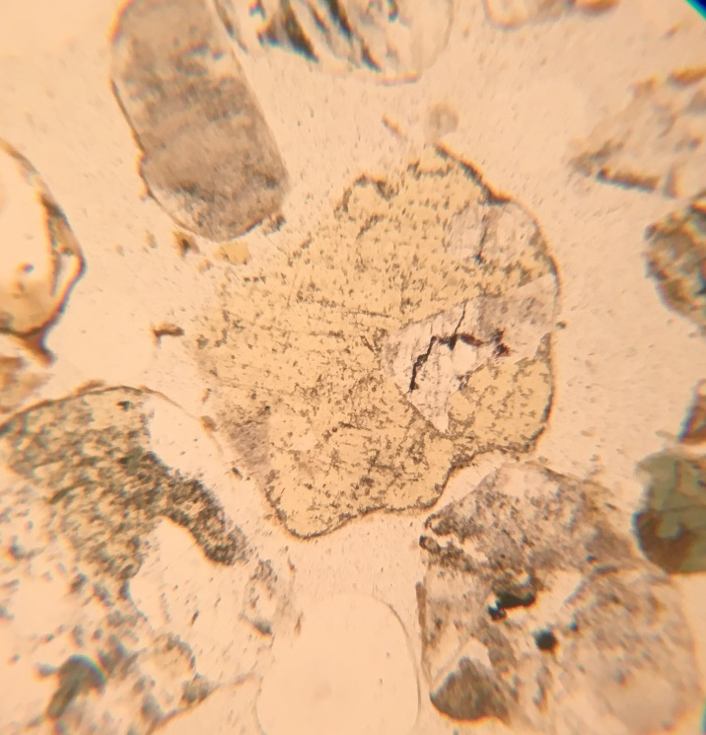
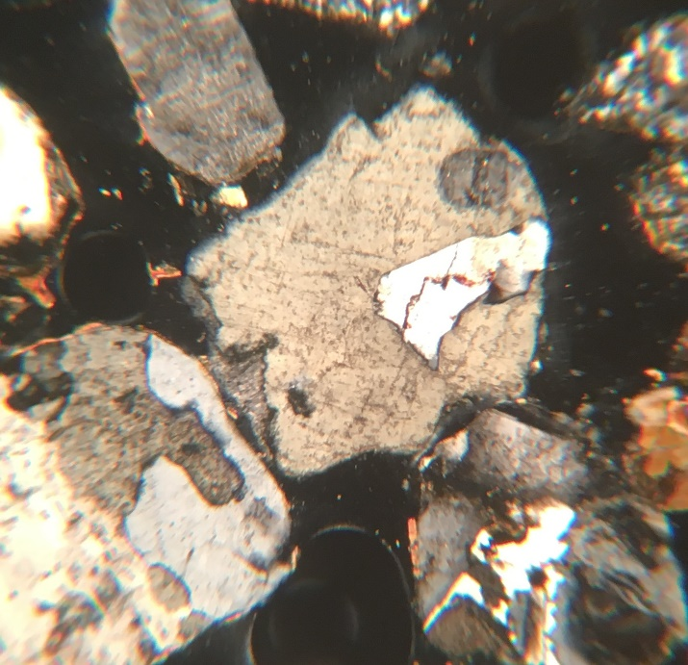
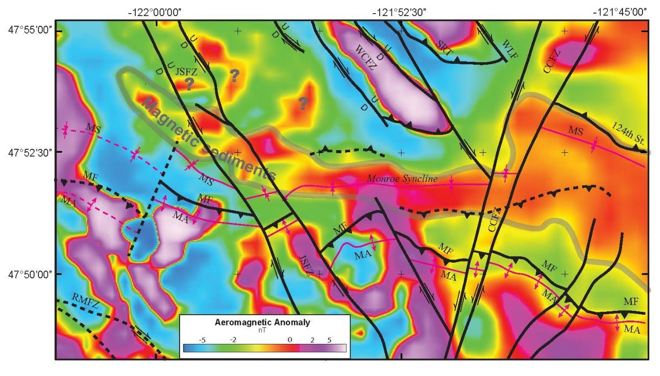
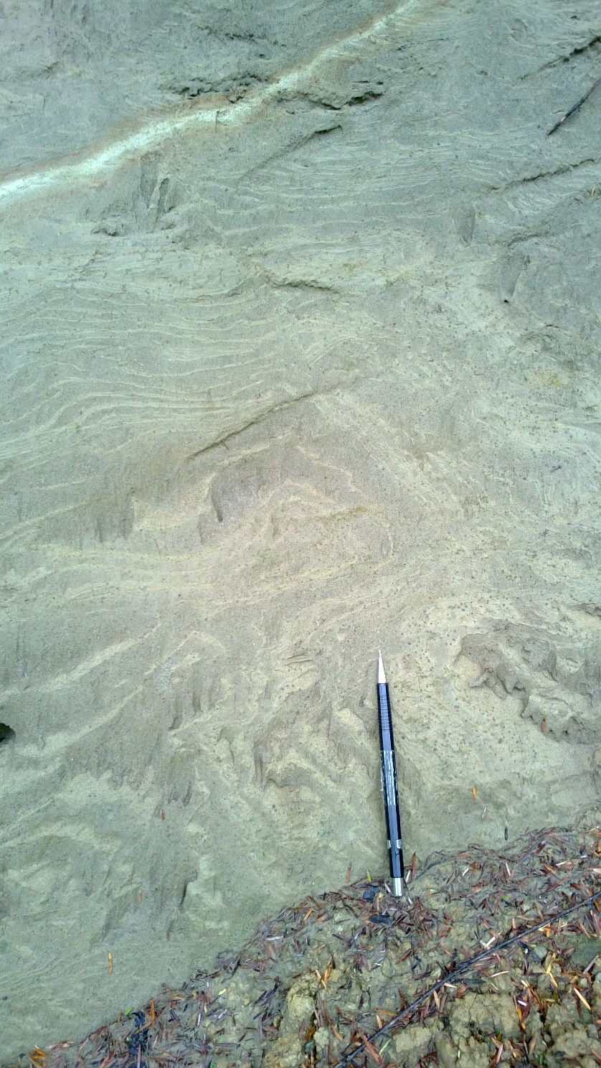
CASCADE PROVENANCE OF NON-GLACIAL HOLOCENE AND PLEISTOCENE SANDS IN THE CASCADE FOOTHILLS AND PUGET LOWLANDS OF KING AND SNOHOMISH COUNTIES, WASHINGTON—A RICH HISTORY OF SNOQUALMIE, SKYKOMISH AND PILCHUCK RIVER BASIN DEVELOPMENT AND NEOTECTONICS DURING THE QUATERNARY
_{ABSTRACT}
Joe D. Dragovich¹, James H. MacDonald, Jr.², Shannon A. Mahan³, Megan L. Anderson⁴, Jr., S. Andrew DuFrane⁵, Curtis J. Koger⁶, Daniel T. Smith⁷, Skyler P. Mavor⁸, and Jennifer H. Saltonstall⁶
Our geologic mapping in concert with petrography, geochronology, geochemistry, geophysics, and stratigraphy of ten contiguous 7.5’ quadrangles from North Bend to Granite Falls (Fig. 1) indicate that most Pleistocene nonglacial strata (PNS) have a distinct Cascade Provenance (CP) fluvial origin. Our correlation of this CP PNS with the Olympia beds (20-60 ka), Whidbey Formation (75-130 ka), Hamm Creek unit (178-243 ka), and pre-Hamm Creek PNS units are supported by 42 ¹⁴C and 44 OSL/IRSL ages (Table 1) and by stratigraphic relations.
The CP PNS is distinctly compositionally and stratigraphically similar to Holocene Snoqualmie, Skykomish and Pilchuck River (SSPR) alluvium. Point count petrography of CP PNS sands reveals a granitic source containing mostly monocrystalline quartz, plagioclase, K-spar, hornblende, pyroxene, mica and granitic lithic grains (Table 2 and Fig. 2). The granitic CP is largely ascribed to Quaternary erosion of the Eocene-Miocene Snoqualmie, Index and Mount Pilchuck batholiths in the upper SSPR basins and is supported by detrital zircon age data for the PNS (Fig. 3). Higher Pb/Yb ratios for the CP PNS and Holocene SSPR sediments also distinguish glacial and CP sediments (Fig. 4). Most CP PNS basin sediments (e.g. Monroe basin) have a distinctive modest magnetic susceptibility due to the inclusion of granite source oxides such as magnetite, which we use to track basin axes and extent (Fig. 5).
Fault and fold geometry indicate local Quaternary structural control of the SSPR basins by the Monroe, Carpenter Creek, and southern Whidbey Island fault (SWIF) zones. Local thick sequences of CP PNS were deposited in actively subsiding tectonic basins such as the Monroe synclinal basin north of the Monroe reverse fault (Fig. 6). In the SWIF, the CP PNS were deposited in small, strike-slip basins then inverted into active growth folds such as the Tolt River anticline. Some extensional PNS basins, such as the Explorer Falls basin, which is bounded by the active Carpenter Creek reverse fault, were later uplifted to form inverted basins (Fig. 6 and 7). Neotectonism in the area is also suggested by widespread liquefaction features in nonglacial Pleistocene sediments in the study area (Fig. 8).
Regional CP PNS sand petrography reveals Pleistocene SSPR alluviation into the lowlands as far W to NW as central Whidbey Island and Lofall/Quilcene areas, respectively. Although further work is warranted, the apparent restriction of the CP PNS north of the Seattle fault may reflect structurally controlled, Pleistocene SSPR alluviation into the Seattle basin north of the Seattle uplift (Fig. 1).
Figure 3A. Age distribution plot for sand sample 37A.
Figure 3B. Age distribution plot for the younger age peak for Sample 37A.
Figure 3: Sand Detrital Zircon Ages
The Cascade provenance of the SP deposits (Fig. 6) is supported by a detrital zircon study of an Olympia bed SP sand. We obtained and OSL age of 40 ka (Table 1) in the Monroe synclinal basin for this sediment (site 37A on Fig. 6). A. Probability density plot with histogram shows the age distribution for all sample zircons (N=158). B. Probability density plot with histogram shows the age distribution for the younger age peak (32–36 Ma) for sample 37A. The Tertiary and Cretaceous intrusive rocks to the east of the study area in the Cascade Mountains (for example, the Grotto and Index batholiths) are predominantly intermediate and locally contain true granite (Tabor and others, 1993). The detrital-zircon age populations, petrography, and geochemistry all indicate that these intrusive rocks were a major source of the modern and ancient Skykomish River alluvium. The detrital zircon spectra shown above shows a strong correlation with the age and distribution of the intrusive rocks presently exposed in the Skykomish basin east of the study area. Tertiary and Cretaceous intrusive rocks exposed over 66% of the Skykomish River basin area. Most compelling are the large number of 32 to 36 Ma zircon ages, consistent with erosion of the widespread 33 to 34 Ma Index batholith in the Cascades directly to the east. PP nonglacial deposits also have a abundant Tertiary to Cretaceous detrital zircon age populations but have more Western mélange belt detritus. (Data not presented; see Dragovich and others, 2014a, 2015).
Figure 7
Figure 5
Seattle
Basin
Figure 6: Regional Geologic Relationships
Simplified geologic map of the north-central part of the study area showing the Monroe syncline (MS), Monroe fault (MF), Explorer Falls basin (EFB), Cherry Creek fault zone (CCFZ), Cherry Valley fault (CVF), Carnation fault (CF), and southern Whidbey Island fault zone. (Map extents located on Fig. 1.) The geochronology (age) sites shown on the map are documented in Table 1. Structural, seismic and other evidence suggests the MS, MF, EFB, CF, SWIF and CCFZ are potentially active to active structures. For example, the MS may be a synclinal basin related to reverse offset of the MF with the syncline folding or tilting Olympia bed SP deposits that are latest Pleistocene in age. The CFZ and the EFB faults are locally associated with active seismicity with the Duvall earthquake centered on the CCFZ near the junction of the Carnation, Lake Joy, Sultan and Monroe quadrangles. The Carpenter Creek fault in the EFB (Fig. 7 shown directly below) are associated with Pleistocene growth folding of PP deposits interpreted to be associated with the active Carpenter Creek reverse fault. Neotectonism in the area is also suggested by widespread liquefaction features in nonglacial Pleistocene sediments in the study area (Fig. 8).
Figure 6
Figure 5 map extent
Figure 6 map extent
Figure 7 map extent
Fall City
Quadrangle
Snoqualmie
Quadrangle
Figure 4: Sand Geochemistry
A large geochemical dataset for Quaternary sands (n=145) has been compiled from our previously published mapping studies, covering ten quadrangles. The nonglacial sand samples include ancient (Pleistocene) and modern (Holocene) alluvium and various glacial deposits representing several sedimentary provenances (Table 2). We are able to discriminate modern and ancient alluvial sands that have a local provenance (LP) from samples that have a granitic Cascade provenance (SP) on the basis of their generally higher Sc, V, and Ti (Fig. 4A and 4B). In addition, we can distinguish glacial (NP) from nonglacial sediments using Pb/Yb ratios (Fig. 4C). The higher Sc, V, and Ti for the LP most likely represents a strongly mafic volcanic source area, mostly likely accreted Mesozoic and Cenozoic terranes (Fig. 4). The higher SiO2, and low Ti and Sc of the SP is a result of its strongly felsic plutonic provenance (Fig. 4A-B). The NP has low Pb/Yb ratios due to its strong mixing of numerous accreted terranes from the north of the study area -- which do not have a strong volcanic or plutonic source (Fig. 4C). The NP overlaps the LP and SP on Fig. 4A and 4B due to mixing of various sources by outwash.
Figure 1: Regional Setting
Simplified regional tectonic map of the central Puget Lowland and Cascade Range foothills showing the study area (red rectangles; North Bend quadrangle south of Fall City quadrangle not shown). Structural features include in the north part of the study area include the Explorer Falls basin (EFB) and Bosworth Lake Basin (BLB), Pilchuck River fault (PF). The EFB is illustrated in Figure 7 (green rectangle). The PF and EFB might be related to rejuvenated Eocene extensional structures that preserve Paleogene to Pleistocene basin sediments in the Pilchuck River valley. The broad Granite Falls fault zone (GFFZ) bounds the Everett basin in the Granite Falls quadrangle. See Figure 6 (blue rectangle) for more detailed map of the Monroe syncline (MS), Monroe fault (MF) and the Monroe anticline (MA) as well as the Cherry Creek fault zone (CCFZ). The Tokul Creek fault zone (TCFZ) is similar to the CCFZ; they are likely left-lateral conjugates of the southern Whidbey Island fault zone. The Rattlesnake Mountain fault zone (RMFZ) is likely a southern continuation of the SWIF. The Seattle fault merges with the SWIF/RMFZ. Note the apparent local structural control of the Snoqualmie and Skykomish River valleys by the SWIF/RMFZ, MF, and MS.
Sample 33C plane light
mica
Sample 33C
crossed polars
Granitic lithic
Sample 33C plane light
Sample 33C crossed polars
gabbro
Figure 7: Basin Involvement
Schematic north-south cross section across the Pilchuck River anticline in the southernmost part of the map area. (See Fig. 1 for location of EFB.) We interpret this anticline as a growth fold resulting from compression along the Carpenter Creek fault (CCF). The Carpenter Creek earthquake cluster is likely related to active compression across the CCF as a result of oblique reverse slip along this structure. We suspect that this growth folding occurred before deposition of the Hamm Creek formation (not pictured above) but after deposition of pre-Hamm Creek nonglacial deposits (unit Qc_{ph}) Unit Qc_{ph} deposition occurred during the Early to Middle Pleistocene transtensional development of the Explorer Falls and Bosworth Lake basins and deposition of thick Cascade provenance PP fluvial deposits (Table 2); later north-south compression occurred during the Late Pleistocene. In the Granite Falls quadrangle, Whidbey and Hamm Creek PP strata are exposed in the northernmost part of the EFB on the northern limb of the Pilchuck anticline, as well as in the newly named Lake Bosworth basin shown on Figure 1.
plag
MQ
K-spar
plag
plag
gabbro
Granitic lithic
hbl
Figure 2: Petrography
SP-provenance thin section sand sample 33C. SP sediments contain detrital grains of monocrystalline quartz (MQ)(~20%), plagioclase (plag), K-spar (~8%), hornblende (hbl), pyroxene, and mica with some granitic lithic clasts. The above microphotos of SP-provenance sand has the ‘grus’ appearance typical of SP deposits regionally, with much subangular to angular grains. Most important is the relative abundance of K-spar, which is largely derived from Tertiary to Cretaceous granite, granodiorite, and tonalite. We obtained an OSL age 77 ka (Whidbey Formation) for this sand. (See 33 in Table 1 and Fig. 6). Glacial deposits are have more polymictic (variable) lithic clast types, including variable high-grade metamorphic clasts. Glacial deposits also have high polycrystalline/monocrystalline quartz ratio and less K-spar than in Cascade Range-sourced nonglacial units. The Index batholith is an important source of detritus for ancient Skykomish River SP deposits as suggested by the detrital zircon age information for SP sediments (Fig. 3). See Table 2 sand provenance information for further details.
CONCLUSIONS
Ancient alluvium from several Pleistocene nonglacial intervals is widespread in the lower Snoqualmie, Skykomish, and Pilchuck River valleys. These Pleistocene alluvial deposits have a composition, sedimentology, geochemistry and general stratigraphic architecture that mirrors modern alluvium (Qm₅₉₋₆₅Qp₁₂₋₂₉ PF₁₂₋₂₆). These sediments are derived from an intermediate, continental arc and are predominately from Tertiary granitic to granodioritic erosional sources in the Cascade Mountains, such as the Index, Grotto, and Snoqualmie batholiths (Fig. 3 and 4)(Table 2). SP-provenance sediments typically have liquefaction features, including contorted or chaotic bedding and (or) sand dikes (Fig. 8) suggesting past tectonism of these fluvial basin sediments during earthquake events. The widespread nature of these features in ancient alluvium, combined with the deformation (e.g. tilting and folding) of SP and PP Pleistocene deposits in the Monroe Syncline, Explorer Falls basin and the Tolt River anticline, suggest neotectonism of these sediments locally. Similarly, the Snoqualmie and Skykomish River valleys appear to be locally structurally controlled by faults such as the RMFZ–SWIF and (or) Monroe fault and Monroe synclinal basin (Fig. 1).
Figure 5: Subsurface Distribution
Residual aeromagnetic map (reduced to pole) of the Monroe syncline region (See Fig. 1 and Fig 6 for map location and Monroe synclinal basin location, respectively). Data from Blakely and others (1999). Heavy grey line encloses an area of a moderate magnetic high spatially correlated with the Monroe synclinal basin. The likely source of this anomaly are the thick, moderately magnetically susceptible, SP sediments including sediments of both the Olympia beds and Whidbey Formation in the synclinal basin (Table 2). Because of its continuity and anomaly amplitude, this region is distinctive from the stronger magnetic highs which are sourced from metagabbros (see gabbro) of the western mélange belt. Superimposed fault and fold structures are from Mahan and others (under review). Abbreviations: 124th St., 124th Street fault; CCFZ, Cherry Creek fault zone; JSFZ, Johnsons Swamp fault zone; MA, Monroe anticline; MF, Monroe fault; MS, Monroe syncline; SRT, Sultan River thrust; RMFZ, Rattlesnake Mountain fault zone; WCFZ, Woods Creek fault zone, WLF, Woods Lake fault.
Acknowledgements/Coauthor Contact Information
This geologic map was funded in part by the U.S. Geological Survey (USGS) National Cooperative Geologic Mapping Program under award no. G15AC00248. ¹Associated Earth Sciences, Inc., 1552 Commerce Street, Suite 102, Tacoma, WA 98402, jdragovich@aesgeo.com; ²Marine & Ecological Sciences, Florida Gulf Coast University, 10501 FGCU Blvd South, Ft. Myers, FL 33965; ³U.S. Geological Survey, Denver Federal Center; ⁴Washington Geological Survey, Department of Natural Resources, 1111 Washington St. SE MS 47007, Olympia, WA 98504; ⁵Earth and Atmospheric Sciences, University of Alberta, 1-26 Earth Science Building, Edmonton, AB T6G 2E3, Canada; ⁶Associated Earth Sciences, Inc., 911 5th Ave., Suite 100, Kirkland, WA 98033; ⁷King County Department of Natural Resources and Parks, Water and Land Resource Division; ⁸Department of Geosciences, Colorado State University, 1401 Campus Delivery, Ft. Collins, CO 80523.
Figure 8: Liquefaction
Liquefied Olympia bed nonglacial sands with overturned folds, flame structures, and chaotic bedding. We obtained an OSL age of 32.3 ka at this site in the Lake Chaplain quadrangle (Table 1).

