Slide 1
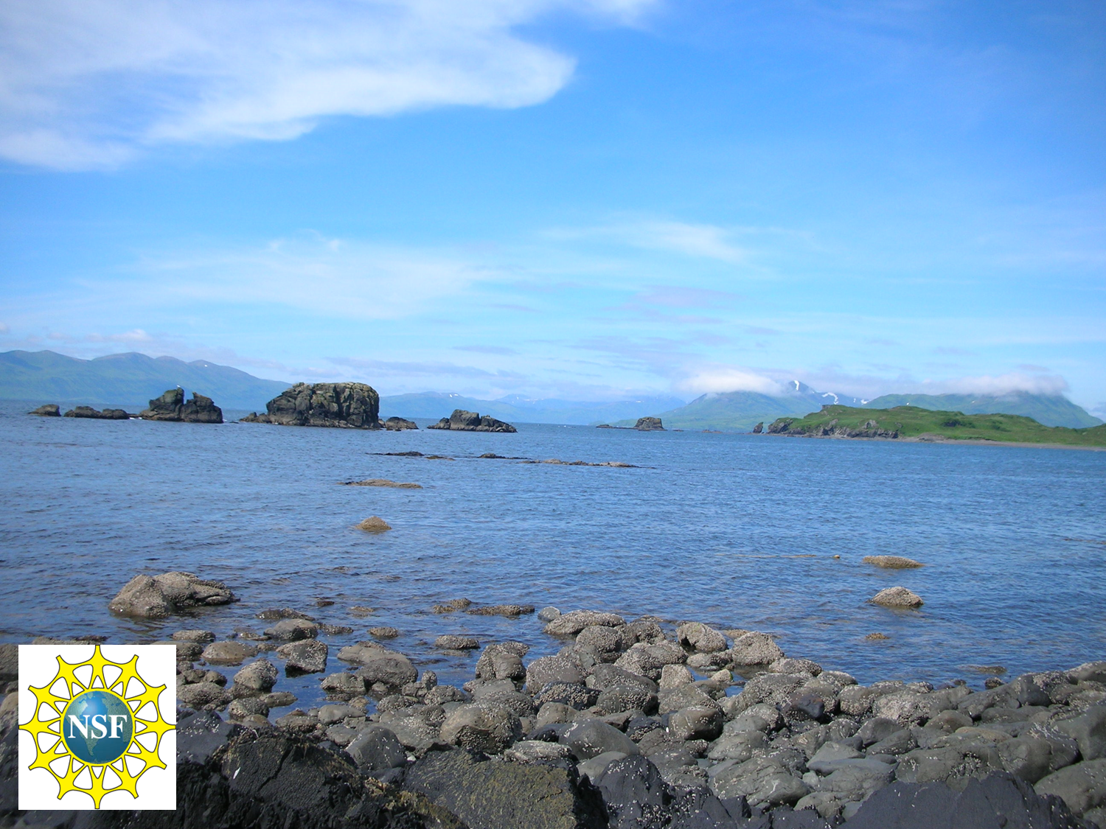
A Paleomagnetic framework for the paleogeography of North America and Cordilleran Terranes during Cretaceous time
Bernie Housen
Geology Dept
Western Washington University

Slide 2
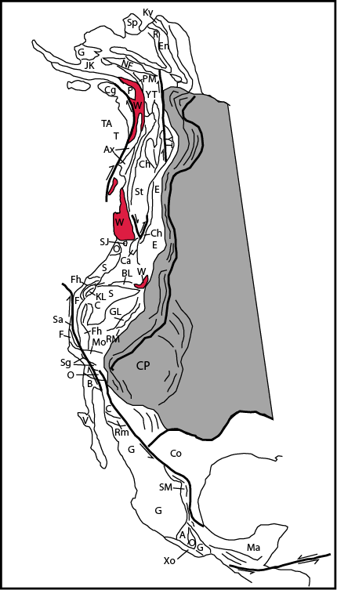
Paleogeographic models
tectonic evolution and assembly continents
produced with a variety of tools
can be tested and refined using paleomagnetism
Mesozoic North America:
excellent to good set of data for craton
long-lived Cordilleran accretionary margin
variety of proposed models for terranes

Slide 3
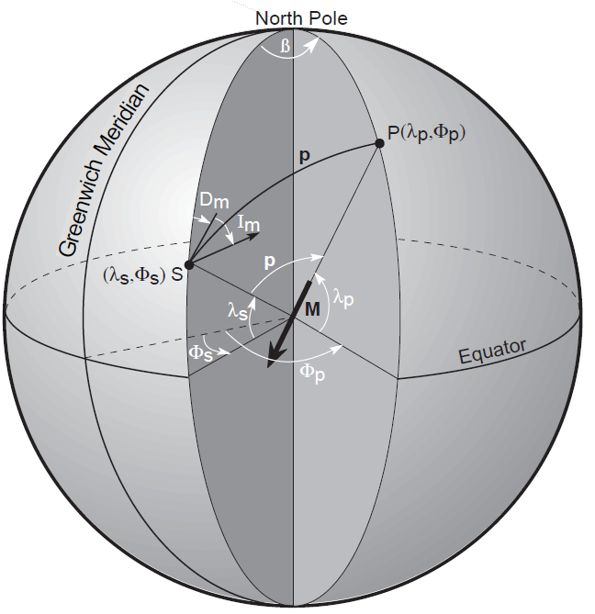
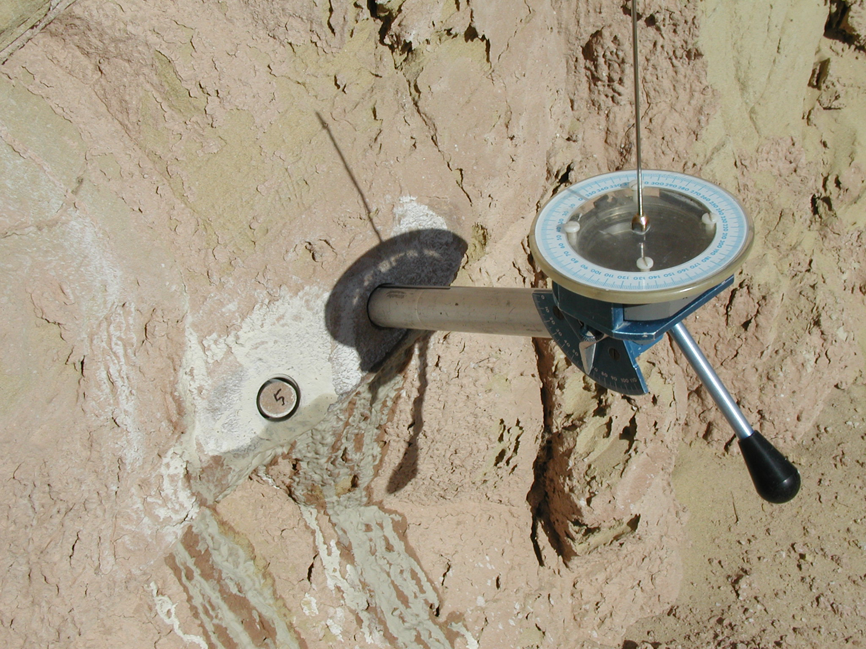
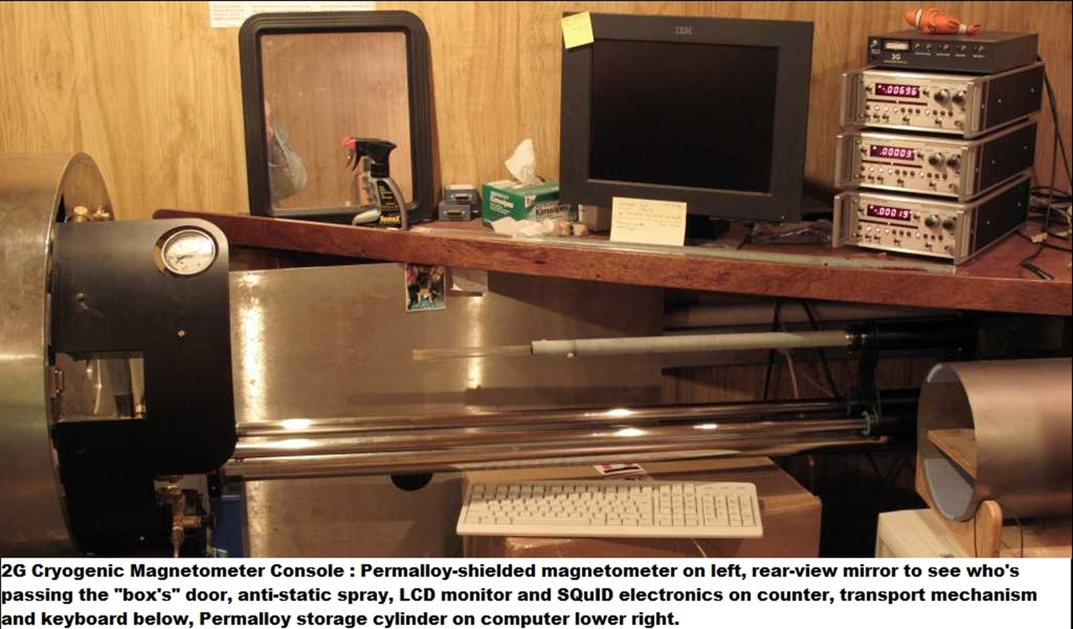
Oriented sample
magnetic
pole
Magnetization direction(s)

Slide 4
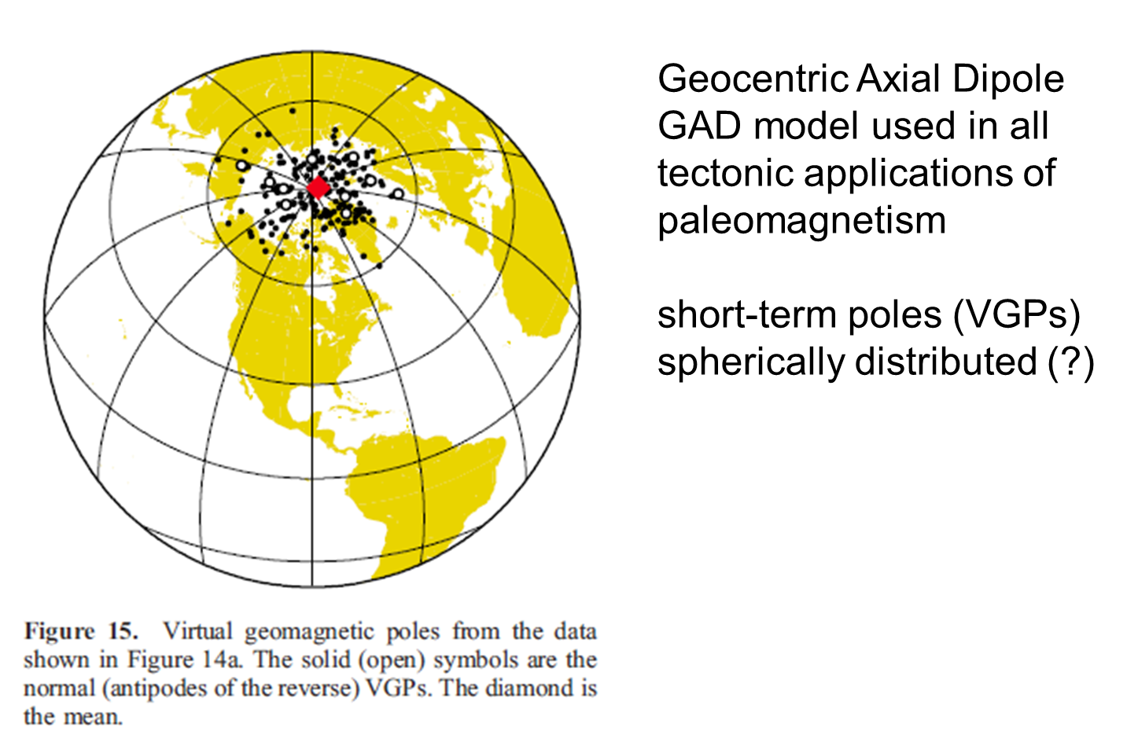
Averages of longer-term (t > 10 to 100 ka)
field variation yield simpler GAD geometry
Average pole = Earth spin axis

Slide 5
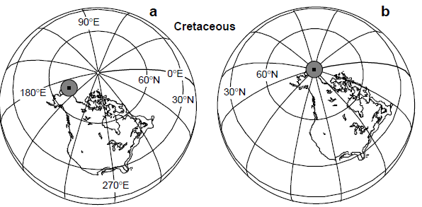
Paleogeographic
reconstruction using paleopole-
In this case, NA located ~10 degrees further north
Geocentric Axial Dipole (GAD):
averaged magnetic pole
corresponds to spin axis
Figures from Butler, 1990

Slide 6

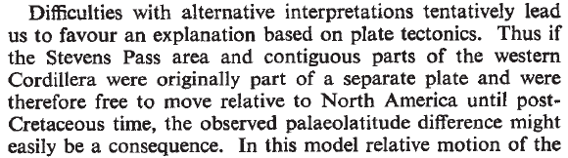

Beck and Noson 1972
There can be only one (spin axis):
Discordant paleomagnetic poles require explanation
Local structures (tilt, rotation, etc)
Evidence of differential tectonic history (separate plates)
Mismatch between paleopoles with same age from NA craton and from Mt Stuart Batholith was explained by Beck and Noson, who supposed that a portion of the Cordillera may have been on a separate plate

Slide 7
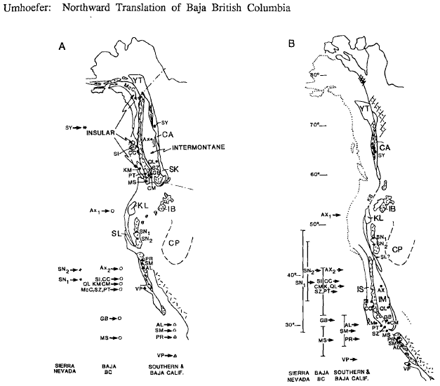
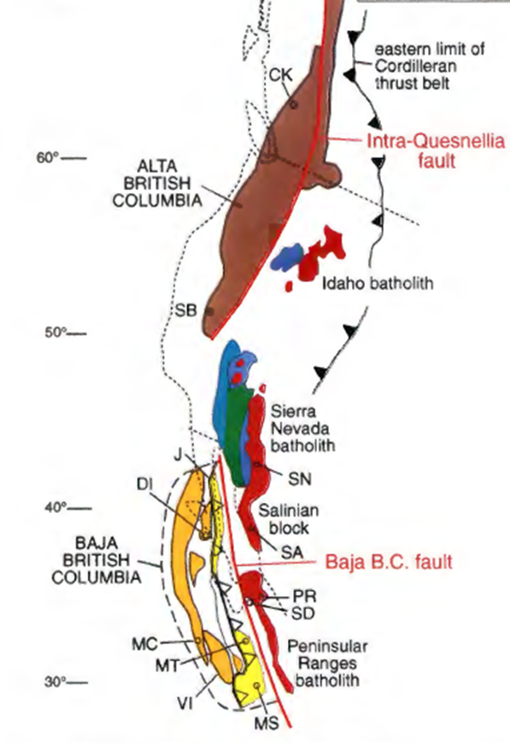
Umhoefer, 1987:
En-block Baja-BC model
Cowan et al, 1997:
Baja BC review, “Crucial tests”
Alta BC (Intermontane) and Baja BC (Insular)

Slide 8
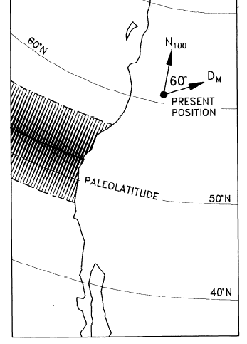
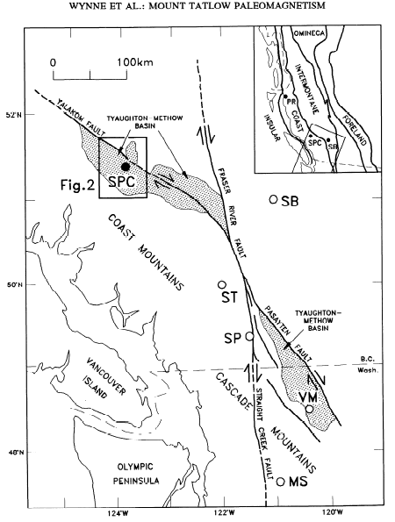
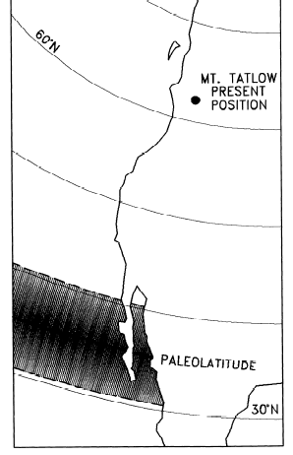
Best basis for Baja-BC and Alta-BC:
Studies of volcanic units with good paleohorizontal control
Irving et al., 1995
Spences Bridge volcanics
Wynne et al., 1995
Mt Tatlow (Silverquick/Powell Creek volcanics and sediments)
SB: 105 Ma, 53 N paleolatitude
MT: 90 Ma, 36 N paleolatitude
Differential displacement of Intermontane and Insular

Slide 9
Paleomagnetic framework
Constraints on paleogeography of NA (craton)
updated compilation using updated geochronology
group paleomagnetic results by ages of units
compare with global compilations
Synopsis of paleomagnetic data from Baja-BC and other terranes
Use NA craton compilations as reference
Consider and compare units with similar ages
select for good paleohorizontal control or consideration of inclination error
“early-mid” Cretaceous vs Late Cretaceous reconstructions

Slide 10
North America APWP examples- spanning Cretaceous time
Enkin, 2006; Kent and Irving, 2010
Kent et al., 2015
Torsvik et al, 2012
Beck and Housen, 2003, this study
Global compilation, moving window average
Global compilation, age groups weighted by quality,
Spline-fit path
North America poles, age groups averaged

Slide 11
Paleogeographic comparison: latitude of Bellingham, WA if fixed to NA, over time
Each APWP provides very similar paleolatitudes for most of Cretaceous time, especially 130 to 85 Ma.
Global paths maintain higher latitudes during latest Cretaceous, relative to domestic (NA) path
Excellent reference for NA craton- long still-stand also indicates toroidal (E-W) motion of NA predominant

Slide 12
Paleomagnetic studies unbundled
Separate different locations/rock units
Evaluate ages of rock units
Compare poles in age-defined group
North America Cretaceous poles:
New England igneous
Monteregian Hills
Arkansas Alkalics
Canadian Arctic
Niobrara Fm limestones
Newfoundland intrusives
27 locations (5-10 sites per location)
Updated geochronology
Grouped by ages: range 130 Ma to 86 Ma

Slide 13
Reanalysis of NA craton paleomagnetic studies: Cretaceous polar still-stand
Compilation of ages and polarities of paleomagnetic results from NA craton that define K still-stand
Some locations have rocks with ages that span >10 Ma, and have distributions of ages that do not match well with reported (original) averages
Separate poles into age-defined groups- still many sites from each location within group (satisfies GAD)

Slide 14
Key observations:
Clustered poles
Small variation in poles as function of time (polar still-stand)
NA motion:
lack of “path” signifies little/no latitudinal motion
Euler pole for NA motion coincides with mean paleopole
Only toroidal motion of NA

Slide 16
Latest Cretaceous (80 to 65 Ma)
Selection of poles important
Global paths similar to still-stand pole (Enkin, 2006; Somoza, 2011)
Enkin/Torsvik include AZ volcanics
Differ from MT (Adel/Elkhorn) volcanics
Hell Creek (MT) sediments:
  Shallow inclinations (as expected)- far sided poles
  Great circle from sites to pole will pass through correct late K pole for NA
  This supports use of MT volcanics as late K NA pole

Slide 17
Preferred NA APWP
No imports (tariff too high ☺)
emK: still-stand pole
lack of “wander” indicates Euler pole for NA located at spin axis
Toroidal motion only for NA from ~130 to ~85 Ma
Late K pole: Elkhorn and Adel Mtn volcanics
Paleocene pole: compilation of 7 NA studies
Eocene pole: compilation of 14 NA studies
Key points:
NA data place NA at lower latitudes in late K
relatively fast APWP (10 degrees) ~85 to ~75 Ma
imported/global data extend still-stand to 50 Ma

Slide 18
“middle” Cretaceous: 120 to 85 Ma
Baja BC (Insular, Coast Plutonic, N Cascades):
Silverquick/Powell Creek (SPC): volcanics/seds (Enkin et al, 2006)
Mt Stuart (MSB): pluton, Al-in-Hb tilt (Housen et al, 2003)
Duke Island (DI): layered mafic, (Bogue and Grommé, 2004)
Methow Valley (Met): remag. Sediments (Enkin et al, 2002)
Knight Inlet (KI): pluton, Al-in-hbl tilt (Rusmore et al, 2013)
Alta BC (Intermontane, etc):
Spences Bridge (SB): volcanics (Irving et al., 1995)
Empire Valley (EV): volcanics (Haskin et al., 2003)
Inboard terranes (Sierra Nevada, Blue Mtns):
Sierra Nevada: pluton (Hillhouse and Grommé, 2011)
Ochoco Basin: sediments, E/I and fabric corrected (Callebert in prep)
10-15 degree difference between Baja-BC (38N) /Alta BC (53N)
SNB is not translated

Slide 19
“middle” Cretaceous: 120 to 85 Ma
Baja BC:
Silverquick/Powell Creek (SPC): volcanics/seds (Enkin et al, 2006)
Observed paleolatitude: 39 N
NA pole: expected paleolatitude 62 N, translation 2500 km
Global pole: expected paleolatitude 60 N, translation 2200 km
Differences in Baja-BC translation, using different NA APWP, are not very large
Most robust Baja-BC paleolatitude provided by the SPC sections:
80 sites, over 500 samples
Volcanics and sediments (paleohorizontal, no inclination error)
Perfect fold test
All normal polarity- unit ages mainly 95-85 Ma (90 Ma)

Slide 20
Late Cretaceous (80-65 Ma)
Baja BC:
Jameson Creek (JC): volcanics/sediments, youngest SPC (Enkin et al 2006)
McColl Ridge (MR): volcaniclastics (Stamatakos et al, 2001)
Nanaimo Group (KG-KK04): sediment, fabric corrected, Kim and Kodama, 2004)
Nanaimo Group (KG-KT-06): sediment, E/I corrected, Krijgsman and Tauxe, 2006)
Alta BC:
Carmacks volcanics (CV): volcanics, Enkin et al, 2006
Chugach: (Paleocene)
Ghost Rocks, Kodiak (GR): pillow basalts, seds for horizontal (Roeske/Housen 2007 and in prep)
Using global NA APWP, Late Cretaceous latitude differences and translations are larger by ~5 degree (600 km)

Slide 21
Baja BC options:
En-block Baja BC:
Insular and Intermontane linked
1500 km S motion 105 to 90 Ma
(10 cm/yr)- using mid-range of ages for MT/Churn Creek, older end of age range for SB/Empire Valley
2500 km motion 90 to 55 Ma
(7 cm/yr)
Alta and Baja BC:
Insular and Intermontane separate
no sinistral-then-dextral required

Slide 22
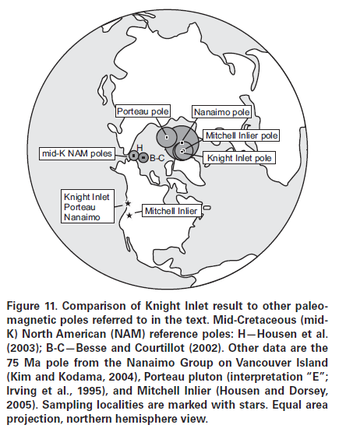
Housen, 2018
Rusmore et al 2013
Blue Mtns and Intermontane may share similarities in displacement relative to NA

Slide 23
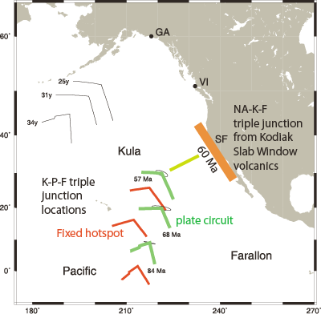
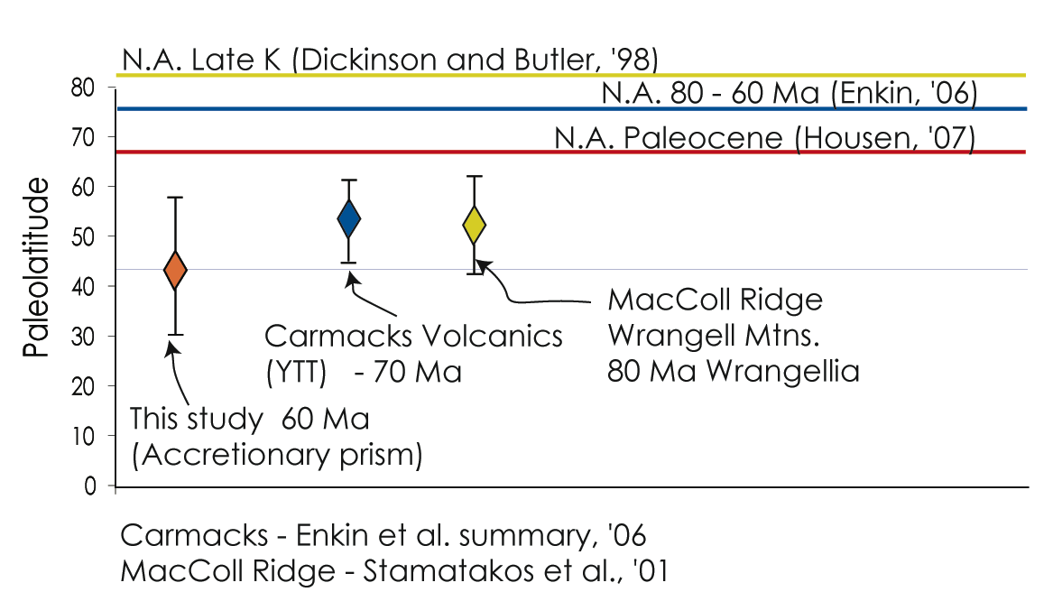
Late K to Paleocene units:
MacColl Ridge (80 Ma volcanics): Wrangellia (Stamatakos et al 2001)
Carmacks volcanics (70 Ma): Yukon-Tanana: Enkin et al., 2006
Ghost Rocks (60 Ma volcanics): Chugach: Housen/Roeske 2007 and in prep
Dubrovine and Tarduno 2008
Moving hot-spot reconciled with K-F-P plate models
Ghost Rocks r-t-r triple junction (slab window volcanics)

Slide 24
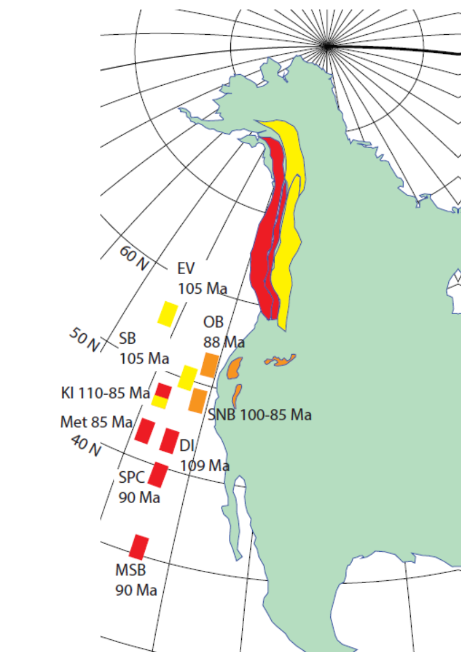
110 to 85 Ma
80 to 65 Ma
Summary:
Paleomagnetic data for Cretaceous NA robust, well defined reference, minimal latitudinal motion for 130 to 85 Ma
Need earliest K (145 to 130 Ma) data
Need better age control of paleomagnetically investigated rocks
Baja-BC models supported by robust data from volcanics, and I-corrected sediments, tilt-constrained plutons
Separate Insular/Intermontane preferred, but large-block Baja BC clearly permissible
Latest K displacements of YTT, Chugach, Wrangellia are also significant- margin parallel motion needs to be considered
(Hayward, 2019)
late K paleolatitude of terranes and NA are fruitful targets for further work

