Slide 1


Thermo-kinematic modeling of detachment faulting: Funeral Mountains, CA
2019 GSA Cordilleran Section Meeting
Portland, OR
Lutz, Brandon¹; Axen, Gary¹, and Ketcham, Richard²
¹New Mexico Institute of Mining and Technology, Socorro, NM
²Jackson School of Geosciences, Univ. of Texas, Austin, TX
Integrated Earth Systems
Notes:
Thanks, Thanks

Slide 2
Thermo-kinematic modeling of detachment faulting: Funeral Mountains, CA
Thanks to supporters…
NSF: Integrated Earth Systems
NMT Graduate Student Association
Professors:
Gary Axen, Jolante Van Wijk, Fred Phillips, Rich Ketcham
Thermochron data:
Michael Wells, Mangesha Beyenne
Petroleum Experts: MOVE software
2019 GSA Cordilleran Section Meeting
Portland, OR
Lutz, Brandon¹; Axen, Gary¹, and Ketcham, Richard²
¹New Mexico Institute of Mining and Technology, Socorro, NM
²Jackson School of Geosciences, Univ. of Texas, Austin, TX
Integrated Earth Systems
Notes:
More thanks

Slide 3
  Overview
Problem:
-Detachment fault mechanics
-What happens at depth?
Geologic Reconstructions
fault geometry
thermal state
velocity vectors
FWD model closure ages
Thermal model: Fetkin
mechanical analysis
rheology

Slide 4
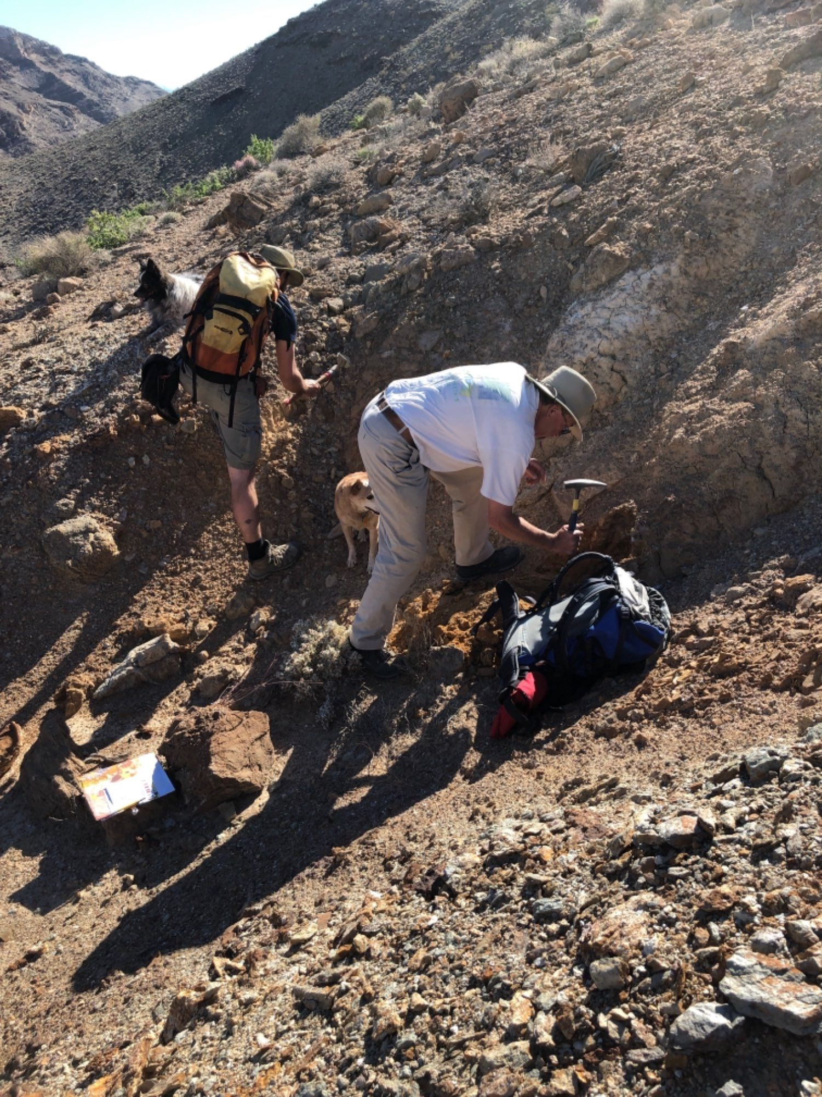
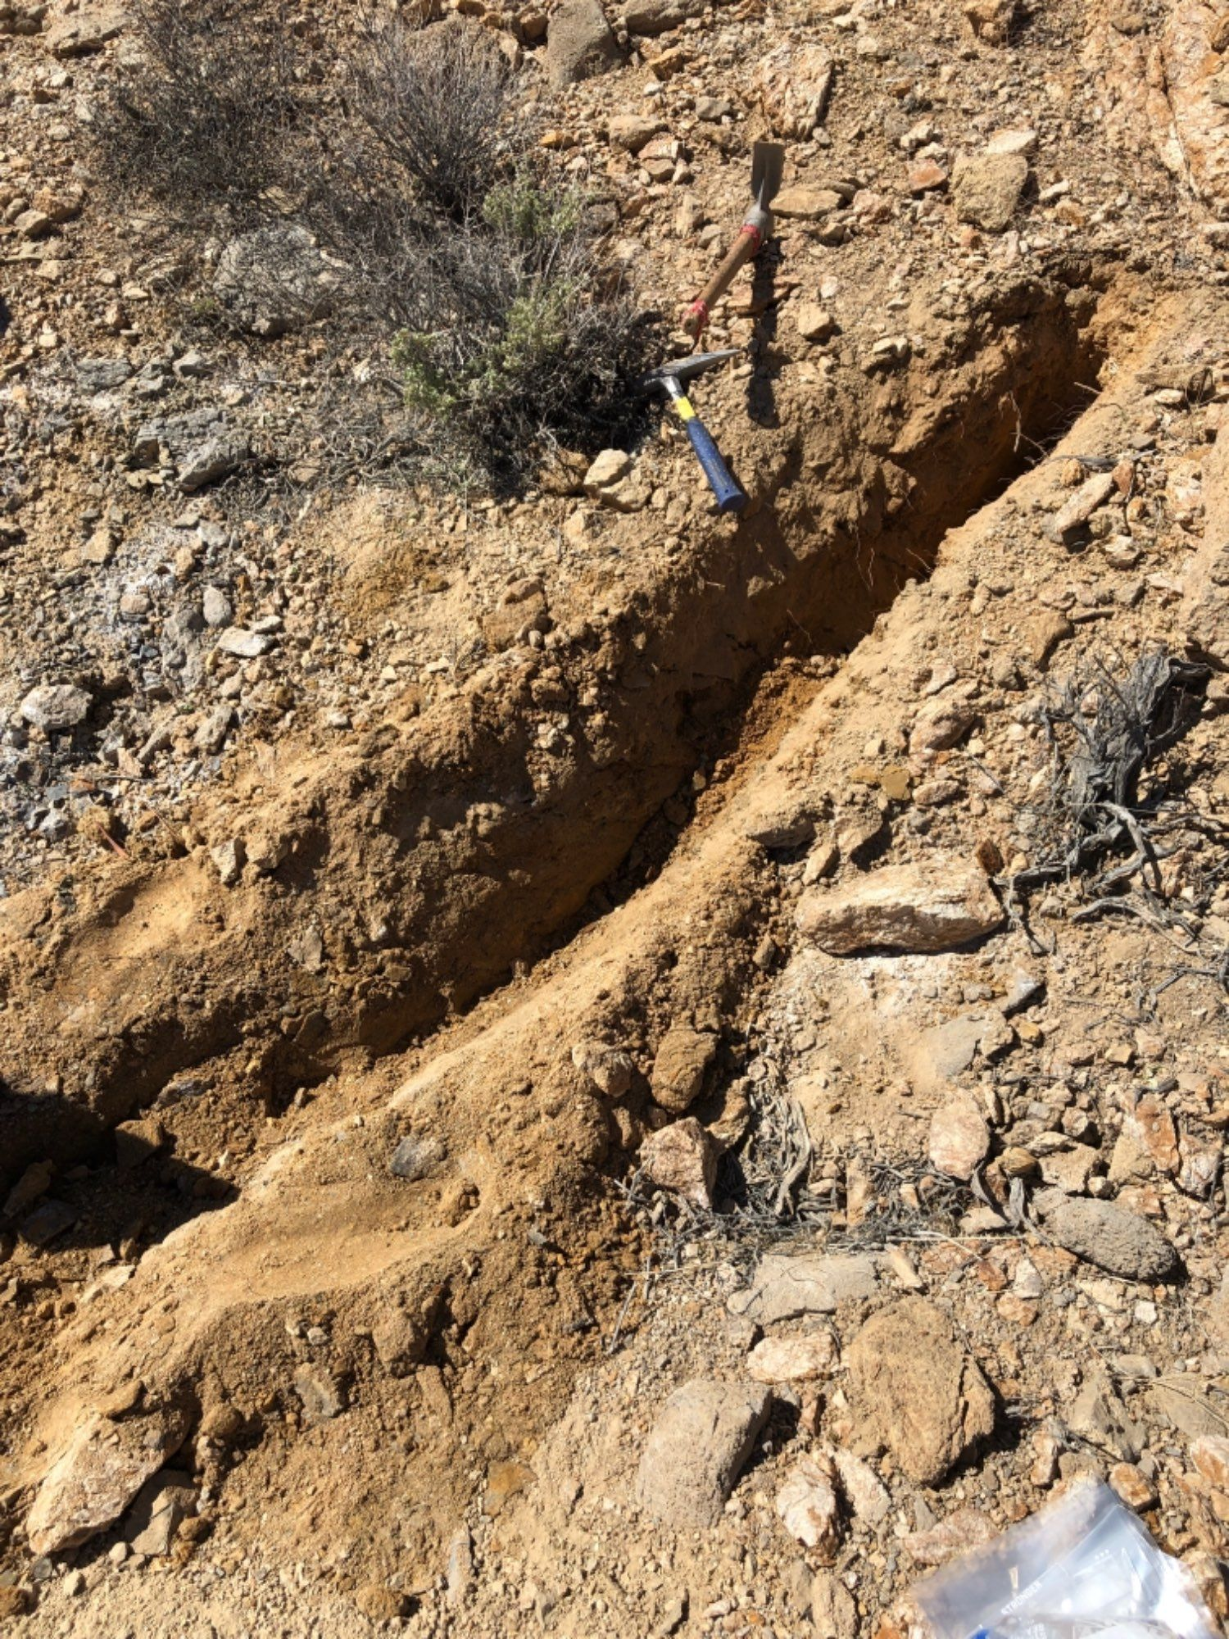
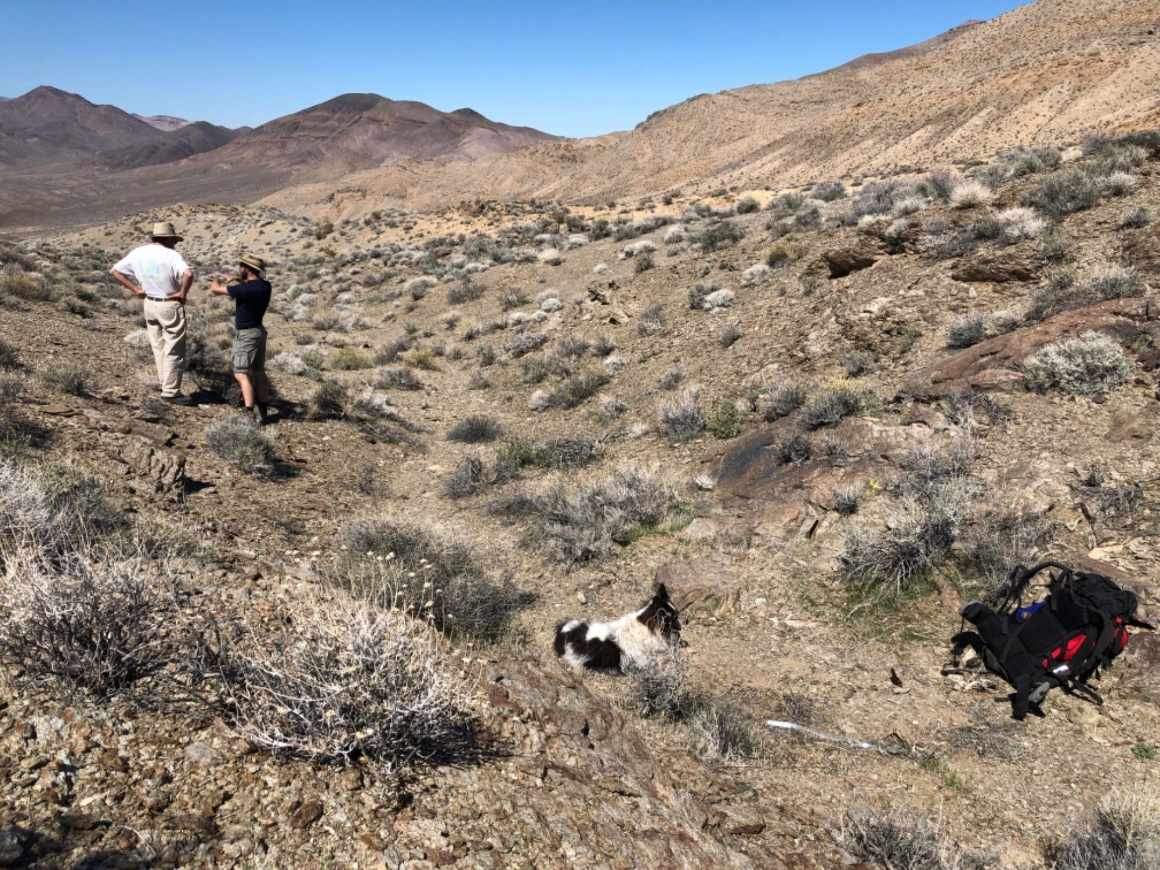
  2019 fieldwork
Notes:
Relate to mechanical model at the end.

Slide 5
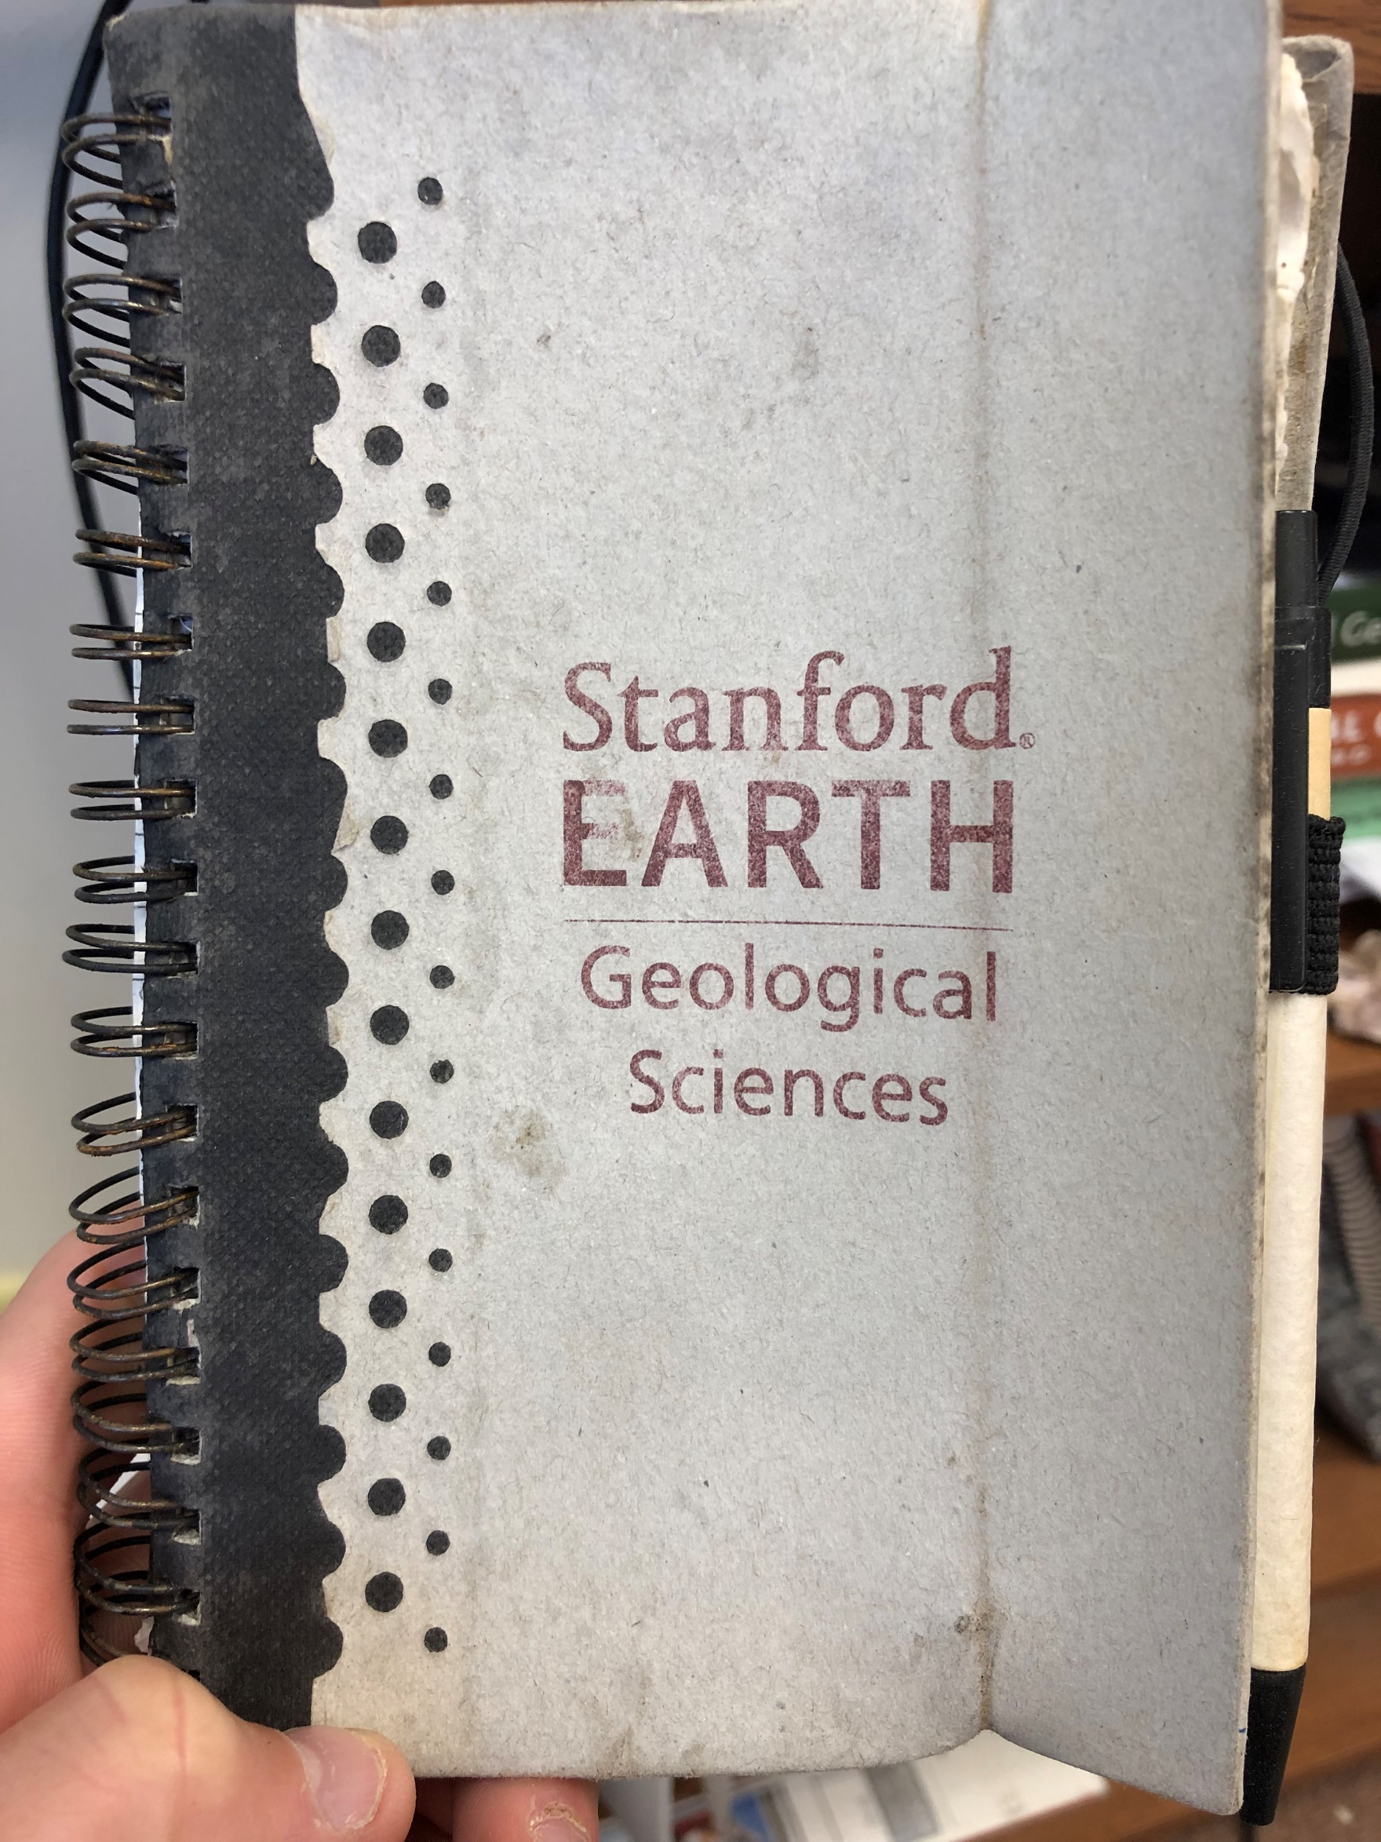
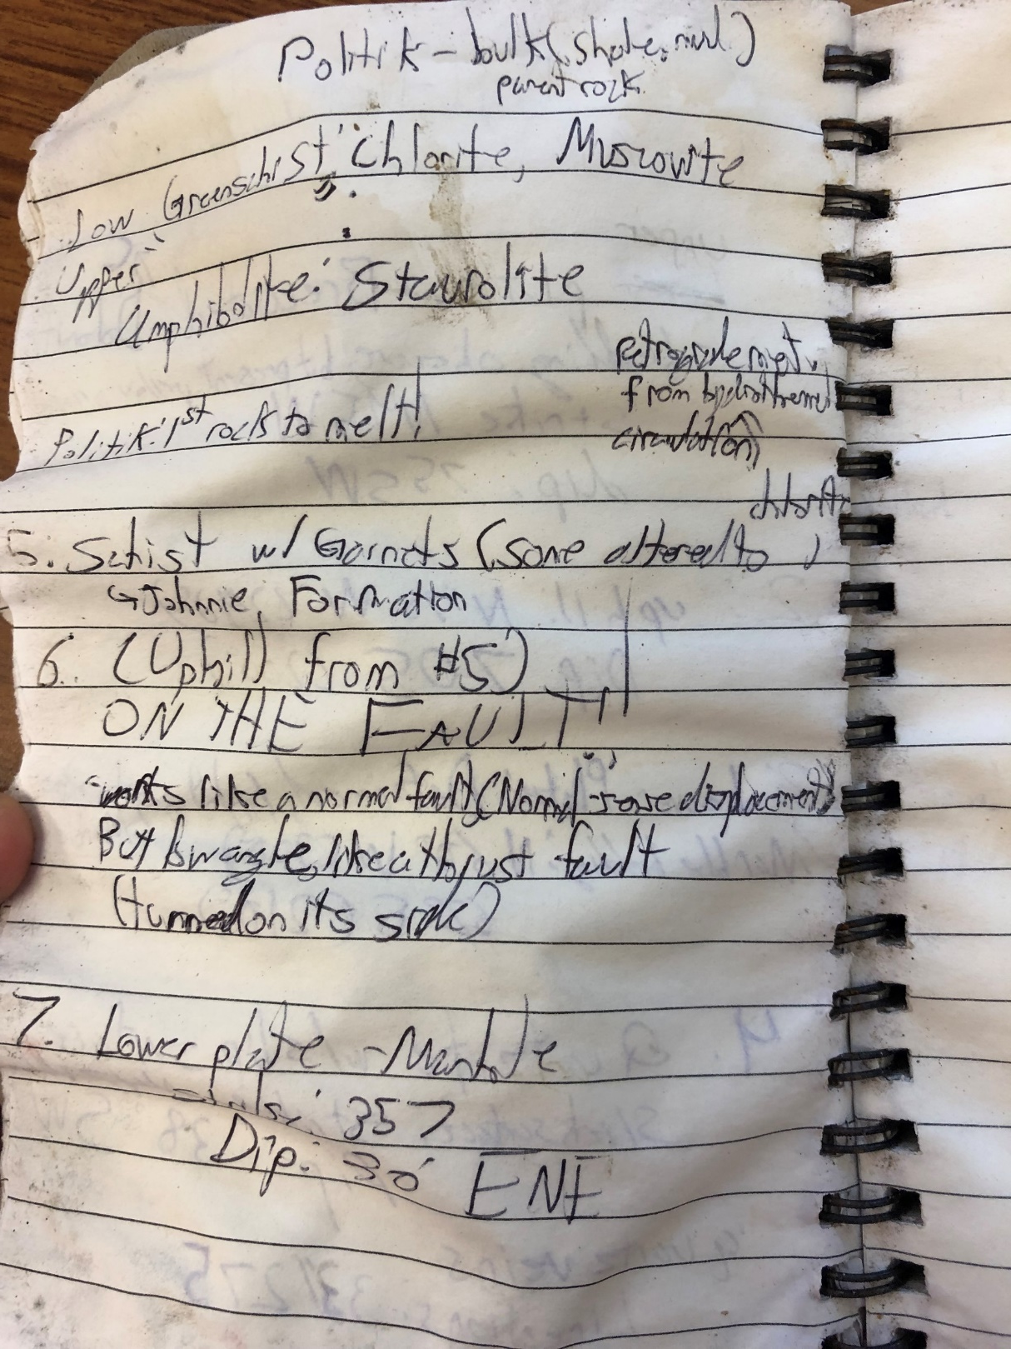

Slide 6
  Why are detachment faults important?
NSF SGT research “grand challenges”
  Variations in rheology throughout the lithosphere
  Fault zone behavior from Earth’s surface to the base of the lithosphere

Slide 7

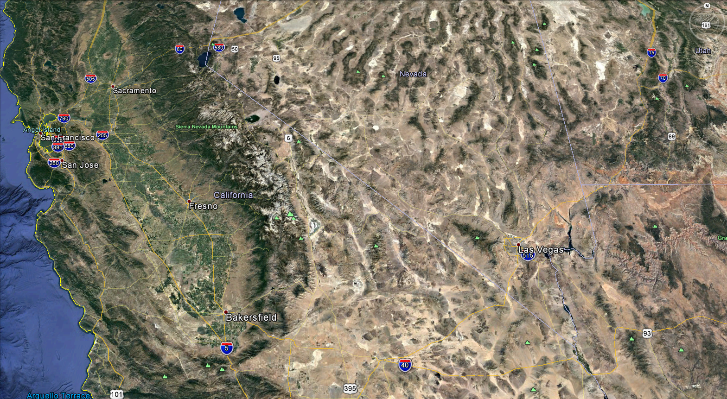
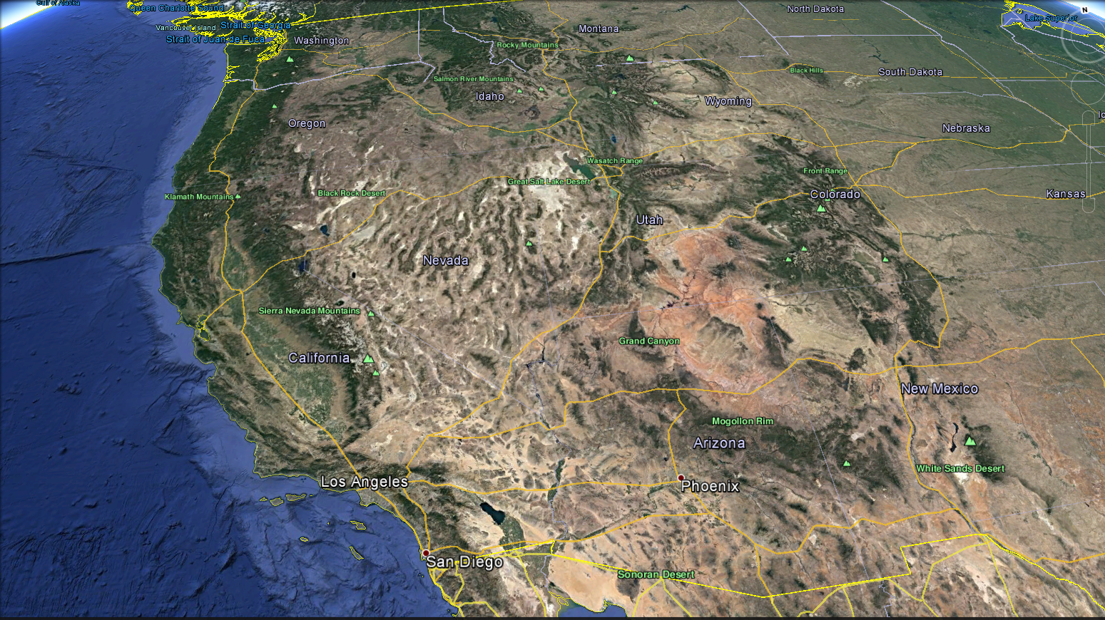

Grapevine Mountains
Funeral Mountains
Google Earth west-North America
Death Valley

Slide 8
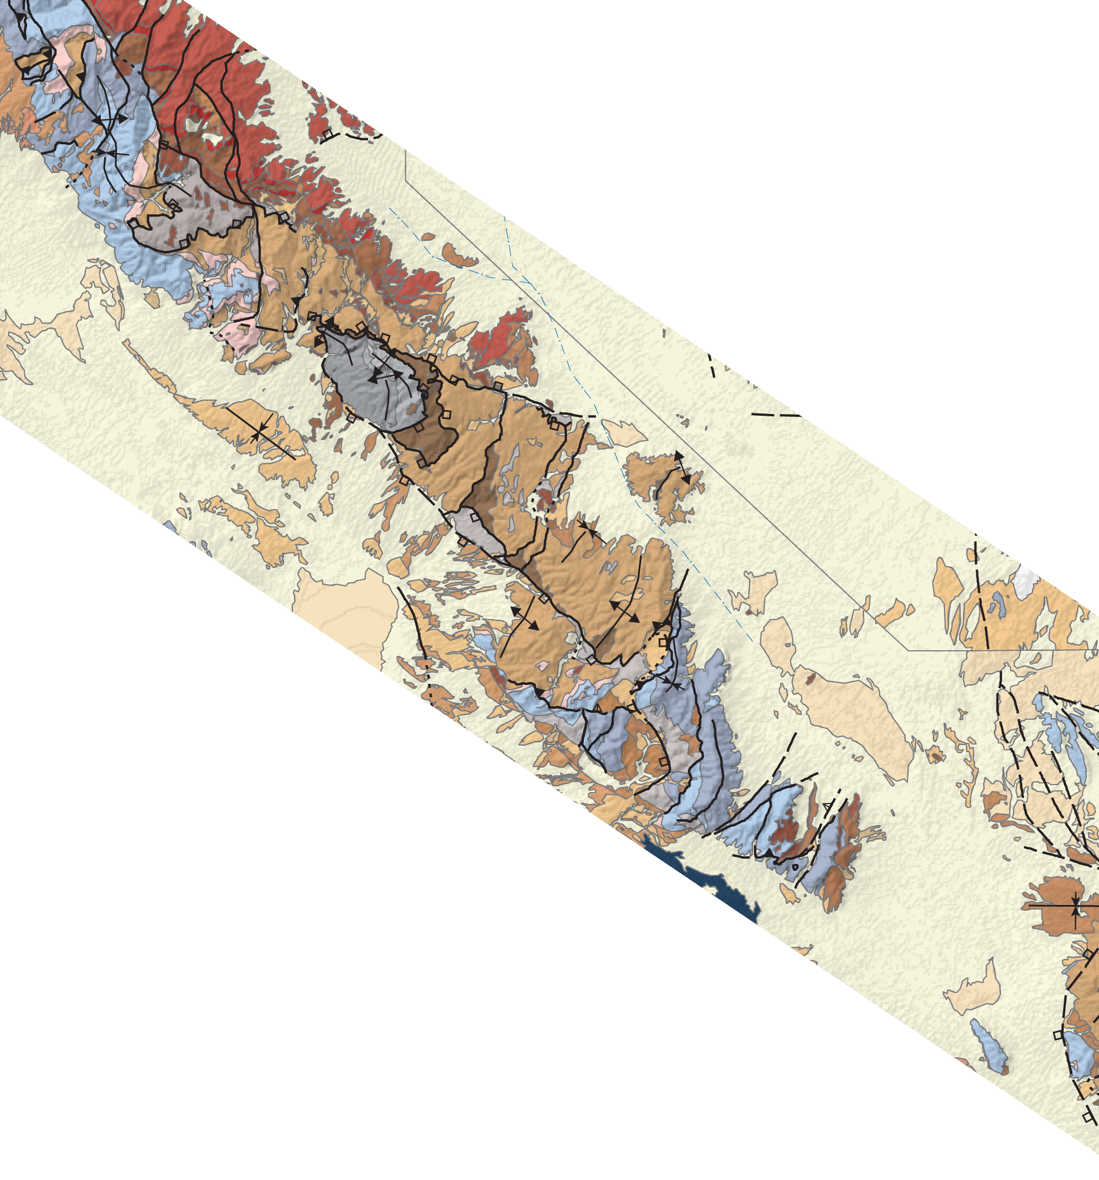
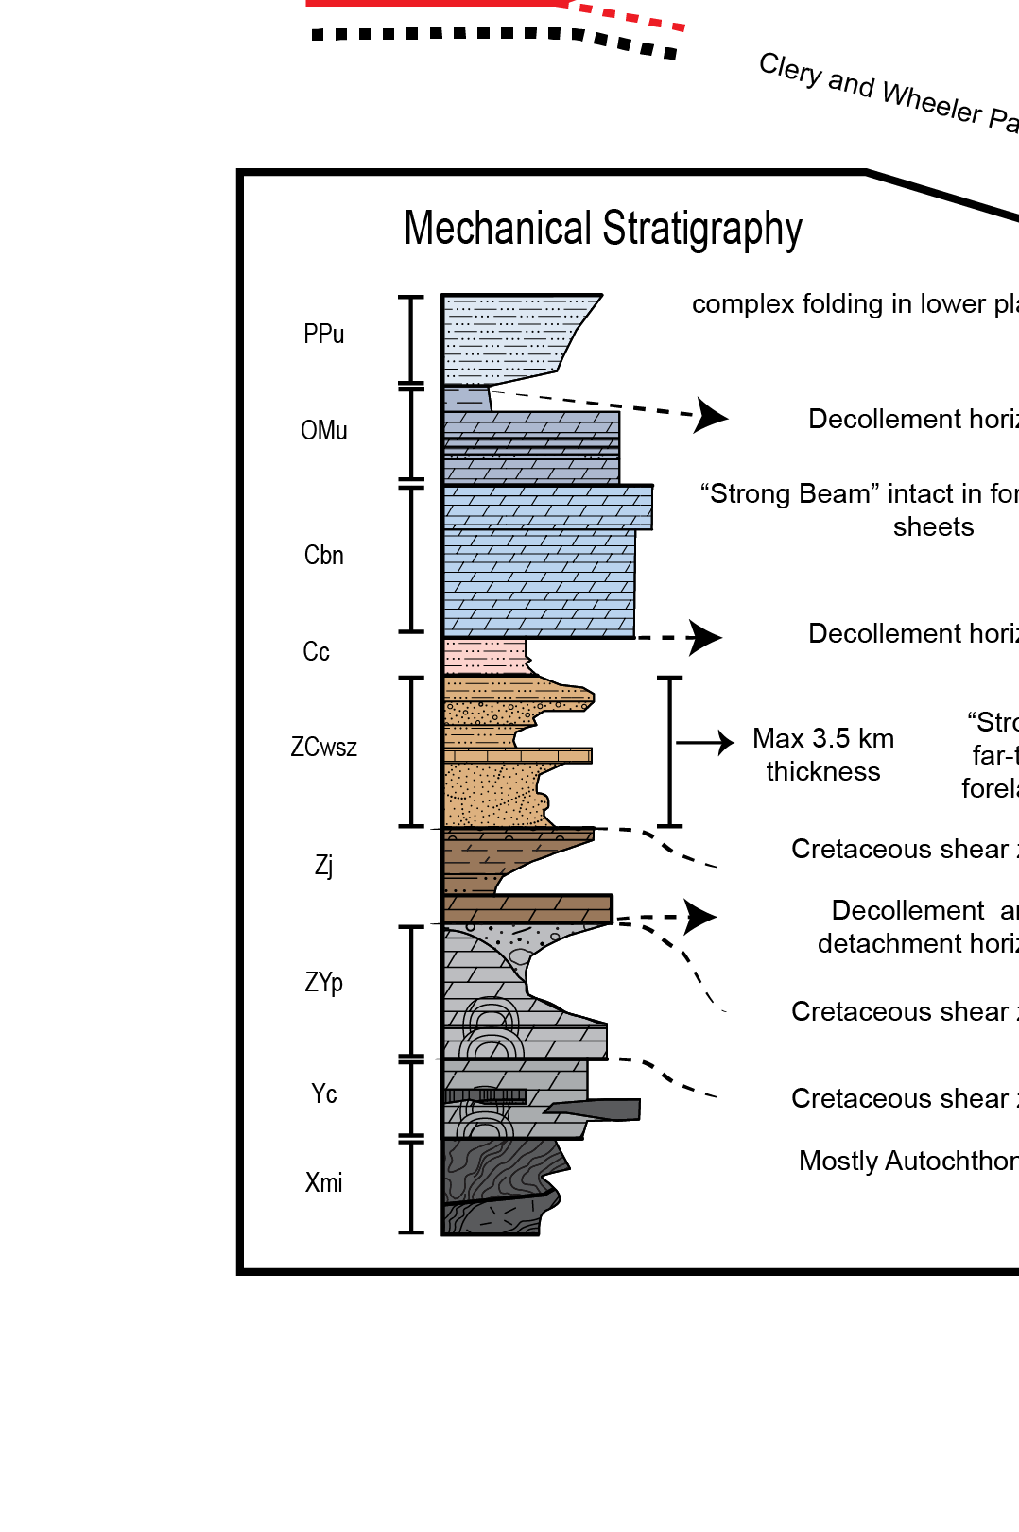
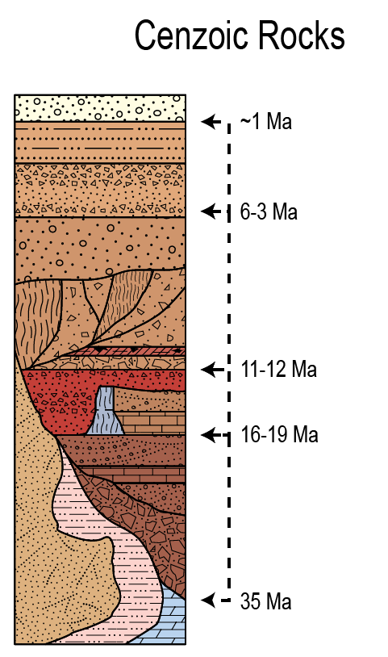
Geology of model transect
Grapevine M
Upper Plate
Funeral M
Lower plate
N
Paleozoic
5000-7000 m
2000-3000 m
Proterozoic
~35 km
Wright and Troxel, 1993
Niemi, 2012
Fridrich et al., 2012
Notes:
Late K history of deepest rocks

Slide 9
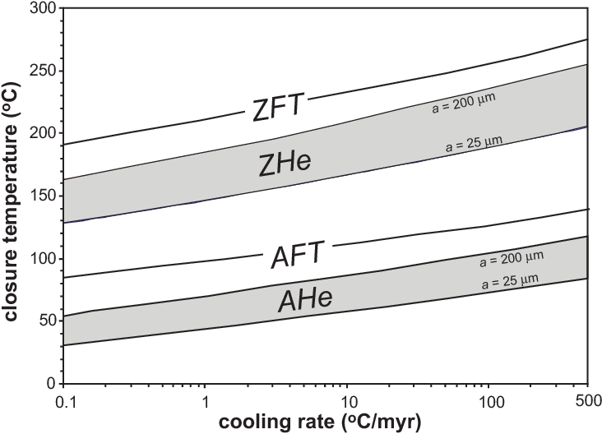
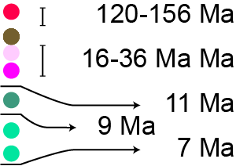
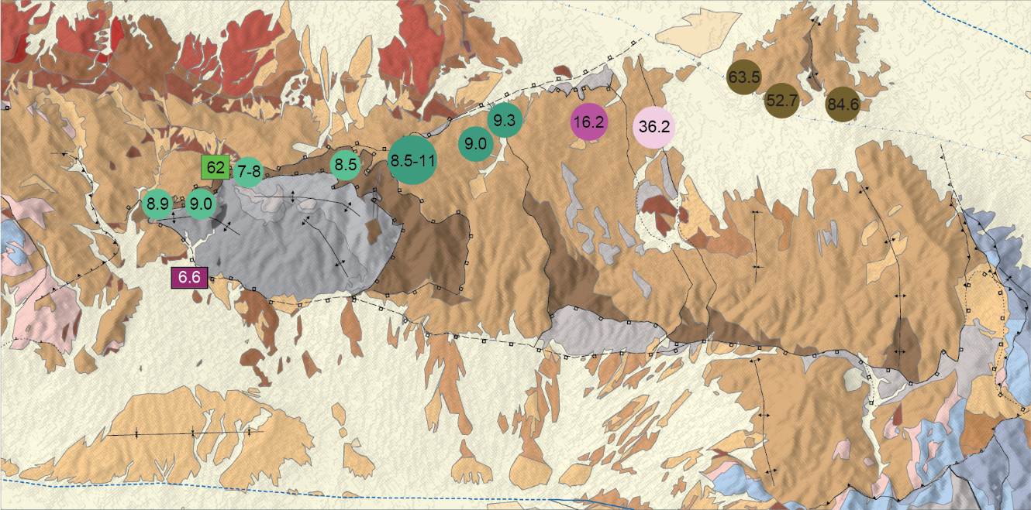
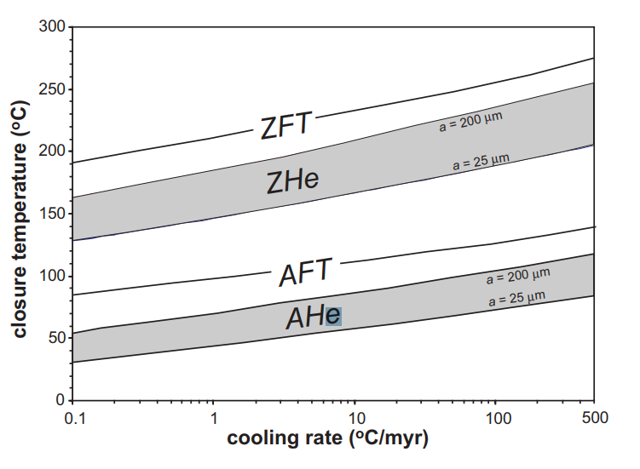
Zircon He ages
Footwall thermal history
Cooling rates 25-50°C/my
N
Upper Plate
Lower plate
Reiners, 2005
Wells et al., in prep
Beyenne, 2011
Notes:
Z-He in a big box in the legend

Slide 10
35-40 km of net heave on the BCD
11-6 Ma (Wells et al., in prep)
Grapevine M
Funeral M
Snow and Wernicke, 2000 (~35-40 km)
Wells (min 28 km)
Hoisch et. al 1993 (40 km)
Applegate et al.,1995 (35 km)
N
Paleozoic
5000-7000 m
~35 km
Proterozoic
Wright and Troxel, 1993
Niemi, 2012
Fridrich et al., 2012

Slide 11
Model setup
Grapevine M
Funeral M
N
Paleozoic
5000-7000 m
Proterozoic
Resting Spring R

Slide 12
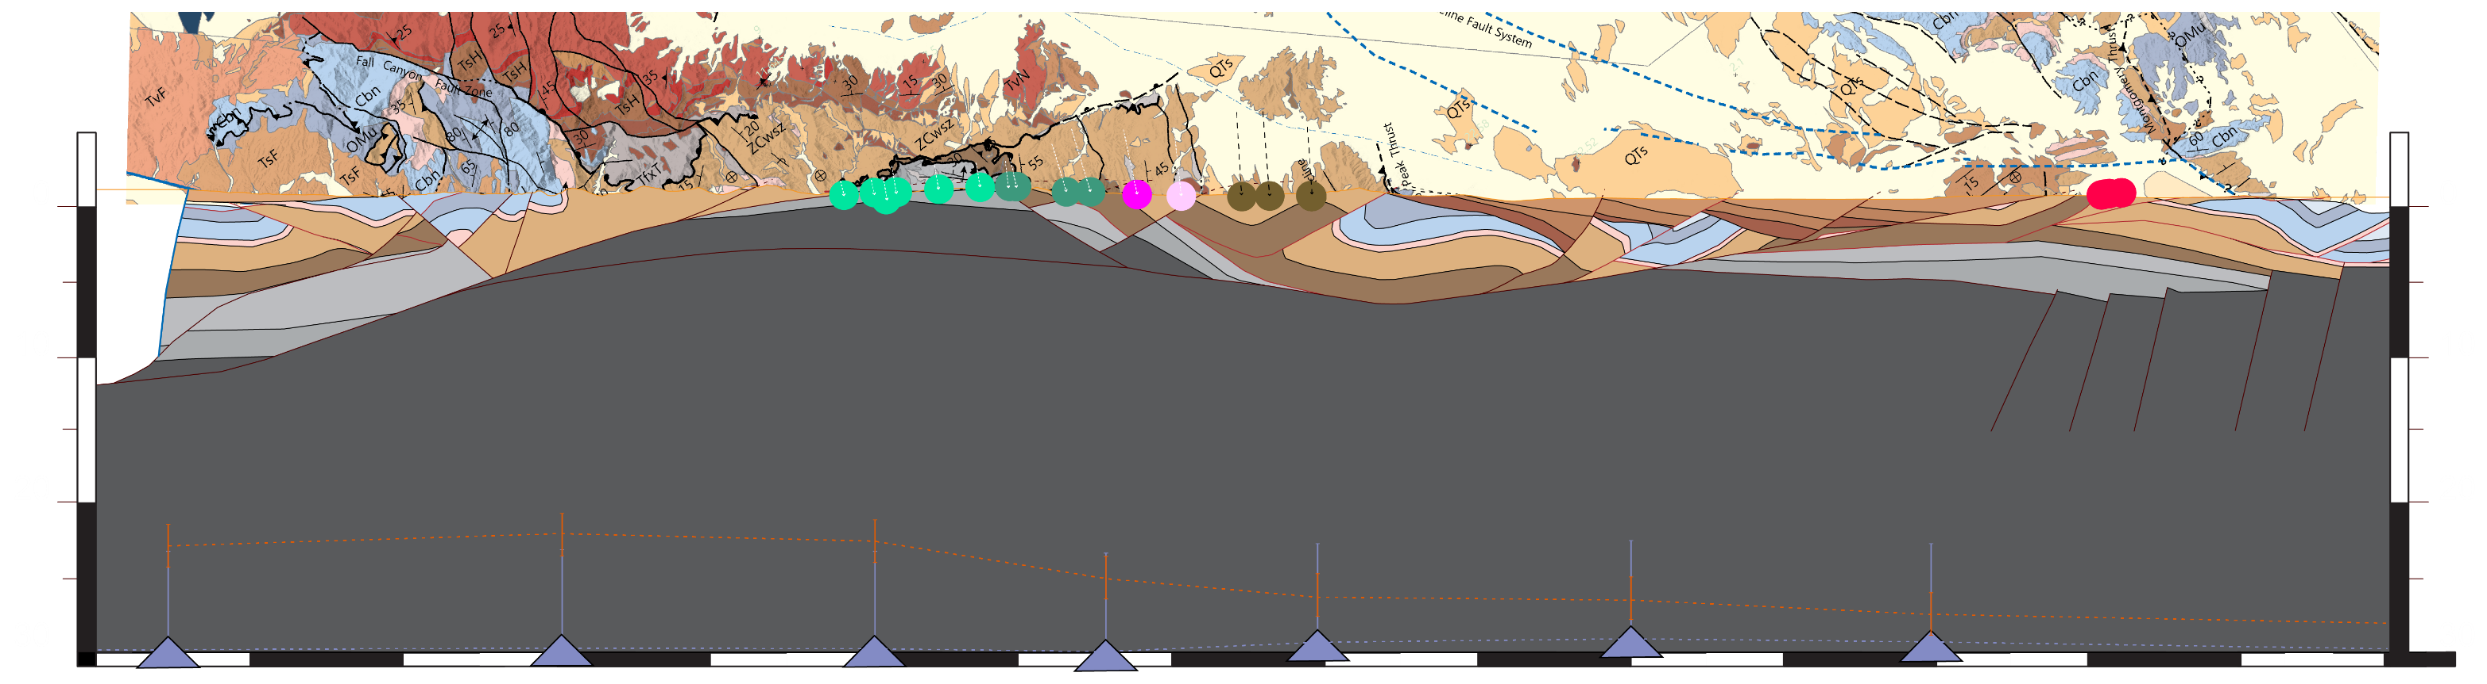
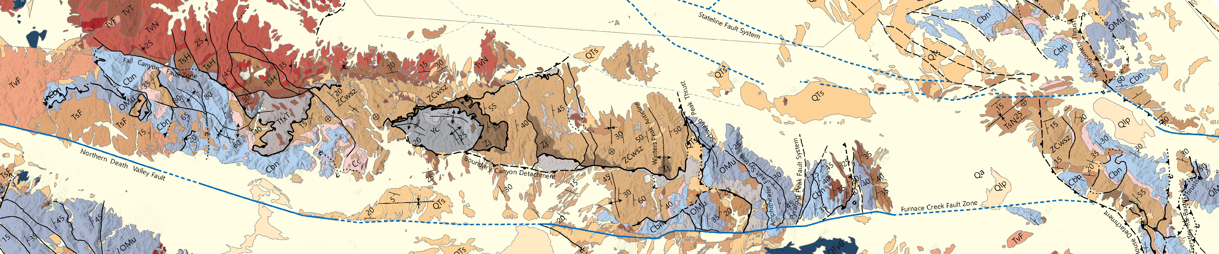
N
Model setup
Grapevine M
Funeral M
Resting Spring R
Grapevine M
Funeral M

Slide 13
N
Model setup
Resting Spring R
Grapevine M
Resting Spring R
Grapevine M
Funeral M
Funeral M

Slide 14
N
Model setup
Grapevine M
Funeral M
Resting Spring R
a
35-40 km NW-transport
50 km
100 km
Notes:
Scale—
Really two detachments; but focused on BCD

Slide 15
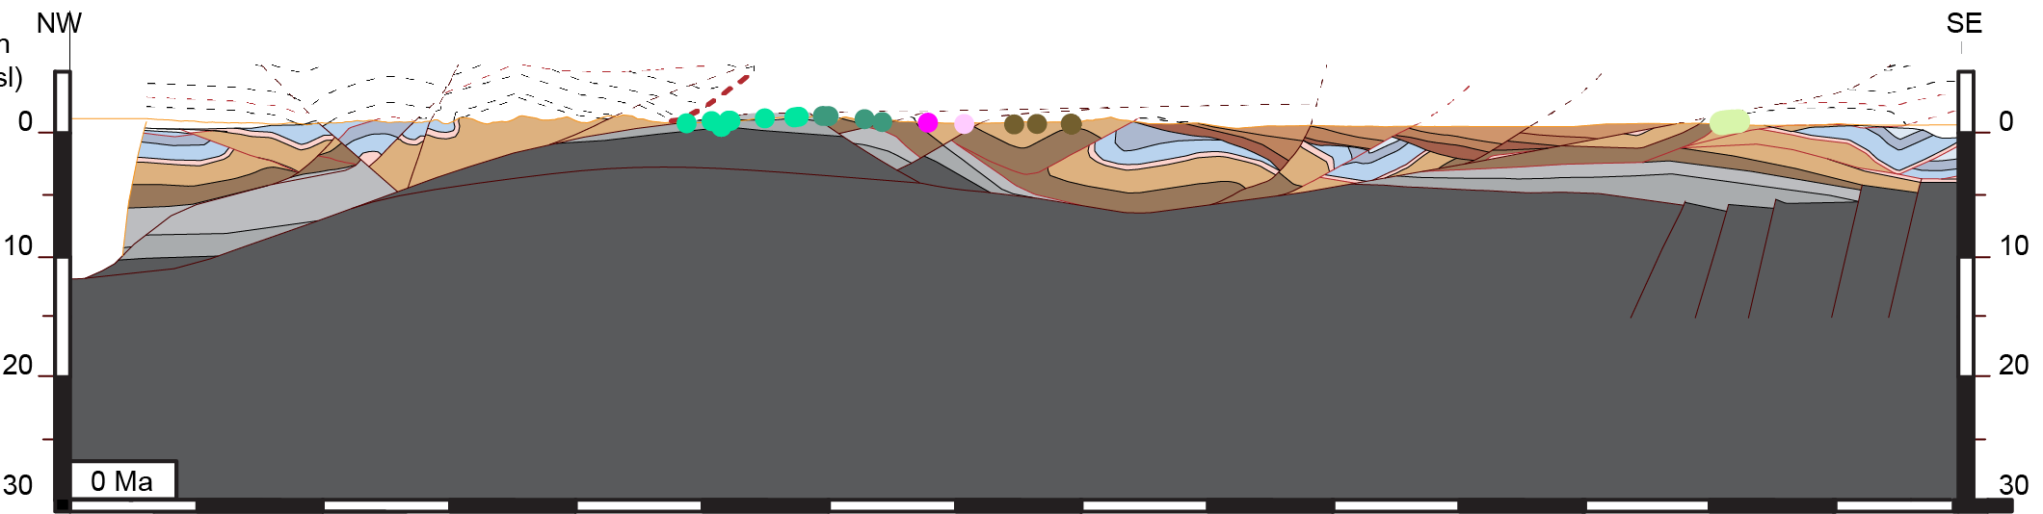
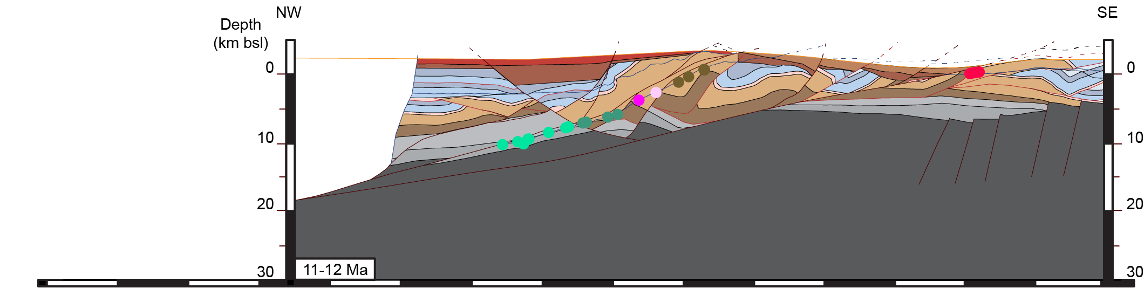
N
Balanced cross section reconstructions
Grapevine M
Funeral M
Amargosa V
Resting Spring R
Break up 35 km heave
11-6 Ma ; 7 km/my
Track thermochronometers through reconstruction
0 Ma
~50 km total 11-6 Ma extension
35 km on the BCD
11-12 Ma

Slide 16
N
Balanced cross section reconstructions
Grapevine M
Funeral M
Resting Spring R
11-12 Ma
Paleozoic
Proterozoic

Slide 17
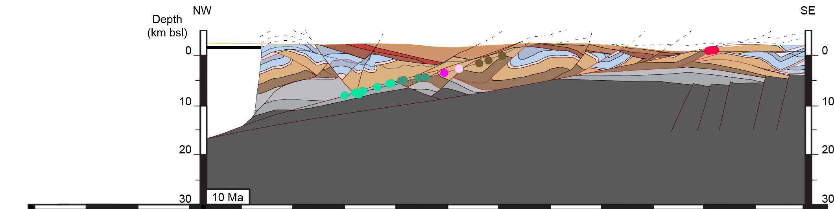
N
Balanced cross section reconstructions
Grapevine M
Funeral M
Resting Spring R
10 Ma
Paleozoic
Proterozoic

Slide 18
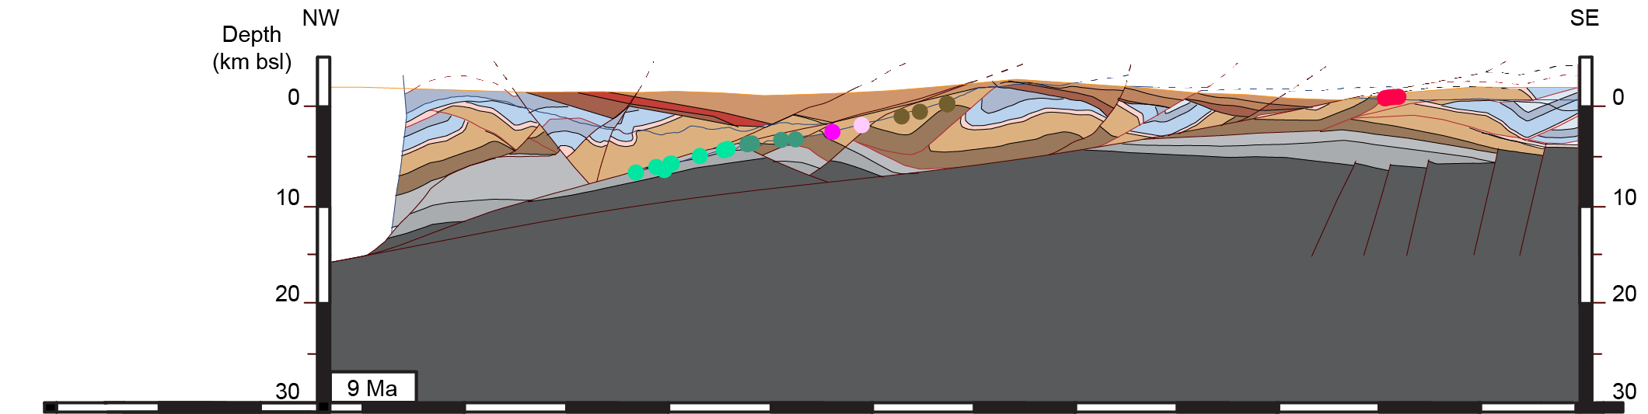
N
Balanced cross section reconstructions
Grapevine M
Funeral M
Resting Spring R
9 Ma
Paleozoic
Proterozoic

Slide 19
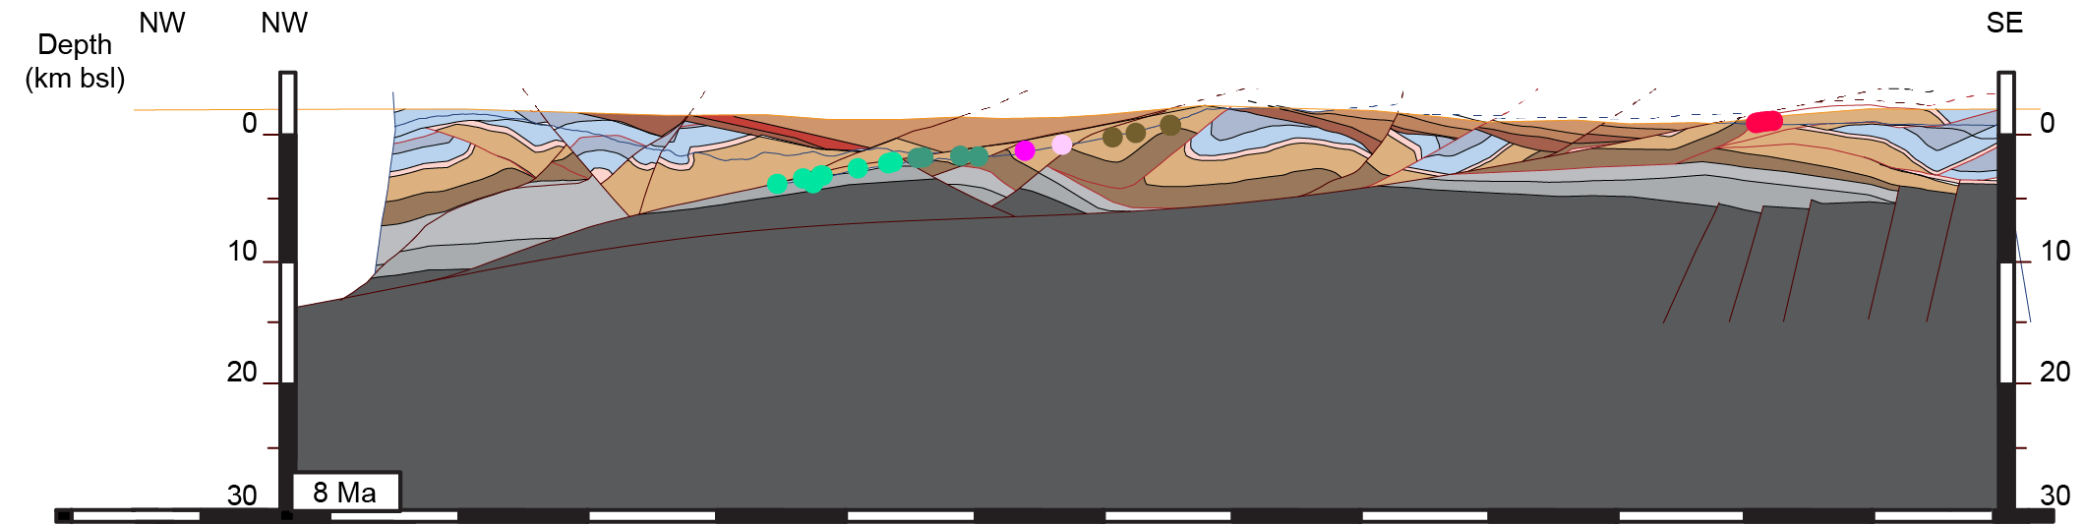
N
Balanced cross section reconstructions
Grapevine M
Funeral M
Resting Spring R
8 Ma
Paleozoic
Proterozoic

Slide 20
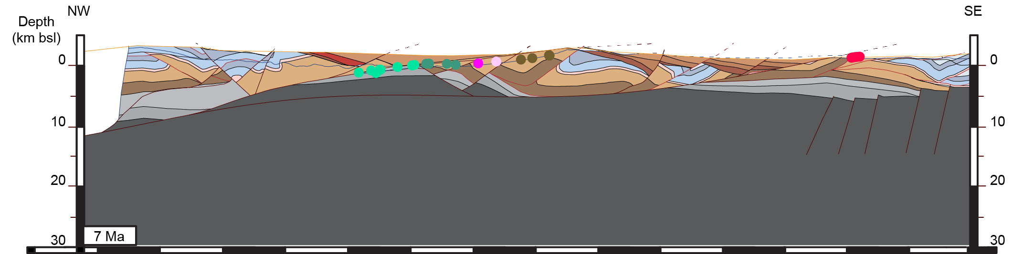
N
Balanced cross section reconstructions
Grapevine M
Funeral M
Resting Spring R
7 Ma
Paleozoic
Proterozoic

Slide 21
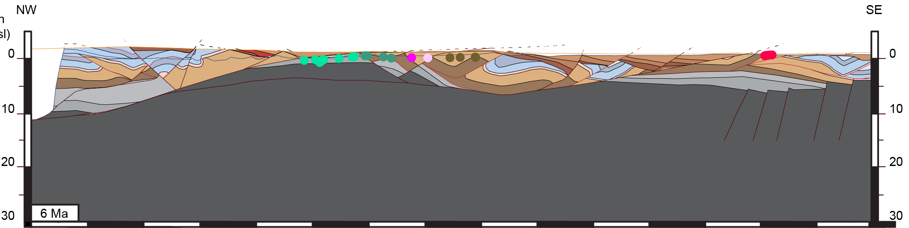
N
Balanced cross section reconstructions
Grapevine M
Funeral M
Resting Spring R
6 Ma
Paleozoic
Proterozoic

Slide 22
N
Balanced cross section reconstructions
Grapevine M
Funeral M
Resting Spring R
0 Ma
Velocity field from particle tracking
Horizon lines, faults, and points are tracked
Paleozoic
Proterozoic

Slide 23
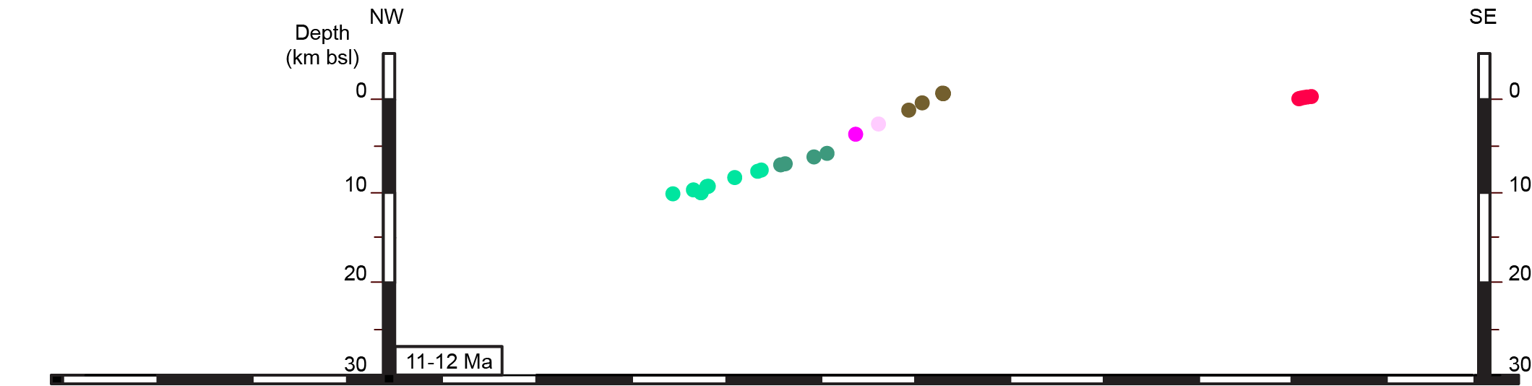
  2D thermal model setup
200 km
Topography line
Velocity
40 km
10 km
Preferred thermal model
(1x1 km elements):
27°C/km basal thermal gradient
Homogenous material properties
  Density = 2500 kgm⁻³
  k(xy) = 2.5 Wm⁻¹K⁻¹
  Heat c. = 1000 kg⁻¹K⁻¹
No heat generation
10 km

Slide 24
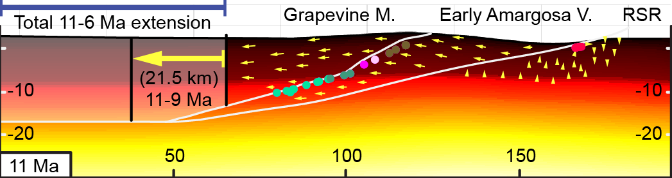
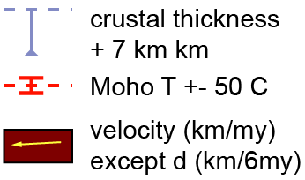
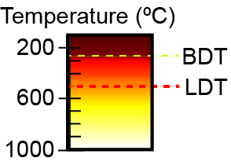
  2D thermo-kinematic models
11 Ma Z He age

Slide 25
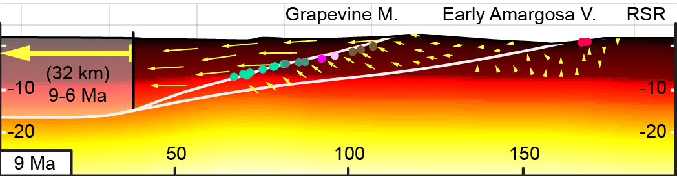
  2D thermo-kinematic models
7-9 Ma Z He ages

Slide 26
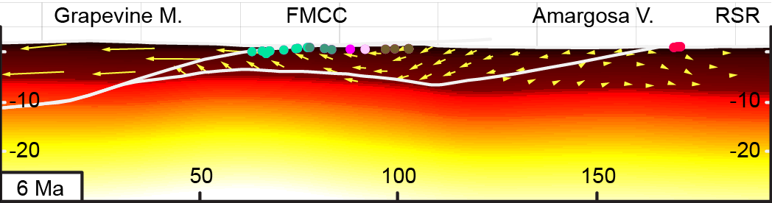
  2D thermo-kinematic models
All samples closed

Slide 27
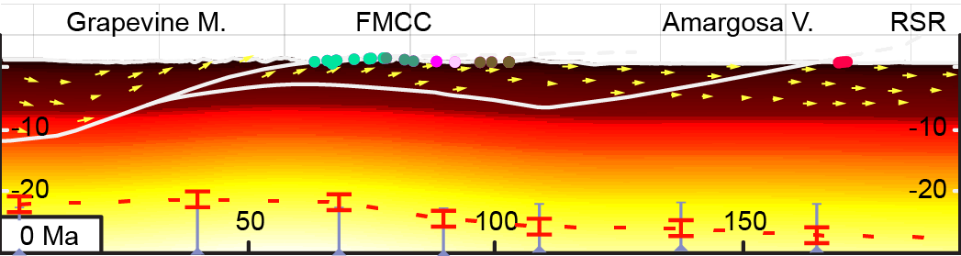
  2D thermo-kinematic models
Final FWD-thermal model
Moho depths
  Moho T from Schutt et al., 2018
Notes:
Explain the Moho and comparisons with Schutt better.
A little hot.
strong? weak?

Slide 28
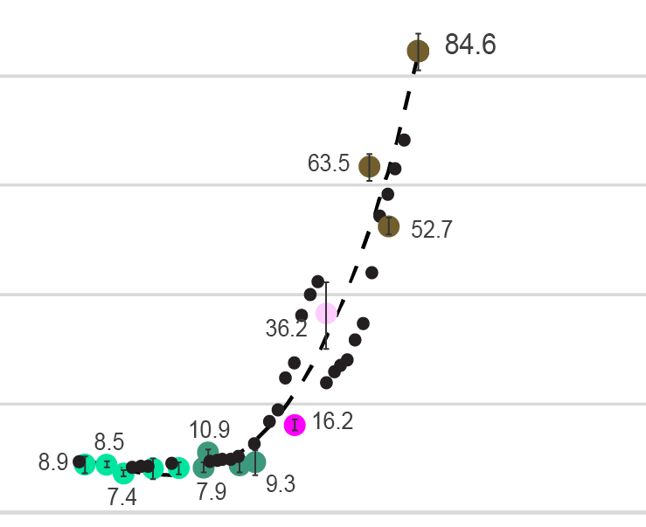
  FWD model vs actual closure ages
20°C/km
Model ages and best fit curve
30°C/km
60 Ma
Closure
Age
40 Ma
20 Ma
Zircon He ages from Wells et al., in prep
0 Ma
Grapevine M
Notes:
Want to understand mechanics of detachment faults
happens?
strong? weak?

Slide 29
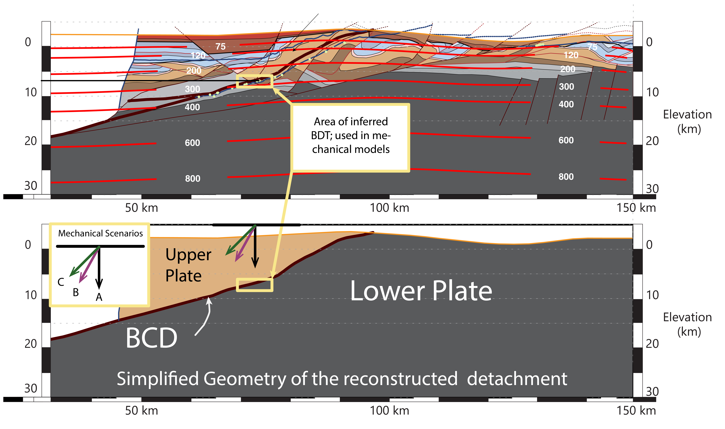
  Mechanical Analysis

Slide 30
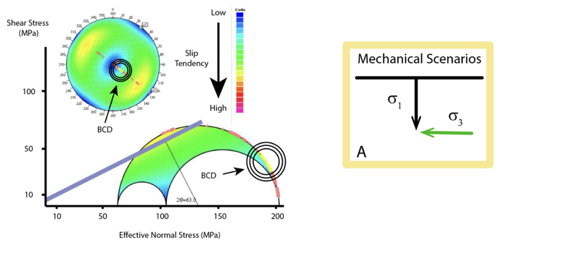
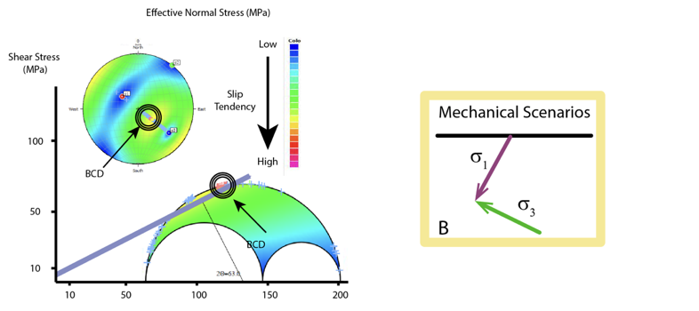
  Mechanical Analysis
Rotation of S1 enables brittle failure on reconstructed BCD
Buoyancy Force
Flowing lower crust
Notes:
presenting two mechanical scenarios here. and associated Mohr Diagrams.
Colors are “slip tendency”, ratio:
stress state on given fault plotted on MOhr circle
A:
B:

Slide 31
Summary:
Thermo-kinematic modeling used to reconstruct detachment at 1 my time-steps
    Mechanical models at 11 Ma support stress field rotation for embrittlement
    Methodology can test numerical simulations; shed light on mechanical decoupling processes in the lithosphere
2D cross sections
Reconstructed LANF; estimate BPT
Velocity field
Thermal evolution
Heat flow: Fetkin
Stress modeling and mechanical analysis
Integrated Earth Systems

Slide 32
Thank you!
questions?
Integrated Earth Systems

Slide 33
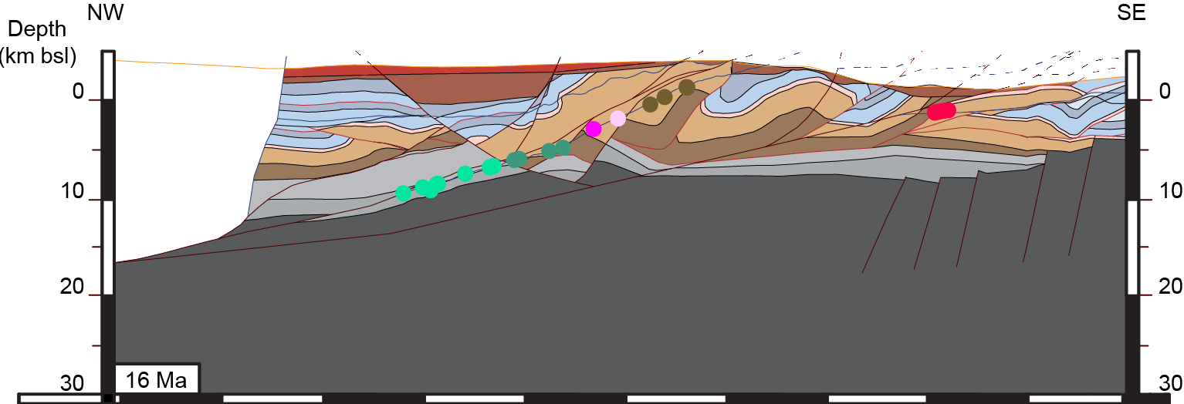
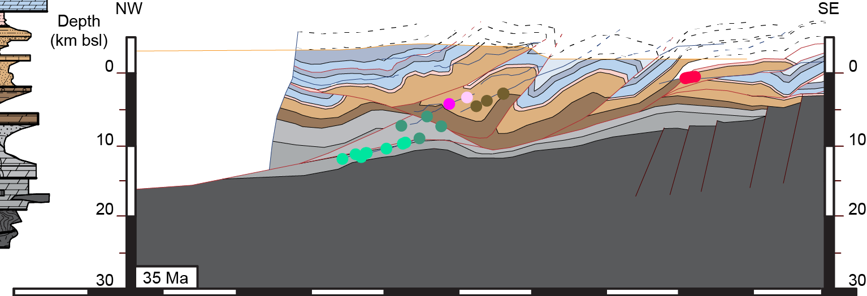
N
Balanced cross section reconstructions
Grapevine M
Funeral M
Resting Spring R
Maximum thickness ~3.5 km
16 Ma
35 Ma
Notes:
Fix strip map. Get new slide made in AI.
Still make zoom in.
Remove the isotherms and crustal thickness symbols;
possibly make the model only 15 km deep?? or 20??

Slide 34
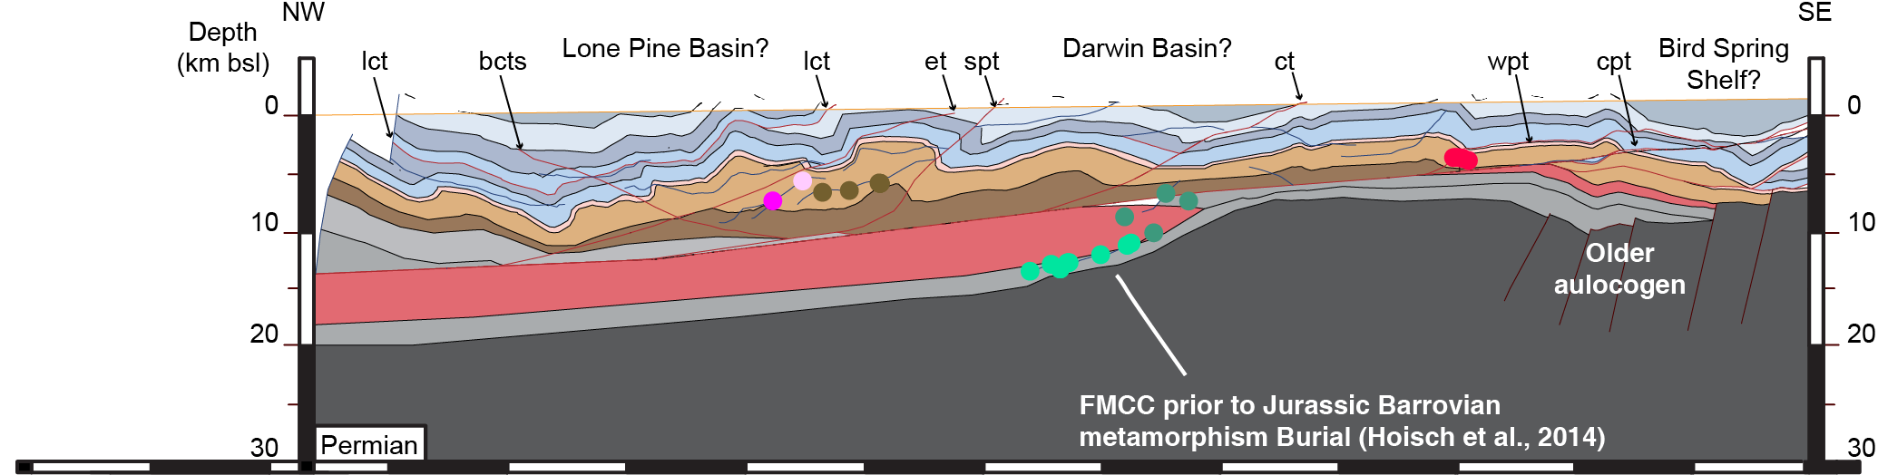
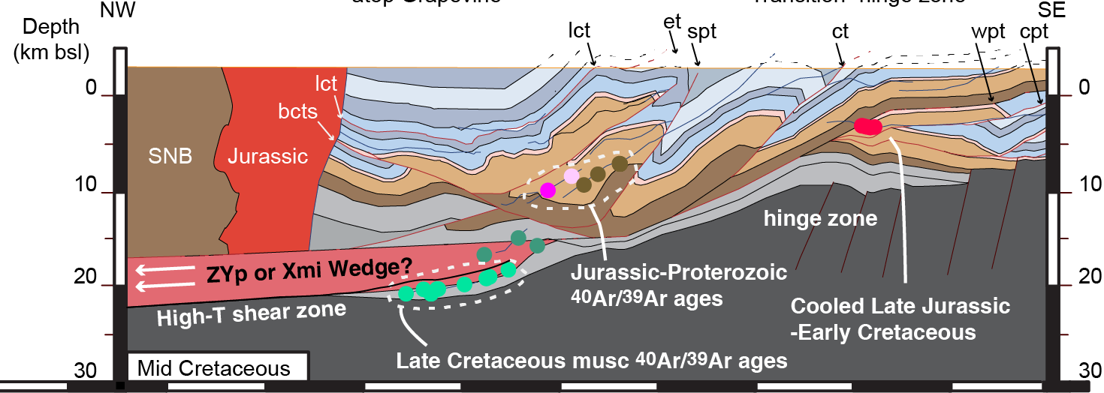
N
Balanced cross section reconstructions
Grapevine M
Funeral M
Resting Spring R
~125 km
Mid- Cretaceous?
75 km
Notes:
Fix strip map. Get new slide made in AI.
Still make zoom in.
Remove the isotherms and crustal thickness symbols;
possibly make the model only 15 km deep?? or 20??

Slide 35
N
Balanced cross section reconstructions
Grapevine M
Funeral M
Amargosa V
Resting Spring R
0 Ma
~50 km total extension
Paleozoic
Proterozoic
11-12 Ma
Notes:
Fix strip map. Get new slide made in AI.
Still make zoom in.
Remove the isotherms and crustal thickness symbols;
possibly make the model only 15 km deep?? or 20??

Slide 36
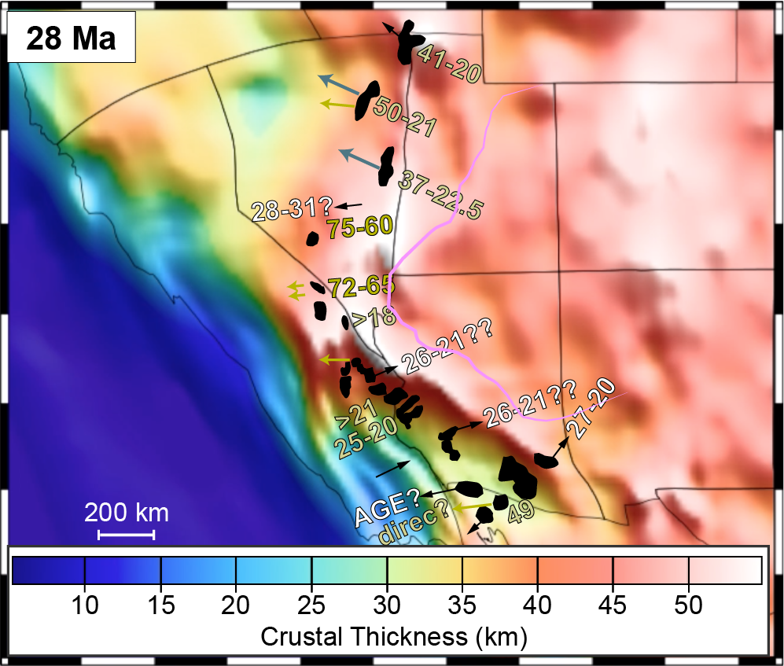
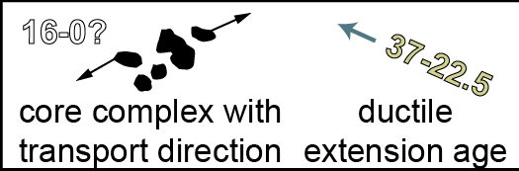
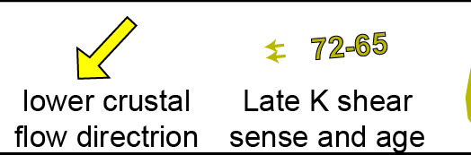
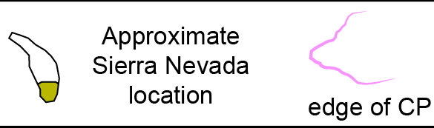
  Pre-detachment crustal thicknesses
Bahadori et al., 2018

Slide 37

  Pre-detachment crustal thicknesses
Gradients oppose upper plate transport
Bahadori et al., 2018

Slide 38
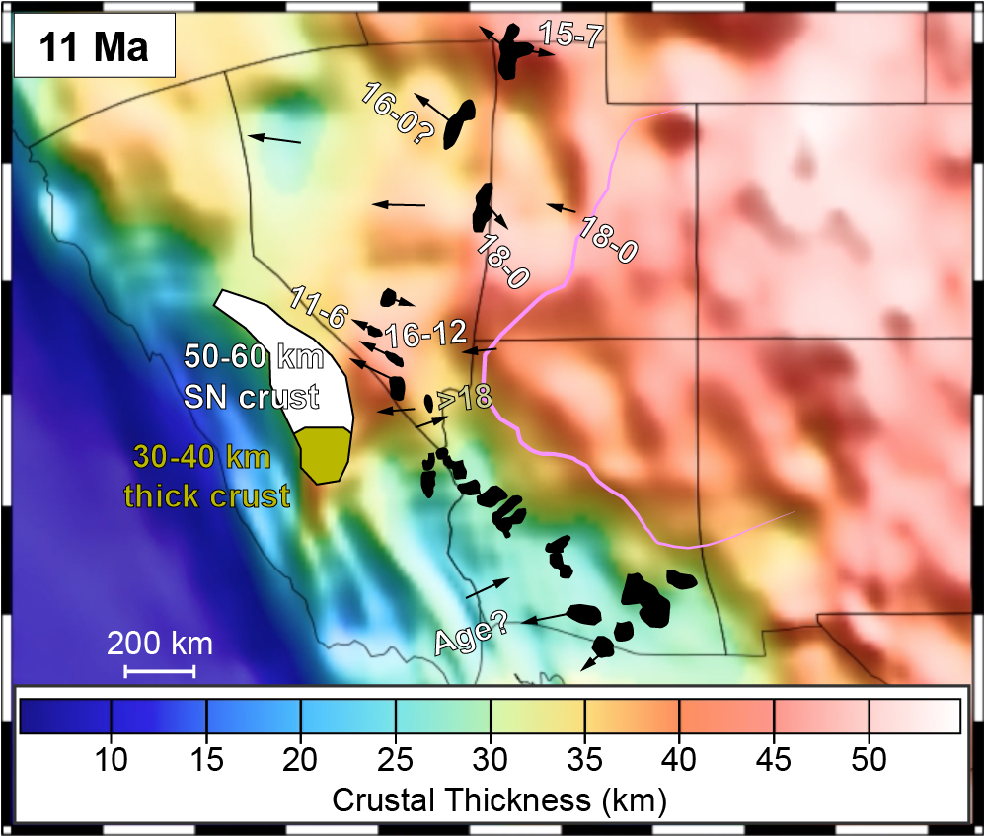
  Pre-detachment crustal thicknesses
Bahadori et al., 2018

Slide 39

  Pre-detachment crustal thicknesses
Gradients oppose upper plate transport
Bahadori et al., 2018

Slide 40
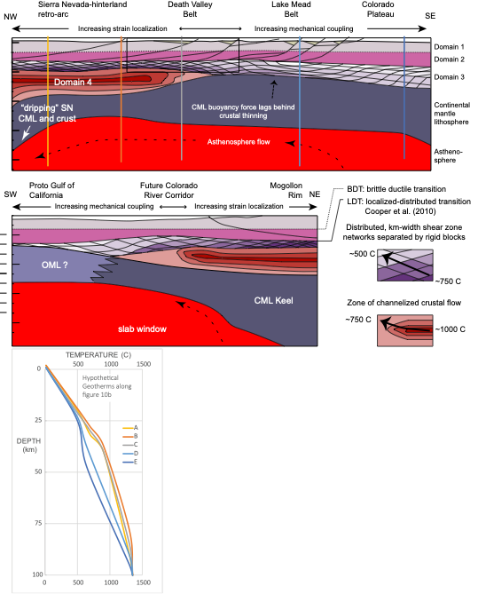
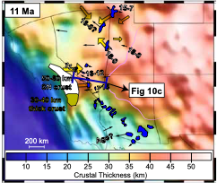
Domain 3
Bahadori et al., 2018

