Slide 1
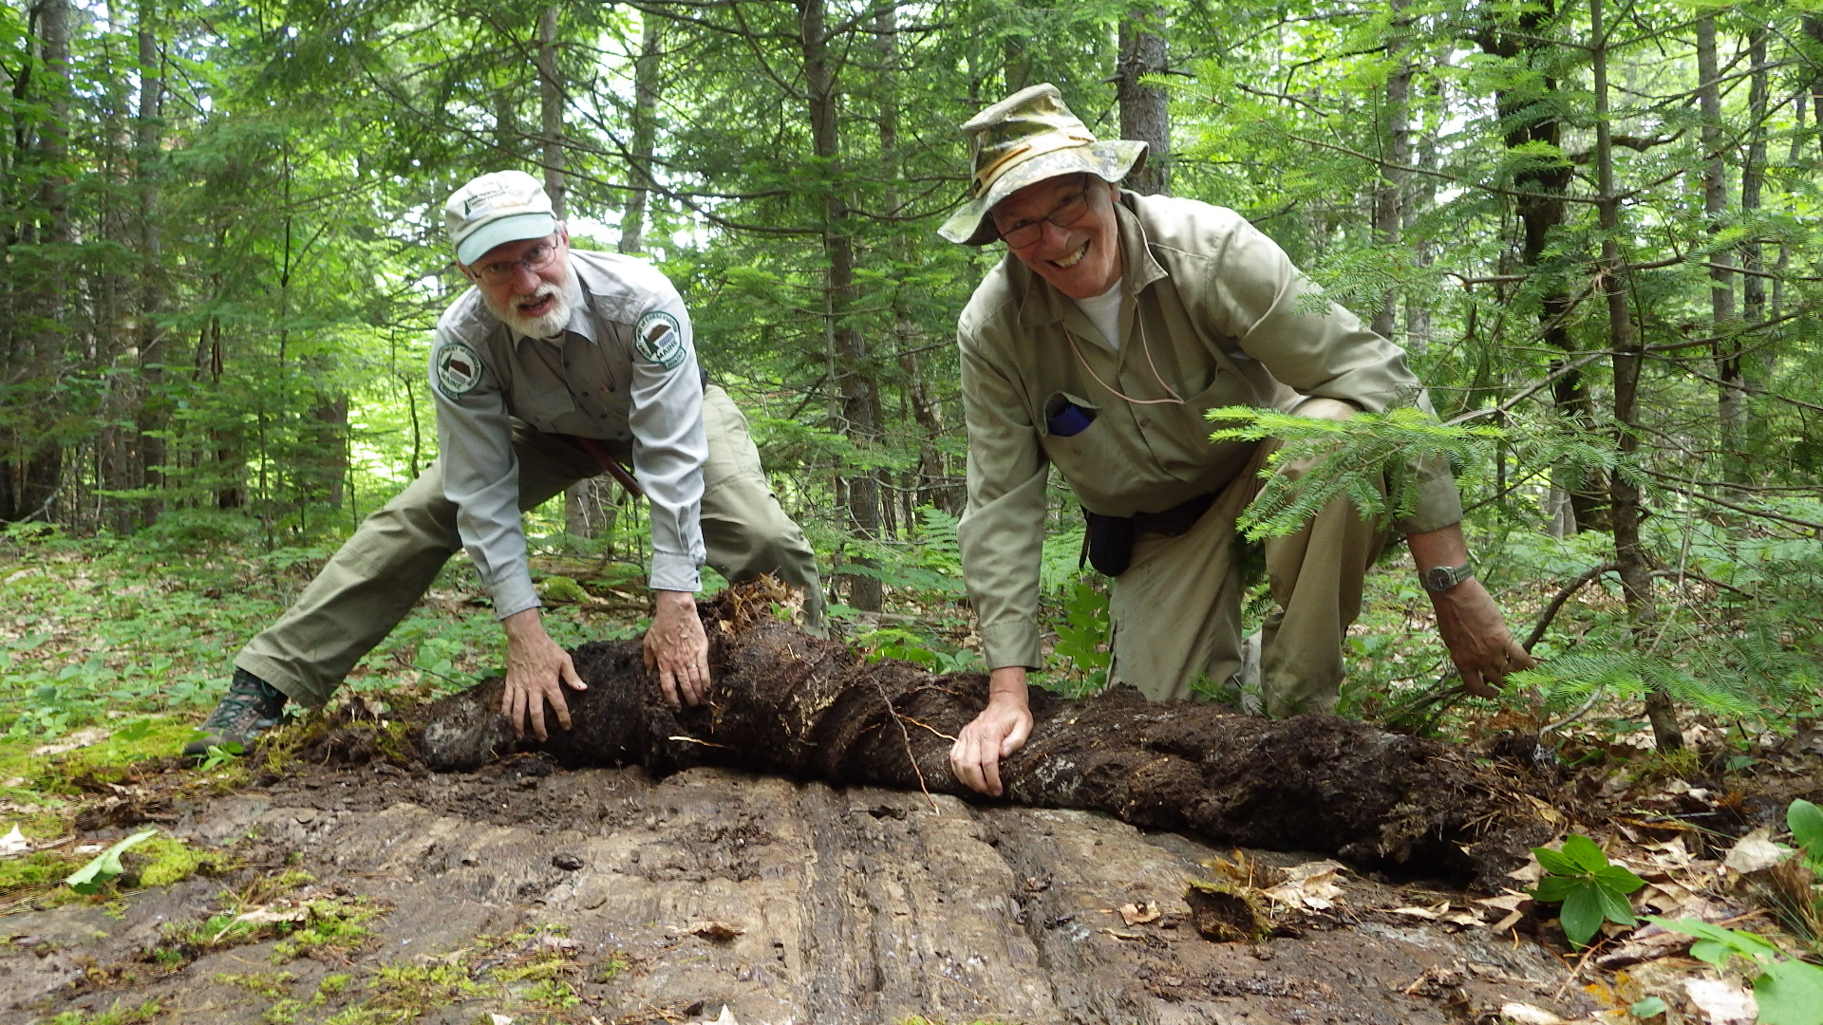
Interpreting detrital zircon provenance in the context of regional stratigraphic and tectonic models: an example from Late Ordovician–Early Devonian cover rocks on Ganderia, eastern Maine
Allan Ludman, John Aleinikoff, Bill Devlin
Notes:
For those of you who spend most of your time in the lab, Henry Berry and I are demonstrating the lengths that Maine mappers will go to find outcrops from which you can date zircons.

Slide 2
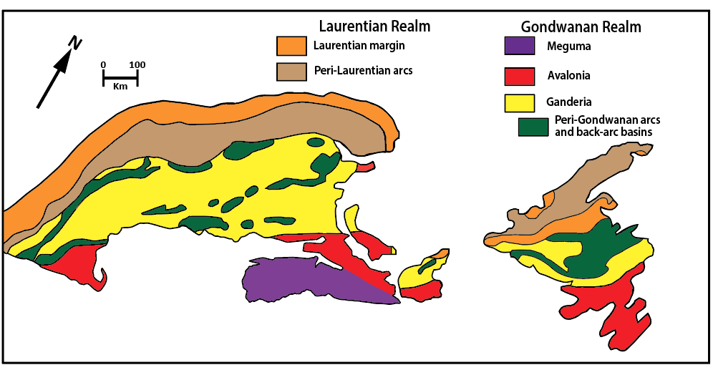
NORTHERN APPALACHIAN TECTONIC FRAMEWORK
Hibbard et al., 2006
Notes:
Ganderia widens to the northeast from southern New England, reaching its greatest width in Maine and New Brunswick. We will look today at rocks from the heart of the Ganderia terrane in eastern and east central Maine [outlined here].

Slide 3
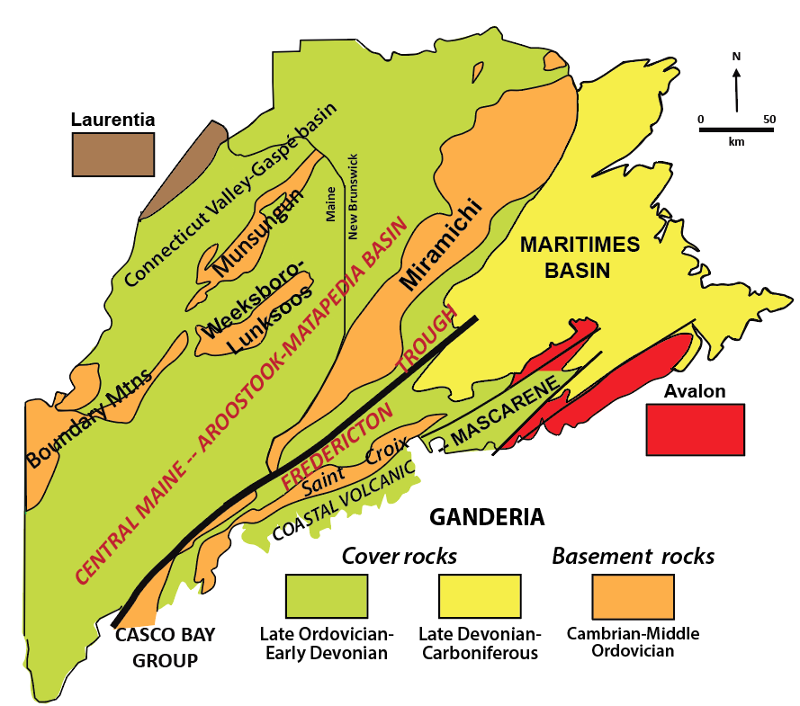

Notes:
Ganderian rocks underlie nearly all of Maine and consist of NE-trending belts of Cambrian through late Middle Ordovician basement rocks, that are blanketed and separated by Late Ordovician through Early Devonian cover rocks. Our focus today is on detrital age spectra from the cover rocks of the Central Maine/Aroostook-Matapedia basin and Fredericton trough. If you thought from the first slide that we’re desperate for outcrops, the fossil age control situation is worse. In the entire area outlined here, there are three fossil localities and we turned to detrital zircons for some age constraints of broad swaths of turbidites of the Central Maine/Aroostook-Matapedia basin and Fredericton trough.

Slide 4
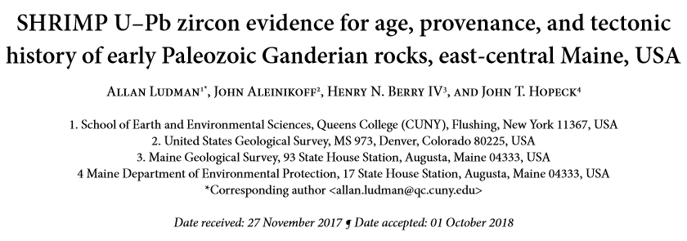
ATLANTIC GEOLOGY 54, 335–387 (2018)
Notes:
Ganderian rocks underlie nearly all of Maine and consist of NE-trending belts of Cambrian through late Middle Ordovician basement rocks, that are blanketed and separated by Late Ordovician through Early Devonian cover rocks. Our focus today is on detrital age spectra from the cover rocks of the Central Maine/Aroostook-Matapedia basin and Fredericton trough. If you thought from the first slide that we’re desperate for outcrops, the fossil age control situation is worse. In the entire area outlined here, there are three fossil localities and we turned to detrital zircons for some age constraints of broad swaths of turbidites of the Central Maine/Aroostook-Matapedia basin and Fredericton trough.

Slide 5
AGE CONSTRAINTS FOR UNFOSSILIFEROUS COVER ROCK UNITS
2. IMMEDIATE SEDIMENTARY PROVENANCE OF COVER ROCKS
3. ULTIMATE TECTONIC PROVENANCE OF GANDERIA
Notes:
We are also desperate for any information that could help constrain the ages of the rocks we do uncover, and the project that led to this talk was originally designed to do that. Complete results are available in Atlantic Geology. Today we highlight some unanticipated results from that study.

Slide 6
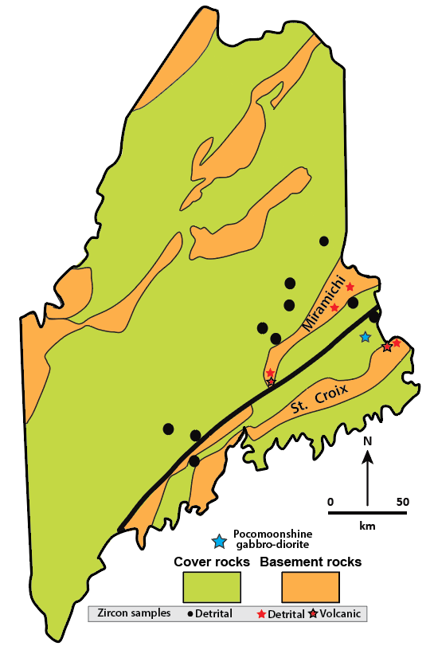
Fredericton
trough
Central Maine/Aroostook-Matapedia basin
Notes:
This shows the distribution of cover rock detrital zircon samples. We also dated detrital and volcanic zircons from the Miramichi and St. Croix basement belts, and a plutonic sample from the Pocomoonshine gabbro diorite. Complete results are reported in Atlantic Geology – today we will focus on three interpretations, two of which were unanticipated.

Slide 7
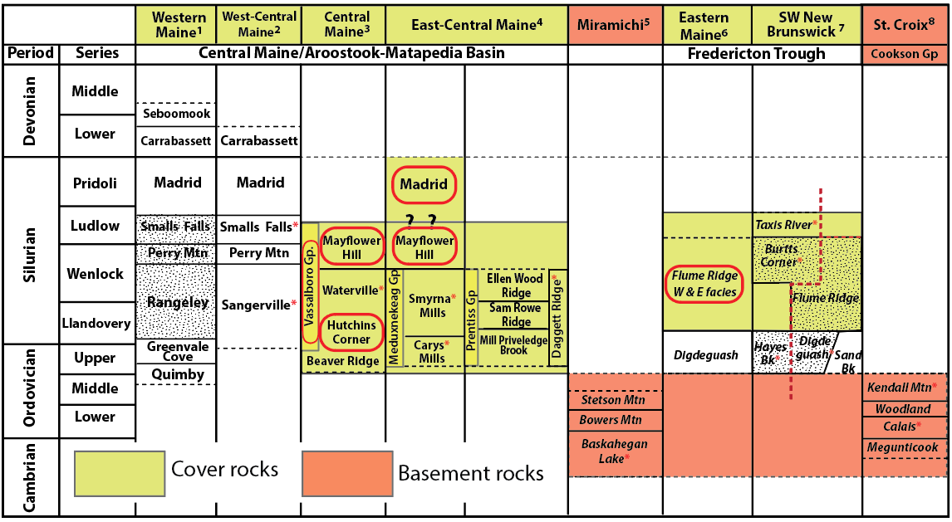
Correlation across the Central Maine basin and Fredericton trough
Notes:
This figure shows the inferred ages and correlation of Ganderian cover rocks across the Central Maine/Aroostook-Matapedia basin and Fredericton trough. The red lines identify units sampled in our study, none of which were fossiliferous at the time they were sampled. Palynomorphs now confirm the age ranges of the Flume Ridge and part of the Vassalboro Group.

Slide 8
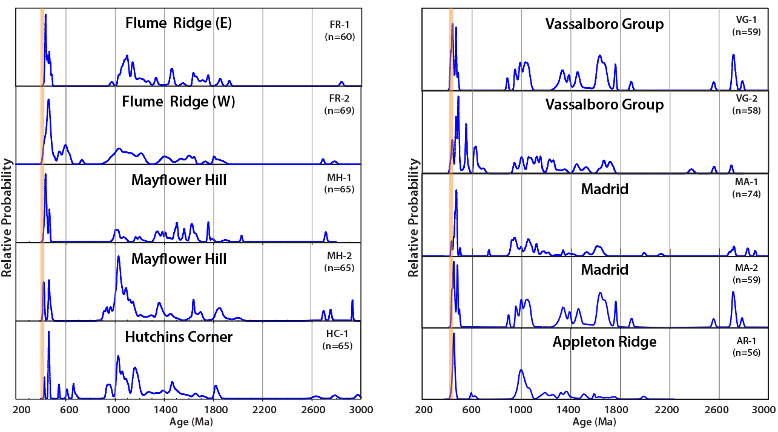
ZIRCON AGE SPECTRA FOR COVER ROCKS
Notes:
One of the surprises was the presence of a young zircon population in most rocks of 430 -422 Ma, corresponding to Wenlock and Ludlow stages – just a few million years younger than the inferred ages of the rocks from which they were collected –as seen in the next slide.

Slide 9
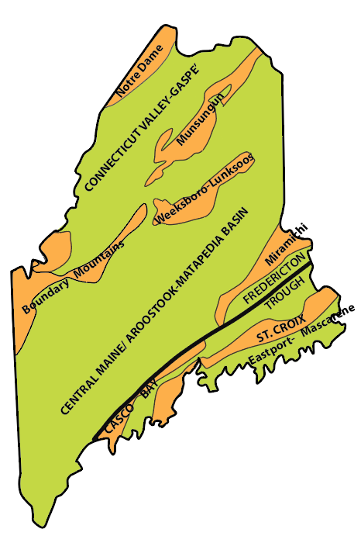
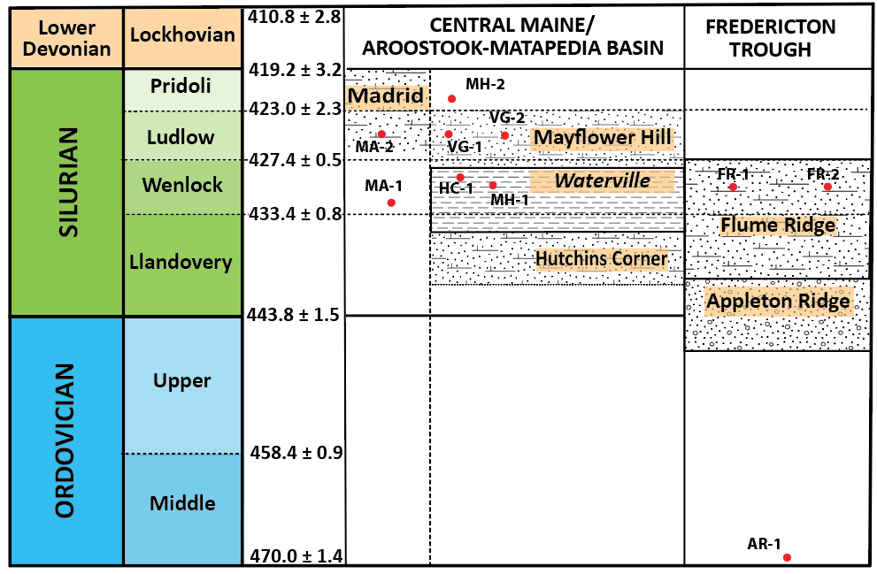
COVER ROCK Youngest zircons
Zircons too young for proposed age
Zircons very young for proposed age
F
F
F
Notes:
Although the zircon ages are in general consistent with the proposed stratigraphic ages, there are some issues. CLICK the youngest Hutchins Corner zircons are younger than the Llandovery age of the formation. This is not catastrophic as the Hutchins Corner and Mayflower Hill formations are nearly identical – although our sample had been assigned to the Hutchins Corner, it appears that it is Mayflower Hill.
CLICK these zircons are just a few million years older than the units in which they are found, and this led to our first unexpected result.

Slide 10
AGE CONSTRAINTS FROM DETRITAL ZIRCONS
Age spectra/youngest zircons are generally consistent with the previously interpreted ages of the cover rock units– no big problems, BUT
It is unlikely that the youngest zircons, in at least the Flume Ridge Formation, would have had enough time to crystallize in an igneous rock, be exhumed, eroded, deposited, and incorporated in thousands of meters of sediments that were then lithified, folded, and intruded by the Pocomoonshine gabbro-diorite at ̴421.9 ± 2.4 Ma
We therefore suggest that these zircons were not recycled from older rocks, but were instead, erupted with tephra during local early Silurian volcanic activity, e.g. the Eastport-Mascarene arc, and incorporated directly into the sediment
Notes:
At last year’s meeting, Sheila Seaman proposed that there had been “supervolcano eruptions” in the Coastal Maine magmatic province, and we suggest that this is the most likely source of the anomalously young zircons – although this is not the only possibility.

Slide 11
AGE CONSTRAINTS FOR COVER ROCK UNITS
2. IMMEDIATE SEDIMENTARY PROVENANCE OF COVER ROCKS
3. ULTIMATE TECTONIC PROVENANCE OF GANDERIA

Slide 12
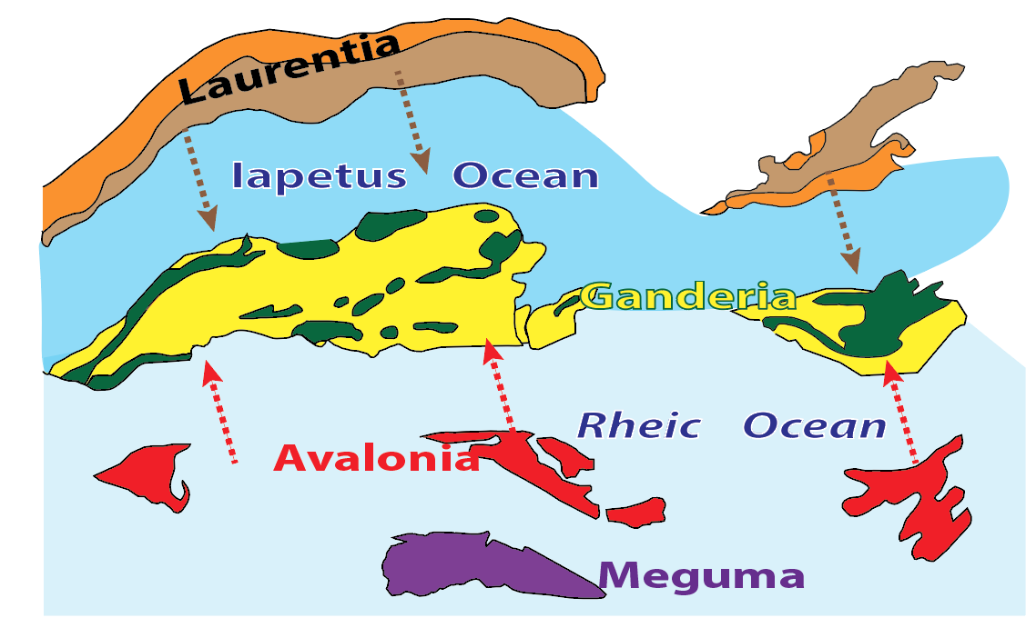
Possible sources of Ganderian cover-rock sediment:
Laurentia, Avalonia, and internal Ganderian “basement”
Notes:
Silurian paleogeography and Northern Appalachian tectonic models indicate three probable sources for the Ganderian cover-rock sediments: internal Ganderian sources, and external sources from Laurentia and Avalonia.

Slide 13
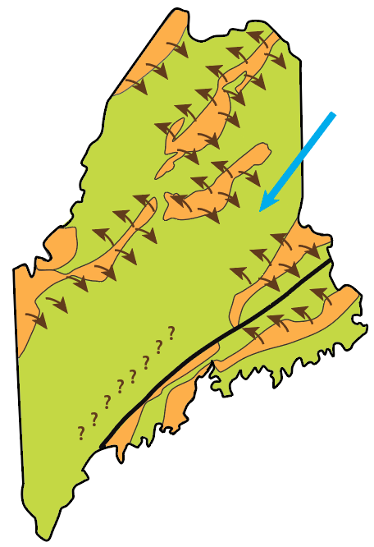
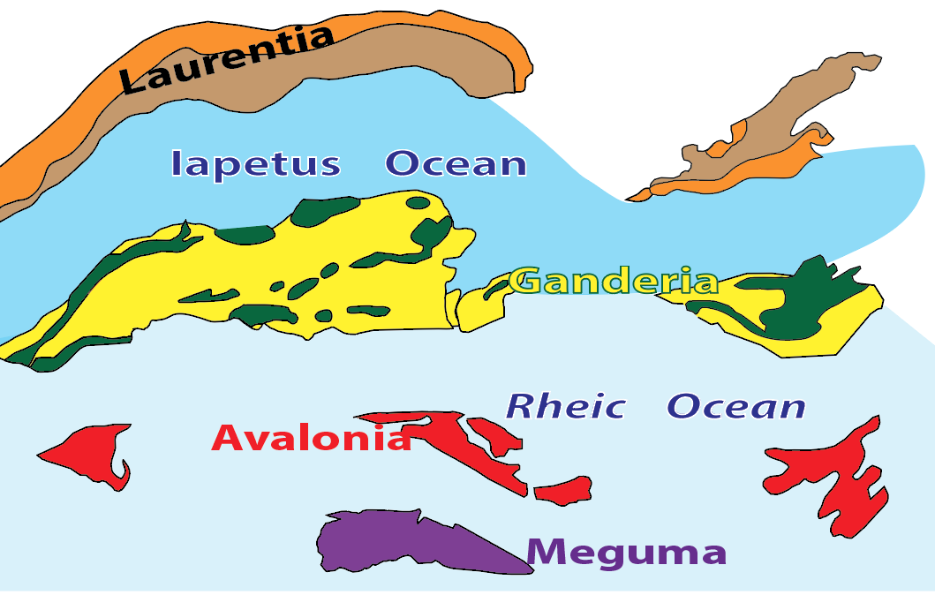
Clast provenance and lithofacies patterns confirm basement Ganderian sources for the cover rocks— highlands emergent during initiation of Late Ordovician sedimentation.
Those highlands are represented today by the Cambro-Ordovician belts.
But were there also external contributions from Avalonia to the east and Laurentia to the west?
After Ludman et al, 2017
Tremblay and Pinet, 2005, 2016
Notes:
There is abundant evidence for internal Ganderian sources. The basement belts in most of Maine were emergent immediately after late Middle Ordovician accretion of Ganderia to Laurentia, and unique basement lithologies are readily identified in the adjacent proximal facies. But several previous workers have cited both Laurentian and Avalonian provenance for cover rock units, and that is what we expected to find.

Slide 14
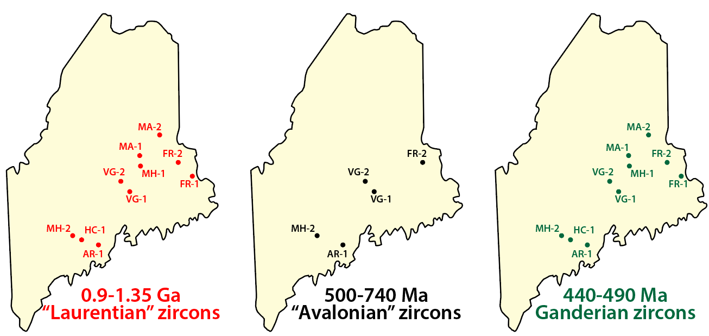
Initial thought: zircon ages suggest provenance from all three sources
Notes:
There are certainly zircon populations corresponding to frequently cited Laurentian and Avalonian ages, and this figure represents our first thoughts. However,

Slide 15
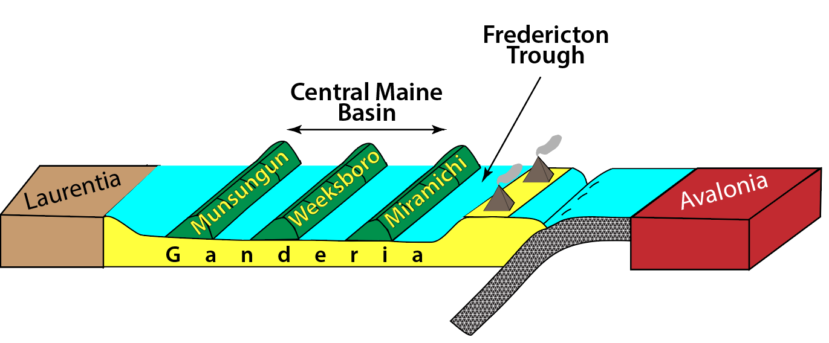
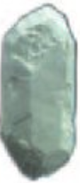
However, generally accepted tectonic models (e.g. Llamas and Hepburn, 2013) suggest that there would have been a significant, if not impenetrable, barrier to sediment transport from Avalon to the “east”
Eastport-Mascarene arc-trench system
Notes:
Widely accepted tectonic models for the region suggest that it would have been difficult for Avalonian or Laurentian zircons to reach the depocenters that we studied.

Slide 16
…….and similarly from Laurentia to the west, where zircons would have had to negotiate the deep-water Central Maine basin with its islands and marginal highlands
Notes:
1000 km not unlikely – twice the width of the Sea of Japan

Slide 17
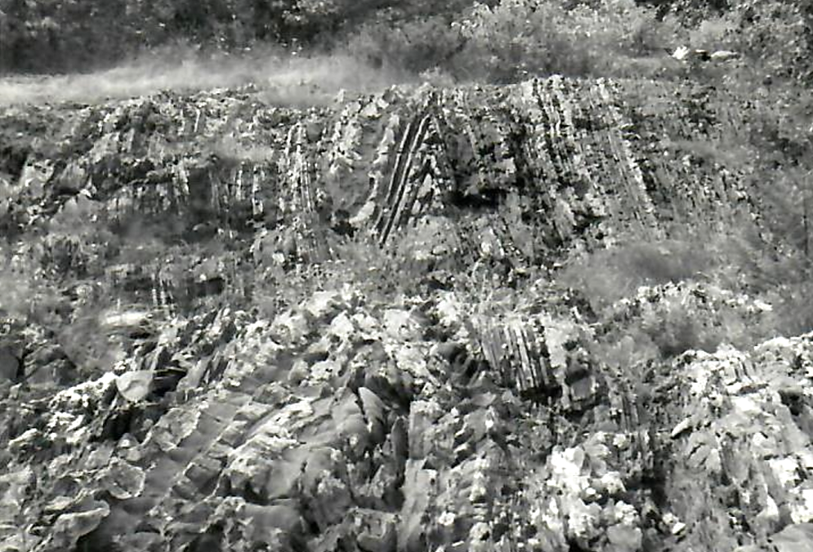
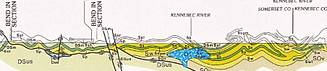
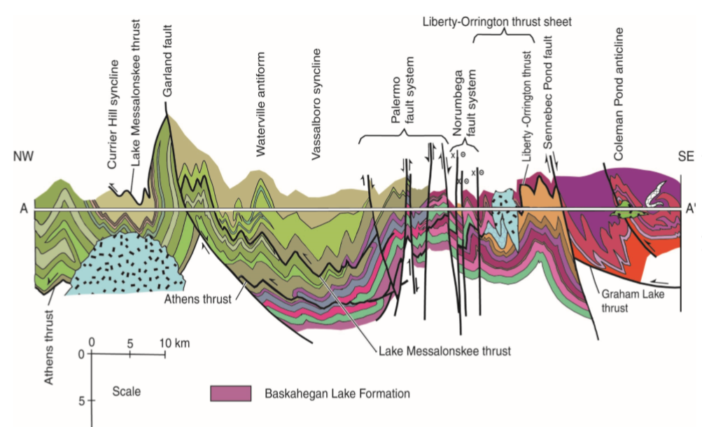
HOW WIDE A BARRIER WAS THE DEEP-WATER CENTRAL MAINE BASIN?
Ludman, 1969
Currently: 150 Km wide
Minimum 50% shortening based on scant data from upright isoclinal folds (“conservative estimate” from Bradley et al, 2000)
W > 300 – 400 Km.
Add effects of early recumbent folds
W > 500 – 600 Km ??
[Wider than the Sea of Japan]
Osberg et al., 1985
Include multiple early and late thrusts
W ̴̴ ?? Km
Tucker et al., 2001
Notes:
1000 km not unlikely – twice the width of the Sea of Japan

Slide 18
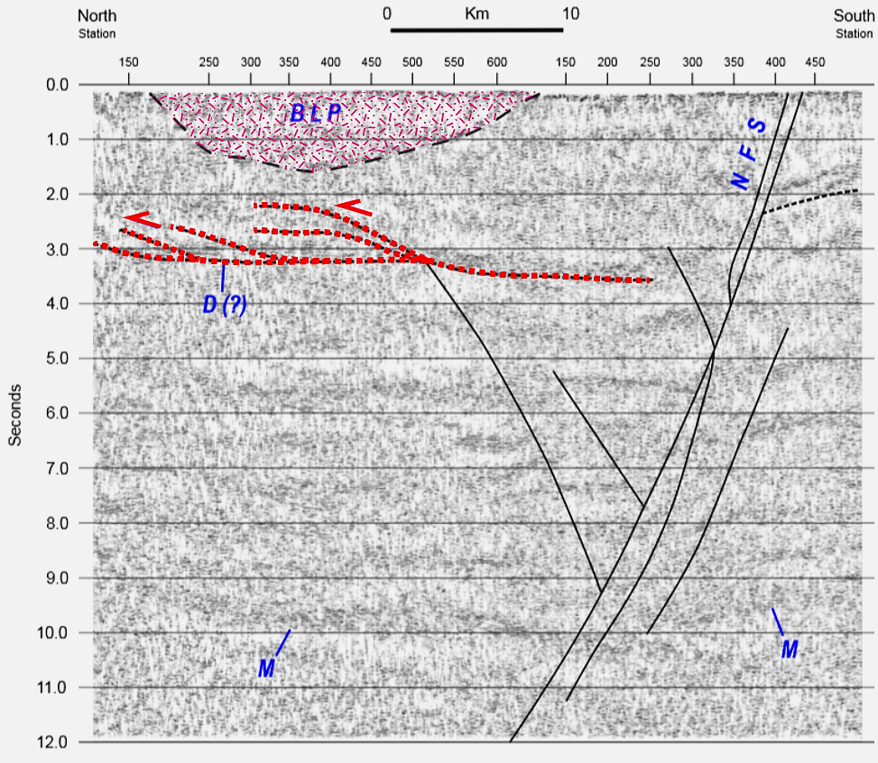
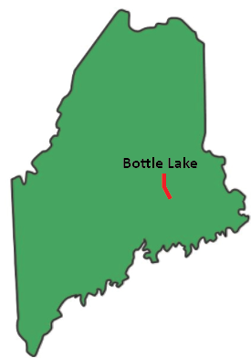
Add shallow crustal blind thrusts
W = ??
Perhaps 2X
the Sea of Japan?

Slide 20
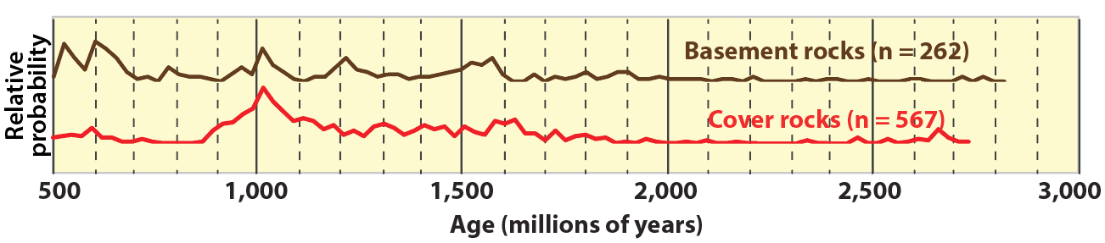
IMMEDIATE SEDIMENTARY PROVENANCE CONCLUSIONS
Cover rock detrital zircons were sourced internally, from Cambro-Ordovician rocks in Late Ordovician Ganderian basement highlands and from Silurian volcanic eruptions derived by melting of Ganderian crust.
2. The detrital zircon signature of basement and cover rocks is therefore the pristine “signature of Ganderia” – useful, perhaps, for workers elsewhere in the Northern Appalachians.

Slide 21
AGE CONSTRAINTS FOR COVER ROCK UNITS
2. IMMEDIATE SEDIMENTARY PROVENANCE OF COVER ROCKS
3. ULTIMATE TECTONIC PROVENANCE OF GANDERIA

Slide 22
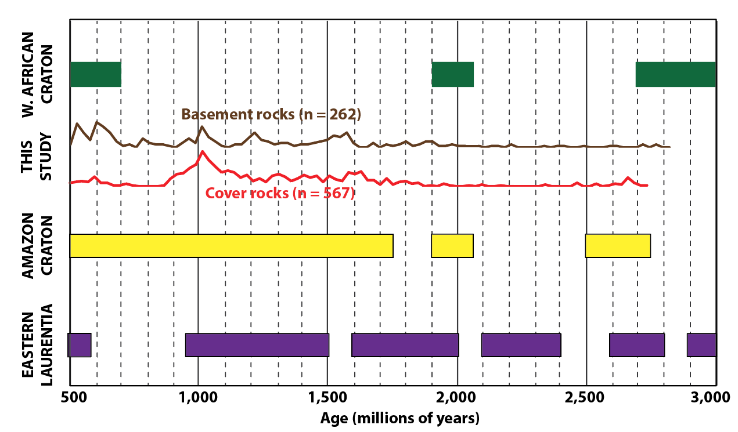
Zircon age spectra compared with zircon-producing events in post-Rodinian plates
Bradley, this meeting
Modified after Nance et al., 2008

