Slide 1
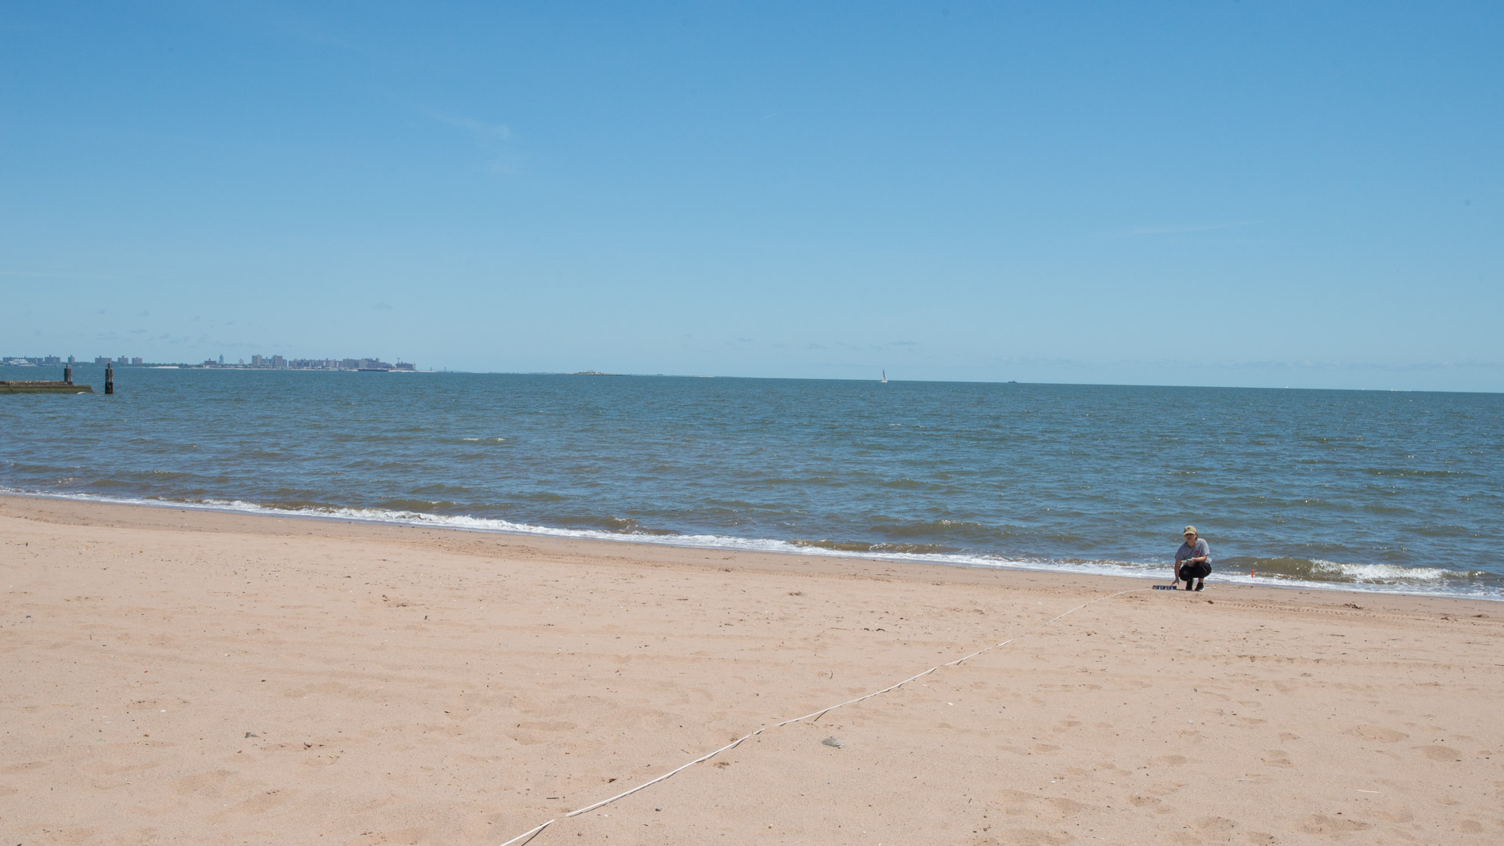

Staten Island Beach Morphology - Implications for shoreline response to storm events
Jane Alexander and Jennifer Avila Sanchez

Slide 2
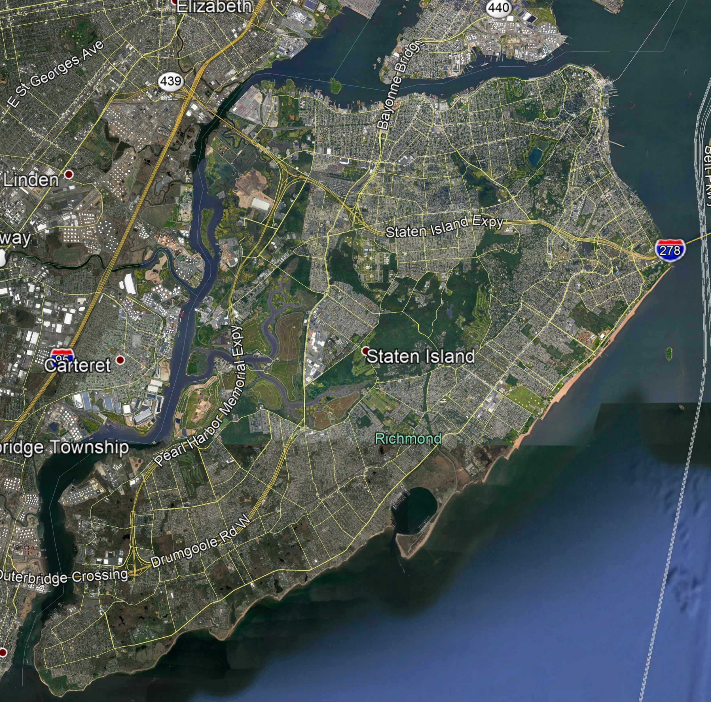
Outline
The east shore of Staten Island was badly damaged during Superstorm Sandy
Proposed sea wall to be built by Army Corps of Engineers
Preliminary survey of South Beach, Midland Beach and New Dorp Beach to determine baseline against which future changes may be measured

Slide 3
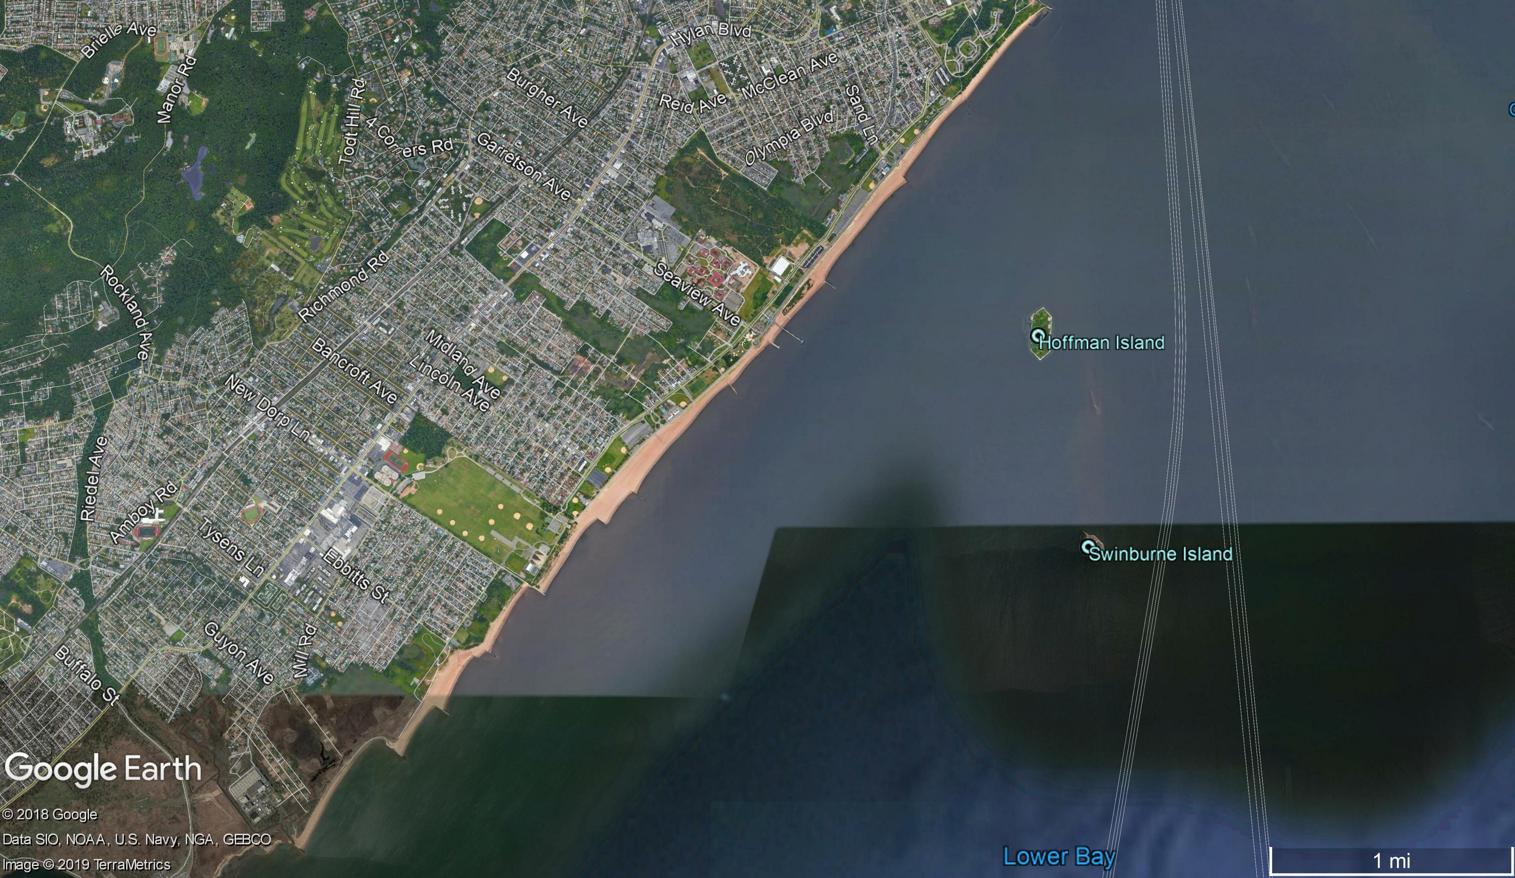
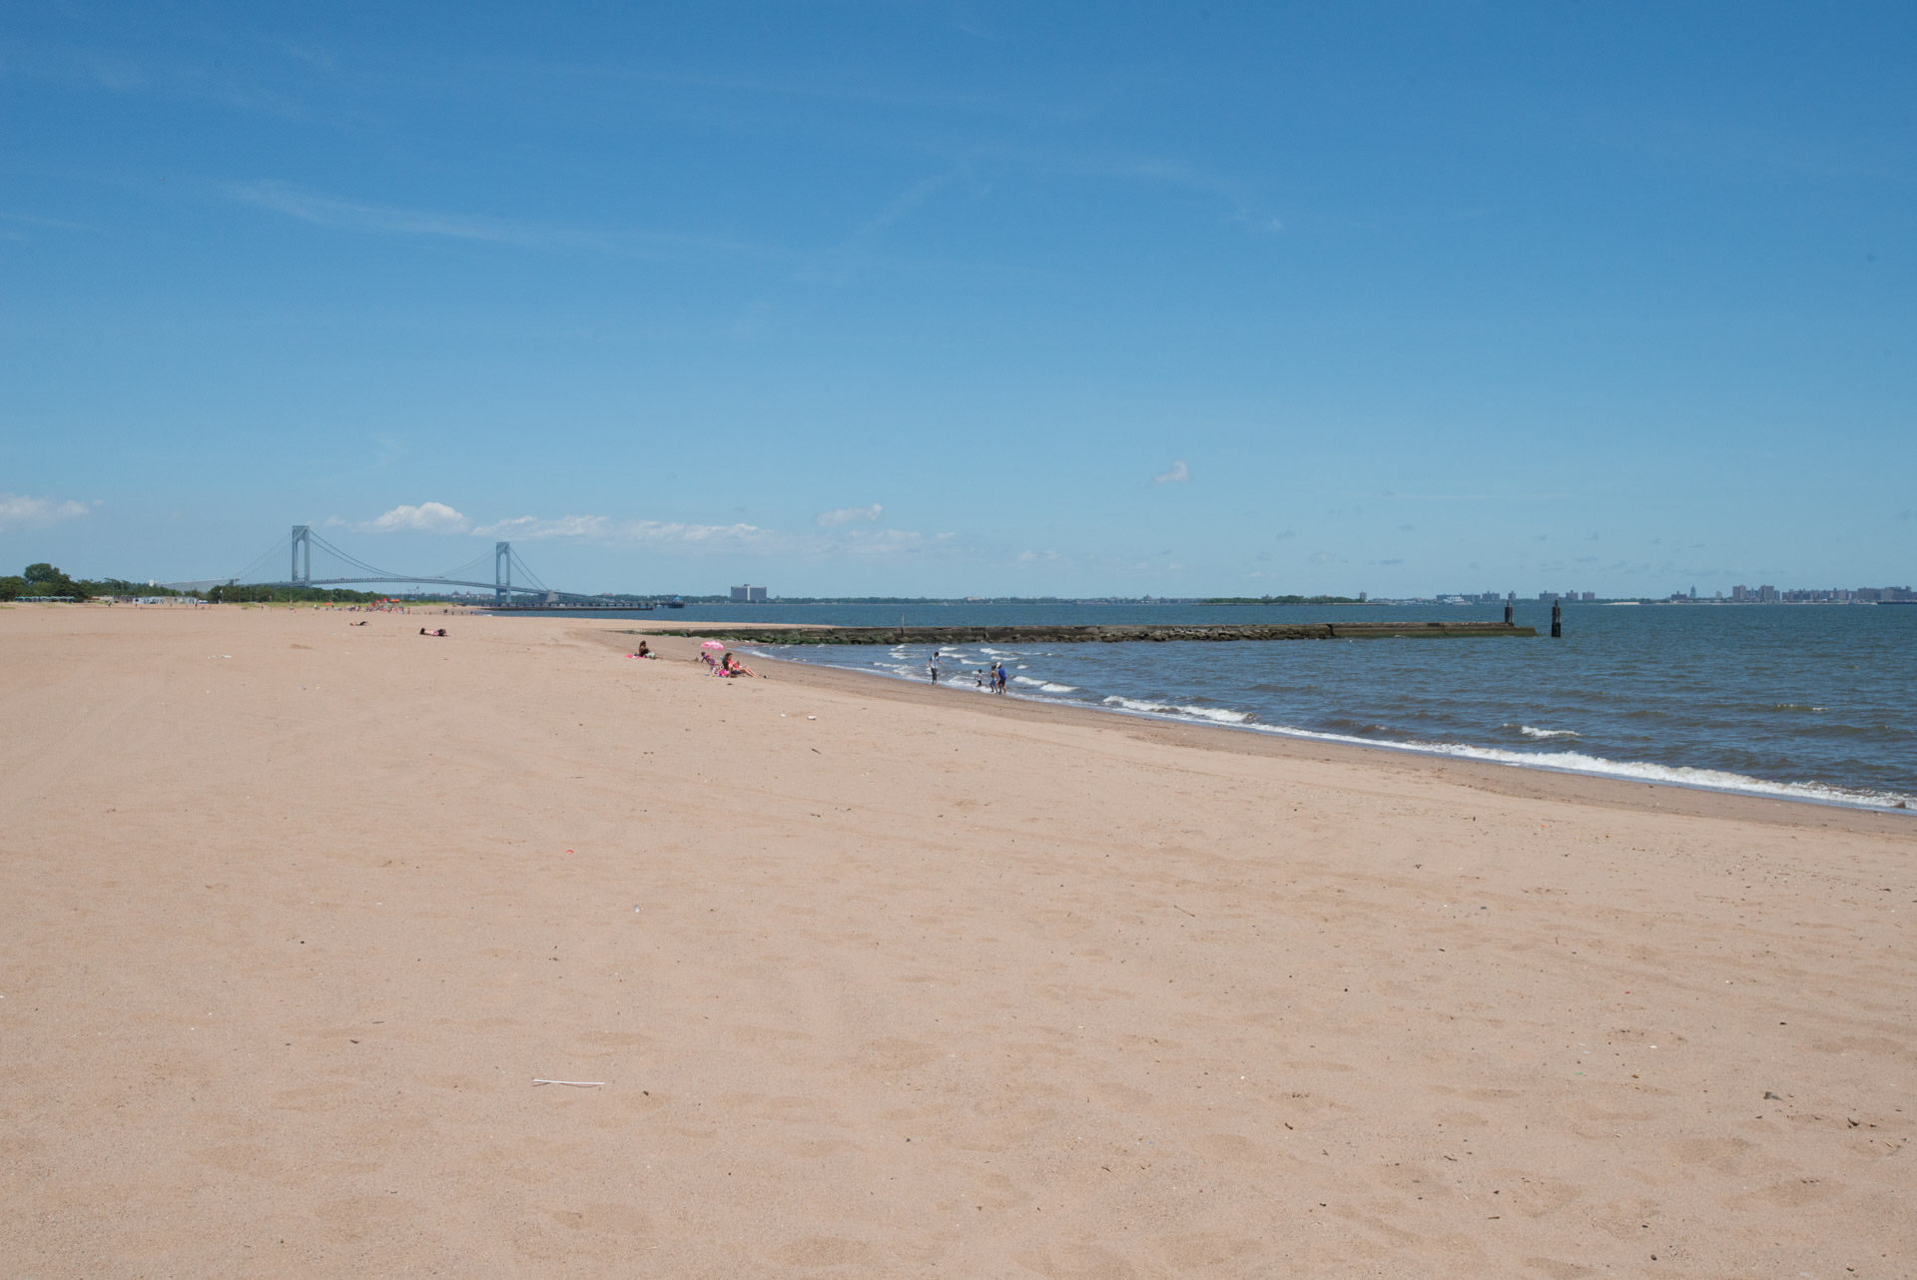
East shore of Staten Island
Low tidal range of 0.8 – 2.1 m
Generally low wave height
Sheltered location in the mouth of the Hudson Estuary
Beaches stabilized by a series of groins
Littoral drift towards the south, south of Fishing Pier, and towards the north in the north

Slide 4
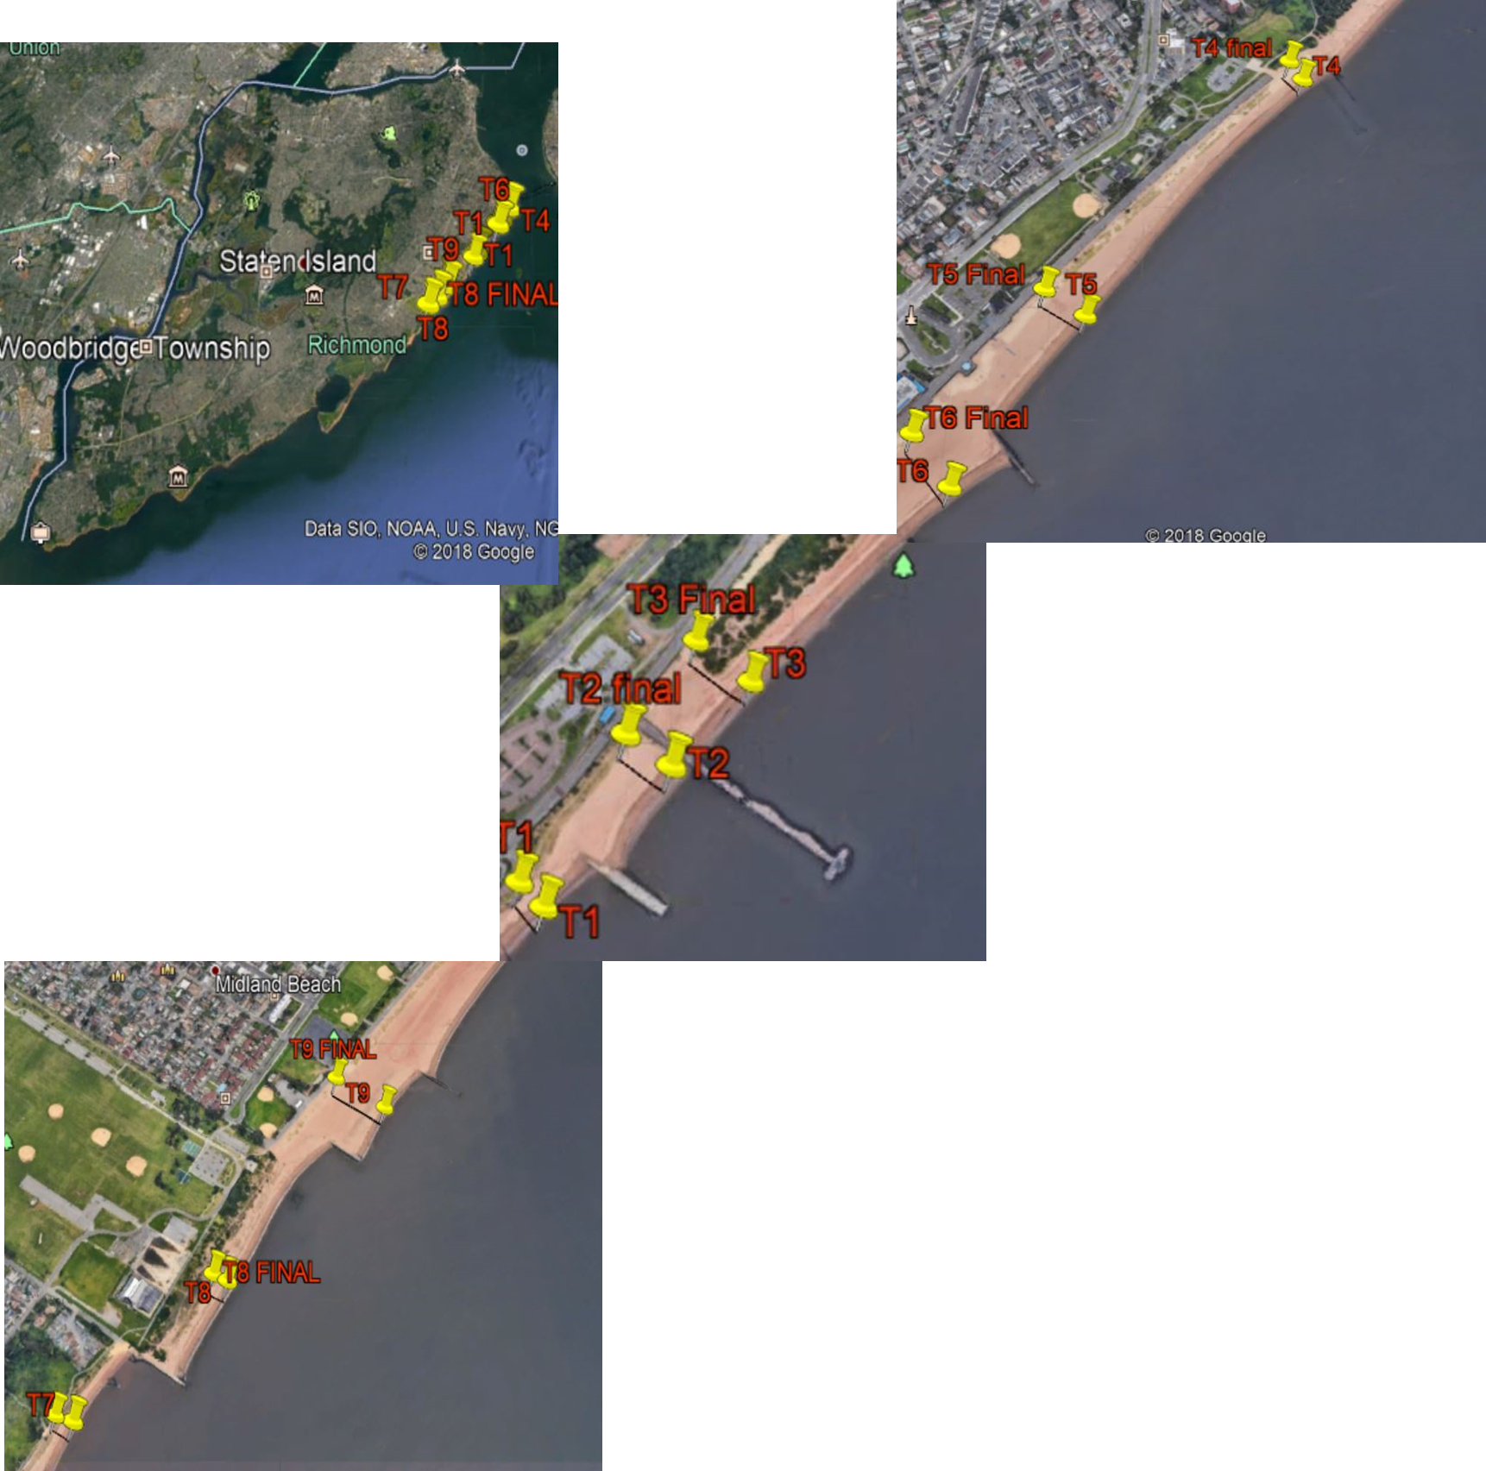
Beach profiles
I
Profiles measured during late June 2018
Measured within an hour of low tide
Simple measurement of slope angle at 2m intervals
Sediment samples collected at low tide line, high tide line and base of dunes
H
G
F
E
D
C
B
A

Slide 5
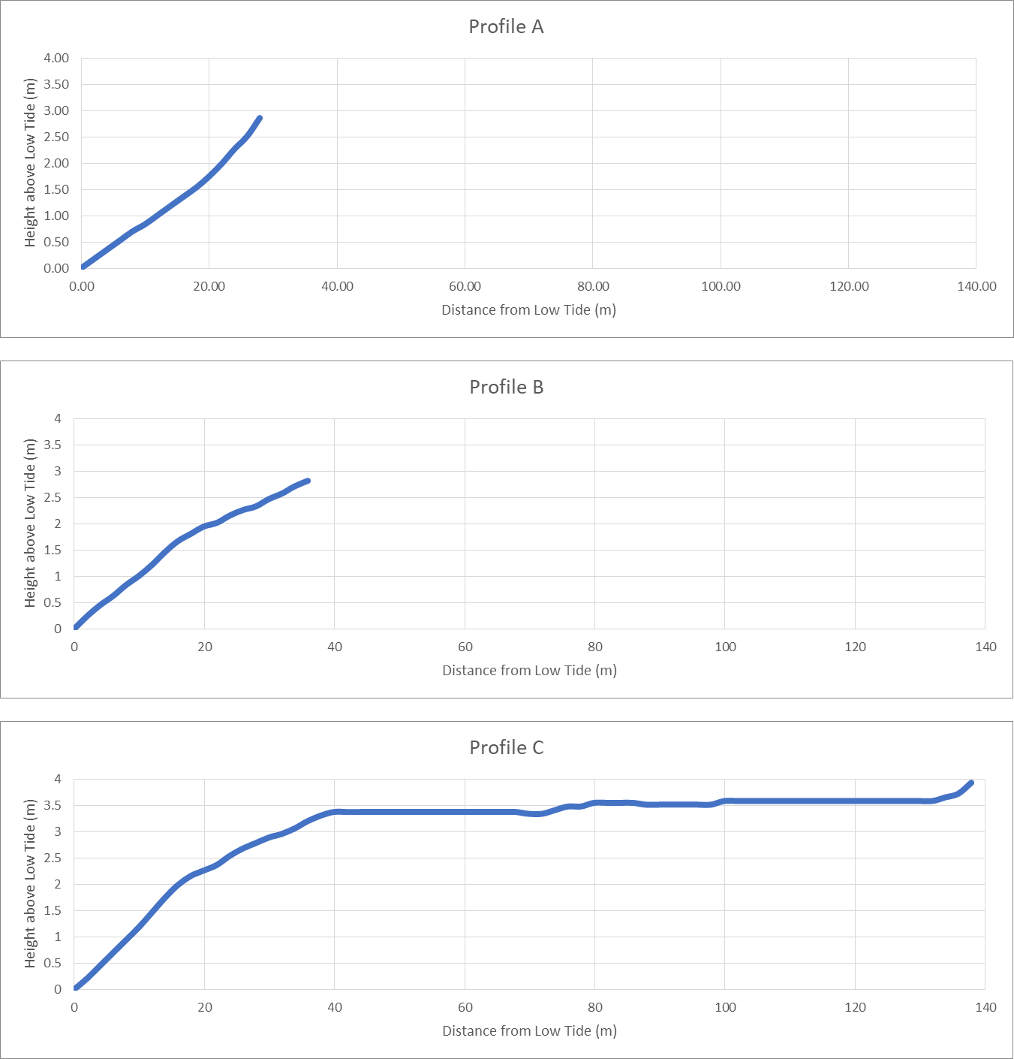
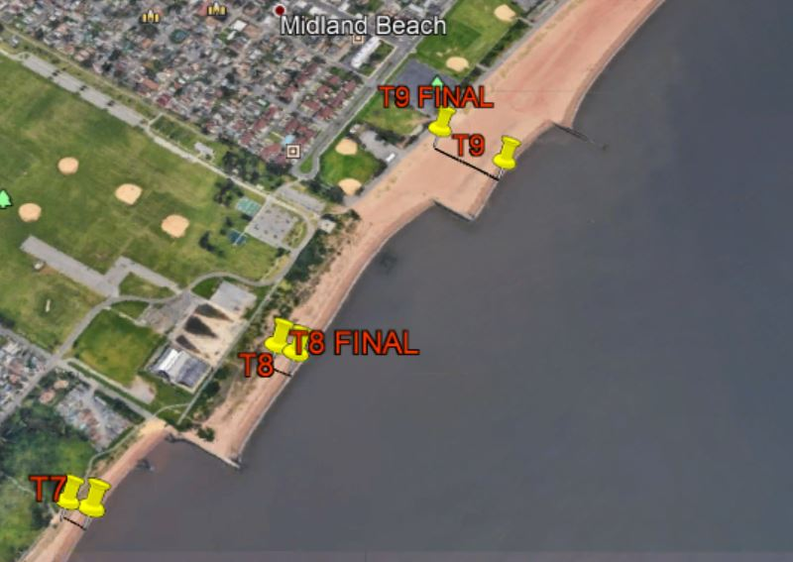
New Dorp Beach and southern Midland Beach Profiles
C
B
A

Slide 6
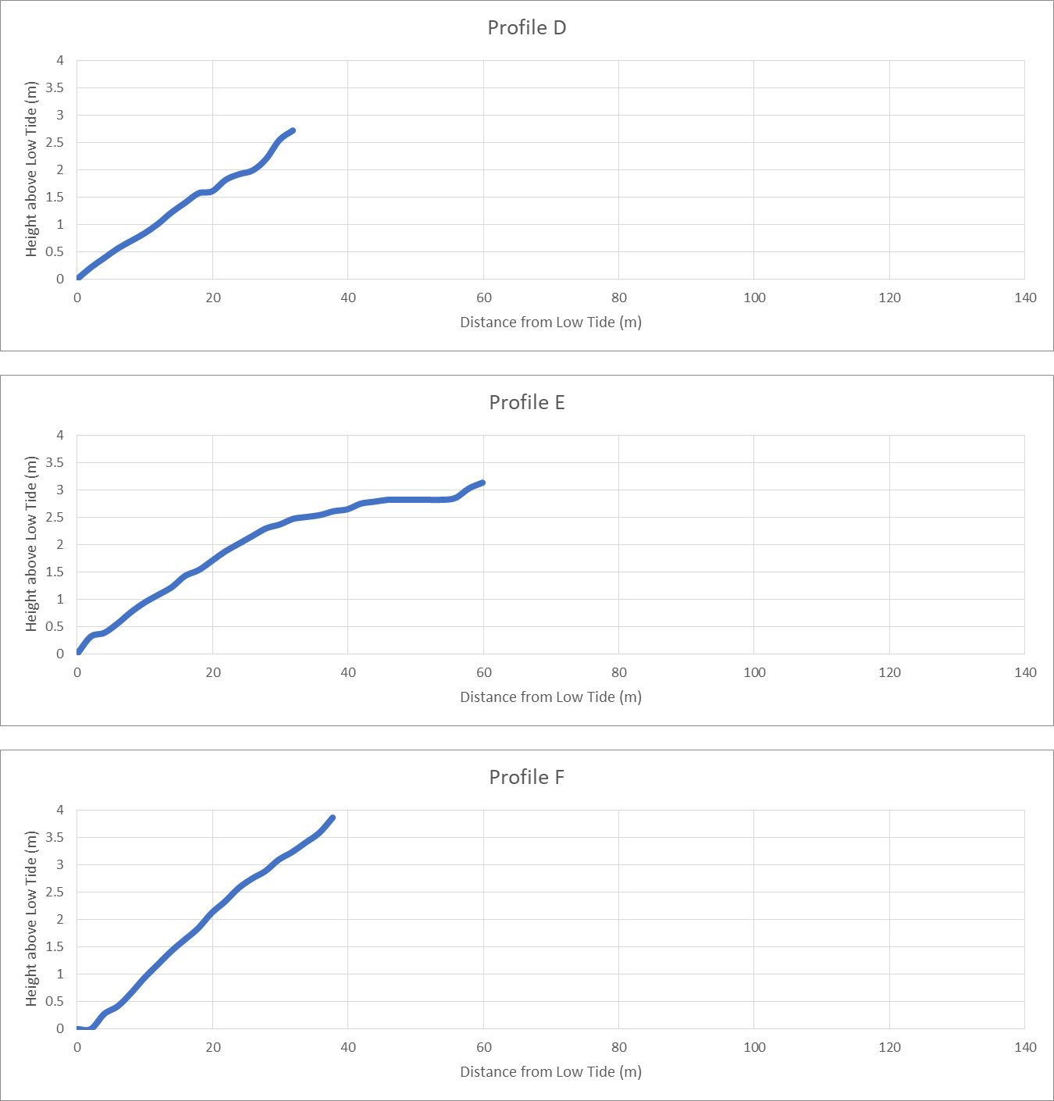
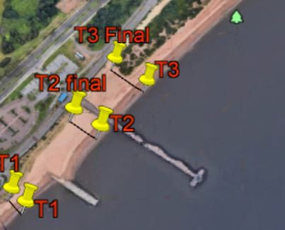
Midland Beach Profiles
F
E
D

Slide 7
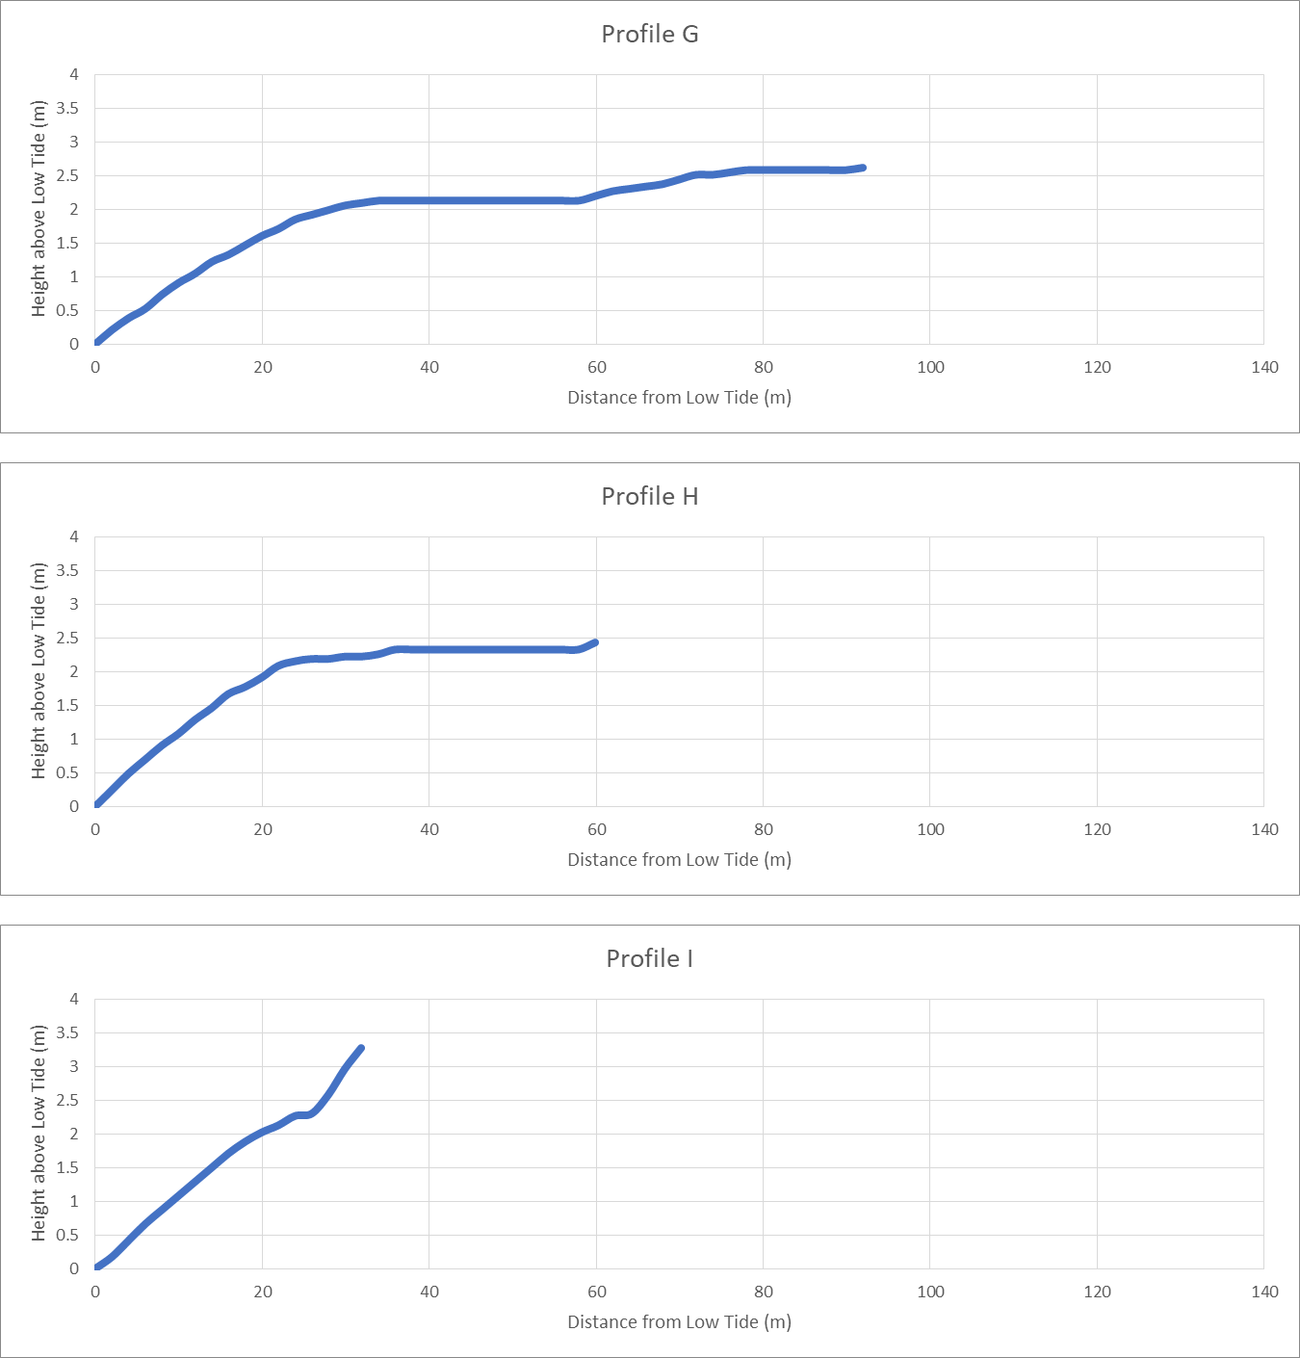
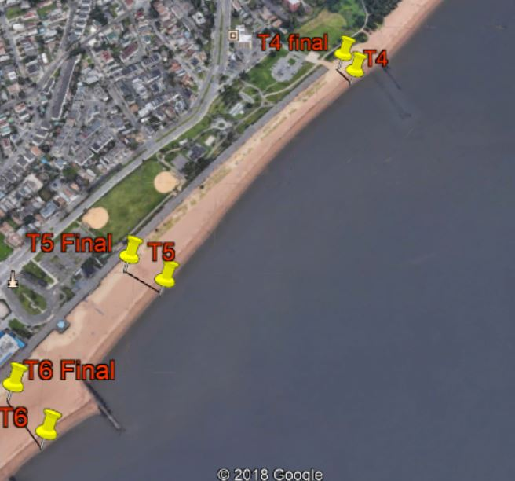
South Beach Profiles
I
H
G

Slide 8
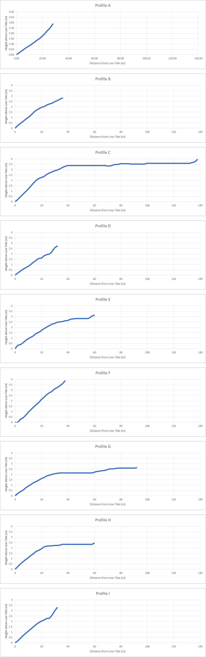
Beach Profile Summary
Total width of beach influenced by groins
Beach face slopes all similar, regardless of total beach width
4° - 6°
No clearly defined berm
Erosion and human influence greatest in transects D and E

Slide 9
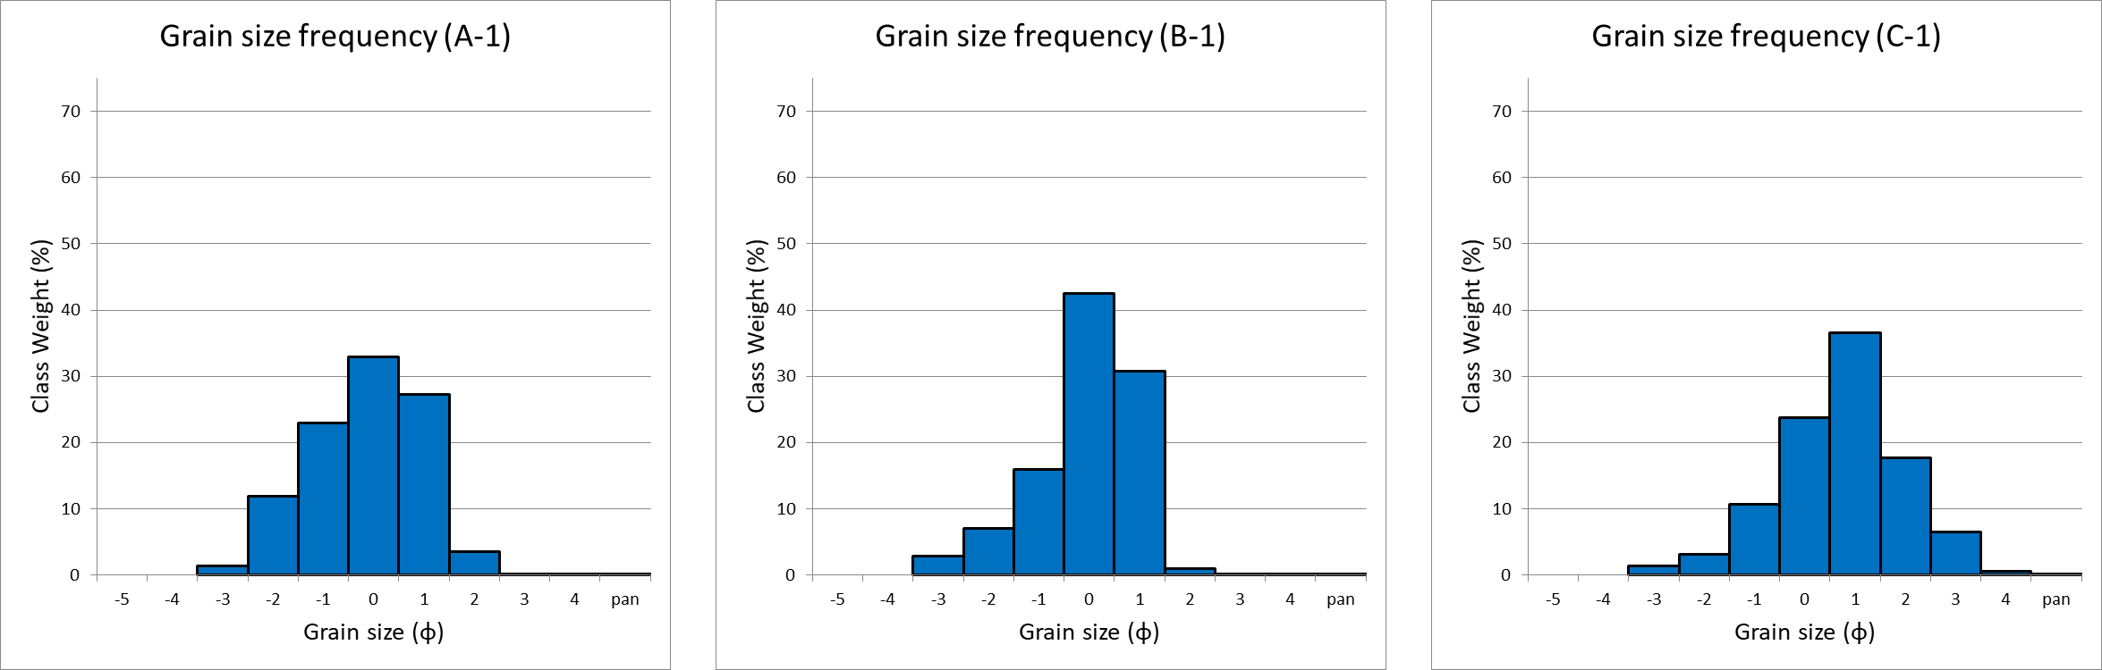
New Dorp Beach and southern Midland Beach. Low tide grain size analysis.
C
Sample | A-1 | B-1 | C-1
Textural Group | Sandy Gravel | Gravelly Sand | Gravelly Sand
Mean grain size | Very Coarse Sand | Very Coarse Sand | Coarse Sand
Sorting | Poorly Sorted | Poorly Sorted | Poorly Sorted
Skewness | Coarse Skewed | Coarse Skewed | Symmetrical
B
A

Slide 10
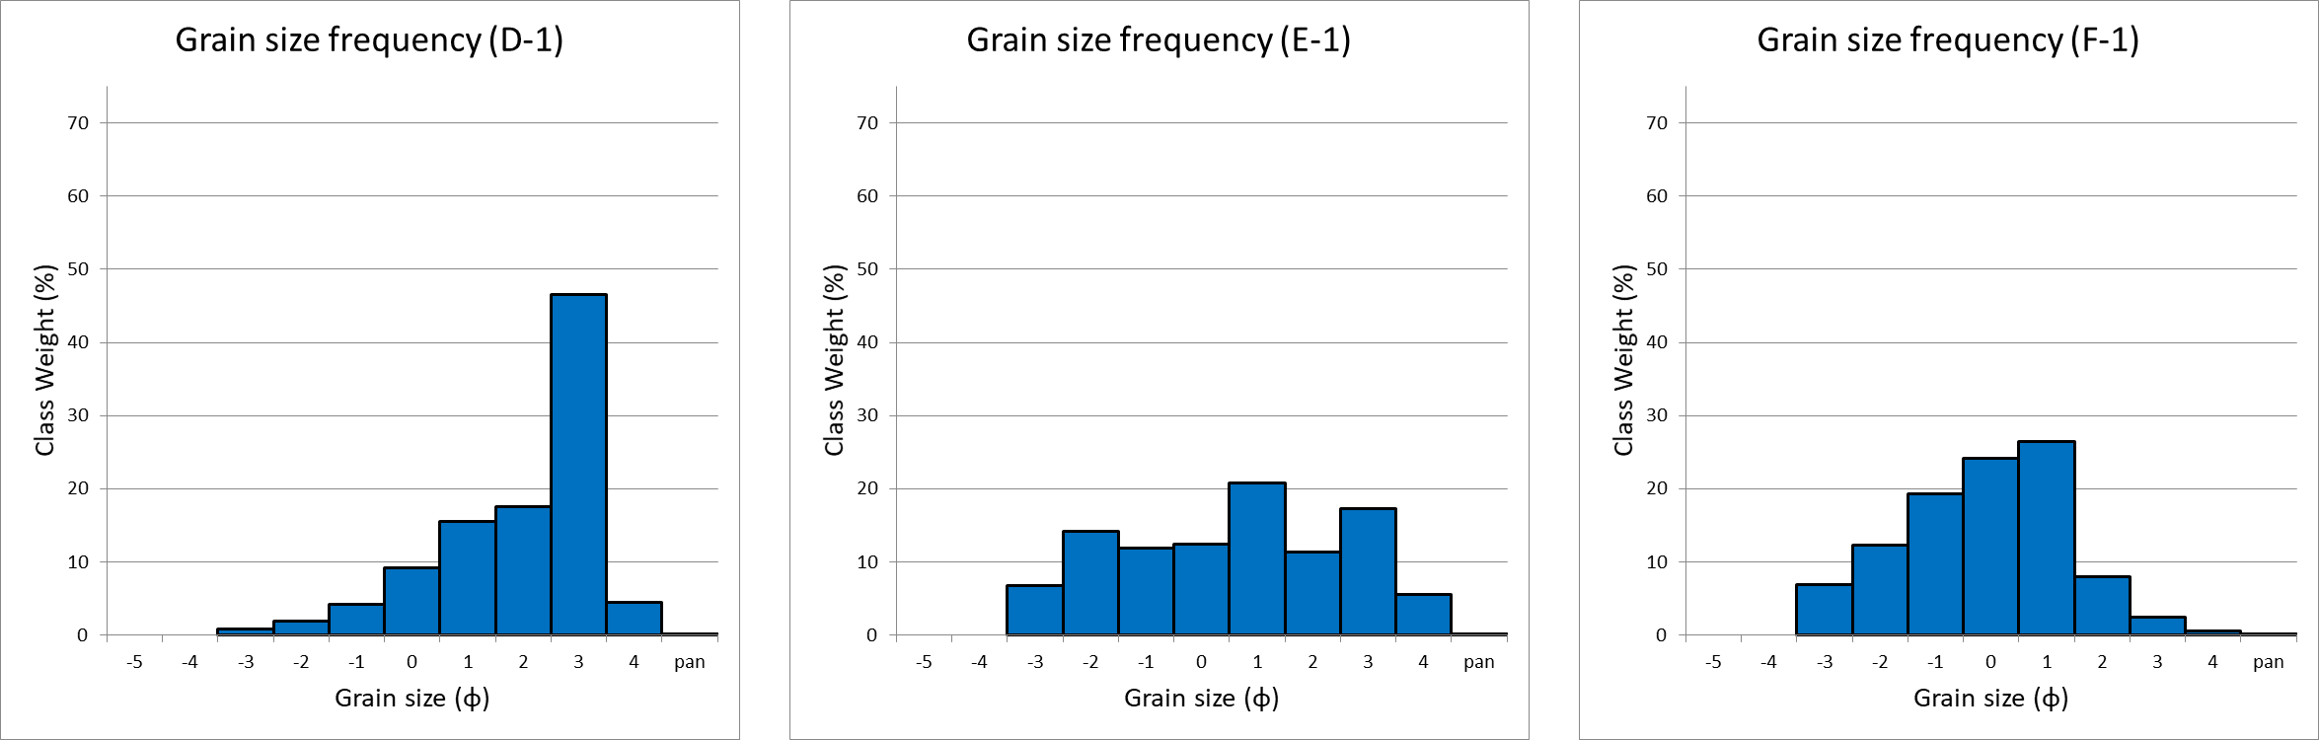
Midland Beach. Low tide grain size analysis.
F
Sample | D-1 | E-1 | F-1
Textural Group | Gravelly Sand | Sandy Gravel | Sandy Gravel
Mean grain size | Medium Sand | Coarse Sand | Very Coarse Sand
Sorting | Poorly Sorted | Very Poorly Sorted | Poorly Sorted
Skewness | Very Coarse Skewed | Symmetrical | Coarse Skewed
E
D

Slide 11
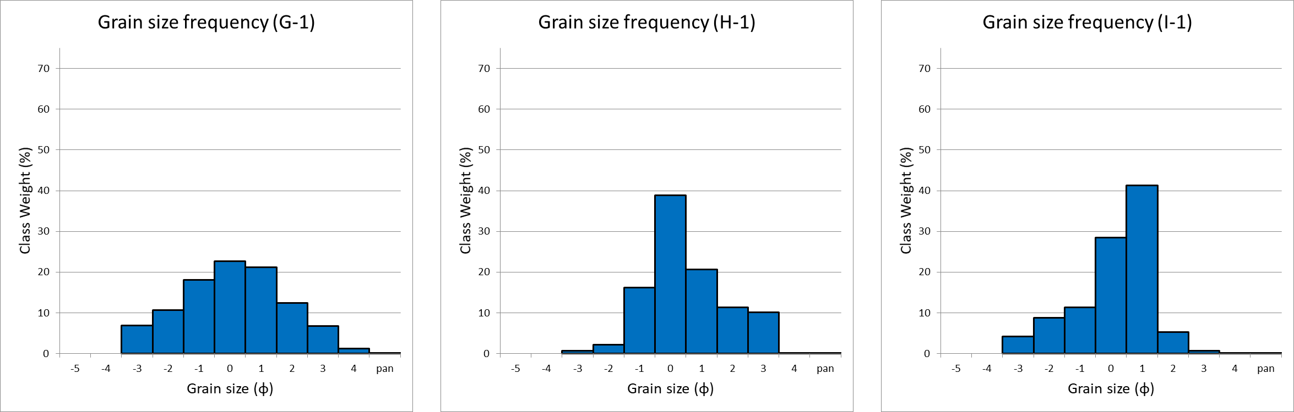
South Beach. Low tide grain size analysis.
I
Sample | G-1 | H-1 | I-1
Textural Group | Sandy Gravel | Gravelly Sand | Gravelly Sand
Mean grain size | Very Coarse Sand | Coarse Sand | Very Coarse Sand
Sorting | Poorly Sorted | Poorly Sorted | Poorly Sorted
Skewness | Symmetrical | Fine Skewed | Very Coarse Skewed
H
G

Slide 12
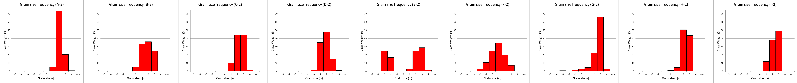
Grain size analysis – High tide
Sample | A-2 | B-2 | C-2 | D-2 | E-2 | F-2 | G-2 | H-2 | I-2
Textural Group | Slightly Gravelly Sand | Slightly Gravelly Sand | Slightly Gravelly Sand | Slightly Gravelly Sand | Sandy Gravel | Gravelly Sand | Slightly Gravelly Sand | Slightly Gravelly Sand | Slightly Gravelly Sand
Mean grain size | Medium Sand | Medium Sand | Medium Sand | Medium Sand | Coarse Sand | Coarse Sand | Fine Sand | Medium Sand | Medium Sand
Sorting | Moderately Well Sorted | Moderately Sorted | Moderately Sorted | Moderately Sorted | Very Poorly Sorted | Poorly Sorted | Moderately Sorted | Moderately Well Sorted | Moderately Sorted
Skewness | Fine Skewed | Symmetrical | Symmetrical | Symmetrical | Very Coarse Skewed | Symmetrical | Very Coarse Skewed | Symmetrical | Coarse Skewed

Slide 13
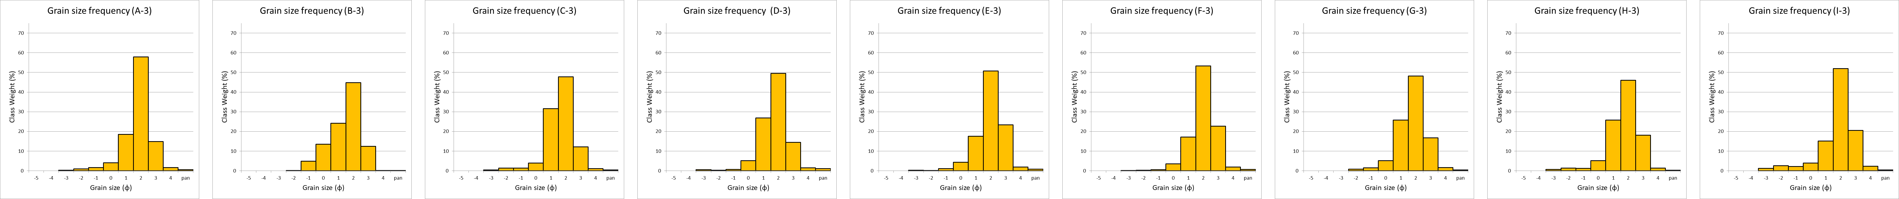
Grain size analysis – base of dune
Sample | A-3 | B-3 | C-3 | D-3 | E-3 | F-3 | G-3 | H-3 | I-3
Textural Group | Slightly Gravelly Sand | Slightly Gravelly Sand | Slightly Gravelly Sand | Slightly Gravelly Sand | Slightly Gravelly Sand | Slightly Gravelly Sand | Slightly Gravelly Sand | Slightly Gravelly Sand | Gravelly Sand
Mean grain size | Medium Sand | Coarse Sand | Medium Sand | Medium Sand | Medium Sand | Medium Sand | Medium Sand | Medium Sand | Medium Sand
Sorting | Moderately Sorted | Poorly Sorted | Moderately Sorted | Moderately Sorted | Moderately Sorted | Moderately Sorted | Moderately Sorted | Poorly Sorted | Poorly Sorted
Skewness | Coarse Skewed | Coarse Skewed | Coarse Skewed | Symmetrical | Symmetrical | Symmetrical | Coarse Skewed | Coarse Skewed | Coarse Skewed

Slide 14
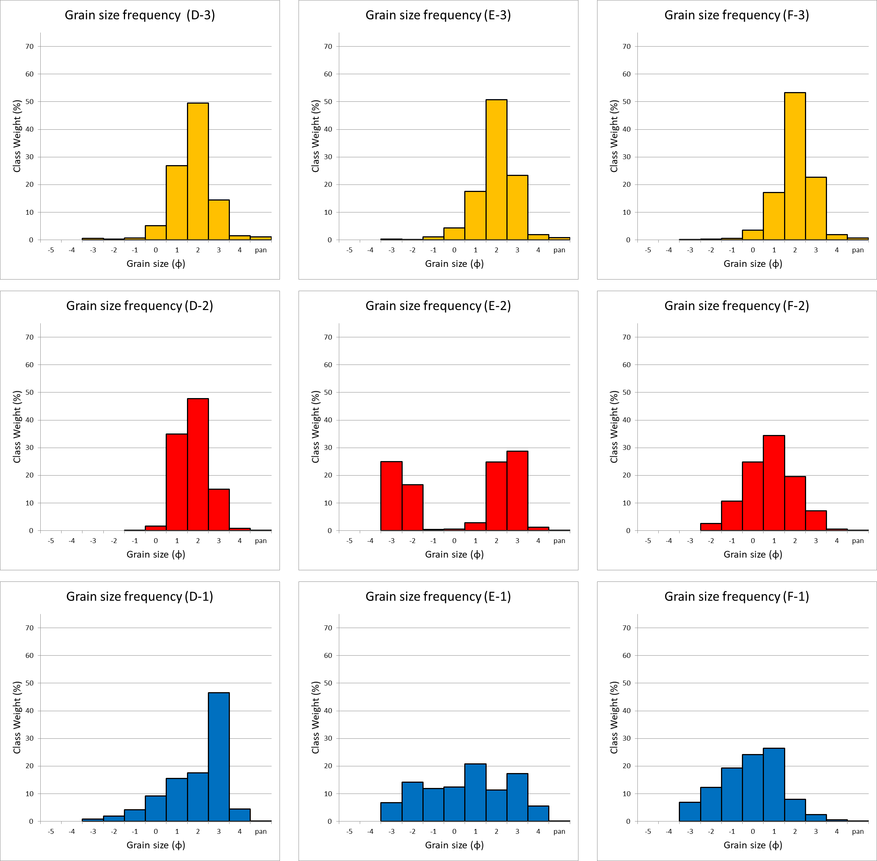
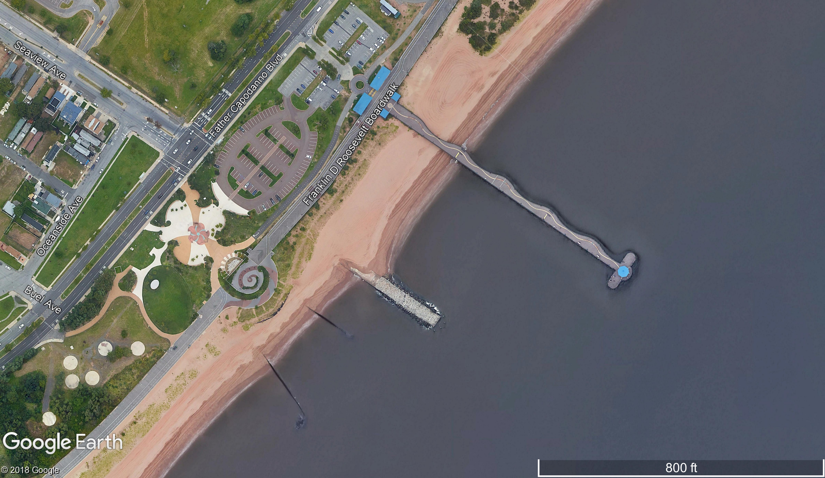
Midland beach – eroded area
F
E
D

Slide 15
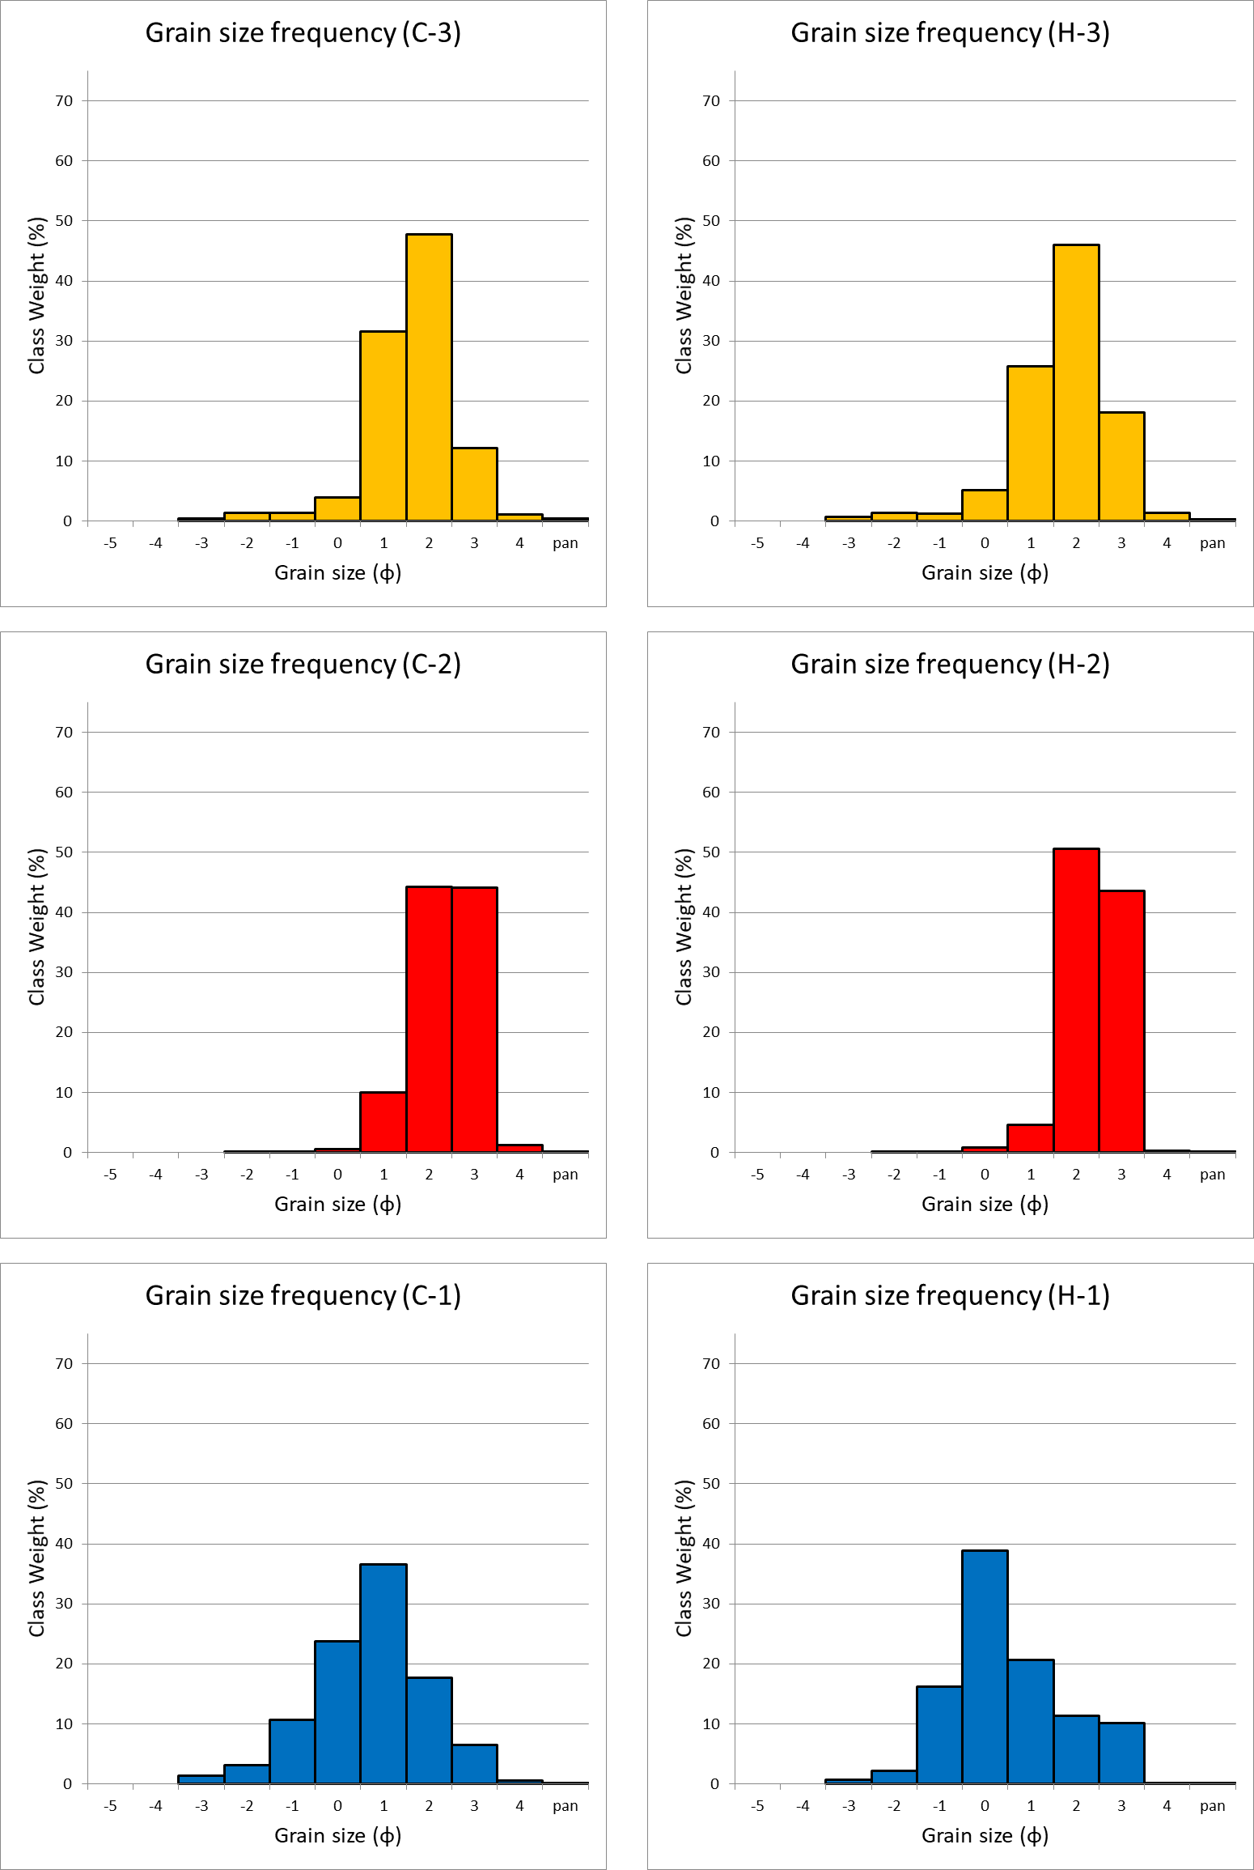
Grain size analysis summary
Beach face sediments medium – very coarse sand, generally poorly sorted
Most coarse sediment at low water mark
Sediment composition more variable in area of high erosion and human disturbance

Slide 16
Wave dominated beaches
Reflective
Beach face slope >4°
Beach face sediment medium – coarse sand
Step at low water mark containing most coarse sediment
No offshore bar
Low sediment transfer as base load
Little variation in beach morphology over the course of a year
Dissipative
Beach face slope <2°
Beach face sediment fine sand
Multiple offshore bars
High sediment transfer as suspended load
Few beaches permanently dissipative, only during storm events
Intermediate beaches are the most dynamic
Reference: Short, A (1999) Handbook of Beach and Shoreface Morphodynamics

Slide 17
Conclusions
Beaches on the east shore of Staten Island are reflective, wave dominated beaches
Beach face slope of 4° - 6°
Sediment is medium to very coarse sand
This results in little temporal variation in morphology, making development seem safe
Vulnerable to storm events
Long waves during storm surge at high (spring) tides likely to lead to overtopping and beach face slumping
Area with high erosion and human disturbance has more fine sediment, making it more vulnerable to further erosion

Slide 18
Future Work
Monitor seasonal changes in morphology and sediment properties
Monitor changes after any major storm events
Compare field survey to 2014 Lidar survey
Extend survey and sampling offshore
Model sediment transport
Investigate influence of sand replenishment and other beach stabilization projects

