Slide 1

INVESTIGATION OF SNOWMELT IMPACT ON TRENDS IN RUNOFF COEFFICIENTS OF FLOODS IN NEW ENGLAND
2019 GSA Northeastern Section
March 18, 2019
Presented by:
Iman Hosseini-Shakib; PhD Candidate at UNH

Slide 2

Future of Dams Project
Four-year NSF EPSCoR grant
Collaborators in NH, ME and RI
Focus on stakeholder engagement (to help the NE communities make complex decisions about dams)
Dam risk as a major factor for decisions about dams
Floods & overtopping are the main reasons of dam breaks

Slide 3
Background
Historical floods in New England
Before establishment of gauging stations
600+ “outstanding” floods since 17th century
Floods with consequences recorded in peoples minds, reports, local papers etc.
(Thomson et al, 1964)

Slide 4
Background
(Thomson et al, 1964)
Monthly Distribution of Historical Floods in New England until 1955

Slide 5
Background
Monthly Relative Frequency of Annual Peaks in NE Stream Gauges
On average, March and April floods account for 53% of annual floods at these gauges.

Slide 6
Background
Collins (2009): “Evidence for Changing Flood Risk in New England Since the Late 20th Century”
Trends in “28 long-term annual flood series for New England watersheds with dominantly natural streamflow”
25 upward trends, 40% of which statistically significant (p < 0.10)
Step change in increasing flood magnitude in 1970’s, synchronous with North Atlantic Oscillation phase change

Slide 7
Research Question
Have runoff production and transfer mechanisms changed in large events in New England?
or
Is there a trend in runoff coefficients of large events in New England?

Slide 8
Methods
No. | USGS Gage Station Number | USGS Gauge Station Name | State
1 | 01010000 | St. John River at Ninemile Bridge | ME
2 | 01010500 | St. John River at Dickey | ME
3 | 01011000 | Allagash River near Allagash | ME
4 | 01013500 | Fish River near Fort Kent | ME
5 | 01014000 | St. John River below Fish River at Fort Kent | ME
6 | 01022500 | Narraguagus River at Cherryfield | ME
7 | 01030500 | Mattawamkeag River near Mattawamkeag | ME
8 | 01031500 | Piscataquis River near Dover-Foxcroft | ME
9 | 01038000 | Sheepscot River at North Whitefield | ME
10 | 01047000 | Carrabassett River near North Anson | ME
11 | 01052500 | Diamond River near Wentworth Location | NH
12 | 01055000 | Swift River near Roxbury | ME
13 | 01057000 | Little Androscoggin River near South Paris | ME
14 | 01064500 | Saco River near Conway | NH
15 | 01073000 | Oyster River near Durham | NH
16 | 01076500 | Pemigewasset River at Plymouth | NH
17 | 01078000 | Smith River near Bristol | NH
18 | 01121000 | Mount Hope River near Warrenville | CT
19 | 01134500 | Moose River at Victory | VT
20 | 01137500 | Ammonoosuc River at Bethlehem Junction | NH
21 | 01142500 | Ayers Brook at Randolph | VT
22 | 01144000 | White River at West Hartford | VT
23 | 01169000 | North River at Shattuckville | MA
24 | 01181000 | West Branch Westfield River at Huntington | MA
25 | 01188000 | Burlington Brook near Burlington | CT
26 | 01193500 | Salmon River near East Hampton | CT
27 | 01196500 | Quinnipiac River at Wallingford | CT
28 | 01204000 | Pomperaug River at Southbury | CT
Follow-up on the work of Collins (2009) using same 28 stream flow gauge stations,
ArcGIS for basin delineation and R for data analysis
Collins, 2009

Slide 9
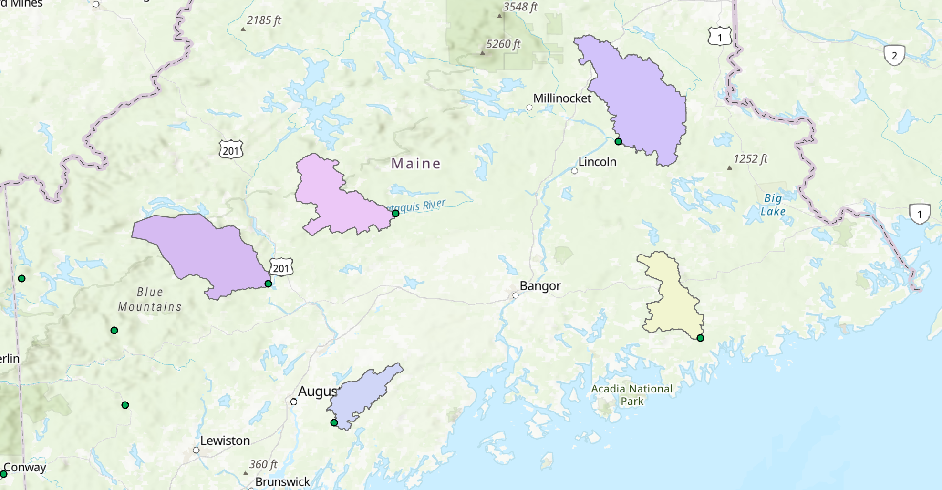
Methods
Delineation of basins upstream of gauges in ArcGIS using USGS 10m DEMs,
Using USGS daily stream flow data,
Using PRISM daily precipitation data with 4km resolution from 1981-2006

Slide 10
Methods
Cropping gridded NetCDF precipitation files for each basin
Taking average of grid cells of a basin for daily precipitation and making P and R timeseries.
U
=
US NetCDF Basin Shapefile Cropped NetCDF

Slide 11
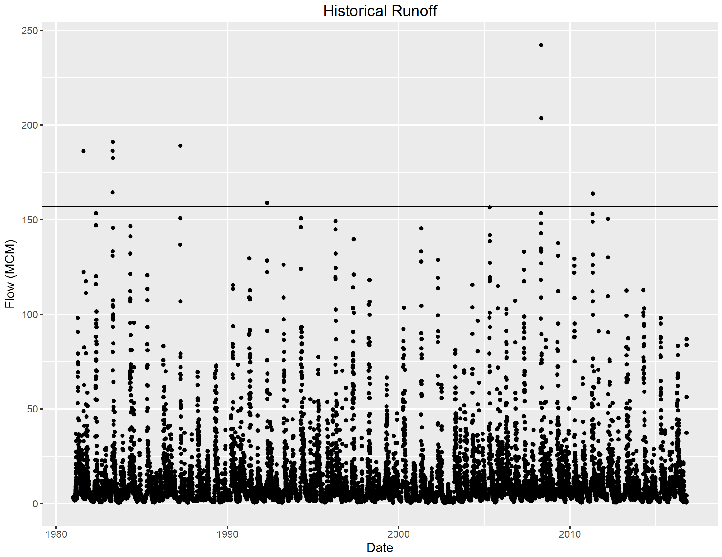
Methods
Flood frequency analysis, finding 5-year floods
Separating floods larger than 5-year magnitude
Forming timeseries of large events ±15 days and finding C,
Trend analysis using Mann-Kendall method.

Slide 12
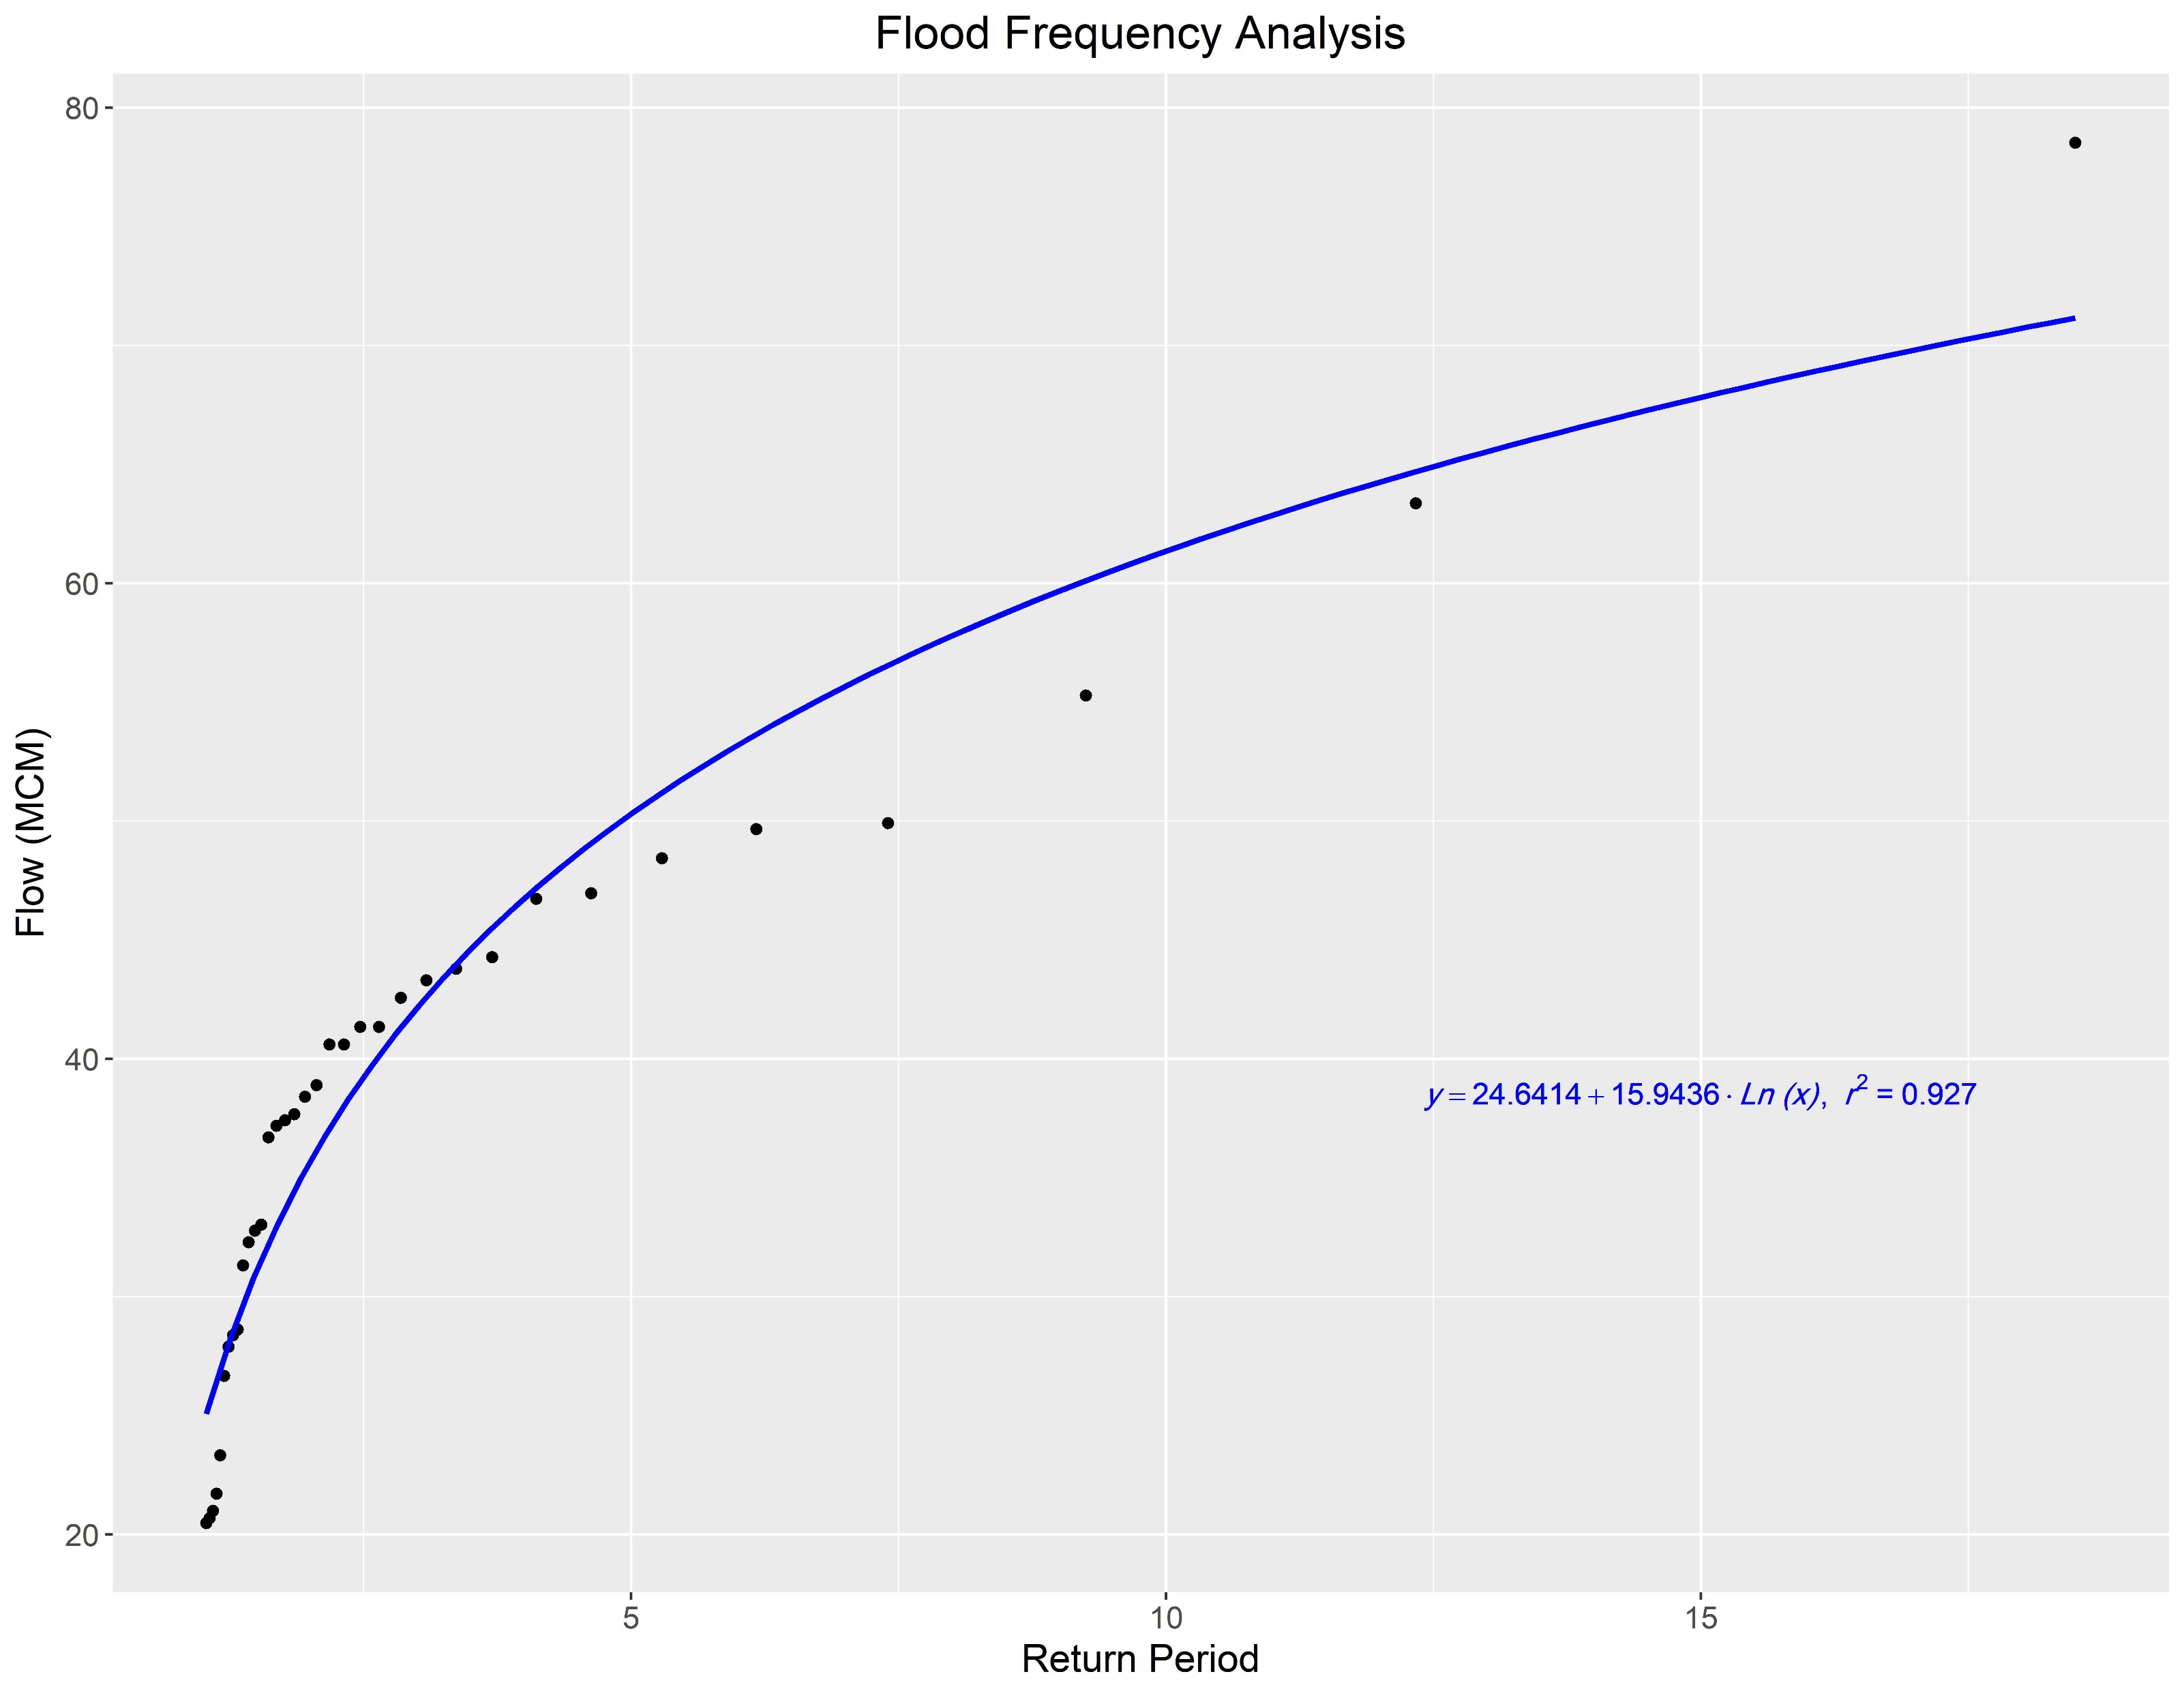
Results
At each station:
Flood frequency analysis tables and graphs
Calculated 5-yr floods based on the obtained equation of flow vs. return period

Slide 13
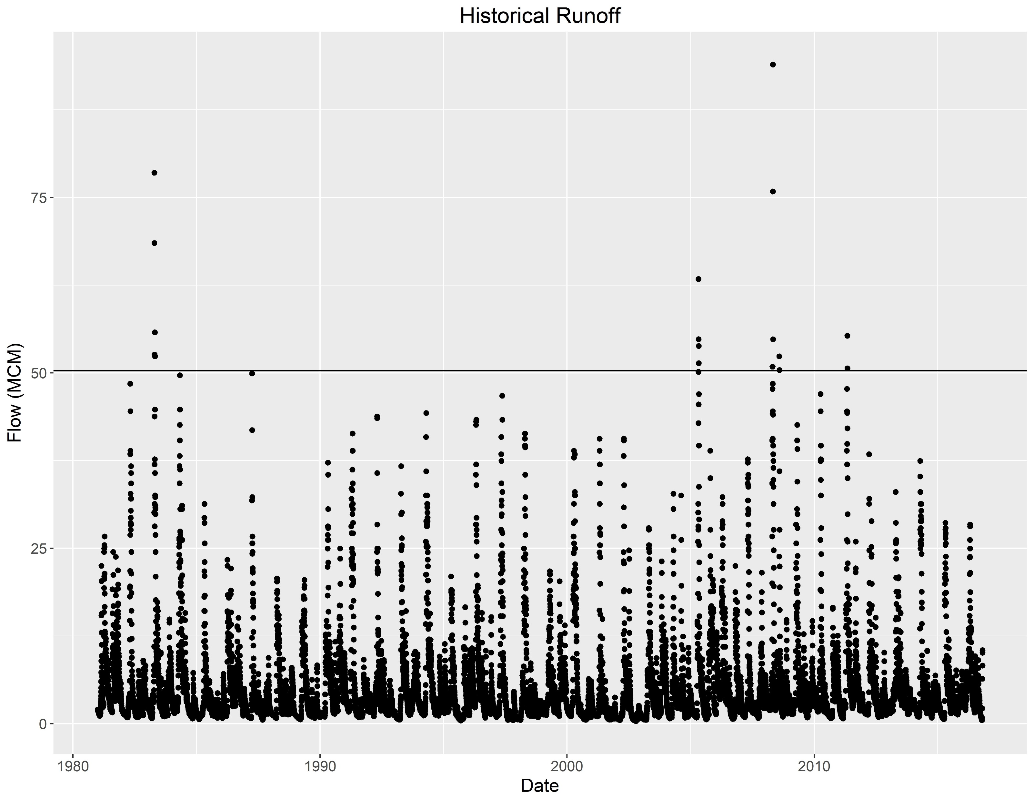
Results
At each station:
Days of large events
Tables and graphs of monthly frequency of events
5-yr Flood

Slide 14
Results
225 large events
65% of floods in March, April & May
Average runoff coefficient of a large event in New England is 1.44
Relative frequency of floods in New England

Slide 15
Results
Month | Relative Frequency | Average C
Apr | 43.6% | 1.95
May | 12.4% | 1.53
Mar | 9.3% | 1.78
Jun | 7.1% | 0.60
Oct | 7.1% | 0.62
Aug | 6.7% | 0.53
Dec | 5.3% | 0.89
Sep | 3.1% | 0.53
Jan | 2.7% | 0.92
Feb | 1.3% | 1.21
Jul | 0.9% | 0.80
Nov | 0.4% | 0.59
Average Runoff Coefficients of floods in New England

Slide 16
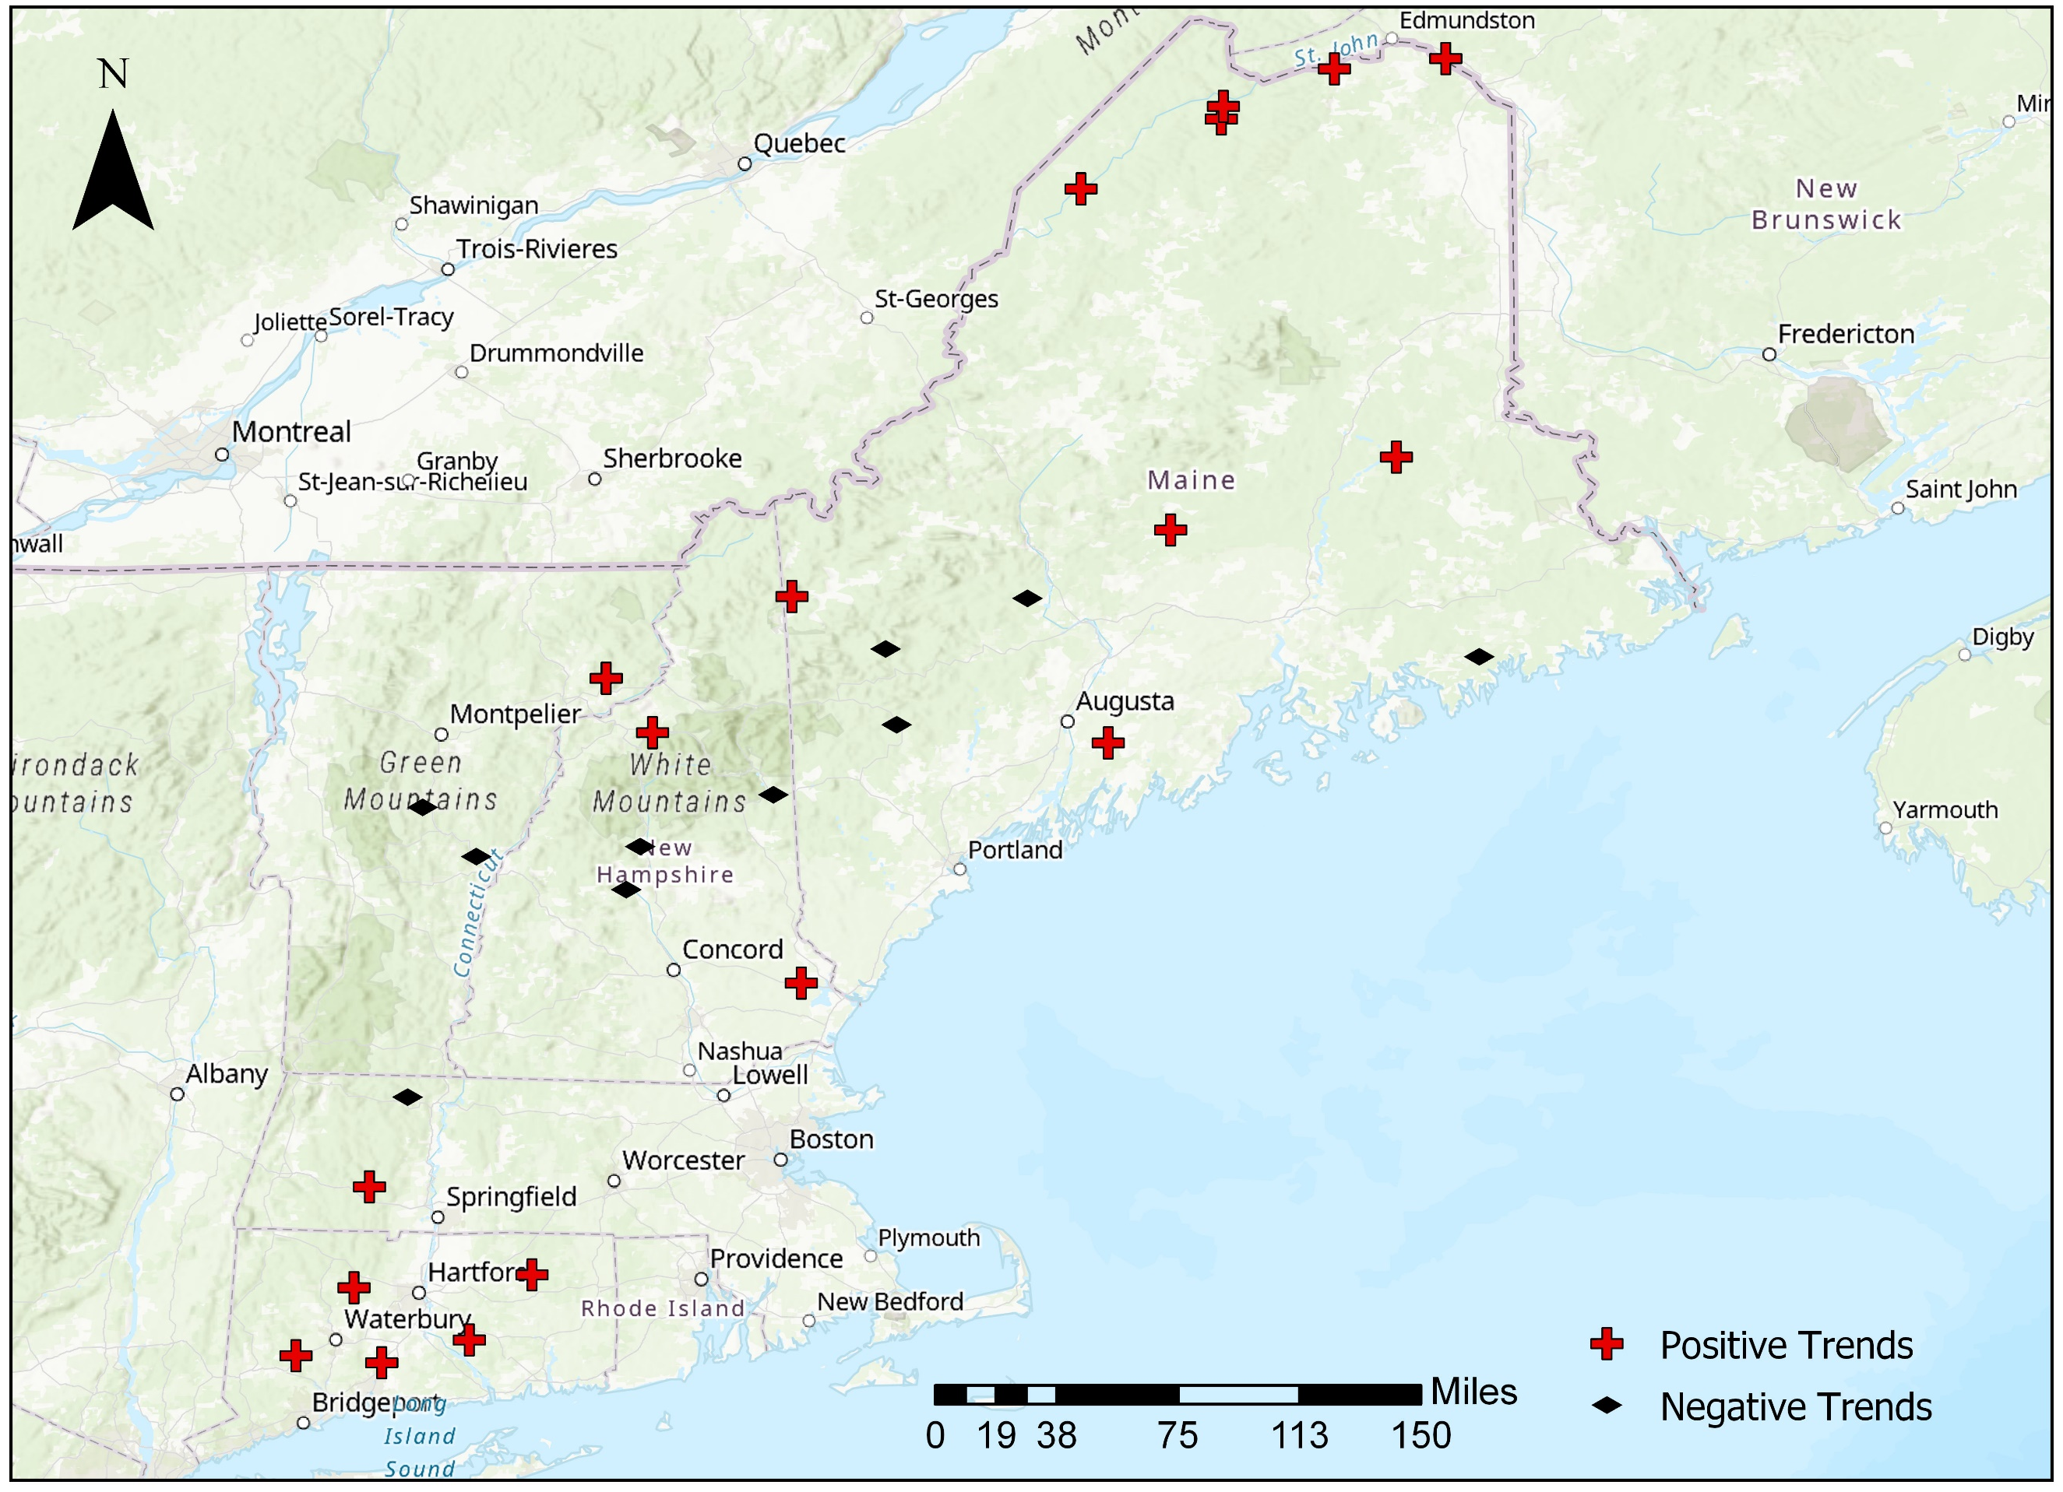
Results

Slide 17
Results
No. | USGS Gage Station Number | USGS Gauge Station Name | State | Latitude | Longitude | Drainage Area (sq. km.) | Mann-Kendall S-value | Mann-Kendall p-value | Trend | Significance at 90% CL
1 | 01010000 | St. John River at Ninemile Bridge | ME | 46.7006 | -69.7156 | 3473 | 22 | 0.01 | + | Yes
2 | 01010500 | St. John River at Dickey | ME | 47.0131 | -69.0881 | 6941 | 13 | 0.07 | + | Yes
3 | 01011000 | Allagash River near Allagash | ME | 47.0697 | -69.0794 | 3828 | 6 | 0.60 | + | No
4 | 01013500 | Fish River near Fort Kent | ME | 47.2375 | -68.5828 | 2261 | 12 | 0.17 | + | No
5 | 01014000 | St. John River below Fish River at Fort Kent | ME | 47.2833 | -68.0853 | 15317 | 15 | 0.21 | + | No
6 | 01022500 | Narraguagus River at Cherryfield | ME | 44.6081 | -67.9353 | 588 | -9 | 0.23 | - | No
7 | 01030500 | Mattawamkeag River near Mattawamkeag | ME | 45.5011 | -68.3058 | 3673 | 12 | 0.17 | + | No
8 | 01031500 | Piscataquis River near Dover-Foxcroft | ME | 45.1750 | -69.3147 | 772 | 12 | 0.25 | + | No
9 | 01038000 | Sheepscot River at North Whitefield | ME | 44.2228 | -69.5939 | 376 | 7 | 0.37 | + | No
10 | 01047000 | Carrabassett River near North Anson | ME | 44.8692 | -69.9550 | 914 | -8 | 0.47 | - | No
11 | 01052500 | Diamond River near Wentworth Location | NH | 44.8775 | -71.0075 | 394 | 3 | 0.76 | + | No
12 | 01055000 | Swift River near Roxbury | ME | 44.6428 | -70.5889 | 251 | -9 | 0.47 | - | No
13 | 01057000 | Little Androscoggin River near South Paris | ME | 44.3039 | -70.5397 | 190 | -5 | 0.45 | - | No
14 | 01064500 | Saco River near Conway | NH | 43.9908 | -71.0906 | 997 | -1 | 1.00 | - | No
15 | 01073000 | Oyster River near Durham | NH | 43.1486 | -70.9656 | 31.5 | 4 | 0.71 | + | No
16 | 01076500 | Pemigewasset River at Plymouth | NH | 43.7592 | -71.6861 | 1611 | -16 | 0.06 | - | Yes
17 | 01078000 | Smith River near Bristol | NH | 43.5664 | -71.7483 | 222 | -10 | 0.27 | - | No
18 | 01121000 | Mount Hope River near Warrenville | CT | 41.8436 | -72.1694 | 74 | 11 | 0.13 | + | No
19 | 01134500 | Moose River at Victory | VT | 44.5117 | -71.8378 | 195 | 2 | 0.81 | + | No
20 | 01137500 | Ammonoosuc River at Bethlehem Junction | NH | 44.2686 | -71.6308 | 227 | 3 | 0.76 | + | No
21 | 01142500 | Ayers Brook at Randolph | VT | 43.9344 | -72.6583 | 79 | -3 | 0.86 | - | No
22 | 01144000 | White River at West Hartford | VT | 43.7142 | -72.4186 | 1787 | -9 | 0.47 | - | No
23 | 01169000 | North River at Shattuckville | MA | 42.6383 | -72.7256 | 231 | -6 | 0.54 | - | No
24 | 01181000 | West Branch Westfield River at Huntington | MA | 42.2372 | -72.8961 | 244 | 3 | 0.76 | + | No
25 | 01188000 | Burlington Brook near Burlington | CT | 41.7861 | -72.9653 | 10.6 | 9 | 0.47 | + | No
26 | 01193500 | Salmon River near East Hampton | CT | 41.5522 | -72.4497 | 259 | 10 | 0.27 | + | No
27 | 01196500 | Quinnipiac River at Wallingford | CT | 41.4503 | -72.8413 | 298 | 6 | 0.54 | + | No
28 | 01204000 | Pomperaug River at Southbury | CT | 41.4819 | -73.2246 | 195 | 6 | 0.60 | + | No

Slide 18
Next Step
Investigation of trends in basins with higher anthropogenic manipulation

Slide 19
Thank You!

