Slide 1
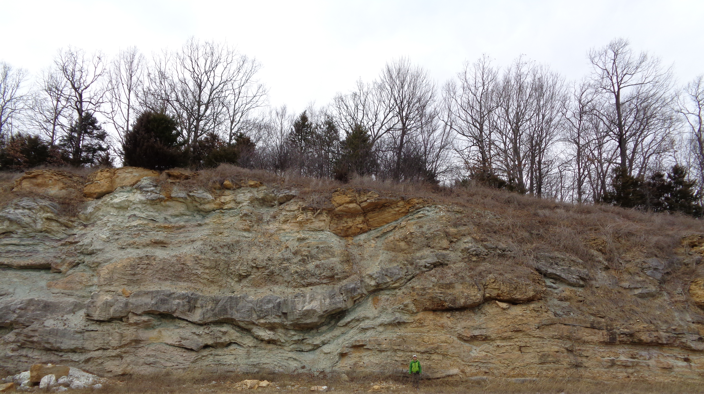


DETRITAL ZIRCON GEOCHRONOLOGY OF PALEOZOIC CLASTICS OF THE OZARK PLATEAU: IMPLICATION FOR SEA-LEVEL FLUCTUATION & FAR-FIELD TECTONICS
Chen Zhao, J. P. Hogan, J. Obrist-Farner, & A. D. Chapman*
Missouri University of Science and Technology, Rolla, MO
*Macalester College, St. Paul, MN
“Filled Sink Structure”

Slide 2
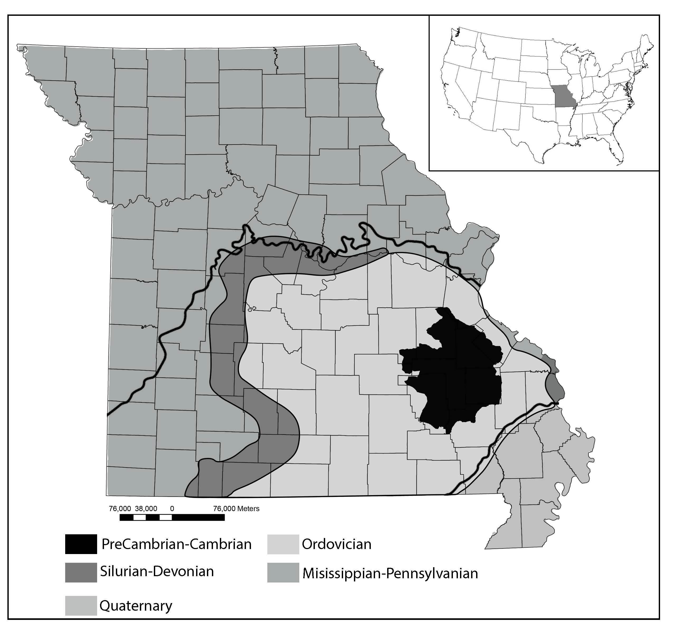
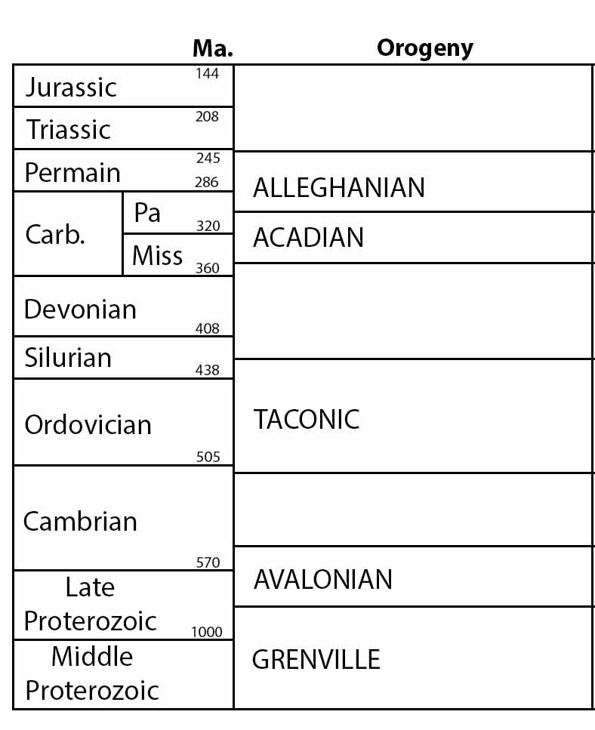
BACKGROUND
1
The Ozark Plateau, central Missouri
Mean altitude: 1000’ (305m)
Tectonics
Modified from Hatcher et al., (1989)
Modified from Greitens, Department of Natural Resource (2017)

Slide 3
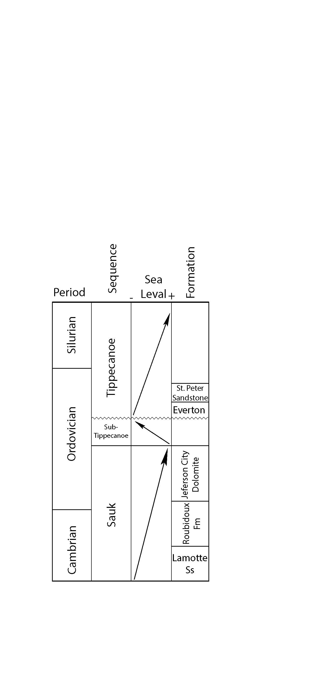
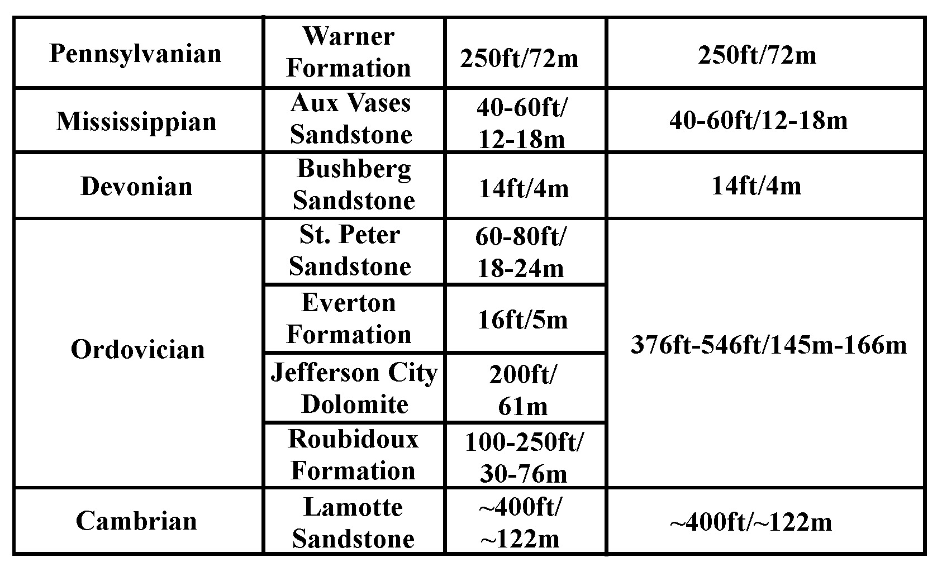
BACKGROUND
2
Stratigraphy
Widespread carbonate
Sea-Level Fluctuation

Slide 4
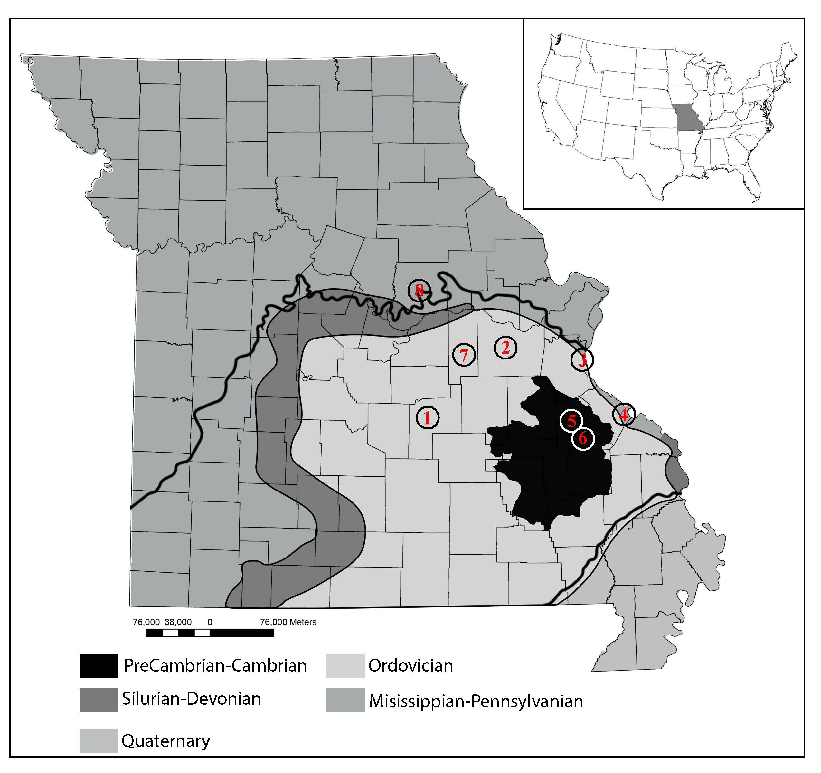
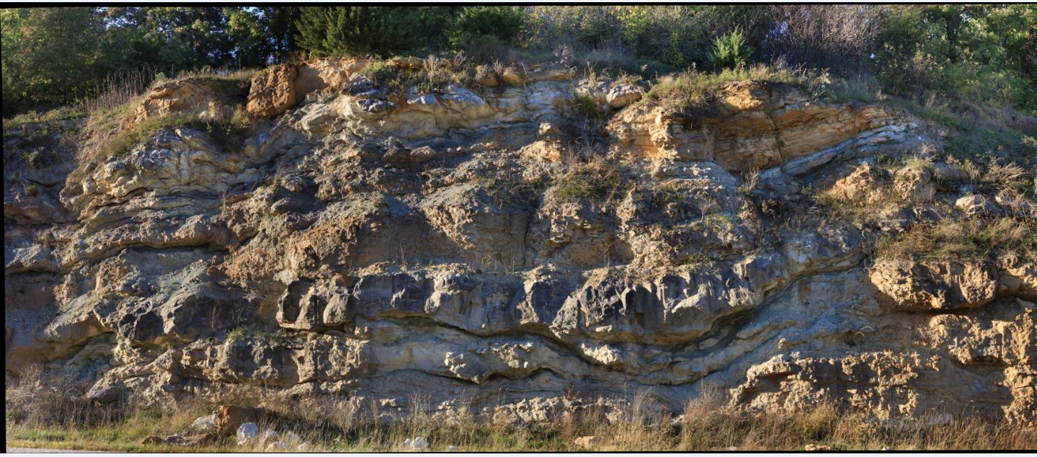
BACKGROUND
3
“Filled sink structure”
Unconformable bottom
Carbonate country rock
Filling with younger sediments
Capped by sandstone
2m
Bretz, (1950)

Slide 5
METHOD
4
Detrital Zircon U-Pb Geochronology
CZ-5 & CZ-6 Warner Formation (8)
14MO3 Aux Vases Formation (4)
14MO4 Bushberg Formation (3)
14MO6 Filled sink structure (2)
CZ-1 & CZ-2 Jefferson City Dolomite & Everton Formation (7)
13MO1 Roubidoux Formation (1)
14MO1 Lamotte Sandstone (Upper) (5)
14MO2 Lamotte Sandstone (Bottom) (6)

Slide 6
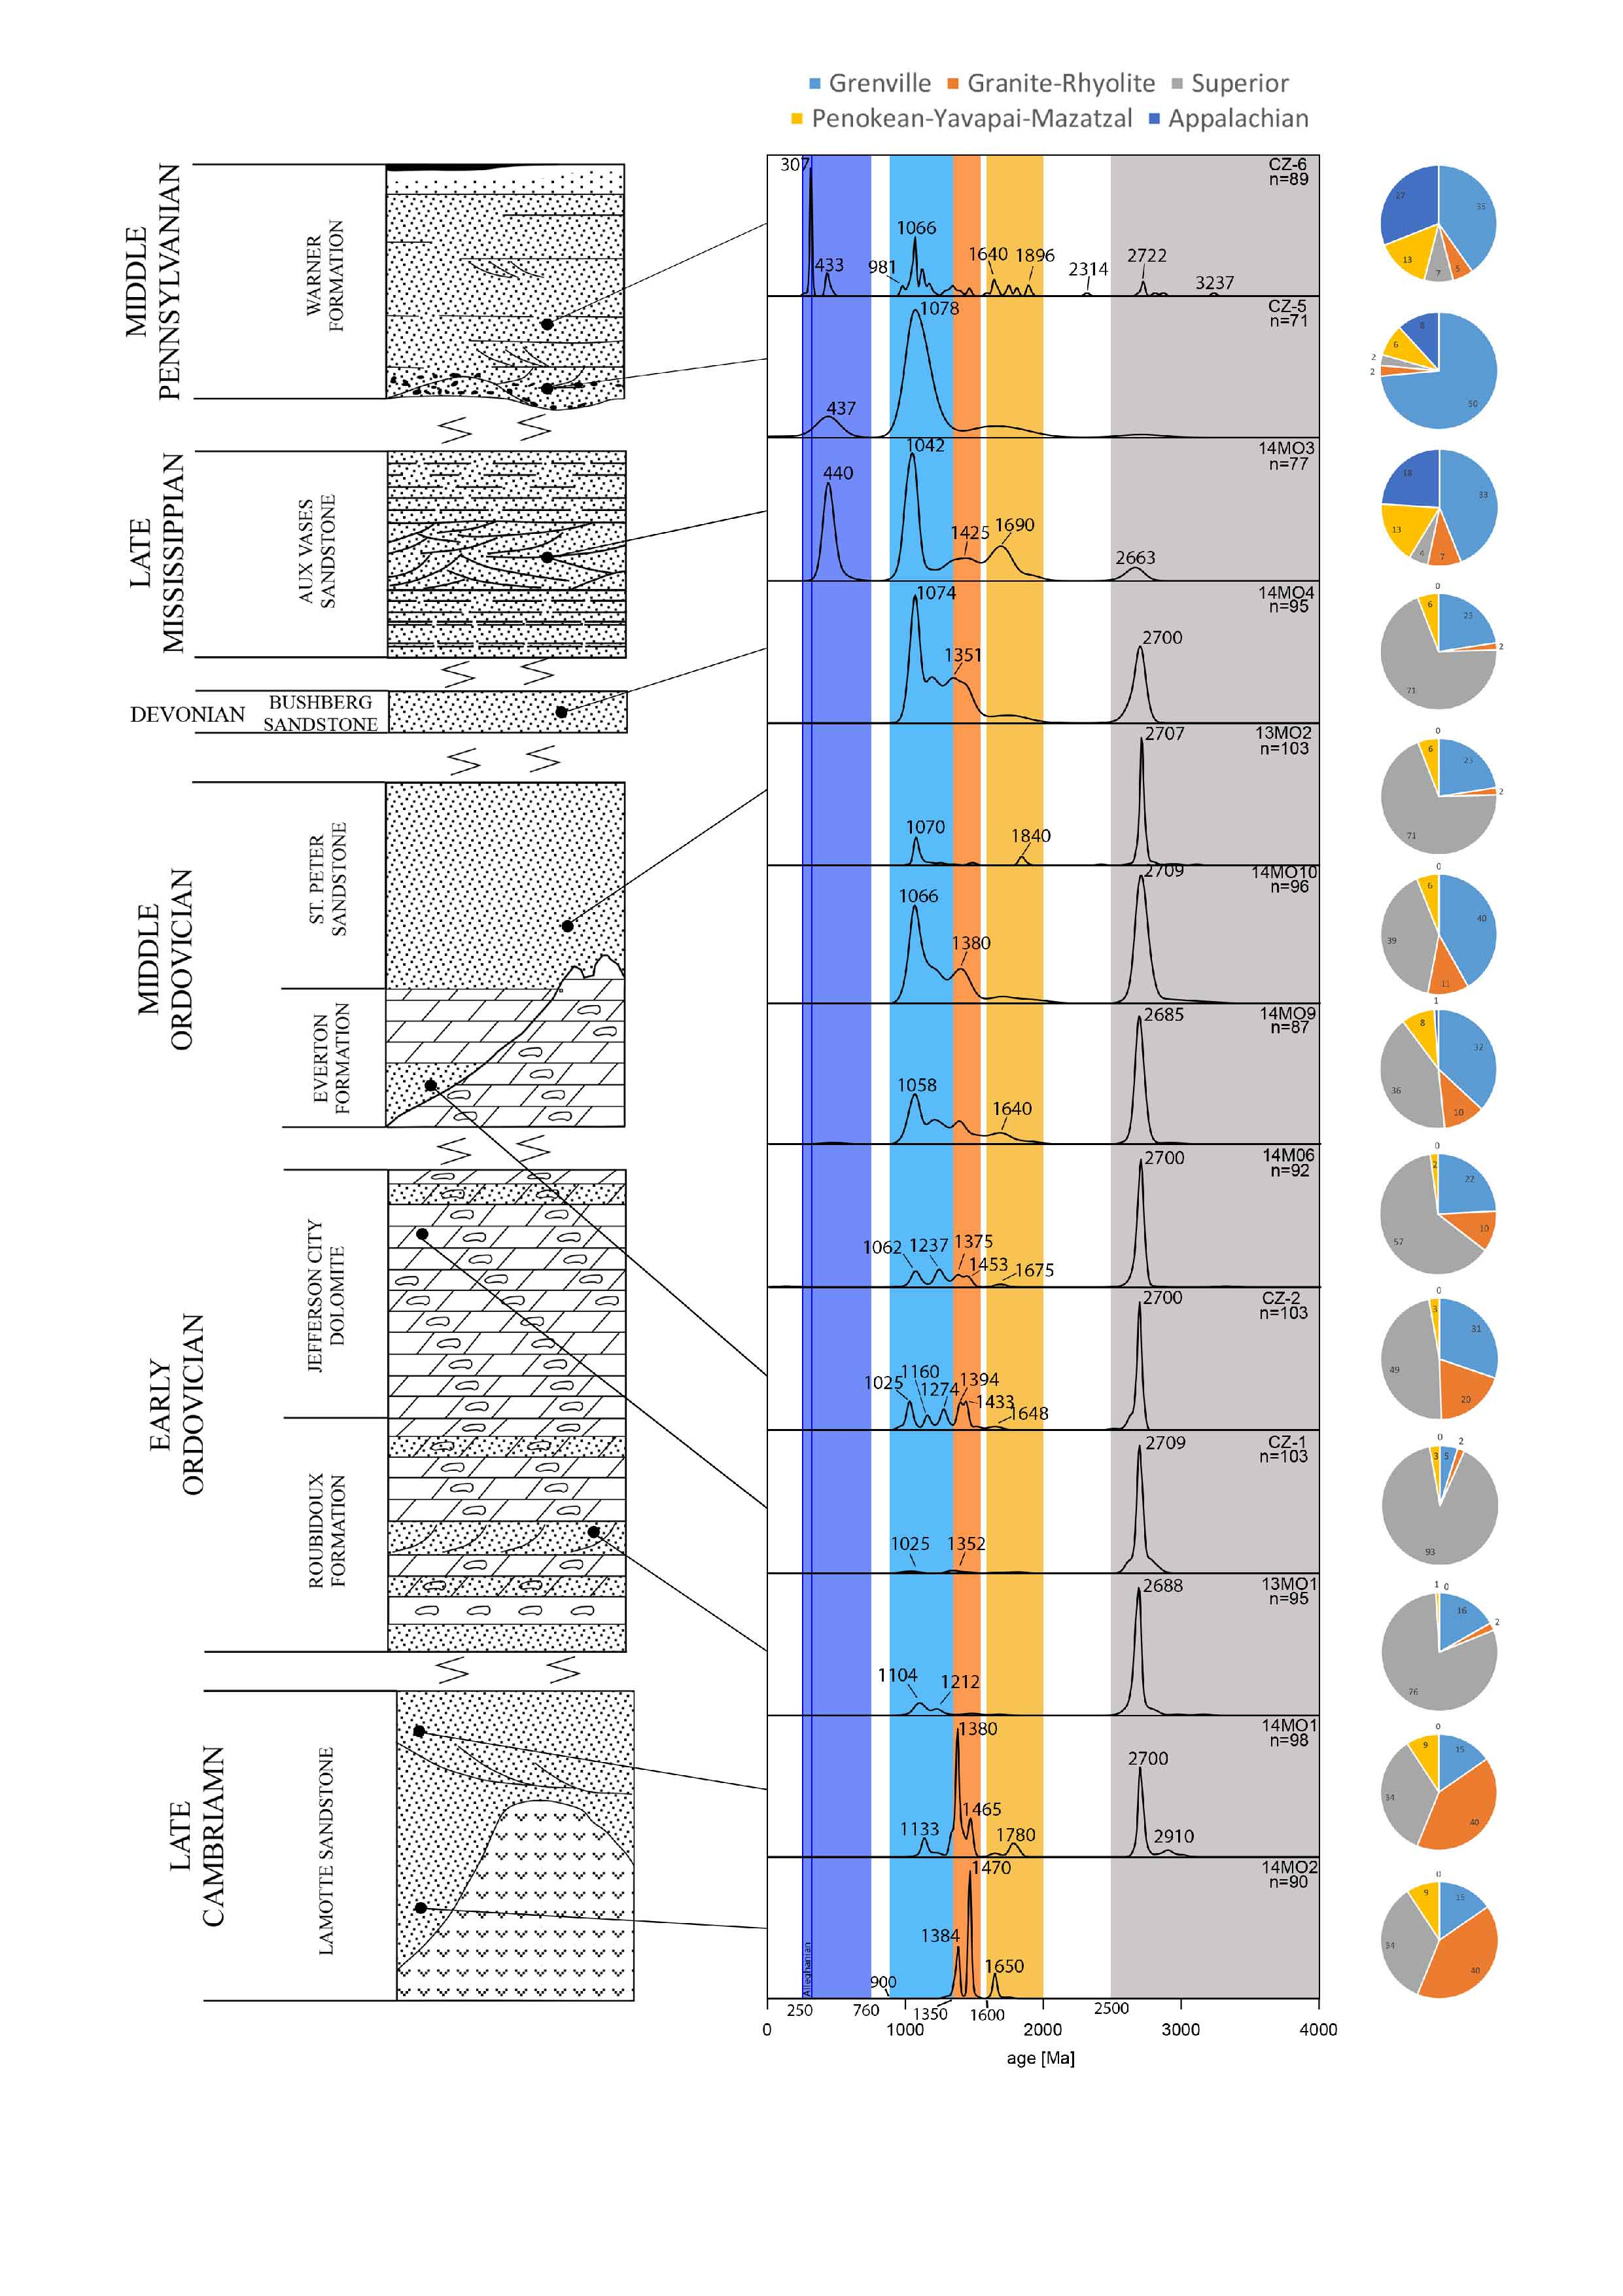
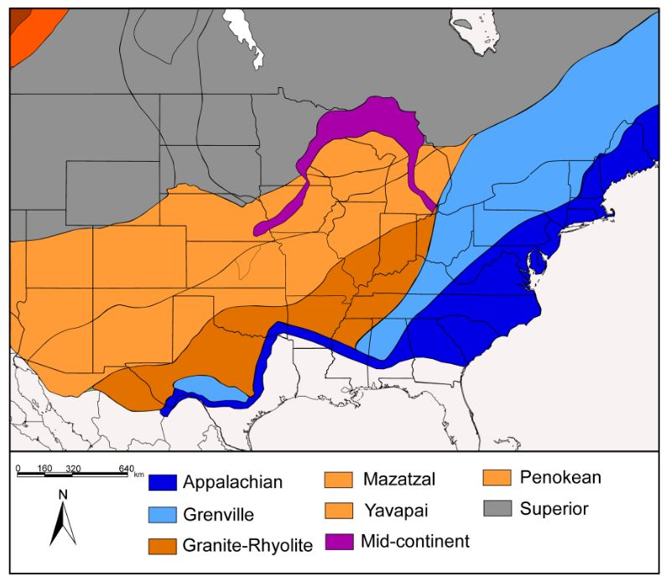
RESULTS
5
Kernel Density Estimation
13 samples
Total 1302 grains
Five populations
Superior
Penokean-Yavapai-Mazatzal
Granite-Rhyolite
Grenville
Appalachian

Slide 7
PROVENANCE
6
Late Cambrian Lamotte Sandstone

Slide 8
PROVENANCE
7
Early & Middle Ordovician
Superior
Wide coverage of 2000-900Ma
St. Peter Sandstone
Everton Fm
Jefferson City Dolomite
Roubidoux Fm

Slide 9
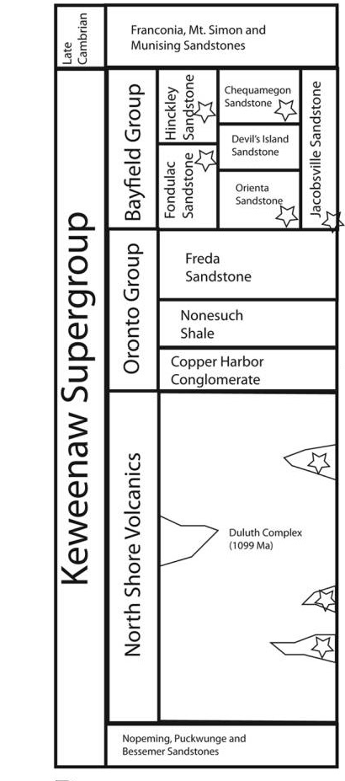
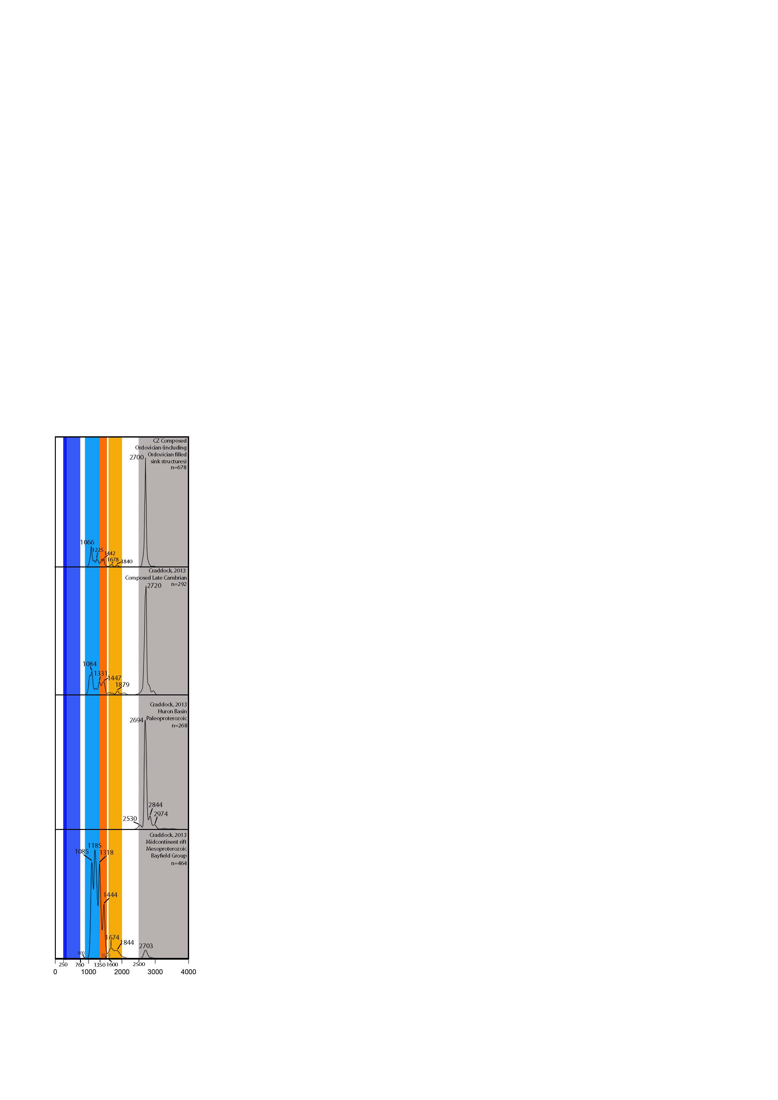
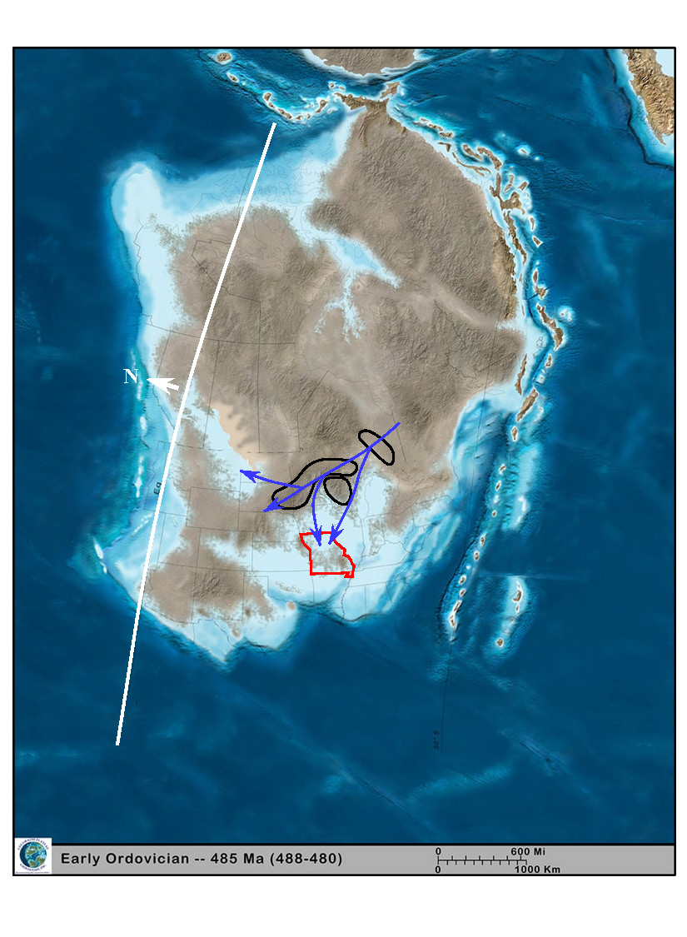
PROVENANCE
8
Early & Middle Ordovician
Ozark Plateau
HB
MCR: Mid-Continent Rift
HB: Huron Basin
MCR
HB
MCR
Bayfield
MCR
Late Є
Craddock, J. P., et al.,(2013).

Slide 10
PROVENANCE
9
Early & Middle Ordovician
Ozark Plateau
HB
MCR
MCR
Late Є

Slide 11
PROVENANCE
10
Devonian Bushberg Sandstone
Grenville Superior

Slide 12
PROVENANCE
11
Late Paleozoic Aux Vases Sandstone & Warner Fm
Grenville
Appalachian
Appalachian
Foreland Basin
Warner Fm (Upper)
Warner Fm (Bottom)
Aux Vases Sandstone

Slide 13
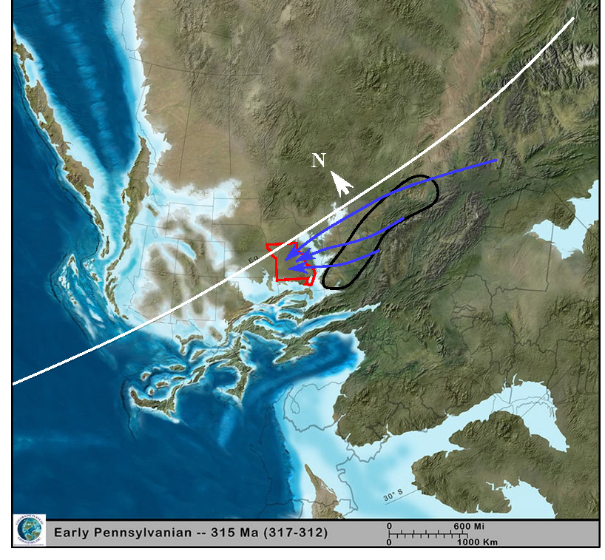
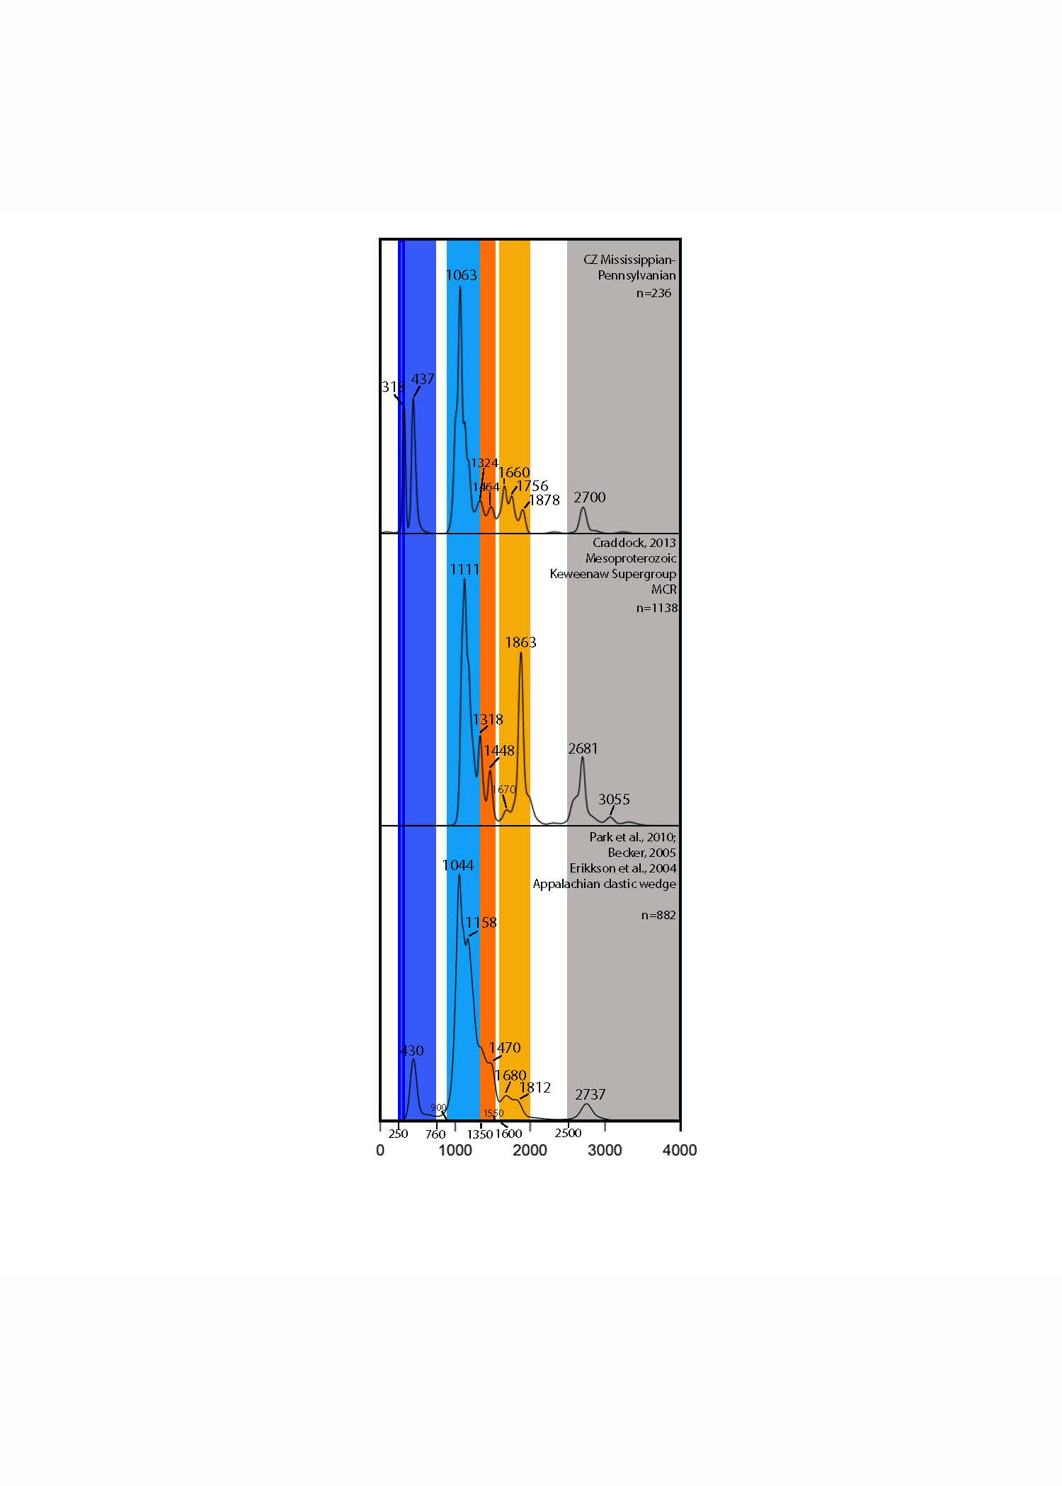
PROVENANCE & DISPERSAL PATH OF CLASTIC SEDIMENTS
12
Late Paleozoic Aux Vases Sandstone & Warner Fm
AFB:
Appalachian Foreland Basin
Ozark Plateau
AFB
AFB
MCR

Slide 14
PROVENANCE & DISPERSAL PATH OF CLASTIC SEDIMENTS
13
Late Paleozoic Aux Vases Sandstone & Warner Fm
AFB:
Appalachian Foreland Basin
Ozark Plateau
AFB
AFB

Slide 15
ORIGIN OF “PENNSYLVANIAN FILLED SINK” STRUCTURES
14
“Filled sink structure”
Superior
Wide coverage of 2000-900Ma
2m

Slide 16
ORIGIN OF “PENNSYLVANIAN FILLED SINK” STRUCTURES
15
Mississippian & Pennsylvanian
Ordovician “Filled Sink Structure”
Ordovician
“Pennsylvanian Filled Sink” Structure

Slide 17
ORIGIN OF “PENNSYLVANIAN FILLED SINK” STRUCTURES
16
Shoreface structures
Sea-Level Fluctuation
(Little, 2004)

Slide 18
ORIGIN OF “PENNSYLVANIAN FILLED SINK” STRUCTURES
17
Shoreface structures
Sea-Level Fluctuation
2m

Slide 19
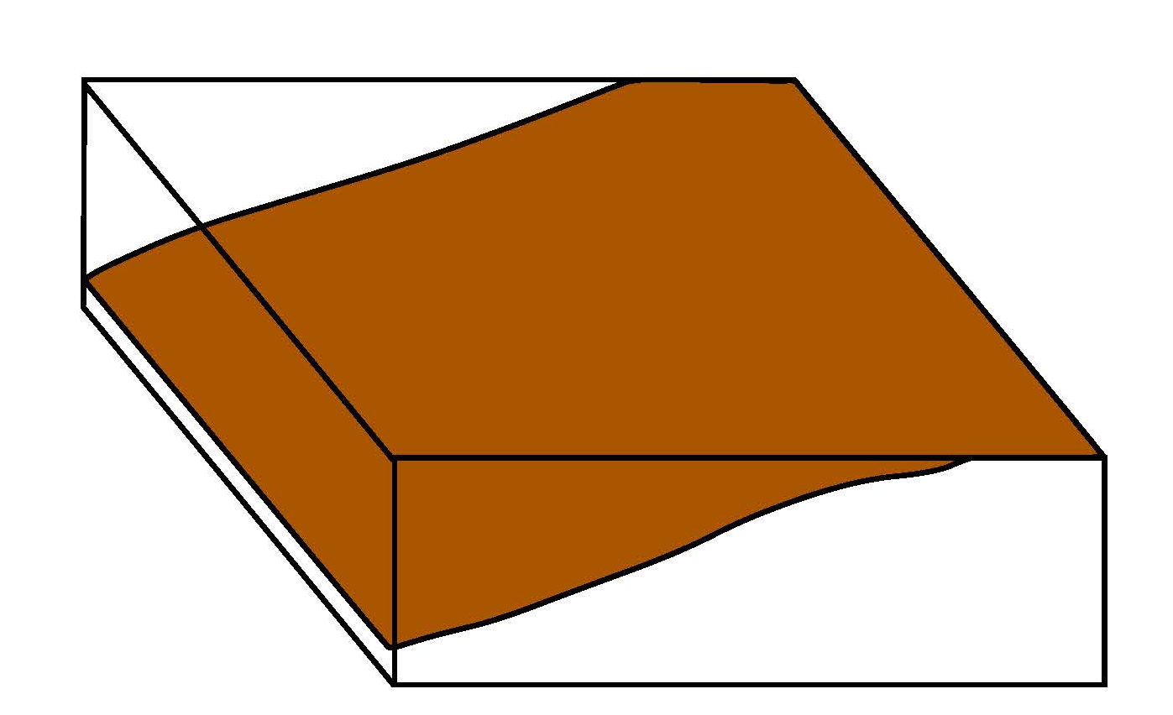
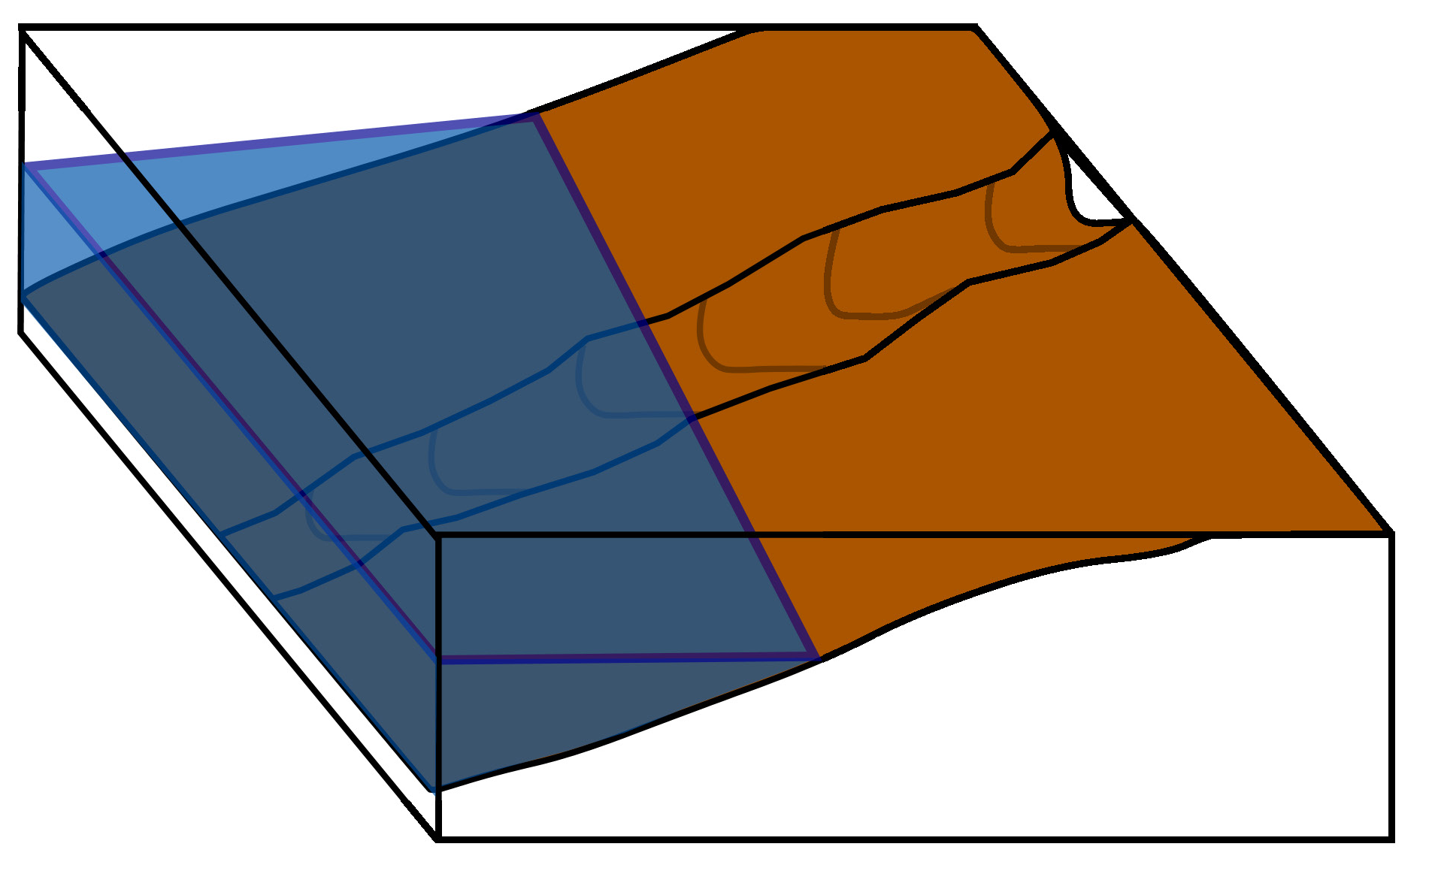
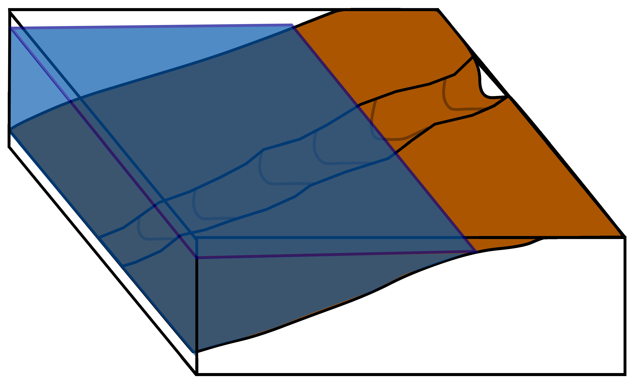
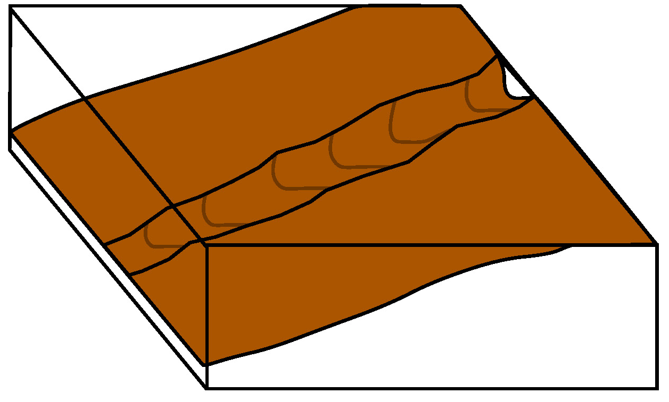
ORIGIN OF “PENNSYLVANIAN FILLED SINK” STRUCTURES
18
N
2m

Slide 20
CONCLUSIONS
19
The Ozark Plateau Provenance & Regional Tectonics
Cambrian, Local Sources transition to Canadian Shield
Ordovician, Sediment Sourced from the Mid-Continent Rift
Ordovician, Ozark Plateau uplifted and eroded (Taconic Orogeny (?))
Mississippian Sediments sourced from Appalachians
Taconic, Acadian, and Alleghanian Orogeny

Slide 21

CONCLUSIONS
20
Origin of the “filled sink” structures
Produced by the Ordovician sea-level fluctuations in the flank of the Ozark Plateau.
2m

