Slide 1
A Possible Archean Source for Arkansas Diamonds?
Dennis P Dunn
  Dept. of Natural Sciences
  University of Texas at Austin

Slide 2
Topics of Discussion
Regional Setting
Mantle Xenoliths
  Layered mantle lithosphere
  Re-Os model ages
  Emplacement models

Slide 3
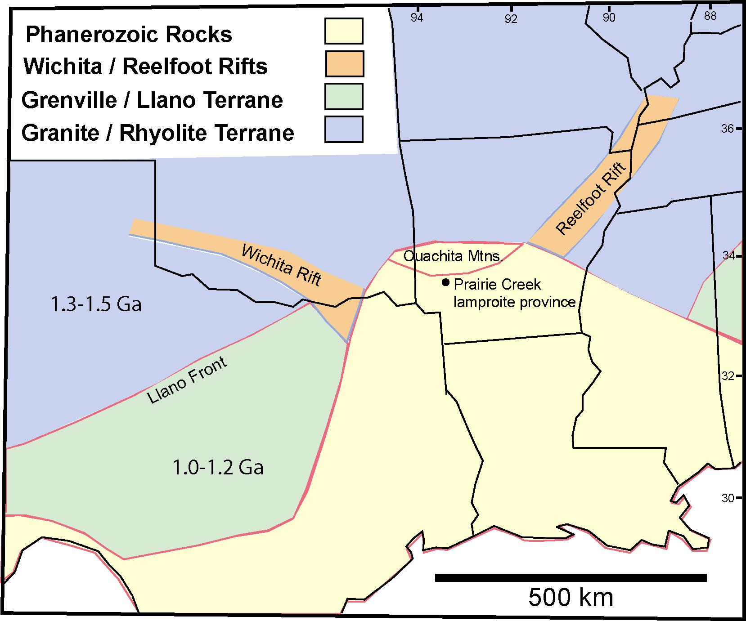

Slide 4
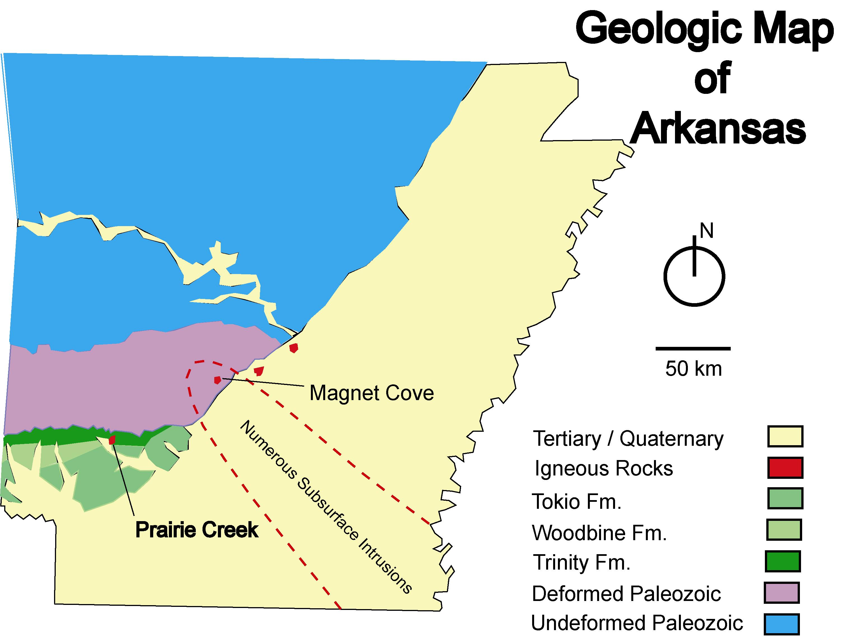

Slide 5
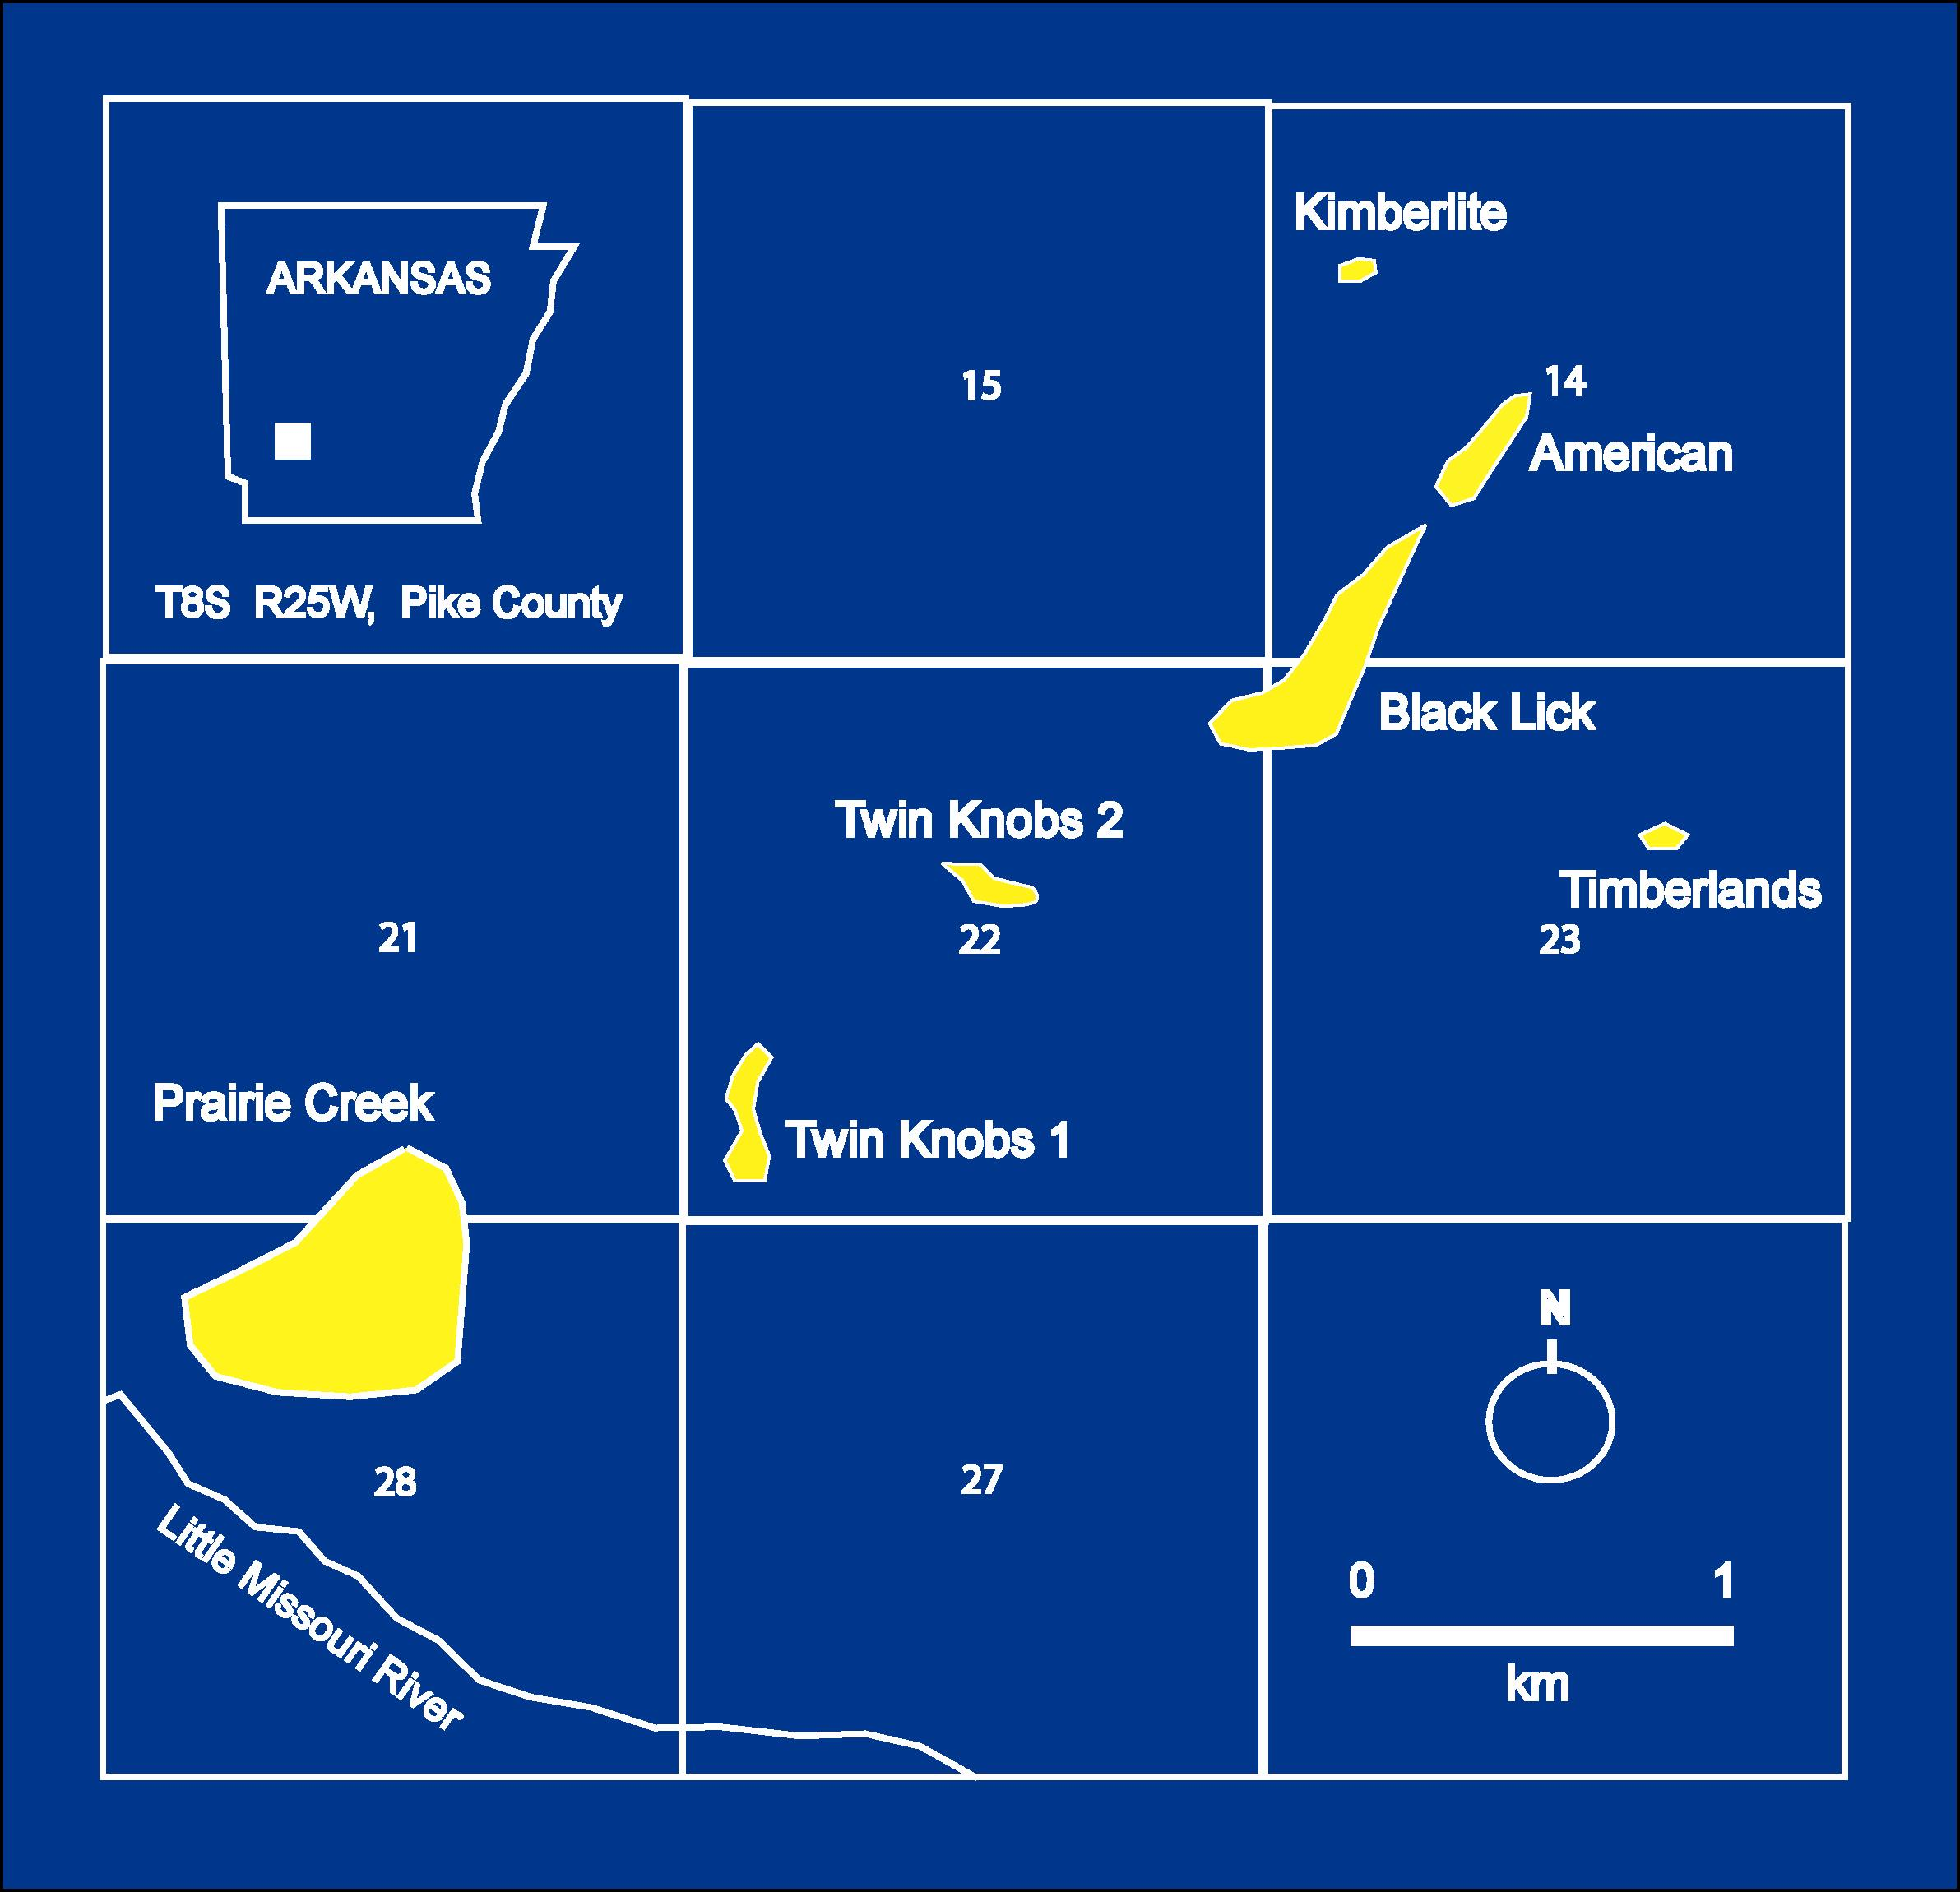

Slide 6
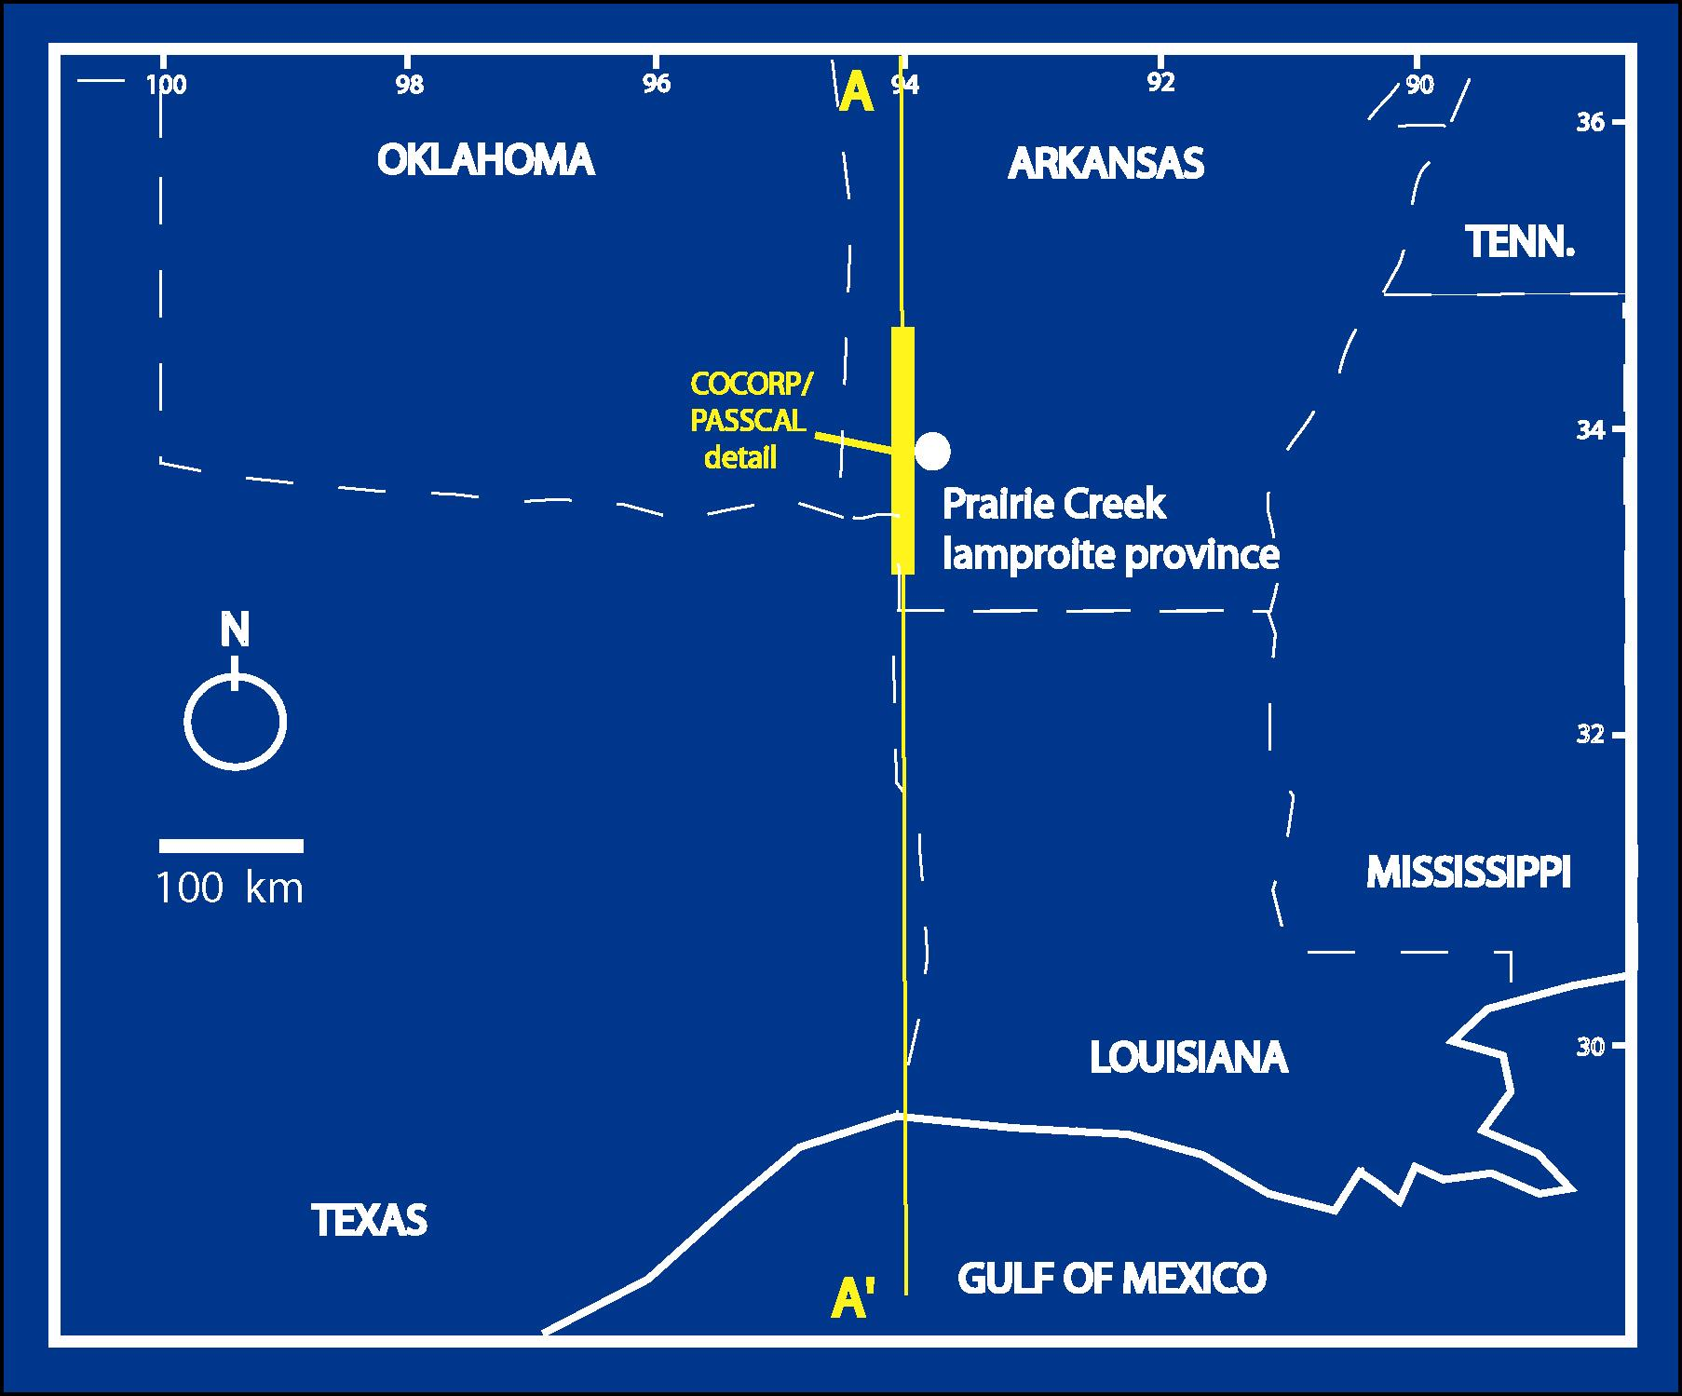

Slide 7
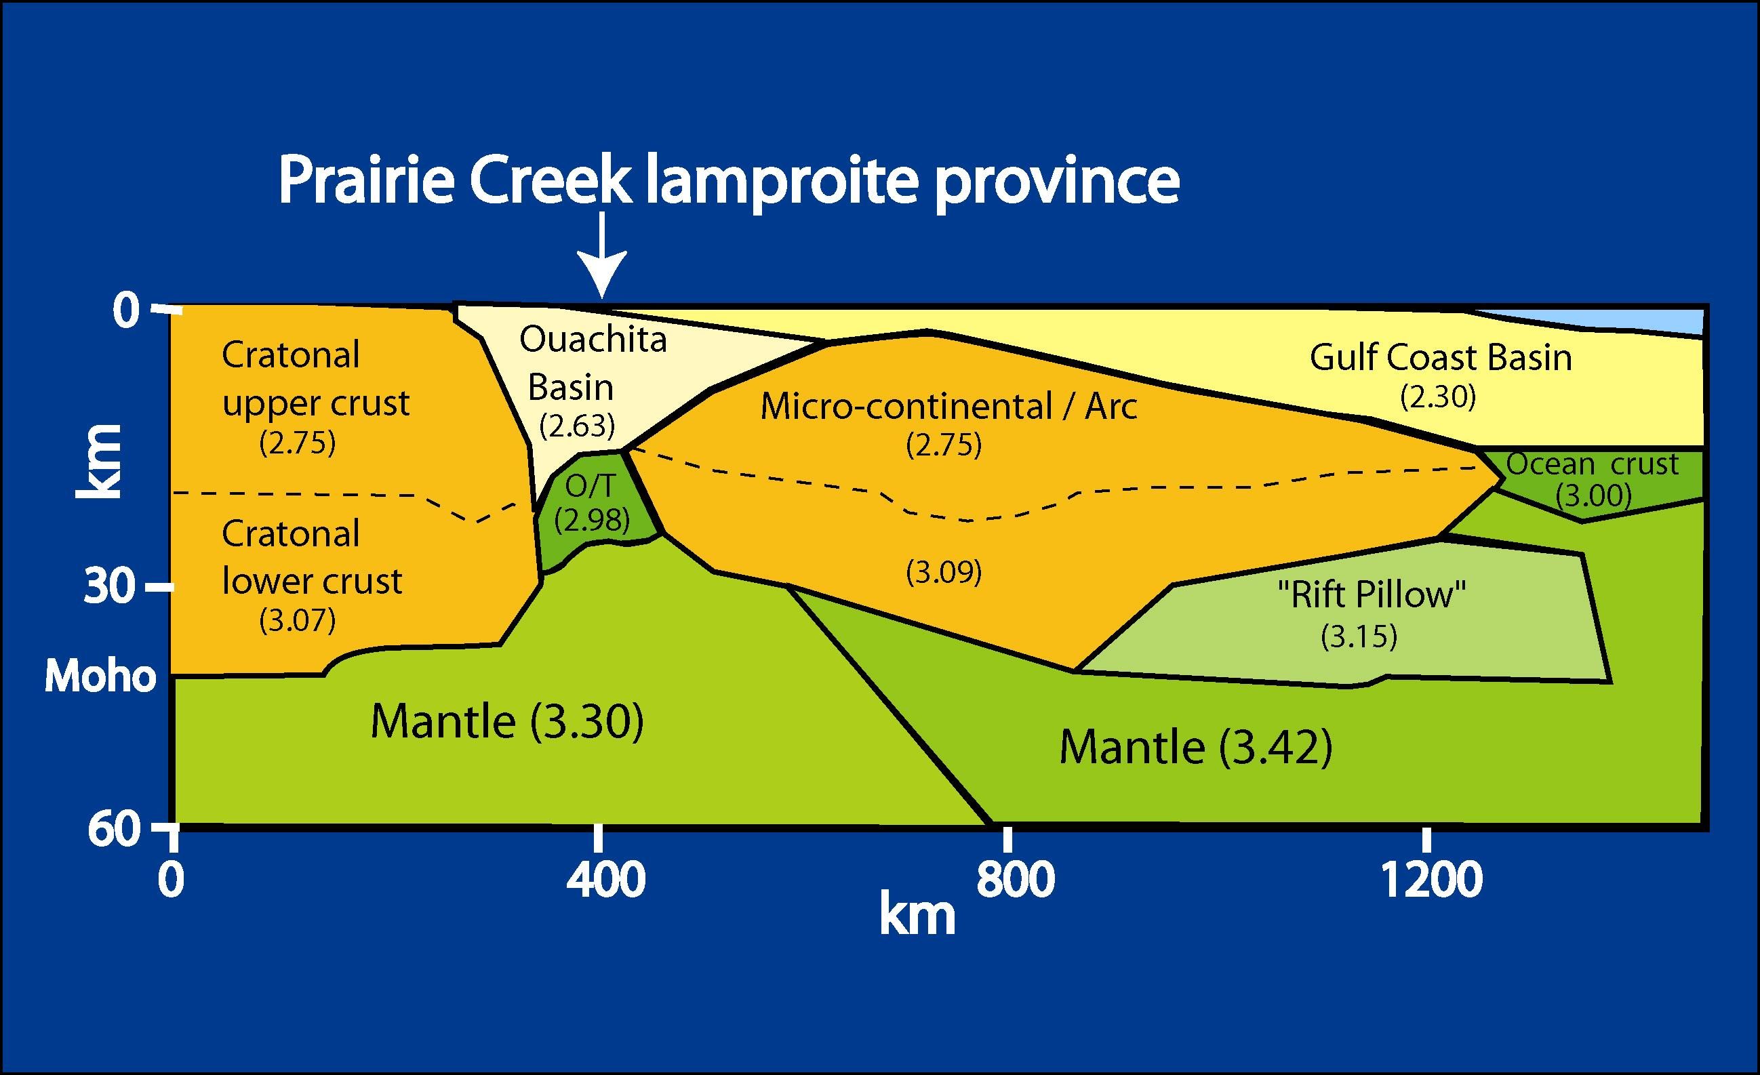

Slide 8
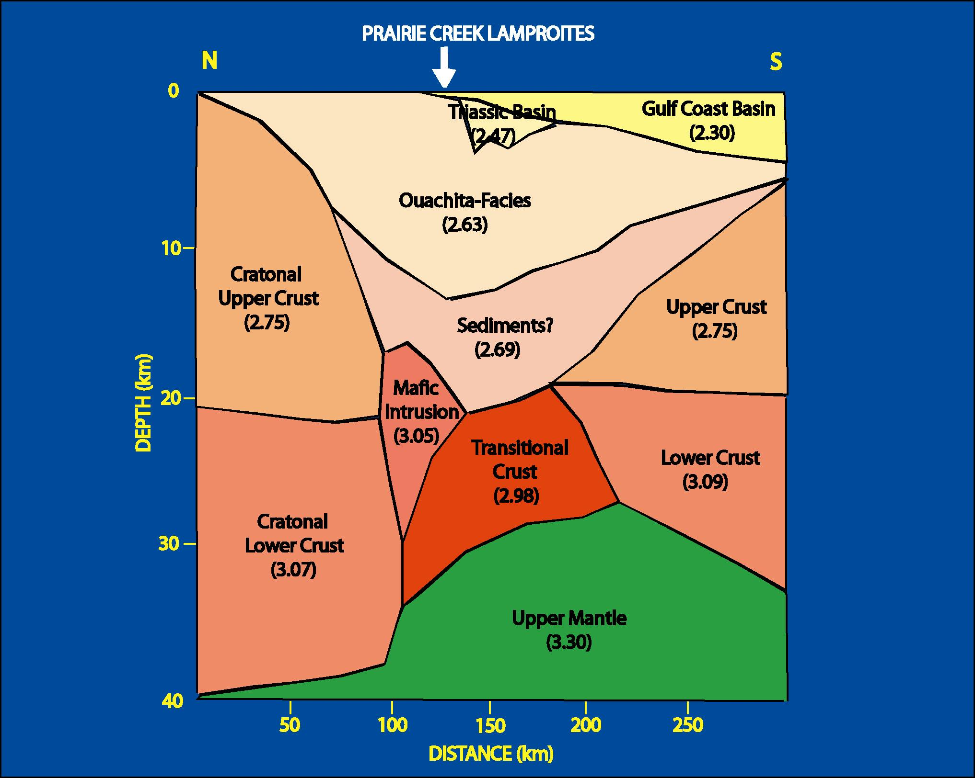

Slide 9
Regional Geology
Prairie Creek Lamproite Province
  Located southern edge of N.A. craton?
  Located northern margin Sabine Block
  Association with Reelfoot Rift (?)
  Middle Cretaceous igneous intrusions
  Seven diamondiferous lamproite vents

Slide 10
Mantle Xenoliths
Xenoliths
  Recovered during diamond evaluation
  ~ 40 rock fragments (1-3 cm)
    Garnet lherzolite
    Garnet / spinel lherzolite
    Spinel peridotite
    Eclogite
    Garnet Websterite

Slide 11
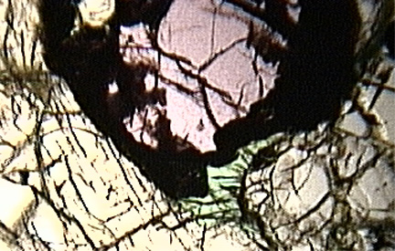
M7
Garnet Lherzolite
400 um

Slide 12
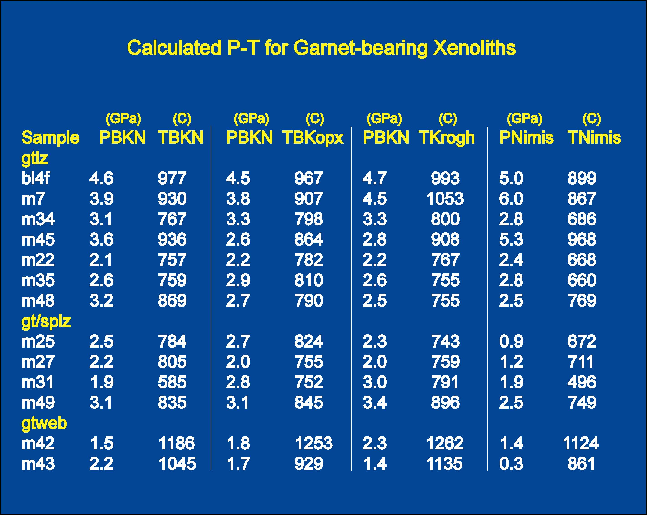

Slide 13
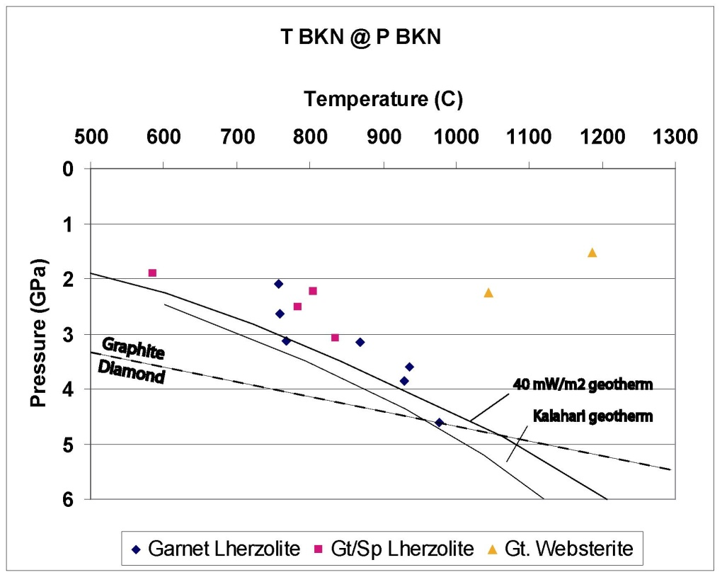
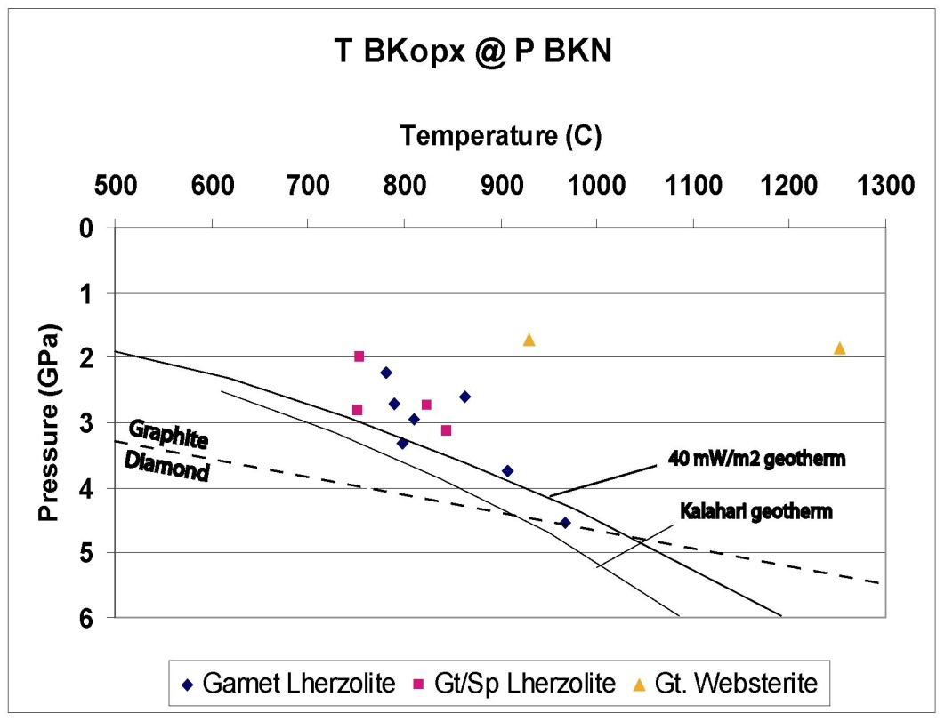
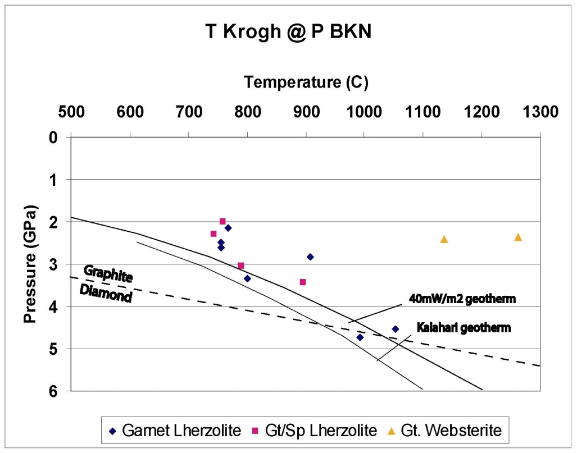
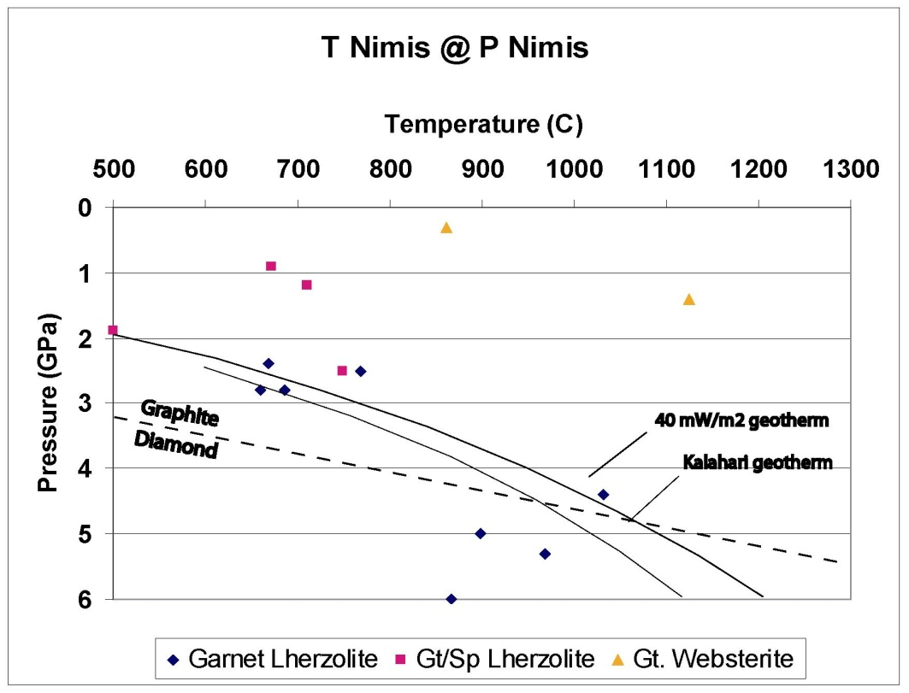

Slide 17
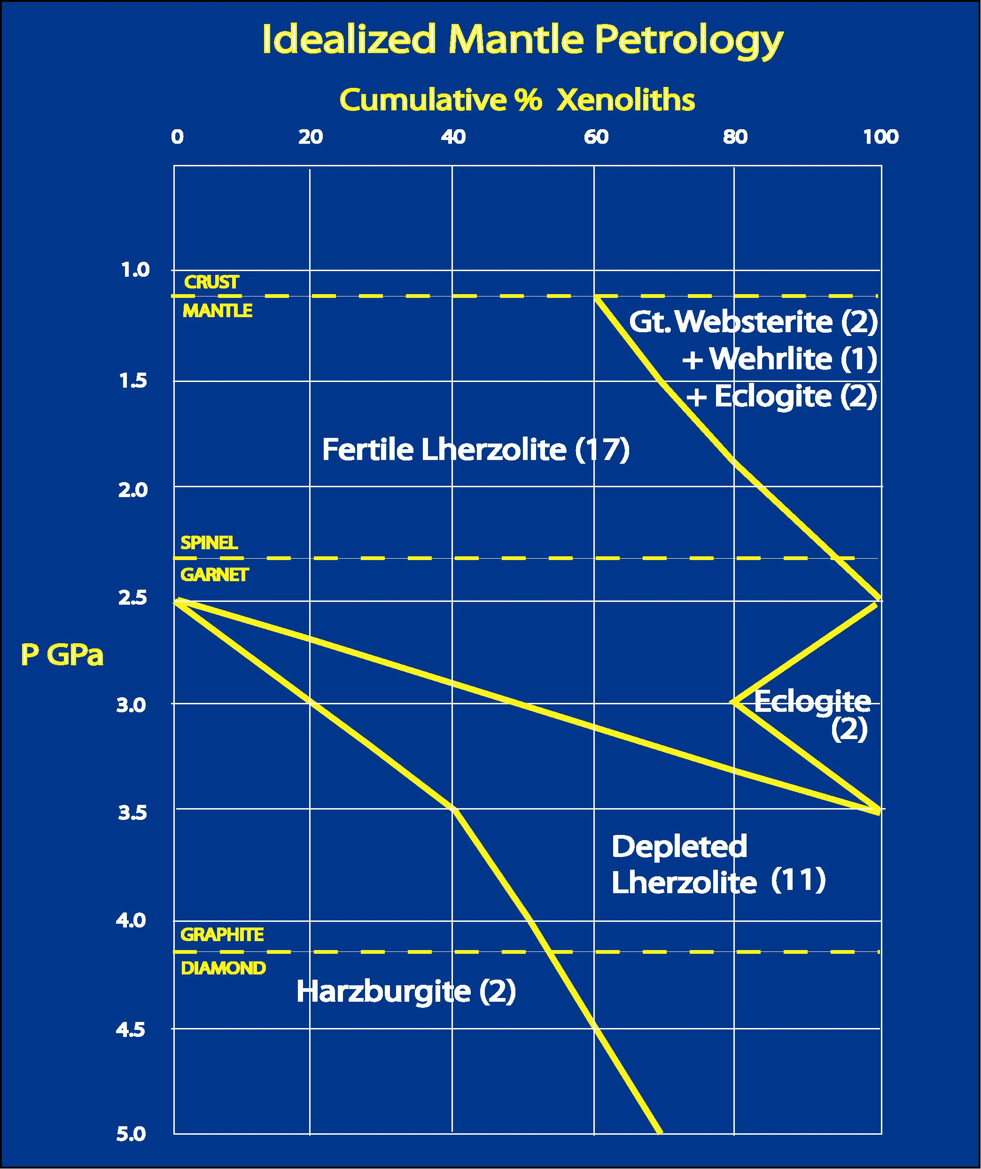

Slide 18
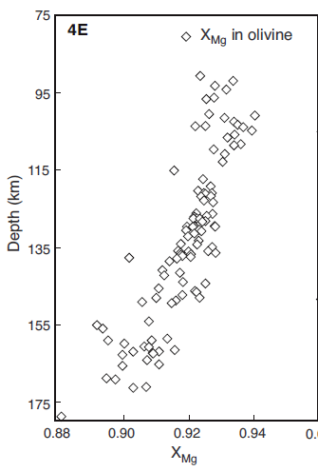
Cr-Pyrope Data
Griffin et al, 2011
Maximum depletion
Depth ~95-115 km

Slide 19
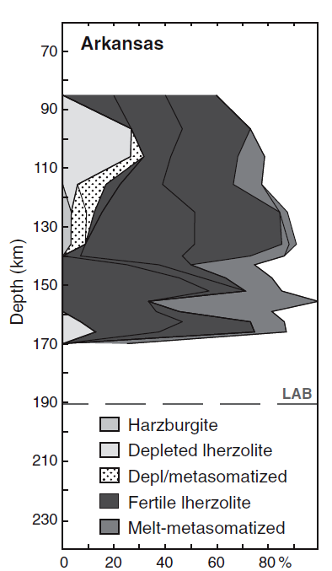
Chemical Tomography
O’Reilly and Griffin, 2006
Maximum depletion
Depth ~95-115 km

Slide 20
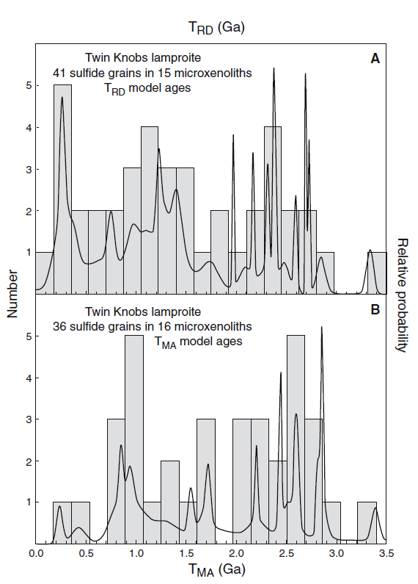
Re-Os sulfide data
Twin Knobs xenoliths
Peak model ages:
~0.27, 1.0, & 1.4 Ga
Older model ages:
~2.2, 2.5, 2.8 & 3.4 Ga

Slide 21
Emplacement Models
Metasomatism (Griffen et al, 2011)
  Archean age microcontinent
  Mantle metasomatism
Mantle Underplate (Dunn, 2019)
  ~20 km thick depleted layer
  Archean Re-Os model ages
  Tectonic ages match African cratons

Slide 22
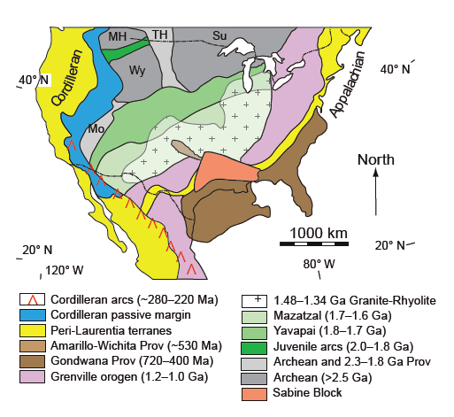
Tectonic Ages
Clift et al, 2018

Slide 23
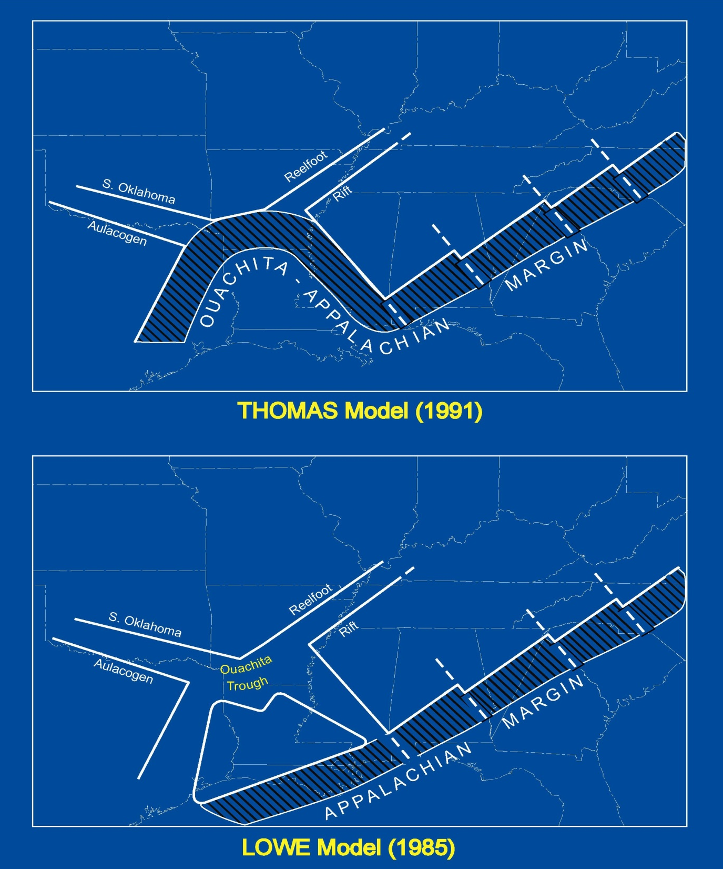

Slide 24
Crustal Xenoliths
Deep Lithologies
  Amphibolite
  Granite and rhyolite
  Epidote-rich alteration
Rift-Basin vs. Oceanic Margin Models
  Xenolith lithologies
  Amphibolite ages (~1.42 Ga)
  Geophysical models

Slide 25
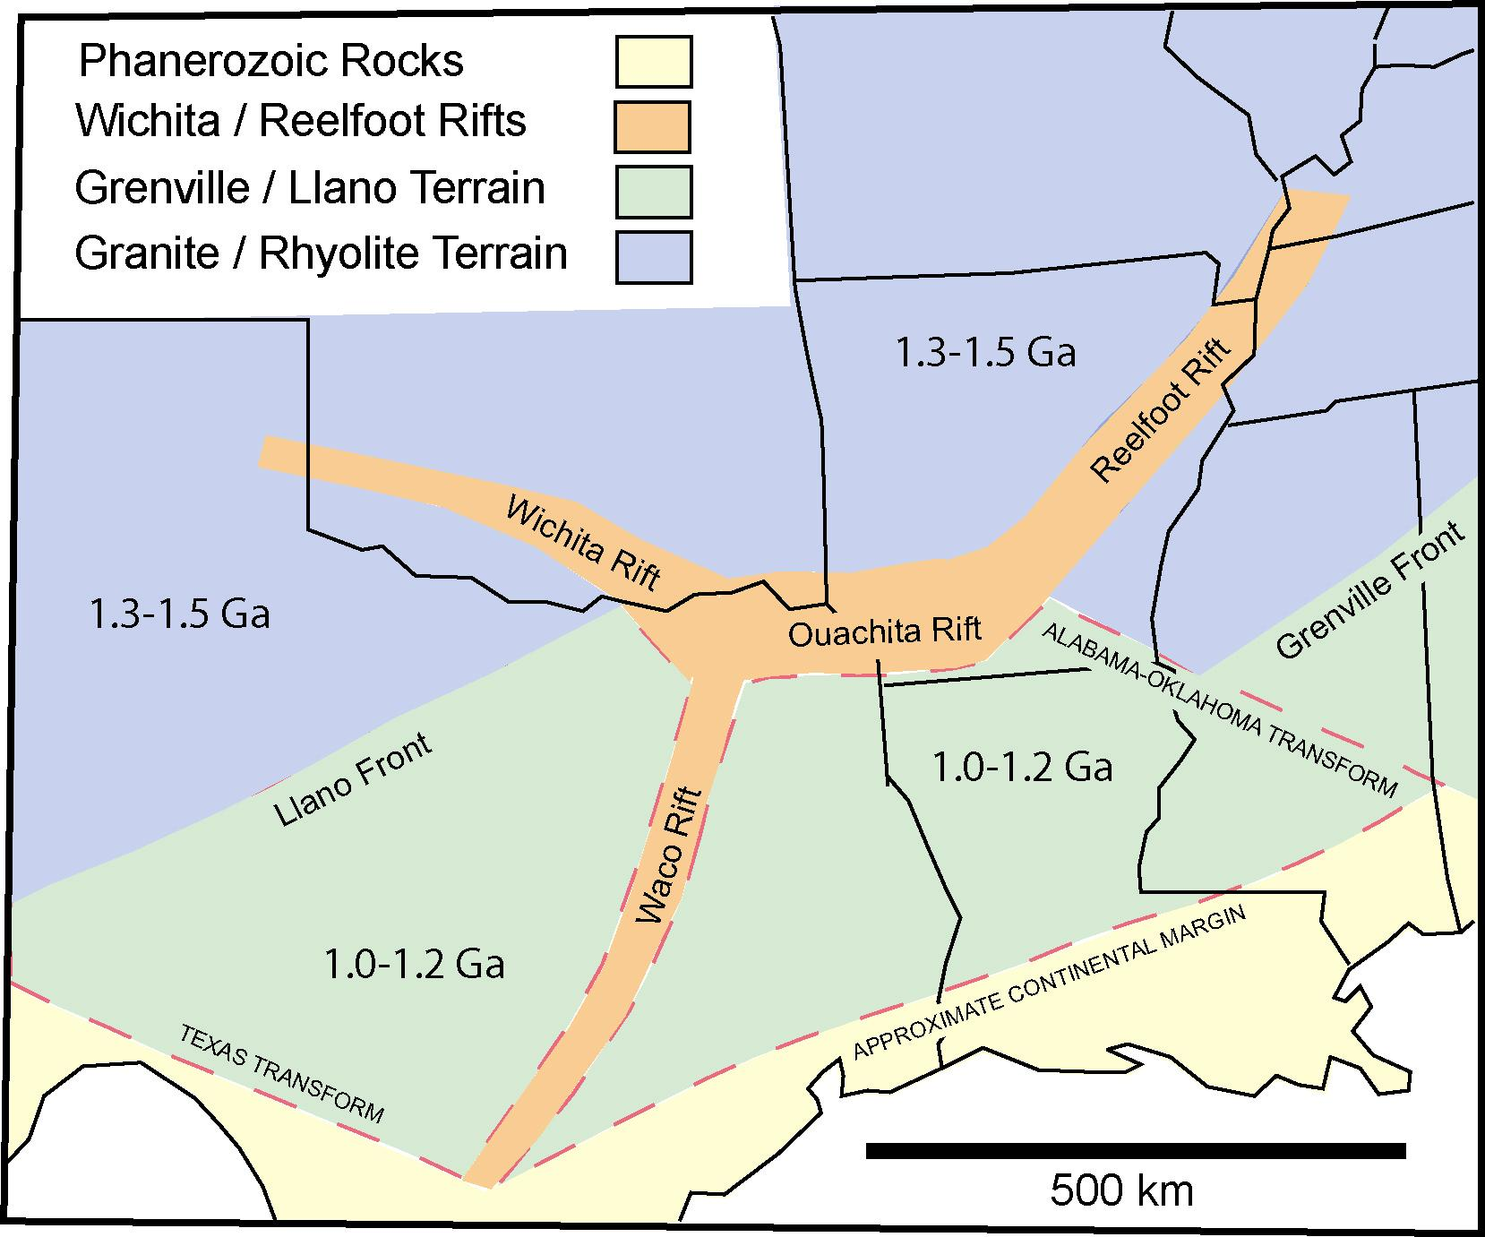

Slide 26
Tectonic Ages
Clift et al, 2018

Slide 27
Emplacement Models
Metasomatism (Griffen et al, 2011)
  Archean age microcontinent
  Mantle metasomatism
Mantle Underplate (Dunn, 2019)
  ~20 km thick depleted layer
  Archean Re-Os model ages
  Tectonic ages match African cratons

Slide 28
African Tectonic Ages
Begg et al, 2009
West Africa Craton
  ~3.4, 2.8, and 2.2 Ga
Congo Craton
  ~3.4, 2.8, 2.5 and 2.1 Ga
Arkansas Xenoliths
  ~3.4, 2.8, 2.5 and 2.2 Ga

Slide 29
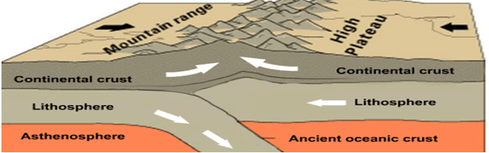
Proposed Mantle Underplating

Slide 30
Summary and Conclusions
Archean Microcontinent Unlikely
Evidence for Mantle Underplating
  20 km depleted layer
  zoned US crustal ages
  African tectonic age similarities
  African source of diamonds?

