Slide 1

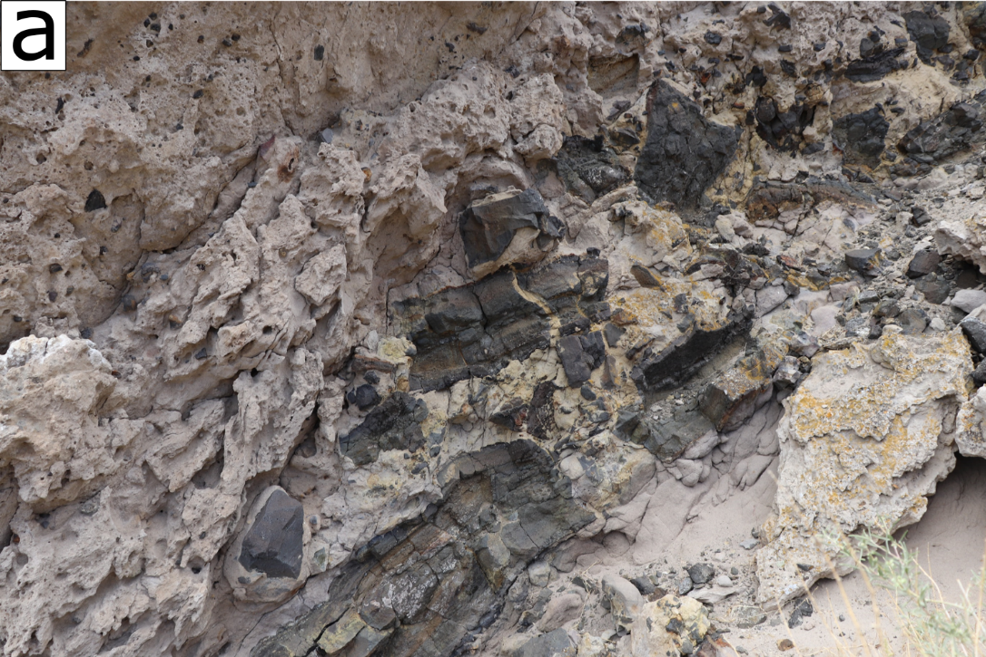
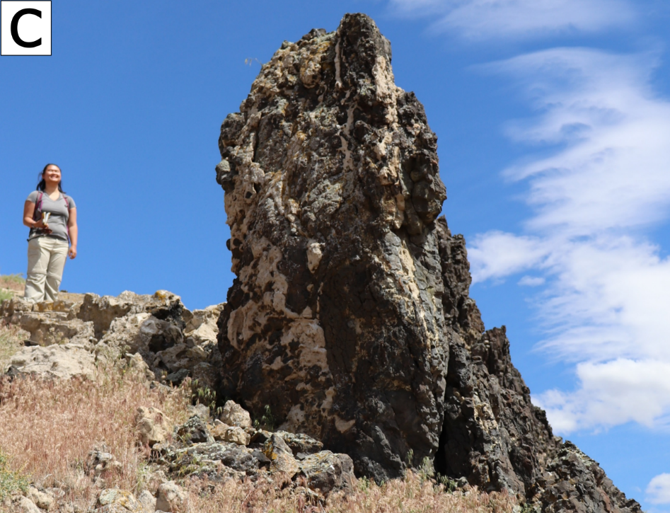
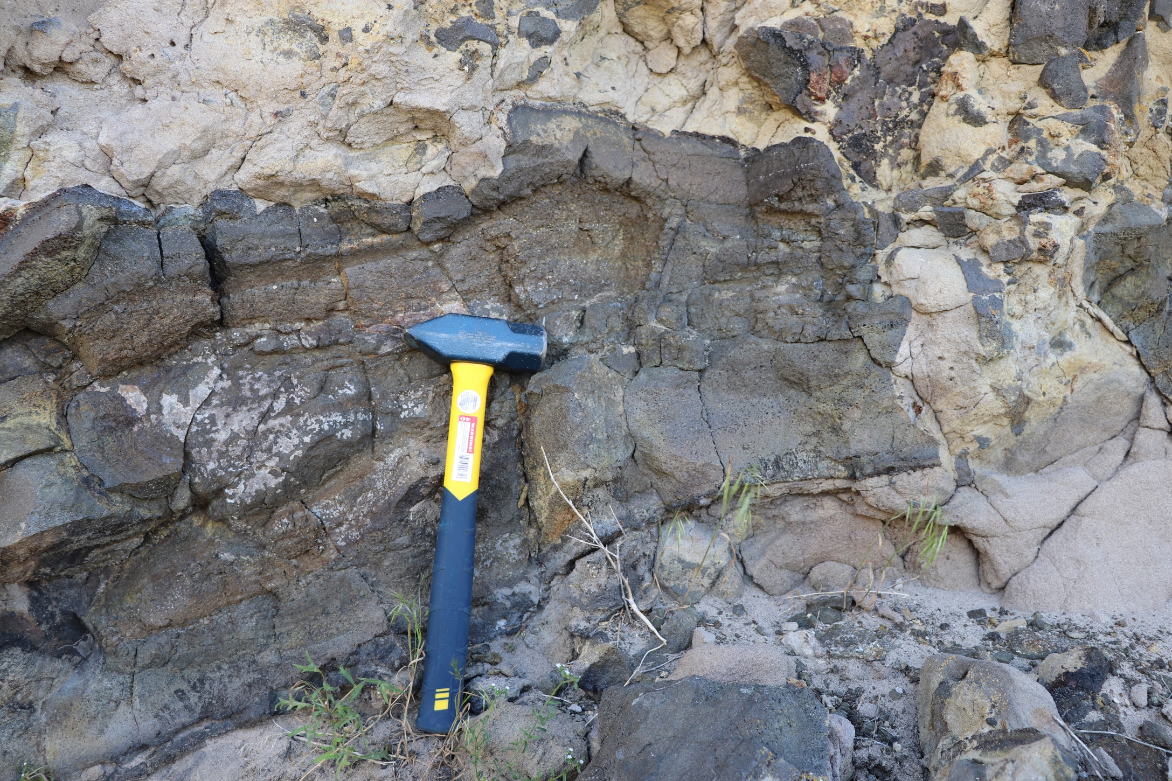
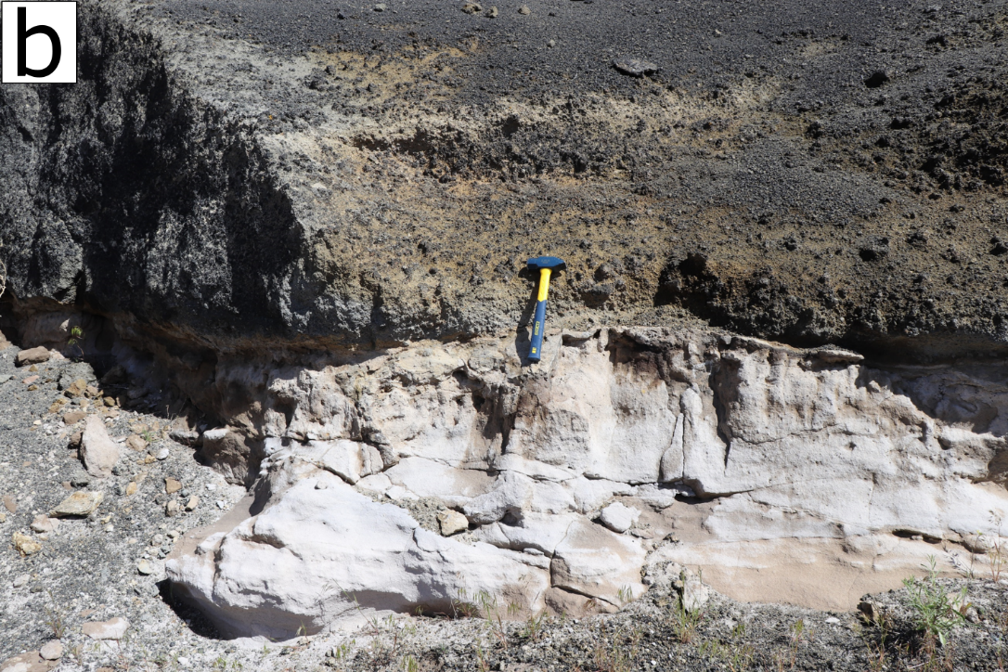
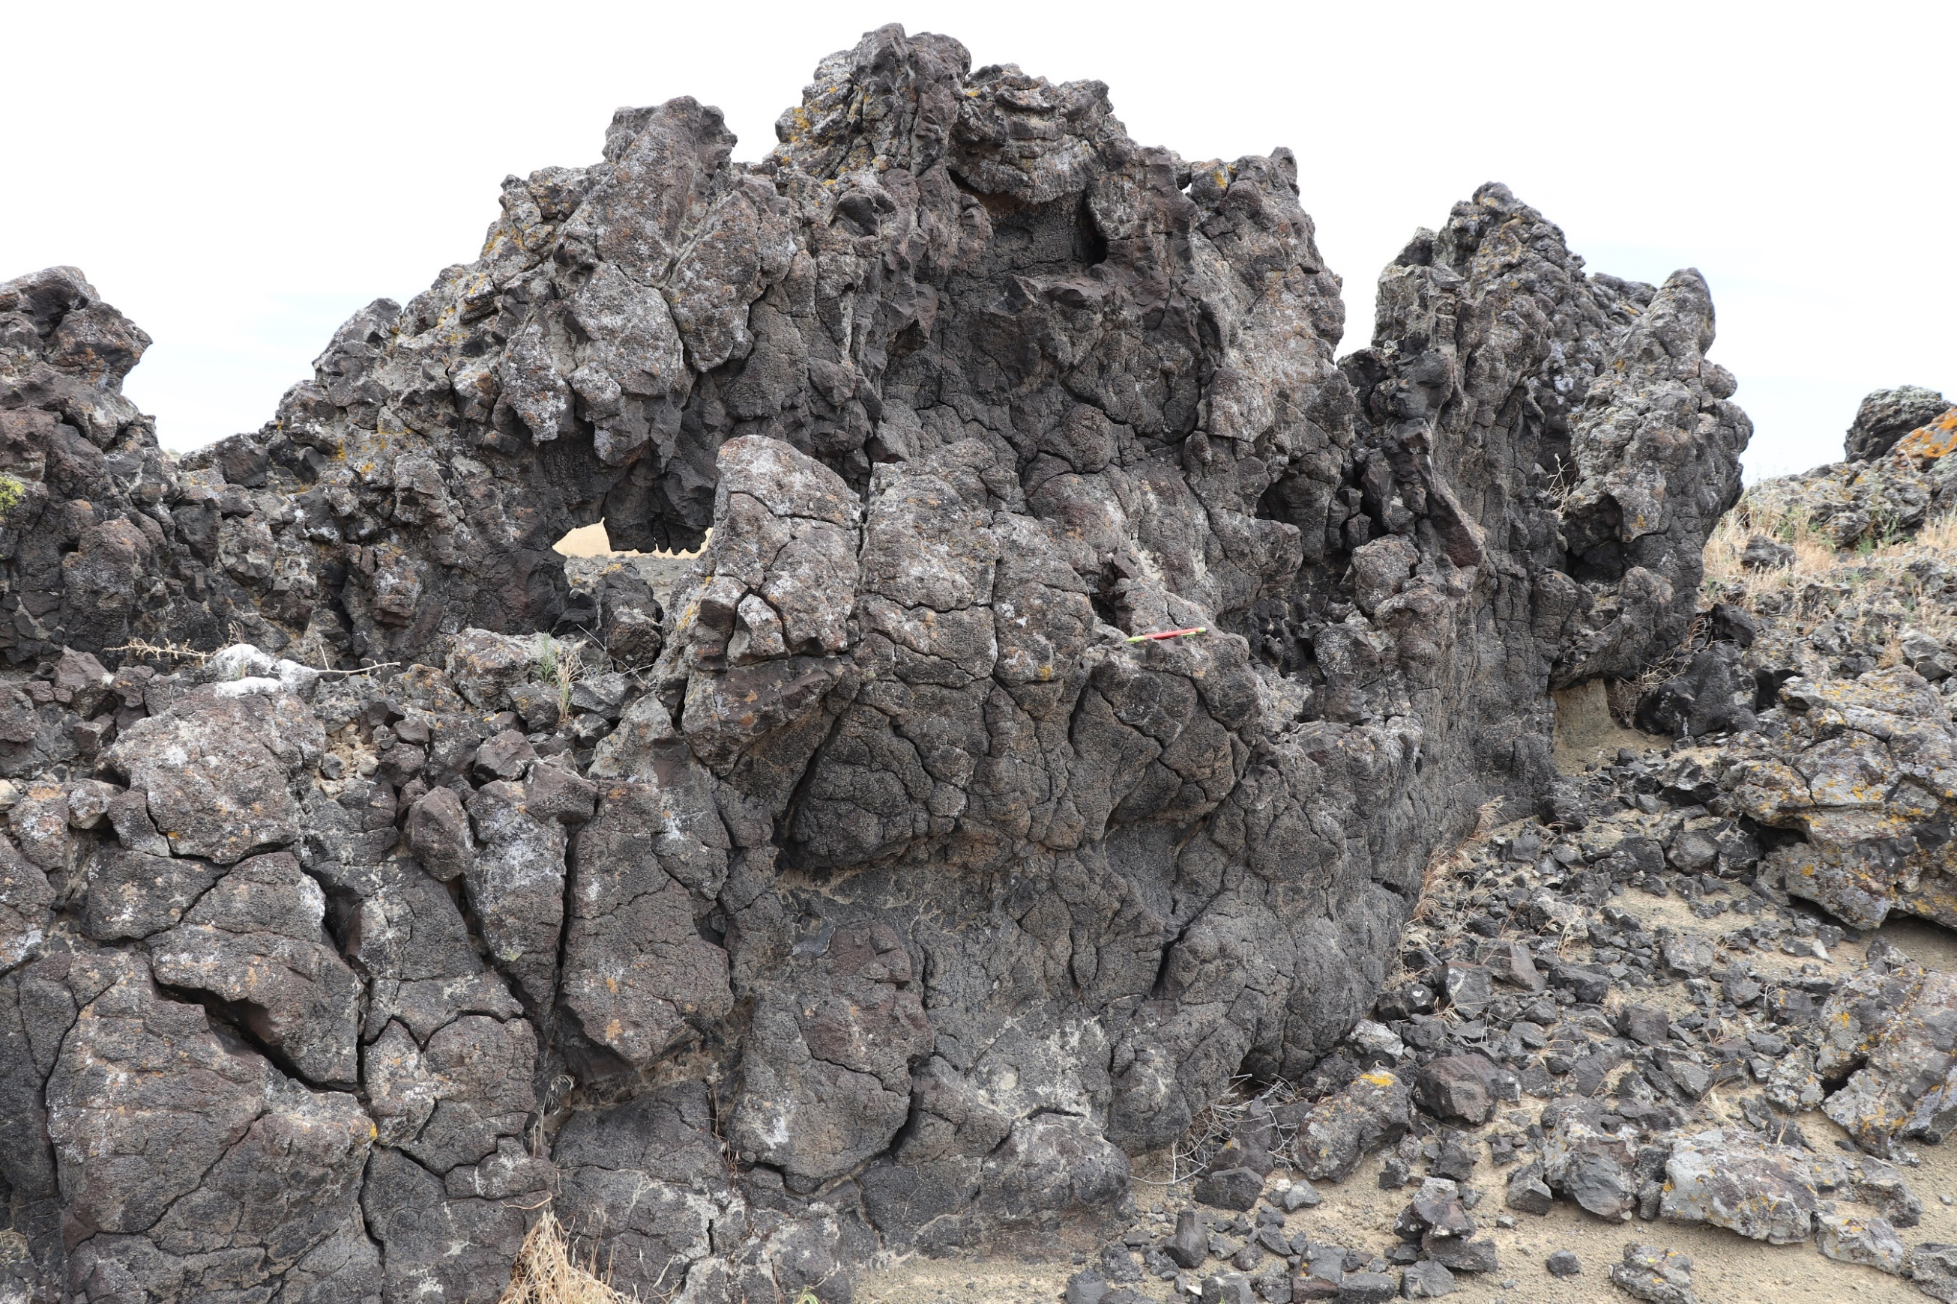
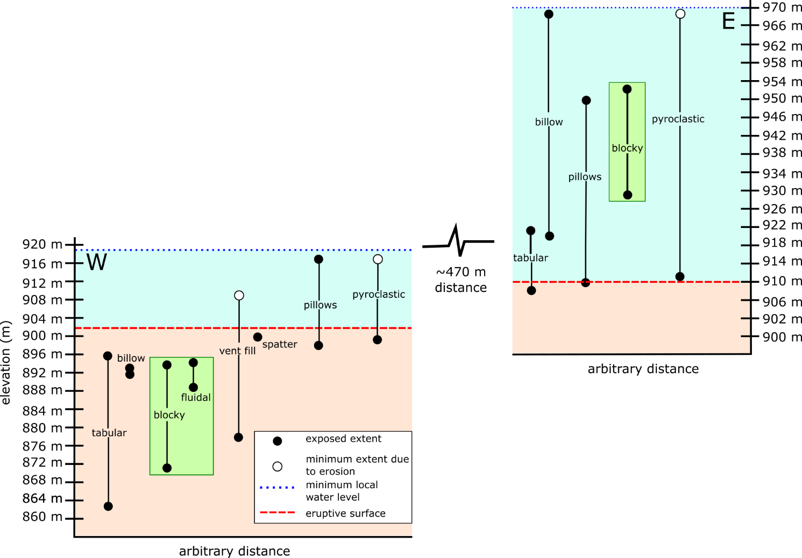
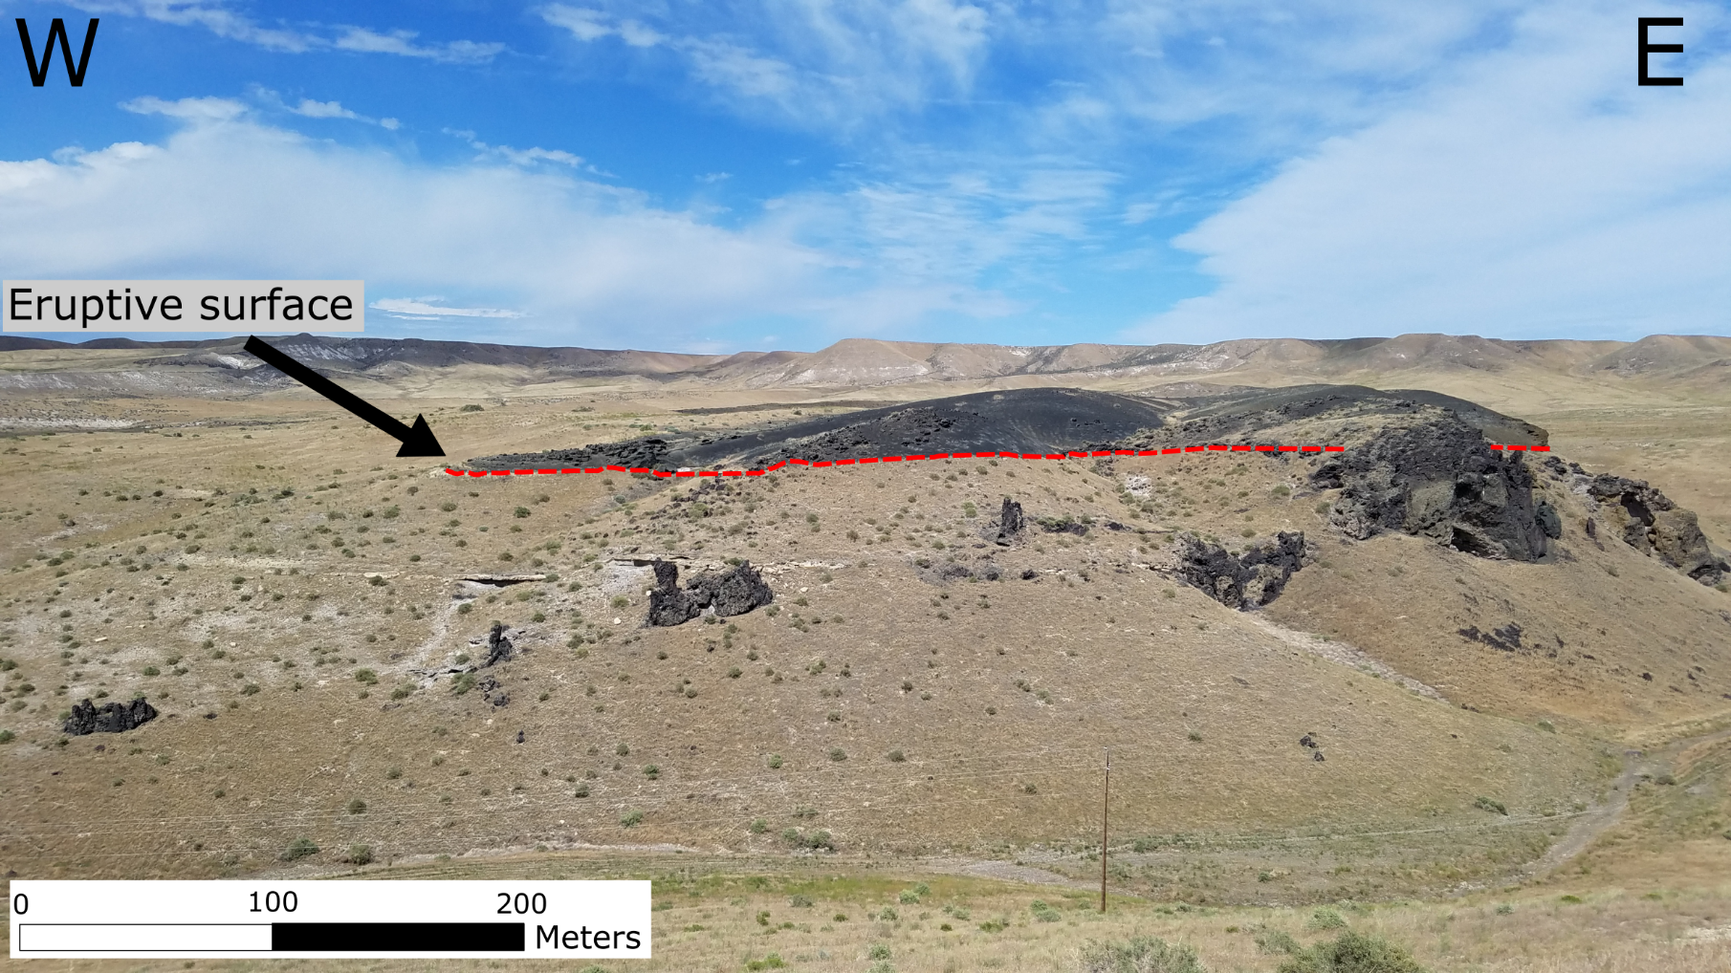
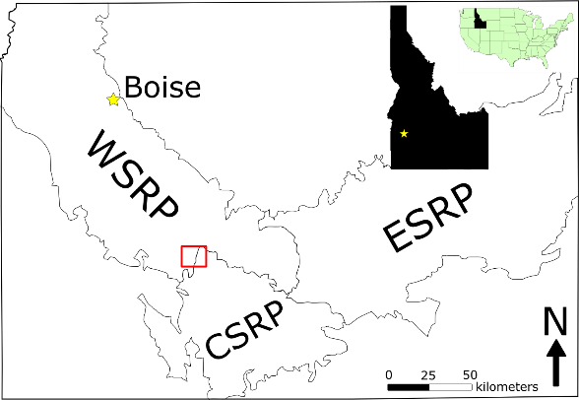
Constraints on sediment-magma mingling from peperites formed in a subaqueous basaltic fissure eruption
Kadie Bennis¹ and Alison Graettinger¹
University of Missouri – Kansas City, 5100 Rockhill Rd. 64110, Kansas City, MO, USA. kadie.bennis@mail.umkc.edu.
I. Significance
IV. Peperites
V. Results
When magma and water interact, they can explode, known as phreatomagmatic explosions
Nonexplosive eruptions can result in peperite
Peperites are made of fragmented igneous rock within a sedimentary host
At 71 Gulch, they form from basaltic intrusions into wet lake sediment
Peperites can be used as evidence to describe the nonexplosive processes of magma-sediment interactions
Blocky peperite
Fluidal peperite
Distribution (elev. m asl):
885 – 952
863 – 953
Peperites and dikes occur in both lake and pyroclastic host sediment
Fluidal peperites only occur in lake sediment
Grain size and composition does not significantly affect peperite formation
Dikes will not always produce peperites
Billowed dikes and fluidal peperites are similar in that they tend to form at shallow depths (≤ 14 m below the eruptive surface), while tabular dikes and blocky peperites can occur at much deeper depths (up to ~42 m below the eruptive surface)
Figure 4c. Fluidal peperite into lacustrine host sediment. Blocks are ragged and irregular in comparison to the blocky peperites.
Figure 6. Example of a billowed dike with a repetitive morphology.
Figure 1. Example of a blocky peperite from a tabular dike.
II. Background
Western Snake River Plain (WSRP), located in SW Idaho, is a shallow, normal fault-bounded basin
Volcanic processes occurred due to the migration of the Yellowstone hotspot
Figure 3. (a) Blocky peperite fragmenting into lacustrine host sediment. Blocks are sharp, angular, and there are some jigsaw fit textures. (b) Exposed eruptive surface where the lake sediment is in direct contact with pyroclastic deposits.
71 Gulch Volcano
VI. Discussion
4 Ma basaltic fissure structure that erupted into a dominantly subaqueous lake environment
Fissure stretches 2 km from West to East
Exposed 25 m below the eruptive surface
Pillow lavas, peperites, and billows help determine the minimum local water level (~16 m above the eruptive surface in the west; ~59 m above the eruptive surface in the east)
Billow and peperite formation are not dependent on rock geochemistry nor host sediment type
Peperites form in relatively shallow subaqueous conditions, which indicates that lithostatic and hydrostatic pressure could be a variable that affects its formation
Similarly, billows also seem limited to shallow depths to form
Peperites are evidence of nonexplosive sediment-magma mingling
III. Field Location
Figure 5. Relative depth drawing based on measured elevations to compare the depths of dikes, peperites, vent fill, pillow lavas, and pyroclastic deposits. Lateral distance is arbitrary. The blue dotted line (as well as the blue box) indicates a minimum local water level and the red dashed line (as well as the red box) delineates the eruptive surface. The green box highlights blocky and fluidal peperite. Elevations are absolute. The paleolake surface is approximate and is better constrained in the west.
Fluidal peperite
Contains irregular basaltic blocks that measure up to tens of cm long
Blocks are all aphanitic and have more continuous margins
References
Figure 2. Located in SW Idaho in the WRSP, this is a photo of the western part of 71 Gulch highlighting the intrusive to eruptive surface.
Bonnichsen, B., Leeman, W.P., Honjo, N., McIntosh, W.C., Godchaux, M.M., 2008. Miocene silicic volcanism in southwestern Idaho: geochronology, geochemistry, and evolution of the central Snake River Plain. Bull. Volcanol. 70, 315–342. https://doi.org/10.1007/s00445-007-0141-6
Shervais, J.W., Shroff, G., Vetter, S.K., Matthews, S., Hanan, B.B., McGee, J.J., 2002. Origin and evolution of the western Snake River Plain: Implications from stratigraphy, faulting, and the geochemistry of basalts near Mountain Home, Idaho. Tecton. Magmat. Evol. Snake River Plain Volcan. Prov. 30, 343–361.
Wood, S.H., Clemens, D.M., 2002. Geologic and tectonic history of the western Snake River Plain, Idaho and Oregon. Tecton. Magmat. Evol. Snake River Plain Volcan. Prov. Idaho Geol. Surv. Bull.

