Slide 1
Utilizing resistivity logs and the R_{wa} Method to map salinity zones in the Eocene Queen City Aquifer, central Texas
Presentation 4-1
T18. Unconventional Aquifers and Aquifer Management
Monday March 25, 2019
2019 GSA South-Central/North-Central/Rocky Mountain Section Meeting
Authors:
Andrea Croskrey*, John Meyer, Alysa Suydam

Slide 2

Texas Water Development Board (TWDB)
Brackish Resource Aquifer Characterization System (BRACS)
http://www.twdb.texas.gov/innovativewater/bracs/studies.asp
Map brackish groundwater!
Stratigraphy
Lithology
Water Quality
All this data is managed in an MS Access Database (available for download!!!)
Outreach
State Water Plan
$$$
Data
Create a 50-year State Water Plan every 5 years!
Notes:
Introduction to the Texas Water Development Board (50 year water plan) and brackish groundwater mapping (study outline)

Slide 3
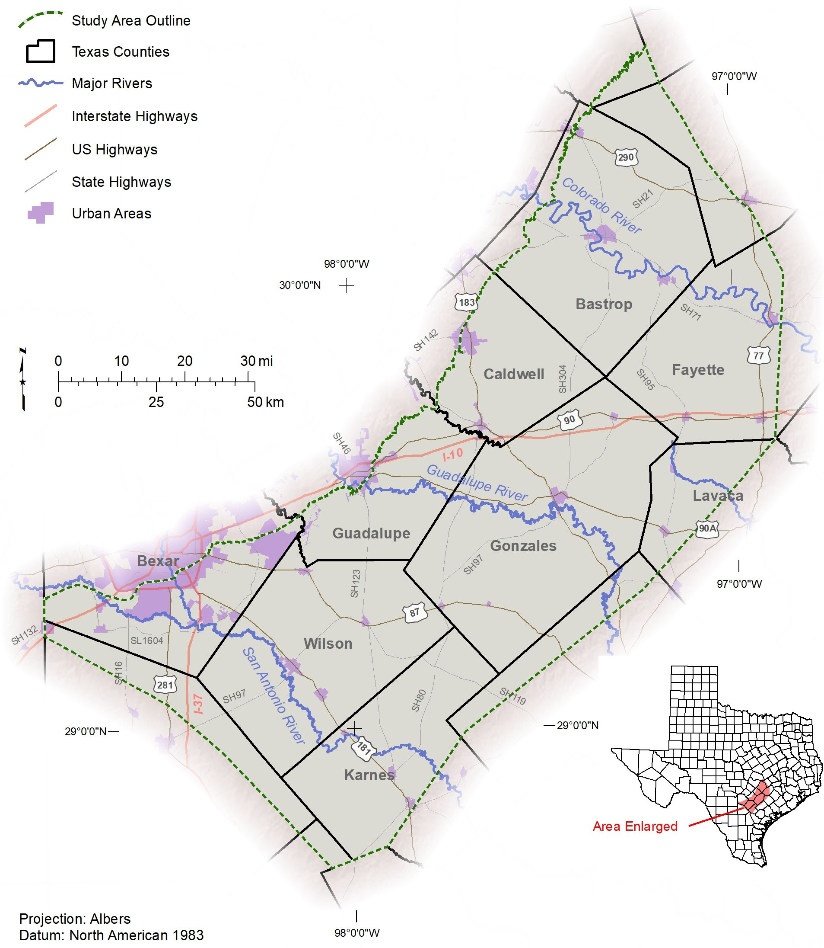
Upper Coastal Plains – Central
Study Overview
Parts of 14 counties in central Texas
5 aquifers
  (Yegua, Sparta, Queen City, Carrizo, Wilcox)
8 Eocene stratigraphic units mapped
  (Yegua, Cook Mountain, Sparta, Weches, Queen City, Reklaw, Carrizo, Wilcox)
Thousands of lithologic picks
  (sand, sand with clay, clay with sand, clay)
Notes:
Study summary

Slide 4
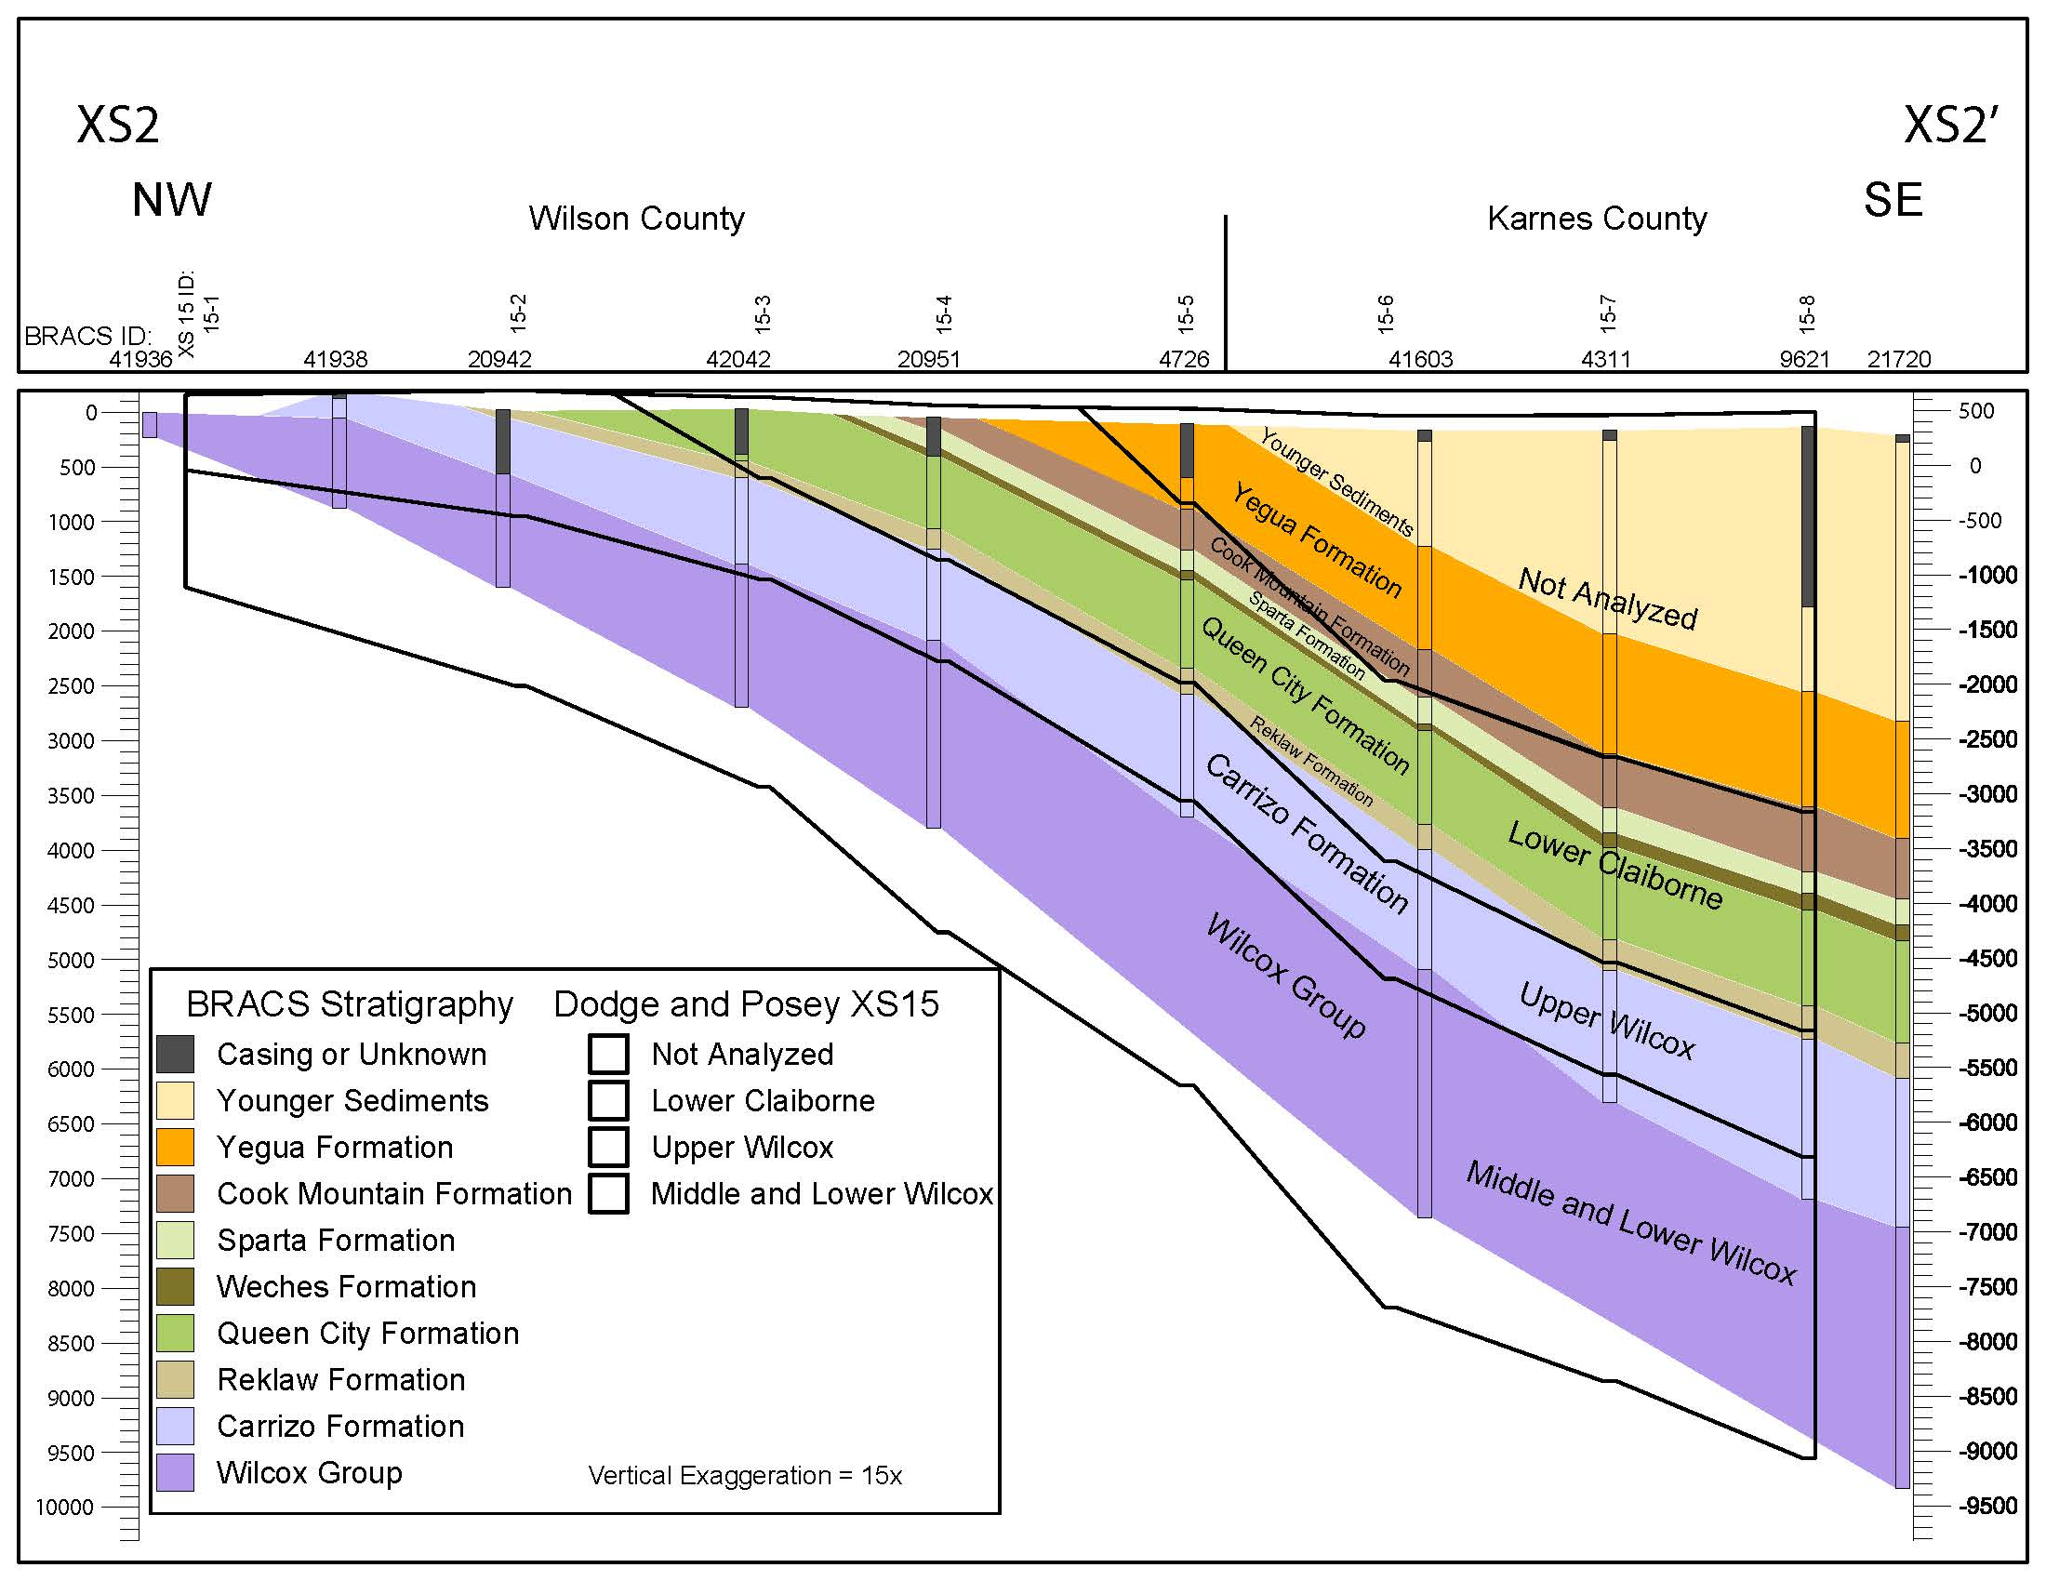
Epoch | Group | Formation | USGS nomenclature | Texas Hydrogeologic unit
 |  | Caddell
 | Jackson | Moodys Branch | Vicksburg-Jackson
 |  |  | confining unit | Yegua-Jackson Aquifer
 |  | Hiatus
 |  | Yegua | Upper Claiborne Aquifer
 |  | Cook Mountain | Middle Claiborne | Confining unit
 |  | Hiatus | Confining unit
 |  | Sparta |  | Sparta Aquifer
 |  | Weches | Middle Claiborne Aquifer | Confining unit
 | Claiborne | Hiatus
 |  | Queen City |  | Queen City Aquifer
 |  | Reklaw
Eocene |  | Hiatus | Lower Claiborne confining unit | Confining unit
 |  | Carrizo
 |  | Hiatus | Lower Claiborne – upper Wilcox
 |  | Sabinetown | Aquifer
 |  |  |  | Carrizo-Wilcox Aquifer
 | Wilcox | Rockdale
 |  |  | Middle Wilcox Aquifer
 |  | Seguin
Paleocene
 | Midway
 |  | Wills Point | Midway confining unit | Confining unit
Stratigraphic column showing relationship between the epochs, formations, and hydrogeologic units. The United States Geological Survey (USGS) nomenclature is based on Ryder (1996). Texas hydrogeologic units are based on TWDB (2007a) and George and others (2011). This table does not reflect the entire Jackson or Midway group stratigraphy. This table is not scaled vertically in uniform units of time.
Cross-section comparing the stratigraphic nomenclature and picks between this study and Dodge and Posey (1981)
Notes:
Stratigraphic units

Slide 5
Salinity Mapping
Groundwater Salinity Classification | Salinity Zone Code | Total Dissolved Solids (milligrams per liter)
Fresh | FR | 0 to 1,000
Slightly Saline | SS | 1,000 to 3,000
Moderately Saline | MS | 3,000 to 10,000
Very Saline | VS | 10,000 to 35,000
Brine | BR | Greater than 35,000
PWS
Most Texas Major/Minor Aquifer Mapped Limit
BRACKISH
BUQ
USDW
Seawater
PWS: Public Water System threshold for fresh water, TX Commission on Environmental Quality
BUQ: Base Useable Quality water, TX Railroad Commission
USDW: Underground Source Drinking Water, US Environmental Protection Agency
modified from Winslow and Kister (1956) USGS WSP 1365
Notes:
PWS: Public Water System threshold for fresh water, TX Commission on Environmental Quality (1,000 mg/L TDS)
BUQW: Base Useable Quality water, TX Railroad Commission (3,000 mg/L TDS)
USDW: Underground Source Drinking Water, US Environmental Protection Agency (10,000 mg/L TDS)
Most Tx Major and Minor aquifers are mapped to 3,000 mg/L TDS
Seawater averages 35,000 mg/L TDS

Slide 6
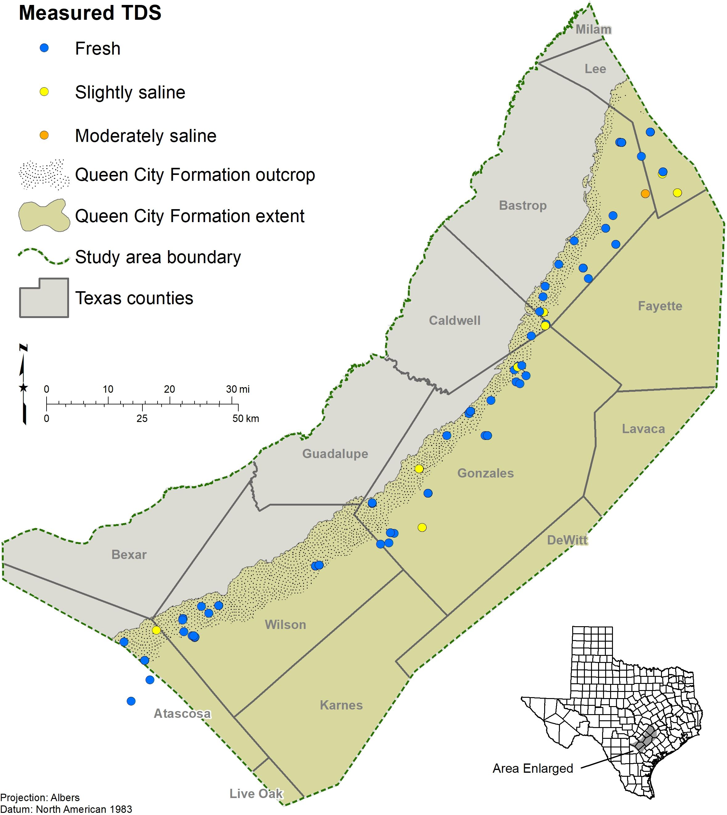
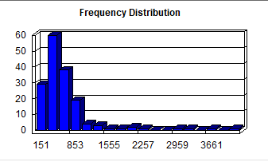
Measured Water Quality (TDS_{meas})
61 water wells, 146 measurements identified using aquifer determination
Limited to where people drill wells (shallow & fresh)
Min: 151, Max: 4,345, Mean: 729
Sources: TWDB Groundwater Database, San Antonio Water System, Gonzales Underground Water Conservation District, U.S. Geological Survey Produced Water Database, published reports, raw-water sample reports from the Texas Commission on Environmental Quality public drinking water system program

Slide 7

Calculating Water Quality (TDS_{calc})
348 oil & gas wells with 538 TDS_{calc} values
The R_{wa} Minimum Method (Resistivity Water Apparent) is based on the relationship between water salinity and resistivity.
A simplified version of Archie’s equation (1942) assumes 100% water saturation and Winsauer factor = 1 :
$$R_{w}= R_{o}· ɸ^{m}$$
where: R_{o} = resistivity of the formation (units: ohm-meter)
R_{w} = resistivity of water (units: ohm-meter)
ɸ = porosity (units: percent)
m = cementation exponent (units: dimensionless)
Resistivity → specific conductance → total dissolved solids.
Let’s look at the details…

Slide 8
Parameters (1/3)
Depth and Temperatures
(D_{t,} D_{f,} T_{s,} T_{bh})
Deep Resistivity
(R_{o})
Temperature effects resistivity
We assume a constant temperature gradient from the surface to bottom of the well hole to calculate the formation temperature
D_{t}: total depth of the well
D_{f}: depth of the formation
T_{s}: surface temperature
T_{bh}: bottom hole temperature
Avoid the mud infiltrate “invaded zone”
Take value from a clean, shale-free sand >10ft thick
Units are in ohm-m

Slide 9

Parameters (2/3)
“ct” factors
Porosity (ɸ)
TDS low | TDS high | Number records | TDS | ct | R_{wcRw} | Ca | Mg | Na | HCO₃ | SO₄ | Cl
0 | 499 | 35 | 335 | 0.54 | 1.23 | 39 | 9 | 72 | 183 | 55 | 63
500 | 999 | 61 | 686 | 0.56 | 1.22 | 69 | 21 | 146 | 282 | 181 | 122
1,000 | 1,999 | 6 | 1,224 | 0.62 | 1.25 | 110 | 41 | 245 | 279 | 504 | 179
2,000 | 2,999 | 2 | 2,272 | 0.52 | 1.25 | 190 | 75 | 497 | 395 | 876 | 438
3,000 | 3,999 | 3 | 3,420 | 0.57 | 1.11 | 140 | 48 | 1,050 | 205 | 623 | 1,450
4,000 | 4,999 | 1 | 4,345 | 0.5 | 1.14 | 15 | 12 | 1,607 | 682 | 704 | 1,654
>5,000 |  | 0
Geological formation | Total porosity
Yegua Formation | 39
Sparta Formation | 34
Queen City Formation | y = -0.0023x + 41.657
Carrizo Formation | y = -0.0015x + 38.465
Wilcox Group | y = -0.0019x + 39.839
15 wells with 20 measurements
If a nearby measurement was not available, we used a depth regression to estimate ɸ
108 TDS_{meas} correlated with specific conductance
$$ct=\frac{TDS}{C_{w}}$$
ct = ct conversion factor
TDS = interpreted total dissolved solids (milligrams per liter)
Cw = conductivity water at 77°F (microsiemens centimeter)

Slide 10
Parameters (3/3)
Cementation exponent
(m)
Water quality correction factor (RwcRw)
Function of grain size, grain size distribution, grain sorting, pore tortuosity, and grain lithology
No core analysis
Therefore assumed m = 1.75
1.75 is within the range of slightly to moderately cemented sandstones
Logs were developed for oil & gas exploration and assume NaCl dominated H₂O
Ions have different resistivities
Factor calibrates solution to an equivalent NaCl concentration for analysis
We used weighting multipliers from Chart Gen-8, Resistivities of Solutions (Schlumberger, 1979; 1985)
Notes:
For example, bicarbonate contributes more resistivity than an equal weight of chloride in a solution

Slide 11
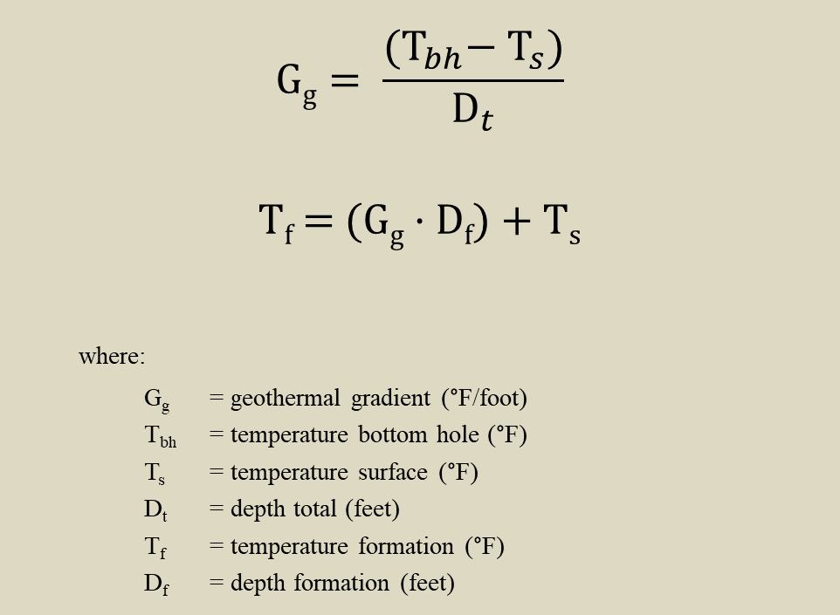
Math is Fun!
Determine the temperature of the formation being investigated.
Determine resistivity of water equivalent.
Correct resistivity water based on groundwater type correction factor.
Convert resistivity water at formation temperature to 77°F using Arp’s Equation.
Convert resistivity water at 77°F to conductivity water at 77°F.
Calculate interpreted total dissolved solids.
$$\text{G}\text{g}= \frac{{(T}_{bh}− T_{s})}{D_{t}}$$
$$\text{T}\text{f}\text{ = (}\text{Gg}\text{ · }\text{Df}\text{) + }\text{Ts}$$
where:
G_{g} = geothermal gradient (°F/foot)
T_{bh} = temperature bottom hole (°F)
T_{s} = temperature surface (°F)
D_{t} = depth total (feet)
T_{f} = temperature formation (°F)
D_{f} = depth formation (feet)

Slide 12
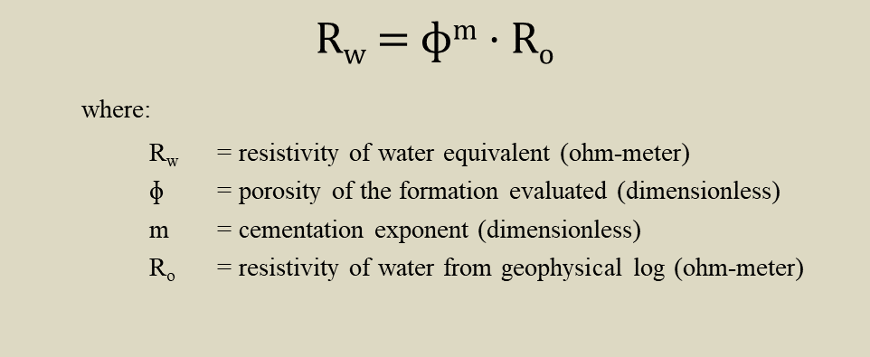
Math is Fun!
Determine the temperature of the formation being investigated.
Determine resistivity of water equivalent.
Correct resistivity water based on groundwater type correction factor.
Convert resistivity water at formation temperature to 77°F using Arp’s Equation.
Convert resistivity water at 77°F to conductivity water at 77°F.
Calculate interpreted total dissolved solids.
$$\text{R}\text{w}\text{ = ɸ}\text{m}\text{ · }\text{Ro}$$
where:
R_{w} = resistivity of water equivalent (ohm-meter)
ɸ = porosity of the formation evaluated (dimensionless)
m = cementation exponent (dimensionless)
R_{o} = resistivity of water from geophysical log (ohm-meter)

Slide 13
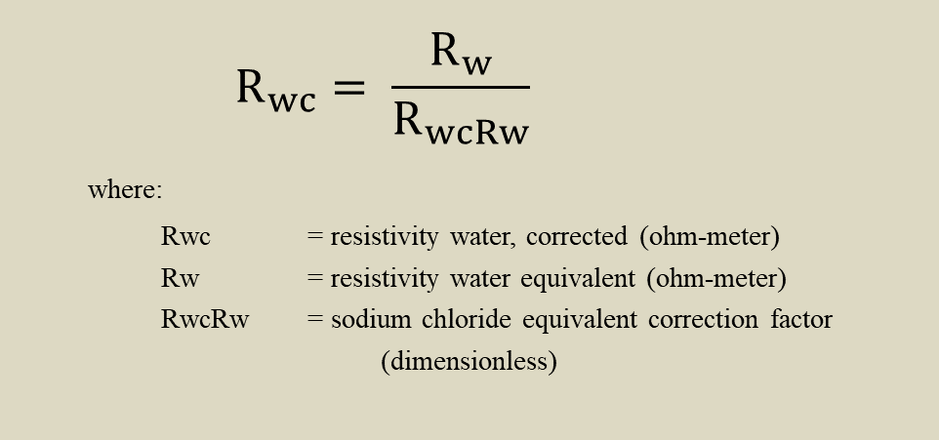
Math is Fun!
Determine the temperature of the formation being investigated.
Determine resistivity of water equivalent.
Correct resistivity water based on groundwater type correction factor.
Convert resistivity water at formation temperature to 77°F using Arp’s Equation.
Convert resistivity water at 77°F to conductivity water at 77°F.
Calculate interpreted total dissolved solids.
$$R_{wc}= \frac{R_{w}}{R_{wcRw}}$$
where:
Rwc = resistivity water, corrected (ohm-meter)
Rw = resistivity water equivalent (ohm-meter)
RwcRw = sodium chloride equivalent correction factor
(dimensionless)

Slide 14
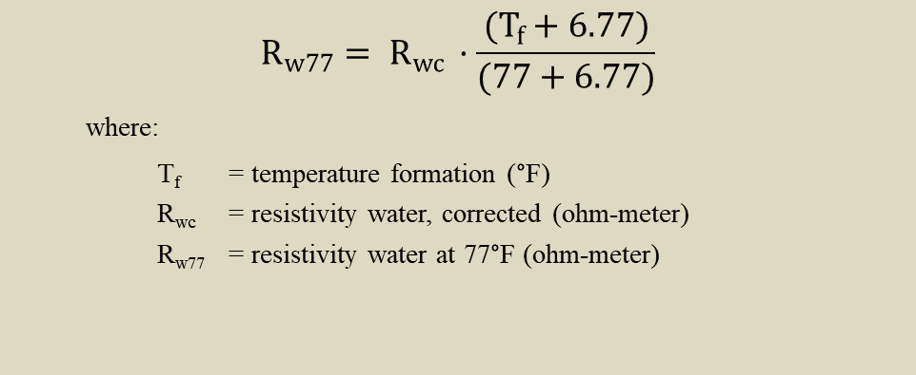
Math is Fun!
Determine the temperature of the formation being investigated.
Determine resistivity of water equivalent.
Correct resistivity water based on groundwater type correction factor.
Convert resistivity water at formation temperature to 77°F using Arp’s Equation.
Convert resistivity water at 77°F to conductivity water at 77°F.
Calculate interpreted total dissolved solids.
$$R_{w77}= R_{wc }·\frac{(T_{f}+6.77)}{(77+6.77)}$$
where:
T_{f} = temperature formation (°F)
R_{wc} = resistivity water, corrected (ohm-meter)
R_{w77} = resistivity water at 77°F (ohm-meter)

Slide 15
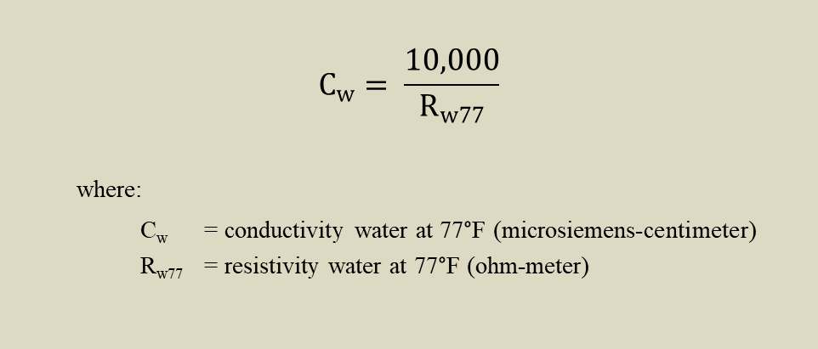
Math is Fun!
Determine the temperature of the formation being investigated.
Determine resistivity of water equivalent.
Correct resistivity water based on groundwater type correction factor.
Convert resistivity water at formation temperature to 77°F using Arp’s Equation.
Convert resistivity water at 77°F to conductivity water at 77°F.
Calculate interpreted total dissolved solids.
$$C_{w}= \frac{10,000}{R_{w77}}$$
where:
C_{w} = conductivity water at 77°F (microsiemens-centimeter)
R_{w77} = resistivity water at 77°F (ohm-meter)

Slide 16
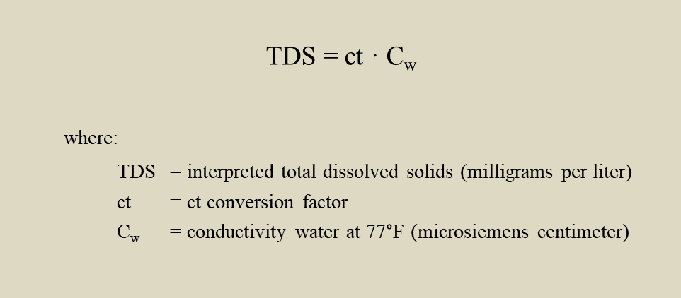
Math is Fun!
Determine the temperature of the formation being investigated.
Determine resistivity of water equivalent.
Correct resistivity water based on groundwater type correction factor.
Convert resistivity water at formation temperature to 77°F using Arp’s Equation.
Convert resistivity water at 77°F to conductivity water at 77°F.
Calculate interpreted total dissolved solids.
$$\text{TDS}\text{ = }\text{ct}\text{ · }\text{Cw}$$
where:
TDS = interpreted total dissolved solids (milligrams per liter)
ct = ct conversion factor
C_{w} = conductivity water at 77°F (microsiemens centimeter)

Slide 17
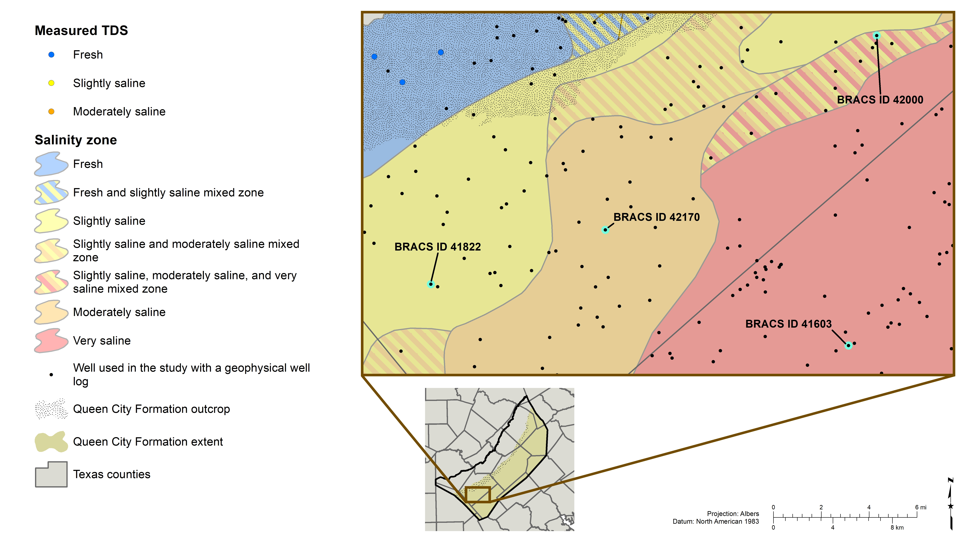
Notes:
Map just showing salinity zone mapping in the example area

Slide 18


Slightly saline well 41822
Top of the Queen City Formation at 740 feet below Kelly Bushing
$$=0.62 ∗\frac{10,000}{\frac{{\text{0.39}}^{1.75} ∗18}{1.25} ∗ \frac{\left(\frac{103 −70}{1,505} ∗1,200+70\right) + 6.77}{77 + 6.77}}$$
1,824
$TDS=ct ∗\frac{10,000}{\frac{{\text{Ø}}^{m} ∗ Ro}{RwcRw} ∗ \frac{\left(\frac{Tbh −Ts}{Dt} ∗ Df+Ts\right) + 6.77}{77 + 6.77}}$
Value | Parameter | Units
1,505 | Depth total, Dt | Feet below Kelly Bushing
1,200 | Depth formation, Df | Feet below Kelly Bushing
70 | Temperature surface, Ts | Degrees Fahrenheit
103 | Temperature bottom hole, Tbh | Degrees Fahrenheit
18 | Deep resistivity, Ro | Ohm-meter
0.39 | Porosity, Ø | Percent
0.62 | ct conversion factor, ct | Dimensionless
1.75 | Cementation exponent, m | Dimensionless
1.25 | Water quality correction factor, R_{wcRw} | Dimensionless
Bottom of the Queen City Formation at 1,500 feet below Kelly Bushing
Notes:
Slightly saline calculation example, Ro is base 5

Slide 19


Moderately saline well 42170
Top of the Queen City Formation at 903 feet below Kelly Bushing
$$=0.56 ∗\frac{10,000}{\frac{{\text{0.39}}^{1.75} ∗7.5}{1} ∗ \frac{\left(\frac{201 − 69}{1505} ∗7903+69\right) + 6.77}{77 + 6.77}}$$
3,478
$TDS=ct ∗\frac{10,000}{\frac{{\text{Ø}}^{m} ∗ Ro}{RwcRw} ∗ \frac{\left(\frac{Tbh −Ts}{Dt} ∗ Df+Ts\right) + 6.77}{77 + 6.77}}$
Value | Parameter | Units
7903 | Depth total, Dt | Feet below Kelly Bushing
1090 | Depth formation, Df | Feet below Kelly Bushing
69 | Temperature surface, Ts | Degrees Fahrenheit
201 | Temperature bottom hole, Tbh | Degrees Fahrenheit
7.5 | Deep resistivity, Ro | Ohm-meter
0.39 | Porosity, Ø | Percent
0.56 | ct conversion factor, ct | Dimensionless
1.75 | Cementation exponent, m | Dimensionless
1 | Water quality correction factor, R_{wcRw} | Dimensionless
Bottom of the Queen City Formation at 1,702 feet below Kelly Bushing
Notes:
Moderately saline calculation example, Ro is base 5

Slide 20

Very saline well 41603
Top of the Queen City Formation at 2,745 feet below Kelly Bushing
$$=0. 56∗\frac{10,000}{\frac{{\text{0.3}5}^{1.75} ∗1}{1} ∗ \frac{\left(\frac{269.6 −70}{11,450} ∗2,30+70\right) + 6.77}{77 + 6.77}}$$
23,333
$TDS=ct ∗\frac{10,000}{\frac{{\text{Ø}}^{m} ∗ Ro}{RwcRw} ∗ \frac{\left(\frac{Tbh −Ts}{Dt} ∗ Df+Ts\right) + 6.77}{77 + 6.77}}$
Value | Parameter | Units
11,450 | Depth total, Dt | Feet below Kelly Bushing
2,830 | Depth formation, Df | Feet below Kelly Bushing
70 | Temperature surface, Ts | Degrees Fahrenheit
269.6 | Temperature bottom hole, Tbh | Degrees Fahrenheit
1 | Deep resistivity, Ro | Ohm-meter
0.35 | Porosity, Ø | Percent
0.56 | ct conversion factor, ct | Dimensionless
1.75 | Cementation exponent, m | Dimensionless
1 | Water quality correction factor, R_{wcRw} | Dimensionless
Bottom of the Queen City Formation at 3,600 feet below Kelly Bushing
Notes:
Very saline calculation example, Ro is base 2

Slide 21
Top of the Queen City Formation at 740 feet below Kelly Bushing
Mixed salinity well 42000
#1 | #2 | #3 | Parameter | Units
4003 | 4003 | 4003 | Depth total, Dt | Feet below Kelly Bushing
820 | 1070 | 1360 | Depth formation, Df | Feet below Kelly Bushing
69 | 69 | 69 | Temperature surface, Ts | Degrees Fahrenheit
127.1 | 127.1 | 127.1 | Temperature bottom hole, Tbh | Degrees Fahrenheit
2.6 | 3.2 | 10 | Deep resistivity, Ro | Ohm-meter
0.4 | 0.39 | 0.39 | Porosity, Ø | Percent
0.56 | 0.56 | 0.57 | ct conversion factor, ct | Dimensionless
1.75 | 1.75 | 1.75 | Cementation exponent, m | Dimensionless
1 | 1 | 1.11 | Water quality correction factor, R_{wcRw} | Dimensionless
Calculation 1, TDS = 10,370
Calculation #2, TDS = 8,235
Calculation #3, TDS = 2,879
Bottom of the Queen City Formation at 1,435 feet below Kelly Bushing
Notes:
Ro is base 2. Both John and Alysa looked at logs and thought the SS sand was anomalous. Then Alysa noticed that there was a cluster of logs with “anomalous” SS sand, mixed zone made. John speculates there might be fresher CZ water migrating up a fault, overall not solid explanation.

Slide 22
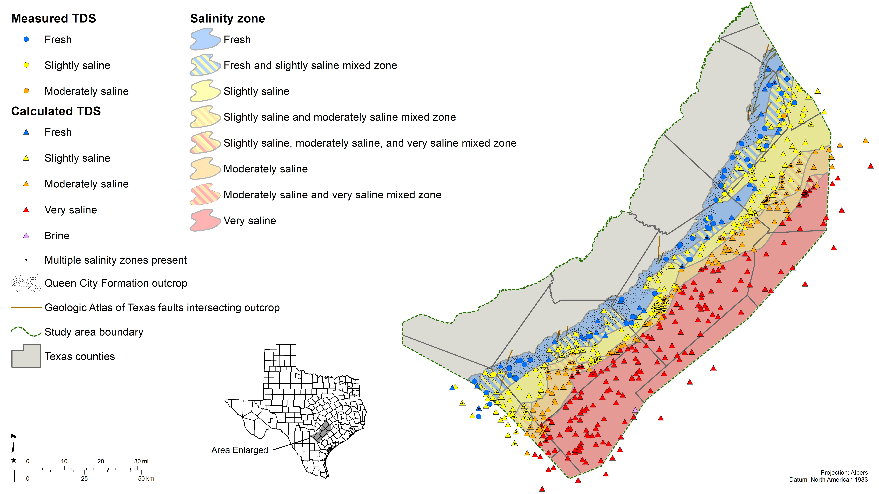
Notes:
Map showing salinity zone mapping for the Queen City Aquifer for the entire study area

Slide 23
Conclusions
Resistivity logs can be used to estimate water quality
The calculations work best when:
  Correlations with measured water quality can be established
  Parameters such as the porosity and cementation exponent are well defined
  The water quality is dominated by NaCl and not SO₄²⁻ or HCO₃⁻
  Log headers are complete (bottom hole temperature, etc.)
  Logs start shallow enough and are run before casing is placed

Slide 24
JOB VACANCY NOTICE:
Professional Geoscientist / Geoscientist-In-Training
(Geoscientist II/Hydrologist II)
http://www.twdb.texas.gov/jobs/index.asp
Andrea Croskrey, M.S., P.G.
Geologist
Innovative Water Technologies
Texas Water Development Board
andrea.croskrey@twdb.texas.gov
(512) 463-2865
http://www.twdb.texas.gov/innovativewater/index.asp
2017 Water Plan: http://www.twdb.texas.gov/waterplanning/swp/2017/index.asp
Work Location: Austin
Monthly Salary: $4,375.00 – 4,635.50*
Travel %: 15
Number of Positions: 2
*Salary commensurate with experience and qualifications
Minimum Qualifications
• Graduation from an accredited four-year college or university with a Bachelor of Science in Geology, Geophysics, Hydrogeology or related field.
• Three to five years of progressive work experience in the Geology, Geophysics, and Hydrogeology field.
• Licensed as a Geoscientist-In-Training or Professional Geoscientist by the Texas Board of Professional Geoscientists.
• Previous experience with GIS applications and database applications.
• Previous experience with preparing and writing technical reports.
• Relevant education and experience can be substituted on a year-for-year basis.
Notes:
Professional Connections

