Slide 1
Kinematic Deconstructions/Reconstructions from Rodinia to the Present Gulf of Mexico Basin
Gary L. Kinsland
University of Louisiana at Lafayette

Slide 2
I use scissor cuts and tape to illustrate my ideas of the kinematics of development of the Gulf of Mexico Basin (GoMB) from the Pre-Cambrian breakup of Rodinia, through the Paleozoic construction of Pangea, to the Mesozoic rifting of the northern GoMB and ending with the rotational drift of the Yucatan Peninsula which resulted in the present Gulf of Mexico. The tectonic features and boundaries represented by the cuts and those which constrain the motions are documented with available geophysical and geological data.
The key assumption is “thin slab rifting” of the northern GoMB resulting in the East Texas, Northern Louisiana and Mississippi Salt Basins. This rifting moves the Yucatan Block, still attached to the Louisiana/Mississippi slab, away from Texas resulting in a volcanic rifted margin and moves Florida southeast by rifting within the Suwanee Terrane in southern Georgia and northern Florida. This latter rifting allows the southeastward motion, parallel to the late Pre-Cambrian – Paleozoic transform margin, without requiring a strike-slip fault through Florida or the western Florida platform.

Slide 3
As I was thinking what and how I wanted to present my ideas in this talk I realized I had three particular points I wanted to make:
I don’t believe the oft repeated model of Thomas (1976) is relevant for the northern and northeastern Gulf of Mexico Basin (GoMB) as it doesn’t fit the present data.
The apparent lack of a southeastern extension, through Florida, of the northeastern GoMB bounding strike slip fault may be explained by Mesozoic extension of rift basins in Georgia.
Knowing “what is down there” would be a big help in understanding the tectonic history of the northern GoMB. Deep drilling the Sabine Uplift would likely answer many questions.

Slide 4
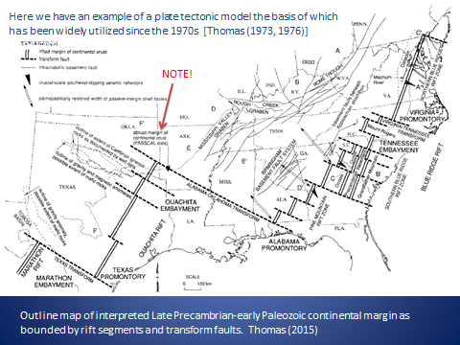
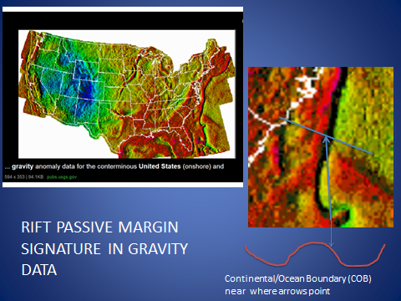
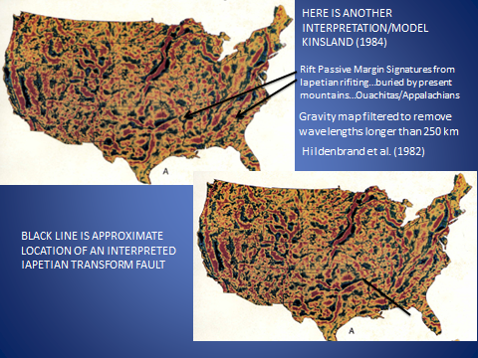
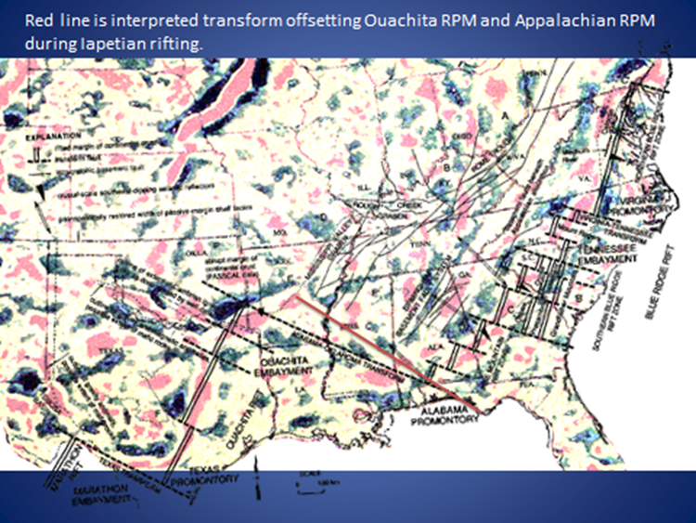

Slide 5
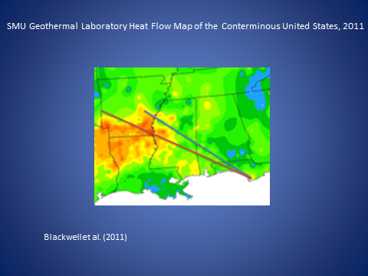
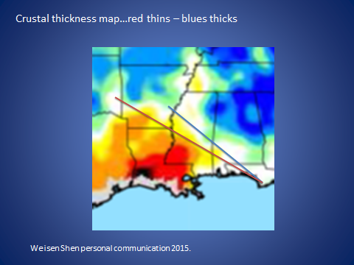
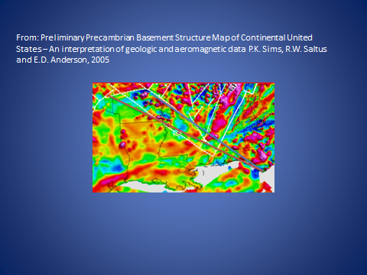
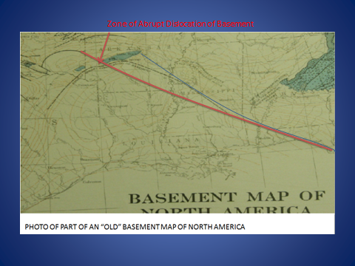

Slide 6
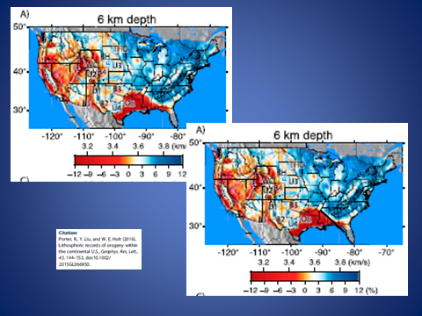

Slide 7
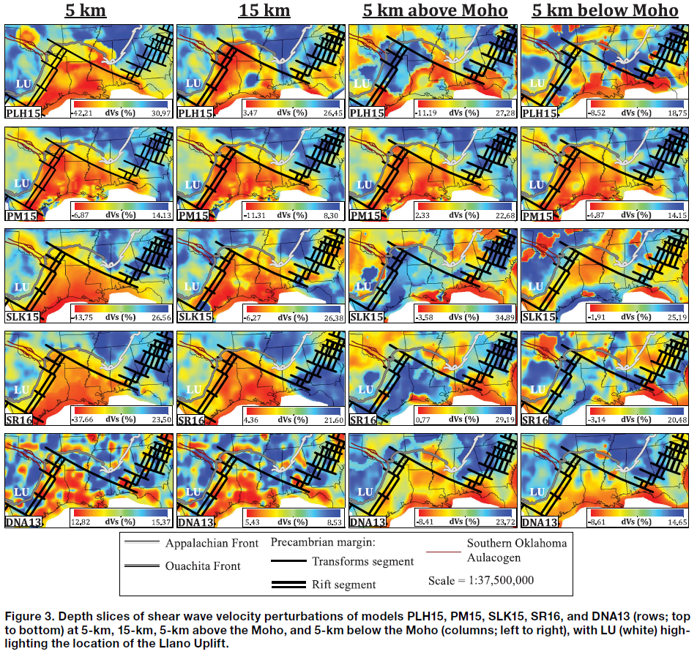
Netto, Pulliam and Persaud (2019)

Slide 8
Thomas’ conceptual model was groundbreaking when it was proposed…remember plate tectonics was just being accepted in the early ‘70s. That his model has served to focus thinking about the origin of the Gulf of Mexico for so many years is testament to his insight. However, models are to guide us in our pursuit of data to test the model. A model must be modified when new data become available which are inconsistent with the model.
I think the data I have just shown are sufficient reason to modify the very rectilinear model of Thomas to a model for the Gulf of Mexico Basin which maintains the basic plate tectonic features of rifted margins but which conforms to the many data sets now available. In particular, the data show that the northeastern boundary of the Gulf of Mexico Basin is not the “Alabama Oklahoma Transform” (AOT) of Thomas. The boundary lies to the northeast of the AOT.

Slide 9
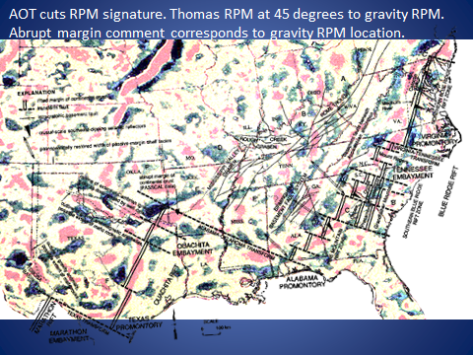
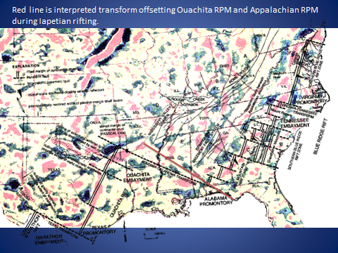
Thomas’ Rift Passive Margins (RPM) do not align with the gravity high signatures of the Iapetan RPM particularly in Arkansas, Oklahoma, Texas area.
My proposed Precambrian boundary follows the gravity high of the Rift Passive Margin from southern Texas into Arkansas and then down the Transform Passive Margin to southern Alabama

Slide 10
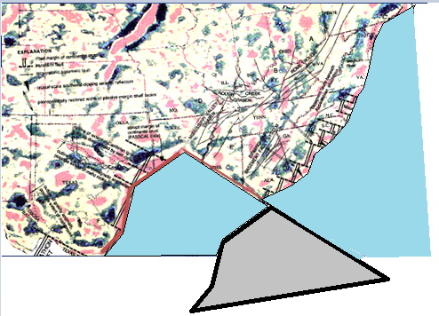
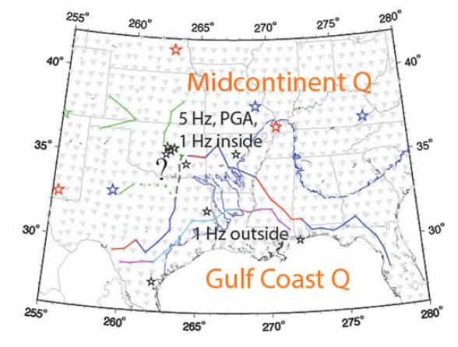
Boundary follows gravity high of Rift Passive Margin from southern Texas into Arkansas and then down Transform Passive Margin to the Rift Passive Margin gravity high in southern Alabama. (Showing only the piece rifted from southern Laurentian margin.)
The location of the rift/transform boundary
(Late Precambrian) is very similar to the boundary in this figure from Cramer (2017) based on Q within the Gulf Coast
Region.

Slide 11
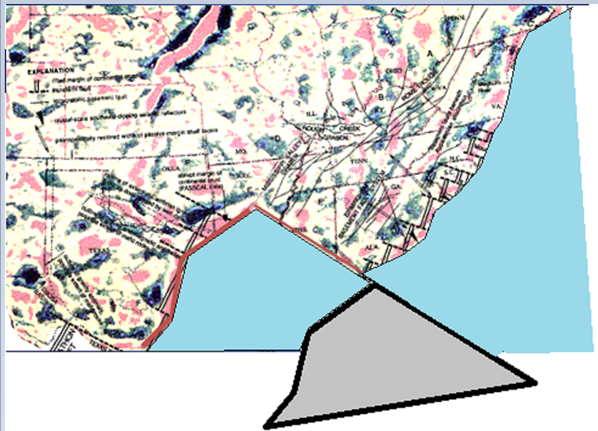

Perhaps the piece moved completely out or…
Perhaps it moved only partially
out of the Iapetan Gulf Basin.
Moving only partially out would result in there being little oceanic crust in the gap and little subduction when it closes. Perhaps explaining lack of evidence of subduction volcanism on either side.

Slide 12
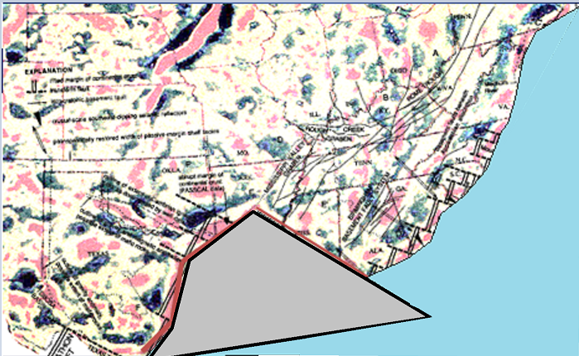
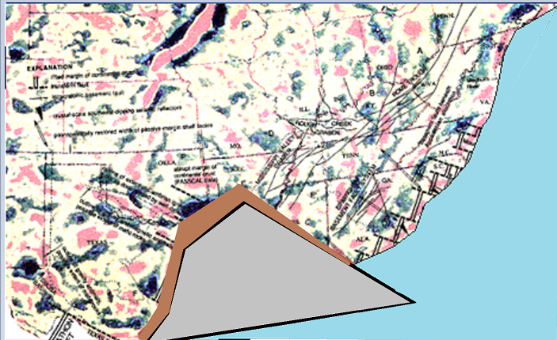
I suggest that the partial removal of a shape which closely fits the Laurentian margin allows crust of this shape to re-enter the basin upon Paleozoic formation of Pangea.
Imagine Madagascar being re-emplaced into eastern Africa.
This “shape fitting” supplies an explanation for the variation in deformation upon collision as the southwestern and northeastern margins experience a larger component of shear deformation while the northern (exposed Ouachitas) margin is directly impacted leading to greater tectonism.
Area of tectonic influence

Slide 13
In this scenario the deep continental crust underneath the northern GoMB would be very much like that of the southern Laurentian deep crust as it would originally have been Laurentian deep crust…split off and then replaced.
The Mesozoic breakup and formation of the modern GoMB follows:

Slide 14
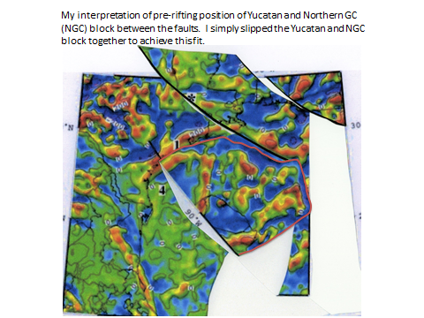
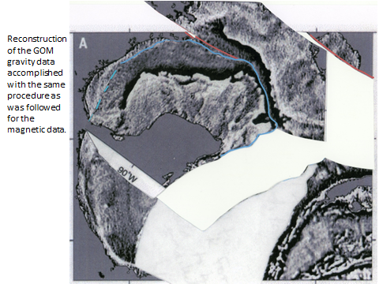
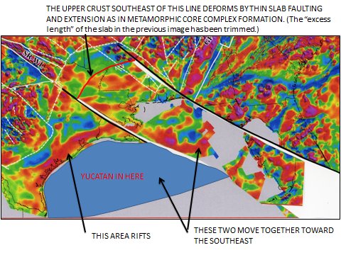
These three (which I have shown before and which are available in GSA SC digital files) are my interpretations of possible pre-Mesozoic-rifting configurations. There is a major problem with what these images suggest…each implies the existence of a major left-lateral strike-slip fault from Alabama, across the Florida Platform and through southern Florida. A fault for which there is little evidence.
Gulf Coast Magnetic Anomaly is continuous in this.

Slide 15
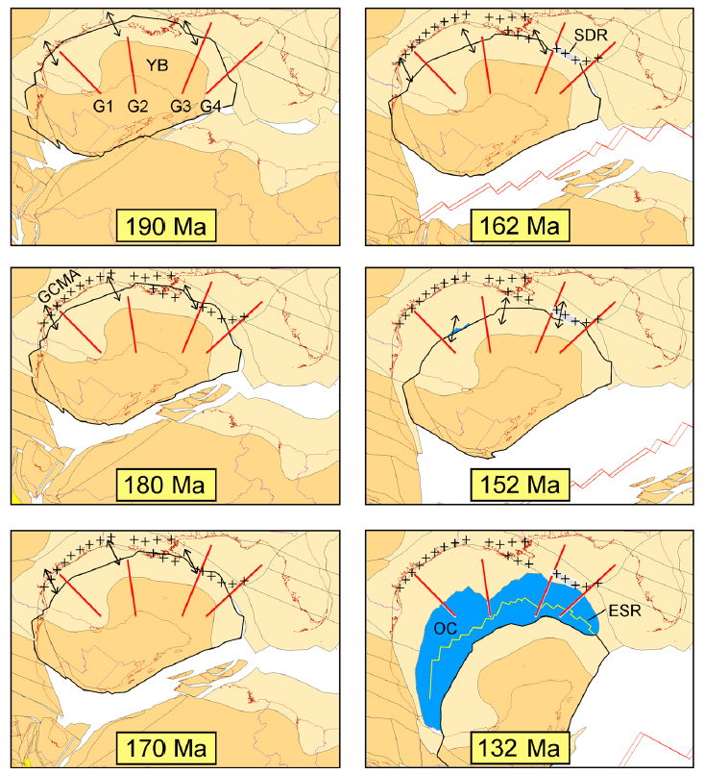
Their interpretation and mine are very similar. The main difference is in a slightly different fit of the Yucatan Block into the Gulf Coast Magnetic Anomaly (GCMA). My fit allows the westernmost of my faults to be coincident with the Five Islands Salt Dome line and to bound the northeastern edge of the pre-rift Yucatan Block. In my interpretation the GCMA in Texas and western Louisiana forms as the “slab” moves out of Louisiana carrying Yucatan with it. The GCMA in central and easstern Louisiana and the Gulf forms as the Yucatan rotates. They imply a transform fault from western Louisiana along the Florida shelf…I don’t.
Eddy et al. (2014)
Doi: 10.1002/2014JB011311

Slide 16
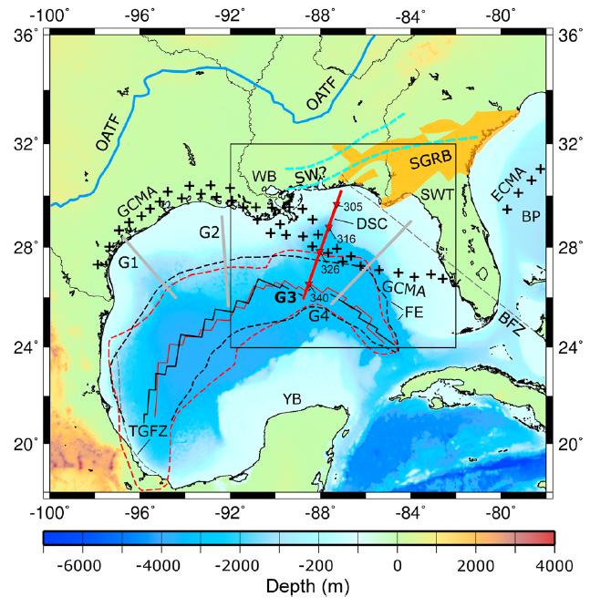
My southwestern fault
My northeastern fault
South Georgia Rift Basins (SGRB)
With this interpretation no fault passing through Florida is necessary as the spreading motion from the northern margin of the GOMB is accommodated by spreading in the SGRB. Florida moves southeastward attached to the “slab” from Louisiana/Mississippi which is attached to the Yucatan Block. This southeastward motion ceases when the Yucatan Block rotates away to form the Gulf of Mexico.
Eddy, et al. (2014) doi: 10.1002/2014JB011311

Slide 17
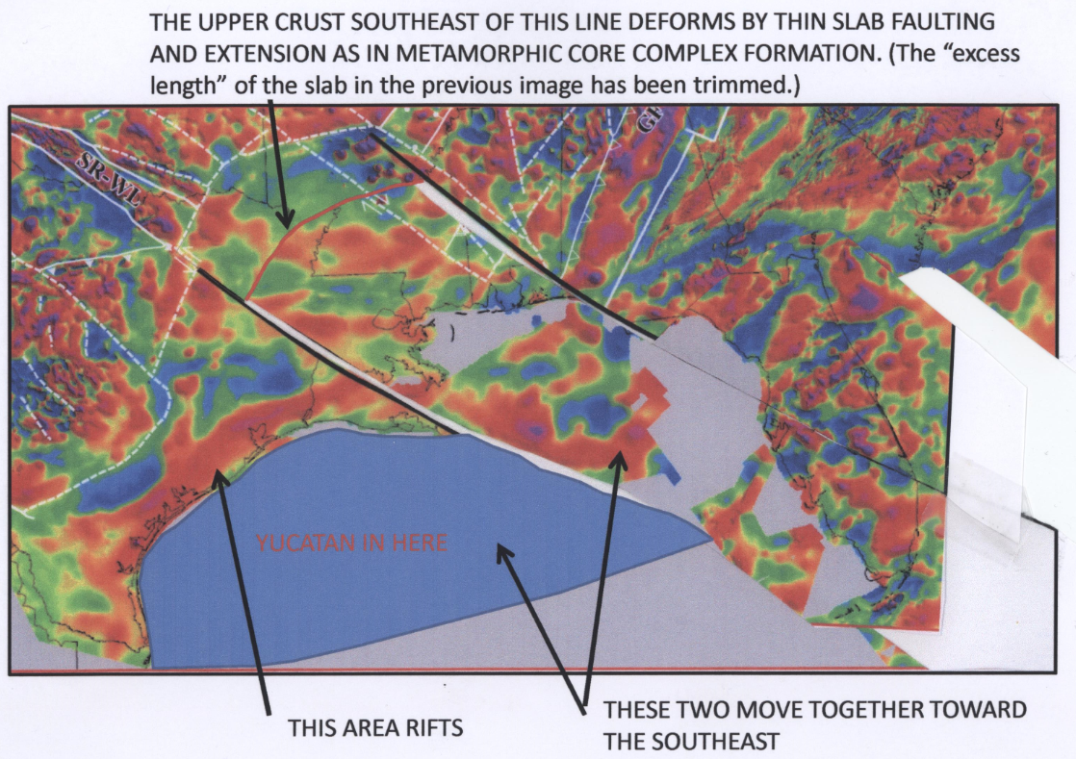
Note where SE LA and Miss. “shoreline” was
RIFTING/
SPREADING
OCCURS IN
THIS AREA

Slide 18
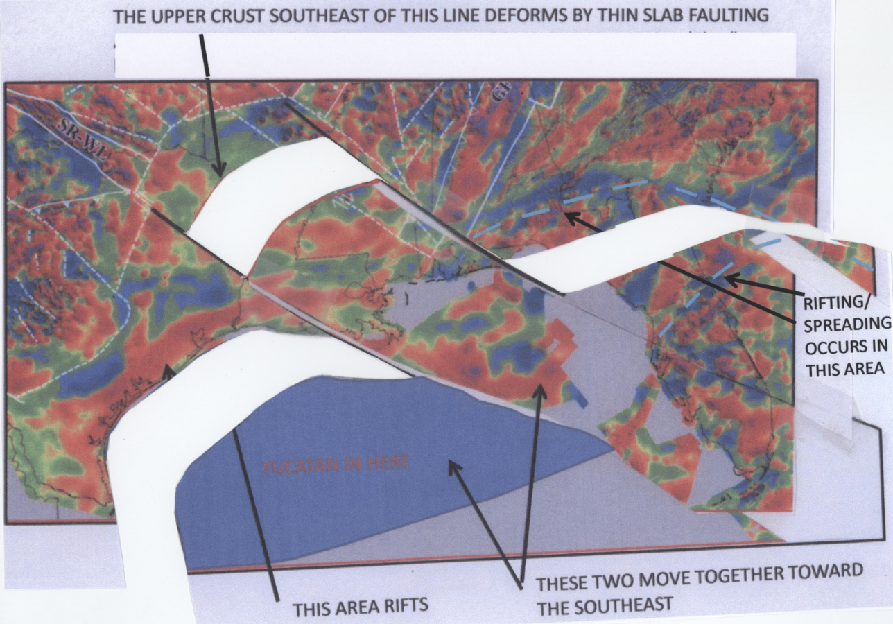
Rifting, spreading, stretching also occurs in these places.
Note the implication a transform offshore Georgia/Florida which is parallel to Atlantic Transforms.

Slide 19
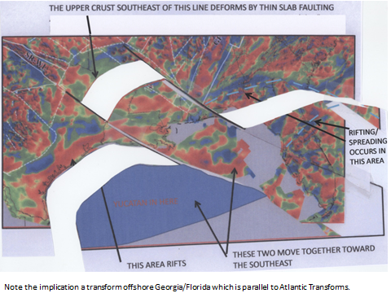
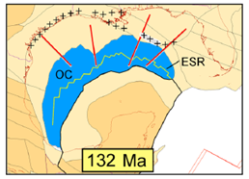
In the two models the locations for the Yucatan block before translation and before the rotation of the Yucatan block are very similar. My model explains opening of the northern GoMB and the translation of the Yucatan…allowing incursion of salt water and initiation of salt deposition in the northern salt basins and in the forming Gulf of Mexico basin.
Eddy et al. (2014)

Slide 20
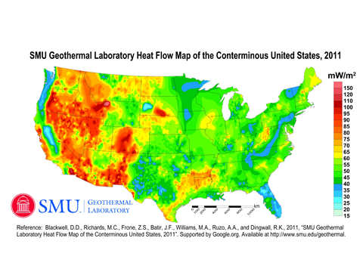
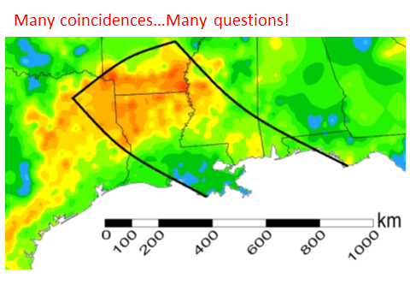
The northern GoMB is an area of anomalously high heat flow.
Is this high heat flow possibly related to the proposed thin slab rifting as the rifting uncovered crustal material which has risen?
The tectonic history of this region of high heat flow is unusual…uplifts and basins have each undergone multiple episodes of ups and downs from the Early Mesozoic right up until the Oligocene or later (present?).
Deep drilling the Sabine Uplift in the northwestern corner of Louisiana would likely answer many questions about crustal type, Paleozoic compression, Mesozoic rifting, uplift/basin formation.
We do not understand the southern margin of Laurentia as well as we understand the other margins. We have geophysical data and we have models. We need more deep geological data.

