Slide 1


Laboratory Electrical Resistivity Imaging of Macropore Flow
By John Hager, Lucie Guertault, Todd Halihan, and Garey Fox

Slide 2
Introduction
Runoff prevention is essential for streams and rivers adjacent to major farms
It’s unclear how temporal resistivity will detect flow with macropores
Hypothesis: macropores will significantly affect flow and ERI will detect it.
A 150 cm x 40 cm x 40 cm plexiglass tank on a wooden base was used in a controlled setting

Slide 3
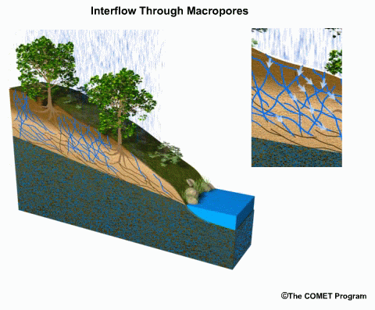
Macropore Definition
Macropore definition not trivial as it involves a couple parameters ((Beven and Germann 1982))
Channeling of fluid through the pores in comparison to the surrounding strata makes it a macropore (Weiler and Naef 2003)
Size is irrelevant, a macropore can range from 75 μm in a clay layer to 50 mm holes caused by burrowing (Seladji, Cosenza et al. 2010).

Slide 4
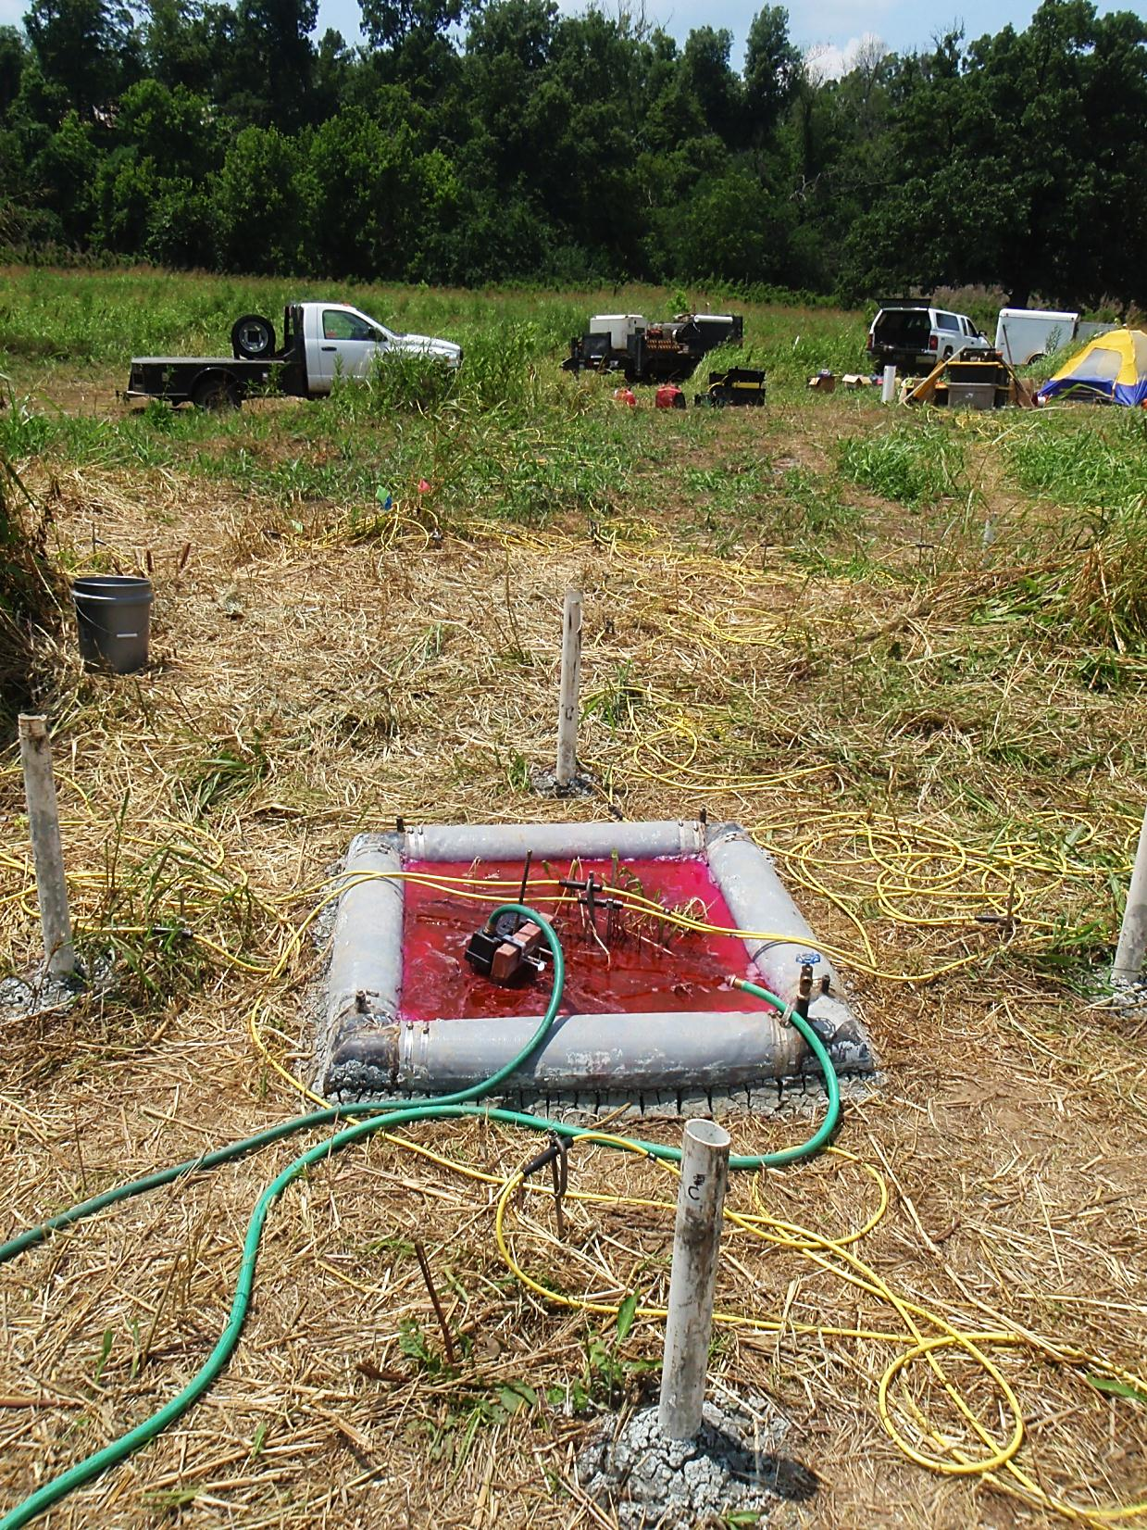
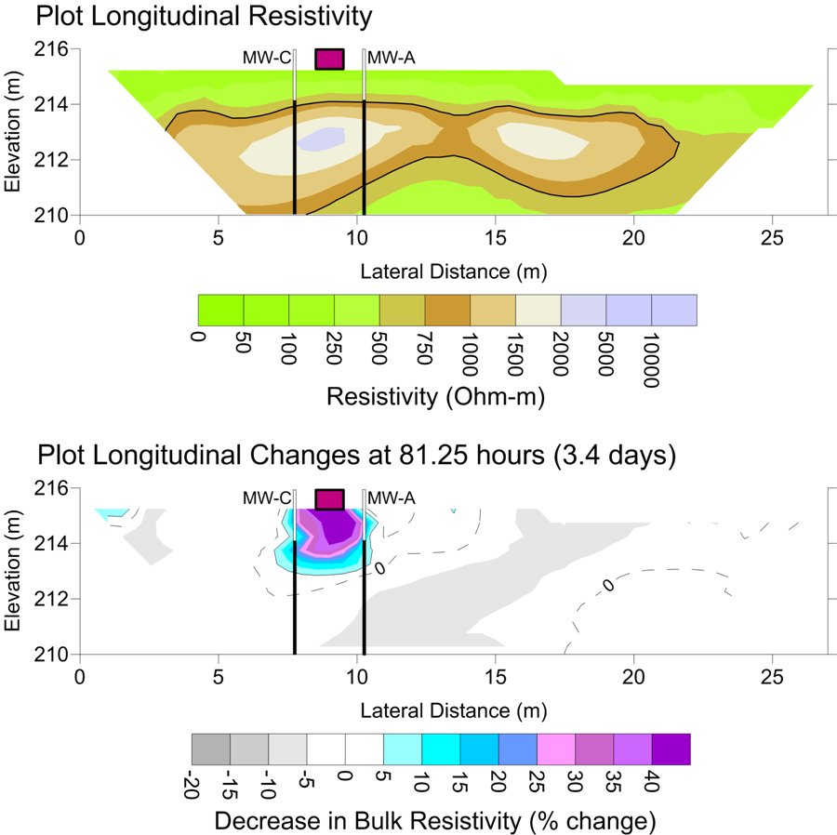
Previous Work
Halihan et al., 2019

Slide 5
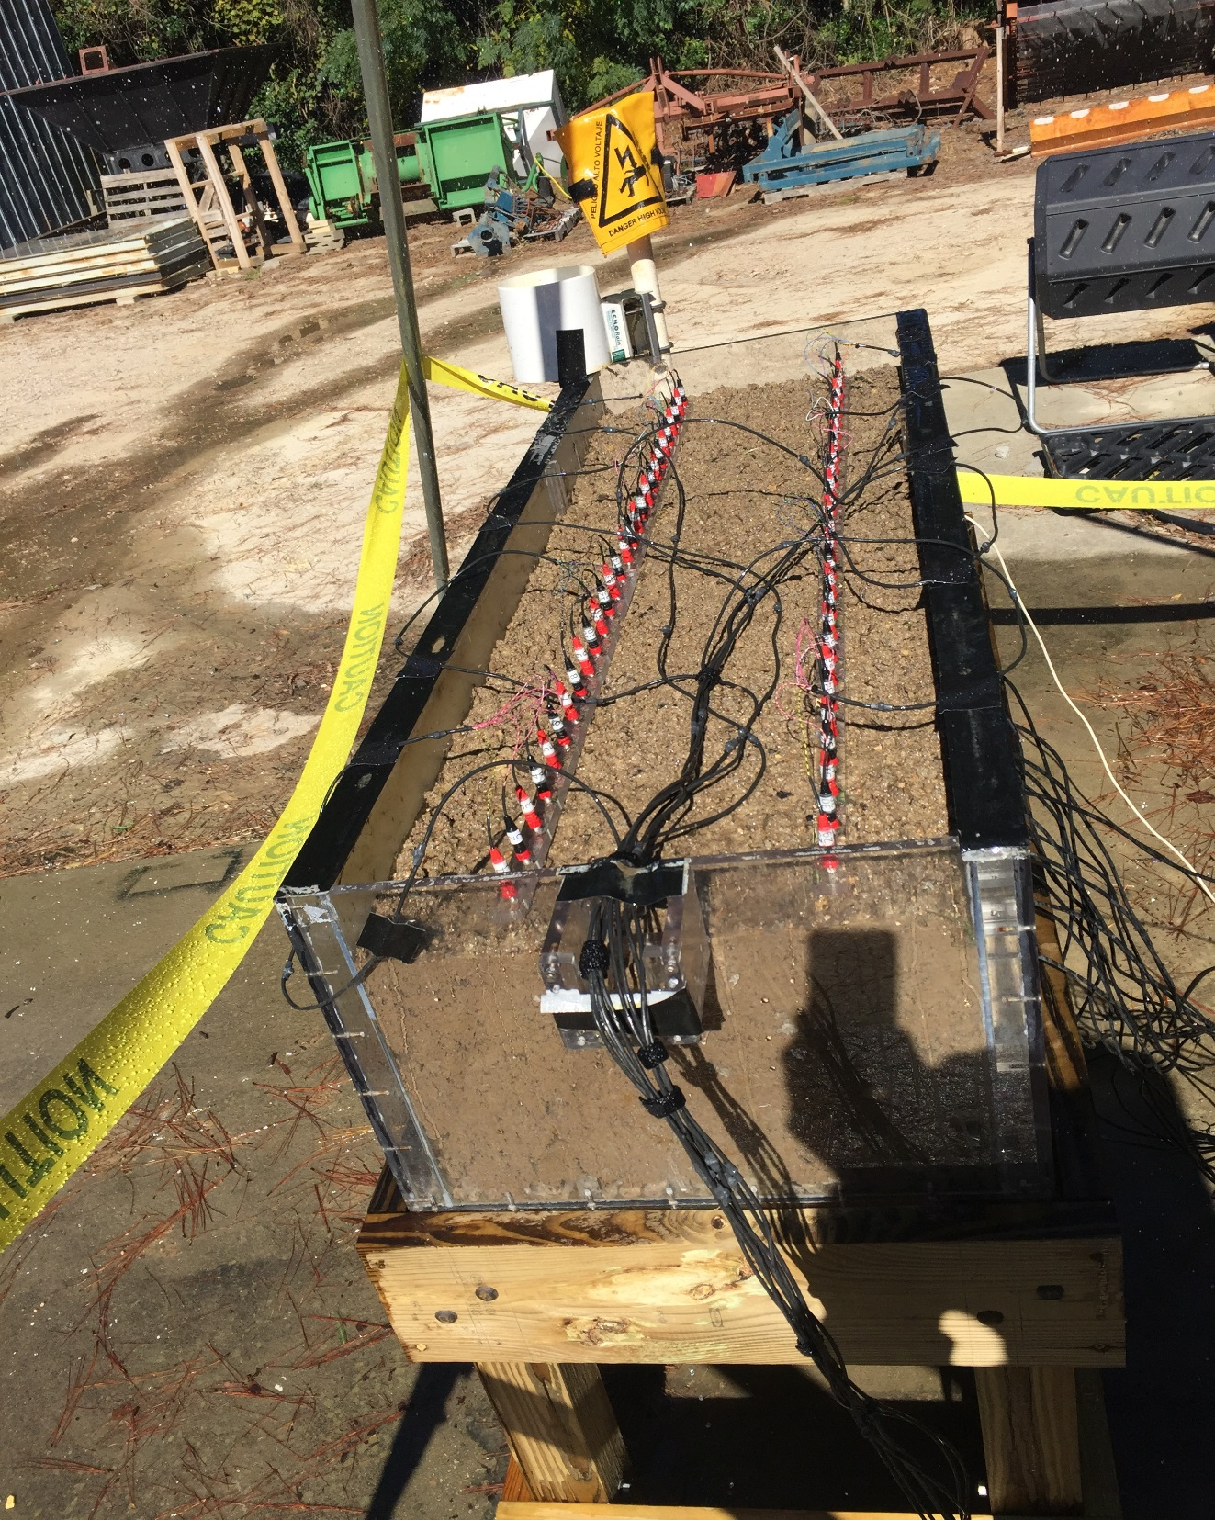
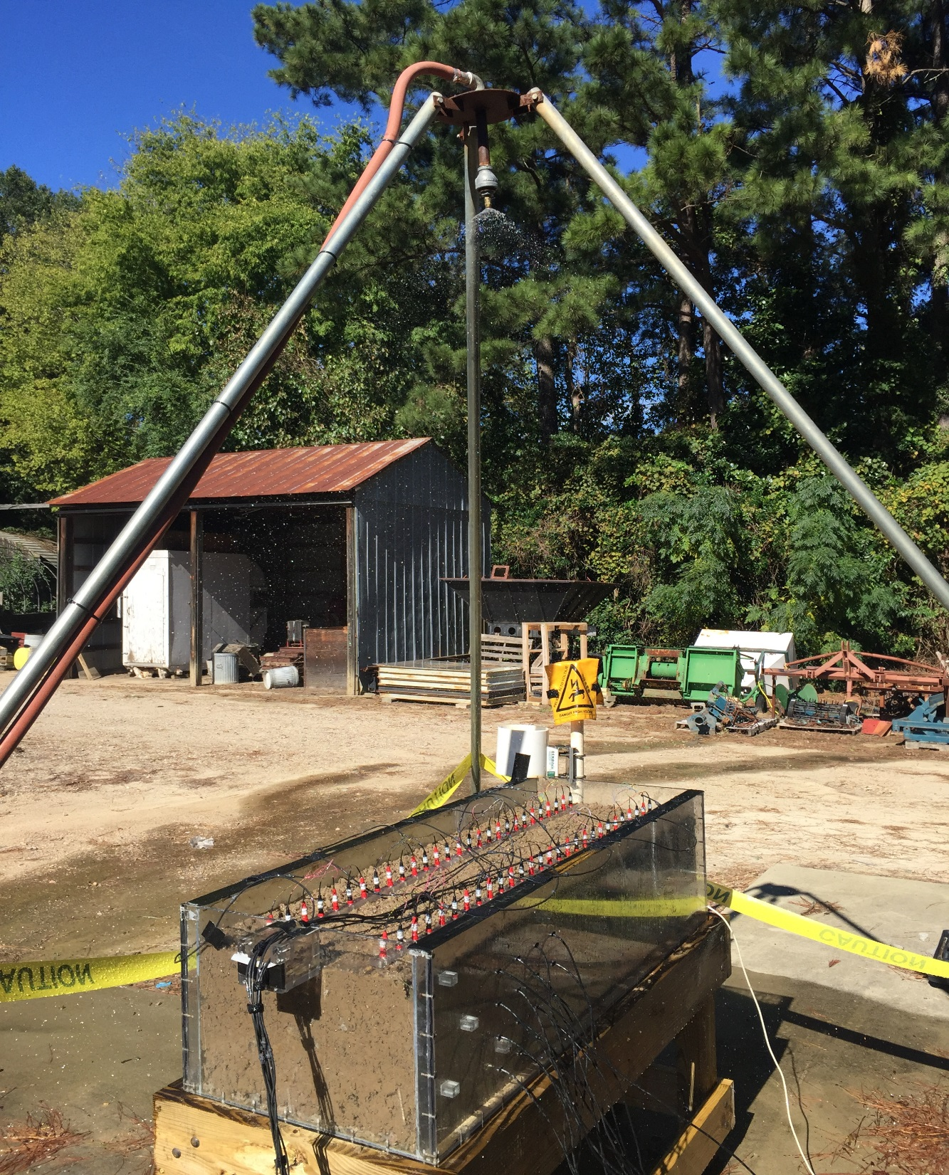
Tank Experiments aren’t Easy

Slide 6
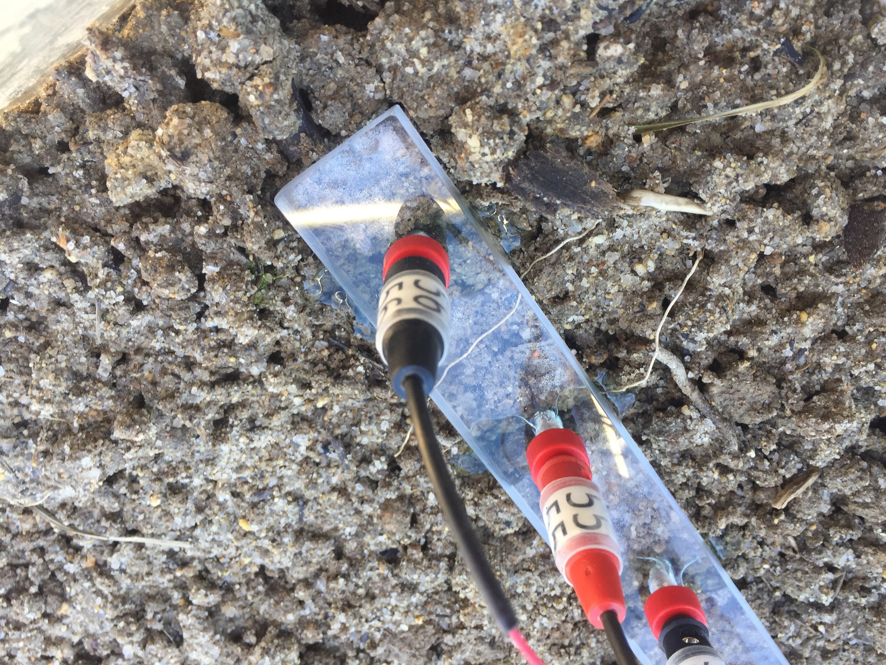
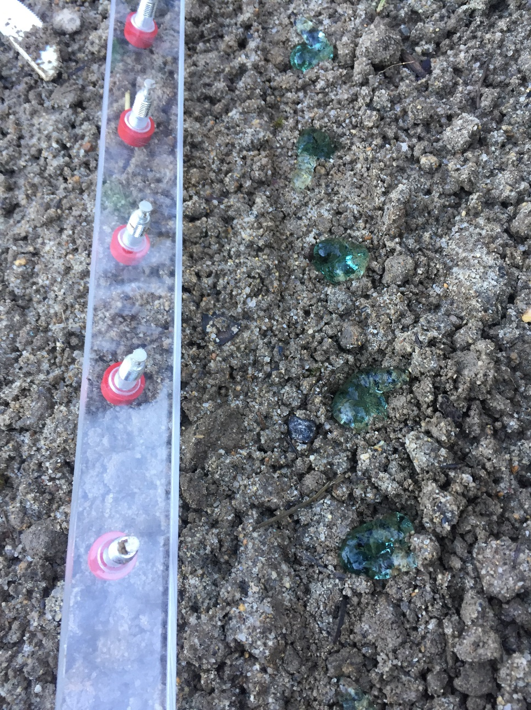
Methodology - Electrodes
6 cm.

Slide 7
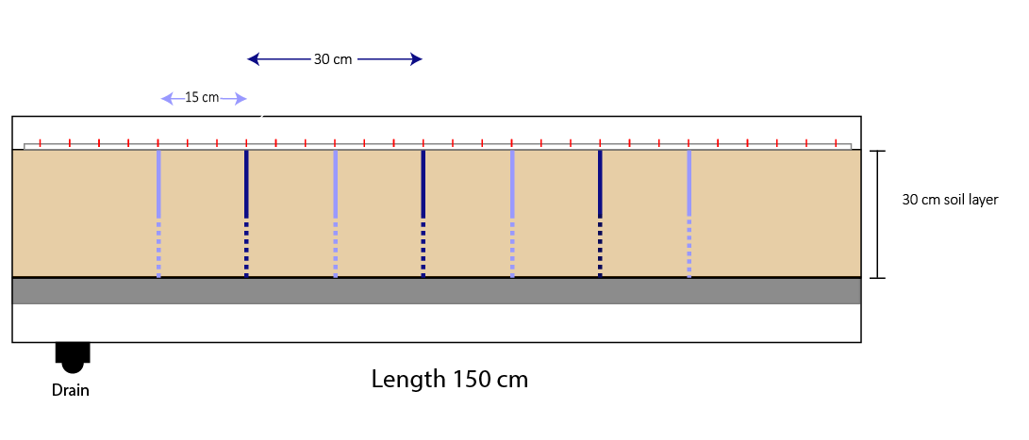
Methodology
Line 1 has three macropores spaced 30 cm apart
Line 2 has seven macropores spaced 15 cm apart
The investigated portion of the tank is the 30 cm of top soil. Underneath the soil lies 3 cm of crushed limestone and a void to aid drainage.
5 cm

Slide 8
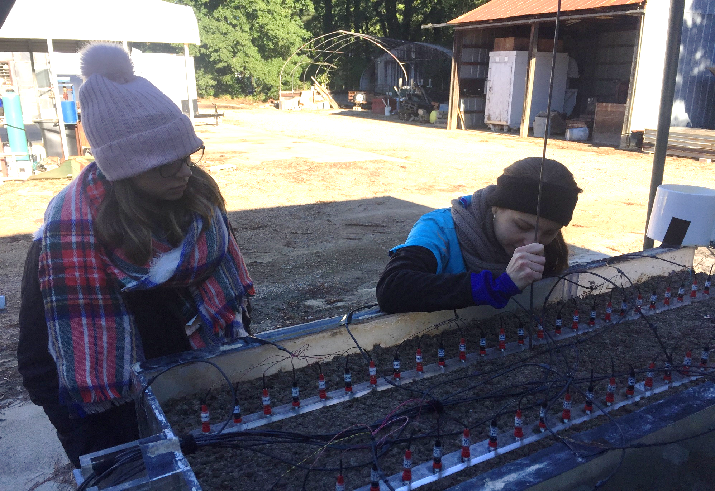
How were the macropores created?

Slide 9
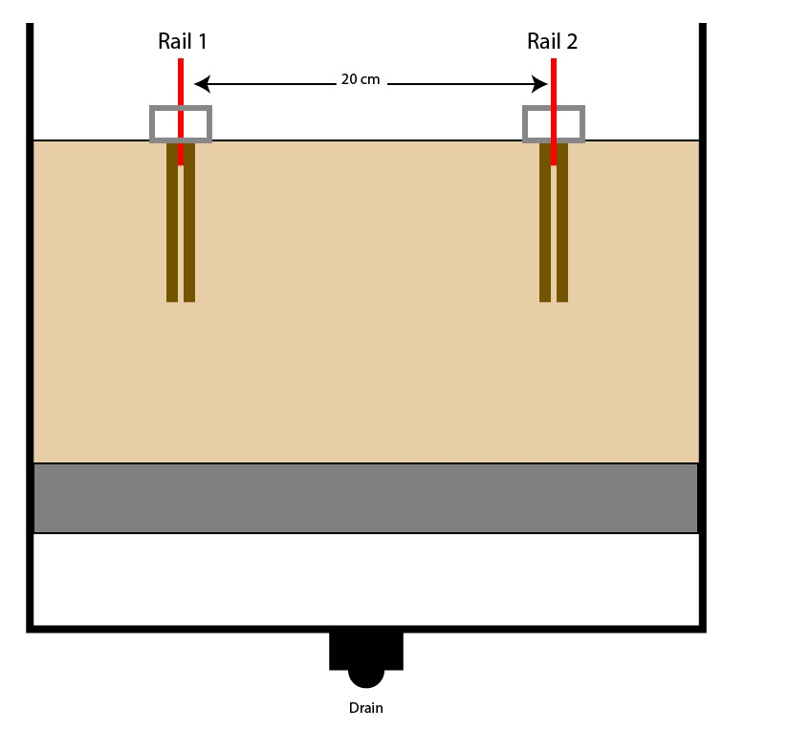
Line 1
Line 2
Tank Side View
Experiment 1
macropores ½ depth

Slide 10
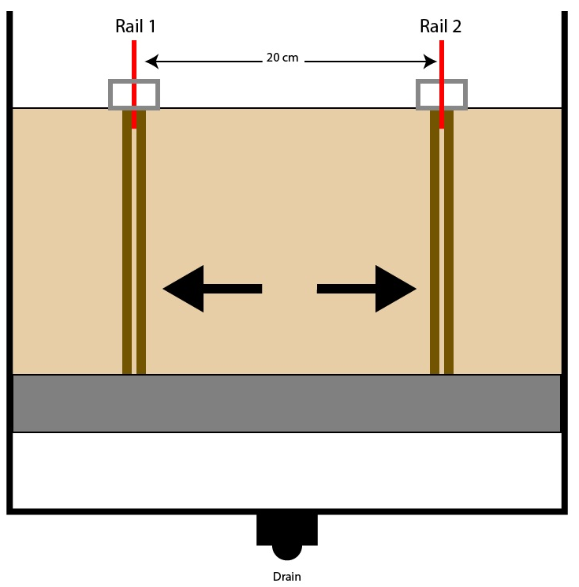
Line 1
Line 2
Experiment 2
macropores full depth

Slide 11
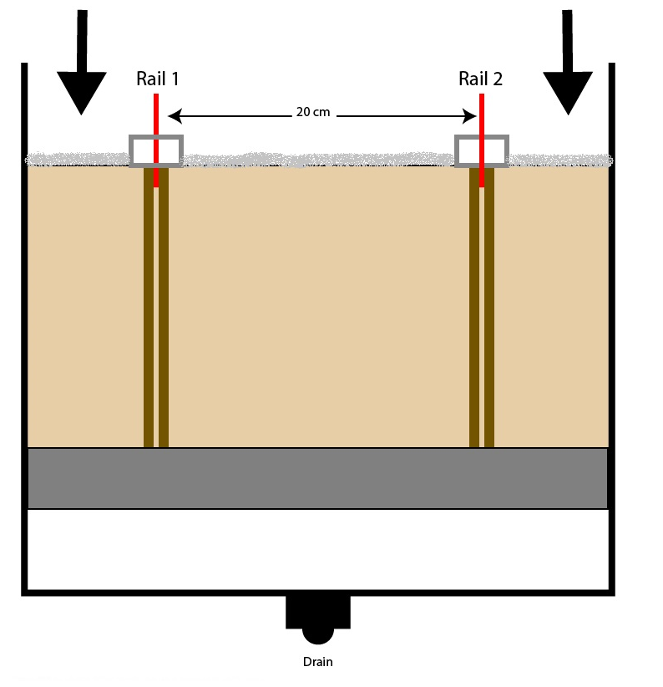
Line 1
Line 2
Experiment 3
800 mL of NaCl solution added to the top of the soil conc. = 1,000 ppm

Slide 12
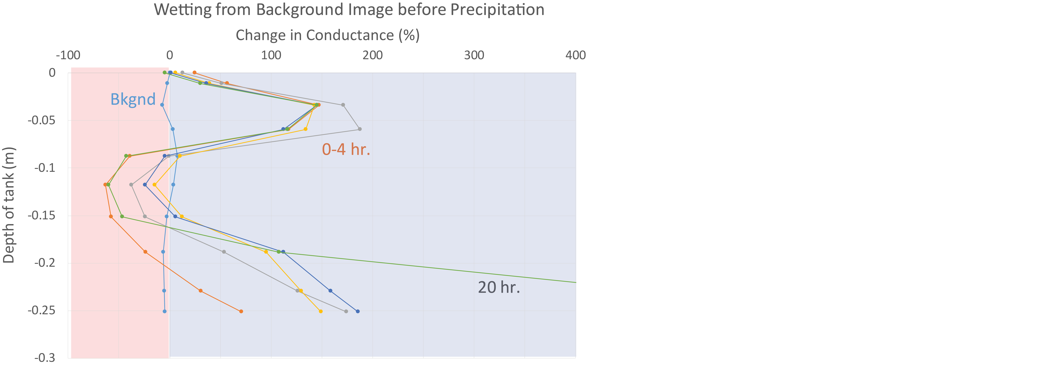
Results

Slide 13
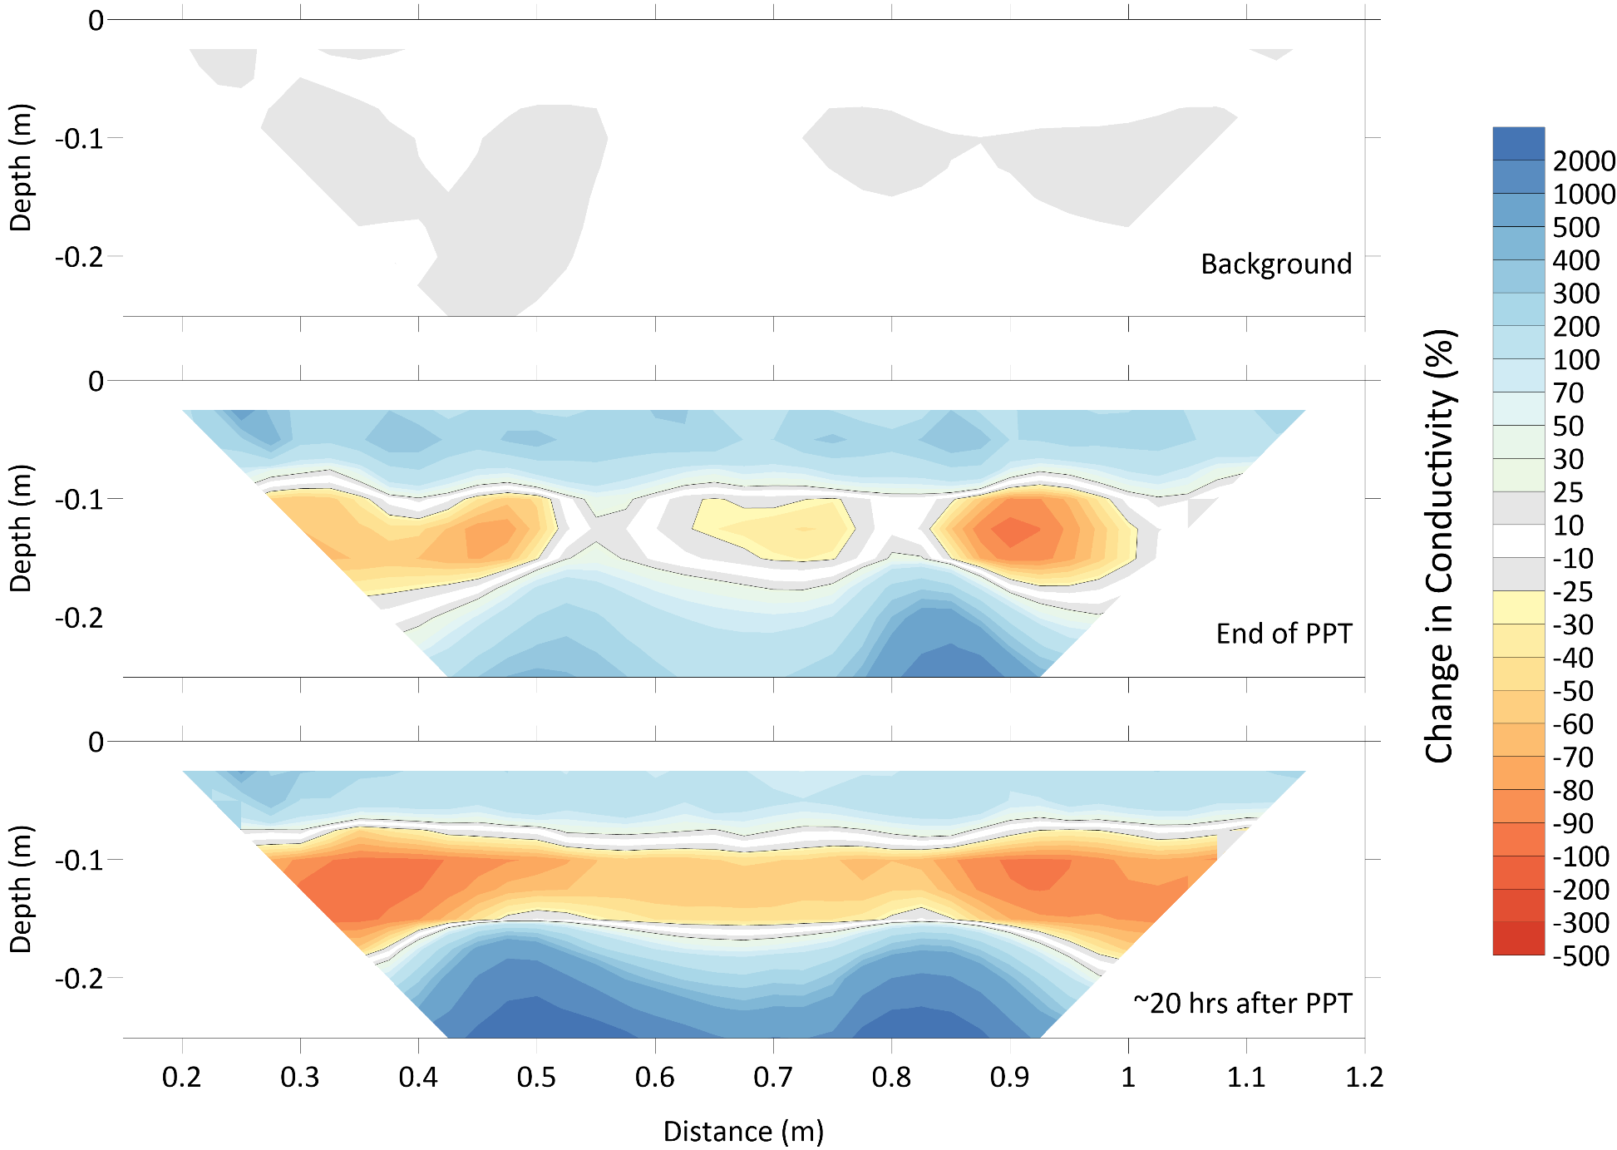
Wetting Image: Res Diff from Bkgnd

Slide 14
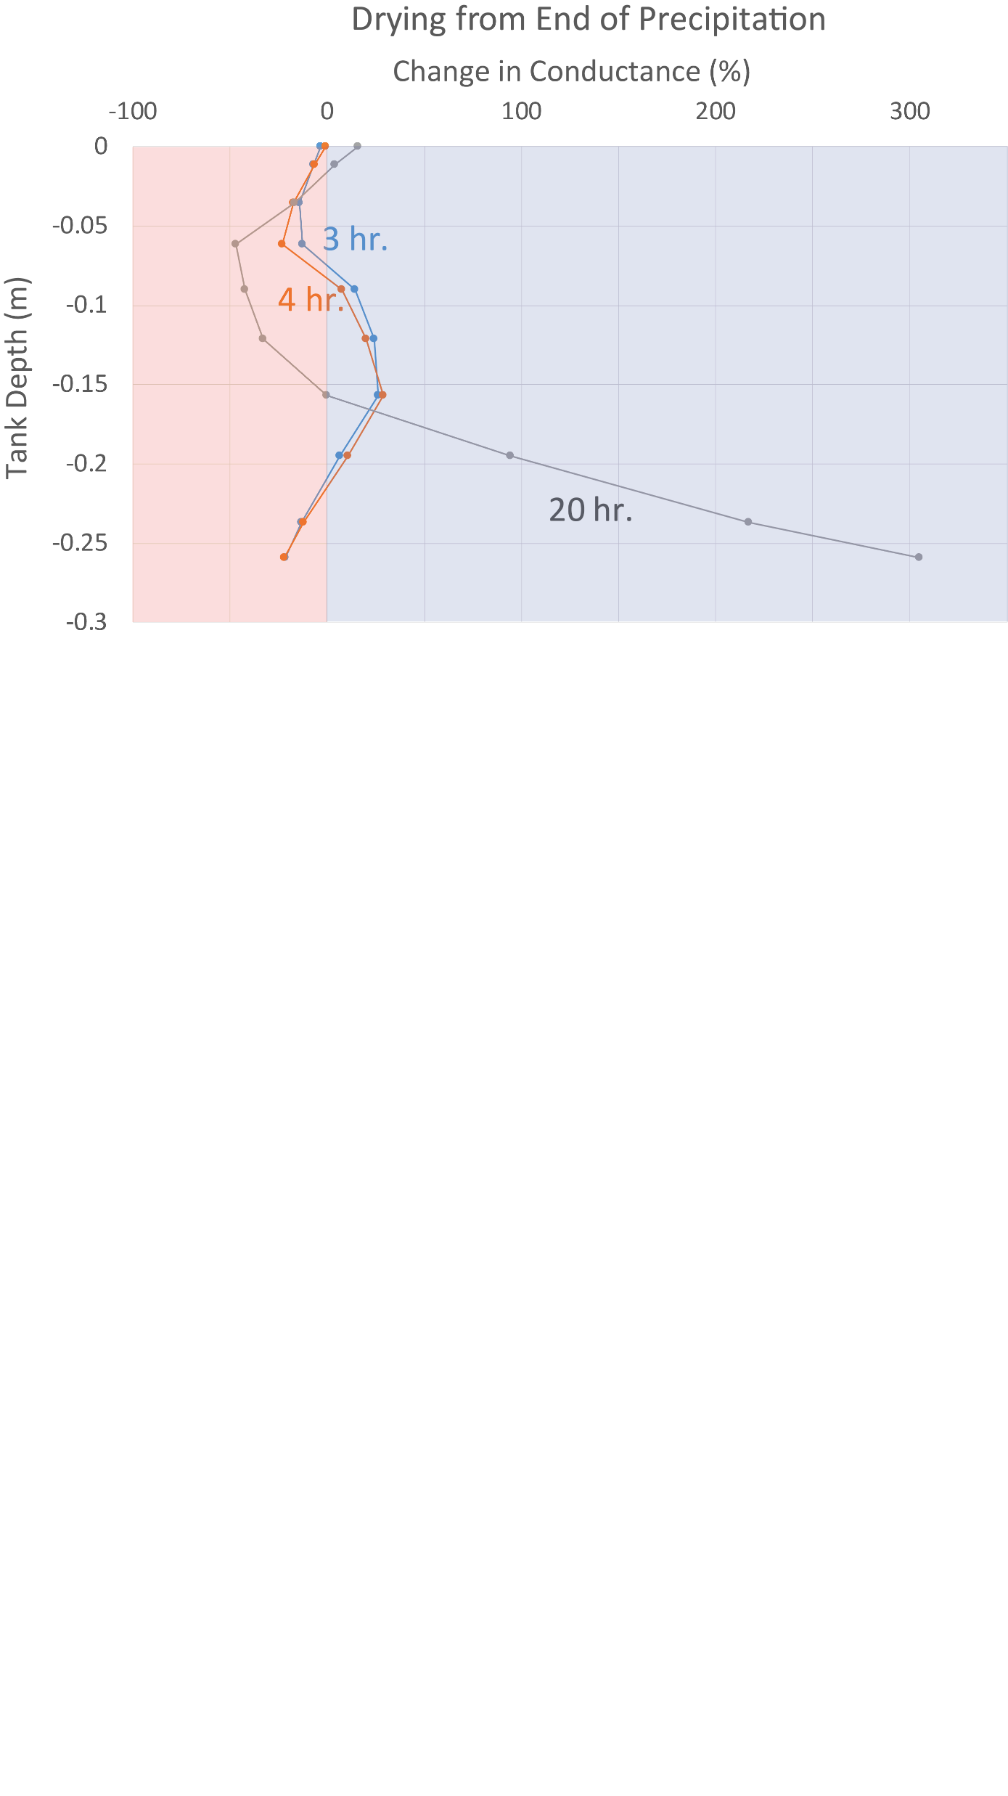
Results Cont.

Slide 15
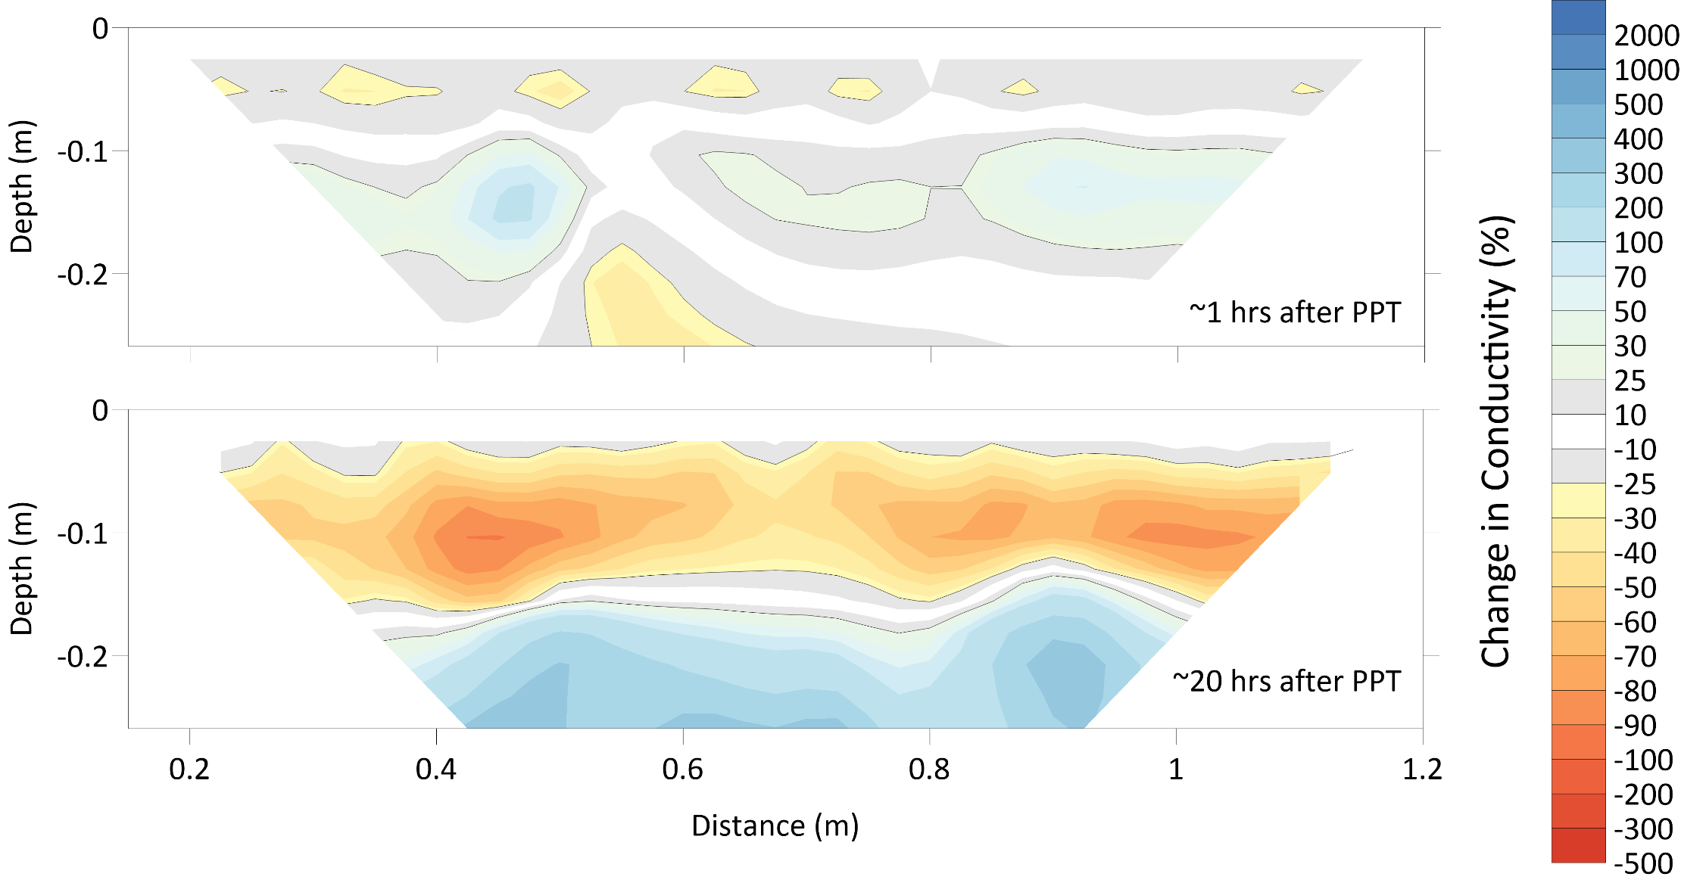
Drying Image: Res Diff from End of PPT

Slide 16
Preliminary Conclusion
Hypothesis not confirmed by experiment
tank simulated vadose zone
Expecting similar results in field

Slide 17
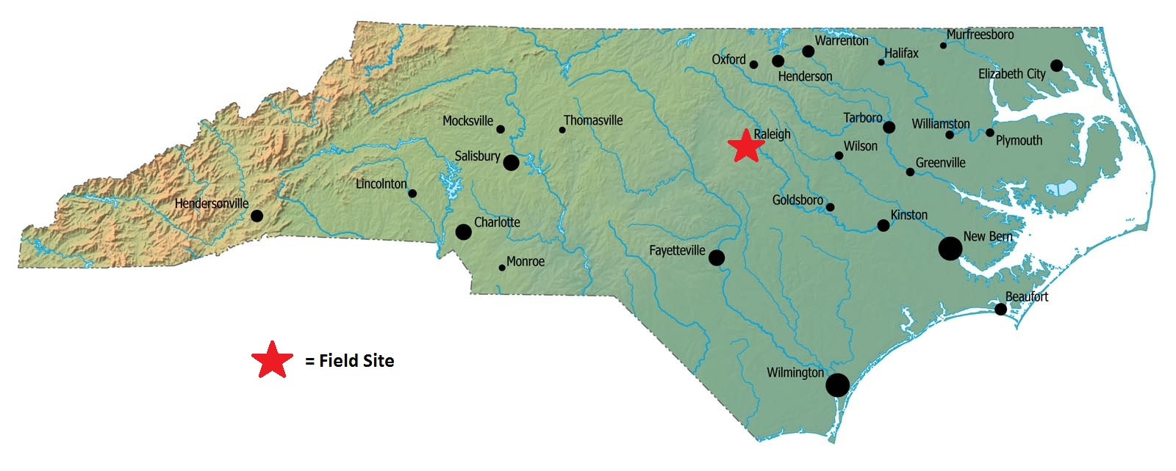
Future Work
Returning to Raleigh, North Carolina in May, 2019
Area of investigation is a small stream next a golf course

Slide 18
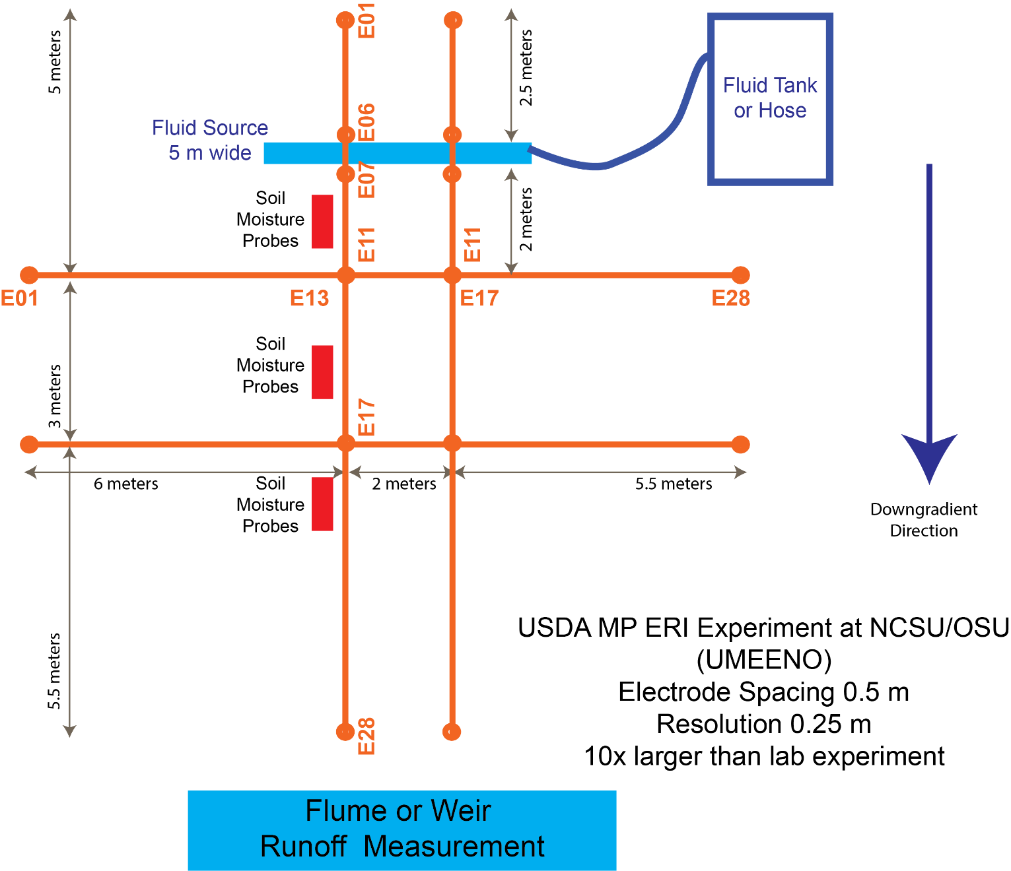
Future Work Cont.

Slide 19

Special Thanks
USDA – Agriculture and Food Research Initiative (AFRI)

Slide 20
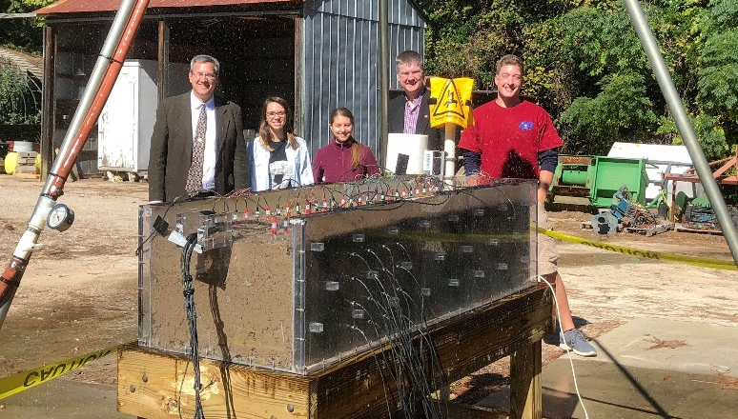
Questions?

