Slide 1
Scour Nuclei, Erosion and the Potential for Site Discovery
Author: Ervan G. Garrison, University of Georgia

Slide 2
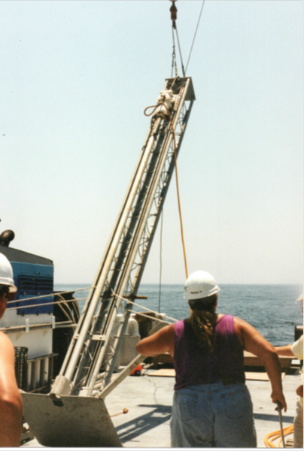
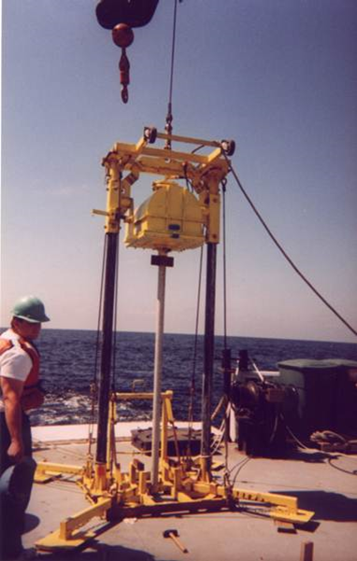
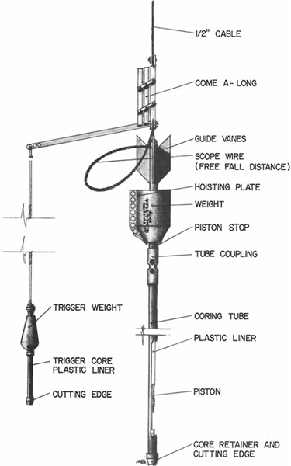
This paper discusses a survey methodology to locate and study submerged prehistoric archaeological and paleontological sites. Typically, these studies demand the use geophysical instrumentation and geoarchaeological methods such as coring.
Left and center. Sediment coring at Gray’s Reef National Marine Sanctuary, 1996, 2000 – two vibracorers
(Photos by Garrison); right, a Ewing piston corer (graphic by Mark Bray)

Slide 3
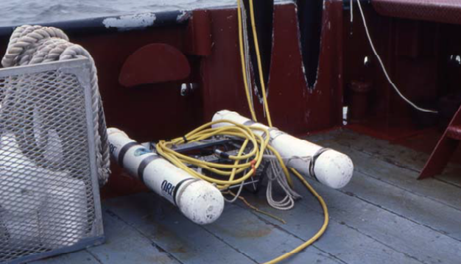
What are “heroic methods” for detection and assessment?
Left, “boomer” pinger-subbottom profiler used in Pearson et al., study. Courtesy Charles Pearson;
Right, Remotely Operated Vehicle (ROV). Image of Deep Discoverer courtesy of the NOAA Office of Ocean Exploration and Research.

Slide 4
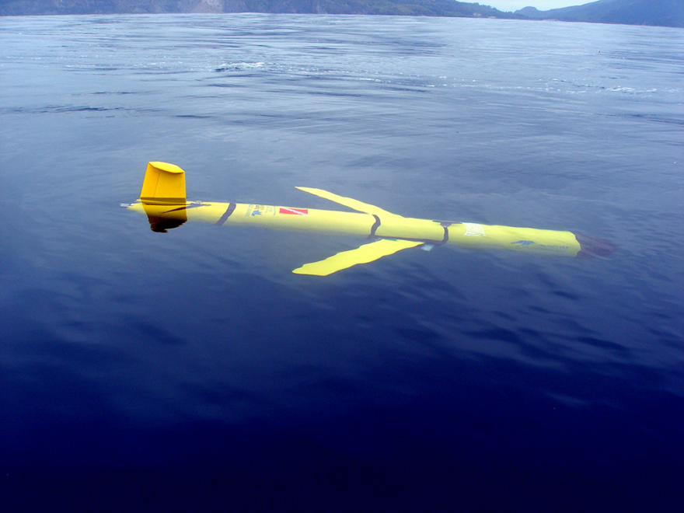
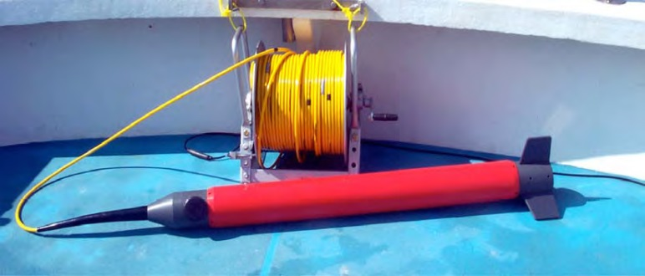
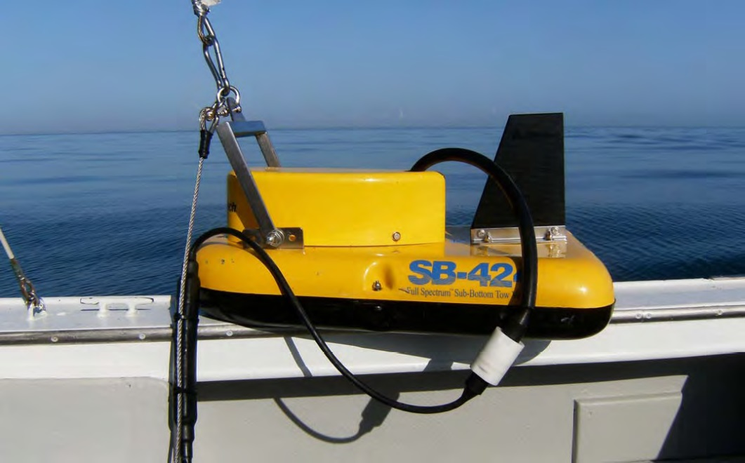
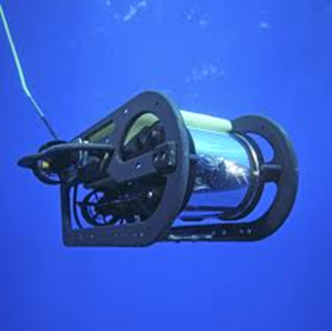
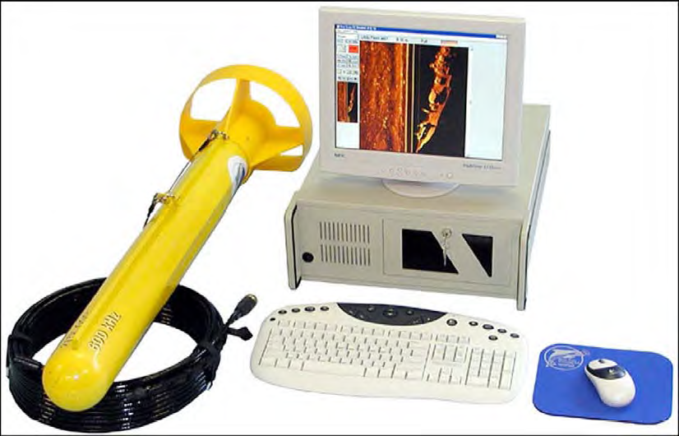
What are “heroic methods” for detection and assessment cont. -
More modern day instrumentation – AUV, Side scan SONAR, magnetometer, ROV, subbottom profiler

Slide 5
What are “heroic methods” for detection and assessment cont. -
The geophysical instrumentation and coring equipment not to mention the daily cost of a research vessel requires deep pockets. One could characterize the costs as “heroic.”

Slide 6
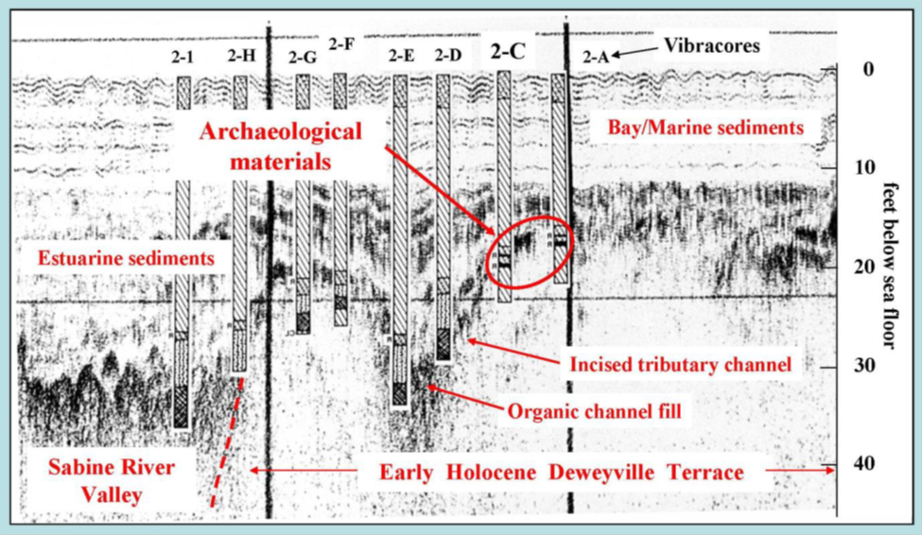
What are “heroic methods” for detection and assessment cont. -
Acoustical profile, schematic view and interpretation of sonar images produced by an acoustic subbottom profiler of a drowned paleochannel in 15 m water depth in the Gulf of Mexico. Sediment vibracore locations are indicated. This ancient estuary as illustrated had its drowning at transgression ca. 9000 BP. (Pearson, et al., 2008)

Slide 7
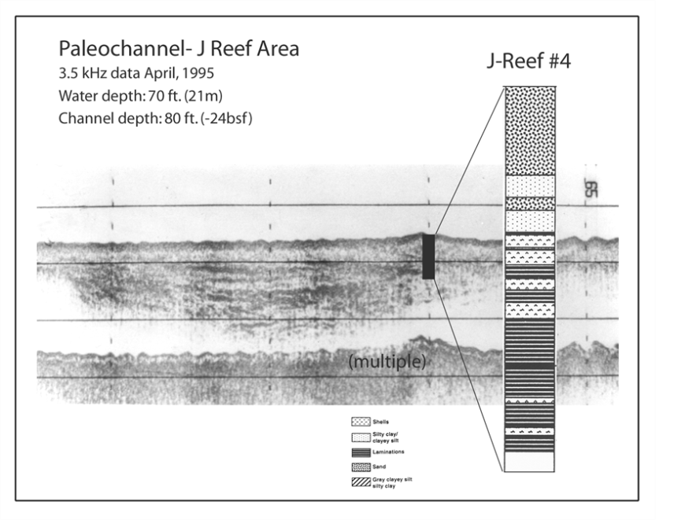
A potentially less “heroic” and more effective method to locate underwater prehistoric sites – use “Scour Nuclei.”
The reason previous methods have proven costly and oft-times ineffective in locating these sites is simply burial.
To locate these buried sites geophysical methods and subsequent sediment coring must penetrate the sediment prism.
I have, elsewhere, characterized this assessment approach as “the world through a 3-inch pipe.” Why? Typically the standard size pipe diameter for sediment coring is 3 inch aluminum irrigation tubing.
It is also very difficult (and costly)
to excavate on the sea-floor. Dredges
and “air lifts” do work but require
significant investment of time and
money to effectively deploy

Slide 8
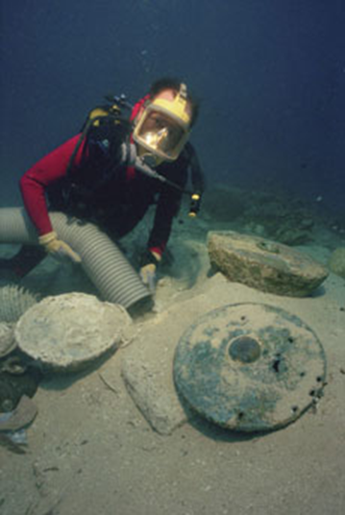
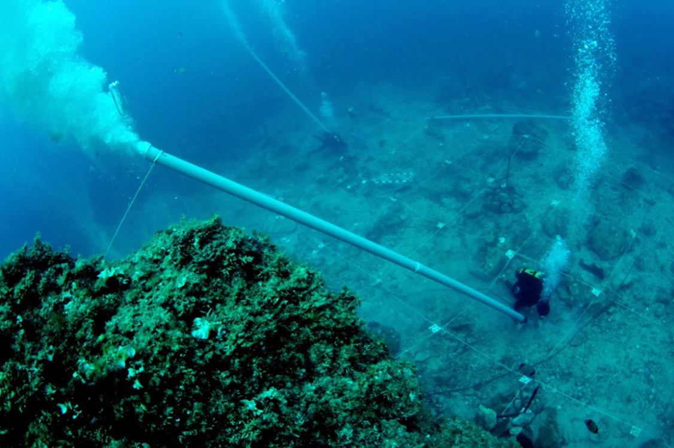
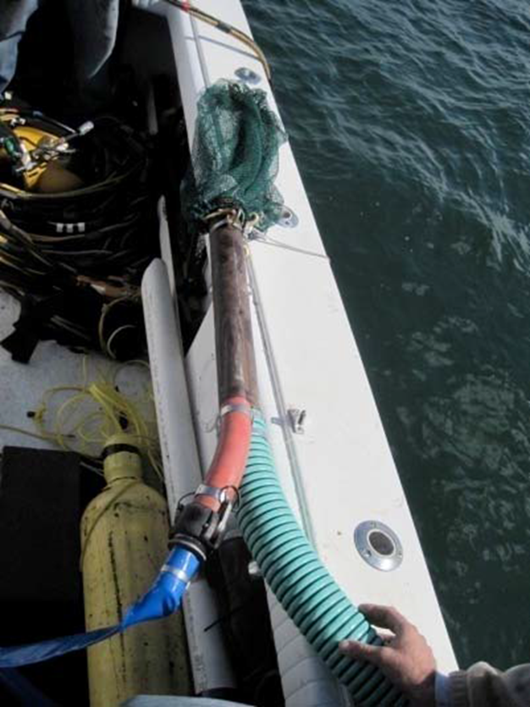
Excavation using air-lifts and dredges
Both methods can remove sea floor sediments. They are most effective on loose, clastic sediments on shallowly buried sites. To dig through or remove several meters of overburden deposits is difficult and, again, approaches “heroic.”

Slide 9
Palaeontological and archaeological remains may be found in their original context adjacent to erosional features that often form around artificial reefs and shipwrecks termed “scour nuclei.”
Nucleating objects such as natural geology, shipwrecks and artificial reef structures erode and embed into a sediment matrix, exhuming stratigraphy along with any other buried inclusions.
A steel cylinder in a test sand bed A shipwreck on a sand substrate nucleating scour nucleating scour
The extent of scour is roughly proportional to the size of the nucleating object

Slide 10
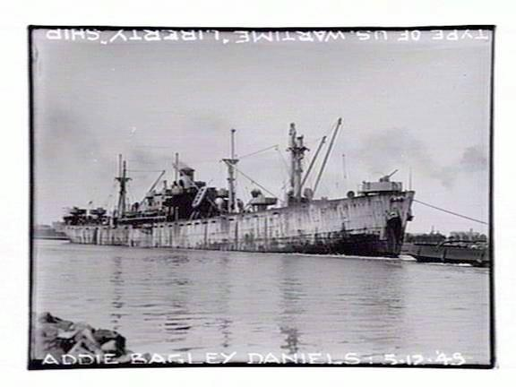
Scour created by marine processes can reveal potential prehistoric sites.
Instead of fighting the results of those processes I propose a protocol to utilize them.
Proof of concept has been demonstrated on the Southeast U.S.' s continental shelf at artificial reefs such as the wreck of the Liberty Ship AB Daniel (below) near JY Reef, off St. Catherine’s Island (GA), as a well as at artificial reefs off Savannah.

Slide 11
Hypothetical Erosion or “Scour” around a sunken hull form. Courtesy of R. Quinn.

Slide 12
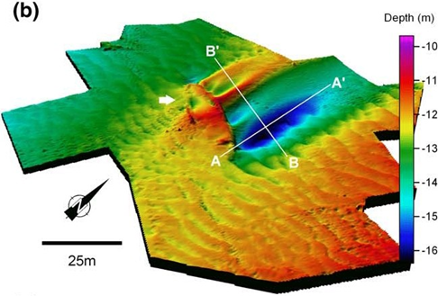
Actual Erosion or “Scour” around a sunken hull form. Courtesy of R. Quinn.
The Arklow Bank wreck site three dimensional terrain model of the wreck site generated from multi-beam bathymetric data (Quinn, et al, 2006). The scale indicates a depth of scour of over 5 meters and an overall length of 50 meters.

Slide 13
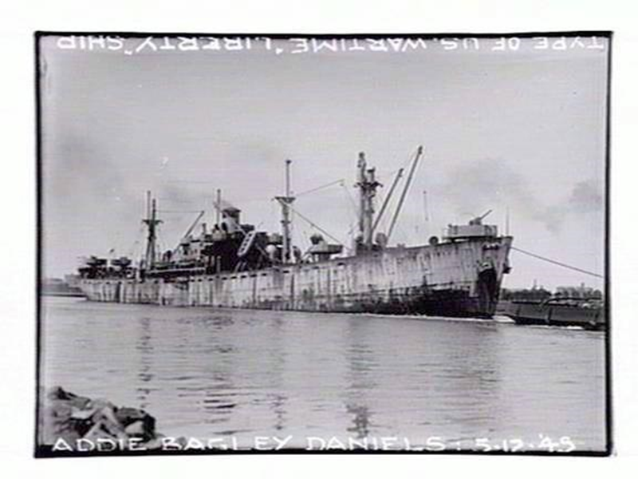
Using Scour Nuclei – Back to the A.B. Daniels as example

Slide 14
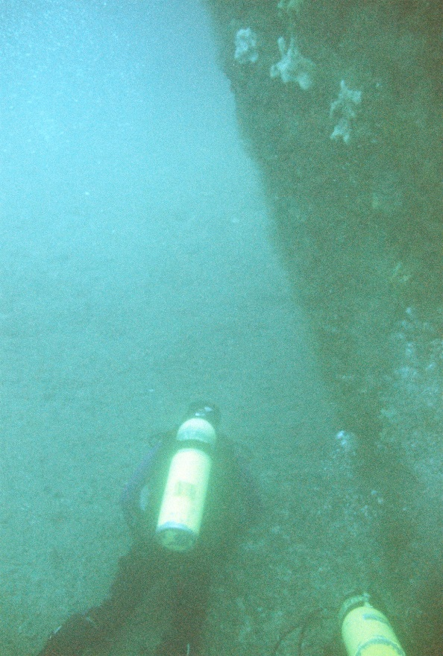
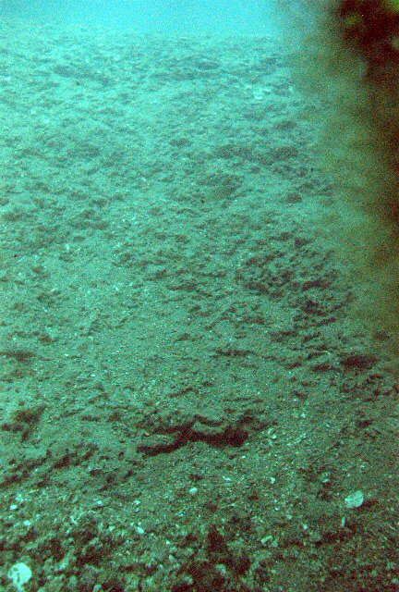
Scour often results in a stratigraphic profile of the sediments as well as paleontological and archaeological deposits that do not require “heroic methods” for detection and assessment.

Slide 15
The A.B. Daniels Liberty Ship was set down as an artificial reef in 1973. It was subsequently broken in two by a small hurricane in 1977.
Location map for J-Reef and the A.B. Daniels site.

Slide 16
WHY SCOUR?
Sub-tidal currents are a key factor, on the Georgia Bight’s continental shelf, due to the relatively shallow water depths that average 30-35 m (Werner, et al, 1993:976).
The Georgia shelf is 120 km in average width and, for nearly 90 % of its area, less that 50 m in depth (Lee and Brooks, 1979). The SAB continental shelf seafloor is considered a high-energy, non-accumulating environment of coarse-to-medium sands (Riggs, et al, 1996).
Scour and erosion result from the effects of currents at inner-to-mid shelf locations like Gray’s and J-Reefs. Indeed, the very definition of inner-mid-outer shelf is based on current regimes ((Atkinson, et al, 1983) –
the inner shelf where local winds and river runoff are primary forcing mechanisms;
the mid-shelf where local winds dominate the flow at sub-tidal frequencies and
the outer shelf where the Gulf Stream and it related disturbances influence observed flows.

Slide 17
Left, plan and cross-sectional views of scour pits #1, 2 at the A.B. Daniels site; right, depth of scour at the bow was more than 3 meters. Sea floor horizon elevation indicated by black line above divers.

Slide 19
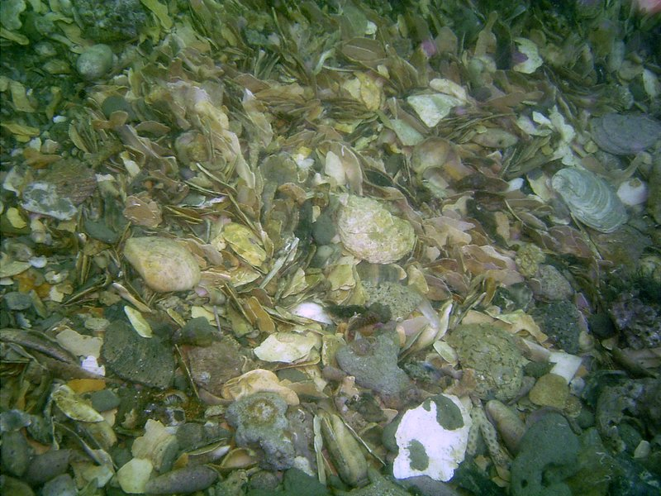
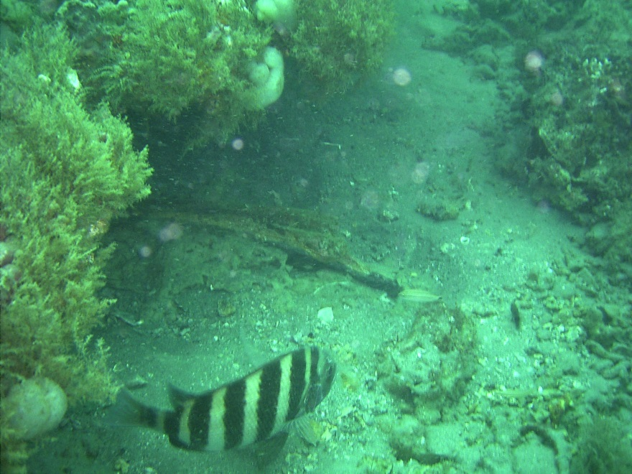
Potentials for BOTH Invertebrate & Vertebrate Paleontology
A condensed shell deposit, Georgia Bight, A partially exposed gray whale
A.B. Daniels scour pit, port side. mandible , JY Reef outcrop, ~ 100 m
from the A.B. Daniels.

Slide 20
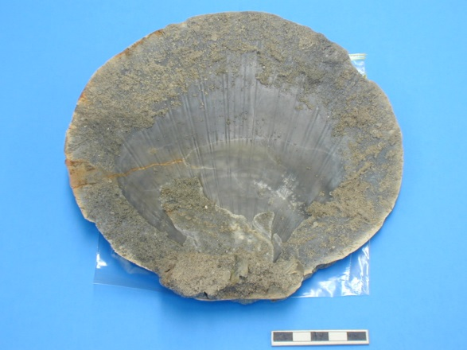
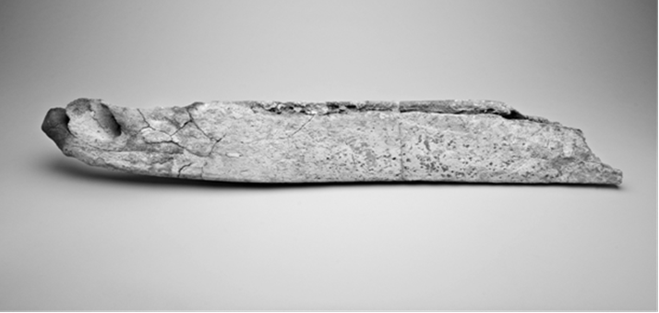
Potentials for BOTH Invertebrate & Vertebrate Paleontology cont. -
Late Pleistocene Placopecten magellianicus
– “Sea Scallop”
The excavated JY Reef gray whale mandible.

Slide 21
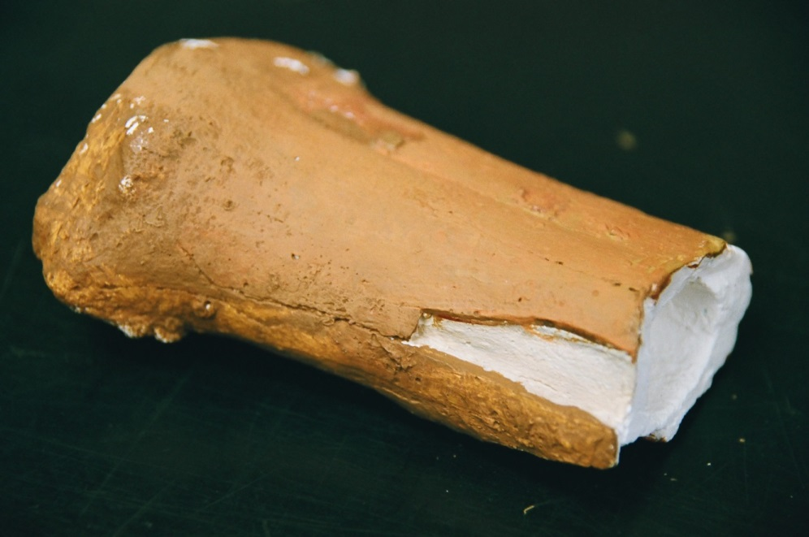
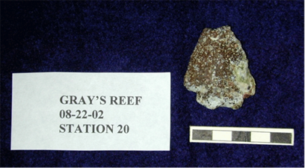
Potentials for BOTH Invertebrate & Vertebrate Paleontology AND Archaeology
Left, cast of a Bison metapodial, RC dated to 6000 BP; bottom, Early Archaic Period projectile point, ca. 8000-5000 BP

Slide 22
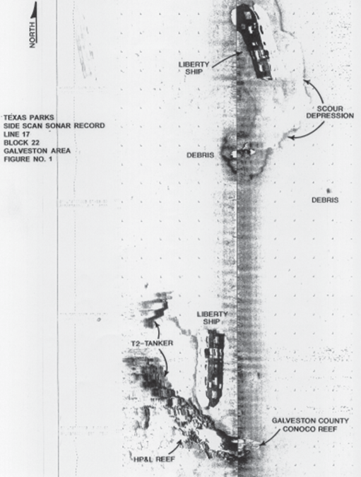
Scour is not unique to the Atlantic. Scour was observed in the Gulf of Mexico in 1985 around wrecks.
Side-scan SONAR record of the B.F. SHAW and V.A. FOGG sites. The SHAW is at the upper margin. Scour features are indicated on the record. Record taken from Texas Parks & Wildlife Bulletin no. 99-1 (1999). The FOGG is labelled as “T-2 Tanker.”

Slide 23
Scour Nuclei – a concluding example, Savannah- Tybee Island, Georgia, 2018.

Slide 24
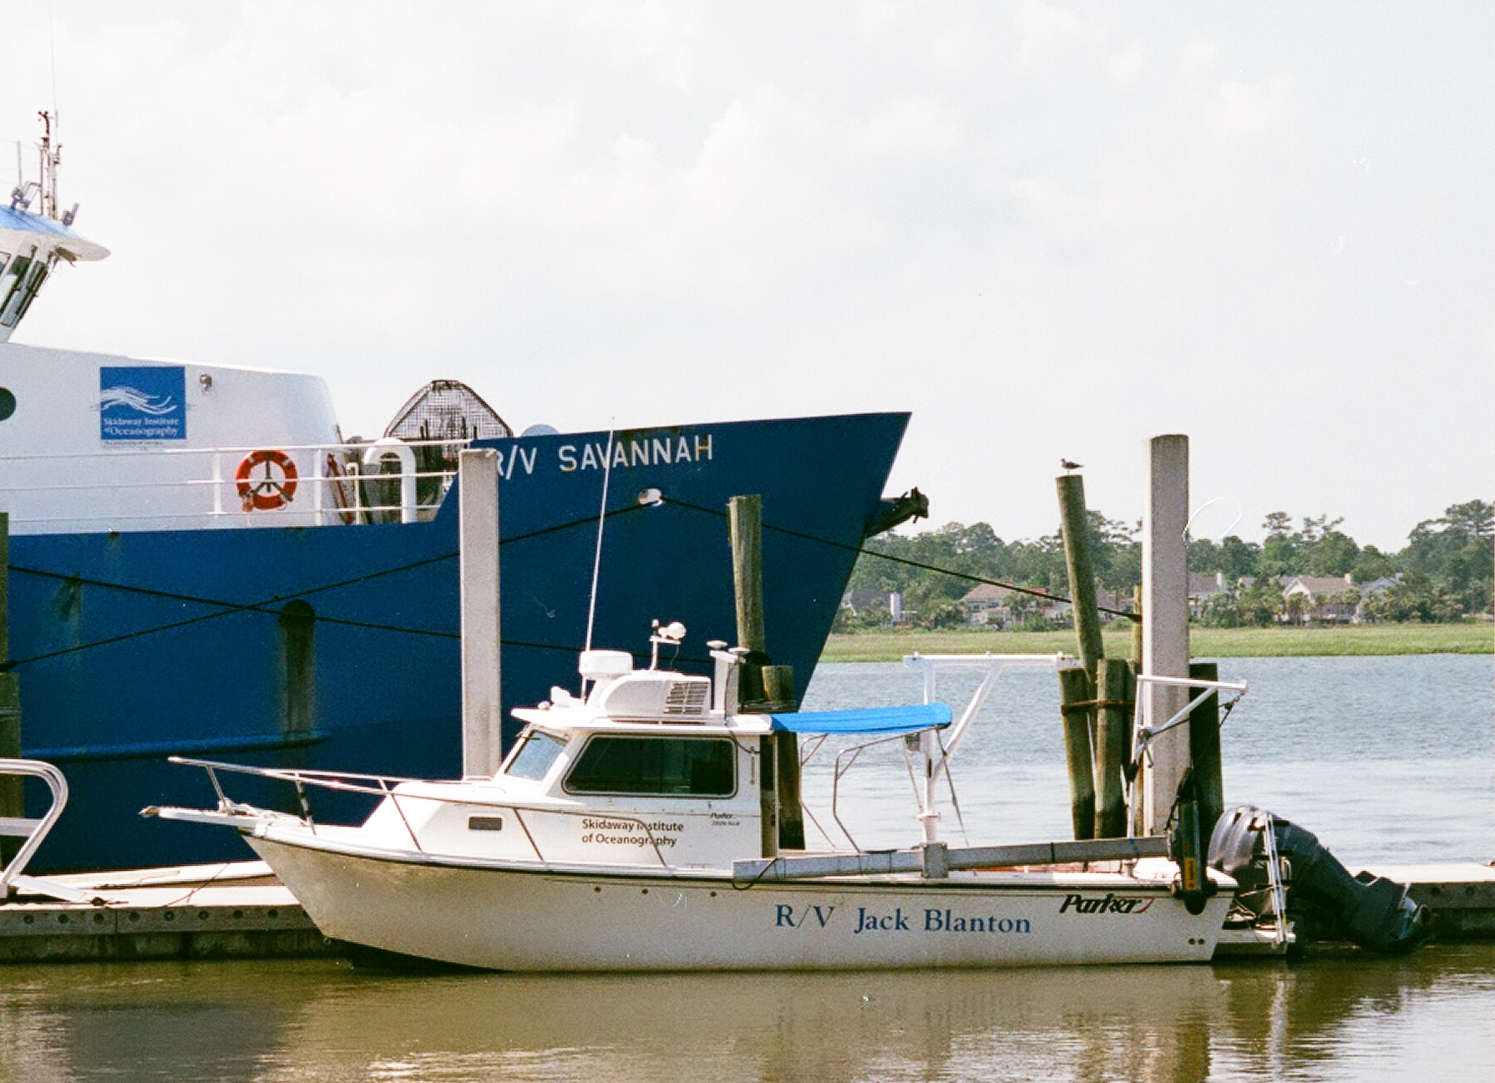
Very expensive SONAR

Slide 25
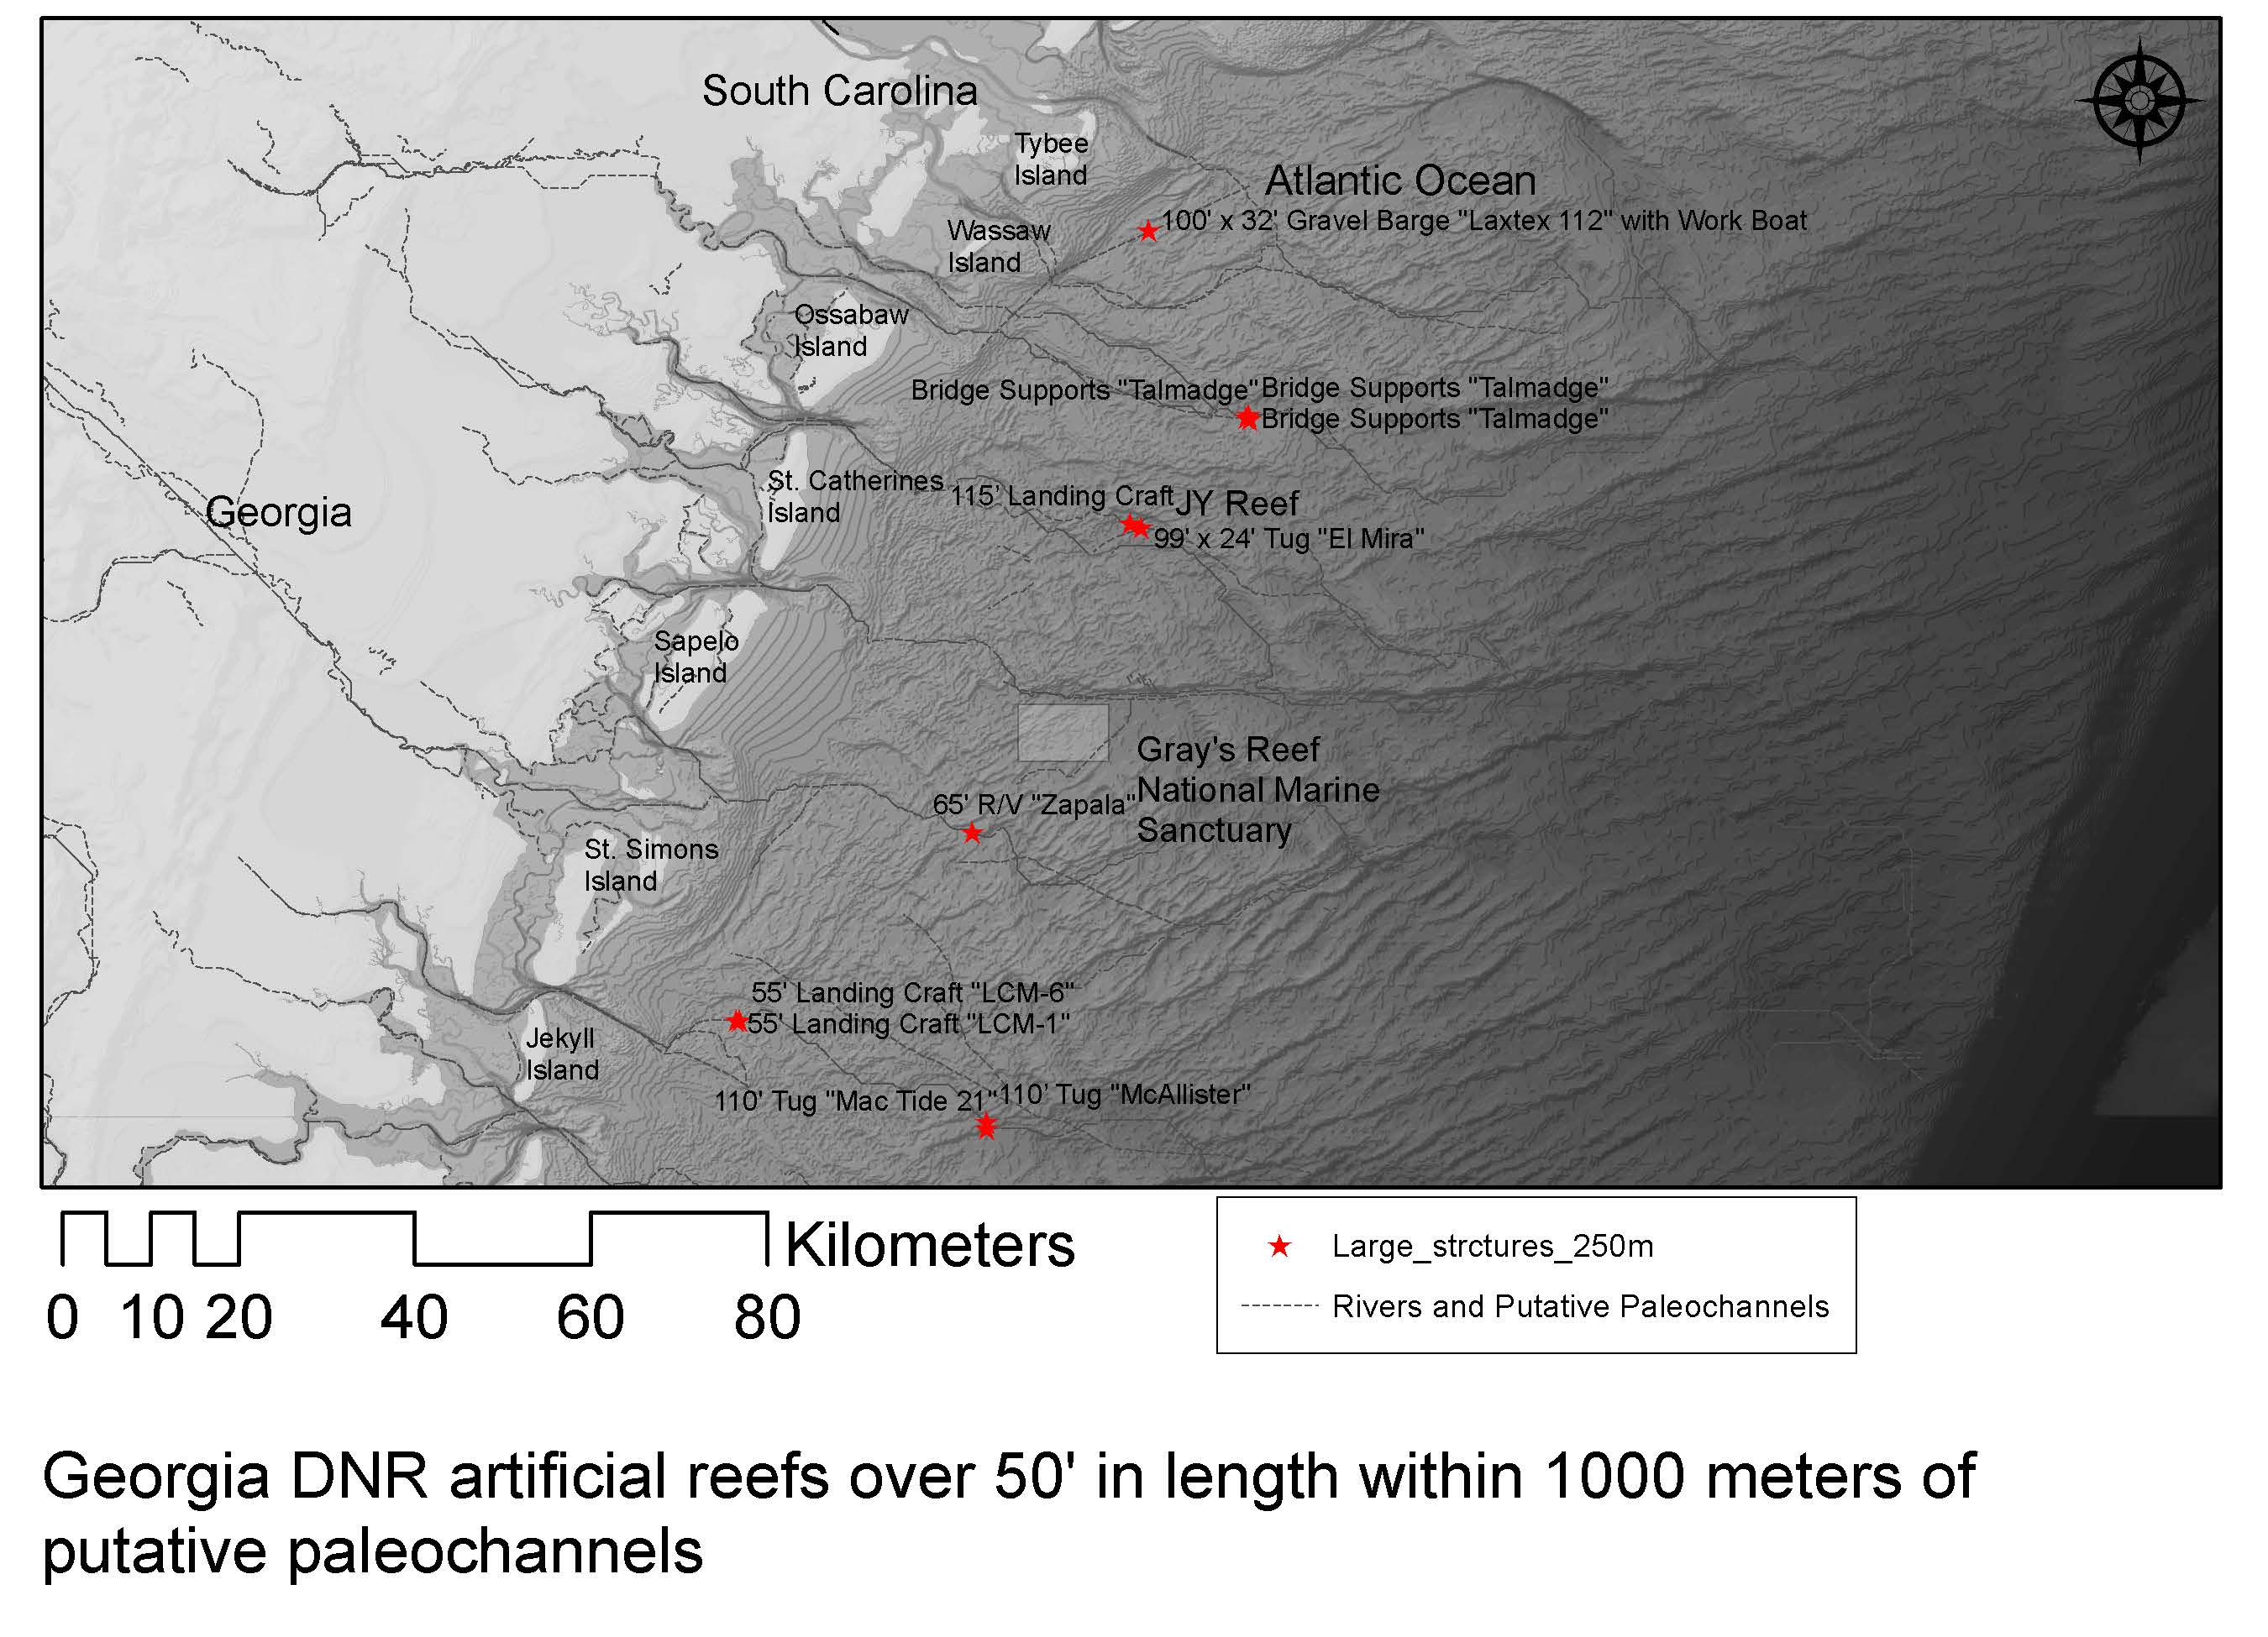
Reef SAV

Slide 26
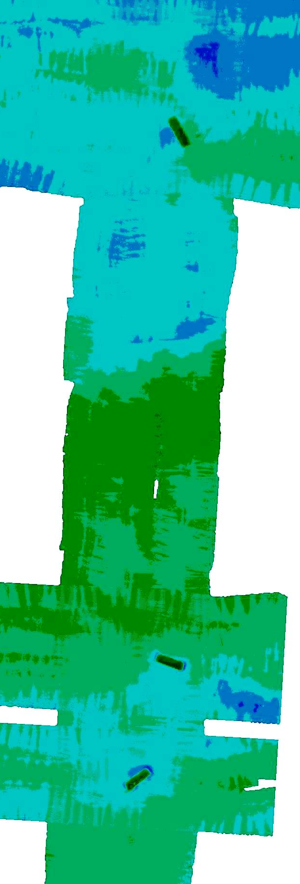
Side scan SONAR &
Bathymetry of three
barges. Reef SAV.

Slide 27
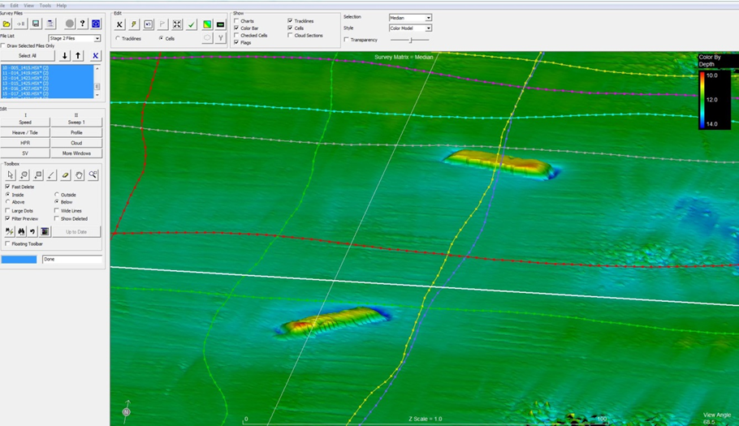
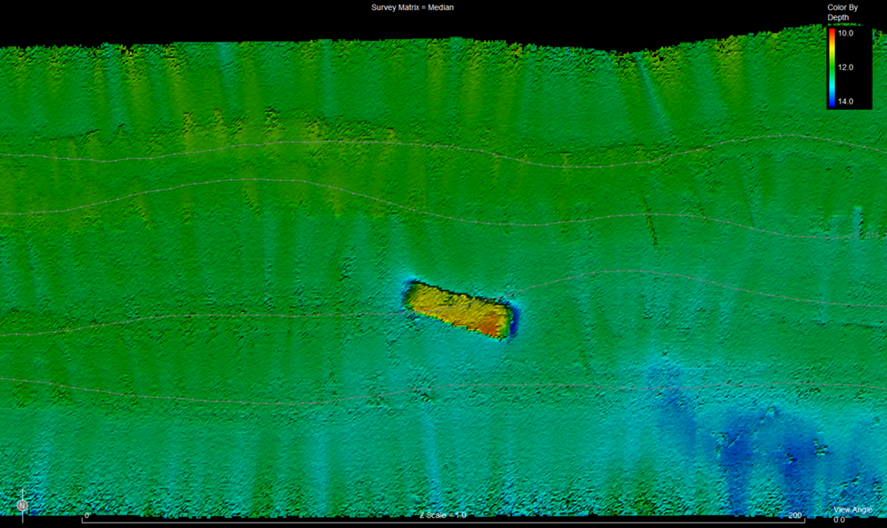
Scour at Reef SAV sites. Top, barges 5, 6; bottom, detail of barge 6 scour pattern. Scour erosion is estimated to be over 1 meter at the two sites but this has not been confirmed by ground truth dives. Both images created by M. Robinson, Skidaway Institute of Oceanography

Slide 28
This paper discussed a survey methodology to locate and study submerged prehistoric archaeological and paleontological sites.
It has been demonstrated that “Scour Nuclei” can be an effective method to locate and examine buried, prehistoric submerged archaeological and paleontological sites.
Scour has been found be a common occurrence around sunken objects such as artificial reefs and shipwrecks.
The depth and volume of that scour significantly exceeds that which can be obtained using sediment coring or current excavation tools.

Slide 29
One significant advantage of scour nuclei is their observed capacity for generating relatively deep – 2- 3 meter deep erosional features - which clearly exceed the limited capabilities of sediment corers, bottom dredges and grabs.
The use of these scour nuclei for the detection and identification of archaeological/paleontological-bearing sediments can greatly improve the current methodology utilized for the detection of submerged prehistoric sites.

Slide 30
Selected References
Atkinson, L.P., T.N. Lee, J.O. Blanton and W.S. Chandler. 1983. Climatology of the southeastern United States continental shelf waters. Journal of Geophysical Research, 88: 4705-4718.
Pearson, C. E., R.A. Weinstein and D. B. Kelley. 2006. Prehistoric Site Discovery on the Outer Continental Shelf, Gulf of Mexico, United States of America. World Archaeological Congress - 6, Dublin, Ireland.
Quinn, R., 2006. The role of scour in shipwreck site formation processes and the preservation of wreck-associated scour signatures in the sedimentary record–evidence from seabed and sub-surface data. Journal of Archaeological Science, 33(10): 1419-1432.
Riggs, S.R., Snyder, S.W., Hine, A.C. and Mearns, D.L. 1996. Hardbottom morphology and relationship to the geologic framework; Mid-Atlantic continental shelf. Journal of Sedimentary Research, 66(4): 830-846.
Werner, F.E., J.O. Blanton, D.R. Lynch and D.K. Savidge. 1993. A numerical study of the continental shelf circulation of the U.S. South Atlantic Bight during the autumn of 1987. Continental Shelf Research, 13 (8/9): 971-007.

Slide 31
THANK YOU!

