Slide 1
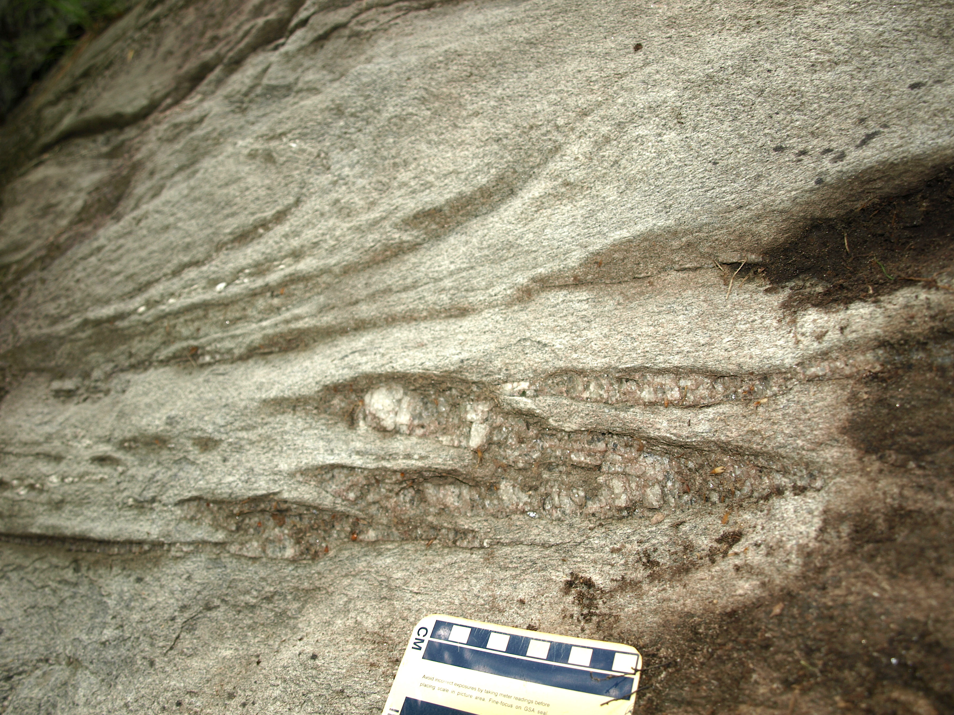
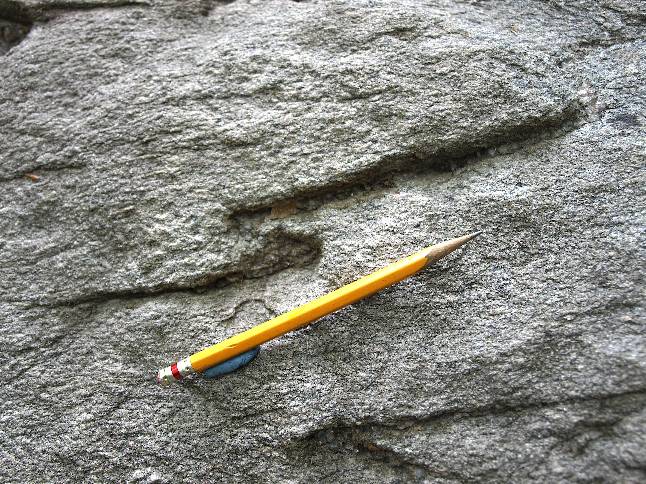
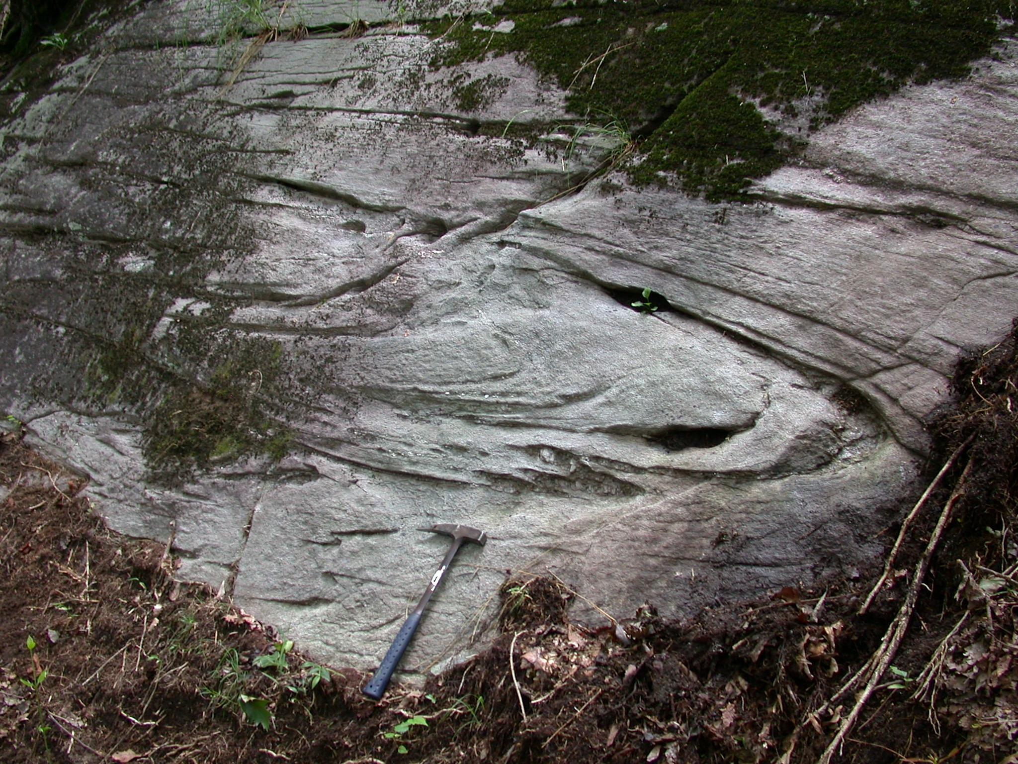
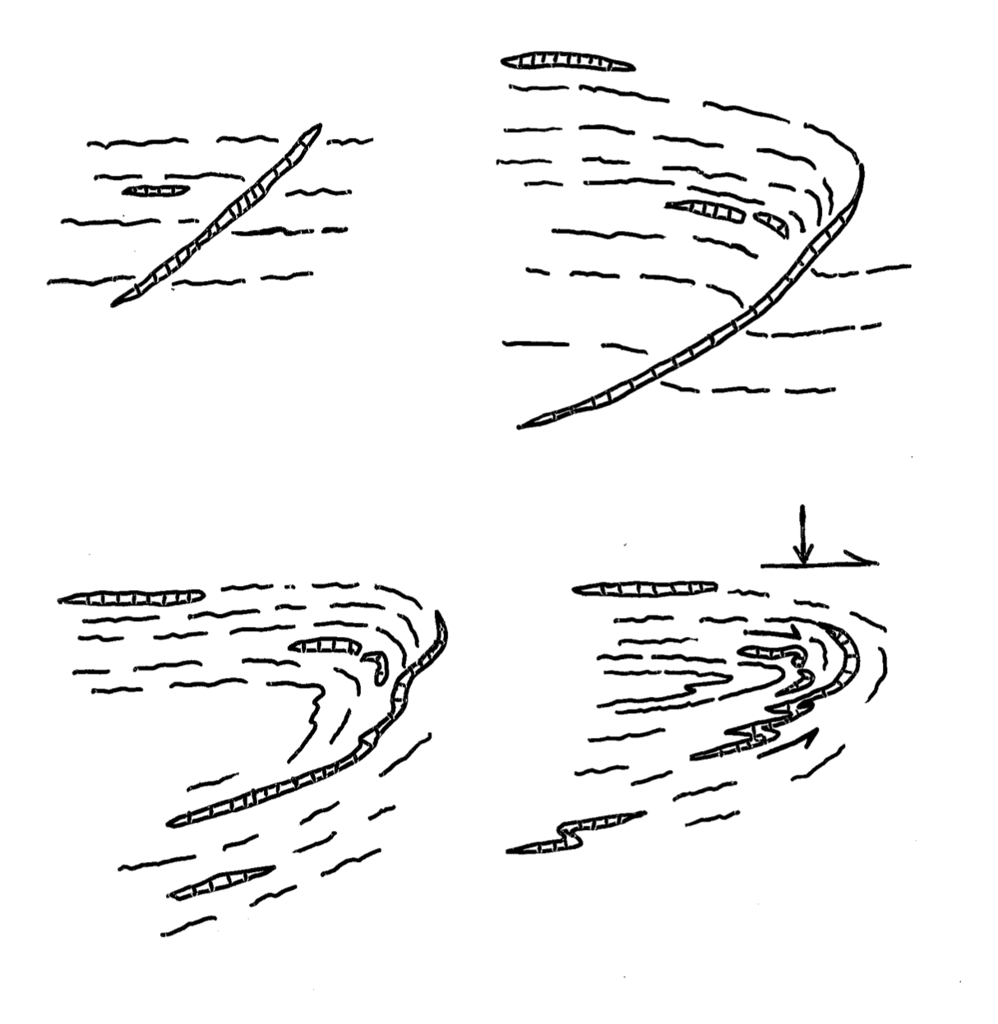
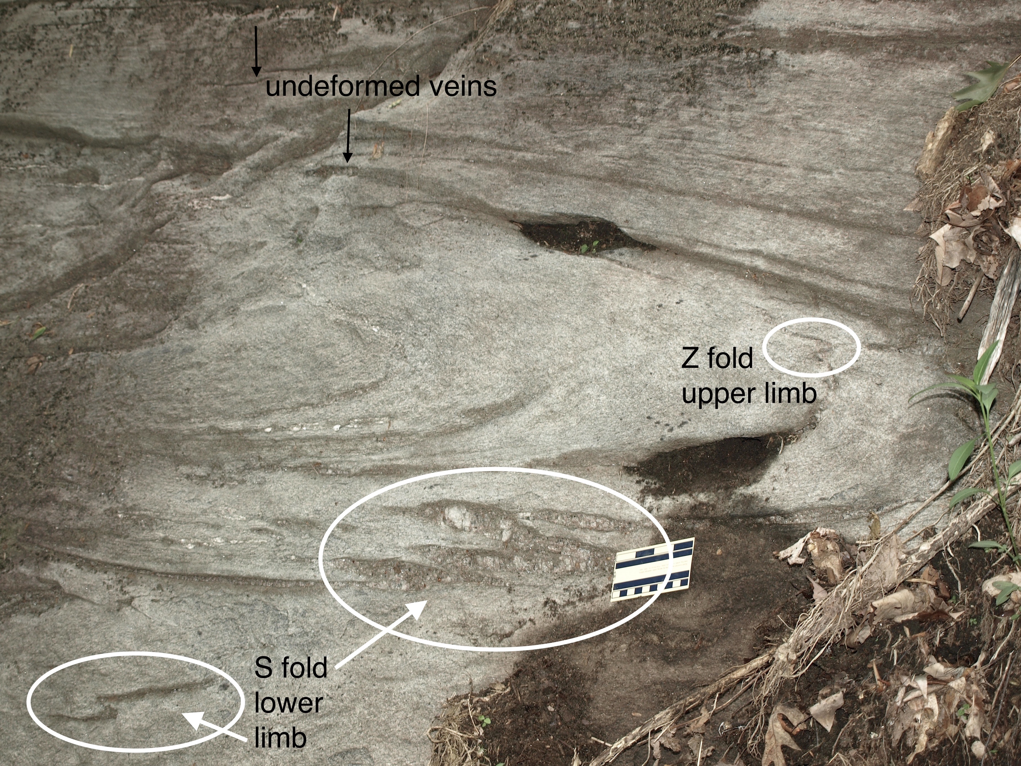
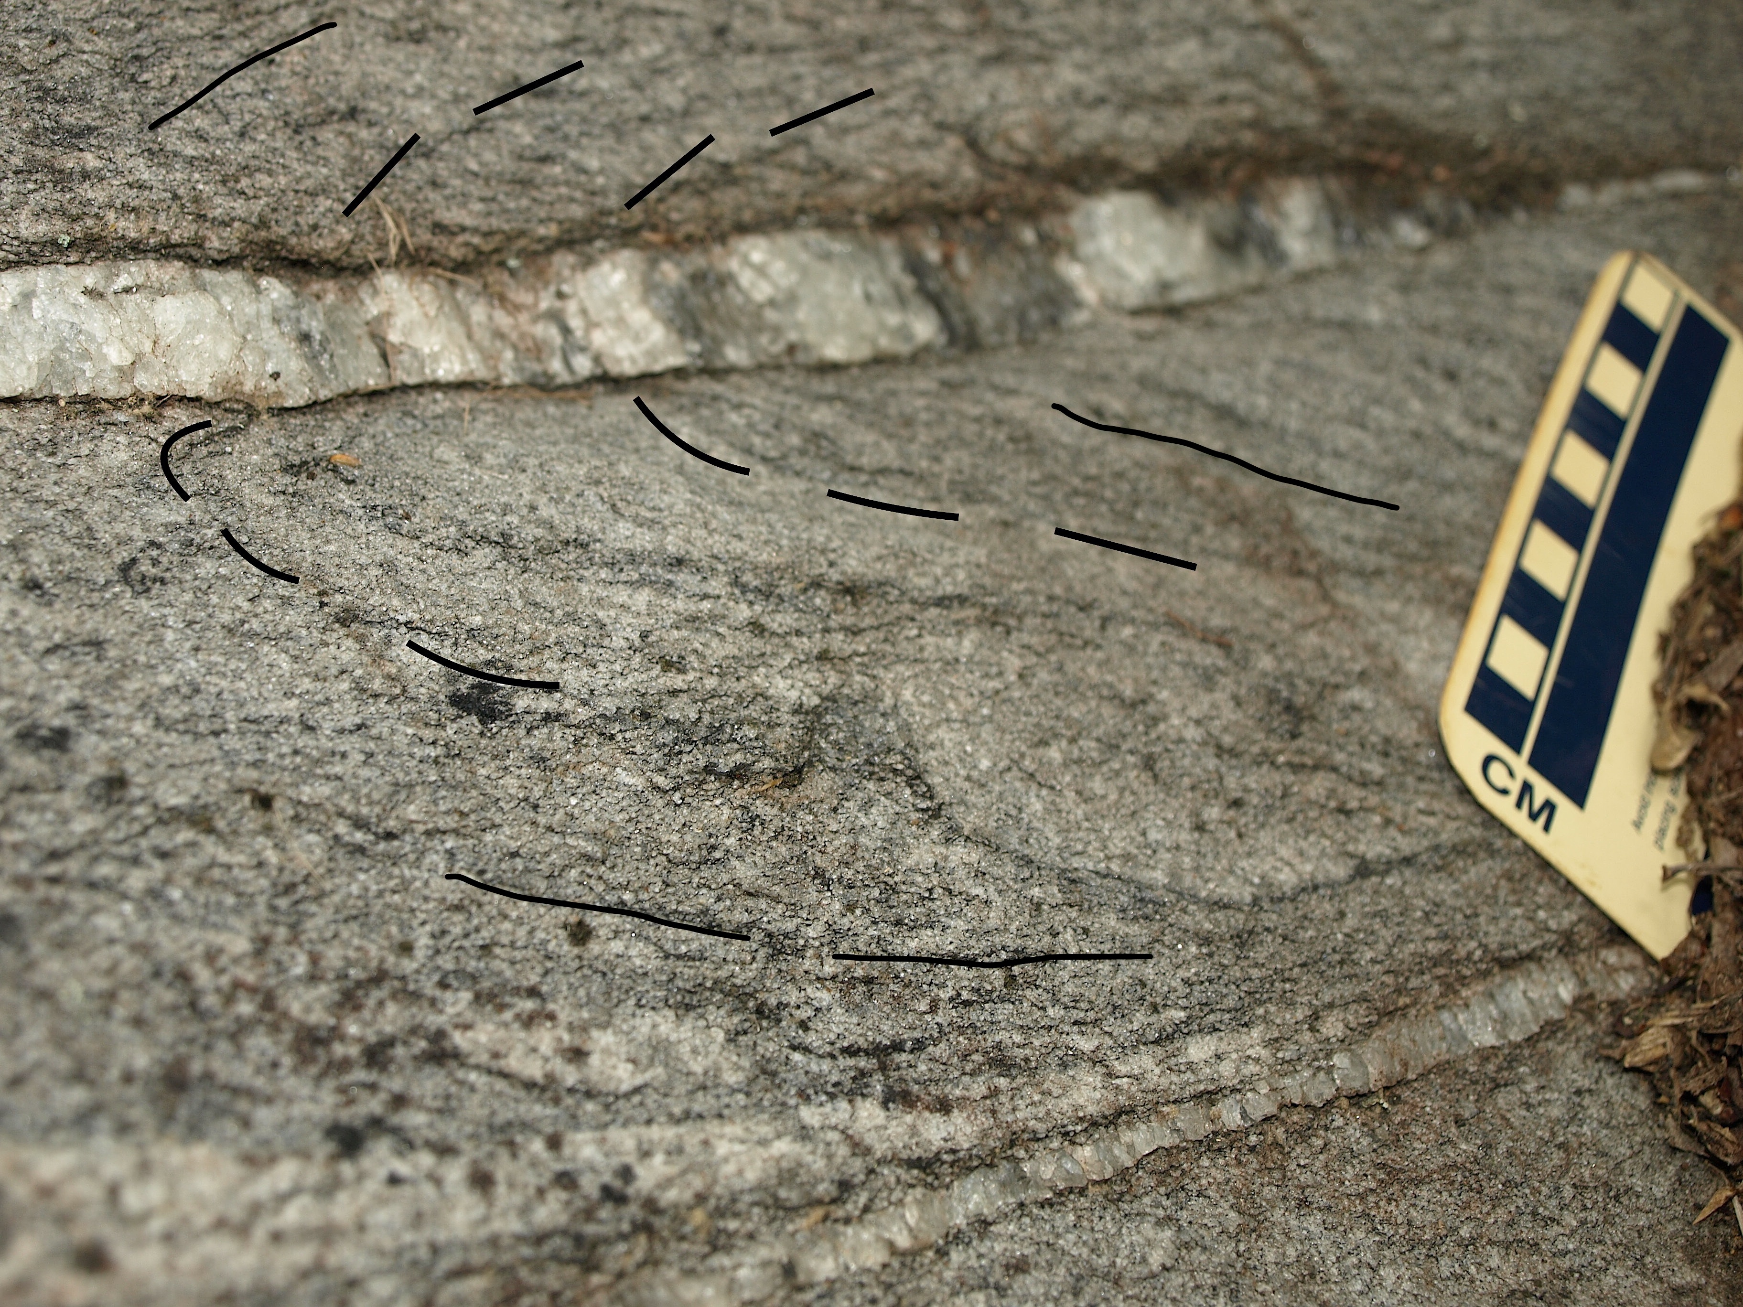
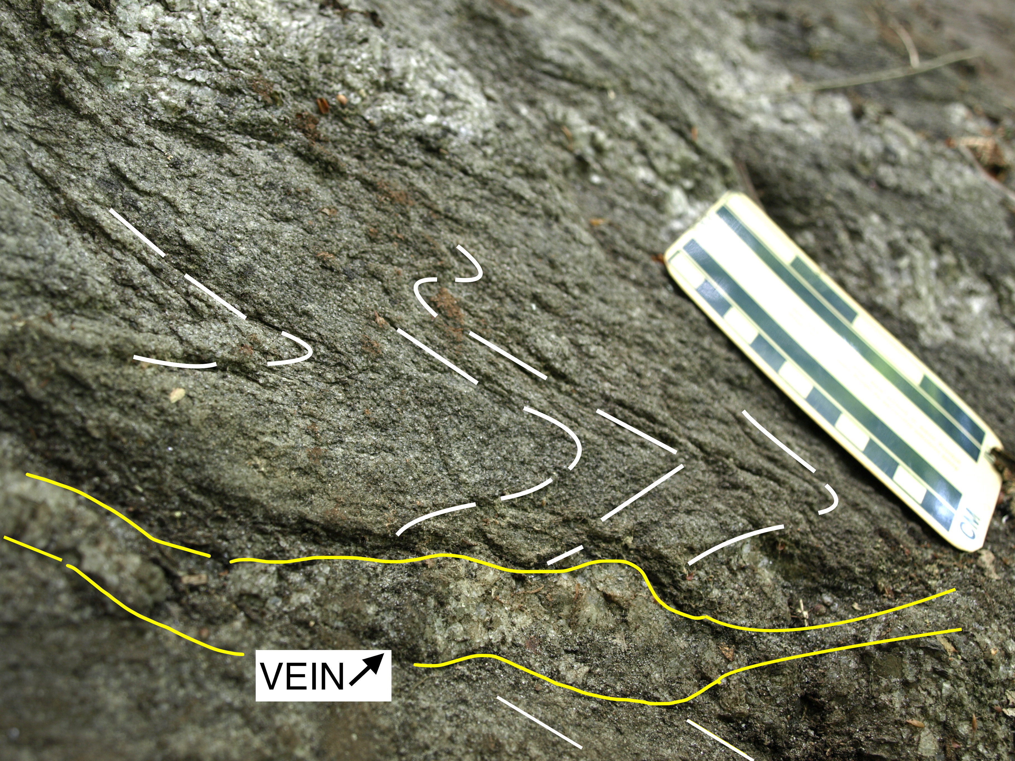
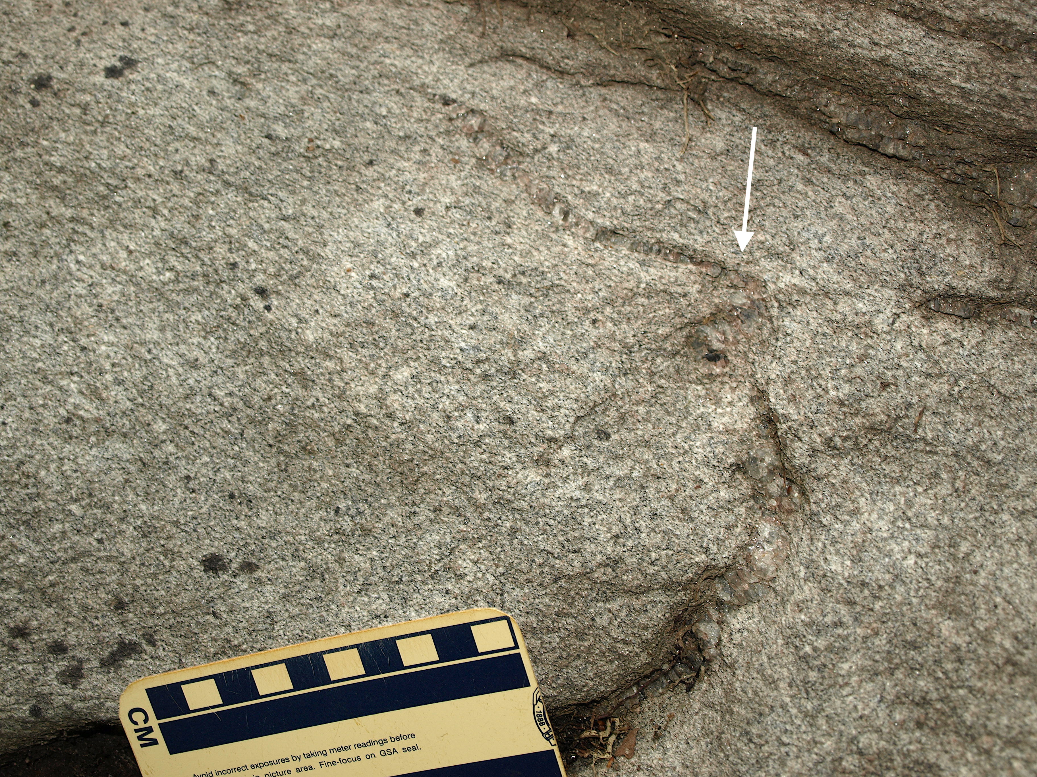
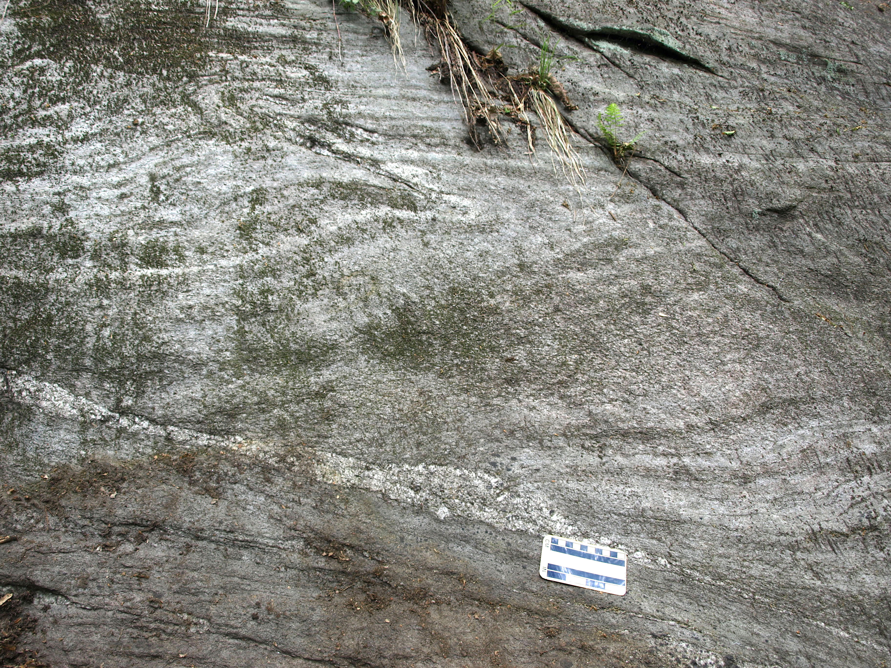
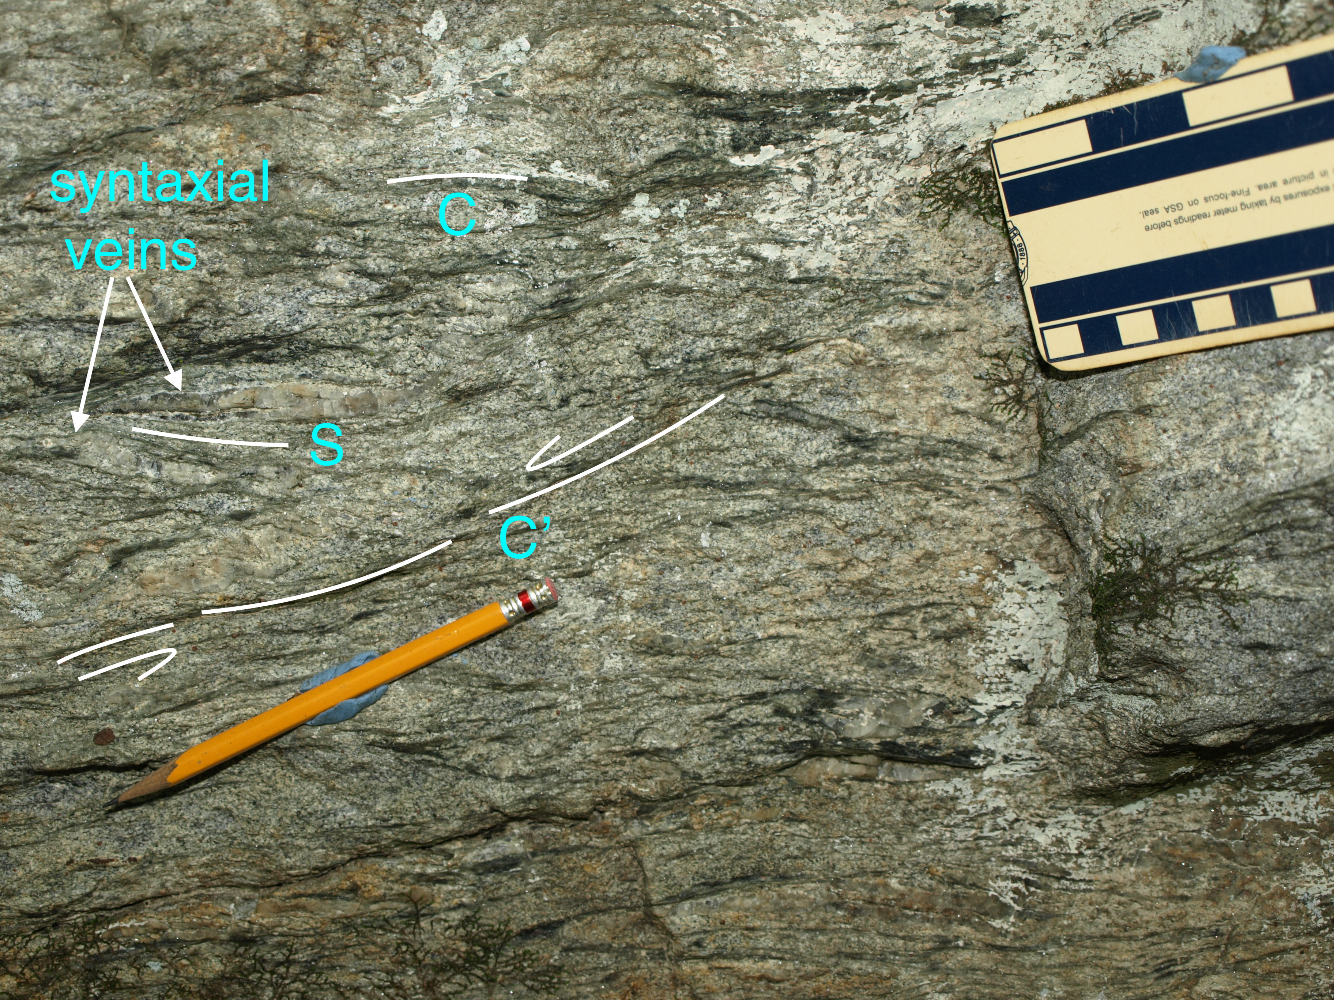

Veins act as mechanical anisotropy during shortening, leading to folding.
4. EXAMPLE 2. Isocline. Cleveland quadrangle, south of Caesars Head.
Details of lower isocline limb syntaxial vein deformed into multiple tight, chevron-style S folds. The total length of the syntaxial vein is 1.1 m; it continues to the right around the nose of the isocline.
Isolated lower isoclinal limb syntaxial vein S-fold.
shortening along
gneiss foliation
1.
2.
folding initiated at vein end
Interpretation of Example 2
vein-isoclinal fold development
through four stages.
deflecting vein/
mechanical anisotropy
Overview of isocline, with adjacent syntaxial vein S and Z parasitic folds.
Oblique view is to the northwest. Hammer is 40 cm. (Photo by Bill Clendenin, SC Geological Survey.)
overturning
of limb
3.
4.
Isocline developed, with
shearing and flattening (?),
also deforming the lower limb
syntaxial veins into single
and multiple parasitic S folds.
syntaxial vein
1.1 m length
5. History indicated by syntaxial vein relationships to other structures:
1) Pre-vein tight folding of gneiss foliation.
Locations of S and Z parasitic folds affecting syntaxial veins on isocline limbs. Shown in images below and to the right, above.
Pre-vein tight folding of gneiss. Gneiss foliation partly outlined. To the right, the tight chevron hinge is 42°/N42°E.
2) Development of syntaxial veins by compression parallel to shallow gneissic foliation.
Fold initiation at a quartz vein heterogeneity. Continued fold development.
Tight-isoclinal folding of both gneiss and vein, interpreted to occur during compression-related
northwest emplacement of the Walhalla and Six Mile thrust sheets.
3) Post-vein regional normal faulting, interpreted to be associated with regional SW-directed gravitational
collapse of the Six Mile-Walhalla thrust stack.
Detail of upper isocline limb syntaxial vein Z fold.
An unrelated, later meso-scale normal fault developed below the tight,
overturned fold of Example 1. Pegmatite has intruded along the normal
fault surface. Footwall foliation is parallel to the fault (a footwall flat). Above
It, gneiss foliation is dragged down, to the right (a hanging wall ramp).
Demonstration of post-vein timing. S-C-C’ relationship in gneiss
due to down-to-southwest gravitational collapse (to the left).
Older syntaxial quartz veins, parallel to schistosity, S, are situated
between later extensional C’ shear bands. View to west.

