Slide 1
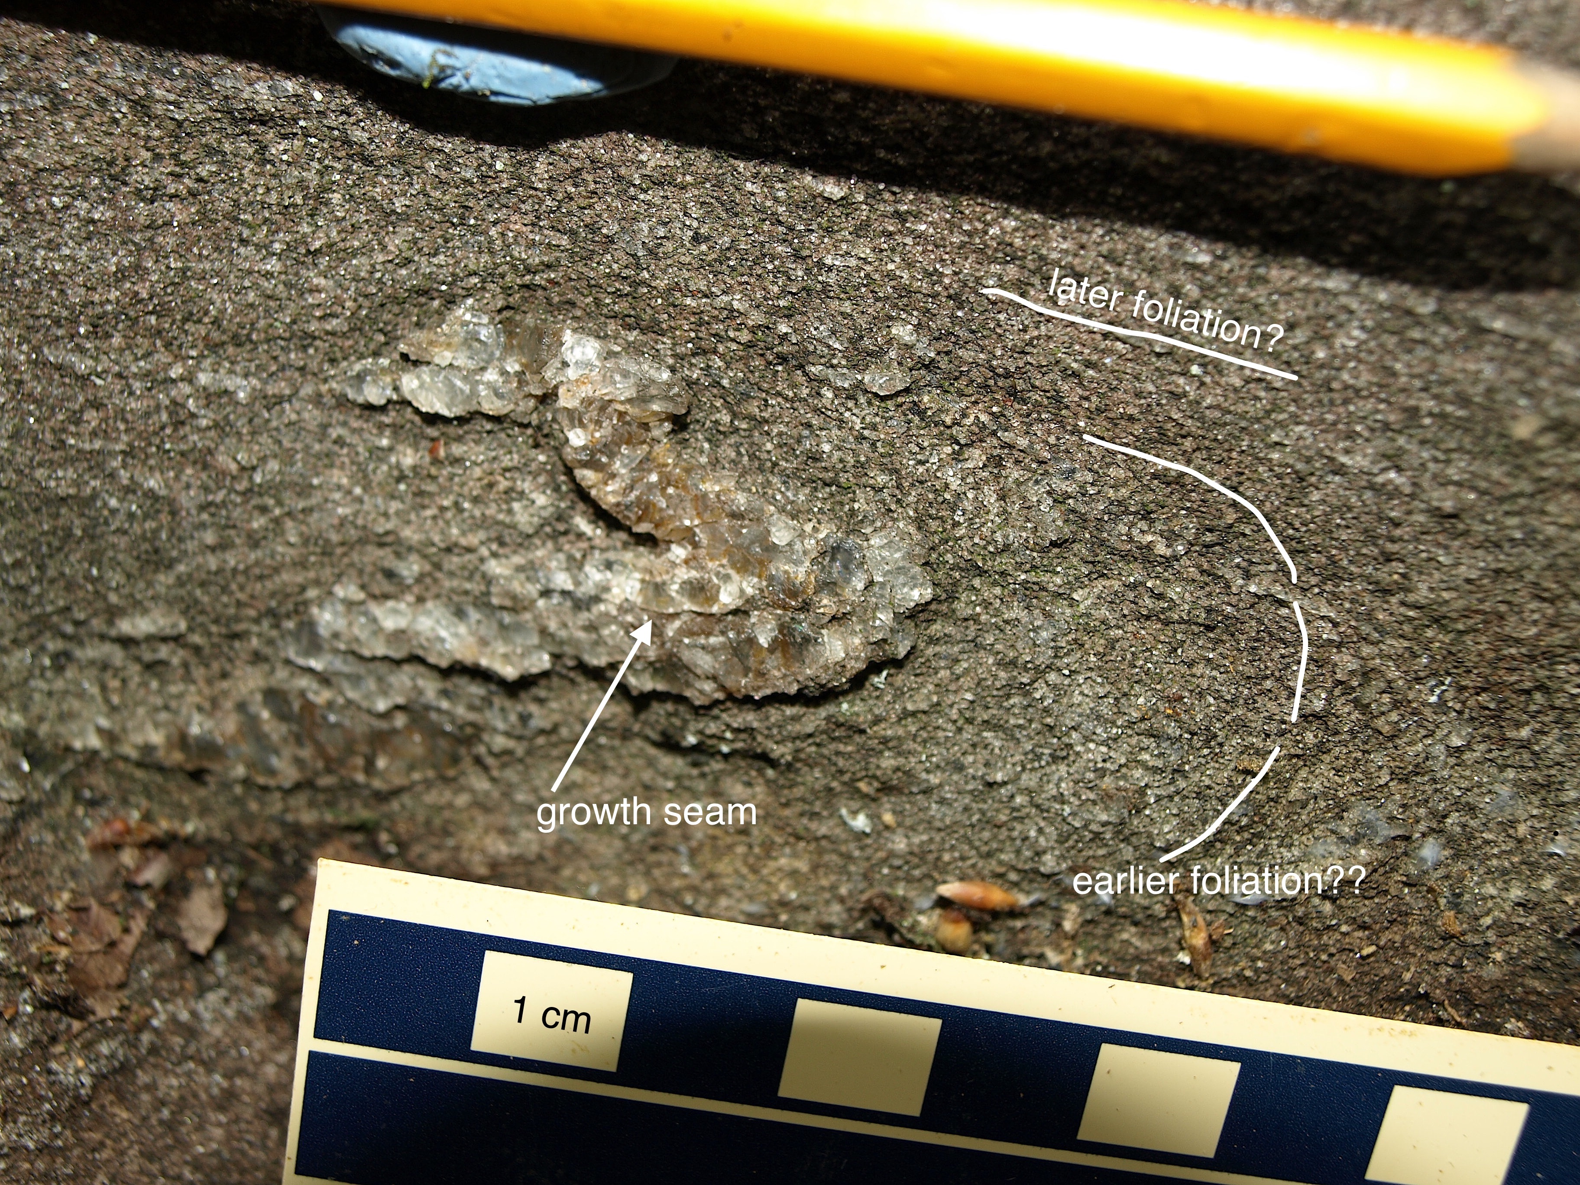
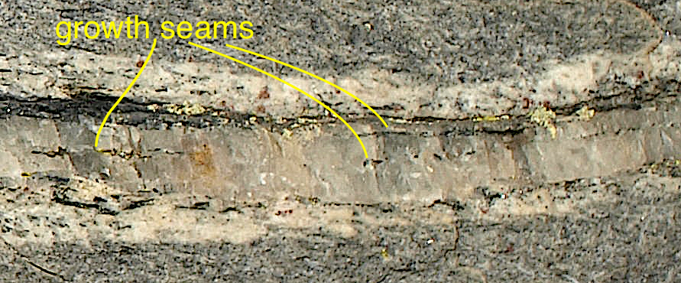
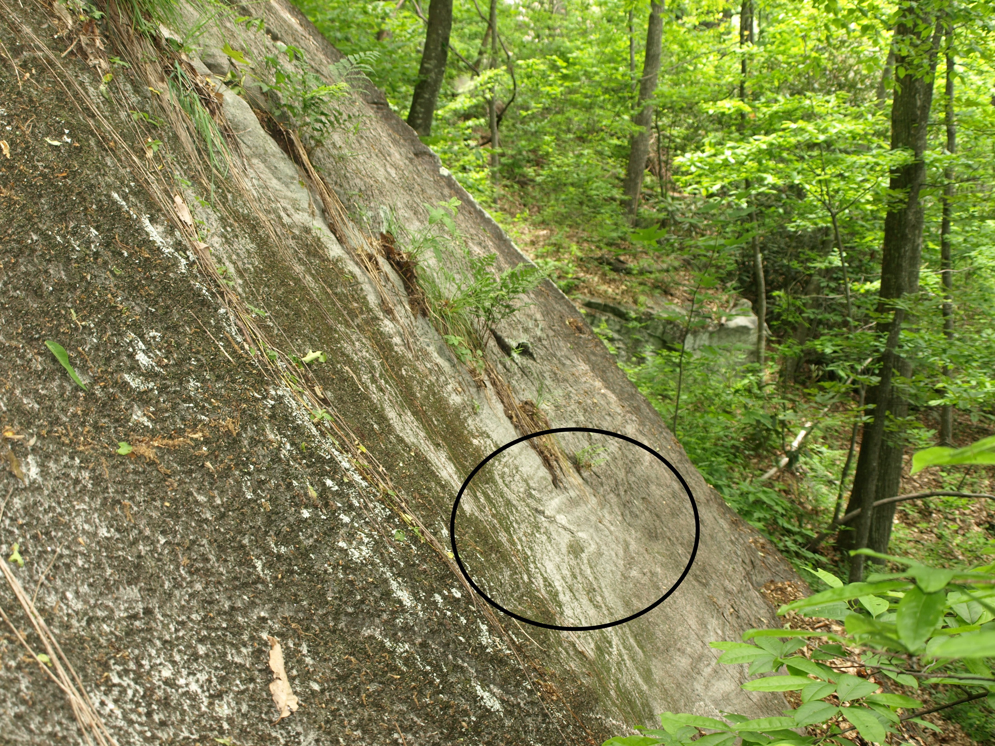
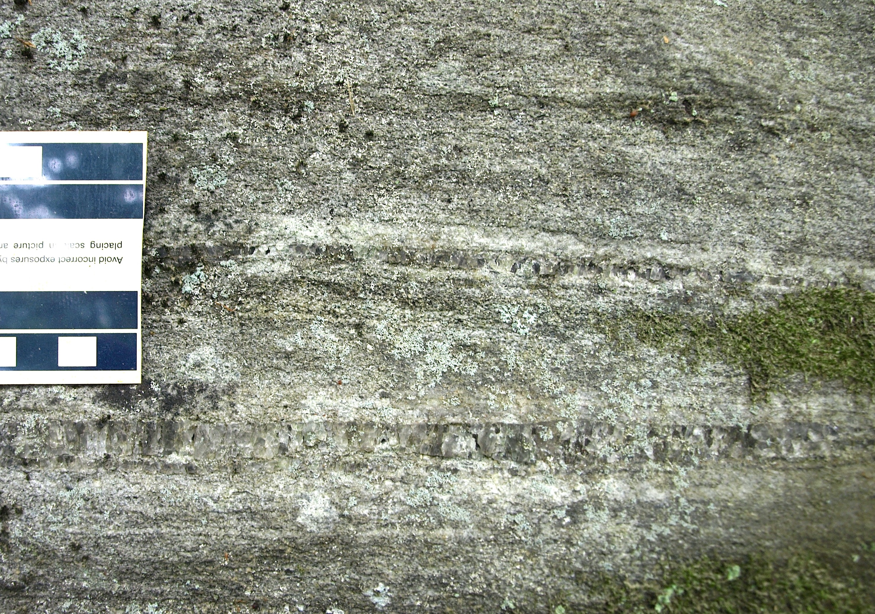
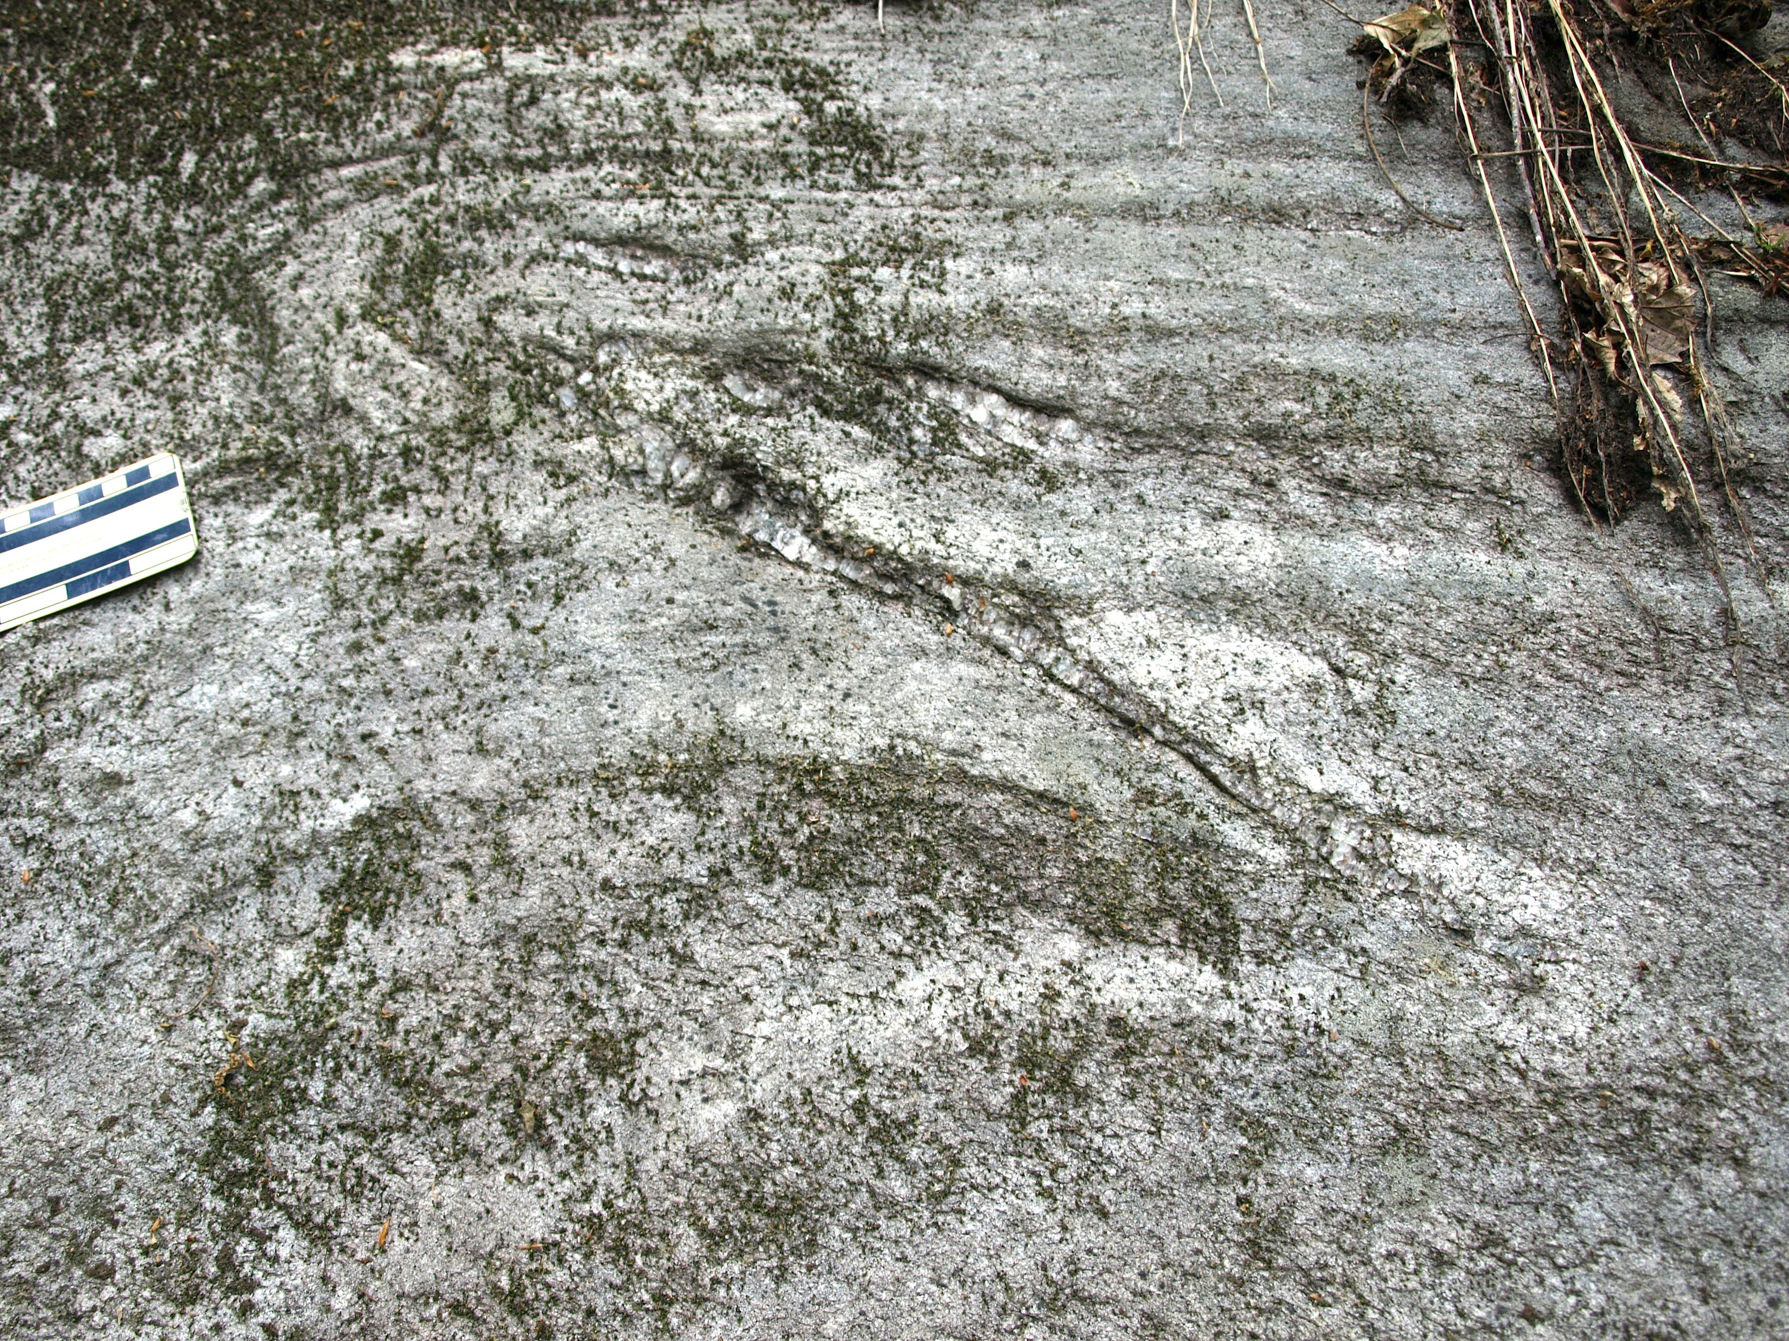
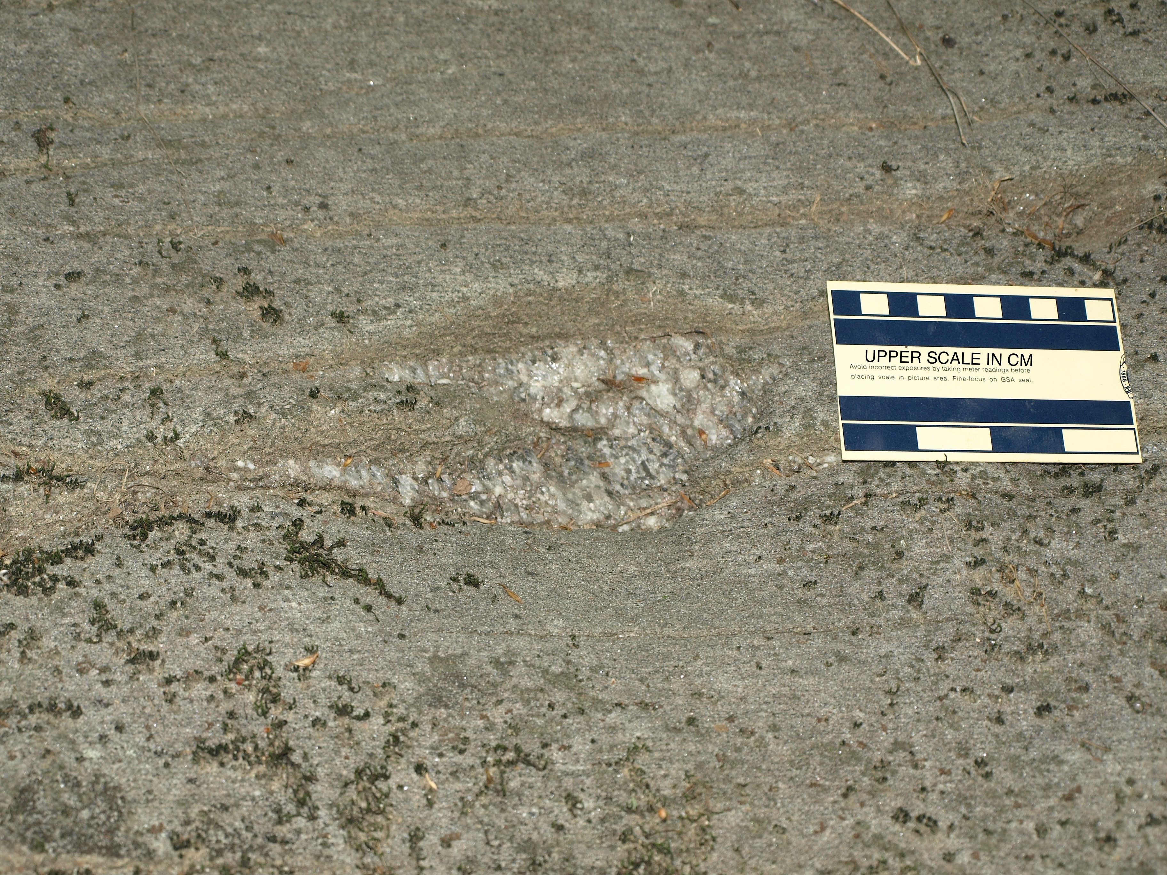
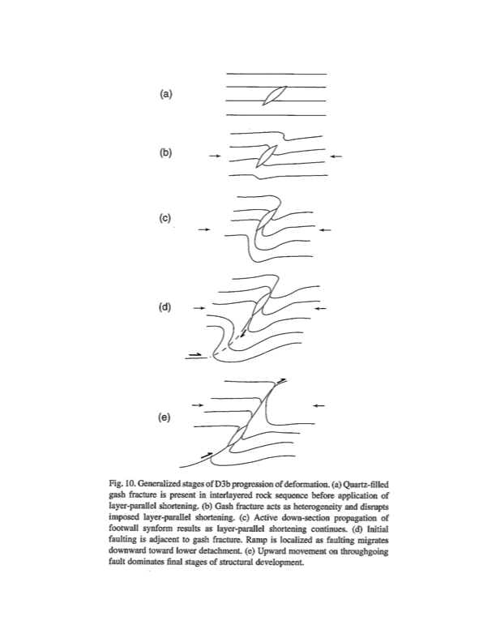
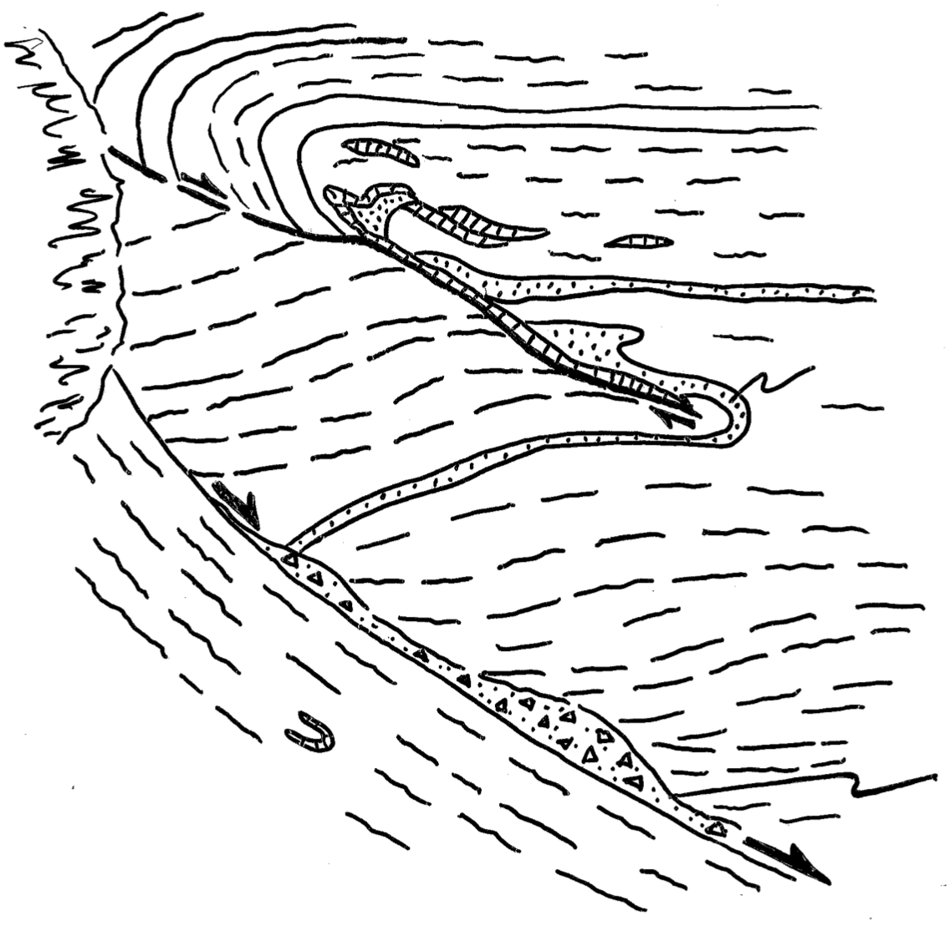
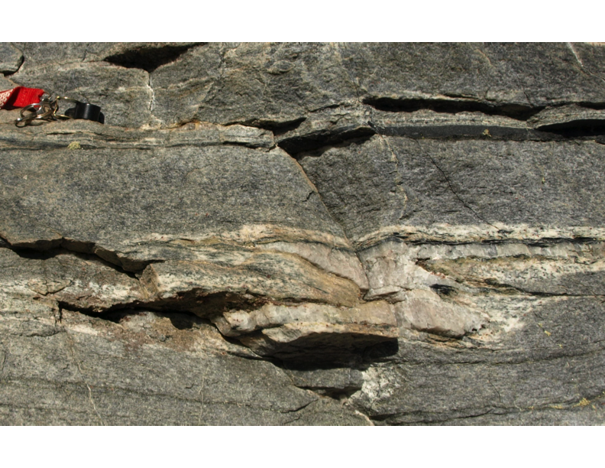
Syntaxial quartz veins act as mechanical anisotropy during layer-parallel shortening, localizing folding in gneiss: Two additional examples from the Inner Piedmont of South Carolina
John M. Garihan, Earth & Environmental Sciences Department,
Furman University, Greenville, SC 29613
Isoclinally folded vein. Pencil parallel to
the more prominent (later?) gneiss
foliation. Possible earlier foliation (?)
parallel to outer vein margin (lines).
Hinge: 10°/N14°W. Cleveland quadrangle.
ABSTRACT
2. IMAGES of syntaxial quartz veins. Views generally to the north.
Extensional syntaxial quartz veins in Late Ordovician orthogneiss in the Inner Piedmont, South Carolina, have localized the formation of some meso-scale folds of the Walhalla thrust sheet. Once localized, continued compression deformed the veins. Previously Clendenin and Garihan (JSG, 28, 2006) had recognized this vein-fold development relationship in Six Mile schists, where progressive folding evolved into fault propagation laterally away from the vein ends.
Coarse quartz crystals are 90° to margins in the lenticular veins, which are a few cm wide and tens of cm to ~1 m long. A middle ‘seam’ marks the position of new quartz growth. Vein characteristics include: parallelism with or at a slight angle to adjacent gneissic foliation; locally overlapping, nested veins; composite veins with several growth ‘seams’; generally no open voids within the vein, indicating quartz growth at ‘seams’ matched vein opening rate(s); a bleached zone adjacent to some vein margins; and vein formation prior to regional extensional, collapse-related structures.
In one example, a localized W-vergent, overturned fold initiated at the vein during layer-parallel shortening, which then continued to deform the vein and adjacent gneiss. Slip along later small-scale normal faults truncated the overturned fold limb and followed straight margins of the folded vein. In the second example, syntaxial veins localized folding and then were deformed into tight, chevron-style S and Z parasitic folds about a developing isocline.
Vein history indicates: 1) a pre-vein episode of tight folding of gneiss foliation; 2) development of syntaxial veins by compression nearly parallel to shallow foliation attitudes, and their subsequent, continued tight-isoclinal folding, likely during regional emplacement of the Walhalla and Six Mile thrust sheets; and 3) later local slip along margins of folded syntaxial veins during normal faulting associated with regional, SW-directed gravitational collapse of the thrust stack.
Veins act as mechanical anisotropy during shortening, leading to folding.
3. EXAMPLE 1. Cleveland quadrangle, south of Caesars Head. View to north.
Multiple growth ‘seams’ in a syntaxial vein. Quartz crystals grew 90° to the vein margin, parallel to sigma-3 and the vein opening direction. Hydrothermal bleached margins are a few cm wide. Rainbow Falls Trail.
Standingstone Mountain quadrangle.
Rounded, 2-D gneiss exposure.
Example 1 fold shown below
is circled.
1. MODEL FOR VEIN-FOLD DEVELOPMENT
Stages (a-e) of fold-fault development at a quartz vein heterogeneity during layer-parallel shortening affecting schist (Clendenin and Garihan, 2006). In this study, a, b, and c stages are seen. In the two examples described the syntaxial veins were folded, rather than faults propagating laterally from vein ends (d). This may have been the result of difficulty of continued slip along foliation surfaces in gneiss during shortening once the fold was initiated. heterogeneity.
Two veins, parallel to adjacent horizontal foliation in biotite
quartzo-feldspathic gneiss. Bleached margins. Exposures are
lichen- and moss-encrusted. Cleveland quadrangle.
Stages a, b, and c for the current study.
Example 1. Tight, west-vergent, overturned fold and syntaxial vein. Upper scale in cm.
C
O
V
E
R
E
D
Sketch of the relationship of
the fold and syntaxial veins,
Example 1. Normal faulting
took place later.
Isoclinally folded vein. Tapered vein ends. Quartz mobilized (?) into the
thickened fold core. Foliation horizontal. Hinge: 16°/N30°E.
Cleveland quadrangle.
nested syntaxial veins
granitoid
A small, sympathetic normal fault
truncated the overturned limb of the
antiform, with its slip occurring along
the straight margin(s) of the syntaxial
vein.
Tight, sharp
chevron-folded
vein. Bleached
vein margin.
Hand lens for
scale.
View north.
Rainbow Falls
trail.
(From Clendenin and Garihan, 2006,
Journal of Structural Geology, v.28,
p. 1316-1326.)
pegmatite intruded along
a later normal fault

