Slide 1


Historical Analysis
Of the Change in Percent Fines during Beach Nourishment
Dr. Jennifer Coor, PG
US Army Corps of Engineers
Jacksonville District
Jase D. Ousley, PG
US Army Corps of Engineers
Portland District
28 March 2019
BUILDING STRONG® US ARMY CORPS OF ENGINEERS | Jacksonville District
Notes:
Top two pictures of construction on Jupiter Island. Lower picture is of a cutter-suction dredge at Anna Maria Island.

Slide 2
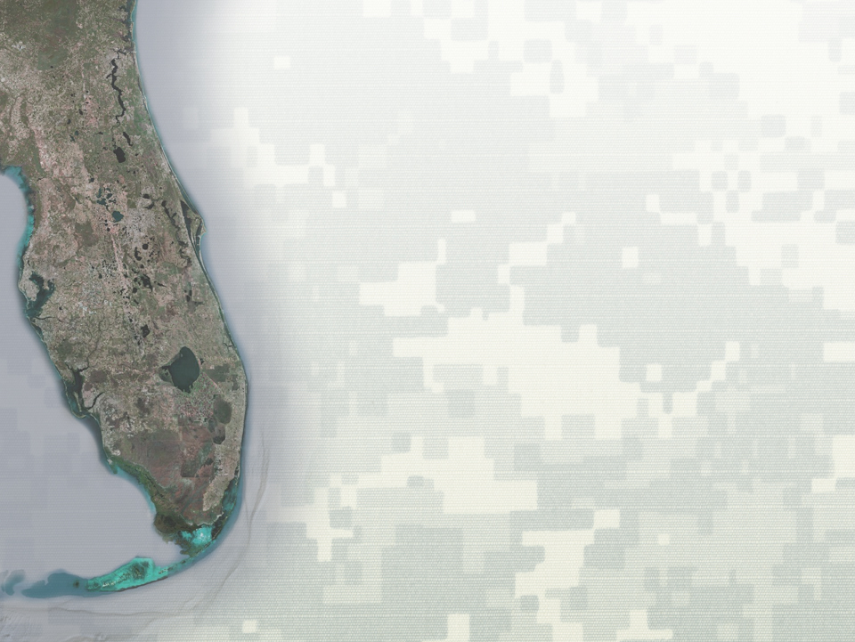


Change in Fines During Beach Nourishment
Itinerary
Background
Objectives
Data Collection and Analysis
Project Examples
Environmental Considerations
Outcome Applicability
Future Work
Conclusions
BUILDING STRONG®
US ARMY CORPS OF ENGINEERS | Jacksonville District

Slide 3
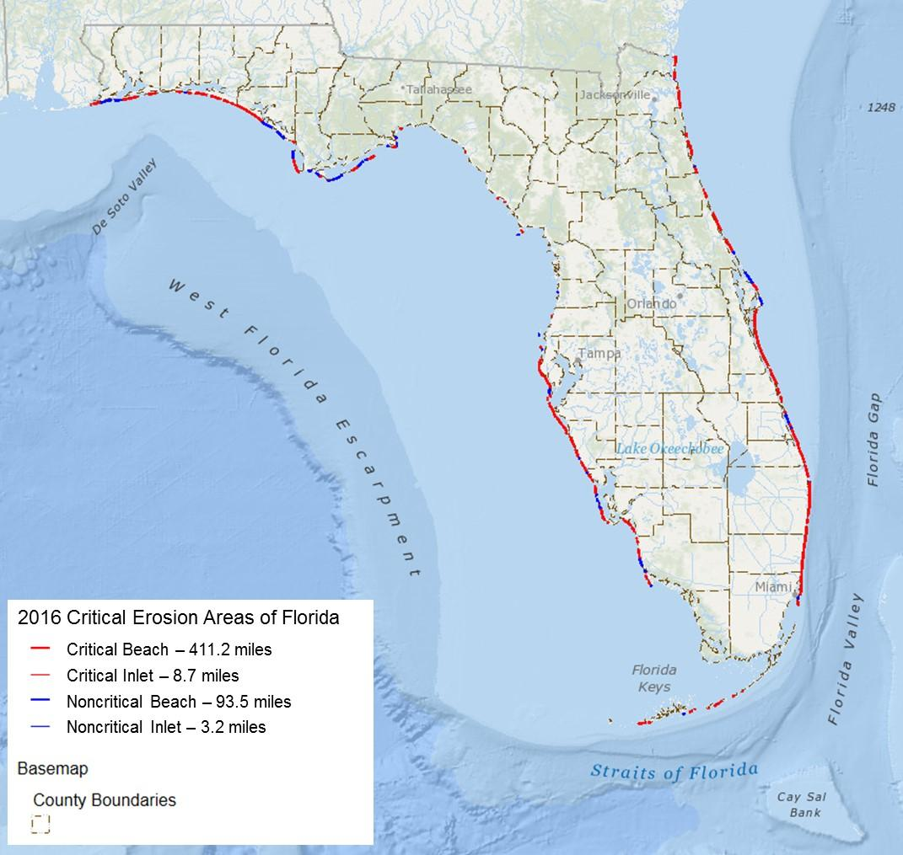
Bottom Line Up Front
Existing data shows a fines loss due to hydraulic dredging of greater than 50% from in-situ sources to post construction fill
Understanding change in fines can have regional sediment management (RSM) opportunities
Regulators
More sediment sources
BUILDING STRONG®
US ARMY CORPS OF ENGINEERS | Jacksonville District
Notes:
Beach erosion is a chronic problem in Florida, influenced by sea-level rise, natural coastal processes, storms, and inlet management. The FDEP has documented 411.2 miles of critically eroded beaches, 8.7 miles of critically eroded inlet shoreline, 93.5 miles of non-critically eroded beaches, and 3.2 miles of non-critically eroded inlet shoreline statewide (2016 numbers)

Slide 4
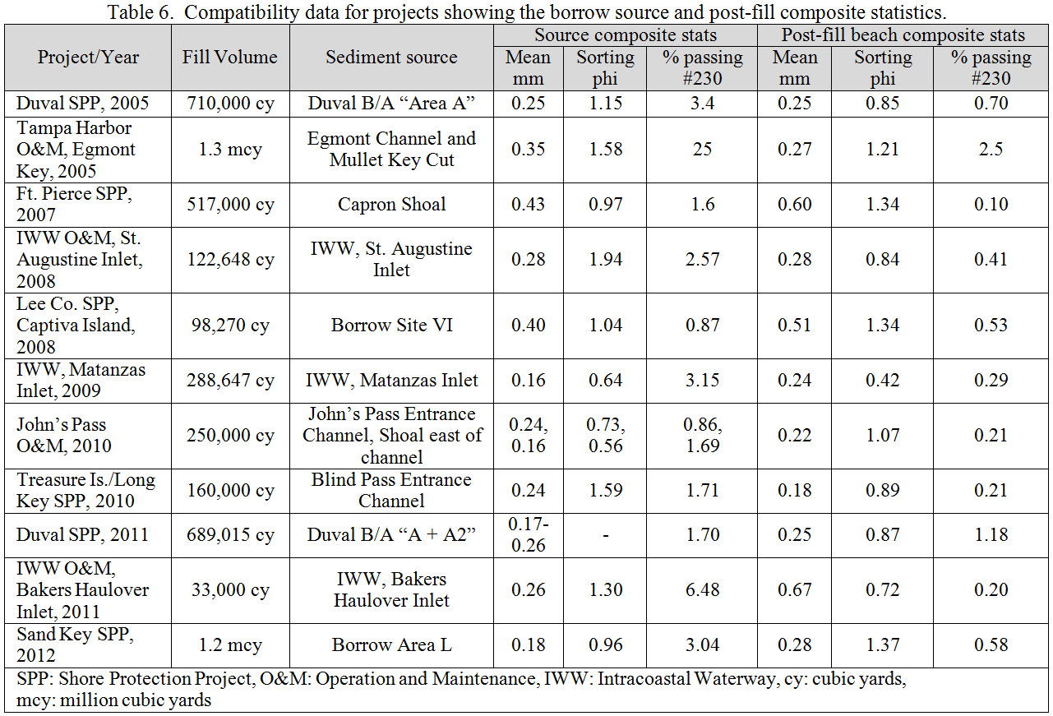
Background
Originated with the SAND Study (ERDC/CHL TR-14-10)
FDEP “Sand Rule” sets criteria for beach quality sediment
62B-41.007(2)(j)(k), FAC
Regulators apply conservative assumption of 0% fines loss
Concern for fines related to: compaction, cementation, turtle nesting, turbidity, & sensitive resources
US ARMY CORPS OF ENGINEERS | Jacksonville District

Slide 5
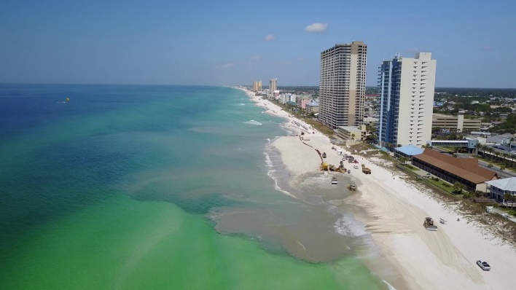
Study Objectives
Quantify historic change in fines during beach nourishment
Benefit the Navigation program by retaining more sand in the system, closer placement, reserving ODMDS and DMMA capacity,
Benefit SPP by increasing the
amount of sand available for
beach construction.
Provide reasonable assurance to regulators.
Partner with the State and other agencies
US ARMY CORPS OF ENGINEERS | Jacksonville District

Slide 6
Data Collection
Historic project data from FDEP and USACE
103 construction events in Florida analyzed
44 project locations
In Situ sand source
Post construction beach
Focus on hydraulic dredges
Hopper has two loss points
Cutter has just fill site
US ARMY CORPS OF ENGINEERS | Jacksonville District
Notes:
Total of 103 pre-post datasets included at 44 locations
Specify the type of dredge in post-fill reports – very useful data

Slide 7
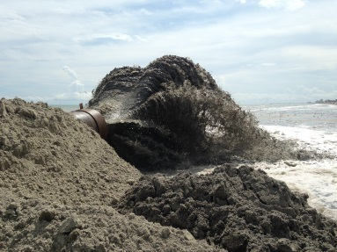
Data Analysis
Data spans high and low in-situ fines contents
Includes 33 hopper, 29 cutter suction, 15 combo and 26 generically hydraulic
US ARMY CORPS OF ENGINEERS | Jacksonville District
Notes:
The linear relation ship between the in situ source and post-fill beach is 10:1
No separation in the type of dredge used (hydraulic), no matter the number of loss points (1 – cutter, 2 hopper)

Slide 8
Data Analysis
n=103
Mean loss: 57%
Median loss : 70%
69% of projects show greater than 50% loss of fines
90% showed loss of fines
10% showed increase in fines
US ARMY CORPS OF ENGINEERS | Jacksonville District
Notes:
If we assume 50% fines loss, we could meet the rule with 10% in-situ fines.
Skimmer in dredge and sampler sampling overflow slurry on a time intercal for bulk density and mass balance determinations (in situ to berm)

Slide 9
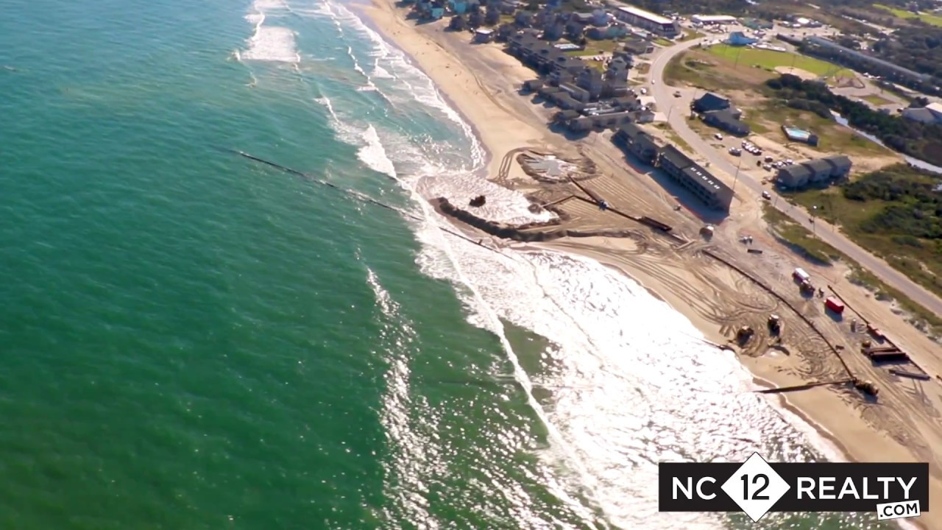
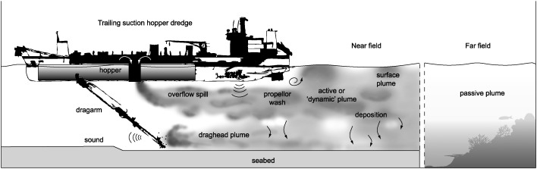
How are Fines “Lost” during Dredging?
Dredge Head
Hopper Overflow
Beach Construction

Slide 10
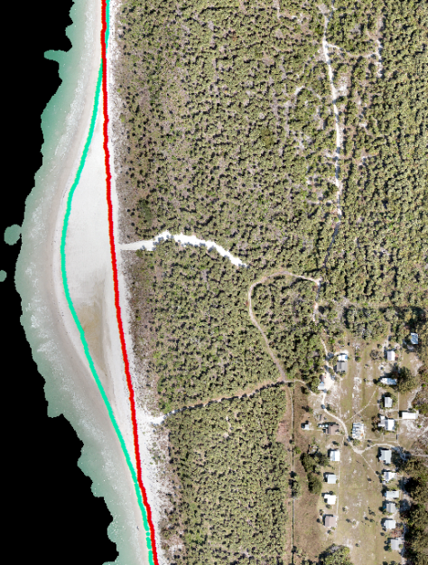
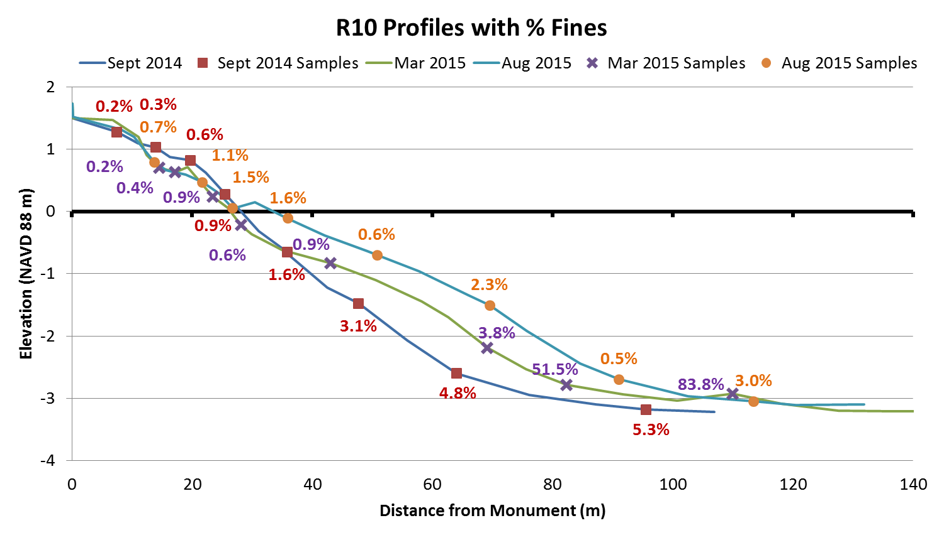
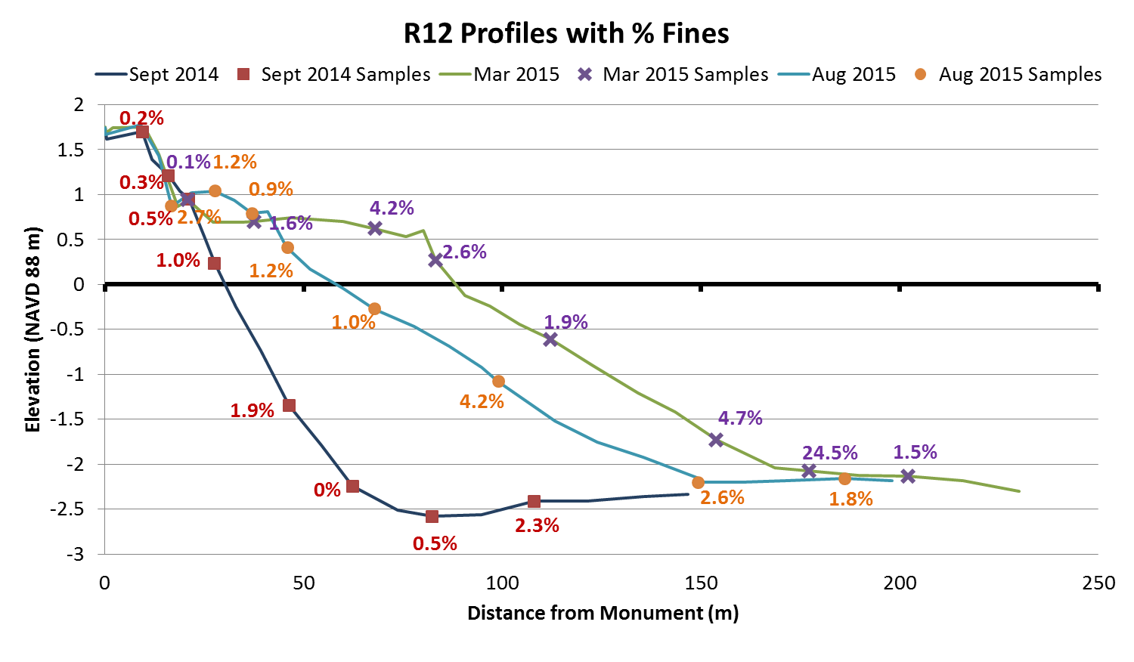
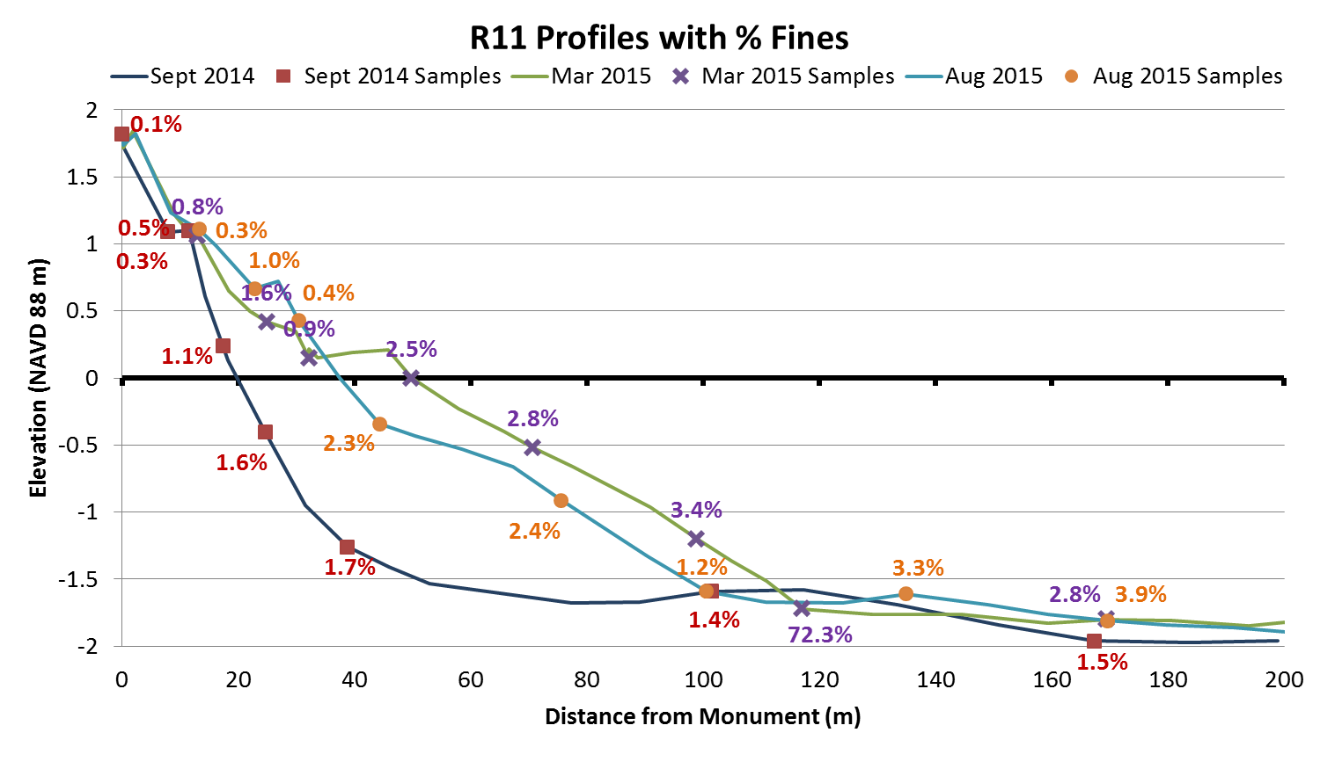
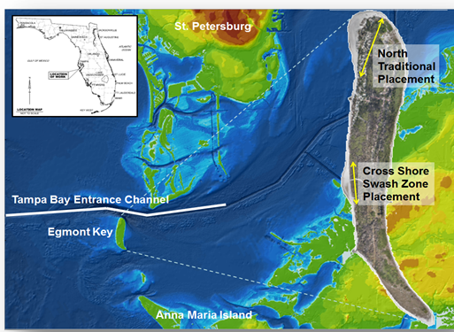
Example of Fines Loss
R12
R11
R10
23.8% fines in-situ
1.5% post-fill berm
Egmont Key, Tampa O&M, 2015
US ARMY CORPS OF ENGINEERS | Jacksonville District
Notes:
Tampa O&M – traditional placement and dry berm creation with a single discharge point.
Surveyed FDEP R-monuments (survey markers located every ~1000 linear ft of beach)
In situ sediments had instances of up to 82% fines; no turbidity violations during construction
At all R-monuments, can see fines at toe of construction immediately post-con, which had equilibrated and moved offshore 6 months later. Berm was clean, with no compaction or cementation problems. Fines most visible at R-10, which had also shown fines moving offshore.

Slide 11
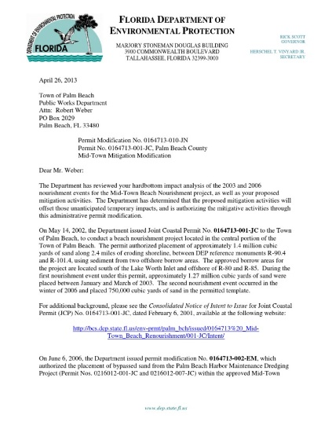
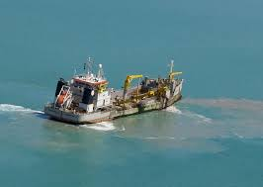
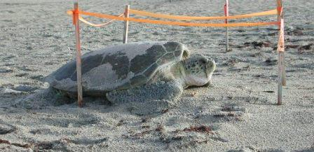

Environmental Considerations
Must perform function of shore protection
Must meet all other WQC permit criteria for sediment quality
Maintain engineering and biological functions of a beach
Must not exceed turbidity requirements
US ARMY CORPS OF ENGINEERS | Jacksonville District
Notes:
Red dots are turtle nests – had a season of nesting success, but too soon to determine hatching success.
Turbidity is still a concern, as monitoring is still required, so fines must be going somewhere.

Slide 12
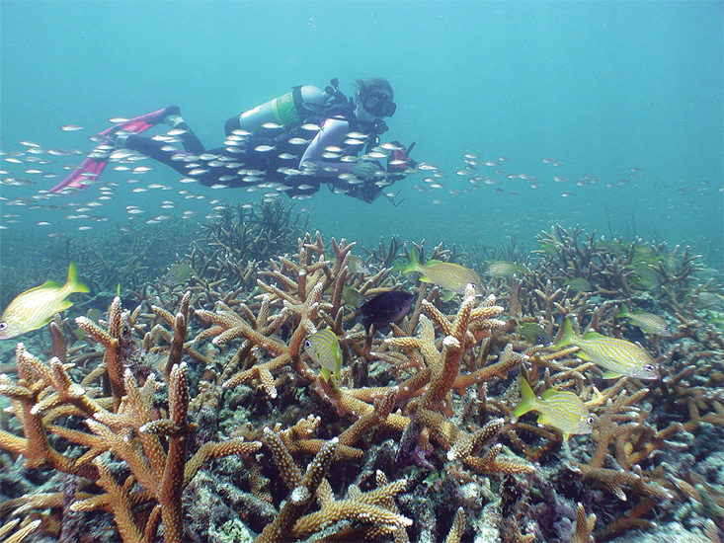
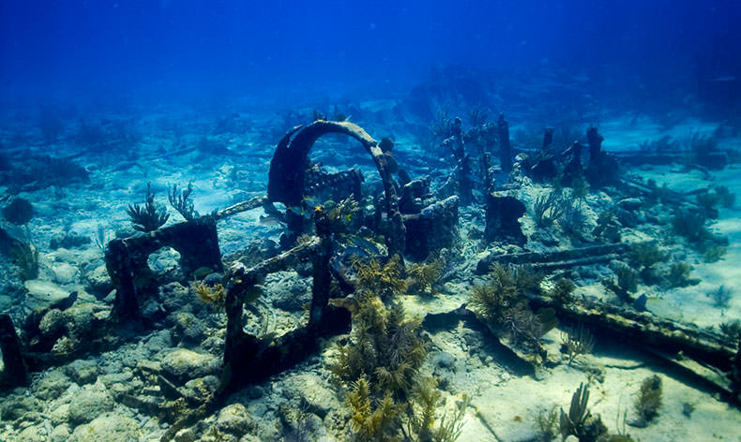
Environmental Considerations
Consideration for sensitive resources
Protect limited, high sensitivity/density resources
Offshore Resources
Nearshore Resources
US ARMY CORPS OF ENGINEERS | Jacksonville District
Notes:
Due to abundant resources in SE, may have limited applications in SE FL

Slide 13
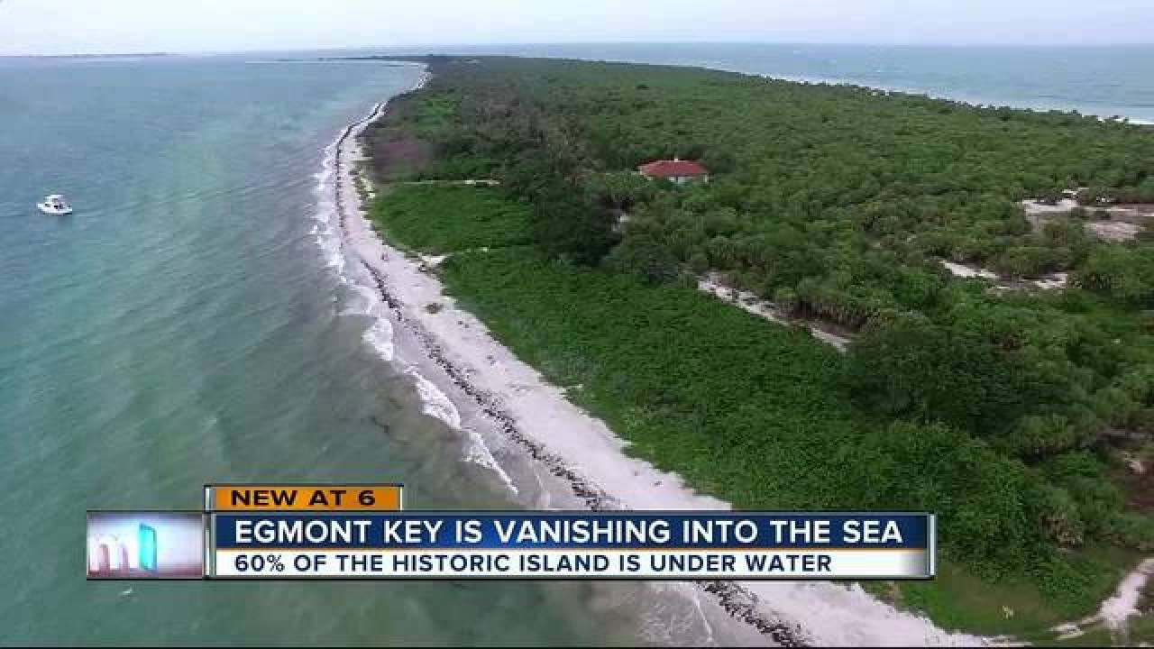
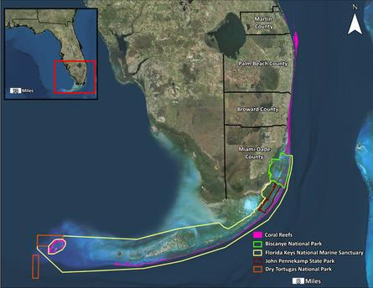
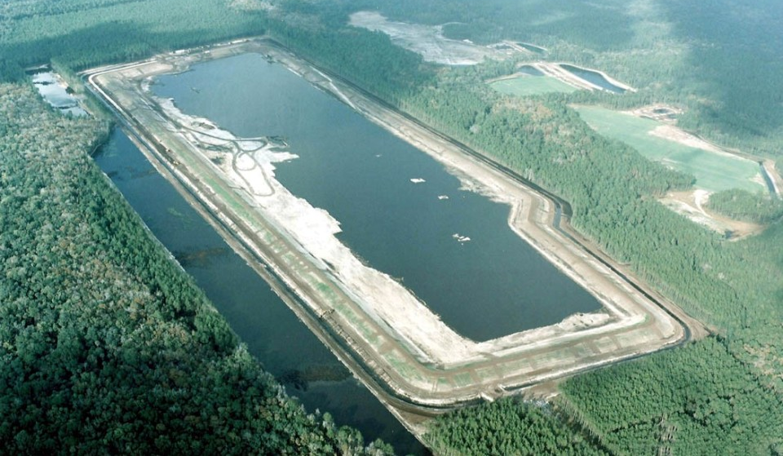
Outcome Applicability
Areas with limited sand resources
Areas with sensitive nearshore resources
Areas with marginal cost/benefit ratios
Projects with limited ODMDS/DMMA capacity
Cases of unusual circumstance
US ARMY CORPS OF ENGINEERS | Jacksonville District

Slide 14
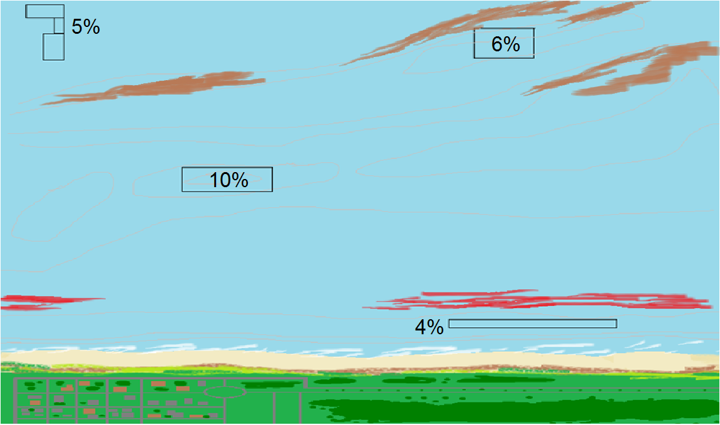
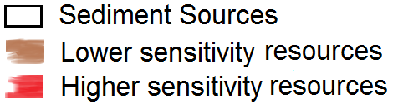
Spatial Impact
X
C
9 Nm
X
C
3 Nm
US ARMY CORPS OF ENGINEERS | Jacksonville District
Notes:
If the boxes shown are prospective sand sources, (click) these would immediately be dropped as potential options due to silt. these borrow areas. Here, we would have to make the choice to potentially impact sensitive nearshore resources.

Slide 15
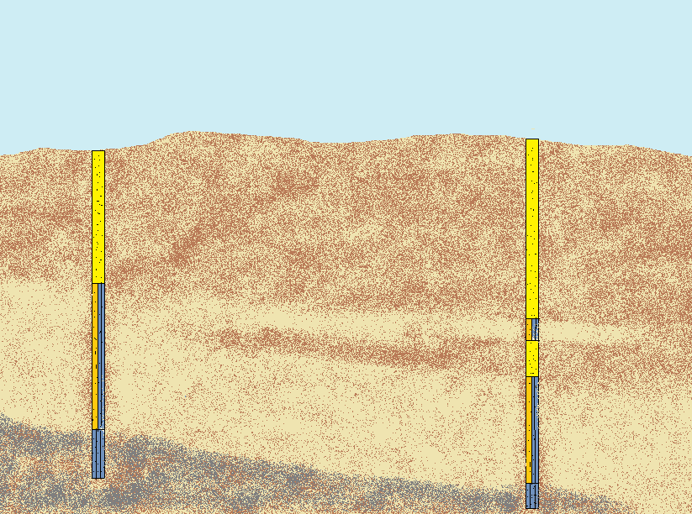
Vertical Impact
US ARMY CORPS OF ENGINEERS | Jacksonville District
Notes:
Better design and use of borrow areas.

Slide 16
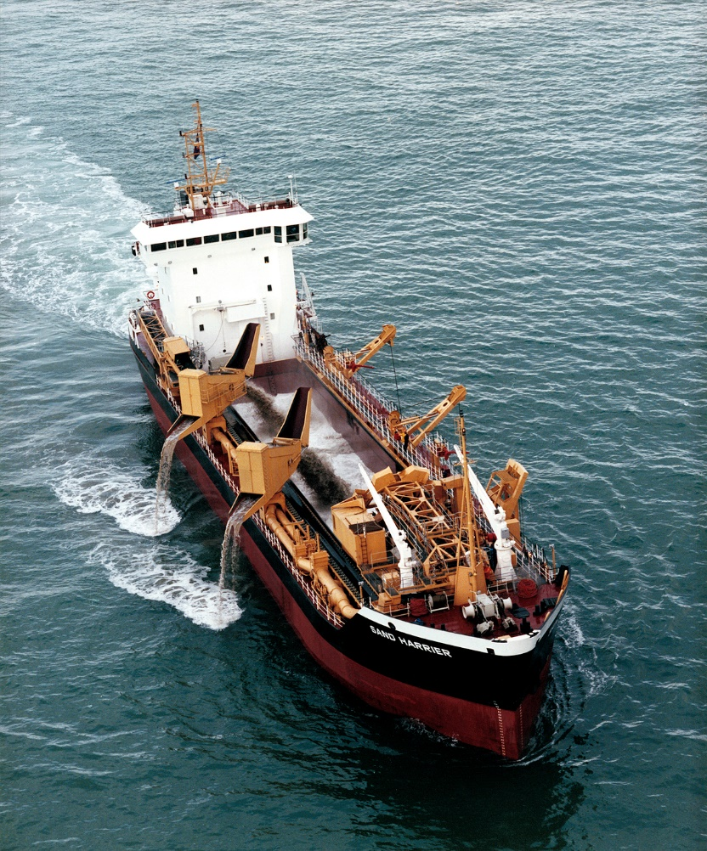
Ongoing and Future Work
Ongoing work with BOEM to address where do the fines go?
The steps in dredging process
Plume dynamics and transport
Background turbidity monitoring
Continuing Work:
New Interagency Agreement with BOEM to study fines during dredging
Predicting loss
What does this mean?
Continuation of study to give reasonable assurance
FDEP and USACE are discussing a future test project location.
US ARMY CORPS OF ENGINEERS | Jacksonville District

Slide 17
Conclusions
Hydraulic dredging and placement remove fine sediments from the berm and the loss of fines across sieves can be predicted.
Findings indicate losses:
69% of projects lose < 50% fines
90% of projects lose fines
Assume 50% loss of fines as new conservative estimate = 10% fines
Better RSM practice (beneficial use opportunities), better environmental practice, and better economic practice
BUILDING STRONG®
US ARMY CORPS OF ENGINEERS | Jacksonville District

Slide 18
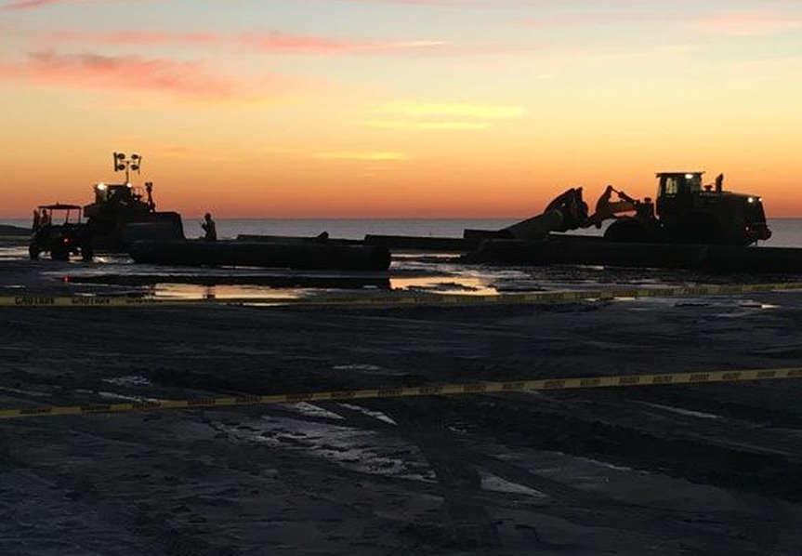
Thank you! Questions?
BUILDING STRONG®
US ARMY CORPS OF ENGINEERS | Jacksonville District

