Slide 1
Low-altitude Remote Sensing Applications for Coastal Zone Management in South Carolina
Brian Palus, Norman S. Levine, Daniel Burger

Slide 2
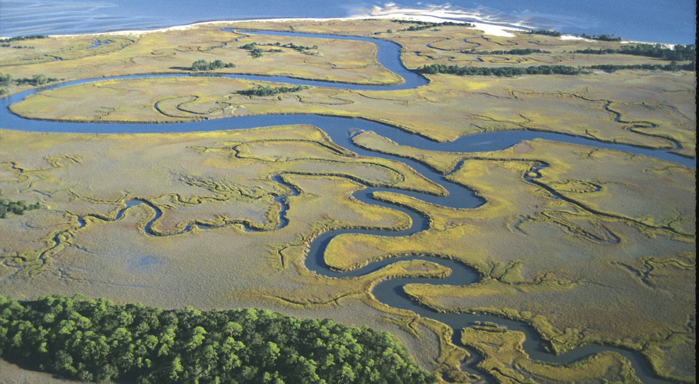
South Carolina Coastal Zone
Technological priorities of the SC Coastal Management program include continuing to improve assessment methods for critical wetlands through GIS and coastal modeling
Emerging technologies can be used to improve classification and monitoring of coastal zones
LiDAR-Imagery ‘fusion’ for transition zones
Drone/UAV technologies for on-demand and ultra-fine resolution monitoring
Charleston County used for county-wide and site specific wetlands classifications

Slide 3
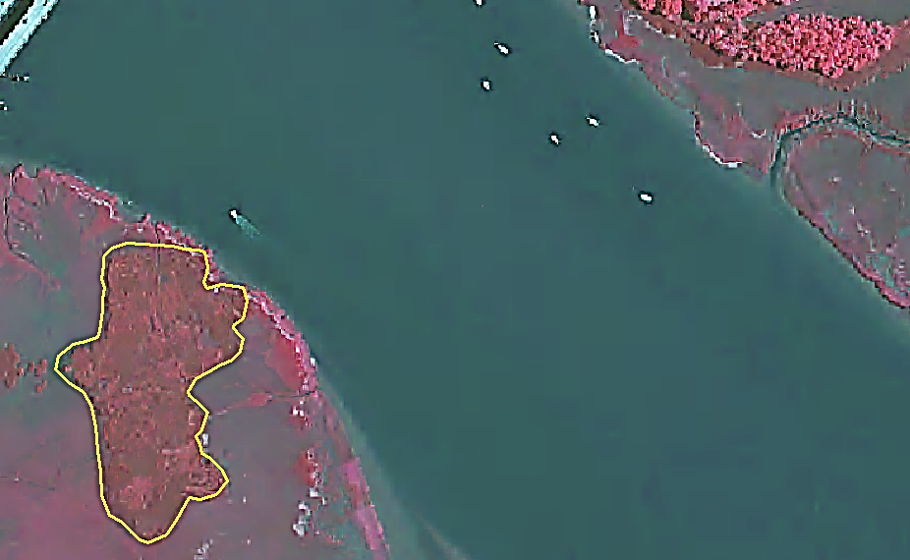
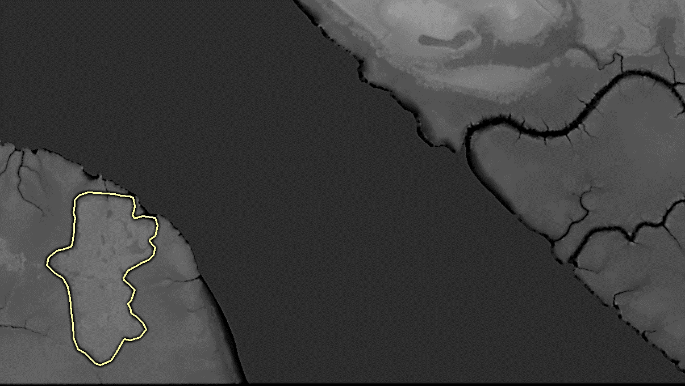
LiDAR/DEM Inclusion
Traditionally, NIR used in vegetation classification
Salt marsh vegetation zones are largely dependent on elevation above MSL
Species based on frequency and tolerance of tidal saltwater inundation
LiDAR-based elevation data increasingly use for classification studies
NAIP 432
1m DEM

Slide 4
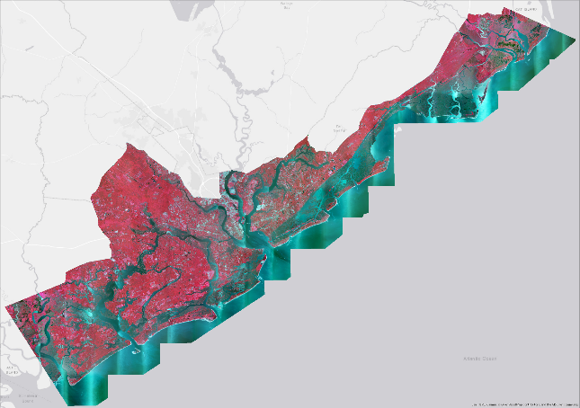
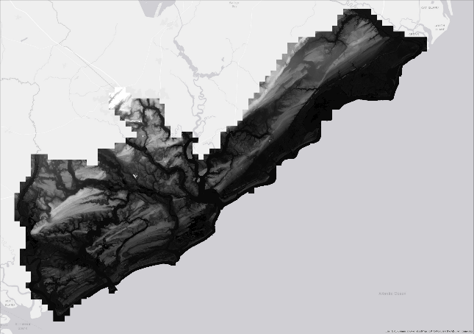
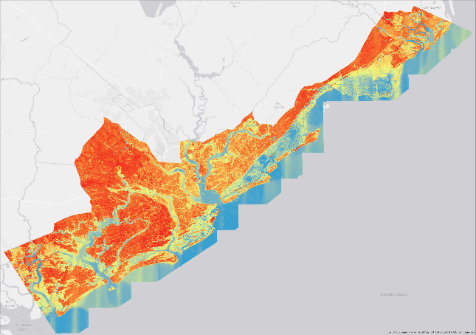
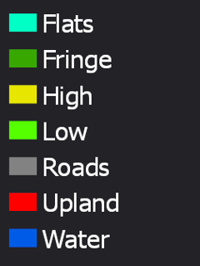
Classification Methods
Data Preparation:
2015 NAIP (Vis+NIR) Imagery gathered for Charleston County
1m-resolution County DEM
Calculated NDVI band from NIR and Red bands of NAIP imagery
ArcGIS Composite Bands tool to create 6-layer imagery dataset of Charleston County
Upland, developed areas, open water clipped from imagery based on OCRM data
Training samples created:
+
+

Slide 5
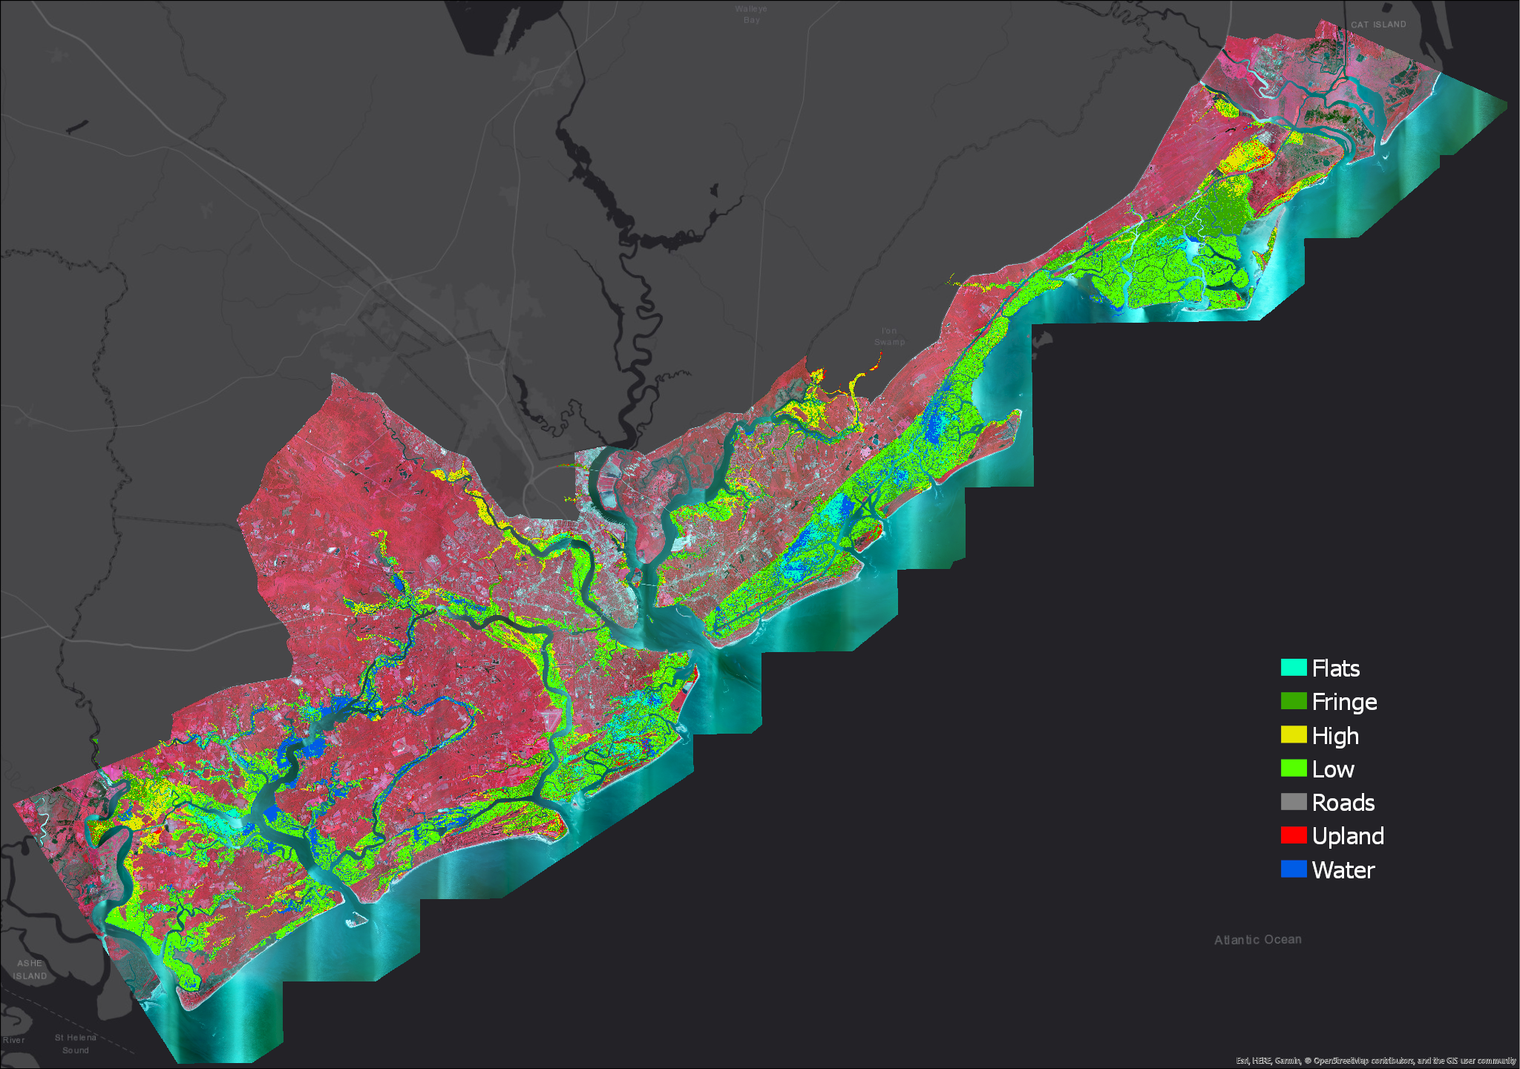
Results
Calculated Low Marsh Acreage:
98,988
(Fringe + Low)
Calculated High Marsh Acreage:
18,757
Historical Studies:
Pendleton (2007)
Low: 122,030
High: 18,078
Tiner (1977)
Low: 117,989
High: 13,569

Slide 6
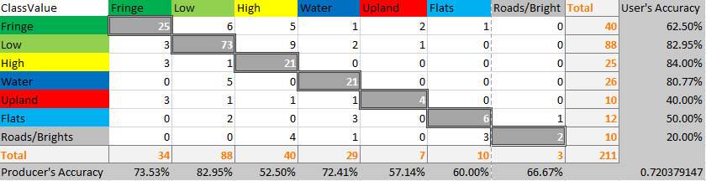
Accuracy & Discussion
Accuracy Assessment
Accuracy Assessment
Confusion Matrix
Accuracy > 80% suggests strong agreement of accuracy (Congalton, R. G., & Green, K., 2008)
Fringe and High Marsh classes were often misclassified as each other
Previous imagery-based study (Pendleton, 2007) used tide-controlled image acquisition

Slide 7
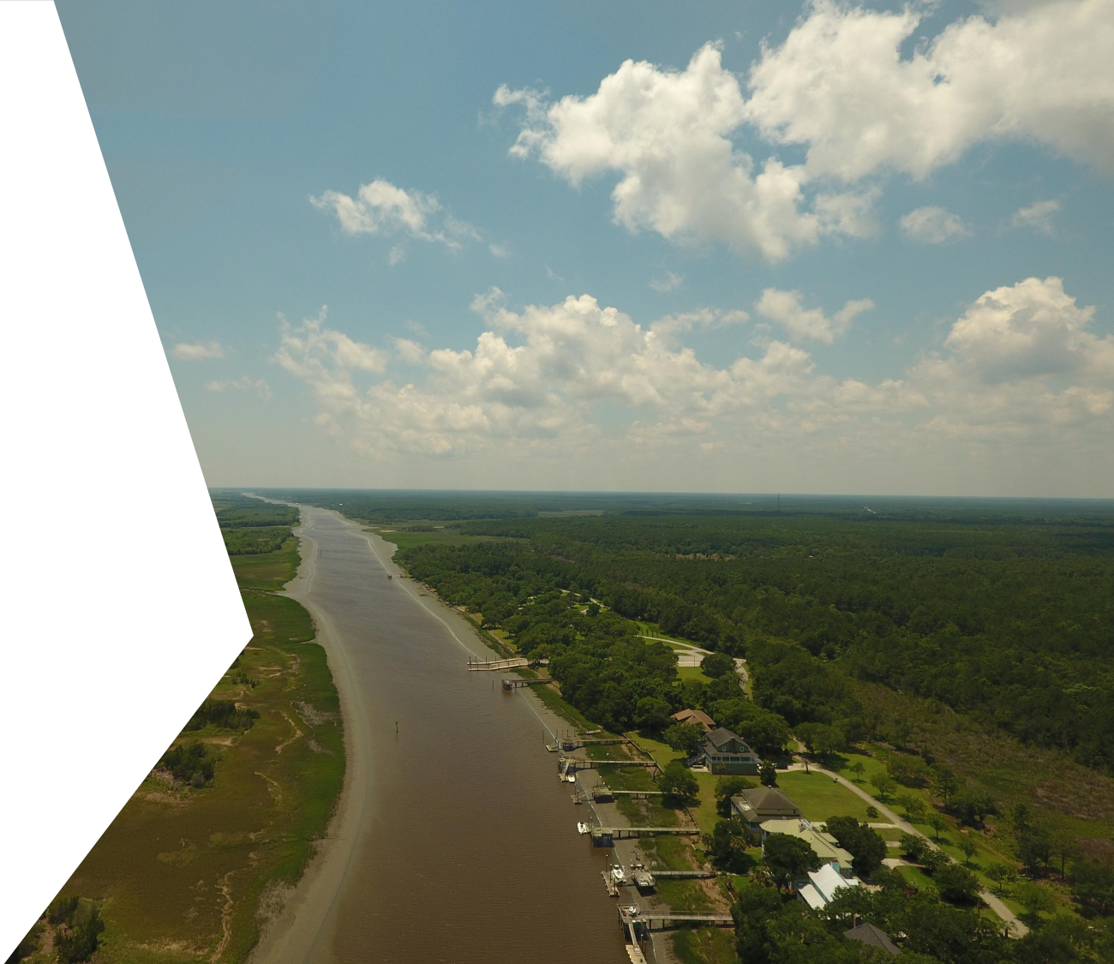
Drone/UAV Site Classification
On-demand imagery acquisition
<5cm pixel resolution
Ability to create digital surface models (DSMs)
Ideal for marsh ecosystems where vegetation sampling and ground truthing can be difficult or destructive
Six sites chosen in Charleston County
Flight plans mapped with DroneDeploy
Imagery acquisition at peak low tides
Orthophotos stitched together with Pix4D
Classification methods similar to county-wide study

Slide 8
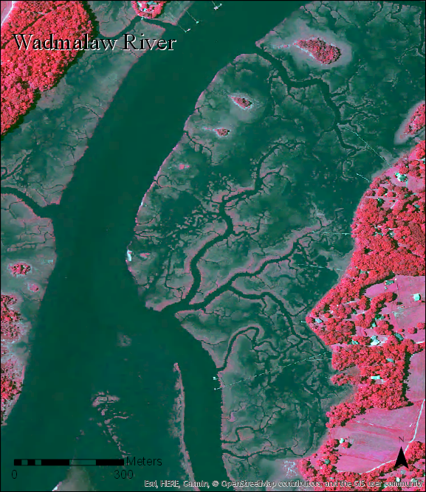
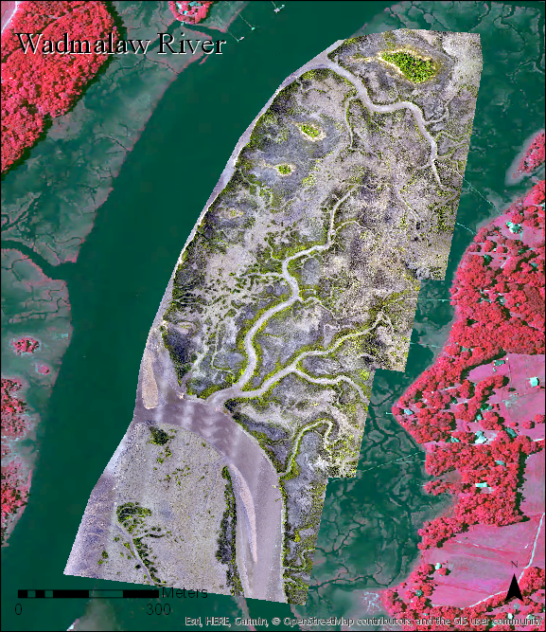
Dixie Plantation/Wadmalaw River
Is it high tide in the original imagery?

Slide 9
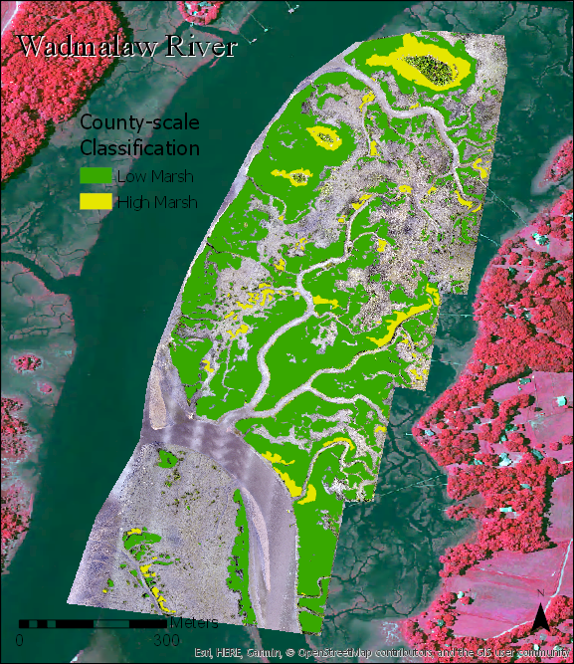
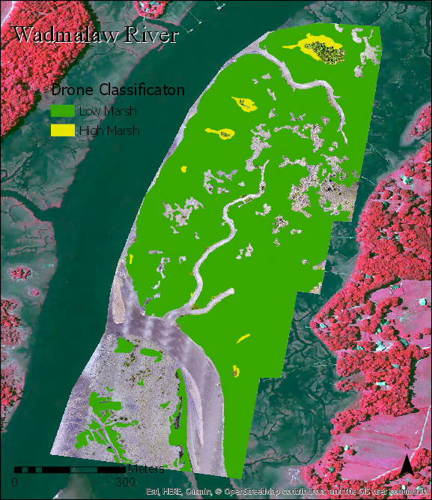
Dixie Plantation/Wadmalaw River
Low Marsh gained
Mudflats remain unclassified
Site | LOW.drone | HIGH.drone | LOW.county | HIGH.county | LOW.difference | HIGH.difference | TOTAL.drone | TOTAL.county | TOTAL.difference | Site Area
Dixie | 130.52 | 2.12 | 71.95 | 8.24 | 58.57 | -6.12 | 132.64 | 80.19 | 52.45 | 198.25
Notes:
Change in High Marsh is near 0 and negative
Low marsh almost doubles
Likely because of tidal influence from NAIP imagery

Slide 10
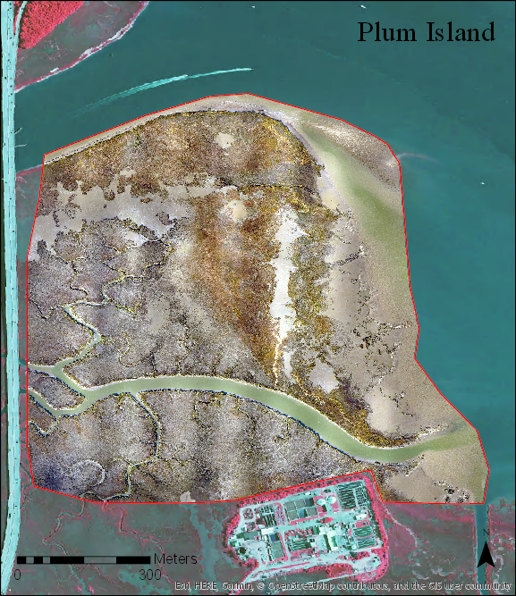
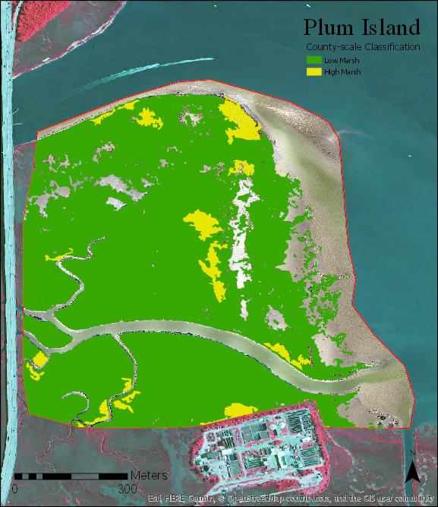
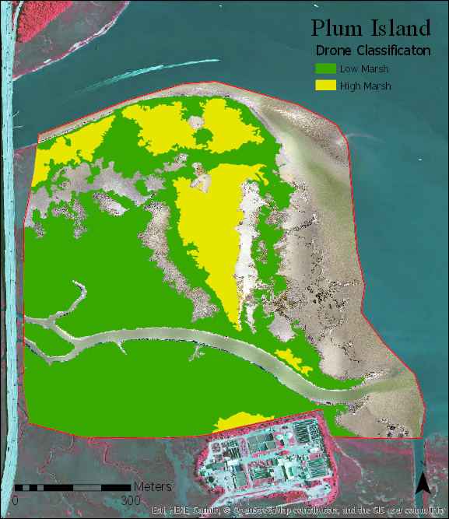
Plum Island
Site | LOW.drone | HIGH.drone | LOW.county | HIGH.county | LOW.difference | HIGH.difference | TOTAL.drone | TOTAL.county | TOTAL.difference | Site Area
Plum Island | 114.51 | 29.18 | 159.78 | 8.97 | -45.27 | 20.21 | 143.69 | 168.74 | -25.06 | 235.76

Slide 11
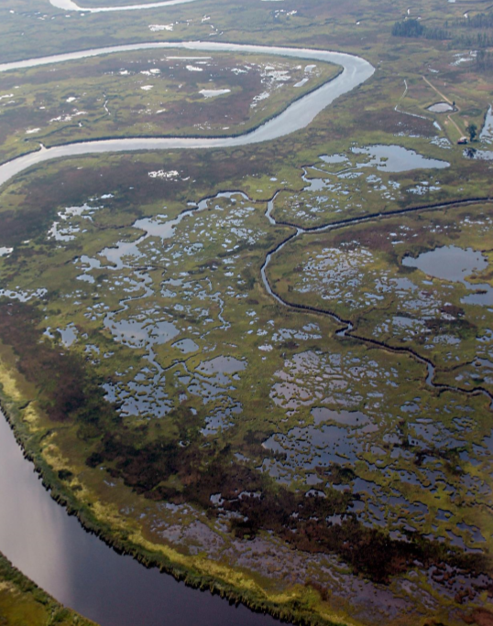
Further Discussion
Conclusions
Further drone discussion:
Drone coverage is a function of image overlap, flight altitude, and battery life.
DSMs were produced but were not of usable quality. Pix4D suggests thorough image overlap, with a second pass perpendicular to the first. (battery life)
Common off-the-shelf UAVs provide ultra-fine, true-color imagery, but no NIR. Near-IR sensors are available in the aftermarket.
Other applications:
Monitoring of restoration projects/shorelines/transitional zones
With DSM, biomass estimates can be improved
Forest canopy assessments
Erosion assessment
Invasives species monitoring

Slide 12
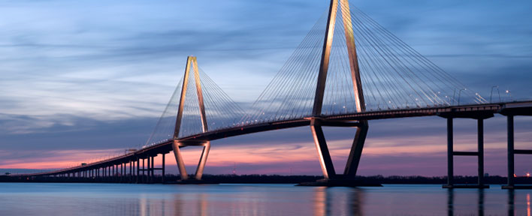
Thank you --- Questions?

