Slide 1


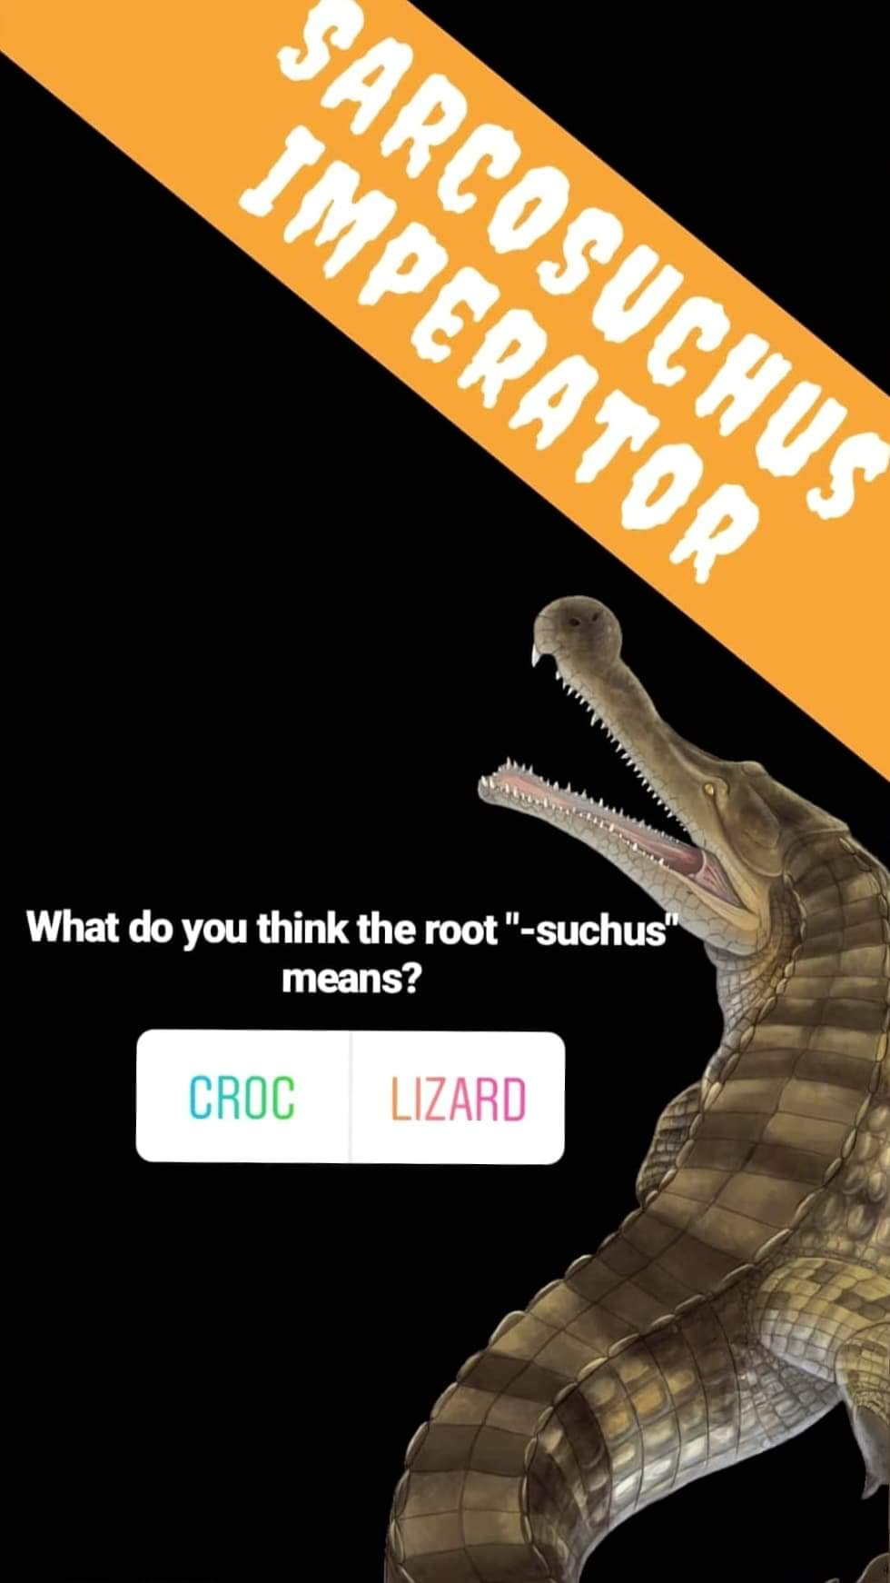
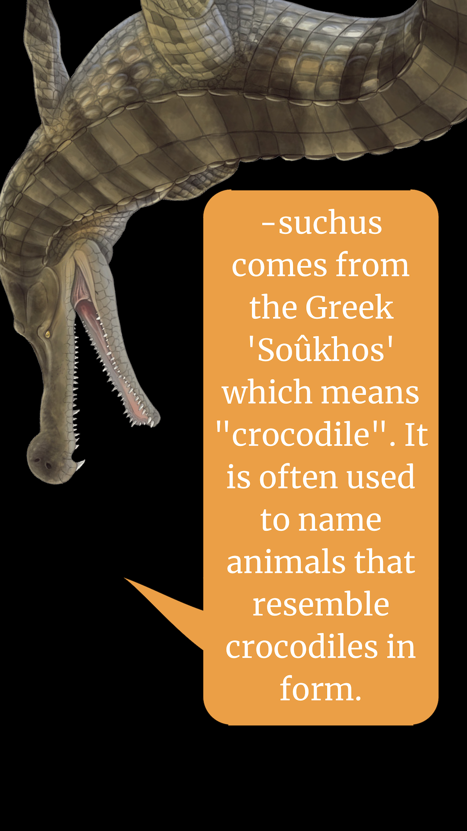

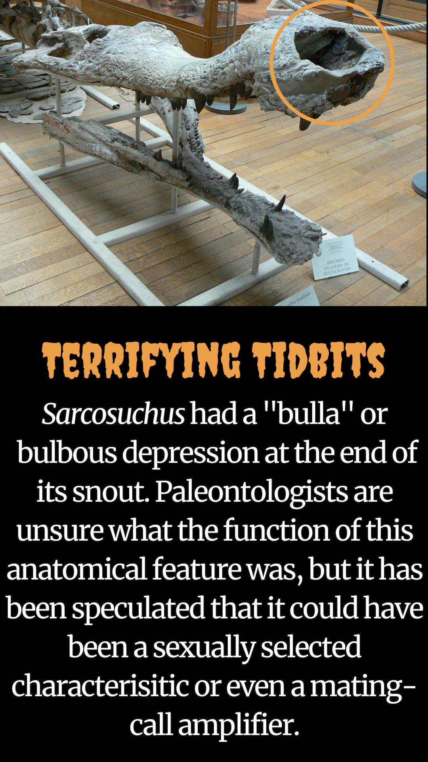


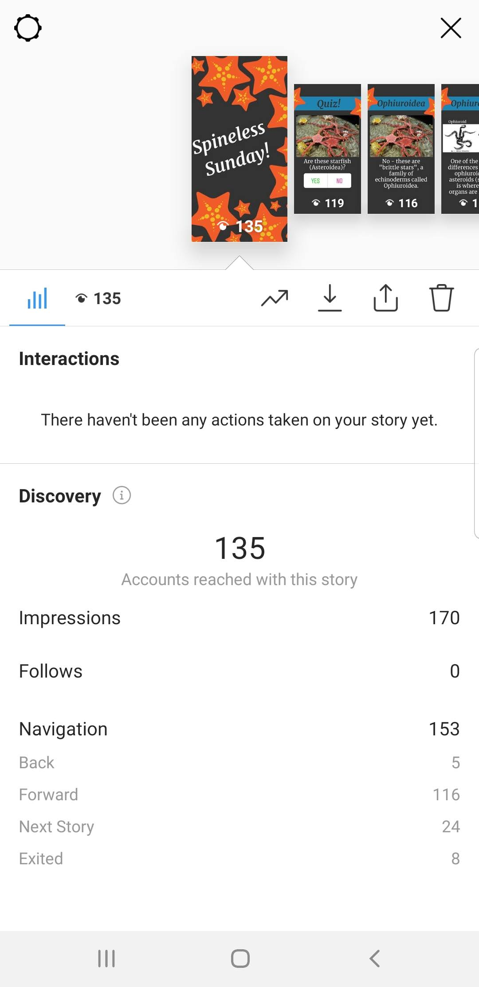
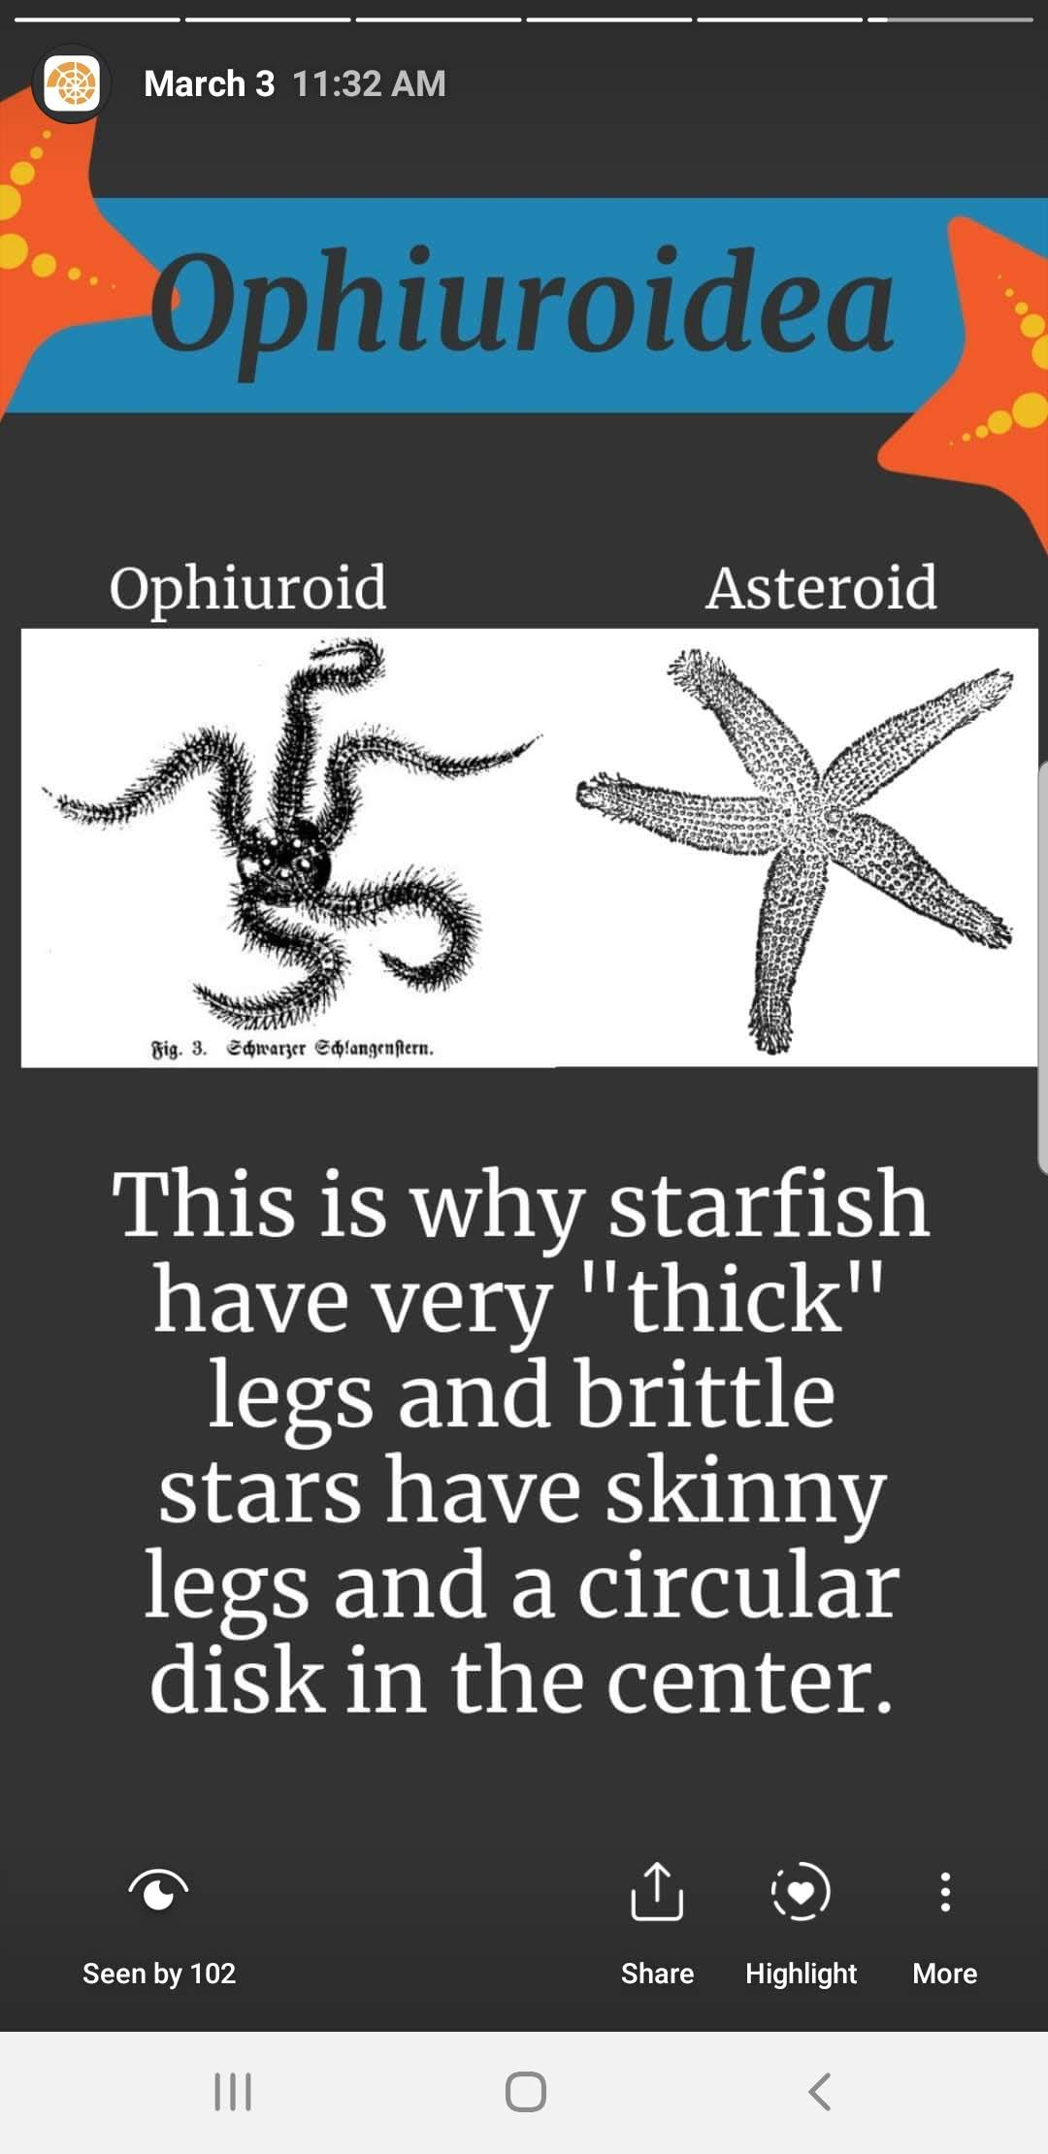
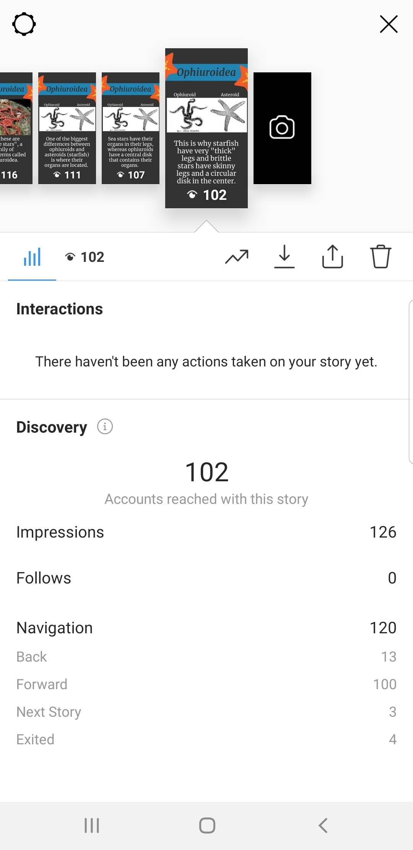

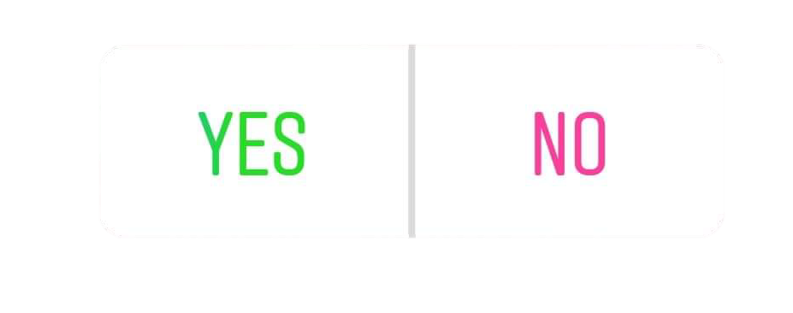






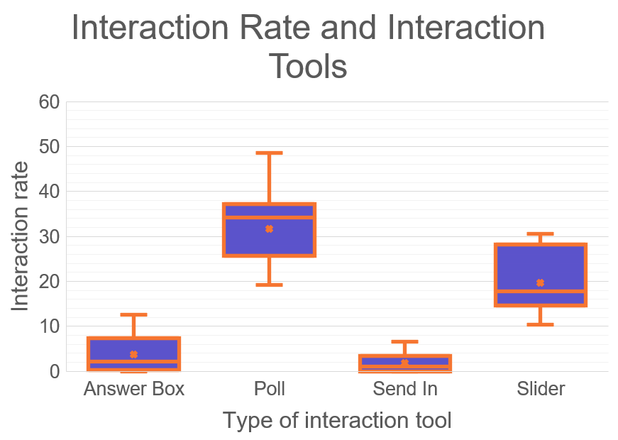
Measuring Success: Evaluating Paleontology Instagram Stories
Samantha B. Ocon¹, Mary Jane Hughes¹, Sadie M. Mills¹, Jennifer E. Bauer¹, Kent J. Crippen¹, Lisa M. Lundgren^{1,2},
Richard T. Bex II¹, and Bruce J. MacFadden¹
The University of Florida¹, North Carolina State University²
Introduction
Results and Discussion
Instagram is a popular social media platform that focuses primarily on visual content. In 2016, Instagram introduced Instagram Stories – a way to post photos and short videos that remain available for a short 24-hour period. Users can tap through multiple “slides” and interact with tools provided by Instagram.
Stories provide a valuable opportunity to educate the public about paleontology in a concise and interactive way and can introduce the next generation of geoscientists to our field. However, there is a lack of literature on measuring the success of an educational Instagram story. This study seeks to create a system for measuring the success of educational paleontology Instagram stories.
The graph featured to the left displays retention rate which was calculated as a percentage. The orange line in the graph is a trendline.
An ANOVA Statistical analysis was run to ensure the statistical significance of data collected.
Stories were eliminated that had slide values of >12 because the sparse data impeded the interpretation of other data.
Retention rate decreases with more slides because the Instagram Story format favors brevity.
These data display a negative relationship between story length and retention rate.
Trendline Equation | P-Value (Retention rate) | R² | t-Statistic (Retention rate) | F
y = -2.48x + 89.6 | 0.0002 | 0.14 | -3.85 | 14.82
Methods
The box and whisker plot to the right displays the mean, median, and range displayed by each interaction tool.
Based on interaction rate, polls performed the best, followed by sliders, then answer boxes, then send ins.
Due to the format of Instagram Stories, we assume this is due to the effort required in using each interaction tool.
These data show that poll-type interaction tools had the highest interaction rate, followed by sliders.
To determine metrics and best practices for Instagram Stories, we created Stories of multiple lengths with varying content and posting times. We determined the success of the stories based on two general statistics: retention rate and interaction rate.
Retention rate was calculated by determining the percentage of users that watched the story from the first slide to the last slide.
Interaction rate was calculated by determining the percentage of users that viewed a slide with an interaction tool and how many of those users interacted with the tool. We also recorded which tool we implemented in the story; some tools had a higher average interaction rate than others.
102 Last slide reach
135 ^{First slide reach}
n = 8
n = 45
n = 13
n = 11
Summary
= 75.5% retention rate
The retention rate data indicates that longer stories result in a decreased average retention rate. This is most likely because stories are designed to accommodate brevity – thus a longer story is more likely to lose the attention of a user. However, retention rate cannot be calculated for stories with only one slide.
The interaction rate data indicates that “quiz”-type interaction tools result in the highest interaction with the story. This is possibly because it requires the least amount of effort for users to interact with the story. The “quiz” tool is also useful for determining how well the story conveyed information.
Instagram stories convey information about the geosciences to the general public and potential students in an interactive and novel way. The tools developed within this study are useful for measuring how well a story accomplishes that goal.
Poll Tool
This tool allows users to choose between two different options
Useful for gauging knowledge
Requires least amount of effort to interact with
Can provide more statistics on whether information was conveyed successfully
Answer Box
This tool allows users to type out a response
Useful for asking about anecdotes or personal favorites
Takes more effort to use because answer must be typed out
Slider
This tool allows users to drag an emoji across a range of values to express their feelings on a slide
Not very exact, good for measuring interaction
Require less effort than answer boxes or “send in” option
Notes:
Dimensions: 36 inches high x 48 inches long

