Slide 1
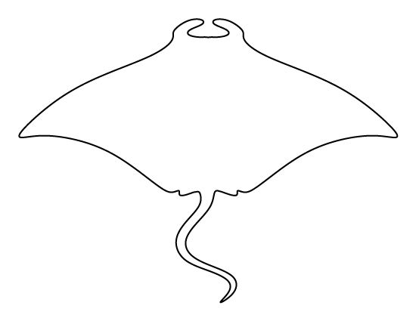
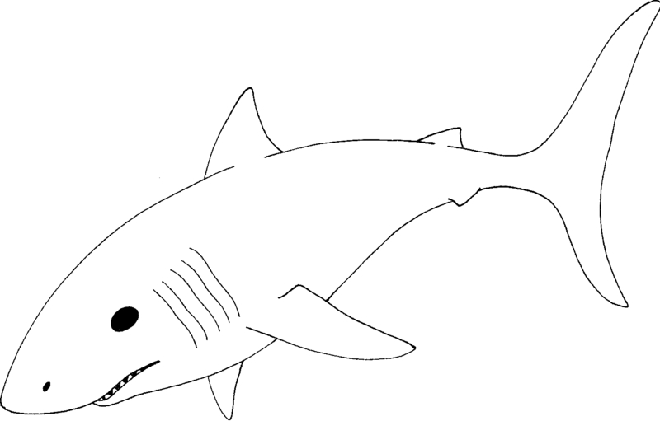



Chondrichthyan Diversity across the EOT of Florida
Victor J. Perez

Slide 2
Chondrichthyan Fossil Record of FL
General Problem:
Chondrichthyan taxa are poorly documented from Florida, despite their popularity, abundance, and utility for interpreting paleoecology.
Driving Question:
How has chondrichthyan diversity changed throughout the Cenozoic of Florida?
Overarching Hypothesis:
I hypothesize that major changes in the chondrichthyan diversity of Florida will correlate with global climate perturbations (i.e., the EOT, MMCO, Messinian Crisis, Pliocene Warming event, and Pleistocene glaciations).

Slide 3
Materials
68 %
FLMNH Vert Paleo Specify Database:
  Total Specimens: 103,364
  Total Sites: 352
  Total Orders: 11
  Total Families: 23
  Total Genera: 40
  Total Species: 52
Temporal Resolution:
North American Land Mammal Age (NALMA)
Chronostratigraphic Stage
23.2 %

Slide 4
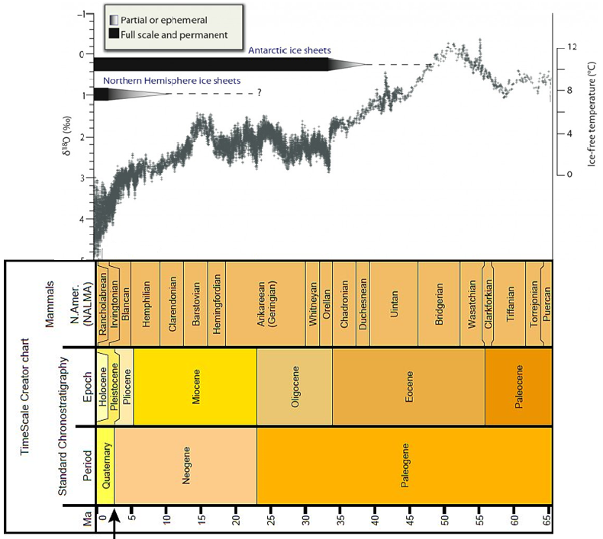
Major Climatic Events
Eocene-Oligocene Transition
Mid Miocene Climatic Optimum
Messinian Crisis
Pliocene Warming Event
Pleistocene Glaciations
Oldest Chondrichthyans in FL
5
4
3
2
1
Modified from Zachos et al. (2008)

Slide 5
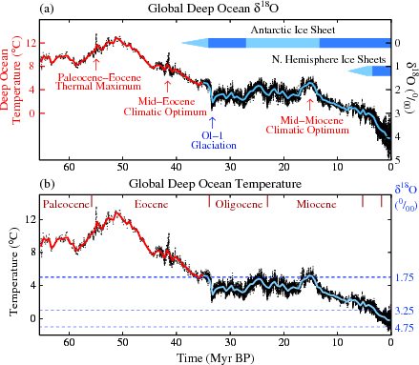
Eocene – Oligocene Transition (EOT)
~2.5 °C drop in sea surface temperature
Formation of Antarctic ice sheet
Large extinction of planktonic foraminifera
The “Grand Coupure”
Modified from Zachos et al. (2008)

Slide 6
EOT Materials
FLMNH Vert Paleo Specify Database:
  Total Specimens: 1,352
  Total Sites: 55
  Total Orders: 5
  Total Families: 9
  Total Genera: 19
  Total Species: 24
Temporal Resolution:
  Arikareean [29.4 – 23]
  Whitneyan [31.4 – 29.4]
  Vicksburgian [33.9 – 31.4]
  Jacksonian [37.2 – 33.9]
  Claibornian [48.6 – 37.2]
Eocene
Oligocene

Slide 7
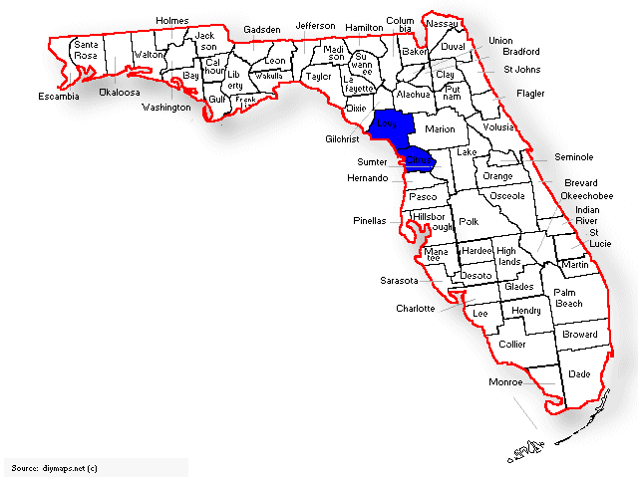
Eocene: Claibornian (=Lutetian + Bartonian)
Taxonomic Summary
4 orders
7 families
7 genera
7 species
Collecting Information
# of specimens: 21
# of sites: 3
# of days: >7
Locality Information
Formation: Avon Park Limestone
Age: 48.6 – 37.2 Ma
Paleoenvironment: Neritic – subtidal to peritidal

Slide 8
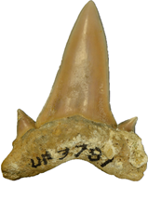
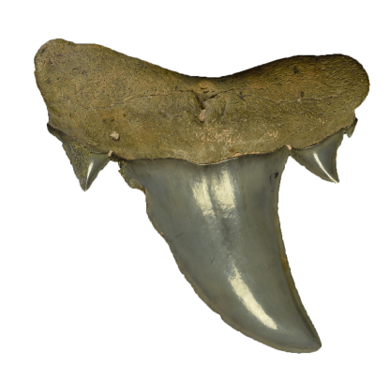
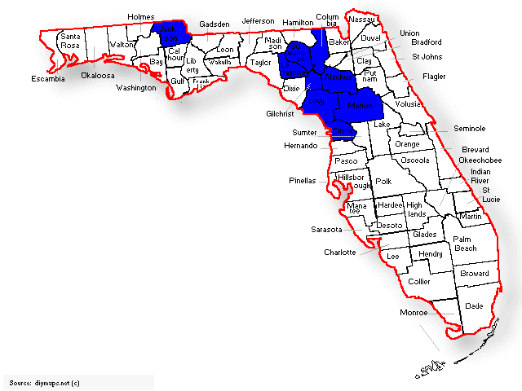
Eocene: Jacksonian (=Prabonian)
Taxonomic Summary
4 orders
8 families
13 genera
14 species
Collecting Information
# of specimens: 173
# of sites: 39
# of days: >30
Locality Information
Formation: Ocala Limestone
Age: 37.2 – 33.9 Ma
Paleoenvironment: Neritic – outer shelf

Slide 9
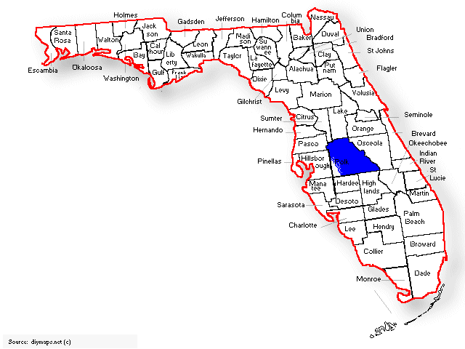
Oligocene: Vicksburgian (=Rupelian)
Taxonomic Summary
4 orders
8 families
11 genera
11 species
Collecting Information
# of specimens: 265
# of sites: 1
# of days: >7
Locality Information
Formation: Suwannee Limestone
Age: 33.9 – 31.4 Ma
Paleoenvironment: Neritic

Slide 10
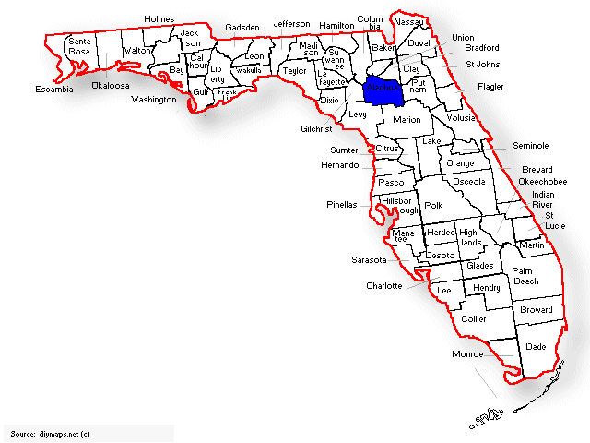
Oligocene: Whitneyan
Taxonomic Summary
3 orders
6 families
9 genera
9 species
Collecting Information
# of specimens: 23
# of sites: 1
# of days: unknown (1966-1967)
Locality Information
Formation: N/A (I-75 Local Fauna)
Age: 31.4 – 29.4 Ma
Paleoenvironment: Sink Hole Deposit

Slide 11
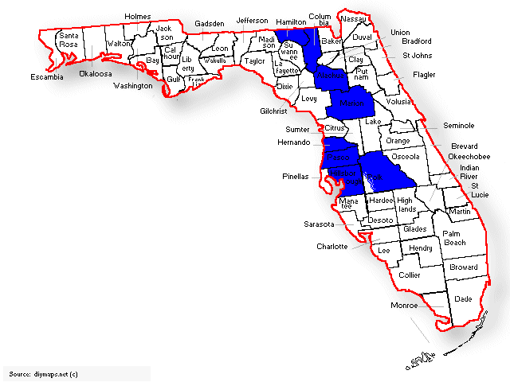
Oligocene: Arikareean
Taxonomic Summary
5 orders
9 families
12 genera
12 species
Collecting Information
# of specimens: 835
# of sites: 11
# of days: >10
Locality Information
Formation: Parachucla; Arcadia; Hawthorn?
Age: 29.4 – 23 Ma
Paleoenvironment: Neritic

Slide 12
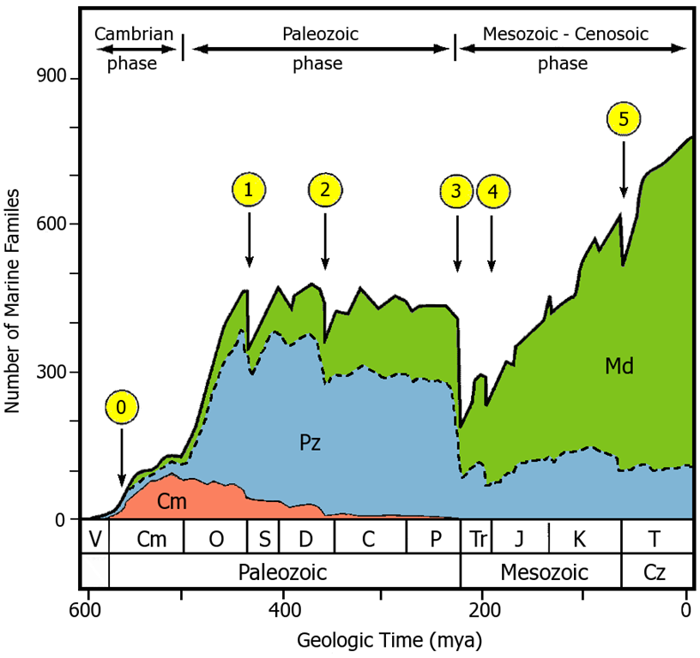
Limitations in Paleo-Biodiversity Studies
Temporal Resolution
Spatial Resolution
Taxonomic Resolution
Preservation Bias
Stratigraphic Bias
Collection Bias
Curation Bias
Modified from Sepkoski (2002)

Slide 13
Chondrichthyan Diversity across the
K-T Boundary
Taxonomic Diversity
Functional Diversity
Kriwet & Benton (2003)

Slide 14
Building Blocks for Global Diversity
Temporal Range
Spatial Range
Taxonomic Focus
Focus on specific intervals of time
Eocene-Oligocene
Focus on specific geographic regions
Florida
Focus on specific taxonomic groups
Chondrichthyans
Genera unique to Eocene:
-Macrorhizodus
-Striatolamia
-Brachycarcharias
-Tethylamna
-Jaekelotodus
Genera unique to Oligocene:
-Negaprion
-Rhizoprionodon
-Isogomphodon

Slide 15
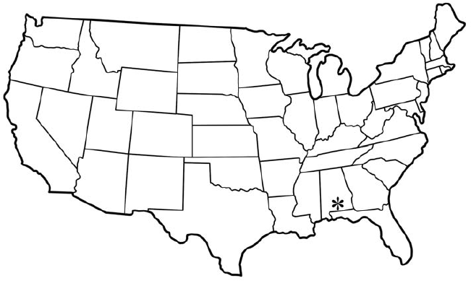
Eocene Fauna of Alabama
(Lisbon Formation – Claibornian)
# | Taxa | %
1 | Brachycarcharias lerichei | 34
2 | Striatolamia macrota | 13
3 | Physogaleus secundus | 11
4 | Galeocerdo latidens | 7.5
5 | Tethylamna dunni | 6.8
6 | Abdounia spp. | 6.6
7 | Orectolobus ziegenhinei | 6
8 | Nebrius obliquus | 3.8
9 | Myliobatid | 3.4
10 | Jaekelotodus robustus | 2
11 | Pristis spp. | 2
12 | Scoliodon conecuhensis | 1.1
Total |  | 97.2
Summary:
4570 specimens
5 orders
14 families
31 genera
38 species
Paleoenvironment:
Neritic
Cappetta and Case (2016)

Slide 16
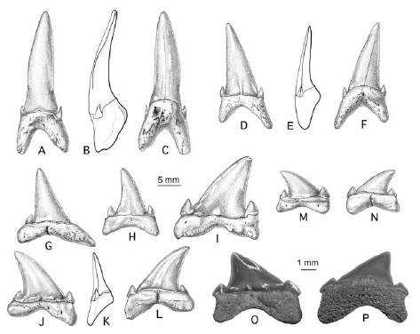
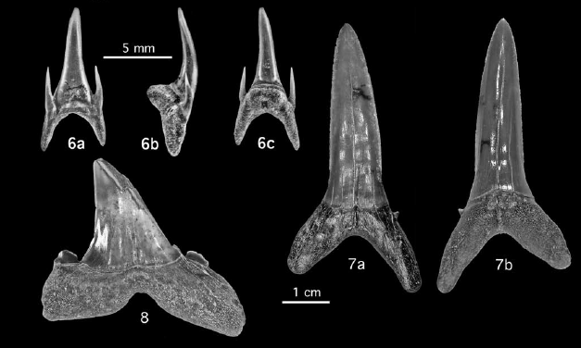
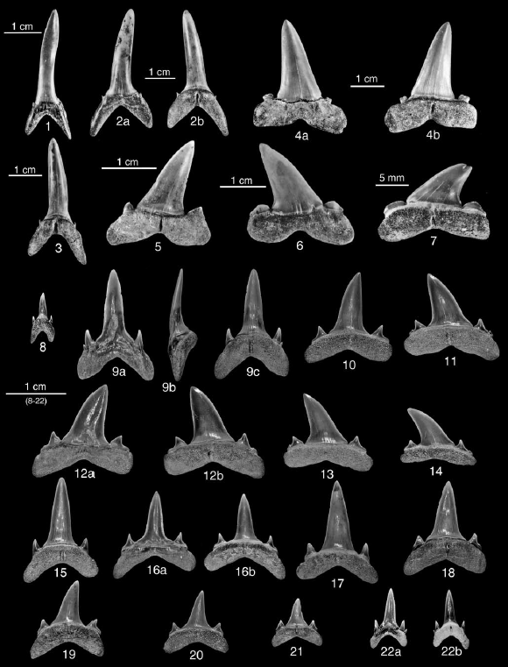
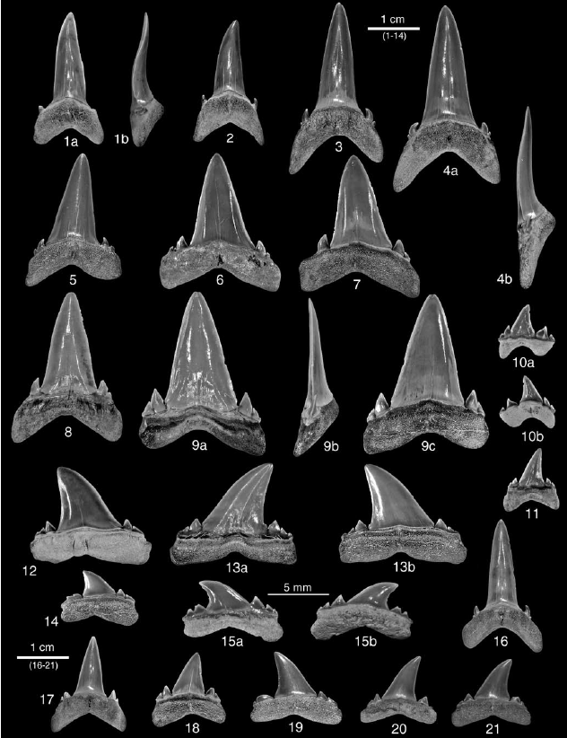
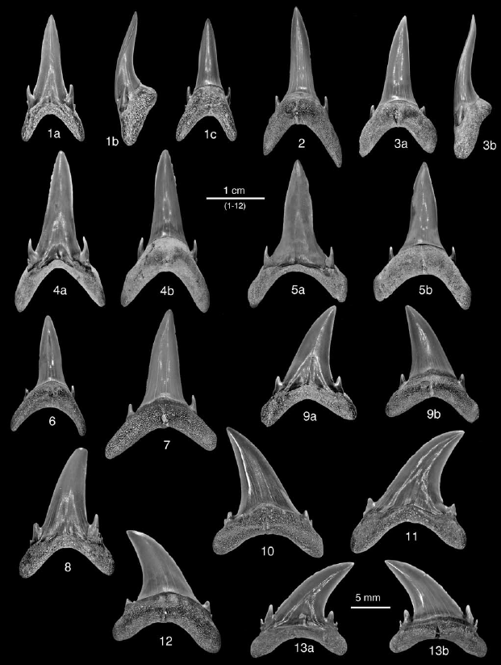
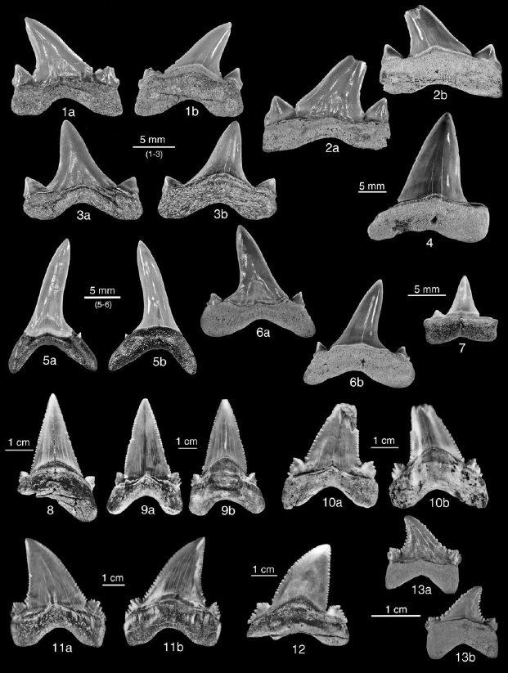
Eocene Lamniform Diversity
10 genera
Two general forms:
(1) Broadly triangular (=cutting)
(2) Tall, narrow (=grasping)
Cappetta and Case (2016)

Slide 17
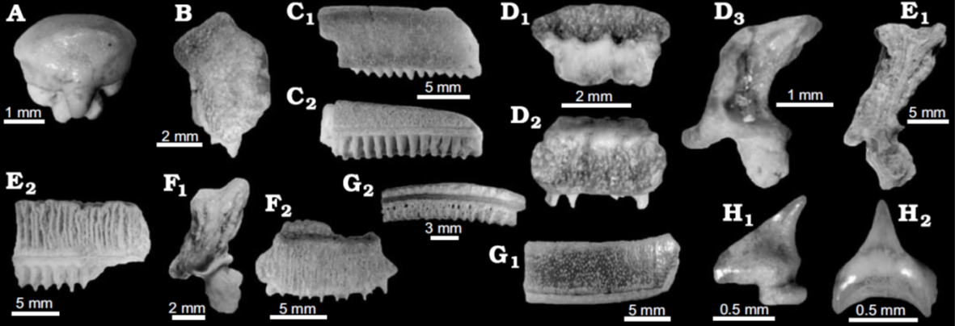
Oligocene Fauna of South Carolina
(Chandler Bridge Formation – Arikareean)
Summary:
~3500 specimens
6 orders
17 families
23 genera
29 species
Paleoenvironment:
Neritic
Cicimurri and Knight (2009)

Slide 18
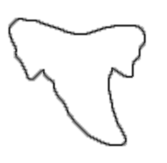
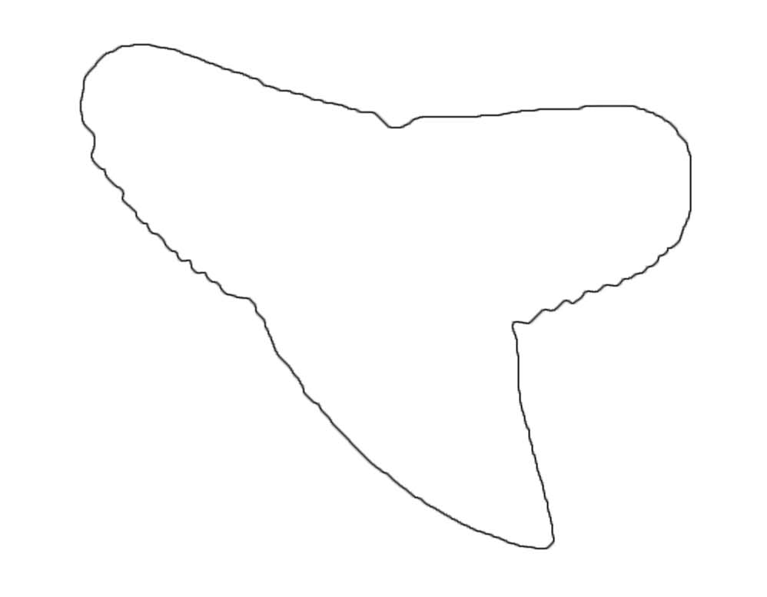
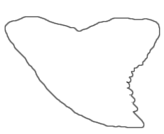
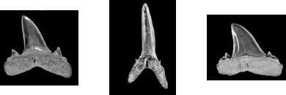
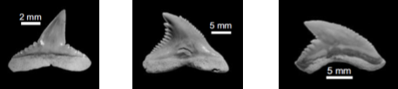
Shark Diversity across the EOT
Eocene
Oligocene
Most abundant and diverse:
  Lamniform sharks
Common dental morphologies:
Most abundant and diverse:
  Carcharhiniform sharks
Common dental morphologies:
Brachycarcharias
Striatolamia
Tethylamna
Carcharhinus
Hemipristis
Galeocerdo

Slide 19
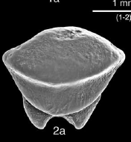
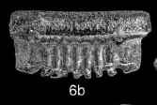
Ray Diversity across the EOT
Eocene
Oligocene
Most abundant and diverse:
  Myliobatiformes
Dentition Types:
Crushing; Clutching
Most abundant and diverse:
  Myliobatiformes
Dentition Types:
Crushing; Clutching; Filter-feeding

Slide 20
Future Work
Continue cataloging and correcting material already housed at FLMNH
Better constrain temporal range of time bins
Additional fieldwork to increase and even out sampling effort
Greater focus on screenwashing to capture micro-fauna
Test impact of different standardization metrics

Slide 21



Acknowledgements
NSF Grant No. DGE-1315138; DGE-1842473; DRL-1322725

