Slide 1
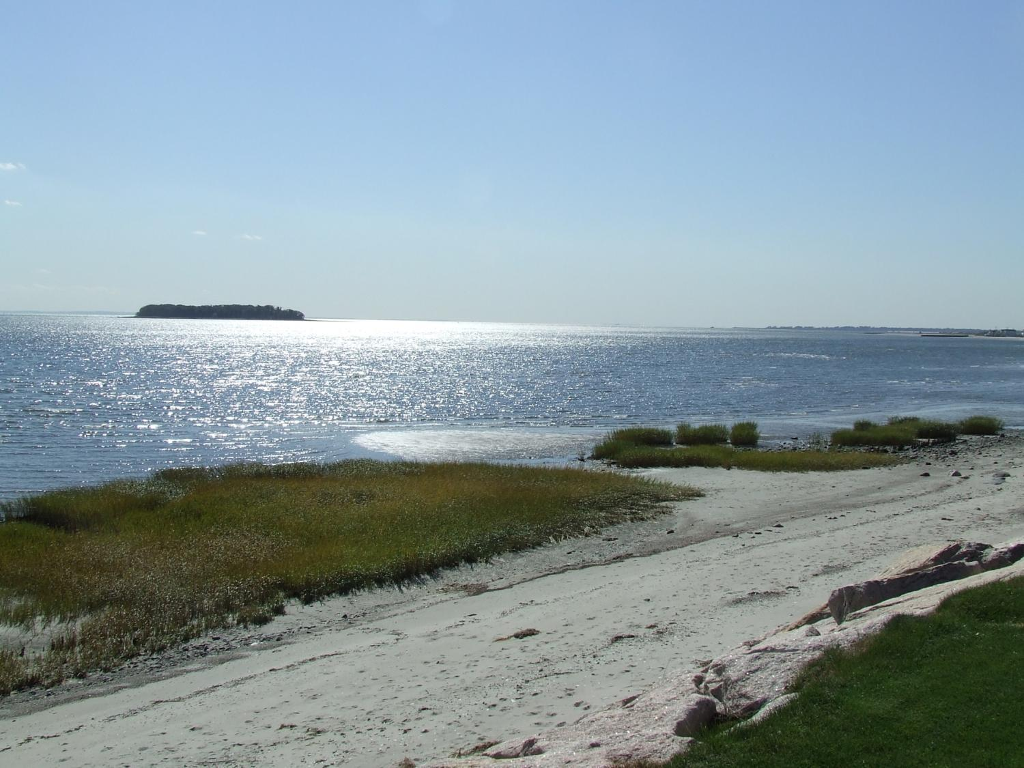
Neoichnology as an Indicator of Community Health in Long Island Sound, CT, USA
Michelle Casey & Marie White
Murray State University
03/28/2019

Slide 2
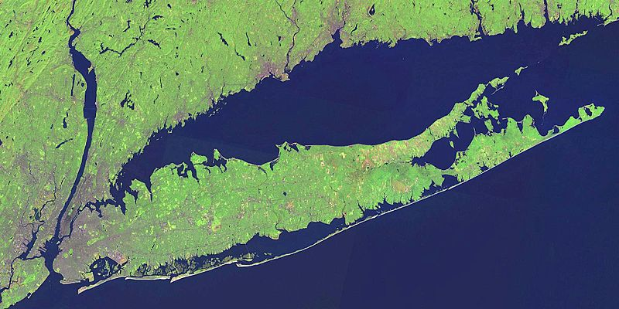
Long Island Sound
NASA Satellite Photo
Notes:
Long Island Sound is a large urban estuary which has undergone a long history of commercial fishing and eutrophication. It’s a great study area because we know the history of LIS because it has bee well studied including core work by Ellen Thomas and her colleagues, historical fishing records, and ongoing biochemical monitoring efforts. As of 1990…
8 million people lived within the Long Island Sound watershed
$148 million in commercial finfish and shellfish fishing
$5 billion a year in recreation (swimming, beach-going, recreational fishing, boating, etc)

Slide 3
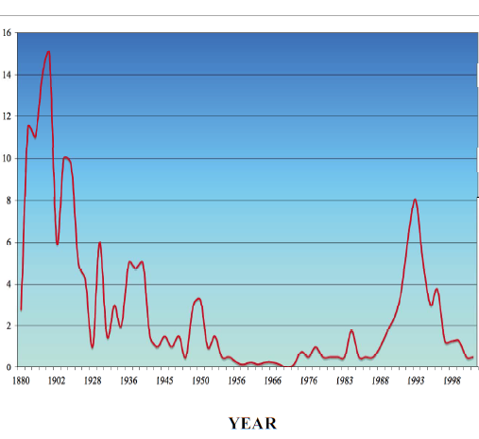
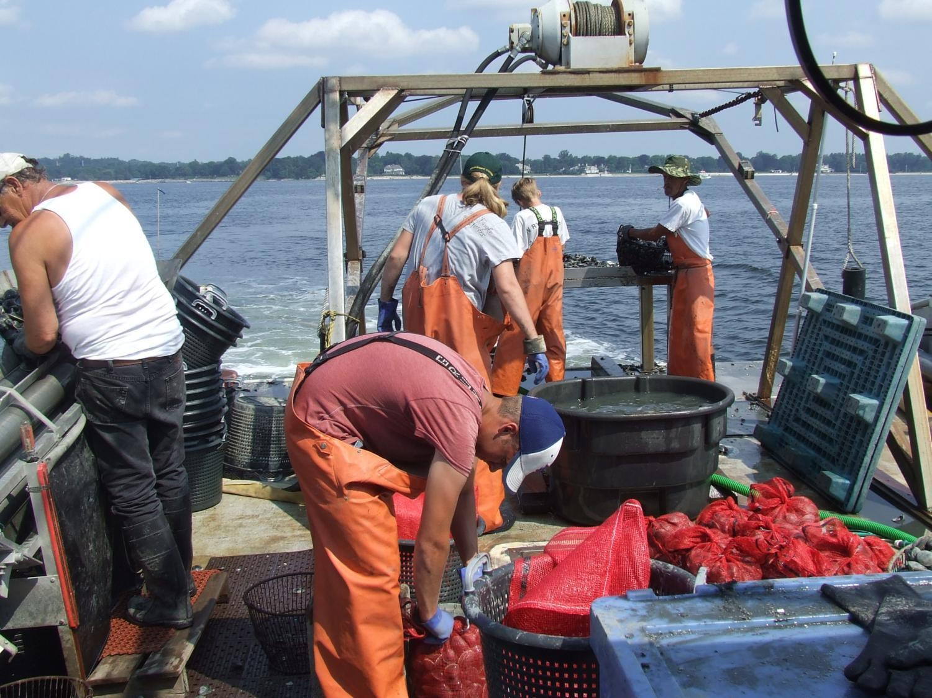
History of Shellfishing
Millions of Pounds of Oysters
Visel, 2006; MacKenzie et al., 2002; Koppelman, 1976
Notes:
Typhoid outbreak related to contaminated oysters served at a Weslyan banquet - 1906

Slide 4
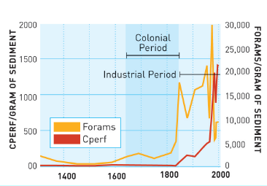
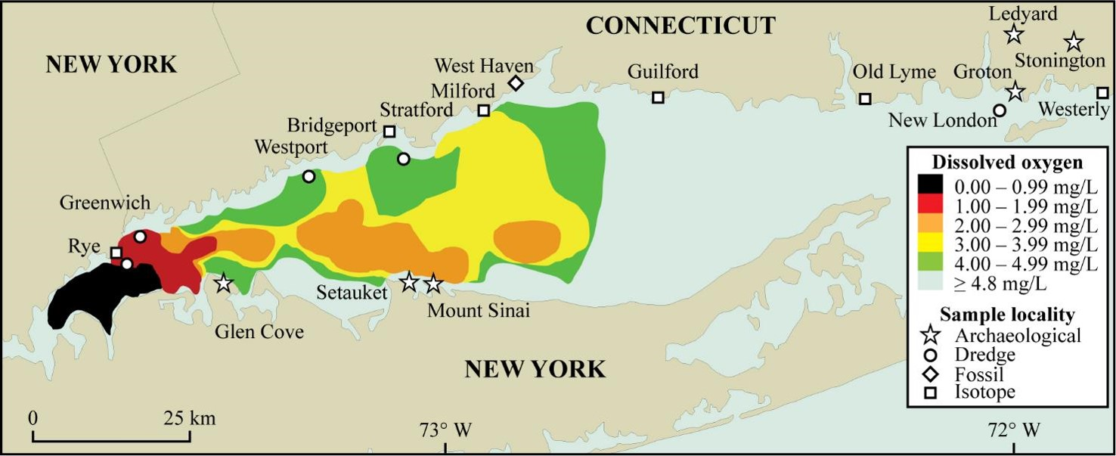
Eutrophication-Induced Summer Hypoxia
CT Department of Environmental Protection, 2002
Wesleyan University/USGS Woods Hole Field Center
Notes:
Shallow estuary results in summer stratification and anoxic to hypoxic bottom waters. Happening since the 1970’s, been studied extensively since 1985. Eutrophication gradient exists, worse in west, less severe in the east
Increased nutrients delivered by river run-off and sewage treatment plants
Increase in primary producers
Greater biomass decaying on the bottom
Decay process uses up oxygen
Increased summer surface temperatures inhibits mixing

Slide 5
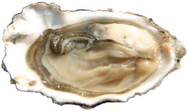
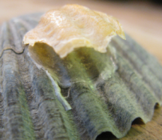
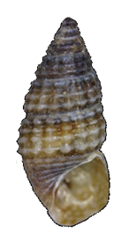
Live-Dead Analysis
1
Perfect Agreement
All the same taxa
Taxonomic Similarity
-1
1
Fossil-Dead
Fossil-Live
None of the same taxa
Opposite abundance structure
0
Same abundance structure
Rank Order Abundance
Casey et al., 2014
Notes:
All characterized by fairly good

Slide 6
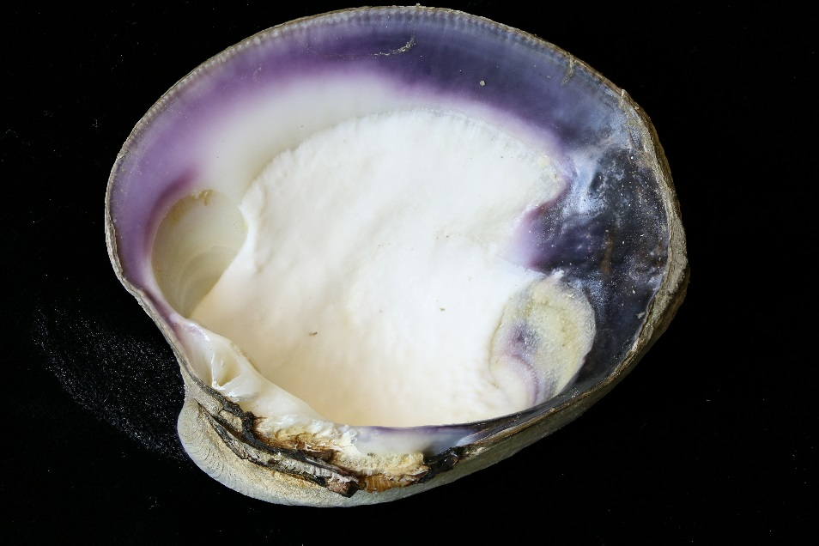
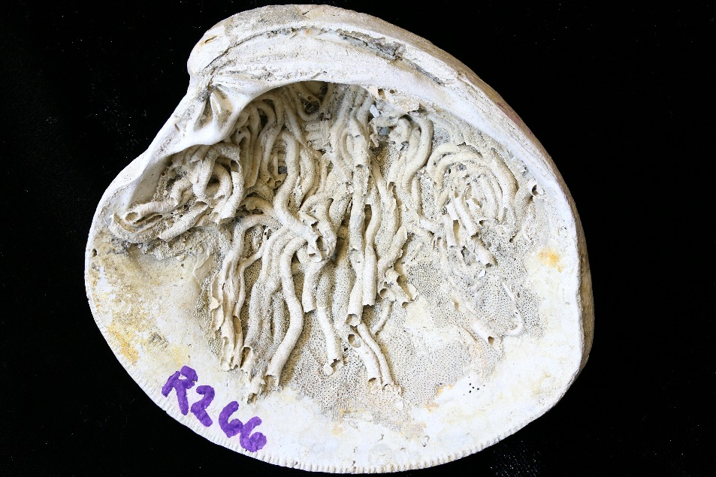
Water Quality Indicator for LIS
Can we use neoichnology, the traces of epibionts and endobionts found on venerid bivalve shells, to assess the health of benthic communities along the east-west human impact gradient in Long Island Sound?

Slide 7
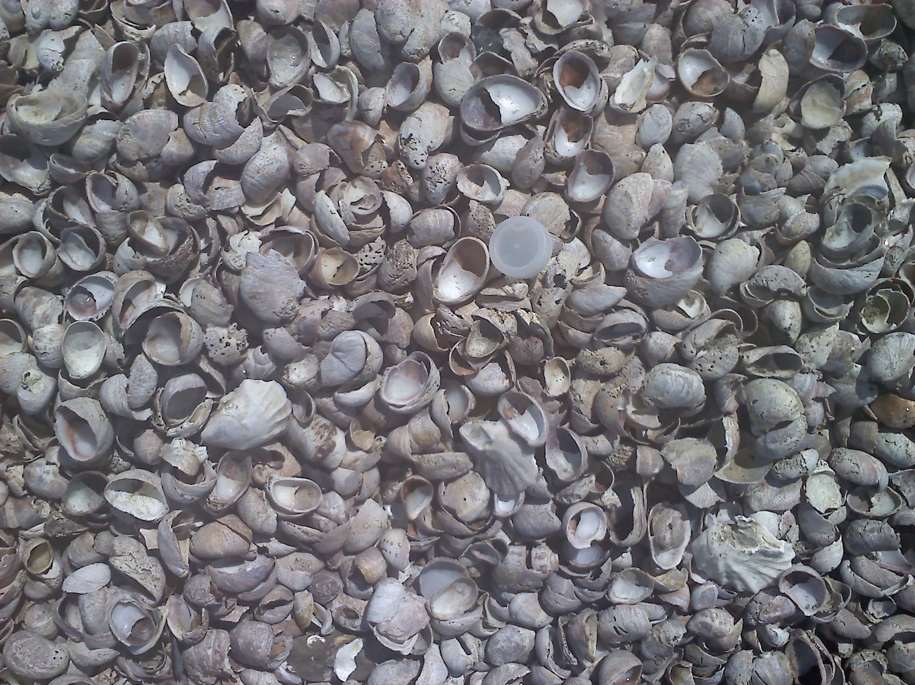
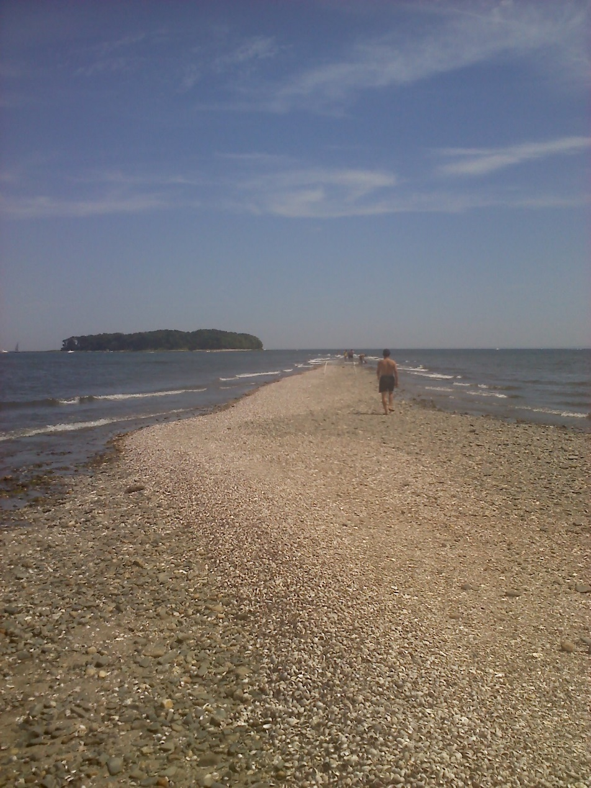
Observations
High tolerance for environmental variations (Bohn et al., 2013), ability to feed on HABs (Harke et al., 2011)
Notes:
Eurybiotic (Walne, 1956); colonize areas characterized by high concentration of suspended particulate matter (Thieltges et al., 2003); resistant to environmental variations (Le Gall, 1980; Richard et al., 2006); high plankton concentrations, shallow water depths, and low salinity favor creipdula’s spread (Blanchard, 2009)

Slide 8
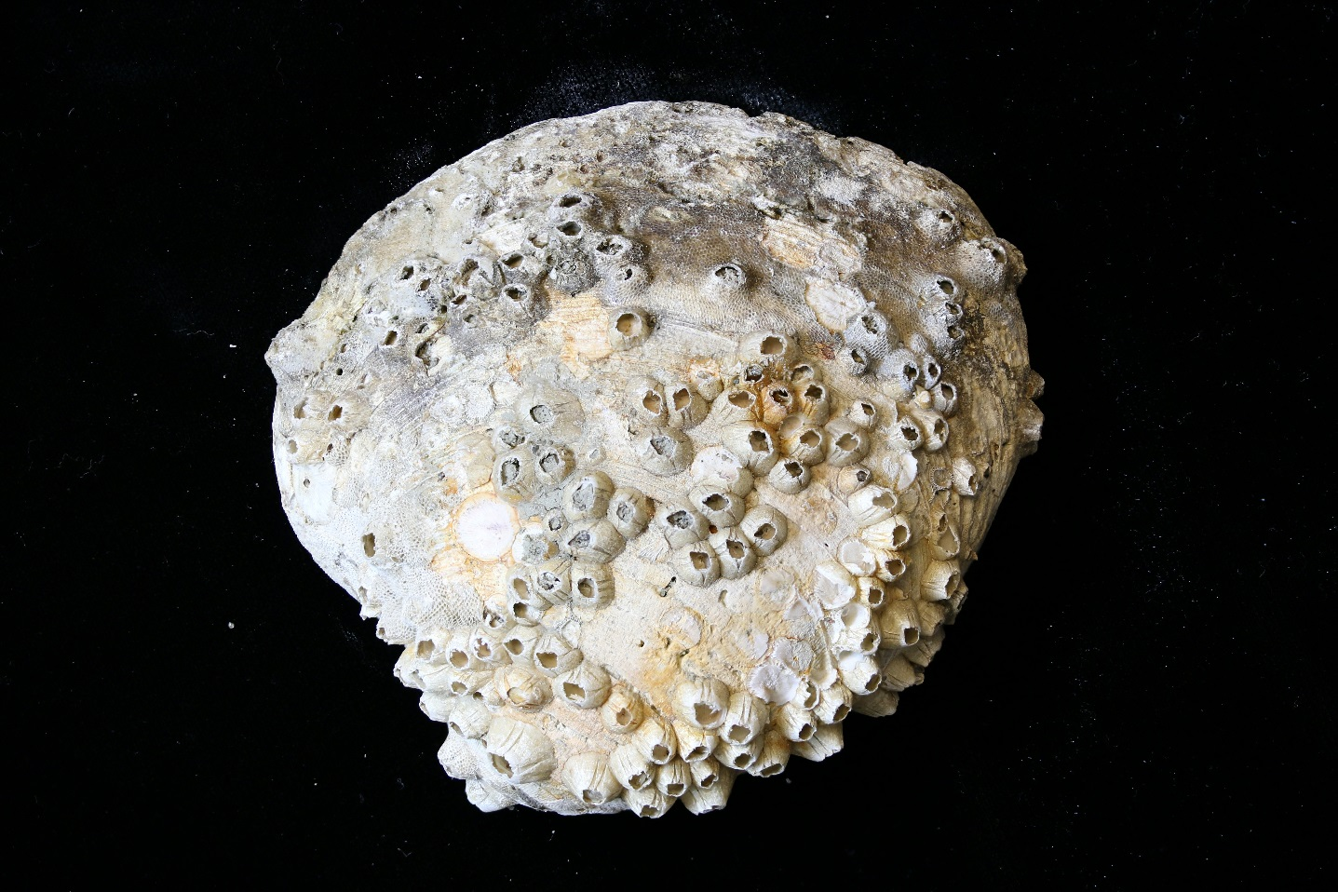
Observations
Barnacles, like LIS’s Semibalanus balanoides, are very sensitive to hypoxia and anoxia (Desai and Sanjeevi, 2009)
Notes:
Eurybiotic (Walne, 1956); colonize areas characterized by high concentration of suspended particulate matter (Thieltges et al., 2003); resistant to environmental variations (Le Gall, 1980; Richard et al., 2006); high plankton concentrations, shallow water depths, and low salinity favor creipdula’s spread (Blanchard, 2009)

Slide 9
Predictions
The slipper limpet Crepidula fornicata will be found on a greater proportion of shells in the heavily eutrophied western sound.
Hypoxia-sensitive barnacles will be found on a greater proportion of shells in the normoxic east.
Notes:
The prevalence of the slipper limpet, Crepidula fornicata, has dramatically increased over the last 100-200 years based on evaluation of archaeological shell middens and Holocene fossils.

Slide 10
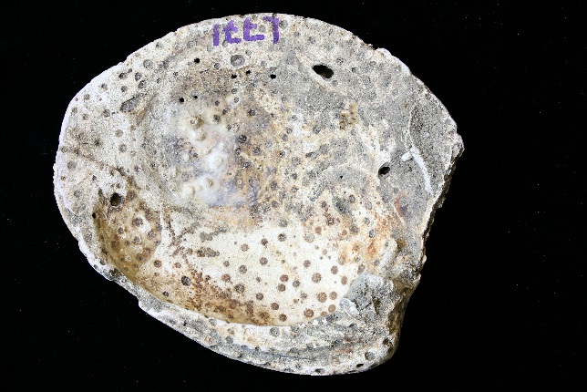
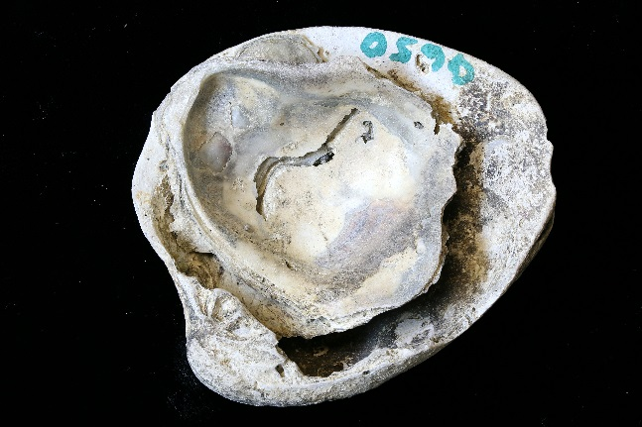
Methods
Endobionts (borers): sponge borings (most likely Cliona celata), worm borings (most likely Polydora ciliate), incomplete drill-holes, complete drill-holes (most likely drilled by Neverita duplicata)
Photo credit: Marie White

Slide 11
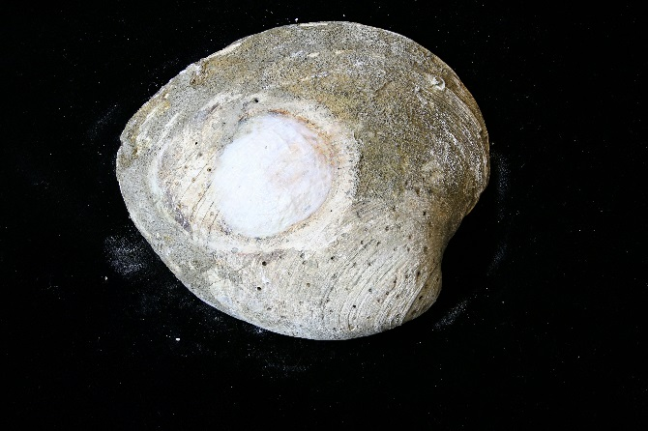
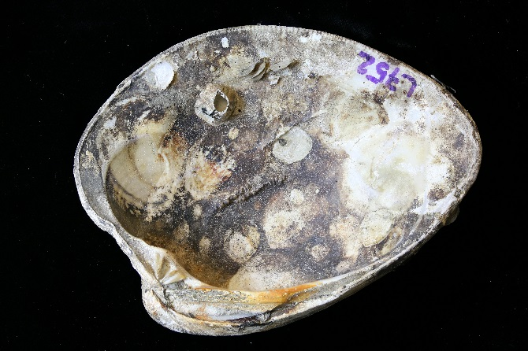

Methods
Epibionts (encrusters): algae, barnacles, bryozoans, corals, jingle shells, oysters, slipper limpets, serpulid worm tubes
Photo credit: Marie White

Slide 12
Results
Species | Site | Sponge | Anomia | Worm Tubes | Crepidula | Algae | Barnacle
Mercenaria | Rye, NY | 6.2% | 0% | 30.7% | 10.0% | 64.8% | 52.8%
Mercenaria | Greenwich, CT | 8.4% | 0% | 12.2% | 13.4% | 11.6% | 26.6%
Mercenaria | Westport, CT | 0% | 0% | 0.4% | 3.2% | 0.8% | 9.9%
Mercenaria | New London | 54.2% | 8.7% | 14.6% | 50.0% | 27.1% | 50.0%
Pitar | Rye, NY | 0.7% | 0% | 6.6% | 2.0% | 64.8% | 63.6%
Pitar | Greenwich, CT | 1.3% | 0% | 36.6% | 5.2% | 11.6% | 22.2%
Pitar | Westport, CT | 0.4% | 0% | 0.6% | 0% | 0.8% | 13.5%
Pitar | New London | 14.3% | 0% | 50.5% | 49.3% | 27.1% | 53.3%
Is there something unique about Westport? Sedimentation rates? Water quality?

Slide 13
Results
Species | Site | Sponge | Anomia | Worm Tubes | Crepidula | Algae | Barnacle
Mercenaria | Rye, NY | 6.2% | 0% | 30.7% | 10.0% | 64.8% | 52.8%
Mercenaria | Greenwich, CT | 8.4% | 0% | 12.2% | 13.4% | 11.6% | 26.6%
Mercenaria | Westport, CT | 0% | 0% | 0.4% | 3.2% | 0.8% | 9.9%
Mercenaria | New London | 54.2% | 8.7% | 14.6% | 50.0% | 27.1% | 50.0%
Pitar | Rye, NY | 0.7% | 0% | 6.6% | 2.0% | 64.8% | 63.6%
Pitar | Greenwich, CT | 1.3% | 0% | 36.6% | 5.2% | 11.6% | 22.2%
Pitar | Westport, CT | 0.4% | 0% | 0.6% | 0% | 0.8% | 13.5%
Pitar | New London | 14.3% | 0% | 50.5% | 49.3% | 27.1% | 53.3%
Increasing to the east
Increasing to the west
Lowest in the center

Slide 14
Percentage of Shell Covered
Pristine
1-20%
21-40%
41-60%
61-80%
81-100%

Slide 15
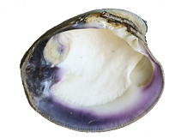
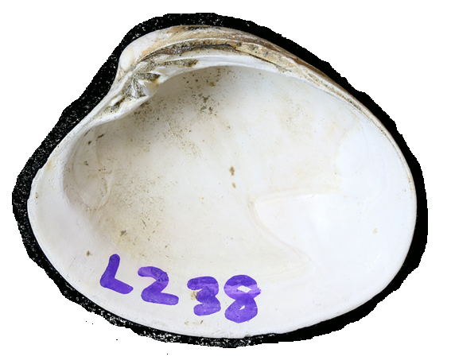
Results
% of shells with trace
Rye, NY
Greenwich, CT
Turbidity difference between fished and unfished sites?

Slide 16
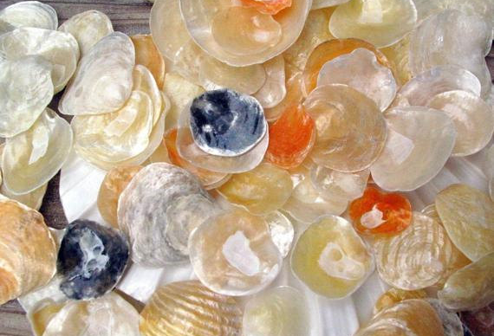
Conclusions
Crepidula and barnacles did not follow the E-W eutrophication gradient as predicted
The presence of Anomia or high rates of sponge boring correlated with better water quality
Host taxonomy did not determine encrustation rates; max number of encrusters was found on Mercenaria shells
Increased prevalence of borers and encrusters in unfished areas, possibly due to reduced turbidity

Slide 17
Acknowledgements
MSU Student Workers: Megan Paule, Lance Stewart, Phil Roberson, Nikki Harris, Abby Glass
Earth and Environmental Sciences Department at Murray State University
Connecticut Department of Aquaculture, especially David Carey, Glenn Charland, and Shannon Kelly
Amelinda Webb, Simon Darroch, Richard Krause
Ed Stillwagon and his crew, David Hopp and his crew, John Tinkowski and his crew, Gary Yerman and his crew

