Slide 1

Flood Hazard mapping in Charleston, sc
An L-thia based, modified curve number model
Casey Conrad
Master of Environmental Studies
Advisor: Norm Levine

Slide 2
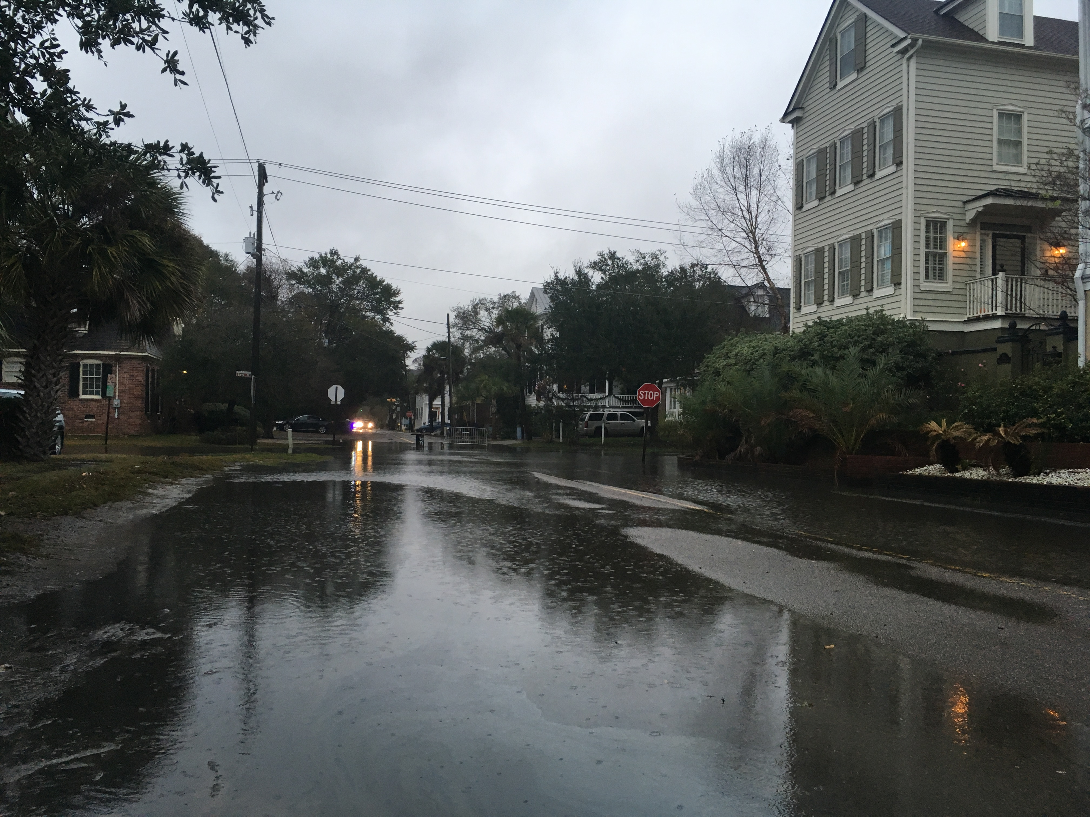
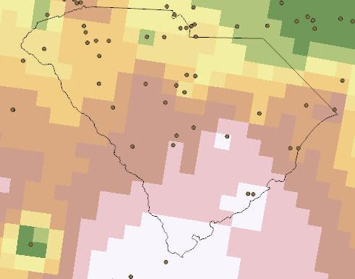
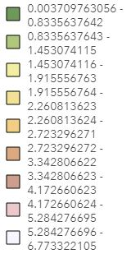
Flooding In Charleston
Joaquin “Rain Bomb” (2015): 11.5” in one day
Bonnie (2016): 4-10”
Matthew (2016): 10-17” from Savannah to Florence
Irma (2017): 3-7”
Notes:
Mayor Tecklenburg calls it our top priority
“Stormwater fund” for drainage-related expenses at $11.3 mil for 2019
Rainfall flooding different from tidal flooding: record 50 days in 2016
Images are from Irma
Precipitation map made using Inverse Distance Weighted on rain gauge values

Slide 3
Modelling Storm water Runoff
Land Use
Soil Type/Hydric Group
Long-Term Hydrologic Impact Assessment (L-THIA)
Developed at Purdue University
Curve Number (CN) method similar to SWARM
Traditional L-THIA uses CN values from TR-55 manual
Long-Term
Rainfall
Curve Number
L-THIA
Runoff Depths/Volumes

Slide 4
Modelling Storm water Runoff
Land Use
Soil Type/Hydric Group
Long-Term Hydrologic Impact Assessment (L-THIA)
Developed at Purdue University
Curve Number (CN) method similar to SWARM
Use of impervious surface cover in calculating CN
Classifying impervious/pervious surfaces from satellite imagery
Long-Term
Rainfall
Curve Number
CN
L-THIA
Runoff Depths/Volumes
Notes:
Fair amount of literature on L-THIA use
So we’re focused on the modification to CN calculation

Slide 5
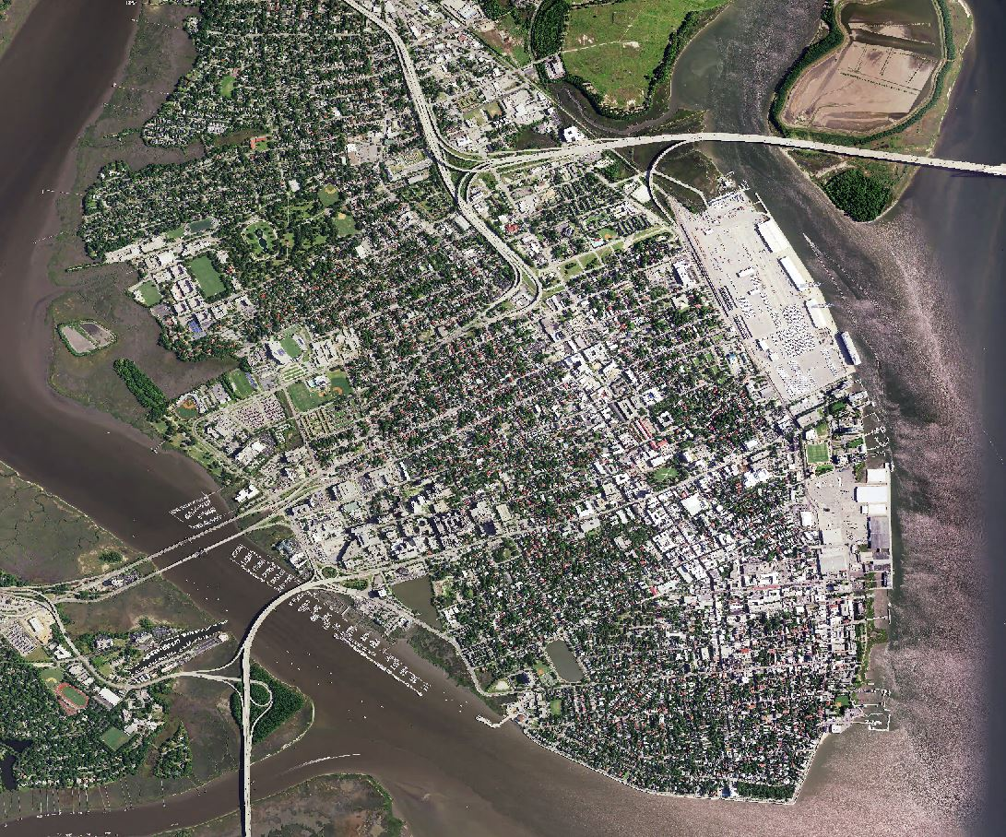
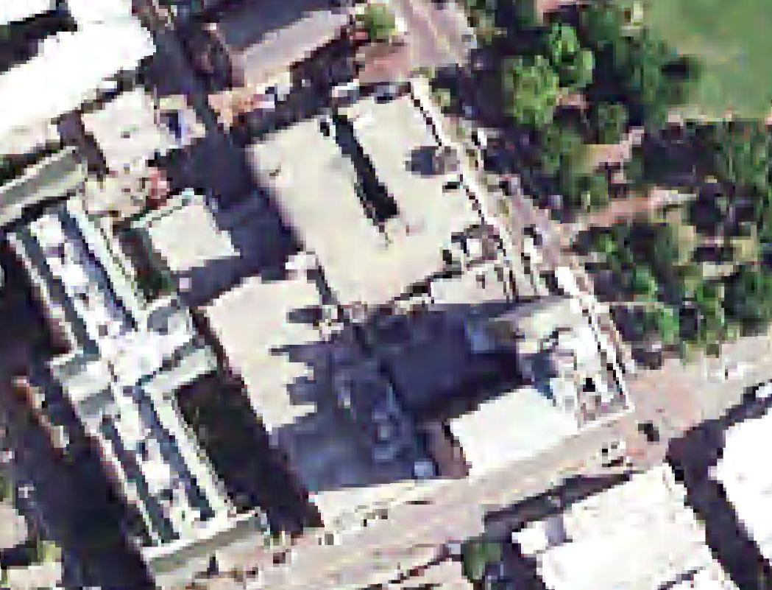
Charleston, SC
NAIP Satellite Imagery
Captured in 2015
4-band: red, green, blue, near infrared
1 meter resolution
Notes:
There is 2017 NAIP imagery but its only 3 band (no NIR)
1 meter means each pixel is a meter
Here we are at the Francis Marion– image beginning to pixilate
The peninsula is about a mile and a half wide by three miles long

Slide 6
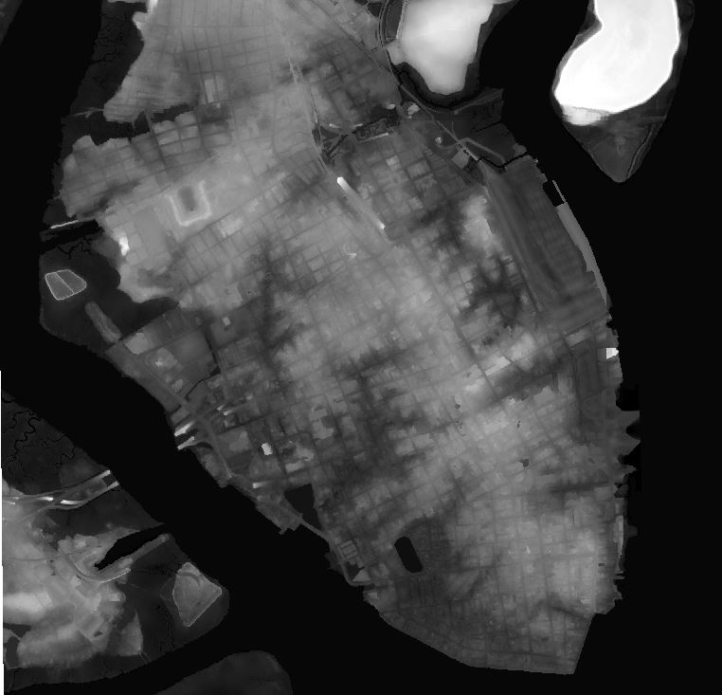
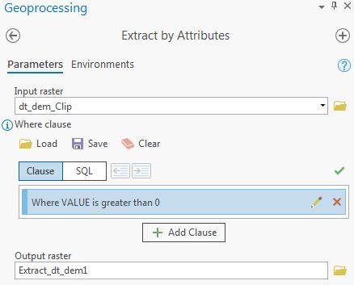
Digital elevation model (Dem)
Captured in 2009, LiDAR from NOAA digital coast
DEM generated in 2016, IDW from last return
1 meter resolution
Extract peninsula outline (Value > 0)
Notes:
LiDAR data publicly available

Slide 7
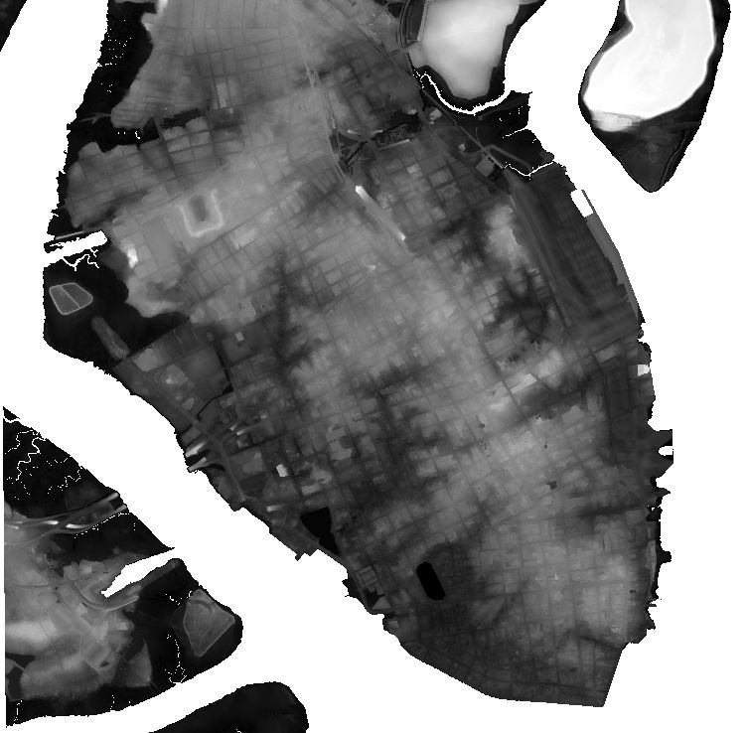
Digital elevation model (Dem)
Captured in 2009, LiDAR from NOAA digital coast
DEM generated in 2016, IDW from last return
1 meter resolution
Extract peninsula outline (Value > 0)
Notes:
Next we delineate marshes and wetlands

Slide 8
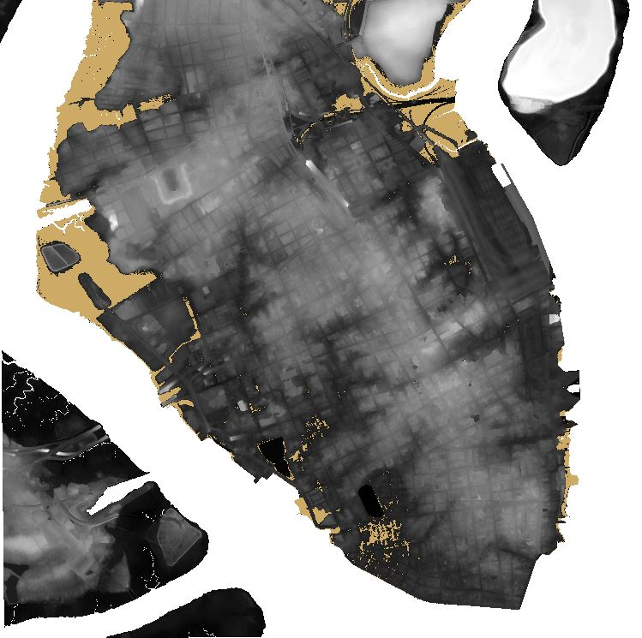
Digital elevation model (Dem)
Captured in 2009, LiDAR from NOAA digital coast
DEM generated in 2016, IDW from last return
1 meter resolution
Extract peninsula outline (Value > 0)
Extract marsh/wetland (Value > 0, & < 0.95)
Notes:
Picks up low-lying south of Broad areas but those will be covered by other layers
Next we identify bodies of water

Slide 9

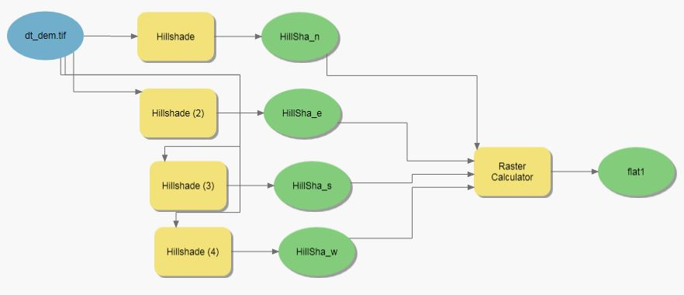
Water finder tool
Uses a “Hillshade” tool in 4 directions (N, E, S, W)
Conditional statement where all 4 equal 180
Finds perfectly flat areas
Notes:
Particularly the two pesky ponds on the south end of the peninsula
Credit Norm on tool

Slide 10
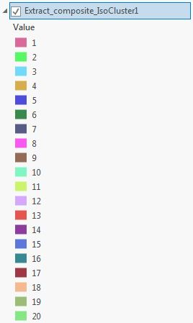
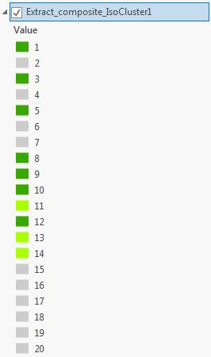
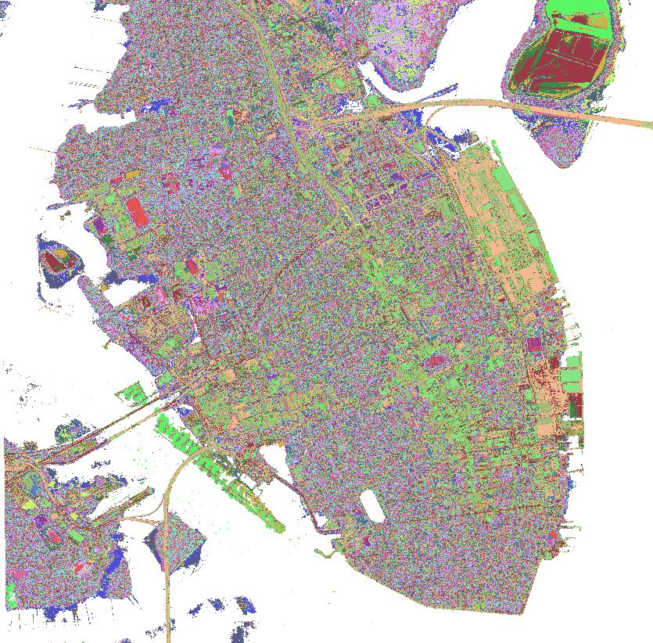
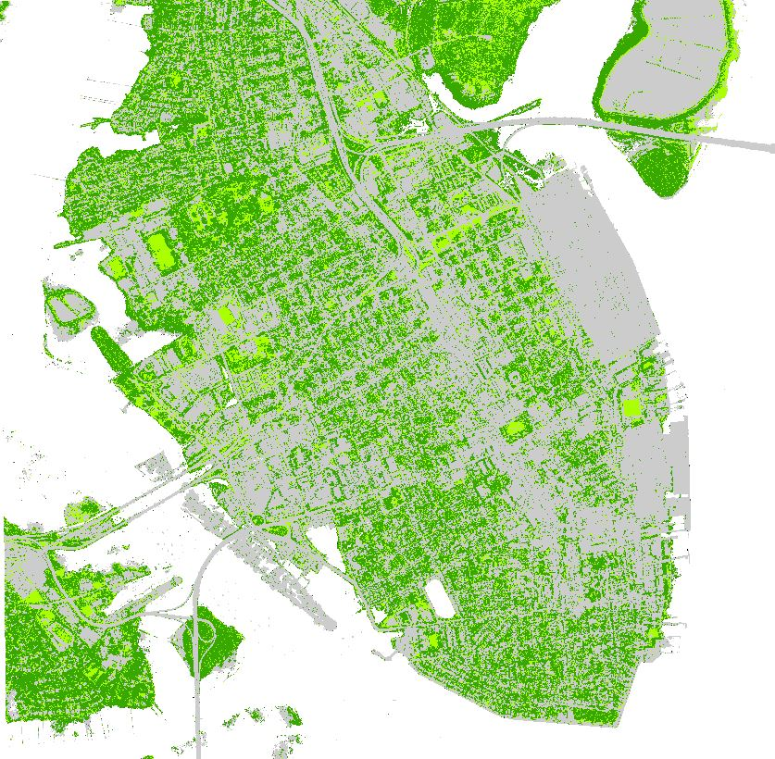
Unsupervised iso Cluster Classification
…but can this be automated?
Notes:
Play a game called “greys and greens”
Starting with asphalt and rooftops and working toward grass and trees
Is there a way to automate this process?
We have an accurately classified map from this methodology (later)
But labor intensive on a larger scale

Slide 11
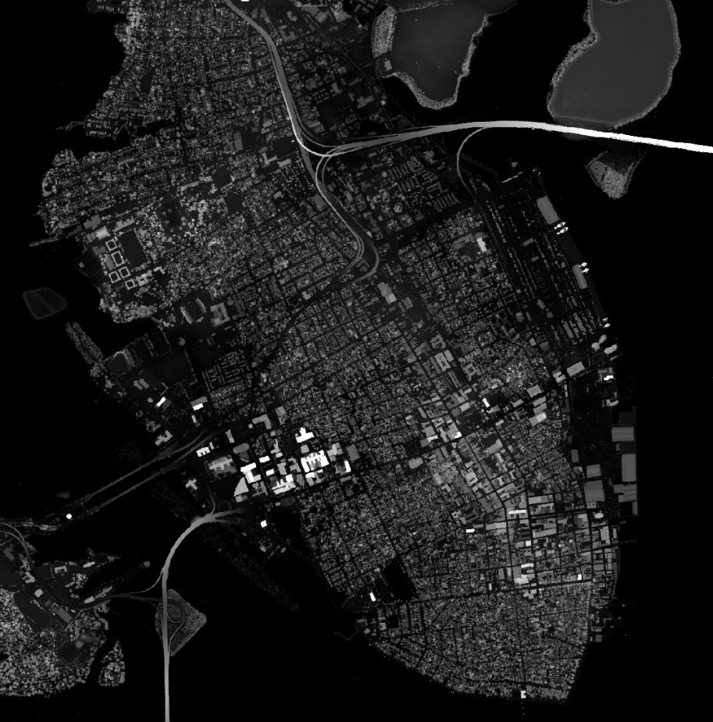
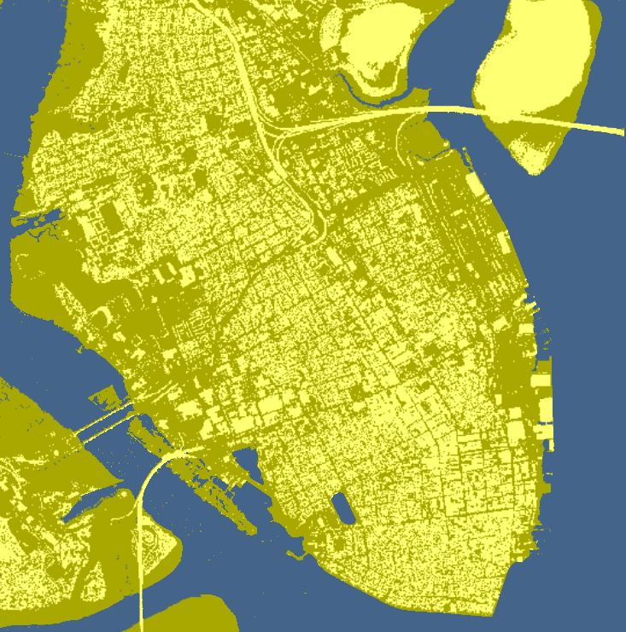
Digital Surface Model (DSM)
Notes:
LiDAR from NOAA digital coast
1 meter resolution
Classified symbology to separate everything over 1 meter

Slide 12
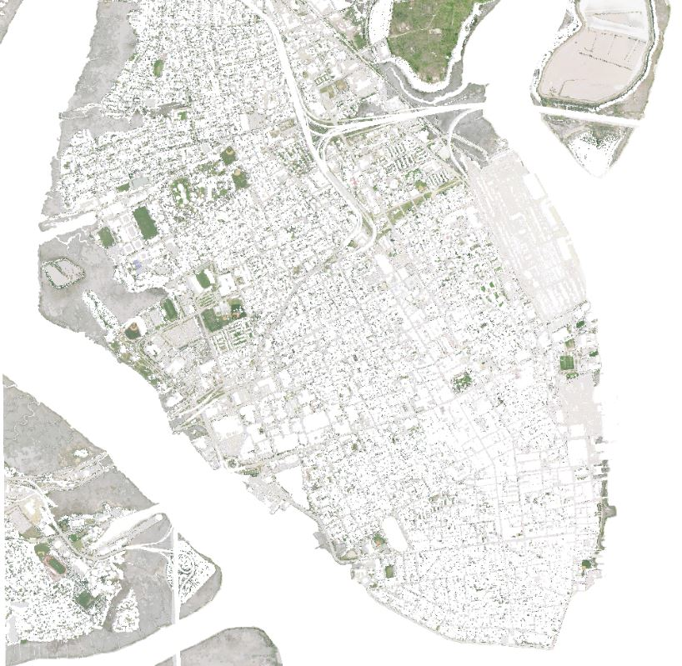
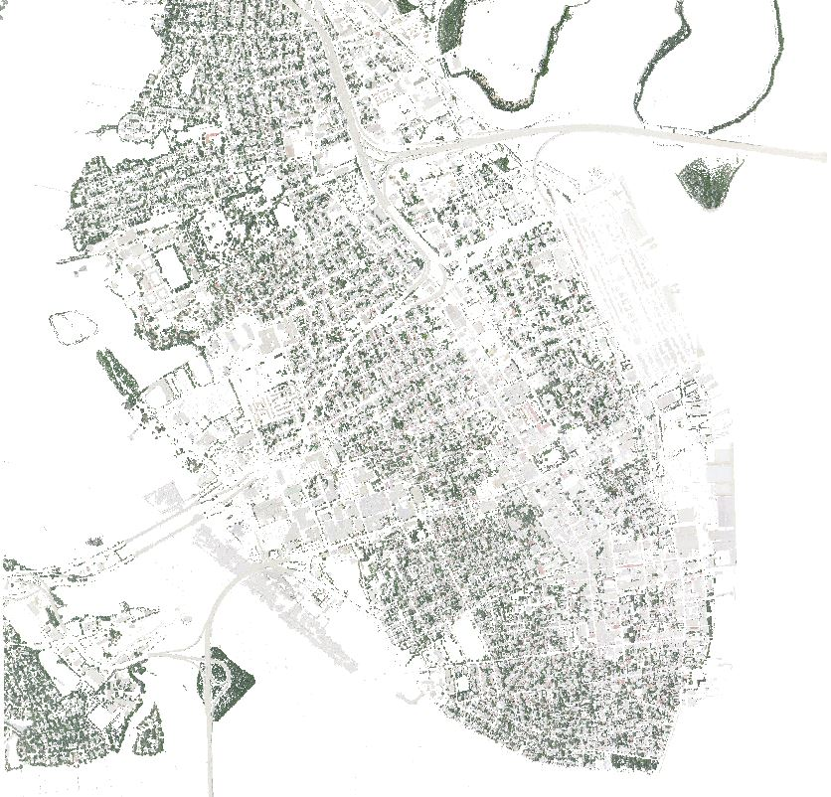
Separating IMagery
Ground Level
Above 1 meter
Notes:
Extract by mask tool to separate layers

Slide 13
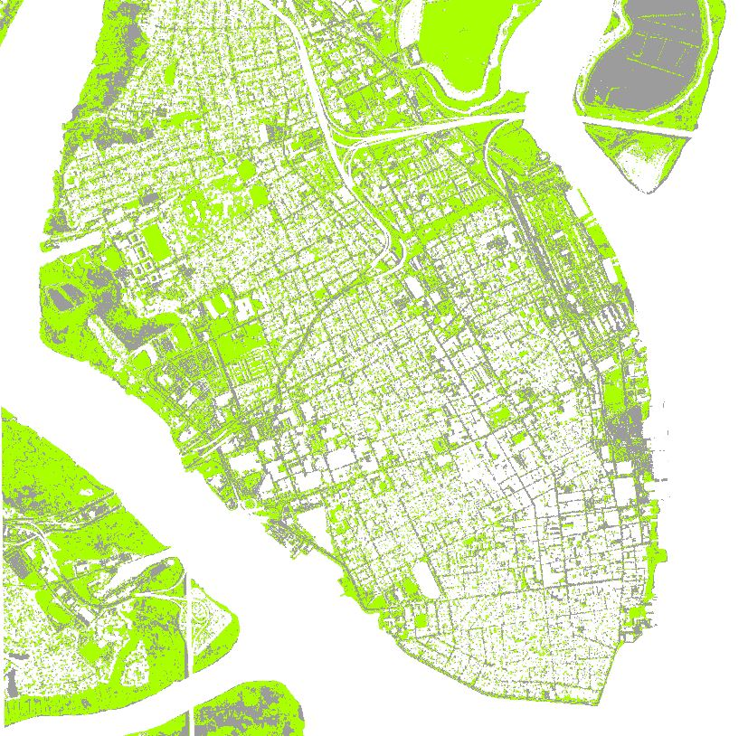
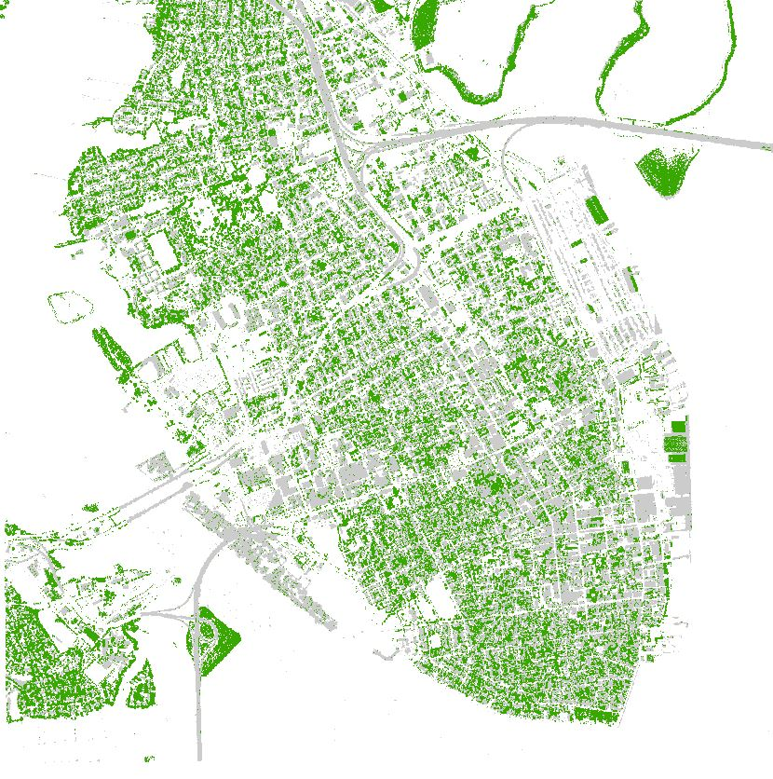
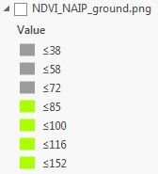
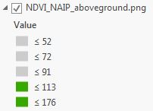
NDVI
Ground Level
Above 1 meter
Notes:
Normalized Difference Vegetation Index
Highlights healthy vegetation
Ground level vegetation must be grass, above must be trees
Ground level non vegetative must be asphalt or barren, above must be buildings

Slide 14
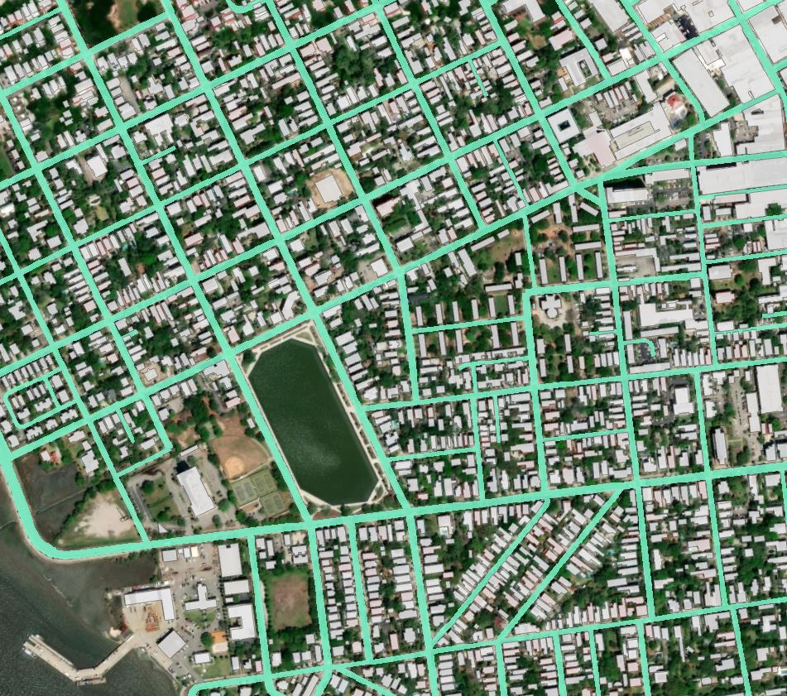
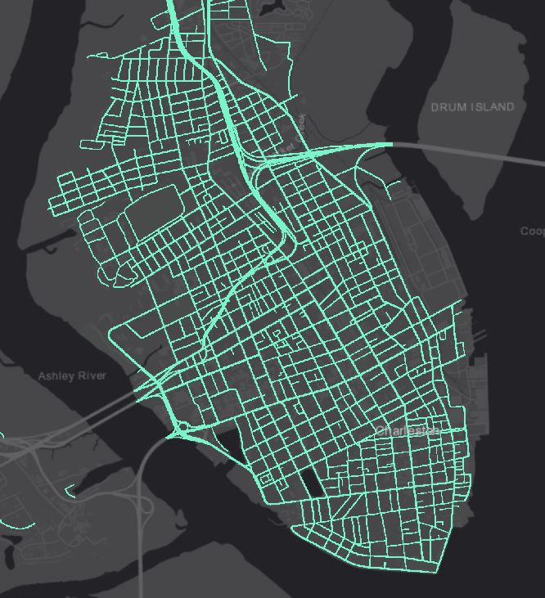
Streets & Buildings
Streets were measured individually (on imagery)
378 in total
N/S streets measured at major intersections
“Buffer” tool used to create accurate widths
Building footprint polygon updated in 2018
Notes:
Downtown streets are variable and inconsistent
East Bay, Meeting, King, Rutledge change often
I didn’t have to digitize buildings so streets are my contribution to future analysts
How to automate elsewhere?
Developed a decision tree: Functional Class (2-7), Direction of travel, Median type, and Speed Category
*Next slide is a little disorienting *

Slide 15
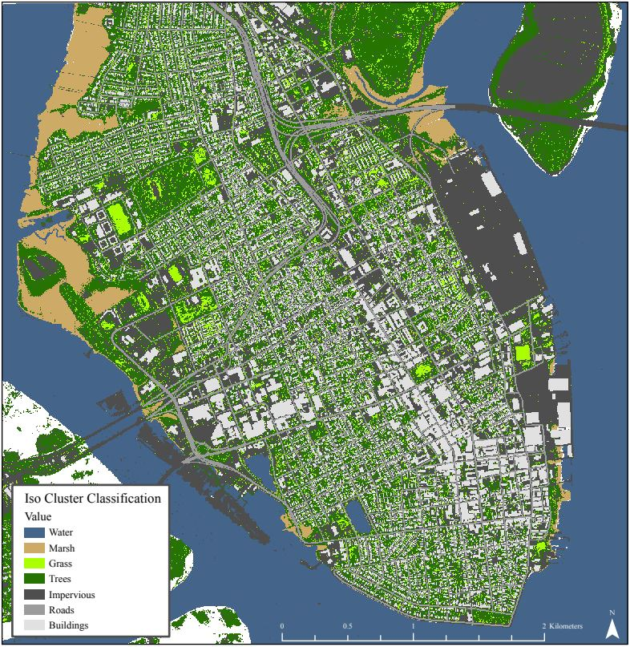
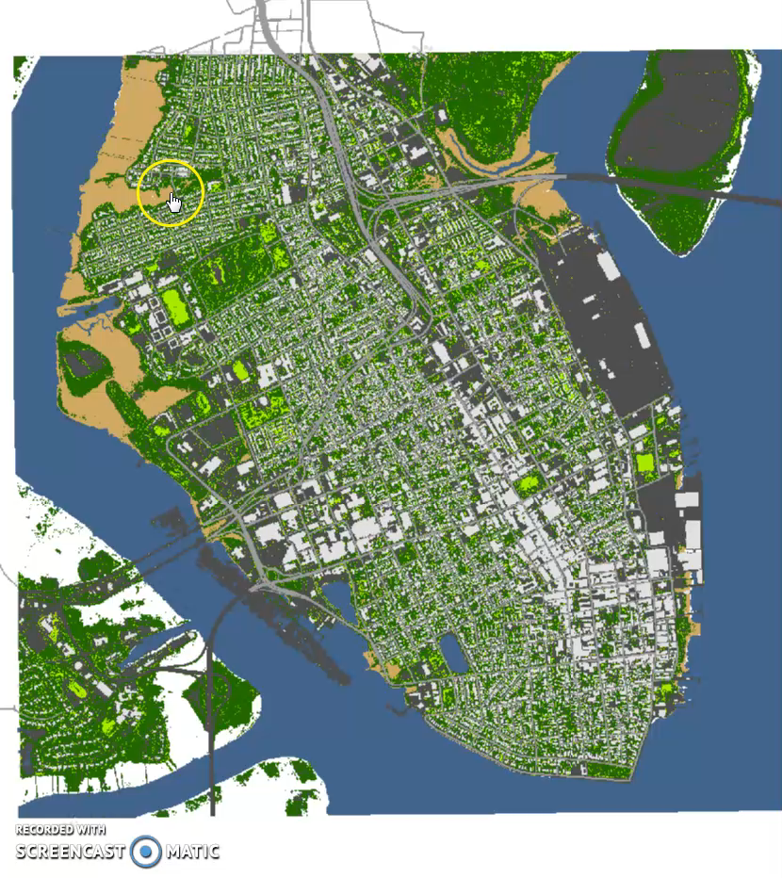
Notes:
Final classification using only the unsupervised ISO Cluster classifier
Looks pretty good, but how accurate is it?

Slide 16
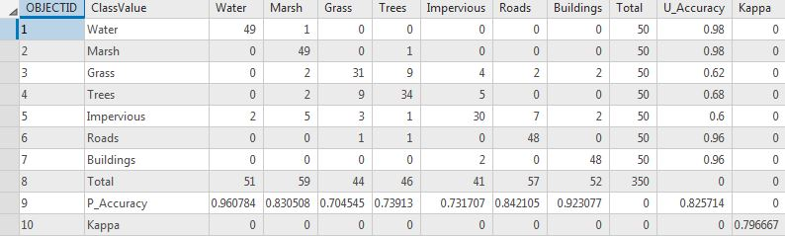
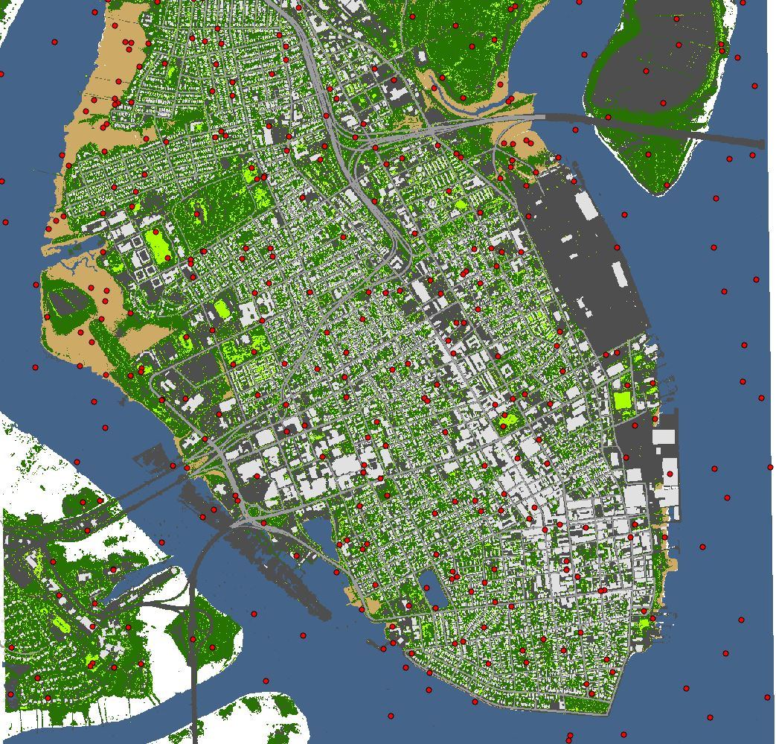
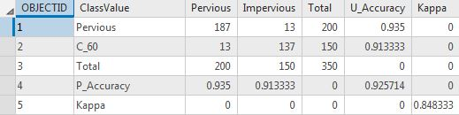
Accuracy Assessment
Equal stratified random point generator
350 total, 50 per class
Confusion matrix with 82.5% total accuracy
92.5% when pervious and impervious classes were collapsed
Notes:
So we’ve got impervious surface cover. How does that fit into the runoff model?
Begin by delineating watersheds appropriate for study area

Slide 17
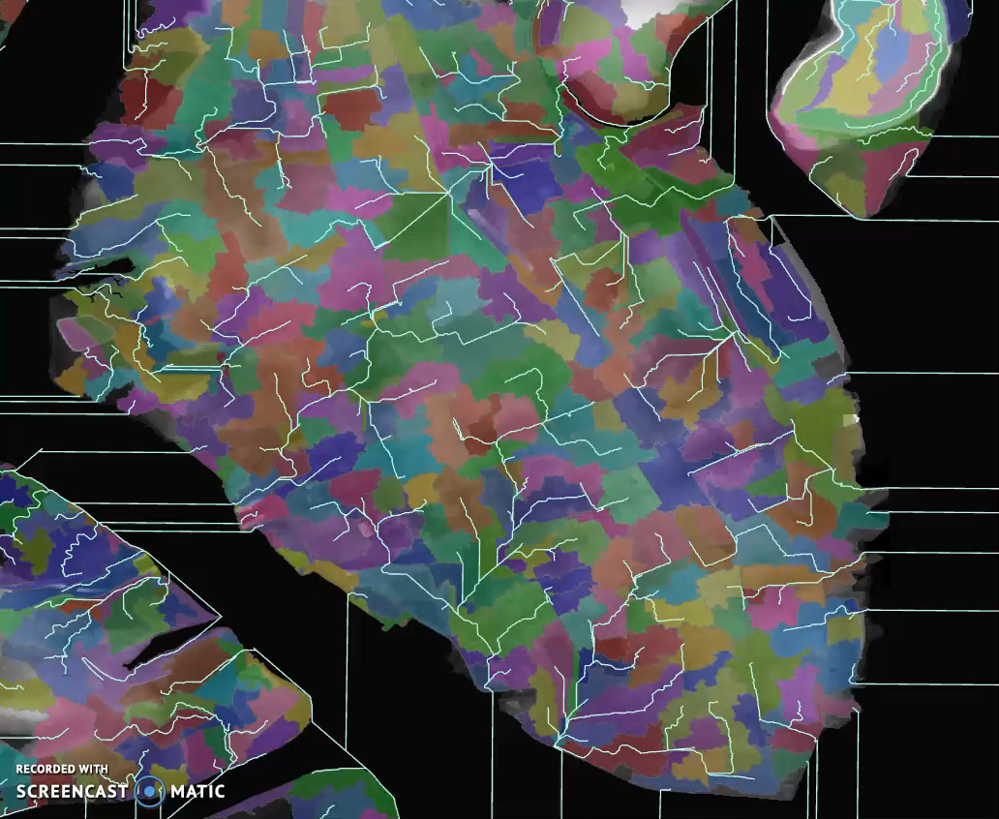
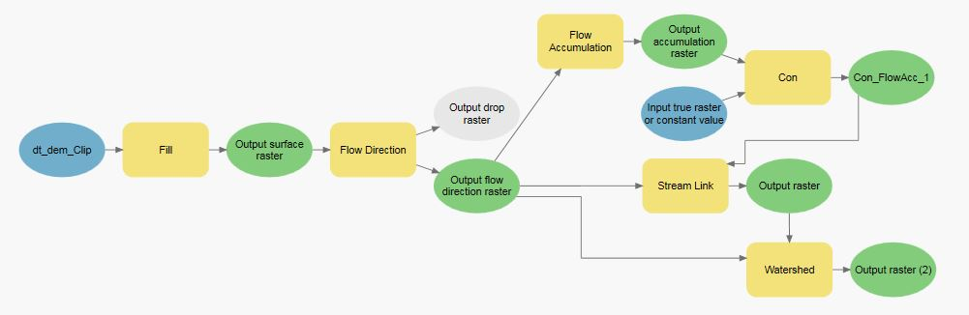
WaterSHeds
Start with DEM
Fill sinks
Flow Direction Tool
Flow Accumulation Tool
Conditional Tool to set threshold
Stream Tool
Watershed Tool
Notes:
There’s about 350 on the peninsula
Threshold determines watershed size by how many cells flow into what is defined a “stream”
20,000 used for this analysis
On average, sheds are about 14 acres

Slide 18
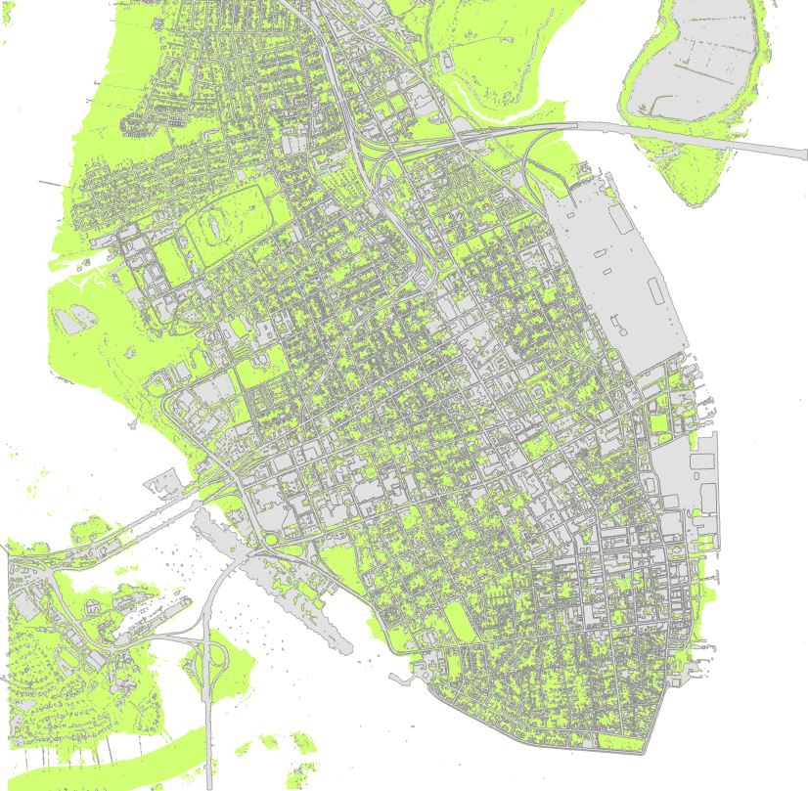
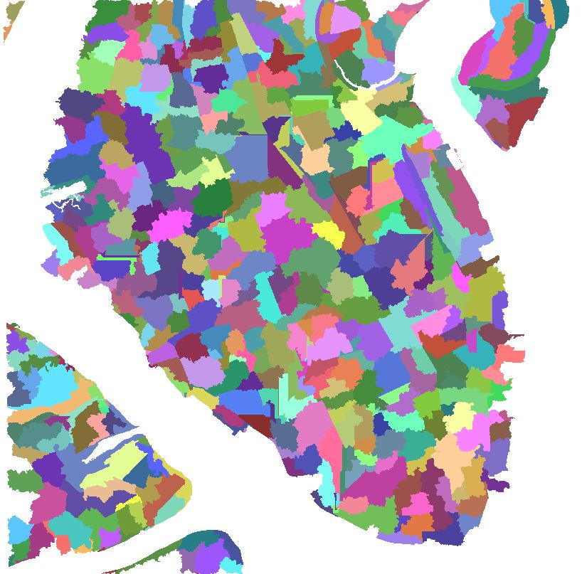
Union!
% Impervious
Notes:
This creates a map with impervious and pervious polygons within each watershed boundary
Therefore yielding percent impervious

Slide 19
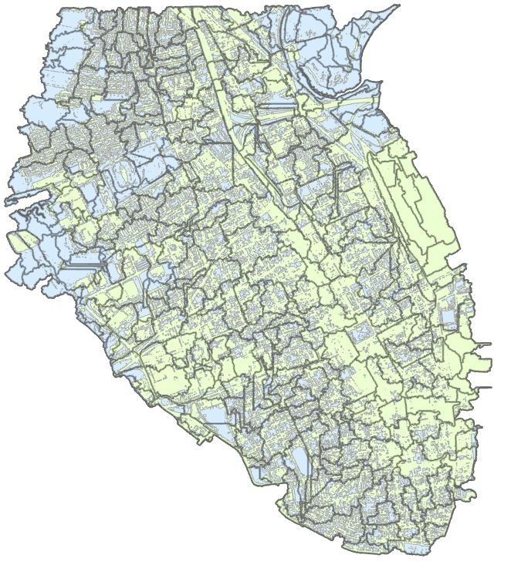
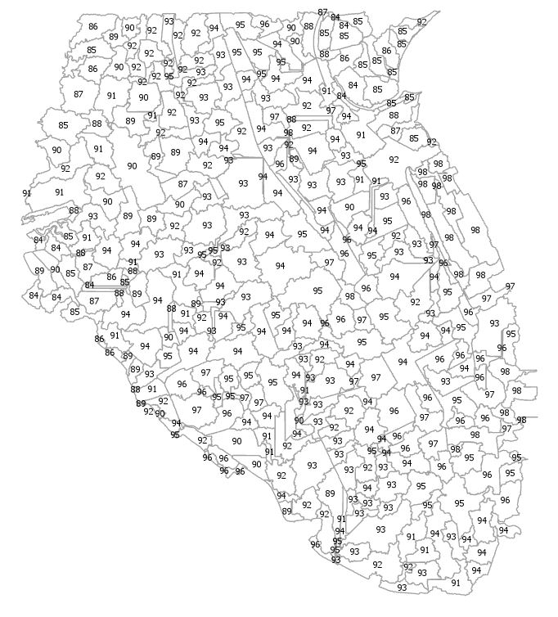

Calculating Curve Numbers
Notes:
This equation comes from Purdue’s L-THIA manual
Peninsula soil is all hydrologic group D as even open grass is firmly compacted/disturbed
and from their table, CN0% impervious has a value of 84

Slide 20


Using Cn values:
S is the potential maximum retention after runoff begins
Ia is initial abstraction, or rainfall lost to interception, surface depressions, or infiltration. Calculated as either 20% or 5% of S
P in rainfall depth in inches
Q is depth of runoff
Notes:
For P, we will use 1 year, 2 year, 5 year, 10 year, 25 year, 50 year, and 100 year rainfall values
Qd will be normalized for shed area and values from sheds that feed into one another will be summed

Slide 21
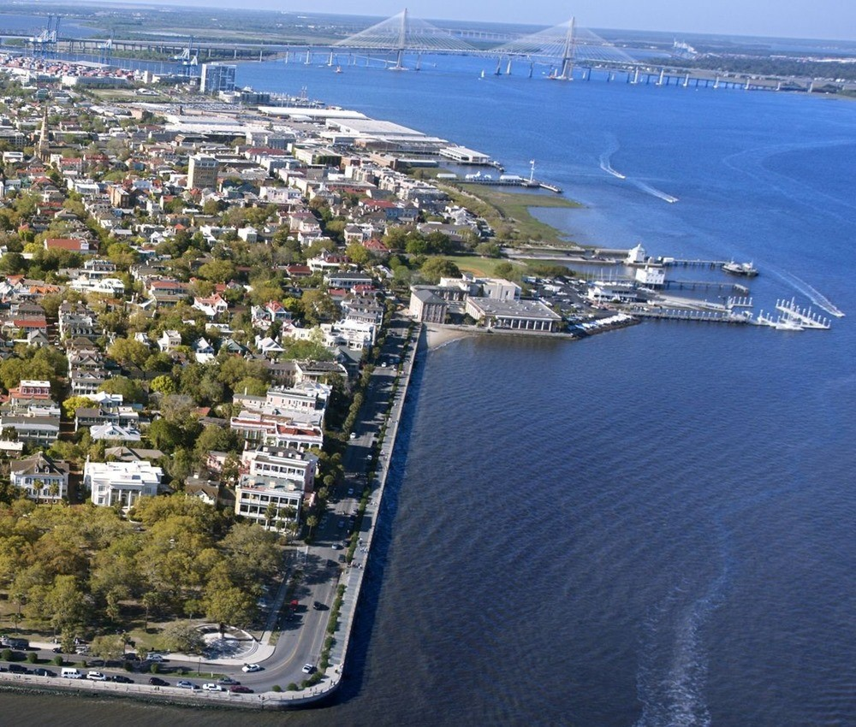
Project Goals
These Q values will be assigned to pour points from each watershed and their level above the DEM will be used to create flood inundation maps for each design storm
Other runoff models like the Rational Formula and SWARM will be run on the same study area to compare results
Flood maps will be used to determine parcel level risk assessment for properties on the peninsula
A suite of tools in ArcGIS model builder will be created for replicating this study in other coastal areas
Particularly tools for automating the classification process
Image: cruisemapper.com

