Slide 1
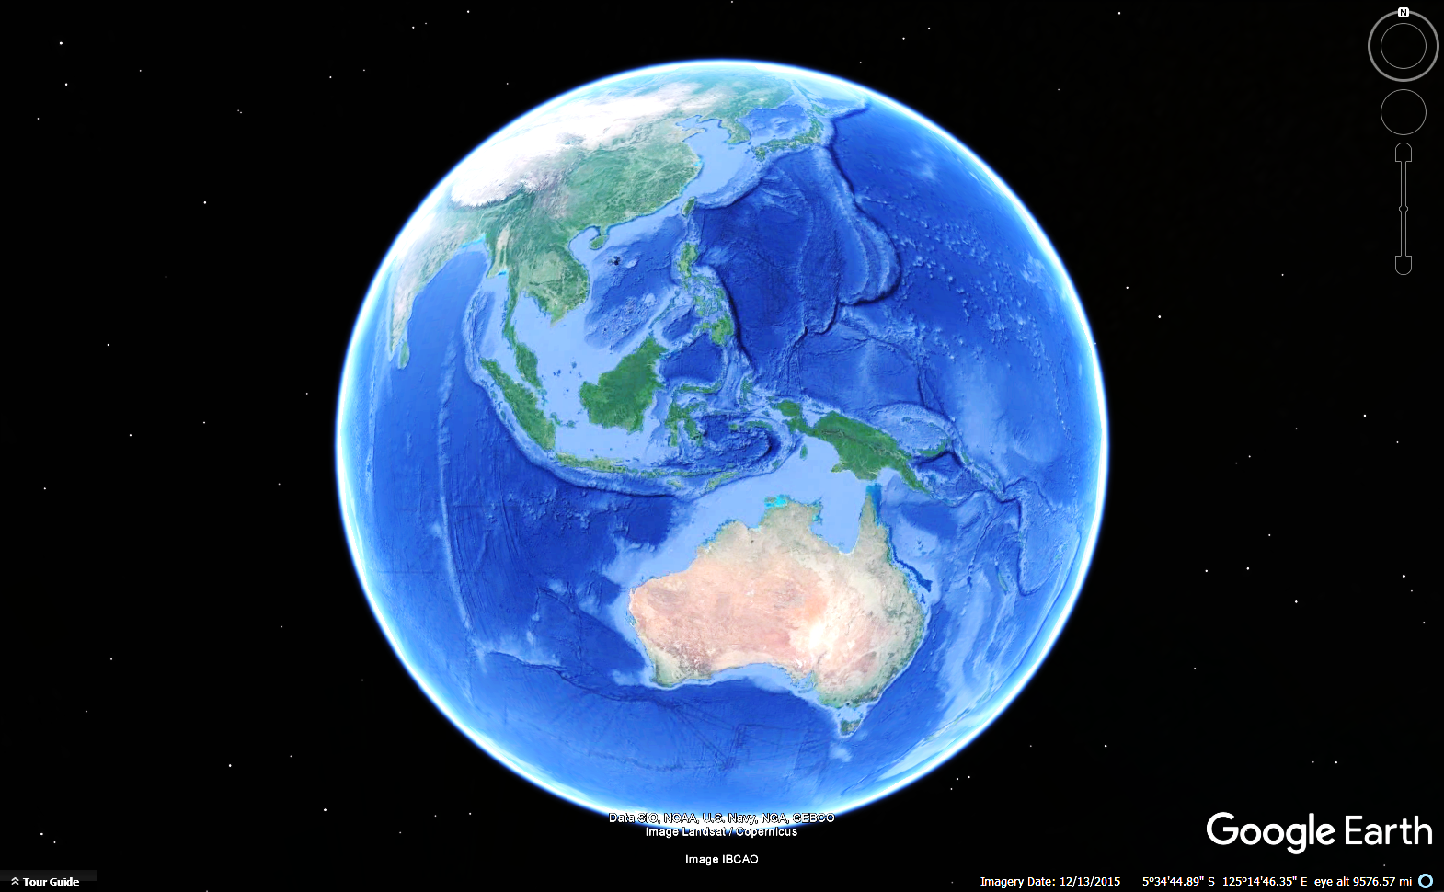

Continental Subduction and
the Antler
Orogeny
Indonesian
by
Archipelago
John
Dunham
1000 Km
Australia
Notes:
The Antler Orogeny was the first tectonic event to affect Western North America since Precambrian rifting. This talk uses Recent analogs to infer the process. The slide animations are meant to draw your eye to details without using a pointer.

Slide 2
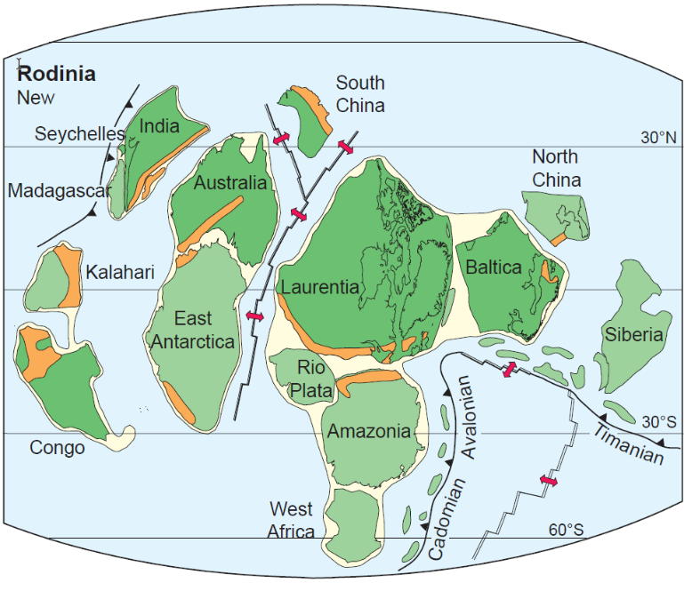
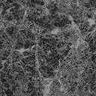
Torsvik, 2003
Breakup of Rodinia begins ~ 1 GA, Separation of Laurentia complete by ~ 600 MA, forming a Continent to Ocean Passive Margin.
Laurentia
_
PC to Late Devonian
Ocean Crust
Continental Crust
Continental Crust
Notes:
The breakup of Rodinia begins in Late Precambrian and separation of Laurentia is complete by about 600 MY, forming a Continent to Ocean passive margin.

Slide 3

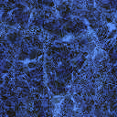
The Continental Shelf of Laurentia exists as a Passive Margin for over 350 Million Years.
In the Late Devonian, something happens.
The Antler Orogeny is the first tectonic event to affect the west coast of Laurentia.
Late Devonian Obduction
Ocean Crust
Continental Crust
Continental Crust
Notes:
The Antler Orogeny obducted deep-water clay shale onto shallow water carbonate platform sediment. The Roberts Mountains thrust is the base of the allochthon. How did this happen?

Slide 4
Tectonic Events
Goal: Consider the Antler Orogeny.
  What was the tectonic process?
  Trigger of the process?
  What were its immediate effects?
  What were the long-term consequences?
Antler
Method: Use Recent Analogs.
Passive Margin
Notes:
Many papers discuss the Antler event, most involving collision with an island arc, though some propose east-dipping subduction while others suggest west-dipping. All agree that Antler was the first event to affect the region since rifting. Recent Analogs may help visualize the process of formation.

Slide 5
W. CENTRAL NEVADA
BASIN
ROBERTS MTNS.
SHELF EDGE
EASTERN NEVADA and UTAH
RESTRICTED PLATFORM and TIDAL FLATS
Basement
OCEAN CRUST
Transitional
CONTINENTAL CRUST
Adapted from Cook, 1983
Notes:
This cross section from Harry Cook shows the Laurentian shelf and slope from the late Precambrian up to the Late Devonian. Fossiliferous limestone grew atop transitional crust at the shelf edge, while restricted platform dolostone accumulated to the east. To the west, Graptolite shale was deposited in deep water on a continental slope.

Slide 6
W. CENTRAL NEVADA
BASIN
ROBERTS MTNS.
SHELF EDGE
RMT
EASTERN NEVADA and UTAH
RESTRICTED PLATFORM and TIDAL FLATS
Basement
Late Devonian Obduction
OCEAN CRUST
Transitional
CONTINENTAL CRUST
Adapted from Cook, 1983
Notes:
Something happened that pushed slope-shale onto the carbonate platform.

Slide 7
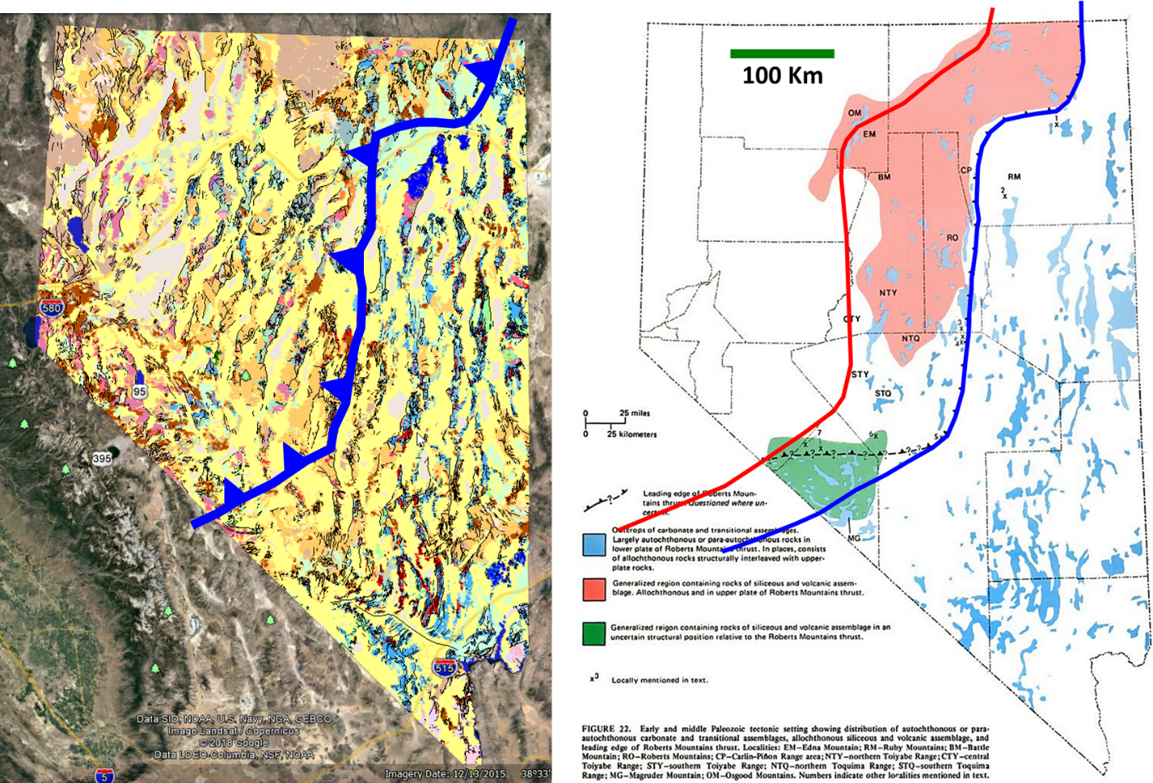
Deepwater claystone and chert thrusted atop shallow carbonate platform.
Geologic Map of Nevada. Red is the edge of carbonate platform. Blue is leading edge of the RM Thrust.
Stewart, 1980
Overlap of deepwater
facies atop carbonate
Western Extent of
Paleozoic Carbonate
Eastern Extent
of RM Thrust
~ 100 Km overlap onto platform.
Carbonates
Allochthon
Siliceous & Volcanic Rx
100 Km
Notes:
John Stewart’s map shows the trace of the Roberts Mountains thrust. The red line is the western extent of the shallow water carbonate platform beneath the thrust. The allochthon overlaps the carbonate platform by about 100 kilometers. A cross section through the overlap would look like this.

Slide 8
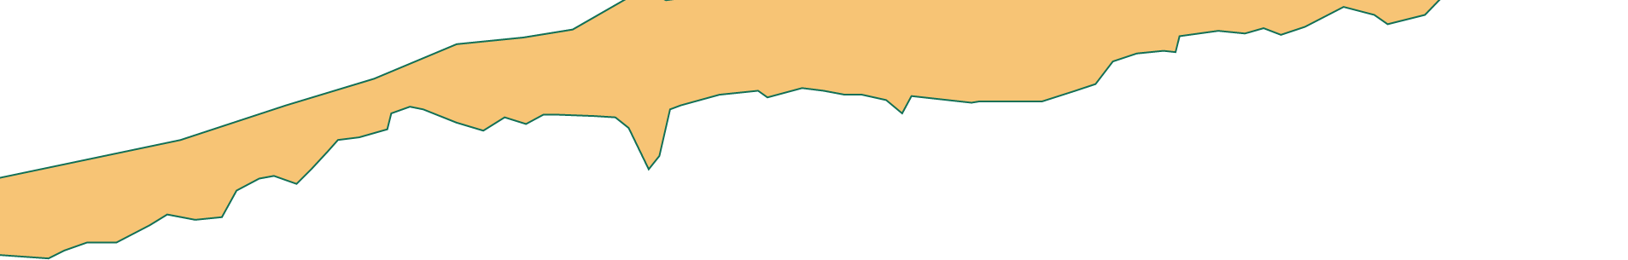
West
East
Eastern Edge of
Roberts Mountains Thrust
Deep Water Shale
Deep Water Shale
Shallow Water Carbonate
Shallow Water
Carbonate Platform
Overlapped Platform
Carbonate Platform
Basement
Notes:
Deepwater shale has obducted on top of a shallow water carbonate platform.

Slide 9
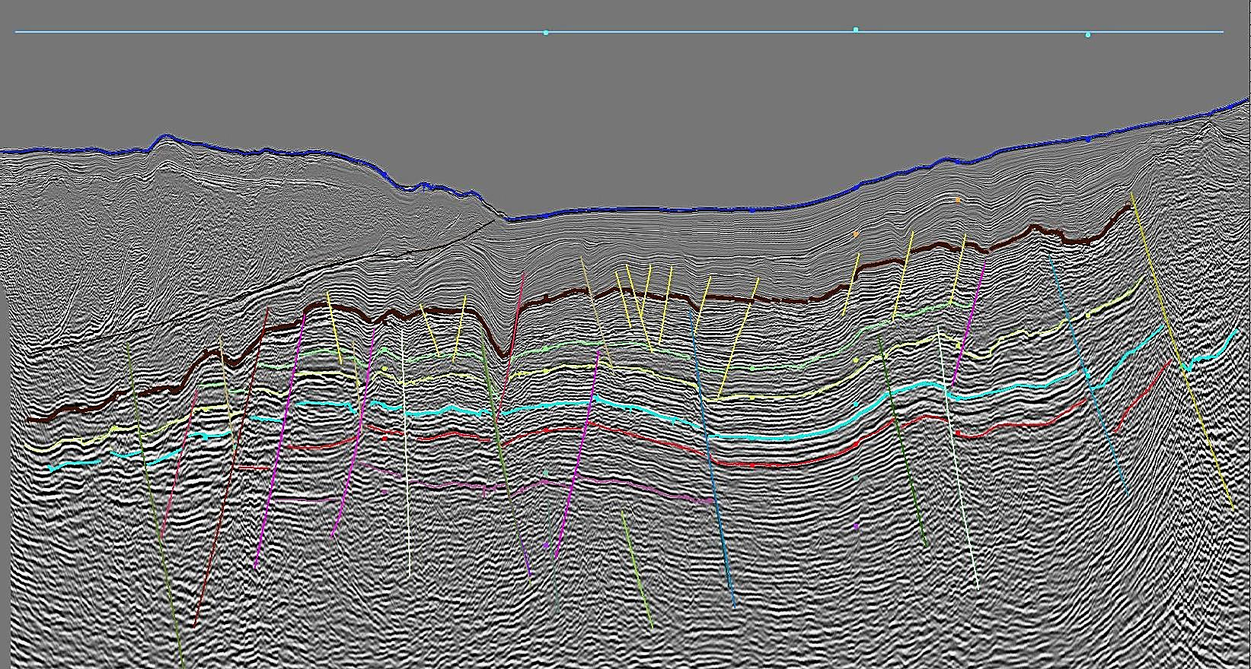

West
West
East
Sea Level
East
500
Eastern Edge of
Roberts Mountains Thrust
1000
1500
Water Depth
6000 Feet
2000
Deep Water Shale
Deep Water Shale
2500
Deep Water Shale
Plio-Pleistocene Foredeep
Claystone
3000
Shallow Water Carbonate
Miocene Shallow Water
Carbonate Platform
Shallow Water
Carbonate Platform
3500
4000
Overlapped Platform
Miocene Carbonate Platform
4500
Carbonate Platform
5000
Two-Way Travel time in milliseconds
5500
Basement
6000
Basement
6500
50 Km
7000
Notes:
That’s why when I looked at this seismic line, I thought I had seen something like it before.

Slide 10
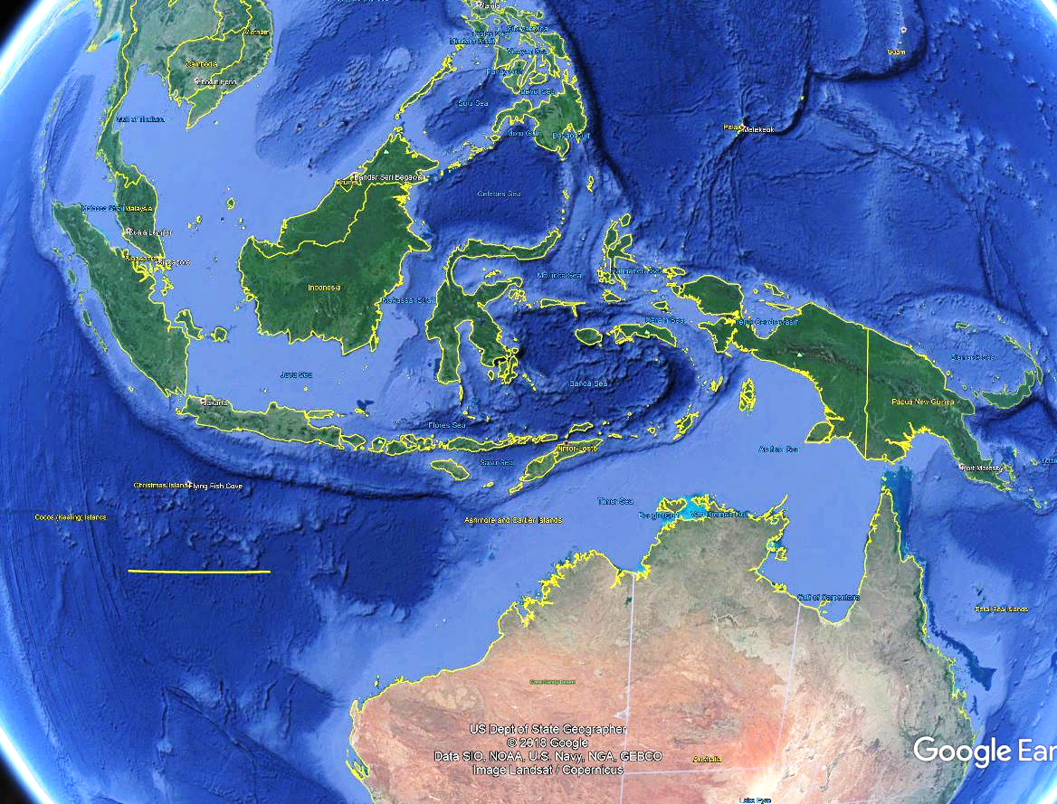
Continental Crust of the Australian Plate is Falling Into the Indonesian Trench
Borneo
Sumatra -
New Guinea
Continental Shelf
Java -
Trench
1000 Km
Australia
Notes:
The seismic line is from western New Guinea, where continental crust of the Australian plate is falling into the East Indonesia subduction zone. I worked in Indonesia for several years, after having mapped in the Roberts Mountains some 40 years earlier.

Slide 11
0
Sea Level
Sea Level
East
West
500
TWT ms
Water Depth
6000 Feet
1000
Water Depth
6000 Feet
1500
2000
Accretionary Prism
Imbricate Thrusts
2500
Plio-Pleistocene Foredeep
Claystone
3000
Miocene Shallow Water
Carbonate Platform
3500
4000
Miocene Carbonate Platform
4500
5000
Two-Way Travel time in milliseconds
5500
6000
6500
50 Km
7000
Notes:
A Miocene carbonate platform is falling into a subduction zone. Sediment scraped off the descending plate forms an accretionary prism above a detachment surface. The carbonate platform grew in shallow water, but as subsidence accelerated through descent into the trench, the platform stopped growing due to drowning, and became overlain by fore-deep claystone.

Slide 12
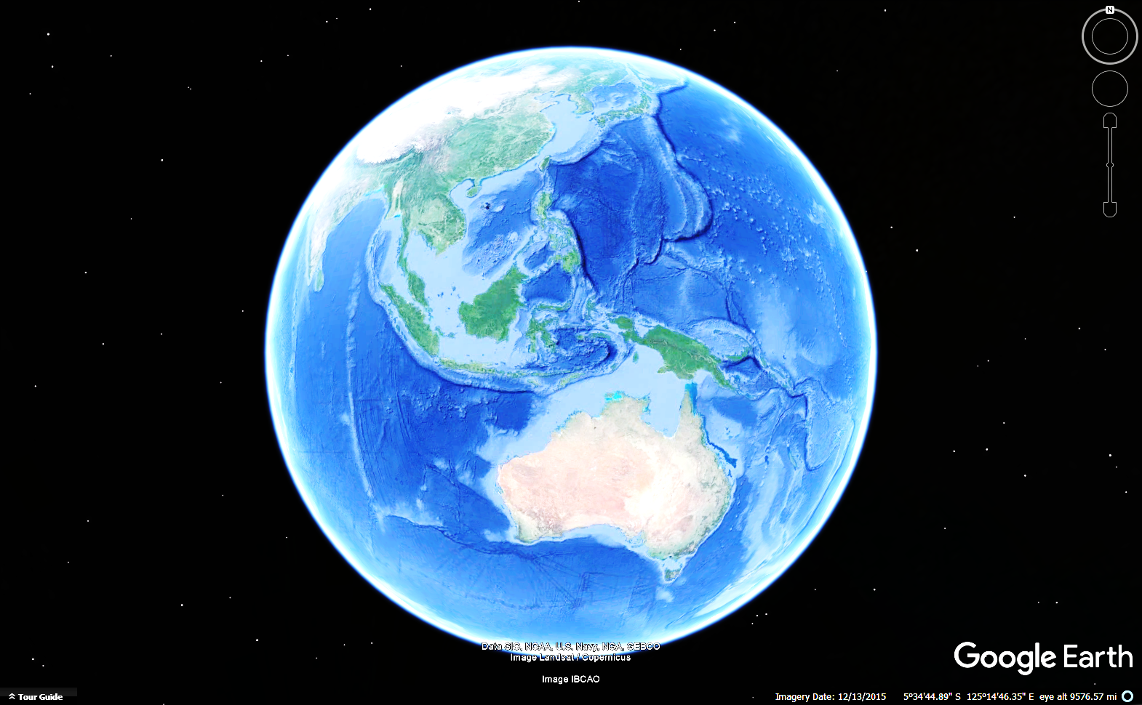
The southwest and south coasts
of Australia are Passive
Margins.
1000 Km
Sumatra -
Timor Trough
Java -
NW Shelf
Trench
SW Shelf
Passive
Margin
The Northwest Shelf of
Australia is different.
Here, continental crust subducts into the
Indonesian Arc.
Notes:
The northwest shelf of Australia is colliding with the Indonesia subduction zone. Australia rifted from Gondwanaland in the Jurassic and has migrated north ever since. At the same time, slab-rollback is moving the Indonesian subduction zone to the south. Simply by coincidence, these plates have encountered one another. This map shows that the south and southwestern coasts of Australia are still passive margins. It is only the Northwest Shelf that has encountered the Timor Trough.

Slide 13
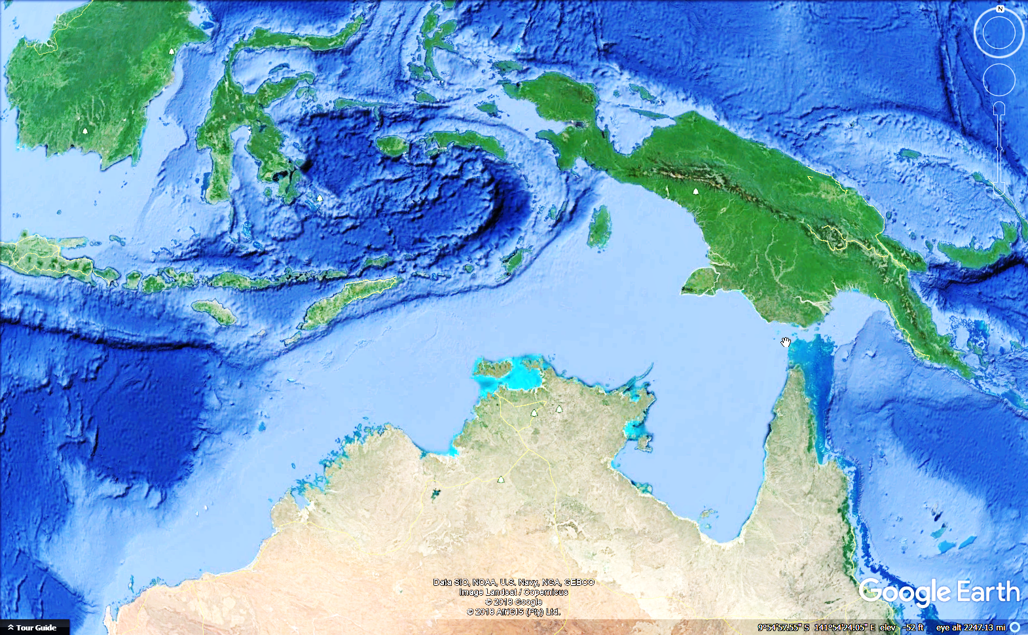
Timor Island
N
500 Km
S
Northwest
Shelf
Darwin
WD 17,000’
Northern
Territory
Western
Australia
Queensland
Notes:
This is the trace of a seismic line that extends from shallow water down to 10,000-foot water depth at the base of the Timor Trough.

Slide 14
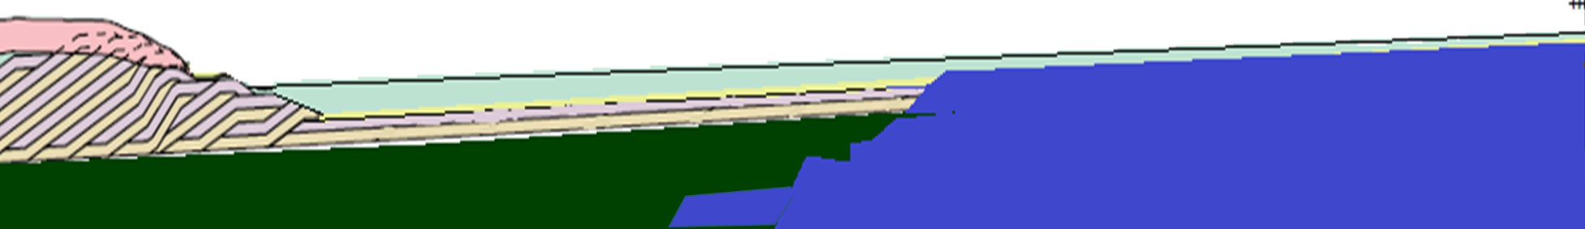
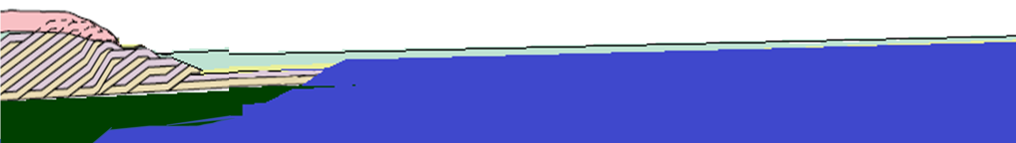
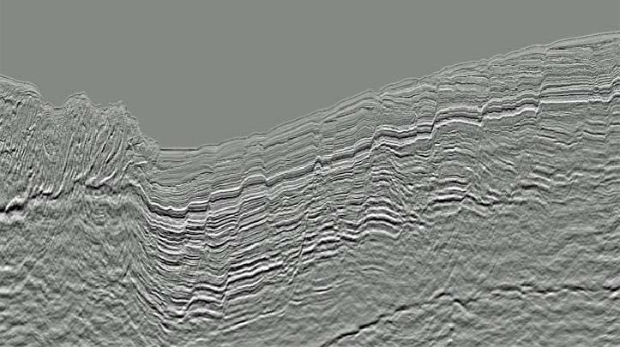
Sea Level
Tate et al., 2015
Paleogene Location of
Australian Continental Crust
N
S
Sea Level
Neogene Location of
Australian Continental Crust
Timor Accretionary Prism
Sea Level
Northwest Shelf
Timor Trough
WD 10,000 ft.
Baillie, 2019
Recent Location of
N
Australian Continental Crust
50 Km
S
Notes:
Continental Crust of the Australian Northwest Shelf is falling into the Timor Trough. Deepwater sediment scrapes off the descending plate and piles up into an accretionary prism.

Slide 15
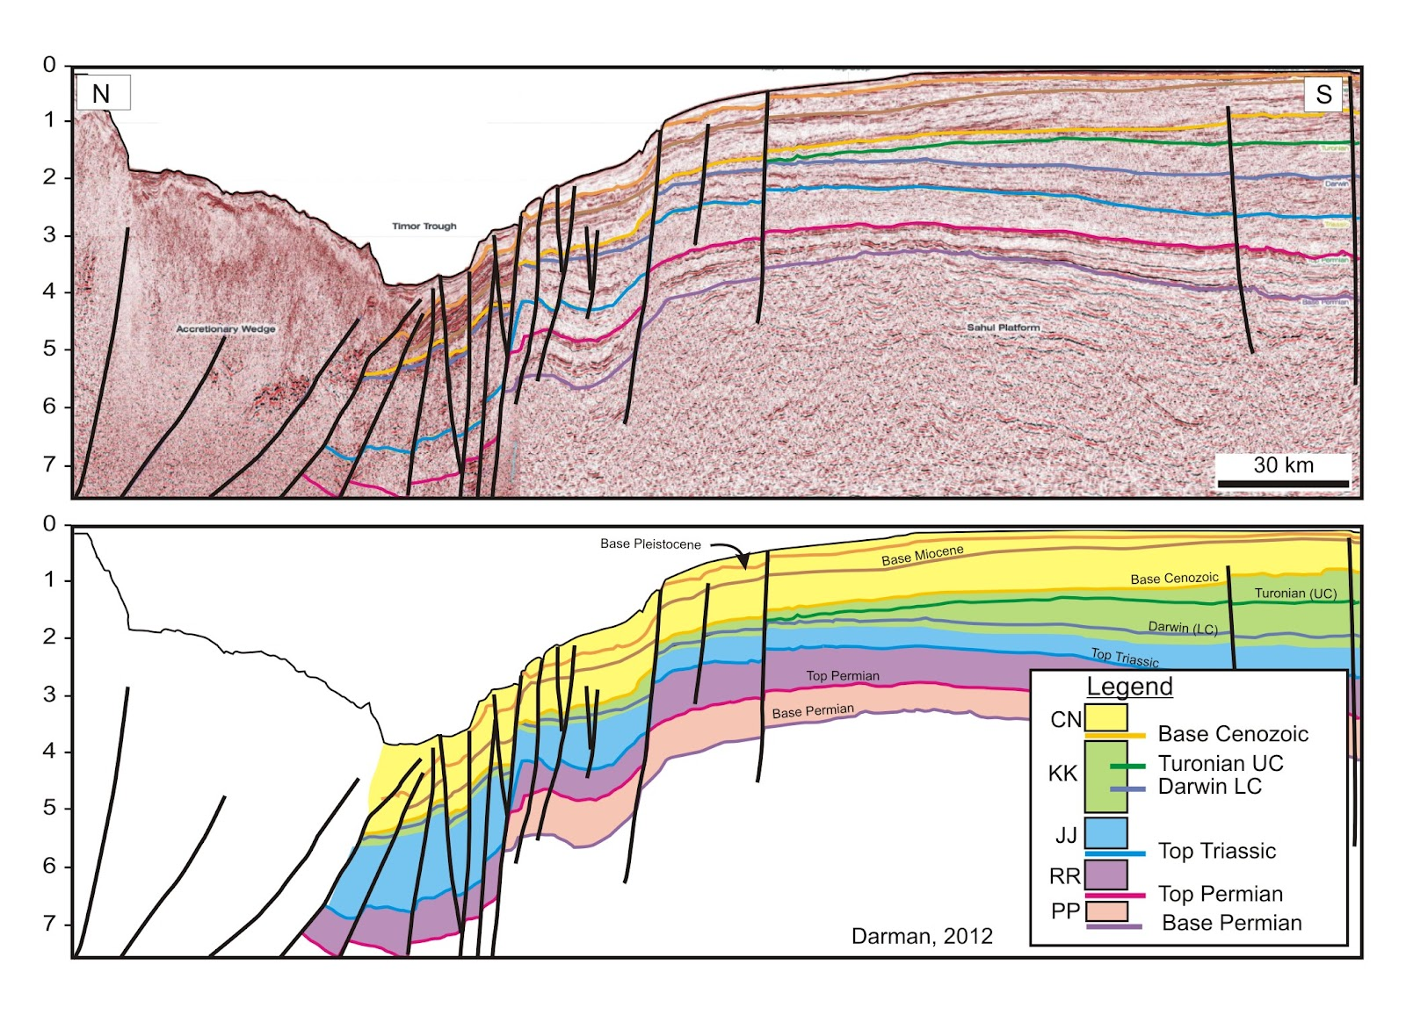


N
Sea Level
S
Timor Prism
Timor Trough
10,000’ WD
Accretionary
Wedge
Two-Way Time
Australian Plate
50 Km
Sea Level
Timor Prism
Peripheral-Bulge Unconformity
Timor Trough
10,000’ WD
Two-Way Time
Australian Plate
Darman, 2012
Notes:
This line stretches for more than 300 kilometers, from a few feet of water on the shelf, to more than 10,000 feet deep at the bottom of the Timor Trough. The Australian plate bends toward the trench, resulting in tension and normal faulting. Toward the shelf, the plate flexes upward into a broad Peripheral Bulge. Shallow water carbonate descends into the trench and is overlain by foredeep mudstone. At the bottom of the trench, the mudstone scrapes off into an accretionary prism that piles up on top of the shallow water carbonate.

Slide 16
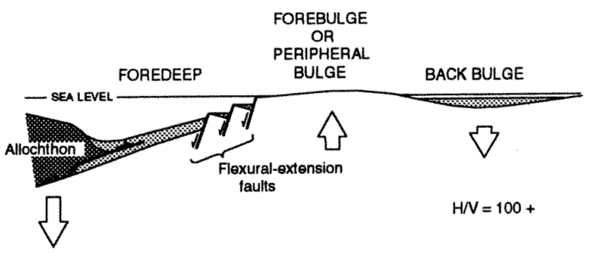
N
Sea Level
S
Timor Prism
Timor Trough
10,000’ WD
Accretionary
Wedge
Silberling and Nichols, USGS, 1997
Sea Level
Timor Prism
Peripheral-Bulge Unconformity
Timor Trough
10,000’ WD
Australian Plate
Darman, 2012
Notes:
This insert shows a structure section through central Nevada at the time of the Antler Orogeny. You can see by the dates on the sections that Silberling and Nichols could not have seen this seismic line, but their geologic concept based on pure field geology at its finest, compares well to data from the Northwest Shelf.

Slide 17
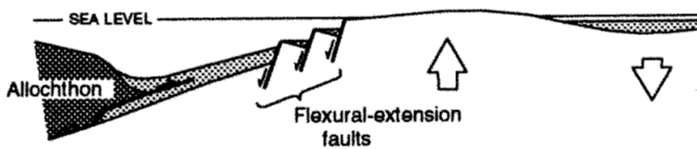
N
Sea Level
S
Timor Prism
Timor Trough
10,000’ WD
Silberling and Nichols, USGS, 1997
Silberling and Nichols, USGS, 1997
Sea Level
Timor Prism
Peripheral-Bulge Unconformity
Timor Trough
10,000’ WD
Australian Plate
Darman, 2012
Notes:
The Silberling and Nichols interpretation, based on field mapping and biostratigraphy,

Slide 18
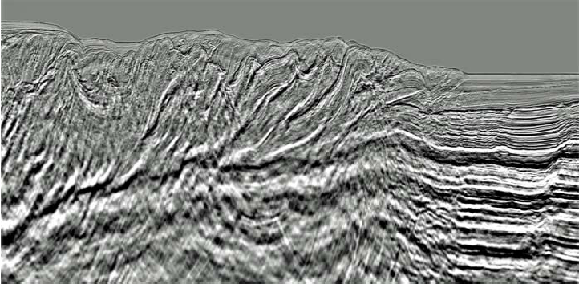
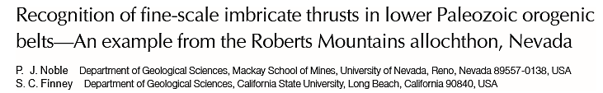
Timor Accretionary Prism
Courtesy of Peter Baillie, TGS Corporation
N
Imbricate Thrusts
10 Km
S
10,000’ Water Depth
Oldest Thrusts
Older Thrusts
Younger Thrusts
Prism Thickness
~5000 Feet
Notes:
The Timor Accretionary Prism is a sequence of forward-breaking thrusts. The oldest thrust is at the highest part of the prism, while the youngest thrust cuts sediment at the bottom of the trench. Professor Stan Finney’s detailed study of the Roberts Mountains thrust concluded that the upper plate was not a single sheet, but rather a collection of imbricate thrusts.

Slide 19
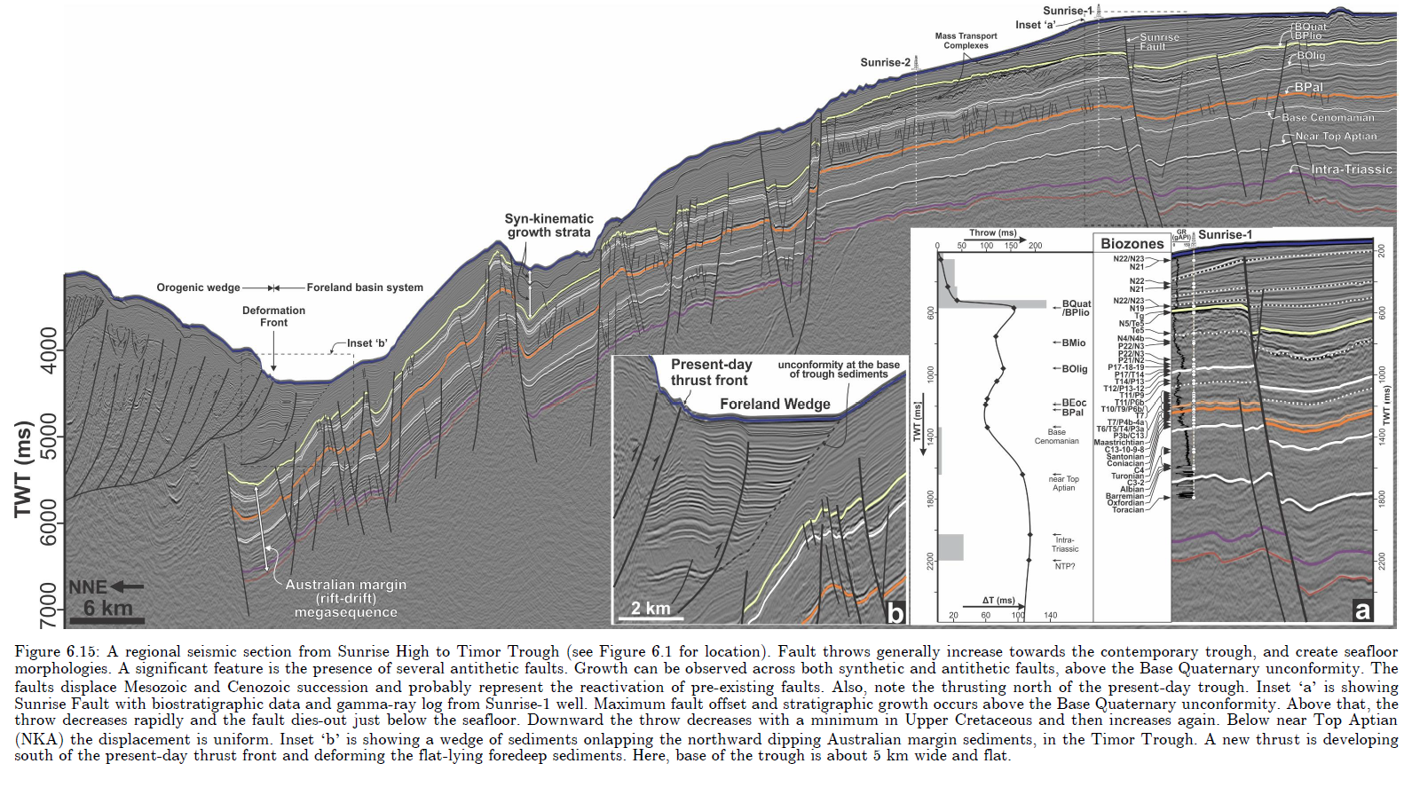
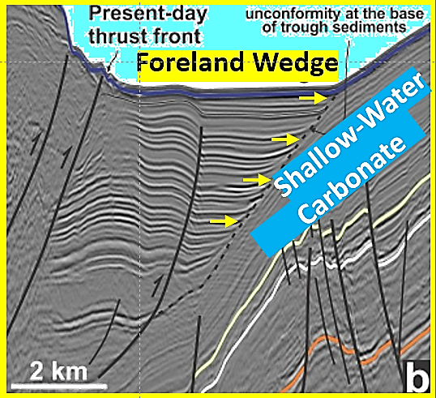
0
Sea Level
0
S
N
50 Km
2000
1000
(~10x V.E.)
4000
2000
Feet Water Depth
6000
3000
Imbricate
Thrusts
Saqab, 2016
8000
10000
Foreland Wedge
Shallow-Water
Carbonate
A Foreland Wedge fills the bottom of the trench at Timor, and in the Roberts Mountains.
Notes:
This is a detail of the Timor Foreland Wedge, which is the fill at the very bottom of the trench. To the left is the first imbricate of the accretionary prism. To the right is an angular unconformity where flat-lying trench-fill sediment onlaps against the subducting slab.

Slide 20
0
Sea Level
0
S
N
Murphy, Power, and Johnson, 1984: Mississippian Webb Formation “accumulated at the toe of the moving Roberts Mountains allochthon”.
Black shale and chert overlie an angular unconformity atop Devonian Limestone.
50 Km
2000
1000
(~10x V.E.)
4000
2000
Feet Water Depth
6000
3000
Imbricate
Thrusts
8000
10000
Foreland Wedge
Shallow-Water
Carbonate
Saqab, 2016: Timor Trough
Analog for Webb Formation at the bottom of the Roberts Trench.
Notes:
In the Roberts Mountains, the Mississippian Webb Formation forms a foreland wedge bounded by the first imbricate of the Roberts Mountains Thrust to the West, and onlap against Upper Devonian Limestone to the East.

Slide 21
What triggered the Antler Event?
West-dipping subduction of the Laurentian passive-margin carbonate platform into an ocean trench can explain emplacement of deepwater claystone on top of shallow-water carbonate sediment.
Notes:
What triggered the Antler Event? Continental subduction can emplace deep-water shale on top of shallow water carbonate; with geometry and scale comparable to the Roberts Mountains thrust.

Slide 22
How did a trench arrive on the scene after ~ 300 MY of Passive Margin conditions?
Notes:
But if it was a subduction zone, how did it get to the Laurentian shelf?

Slide 23
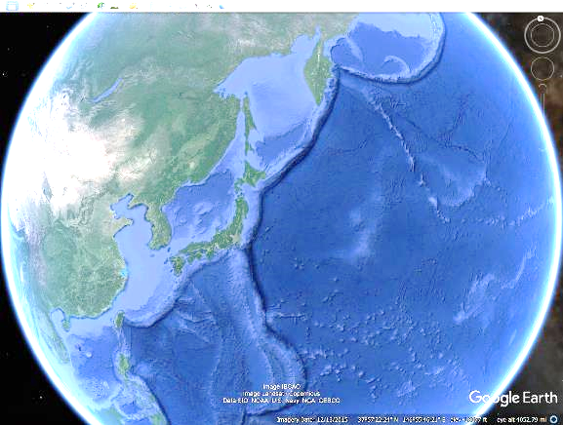
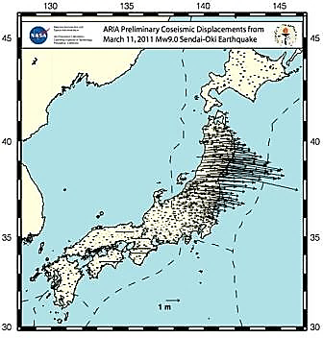
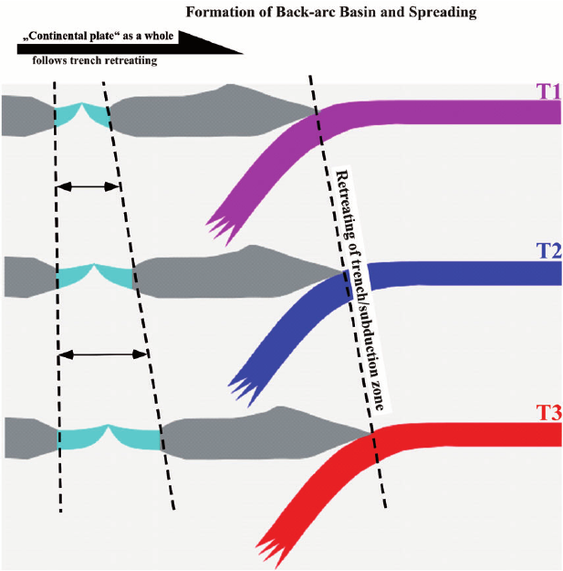
Slab-Rollback and Back-Arc Basin Formation
Upper Plate follows
retreating trench.
Subducting Plate
rolls back.
Coseismic
Displacements
Japan
2011 Sendai
M 9.0
1 meter movement
Caltech, 2011
Trench retreats as slab rolls back
Opening of Back-Arc Basin
Japan
epicenter
Niu, 2014
500 Km
Notes:
Ocean Trenches migrate through the process of Slab Rollback. The hinge line of the subducting plate moves backward away from the trench. GPS ground motion measurements following the magnitude 9 Sendai Earthquake show that the hinge line of the descending slab moved eastward, and at the same time the upper plate moved eastward instantaneously up to 10 meters to take up the space left by the slab-rollback process.

Slide 24
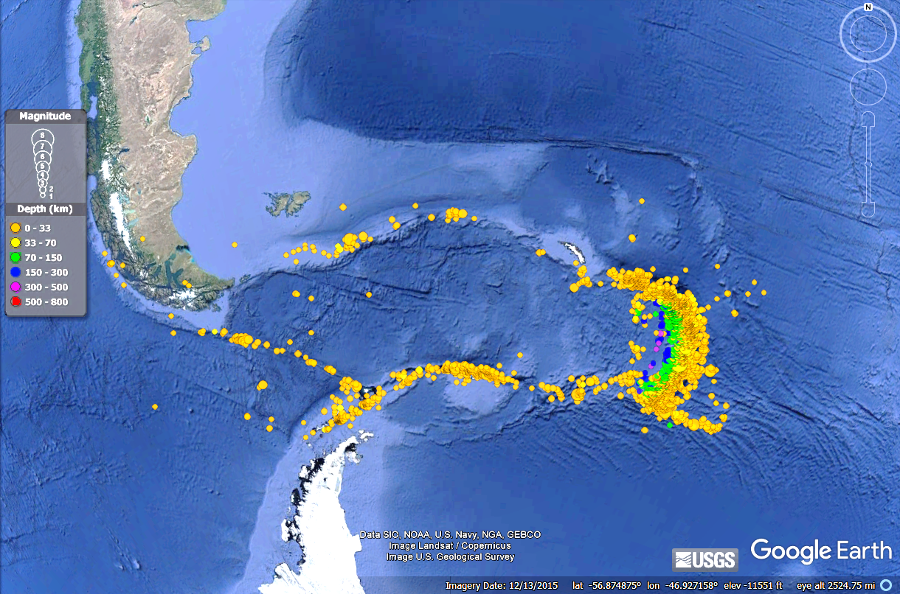
Scotia Arc: Schellart (2009) estimates 2000 km eastward retreat in 40 MY: velocity = 50Km/MY
50 Km/My
7.5
8.1
500 Km
Notes:
Ocean trenches roll across ocean crust at plate tectonic rates. Estimates from the Scotia Arc indicate 50 km of migration per million years. At this rate, a trench could have migrated thousands of kilometers over the 300-million-year history of the Laurentian passive margin.

Slide 25
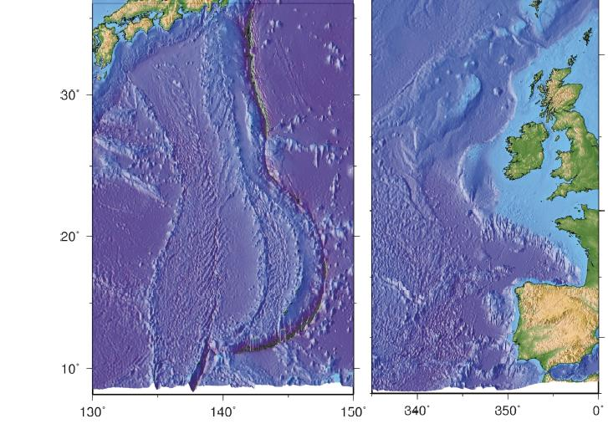
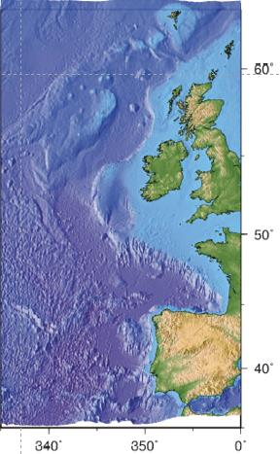

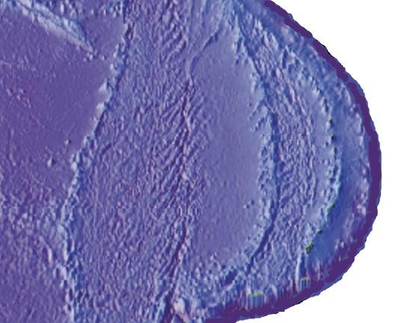
East Atlantic Passive Margin
Backarc Spreading
Abandoned Arc
Notes:
How could an arc move toward a passive margin? Slab rollback provides an explanation.

Slide 26
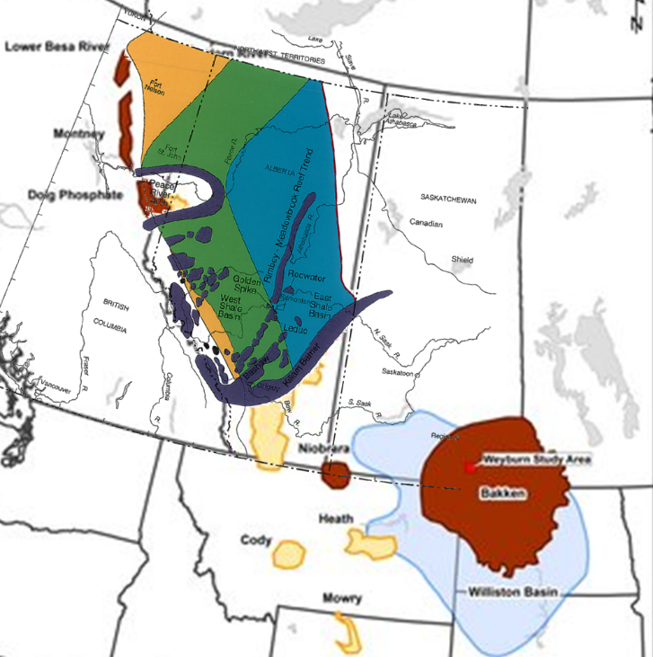
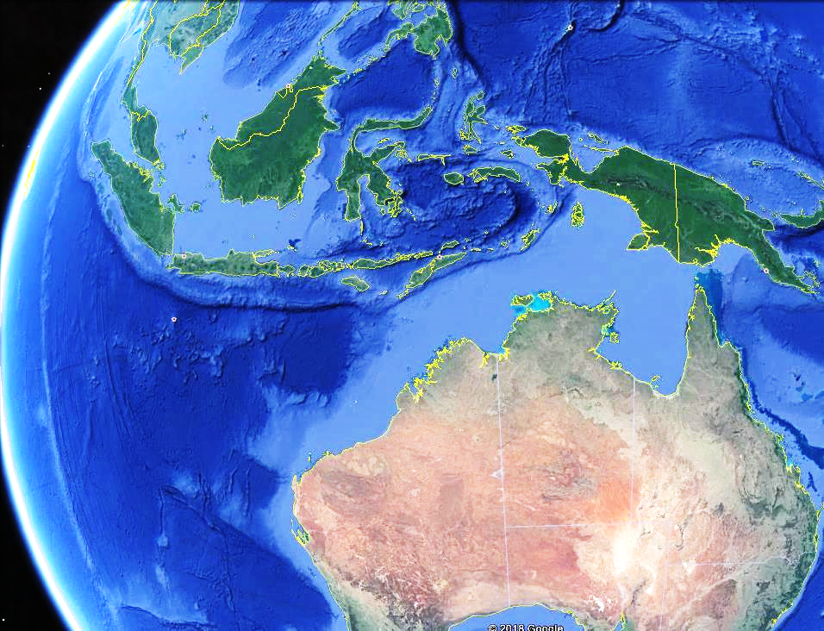
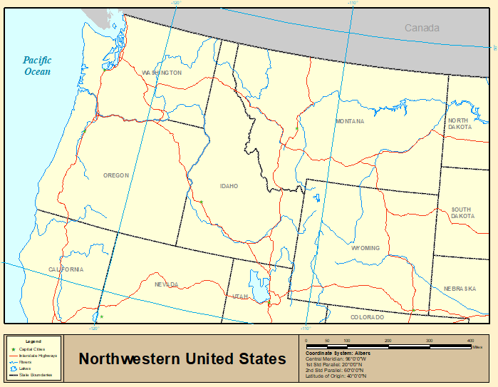
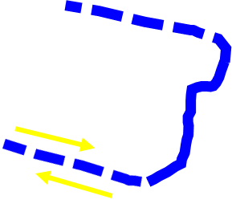
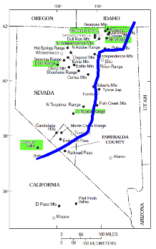
Recent Continental Subduction
Alberta
Basin
500 Km
Miss. Shelf Lime
Devonian Reefs
Subducted
Williston
Basin
Unaffected
Australia
500 Km
Subducted
Mississippian
Continental
Subduction
Notes:
Continental subduction takes place where a passive margin encounters a trench. But subduction zones do not go on forever. They may terminate at transform faults, or they may curve away from the edge of a passive margin. In the case of Australia, the Indonesian subduction zone curves to the west and leaves the southwest shelf unaffected. The map on the right shows that the Alberta and Williston Basins had continuous carbonate growth from the Devonian up through the Carboniferous. These areas were not affected by the Antler Orogeny. The Roberts Mountains trench may have terminated at Transform Faults to the south of those basins.

Slide 27
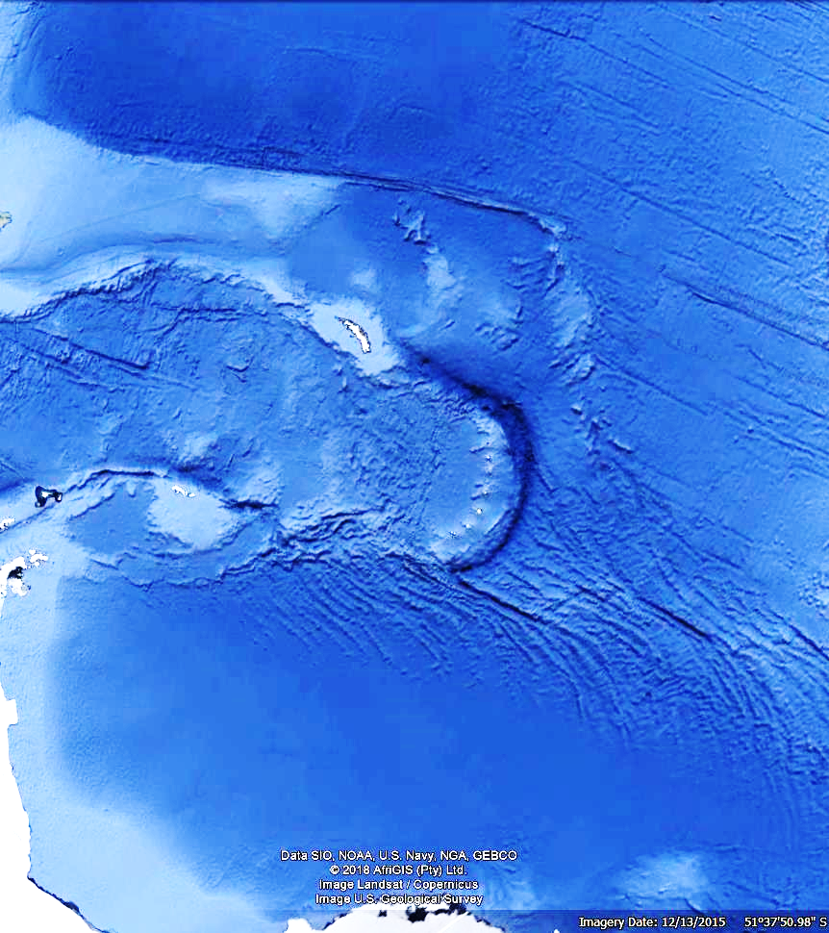
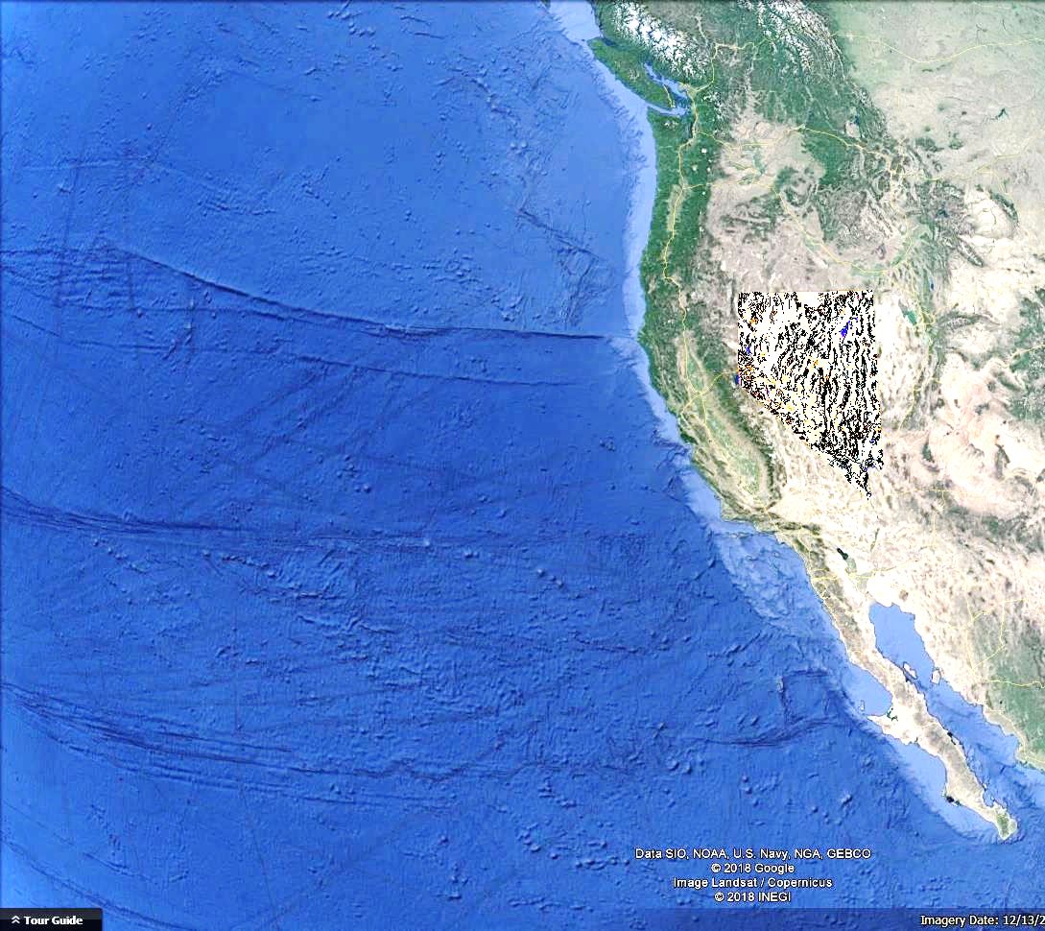

Roberts Mountains Thrust
500 Km
500 Km
Scotia Arc
Same Scale
Notes:
A comparison of the Roberts Mountains Thrust and the Scotia Arc at the same scale. Though their precise location isn’t known, there must be transforms at either end of the Roberts Thrust.

Slide 28
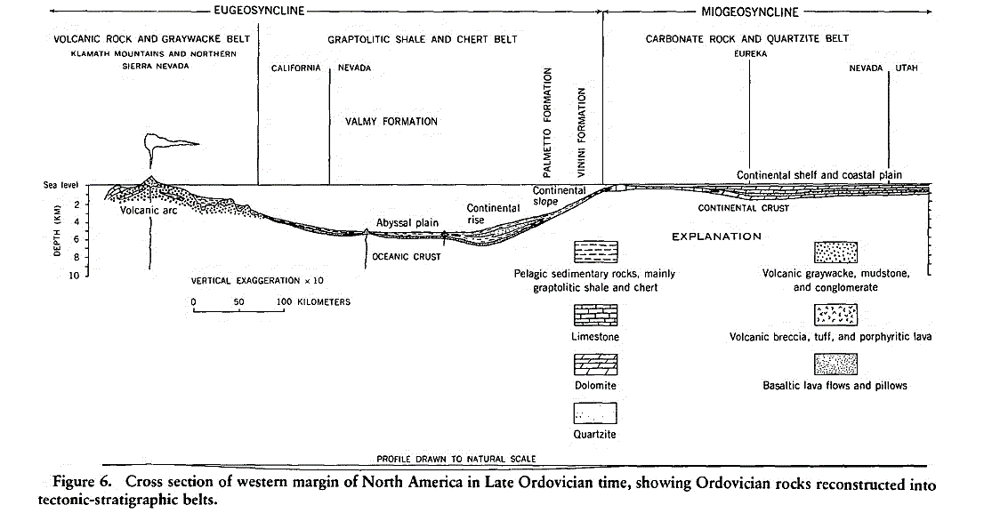

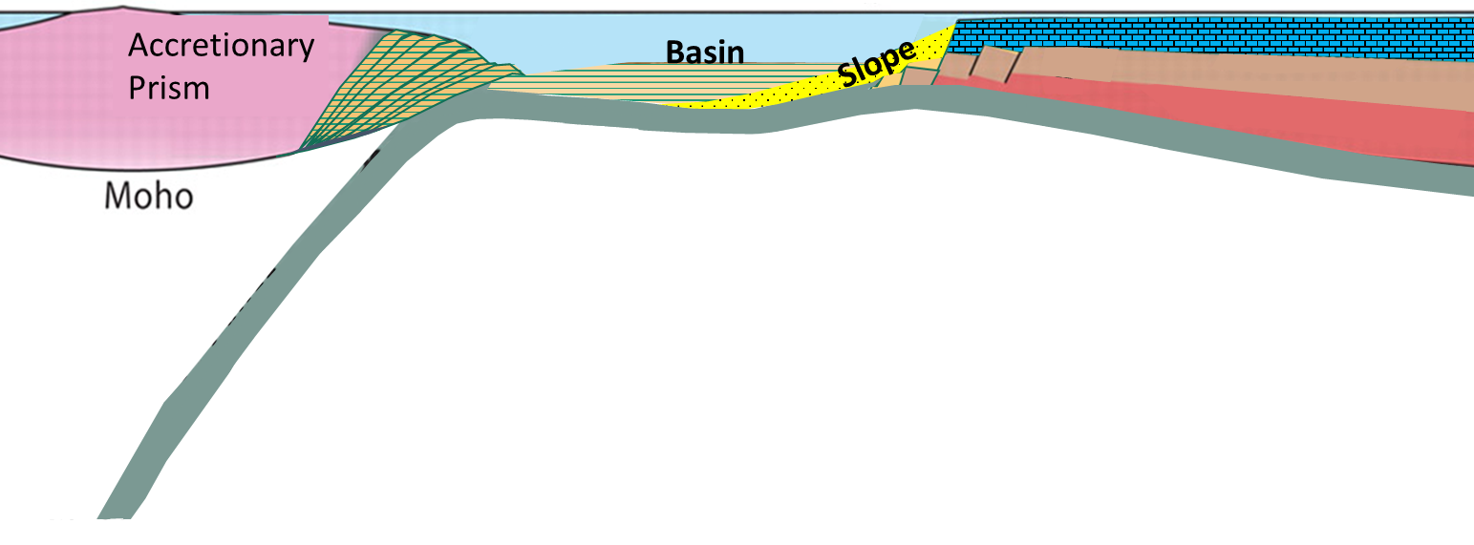
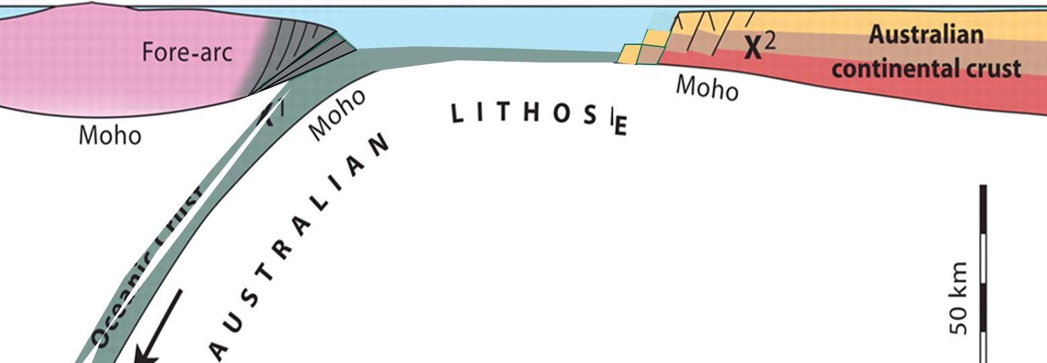

Subduction Zone to West Passive Margin to East
Roberts
Trench
Rise-Slope
Sediment
Laurentian Continental Shelf
carbonate platform
Accretionary
Prism
Accretionary Prism
continental crust
lithospheric mantle
MOHO
ROLL-BACK
ocean crust and lithospheric mantle
ASTHENOSPHERE
Notes:
Slab rollback causes a west-dipping subduction zone to approach the Laurentian shelf. Sediments of the slope and basin would contain fossils transported from the shelf.

Slide 29
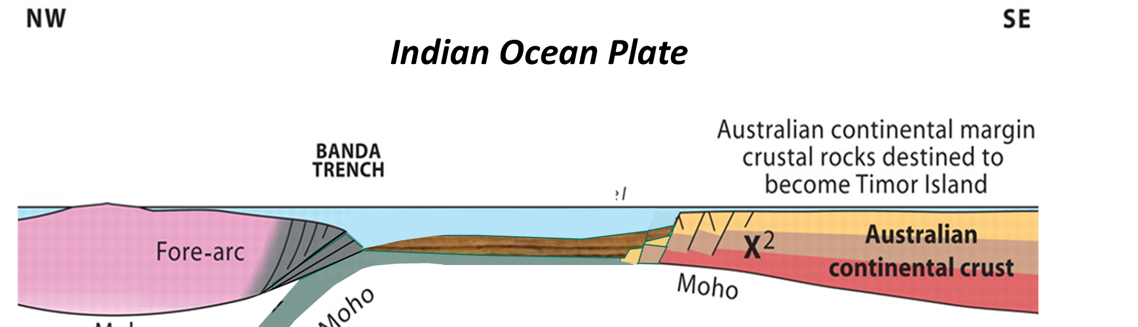
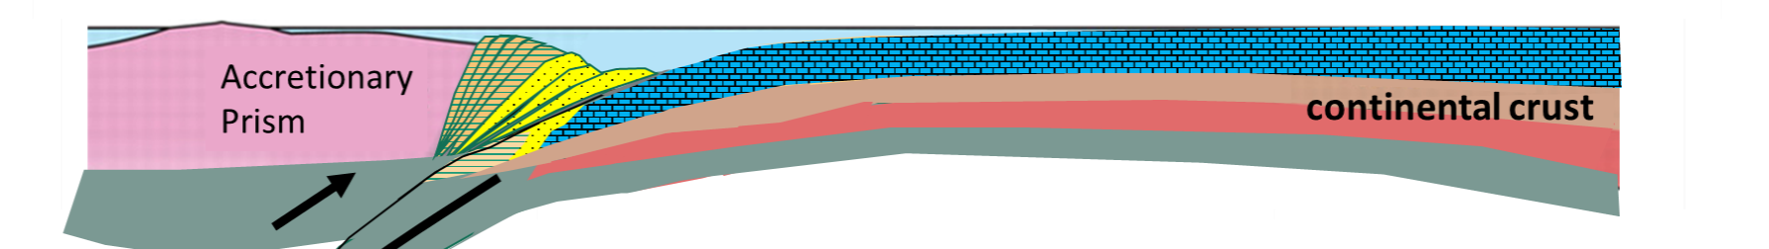

Laurentian shelf slides under deepwater sediments due to subduction driven by gravity. The rise and slope sediments contain fossils transported from the adjacent shallow water carbonate platform by turbidity currents.
Rise-Slope
Sediment
Laurentian Continental Shelf
Accretionary
Prism
carbonate platform
Accretionary
Prism
lithospheric mantle
MOHO
ocean crust
ASTHENOSPHERE
Notes:
The shallow water carbonate platform descends into the trench, and slides below the accretionary prism. By this time, a stack of imbricately thrusted deep-water sediment is emplaced atop shallow-water carbonate platform sediment. Gravity drives the process; nothing is really thrusted up on top of the platform.

Slide 30
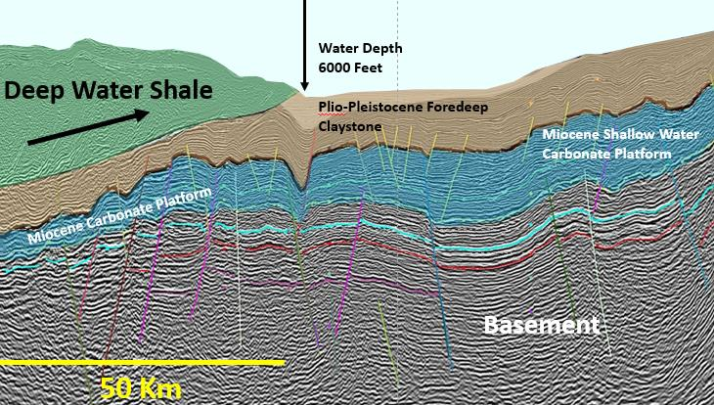
Laurentian shelf slides under deepwater sediments due to subduction driven by gravity. The rise and slope sediments contain fossils transported from the adjacent shallow water carbonate platform by turbidity currents.
Rise-Slope
Sediment
Laurentian Continental Shelf
Accretionary
Prism
carbonate platform
Accretionary
Prism
lithospheric mantle
MOHO
ASTHENOSPHERE
ocean crust
Notes:
This process is driven by gravity and is active in Recent time.

Slide 31
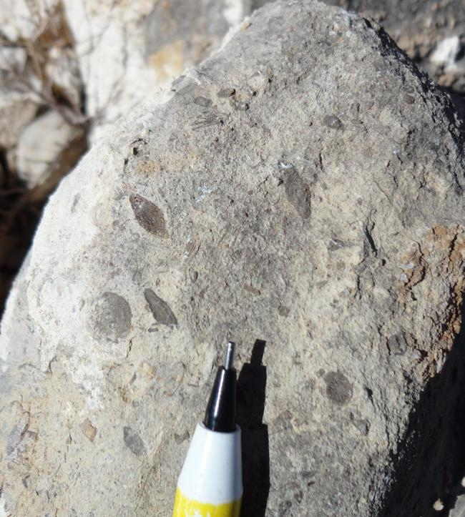
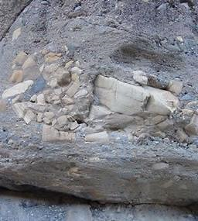
Fusilinids
Chert
5 cm
5 cm
Permian Carbonates in Simpson Park Range contain large fusilinids and abundant green chert clasts eroded from upper plate. This is analogous to subaerially exposed Timor and Barbados accretionary prisms.
Notes:
Analogous to Timor Island, traces of an uplifted Permian landmass in Nevada are seen in “mollase” deposits containing eroded deep-water radiolarian chert clasts and shallow water Permian fusilinid limestones.

Slide 32
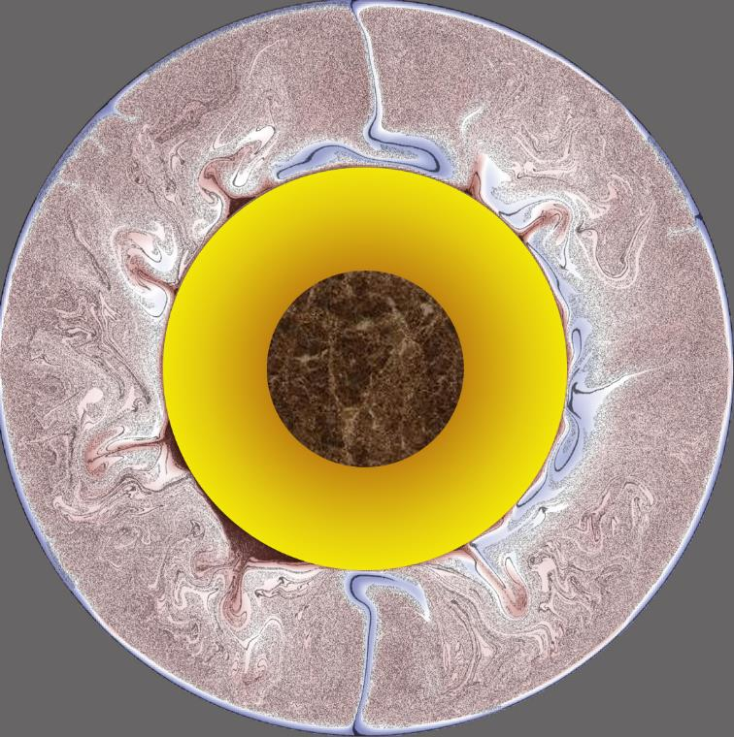

Deepwater rise and slope sediments containing fossils from the shelf are now emplaced atop the shallow water carbonate platform. Basalt slab descends into mantle. Accretionary prism rebounds and sheds rock-fragment “molasse”.
Permian Landmass
Red = Hot
Blue = Cold
Accretionary
Prism
Accretionary
Prism
carbonate platform
Mantle
continental crust
MOHO
Core
Outer
Rebound of
Low Density Crust
Break
Descent of High
Density Crust
ocean crust
Brandenburg et al., 2008
Notes:
The low density of continental crust prevents it from subducting into the mantle. Eventually it sticks, and the basalt part of the plate breaks-off and continues descent. Then, the continental part rebounds to some degree, accentuating the uplift of the Accretionary prism. In the case of Timor Island in Indonesia, the exposed landmass reaches 1000 meters elevation. The figure on the right is a computer model based on seismic tomography that shows cold dense subducted lithosphere descending to the base of the mantle.

Slide 33
What were the long-term consequences of the Antler event?
Permian Landmass
Red = Hot
Blue = Cold
Accretionary
Prism
Accretionary
Prism
carbonate platform
Mantle
continental crust
MOHO
Core
Outer
Rebound of
Low Density Crust
Descent of High
Density Crust
ocean crust
Brandenburg et al., 2008
Notes:
What were the long-term consequences of the Antler event?

Slide 34


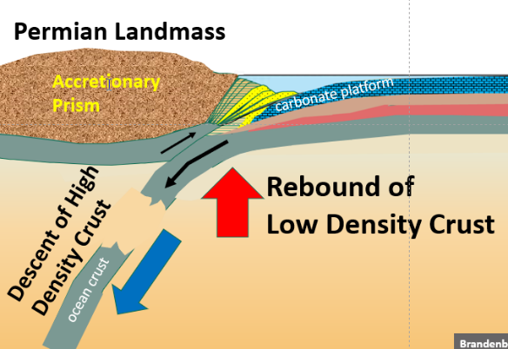

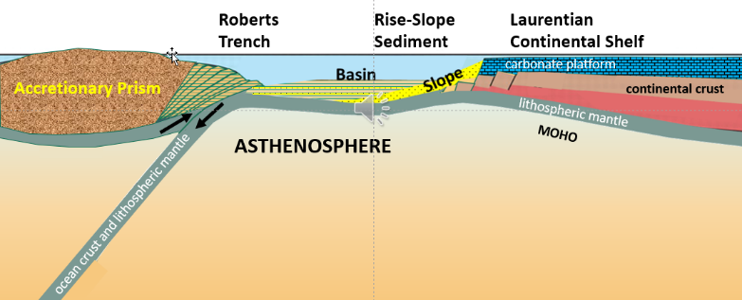
MY
Tectonic Events
East Subduction -
Docking of Terrains
Jurassic to Paleogene
Laramide
Sevier
Nevadan
Subduction Polarity
Reversal
Mississippian to Triassic
Sonoma
Breaking of Lithosphere
Antler
Breaking of 300 M.Y.-Old Weld
~ 300 Million Years of
Welded Lithosphere
Late Devonian
Ediacaran
Passive Margin
635
Notes:
For the first time since the Precambrian, the weld between continental crust and basalt ocean crust was broken. Once the break took place, old, cold, ocean crust began to sink into the mantle. This break led to development, for the first time, of an east-dipping subduction zone along the west coast of North America.

Slide 35
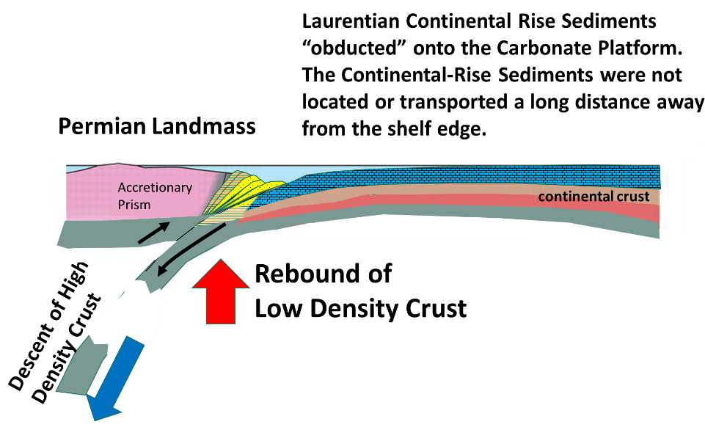
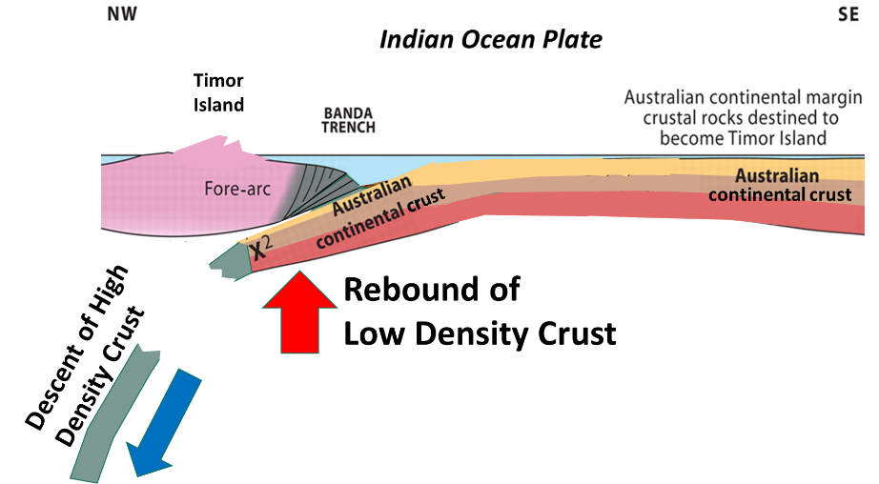
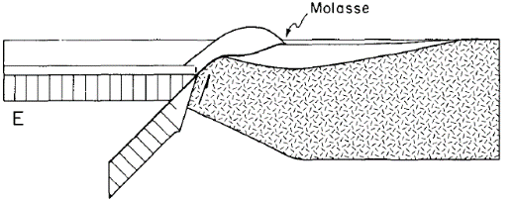
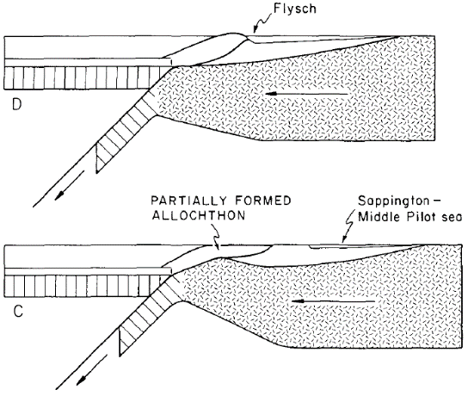
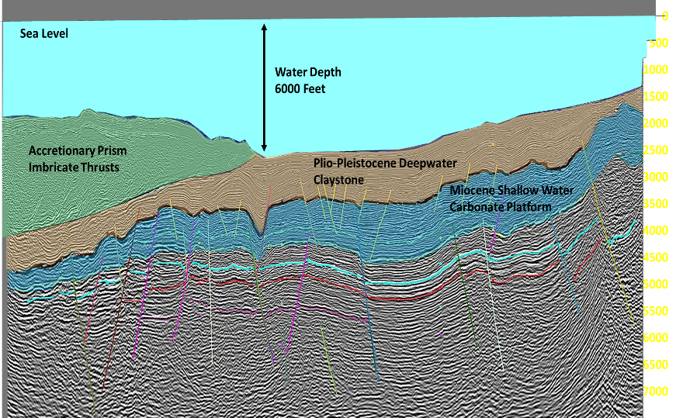

Johnson and Pendergast, 1981: GSA Bulletin v.92, p. 648-658.
E: Post-emplacement isostatic uplift of allochthon and deposition of molasse.
Accretionary
Prism
Accretionary
Prism
D: Emplacement phase 2, after descent of continental crust and after flysch trough has formed.
C: Emplacement phase 1, after partial under-thrusting.
Recent Continental
Subduction Zone
B: Location of future structural elements related to Roberts Mountains Thrust
A: Prethrust Lithofacies
Notes:
In summary, Jess Johnson envisioned this in 1981. West-dipping subduction caused the overlap of deepwater shale atop shallow-water carbonate. Slab-rollback drove the migration of the subduction zone. Recent analogs make it easier to see this process.

Slide 36


johndunham76@gmail.com
Questions?
500 Km
500 Km
Notes:
In anticipation of questions, I’ll show the following backup slides.

Slide 37

Thanks to: Mike Murphy, Stan Finney, Ted McKee,
Jon Matti, David Jessup, Peter Baillie
Notes:
This backup slide anticipates a question about what it would take to turn this presentation into a paper. To do that, I would ask the names in blue to supply field observations and biostratigraphic data as co-authors, and the names in red to provide additional geophysical data as co-authors.

Slide 38

Sonoma Orogeny –
A Reassessment
Snyder, W.S.,
Brueckner, H.K.,
Northrup, C.J., 2019
SEPM Sp. Pub. 113
Klamath-N.
Sierra Arc
Antler
high
Havallah
basin
Antler
foreland
Notes:
This slide anticipates a question about a recent publication on the Sonoma Orogeny that affected the Antler Forearc Basin. Compare this map to the following analogy from the Caribbean Plate.

Slide 39
200 Km
Volcanic Arc
Caribbean Plate
Abandoned Arc
Slab Rollback
Pull-Apart
-5000 m
Backarc
Pull-Apart
-1000 m
-3000 m
+1230 m
+336 m
-4500 m
Forearc
Basin
Accretionary
Prism
Pull-Apart
Trench
-2300 m
Slab Rollback
Notes:
The Caribbean Plate migrates at a rate of about 30 km per million years through the process of slab rollback. A foreland wedge fills the bottom of the trench, an accretionary prism rises to above sea level at Barbados Island. The topographic low between the accretionary prism and the volcanic arc is the forearc basin, which continuously deforms as the upper plate moves to the east. Behind the arc are spreading centers that pull apart as the upper plate jumps to the east, leaving behind pullapart basins and abandoned arcs. The Antler orogeny occurred when the laurentian margin fell into the trench. The Sonoma orogeny occurred as the momentum of the converging plates deformed the forearc basin.

Slide 40
References Cited on Slides:
Reference
Baillie, P., Carter, P., and Duran, P.M., 2019, Evolution and Plays of the Banda Arc: AAPG Search and Discovery Article #11245, DOI:10.1306/11245Baillie2019, http://www.searchanddiscovery.com/documents/2019/11245baillie/ndx_baillie.pdf
Brandenburg, J.P., Hauri, E., vanKeken, P., and Ballentine, C., 2008, A multiple-system study of the geochemical eolution of the mantle with force-balanced plates and thermochemical effects: Earth and Planetary Science Letters v. 276, p. 1-13, doi:10.1016/j.epsl.2008.08.027 See also: Plank, T., and vanKeken, P., 2008, The ups and downs of sediments: Nature Geoscience, v. 1, p. 17-18. https://doi.org/10.1038/ngeo.2007.68
Caltech - JPL ARIA group, 2011: http://www.tectonics.caltech.edu/slip_history/2011_taiheiyo-oki/
Cook, H.E., 1983, Great Basin Paleozoic Carbonate Platform: facies, facies transitions, depositinal models, platform architecture, seuence stratigraphy, and predictive mineral host models: USGS Open-File Report 2004-1078, 129 p.
Darman, H., 2012, Timor Sea - Chapter 11 of Seismic Atlas of SE Asian Basins: http://geoseismic-seasia.blogspot.com/search/label/11%20Timor%20Sea
Ingersoll, 2008, Subduction-related sedimentary basins of the USA Cordillera: in Miall, A.D. (ed.), the Sedimentary Basins of the United States and Canada, Elsevier, p. 395-428, doi: 10.1016/S1874-5997(08)00011-7
Johnson, J.G., and Pendergast, A., 1981, Timing and mode of emplacement of the Roberts Mountains allochthon, Antler orogeny: Geological Society of America Bulletin, v. 92, p. 648-658.
Ligi et al., 2012, Birth of an ocean in the Red Sea: initial pangs: Geochemistry Geophysics Geosystems, v. 13, p. 1-29, doi:10.1029/2012GC004155
Murphy, M.A., Power, J.D., and Johnson, J.G., 1984, Evidence for Late Devonian movement within the Roberts Mountains allochthon, Roberts Mountains, Nevada: Geology, v. 12, p. 20-23.
Niu, Y., 2014, Geological understanding of plate tectonics: Basic concepts, illustrations, examples and new perspectives: Global Tectonics and Metallogeny v. 10, p. 23-46, DOI: 10.1127/gtm/2014/0009, https://dro.dur.ac.uk/15761/1/15761.pdf?DDD15+dgl0yn+d700tmt
Noble, P.J., and Finney, S.C., 1999, Recognition of fine-scale imbricate thrusts in lower Paleozoic orogenic belts - an example from the Roberts Mountains allochthon, Nevada: Geology, v. 27, no. 6, p. 543-546.
Schellart, W.P., 2010, Evolution of subduction zone curvature and its dependence on the trench velocity and the slab to upper mantle viscosity ratio: Journal of Geophysical Research vol. 115, B11406, p 1-18, doi:10.1029/2009JB006643
Silberling, N.J., Nichols, K.M., Trexler, J.H., Jewell, P.W., and Crosbie, R.A., 1997, Overview of Mississippian Depositional and Paleotectonic History of the Antler Foreland, Eastern Nevada and Western Utah: BYU Studies in Geology v. 42, part 1, p. 161-196.
Speed, R.C., and Sleep, N.H., 1982, Antler orogeny and forland basin: a model: Geological Society of America Bulletin, v. 93, p. 815-828.
Stewart, 1980, The Geology of Nevada - a discussion to accompany the Geologic Map of Nevada: Nevada Bureau of Mines and Geology Special Publication 4, 136 p.
Tate, G.W., McQuarrie, N., vanHinsbergen, J., Bakker, R., Harris, R., and Jiang, H., 2015, Australia going down under; quantifyng continental subduction during arc-continent accretion in Timor-Leste: Geosphere, v. 11, no. 6, p. 1-24, doi:10.1130/GES01144.1
Torsvik, T.H., 2003, The Rodinia jigsaw puzzle: Science, V. 300 p. 1379-1381, doi.10.1126/science.1083469
Notes:
References listed above

